Slide 1
CSE 331 Software Design & Implementation
Winter 2020
“Section 8” – Common React Bugs, HW8

Slide 2
Administrivia
Done with HW6!
HW7 due today!
Reminder (1): Use a DEBUG flag to turn off an expensive checkRep
Reminder (2): Make sure PathfinderTestDriver constructor and runTests() are public.
Reminder (3): IntelliJ Ultimate (not Community) is recommended because it can help with JS/React. (Free for students, see Resources on course website.)
HW8 due next Thursday.
HW9 due the following Wednesday.
Any questions?

Slide 3
Agenda
Overview of HW8 – “Connect the Dots”
Common React bugs & how to fix them

Slide 4
HW8 Overview
Starter code has (most of) the pieces, but not much functionality.
Lots of hard-coded values, placeholders (console.log instead of actually doing stuff), etc..
Your job: "wire all the pieces together"
Accept user input
Process/parse the data
Error check – users do weird stuff, make sure you can't crash
Move data between components as necessary
Add the actual functionality in response to user input.
Structure:
Top-level <App> component, with three child components.

Slide 5
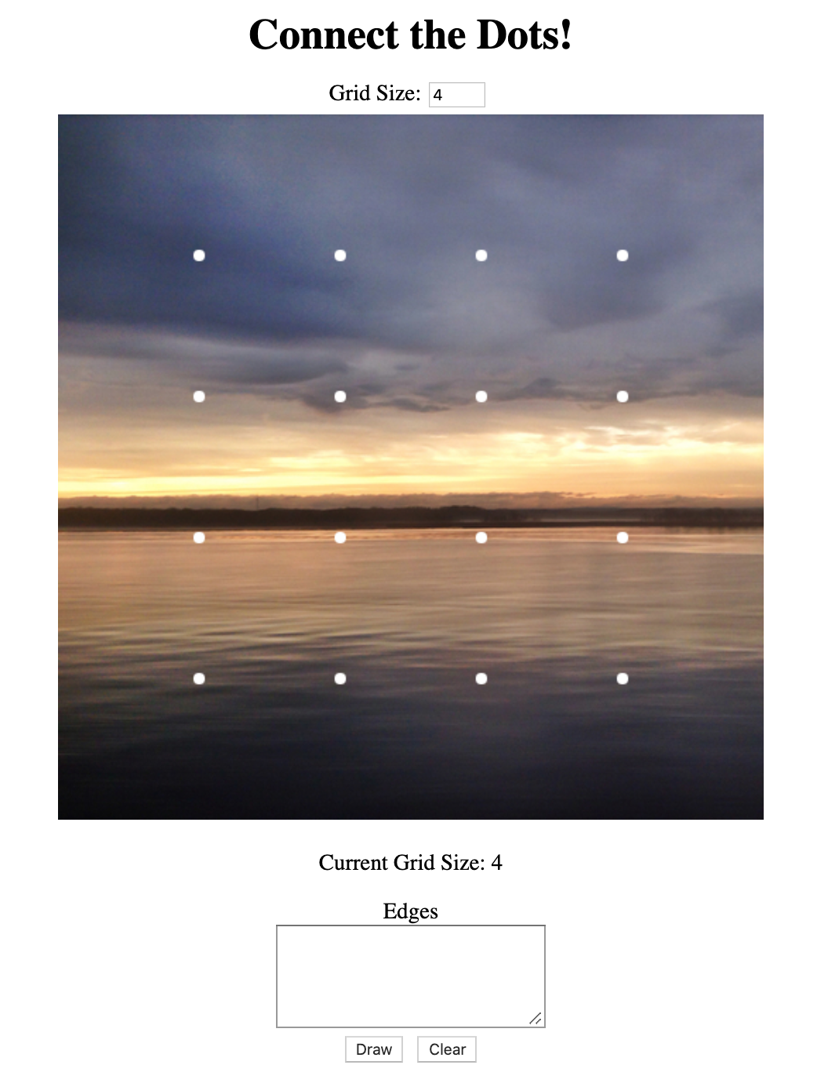
HW8 Component Structure
<GridSizePicker>
<App>
<Grid>
<EdgeList>

Slide 6
Running a React App
npm: Similar to gradle, but we need to install manually the first time.
In the terminal, change directory until you're in the same place as the "package.json" file for the project you want to run.
To Install (first time): npm install
To Run (every time): npm start
Once started, you can edit and save files and the page will automatically reload – no need to restart. Use Control-C to shut down when you're done developing.

Slide 7
Common React Bugs
Most common bugs in React are:
Reading from React state before the data has been populated.
Not properly understanding the React life cycle (the order that things happen within your app).
This is because of specific asynchronous updates to React’s internal representation of the webpage.
Note: There may be a very slight delay to updating your React components.
IMPORTANT: You need to be careful when updating your React component’s state and trying to access data!

Slide 8
Debugging React Strategies
When you hit a bug…
Walk step by step through the order that your code runs, checking how the state should be populated.
Use documentation about the React lifecycle to help you figure out which things happen in which order.
Put a console.log() in your methods if needed, and in componentDidUpdate() to check when your state was updated.
Last resort: Googling may be useful! Be very careful about this.

Slide 9
Section Demo Code
package.json | Tells npm what to install (don't need to modify)
README | Read it, has lots of explanations.
public/index.html | React "starter template"
src/index.js | Contains the ReactDOM.render call
src/1-lifecycle/* | First example, 1 buggy and 1 fixed versions
src/2-state/* | Second example, 2 buggy and 1 fixed version
src/3-desync/* | Third example, 1 buggy and 1 fixed version
Modify the import statement in src/index.js to change which demo you're currently running. (See README for more info).

Slide 10
Bug 1 – “Read before Write”
src/1-lifecycle/Buggy.js
Expected Functionality:
Adds a canvas to the page and displays a blue rectangle immediately.
Current Functionality:
TypeError when the page is loaded.

Slide 11
Bug 1 –The Problem
src/1-lifecycle/Buggy.js
It seems like this.canvasRef.current is null, when it's supposed to be our Canvas object.
Why doesn't the Canvas object exist yet? Let's think about how the <canvas> is eventually inserted into the page...
Our component is created and inserted into the page (in this case by ReactDOM.render())
React constructs the component and then calls the component’s render() to get the HTML tags we want.
React inserts those tags into the webpage and then sets up all the reference objects.

Slide 12
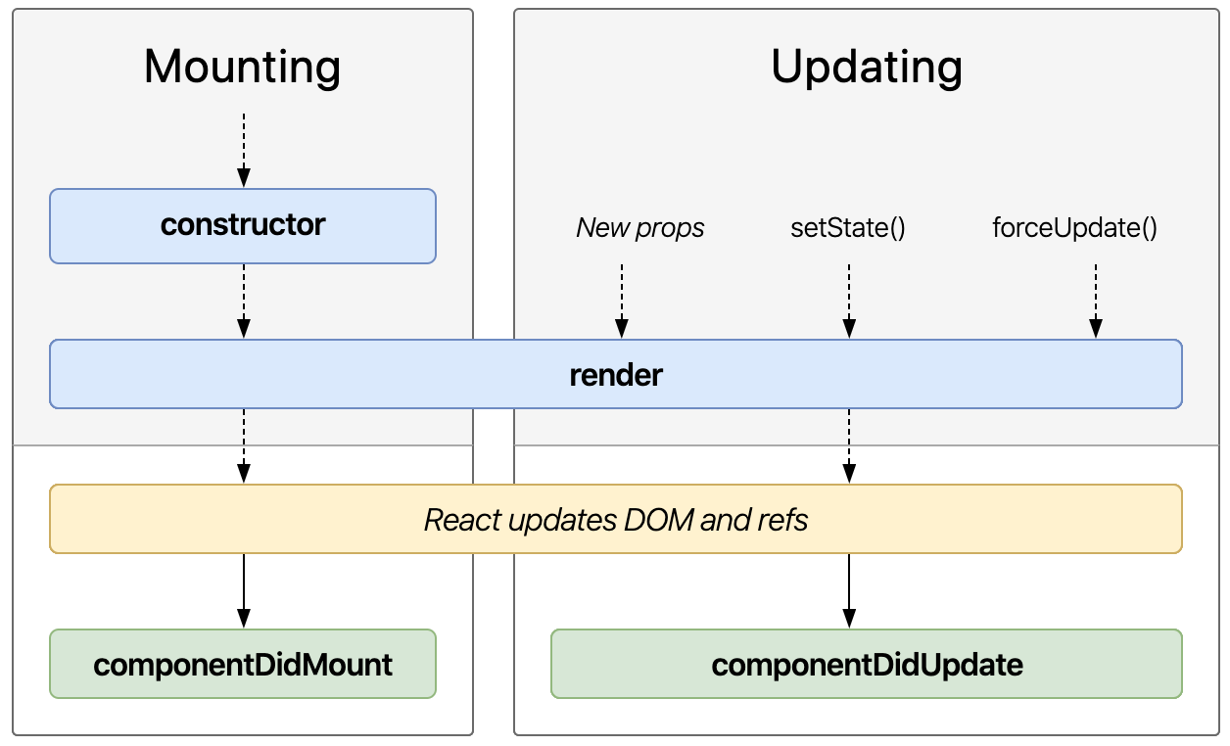
Bug 1 – “Read before Write”
src/1-lifecycle/Buggy.js
(Part of) The React Lifecycle
Order that React calls methods.
We're accessing the reference during the constructor
React doesn't update the refs (yellow box) until after render() – so they don’t exist when the constructor is running!
Image: http://projects.wojtekmaj.pl/react-lifecycle-methods-diagram/

Slide 13
Bug 1 – The Fix
src/1-lifecycle/Fixed.js
(Part of) The React Lifecycle
Solution
Override componentDidMount: called when React is done inserting all the DOM nodes and updating refs.
In componentDidMount, we know it's safe to use the ref (“read”), since it’s guaranteed to happen after the updating the refs (the “write”) has finished.
Image: http://projects.wojtekmaj.pl/react-lifecycle-methods-diagram/

Slide 14
Bug 1 – The Fix
src/1-lifecycle/Fixed.js
Move the updateCanvasImage call into componentDidMount
Still called during the component "mounting” phase – so we're able to set up the "first look" of the canvas like we wanted.
Happens after React sets up our refs, so we know we'll have a valid Canvas object to work with.
Common idea in React:
Set something up (like the <canvas> tag) and give it to React (by returning from render)
Some time later, React will do its job.
React makes a callback (like componentDidMount) to let us know that it's done and we can use whatever we set up (like accessing the Canvas through its ref).

Slide 15
Bug 2 – “React Doesn’t Know”
src/2-state/Buggy.js
Expected Functionality:
When the button is clicked, the message on the page changes to "I've been clicked!"
Current Functionality:
The message on the page never changes.
We know that the button event is working because the console.log() inside the listener is being run, so the bug must be somewhere else.

Slide 16
Bug 2 – The Problem
src/2-state/Buggy.js
The this.clicked variable is being updated correctly
You can print it out to double check, if you'd like.
The only place we can modify what text is being put in the <p> is during the render() method – we need to return a different <p> element to change what's on the page.
But React doesn't know it's supposed to call render again!
More accurately: React doesn't know that the contents of the this.clicked variable matters for render.

Slide 17
Bug 2 – The Solution?
src/2-state/Buggy2.js
React has a special place for variables that affect how a component renders: this.state.
Store an object ( {...} ) inside this.state, put whatever properties we want in that object to track the data we need.
Instead of this.clicked, we write this.state.clicked
"clicked" isn't a special name here – just a variable name. Could easily call it "this.state.pizza"
"state" is a special name: part of the React convention, React code expects that you store your state variables in this.state
Not quite a fix yet, but a step in the right direction.

Slide 18
Bug 2 – The New Problem
src/2-state/Buggy2.js
We're now storing our data in the right place, but we still aren't telling React when we change it.
React requires that you notify it when you want to change the data, instead of changing it yourself.
To request a state change, call this.setState and pass it an object representing the changes you want to make.
You should never directly modify the contents of this.state (except for constructor initialization)
Since you use this.setState (which is React code) to update the state, React knows that you’ll need things to be updated based on what changed. (So, React will re-do the render).

Slide 19
Bug 2 – The Fix
src/2-state/Fixed.js
(Part of) The React Lifecycle
Solution
By calling setState to update our state, we trigger a "component update cycle". During an update, React will change the state and then re-call render(). In render(), we can return the new text to be displayed on the page.
Image: http://projects.wojtekmaj.pl/react-lifecycle-methods-diagram/

Slide 20
Bug 3 – “Read before Write (is done)”
src/3-desync/Buggy.js
Expected Functionality:
When a button is clicked, a square of that color appears in the canvas.
The current color is displayed in the text above the buttons.
Current Functionality:
The text above the buttons seems to be working correctly.
The canvas is lagging behind one click – displays the color from two clicks ago instead of the most recent click.

Slide 21
Bug 3 – The Problem
src/3-desync/Buggy.js
Remember that, in React, setState is a request for a future change to state. When setState returns, the state has not yet been updated.
React delays state changes for performance reasons.
Means we need to be careful about reading state: when do we know that it's guaranteed to be up-to-date?
The problem is that we're trying to access the state immediately after calling setState – React hasn't gotten around to updating the state yet, so we're seeing the old value.
This is why the canvas is "lagging behind" by one: when we draw the canvas, we're seeing the value of state from the previous button press.

Slide 22
Bug 3 – What’s Actually Happening
src/3-desync/Fixed.js
setState returns,
our code keeps going
(Part of) The React Lifecycle
Our code calls this.drawSquare, which sees the old value still in this.state
this.state gets changed later (by React)
The <p> gets updated here, which is why it sees the correct state (state is guaranteed to be updated before render is called)
Image: http://projects.wojtekmaj.pl/react-lifecycle-methods-diagram/

Slide 23
Bug 3 – The Fix
src/3-desync/Fixed.js
(Part of) The React Lifecycle
setState returns,
our code keeps going
this.state gets changed later (by React)
<p> gets updated here, so it sees the correct state
Solution
Should call drawSquare, here, since it is guaranteed to happen after the this.state value has been updated.
Image: http://projects.wojtekmaj.pl/react-lifecycle-methods-diagram/

