Slide 1
CSE 331 Software Design & Implementation
Hal Perkins
Winter 2020
Module Design and General Style Guidelines

Slide 2
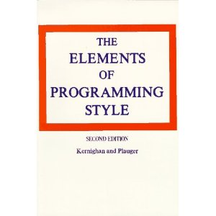
Style
“Use the active voice.”
“Omit needless words.”
“Don't patch bad code - rewrite it.”
“Make sure your code 'does nothing' gracefully.”

Slide 3
Modules
A module is a unit in a software system
Class, ADT, package, layer, …
Modular design is the heart of software design
What modules
What are their specifications
How they interact
But not the implementations of the modules
Each module respects other modules’ abstraction barriers and enforces its own

Slide 4
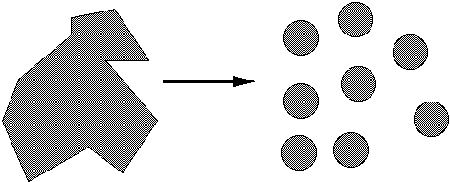
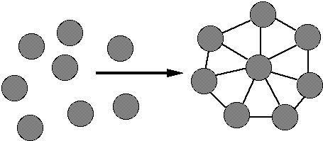
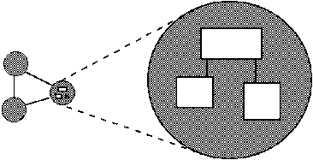
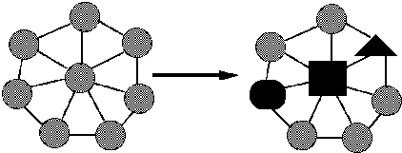
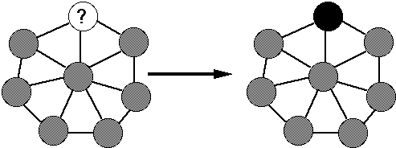
Goals of modular design
Decomposable – can be broken down into modules to reduce complexity and allow teamwork
Composable – “Having divided to conquer, we must reunite to rule [M. Jackson].”
Understandable – one module can be examined, reasoned about, developed, etc. in isolation
Continuity – a small change in the requirements should affect a small number of modules
Isolation – an error in one module should be as contained as possible

Slide 5
Two general design issues
Cohesion = internal consistency
A property of the module specification
And applies to implementations
Want module to be self-contained, independent, and with a single, well-defined purpose
Coupling = dependency between components
A property of module implementation
Is usually low when each subpart has good cohesion
Goal: increase cohesion, decrease coupling

Slide 6
Cohesion
Separation of concerns
For methods: do one thing well
Compute a value, let client decide what to do with it
Observe or mutate; don’t do both
Don’t print as a side effect of another operation
“Flag” variables are often a symptom of poor cohesion
For ADTs: provide a single abstraction, represent a single concept
Poor cohesion limits future possible uses
If your module violates this principle, redesign it
Refactor a method into multiple simpler methods
Break an ADT or module into separate ones, each of which represents a single abstraction or concept

Slide 7
Coupling
How are modules dependent on one another?
Statically (in the code)? Dynamically (at run-time)? More?
Ideally, split design into parts that don't interact much
If modules are highly coupled you must reason about them as though they are a single, larger module
MY
FINAL
PROJECT
MY
MY
FINAL
PROJECT
FINECT
PROJAL
An application
A poor decomposition
(parts strongly coupled)
A better decomposition
(parts weakly coupled)

Slide 8
Coupling is the path to the dark side
Coupling leads to complexity
Complexity leads to confusion
Confusion leads to suffering
Once you start down the dark path, forever will it dominate your destiny, consume you it will

Slide 9
God classes
God class: a class that hoards much of the data or functionality of a system
Poor cohesion – little thought about why all the elements are placed together
Reduces coupling but only by collapsing multiple modules into one (which replaces dependences between modules with dependences within a module)
A god class is an example of an anti-pattern: a known bad way of doing things

Slide 10
Method design
Effective Java (3rd ed.) Tip # 51: Design method signatures carefully
Avoid long parameter lists
Perlis: “If you have a procedure with ten parameters, you probably missed some.”
Especially error-prone if parameters are all the same type
Which of these has a bug?
memset(ptr, size, 0);
memset(ptr, 0, size);
Avoid methods that have lots of (or any?) Boolean “flag” parameters
EJ Tip #52: Use overloading judiciously
Avoids having arbitrary different method names
But use only when specifications are analogous
Notes:
Memset example from Zero Bugs and Program Faster by Kate Thompson

Slide 11
Field design
A variable should be made into a field if and only if:
It is part of the inherent internal state of the object
It has a value that retains meaning throughout the object's life
Its state must persist between public method invocations
All other variables should be local to a method
Fields should not be used to avoid parameter passing
Not every constructor parameter needs to be a field
Exception: Certain cases where overriding is needed
Example: Thread.run

Slide 12
Constructor design
Constructors should have all the arguments necessary to initialize the object's state – no more, no less
Object should be completely initialized after constructor is done
The rep invariant should hold
Client shouldn't need to call other methods to “finish” initialization

Slide 13
Good names
EJ Tip #68: Adhere to generally accepted naming conventions
Class names: generally nouns
Beware "verb + er" names, e.g. Manager, Scheduler, ShapeDisplayer
Interface names often –able/-ible adjectives:
Iterable, Comparable, …
Method names: noun or verb phrases
Nouns for observers: size, totalSales
Verbs+noun for observers: getX, isX, hasX
Verbs for mutators: move, append
Verbs+noun for mutators: setX
Choose affirmative, positive names over negative ones
isSafe not isUnsafe
isEmpty not hasNoElements

Slide 14
Bad names
count, flag, status, compute, check, value, pointer, names starting with my…
Convey no useful information
Describe what is being counted, what the “flag” indicates, etc.
numberOfStudents, courseFull, noMorePizza, calculatePayroll, validateWebForm, …
But short names in local contexts are good:
Good: for(i = 0; i < size; i++) items[i]=0;
Not: for(theLoopCounter = 0; theLoopCounter < theCollectionSize; theLoopCounter++) theCollectionItems[theLoopCounter]=0;
Notes:
But theSystemIsAboutToDieAHorribleDeath was pretty good in an old OS

Slide 15
Class design ideals
Cohesion: already discussed
Coupling: already discussed
Completeness: Every class should present a complete interface
Consistency: In names, param/returns, ordering, and behavior

Slide 16
Completeness
Include important methods to make a class easy to use
Counterexamples:
A mutable collection with add but no remove
A tool object with a setHighlighted method to select it, but no setUnhighlighted method to deselect it
Date class with no date-arithmetic operations
Also:
Objects that have a natural ordering should implement Comparable
Usually implement (override) equals (and therefore hashCode) – more about these in next lecture(s)
Always override Object.toString (a superclass may have done this for you)

Slide 17
Don’t include the kitchen sink
Don’t include everything you can possibly think of
If you include it, you’re stuck with it forever (even if almost nobody ever uses it)
Don’t include compound operations (client can call two operations)
Sometimes use cases mean rethinking completeness: does remove always make sense for a mutable collection if it is ghastly expensive and never used?
Tricky balancing act that depends on taste
Err on the side of omitting an operation
You can always add it later if you really need it
“Everything should be made as simple as possible, but not simpler.”
- Einstein

Slide 18
Consistency
A module should have consistent names, parameters in the same order, and consistent behavior
Counterexamples:
setFirst(int index, String value) setLast(String value, int index)
Date/GregorianCalendar use 0-based months
String methods: equalsIgnoreCase, compareToIgnoreCase; but regionMatches(boolean ignoreCase)
Collection size: String.length(), array.length, collection.size()

Slide 19
Open-Closed Principle
Software entities should be open for extension, but closed for modification
Add features by adding new classes or reusing existing ones in new ways
Avoid modifying existing ones
Changing existing code can introduce bugs and errors
Related: Code to interfaces, not to classes
Example: accept a List parameter, not ArrayList or LinkedList
EJ Tip #64: Refer to objects by their interfaces
Really: use the most general/highest type that provides the needed operations

Slide 20
Documenting a class
Keep internal and external documentation separate
External documentation: Specification
/** ... */ Javadoc for classes, interfaces, methods
What clients need to know
Includes abstract values & invariants, pre/postconditons, etc.
Internal documentation: Implementation
// comments inside method bodies & classes
Clients don’t need this information and shouldn’t know (see) it
What someone reading the code needs to know to understand it
Includes rep. invariant, abstraction function, internal pre/post conditions, algorithm explanations, rationale for design and implementation choices, why it was done this way
If it’s hard to document/explain, redesign it

Slide 21
Enums improve readability
Consider use of enums, even with only two values
Which of the following is better?
oven.setTemp(97, true);
oven.setTemp(97, Temperature.CELSIUS);
(see EJ #51)

Slide 22
Choosing types – some hints
Numbers: Favor int and long for most numeric computations
EJ Tip #60: Avoid float and double if exact answers are required
Classic example: money (round-off is bad here)
Avoid using String representations
If implementation is parsing String representations, redesign
(watch for String.indexOf, regular expressions)
String is tempting because it’s a common input/output format, but avoid unless the data actually is text
EJ Tip #12: provide observer methods so client doesn’t have to rely on exact format of toString() output

Slide 23
Independence of views
Confine user interaction to a core set of “view” classes
Isolate these from the “model” classes that maintain the key system data
Do not put print statements in your core (model) classes
This locks your code into a text representation
Makes it less useful if the client wants a GUI, a web app, etc.
Instead, have model classes return data for use by view classes
Which of the following is better?
public void printMyself()
public String toString()

Slide 24
The model is small
Do keep the core model of what you are doing small and independent
Don’t get sloppy on the “extra layers” around it
It ends up being most of your code!
Less than 10% of the code has to do with the ostensible purpose of the system; the rest deals with input-output, data validation, data structure maintenance, and other housekeeping.
-- Mary Shaw

Slide 25
Last thoughts (for now)
Specs and code are read more often than written – writing matters!
Who are your readers?
Clients of your code – need to know how to use it
Programmers maintaining the code – need to know how it works, but, even more, why it was done this way
(including you in 3 weeks/months/years)
Write comments and documentation when you create things – don’t try to reconstruct “why” later
Read/reread style and design advice regularly
Keep practicing – mastery takes time and experience
You’ll always be learning. Get feedback! Keep looking for better ways to do things!

