Slide 1
CSE 331 Software Design & Implementation
Kevin Zatloukal
Spring 2020
Lecture 1 – Introduction & Administrivia
(Based on slides by Mike Ernst, Dan Grossman, and many others)

Slide 2
Motivation

Slide 3
What is the goal of CSE 331?
How to build harder-to-build software
Move from CSE 143 problems toward what you’ll see in upper-level courses and in industry
Specifically, how to write code of
Higher quality
Increased complexity
We will discuss tools and techniques to help with this and the concepts and ideas behind them
There are timeless principles to both
Widely used across the industry
Notes:
Help you step up from 143 to 400 level courses.
What do I mean by quality?

Slide 4
What is high quality?
Code is high quality when it is
​​​​​​​​Correct
Everything else is of secondary importance
Easy to change
Most work is making changes to existing systems
Easy to understand
Needed for 1 & 2 above

Slide 5
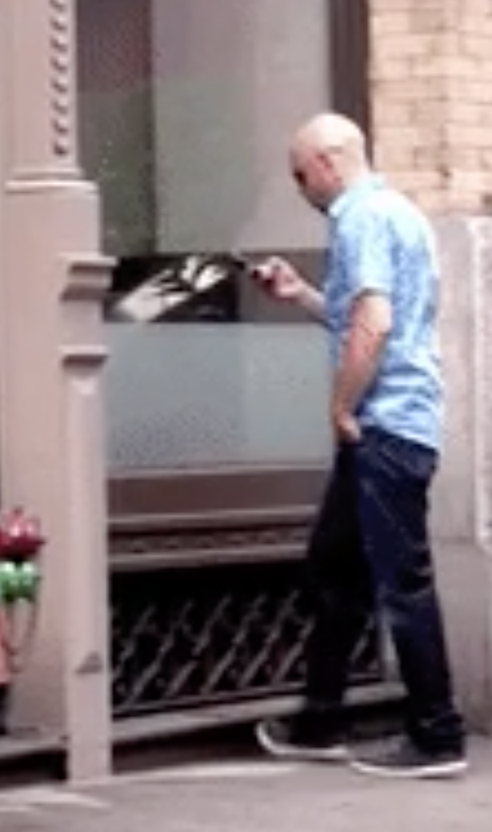
How do we ensure correctness...
... when people are involved?
People have been known to
walk into windows
drive away with a coffee cup on the roof
drive away still tied to gas pump
lecture wearing one brown shoe and one black shoe
Notes:
Cannot skip any and produce highest quality software.
Which is the most effective? Inspection!
Inspection is the main tool for interviews

Slide 6
What is increased complexity?
Analogy to building physical objects:
100 well-tested LOC = a nice cabinet
2,500 LOC = a room with furniture
2,500,000 LOC = 1000 rooms ≈
North Carolina class WW2 battleship

Slide 7
≈
the entire British Naval fleet in WW2

Slide 8
Actually, software is more complex…
Every bit of code is unique, individually designed
US built 10 identical Essex carriers
Software equivalent would be one carrier 10 times as large:
Defects can be even more destructive
A defect in one room can sink the ship
But a defective OS could sink the whole fleet

Slide 9
Scale makes everything harder
Modularity makes scale possible but it’s still hard…
Time to write N-line program grows faster than linear
Good estimate is O(N^{1.05}) [Boehm, ‘81]
Bugs grow like Θ(N log N) [Jones, ‘12]
10% of errors are between modules [Seaman, ‘08]
Communication costs dominate schedules [Brooks, ‘75]
Small probability cases become high probability cases
Corner cases are more important with more users
Corollary: quality must be even higher, per line, in order to achieve overall quality in a large program

Slide 10
People Do Build Great Software
Full scope of the challenge:
software is built by people, who make mistakes all the time
surprisingly difficult to get even a small program to work
needed to write hundreds of millions of lines of code
each line gets harder to write as the program scale
Despite those challenges, we have lots of software that works
hundreds of millions of lines of working programs
products rarely fail because the software is too buggy
How do we do it?

Slide 11
How do we ensure correctness...
... when people are involved?
People have been known to
walk into windows
drive away with a coffee cup on the roof
drive away still tied to gas pump
lecture wearing one brown shoe and one black shoe
Key insights:
Can’t stop people from making mistakes
Can stop mistakes from getting to users
Notes:
Cannot skip any and produce highest quality software.
Which is the most effective? Inspection!
Inspection is the main tool for interviews

Slide 12
How do we ensure correctness?
Best practice: use three techniques (we’ll study each)
​Tools
Type checkers, test runners, etc.
​Inspection
Think through your code carefully
Have another person review your code
​Testing
Usually >50% of the work in building software
Each removes ~2/3 of bugs. Together >97%
Notes:
Cannot skip any and produce highest quality software.
Which is the most effective? Inspection!
Inspection is the main tool for interviews

Slide 13
How do we cope with complexity?
We tackle complexity with modularity
Split code into pieces that can be built independently
Each must be documented so others can use it
Also helps understandability and changeability

Slide 14
What is high quality code?
In summary, we want our code to be:
Correct
Easy to change
Easy to understand
Easy to scale (modular)
These qualities also allow for increased complexity

Slide 15
What we will cover in CSE 331
Everything we cover relates to the 4 goals
We’ll use Java but the principles apply in any setting
Correctness
Tools
Git, IntelliJ, JUnit, Javadoc, …
Java libraries: equality & hashing
Adv. Java: generics, assertions, …
debugging
Inspection
reasoning about code
specifications
Testing
test design
coverage
Changeability
specifications, ADTs
listeners & callbacks
Understandability
specifications, ADTs
Adv. Java: exceptions
subtypes
Modularity
module design & design patterns
event-driven programming, MVC, GUIs

Slide 16
Administrivia

Slide 17
Who: Course staff
Instructor: Kevin Zatloukal (kevinz at cs)
15 years in industry, 5th year teaching
≈15 great TAs
mix of veterans and new
Office hours posted soon
(starting later this week)
Get to know us!
We’re here to help you succeed

Slide 18
Who: Students
Assuming you have mastered CSE142 and CSE143
Hoping (but not assuming) have you taken 311
will connect to 311 material where it arises
Assuming you are in your second year of CS courses
seniors may be bored

Slide 19
Prerequisites
Knowing Java is a prerequisite
Examples:
Difference between int and Integer
Distinction between == and equals()
Aliasing: multiple references to the same object, what does assignment (x=y;) really mean?
Subtyping via extends (classes) and implements (interfaces)
Method calls: inheritance and overriding; dynamic dispatch
Difference between compile-time and run-time type

Slide 20
Unique Situation (for all of us)
Much of the rest of this is subject to change
but we are learning as we go
Personal issues may arise
let me know
we will make accommodations as much as possible

Slide 21
Staying in touch
Ed message board (link on course web page)
should have received an invitation already
best place to ask questions
Course staff: cse331-staff@cs.washington.edu
For things that don’t make sense to post on message board
Course email list: cse331a_sp20@u.washington.edu
Students already subscribed (your UW email address)
You must get announcements sent there
Fairly low traffic – one way (from staff to everyone)

Slide 22
Lectures
Includes a pre-recorded video and a live session
Each pre-recording posted 2 days before
please watch that portion beforehand
Each live session will each be a little different
some lecture, Q&A, problems, work in small groups, etc.
link to recording in Canvas
slides posted on web site

Slide 23
Section
Will be focused on helping with homework
held on day HW is released
get you get you started with the work to be done
they should be very useful
Live via Zoom video
links on Canvas (see Zoom app)
Aiming to have 10 sections with 16 students each
will split time schedule sections into two parts
details coming soon

Slide 24
Homework Assignments
Roughly 1 assignment per week
First 3 are paper assignments
submit these in Gradescope
should get an invite email before Tuesday
let me know if you don’t
Remaining 7 are coding assignments
generally due on Wednesday by 11pm
submit and tag your code in Gitlab
TAs will grade and get feedback to you

Slide 25
Homework Assignments
Biggest misconception (?) about CSE331
“Homework was programming projects that seemed disconnected from lecture”
If you think so, you are making them harder!
approaching them as CSE143 homework won’t work well
each HW designed to teach topics from prior lectures
seek out the connections by before typing
(Tip: this is also true of exams / quizzes)

Slide 26
Late Policy: Written Assignments
Allowed only in special situations
let us know 36 hours beforehand
will also make exceptions for emergencies

Slide 27
Late Policy: Coding Assignments
Same special situations as written assignments
And also:
Up to 4 times this quarter you can turn in a homework assignment one day late
Not accepted for credit after that.
Late days are 24-hour chunks
Why?
keep you on schedule (real world has deadlines)
get feedback to you before next deadline

Slide 28
Academic Integrity
“The code you submit must be your own”
no copying from other students, web pages, etc.
Read the full course policy carefully
ask questions if you are unsure
Always explain in your HW any unconventional action
worst result then is some points lost
worst result otherwise is expulsion
Violations are unfair to other students and yourself

Slide 29
Quizzes
Will have ≈5 quizzes during the quarter
20-30 minutes each
probably multiple choice / short answer questions
may take place during the lecture period
make sure that time slot is available
details still TBD...

Slide 30
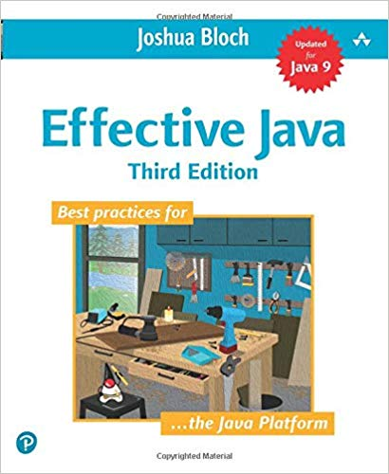
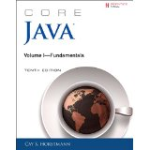
Books
Required book
Effective Java 3rd ed, Bloch (EJ)
Optional book
Pragmatic Programmer, new 20th anniversary (2nd) edition, Hunt & Thomas (PP)
Other books
Program Development in Java, Liskov & Guttag
would be the textbook if not from 2001
Core Java Vol I, Horstmann
good reference on language & libraries

Slide 31
Books? In the 21st century?
Why not just use Google, Stack Overflow, Reddit, Quora, …?
Web-search good for
Finding the parameters of a Java API function
(can be) Bad for
Why does it work this way?
What is the intended use?
How does my issue fit into the bigger picture?
Beware:
Answers on the web are often quickly out of date
aim is to answer the question at the time when asked
“This incantation solved my problem”
give that to users without knowing how it works?

Slide 32
Readings
Calendar will include book sections for you to read
EJ = required, PP = optional
These are “real” books about software, approachable in 331
occasionally slight reach: accept the challenge
Overlap only partially with lectures
books include lots of other useful information
Readings are fair game for quizzes
want to make sure you do it

Slide 33
Exams
No real exams
Our final “exam”
demo your final HW solution to a TA
answer some questions about your experiences writing it

Slide 34
Grading
Approximate weighting (subject to change):
65% | Homework
25% | Quizzes
10% | Final “exam”

Slide 35
CSE 331 can be challenging
Past experience tells us CSE 331 is hard
not my intention to make it difficult!
Big change to move
from programming by trial & error
technique that does not work for building large scale software
to programming by careful design, reasoning, and testing
Programming itself can be hard
surprisingly difficult to specify, design, implement, test, debug, and maintain even a simple program

Slide 36
CSE 331 can be challenging
We strive to create assignments that are reasonable if you apply the techniques taught in class…
… but likely hard to do in a trial & error manner
… and almost certainly impossible to finish if you
put them off until a few days before they’re due
Assignments will take more time than you think (start early)
even professionals routinely underestimate by 3x
these assignments will be a step up in difficulty
If you are having trouble, think before you act
then, look for help

Slide 37
Other Advice
Don’t be afraid to make mistakes
accepting that you will make mistakes is perhaps the most important lesson of this course
we often learn best from our mistakes
if you’re not making mistakes, you’re not challenging yourself
Don’t expect everything to be spelled out for you
real-world problems don’t come that way
if there are detailed instructions for solving a problem, then there should already be a program that does it
world needs you for your intuition, creativity, & intelligence
Notes:
Past student: how did that [mistake] happen? how is that even possible?
Review feedback on design patterns (needing to come earlier)

Slide 38
Problems

Slide 39
A Problem
“Complete this method such that it returns the location of the largest value in the first n elements of the array arr.”
int maxLoc(int[] arr, int n) {
...
}

Slide 40
Solution 1
int maxLoc(int[] arr, int n) {
int maxIndex = 0;
int maxValue = arr[0];
for (int i = 1; i < n; i++) {
if (arr[i] > maxValue) {
maxIndex = i;
maxValue = arr[i];
}
}
return maxIndex;
}

Slide 41
Solution 2
int maxLoc(int[] arr, int n) {
int maxIndex = -1;
int maxValue = Integer.MIN_VALUE;
for (int i = 0; i < n; i++) {
if (arr[i] > maxValue) {
maxIndex = i;
maxValue = arr[i];
}
}
return maxIndex;
}

Slide 42
A Problem
“Complete this method such that it returns the location of the largest value in the first n elements of the array arr.”
int maxLoc(int[] arr, int n) {
...
}
What questions do you have about the specification?
what if n = 0?
what if n < 0?
what if n > arr.length?
what if there are two maximum elements?

Slide 43
A Problem
“Complete this method such that it returns the location of the largest value in the first n elements of the array arr.”
int maxLoc(int[] arr, int n) {
...
}
Could we write a specification with only one correct solution?
throw IllegalArgumentException if n <= 0
throw ArrayOutOfBoundsException if n > arr.length
return smallest index achieving maximum

Slide 44
Morals
You can all write the code
Writing the specification was harder than the code
multiple choices for the “right” specification
have to carefully think through corner cases
once the specification is chosen, code is straightforward
(both of those will be recurrent themes)
Some math (e.g. “if n <= 0”) often shows up in specifications
English (“if n is less or equal to than 0”) is often worse

Slide 45
An exercise before next class
Do HW0 (90 minutes max) before lecture on Wednesday
write an algorithm to rearrange array elements as described
argue in concise, convincing English that it is correct
don’t just explain what the code does!
should run in O(n) time
(optional challenge: can you do it in a single pass?)
do not actually run your code!
Start trying to reason about the code you write
this may be difficult... if so, remember that!
next, we will learn to use a set of tools that will make this easy

Slide 46
Before next class...
Familiarize yourself with website:
http://courses.cs.washington.edu/courses/cse331/20sp/
read the syllabus
read the academic integrity policy
find the homework list
find the link to Canvas
Do HW0 before lecture on Wednesday!
limit this to 90 minutes
submit a PDF on Gradescope (invite coming today)
not graded

