Slide 1
CSE 331 Software Design & Implementation
Hal Perkins
Winter 2018
Module Design and General Style Guidelines

Slide 2
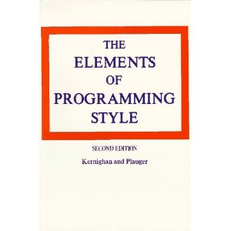
Style
“Use the active voice.”
“Omit needless words.”
“Don't patch bad code - rewrite it.”
“Make sure your code 'does nothing' gracefully.”

Slide 3
Modules
A module is a relatively general term for a class or a type or any kind of design unit in software
A modular design focuses on what modules are defined, what their specifications are, how they relate to each other
Not the implementations of the modules
Each module respects other modules’ abstraction barriers!

Slide 4
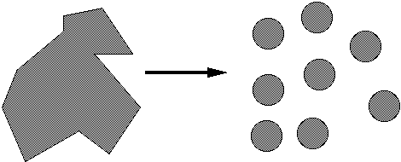
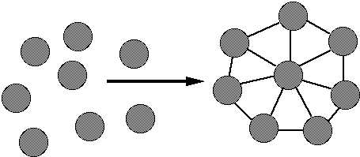
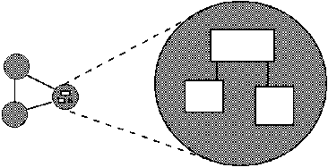
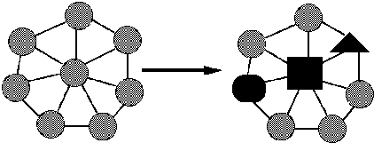
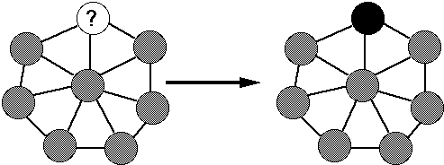
Ideals of modular software
Decomposable – can be broken down into modules to reduce complexity and allow teamwork
Composable – “Having divided to conquer, we must reunite to rule [M. Jackson].”
Understandable – one module can be examined, reasoned about, developed, etc. in isolation
Continuity – a small change in the requirements should affect a small number of modules
Isolation – an error in one module should be as contained as possible

Slide 5
Two general design issues
Cohesion – how well components fit together to form something that is self-contained, independent, and with a single, well-defined purpose
Coupling – how much dependency there is between components
Guideline: increase cohesion, decrease coupling
Applies to modules and smaller units
Each method should do one thing well
Each module should provide a single abstraction

Slide 6
Cohesion
The common design objective of separation of concerns suggests a module should represent a single concept
A common kind of “concept” is an ADT
If a module implements more than one abstraction, consider breaking it into separate modules for each one

Slide 7
Coupling
How are modules dependent on one another?
Statically (in the code)? Dynamically (at run-time)? More?
Ideally, split design into parts that don't interact much
Roughly, the more coupled modules are, the more they need to be reasoned about as though they are a single, larger module
MY
FINAL
PROJECT
MY
MY
FINAL
PROJECT
FINECT
PROJAL
An application
A poor decomposition
(parts strongly coupled)
A better decomposition
(parts weakly coupled)

Slide 8
Coupling is the path to the dark side
Coupling leads to complexity
Complexity leads to confusion
Confusion leads to suffering
Once you start down the dark path, forever will it dominate your destiny, consume you it will

Slide 9
God classes
god class: a class that hoards much of the data or functionality of a system
Poor cohesion – little thought about why all the elements are placed together
Reduces coupling but only by collapsing multiple modules into one (which replaces dependences between modules with dependences within a module)
A god class is an example of an anti-pattern: a known bad way of doing things

Slide 10
Cohesion again…
Methods should do one thing well:
Compute a value but let client decide what to do with it
Observe or mutate, don’t do both
Don’t print as a side effect of some other operation
Don’t limit future possible uses of the method by having it do multiple, not-necessarily-related things
“Flag” variables are often a symptom of poor method cohesion

Slide 11
Method design
Effective Java (EJ) Tip #40 [3rd #51]: Design method signatures carefully
Avoid long parameter lists
Perlis: “If you have a procedure with ten parameters, you probably missed some.”
Especially error-prone if parameters are all the same type
Avoid methods that take lots of Boolean “flag” parameters
Which of these has a bug?
memset(ptr, size, 0);
memset(ptr, 0, size);
EJ Tip #41 [52]: Use overloading judiciously
Can be useful, but avoid overloading with same number of parameters, and think about whether methods really are related
Notes:
Memset example from Zero Bugs and Program Faster by Kate Thompson

Slide 12
Field design
A variable should be made into a field if and only if:
It is part of the inherent internal state of the object
It has a value that retains meaning throughout the object's life
Its state must persist past the end of any one public method
All other variables can and should be local to the methods in which they are used
Fields should not be used to avoid parameter passing
Not every constructor parameter needs to be a field
Exception to the rule: Certain cases where overriding is needed
Example: Thread.run

Slide 13
Constructor design
Constructors should have all the arguments necessary to initialize the object's state – no more, no less
Object should be completely initialized after constructor is done
(i.e., the rep invariant should hold)
Client shouldn't need to call other methods to “finish” initialization

Slide 14
Good names
EJ Tip #56 [68]: Adhere to generally accepted naming conventions
Class names: generally nouns
Beware "verb + er" names, e.g. Manager, Scheduler, ShapeDisplayer
Interface names often –able/-ible adjectives:
Iterable, Comparable, …
Method names: noun or verb phrases
Nouns for observers: size, totalSales
Verbs+noun for observers: getX, isX, hasX
Verbs for mutators: move, append
Verbs+noun for mutators: setX
Choose affirmative, positive names over negative ones
isSafe not isUnsafe
isEmpty not hasNoElements

Slide 15
Bad names
count, flag, status, compute, check, value, pointer, names starting with my…
Convey no useful information
Describe what is being counted, what the “flag” indicates, etc.
numberOfStudents, courseFull, noMorePizza, calculatePayroll, validateWebForm, …
But short names in local contexts are good:
Good: for(i = 0; i < size; i++) items[i]=0;
Bad: for(theLoopCounter = 0; theLoopCounter < theCollectionSize; theLoopCounter++) theCollectionItems[theLoopCounter]=0;
Notes:
But theSystemIsAboutToDieAHorribleDeath was pretty good in an old OS

Slide 16
Class design ideals
Cohesion and coupling, already discussed
Completeness: Every class should present a complete interface
Consistency: In names, param/returns, ordering, and behavior

Slide 17
Completeness
Include important methods to make a class easy to use
Counterexamples:
A mutable collection with add but no remove
A tool object with a setHighlighted method to select it, but no setUnhighlighted method to deselect it
Date class with no date-arithmetic operations
Also:
Objects that have a natural ordering should implement Comparable
Objects that might have duplicates should implement equals (and therefore hashCode)
Most objects should implement toString

Slide 18
But…
Don’t include everything you can possibly think of
If you include it, you’re stuck with it forever (even if almost nobody ever uses it)
Example: does remove make any sense in normal use even if the collection is mutable and supports add ?
Tricky balancing act: include what’s useful, but don’t make things overly complicated
You can always add it later if you really need it
“Everything should be made as simple as possible, but not simpler.”
- Einstein

Slide 19
Consistency
A class or interface should have consistent names, parameters/returns, ordering, and behavior
Use similar naming; accept parameters in the same order
Counterexamples:
setFirst(int index, String value) setLast(String value, int index)
Date/GregorianCalendar use 0-based months
(New/better date/time classes in Java 8)
String methods: equalsIgnoreCase, compareToIgnoreCase; but regionMatches(boolean ignoreCase)
String.length(), array.length, collection.size()

Slide 20
Open-Closed Principle
Software entities should be open for extension, but closed for modification
When features are added to your system, do so by adding new classes or reusing existing ones in new ways
If possible, don't make changes by modifying existing ones – existing code works and changing it can introduce bugs and errors.
Related: Code to interfaces, not to classes
Example: accept a List parameter, not ArrayList or LinkedList
EJ Tip #52 [64]: Refer to objects by their interfaces

Slide 21
Documenting a class
Keep internal and external documentation separate
External: /** ... */ Javadoc for classes, interfaces, methods
Describes things that clients need to know about the class
Should be specific enough to exclude unacceptable implementations, but general enough to allow for all correct implementations
Includes all pre/postconditons, etc.
Internal: // comments inside method bodies & classes
Describes details of how/why the code is implemented as it is
Information that clients wouldn't and shouldn't need, but a fellow developer working on this class would want – invariants and internal pre/post conditions especially (including RI & AF)

Slide 22
The role of documentation From Kernighan and Plauger
If a program is incorrect, it matters little what the docs say
If documentation does not agree with the code, it is not worth much
Consequently, code must largely document itself. If not, rewrite the code rather than increasing the documentation of the existing complex code. Good code needs fewer comments than bad code.
Comments should provide additional information from the code itself. They should not echo the code.
Mnemonic variable names and labels, and a layout that emphasizes logical structure, help make a program “self-documenting”

Slide 23
Enums help document
Consider use of enums, even with only two values – which of the following is better?
oven.setTemp(97, true);
oven.setTemp(97, Temperature.CELSIUS);
(see EJ #40 [51])

Slide 24
Choosing types – some hints
Numbers: Favor int and long for most numeric computations
EJ Tip #48 [60]: Avoid float and double if exact answers are required
Classic example: Money (round-off is bad here)
Strings are often overused since much data is read as text

Slide 25
Independence of views
Confine user interaction to a core set of “view” classes and isolate these from the classes that maintain the key system data
Do not put print statements in your core classes
This locks your code into a text representation
Makes it less useful if the client wants a GUI, a web app, etc.
Instead, have your core classes return data that can be displayed by the view classes
Which of the following is better?
public void printMyself()
public String toString()

Slide 26
Last thoughts (for now)
Always remember your reader
Who are they?
Clients of your code
Other programmers working with the code
(including yourself in 3 weeks/months/years)
What do they need to know?
How to use it (clients)
How it works, but more important, why it was done this way (implementers)
Read/reread style and design advice regularly
Keep practicing – mastery takes time and experience
You’ll always be learning. Keep looking for better ways to do things!

