Slide 1
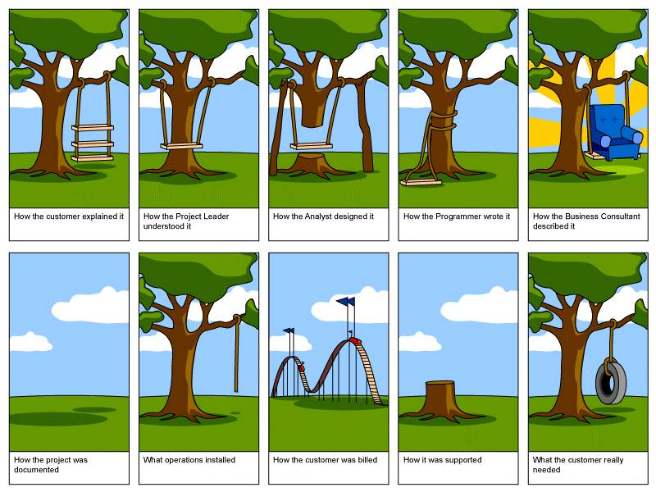

Slide 2
Section 8: Design Patterns
Slides by Alex Mariakakis
with material from David Mailhot,
Hal Perkins, Mike Ernst

Slide 3
Announcements
HW8 due tonight 10 pm
Quiz 7 due tonight 10 pm
Industry guest speaker tomorrow!
Topic: Tech Interviews
Room change: GUG 220 (the large lecture hall next to our normal room)

Slide 4
What Is A Design Pattern
A standard solution to a common programming problem
A technique for making code more flexible
Shorthand for describing program design and how program components are connected

Slide 5
Creational Patterns
Problem: Constructors in Java are not flexible
Always return a fresh new object, never reuse one
Can’t return a subtype of the class they belong to
Solution: Creational patterns!
Sharing
Singleton
Interning
Flyweight
Factories
Factory method
Factory object
Builder

Slide 6
Creational Patterns: Sharing
The old way: Java constructors always create a new object
Singleton: only one object exists at runtime
Interning: only one object with a particular (abstract) value exists at runtime
Flyweight: separate intrinsic and extrinsic state, represents them separately, and interns the intrinsic state

Slide 7
Singleton
For a class where only one object of that class can ever exist
“Ensure a class has only one instance, and provide a global point of access to it.” -- GoF, Design Patterns
Two possible implementations
Eager initialization: creates the instance when the class is loaded to guarantee availability
Lazy initialization: only creates the instance once it’s needed to avoid unnecessary creation

Slide 8
Singleton
Eager initialization
public class Bank {
private static Bank INSTANCE = new Bank();
// private constructor
private Bank() { … }
// factory method
public static Bank getInstance() {
return INSTANCE;
}
}
Bank b = new Bank();
Bank b = Bank.getInstance();

Slide 9
Singleton
Lazy initialization
public class Bank {
private static Bank INSTANCE;
// private constructor
private Bank() { … }
// factory method
public static Bank getInstance() {
if (INSTANCE == null) {
INSTANCE = new Bank();
}
return INSTANCE;
}
}
Bank b = new Bank();
Bank b = Bank.getInstance();

Slide 10
Singleton
Would you prefer eager or lazy instantiation for an HTTPRequest class?
handles authentication
definitely needed for any HTTP transaction
Would you prefer eager or lazy instantiation for a Comparator class?
compares objects
may or may not be used at runtime

Slide 11
Singleton
public class HttpRequest {
private static class HttpRequestHolder {
public static final HttpRequest INSTANCE = new HttpRequest();
}
/* Singleton – Don’t instantiate */
private HttpRequest() { … }
public static HttpRequest getInstance() {
return HttpRequestHolder.INSTANCE;
}
}

Slide 12
Singleton
public class LengthComparator implements Comparator<String> {
private int compare(String s1, String s2) {
return s1.length()-s2.length();
}
/* Singleton – Don’t instantiate */
private LengthComparator() { … }
private static LengthComparator comp = null;
public static LengthComparator getInstance() {
if (comp == null) {
comp = new LengthComparator();
}
return comp;
}
}

Slide 13
Interning
Similar to Singleton, except instead of just having one object per class, there’s one object per abstract value of the class
Saves memory by compacting multiple copies

Slide 14
Interning
public class Point {
private int x, y;
public Point(int x, int y) {
this.x = x;
this.y = y;
}
public int getX() { return x; }
public int getY() { return y; }
@Override
public String toString() {
return “(” + x + “,” + y + “)”;
}
}

Slide 15
Interning
public class Point {
private static Map<String, Point> instances =
new HashMap<String, Point>();
public static Point getInstance(int x, int y) {
String key = x + “,”, + y;
if (!instances.containsKey(key))
instances.put(key, new Point(x,y));
return instances.get(key);
}
private final int x, y; // immutable
private Point(int x, int y) {…}
}
Requires the class being interned to be immutable. Why?

Slide 16
Interning
What if Points were represented in polar coordinates?
What further checks are necessary to make sure these kinds of Points are interned correctly?
Notes:
A note about space leaks
It’s possible with this implementation for the intern pool to get full of objects that aren’t referenced anymore. (memory leak)
Need some way to clean up unused objects from the intern pool.
Probably don’t mention:
You might be able to do this using WeakReferences, but I’m not sure how.
I’m 95% sure that WeakHashMap is not the right way to do this, despite what the internet says. We tried it and it didn’t work. I think WeakHashMap is intended for caching, not interning. If you can show me Java code that effectively uses WeakHashMap for an intern pool despite adversarial use of memory to purposely trigger garbage collection at the worst times, then I might believe you.

Slide 17
Interning
public class Point {
private static Map<String, Point> instances =
new HashMap<String, Point>();
public static Point getInstance(double r, double theta) {
double normalizedTheta = normalize(theta);
String key = r + “,” + normalizedTheta;
if (!instances.containsKey(key))
instances.put(key,
new Point(r, normalizedTheta));
return instances.get(key);
}
private final double r, theta; // immutable
private Point(double r, double theta) {...}
}
Why do we need to normalize?
Notes:
If points are represented with r and theta, must constrain them for use in the key. Otherwise, we’d have “5, pi” and “5, 3pi” as different entries in our map even though they are the same abstract value.

Slide 18
Summary: Sharing Patterns
The old way: Java constructors always create a new object
Singleton: only one object exists at runtime
Interning: only one object with a particular (abstract) value exists at runtime
Flyweight: separate intrinsic and extrinsic state, represents them separately, and interns the intrinsic state

Slide 19
Factories
Suppose we want a constructor for Set that takes a list as a parameter, and produces a TreeSet if the list is sorted, and a HashSet otherwise.
Is this possible?

Slide 20
Factories
Factories solve the problem that Java constructors cannot return a subtype of the class they belong to
Two options:
Factory method
A method that creates and returns objects
Method defines the interface for creating an object, but defers instantiation to subclasses
Factory object
Abstract superclass defines what can be customized
Concrete subclass does the customization, returns appropriate subclass

Slide 21
Factory Method
public static Set produceSet(List list) {
if (isSorted(list)) {
return new TreeSet(list);
} else {
return new HashSet(list);
}
}

Slide 22
Factory Object
interface SetFactory {
Set getSet();
}
class HashSetFactory implements SetFactory {
public Set getSet() {
return new HashSet();
}
}

Slide 23
Builder
The class has an inner class Builder and is created using the Builder instead of the constructor
The Builder takes optional parameters via setter methods (e.g., setX(), setY(), etc.)
When the client is done supplying parameters, she calls build() on the Builder, finalizing the builder and returning an instance of the object desired
Useful when you have many constructor parameters
It is hard to remember which order they should all go in
Easily allows for optional parameters
If you have n optional parameters, you need 2^n constructors, but only one builder

Slide 24
Builder
public class NutritionFacts {
private final int servingSize, servings; // required
private final int calories, fat, sodium; // optional
// all the contructors!
public NutritionFacts(int srvSize, int servings) {
this(srvSize, servings, 0); }
public NutritionFacts(int srvSize, int servings, int cal) {
this(srvSize, servings, cal, 0); }
public NutritionFacts(int srvSize, int servings, int cal, int fat) {
this(srvSize, servings, cal, fat, 0); }
...
public NutritionFacts(int srvSize, int servings, int calories,
int fat, int sodium) {
this.servingSize = srvSize;
this.servings = servings;
this.calories = calories;
this.fat = fat;
this.sodium = sodium;
}
}

Slide 25
Builder
public class NutritionFacts {
private final int servingSize, servings, calories, fat, sodium;
// inner builder class
public static class Builder {
private int servingSize, servings; // required
private int calories = 0, fat = 0, sodium = 0; // optional
public Builder(int servingSize, int servings) {
this.servingSize = servingSize; this.servings = servings; }
public Builder calories(int val) { calories = val; return this; }
public Builder fat(int val) { fat = val; return this; }
public Builder sodium(int val) { sodium = val; return this; }
public NutritionFacts build() { return new NutritionFacts(this); }
}
// only one constructor ☺
public NutritionFacts(Builder builder) {
this.servingSize = builder.servingSize;
this.servings = builder.servings;
this.calories = builder.calories;
this.fat = builder.fat;
this.sodium = builder.sodium;
}
}
Notes:
Static not final

Slide 26
Builder
public class NutritionFacts {
private final int servingSize, servings, calories, fat, sodium;
// inner builder class
public static class Builder {
private int servingSize, servings; // required
private int calories = 0, fat = 0, sodium = 0; // optional
public Builder(int servingSize, int servings) {
this.servingSize = servingSize; this.servings = servings; }
public Builder calories(int val) { calories = val; return this; }
public Builder fat(int val) { fat = val; return this; }
public Builder sodium(int val) { sodium = val; return this; }
public NutritionFacts build() { return new NutritionFacts(this); }
}
// only one constructor ☺
public NutritionFacts(Builder builder) {
this.servingSize = builder.servingSize;
this.servings = builder.servings;
this.calories = builder.calories;
this.fat = builder.fat;
this.sodium = builder.sodium;
}
}
why return this (rather than void) from these methods?
Notes:
Why does each builder method return this?
so you can chain them together, like this
NutritionFacts nf = new NutritionFacts.Builder(50, 3).calories(100).fat(3).sodium(300).build();
if too many calls, might not want to chain them all on one line

Slide 27
Structural Patterns
Problem: Sometimes difficult to realize relationships between entities
Important for code readability
Solution: Structural patterns!
We’re just going to talk about wrappers, which translate between incompatible interfaces
Pattern | Functionality | Interface | Purpose
Adapter | same | different | modify the interface
Decorator | different | same | extend behavior
Proxy | same* | same | restrict access
*from client’s perspective

Slide 28
Adapter
Changes an interface without changing functionality
Rename a method
Convert units
Examples:
Angles passed in using radians vs. degrees
Bytes vs. strings

Slide 29
Decorator
Adds functionality without changing the interface
Add caching
Adds to existing methods to do something additional while still preserving the previous spec
Add logging
Decorators can remove functionality without changing the interface
UnmodifiableList with add() and put()

Slide 30
Proxy
Wraps the class while maintaining the same interface and functionality
Integer vs. int, Boolean vs. boolean
Controls access to other objects
Communication: manage network details when using a remote object
Security: permit access only if proper credentials
Creation: object might not yet exist because creation is expensive

Slide 31
Activity
Adapter, Builder, Decorator, Factory, Flyweight, Intern, Model-View-Controller (MVC), Proxy, Singleton, Visitor, Wrapper
What pattern would you use to…
add a scroll bar to an existing window object in Swing
We have an existing object that controls a communications channel. We would like to provide the same interface to clients but transmit and receive encrypted data over the existing channel.

Slide 32
Activity
Adapter, Builder, Decorator, Factory, Flyweight, Intern, Model-View-Controller (MVC), Proxy, Singleton, Visitor, Wrapper
What pattern would you use to…
add a scroll bar to an existing window object in Swing
Decorator
We have an existing object that controls a communications channel. We would like to provide the same interface to clients but transmit and receive encrypted data over the existing channel.
Proxy

Slide 33
Announcements
HW8 due tonight 10 pm
Quiz 7 due tonight 10 pm
Guest speaker tomorrow!
Topic: Tech Interviews!
Lecture in GUG 220 (the large lecture hall next door to our normal room)

