Slide 2
Section 7: Model-View-Controller and HW 8
Slides adapted from Alex Mariakakis
with material from Krysta Yousoufian, Kellen Donohue, and James Fogarty

Slide 3
Agenda
Announcements
Homework 7 due tonight Thursday (8/2)
Regression testing: Make sure HW5 and HW6 tests pass!
Homework 8 due next Thursday (8/9)
Overview
Model-View-Controller
Homework 8

Slide 4
MVC
The classic design pattern
Used for data-driven user applications
Such apps juggle several tasks:
Loading and storing the data – getting it in/out of storage on request
Constructing the user interface – what the user sees
Interpreting user actions – deciding whether to modify the UI or data
These tasks are largely independent of each other
Model, view, and controller each get one task

Slide 5
MODEL
talks to data source to retrieve and store data
Which database table is the requested data stored in?
What SQL query will get me the data
I need?

Slide 6
VIEW
asks model for data and presents it in a user-friendly format
Would this text look better blue or red? In the bottom corner
or front and center?
Should these items go in a dropdown list or radio buttons?

Slide 7
CONTROLLER
listens for the user to change data or state in the UI, notifying the model or view accordingly
The user just clicked the “hide details” button. I better tell the view.
The user just changed the event details. I better let the model know to update the data.

Slide 8
BENEFITS OF MVC
Organization of code
Maintainable, easy to find what you need
Ease of development
Build and test components independently
Flexibility
Swap out views for different presentations of the same data (ex: calendar daily, weekly, or monthly view)
Swap out models to change data storage without affecting user

Slide 9
MVC FLOW IN THEORY
View
Model
Controller

Slide 10
MVC FLOW
In theory…
Pattern of behavior in response to inputs (controller) are independent of visual geometry (view)
Controller contacts view to interpret what input events should mean in the context of the view
In practice…
View and controller are so intertwined that they almost always occur in matched pairs (ex: command line interface)
Many architectures combine the two

Slide 11
MVC FLOW IN PRACTICE
View
Model
Controller

Slide 12
PUSH VS. PULL
View
Model
Controller

Slide 13
PUSH VS. PULL ARCHITECTURE
Push architecture
As soon as the model changes, it notifies all of the views
Pull architecture
When a view needs to be updated, it asks the model for new data

Slide 14
PUSH VS. PULL ARCHITECTURE
Advantages for push
Guaranteed to have latest data in case something goes wrong later on
Advantages for pull
Avoid unnecessary updates, not nearly as intensive on the view

Slide 15
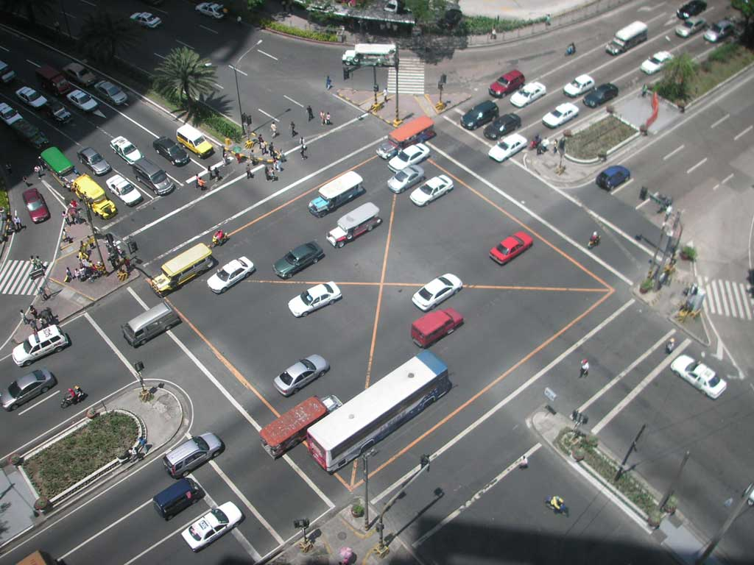
MVC EXAMPLE – TRAFFIC SIGNAL

Slide 16
TRAFFIC SIGNAL – MVC
Component | Model | View | Controller
Detect cars waiting to enter intersection
Traffic lights to direct car traffic
Decide to change the light’s status
Manual override for particular lights
Detect pedestrians waiting to cross
Pedestrian signals to direct pedestrians
External timer which triggers changes at set interval
X
X
X
X
X
X
X
Notes:
The Xs look out of place, but they should up in the right places

Slide 17
TRAFFIC SIGNAL
Model
Stores current state of traffic flow
Knows current direction of traffic
Capable of skipping a light cycle
Stores whether there are cars and/or pedestrians waiting
View
Conveys information to cars and pedestrians in a specific direction
Controller
Aware of model’s current direction
Triggers methods to notify model that state should change

Slide 18
TRAFFIC SIGNAL CODE
Model
TrafficModel – keeps track of which lights should be on and off
View
CarLight – shows relevant state of TrafficModel to cars
PedestrianLight – shows relevant state of TrafficModel to pedestrians
Controller
PedestrianButton – notifies TrafficModel that there is a pedestrian waiting
CarDetector – notifies TrafficModel that there is a car waiting
LightSwitch – enables or disables the light
Timer – regulates time in some way, possibly to skip cycles

Slide 19
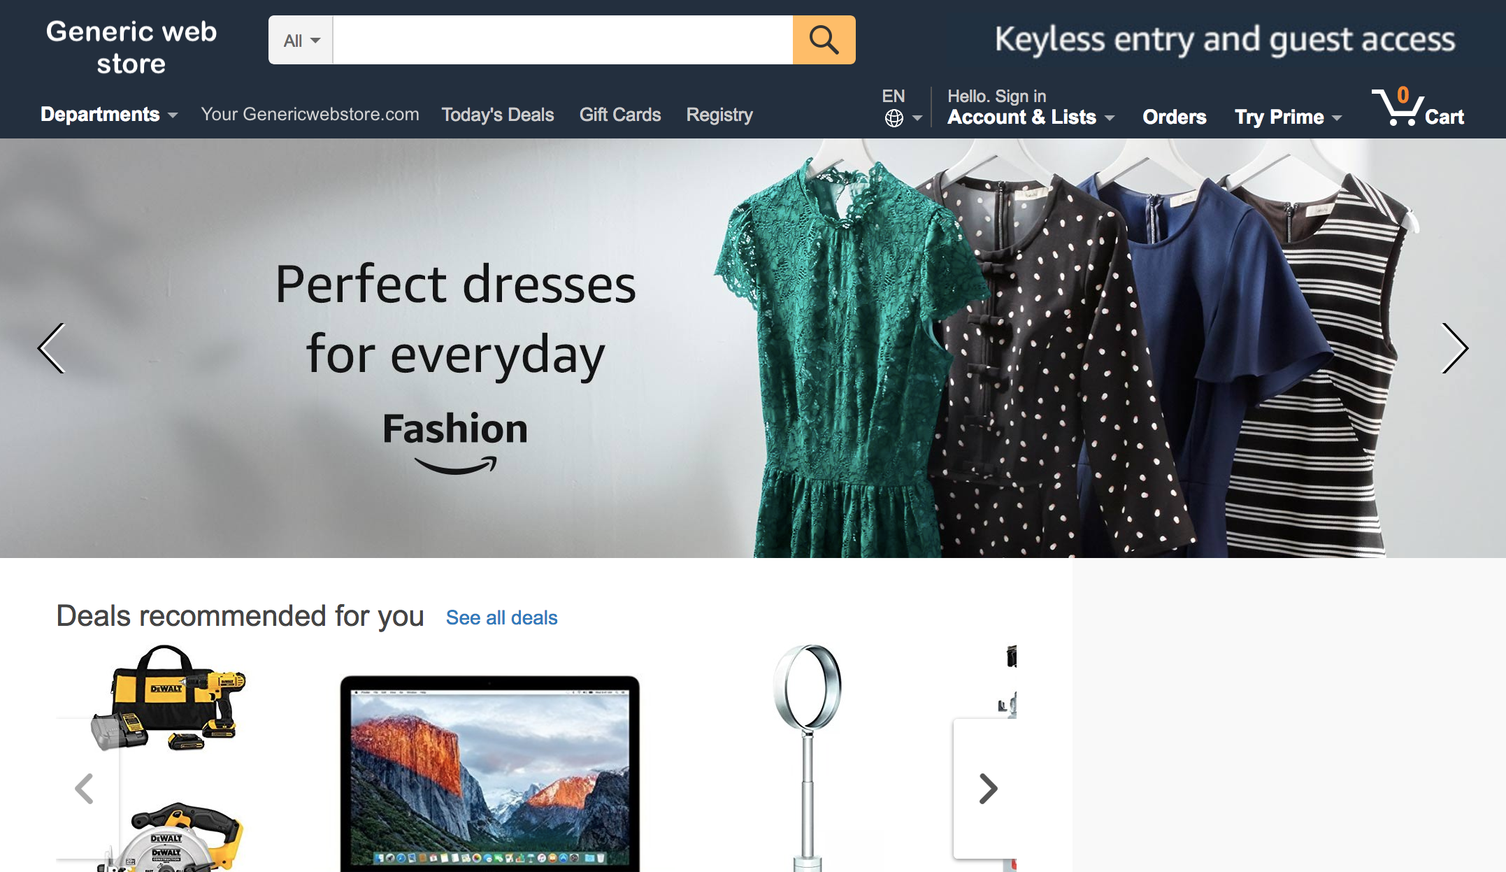
MVC EXAMPLE – WEB STORE

Slide 20
WEB STORE – MVC
Component | Model | View | Controller
Update user’s shopping cart
Display price/details of a product
Storage of product/inventory details
Purchase items in shopping cart
Record of customer transactions
User sign-in
Authenticate user sign-in attempt
Check user credentials

Slide 21
WEB STORE – MVC
Component | Model | View | Controller
Update user’s shopping cart |  |  | X
Display price/details of a product |  | X
Storage of product/inventory details | X
Purchase items in shopping cart |  |  | X
Record of customer transactions | X
User sign-in |  | X
Authenticate user sign-in attempt |  |  | X
Check user credentials | X

Slide 22
To summarize – Don’t do this
View
Model and Controller

Slide 23
HW8 OVERVIEW
Apply your generic graph & Dijkstra’s to campus map data
Given a list of buildings and walking paths
Produce routes from one building to another on the walking paths

Slide 24
HW8 DATA FORMAT
List of buildings (abbreviation, name, loc in pixels)
BAG Bagley Hall (East Entrance) 1914.5103,1708.8816
BGR By George 1671.5499,1258.4333
List of paths (endpoint 1, endpoint 2, dist in feet)
1903.7201,1952.4322
1906.1864,1939.0633: 26.583482327919597
1897.9472,1960.0194: 20.597253035175832
1915.7143,1956.5: 26.68364745009741
2337.0143,806.8278
2346.3446,817.55768: 29.685363221542797
2321.6193,788.16714: 49.5110360968527
2316.4876,813.59229: 44.65826043418031
(0,0) is in the upper left

Slide 25
MVC IN HW8
Model stores graph, performs Dijkstra’s
View shows results to users in text format
Controller takes user commands and uses view to show results
View and Controller will change in HW9, but Model will stay the same

Slide 26
Homework 8 in Detail
Data files
campus_buildings.dat: Possible src/dst for path finding
campus_paths.dat: Info for all nodes, edges in your Graph/Model
You do the parsing

Slide 27
Homework 8 in Detail Cont.
Runnable program with following commands:
b lists all buildings in form abbreviated name: long name
r prompts user for abbrev. names of two buildings then finds a path between them
q quits the program (don’t use System.exit)
m prints the menu of commands
Route directions format
Path from Building_A to Building_B:
Walk dist feet direction to (x₁, y₁)
Walk dist feet direction to (x₂, y₂)
…
Total distance: x feet

Slide 28
Homework 8 in Detail Cont.
Solving for the direction
Compare coordinates for start, end of edge
Pixel (0, 0) is the top-left corner (this is the tricky part)
Helper functions can be very useful
Math.atan2(double y, double x)
Math.toDegrees(double angleRadian)
Points that are exactly on the boundary should default to the single-letter direction (N, S, E, W)
More info on the homework spec

Slide 29
Homework 8 in Detail Cont.
(0, 0)
Start
End

Slide 30
Homework 8 in Detail Cont.
(0, 0)
Start
Finding slope between start/end will help
End

