Slide 1
Section 4: Graphs and Testing
Slides by Kevin Pusich and Cody Kesting
with material from Erin Peach and Nick Carney, Vinod Rathnam, Alex Mariakakis, Krysta Yousoufian, Mike Ernst, Kellen Donohue
Notes:
Students should go back to the debugging slides from previous sections
Bugs might not be in the test that it seems like it’ll be in. something testing add might rely on dup, etc.

Slide 2
Agenda
Graphs (HW 5)
JUnit Testing
Test Script Language
JavaDoc

Slide 3
Graphs
Node
Edge

Slide 4
Graphs
Node
data item in a graph
Edge
connection between two nodes

Slide 5
Graphs
Directed graph: edges have a source and destination
Edges represented with arrows
Parent/child nodes: related by an edge

Slide 6
Graphs collection of nodes (vertices) and edges
A
B
Nodes: states or objects within the graph
Edges: connection between two nodes
C
D
E

Slide 7
Graphs
Edges can be:
Directed
Undirected
What are some examples where each type of edge would be useful?
A
B
C
D

Slide 8
Graphs
Directed:
Flight itinerary
Class dependencies
Undirected:
Facebook friends
Computer networks
Seattle
Zürich
John
Sally
* Common term: Directed Acyclic Graph (DAG)

Slide 9
Graphs
A
B
C
D
Children of A?
E

Slide 10
Graphs
A
B
Children of A:
nodes reached by an edge starting at node A
C
D
E

Slide 11
Graphs
A
B
C
D
Parents of D?
E

Slide 12
Graphs
A
B
Parents of D:
nodes that have an edge ending at node D
C
D
E

Slide 13
Graphs
A
B
Paths from
A to C:
a sequence or ordered list of edges starting at A and ending at C
C
D
E

Slide 14
Graphs
A
B
Paths from
A to C:
A ⇒ C
A ⇒ D ⇒ E ⇒ C
C
D
Shortest path
from A to C?
E

Slide 15
REMINDER: You’ve seen Graphs before!
Linked Lists
Binary Trees
Luke
A
B
C
Leia
Droids
C3PO
R2-D2

Slide 16
Before we move on...
Read the wikipedia article in the spec!
(It has implementation hints!)
Notes:
Article has good implementation hints

Slide 17
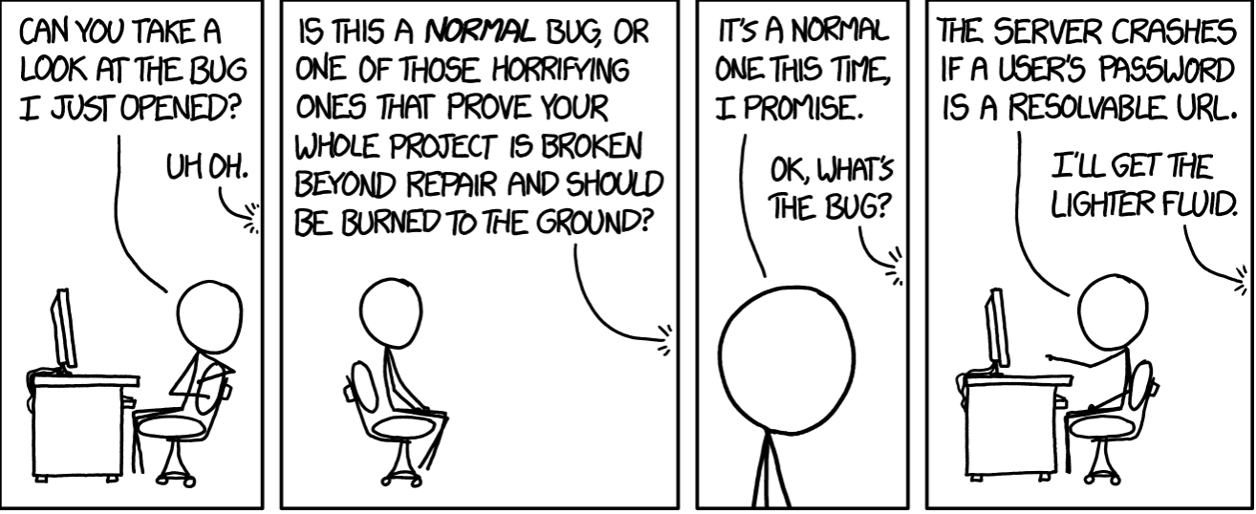
Testing

Slide 18
Internal vs. external
Internal : JUnit
How you decide to implement the object
Checked with implementation tests
External: test script
Your API and specifications
Testing against the specification
Checked with specification tests

Slide 19
A JUnit test class
A method with @Test is flagged as a JUnit test
All @Test methods run when JUnit runs
import org.junit.*;
import static org.junit.Assert.*;
public class TestSuite {
@Test
public void Test1() { … }

Slide 20
Using JUnit assertions
Verifies that a value matches expectations
assertEquals(42, meaningOfLife());
assertTrue(list.isEmpty());
If the assert fails:
Test immediately terminates
Other tests in the test class are still run as normal
Results show “details” of failed tests (We’ll get to this later)

Slide 21
Using JUnit assertions
Assertion | Case for failure
assertTrue(test) | the boolean test is false
assertFalse(test) | the boolean test is true
assertEquals(expected, actual) | the values are not equal
assertSame(expected, actual) | the values are not the same (by ==)
assertNotSame(expected, actual) | the values are the same (by ==)
assertNull(value) | the given value is not null
assertNotNull(value) | the given value is null
And others: https://junit.org/junit4/javadoc/4.11/org/junit/Assert.html Each method can also be passed a string to display if it fails:
assertEquals("message", expected, actual)

Slide 22
USING JUNIT ASSERTIONS
When writing JUnit assertions, make sure to use the appropriate test
Ex: Testing Java’s List.size()
Use assertEquals(list.size(), 1)
Don’t use assertTrue(list.size() == 1)

Slide 23
Checking for exceptions
Verify that a method throws an exception when it should:
Passes only if specified exception is thrown
Only time it’s OK to write a test without a form of asserts
@Test(expected=IndexOutOfBoundsException.class)
public void testGetEmptyList() {
List<String> list = new ArrayList<String>();
list.get(0);
}

Slide 24
Setup and teardown
Methods to run before/after each test case method is called:
@Before
public void name() { ... }
@After
public void name() { ... }
Methods to run once before/after the entire test class runs:
@BeforeClass
public static void name() { ... }
@AfterClass
public static void name() { ... }

Slide 25
Setup and teardown
public class Example {
List empty;
@Before
public void initialize() {
empty = new ArrayList();
}
@Test
public void size() {...}
@Test
public void remove() {...}
}

Slide 26
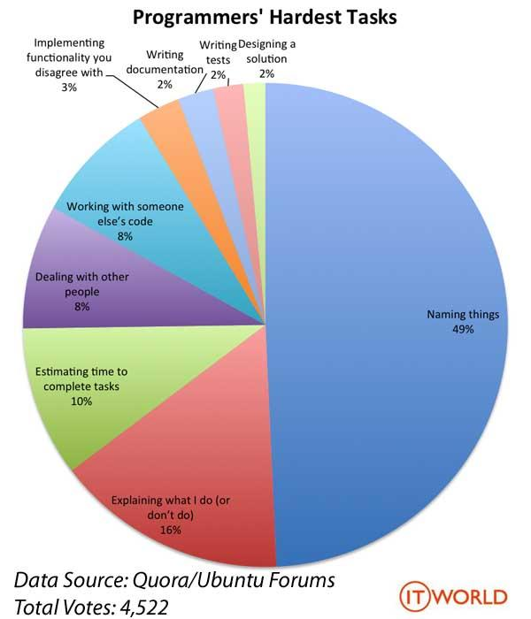
Test Writing Etiquette

Slide 27
Ground rules
1. Don’t Repeat Yourself
Use constants and helper methods
2. Be Descriptive
Take advantage of message, expected, and actual values
Ex: testAddElementToEmptyList instead of testAdd
3. Keep Tests Small
Isolate bugs one at a time; failing assertion halts test
Helps to catch bugs at the source
4. Be Thorough
Test big, small, boundaries, exceptions, errors
5. Order of Testing Matters
If methodB() relies on methodA() to work correctly, test methodA() first

Slide 28
Let’s put it all together!
public class DateTest {
// Test addDays when it causes a rollover between months
@Test
public void testAddDaysWrapToNextMonth() {
Date actual = new Date(2050, 2, 15);
actual.addDays(14);
Date expected = new Date(2050, 3, 1);
assertEquals("date after +14 days",
expected, actual);
}

Slide 29
How to create JUnit test classes
Right-click hw5.test -> New -> JUnit Test Case
Important: Follow naming guidelines we provide
Demo
Notes:
Open up your copy of hw5 in Eclipse, then follow the instructions here. Show how to create a new JUnit test.
Pull HW5
Right click on hw5.test > New > JUnit Test Case
Name it SectionTest or a different (style appropriate) name
Select a sample option such as “setUpBeforeClass”
Make two private fields, good=true & bad=false
You can have the field be set in the @BeforeClass method or just hardcode it at the top
In the @Test method, make a test (or populate the one auto-created for you) with: assertTrue(“This test should pass”, good);
Run the test (it should pass) via RightClick->Run As->JUnit Test
Or can run from the options in toolbar
Add a new @Test method that will fail by calling:
assertTrue(“This test was never going to pass”, bad)
rerun the test, point out the message in the bottom left

Slide 30
JUnit asserts vs. Java asserts
We’ve just been discussing JUnit assertions so far
Tests for incorrect behavior
Java itself has assertions
Tests for invalid states
public class LitterBox {
ArrayList<Kitten> kittens;
public Kitten getKitten(int n) {
assert(n >= 0);
return kittens(n);
}
}

Slide 31
Reminder: Enabling asserts in Eclipse
To enable asserts:
Go to Run -> Run Configurations… -> Arguments tab -> input -ea in VM arguments section

Slide 32
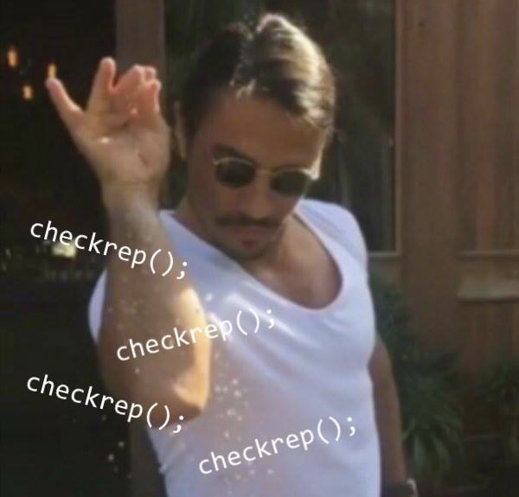
Don’t forgot your CheckReps!

Slide 33
Expensive CheckReps
ant validate and staff grading will have assertions enabled
But sometimes a checkRep can be expensive
For example, looking at each node in a Graph with a large number of nodes
This could cause the grading scripts to timeout

Slide 34
Expensive CheckReps
Before your final commit, remove the checking of expensive parts of your checkRep or the checking of your checkRep entirely
Example: boolean flag and structure your checkRep as so:
private void checkRep() {
cheap-stuff
if(DEBUG_FLAG) { // or can have this for entire checkRep
expensive-stuff
}
cheap-stuff
...

Slide 35
External tests: Test script language

Slide 36
Test script language
Text file with one command listed per line
First word is always the command name
Remaining words are arguments
Commands will correspond to methods in your code

Slide 37
Test script language
# Create a graph
CreateGraph graph1
# Add a pair of nodes
AddNode graph1 n1
AddNode graph1 n2
# Add an edge
AddEdge graph1 n1 n2 e1
# Print the nodes in the graph and the outgoing edges from n1
ListNodes graph1
ListChildren graph1 n1
n1
n2
e1
graph1

Slide 38
Test script language
# Create a graph
CreateGraph graph1
# Add a pair of nodes
AddNode graph1 n1
AddNode graph1 n2
# Add an edge
AddEdge graph1 n1 n2 e1
# Print the nodes in the graph and the outgoing edges from n1
ListNodes graph1
ListChildren graph1 n1
n1
n2
e1
graph1

Slide 39
Test script language
# Create a graph
created graph graph1
# Add a pair of nodes
added node n1 to graph1
added node n2 to graph1
# Add an edge
added edge e1 from n1 to n2 in graph1
# Print the nodes in the graph and the outgoing edges from n1
graph1 contains: n1 n2
the children of n1 in graph1 are: n2(e1)
n1
n2
e1
graph1

Slide 40
How to create specification tests
Create .test and .expected file pairs under hw5.test
Implement parts of HW5TestDriver
driver connects commands from .test file to your Graph implementation to the output which is matched with .expected file
Run all tests by running SpecificationTests.java
Note: staff will have our own .test and .expected pairs to run with your code
Do not hardcode .test/.expected pairs to pass, but instead make sure the format in hw5 instructions is correctly followed

Slide 41
Workflow for Specification Tests
Translate commands, apply them to your graph
Formats output
to match expected output style
Read in
commands
Return results
of commands
.test
file
HW5
Test
Driver
Graph
.java
HW5
Test
Driver
.actual
file

Slide 42
Demo: Test script language
Notes:
Just show how to create a simple test, and then point out the specification tests JUnit file

Slide 43
JavaDoc API
Now you can generate the JavaDoc API for your code
Instructions in the Editing/Compiling Handout
Demo: Generate JavaDocs
Demo steps are in spec
Notes:
Run the Javadoc command

