Slide 1
How To Read Minds
Demystifying the Interview Process

Slide 2
Don’t Panic
You are not there to get a job. You’re there to see if it’s a good fit.

Slide 3
Truth
You are not there to get a job. You’re there to see if it’s a good fit.
You have one day to make a decision that will impact the rest of your life. You owe it to yourself to spend that entire time gathering data.
You will get rejected.
You will reject.
Sometimes, you may get rejected for something that doesn’t feel “fair”. Sometimes, it may actually not be fair. Decide how you’re going to deal with that.
See (1).

Slide 4
Me
Notes:
Who I am and why I am here
My work history
Currently taking a year off – mention Bob Ross paintings
1500 interviews in all roles
Bar Raiser program at Amazon / Bar Tender program at Oracle
Given talks on interviewing at all my companies (from the interviewer spec)
Worked on recruiting software for my last year and a half at Amazon
My First Interview
Suuuuuuuuuuucked, I bombed
Tried to divide by zero
Show the “resume”

Slide 5
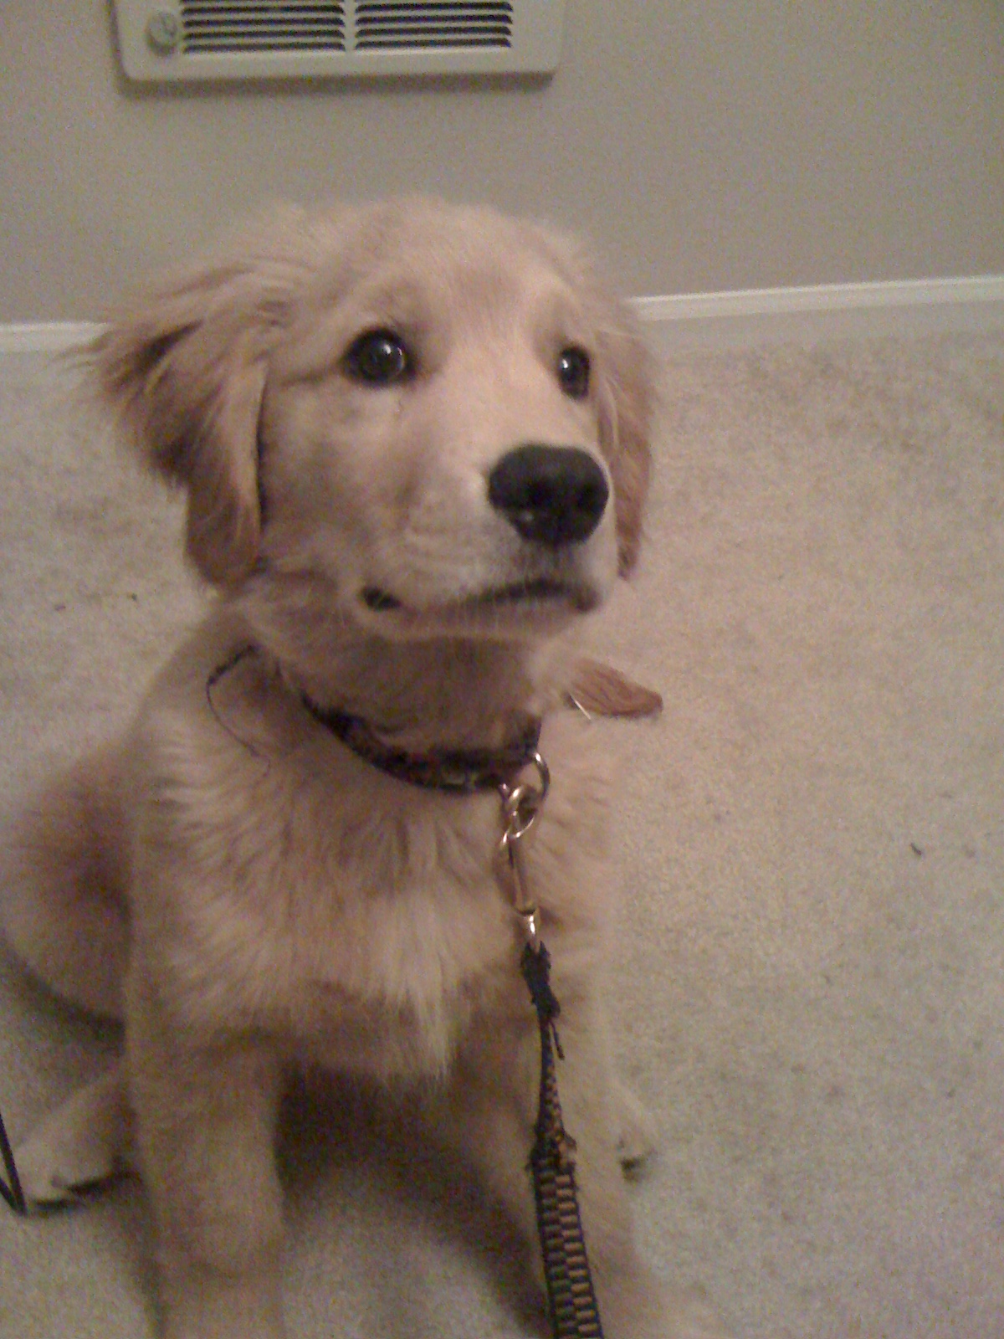
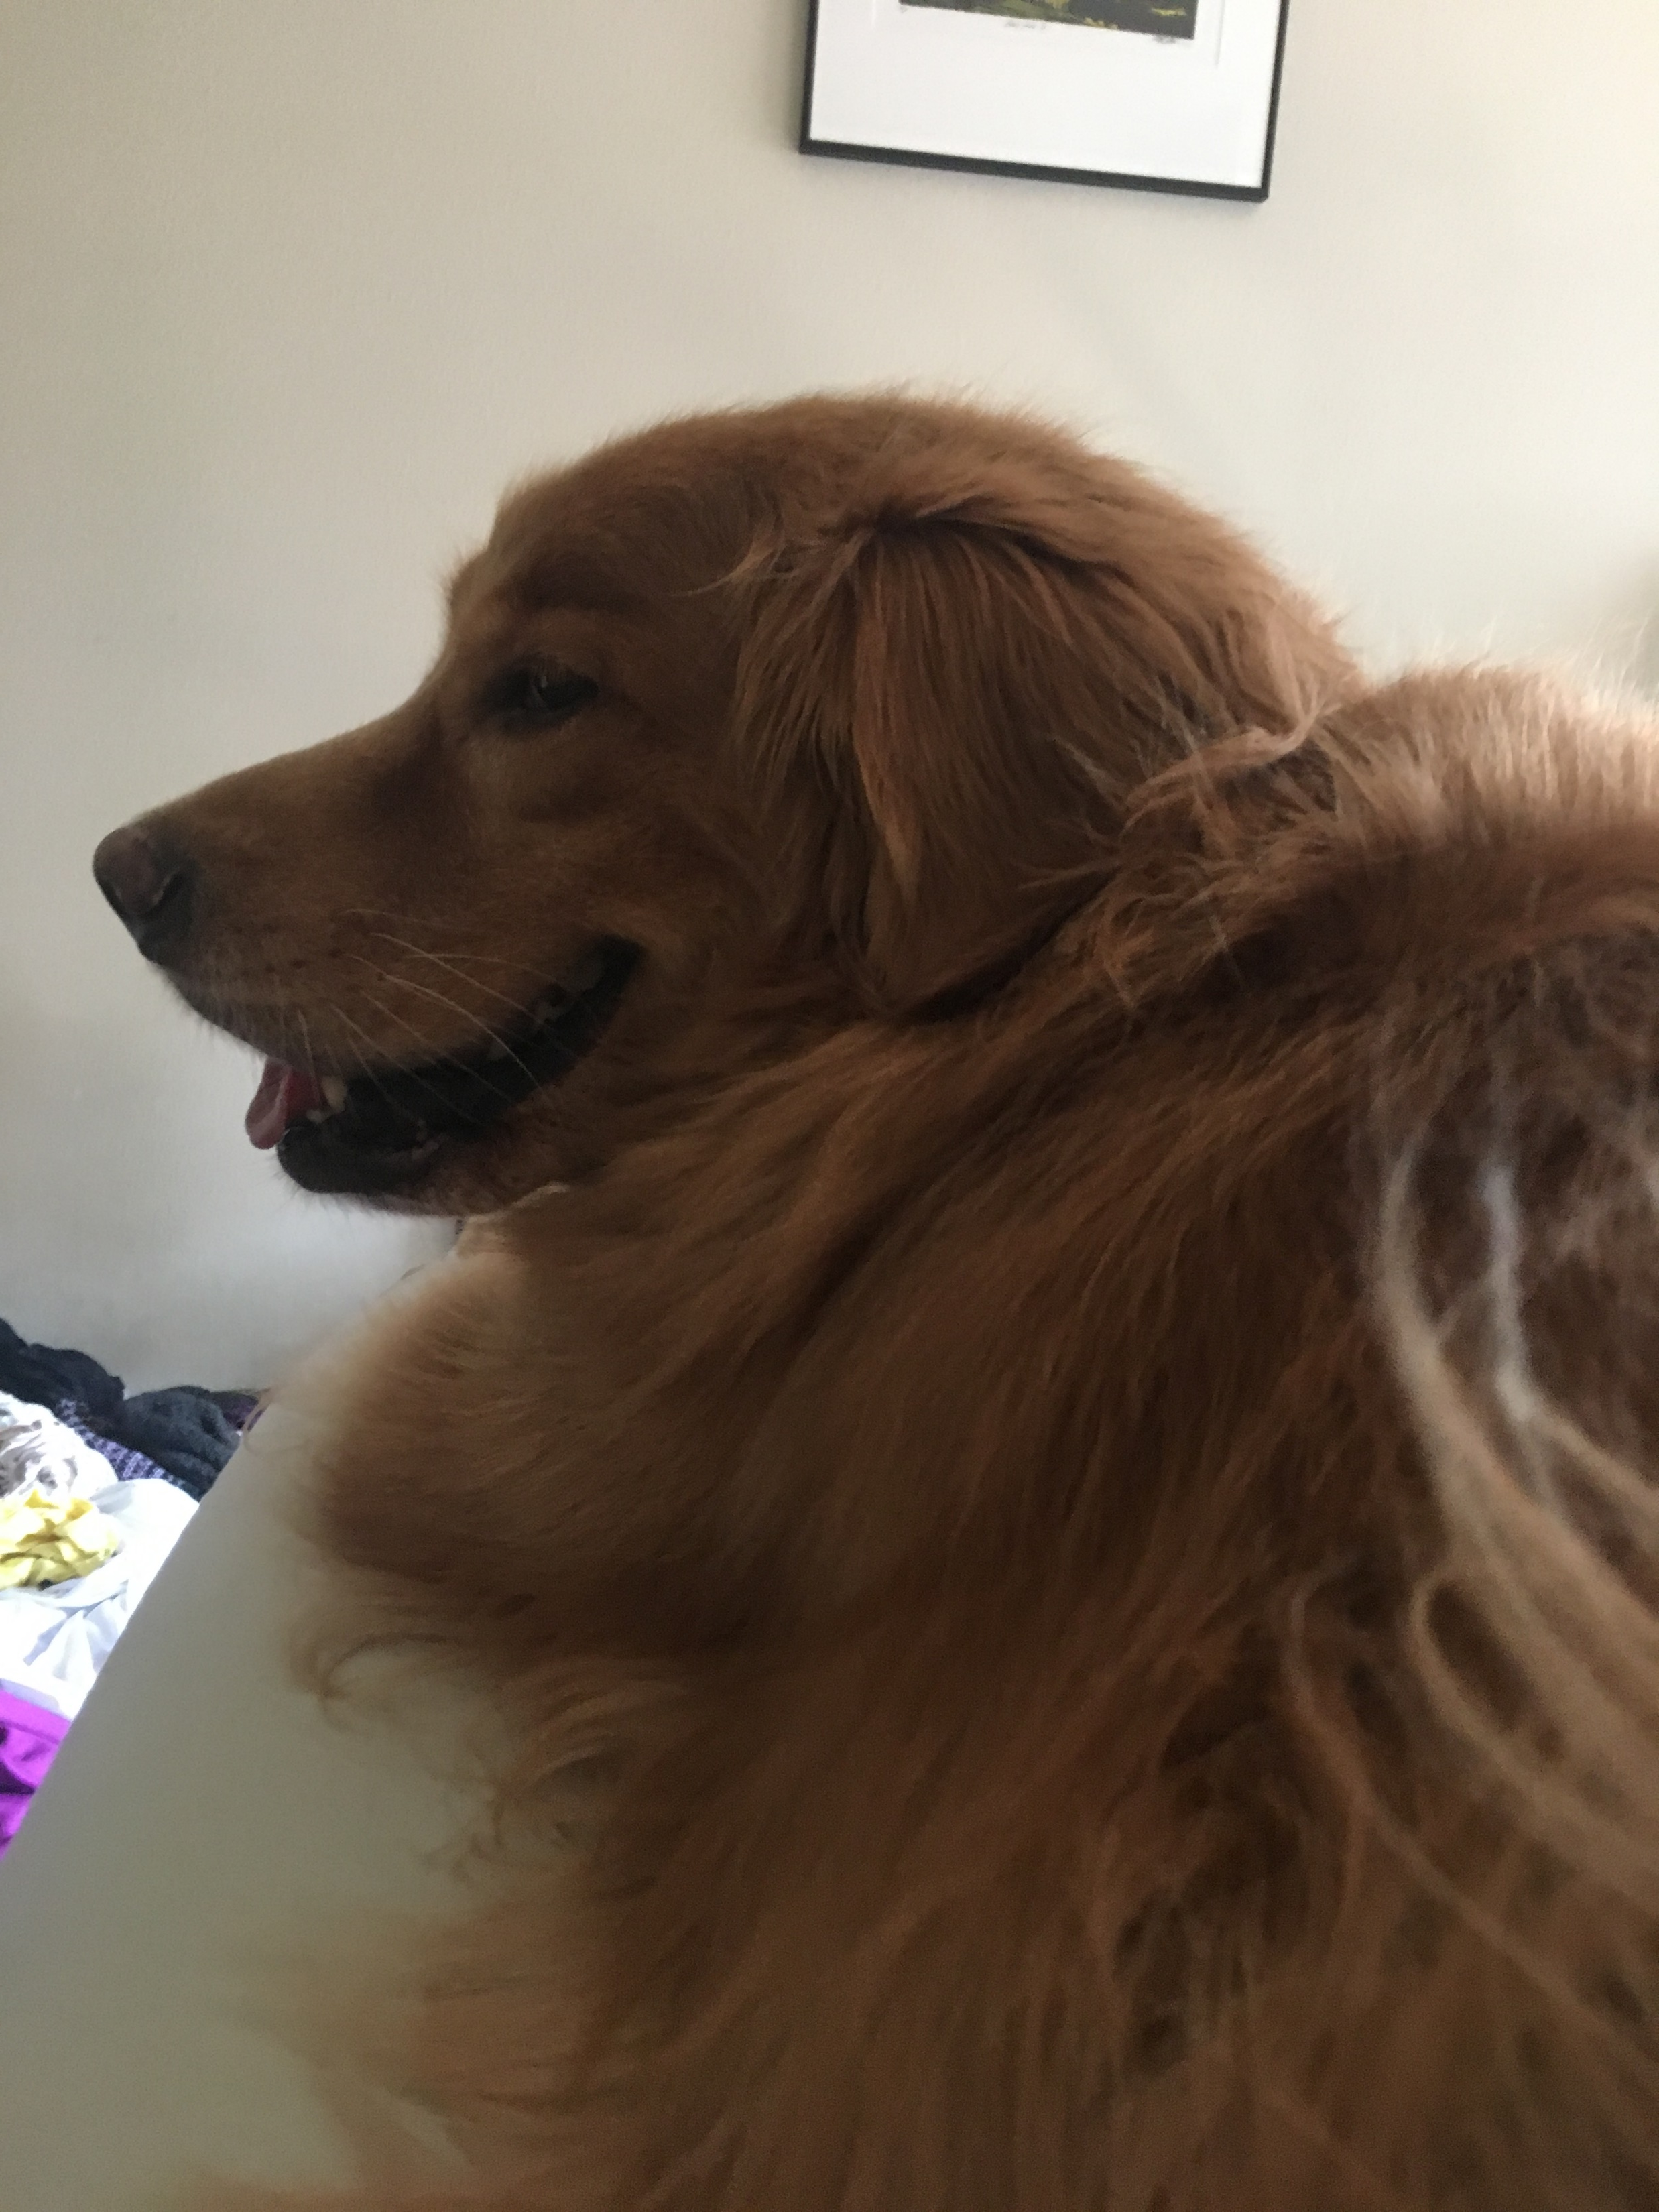
Me My Dog
(my dog is way more photogenic than I am)
Notes:
Who I am and why I am here
My work history
Currently taking a year off – mention Bob Ross paintings
1500 interviews in all roles
Bar Raiser program at Amazon / Bar Tender program at Oracle
Given talks on interviewing at all my companies (from the interviewer spec)
Worked on recruiting software for my last year and a half at Amazon
My First Interview
Suuuuuuuuuuucked, I bombed
Tried to divide by zero
Show the “resume”

Slide 6
Who’s Who
Sourcer
Recruiter
Recruiting Coordinator
Interviewers
Hiring Manager
Company Specific: Bar Raiser / Bar Tender / As-Appropriate / etc
Notes:
Sourcer
Benefits of having a friend on the inside
Includes knowing the company’s REAL hiring state!
Talk about career fairs
Company Specific: Bar Raiser / Bar Tender / As-Appropriate / etc
Don’t Game The System:
Guy with multiple names
Lady with same questions
BUT REMEMBER COMPANIES HAVE PEOPLE, TOO – mistakes happen

Slide 7
Prepare
Use University resume services
Practice
Pick a language
Review:
Data structures
Calculating O-notation
Recursion
Dynamic programming
Testing
Code something longhand
Create questions

Slide 8
Interview Questions
Hypothetical (AWFUL)
Functional (just Google that)
Level of suck
Example (“Tell me about a time when…”)
Scenario (show me, don’t tell me)
Notes:
Hypothetical
Terrible
Hand-waving
Functional
Slightly less terrible
Yet, extremely popular (particularly in tech)
Example
About half-terrible
Easy to prepare for… like a politician
Scenario
SHOW me, don’t TELL me

Slide 9
Hypothetical Questions Suck, And Are Usually A Sign Of Inexperienced Interviewer… Or It’s A Trap
Hypothetical
How do you drive consensus?
How do you prioritize tasks?
How do you herp a derp?
If you can append “In general…” to their question, it’s hypothetical
ANSWERS:
[a] “I had to prioritize three different class projects once. Here’s how I did it…”
[b] “…and this is what I learned from it…”
[c] “…and here’s how I would use that knowledge in the future.”
Pretend they asked you an example question.

Slide 10
Functional Questions Are Popular In Tech, But Contribute More To Failure Than Good Decisions
Functional
“In Outlook, how do you add a signature?”
“What is the difference between a hashmap and a hashtable in Java?”
“Compare final, finally, and finalize.”
Google-ready book fact does not help make a good decision
ANSWERS:
[a] “I haven’t used that since freshman year, but here’s what I remember…”
[b] “I would do X and Y to learn more about this.”
Answer as best as you can and be honest about the parts you aren’t sure of. “I would Google that”.

Slide 11
Examples Are Part Of That Behavioral Interviewing Thing Everyone Seems To Like These Days
Example
“Tell me about a time when you disagreed with your manager.”
“What is the worst technical decision you’ve ever made?”
“Tell me about the most interesting code you’ve ever written.”
Dangerous…
Remember, some of us can lie really well.
Not all questions work on all candidates
ANSWERS:
[a] “Here’s an example of something similar…”
[b] “…and here’s what I learned from it…”
[c] “…and here’s what I would have done differently if I’d had that knowledge.”
Think like a politician.

Slide 12
Scenario Questions Are The Epitome Of “Show Me” And Represent The Best Possible Interview
Scenario
“As your manager, I’d like you to figure out how to move all of our code over to Java and use git as our source control. Right now, we use PHP and dev desktops. What do you do with this?”
“Company has decided to get into the business of matchmaking. Design Lovelily, our new online dating service.”
ANSWERS:
[a] “Let me start by asking…”
[b] “…Okay, the first answer that pops to my mind is…”
[c] “…but I should also consider…”
[d] “…here is how I would test this.”
Have a dialogue with the interviewer. This is the fun part! Interview them.

Slide 13
These Are Bad To Hear
Tricks: “…the doctor is HIS MOTHER!”
Puzzle questions (AKA “stupid XOR tricks): “…oh, that’s how it’s O(1).”
Logic puzzles: “…and that’s why manhole covers are round.”
Language-specific questions: “…so it’s only one line in LISP.)))))))))))”
Glassdoor: “…and that’s how you find the integers that sum to k.”
(these change over time… nobody’s asking atoi anymore)
Software-specific questions: “…this is easier in Taleo.”
Fillers: “…see, my top three weaknesses are really strengths!”
You will hear at least one of these. They’re stupid. Treat them like Functional questions.

Slide 14
These Are Bad To Say
Notes:
“I’d have to ask my manager.”
“I’ll ask the IT team.”
“That really wouldn’t be my job, right?”
“I’d investigate because I need more data!”
“I would get everyone to agree.”
“Clearly, we need to proactively leverage synergistic paradigms as we utilize a hockey-stick approach into credibly rebalancing a holistic action plan as a consequence of double-digit throughput increase…”
“I’m not technical.”
“I dunno.”

Slide 15
The next slide is the complete list of reasons I teach interviewers to give a candidate a No-Hire

Slide 16
Getting stuck… and not knowing how to get themselves un-stuck.
Thinking silently… and getting annoyed when interrupted.
Not knowing an API… and not being able to come up with one.
Being wrong… and being aggressive about their position when challenged.
Not knowing an answer… and handwaving instead of admitting that.
Making assumptions… and not vetting them.
Not finishing… and not being able to explain their algorithm.

Slide 17
That’s It.

Slide 18
Here Are Some Examples Of Stuff I Don’t Care About, But Your Interviewer May, So Ask Them
Language-specific syntax
mystack.extract() //meh
hm[i]++ (in java) //I’m going to question this
…remember it’s a whiteboard
Off-by-one
Handling certain edge cases
if( mystr == null ) //good
register void* value = malloc (x)… //too much!
Coding practices
getters, setters, constructors //bonus if they ask
public v private //same as the above
Naming
Stuff caught by compiler

Slide 19
Sometimes Things Fall Apart
Interviewer is a no-show
Room isn’t reserved
“Can you come back tomorrow?”
Whiff an easy question
Sudden inspiration… for a question you already answered
You have NO IDEA how to answer a question
¯\_(ツ)_/¯
Notes:
You have no idea how to answer the question: Admit it! “I’m really actually just lost here. I think I’m nervous, but I’m having a hard time even figuring out where to start. If it were more like Question Y, I would do Z.”
If you realize halfway through that you do not want to work here: Keep going, act as though you are still interested, it is a small world

Slide 20
…And Sometimes, It Was Just Never Meant To Be
Interviewer is unprepared
Interviewer is bad
Interviewer is a jerk
It’s going horribly, and you can tell
(ಥ﹏ಥ)
Notes:
Your interviewer is asking terrible questions: Remember the advice in this presentation. Many interviewers are not good at it.
Tell the story of HR
Interviewer is a jerk
Tell the story of Microsoft UI guy
Some interviewers just want to smugly prove they’re smarter than you
Some interviewers just don’t like the way you look, and they’ve made a decision before you even say hello
It’s a data point for you
At this point in my career, I would likely walk out, but I don’t recommend that for you – you should keep going to get the practice / experience
It’s going horribly, and you can tell.
Tell the story of the Towers of Hanoi guy
And, hey, now the pressure is off!

Slide 21
Questions
Why did you decide to work here versus anywhere else?
What’s the most interesting project YOU’VE worked on while here?
What’s one thing you wish you could change about this company?
What advice do you have for me as I look for a job?
If you had to describe the culture here in just one word, what would it be?
Avoid cliché questions, or asking a question “just because it’s expected”.
You are interviewing them.

Slide 22
Afterwards
Notes:
Interviewers compare notes
“debrief”
“hiring committee”
Generally making a decision for a team or two
“Will this person be successful at our role”
They’ll give you a time frame – if not, recruiter
Remember most companies TRY to come to an answer quickly
Valve: same day, literally while you sit there
Negotiations
Tell the truth, but not the whole truth (“I’m also talking with Microsoft and expect to hear back from them next week.”)
Glassdoor / Blind should give you salary expectations
Generally, the HM and recruiter are your friends here at large companies

Slide 23
Internship To Offer
Make your manager happy.
Notes:
Most interns get offers at most places – they have an investment in you already. It’s a huge advantage.
Typically, your hiring manager has full control over this decision
MAKE YOUR MANAGER HAPPY
Intern projects are usually suggestions from the HM or other developers. They can be…
Impossible
Crap that nobody else wanted to do
Handwavy
Follow the same interview advice: be honest, be proactive, tell your manager ASAP if there’s an issue with the project
Week 1: OK to ask a million questions, Week 2 less so, etc

Slide 24
Truth: Redux
You are not there to get a job. You’re there to see if it’s a good fit.
You have one day to make a decision that will impact the rest of your life. You owe it to yourself to spend that entire time gathering data.
You will get rejected.
You will reject.
Sometimes, you may get rejected for something that doesn’t feel “fair”. Sometimes, it may actually not be fair. Decide how you’re going to deal with that.
See (1).

