Slide 1
CSE 331 Software Design and Implementation
Lecture 9
Style and Design
Leah Perlmutter / Summer 2018

Slide 2
Announcements

Slide 3
Announcements
Reading 4 posted
Quiz due Thursday 7/12, 10 pm
HW4 due Thursday 7/12, 10 pm
HW2 feedback out soon
Midterm Monday 7/16 in class
Midterm Review Friday 7/13, 3:30 – 5pm, in lecture classroom

Slide 4
Introduction

Slide 5
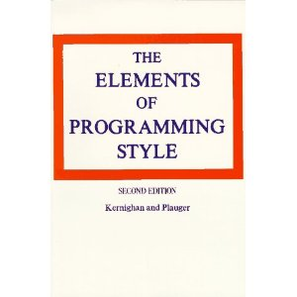
Style
“Use the active voice.”
“Omit needless words.”
“Don't patch bad code - rewrite it.”
“Make sure your code 'does nothing' gracefully.”
Notes:
writing style affects how clear and compelling your writing is
coding sytle affects correctness of your code by making it easier to reason about and work with your code

Slide 6
No one right answer
Style is an art as much as a science
Somewhat subjective rules
developed over combined coding experience of many programmers
Every program is a special snowflake
When you encounter design principles in real life coding experiences, challenge them! (if you have time)
Notes:
most of these design principles apply to most programs
You may encounter exceptions
Systematically experiment with bending and breaking these rules in real life
prove or disprove them to yourself

Slide 7
Outline
Modular design
Cohesion and Coupling
Method Design
Field Design
Constructor Design
Naming
Class design
Completeness and Consistency
Documentation
Choosing types
Independence of views
Notes:
Modules and modularty is an overarching theme of this lecture
lots of loosely related topics, we’ll jump around a bit
Bold topics have more than one slide

Slide 8
Modules
A module is a relatively general term for a class or a type or any kind of design unit in software
A modular design focuses on what modules are defined, what their specifications are, how they relate to each other
Not the implementations of the modules
Each module respects other modules’ abstraction barriers!
Notes:
-

Slide 9
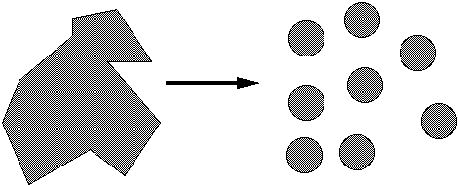
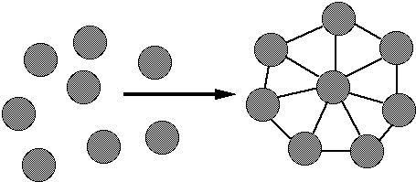
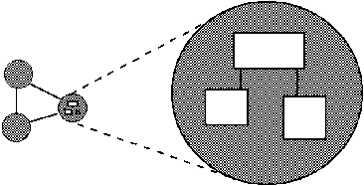
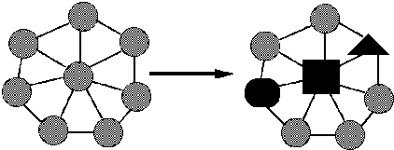
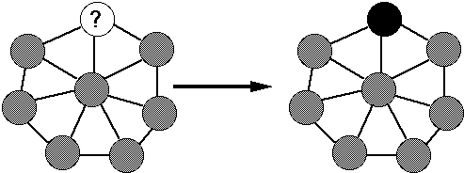
Ideals of modular software
Decomposable – can be broken down into modules to reduce complexity and allow teamwork
Composable – “Having divided to conquer, we must reunite to rule [M. Jackson].”
Understandable – one module can be examined, reasoned about, developed, etc. in isolation
Continuity – a small change in the requirements should affect a small number of modules
Isolation – an error in one module should be as contained as possible

Slide 10
Cohesion and
Coupling

Slide 11
Two general design issues
Cohesion – how well components fit together to form something that is self-contained, independent, and with a single, well-defined purpose
Coupling – how much dependency there is between components
Guideline: decrease coupling, increase cohesion
Applies to modules and smaller units
Each method should do one thing, and do it well
Each module should provide a single abstraction

Slide 12
Cohesion
The common design objective of separation of concerns suggests a module should represent a single concept
A common kind of “concept” is an ADT
Encapsulation (Data Hiding) – Enclosing the concrete representation of data in an object so it is inaccessible to clients
If a module implements more than one abstraction, consider breaking it into separate modules for each one
Notes:
If a client had to worry about implementation details of a data structure, it wouldn’t be cohesive
hide the implementation details in an ADT to separate these concerns from the client’s application

Slide 13
Coupling
How are modules dependent on one another?
Statically (in the code)? Dynamically (at run-time)? More?
Ideally, split design into parts that don't interact much
Roughly, the more coupled modules are, the more they need to be reasoned about as though they are a single, larger module
MY
FINAL
PROJECT
MY
MY
FINAL
PROJECT
PRINAL
FOJECT
An application
A poor decomposition
(parts strongly coupled)
A better decomposition
(parts weakly coupled)
Notes:
Real life example of coupling – 331 infrastructure
- pushing starter code was coupled with the old style of website deployment

Slide 14
Coupling is the path to the dark side
Coupling leads to complexity
Complexity leads to confusion
Confusion leads to suffering
Once you start down the dark path, forever will it dominate your destiny, consume you it will
Notes:
You have permission to laugh when your instructor does a really bad impression of a fictional character

Slide 15
God classes
god class: a class that hoards much of the data or functionality of a system
Poor cohesion – little thought about why all the elements are placed together
Reduces coupling but only by collapsing multiple modules into one (which replaces dependences between modules with dependences within a module)
A god class is an example of an anti-pattern: a known bad way of doing things
Notes:
Commonly written by beginners.
You are no longer a beginner!
By being here in 331, you are leveling up! Welcome to Programming for Adults.
No more god classes

Slide 16
Cohesion again…
Methods should do one thing well:
Compute a value but let client decide what to do with it
Observe or mutate, don’t do both
Don’t print as a side effect of some other operation
Don’t limit future possible uses of the method by having it do multiple, not-necessarily-related things
“Flag” variables are often a symptom of poor method cohesion

Slide 17
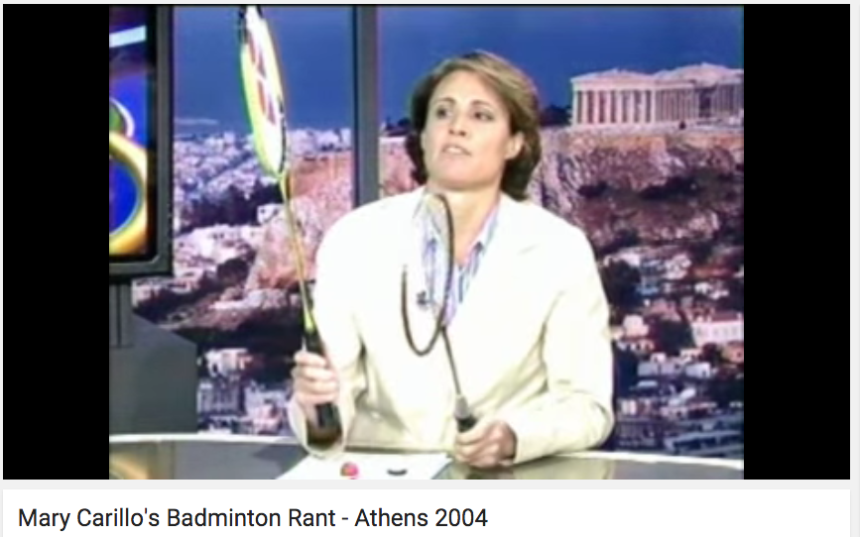
Cohesive?
Notes:
Is this rant cohesive?
the transitions between parts may be smooth
each component is a well formed story
the entire rant does not form an elegant unit
Concept of the unified whole
not only does each part have to be well designed
they have to fit together to form an elegant unit
Software is hierarchical

Slide 18
Making all the components highly reliable will not necessarily make the system safe.
― Nancy G. Leveson
Engineering a Safer World:
Systems Thinking Applied to Safety

Slide 19
Summary
Each unit should do one thing and do it well
If one unit does multiple things, it should be split up
Units should interact with each other via a minimal interface
Minimize each module’s knowledge of other modules
Large modules rely on smaller modules working together well
It’s not sufficient for each small unit to work well on its own
Must fit together to form an elegant whole

Slide 20
More Stuff
Notes:
A few disjointed design principles

Slide 21
Method design
Effective Java (EJ) Tip #40 [51]: Design method signatures carefully
Avoid long parameter lists
Perlis: “If you have a procedure with ten parameters, you probably missed some.”
Especially error-prone if parameters are all the same type
Avoid methods that take lots of Boolean “flag” parameters
Which of these has a bug?
memset(ptr, size, 0);
memset(ptr, 0, size);
EJ Tip #41 [52]: Use overloading judiciously
Can be useful, but avoid overloading with same number of parameters, and think about whether methods really are related
Notes:
memset is a c library function that sets a block of memory to a certain byte
the size and the byte can both be expressed as integers
compiler will not catch errors

Slide 22
Field design
A variable should be made into a field if and only if:
It is part of the inherent internal state of the object
It has a value that retains meaning throughout the object's life
Its state must persist past the end of any one public method
All other variables should be local to the methods in which they are used
Fields should not be used to avoid parameter passing
Not every constructor parameter needs to be a field
Exception to the rule: Certain cases where overriding is needed
Example: Thread.run
Notes:
Make your variables local
Minimize scope of variables
the greater a variable’s scope, the easier it is to accidentally misuse
Related to the fact that global variables are bad
java has no global variables

Slide 23
Constructor design
Constructors should have all the arguments necessary to initialize the object's state – no more, no less
Object should be completely initialized after constructor is done
(i.e., the rep invariant should hold)
Shouldn't need to call other methods to “finish” initialization
Notes:
Related to minimizing the number of arguments in a method
do one thing – initialize the object
do it well – fully initialize.

Slide 24
Naming

Slide 25
Any true wizard knows, once you know the name of a thing you can control it.
-- Jerry Sussman

Slide 26
Class and method naming
EJ Tip #56 [68]: Adhere to generally accepted naming conventions
Class names: generally nouns
Beware "verb + er" names, e.g. Manager, Scheduler, ShapeDisplayer
Interface names often –able/-ible adjectives:
Iterable, Comparable, …
Method names: noun or verb phrases
Nouns for observers: size, totalSales
Verbs+noun for observers: getX, isX, hasX
Verbs for mutators: move, append
Verbs+noun for mutators: setX
Choose affirmative, positive names over negative ones
isSafe not isUnsafe
isEmpty not hasNoElements

Slide 27
Local variable naming
count, flag, status, compute, check, value, pointer, names starting with my…
Convey no useful information
Describe what is being counted, what the “flag” indicates, etc.
numberOfStudents, isCourseFull, calculatePayroll, validateWebForm, …
But short names in local contexts are good:
Good: for(i = 0; i < size; i++) items[i]=0;
Bad: for(theLoopCounter = 0; theLoopCounter < theCollectionSize; theLoopCounter++) theCollectionItems[theLoopCounter]=0;
Notes:
What would be better names for some of these variables?
(specific names add information, so you can make up information about the variable in your answer)
Loop variables: the exception that proves the rule

Slide 28
Class Design

Slide 29
Class design ideals
Cohesion and coupling, already discussed
Completeness: Every class should present a complete interface
Consistency: In names, param/returns, ordering, and behavior

Slide 30
Completeness
Include important methods to make a class easy to use
Counterexamples:
A mutable collection with add but no remove
A tool object with a setHighlighted method to select it, but no setUnhighlighted method to deselect it
Date class with no date-arithmetic operations
Also:
Objects that have a natural ordering should implement Comparable
Objects that might have duplicates should implement equals (and therefore hashCode)
Most objects should implement toString

Slide 31
But…
Don’t include everything you can possibly think of
If you include it, you’re stuck with it forever (even if almost nobody ever uses it)
Tricky balancing act: include what’s useful, but don’t make things overly complicated
You can always add it later if you really need it
“Everything should be made as simple as possible, but not simpler.”
- Einstein
Notes:
When I first started programming, I found myself implementing too many methods
trying to think of every possible contingency
Don’t do this
it’s a waste of time as an implementer
it makes the interface more complex and harder for the client to understand
“Complete but not Overdone”

Slide 32
Consistency
A class or interface should have consistent names, parameters/returns, ordering, and behavior
Use similar naming; accept parameters in the same order
Counterexamples:
setFirst(int index, String value) setLast(String value, int index)
Date/GregorianCalendar use 0-based months
String methods: equalsIgnoreCase, compareToIgnoreCase; but regionMatches(boolean ignoreCase)
String.length(), array.length, collection.size()
Notes:
- Why is this a bad idea?

Slide 33
Open-Closed Principle
Software entities should be open for extension, but closed for modification
When features are added to your system, do so by adding new classes or reusing existing ones in new ways
If possible, don't make changes by modifying existing ones – existing code works and changing it can introduce bugs and errors.
Related: Code to interfaces, not to classes
Example: accept a List parameter, not ArrayList or LinkedList
EJ Tip #52: Refer to objects by their interfaces
Notes:
Suppose you’re writing both a data structure and an application that uses the data structure
Closed for modification means you’re not opening up and updating the data structure every time you write client code that uses the data structure
Instead, define an ADT. The application relies on the ADT. The data structure is closed to modification
Once you’ve defined the ADT, if you need a class that does more, make a child class
this is what it means to be open to extension
This is how it works in an ideal world, but not always in real life.
nevertheless, keeping this principle in mind can help make your life easier

Slide 34
Documenting a class
Keep internal and external documentation separate
External: /** ... */ Javadoc for classes, interfaces, methods
Specifications only!
Describes things that clients need to know about the class
Should be specific enough to exclude unacceptable implementations, but general enough to allow for all correct implementations
Includes all pre/postconditons, etc.
Internal: // comments inside class and method bodies
Describes details of how the code is implemented
Information that clients wouldn't and shouldn't need, but a fellow developer working on this class would want – invariants and internal pre/post conditions especially
Includes Abstraction Function and Rep Invariant

Slide 35
Internal Documentation
Comments should provide additional information from the code itself. They should not echo the code.
Don’t comment every line saying what that line does
Comments should summarize blocks of code
Like headers and subheaders in a textbook
Makes it easier to skim the code
Documentation should match the code – keep them in sync!
It’s better to write clear, understandable code than to write a ton of comments on messy, hard-to-understand code.
Good code is sometimes self-explanatory and therefore needs fewer comments than bad code.

Slide 36
Enums help document
Consider use of enums, even with only two values – which of the following is better?
oven.setTemp(97, true); oven.setTemp(97, Temperature.CELSIUS);
Notes:
Are there any questions about documentation?

Slide 37
More Stuff
Notes:
Are there any questions about documentation?

Slide 38
Choosing types – some hints
Numbers: Favor int and long for most numeric computations
EJ Tip #48: Avoid float and double if exact answers are required
Classic example: Money (round-off is bad here)
Strings are often overused since much data is read as text
Notes:
- Acknowledge the existence of floating point error

Slide 39
Independence of views
Confine user interaction to a core set of “view” classes and isolate these from the classes that maintain the key system data
Do not put print statements in your core classes
This locks your code into a text representation
Makes it less useful if the client wants a GUI, a web app, etc.
Instead, have your core classes return data that can be displayed by the view classes
Which of the following is better?
public void printMyself()
public String toString()
Notes:
printing ok for debugging purposes
in production don’t use print statements

Slide 40
Last thoughts (for now)
Always remember your reader
Who are they?
Clients of your code
Other programmers working with the code
(including yourself in 3 weeks/months/years)
What do they need to know?
How to use it (clients)
How it works, but more important, why it was done this way (implementers)
Read/reread style and design advice regularly
Keep practicing – mastery takes time and experience
You’ll always be learning. Keep looking for better ways to do things!
Notes:
writing code is like writing an essay – you have an audience
work in progress

Slide 41
Large-scale engineered systems are more than just a collection of technological artifacts: They are a reflection of the structure, management, procedures, and culture of the engineering organization that created them. They are usually also a reflection of the society in which they were created.
― Nancy G. Leveson
Engineering a Safer World:
Systems Thinking Applied to Safety
Notes:
Nancy Leveson says... (read quote)

Slide 42
Closing

Slide 43
Announcements (recap)
Reading 4 posted
Quiz due Thursday 7/12, 10 pm
HW4 due Thursday 7/12, 10 pm
HW2 feedback out soon
Midterm Monday 7/16 in class
Midterm Review Friday 7/13, 3:30 – 5pm, in lecture classroom
Thank you for coming to class!

