Slide 1
Note Card Survey (Anonymous)
1. Keep: What have I been doing well that I should continue doing?
2. Change: What is something I already do, but should change so I do it better?
3. Stop: What is one bad thing I should stop doing?
4. Start: What is one good thing I haven't done that I should start doing?
5. Any other feedback you wish to give!
Topic Suggestions:
Lecture: Clarity, Speed/Pacing, Active Learning, Interaction with Students
Office Hours
Homework

Slide 2
CSE 331
Software Design and Implementation
Lecture 8
Testing
Leah Perlmutter / Summer 2018

Slide 3
Announcements

Slide 4
Announcements
Homework
  Congrats on making it past the HW3 due date!
    technical issues persisting?
  HW4 is out! Due Thursday, July 12, 10 pm
Midterm: Monday, July 16
  in our normal lecture time and location
Midterm Review: Friday, July 13, 3:30 - 5 pm
  Location TBD

Slide 5
Testing

Slide 6
Outline
Why correct software matters
  Motivates testing and more than testing, but now seems like a fine time for the discussion
Testing principles and strategies
  Purpose of testing
  Kinds of testing
  Heuristics for good test suites
  Black-box testing
  Clear-box testing and coverage metrics
  Regression testing

Slide 7
There is no one right answer
The way you test depends on many things
Who your customers are
How safety-critical your code is
The conventions at your company
Testing is as much an art as a science
Need to be systematic
Also need to be creative
I will tell you some things I know about testing!

Slide 8
Note about tools
Modern development ecosystems have much built-in support for testing
  Unit-testing frameworks like JUnit
  Regression-testing frameworks connected to builds and version control
  Continuous testing
  …
No tool details covered here
  See homework, section, internships, …

Slide 9
Motivation

Slide 10
Building Quality Software
What Affects Software Quality?
External
  Correctness Does it match what the customer wanted?
  Reliability Does it do it accurately all the time?
  Efficiency Does it do without excessive resources?
  Integrity Is it secure?
Internal
  Correctness Does the software match the spec?
  Portability Can I use it under different conditions?
  Maintainability Can I fix it?
  Flexibility Can I change it or extend it or reuse it?
Quality Assurance (QA)
  Process of uncovering problems and improving software quality
  Testing is a major part of QA

Slide 11
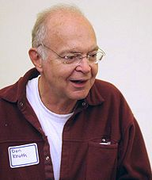
Software Quality Assurance (QA)
Testing plus other activities including:
  Static analysis (assessing code without executing it)
  Correctness proofs (theorems about program properties)
  Code reviews (people reading each others’ code)
  Software process (methodology for code development)
  …and many other ways to find problems and increase confidence
No single activity or approach can guarantee software quality
  “Beware of bugs in the above code;
  I have only proved it correct, not tried it.”
  -Donald Knuth, 1977

Slide 12
Kinds of Software Customers
How much assure software quality before we “ship it” ⛵?
Depends on the cost of mistakes
  Depends on the customer!
Some potential customers
The person at the next desk
Business contract customers
Web or app customers
Airplane passengers
Medical patients
The Space Program

Slide 13
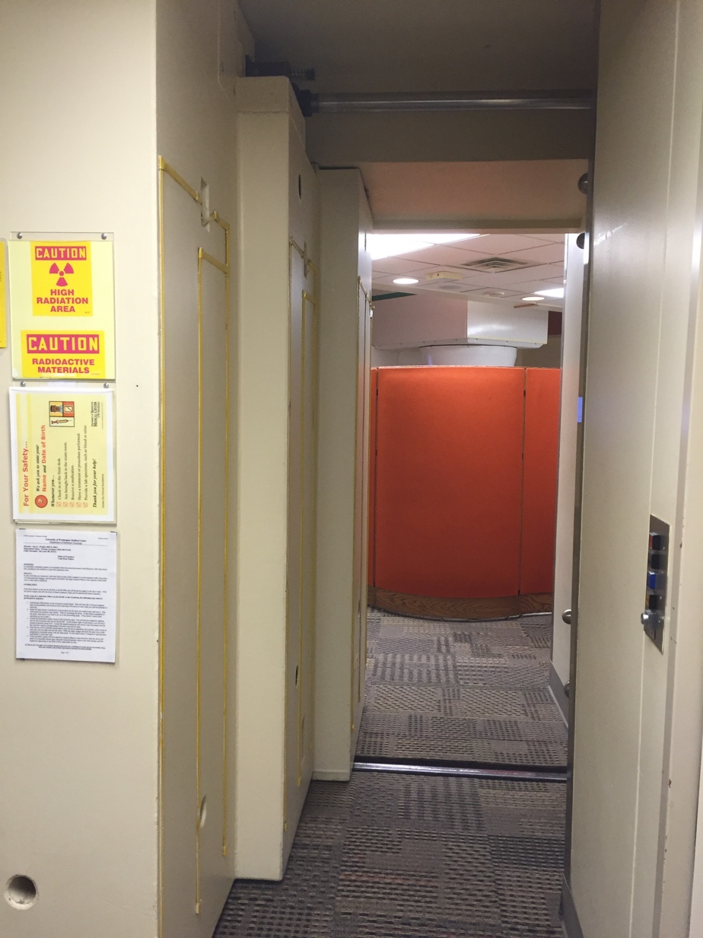
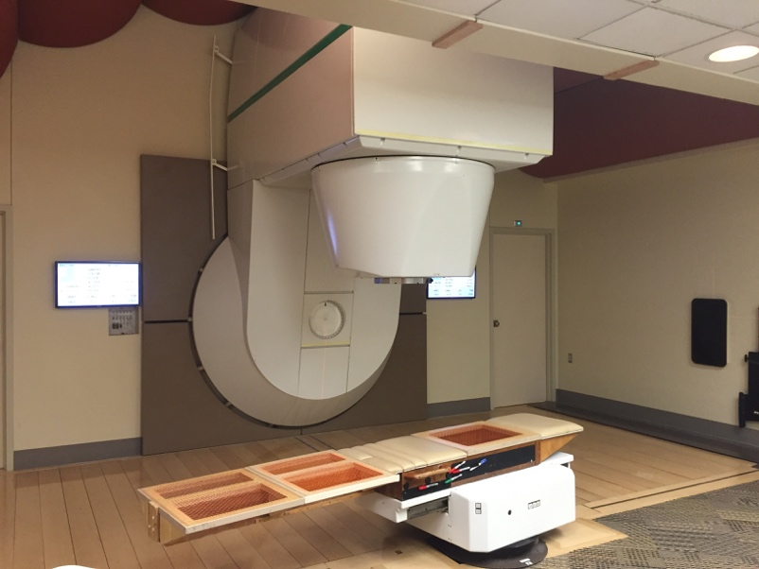

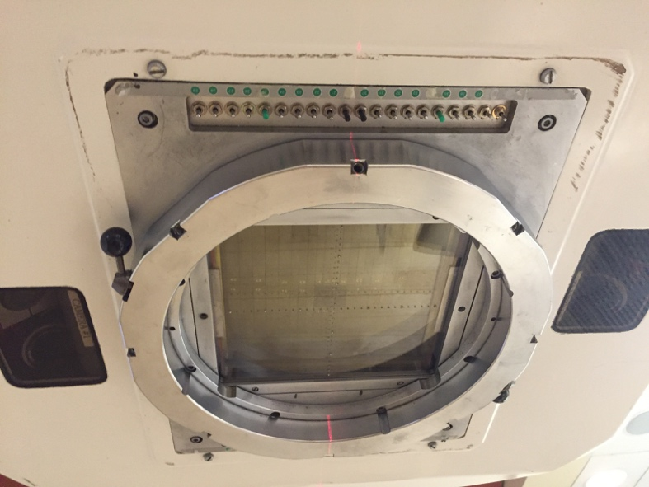
Clinical Neutron Therapy System
Notes:
Here are some systems where software quality is critical

Slide 14
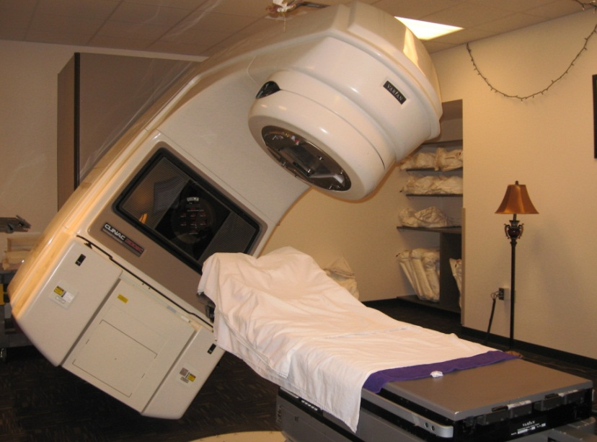
Therac-25 radiation therapy machine
Excessive radiation killed patients (1985-87)
  New design removed hardware that prevents the electron-beam from operating in its high-energy mode. Now safety checks done in software.
  Equipment control software task did not properly synchronize with the operator interface task, so race conditions occurred if the operator changed the setup too quickly.
  Missed during testing
  because it took practice before
  operators worked quickly enough
  for the problem to occur.

Slide 15
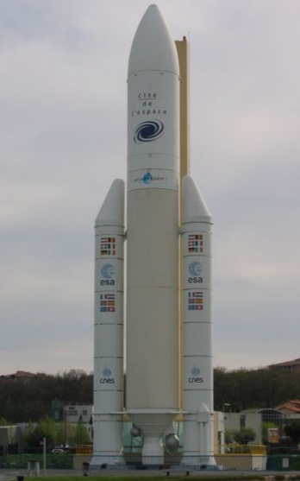
Ariane 5 rocket (1996)
Rocket self-destructed 37 seconds after launch
  Cost: over $1 billion
Reason: Undetected bug in control software
  Conversion from 64-bit floating point to 16-bit signed integer caused an exception
  The floating point number was larger than 32767
  Efficiency considerations led to the disabling of the exception handler, so program crashed, so rocket crashed
Notes:
GO QUICKLY through these intro slides; don’t get bogged down in details. Spending too much time on them distracts from the more important content.

Slide 16
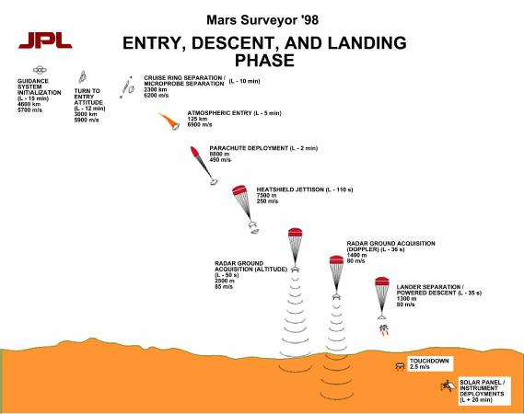
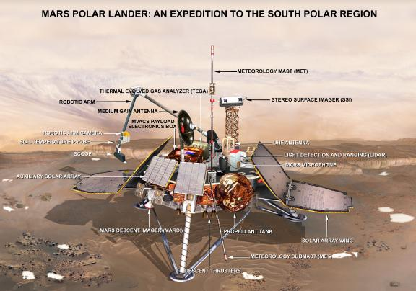
Mars Polar Lander
Legs deployed → Sensor signal falsely indicated that the craft had touched down (130 feet above the surface)
  Then the descent engines shut down prematurely

Slide 17
More examples
Mariner I space probe (1962)
Microsoft Zune New Year’s Eve crash (2008)
iPhone alarm (2011)
Denver Airport baggage-handling system (1994)
Air-Traffic Control System in LA Airport (2004)
AT&T network outage (1990)
Northeast blackout (2003)
USS Yorktown Incapacitated (1997)
Intel Pentium floating point divide (1993)
Excel: 65,535 displays as 100,000 (2007)
Prius brakes and engine stalling (2005)
Soviet gas pipeline (1982)
Study linking national debt to slow growth (2010)
…

Slide 18
Software bugs cost money
2013 Cambridge University study: Software bugs cost global economy $312 Billion per year
  http://www.prweb.com/releases/2013/1/prweb10298185.htm
$440 million loss by Knight Capital Group in 30 minutes
  August 2012 high-frequency trading error
$6 billion loss from 2003 blackout in NE USA & Canada
  Software bug in alarm system in Ohio power control room
Notes:
Testing is one tool to mitigate the risks of low quality software

Slide 19
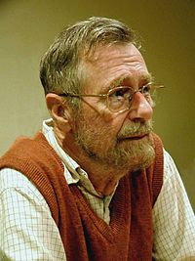
What can you learn from testing?
“Program testing can be used to show the presence of bugs, but never to show their absence!”
Edsgar Dijkstra
Notes on Structured Programming, 1970
Notes:
- that’s why we need to be systematic and pick our test cases in a way that they’re representative of the whole program – more on this later...

Slide 20
What Is Testing For?
Validation = reasoning + testing
  Make sure module does what it is specified to do
  Uncover problems, increase confidence
Two rules:
1. Do it early and often
  Catch bugs quickly, before they have a chance to hide
  Automate the process wherever feasible
2. Be systematic
  If you thrash about randomly, the bugs will hide in the corner until you're gone
  Understand what has been tested for and what has not
  Have a strategy!
Notes:
- not only can testing help to validate your code before you ship it to a customer, it can also help you to have confidence in each part of your code before you write the next part that depends on it

Slide 21
Summary: Why test?
Low quality can have great costs
  human lives
  billions of dollars
  ruined business relationships
  your company’s reputation
  making your life harder as a programmer
Software quality is important
  Testing is one way to improve quality
331 homeworks will give you the opportunity to practice testing!

Slide 22
How to Test

Slide 23
Kinds of testing
Testing is so important the field has terminology for different kinds of tests
  Won’t discuss all the kinds and terms
Here are three orthogonal dimensions:
  Unit testing versus system/integration testing
    One module’s functionality versus pieces fitting together
  Black-box testing versus clear-box testing
    Does implementation influence test creation?
    “Do you look at the code when choosing test data?”
  Specification testing versus implementation testing
    Test only behavior guaranteed by specification or other behavior expected for the implementation?

Slide 24
Unit Testing
A unit test focuses on one method, class, interface, or module
Test a single unit in isolation from all others
Typically done earlier in software life-cycle
  Integrate (and test the integration) after successful unit testing
Notes:
Most of today’s examples will be about unit testing

Slide 25
How is testing done?
  Choose a part to test
  Choose input data/configuration
  Define the expected outcome
  Run with input and record the outcome
  Compare observed outcome to expected outcome
Lots of these!
Input selection is hard!
Notes:
outputs are important!
generally not sufficient to just run code and see if it doesn’t throw an exception
Input selection is hard, and we’re going to talk a lot about it today

Slide 26
sqrt example: Input Selection
// throws: IllegalArgumentException if x<0
// returns: approximation to square root of x
public double sqrt(double x){…}
What are some values or ranges of x that might be worth probing?
    x < 0 (exception thrown)
    x ≥ 0 (returns normally)
    around x = 0 (boundary condition)
    perfect squares (sqrt(x) an integer), non-perfect squares
    x<sqrt(x) and x>sqrt(x) – that's x<1 and x>1 (and x=1)
    Specific tests: say x = -1, 0, 0.5, 1, 4
Notes:
What values of x do we want to test?
(and why for each one)

Slide 27
Why is Input Selection Hard?
“Just try it and see if it works...”
// requires: 1 ≤ x,y,z ≤ 10000
// returns: computes some f(x,y,z)
int proc1(int x, int y, int z){…}
Exhaustive testing would require 1 trillion runs!
  Sounds totally impractical – and this is a trivially small problem
Key problem: choosing test suite
  Small enough to finish in a useful amount of time
  Large enough to provide a useful amount of validation
Notes:
This is why we need to be systematic.

Slide 28
Approach: Partition the Input Space
Ideal test suite:
  Identify sets with same behavior
  Try one input from each set
Two problems:
  1. Notion of same behavior is subtle
    Naive approach: execution equivalence
    Better approach: revealing subdomains
  2. Discovering the sets requires perfect knowledge
    If we had it, we wouldn’t need to test
    Use heuristics to approximate cheaply

Slide 29
Naive Approach: Execution Equivalence
// returns: x < 0 ⇒ returns –x
// otherwise ⇒ returns x
int abs(int x) {
if (x < 0) return -x;
else return x;
}
All x < 0 are execution equivalent:
  Program takes same sequence of steps for any x < 0
All x ≥ 0 are execution equivalent
Suggests that {-3, 3}, for example, is a good test suite
Notes:
Look at the code, try one input in each execution-equivalent set

Slide 30
Execution Equivalence Can Be Wrong
// returns: x < 0 ⇒ returns –x
// otherwise ⇒ returns x
int abs(int x) {
if (x < -2) return -x;
else return x;
}
{-3, 3} does not reveal the error!
Two possible executions: x < -2 and x >= -2
Three possible behaviors:
  x < -2 OK
  x = -2 or x= -1 (BAD)
  x ≥ 0 OK
Notes:
Now consider this buggy implementation. By testing one input in each execution-equivalent set, we didn’t find the bug
By looking at the code and the spec, we can see there are actually three subdomains!

Slide 31
Heuristic: Revealing Subdomains
A subdomain is a subset of possible inputs
A subdomain is revealing for error E if either:
  Every input in that subdomain triggers error E, or
  No input in that subdomain triggers error E
Need test only one input from a given subdomain
  If subdomains cover the entire input space, we are guaranteed to detect the error if it is present
The trick is to guess these revealing subdomains
Notes:
In the previous example, we didn’t find the right set of subdomains
Let’s try to define the ideal subdomains we want to find
The problem is that they’re not always obvious.
If we knew the revealing subdomains, up front, they would reveal our bugs, we’d hardly have to test at all

Slide 32
Example
For buggy abs, what are revealing subdomains?
  Value tested on is a good (clear-box) hint
// returns: x < 0 ⇒ returns –x
// otherwise ⇒ returns x
int abs(int x) {
if (x < -2) return -x;
else return x;
}
Example sets of subdomains:
… {-2} {-1} {0} {1} …
too many!
{…,-6, -5, -4} {-3, -2, -1} {0, 1, 2, …}
not revealing!
{…, -4, -3} {-2, -1} {0, 1, …}
just right!
Notes:
In this case, we managed ot figure out the true subdomains by looking at the spec and the code
we’re going to slightly formalize this by talking about heuristics

Slide 33
Heuristics for Designing Test Suites
A good heuristic gives:
  Few subdomains
  for all errors in some class of errors E,
  High probability that some subdomain is revealing for E and triggers E
Different heuristics target different classes of errors
  In practice, combine multiple heuristics
  Really a way to think about and communicate your test choices
Notes:
This all comes back to input selection
want to select right set of inputs to run tests on
for this we need to guess the true revealing subdomains
heuristics are rules that help us make good guesses about what the true subdomains are

Slide 34
Heuristic: Cases in Specification
Heuristic: Explore alternate cases in the specification
  Procedure is a black box: interface visible, internals hidden
Example
  // returns: a > b ⇒ returns a
  // a < b ⇒ returns b
  // a = b ⇒ returns a
  int max(int a, int b) {…}
  3 cases lead to 3 tests
  (4, 3) ⇒ 4 (i.e. any input in the subdomain a > b)
  (3, 4) ⇒ 4 (i.e. any input in the subdomain a < b)
  (3, 3) ⇒ 3 (i.e. any input in the subdomain a = b)
Notes:
- If we only test cases in the specification, it’s called black box testing

Slide 35
Black Box Testing: Advantages
Process is not influenced by component being tested
  Assumptions embodied in code not propagated to test data
  (Avoids “group-think” of making the same mistake)
Robust with respect to changes in implementation
  Test data need not be changed when code is changed
Allows for independent testers
  Testers need not be familiar with code
  Tests can be developed before the code

Slide 36
More Complex Example
Write tests based on cases in the specification
  // returns: the smallest i such
  // that a[i] == value
  // throws: Missing if value is not in a
  int find(int[] a, int value) throws Missing
Two obvious tests:
( [4, 5, 6], 5 ) ⇒ 1
( [4, 5, 6], 7 ) ⇒ throw Missing
Have we captured all the cases?
Must hunt for multiple cases
  explicit cases in the spec are not enouch
( [4, 5, 5], 5 ) ⇒ 1
Notes:
- Sometimes it’s not enough to test one input from each case in the specification

Slide 37
Heuristic: Boundary Testing
Create tests at the edges of subdomains
Why?
  Off-by-one bugs
  “Empty” cases (0 elements,
  null, …)
  Overflow errors in arithmetic
  Object aliasing
Small subdomains at the edges of the “main” subdomains have a high probability of revealing many common errors
  Also, you might have misdrawn the boundaries

Slide 38
Boundary Testing
To define the boundary, need a notion of adjacent inputs
One approach:
  Identify basic operations on input points
  Two points are adjacent if one basic operation apart
Point is on a boundary if either:
  There exists an adjacent point in a different subdomain
  Some basic operation cannot be applied to the point
Example: list of integers
  Basic operations: create, append, remove
  Adjacent points: <[2,3],[2,3,3]>, <[2,3],[2]>
  Boundary point: [ ] (can’t apply remove)

Slide 39
Other Boundary Cases
Arithmetic
  Smallest/largest values
  Zero
Objects
  null
  Circular list
  Same object passed as multiple arguments (aliasing)
Boundary cases are also called “edge cases” and “corner cases”

Slide 40
Boundary Cases: Arithmetic Overflow
// returns: |x|
public int abs(int x) {…}
  What are some values or ranges of x that might be worth probing?
      x < 0 (flips sign) or x ≥ 0 (returns unchanged)
      Around x = 0 (boundary condition)
      Specific tests: say x = -1, 0, 1
How about…
int x = Integer.MIN_VALUE; // x=-2147483648
System.out.println(x<0); // true
System.out.println(Math.abs(x)<0); // also true!
From Javadoc for Math.abs:
  Note that if the argument is equal to the value of Integer.MIN_VALUE, the most negative representable int value, the result is that same value, which is negative
Notes:
- What are the edge cases?

Slide 41
Boundary Cases: Duplicates & Aliases
// modifies: src, dest
// effects: removes all elements of src and
// appends them in reverse order to
// the end of dest
<E> void appendList(List<E> src, List<E> dest) {
while (src.size()>0) {
E elt = src.remove(src.size()-1);
dest.add(elt);
}
}
What happens if src and dest refer to the same object?
  This is aliasing
  It’s easy to forget!
  Watch out for shared references in inputs
Notes:
- What are some edge cases here?

Slide 42
Buggy abs Revisited
For buggy abs, what are revealing subdomains?
  Value tested on is a good (clear-box) hint
// returns: x < 0 ⇒ returns –x
// otherwise ⇒ returns x
int abs(int x) {
if (x < -2) return -x;
else return x;
}
Subdomains based on spec
(black box)
{… -2, -1, 0} {1, 2, …}
Boundary cases
0 1
Notes:
Black box testing and boundary cases are not sufficient to find the bug!
We’re going to need more heuristics to find the bug!

Slide 43
Heuristic: Clear (glass, white)-box testing
Focus: features not described by specification
  Control-flow details
  Performance optimizations
  Alternate algorithms for different cases
Common goal:
  Ensure test suite covers (executes) all of the program
  Measure quality of test suite with % coverage
Assumption implicit in goal:
  If high coverage, then most mistakes discovered

Slide 44
Glass-box Motivation
There are some subdomains that black-box testing won't catch:
boolean[] primeTable = new boolean[CACHE_SIZE];
boolean isPrime(int x) {
if (x>CACHE_SIZE) {
for (int i=2; i<x/2; i++) {
if (x%i==0)
return false;
}
return true;
} else {
return primeTable[x];
}
}

Slide 45
Glass-box Testing: [Dis]Advantages
Finds an important class of boundaries
  Yields useful test cases
Consider CACHE_SIZE in isPrime example
  Important tests CACHE_SIZE-1, CACHE_SIZE, CACHE_SIZE+1
  If CACHE_SIZE is mutable, may need to test with different CACHE_SIZE values
Disadvantage:
  Tests may have same bugs as implementation
  Buggy code tricks you into complacency once you look at it

Slide 46
Buggy abs Revisited
For buggy abs, what are revealing subdomains?
  Value tested on is a good (clear-box) hint
// returns: x < 0 ⇒ returns –x
// otherwise ⇒ returns x
int abs(int x) {
if (x < -2) return -x;
else return x;
}
Subdomains based on spec
(black box)
{… -2, -1, 0} {1, 2, …}
Boundary cases
0 1
Subdomains based on internals
(glass box)
{… -3, -2} {-1, 0 , …}
Boundary cases
-2 -1
Notes:
with glass box, we have enough cases to find the bug!
In conclusion, glass box testing helps us find bugs related in implementation details

Slide 47
Code coverage: what is enough?
int min(int a, int b) {
int r = a;
if (a <= b) {
r = a;
}
return r;
}
Consider any test with a ≤ b (e.g., min(1,2))
  Executes every instruction
  Misses the bug
Statement coverage is not enough
Notes:
now that we’ve talked about clear box testing, let’s talk about code coverage
Code coverage is a useful tool, often used by companies as one metric that measures how good a test suite is
If you have low coverage, that’s a strong sign that your test suite is insufficient
High coverage is better, but does not imply that your test suite is perfect
Code coverage is the idea of tests executing every line of the program

Slide 48
Code coverage: what is enough?
int quadrant(int x, int y) {
int ans;
if (x >= 0)
ans=1;
else
ans=2;
if (y < 0)
ans=4;
return ans;
}
Consider two-test suite: (2,-2) and (-2,2). Misses the bug.
Branch coverage (all tests “go both ways”) is not enough
  Here, path coverage is enough (there are 4 paths)
1
4

Slide 49
Code coverage: what is enough?
int num_pos(int[] a) {
int ans = 0;
for (int x : a) {
if (x > 0)
ans = 1; // should be ans += 1;
}
return ans;
}
Consider two-test suite: {0,0} and {1}. Misses the bug.
Or consider one-test suite: {0,1,0}. Misses the bug.
Branch coverage is not enough
  Here, path coverage is enough, but no bound on path-count

Slide 50
Code coverage: what is enough?
int sum_three(int a, int b, int c) {
return a+b;
}
Path coverage is not enough
  Consider test suites where c is always 0
Typically a moot point since path coverage is unattainable for realistic programs
  But do not assume a tested path is correct
  Even though it is more likely correct than an untested path
Another example: buggy abs method from earlier in lecture

Slide 51
Varieties of coverage
Various coverage metrics (there are more):
  Statement coverage
  Branch coverage
  Loop coverage
  Condition/Decision coverage
  Path coverage
Limitations of coverage:
  100% coverage is not always a reasonable target
  100% may be unattainable (dead code)
  High cost to approach the limit
  Coverage is just a heuristic
  We really want the revealing subdomains
increasing
number of
test cases
required
(generally)

Slide 52
Pragmatics: Regression Testing
Whenever you find a bug
  Store the input that elicited that bug, plus the correct output
  Add these to the test suite
  Verify that the test suite fails
  Fix the bug
  Verify the fix
Ensures that your fix solves the problem
  Don’t add a test that succeeded to begin with!
Helps to populate test suite with good tests
Protects against reversions that reintroduce bug
  It happened at least once, and it might happen again

Slide 53
Concepts so far
Input Selection
  Challenging to find the right set of inputs to reveal bugs
Revealing Subdomains
  The “true” subdomains that will reveal your bugs
Black box
  Choose inputs by looking at cases in spec
  Misses subdomains based on implementation
Clear box
  Choose inputs by looking at cases in code
Code Coverage
  A measure of how much of the code is executed by a test
  Can measure by lines, branches, paths
  Misses bugs of omission

Slide 54
Closing
Thoughts

Slide 55
Rules of Testing
First rule of testing: Do it early and do it often
  Best to catch bugs soon, before they have a chance to hide
  Automate the process if you can
  Regression testing will save time
Second rule of testing: Be systematic
  If you randomly thrash, bugs will hide in the corner until later
  Writing tests is a good way to understand the spec
  Think about revealing domains and boundary cases
    If the spec is confusing, write more tests
  Spec can be buggy too
    Incorrect, incomplete, ambiguous, missing corner cases
  When you find a bug, write a test for it first and then fix it

Slide 56
Closing thoughts on testing
Testing matters
  You need to convince others that the module works
Catch problems earlier
  Bugs become obscure beyond the unit they occur in
Don't confuse volume with quality of test data
  Can lose relevant cases in mass of irrelevant ones
  Look for revealing subdomains
Choose test data to cover:
  Specification (black box testing)
  Code (glass box testing)
Testing can't generally prove absence of bugs
  But it can increase quality and confidence

Slide 57
Announcements

Slide 58
Announcements
HW4 is dueThursday, July 12, 10 pm
Midterm: Monday, July 16
  in our normal lecture time and location
Midterm Review: Friday, July 13, 3:30 - 5 pm
  Location TBD

