Slide 1
CSE 331 Software Design and Implementation
CSE 331 Software Design and Implementation
Lecture 1
Introduction
Leah Perlmutter / Summer 2018

Slide 2
Overview
Motivation
Introductions
Course Philosophy
Administrivia
331
Closing Announcements

Slide 3
Motivation

Slide 4
Writing Good Code
What are some properties of “good code”?
Easy to reason about
Easy for your collaborators to reason about
Easy to debug
Easy to extend
Elegant
Many more...
understandable
debuggable
extensible
Notes:
You already learned how to code in 142-143 or a similar prerequisite experience
This course will help you to write good code
What is good code?
What are some properties of good code
Easy to reason about
Easy for your collaborators to reason about
This is really important in industry
You may need to work on a code base written by someone else
Someone else may need to work on a code base written by you
You may need to work on a code base written by yourself months ago
If code is easy to reason about, it is easier to extend and debug it
One time when I was a new hire at Amazon I was assigned to implement a new feature in an old code base, probably a 5 or 10 thousand line code base, written years ago by someone who no longer worked at the company. I said to myself, how hard could it be? I started to look at the source code, and I started to ask myself, what does this code even do? And what in the world was the author thinking when they wrote it?

Slide 5
Elegance
Elegant code might give you Shivers Of Joy
Inelegant code might give you Shudders of Revulsion
Notes:
Now I will introduce some very serious concepts for this course
I learned them from Dale Skrien, one of my college professors, at Colby College, who taught me a course called Object Oriented Programming
I decided to steal these serious concepts from Dale because they made a big impact on me

Slide 6
Controlling Complexity
“Controlling complexity is the
essence of computer programming.”
-- Brian Kernighan
(UNIX, AWK, C, …)
Notes:
This means that you make something very complex, but it is organized into parts in a way that makes each part simpler, and where the parts can fit together in a simple and elegant way

Slide 7
Controlling Complexity

Slide 8
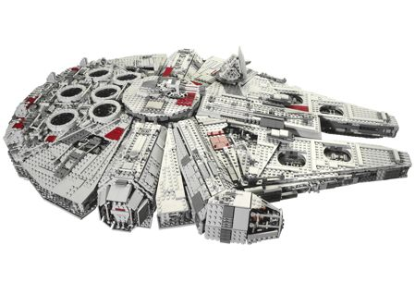
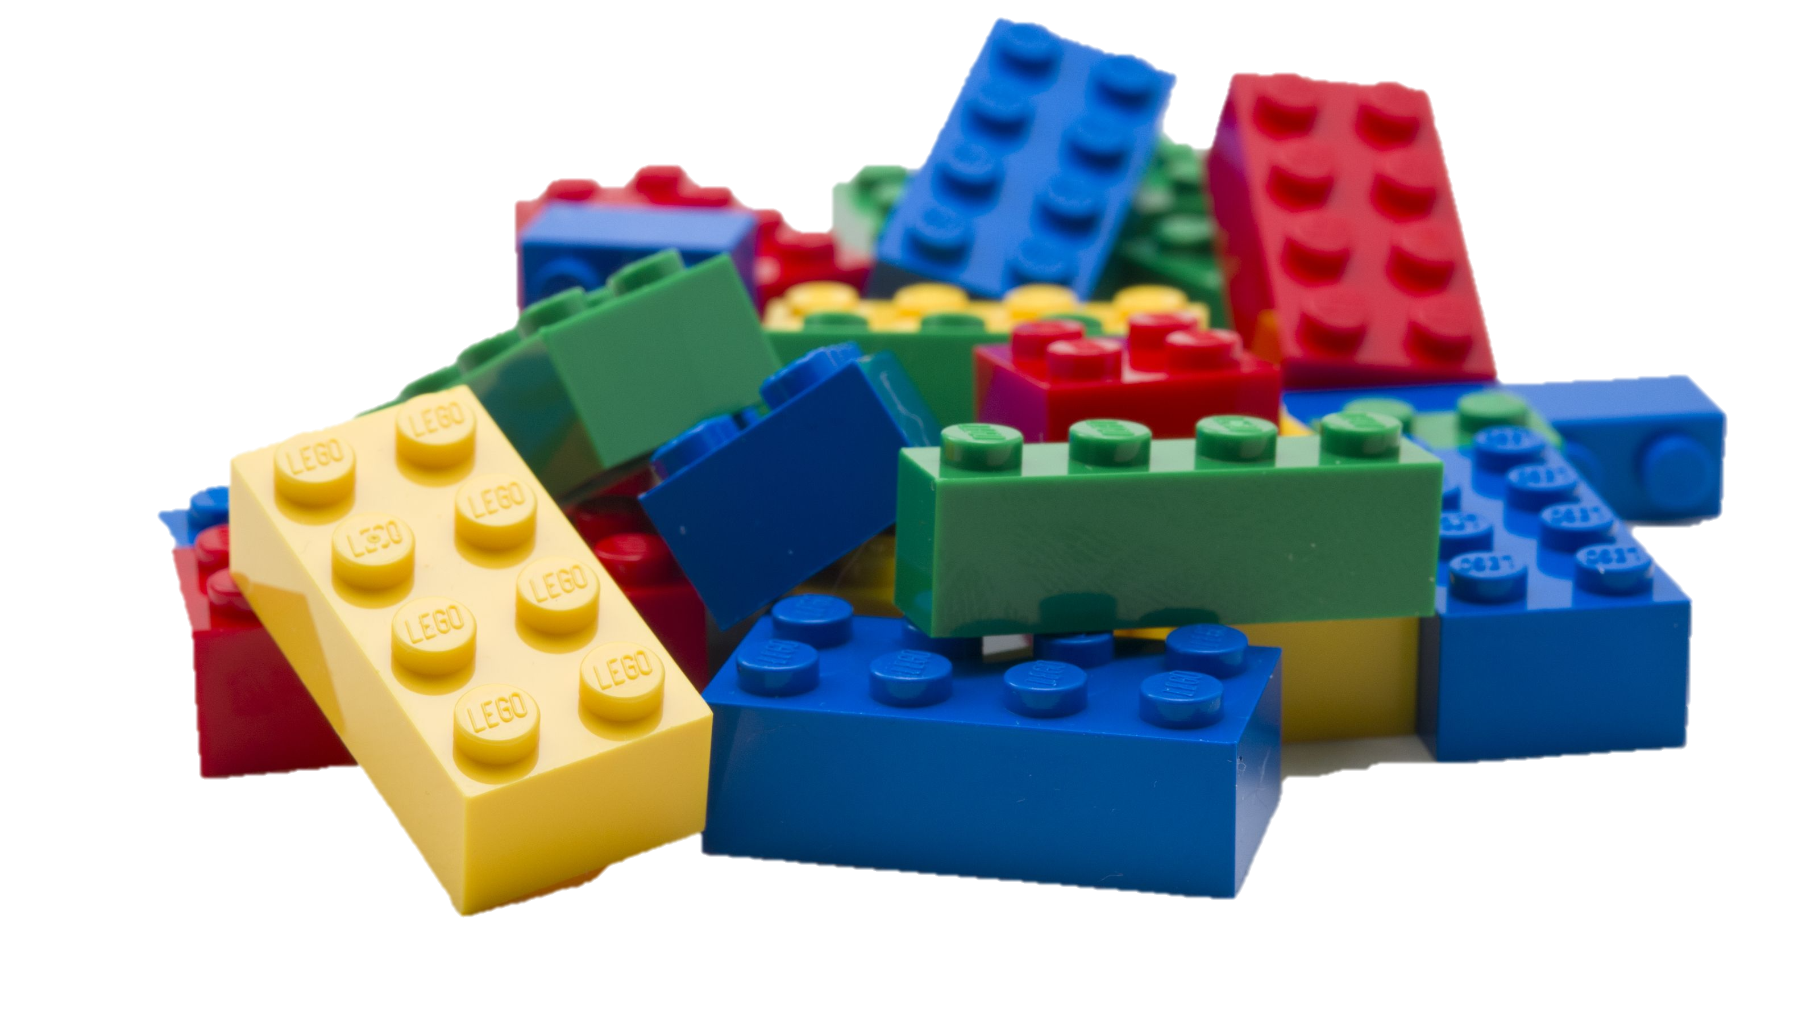
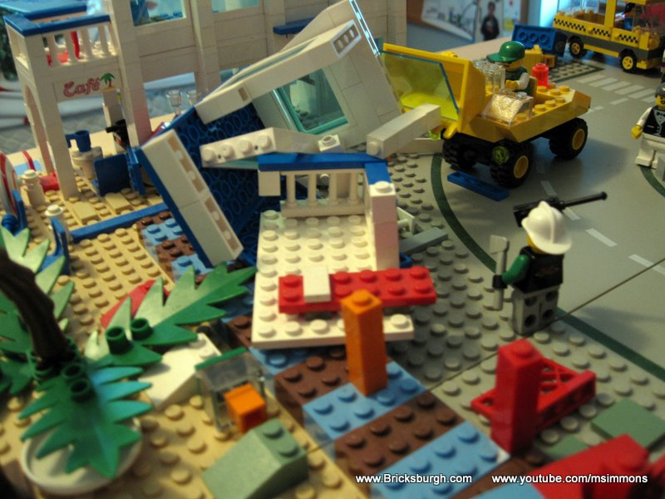
Controlling Complexity

Slide 9
Overview
Motivation
Introductions
Course Philosophy
Administrivia
331
Closing Announcements

Slide 10
Welcome!

Slide 11
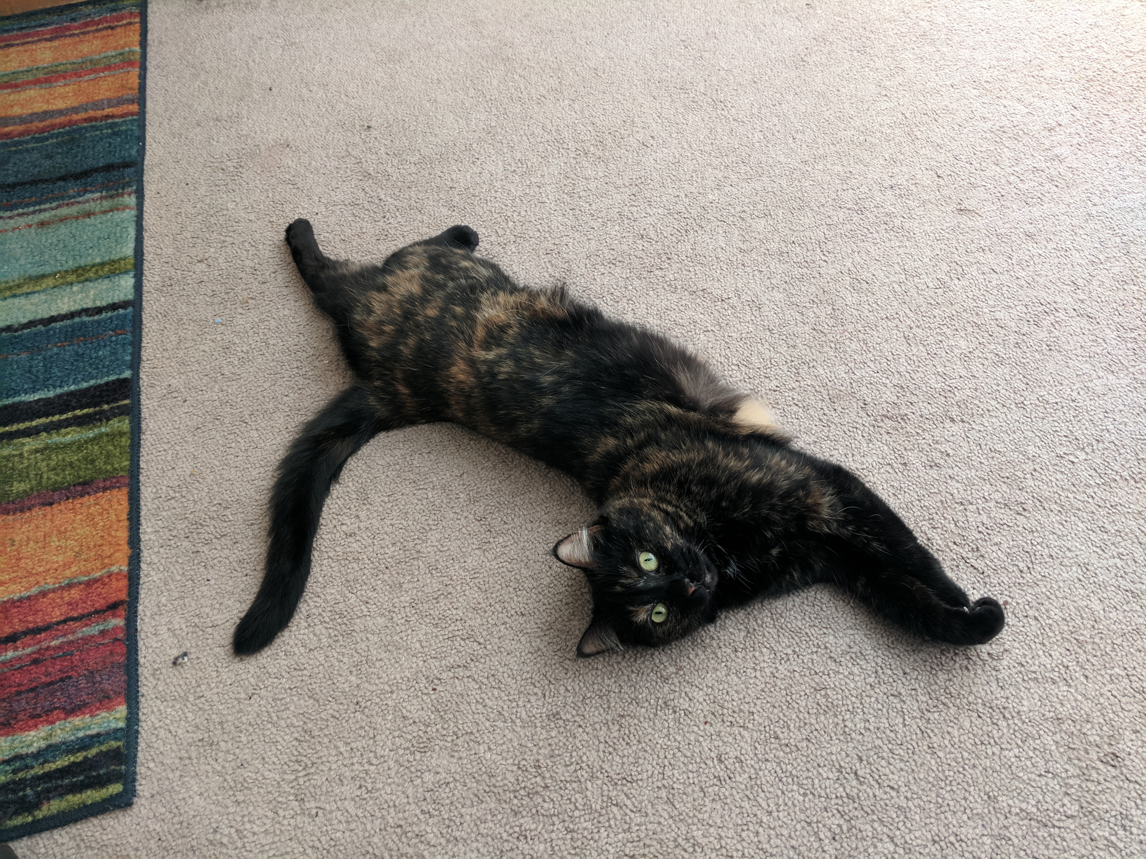
Instructor
Leah Perlmutter
Pronouns: she, her
3rd year PhD student
Worked in software industry before PhD
TA’d 331 last quarter
This is my first time teaching!
Notes:
I’m really excited to teach all of you!
I’m learning how to be an instructor, so please bear with me, and I really appreciate your support and your input.

Slide 12
TAs
Haiqiao Chen
JongHo Lee
Wei Liao
Frank Qin
Matt Xu
Joyce Zhou
Notes:
These amazing people are your TAs!
They’re going to put a lot of hard work into this course to help you learn!
These wonderful TAs have got your back all quarter.
Some of them are new TAs and still learning how to be TAs
TAs please stand up for a moment

Slide 13
Students
Welcome and thanks for being here!!!!!
9 different majors represented
27 Computer Science majors
8 Pre-science, Pre-engineering, or Pre-major
7 In other majors or non-matriculated
Learning names
Notes:
You are the most important people in this course. Without you, there would be no 331!
- Diversity: the person to either side of you might be very different from you and might have different insights into the same course material
Names
I will try to learn everyone’s name, but it will take me some time
I have a mild level of face blindness, so it’s possible I’ll know who you are without successfully matching name to face

Slide 14
Students
Legal Name
Your pronouns
Preferred name
Pronunciation of your preferred name (optional)
One thing you’re looking forward to in 331
A fun fact about yourself!
Leah Perlmutter
she, her
Leah
LAY-uh
Students’ “aha” moments.
I love mountain biking and climbing!
Notes:
Note card survey questions

Slide 15
Overview
Motivation
Introductions
Course Philosophy
Administrivia
331
Closing Announcements

Slide 16
Course
Philosophy

Slide 17
Active Learning
Learning is an active process, not only for the teacher, but also for the student!
Ways to put the ideas through your brain
Note taking
Asking questions
Example problems and worksheets in class
Discussing or re-explaining ideas to a peer
What are your strategies?
Can be existing strategies or something you’d like to try for the first time in this class!
Notes:
“It’s impossible to teach anything to anyone”
If you come to class and don’t ..... then you might not get much out of lecture
What are your strategies – think pair share in groups of 3

Slide 18
Collaboration
You are encouraged to discuss the material with peers!
You are required to report the names of your collaborators (or “none”) on every homework assignment
See Collaboration Policy on the course website
The spirit of this policy is to help you learn

Slide 19
Struggling
It’s normal for good students to struggle on CSE 331 homeworks!
Don’t give up
Do discuss with peers
Other students likely share your struggle
Do persist and keep thinking about the problem
Do seek help if you are struggling unproductively

Slide 20
Overview
Motivation
Introductions
Course Philosophy
Administrivia
331
Closing Announcements

Slide 21
Administrivia
Notes:
This is the part where I read off of the slides because I made the slides so you can refer to them later and get all the information.

Slide 22
Communication
Course website
Message board (Google Groups)
Venue for nearly all questions and answers
Staff email list: cse331-staff [at] cs.washington.edu
For special circumstances
Remember to always reply-all!
Student email list: cse331a_su18 [at] uw.edu
You will receive occasional important announcements on this list

Slide 23
Grade Breakdown
60% Homework (10 assignments)
First three are written assignments
Last seven are coding
15% Midterm
15% Final (not cumulative)
5% Reading quizzes
5% Participation

Slide 24
Homework (60%)
Written assignments (HW0, 1, 2) submitted electronically via Gradescope
Use your @uw.edu email address
More instructions on course website
Coding assignments (HW3, 4, 5, 6, 7, 8, 9) submitted electronically via Gitlab
More info on this later
Homework is weighted according to the number of points in the assignment
Notes:
Did you receive an invite email from Gradescope yesterday?
(Has anybody successfully accessed the course?)

Slide 25
Exams (15% + 15%)
Midterm and final equally weighted
Will be held during lecture time
Final will test the second half of the material
(No finals week in summer quarter)

Slide 26
Readings and Quizzes (5%)
The Pragmatic Programmer
Hunt and Thomas (1999)
Collection of best practices
Effective Java
Bloch, 2nd edition (2000)
Bloch, 3rd edition (2017)
OOP design, expert tips

Slide 27
Readings and Quizzes (5%)
Readings are related to lecture and homework!
Try to make connections as you read and as you attend lecture
There may be a 1-week offset between reading material and lecture material
Reading quizzes will be via Google Forms, and the quiz links will be posted on the course website

Slide 28
Participation (5%)
The following will positively affect your participation grade
Asking questions in class
Coming to instructor office hours
Reporting collaborators on homework
See Collaboration Policy on course website
Notes:
Can I tell that you care about your learning in this course?

Slide 29
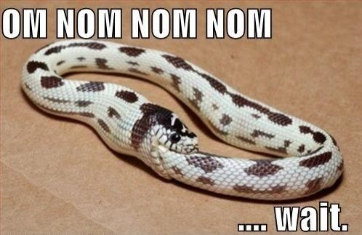
Attendance
Make the most of your tuition dollars
Do not self-cannibalize by skipping lecture or section to do this class’s homework

Slide 30
Academic Integrity
Carefully read the policy on the course website
Do not seek help in a way that destroys the intellectual challenge of the course!
Honest work is the foundation of UW / academia
Your fellow students and I trust you deeply
Zero tolerance for violations, can end career

Slide 31
Organization
331 is a big, complex machine.
As a first-time instructor, I’m a bit scared of 331 too, so I’ll need your help figuring out what works for all of us.
Patience and good faith much appreciated!

Slide 32
Feedback
I really value your feedback about this course!
You have the ability to shape me as an instructor!
Feedback mechanisms
Instructor office hours
Staff email list
Mid-course survey
Mid-course external evaluator session
End of quarter course evaluations

Slide 33
Overview
Motivation
Introductions
Course Philosophy
Administrivia
331
Closing Announcements

Slide 34
331
Notes:
This is what you came here to learn

Slide 35
Goals
One focus will be writing correct programs
What does it mean for a program to be correct?
It must match its specification
How can we determine if a program is correct?
Testing, Model Checking, Verification (proof)
What are ways to build correct programs?
Principled design and development
Abstraction, modularity, documentation

Slide 36
Controlling Complexity
Abstraction and specification
Procedural, data, and control flow abstractions
Why they are useful and how to use them
Writing, understanding, and reasoning about code
Use Java, but the principles apply broadly
Some focus on object-oriented programming
Program design and documentation
What makes a design good or bad (example: modularity)
Design processes and tools
Pragmatic considerations
Testing, debugging, and defensive programming
[more in CSE403: Managing software projects]

Slide 37
The Goal of System Building
To construct a correctly functioning artifact
All other considerations are secondary
Though many required to produce a correct system
Learning how to build correct systems is essential and very difficult, but also fun and rewarding.

Slide 38
Why is Good Software Hard?
Software is different from other artifacts
We build general, reusable mechanisms
Not much repetition, symmetry, or redundancy
Large systems have millions of complex parts
We understand walls in terms of bricks, bricks in terms of crystals, crystals in terms of molecules etc. As a result the number of levels that can be distinguished meaningfully in a hierarchical system is kind of proportional to the logarithm of the ratio between the largest and the smallest grain, and therefore, unless this ratio is very large, we cannot expect many levels. In computer programming our basic building block has an associated time grain of less than a microsecond, but our program may take hours of computation time. I do not know of any other technology covering a ratio of 10¹⁰ or more: the computer, by virtue of its fantastic speed, seems to be the first to provide us with an environment where highly hierarchical artefacts are both possible and necessary.
-- Dijkstra

Slide 39
Why is Good Software Hard?
Software is expected to be malleable
You can’t download a new chip into your phone
But you can update web pages, apps, and the OS
Aggressive competition for more features, platforms
Requirements, laws, and companies change
We are pioneers and explorers!
Often writing a new kind of system
Little relevant experience or specific theory
Software engineering is about:
Managing complexity, managing change
Coping with potential defects: users, devs, environment
Notes:
Building is cheap. Compare to bridge.

Slide 40
Programming is Hard
Despite decades of research, still surprisingly difficult to specify, design, implement, test, and maintain even small, simple programs.
Our assignments will be reasonable if you apply the techniques taught in class…
... but likely very difficult to do brute-force
... and almost certainly impossible unless
you start very early.
If you’re frustrated, think before you type!

Slide 41
Prerequisites
Knowing Java is essential
We assume you’ve mastered 142, 143
Examples:
Sharing:
Distinction between == and equals()
Aliasing: multiple references to the same object
Object-oriented dispatch:
Inheritance and overriding
Objects/values have a run-time type
Subtyping
Expressions have a compile-time type
Subtyping via extends (classes) and implements (interfaces)

Slide 42
You have homework!
Homework 0, due online by 10 PM Wednesday
Rearrange array elements by sign
O(n) time, preferably in a single pass
Only write (don’t run!) your algorithm
Clearly and concisely prove your solution correct!
Full assignment posted on course website...
Purpose:
Great practice and warm-up
Surprisingly difficult
Working up to reasoning about large designs

Slide 43
CSE 331 is a Challenge
We are going to learn a lot and have a good time
Be prepared to work hard and think hard
It’s normal to struggle on the homework!
The staff is here to help you learn
We will be working hard too!
So, let’s get to it!
Before we create masterpieces, we first need to hone our ability to reason about code…

Slide 44
A Problem
“Complete this method so that it returns the index of the max of the first n elements of the array arr.”
int index_of_max(int[] arr, int n) {
…
}
Notes:
Think pair share.
Introduce think-pair-share and describe the steps.
Think about the implementation, and write it down (before slide transition that reveals the last two questions) (1 min or until students start asking questions about the spec)
Now get ready to pair up and discuss the problem. Please discuss these questions, and think of things you might want to share with the class when I ask for volunteers in a couple of minutes. When I say go, introduce yourself to a neighbor and start talking... Go!
Share. I hope you’re having great conversations about specifications! Please raise your hand if you’d like to share your ideas on this question.

Slide 45
A Problem
“Complete this method so that it returns the index of the max of the first n elements of the array arr.”
int index_of_max(int[] arr, int n) {
…
}
What should we ask about the specification?
Given (better) specification, how many possible implementations are there?
Notes:
Think pair share.
Introduce think-pair-share and describe the steps.
Think about the implementation, and write it down (before slide transition that reveals the last two questions) (1 min or until students start asking questions about the spec)
Now get ready to pair up and discuss the problem. Please discuss these questions, and think of things you might want to share with the class when I ask for volunteers in a couple of minutes. When I say go, introduce yourself to a neighbor and start talking... Go!
Share. I hope you’re having great conversations about specifications! Please raise your hand if you’d like to share your ideas on this question.

Slide 46
Moral
You can all write this code
More interesting for us in 331:
What if n is 0?
What if n is less than 0?
What if n is greater than the array length?
What if there are “ties”?
How should we indicate error:
exception, return value, fail-stop, …
Weaker vs. stronger specs?
Challenge writing English specs (n vs. n-1)

Slide 47
Something to Chew On
What is the relationship of “goodness” to “correctness” for programs?

Slide 48
Announcements

Slide 49
To Do
Check out the course website
Read syllabus, academic integrity policy, collaboration policy, and gradescope instructions
Log into the course message board
HW0 is due Wednesday
Posted on course website
Log into Gradescope today to make sure it works
Reading quiz 1 (37 pages) is due Thursday
Get your textbooks now!

