Slide 1
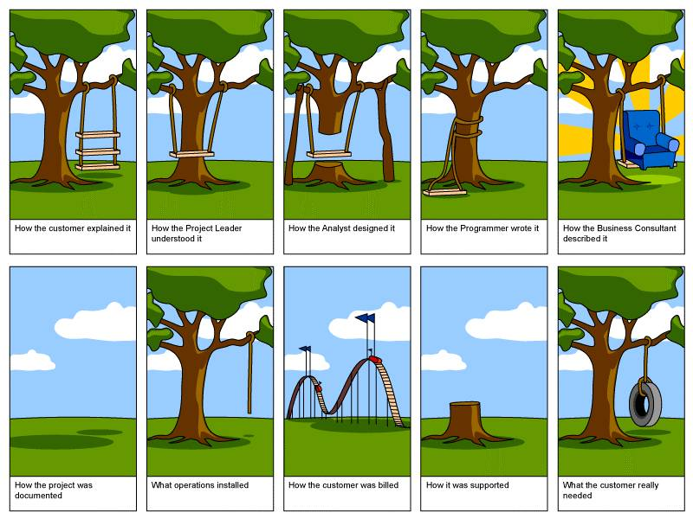

Slide 2
Section 9:
Design Patterns
Slides by Alex Mariakakis
with material from David Mailhot,
Hal Perkins, Mike Ernst

Slide 3
What Is A Design Pattern
A standard solution to a common programming problem
A technique for making code more flexible
Shorthand for describing program design and how program components are connected

Slide 4
Creational Patterns
Problem: Constructors in Java are not flexible
  Always return a fresh new object, never reuse one
  Can’t return a subtype of the class they belong to
Solution: Creational patterns!
  Sharing
    Singleton
    Interning
    Flyweight
  Factories
    Factory method
    Factory object
  Builder

Slide 5
Creational Patterns: Sharing
The old way: Java constructors always create a new object
Singleton: only one object exists at runtime
Interning: only one object with a particular (abstract) value exists at runtime
Flyweight: separate intrinsic and extrinsic state, represents them separately, and interns the intrinsic state

Slide 6
Singleton
For a class where only one object of that class can ever exist
“Ensure a class has only one instance, and provide a global point of access to it.” -- GoF, Design Patterns
Two possible implementations
  Eager initialization: creates the instance when the class is loaded to guarantee availability
  Lazy initialization: only creates the instance once it’s needed to avoid unnecessary creation

Slide 7
Singleton
Eager initialization
  public class Bank {
  private static Bank INSTANCE = new Bank();
  // private constructor
  private Bank() { … }
  // factory method
  public static Bank getInstance() {
  return INSTANCE;
  }
  }
  Bank b = new Bank();
  Bank b = Bank.getInstance();

Slide 8
Singleton
Lazy initialization
  public class Bank {
  private static Bank INSTANCE;
  // private constructor
  private Bank() { … }
  // factory method
  public static Bank getInstance() {
  if (INSTANCE == null) {
  INSTANCE = new Bank();
  }
  return INSTANCE;
  }
  }
  Bank b = new Bank();
  Bank b = Bank.getInstance();

Slide 9
Singleton
Would you prefer eager or lazy instantiation for an HTTPRequest class?
  handles authentication
  definitely needed for any HTTP transaction
Would you prefer eager or lazy instantiation for a Comparator class?
  compares objects
  may or may not be used at runtime

Slide 10
Singleton
public class HttpRequest {
private static class HttpRequestHolder {
public static final HttpRequest INSTANCE = new HttpRequest();
}
/* Singleton – Don’t instantiate */
private HttpRequest() { … }
public static HttpRequest getInstance() {
return HttpRequestHolder.INSTANCE;
}
}

Slide 11
Singleton
public class LengthComparator implements Comparator<String> {
private int compare(String s1, String s2) {
return s1.length()-s2.length();
}
/* Singleton – Don’t instantiate */
private LengthComparator() { … }
private static LengthComparator comp = null;
public static LengthComparator getInstance() {
if (comp == null) {
comp = new LengthComparator();
}
return comp;
}
}

Slide 12
Interning
Similar to Singleton, except instead of just having one object per class, there’s one object per abstract value of the class
Saves memory by compacting multiple copies

Slide 13
Interning
public class Point {
private int x, y;
public Point(int x, int y) {
this.x = x;
this.y = y;
}
public int getX() { return x; }
public int getY() { return y; }
@Override
public String toString() {
return “(” + x + “,” + y + “)”;
}
}

Slide 14
Interning
public class Point {
private static Map<String, Point> instances =
new WeakHashMap<String, Point>();
public static Point getInstance(int x, int y) {
String key = x + “,”, + y;
if (!instances.containsKey(key))
instances.put(key, new Point(x,y));
return instances.get(key);
}
private final int x, y; // immutable
private Point(int x, int y) {…}
}
Requires the class being interned to be immutable. Why?
Notes:
WeakHashMap – only intern the most commonly used items

Slide 15
Interning
What if Points were represented in polar coordinates?
What further checks are necessary to make sure these kinds of Points are interned correctly?
Notes:
WeakHashMap – only intern the most commonly used items

Slide 16
Interning
public class Point {
private static Map<String, Point> instances =
new WeakHashMap<String, Point>();
public static Point getInstance(double r, double theta) {
double normalizedTheta = normalize(theta);
String key = r + “,” + normalizedTheta;
if (!instances.containsKey(key))
instances.put(key,
new Point(r, normalizedTheta));
return instances.get(key);
}
private final double r, theta; // immutable
private Point(double r, double theta) {...}
}
Why do we need to normalize?
Notes:
If points are represented with r and theta, must constrain them for use in the key. Otherwise, we’d have “5, pi” and “5, 3pi” as different entries in our map even though they are the same abstract value.

Slide 17
Factories
Suppose we want a constructor for Set that takes a list as a parameter, and produces a TreeSet if the list is sorted, and a HashSet otherwise.
Is this possible?

Slide 18
Factories
Factories solve the problem that Java constructors cannot return a subtype of the class they belong to
Two options:
  Factory method
    Helper method creates and returns objects
    Method defines the interface for creating an object, but defers instantiation to subclasses
  Factory object
    Abstract superclass defines what can be customized
    Concrete subclass does the customization, returns appropriate subclass

Slide 19
Factory Method
public static Set produceSet(List list) {
if (isSorted(list)) {
return new TreeSet(list);
} else {
return new HashSet(list);
}
}

Slide 20
Factory Object
interface SetFactory {
Set getSet();
}
class HashSetFactory implements SetFactory {
public Set getSet() {
return new HashSet();
}
}

Slide 21
Builder
The class has an inner class Builder and is created using the Builder instead of the constructor
The Builder takes optional parameters via setter methods (e.g., setX(), setY(), etc.)
When the client is done supplying parameters, she calls build() on the Builder, finalizing the builder and returning an instance of the object desired
Useful when you have many constructor parameters
  It is hard to remember which order they should all go in
Easily allows for optional parameters
  If you have n optional parameters, you need 2^n constructors, but only one builder

Slide 22
Builder
public class NutritionFacts {
// required
private final int servingSize, servings;
// optional
private final int calories, fat, sodium;
public NutritionFacts(int servingSize, int servings) {
this(servingSize, servings, 0);
  }
  public NutritionFacts(int servingSize, int servings, int calories) {
  this(servingSize, servings, calories, 0);
  }
  public NutritionFacts(int servingSize, int servings, int calories, int fat) {
  this(servingSize, servings, calories, fat, 0);
  }
  …
public NutritionFacts(int servingSize, int servings, int calories, int fat, int sodium) {
this.servingSize = servingSize;
this.servings = servings;
this.calories = calories;
this.fat = fat;
this.sodium = sodium;
}
}

Slide 23
Builder
public class NutritionFacts {
private final int servingSize, servings, calories, fat, sodium;
public static class Builder {
// required
private int servingSize, servings;
// optional, initialized to default values
private int calories = 0;
private int fat = 0;
private int sodium = 0;
public Builder(int servingSize, int servings) {
this.servingSize = servingSize;
this.servings = servings;
}
public Builder calories(int val) { calories = val; return this; }
public Builder fat(int val) { fat = val; return this; }
public Builder sodium(int val) { sodium = val; return this; }
public NutritionFacts build() { return new NutritionFacts(this); }
  }
  public NutritionFacts(Builder builder) {
this.servingSize = builder.servingSize;
this.servings = builder.servings;
this.calories = builder.calories;
this.fat = builder.fat;
this.sodium = builder.sodium;
}
}
Notes:
Static not final

Slide 24
Structural Patterns
Problem: Sometimes difficult to realize relationships between entities
  Important for code readability
Solution: Structural patterns!
  We’re just going to talk about wrappers, which translate between incompatible interfaces
Pattern | Functionality | Interface | Purpose
Adapter | same | different | modify the interface
Decorator | different | same | extend behavior
Proxy | same | same | restrict access

Slide 25
Adapter
Changes an interface without changing functionality
  Rename a method
  Convert units
Examples:
  Angles passed in using radians vs. degrees
  Bytes vs. strings

Slide 26
Decorator
Adds functionality without changing the interface
  Add caching
Adds to existing methods to do something additional while still preserving the previous spec
  Add logging
Decorators can remove functionality without changing the interface
  UnmodifiableList with add() and put()

Slide 27
Proxy
Wraps the class while maintaining the same interface and functionality
Integer vs. int, Boolean vs. boolean
Controls access to other objects
  Communication: manage network details when using a remote object
  Security: permit access only if proper credentials
  Creation: object might not yet exist because creation is expensive

Slide 28
Activity
Adapter, Builder, Decorator, Factory, Flyweight, Intern, Model-View-Controller (MVC), Proxy, Singleton, Visitor, Wrapper
What pattern would you use to…
  add a scroll bar to an existing window object in Swing
  We have an existing object that controls a communications channel. We would like to provide the same interface to clients but transmit and receive encrypted data over the existing channel.

Slide 29
Activity
Adapter, Builder, Decorator, Factory, Flyweight, Intern, Model-View-Controller (MVC), Proxy, Singleton, Visitor, Wrapper
What pattern would you use to…
  add a scroll bar to an existing window object in Swing
    Decorator
  We have an existing object that controls a communications channel. We would like to provide the same interface to clients but transmit and receive encrypted data over the existing channel.
    Proxy

