Slide 1
Section 5: HW6 and Interfaces
SLIDES ADAPTED FROM ALEX MARIAKAKIS,
WITH MATERIAL FROM KRYSTA YOUSOUFIAN, MIKE ERNST, KELLEN DONOHUE

Slide 2
How is Homework 5 going?

Slide 3
Agenda
Reminders
HW 5 due tomorrow night (4/27)
Midterm on Monday (4/30)
Breadth-first search (BFS)
Interfaces
Parsing Marvel Data

Slide 4
Reminders:
Expensive CheckReps are BAD
(at least when assignments are turned in, but can be useful for finding hard-to-discover problems – so need to be able to control expensive checks)
Debug flags are GOOD
(or enums to indicate depth of debug)

Slide 5
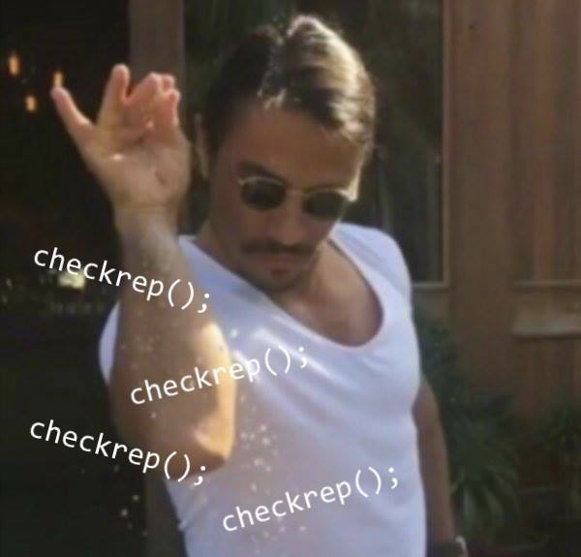
Don’t forget your CheckReps!

Slide 6
Graphs
A
B
Can I reach B from A?
C
D
E

Slide 7
Breadth-First Search (BFS)
Often used for discovering connectivity
Calculates the shortest path if and only if all edges have same positive or no weight
Depth-first search (DFS) is commonly mentioned with BFS
BFS looks “wide”, DFS looks “deep”
DFS can also be used for discovery, but not the shortest path

Slide 8
BFS Pseudocode
put start node in a queue
while (queue is not empty):
pop node N off queue
mark node N as visited
if (N is goal):
return true
else:
for each node O that is child of N: if O is not marked visit
push O onto queue
return false

Slide 9
Breadth-First Search
START: Starting at A
Q: <A> Goal: Fully explore
Pop: A, Q: <>
Q: <B, C>
Pop: B, Q: <C>
Q: <C>
Pop: C, Q: <C>
Q: <>
DONE
A
B
C

Slide 10
Breadth-First Search with Cycle
START: Starting at A
Q: <A> Goal: Fully Explore
Pop: A, Q: <>
Q: <B>
Pop: B, Q: <>
Q: <C>
Pop: C, Q: <>
Q: <A>
NEVER DONE
A
B
C

Slide 11
BFS Pseudocode
Mark the node as visited!
put start node in a queue
while (queue is not empty):
pop node N off queue
mark node N as visited
if (N is goal):
return true
else:
for each node O that is child of N:
if O is not marked visited:
push O onto queue
return false

Slide 12
Breadth-First Search
Problem: Find everything reachable from A
Q: <>
B
A
C
D
E

Slide 13
Breadth-First Search
Q: <>
Q: <A>
B
A
C
D
E

Slide 14
Breadth-First Search
Q: <>
Q: <A>
Q: <>
B
A
C
D
E

Slide 15
Breadth-First Search
Q: <>
Q: <A>
Q: <>
Q: <C>
B
A
C
D
E

Slide 16
Breadth-First Search
Q: <>
Q: <A>
Q: <>
Q: <C>
Q: <C ,D>
B
A
C
D
E

Slide 17
Breadth-First Search
Q: <>
Q: <A>
Q: <>
Q: <C>
Q: <C ,D>
Q: <D>
B
A
C
D
E

Slide 18
Breadth-First Search
Q: <>
Q: <A>
Q: <>
Q: <C>
Q: <C ,D>
Q: <D>
Q: <D, E>
B
A
C
D
E

Slide 19
Breadth-First Search
Q: <>
Q: <A>
Q: <>
Q: <C>
Q: <C ,D>
Q: <D>
Q: <D, E>
Q: <E>
B
A
C
D
E

Slide 20
Breadth-First Search
Q: <>
Q: <A>
Q: <>
Q: <C>
Q: <C ,D>
Q: <D>
Q: <D, E>
Q: <E>
DONE
B
A
C
D
E

Slide 21
Shortest Paths with BFS
1
B
From Node B
A
Destination | Path | Cost
A | <B,A> | 1
B | <B> | 0
C | <B,A,C> | 2
D
E
1
1
1
C
1
D
1
1
Shortest path to D? to E?
What are the costs?
E

Slide 22
Shortest Paths with BFS
1
B
From Node B
A
Destination | Path | Cost
A | <B,A> | 1
B | <B> | 0
C | <B,A,C> | 2
D | <B,D> | 1
E | <B,D,E> | 2
1
1
1
C
1
D
1
1
Shortest path to D? to E?
What are the costs?
E

Slide 23
Shortest Paths with Weights
2
B
From Node B
A
Destination | Path | Cost
A | <B,A> | 2
B | <B> | 0
C | <B,A,C> | 5
D
E
100
3
100
C
2
D
2
6
E
Weights are not the same!
Are the paths?

Slide 24
Shortest Paths with Weights
2
B
From Node B
A
Destination | Path | Cost
A | <B,A> | 2
B | <B> | 0
C | <B,A,C> | 5
D | <B,A,C,D> | 7
E | <B,A,C,E> | 7
100
3
100
C
2
D
2
6
E

Slide 25
Interfaces

Slide 26
Classes, Interfaces, and Types
The fundamental unit of programming in Java is a class
Classes can extend other classes and implement interfaces
Interfaces can extend other interfaces

Slide 27
Classes, Objects, and Java
Everything is an instance of a class
Defines data and methods
Every class extends exactly one other class
Object if no explicit superclass
Inherits superclass fields
Every class also defines a type
Foo defines type Foo
Foo inherits all inherited types

Slide 28
Interfaces
Pure type declaration
public interface Comparable {
int compareTo(Object other);
}
Can contain:
Method specifications (implicitly public abstract)
Named constants (implicitly public final static)
Does not contain implementation!
Cannot create instances of interfaces
Notes:
(Interfaces are a skeleton)

Slide 29
Implementing Interfaces
A class can implement one or more interfaces
class Kitten implements Pettable, Huggable
The implementing class and its instances have the interface type(s) as well as the class type(s)
The class must provide or inherit an implementation of all methods defined by the interface(s)
Not true for abstract classes

Slide 30
Using Interface Types
An interface defines a type, so we can declare variables and parameters of that type
A variable with an interface type can refer to an object of any class implementing that type
List<String> x = new ArrayList<String>();
void sort(List aList) {…}

Slide 31
Guidelines for Interfaces
Provide interfaces for significant types and abstractions
Write code using interface types like Map instead of HashMap and TreeMap wherever possible
Allows code to work with different implementations later on
Both interfaces and classes are appropriate in various circumstances

Slide 32
Parsing Marvel Data
Data is in marvel.tsv
Will be pushed with hw6
Each line is in the form:
"character" "book”
Ex: "CAPTAIN AMERICA" "N 57”
Parsing is already implemented for you!
MarvelParser.parseData()
Returns Map of Character -> List of Books they’re in

