Slide 1
Warmup
What do PCs and Air-Conditioning units have in common?

Slide 2
Warmup
What do PCs and Air-Conditioning units have in common?
They both stop working when you open Windows™️

Slide 3
Section 3: HW4, ADTs, and more
with material from Vinod Rathnam, Alex Mariakakis, Krysta Yousoufian, Mike Ernst, Kellen Donohue

Slide 4
Agenda
Announcements
HW3: due Friday (tomorrow!) at 11pm
Don’t forget to commit/push your changes
Polynomial arithmetic
Abstract data types (ADT)
Representation invariants (RI)
Abstraction Functions

Slide 5
HW4: Polynomial Graphing Calculator
Problem 0: Write pseudocode algorithms for polynomial operations
Problem 1: Answer questions about RatNum
Problem 2: Implement RatTerm
Problem 3: Implement RatPoly
Problem 4: Implement RatPolyStack
Problem 5: Try out the calculator

Slide 6
RatThings
RatNum
ADT for a Rational Number
Has NaN
RatTerm
Single polynomial term
Coefficient (RatNum) & degree
RatPoly
Sum of RatTerms
RatPolyStack
Ordered collection of RatPolys

Slide 7
Polynomial Addition
(5x⁴ + 4x³ - x² + 5)
+
(3x⁵ - 2x³ + x – 5)

Slide 8
Polynomial Addition
(5x⁴ + 4x³ - x² + 5)
+
(3x⁵ - 2x³ + x – 5)
5x⁴ + 4x³ - x² 0x + 5
+
3x⁵ 0x⁴ - 2x³ 0x² + x – 5

Slide 9
Polynomial Addition
(5x⁴ + 4x³ - x² + 5)
+
(3x⁵ - 2x³ + x – 5)
5x⁴ + 4x³ - x² 0x + 5
+
3x⁵ 0x⁴ - 2x³ 0x² + x – 5

Slide 10
Polynomial Addition
(5x⁴ + 4x³ - x² + 5)
+
(3x⁵ - 2x³ + x – 5)
5x⁴ + 4x³ - x² 0x + 5
3x⁵ 0x⁴ - 2x³ 0x² + x – 5
+
3x⁵ + 5x⁴ + 2x³ - x² + x + 0

Slide 11
Polynomial Subtraction
(5x⁴ + 4x³ - x² + 5)
-
(3x⁵ - 2x³ + x – 5)
5x⁴ + 4x³ - x² 0x + 5
-
3x⁵ 0x⁴ - 2x³ 0x² + x – 5

Slide 12
Polynomial Subtraction
(5x⁴ + 4x³ - x² + 5)
-
(3x⁵ - 2x³ + x – 5)
5x⁴ + 4x³ - x² 0x + 5
-
3x⁵ 0x⁴ - 2x³ 0x² + x – 5

Slide 13
Polynomial Subtraction
(5x⁴ + 4x³ - x² + 5)
-
(3x⁵ - 2x³ + x – 5)
5x⁴ + 4x³ - x² 0x + 5
-
3x⁵ 0x⁴ - 2x³ 0x² + x – 5
-3x⁵ + 5x⁴ + 6x³ - x² - x + 10

Slide 14
Polynomial Multiplication
(4x³ - x² + 5)
*
(x – 5)

Slide 15
Polynomial Multiplication
(4x³ - x² + 5)
*
(x – 5)
4x³ - x² + 5
*
x – 5

Slide 16
Polynomial Multiplication
(4x³ - x² + 5)
*
(x – 5)
4x³ - x² + 5
*
x – 5
-20x³ + 5x² – 25

Slide 17
Polynomial Multiplication
(4x³ - x² + 5)
*
(x – 5)
4x³ - x² + 5
*
x – 5
-20x³ + 5x² – 25
4x⁴ -x³ + 5x

Slide 18
Polynomial Multiplication
(4x³ - x² + 5)
*
(x – 5)
4x³ - x² + 5
*
x – 5
-20x³ + 5x² – 25
4x⁴ -x³ + 5x
+
4x⁴ -21x³ + 5x² + 5x - 25

Slide 19
Poly Division
(5x⁶ + 4x⁴ – x³ + 5)
/
(x³ - 2x – 5)

Slide 20
Poly Division
(5x⁶ + 4x⁴ – x³ + 5)
/
(x³ - 2x – 5)
x³ - 2x – 5
5x⁶ + 4x⁴ – x³ + 5

Slide 21
Poly Division
1 0 -2 -5
5 0 4 -1 0 0 5

Slide 22
Poly Division
5
1 0 -2 -5
5 0 4 -1 0 0 5

Slide 23
Poly Division
5
1 0 -2 -5
5 0 4 -1 0 0 5
5 0-10 -25

Slide 24
Poly Division
5
1 0 -2 -5
5 0 4 -1 0 0 5
5 0-10 -25
0 0 14 24

Slide 25
Poly Division
5
1 0 -2 -5
5 0 4 -1 0 0 5
5 0-10 -25
0 0 14 24
14 24 0

Slide 26
Poly Division
5 0
1 0 -2 -5
5 0 4 -1 0 0 5
5 0-10 -25
0 0 14 24
14 24 0

Slide 27
Poly Division
5 0
1 0 -2 -5
5 0 4 -1 0 0 5
5 0-10 -25
0 0 14 24
14 24 0
14 24 0 0

Slide 28
Poly Division
5 0 14
1 0 -2 -5
5 0 4 -1 0 0 5
5 0-10 -25
0 0 14 24
14 24 0
14 24 0 0

Slide 29
Poly Division
5 0 14
1 0 -2 -5
5 0 4 -1 0 0 5
5 0-10 -25
0 0 14 24
14 24 0
14 24 0 0
14 0 -28 -70

Slide 30
Poly Division
5 0 14
1 0 -2 -5
5 0 4 -1 0 0 5
5 0-10 -25
0 0 14 24
14 24 0
14 24 0 0
14 0 -28 -70
0 24 28 70

Slide 31
Poly Division
5 0 14
1 0 -2 -5
5 0 4 -1 0 0 5
5 0-10 -25
0 0 14 24
14 24 0
14 24 0 0
14 0 -28 -70
0 24 28 70
24 28 70 5

Slide 32
Poly Division
5 0 14 24
1 0 -2 -5
5 0 4 -1 0 0 5
5 0-10 -25
0 0 14 24
14 24 0
14 24 0 0
14 0 -28 -70
0 24 28 70
24 28 70 5
24 0 -48 -120

Slide 33
Poly Division
5 0 14 24
1 0 -2 -5
5 0 4 -1 0 0 5
5 0-10 -25
0 0 14 24
14 24 0
14 24 0 0
14 0 -28 -70
0 24 28 70
24 28 70 5
24 0 -48 -120
0 28 118 125

Slide 34
Poly Division
(5x⁶ + 4x⁴ – x³ + 5)
/
(x³ - 2x – 5)
5x³ + 14x + 24

Slide 35
Poly Division
(5x⁶ + 4x⁴ – x³ + 5)
/
(x³ - 2x – 5)
28x² + 118x + 125
5x³ + 14x + 24
+
x³ - 2x – 5

Slide 36
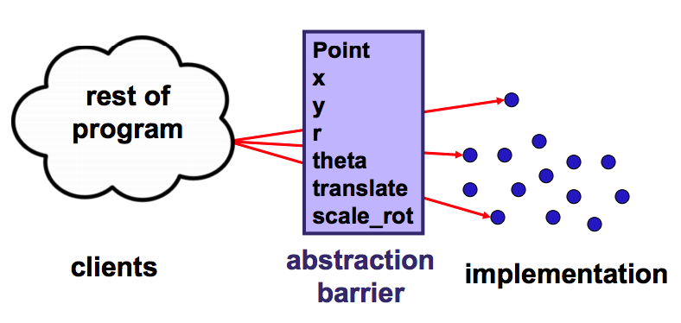
Abstract Data Types
A set of operations:
Abstracts from the organization of data to the meaning of that data
Abstracts from structure to use
Abstraction Barrier
Representation/Implementation doesn’t matter to clients
Hiding the details allows us to change them
The “concept” of 2-D point is the same for either implementation!
Notes:
Warmup question: Difference between an ADT and a Data Structure?
(Answer: data structures are concrete manifestations of ADT. Think of the ADT as just a description, a blueprint, consisting of operations that a client can use. Or: ADT = interface, Data structure = class)

Slide 38
ADT Example: Circle
Circle on the Cartesian coordinate plane
.

Slide 39
Circle: Class Specification
What represents the abstract state of a Circle?
How can we describe a circle? What are some properties of a circle we can determine?
How can we implement this?
What are some ways to “break” a circle?
Notes:
What represents the abstract state of a Circle?
Center
Radius
What are some properties of a circle we can determine?
Circumference
Area
How can we implement this?
#1: Center, radius
#2: Center, edge (center, one point on outside)
#3: Corners of diameter (two points on two sides of diameter)
How can we implement this?
#1: Center, radius
#2: Center, edge
#3: Corners of diameter
“Break a circle”: things may violate the definition of circle (negative radius, etc)

Slide 40
Representation Invariants
Indicates if an instance is well-formed or valid
Defines the set of valid concrete values
Maps concrete representation of object ➔ boolean B
If representation invariant is false/violated, the object is “broken” – doesn’t map to any abstract value
For implementors/debuggers/maintainers of the abstraction: No object should ever violate the rep invariant

Slide 41
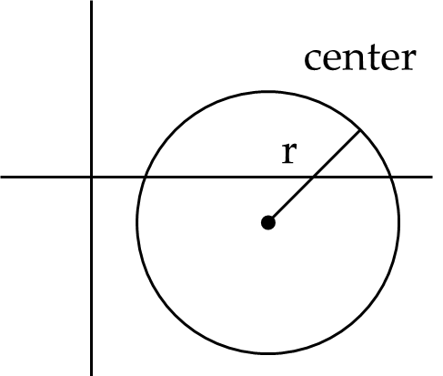
Circle Implementation 1
public class Circle1 {
private Point center;
private double rad;
// Rep invariant:
//
// ...
}

Slide 42
Circle Implementation 1
public class Circle1 {
private Point center;
private double rad;
// Rep invariant:
// center != null && rad > 0
// ...
}

Slide 43
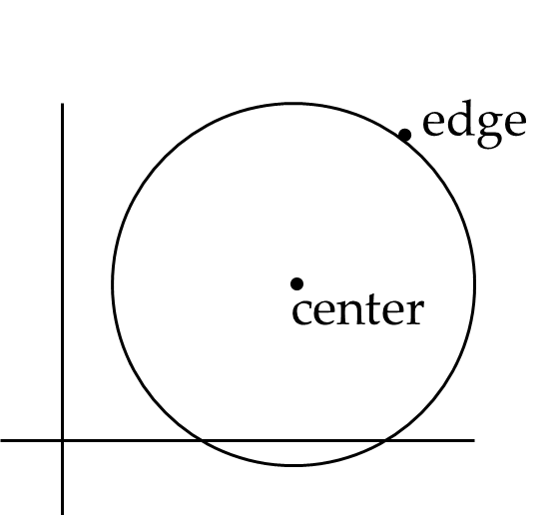
Circle Implementation 2
public class Circle2 {
private Point center;
private Point edge;
// Rep invariant:
//
// ...
}

Slide 44
Circle Implementation 2
public class Circle2 {
private Point center;
private Point edge;
// Rep invariant:
// center != null &&
// edge != null &&
// !center.equals(edge)
// ...
}

Slide 45
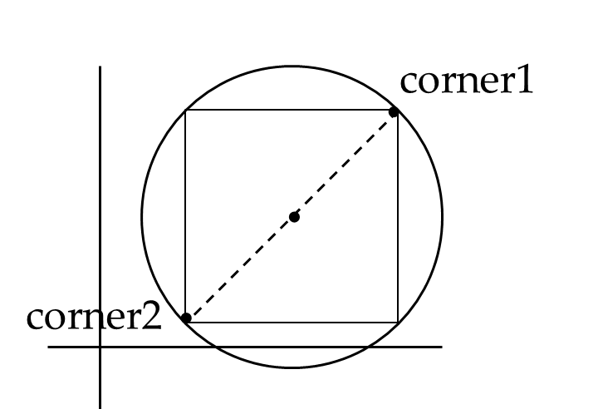
Circle Implementation 3
public class Circle3 {
private Point corner1, corner2;
// Rep invariant:
//
// ...
}

Slide 46
Circle Implementation 3
public class Circle3 {
private Point corner1, corner2;
// Rep invariant:
// corner1 != null &&
// corner2 != null &&
// !corner1.equals(corner2)
// ...
}

Slide 47
Checking Rep Invariants
Representation invariant should hold before and after every public method
Write and use checkRep()
Call before and after public methods
Make use of Java’s assert syntax!
OK that it adds extra code
Asserts won’t be included on release builds
Important for finding bugs
If some checks are expensive, you can use a global boolean variable to conditionally perform them

Slide 48
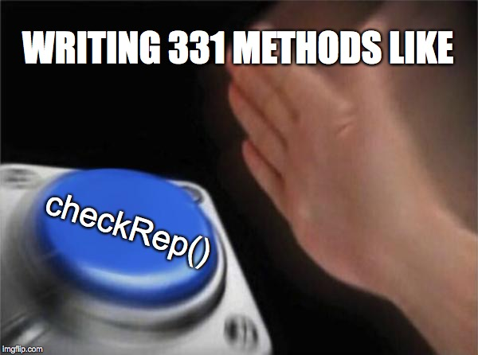
Takeaway for Rep Invariants

Slide 49
checkRep() Example with Asserts
public class Circle1 {
private Point center;
private double rad;
private void checkRep() {
assert center != null : “This does not have a center”;
assert radius > 0 : “This circle has a negative radius”;
}
}

Slide 50
Using Asserts
To enable asserts: Go to Run->Run Configurations…->Arguments. Then put –ea in VM arguments section
Do this for every main class

Slide 51
Abstraction Function
Abstraction function: a mapping from internal state to abstract value
Abstract fields may not map directly to representation fields
Circle has radius but not necessarily
private int radius;
Internal representation can be anything as long as it somehow encodes the abstract value
Representation Invariant excludes values for which the abstraction function has no meaning
Notes:
“Coming up in lecture”

Slide 52
Circle Implementation 1
public class Circle1 {
private Point center;
private double rad;
// Abstraction function:
// AF(this) = a circle c such that
// c.center =
// c.radius =
// Rep invariant:
// center != null && rad > 0
// ...
}

Slide 53
Circle Implementation 1
public class Circle1 {
private Point center;
private double rad;
// Abstraction function:
// AF(this) = a circle c such that
// c.center = this.center
// c.radius = this.rad
// Rep invariant:
// center != null && rad > 0
// ...
}

Slide 54
Circle Implementation 2
public class Circle2 {
private Point center;
private Point edge;
// Abstraction function:
// AF(this) = a circle c such that
// c.center =
// c.radius =
// Rep invariant:
// center != null && edge ! null &&
!center.equals(edge)
// ...
}

Slide 55
Circle Implementation 2
public class Circle2 {
private Point center;
private Point edge;
// Abstraction function:
// AF(this) = a circle c such that
// c.center = this.center
// c.radius = sqrt((center.x-edge.x)^2 +
(center.y-edge.y)^2)
// Rep invariant:
// center != null && edge ! null &&
!center.equals(edge)
// ...
}

Slide 56
Circle Implementation 3
public class Circle3 {
private Point corner1, corner2;
// Abstraction function:
// AF(this) = a circle c such that
// c.center =
// c.radius =
// Rep invariant:
// corner1 != null && corner2 != null &&
!corner1.equals(corner2)
// ...
}

Slide 57
Circle Implementation 3
public class Circle3 {
private Point corner1, corner2;
// Abstraction function:
// AF(this) = a circle c such that
// c.center = <(corner1.x + corner2.x) / 2,
(corner.y + corner2.y) / 2>
// c.radius = (1/2)*sqrt((corner1.x-corner2.x)^2 +
(corner1.y-corner2.y)^2)
// Rep invariant:
// corner1 != null && corner2 != null &&
!corner1.equals(corner2)
// ...
}

Slide 58
checkRep() demo

Slide 59
Solutions to Worksheet: NonNullStringList – Implementation 1
public class NonNullStringList {
// Abstraction function:
// AF(this) = A list lst of strings with size s such that
// lst.get(i) = this.arr[i] for all 0 < i < (s-1)
// (Note you can use .get as it is part of the ADT for lst)
// s = this.count
// Rep invariant:
// arr[0,count-1] != null &&
// count >=0 && arr != null
private String[] arr;
private int count;
public void add(String s) { ... }
public boolean remove(String s) { ... }
public String get(int i) { ... } }

Slide 60
Solutions to Worksheet: NonNullStringList – Implementation 2
public class NonNullStringList {
// Abstraction function:
// AF(this) = A list lst of strings with size s such that
// lst.get(i) = this.head.(i times)next for all 0 < i < (s-1)
// (Note you can use .get as it is part of the ADT for lst)
// Value in the nth node after head contains the
// nth item in the list
// Rep invariant:
// head.val != null, head.next.val != null, …
// No cycle in ListNodes
public ListNode head;
public void add(String s) { ... }
public boolean remove(String s) { ... }
public String get(int i) { ... }

