Slide 1
CSE 331
Software Design and Implementation
Lecture 8
Testing
Zach Tatlock / Spring 2018

Slide 2
Outline
Why correct software matters
  Motivates testing and more than testing, but now seems like a fine time for the discussion
Testing principles and strategies
  Purpose of testing
  Kinds of testing
  Heuristics for good test suites
  Black-box testing
  Clear-box testing and coverage metrics
  Regression testing

Slide 3
Non-outline
Modern development ecosystems have much built-in support for testing
  Unit-testing frameworks like JUnit
  Regression-testing frameworks connected to builds and version control
  Continuous testing
  …
No tool details covered here
  See homework, section, internships, …

Slide 4
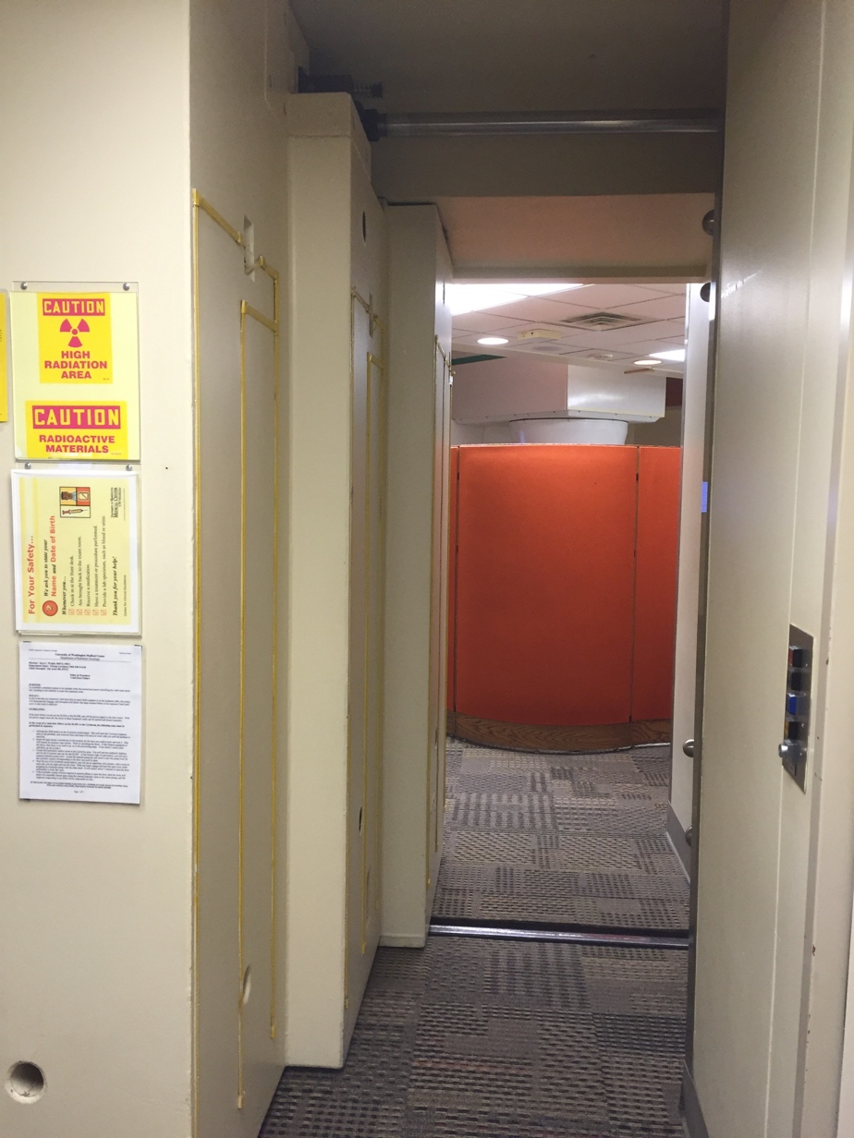
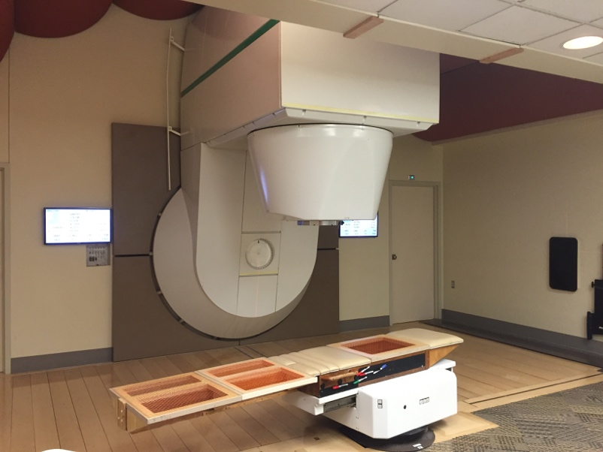

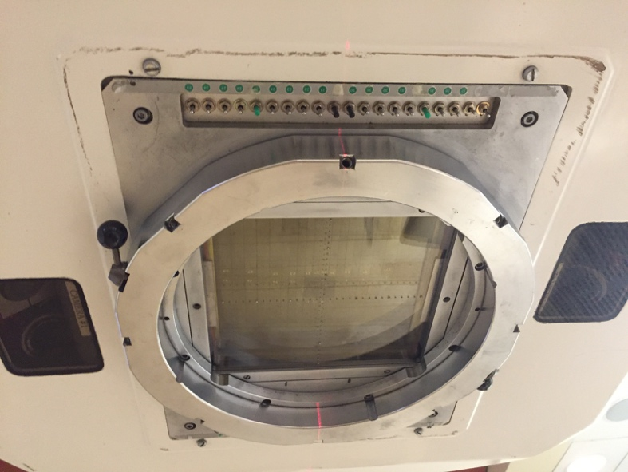
Clinical Neutron Therapy System
Notes:
Radiotherapy haha

Slide 5

CNTS Beamline
Beam Monitor
Focusing Magnets
Faraday Cup
Beam Plug
Cyclotron
Vacuum Pump
Notes:
Radiotherapy haha

Slide 6
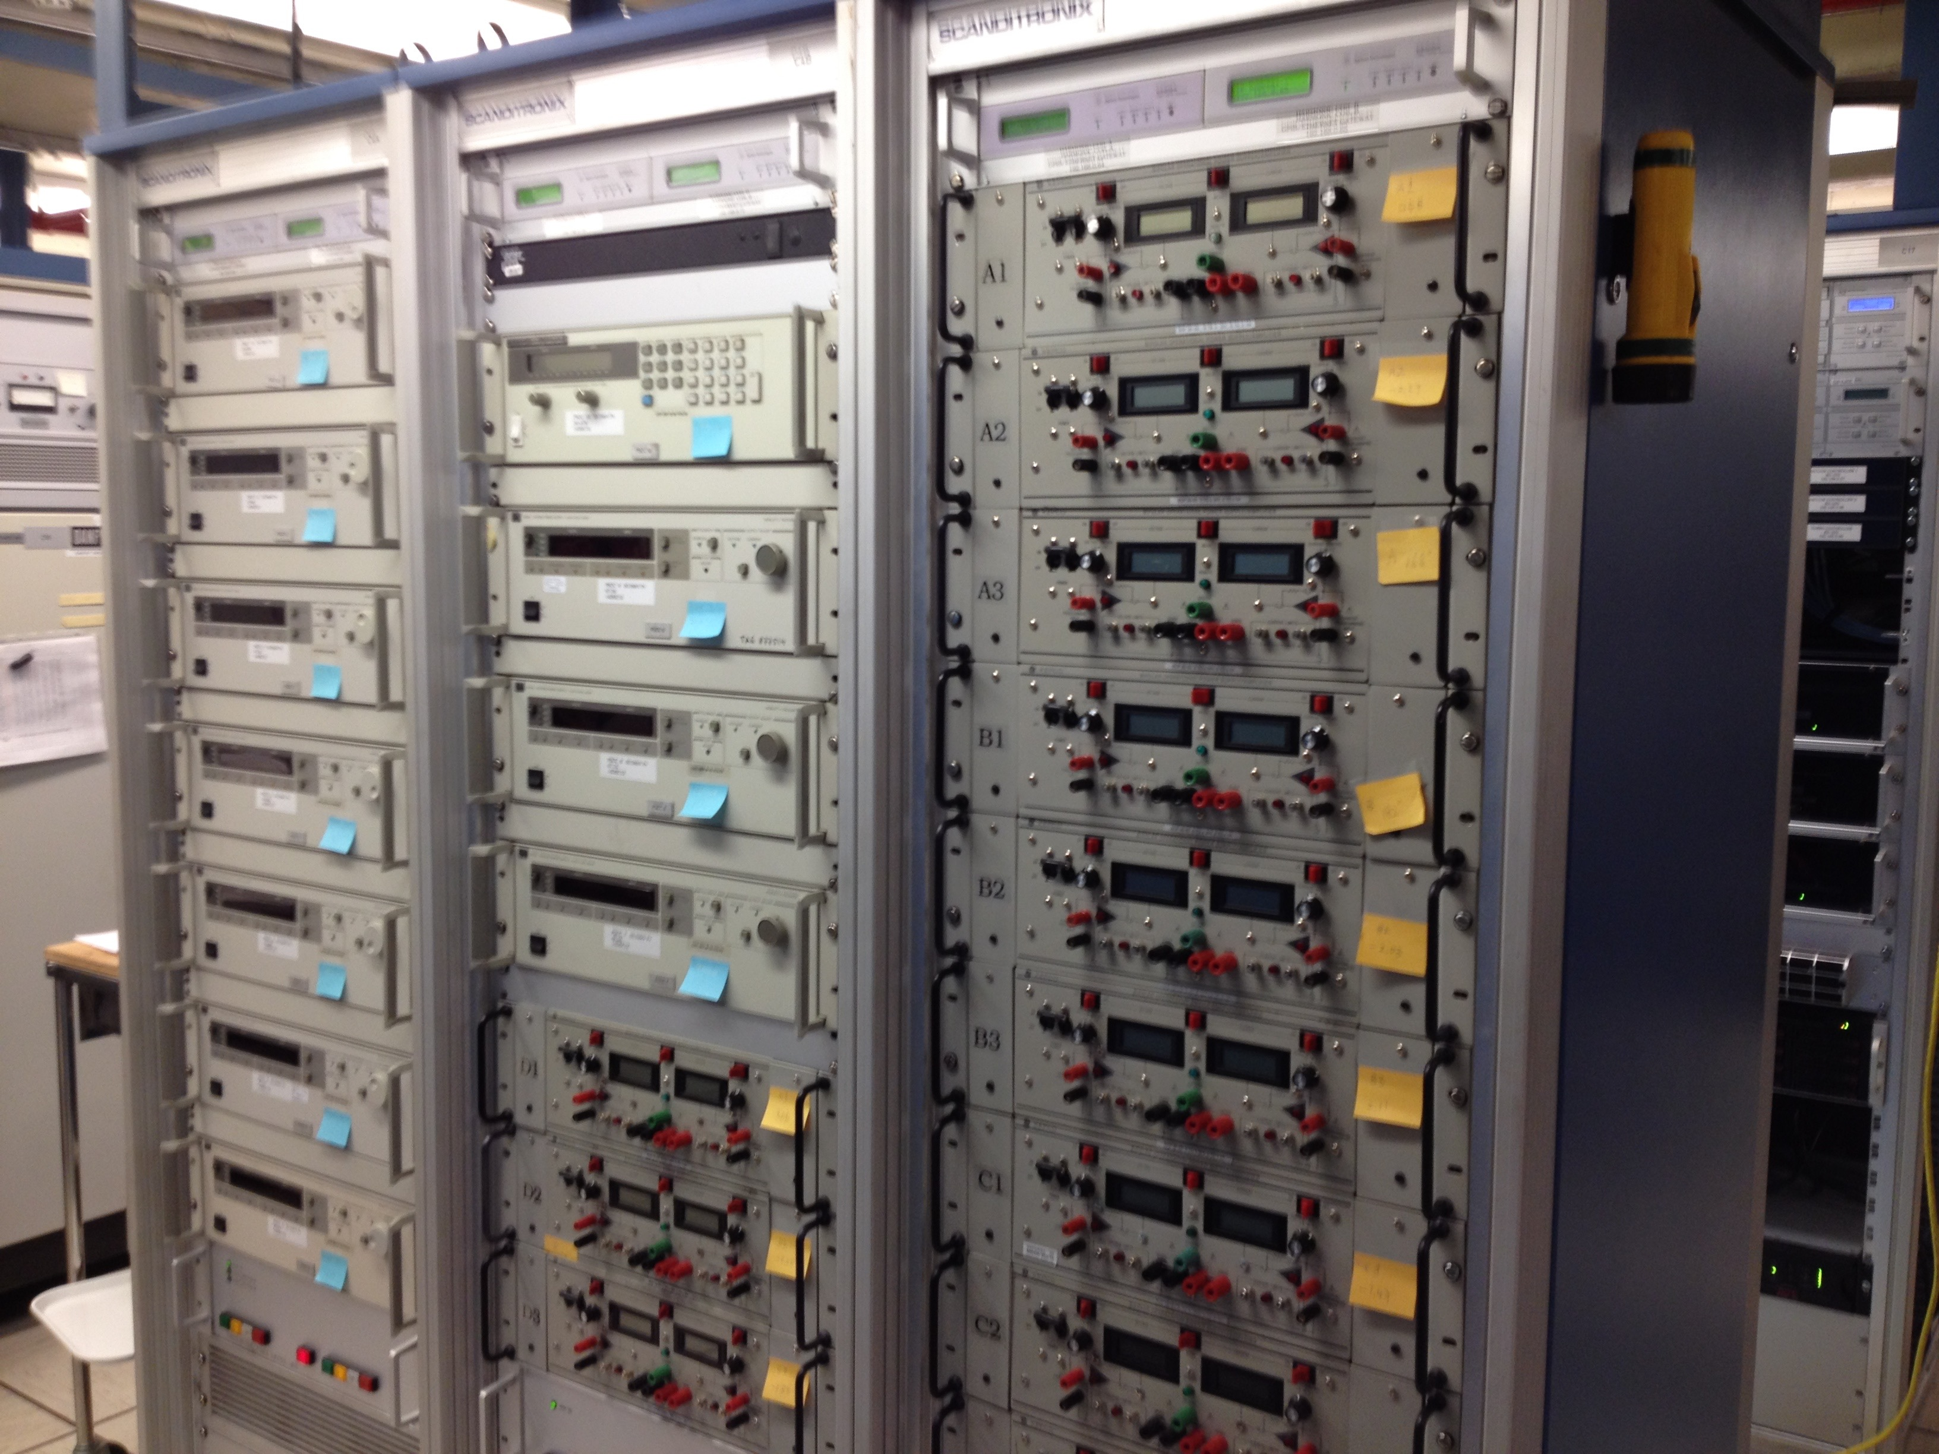
CNTS Control
Hardwired Safety
Interlock System
Sensors
Beamline
Control
Therapy
Control
PLC
HSIS
Private
Ethernet
Programmable Logic Controller
Notes:
Radiotherapy haha

Slide 7
CNTS Control
Sensors
Beamline
Control
Therapy
Control
PLC
HSIS
Prescription Safety:
The beam will turn off and remain off if any machine setting goes out of prescribed tolerances.
Notes:
Radiotherapy haha

Slide 8

CNTS Control
Sensors
Beamline
Control
Therapy
Control
PLC
HSIS
Over 30 year safety record!
Prescription Safety:
The beam will turn off and remain off if any machine setting goes out of prescribed tolerances.

Slide 9
Now: CNTS++
Sensors
Beamline
Control
Therapy
Control
PLC
HSIS
Originally written in C.
Want to extend treatment capabilities.

Slide 10
Now: CNTS++
New version in EPICS
Sensors
Beamline
Control
Therapy
Control++
PLC
HSIS
EPICS documentation
No formal definition
No type checking
Highly dynamic
Ubiquitous float pt.
Config control flow
The Maximize Severity attribute is one of NMS (Non-Maximize Severity), MS (Maximize Severity), MSS (Maximize Status and Severity) or MSI (Maximize Severity if Invalid). It determines whether alarm severity is propagated across links. If the attribute is MSI only a severity of INVALID_ALARM is propagated; settings of MS or MSS propagate all alarms that are more severe than the record's current severity. For input links the alarm severity of the record referred to by the link is propagated to the record containing the link. For output links the alarm severity of the record containing the link is propagated to the record referred to by the link. If the severity is changed the associated alarm status is set to LINK_ALARM, except if the attribute is MSS when the alarm status will be copied along with the severity.

Slide 11
Now: CNTS++
Sensors
Beamline
Control
Therapy
Control++
PLC
HSIS
Prescription Safety?
Will the beam will turn off and remain off if any machine setting goes out of prescribed tolerances?

Slide 12
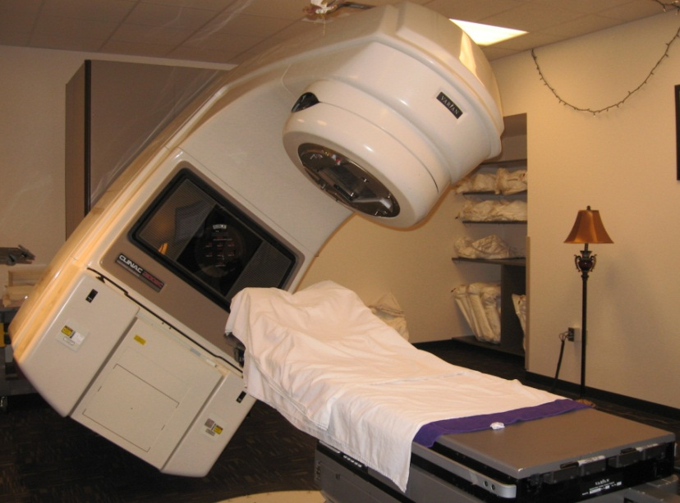
Therac-25 radiation therapy machine
Excessive radiation killed patients (1985-87)
  New design removed hardware that prevents the electron-beam from operating in its high-energy mode. Now safety checks done in software.
  Equipment control software task did not properly synchronize with the operator interface task, so race conditions occurred if the operator changed the setup too quickly.
  Missed during testing
  because it took practice before
  operators worked quickly enough
  for the problem to occur.

Slide 13
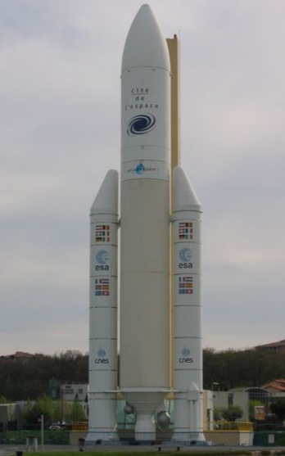
Ariane 5 rocket (1996)
Rocket self-destructed 37 seconds after launch
  Cost: over $1 billion
Reason: Undetected bug in control software
  Conversion from 64-bit floating point to 16-bit signed integer caused an exception
  The floating point number was larger than 32767
  Efficiency considerations led to the disabling of the exception handler, so program crashed, so rocket crashed
Notes:
GO QUICKLY through these intro slides; don’t get bogged down in details. Spending too much time on them distracts from the more important content.

Slide 14
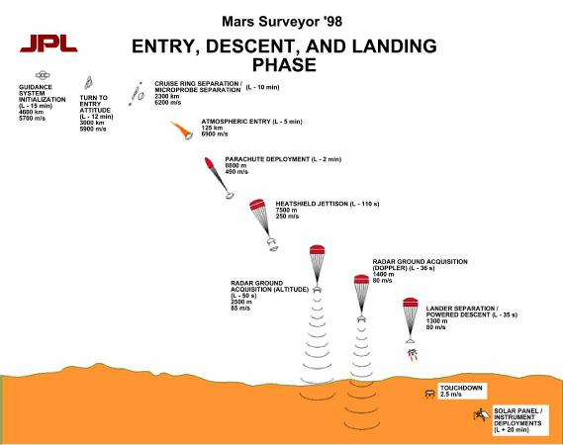
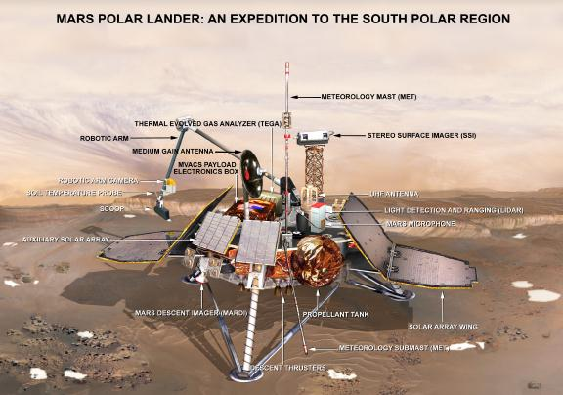
Mars Polar Lander
Legs deployed → Sensor signal falsely indicated that the craft had touched down (130 feet above the surface)
  Then the descent engines shut down prematurely
Error later traced to a single bad line of software code
  Why didn’t they blame the sensor?

Slide 15
More examples
Mariner I space probe (1962)
Microsoft Zune New Year’s Eve crash (2008)
iPhone alarm (2011)
Denver Airport baggage-handling system (1994)
Air-Traffic Control System in LA Airport (2004)
AT&T network outage (1990)
Northeast blackout (2003)
USS Yorktown Incapacitated (1997)
Intel Pentium floating point divide (1993)
Excel: 65,535 displays as 100,000 (2007)
Prius brakes and engine stalling (2005)
Soviet gas pipeline (1982)
Study linking national debt to slow growth (2010)
…

Slide 16
Software bugs cost money
2013 Cambridge University study: Software bugs cost global economy $312 Billion per year
  http://www.prweb.com/releases/2013/1/prweb10298185.htm
$440 million loss by Knight Capital Group in 30 minutes
  August 2012 high-frequency trading error
$6 billion loss from 2003 blackout in NE USA & Canada
  Software bug in alarm system in Ohio power control room

Slide 17
Building Quality Software
What Affects Software Quality?
External
  Correctness Does it do what it supposed to do?
  Reliability Does it do it accurately all the time?
  Efficiency Does it do without excessive resources?
  Integrity Is it secure?
Internal
  Portability Can I use it under different conditions?
  Maintainability Can I fix it?
  Flexibility Can I change it or extend it or reuse it?
Quality Assurance (QA)
  Process of uncovering problems and improving software quality
  Testing is a major part of QA

Slide 18
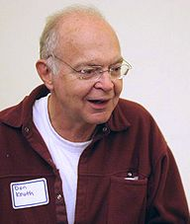
Software Quality Assurance (QA)
Testing plus other activities including:
  Static analysis (assessing code without executing it)
  Correctness proofs (theorems about program properties)
  Code reviews (people reading each others’ code)
  Software process (methodology for code development)
  …and many other ways to find problems and increase confidence
No single activity or approach can guarantee software quality
  “Beware of bugs in the above code;
  I have only proved it correct, not tried it.”
  -Donald Knuth, 1977

Slide 19
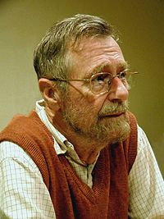
What can you learn from testing?
“Program testing can be used to show the presence of bugs, but never to show their absence!”
Edsgar Dijkstra
Notes on Structured Programming, 1970
Nevertheless testing is essential. Why?

Slide 20
What Is Testing For?
Validation = reasoning + testing
  Make sure module does what it is specified to do
  Uncover problems, increase confidence
Two rules:
1. Do it early and often
  Catch bugs quickly, before they have a chance to hide
  Automate the process wherever feasible
2. Be systematic
  If you thrash about randomly, the bugs will hide in the corner until you're gone
  Understand what has been tested for and what has not
  Have a strategy!

Slide 21
Kinds of testing
Testing is so important the field has terminology for different kinds of tests
  Won’t discuss all the kinds and terms
Here are three orthogonal dimensions [so 8 varieties total]:
  Unit testing versus system/integration testing
    One module’s functionality versus pieces fitting together
  Black-box testing versus clear-box testing
    Does implementation influence test creation?
    “Do you look at the code when choosing test data?”
  Specification testing versus implementation testing
    Test only behavior guaranteed by specification or other behavior expected for the implementation?

Slide 22
Unit Testing
A unit test focuses on one method, class, interface, or module
Test a single unit in isolation from all others
Typically done earlier in software life-cycle
  Integrate (and test the integration) after successful unit testing

Slide 23
How is testing done?
Write the test
  1) Choose input data/configuration
  2) Define the expected outcome
Run the test
  3) Run with input and record the outcome
  4) Compare observed outcome to expected outcome

Slide 24
sqrt example
// throws: IllegalArgumentException if x<0
// returns: approximation to square root of x
public double sqrt(double x){…}
What are some values or ranges of x that might be worth probing?
    x < 0 (exception thrown)
    x ≥ 0 (returns normally)
    around x = 0 (boundary condition)
    perfect squares (sqrt(x) an integer), non-perfect squares
    x<sqrt(x) and x>sqrt(x) – that's x<1 and x>1 (and x=1)
    Specific tests: say x = -1, 0, 0.5, 1, 4

Slide 25
What’s So Hard About Testing?
“Just try it and see if it works...”
// requires: 1 ≤ x,y,z ≤ 10000
// returns: computes some f(x,y,z)
int proc1(int x, int y, int z){…}
Exhaustive testing would require 1 trillion runs!
  Sounds totally impractical – and this is a trivially small problem
Key problem: choosing test suite
  Small enough to finish in a useful amount of time
  Large enough to provide a useful amount of validation
Notes:
(But, can think about doing this many tests today)

Slide 26
Approach: Partition the Input Space
Ideal test suite:
  Identify sets with same behavior
  Try one input from each set
Two problems:
  1. Notion of same behavior is subtle
    Naive approach: execution equivalence
    Better approach: revealing subdomains
  2. Discovering the sets requires perfect knowledge
    If we had it, we wouldn’t need to test
    Use heuristics to approximate cheaply

Slide 27
Naive Approach: Execution Equivalence
// returns: x < 0 ⇒ returns –x
// otherwise ⇒ returns x
int abs(int x) {
if (x < 0) return -x;
else return x;
}
All x < 0 are execution equivalent:
  Program takes same sequence of steps for any x < 0
All x ≥ 0 are execution equivalent
Suggests that {-3, 3}, for example, is a good test suite

Slide 28
Execution Equivalence Can Be Wrong
// returns: x < 0 ⇒ returns –x
// otherwise ⇒ returns x
int abs(int x) {
if (x < -2) return -x;
else return x;
}
{-3, 3} does not reveal the error!
Two possible executions: x < -2 and x >= -2
Three possible behaviors:
  x < -2 OK
  x = -2 or x= -1 (BAD)
  x ≥ 0 OK

Slide 29
Heuristic: Revealing Subdomains
A subdomain is a subset of possible inputs
A subdomain is revealing for error E if either:
  Every input in that subdomain triggers error E, or
  No input in that subdomain triggers error E
Need test only one input from a given subdomain
  If subdomains cover the entire input space, we are guaranteed to detect the error if it is present
The trick is to guess these revealing subdomains

Slide 30
Example
For buggy abs, what are revealing subdomains?
  Value tested on is a good (clear-box) hint
// returns: x < 0 ⇒ returns –x
// otherwise ⇒ returns x
int abs(int x) {
if (x < -2) return -x;
else return x;
}
Example sets of subdomains:
  Which is best?
Why not:
… {-2} {-1} {0} {1} …
{…, -4, -3} {-2, -1} {0, 1, …}
{…,-6, -5, -4} {-3, -2, -1} {0, 1, 2, …}

Slide 31
Heuristics for Designing Test Suites
A good heuristic gives:
  Few subdomains
  ∀ errors in some class of errors E,
  High probability that some subdomain is revealing for E and triggers E
Different heuristics target different classes of errors
  In practice, combine multiple heuristics
  Really a way to think about and communicate your test choices

Slide 32
Black-Box Testing
Heuristic: Explore alternate cases in the specification
  Procedure is a black box: interface visible, internals hidden
Example
  // returns: a > b ⇒ returns a
  // a < b ⇒ returns b
  // a = b ⇒ returns a
  int max(int a, int b) {…}
  3 cases lead to 3 tests
  (4, 3) ⇒ 4 (i.e. any input in the subdomain a > b)
  (3, 4) ⇒ 4 (i.e. any input in the subdomain a < b)
  (3, 3) ⇒ 3 (i.e. any input in the subdomain a = b)

Slide 33
Black Box Testing: Advantages
Process is not influenced by component being tested
  Assumptions embodied in code not propagated to test data
  (Avoids “group-think” of making the same mistake)
Robust with respect to changes in implementation
  Test data need not be changed when code is changed
Allows for independent testers
  Testers need not be familiar with code
  Tests can be developed before the code

Slide 34
More Complex Example
Write tests based on cases in the specification
  // returns: the smallest i such
  // that a[i] == value
  // throws: Missing if value is not in a
  int find(int[] a, int value) throws Missing
Two obvious tests:
( [4, 5, 6], 5 ) ⇒ 1
( [4, 5, 6], 7 ) ⇒ throw Missing
Have we captured all the cases?
Must hunt for multiple cases
  Including scrutiny of effects and modifies
( [4, 5, 5], 5 ) ⇒ 1

Slide 35
Heuristic: Boundary Testing
Create tests at the edges of subdomains
Why?
  Off-by-one bugs
  “Empty” cases (0 elements,
  null, …)
  Overflow errors in arithmetic
  Object aliasing
Small subdomains at the edges of the “main” subdomains have a high probability of revealing many common errors
  Also, you might have misdrawn the boundaries

Slide 36
Boundary Testing
To define the boundary, need a notion of adjacent inputs
One approach:
  Identify basic operations on input points
  Two points are adjacent if one basic operation apart
Point is on a boundary if either:
  There exists an adjacent point in a different subdomain
  Some basic operation cannot be applied to the point
Example: list of integers
  Basic operations: create, append, remove
  Adjacent points: <[2,3],[2,3,3]>, <[2,3],[2]>
  Boundary point: [ ] (can’t apply remove)

Slide 37
Other Boundary Cases
Arithmetic
  Smallest/largest values
  Zero
Objects
  null
  Circular list
  Same object passed as multiple arguments (aliasing)

Slide 38
Boundary Cases: Arithmetic Overflow
// returns: |x|
public int abs(int x) {…}
  What are some values or ranges of x that might be worth probing?
      x < 0 (flips sign) or x ≥ 0 (returns unchanged)
      Around x = 0 (boundary condition)
      Specific tests: say x = -1, 0, 1
How about…
int x = Integer.MIN_VALUE; // x=-2147483648
System.out.println(x<0); // true
System.out.println(Math.abs(x)<0); // also true!
From Javadoc for Math.abs:
  Note that if the argument is equal to the value of Integer.MIN_VALUE, the most negative representable int value, the result is that same value, which is negative

Slide 39
Boundary Cases: Duplicates & Aliases
// modifies: src, dest
// effects: removes all elements of src and
// appends them in reverse order to
// the end of dest
<E> void appendList(List<E> src, List<E> dest) {
while (src.size()>0) {
E elt = src.remove(src.size()-1);
dest.add(elt);
}
}
What happens if src and dest refer to the same object?
  This is aliasing
  It’s easy to forget!
  Watch out for shared references in inputs

Slide 40
Heuristic: Clear (glass, white)-box testing
Focus: features not described by specification
  Control-flow details
  Performance optimizations
  Alternate algorithms for different cases
Common goal:
  Ensure test suite covers (executes) all of the program
  Measure quality of test suite with % coverage
Assumption implicit in goal:
  If high coverage, then most mistakes discovered

Slide 41
Glass-box Motivation
There are some subdomains that black-box testing won't catch:
boolean[] primeTable = new boolean[CACHE_SIZE];
boolean isPrime(int x) {
if (x>CACHE_SIZE) {
for (int i=2; i<x/2; i++) {
if (x%i==0)
return false;
}
return true;
} else {
return primeTable[x];
}
}

Slide 42
Glass-box Testing: [Dis]Advantages
Finds an important class of boundaries
  Yields useful test cases
Consider CACHE_SIZE in isPrime example
  Important tests CACHE_SIZE-1, CACHE_SIZE, CACHE_SIZE+1
  If CACHE_SIZE is mutable, may need to test with different CACHE_SIZE values
Disadvantage:
  Tests may have same bugs as implementation
  Buggy code tricks you into complacency once you look at it

Slide 43
Code coverage: what is enough?
int min(int a, int b) {
int r = a;
if (a <= b) {
r = a;
}
return r;
}
Consider any test with a ≤ b (e.g., min(1,2))
  Executes every instruction
  Misses the bug
Statement coverage is not enough

Slide 44
Code coverage: what is enough?
int quadrant(int x, int y) {
int ans;
if (x >= 0)
ans=1;
else
ans=2;
if (y < 0)
ans=4;
return ans;
}
Consider two-test suite: (2,-2) and (-2,2). Misses the bug.
Branch coverage (all tests “go both ways”) is not enough
  Here, path coverage is enough (there are 4 paths)
1
4

Slide 45
Code coverage: what is enough?
int num_pos(int[] a) {
int ans = 0;
for (int x : a) {
if (x > 0)
ans = 1; // should be ans += 1;
}
return ans;
}
Consider two-test suite: {0,0} and {1}. Misses the bug.
Or consider one-test suite: {0,1,0}. Misses the bug.
Branch coverage is not enough
  Here, path coverage is enough, but no bound on path-count

Slide 46
Code coverage: what is enough?
int sum_three(int a, int b, int c) {
return a+b;
}
Path coverage is not enough
  Consider test suites where c is always 0
Typically a moot point since path coverage is unattainable for realistic programs
  But do not assume a tested path is correct
  Even though it is more likely correct than an untested path
Another example: buggy abs method from earlier in lecture

Slide 47
Varieties of coverage
Various coverage metrics (there are more):
  Statement coverage
  Branch coverage
  Loop coverage
  Condition/Decision coverage
  Path coverage
Limitations of coverage:
  100% coverage is not always a reasonable target
  100% may be unattainable (dead code)
  High cost to approach the limit
  Coverage is just a heuristic
  We really want the revealing subdomains
increasing
number of
test cases
required
(generally)

Slide 48
Pragmatics: Regression Testing
Whenever you find a bug
  Store the input that elicited that bug, plus the correct output
  Add these to the test suite
  Verify that the test suite fails
  Fix the bug
  Verify the fix
Ensures that your fix solves the problem
  Don’t add a test that succeeded to begin with!
Helps to populate test suite with good tests
Protects against reversions that reintroduce bug
  It happened at least once, and it might happen again

Slide 49
Rules of Testing
First rule of testing: Do it early and do it often
  Best to catch bugs soon, before they have a chance to hide
  Automate the process if you can
  Regression testing will save time
Second rule of testing: Be systematic
  If you randomly thrash, bugs will hide in the corner until later
  Writing tests is a good way to understand the spec
  Think about revealing domains and boundary cases
    If the spec is confusing, write more tests
  Spec can be buggy too
    Incorrect, incomplete, ambiguous, missing corner cases
  When you find a bug, write a test for it first and then fix it

Slide 50
Closing thoughts on testing
Testing matters
  You need to convince others that the module works
Catch problems earlier
  Bugs become obscure beyond the unit they occur in
Don't confuse volume with quality of test data
  Can lose relevant cases in mass of irrelevant ones
  Look for revealing subdomains
Choose test data to cover:
  Specification (black box testing)
  Code (glass box testing)
Testing can't generally prove absence of bugs
  But it can increase quality and confidence

