Slide 1
CSE 331
Software Design & Implementation
Hal Perkins
Spring 2017
Course Wrapup

Slide 2
Today
Reminder: Do your course evaluations (!)
Project demos
Final exam information
A look back at CSE 331
  High-level overview of main ideas and goals
  Connection to homeworks
  Context
Also:
  Thank-yous

Slide 3
Final exam information
Monday, 8:30-10:20 AM
Comprehensive but reasonably strongly weighted towards the 2nd half of the course
Old exams on the web
  Some questions won’t apply if we didn’t do similar things this quarter
Last-minute Q&A review Saturday (tomorrow!), 1 pm, EEB 045

Slide 4
CSE 331
What was it all about?
But first….

Slide 5
Huge thanks to the folks who made it work
Course staff: Issac, Grace, Sam, Jason, Armaan, Laura, Amy, Matthew, Stephanie & Reid
This course is itself a sophisticated
(or at least really, really complicated) system
requiring savvy design and implementation

Slide 6
3 slides from Lecture 1…

Slide 7
10 weeks ago: Welcome!
We have 10 weeks to move well beyond novice programmer:
Larger programs
  Small programs are easy: “code it up”
  Complexity changes everything: “design an artifact”
  Analogy: using hammers and saws vs. making cabinets (but not yet building houses)
Principled, systematic software: What does “it’s right” mean? How do we know “it’s right”? What are best practices for “getting it right”?
Effective use of languages and tools: Java, IDEs, debuggers, JUnit, JavaDoc, git, …
  Principles are ultimately more important than details
    You will forever learn details of new tools/versions

Slide 8
10 weeks ago: Goals
CSE 331 will teach you to how to write correct programs
What does it mean for a program to be correct?
  Specifications
What are ways to achieve correctness?
  Principled design and development
  Abstraction and modularity
  Documentation
What are ways to verify correctness?
  Testing
  Reasoning and verification

Slide 9
10 weeks ago: Managing complexity
Abstraction and specification
  Procedural, data, and control flow abstractions
  Why they are useful and how to use them
Writing, understanding, and reasoning about code
  Will use Java, but the issues apply in all languages
  Some focus on object-oriented programming
Program design and documentation
  What makes a design good or bad (example: modularity)
  Design processes and tools
Pragmatic considerations
  Testing
  Debugging and defensive programming
  [more in CSE403: Managing software projects]

Slide 10
Some new slides to tie the pieces together…

Slide 11
Divide and conquer:
Modularity, abstraction, specs
No one person can understand all of a realistic system
Modularity permits focusing on just one part
Abstraction enables ignoring detail
Specifications (and documentation) formally describe behavior
Reasoning relies on all three to understand/fix errors
  Or avoid them in the first place
  Proving, testing, debugging: all are intellectually challenging

Slide 12
How CSE 331 fits together
Lectures: ideas
⇒ Assignments: get practice
Specifications
Testing
Subtyping
Equality & identity
Generics
Design patterns
Reasoning, debugging
Events
Systems integration
Design classes
Write tests
Write subclasses
Override equals, use collections
Write generic classes
Larger designs; MVC
Correctness, testing
GUIs
N/A

Slide 13
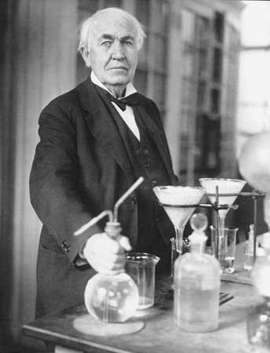
What you have learned in CSE 331
Compare your skills today to 10 weeks ago
  Theory: abstraction, specification, design
  Practice: implementation, testing
  Theory & practice: correctness
  Bottom line aspiration: Much of what we’ve done would be easy for you today
    This is a measure of how much you have learned
There is no such thing as a “born” programmer!
Genius is 1% inspiration and 99% perspiration.
Thomas A. Edison
Notes:
Practice: also “teamwork” in some terms.

Slide 14
What you will learn later
Your next project can be much more ambitious
  But beware of “second system” effect
Know your limits
  Be humble (reality helps you with this)
You will continue to learn
  Building interesting systems is never easy
    Like any worthwhile endeavor
  Practice is a good teacher
    Requires thoughtful introspection
    Don’t learn only by trial and error!
  Voraciously consume ideas and tools

Slide 15
What comes next?
Courses
  CSE 403 Software Engineering
    Focuses more on requirements, software lifecycle, teamwork
  Capstone projects
  Any class that requires software design and implementation
Research
  In software engineering & programming systems
  In any topic that involves software
Having an impact on the world
  Jobs (and job interviews)
  Larger programming projects

Slide 16
Last slide
System building is fun!
  It’s even more fun when you’re successful
Pay attention to what matters
  Take advantage of the techniques and tools you’ve learned (and will learn!)
On a personal note:
  Don’t be a stranger: I love to hear how you do in CSE and beyond as alumni
Closing thoughts?

