Slide 1
CSE 331 Software Design & Implementation
Hal Perkins
Spring 2017
Java Graphics and GUIs

Slide 2
The plan
Today: introduction to Java graphics and Swing/AWT libraries
Then: event-driven programming and user interaction
None of this is comprehensive – only an overview and guide to what you should expect to be out there
Some standard terminology and perspective
Credits: material taken from many places; including slides and materials by Ernst, Hotan, Mercer, Notkin, Perkins, Stepp; Reges; Sun/Oracle docs & tutorial; Horstmann; Wikipedia; others, folklore, …

Slide 3
References
Very useful start: Sun/Oracle Java tutorials
http://docs.oracle.com/javase/tutorial/uiswing/index.html
Mike Hoton’s slides/sample code from CSE 331 Sp12 (lectures 23, 24 with more extensive widget examples)
http://courses.cs.washington.edu/courses/cse331/12sp/lectures/lect23-GUI.pdf
http://courses.cs.washington.edu/courses/cse331/12sp/lectures/lect24-Graphics.pdf
http://courses.cs.washington.edu/courses/cse331/12sp/lectures/lect23-GUI-code.zip
http://courses.cs.washington.edu/courses/cse331/12sp/lectures/lect24-Graphics-code.zip
Good book that covers this (and much more): Core Java vol. I by Horstmann & Cornell
There are other decent Java books out there too
(and probably even more that aren’t so great…)

Slide 4
Why study GUIs?
Er, because graphical user interfaces are pretty common (duh ☺)
And it’s fun!
Classic example of using inheritance to organize large class libraries
The best (?) example of OOP’s strengths
Work with a huge API – and learn how (not) to deal with all of it
Many core design patterns show up: callbacks, listeners, event-driven programs, decorators, façade

Slide 5
What not to do…
Don’t try to learn the whole library: There’s way too much
Don’t memorize – look things up as you need them
Don’t miss the main ideas, fundamental concepts
Don’t get bogged down implementing eye candy

Slide 6
Main topics to learn
Organization of the AWT/Swing library
Names of essential widgets/components
Graphics and drawing
Repaint callbacks, layout managers, etc.
Handling user events
Building GUI applications
MVC, user events, updates, …

Slide 7
A very short history (1)
Java’s standard libraries have supported GUIs from the beginning
Original Java GUI: AWT (Abstract Window Toolkit)
Limited set of user interface elements (widgets)
Mapped Java UI to host system UI widgets
Lowest common denominator
“Write once, debug everywhere”

Slide 8
A very short history (2)
Swing: Newer GUI library, introduced with Java 2 (1998)
Basic idea: underlying system provides only a blank window
Swing draws all UI components directly
Doesn’t use underlying system widgets
Not a total replacement for AWT: Swing is implemented on top of core AWT classes and both still coexist
Use Swing, but deal with AWT when you must

Slide 9
GUI terminology
window: A first-class citizen of the graphical desktop
Also called a top-level container
Examples: frame, dialog box, applet
component: A GUI widget that resides in a window
Called controls in many other languages
Examples: button, text box, label
container: A component that hosts (holds) components
Examples: frame, applet, panel, box

Slide 10
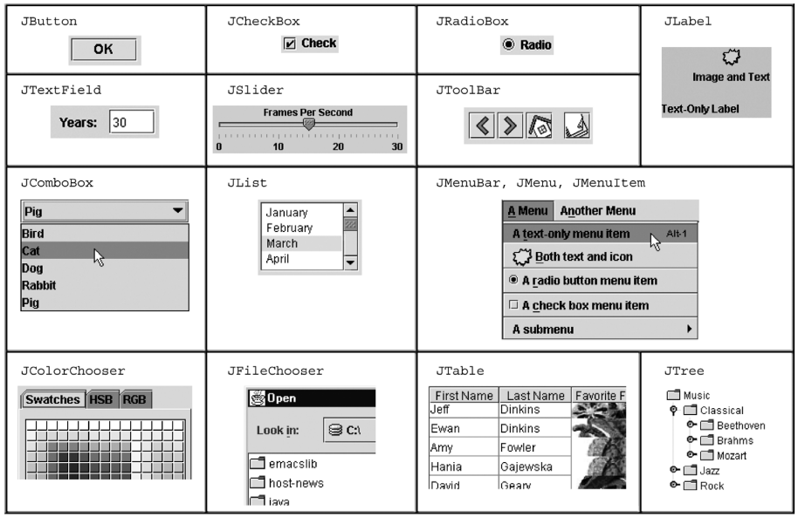
Some components…

Slide 11
Component and container classes
Every GUI-related class descends from Component, which contains dozens of basic methods and fields
Examples: getBounds, isVisible, setForeground, …
“Atomic” components: labels, text fields, buttons, check boxes, icons, menu items…
Many components are containers – things like panels (JPanel) that can hold nested subcomponents
Component
Container
Lots of AWT components
JComponent
Various AWT containers
JPanel
JFileChooser
Tons of JComponents

Slide 12
Swing/AWT inheritance hierarchy
Component (AWT)
Window
Frame
JFrame (Swing)
JDialog
Container
JComponent (Swing)
JButton JColorChooser JFileChooser
JComboBox JLabel JList
JMenuBar JOptionPane JPanel
JPopupMenu JProgressBar JScrollbar
JScrollPane JSlider JSpinner
JSplitPane JTabbedPane JTable
JToolbar JTree JTextArea
JTextField ...

Slide 13
Component properties
Zillions. Each has a get (or is) accessor and a set modifier. Examples: getColor,setFont,isVisible, …
name | type | description
background | Color | background color behind component
border | Border | border line around component
enabled | boolean | whether it can be interacted with
focusable | boolean | whether key text can be typed on it
font | Font | font used for text in component
foreground | Color | foreground color of component
height, width | int | component's current size in pixels
visible | boolean | whether component can be seen
tooltip text | String | text shown when hovering mouse
size, minimum / maximum / preferred size | Dimension | various sizes, size limits, or desired sizes that the component may take

Slide 14
Types of containers
Top-level containers: JFrame, JDialog, …
Often correspond to OS windows
Usually a “host” for other components
Live at top of UI hierarchy, not nested in anything else
Mid-level containers: panels, scroll panes, tool bars
Sometimes contain other containers, sometimes not
JPanel is a general-purpose component for drawing or hosting other UI elements (buttons, etc.)
Specialized containers: menus, list boxes, …
Technically, all JComponents are containers

Slide 15
JFrame – top-level window
Graphical window on the screen
Typically holds (hosts) other components
Common methods:
JFrame(String title): constructor, title optional
setDefaultCloseOperation(int what)
What to do on window close
JFrame.EXIT_ON_CLOSE terminates application
setSize(int width, int height): set size
add(Component c): add component to window
setVisible(boolean b): make window visible or not

Slide 16
Example
SimpleFrameMain.java

Slide 17
JPanel – a general-purpose container
Commonly used as a place for graphics, or to hold a collection of button, labels, etc.
Needs to be added to a window or other container:
frame.add(new JPanel(…))
JPanels can be nested to any depth
Many methods/fields in common with JFrame (since both inherit from Component)
Advice: can’t find a method/field? Check the superclasses
A particularly useful method:
setPreferredSize(Dimension d)

Slide 18
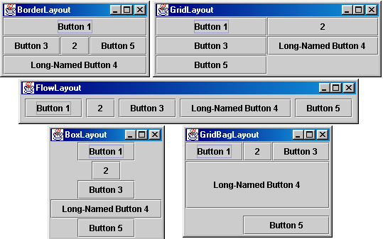
Containers and layout
What if we add several components to a container?
How are they positioned relative to each other?
Answer: each container has a layout manger

Slide 19
Layout managers
Kinds:
FlowLayout (left to right [changeable], top to bottom)
Default for JPanel
Each row centered horizontally [changeable]
BorderLayout (“center”, “north”, “south”, “east”, “west”)
Default for JFrame
No more than one component in each of 5 regions
(Of course, component can itself be a container)
GridLayout (regular 2-D grid)
Others... (some are incredibly complex)
FlowLayout and BorderLayout should be good enough for now…

Slide 20
pack()
Once all the components are added to their containers, do this to make the window visible:
pack();
setVisible(true);
pack() figures out the sizes of all components and calls the container’s layout manager to set locations in the container
(recursively as needed)
If your window doesn’t look right, you may have forgotten pack()

Slide 21
Example
SimpleLayoutMain.java

Slide 22
Graphics and drawing
So far so good – and very boring…
What if we want to actually draw something?
A map, an image, a path, …?
Answer: Override method paintComponent
Components like JLabel provide a suitable paintComponent for themselves that (in JLabel’s case) draws the label text
Other components like JPanel typically inherit an empty paintComponent that we can override to draw things
Note: As we’ll see, we override paintComponent but we don’t call it

Slide 23
Example
SimplePaintMain.java

Slide 24
Graphics methods
Many methods to draw various lines, shapes, etc., …
Can also draw images (pictures, etc.):
In the program (not in paintComponent):
Use AWT’s “Toolkit” to load an image:
Image pic = Toolkit.getDefaultToolkit()
.getImage(file-name (with path));
Then in paintComponent:
g.drawImage(pic, …);

Slide 25
Graphics vs Graphics2D
Class Graphics was part of the original Java AWT
Has a procedural interface: g.drawRect(…), g.fillOval(…), …
Swing introduced Graphics2D (extends Graphics )
Added an object interface – create instances of Shape like Line2D, Rectangle2D, etc., and add these to the Graphics2D object
Actual parameter to paintComponent is always a Graphics2D
Can always cast this parameter from Graphics to Graphics2D
Graphics2D supports both sets of graphics methods
Use whichever you like for CSE 331

Slide 26
So who calls paintComponent? And when??
Answer: the window manager calls paintComponent whenever it wants!!! (a callback!)
When the window is first made visible, and any time after that some or all of it needs to be repainted
Corollary: paintComponent must always be ready to repaint regardless of what else is going on
You have no control over when or how often
You must store enough information to repaint on demand
If “you” want to redraw a window, call repaint() from the program (not from paintComponent)
Tells the window manager to schedule repainting
Window manager will call paintComponent when it decides to redraw (soon, but maybe not right away)
Window manager may combine several quick repaint() requests and call paintComponent() only once

Slide 27
Example
FaceMain.java

Slide 28
How repainting happens
program
window manager (UI)
repaint()
It’s worse than it looks!
Your program and the window manager are running concurrently:
Program thread
User Interface thread
Do not attempt to mess around – follow the rules and nobody gets hurt!
paintComponent(g)
Asynchronous
Callback

Slide 29
Crucial rules for painting
Always override paintComponent(g) if you want to draw on a component
Always call super.paintComponent(g) first
NEVER, EVER, EVER call paintComponent yourself
Always paint the entire picture, from scratch
Use paintComponent’s Graphics parameter to do all the drawing. ONLY use it for that. Don’t copy it, try to replace it, or mess with it. It is quick to anger.
DON’T create new Graphics or Graphics2D objects
Fine print: Once you are a certified™ wizard, you may find reasons to do things differently, but that requires deeper understanding of the GUI library’s structure and specification

Slide 30
What’s next – and not
Major topic for next lecture is how to handle user interactions
We already know the core idea: it’s a big-time use of the observer pattern
Beyond that you’re on your own to explore all the wonderful widgets in Swing/AWT.
Have fun!!
(But don’t sink huge amounts of time into eye candy)

