Slide 1
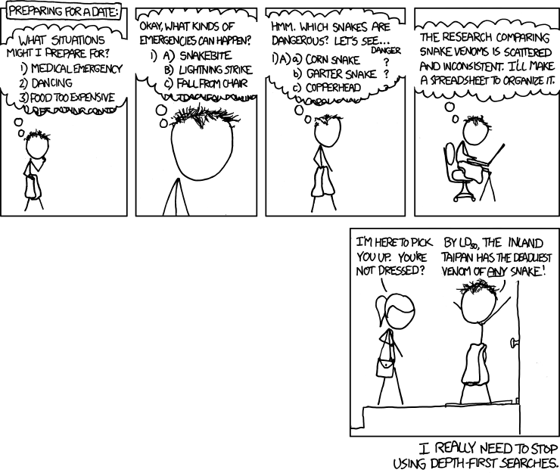

Slide 2
Section 7: Dijkstra’s
Slides adapted from Alex Mariakakis
with material Kellen Donohue, David Mailhot, and Dan Grossman

Slide 3
Things to Discuss
Late days
3 assignments left
Can use 2 late days max per assignment
Let us know how many you are using by filling out the online late day request
Must do this by 48 hours after the initial deadline of the homework assignment!

Slide 4
Homework 7
Modify your graph to use generics
Will have to update HW #5 and HW #6 tests
Implement Dijkstra’s algorithm
Search algorithm that accounts for edge weights
Note: This should not change your implementation of Graph. Dijkstra’s is performed on a Graph, not within a Graph.

Slide 5
Homework 7
The more well-connected two characters are, the lower the weight and the more likely that a path is taken through them
The weight of an edge is equal to the inverse of how many comic books the two characters share
Ex: If Amazing Amoeba and Zany Zebra appeared in 5 comic books together, the weight of their edge would be 1/5

Slide 6
Review: Shortest Paths with BFS
B
1
From Node B
A
Destination | Path | Cost
A | <B,A> | 1
B | <B> | 0
C | <B,A,C> | 2
D | <B,D> | 1
E | <B,D,E> | 2
1
1
1
C
1
D
1
1
E

Slide 7
Shortest Paths with Weights
B
2
From Node B
A
Destination | Path | Cost
A | <B,A> | 2
B | <B> | 0
C | <B,A,C> | 5
D | <B,A,C,D> | 7
E | <B,A,C,E> | 7
100
3
100
C
2
D
2
6
E
Paths are not the same!

Slide 8
BFS vs. Dijkstra’s
100
100
1
100
1
100
5
-10
500
BFS doesn’t work because path with minimal cost ≠ path with fewest edges
Dijkstra’s works if the weights are non-negative
What happens if there is a negative edge?
Minimize cost by repeating the cycle forever
Notes:
Add constant weight to all edges until positive

Slide 9
Dijkstra’s Algorithm
Named after its inventor Edsger Dijkstra (1930-2002)
Truly one of the “founders” of computer science; this is just one of his many contributions
The idea: reminiscent of BFS, but adapted to handle weights
Grow the set of nodes whose shortest distance has been computed
Nodes not in the set will have a “best distance so far”
A priority queue will turn out to be useful for efficiency

Slide 10
Dijkstra’s Algorithm
For each node v, set v.cost = ∞ and v.known = false
Set source.cost = 0
While there are unknown nodes in the graph
Select the unknown node v with lowest cost
Mark v as known
For each edge (v,u) with weight w,
c1 = v.cost + w
c2 = u.cost
if(c1 < c2)
u.cost = c1
u.path = v
// cost of best path through v to u
// cost of best path to u previously known
// if the new path through v is better, update

Slide 11
Example #1
0
◎
◎
◎
2
2
3
A
B
F
H
1
5
10
2
1
4
9
3
◎
◎
G
2
C
D
11
1
◎
E
vertex | known? | cost | path
A | Y | 0
B |  | ∞
C |  | ∞
D |  | ∞
E |  | ∞
F |  | ∞
G |  | ∞
H |  | ∞
7
◎
Order Added to Known Set:

Slide 12
Example #1
0
2
◎
◎
2
2
3
A
B
F
H
1
5
10
2
1
4
9
3
◎
1
G
2
C
D
11
1
4
E
vertex | known? | cost | path
A | Y | 0
B |  | ≤ 2 | A
C |  | ≤ 1 | A
D |  | ≤ 4 | A
E |  | ∞
F |  | ∞
G |  | ∞
H |  | ∞
7
◎
Order Added to Known Set:
A

Slide 13
Example #1
0
2
◎
◎
2
2
3
A
B
F
H
1
5
10
2
1
4
9
3
◎
1
G
2
C
D
11
1
4
E
vertex | known? | cost | path
A | Y | 0
B |  | ≤ 2 | A
C | Y | 1 | A
D |  | ≤ 4 | A
E |  | ∞
F |  | ∞
G |  | ∞
H |  | ∞
7
◎
Order Added to Known Set:
A, C

Slide 14
Example #1
0
2
◎
◎
2
2
3
A
B
F
H
1
5
10
2
1
4
9
3
◎
1
G
2
C
D
11
1
4
E
vertex | known? | cost | path
A | Y | 0
B |  | ≤ 2 | A
C | Y | 1 | A
D |  | ≤ 4 | A
E |  | ≤ 12 | C
F |  | ∞
G |  | ∞
H |  | ∞
7
12
Order Added to Known Set:
A, C

Slide 15
Example #1
0
2
◎
◎
2
2
3
A
B
F
H
1
5
10
2
1
4
9
3
◎
1
G
2
C
D
11
1
4
E
vertex | known? | cost | path
A | Y | 0
B | Y | 2 | A
C | Y | 1 | A
D |  | ≤ 4 | A
E |  | ≤ 12 | C
F |  | ∞
G |  | ∞
H |  | ∞
7
12
Order Added to Known Set:
A, C, B

Slide 16
Example #1
0
2
4
◎
2
2
3
A
B
F
H
1
5
10
2
1
4
9
3
◎
1
G
2
C
D
11
1
4
E
vertex | known? | cost | path
A | Y | 0
B | Y | 2 | A
C | Y | 1 | A
D |  | ≤ 4 | A
E |  | ≤ 12 | C
F |  | ≤ 4 | B
G |  | ∞
H |  | ∞
7
12
Order Added to Known Set:
A, C, B

Slide 17
Example #1
0
2
4
◎
2
2
3
A
B
F
H
1
5
10
2
1
4
9
3
◎
1
G
2
C
D
11
1
4
E
vertex | known? | cost | path
A | Y | 0
B | Y | 2 | A
C | Y | 1 | A
D | Y | 4 | A
E |  | ≤ 12 | C
F |  | ≤ 4 | B
G |  | ∞
H |  | ∞
7
12
Order Added to Known Set:
A, C, B, D

Slide 18
Example #1
0
2
4
◎
2
2
3
A
B
F
H
1
5
10
2
1
4
9
3
◎
1
G
2
C
D
11
1
4
E
vertex | known? | cost | path
A | Y | 0
B | Y | 2 | A
C | Y | 1 | A
D | Y | 4 | A
E |  | ≤ 12 | C
F | Y | 4 | B
G |  | ∞
H |  | ∞
7
12
Order Added to Known Set:
A, C, B, D, F

Slide 19
Example #1
0
2
4
7
2
2
3
A
B
F
H
1
5
10
2
1
4
9
3
◎
1
G
2
C
D
11
1
4
E
vertex | known? | cost | path
A | Y | 0
B | Y | 2 | A
C | Y | 1 | A
D | Y | 4 | A
E |  | ≤ 12 | C
F | Y | 4 | B
G |  | ∞
H |  | ≤ 7 | F
7
12
Order Added to Known Set:
A, C, B, D, F

Slide 20
Example #1
0
2
4
7
2
2
3
A
B
F
H
1
5
10
2
1
4
9
3
◎
1
G
2
C
D
11
1
4
E
vertex | known? | cost | path
A | Y | 0
B | Y | 2 | A
C | Y | 1 | A
D | Y | 4 | A
E |  | ≤ 12 | C
F | Y | 4 | B
G |  | ∞
H | Y | 7 | F
7
12
Order Added to Known Set:
A, C, B, D, F, H

Slide 21
Example #1
0
2
4
7
2
2
3
A
B
F
H
1
5
10
2
1
4
9
3
8
1
G
2
C
D
11
1
4
E
vertex | known? | cost | path
A | Y | 0
B | Y | 2 | A
C | Y | 1 | A
D | Y | 4 | A
E |  | ≤ 12 | C
F | Y | 4 | B
G |  | ≤ 8 | H
H | Y | 7 | F
7
12
Order Added to Known Set:
A, C, B, D, F, H

Slide 22
Example #1
0
2
4
7
2
2
3
A
B
F
H
1
5
10
2
1
4
9
3
8
1
G
2
C
D
11
1
4
7
E
vertex | known? | cost | path
A | Y | 0
B | Y | 2 | A
C | Y | 1 | A
D | Y | 4 | A
E |  | ≤ 12 | C
F | Y | 4 | B
G | Y | 8 | H
H | Y | 7 | F
12
Order Added to Known Set:
A, C, B, D, F, H, G

Slide 23
Example #1
0
2
4
7
2
2
3
A
B
F
H
1
5
10
2
1
4
9
3
8
1
G
2
C
D
11
1
4
7
E
vertex | known? | cost | path
A | Y | 0
B | Y | 2 | A
C | Y | 1 | A
D | Y | 4 | A
E |  | ≤ 11 | G
F | Y | 4 | B
G | Y | 8 | H
H | Y | 7 | F
11
Order Added to Known Set:
A, C, B, D, F, H, G

Slide 24
Example #1
0
2
4
7
2
2
3
A
B
F
H
1
5
10
2
1
4
9
3
8
1
G
2
C
D
11
1
4
E
vertex | known? | cost | path
A | Y | 0
B | Y | 2 | A
C | Y | 1 | A
D | Y | 4 | A
E | Y | 11 | G
F | Y | 4 | B
G | Y | 8 | H
H | Y | 7 | F
7
11
Order Added to Known Set:
A, C, B, D, F, H, G, E

Slide 25
Interpreting the Results
0
2
4
7
vertex | known? | cost | path
A | Y | 0
B | Y | 2 | A
C | Y | 1 | A
D | Y | 4 | A
E | Y | 11 | G
F | Y | 4 | B
G | Y | 8 | H
H | Y | 7 | F
2
2
3
A
B
F
H
1
2
1
4
9
5
10
3
G
8
C
1
2
11
4
D
1
E
7
11
2
2
3
A
B
F
H
1
1
4
3
G
C
D
E

Slide 26
Example #2
0
◎
2
A
B
1
1
◎
2
5
E
◎
1
1
D
3
C
5
◎
◎
2
6
G
vertex | known? | cost | path
A | Y | 0
B |  | ∞
C |  | ∞
D |  | ∞
E |  | ∞
F |  | ∞
G |  | ∞
◎
10
F
Order Added to Known Set:

Slide 27
Example #2
0
3
2
A
B
1
1
2
2
5
E
1
1
1
D
3
C
5
2
6
2
6
G
vertex | known? | cost | path
A | Y | 0
B | Y | 3 | E
C | Y | 2 | A
D | Y | 1 | A
E | Y | 2 | D
F | Y | 4 | C
G | Y | 6 | D
4
10
F
Order Added to Known Set:
A, D, C, E, B, F, G

Slide 28
Pseudocode Attempt #1
dijkstra(Graph G, Node start) {
for each node: x.cost=infinity, x.known=false
start.cost = 0
while(not all nodes are known) {
b = dequeue
b.known = true
for each edge (b,a) in G {
if(!a.known) {
if(b.cost + weight((b,a)) < a.cost){
a.cost = b.cost + weight((b,a))
a.path = b
}
}
…
Notes:
O(V^2) = O(V + V-1 + V-2 + …) = O (V*(V+1)/2)

Slide 29
Can We Do Better?
Increase efficiency by considering lowest cost unknown vertex with sorting instead of looking at all vertices
PriorityQueue is like a queue, but returns elements by lowest value instead of FIFO

Slide 30
Priority Queue
Increase efficiency by considering lowest cost unknown vertex with sorting instead of looking at all vertices
PriorityQueue is like a queue, but returns elements by lowest value instead of FIFO
Two ways to implement:
Comparable
class Node implements Comparable<Node>
public int compareTo(other)
Comparator
class NodeComparator extends Comparator<Node>
new PriorityQueue(new NodeComparator())

Slide 31
Pseudocode Attempt #2
dijkstra(Graph G, Node start) {
for each node: x.cost=infinity, x.known=false
start.cost = 0
build-heap with all nodes
while(heap is not empty) {
b = deleteMin()
if (b.known) continue;
b.known = true
for each edge (b,a) in G {
if(!a.known) {
add(b.cost + weight((b,a)) )
}
…

Slide 32
Hw7 Important Notes!!!
DO NOT access data from hw6/src/data
Copy over data files from hw6/src/data into hw7/src/data, and access data in hw7 from there instead
Remember to do this! Or tests will fail when grading.
DO NOT modify ScriptFileTests.java

Slide 33
Hw7 Test script Command Notes
HW7 LoadGraph command is slightly different from HW6
After graph is loaded, there should be at most one directed edge from one node to another, with the edge label being the multiplicative inverse of the number of books shared
Example: If 8 books are shared between two nodes, the edge label will be 1/8
Since the edge relationship is symmetric, there would be another edge going the other direction with the same edge label

Slide 34
Hw7 Test script Command Notes
Let’s say AddEdge is called by the client after LoadGraph
Now, two things may happen
There is a directed edge from one node to another, but not in the other direction (no longer symmetric)
Need not worry about this. It will be up to the client to run another AddEdge command if they want the symmetry
There are two directed edges from one node to the other
Make sure you choose the edge with the least cost in your pathfinding algorithm
Do not overwrite an existing edge or combine edge values in any way

Slide 35
GenerIcs Lecture (con.)
Slides 39 to 40
https://courses.cs.washington.edu/courses/cse331/15sp/lec13-generics.pdf#page=39

