Slide 1
Warmup
A programmer’s roommate tells him, “Would you mind going to the store and picking up a loaf of bread. Also, if they have eggs, get a dozen.”
The programmer returns with 12 loaves of bread.

Slide 2
Section 3: HW4, ADTs, and more
Slides by Vinod Rathnam
with material from Alex Mariakakis,
Krysta Yousoufian, Mike Ernst, Kellen Donohue

Slide 3
Agenda
Announcements
HW3: due tonight at 11pm
HW4: due next Thursday October 22nd
Polynomial arithmetic
Abstract data types (ADT)
Representation invariants (RI)
Abstraction Functions
Further information found in Calendar/info & docs/handouts link on website

Slide 4
HW4: Polynomial Graphing Calculator
Problem 0: Write pseudocode algorithms for polynomial operations
Problem 1: Answer questions about RatNum
Problem 2: Implement RatTerm
Problem 3: Implement RatPoly
Problem 4: Implement RatPolyStack
Problem 5: Try out the calculator

Slide 5
RatThings
RatNum
ADT for a Rational Number
Has NaN
RatTerm
Single polynomial term
Coefficient (RatNum) & degree
RatPoly
Sum of RatTerms
RatPolyStack
Ordered collection of RatPolys

Slide 6
Polynomial Addition
(5x⁴ + 4x³ - x² + 5)
+
(3x⁵ - 2x³ + x – 5)

Slide 7
Polynomial Addition
(5x⁴ + 4x³ - x² + 5)
+
(3x⁵ - 2x³ + x – 5)
5x⁴ + 4x³ - x² 0x + 5
+
3x⁵ 0x⁴ - 2x³ 0x² + x – 5

Slide 8
Polynomial Addition
(5x⁴ + 4x³ - x² + 5)
+
(3x⁵ - 2x³ + x – 5)
5x⁴ + 4x³ - x² 0x + 5
+
3x⁵ 0x⁴ - 2x³ 0x² + x – 5

Slide 9
Polynomial Addition
(5x⁴ + 4x³ - x² + 5)
+
(3x⁵ - 2x³ + x – 5)
5x⁴ + 4x³ - x² 0x + 5
+
3x⁵ 0x⁴ - 2x³ 0x² + x – 5
3x⁵ + 5x⁴ - 2x³ - x² + x + 0

Slide 10
Polynomial Subtraction
(5x⁴ + 4x³ - x² + 5)
-
(3x⁵ - 2x³ + x – 5)
5x⁴ + 4x³ - x² 0x + 5
-
3x⁵ 0x⁴ - 2x³ 0x² + x – 5

Slide 11
Polynomial Subtraction
(5x⁴ + 4x³ - x² + 5)
-
(3x⁵ - 2x³ + x – 5)
5x⁴ + 4x³ - x² 0x + 5
-
3x⁵ 0x⁴ - 2x³ 0x² + x – 5

Slide 12
Polynomial Subtraction
(5x⁴ + 4x³ - x² + 5)
-
(3x⁵ - 2x³ + x – 5)
5x⁴ + 4x³ - x² 0x + 5
-
3x⁵ 0x⁴ - 2x³ 0x² + x – 5
-3x⁵ + 5x⁴ + 6x³ - x² - x + 10

Slide 13
Polynomial Multiplication
(4x³ - x² + 5)
*
(x – 5)

Slide 14
Polynomial Multiplication
(4x³ - x² + 5)
*
(x – 5)
4x³ - x² + 5
*
x – 5

Slide 15
Polynomial Multiplication
(4x³ - x² + 5)
*
(x – 5)
4x³ - x² + 5
*
x – 5
-20x³ + 5x² – 25

Slide 16
Polynomial Multiplication
(4x³ - x² + 5)
*
(x – 5)
4x³ - x² + 5
*
x – 5
-20x³ + 5x² – 25
4x⁴ -x³ + 5x

Slide 17
Polynomial Multiplication
(4x³ - x² + 5)
*
(x – 5)
4x³ - x² + 5
*
x – 5
-20x³ + 5x² – 25
4x⁴ -x³ + 5x
+
4x⁴ -21x³ + 5x² + 5x - 25

Slide 18
Polynomial Division
(5x⁶ + 4x⁴ – x³ + 5)
/
(x³ - 2x – 5)

Slide 19
Polynomial Division
(5x⁶ + 4x⁴ – x³ + 5)
/
(x³ - 2x – 5)
x³ - 2x – 5
5x⁶ + 4x⁴ – x³ + 5

Slide 20
Polynomial Division
1 0 -2 -5
5 0 4 -1 0 0 5

Slide 21
Polynomial Division
5
1 0 -2 -5
5 0 4 -1 0 0 5

Slide 22
Polynomial Division
5
1 0 -2 -5
5 0 4 -1 0 0 5
5 0-10 -25

Slide 23
Polynomial Division
5
1 0 -2 -5
5 0 4 -1 0 0 5
5 0-10 -25
0 0 14 24

Slide 24
Polynomial Division
5
1 0 -2 -5
5 0 4 -1 0 0 5
5 0-10 -25
0 0 14 24
14 24 0

Slide 25
Polynomial Division
5 0
1 0 -2 -5
5 0 4 -1 0 0 5
5 0-10 -25
0 0 14 24
14 24 0

Slide 26
Polynomial Division
5 0
1 0 -2 -5
5 0 4 -1 0 0 5
5 0-10 -25
0 0 14 24
14 24 0
14 24 0 0

Slide 27
Polynomial Division
5 0 14
1 0 -2 -5
5 0 4 -1 0 0 5
5 0-10 -25
0 0 14 24
14 24 0
14 24 0 0

Slide 28
Polynomial Division
5 0 14
1 0 -2 -5
5 0 4 -1 0 0 5
5 0-10 -25
0 0 14 24
14 24 0
14 24 0 0
14 0 -28 -70

Slide 29
Polynomial Division
5 0 14
1 0 -2 -5
5 0 4 -1 0 0 5
5 0-10 -25
0 0 14 24
14 24 0
14 24 0 0
14 0 -28 -70
0 24 28 70

Slide 30
Polynomial Division
5 0 14
1 0 -2 -5
5 0 4 -1 0 0 5
5 0-10 -25
0 0 14 24
14 24 0
14 24 0 0
14 0 -28 -70
0 24 28 70
24 28 70 5

Slide 31
Polynomial Division
5 0 14 24
1 0 -2 -5
5 0 4 -1 0 0 5
5 0-10 -25
0 0 14 24
14 24 0
14 24 0 0
14 0 -28 -70
0 24 28 70
24 28 70 5
24 0 -48 -120

Slide 32
Polynomial Division
5 0 14 24
1 0 -2 -5
5 0 4 -1 0 0 5
5 0-10 -25
0 0 14 24
14 24 0
14 24 0 0
14 0 -28 -70
0 24 28 70
24 28 70 5
24 0 -48 -120
0 28 118 125

Slide 33
Polynomial Division
(5x⁶ + 4x⁴ – x³ + 5)
/
(x³ - 2x – 5)
5x³ + 14x + 24

Slide 34
Polynomial Division
(5x⁶ + 4x⁴ – x³ + 5)
/
(x³ - 2x – 5)
28x² + 118x + 125
5x³ + 14x + 24
+
x³ - 2x – 5

Slide 35
ADT Example: Line
Suppose we want to make a Line class that represents lines on the Cartesian plane
.
.
See http://courses.cs.washington.edu/courses/cse331/15sp/concepts/specifications.html
for more

Slide 36
ADT Example: Line
/**
* This class represents the mathematical concept of a line segment.
*
* A line is an immutable line segment on the 2D plane that has endpoints p1
* and p2
*/
public class Line {
…
}

Slide 37
ADT Example: Circle
Circle on the Cartesian coordinate plane
.

Slide 38
Circle: Class Specification
What represents the abstract state of a Circle?
What are some properties of a circle we can determine?
How can we implement this?
What are some ways to “break” a circle?
Notes:
What represents the abstract state of a Circle?
Center
Radius
What are some properties of a circle we can determine?
Circumference
Area
How can we implement this?
#1: Center, radius
#2: Center, edge
#3: Corners of diameter
How can we implement this?
#1: Center, radius
#2: Center, edge
#3: Corners of diameter

Slide 39
Representation Invariants
Constrains an object’s internal state
Maps concrete representation of object to a boolean
If representation invariant is false/violated, the object is “broken” – doesn’t map to any abstract value

Slide 40
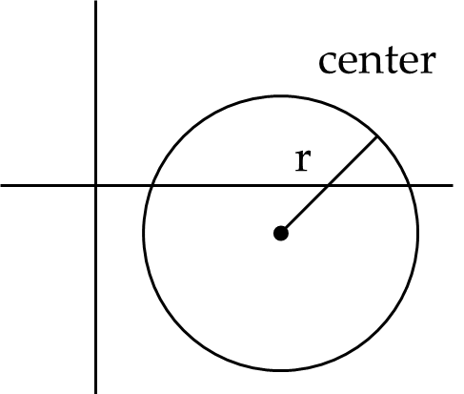
Circle Implementation 1
public class Circle1 {
private Point center;
private double rad;
// Rep invariant:
//
// ...
}

Slide 41
Circle Implementation 1
public class Circle1 {
private Point center;
private double rad;
// Rep invariant:
// center != null && rad > 0
// ...
}

Slide 42
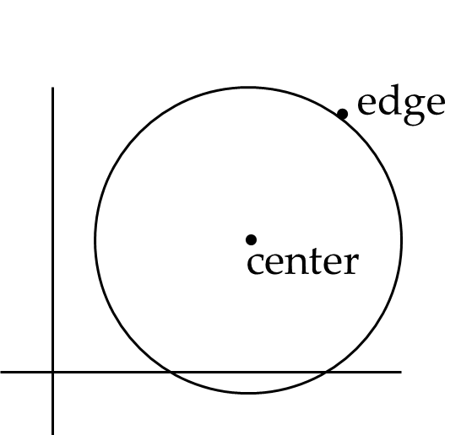
Circle Implementation 2
public class Circle2 {
private Point center;
private Point edge;
// Rep invariant:
//
// ...
}

Slide 43
Circle Implementation 2
public class Circle2 {
private Point center;
private Point edge;
// Rep invariant:
// center != null &&
// edge != null &&
// !center.equals(edge)
// ...
}

Slide 44
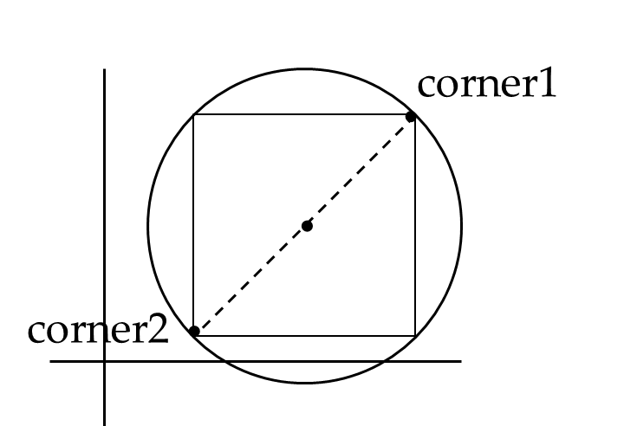
Circle Implementation 3
public class Circle3 {
private Point corner1, corner2;
// Rep invariant:
//
// ...
}

Slide 45
Circle Implementation 3
public class Circle3 {
private Point corner1, corner2;
// Rep invariant:
// corner1 != null &&
// corner2 != null &&
// !corner1.equals(corner2)
// ...
}

Slide 46
Checking Rep Invariants
Representation invariant should hold before and after every public method
Write and use checkRep()
Call before and after public methods
Make use of Java’s assert syntax!
OK that it adds extra code
Asserts won’t be included on release builds
Important for finding bugs

Slide 47
checkRep() Example with Asserts
public class Circle1 {
private Point center;
private double rad;
private void checkRep() {
assert center != null : “This does not have a center”;
assert radius > 0 : “This circle has a negative radius”;
}
}
A lot neater!

Slide 48
Using Asserts
To enable asserts: Go to Run->Run Configurations…->Arguments tab-> input
–ea in VM arguments section
Do this for every test file
Demo!

Slide 49
Abstraction Function
Abstraction function: a mapping from internal state to abstract value
Abstract fields may not map directly to representation fields
Circle has radius but not necessarily
private int radius;
Internal representation can be anything as long as it somehow encodes the abstract value
Representation Invariant excludes values for which the abstraction function has no meaning

Slide 50
Circle Implementation 1
public class Circle1 {
private Point center;
private double rad;
// Abstraction function:
// AF(this) = a circle c such that
// c.center =
// c.radius =
// Rep invariant:
// center != null && rad > 0
// ...
}

Slide 51
Circle Implementation 1
public class Circle1 {
private Point center;
private double rad;
// Abstraction function:
// AF(this) = a circle c such that
// c.center = this.center
// c.radius = this.rad
// Rep invariant:
// center != null && rad > 0
// ...
}

Slide 52
Circle Implementation 2
public class Circle2 {
private Point center;
private Point edge;
// Abstraction function:
// AF(this) = a circle c such that
// c.center =
// c.radius =
// Rep invariant:
// center != null && edge ! null && !center.equals(edge)
// ...
}

Slide 53
Circle Implementation 2
public class Circle2 {
private Point center;
private Point edge;
// Abstraction function:
// AF(this) = a circle c such that
// c.center = this.center
// c.radius = sqrt((center.x-edge.x)^2 + (center.y-edge.y)^2)
// Rep invariant:
// center != null && edge ! null && !center.equals(edge)
// ...
}

Slide 54
Circle Implementation 3
public class Circle3 {
private Point corner1, corner2;
// Abstraction function:
// AF(this) = a circle c such that
// c.center =
// c.radius =
// Rep invariant:
// corner1 != null && corner2 != null && !corner1.equals(corner2)
// ...
}

Slide 55
Circle Implementation 3
public class Circle3 {
private Point corner1, corner2;
// Abstraction function:
// AF(this) = a circle c such that
// c.center = <(corner1.x + corner2.x) / 2, (corner.y + corner2.y) / 2>
// c.radius = (1/2)*sqrt((corner1.x- corner2.x)^2 + (corner1.y- corner2.y)^2)
// Rep invariant:
// corner1 != null && corner2 != null && !corner1.equals(corner2)
// ...
}

Slide 56
ADT Example: NonNullStringList
public class NonNullStringList {
// Abstraction function:
// ??
// Rep invariant:
// ??
public void add(String s) { ... }
public boolean remove(String s) { ... }
public String get(int i) { ... }
}

Slide 57
NonNullStringList Implementation 1
public class NonNullStringList {
// Abstraction function:
// Index i in arr contains the ith element in the list
// Rep invariant:
// RI = [0,count-1] != null
private String[] arr;
private int count;
public void add(String s) { ... }
public boolean remove(String s) { ... }
public String get(int i) { ... }
}
Problems?

Slide 58
NonNullStringList Implementation 2
public class NonNullStringList {
// Abstraction function:
// Value in the nth node after head contains the nth item in the list
// Rep invariant:
// RI = Head has size nodes after it, each whose value is non-null, no cycle in ListNodes
public int size;
public ListNode head;
public void add(String s) { ... }
public boolean remove(String s) { ... }
public String get(int i) { ... }
}

