Slide 1
SECTION 2: HW3 Setup
cse331-staff@cs.washington.edu
slides borrowed and adapted from Alex Mariakis and CSE 390a

Slide 2
DEVELOPER TOOLS
Remote access
Eclipse and Java versions
Version Control

Slide 3
VERSION CONTROL

Slide 4
WHAT IS VERSION CONTROL?
Also known as source control/revision control
System for tracking changes to code
Software for developing software
Essential for managing projects
See a history of changes
Revert back to an older version
Merge changes from multiple sources
We’ll be talking about git/GitLab, but there are alternatives
Subversion, Mercurial, CVS
Email, Dropbox, USB sticks (don’t even think of doing this)
Notes:
Ask: who’s heard of / used version control before?
Motivate: synchronization among devs, seeing history of project, making backups
Extra motivation: have you ever seen what happened to large projects that DON’T use vc? (not just software either)
Especially useful when multiple devs, but useful even for your own projects
Using it for projects in this class. Worth the effort to learn, b/c you will use it in future classes and every internship and job.
Easy to:
Merge multiple developers’ changes
No more “Here’s my list of changes … at least I think that’s everything… now what did you change?”)
Avoid overwriting each others’ changes
No more “don’t touch this file – I’m working on it!”
No more “AHHHHHH, you just erased my last 15 hours of work!!!”
Revert back to an older version of a file
No more “I need to undo these changes… what was there before?”)
See a history of changes
No more “How and when did this bug sneak in?”
Version control describes a TYPE of software (just like a text editor, Internet browser, …)
Just like there are lots of text editors and browsers, there are lots of version control systems; we use Subversion
Each is a little diff, but once you know one it’s easy to learn others

Slide 5
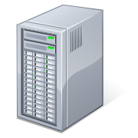
VERSION CONTROL ORGANIZATION
A repository stores the master copy of the project
Someone creates the repo for a new project
Then nobody touches this copy directly
Lives on a server everyone can access
Each person clones her own working copy
Makes a local copy of the repo
You’ll always work off of this copy
The version control system syncs the repo and working copy (with your help)
Repository
git
Working copy
Working copy

Slide 6
REPOSITORY
Can create the repository anywhere
Can be on the same computer that you’re going to work on, which might be ok for a personal project where you just want rollback protection
But, usually you want the repository to be robust:
On a computer that’s up and running 24/7
Everyone always has access to the project
On a computer that has a redundant file system
No more worries about that hard disk crash wiping away your project!
We’ll use CSE GitLab – very similar to GitHub but tied to CSE accounts and authentication

Slide 7
VERSION CONTROL COMMON ACTIONS
Most common commands:
add / commit / push
integrate changes from your working copy into the repository
pull
integrate changes into your working copy from the repository
Repository
git
pull
push
Working copy

Slide 8
VERSION CONTROL UPDATING FILES
In a bit more detail:
You make some local changes, test them, etc., then…
git add – tell git which changed files you want to save in repo
git commit – save all files you’ve “add”ed in the local repo copy as an identifiable update
git push – synchronize with the GitLab repo by pushing local committed changes
Repository
git
pull
push
Working copy

Slide 9
VERSION CONTROL COMMON ACTIONS (CONT.)
Other common commands:
add, rm
add or delete a file in the working copy
just putting a new file in your working copy does not add it to the repo!
still need to commit to make permanent
Repository
git
pull
push
Working copy
Notes:
Summary: create repo, create workspace, repeatedly update & commit
Remember to ask for questions!

Slide 10
THIS QUARTER
We distribute starter code by adding it to your GitLab repo. You retrieve it with git clone the first time then git pull for later assignments
You will write code using Eclipse
You turn in your files by adding them to the repo, committing your changes, and eventually pushing accumulated changes to GitLab
You “turn in” an assignment by tagging your repo and pushing the tag to GitLab
You will validate your homework by SSHing onto attu, cloning your repo, and running an Ant build file

Slide 11
331 VERSION CONTROL
create/push
Repository
pull
Working copy for grading
commit/push
clone/pull
add
Working copy

Slide 12
ECLIPSE

Slide 13
WHAT IS ECLIPSE?
Integrated development environment (IDE)
Allows for software development from start to finish
Type code with syntax highlighting, warnings, etc.
Run code straight through or with breakpoints (debug)
Break code
Mainly used for Java
Supports C, C++, JavaScript, PHP, Python, Ruby, etc.
Alternatives
NetBeans, Visual Studio, IntelliJIDEA

Slide 14
ECLIPSE SHORTCUTS
Shortcut | Purpose
Ctrl + D | Delete an entire line
Alt + Shift + R | Refactor (rename)
Ctrl + Shift + O | Clean up imports
Ctrl + / | Toggle comment
Ctrl + Shift + F | Make my code look nice ☺
Notes:
Demo these shortcuts and their uses briefly

Slide 15
ECLIPSE and Java
Get Java 8
Important: Java separates compile and execution, eg:
javac Example.java Example.class
Both compile and execute have to be the same Java!
Please use Eclipse 4.5 (Mars), “Eclipse for Java Developers”
Instructions: http://courses.cs.washington.edu/courses/cse331/15au/tools/WorkingAtHome.html#Step_1
produces

Slide 16
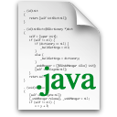
ECLIPSE and Java
.java files
Human readable ‘code’ file
.class files
Compiled version of .java files. Typically represented as Byte code to run on the Java
Virtual Machine (JVM)
.jar files
Packaged aggregate of
.class files and metadata

Slide 17
331 VERSION CONTROL
Your main repository is on GitLab
Only clone once (unless you’re working in a lot of places)
Don’t forget to add/commit/push files!
Check in your work!

Slide 18
HW 3
Many small exercises to get you used to version control and tools and a Java refresher
More information on homework instructions: http://courses.cs.washington.edu/courses/cse331/15au/hws/hw3/hw3.html
Committing changes: Instructions
How you turn in your assignments
Updating changes: Instructions
How you retrieve new assignments

Slide 19
Turning in HW3
Instructions
Done by simply committing your changes
Good to do this early and often
Then when you’re done, create a hw3-final tag on the last commit and push the tag to the repo
After the final commit and tag pushed, remember to log on to attu and run ant validate

Slide 20
Ant Validate
What will this do?
You start with a freshly cloned copy of your repo and do “git checkout hw3-final” to switch to the files you intend for us to grade, then run ant validate
Makes sure you have all the required files
Make sure your homework builds without errors
Passes specification and implementation tests in the repository
Note: this does not include the additional tests we will use when grading
This is just a sanity check that your current tests pass

Slide 21
Ant Validate
How do you run ant validate?
Has to be done on attu from the command line since that is the environment your grading will be done on
Do not use the Eclipse ant validate build tool!
Be sure to use a fresh copy of your repo, and discard that copy when you’re done
If you need to fix things, do it in your primary working copy (eclipse)

Slide 22
Ant Validate
How do you run ant validate?
Steps
Log into attu via SSH
In attu, checkout a brand new local copy (clone) of your repository through the command-line
Note: Now, you have two local copies of your repository, one on your computer through Eclipse and one in attu
Go to the hw folder which you want to validate through the ‘cd’ command, then switch to the hw3 tag
For example: cd ~/cse331/src/hw3 git checkout hw3-final
Run ant validate

Slide 23
Ant Validate
How do you know it works?
If successful, will output Build Successful at the bottom
If unsuccessful, will output Build Failed at the bottom with information on why
If ant validate failed, discard the validate copy of the repo on attu, fix and commit changes through eclipse, go back to attu, clone a fresh copy of the repo, and try ant validate again

Slide 24
ECLIPSE DEBUGGING (if time)
System.out.println() works for debugging…
It’s quick
It’s dirty
Everyone knows how to do it
…but there are drawbacks
What if I’m printing something that’s null?
What if I want to look at something that can’t easily be printed (e.g., what does my binary search tree look like now)?
Eclipse’s debugger is powerful…if you know how to use it

Slide 25
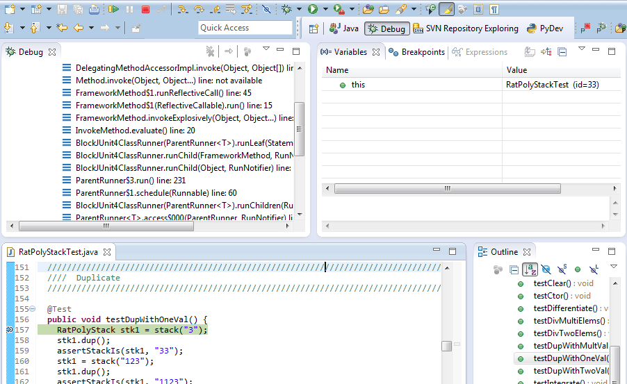
ECLIPSE DEBUGGING

Slide 26
ECLIPSE DEBUGGING
Double click in the grey area to the left of your code to set a breakpoint. A breakpoint is a line that the Java VM will stop at during normal execution of your program, and wait for action from you.

Slide 27
ECLIPSE DEBUGGING
Click the Bug icon to run in Debug mode. Otherwise your program won’t stop at your breakpoints.

Slide 28
ECLIPSE DEBUGGING
Controlling your program while debugging is done with these buttons

Slide 29
ECLIPSE DEBUGGING
Play, pause, stop work just like you’d expect

Slide 30
ECLIPSE DEBUGGING
Step Into
Steps into the method at the current execution point – if possible. If not possible then just proceeds to the next execution point.
If there’s multiple methods at the current execution point step into the first one to be executed.

Slide 31
ECLIPSE DEBUGGING
Step Over
Steps over any method calls at the current execution point.
Theoretically program proceeds just to the next line.
BUT, if you have any breakpoints set that would be hit in the method(s) you stepped over, execution will stop at those points instead.

Slide 32
ECLIPSE DEBUGGING
Step Out
Allows method to finish and brings you up to the point where that method was called.
Useful if you accidentally step into Java internals (more on how to avoid this next).
Just like with step over though you may hit a breakpoint in the remainder of the method, and then you’ll stop at that point.

Slide 33
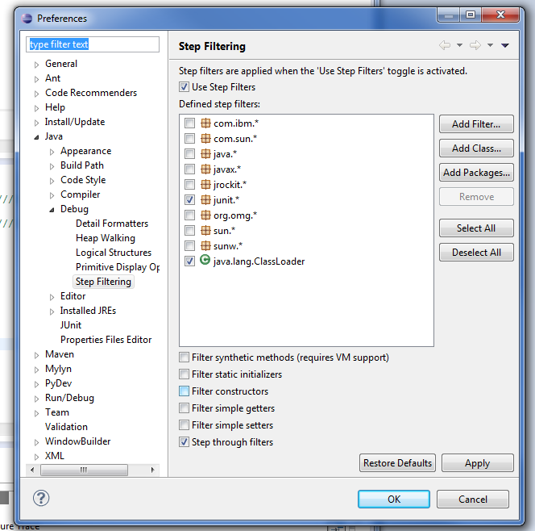
ECLIPSE DEBUGGING
Enable/disable step filters
There’s a lot of code you don’t want to enter when debugging, internals of Java, internals of JUnit, etc.
You can skip these by configuring step filters.
Checked items are skipped.

Slide 34
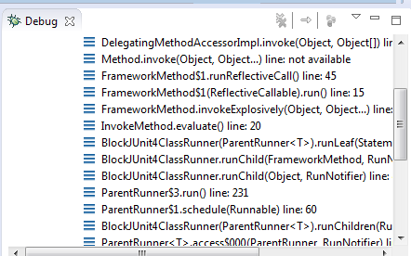
ECLIPSE DEBUGGING
Stack Trace
Shows what methods have been called to get you to current point where program is stopped.
You can click on different method names to navigate to that spot in the code without losing your current spot.

Slide 35
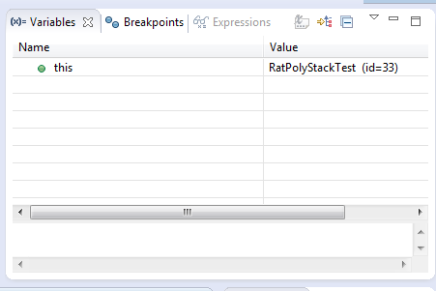
ECLIPSE DEBUGGING
Variables Window
Shows all variables, including method parameters, local variables, and class variables, that are in scope at the current execution spot. Updates when you change positions in the stackframe. You can expand objects to see child member values. There’s a simple value printed, but clicking on an item will fill the box below the list with a pretty format.
Some values are in the form of ObjectName (id=x), this can be used to tell if two variables are reffering to the same object.

Slide 36
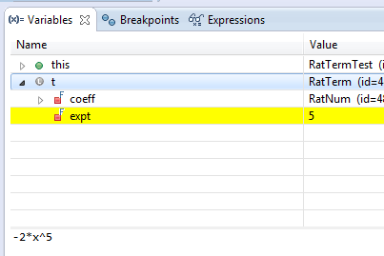
ECLIPSE DEBUGGING
Variables that have changed since the last break point are highlighted in yellow.
You can change variables right from this window by double clicking the row entry in the Value tab.

Slide 37
ECLIPSE DEBUGGING
Variables that have changed since the last break point are highlighted in yellow.
You can change variables right from this window by double clicking the row entry in the Value tab.

Slide 38
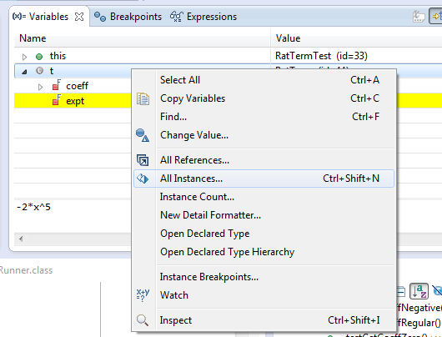
ECLIPSE DEBUGGING
There’s a powerful right-click menu.
See all references to a given variable
See all instances of the variable’s class
Add watch statements for that variables value (more later)

Slide 39
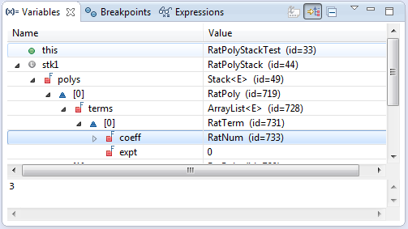
ECLIPSE DEBUGGING
Show Logical Structure
Expands out list items so it’s as if each list item were a field (and continues down for any children list items)

Slide 40
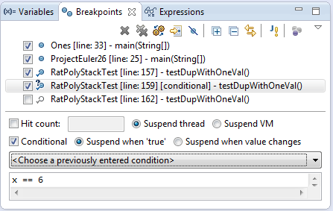
ECLIPSE DEBUGGING
Breakpoints Window
Shows all existing breakpoints in the code, along with their conditions and a variety of options.
Double clicking a breakpoint will take you to its spot in the code.

Slide 41
ECLIPSE DEBUGGING
Enabled/Disabled Breakpoints
Breakpoints can be temporarily disabled by clicking the checkbox next to the breakpoint. This means it won’t stop program execution until re-enabled.
This is useful if you want to hold off testing one thing, but don’t want to completely forget about that breakpoint.

Slide 42
ECLIPSE DEBUGGING
Hit count
Breakpoints can be set to occur less-frequently by supplying a hit count of n.
When this is specified, only each n-th time that breakpoint is hit will code execution stop.

Slide 43
ECLIPSE DEBUGGING
Conditional Breakpoints
Breakpoints can have conditions. This means the breakpoint will only be triggered when a condition you supply is true. This is very useful for when your code only breaks on some inputs!
Watch out though, it can make your code debug very slowly, especially if there’s an error in your breakpoint.

Slide 44
ECLIPSE DEBUGGING
Disable All Breakpoints
You can disable all breakpoints temporarily. This is useful if you’ve identified a bug in the middle of a run but want to let the rest of the run finish normally.
Don’t forget to re-enable breakpoints when you want to use them again.

Slide 45
ECLIPSE DEBUGGING
Break on Java Exception
Eclipse can break whenever a specific exception is thrown. This can be useful to trace an exception that is being “translated” by library code.

Slide 46
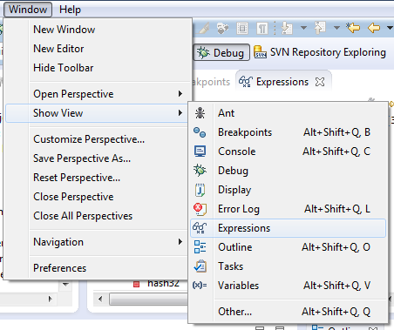
ECLIPSE DEBUGGING
Expressions Window
Used to show the results of custom expressions you provide, and can change any time.
Not shown by default but highly recommended.

Slide 47
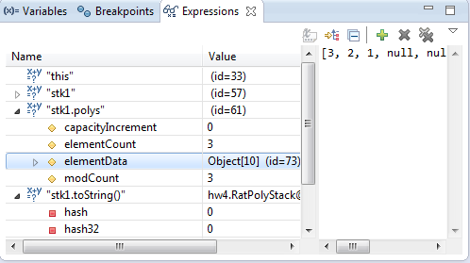
ECLIPSE DEBUGGING
Expressions Window
Used to show the results of custom expressions you provide, and can change any time.
Resolves variables, allows method calls, even arbitrary statements “2+2”
Beware method calls that mutate program state – e.g. stk1.clear() or in.nextLine() – these take effect immediately

Slide 48
ECLIPSE DEBUGGING
Expressions Window
These persist across projects, so clear out old ones as necessary.

Slide 49
ECLIPSE DEBUGGING
The debugger is awesome, but not perfect
Not well-suited for time-dependent code
Recursion can get messy
Technically, we talked about a “breakpoint debugger”
Allows you to stop execution and examine variables
Useful for stepping through and visualizing code
There are other approaches to debugging that don’t involve a debugger

