Slide 1
Warmup
["hip","hip"]
=
???
Hip Hip Array!

Slide 2
Section 3: HW4, ADTs, and more
Slides by Alex Mariakakis
with material from Krysta Yousoufian, Mike Ernst, Kellen Donohue

Slide 3
Agenda
HW4 setup
Abstract data types (ADTs)
Method specifications

Slide 4
HW#4 DEMO

Slide 5
Polynomial Addition
(5x⁴ + 4x³ - x² + 5)
+
(3x⁵ - 2x³ + x – 5)
5x⁴ + 4x³ - x² + 5
+ 0x
+ 0x⁴
+ 0x²
+
3x⁵ - 2x³ + x – 5
3x⁵ + 5x⁴ - 2x³ - x² + x + 0

Slide 6
Polynomial Multiplication
(4x³ - x² + 5)
*
(x – 5)
4x³ - x² + 5
*
x – 5
-20x³ + 5x² – 25
+
4x⁴ -x³ + 5x
4x⁴ -21x³ + 5x² + 5x - 25

Slide 7
Polynomial Division
(5x⁶ + 4x⁴ – x³ + 5)
/
(x³ - 2x – 5)
x³ - 2x – 5
5x⁶ + 4x⁴ – x³ + 5

Slide 8
Polynomial Division
5
0
14
24
1 0 -2 -5
5 0 4 -1 0 0 5
-
5 0 -10 -25
0 14 24 0
0 0 0 0
-
14 24 0 0
5x³ + 14x + 24
-
14 0 -28 -70
28x² + 118x + 125
+
24 28 70 5
x³ - 2x – 5
-
24 0 -48 -120
0 28 118 125

Slide 9
ADT Example: Line
Suppose we want to make a Line class that represents lines on the Cartesian plane
.
.
See http://courses.cs.washington.edu/courses/cse331/13au
/conceptual-info/specifications.html for more

Slide 10
Definitions
Abstract Value: what an instance of a class is supposed to represent
Line represents a given line
Abstract State: the information that defines the abstract value
Each line has a start point and an end point
Abstract Invariant: the conditions that must remain true over the abstract state for all instances
Start point and end point must be distinct

Slide 11
Definitions (cont.)
Specification Fields: describes components of the abstract state of a class
Line has specification fields startPoint, endPoint
Derived Specification Fields: information that can be derived from specification fields but useful to have
length = sqrt((x1-x2)^2 + (y1-y2)^2)

Slide 12
ADT Example: Line
/**
* This class represents the mathematical concept of a line segment.
*
* Specification fields:
* @specfield start-point : point // The starting point of the line.
* @specfield end-point : point // The ending point of the line.
*
* Derived specification fields:
* @derivedfield length : real // The length of the line.
*
* Abstract Invariant:
* A line's start-point must be different from its end-point.
*/
public class Line {
…
}

Slide 13
ADT Example: Line
/**
* This class represents the mathematical concept of a line segment.
*
* Specification fields:
* @specfield start-point : point // The starting point of the line.
* @specfield end-point : point // The ending point of the line.
*
* Derived specification fields:
* @derivedfield length : real // The length of the line.
*
* Abstract Invariant:
* A line's start-point must be different from its end-point.
*/
public class Line {
…
}
Abstract Value

Slide 14
ADT Example: Line
/**
* This class represents the mathematical concept of a line segment.
*
* Specification fields:
* @specfield start-point : point // The starting point of the line.
* @specfield end-point : point // The ending point of the line.
*
* Derived specification fields:
* @derivedfield length : real // The length of the line.
*
* Abstract Invariant:
* A line's start-point must be different from its end-point.
*/
public class Line {
…
}
Abstract State

Slide 15
ADT Example: Line
/**
* This class represents the mathematical concept of a line segment.
*
* Specification fields:
* @specfield start-point : point // The starting point of the line.
* @specfield end-point : point // The ending point of the line.
*
* Derived specification fields:
* @derivedfield length : real // The length of the line.
*
* Abstract Invariant:
* A line's start-point must be different from its end-point.
*/
public class Line {
…
}
Abstract Invariant

Slide 16
ADT Example: Line
/**
* This class represents the mathematical concept of a line segment.
*
* Specification fields:
* @specfield start-point : point // The starting point of the line.
* @specfield end-point : point // The ending point of the line.
*
* Derived specification fields:
* @derivedfield length : real // The length of the line.
*
* Abstract Invariant:
* A line's start-point must be different from its end-point.
*/
public class Line {
…
}
Specification Fields

Slide 17
ADT Example: Line
/**
* This class represents the mathematical concept of a line segment.
*
* Specification fields:
* @specfield start-point : point // The starting point of the line.
* @specfield end-point : point // The ending point of the line.
*
* Derived specification fields:
* @derivedfield length : real // The length of the line.
*
* Abstract Invariant:
* A line's start-point must be different from its end-point.
*/
public class Line {
…
}
Derived Fields

Slide 18
ADT Example: Circle
Suppose we want to make a Circle class that represents circles on the Cartesian plane
.

Slide 19
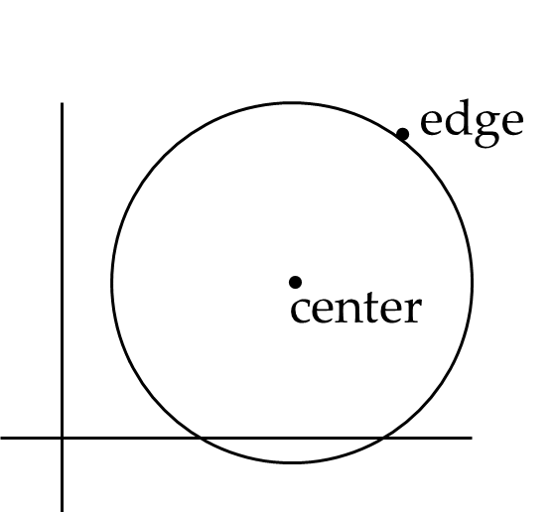
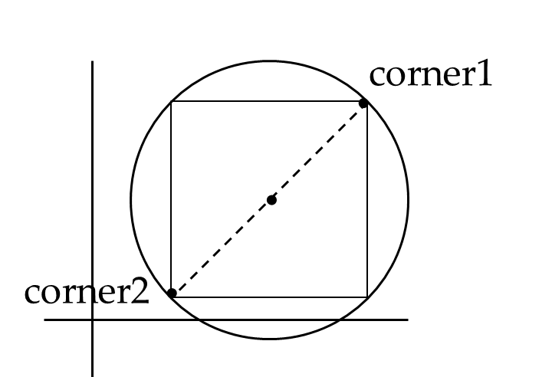
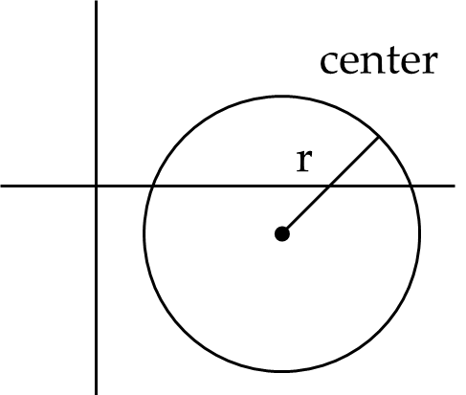
ADT Example: Circle
Abstract Value:
Circle represents a given circle
Abstract State:
Abstract Invariant
Option #1: r > 0, center must exist
Option #2: center and edge must be distinct
Option #3: corner1 and corner2 must be distinct

Slide 20
ADT Example: Circle
Specification Fields:
Option #1: r and center
Option #2: center and edgePoint
Option #3: corner1 and corner2
Derived Specification Fields:
Circumference
Diameter
Area
…

Slide 21
Abstraction
Abstract values, state, and invariants specify the behavior of classes and methods
What should my class do?
We have not implemented any of these ADTs yet
Implementation should not affect abstract state
As long as Circle represents the circle we are interested in, nobody cares how it is implemented

Slide 22
Abstract vs. Concrete
We’ll talk later about representation invariants, which specify how the abstract invariant is implemented
We’ll also discuss how abstraction functions map the concrete representation of an ADT to the abstract value

Slide 23
Javadoc Documentation
Tool made by Oracle for API documentation
We’ve already seen Javadoc for external class specification
Method specifications will describe method behavior in terms of preconditions and postconditions

Slide 24
Javadoc Method Tags
@requires: the statements that must be met by the method’s caller
@return: the value returned by the method, if any
@throws: the exceptions that may be raised, and under which conditions
@modifies: the variables that may change because of the method
@effects: the side effects of the method

Slide 25
Javadoc Method Tags
If @requires is not met, anything can happen
False implies everything
The conditions for @throws must be a subset of the precondition
Ex: If a method @requires x > 0, @throws should not say anything about x < 0
@modifies lists what may change, while @effects indicates how they change
If a specification field is listed in the @modifies clause but not in the @effects clause, it may take on any value (provided that it follows the abstract invariant)
If you mention a field in @modifies, you should try to specify what happens in @effects

