Slide 1
CSE 331 Software Design & Implementation
Hal Perkins
Autumn 2012
Wrapup

Slide 2
10 weeks ago…
We have 10 weeks to move to a level well above novice programmer:
Principled, systematic programming: What does it mean to get it right? How do we know when we get there? What are best practices for doing this?
Effective use of languages and tools: Java, IDEs, debuggers, JUnit, JavaDoc, svn
The principles are ultimately more important than the details
Larger programs

Slide 3
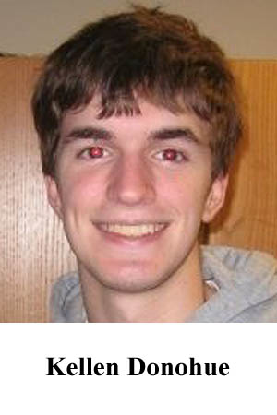
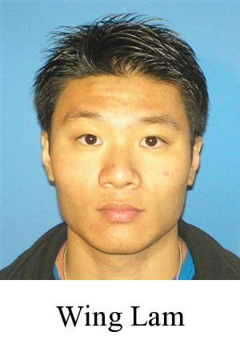
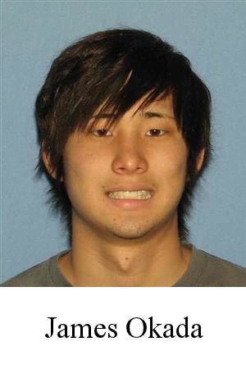
A huge thanks to the folks who made it work

Slide 4
CSE 331 goals
Enable you to
manage complexity
ensure correctness
write modest programs
(modest by industry standards, that is….)
Notes:
Prerequisite: CSE 143

Slide 5
CSE 331 topics
Manage complexity:
Abstraction
Specification
Modularity
Program design & organization
OO design, dependences, design patterns, tradeoffs
Subtyping
Documentation
Ensure correctness:
Reasoning
Testing
Debugging
Write programs:
Practice and feedback
Introduction to: tools (version control, debuggers), understanding libraries, software process, requirements, usability

Slide 6
Divide and conquer: Modularity, abstraction, specs
No one person can understand all of a realistic system
Modularity permits focusing on just one part
Abstraction enables ignoring detail
Specifications (and documentation) formally describe behavior
Reasoning relies on all three to understand/fix errors
Or to avoid them in the first place

Slide 7
Getting it right ahead of time
Design: predicting implications
Example: understanding interconnections, module dependency diagrams
Understanding the strengths and weaknesses
If you don’t understand a design, you can’t use it
Documentation matters!

Slide 8
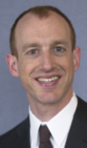
Documentation
Everyone wants good documentation when using a system
Not everyone likes writing documentation
Documentation is often the most important part of a user interface
What’s obvious to you may not be obvious to others
An undocumented software system has zero commercial value.
John Chapin
CTO of Vanu, Inc.

Slide 9
Testing
Helps you understand what you didn’t understand while designing and implementing
A good test suite exercises each behavior
Theory: revealing subdomains, proves correctness
Practice: code coverage, value coverage, boundary values
Practice: testing reveals errors, never proves correctness
A good test suite makes a developer fearless during maintenance

Slide 10
Maintenance
Maintenance accounts for most of the effort spent on a successful software system
often 90% or more
A good design enables the system to adapt to new requirements while maintaining quality
Think about the long term, but don’t prematurely optimize
Good documentation enables others to understand the design
A good test suite greatly reduces the risks of changes
And is a big part of the documentation/history of the project

Slide 11
Correctness
In the end, only correctness matters
Near-correctness is often easy!
Getting it right can be difficult
How to determine the goal?
Requirements
Design documents for the customer
How to increase the likelihood of achieving the goal?
Unlikely without use of modularity, abstraction, specification, documentation, design, …
Doing the job right is usually justified by return on investment (ROI)
How to verify that you achieved it?
Testing
Reasoning (formal or informal) helps!
Use proofs and tools as appropriate

Slide 12
Working in a team
No one person can understand all of a realistic system
Break the system into pieces
Use modularity, abstraction, specification, documentation
Different points of view bring value
Diversity is not just a “feel good” issue
Work effectively with others
Sometimes challenging, usually worth it
Manage your resources effectively
Time, people
Engineering is about tradeoffs
Both technical and management contributions are critical

Slide 13
How CSE 331 fits together
Lectures: ideas
⇒ Assignments: get practice
Specifications
Testing
Subtyping
Equality & identity
Polymorphism
Design patterns
Reasoning, debugging
Events
Usability, teamwork
Design classes
Write tests
Write subclasses
Override equals, use collections
Write generic class
Larger designs
Correctness, testing
GUIs
(For fun and for future use)

Slide 14
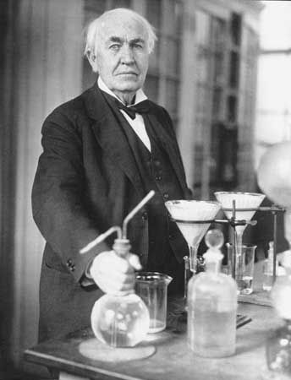
What you have learned in CSE 331
Compare your skills today to 3 months ago
Theory: abstraction, specification, design
Practice: implementation, testing
Theory & practice: correctness
Bottom line: Much of what we’ve done would be easy for you today
This is a measure of how much you have learned
There is no such thing as a “born” programmer!
Your next project can be more ambitious
Genius is 1% inspiration and 99% perspiration.
Thomas A. Edison
Notes:
Practice: also “teamwork” in some terms.

Slide 15
What you will learn later
Your next project can be much more ambitious
Know your limits
Be humble (reality helps you with this)
You will continue to learn
Building interesting systems is never easy
Like any worthwhile endeavor
Practice is a good teacher
Requires thoughtful introspection
Don’t learn only by trial and error!

Slide 16
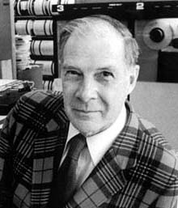
What comes next?
Classes
CSE 403 Software Engineering
Focuses more on requirements, sofware lifecycle, teamwork
Capstone projects
Any class that requires software design and implementation
Research
In software engineering & programming systems
In any topic that involves software
Having an impact on the world
Jobs (and job interviews)
Larger programming projects
The purpose of computing is insight, not numbers.
Richard W. Hamming
Numerical Methods for Scientists and Engineers

Slide 17
Go forth and conquer
System building is fun!
It’s even more fun when you build it successfully
Pay attention to what matters
Use the techniques and tools of CSE 331 effectively

