Slide 1
CSE 331 Software Design & Implementation
Hal Perkins
Winter 2012
Usability
(Slides by Mike Ernst and David Notkin based on slides due to Robin Miller)

Slide 2
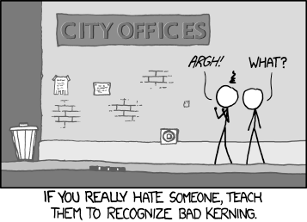
Usability
A lecture on usability won’t make anyone an interface expert – any more than using LaTeX makes one a graphics designer. But it’s important to have some appreciation for the issues. And you’re designing a UI in hw8….

Slide 3
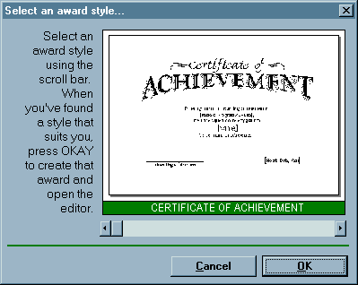
User Interface Hall of Shame
Source: Interface Hall of Shame
Notes:
Usability is about creating effective user interfaces (UIs). Slapping a pretty window interface on a program does not automatically confer usability on it. This example shows why. This dialog box, which appeared in a program that prints custom award certificates, presents the task of selecting a template for the certificate.
This interface is clearly graphical. It’s mouse-driven – no memorizing or typing complicated commands. It’s even what-you-see-is-what-you-get (WYSIWYG) – the user gets a preview of the award that will be created. So why isn’t it usable?
The first clue that there might be a problem here is the long help message on the left side. Why so much help for a simple selection task? Because the interface is bizarre! The scrollbar is used to select an award template. Each position on the scrollbar represents a template, and moving the scrollbar back and forth changes the template shown.
This is a cute but bad use of a scrollbar. Notice that the scrollbar doesn’t have any marks on it. How many templates are there? How are they sorted? How far do you have to move the scrollbar to select the next one? You can’t even guess from this interface.

Slide 4
What’s wrong?
Usability is about creating effective user interfaces
The first slide shows a WYSIWYG GUI – but it still fails – why?
The long help message is needed for a simple task because the interface is bizarre!
The scrollbar is used to select an award template
Each position on the scrollbar represents a template, and moving the scrollbar back and forth changes the template shown
Cute but bad use of a scrollbar
How many templates? No indication on scrollbar
How are the templates organized? No hint

Slide 5
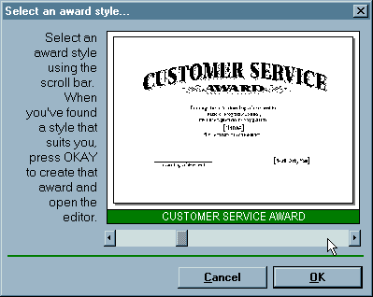
User Interface Hall of Shame
Inconsistent with common usage of scrollbars – usually used for continuous scrolling, not discrete selection
How does a frequent user find a template they’ve used before?
Source: Interface Hall of Shame
Notes:
Normally, a horizontal scrollbar underneath an image (or document, or some other content) is designed for scrolling the content horizontally. A new or infrequent user looking at the window sees the scrollbar, assumes it serves that function, and ignores it. Inconsistency with prior experience and other applications tends to trip up new or infrequent users.
Another way to put it is that the horizontal scrollbar is an affordance for continuous scrolling, not for discrete selection. We see affordances out in the real world, too; a door knob says “turn me”, a handle says “pull me”. We’ve all seen those apparently-pullable door handles with a little sign that says “Push”; and many of us have had the embarrassing experience of trying to pull on the door before we notice the sign. The help text on this dialog box is filling the same role here.
But the dialog doesn’t get any better for frequent users, either. If a frequent user wants a template they’ve used before, how can they find it? Surely they’ll remember that it’s 56% of the way along the scrollbar? This interface provides no shortcuts for frequent users. In fact, this interface takes what should be a random access process and transforms it into a linear process. Every user has to look through all the choices, even if they already know which one they want. The computer scientist in you should cringe at that algorithm.
Even the help text has usability problems. “Press OKAY”? Where is that? And why does the message have a ragged left margin? You don’t see ragged left too often in newspapers and magazine layout, and there’s a good reason.
On the plus side, the designer of this dialog box at least recognized that there was a problem – hence the help message. But the help message is indicative of a flawed approach to usability. Usability can’t be left until the end of software development, like package artwork or an installer. It can’t be patched here and there with extra messages or more documentation. It must be part of the process, so that usability bugs can be fixed, instead of merely patched.
How could this dialog box be redesigned to solve some of these problems?

Slide 6
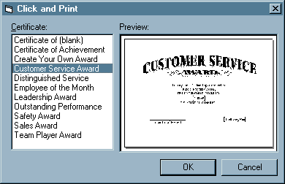
Redesigning the Interface
Source: Interface Hall of Shame
Notes:
Here’s one way it might be redesigned. The templates now fill a list box on the left; selecting a template shows its preview on the right. This interface suffers from none of the problems of its predecessor: list boxes clearly afford selection to new or infrequent users; random access is trivial for frequent users. And no help message is needed.

Slide 7
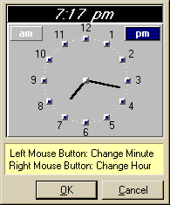
Another for the Hall of Shame
The date and time look editable but aren’t – click “Set Time” for a dialog box instead
Dialog box displays inconsistently with launch time – 12 vs. 24, analog vs. digital
Click left [right] button to increase the minutes [hours] by 1 – makes a sophisticated GUI into a clock radio!
Source: Interface Hall of Shame
Notes:
Here’s another bizarre interface, taken from a program that launches housekeeping tasks at scheduled intervals. The date and time look like editable fields (affordance!), but you can’t edit them with the keyboard. Instead, if you want to change the time, you have to click on the Set Time button to bring up a dialog box.
This dialog box displays time differently, using 12-hour time (7:17 pm) where the original dialog used 24-hour time (consistency!). Just to increase the confusion, it also adds a third representation, an analog clock face.
So how is the time actually changed? By clicking mouse buttons: clicking the left mouse button increases the minute by 1 (wrapping around from 59 to 0), and clicking the right mouse button increases the hour. Sound familiar? This designer has managed to turn a sophisticated graphical user interface, full of windows, buttons, and widgets, and controlled by a hundred-key keyboard and two-button mouse, into a clock radio!
Perhaps the worst part of this example is that it’s not a result of laziness. Somebody went to a lot of effort to draw that clock face with hands. If only they’d spent some of that time thinking about usability instead.

Slide 8
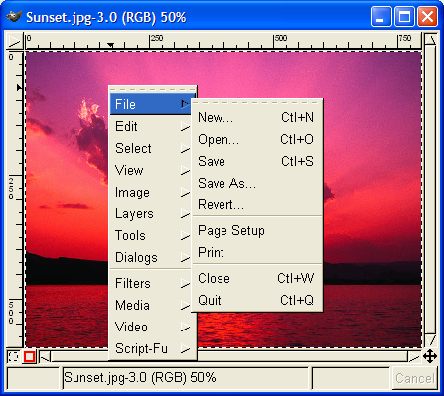
Hall of Fame or Hall of Shame?
Gimp windows had no menus – instead, right-click to get a popup menu and navigate further. Is this a fast way to select commands?
Notes:
Gimp is an open-source image editing program, comparable to Adobe Photoshop. Gimp’s designers made a strange choice for its menus. Gimp windows have no menu bar. Instead, all Gimp menus are accessed from a context menu, which pops up on right-click.
This is certainly inconsistent with other applications, and new users are likely to stumble trying to find, for example, the File menu, which never appears on a context menu in other applications. (I certainly stumbled as a new user of Gimp.) But Gimp’s designers were probably thinking about expert users when they made this decision. A context menu should be faster to invoke, since you don’t have to move the mouse up to the menu bar. A context menu can be popped up anywhere. So it should be faster. Right?
Wrong. We'll see why later in this lecture.

Slide 9
User Interfaces Are Hard to Design
You are not the user
Most software engineering is about communicating with other programmers
UI is about communicating with users
The user is always right
Consistent problems are the system’s fault
…but the user is not always right
Users aren’t designers
Notes:
Unfortunately, user interfaces are not easy to design. You (the developer) are not a typical user. You know far more about your application than any user will. You can try to imagine being your mother, or your grandma, but it doesn’t help much. It’s very hard to forget things you know.
This is how usability is different from everything else you learn about software engineering. Specifications, assertions, and object models are all about communicating with other programmers, who are probably a lot like us. Usability is about communicating with other users, who are probably not like us.
The user is always right. Don’t blame the user for what goes wrong. If users consistently make mistakes with some part of your interface, take it as a sign that your interface is wrong, not that the users are dumb. This lesson can be very hard for a software designer to swallow!
Unfortunately, the user is not always right. Users aren’t oracles. They don’t always know what they want, or what would help them. In a study conducted in the 1950s, people were asked whether they would prefer lighter telephone handsets, and on average, they said they were happy with the handsets they had (which at the time were made rather heavy for durability). Yet an actual test of telephone handsets, identical except for weight, revealed that people preferred the handsets that were about half the weight that was normal at the time. (Klemmer, Ergonomics, Ablex, 1989, pp 197-201).
Users aren’t designers, either, and shouldn’t be forced to fill that role. It’s easy to say, “Yeah, the interface is bad, but users can customize it however they want it.” There are two problems with this statement: (1) most users don’t, and (2) user customizations may be even worse! One study of command abbreviations found that users made twice as many errors with their own command abbreviations than with a carefully-designed set (Grudin & Barnard, “When does an abbreviation become a word?”, CHI ’85). So customization isn’t the silver bullet.

Slide 10
Iterative Design
UI development is an iterative process
Iterations can be costly
If the design turns out to be bad, you may have to throw away most of your code
Design
Evaluate
Implement
Notes:
So user interface development is inherently risky. We don’t (yet) have an easy way to predict whether a UI design will succeed.
Iterative design offers a way to manage the inherent risk in user interface design. In iterative design, the software is refined by repeated trips around a design cycle: first imagining it (design), then realizing it physically (implementation), then testing it (evaluation).
Unfortunately, many commercial UI projects inflict iterative design on their paying customers. They design a bad user interface, implement it, and release it. Evaluation then takes place in the marketplace, as hapless customers buy their product and complain about it. Then they iterate the design process on version 2.
On the other hand, if you keep all your design iterations in-house, you may never release anything! It’s very costly to do every iteration of a design with a high-quality implementation in a language like Java or C++ -- especially if you discover you have to throw away all that code because the design was bad.

Slide 11
Spiral Model
Use throw-away prototypes and cheap evaluation for early iterations
Design
Evaluate
Implement
Notes:
The spiral model offers a way out of the dilemma. We build room for several iterations into our design process, and we do it by making the early iterations as cheap as possible.
The radial dimension of the spiral model corresponds to the cost of the iteration step – or, equivalently, its fidelity or accuracy. For example, an early implementation might be a paper sketch or mockup. It’s low-fidelity, only a pale shadow of what it would look and behave like as interactive software. But it’s incredibly cheap to make, and we can evaluate it by showing it to users and asking them questions about it.

Slide 12
Usability Defined
Usability: how well users can use the system’s functionality
Dimensions of usability
Learnability: is it easy to learn?
Efficiency: once learned, is it fast to use?
Memorability: is it easy to remember what you learned?
Errors: are errors few and recoverable?
Satisfaction: is it enjoyable to use?
Notes:
The property we’re concerned with here, usability, is more precise than just how “good” the system is. A system can be good or bad in many ways. If important requirements are unsatisfied by the system, that’s probably a deficiency in functionality, not in usability. If the system is very expensive or crashes frequently, those problems certainly detract from the user’s experience, but we don’t need user testing to tell us that.
More narrowly defined, usability measures how well users can use the system’s functionality. Usability has several dimensions: learnability, efficiency, memorability, error rate/severity, and subjective satisfaction.
Notice that we can quantify all these measures of usability. Just as we can say algorithm X is faster than algorithm Y on some workload, we can say that interface X is more learnable, or more efficient, or more memorable than interface Y for some set of tasks and some class of users.

Slide 13
Lecture Outline
1. Design
design principles
3. Evaluate
2. Implement
user testing
low-fidelity prototypes
Notes:
Today we’re going to talk about some ideas and techniques used in user interface design: (1) design principles that can guide your conception of a user interface; (2) low-fidelity prototyping techniques that help you try out your design cheaply and easily; and (3) user testing to measure whether your design is usable.

Slide 14
Learnability
Related to “intuitive” and “user-friendly”
The first example had serious problems with learnability, especially with the scrollbar
Unfamiliar usage
Inconsistent usage
And outright inappropriate usage
Source: Interface Hall of Shame
Notes:
Let's start with learnability. This is what many people are thinking about when they use words like "intuitive" or "user-friendly". This example that we saw at the beginning of lecture had serious problems with learnability, because it used the scrollbar in a way that's unfamiliar, inconsistent, and frankly inappropriate

Slide 15
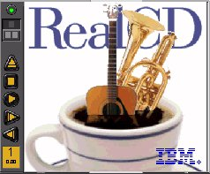
Metaphorical Design
Designers based it on a real-world plastic CD case
Metaphors are one way to make an interface “intuitive,” since users can make guesses about how it will work
Dominated by static artwork – clicking it does nothing
Why? A CD case doesn’t actually play CDs, so the designers had to find a place for the core player controls
The metaphor is dictating control layout, against all other considerations
Also disregards consistency with other desktop applications. Close box? Shut it down?
Source: Interface Hall of Shame
Notes:
IBM’s RealCD is CD player software, which allows you to play an audio CD in your CD-ROM drive.
Why is it called “Real”? Because its designers based it on a real-world object: a plastic CD case. This interface has a metaphor, an analogue in the real world. Metaphors are one way to make an interface “intuitive,” since users can make guesses about how it will work based on what they already know about the physical object that the interface is using as its metaphor. Unfortunately, the designers’ careful adherence to this metaphor produced some remarkable effects, none of them good.
Here’s how RealCD looks when it first starts up. Notice that the UI is dominated by artwork, just like the outside of a CD case is dominated by the cover art. That big RealCD logo is just that – static artwork. Clicking on it does nothing.
There’s an obvious problem with the choice of metaphor, of course: a CD case doesn’t actually play CDs. The designers had to find a place for the player controls – which, remember, serve the primary task of the interface – so they arrayed them vertically along the case hinge. The metaphor is dictating control layout, against all other considerations.
Slavish adherence to the metaphor also drove the designers to disregard all consistency with other desktop applications. Where is this window’s close box? How do I shut it down? You might be able to guess, but is it “intuitive?” Learnability comes from more than just metaphor.

Slide 16
People Don't Learn Instantly
Source: Interface Hall of Shame
To design for learnability it helps to know how people actually learn
This example shows overreliance on the user’s memory
It’s a modal dialog box, so the user needs to click OK
But then the instructions vanish from the screen, and the user is left to struggle to remember them
Just because you've said it, doesn't mean they know it
Notes:
When you're designing for learnability, you have to be aware of how people actually learn. You can't assume that if the interface tells the user something, that the user will immediately learn and remember it.
This dialog box is a great example of overreliance on the user’s memory. It’s a modal dialog box, so the user can’t start following its instructions until after clicking OK. But then the instructions vanish from the screen, and the user is left to struggle to remember them. Just because you've said it, doesn't mean they know it. (Incidentally, an obvious solution to this problem would be a button that simply executes the instructions directly! This message is clearly a last-minute patch for a usability problem.)

Slide 17
Some Facts About Memory & Learning
Working
Memory
Long-term
Memory
Working memory
Small: 7 ± 2 “chunks”
Short-lived: gone in ~10 sec
Maintenance rehearsal is required to keep it from decaying (but costs attention)
Long-term memory
Practically infinite in size and duration
Elaborative rehearsal transfers chunks to long-term memory
Notes:
Here are a few facts about how we learn. Working memory is where you do your conscious thinking. The currently favored model in cognitive science holds that working memory is not actually a separate place in the brain, but rather a pattern of activation of elements in the long-term memory.
A famous result is that the capacity of working memory is roughly 7 ± 2 things. That’s pretty small! A good interface won’t put heavy demands on the user’s working memory. Working memory decays in tens of seconds. Maintenance rehearsal – repeating the items to yourself – fends off this decay, but maintenance rehearsal requires attention. So distractions can destroy working memory.
Long-term memory is probably the least understood part of human cognition. It contains the mass of our memories. Its capacity is huge, and it exhibits little decay. Long-term memories are apparently not intentionally erased; they just become inaccessible.
Maintenance rehearsal (repetition) appears to be useless for moving information into long-term memory. Instead, the mechanism seems to be elaborative rehearsal, which seeks to make connections with existing chunks. Elaborative rehearsal lies behind the power of mnemonic techniques like associating things you need to remember with familiar places, like rooms in your childhood home.

Slide 18
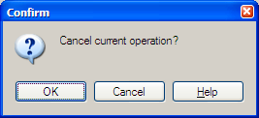
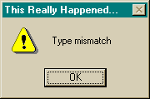
Design Principles for Learnability
Consistency
Similar things look similar, different things different
Terminology, location, argument order, ...
Internal, external, metaphorical
Match the real world
Common words, not tech jargon
Recognition, not recall
Labeled buttons are better than command languages
Combo boxes are better than text boxes
Source: Interface Hall of Shame
Notes:
In designing for learnability, the most important rule is consistency. This rule is often given the hifalutin’ name the Principle of Least Surprise, which basically means that you shouldn’t surprise the user with the way a command or interface object works. Similar things should look, and act, in similar ways. Conversely, different things should be visibly different.
Consistency is important to lots of properties. One important kind of consistency is in wording. Use the same terms throughout your user interface. If your interface says “share price” in one place, “stock price” in another, and “stock quote” in a third, users will wonder whether these are three different things you’re talking about.
There are three kinds of consistency you need to think about: internal consistency within your application, so that things the user learns in one place can be carried over to other places; external consistency with other applications on the same platform; and metaphorical consistency with your interface metaphor or similar real-world objects.
The system should match the real world of the user’s experience as much as possible. Another way to say this is “speak the user’s language.” If the user speaks English, then the interface should also speak English, not Geekish. Technical jargon should be avoided. How might a user interpret the second dialog box shown above? One poor user actually read type as a verb, and dutifully typed M-I-S-M-A-T-C-H every time this dialog appeared. The user’s reaction makes perfect sense when you remember that most computer users do just that, type, all day. But most programmers wouldn’t even think of reading the message that way. Yet another example showing that You Are Not The User.
Technical jargon should only be used when it is specific to the application domain and the expected users are domain experts. An interface designed for doctors shouldn’t dumb down medical terms.
Recognition is better than recall – i.e., if the user can operate your interface by recognizing the function they want, rather than having to recall it from memory, then their learning burden is significantly reduced. Norman (in The Design of Everyday Things) makes a useful distinction between knowledge in the head, which is hard to get in there and still harder to recover, and knowledge in the world, which is far more accessible. Knowledge in the head is what we usually think of as knowledge and memory. Knowledge in the world, on the other hand, means not just documentation and button labels and signs, but also nonverbal features of a system that constrain our actions or remind us of what to do. Command languages demand lots of knowledge in the head, while GUI interfaces driven by buttons and menus rely on knowledge in the world.

Slide 19
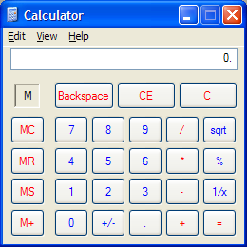
Visibility
Familiar, easy to use
But passes up some tremendous opportunities, including
Why only one line of display?
Why not a history?
Why only one memory slot? Why display “M” instead of the actual number stored in memory?
Visibility also compromised by invisible modes
When entering a number, pressing a digit appends it to the number; but after pressing an operator button, the next digit starts a new number – no visible feedback the low-level mode
It also lets you type numbers on the keyboard, but there is no hint about this
Notes:
We now turn to visibility – making the program's state visible to the user.
This is the Windows XP calculator. It looks and works just like a familiar desk calculator, a stable and widely-copied interface that many people are familiar with. It’s a familiar metaphor, and trivial for calculator users to pick up and use. Unfortunately it deviates from the metaphor in some small ways, largely because the buttons are limited to text labels. The square root button is labeled “sqrt” rather than the root symbol. The multiplication operator is * instead of ×.
But this interface adheres to its metaphor so carefully that it passes up some tremendous opportunities to improve on the desk calculator interface. Why only one line of display? A history, analogous to the paper tape printed by some desk calculators, would cost almost nothing. Why only one memory slot? Why display “M” instead of the actual number stored in memory? All these issues violate visibility. A more serious violation of the same heuristic: the interface actually has invisible modes. When I’m entering a number, pressing a digit appends it to the number. But after I press an operator button, the next digit I press starts a new number. There’s no visible feedback about what low-level mode I’m in. Nor can I tell, once it’s time to push the = button, what computation will actually be made.
(Incidentally, although this interface has good metaphorical consistency, so it's easy to learn for people who've used a pocket calculator before, it's not easily learnable if you haven't. Most of the buttons are cryptically worded, violating the principle "recognition, not recall". MC, MR, MS, and M+? What’s the difference between CE and C? My first guess was that CE meant “Clear Error” (for divide-by-zero errors and the like); some people in class suggested that it means “Clear Everything”. In fact, it means “Clear Entry”, which just deletes the last number you entered without erasing the previous part of the computation. “C” actually clears everything.
It turns out that this interface also lets you type numbers on the keyboard, but the interface doesn’t give a hint about that possibility. In fact, in a study of experienced GUI users who were given an onscreen calculator like this one to use, 13 of 24 never realized that they could use the keyboard instead of the mouse (Nielsen, Usability Engineering, p. 61-62). One possible solution to this problem would be to make the display look more like a text field, with a blinking cursor in it, implying “type here”. Text field appearance would also help the Edit menu, which offers Copy and Paste commands without any obvious selection (external consistency).

Slide 20
Feedback
Notes:
Here's the latest version of Microsoft Office (Office 2007). Compared to earlier versions of Office, Office 2007 has a radically different user interface. The menubar and toolbars are merged into a single widget, called a command ribbon. Clicking on one of the tabs (“Write”, “Insert”, “Page Layout”, etc) switches to a different ribbon of widgets underneath. The metaphor is a mix of menubar, toolbar, and tabbed pane. (Notice how UIs have evolved to the point where new metaphorical designs are riffing on existing GUI objects, rather than physical objects. Expect to see more of that in the future.)
Needless to say, slavish consistency has been thrown out the window – Office 2007 doesn't have a menubar or toolbar anymore. But if we were slavishly consistent, we’d never make any progress in user interface design. If you look carefully at the interface, it is consistent in some important ways: (1) critical toolbar buttons still look the same, like Save, Cut, Copy, and Paste; (2) the command tab buttons resemble menubar menus, in both location and naming; (3) the ribbons look and act like rich toolbars, with familiar widgets and familiar affordances. So even though some new learning has to happen for Office users, the knowledge transfer from other apps or previous Office is likely to be substantial.
Office also provides more feedback about what a command will do, by showing a preview of its effect right in the document while you’re mousing over the command. So if you hover over the Heading 2 option, your document will reformat to show you what the selection would look like with that new style. This is a tremendous improvement to the visibility and feedback of the interface.

Slide 21
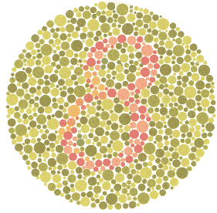
Facts About Human Perception
Perceptual fusion: stimuli < 100ms apart appear fused to our perceptual systems
10 frames/sec is enough to perceive a moving picture
Computer response < 100 ms feels instantaneous
Color blindness: many users (~8% of all males) can't distinguish red from green
normal vision
red-green deficient
Notes:
Here are some useful facts to know about the human perceptual system, which are helpful in designing user interfaces. One interesting effect is perceptual fusion. Here’s an intuition for how fusion works. Every cycle of roughly 100ms, your perceptual system grabs a frame (snaps a picture). Two events occurring less than the cycle time apart are likely to appear in the same frame. If the events are similar – e.g., Mickey Mouse appearing in one position, and then a short time later in another position – then the events tend to fuse into a single perceived event – a single Mickey Mouse, in motion.
Perceptual fusion is responsible for the way we perceive a sequence of movie frames as a moving picture, so the parameters of the perceptual processor give us a lower bound on the frame rate for believable animation. 10 frames per second is good enough, but 20 frames per second is better. (Film) movie projectors have 24 frames per second, but each frame is shown twice rather than once to improve fusing.
Perceptual fusion also gives an upper bound on good computer response time. If a computer responds to a user’s action within the perceptual fusion time, its response feels instantaneous with the action itself. Systems with that kind of response time tend to feel like extensions of the user’s body. If you used a text editor that took longer than that time to display each keystroke, you would notice.
Another essential fact to know about when you're designing feedback mechanisms is that color deficiency (“color blindness”) affects a significant fraction of human beings. An overwhelming number of them are male. Since color blindness affects so many people, it is essential to take it into account when you are deciding how to use color in a user interface. Don’t depend solely on color distinctions, particularly red-green distinctions, for conveying information. Microsoft Office applications fail in this respect: red wavy underlines indicate spelling errors, while identical green wavy underlines indicate grammar errors.
Traffic lights are another source of problems. How do red-green color-blind people know whether the light is green or red? Fortunately, for US traffic lights, there’s a spatial cue: red is always above (or to the left of) green. For some kinds of red-green color deficiency, the red light also looks darker than the green light.

Slide 22
Design Principles for Visibility
Make system state visible: keep the user informed about what's going on
Mouse cursor, selection highlight, status bar
Give prompt feedback
Response time rules-of-thumb
< 0.1 sec seems instantaneous
0.1-1 sec user notices, but no feedback needed
1-5 sec display busy cursor
> 1-5 sec display progress bar
Notes:
Keep the user informed about what’s going on. We’ve developed lots of idioms for feedback in graphical user interfaces. Use them:
Change the cursor to indicate possible actions (e.g. hand over a hyperlink), modes (e.g. drag/drop), and activity (hourglass).
Use highlights to show selected objects. Don’t leave selections implicit.
Use the status bar for messages and progress indicators.
Depending on how long an operation takes, you may need different amounts of feedback. Even though we say “no feedback needed” if the operation takes less than a second, remember that something should change, visibly, within 100 ms, or perceptual fusion will be disrupted.

Slide 23
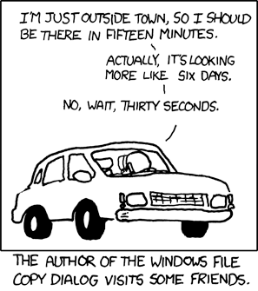
Progress bars…

Slide 24
Efficiency
How quickly can an expert operate the system – input, commands, perceiving and processing output
About the performance of the I/O channel between the user and the program
Fewer keystrokes to do a task is usually more efficient; but it’s subtle
The old Gimp interface used only contextual, cascading submenus – studies show it’s actually slower to use than a menu bar
Notes:
Efficiency concerns how quickly an expert user can operate the system – submitting input or commands, and perceiving and processing the system's output. Note that this is typically not about the performance of the program's algorithms at all – instead, it's about the performance of the I/O channel between the user and the program. A user interface that requires fewer keystrokes to do a task is more efficient. The problem of efficiency is more subtle than just counting keystrokes, however.
Recall the example of Gimp from the start of this lecture. All Gimp menus are accessed from a context menu, which pops up on right-click. You don't have to move your mouse up to the menu bar – a context menu can be popped up anywhere. So it should be faster. Right?
Wrong. With Gimp’s design, as soon as the mouse hovers over a choice on the context menu (like File or Edit), the submenu immediately pops up to the right. That means, if I want to reach an option on the File menu, I have to move my mouse carefully to the right, staying within the File choice, until it reaches the File submenu. If my mouse ever strays into the Edit item, the File menu I’m aiming for vanishes, replaced by the Edit menu. So if I want to select File/Quit, I can’t just drag my mouse in a straight line from File to Quit – I have to drive into the File menu, turn 90 degrees and then drive down to Quit! Cascading submenus are actually slower to use than a menu bar.
Gimp’s designers made a choice without fully considering how it interacted with human capabilities.

Slide 25
Some Facts About Motor Processing
Perceptual
Cognitive
Motor
Senses
Muscles
Open-loop control
Motor processor runs by itself
Cycle time is ~ 70 ms
Closed-loop control
Muscle movements (or their effect on the world) are perceived and compared with desired result
Cycle time is ~ 240 ms
Feedback
Notes:
Let's look at some facts about the human motor processing system, because this will help us understand just how bad the cascading submenu problem is.
In simplified form, the human cognitive system is a feedback loop: your senses feed stimuli into your brain, your brain processes those stimuli, and your brain instructs your muscles to do something. Then your senses perceive the effect your muscles had on the world, and your brain can adjust what the muscles are doing to correct for errors. We rely on this feedback loop to walk, catch a ball, draw a straight line, put food in our mouths, and do almost everything we do.
In fact, this system can run two ways. The motor system can run autonomously, repeatedly issuing the same instructions to the muscles without waiting for feedback. This is “open-loop” control; the motor processor receives no feedback from the perceptual system about whether its instructions are correct. With open loop control, the maximum rate of operation is just the cycle time of this "motor processor", which is typically Tmotor = 70 msec.
The other way is “closed-loop” control, which has a complete feedback loop. The perceptual system looks at what the motor processor did, and the cognitive system makes a decision about how to correct the movement, and then the motor system issues a new instruction. At best, the feedback loop needs one cycle of the entire feedback loop to run, which is roughly Tloop = 240 ms.
Here’s a simple but interesting experiment that you can try: take a sheet of lined paper and scribble a sawtooth wave back and forth between two lines, going as fast as you can but trying to hit the lines exactly on every peak and trough. Do it for 5 seconds. The frequency of the sawtooth carrier wave is dictated by open-loop control. The frequency of the wave’s envelope, the corrections you had to make to get your scribble back to the lines, is closed-loop control.

Slide 26
Pointing Tasks: Fitts’s Law
How long does it take to reach a target?
Moving mouse to target on screen
Moving finger to key on keyboard
Moving hand between keyboard and mouse
D
S
Notes:
Let’s consider a common motor task in user interfaces: pointing at a target of a certain size at a certain distance away (within arm’s length). The time it takes to do this task is governed by a relationship called Fitts’s Law. It’s a fundamental law of the human sensory-motor system, which has been replicated by numerous studies. Fitts’s Law applies equally well to using a mouse to point at a target on a screen, putting your finger on a keyboard key, or moving your hand between keyboard and mouse.

Slide 27
Analytical Derivation of Fitts’s Law
Moving your hand to a target is closed-loop control
Each cycle covers remaining distance D with error εD
After 2 cycles, within ε²D of target
Position
Velocity
Time
Time
Notes:
We can derive Fitts’s Law by appealing to the human information processing model. Fitts’s Law relies on closed-loop control. In each cycle, your motor system instructs your hand to move the entire remaining distance D. The accuracy of that motion is proportional to the distance moved, so your hand gets within some error εD of the target (possibly undershooting, possibly overshooting). Your perceptual and cognitive systems perceive where your hand arrived and compare it to the target, and then your motor system issues a correction to move the remaining distance εD – which it does, but again with proportional error, so your hand is now within ε²D. This process repeats, with the error decreasing geometrically, until n iterations of the feedback loop have brought your hand within the target – i.e., ε^{n}D ≤ S. Solving for n, and letting the total time T = n Tloop (where Tloop is the cycle time of closed-loop feedback we saw earlier), we get:
T = a + b log (D/S)
where a is the reaction time (a.k.a. RT) for getting your hand moving, and b = - (Tp + Tc + Tm)/log ε.
The graphs above show the typical trajectory of a person’s hand, demonstrating this correction cycle in action. The position-time graph shows an alternating sequence of movements and plateaus; each one corresponds to one cycle. The velocity-time graph shows the same effect, and emphasizes that hand velocity of each subsequent cycle is smaller, since the motor processor must achieve more precision on each iteration.

Slide 28
Fitts’s Law
T = RT + MT = a + b log (D/S)
log(D/S) is the index of difficulty of the pointing task
Reaction time
Movement time
D
S
Notes:
Fitts’s Law has some interesting implications. The edge of the screen stops the mouse pointer, so you don’t need a correcting cycle to hit it. Essentially, the edge of the screen acts like a target with infinite size. So edge-of-screen real estate is precious. The Macintosh menu bar, positioned at the top of the screen, is faster to use than a Windows menu bar (which, even when a window is maximized, is displaced by the title bar).
So if you put controls at the edges of the screen, they should be active all the way to the edge to take advantage of this effect. Don’t put an unclickable margin beside them.
(You don’t get all the benefits of the infinite size: if a user decides to move (say) 1 meter, then the error will be correspondingly large and may be orthogonal to the direction of travel.)
RT: reaction time
MT: movement time

Slide 29
Path Steering Tasks
Fitts’s Law applies only if path to target is unconstrained
But the task is much harder if path is constrained to a tunnel
This is why cascading menus are slow!
D
T = a + b (D/S)
S
Notes:
We can also see why cascading submenus like Gimp’s are hard to use, because of the correction cycles the user is forced to spend getting the mouse pointer carefully over into the submenu. Because the user must keep the mouse inside the menu tunnel, they must move it slowly enough so that the error of each cycle (εd where d is the distance moved in that cycle) is always less than S. Thus the distance of each cycle is d ≤ S/ε, and so the total number of cycles is proportional to D/S. That’s a lot slower than the log(D/S) in Fitts’s Law, which applies to unconstrained pointing – it’s exponentially slower!
Gimp offers the worst possible behavior here, by making the submenu disappear as soon as the mouse pointer exits the tunnel. Microsoft Windows does it a little better – you have to hover over a choice for about half a second before the submenu appears, so if you veer off course briefly, you won’t lose your target. But now we know a reason that this solution isn’t ideal: it exceeds Tp, so it destroys perceptual fusion and our sense of causality. And you still have to make that right-angle turn to get into the menu.
Apple Macintosh does even better: when a submenu opens, there’s a triangular zone, spreading from the mouse to the submenu, in which the mouse pointer can move without losing the submenu. The user can point straight to the submenu without unusual corrections, and without even noticing that there might be a problem.

Slide 30
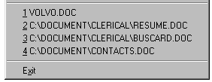
Design Principles for Efficiency
Fitts's Law and Steering Law
Make important targets big, nearby, or at screen edges
Avoid steering tasks
Provide shortcuts
Keyboard accelerators
Styles
Bookmarks
History
Source: Interface Hall of Shame
Notes:
What we've learned leads to some useful principles for making interfaces more efficient.
We can apply what we know about Fitts's Law – if a button or control is frequently used, make it bigger, or anchor it to the edge of the screen so that its size is effectively huge. If two buttons are frequently used together, put them close to each other. Minimize steering tasks as much as possible.
Another way to improve efficiency is by providing shortcuts that expert users can learn and apply to maximize their bandwidth. Keyboard combinations are a good example of this. (But be sure to strive for learnability too! If your shortcuts are too hard to learn and remember, then users won't get any benefit from them.)
Another incredibly useful kind of shortcut is a history. The recently-used files menu is a good example of this. Since users often reopen a file that they recently used, providing this history list saves them from navigating through the filesystem. Histories can be used all over an interface to save time and typing.

Slide 31
Mode Error
Modes: states in which actions have different meanings
Vi’s insert mode vs. command mode
Drawing palette
Avoiding mode errors
Eliminate modes entirely
Visibility of mode
Spring-loaded or temporary modes
Disjoint action sets in different modes
Notes:
Our fourth goal is error handling. Users make errors; you have to anticipate them, prevent them as much as possible, and deal with them well when they do happen.
Modes are states of the system in which the same action has different meanings. For example, when Caps Lock mode is enabled on a keyboard, the letter keys produce uppercase letters. The text editor vi is famous for its modes: in insert mode, letter keys are inserted into your text file, while in command mode (the default), the letter keys invoke editing commands. A browser like Firefox also has modes, because a webpage can take over keystrokes that would ordinarily be handled by the browser itself. And being in your browser vs. in your editor leads to another kind of mode confusion.
Mode errors occur when the user tries to invoke an action that doesn’t have the desired effect in the current mode. For example, if the user means to type lowercase letters but doesn’t notice that Caps Lock is enabled, then a mode error occurs.
There are many ways to avoid or mitigate mode errors. Eliminating the modes entirely is best, although not always possible. When modes are necessary, it’s essential to make the mode visible. But visibility is a much harder problem for mode status than it is for affordances. When mode errors occur, the user isn’t actively looking for the mode, like they might actively look for a control. As a result, mode status indicators must be visible in the user’s locus of attention. That’s why the Caps Lock light, which displays the status of the Caps Lock mode on a keyboard, doesn’t really work. (Raskin, The Humane Interface, 2000 has a good discussion of locus of attention as it relates to mode visibility.)
Other solutions are spring-loaded or temporary modes. With a spring-loaded mode, the user has to do something active to stay in the alternate mode, essentially eliminating the chance that they’ll forget what mode they’re in. The Shift key is a spring-loaded version of the uppercase mode. Drag-and-drop is another spring-loaded mode; you’re only dragging as long as you hold down the mouse button. Temporary modes are similarly short-term. For example, in many graphics programs, when you select a drawing object like a rectangle or line from the palette, that drawing mode is active only for one mouse gesture. Once you’ve drawn one rectangle, the mode automatically reverts to ordinary pointer selection.
Finally, you can also mitigate the effects of mode errors by designing action sets so that no two modes share any actions. Mode errors may still occur, when the user invokes an action in the wrong mode, but the action can simply be ignored rather than triggering any undesired effect. (Although then, you might ask, why have two modes in the first place?)

Slide 32
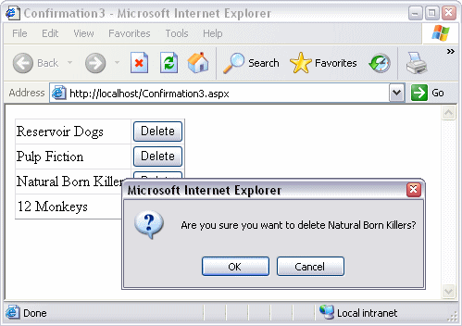
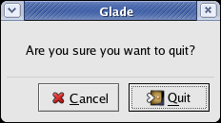
Confirmation Dialogs
Notes:
An unfortunately common strategy for error prevention is the confirmation dialog, or “Are you sure?” dialog. It’s not a good approach, and should be used only sparingly, for several reasons:
Confirmation dialogs can substantially reduce the efficiency of the interface. In the example above, a confirmation dialog pops up whenever the user deletes something, forcing the user to make two button presses for every delete, instead of just one. Frequent commands should avoid confirmations.
If a confirmation dialog is frequently seen – for example, every time the Delete button is pressed – then the expert users will learn to expect it, and will start to chunk it as part of the operation. In other words, to delete something, the user will learn to push Delete and then OK, without reading or even thinking about the confirmation dialog! The dialog has then completely lost its effectiveness, serving only to slow down the interface without actually preventing any errors.
In general, reversibility (i.e. undo) is a far better solution than confirmation. Even a web interface can provide at least single-level undo (undoing the last operation). Operations that are very hard to reverse may deserve confirmation, however. For example, quitting an application with unsaved work is hard to undo – but a well-designed application could make even this undoable, using automatic save or keeping unsaved drafts in a special directory.

Slide 33
Confirmation Dialogs: “Are you sure?”
They make common operations take two button presses rather than one
Frequent confirmations dialogs lead to expert users chunking it as part of the operation
Reversibility (i.e. undo) is a far better solution than confirmation – operations that are very hard to reverse may deserve confirmation, however
Notes:
An unfortunately common strategy for error prevention is the confirmation dialog, or “Are you sure?” dialog. It’s not a good approach, and should be used only sparingly, for several reasons:
Confirmation dialogs can substantially reduce the efficiency of the interface. In the example above, a confirmation dialog pops up whenever the user deletes something, forcing the user to make two button presses for every delete, instead of just one. Frequent commands should avoid confirmations.
If a confirmation dialog is frequently seen – for example, every time the Delete button is pressed – then the expert users will learn to expect it, and will start to chunk it as part of the operation. In other words, to delete something, the user will learn to push Delete and then OK, without reading or even thinking about the confirmation dialog! The dialog has then completely lost its effectiveness, serving only to slow down the interface without actually preventing any errors.
In general, reversibility (i.e. undo) is a far better solution than confirmation. Even a web interface can provide at least single-level undo (undoing the last operation). Operations that are very hard to reverse may deserve confirmation, however. For example, quitting an application with unsaved work is hard to undo – but a well-designed application could make even this undoable, using automatic save or keeping unsaved drafts in a special directory.

Slide 34
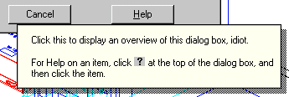
Design Principles for Error Handling
Prevent errors as much as possible
Selection is better than typing
Avoid mode errors
Disable illegal commands
Separate risky commands from common ones
Use confirmation dialogs sparingly
Support undo
Good error messages
Precise
Speak the user’s language
Constructive help
Polite
Source: Interface Hall of Shame
Notes:
One way to prevent errors is to allow users to select rather type. Misspellings then become impossible.
If a command is illegal in the current state of the interface – e.g., Copy is impossible if nothing is selected – then the command should be disabled (“grayed out”) so that it simply can’t be selected in the first place.
You can also reduce errors by making sure that dangerous functions (hard to recover from if invoked accidentally) are well-separated from frequently-used commands. Outlook 2003 makes this mistake: when you right-click on an email attachment, you get a menu that mixes common commands (Open, Save As) with less common and less recoverable ones – if you print that big file by mistake, you can’t get the paper back. And if you Remove the attachment, it’s even worse – undo won’t bring it back! (Thanks to Amir Karger for this example.)
If you can’t prevent the error, at least give a good error message. A good error message should (1) be precise; (2) speak the user’s language, avoiding technical terms and details unless explicitly requested; (3) give constructive help; and (4) be polite. The message should be worded to take as much blame as possible away from the user and heap the blame instead on the system. Save the user’s face; don’t worry about the computer’s. The computer doesn’t feel it, and in many cases it is the interface’s fault anyway for not finding a way to prevent the error in the first place.
The tooltip shown here came from a production version of AutoCad! As the story goes, it was inserted by a programmer as a joke, but somehow never removed before release.

Slide 35
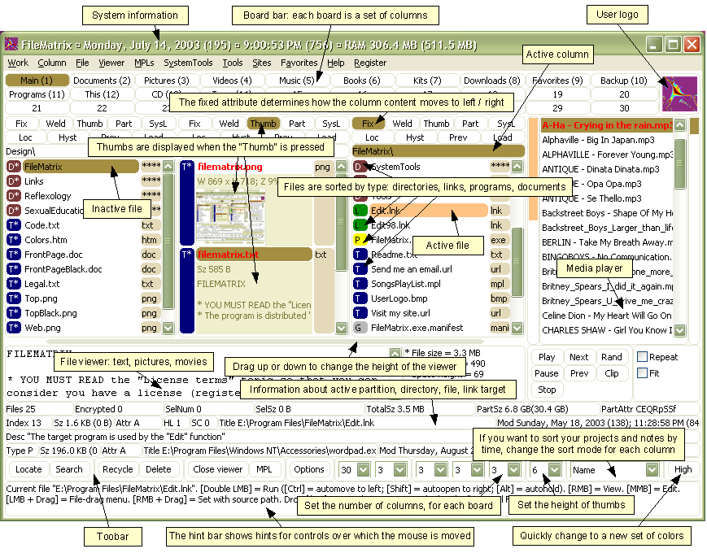
Simplicity
Source: Alex Papadimoulis
Notes:
The final design principle is a catch-all for a number of rules of good design, which really boil down to one word: simplicity.
This is a program called FileMatrix. I have no idea what it does, but it seems to do it all. The complexity of this interface actually interferes with a lot of our usability goals: it's less learnable (because there are so many things you have to learn), less efficient (because cramming all the functions into the window means that each button is tiny), and more error-prone (because so many things look alike).
Incidentally, this may be a good example of designing for yourself, rather than for others. The programmer who wrote this probably understands it completely, and maybe even uses a significant fraction of those features; but few other users will need that much, and it will just interfere with their ability to use it.

Slide 36
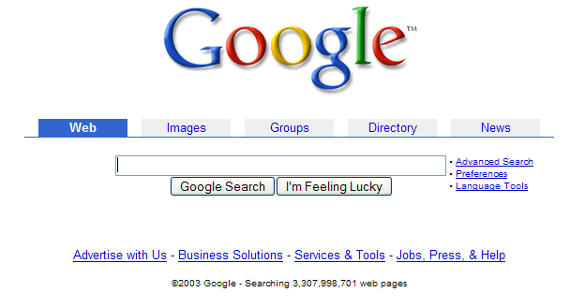
Simplicity
Notes:
In contrast to the previous example, here’s Google’s start page. Google is an outstanding example of simplicity. Its interface is as simple as possible. Unnecessary features and hyperlinks are omitted, lots of whitespace is used. Google is fast to load and trivial to use.

Slide 37
Design Principles for Simplicity
“Less is More”
Omit extraneous information, graphics, features
Good graphic design
Few, well-chosen colors and fonts
Group with whitespace
Use concise language
Choose labels carefully
Notes:
The way to achieve simplicity is by relentless reduction of your design. Leave things out unless you have good reason to include them. Don’t put more help text on your main window than what’s really necessary. Leave out extraneous graphics. Most important, leave out unnecessary features. If a feature is never used, there’s no reason for it to complicate your interface. Google offers a great positive example of the less-is-more philosophy.
Use few, well-chosen colors. The toolbars at the top show the difference between cluttered and minimalist color design. The first toolbar is full of many saturated colors. It’s not only gaudy and distracting, but actually hard to scan. The second toolbar, from Microsoft Office, uses only a handful of colors – black, white, gray, blue, yellow. It’s muted, calming, and the few colors are used to great effect to distinguish the icons. The whitespace separating icon groups helps a lot too.

Slide 38
Document your system
Write the user manual
Program and UI metaphors
Key functionality
Not: exhaustive list of all menus
What is hard to describe?
Who is your target user?
Power users need a manual
Casual users might not
Piecemeal online help is no substitute
Notes:
This may be the most important aspect of usability. It’s about how the system fits together as a whole, not just surface details about saving a fraction of a second when mousing.

Slide 39
Lecture Outline
1. Design
design principles
3. Evaluate
2. Implement
user testing
low-fidelity prototypes
Notes:
So we’ve talked about design principles, and you’ve developed a design. Now let’s think about how to implement it cheaply.

Slide 40
Low-fidelity Prototypes
Paper is a very fast and effective prototyping tool
Sketch windows, menus, dialogs, widgets
Crank out lots of designs and evaluate them
Hand-sketching is OK – even preferable
Focus on behavior & interaction, not fonts & colors
Similar to design of your data structures & algorithms
Paper prototypes can even be executed
Use pieces to represent windows, dialogs, menus
Simulate the computer’s responses by moving pieces around and writing on them
Notes:
It turns out that paper is a terrific prototyping tool. If you sit down and write Java code for your UI without having drawn a sketch first, you’re letting Java design the UI for you. Always sketch it on paper first.
Hand sketching is valuable because it focuses attention on the issues that matter in early design without distracting anybody with details. When you’re sketching by hand, you aren’t bothered with details like font, color, alignment, whitespace, etc. In a drawing program, you would be faced with all these decisions, and you might spend a lot of time on them – time that would clearly be wasted if you have to throw away this design. Hand sketching also improves the feedback you get when you show your design to other people. They’re less likely to nitpick about details that aren’t relevant at this stage. They won’t complain about the color scheme if there isn’t one. More important, however, a hand-sketched design seems less finished, less set in stone, and more open to suggestions and improvements. Architects have known about this phenomenon for many years. If they show clean CAD drawings to their clients in the early design discussions, the clients are less able to discuss needs and requirements that may require radical changes in the design. In fact, many CAD tools have an option for rendering drawings with a “sketchy” look for precisely this reason.
It turns out that paper designs can even be executed. A paper prototype is a physical mockup of the interface, mostly made of paper. It’s usually hand-sketched on mutiple pieces, with different pieces showing different menus, dialog boxes, or window elements. A paper prototype can be brought to life by a person who simulates what the computer would do in response to a user’s “clicks” and “keystrokes”, by rearranging pieces, writing custom responses, and occasionally announcing some effects verbally that are too hard to show on paper. Because a paper prototype is actually interactive, you can actually user-test it: give users a task to do and watch how they do it.

Slide 41
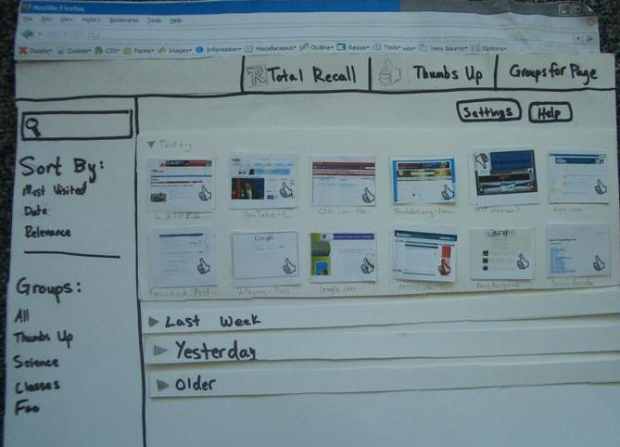
Paper Prototypes
Notes:
Here are some paper prototypes.
This prototype is big, dark, and easy to read. Markers are better than pencil. (Whiteout and correction tape can fix mistakes as well as erasers can!) Color is also neat, but don’t bother unless color is a design decision that needs to be tested, as it is in this prototype. If color doesn’t really matter, monochromatic prototypes work just as well.

Slide 42
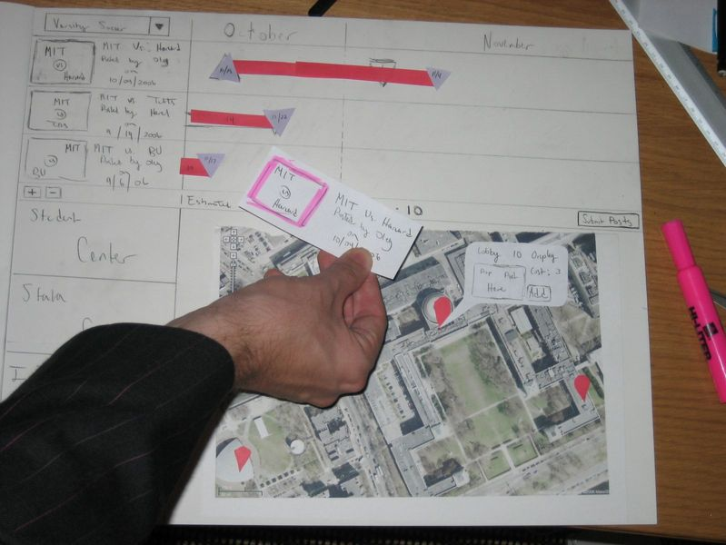
Paper Prototypes
Notes:
Should a paper prototype be hand-sketched or computer-drawn? Generally hand-sketching is better in early design, but sometimes realistic images can be constructive additions. This prototype uses a printout of an aerial view of the MIT campus, along with hand-drawn elements.

Slide 43
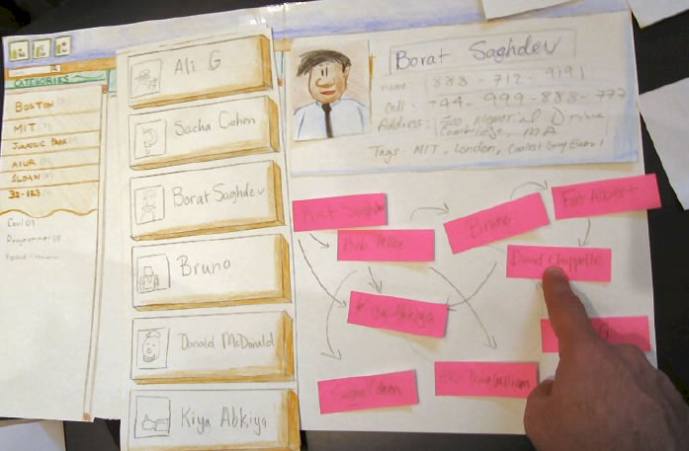
Paper Prototypes
Notes:
Paper is great for prototyping features that would be difficult to implement. This project (a contact manager) originally envisioned showing your social network as a graph, but when they prototyped it, it turned out that it wasn't too useful. The cost of trying that feature on paper was trivial, so it was easy to throw it away. Trying it in code, however, would have taken much longer, and been much harder to discard.

Slide 44
User Testing
Start with a prototype
Write up a few representative tasks
Short, but not trivial
e.g.: “add this meeting to calendar”, “type this letter and print it”
Find a few representative users
3 is often enough to find obvious problems
Watch them do tasks with the prototype
Notes:
User testing is the gold standard for evaluating a user interface. Since it’s hard to predict how a typical user will respond to an interface, the best way to learn is to actually find some typical users, put them in front of your interface, and watch what happens.
You don’t need to have a finished implementation to do user testing. A paper prototype is enough to test, and it’s so easy to build (relative to code) that paper prototypes are often the first version of your interface that you test on users.
A good user test shouldn’t be undirected. Don’t just plop a user down and say “try this interface”. You should prepare some representative tasks that are appropriate to your interface. Pick tasks that are common, tasks that should be easy, and tasks that you’re worried may be hard. Make the tasks short (if possible), but not trivial. Make each task concrete (e.g., “schedule a meeting for 3pm this Wednesday”), but don’t provide specific instructions on how to do it.
Once you have your tasks, find some users that are representative of your target user population. Needless to say, don’t use people from the development team, even if they happen to fall in the target user population. They know too much about the underlying system, so they’re not typical users. A handful of users is usually enough for feedback about obvious usability problems. (If you wanted to measure some quantitative improvement due to your design, however, you’d need many more users, and you’d need to carefully design the testing.)

Slide 45
How to Watch Users
Brief the user first (being a test user is stressful)
“I’m testing the system, not testing you”
“If you have trouble, it’s the system’s fault”
“Feel free to quit at any time”
Ethical issues: informed consent
Ask user to think aloud
Be quiet!
Don’t help, don’t explain, don’t point out mistakes
Sit on your hands if it helps
Two exceptions: prod user to think aloud (“what are you thinking now?”), and move on to next task when stuck
Take lots of notes
Notes:
Once you have your tasks and your users, the final step is simple: watch what happens. This is harder than it sounds.
First, being a test user is stressful for most people. There’s a tendency to feel like a subject of an intelligence test. If they can’t figure out how to use your interface, they may feel like they’ve failed. You need to be aware of this phenomenon, and take steps in advance to ward it off. When you brief a user before a test, make very clear that the goal of the test is to uncover problems in the computer program. Anything that goes wrong is the interface’s fault, not the user’s. Assure them that they can quit the test at any time.
User studies conducted in connection with research should also be cognizant of the ethical issues surrounding use of human subjects. Institutional policies may treat the user of humans in software user studies identically with their use in psychology experiments, drug trials, and studies of new medical procedures. You have to obtain approval for a research user study from the Committee on the Use of Humans as Experimental Subjects (COUHES).
While the user is actually using your interface, encourage them to think aloud: verbalize what they’re thinking as they use the interface. Encourage them to say things like “OK, now I’m looking for the place to set the font size, usually it’s on the toolbar, nope, hmm, maybe the Format menu…” Thinking aloud gives you (the observer) a window into their thought processes, so you can understand what they’re trying to do and what they expect. Thinking aloud can be hard to do, particularly when the user gets absorbed in the task. Sometimes you have to nudge the user a little: “what are you thinking now?” “Why did you look there?”
While the user is talking, you, as the observer, should be doing the opposite: keeping quiet. Don’t offer any help, don’t attempt to explain the interface. Just sit on your hands, bite your tongue, and watch. You’re trying to get a glimpse of how a typical user will interact with the interface. Since a typical user won’t have the system’s designer sitting next to them, you have to minimize your effect on the situation. It may be very hard for you to sit and watch someone struggle with a task, when the solution seems so obvious to you, but that’s how you learn the usability problems in your interface.
You have only two excuses for opening your mouth during a user test: first, to prod the user to think aloud, and second, to move the user along to another task if they really get stuck.
Keep yourself busy by taking a lot of notes.

Slide 46
Watch for Critical Incidents
Critical incidents: events that strongly affect task performance or satisfaction
Usually negative
Errors
Repeated attempts
Curses
Can also be positive
“Cool!”
“Oh, now I see.”
Notes:
What should you take notes about? As much as you can, but focus particularly on critical incidents, which are moments that strongly affect usability, either in task performance (efficiency or error rate) or in the user’s satisfaction. Most critical incidents are negative. Pressing the wrong button is a critical incident. So is repeatedly trying the same feature to accomplish a task. Users may draw attention to the critical incidents with their think-aloud, with comments like “why did it do that?” or “@%!@#$!” Critical incidents can also be positive, of course. You should note down these pleasant surprises too.
Critical incidents give you a list of potential usability problems that you should focus on in the next round of iterative design.

Slide 47
Summary
You are not the user
Keep human capabilities and design principles in mind
Iterate over your design
Write documentation
Make cheap, throw-away prototypes
Evaluate them with users

Slide 48
Further Reading
General books on usability
Johnson. GUI Bloopers: Don’ts and Dos for Software Developers and Web Designers, Morgan Kaufmann, 2000.
Jef Raskin, The Humane Interface, Addison-Wesley 2000.
Hix & Hartson, Developing User Interfaces, Wiley 1995.
Low-fidelity prototyping
Rettig, “Prototyping for Tiny Fingers”, CACM April 1994.
Usability heuristics
Nielsen, “Heuristic Evaluation.” http://www.useit.com/papers/heuristic/
Tognazzini, “First Principles.” http://www.asktog.com/basics/firstPrinciples.html

