Slide 1
CSE 331 Software Design & Implementation
Hal Perkins
Autumn 2012
Debugging
(Slides by Mike Ernst and David Notkin)

Slide 2
Ways to get your code right
Verification/quality assurance
Purpose is to uncover problems and increase confidence
Combination of reasoning and test
Debugging
Finding out why a program is not functioning as intended
Defensive programming
Programming with validation and debugging in mind
Testing ≠ debugging
test: reveals existence of problem; test suite can also increase overall confidence
debug: pinpoint location + cause of problem

Slide 3
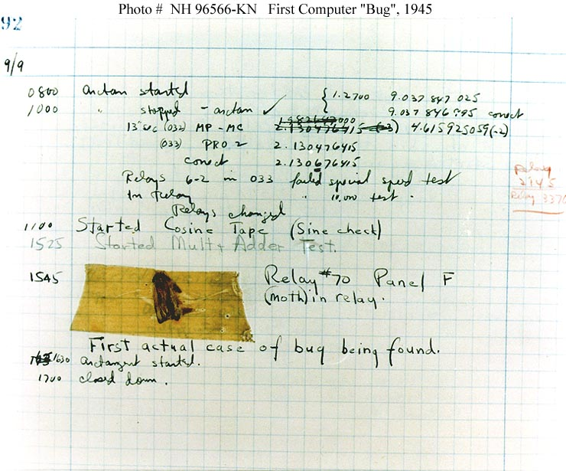
Grace Hopper’s log book, Sep 9, 1947
Alan Perlis 
Grace Hopper

Slide 4
A Bug’s Life
defect – mistake committed by a human as seen as a problem in the code
failure – visible error: program violates its specification
root cause – core issue that led to the defect
[One set of definitions – there are others]
Debugging starts when a failure is observed
Unit testing
Integration testing
In the field

Slide 5
Defense in depth (1)
Make errors impossible
Java prevents type errors, memory overwrites
Don’t introduce defects
Correctness: get things right the first time
Make errors immediately visible
Local visibility of errors: best to fail immediately
Examples: assertions; checkRep() to check representation invariants

Slide 6
Defense in depth (2)
Last resort is debugging
Needed when failure (effect) is distant from cause (defect)
Scientific method: Design experiments to gain information about the defect
Fairly easy in a program with good modularity, representation hiding, specs, unit tests etc.
Much harder and more painstaking with a poor design, e.g., with rampant representation exposure

Slide 7
First defense: Impossible by design
In the language
Java makes memory overwrite errors impossible
Java/etc. won’t allow method argument type mismatch
In the protocols/libraries/modules
TCP/IP guarantees that data is not reordered
BigInteger guarantees that there is no overflow
In self-imposed conventions
Ban recursion to prevent infinite recursion/ insufficient stack – although it may just push the problem elsewhere
Immutable data structure guarantees behavioral equality
Caution: You must maintain the discipline

Slide 8
Second defense: Correctness
Get things right the first time
Think before you code. Don’t code before you think!
If you're making lots of easy-to-find defects, you're also making hard-to-find defects – don't use the compiler as crutch
Especially true, when debugging is going to be hard
Concurrency, real-time environment, no access to customer environment, etc.
Simplicity is key
Modularity
Divide program into chunks that are easy to understand
Use abstract data types/modules with well-defined interfaces
Use defensive programming; avoid rep exposure
Specification
Write specs for all modules, so that an explicit, well-defined contract exists between each module and its clients

Slide 9
Strive for simplicity
“There are two ways of constructing a software design:
One way is to make it so simple that there are obviously no deficiencies, and
the other way is to make it so complicated that there are no obvious deficiencies.
The first method is far more difficult.”
“Debugging is twice as hard as writing the code in the first place. Therefore, if you write the code as cleverly as possible, you are, by definition, not smart enough to debug it.”
Sir Anthony Hoare
Brian Kernighan

Slide 10
Third defense: Immediate visibility
If we can't prevent errors, we can try to localize them to a small part of the program
Assertions: catch errors early, before they contaminate and are perhaps masked by further computation
Unit testing: when you test a module in isolation, any failure is due to a defect in that unit (or the test driver)
Regression testing: run tests as often as possible when changing code. If there is a failure, chances are there's a mistake in the code you just changed
If you can localize problems to a single method or small module, defects can usually be found simply by studying the program text

Slide 11
Benefits of immediate visibility
The key difficulty of debugging is to find the defect: the code fragment responsible for an observed problem
A method may return an erroneous result, but be itself error-free, if there is prior corruption of representation
The earlier a problem is observed, the easier it is to fix
Frequently checking the rep invariant helps
General approach: fail-fast
Check invariants, don't just assume them
Don't (usually) try to recover from errors – it may just mask them

Slide 12
Don't hide errors
// k is guaranteed to be present in a
int i = 0;
while (a[i] != k) {
//if (a[i]==k) break;
i++;
}
This code fragment searches an array a for a value k
Value is guaranteed to be in the array
What if that guarantee is broken (by a defect)?
Temptation: make code more “robust” by not failing

Slide 13
Don't hide errors
// k is guaranteed to be present in a
int i = 0;
while (i<a.length) {
if (a[i]==k) break;
i++;
}
Now at least the loop will always terminate
But it is no longer guaranteed that a[i]==k
If other code relies on this, then problems arise later
Hiding the error makes it harder to see the link between the defect and the failure

Slide 14
Don't hide errors
// k is guaranteed to be present in a
int i = 0;
while (i<a.length) {
if (a[i]==k) break;
i++;
}
assert (i!=a.length) : "key not found";
Assertions let us document and check invariants
Abort/debug program as soon as problem is detected
Turn an error into a failure
But the assertion is not checked until we use the data, which might be a long time after the original error
“why isn’t the key in the array?”

Slide 15
Checks In Production Code
Should you include assertions and checks in production code?
Yes: stop program if check fails - don’t want to take chance program will do something wrong
No: may need program to keep going, maybe defect does not have such bad consequences (the failure is acceptable)
Correct answer depends on context!
Ariane 5 – program halted because of overflow in unused value, exception thrown but not handled until top level, rocket crashes…
[full story is more complicated]

Slide 16
Regression testing
Whenever you find and fix a defect
Add a test for it
Re-run all your tests
Why is this a good idea?
Often reintroduce old defects while fixing new ones
Helps to populate test suite with good tests
If a defect happened once, it could well happen again
Run regression tests as frequently as you can afford to
Automate the process
Make concise test suites, with few superfluous tests

Slide 17
Last resort: debugging
Defects happen – people are imperfect
Industry average: 10 defects per 1000 lines of code (“kloc”)
Defects that are not immediately localizable happen
Found during integration testing
Or reported by user
The cost of an error increases by an order of magnitude for each lifecycle phase it passes through
step 1 – Clarify symptom (simplify input), create test
step 2 – Find and understand cause, create better test
step 3 – Fix
step 4 – Rerun all tests

Slide 18
The debugging process
step 1 – find a small, repeatable test case that produces the failure (may take effort, but helps clarify the defect, and also gives you something for regression)
Don't move on to next step until you have a repeatable test
step 2 – narrow down location and proximate cause
Study the data / hypothesize / experiment / repeat
May change the code to get more information
Don't move on to next step until you understand the cause
step 3 – fix the defect
Is it a simple typo, or design flaw? Does it occur elsewhere?
step 4 – add test case to regression suite
Is this failure fixed? Are any other new failures introduced?

Slide 19
Debugging and the scientific method
Debugging should be systematic
Carefully decide what to do
Don’t flail!
Keep a record of everything that you do
Don’t get sucked into fruitless avenues
Formulate a hypothesis
Design an experiment
Perform the experiment
Adjust your hypothesis and continue

Slide 20
Reducing input size example
// returns true iff sub is a substring of full
// (i.e. iff there exists A,B s.t.full=A+sub+B)
boolean contains(String full, String sub);
User bug report
It can't find the string "very happy" within:
"Fáilte, you are very welcome! Hi Seán! I am very very happy to see you all."
Poor responses
See accented characters, panic about not knowing about unicode, grab your Java texts to see how that is handled
Or google “unicode”, “funny characters”, etc.
Try to trace the execution of this example
Better response: simplify/clarify the symptom

Slide 21
Reducing absolute input size
Find a simple test case by divide-and-conquer
Pare test down – can't find "very happy" within
"Fáilte, you are very welcome! Hi Seán! I am very very happy to see you all."
"I am very very happy to see you all."
"very very happy"
Can find "very happy" within
"very happy"
Can't find "ab" within "aab"

Slide 22
Reducing relative input size
Sometimes it is helpful to find two almost identical test cases where one gives the correct answer and the other does not
Can't find "very happy" within
"I am very very happy to see you all."
Can find "very happy" within
"I am very happy to see you all.”

Slide 23
General strategy: simplify
In general: find simplest input that will provoke failure
Usually not the input that revealed existence of the defect
Start with data that revealed the defect
Keep paring it down (“binary search” can help)
Often leads directly to an understanding of the cause
When not dealing with simple method calls:
The “test input” is the set of steps that reliably trigger the failure
Same basic idea

Slide 24
Localizing a defect
Take advantage of modularity
Start with everything, take away pieces until failure goes away
Start with nothing, add pieces back in until failure appears
Take advantage of modular reasoning
Trace through program, viewing intermediate results
Binary search speeds up the process
Error happens somewhere between first and last statement
Do binary search on that ordered set of statements

Slide 25
binary search on buggy code
public class MotionDetector {
private boolean first = true;
private Matrix prev = new Matrix();
public Point apply(Matrix current) {
if (first) {
prev = current;
}
Matrix motion = new Matrix();
getDifference(prev,current,motion);
applyThreshold(motion,motion,10);
labelImage(motion,motion);
Hist hist = getHistogram(motion);
int top = hist.getMostFrequent();
applyThreshold(motion,motion,top,top);
Point result = getCentroid(motion);
prev.copy(current);
return result;
}
}
no problem yet
Check
intermediate result
at half-way point
problem exists

Slide 26
binary search on buggy code
public class MotionDetector {
private boolean first = true;
private Matrix prev = new Matrix();
public Point apply(Matrix current) {
if (first) {
prev = current;
}
Matrix motion = new Matrix();
getDifference(prev,current,motion);
applyThreshold(motion,motion,10);
labelImage(motion,motion);
Hist hist = getHistogram(motion);
int top = hist.getMostFrequent();
applyThreshold(motion,motion,top,top);
Point result = getCentroid(motion);
prev.copy(current);
return result;
}
}
no problem yet
Check
intermediate result
at half-way point
problem exists
Quickly home in
on defect in O(log n) time
by repeated subdivision

Slide 27
Detecting Bugs in the Real World
Real Systems
Large and complex (duh!)
Collection of modules, written by multiple people
Complex input
Many external interactions
Non-deterministic
Replication can be an issue
Infrequent failure
Instrumentation eliminates the failure
Defects cross abstraction barriers
Large time lag from corruption (defect) to detection (failure)

Slide 28
Heisenbugs
Sequential, deterministic program – failure is repeatable
But the real world is not that nice…
Continuous input/environment changes
Timing dependencies
Concurrency and parallelism
Failure occurs randomly
Hard to reproduce
Use of debugger or assertions → failure goes away
Only happens when under heavy load
Only happens once in a while

Slide 29
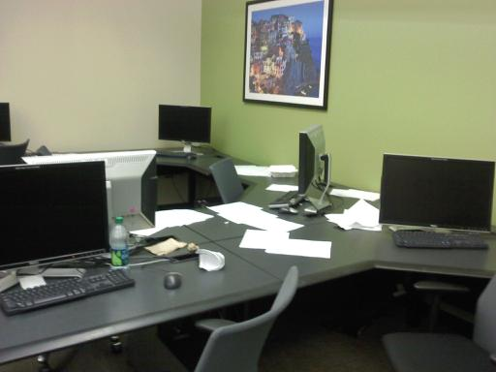
Debugging In Harsh Environments
Failure is non-deterministic, difficult to reproduce
Can’t print or use debugger
Can’t change timing of program (or defect/failure depends on timing)

Slide 30
Logging Events
Log (record) events during execution as program runs at speed
When error detected, stop program and examine logs to help reconstruct the past
The log may be all you know about a customer’s environment
Needs to tell you enough to reproduce the failure
Performance / advanced issues:
To reduce overhead, store in main memory, not on disk (trade performance vs stable storage)
Circular logs avoid resource exhaustion and may be good enough

Slide 31
Tricks for Hard Bugs
Rebuild system from scratch, or restart/reboot
Find the bug in your build system or persistent data structures
Explain the problem to a friend (or to a rubber duck)
Make sure it is a bug
Program may be working correctly and you don’t realize it!
Minimize input required to exercise bug (exhibit failure)
Add checks to the program
Minimize distance between error and detection/failure
Use binary search to narrow down possible locations
Use logs to record events in history

Slide 32
Where is the defect?
The defect is not where you think it is
Ask yourself where it cannot be; explain why
Look for stupid mistakes first, e.g.,
Reversed order of arguments: Collections.copy(src, dest);
Spelling of identifiers: int hashcode()
@Override can help catch method name typos
Same object vs. equal: a == b versus a.equals(b)
Failure to reinitialize a variable
Deep vs. shallow copy
Make sure that you have correct source code!
Check out fresh copy from repository
Recompile everything

Slide 33
When the going gets tough
Reconsider assumptions
e.g., has the OS changed? Is there room on the hard drive? Is it a leap year? 2 full moons in the month?
Debug the code, not the comments
Verify that comments and specs describe the code
Start documenting your system
Gives a fresh angle, and highlights area of confusion
Get help
We all develop blind spots
Explaining the problem often helps (even to rubber duck)
Walk away
Trade latency for efficiency – sleep!
One good reason to start early

Slide 34
Key Concepts
Testing and debugging are different
Testing reveals existence of failures
Debugging pinpoints location of defects
Goal is to get program right
Debugging should be a systematic process
Use the scientific method
Understand the source of defects
To find similar ones and prevent them in the future

