Slide 1
CSE 331 Software Design & Implementation
Hal Perkins
Autumn 2012
Exceptions and Assertions
(Slides by Mike Ernst and David Notkin)

Slide 2
Failure causes
Partial failure is inevitable
Goal: prevent complete failure
Structure your code to be reliable and understandable
Some failure causes:
1. Misuse of your code
Precondition violation
2. Errors in your code
Bugs, representation exposure, many more
3. Unpredictable external problems
Out of memory
Missing file
Memory corruption
How would you categorize these?
Failure of a subcomponent
No return value (e.g., list element not found, division by zero)
Notes:
Actually, you don’t use or call a specification directly: you use or call an implementation.
And it’s possible that the upgrade from S2 to S1 does not work. Why?
Because of details of the implementation that were incorrectly relied upon.
Because of an underdetermined spec, and the implementation didn’t correctly deal with all possibilities.

Slide 3
Avoiding errors
A precondition prohibits misuse of your code
Adding a precondition weakens the spec
This ducks the problem
Does not address errors in your own code
Does not help others who are misusing your code
Removing the precondition requires specifying the behavior
Strengthens the spec
Example: specify that an exception is thrown

Slide 4
Defensive programming
Check
precondition
postcondition
representation invariant
other properties that you know to be true
Check statically via reasoning (& tools)
Check dynamically at run time via assertions
assert index >= 0;
assert size % 2 == 0 : “Bad size for ” + toString();
Write the assertions as you write the code

Slide 5
Enabling assertions
In Java, assertions can be enabled or disabled at runtime without recompiling the program
Command line:
java -ea runs code with assertions enabled
java runs code with assertions disabled (default)
Eclipse:
Pick Run>Run Configurations… then add -ea to VM arguments under (x)=arguments tab

Slide 6
When not to use assertions
Don’t clutter the code
x = y + 1;
assert x == y + 1; // useless, distracting
Don’t perform side effects
assert list.remove(x); // won’t happen if disabled
// Better:
boolean found = list.remove(x);
assert found;
Turn them off in rare circumstances (production code(?) )
Most assertions should always be enabled

Slide 7
assert and checkRep()
CSE 331’s checkRep() is another dynamic check
Strategy: use assert in checkRep() to test and fail with meaningful traceback/message if trouble found
Expensive checkRep()s
Detailed checks can be too slow in production
Even if asserts are disabled, if checkRep has a deep loop nest it takes lots of time to do nothing
No great answers
Maybe call checkRep only if asserts are enabled?
(e.g., assert checkRep())
Maybe comment out expensive tests if needed?

Slide 8
What to do when something goes wrong
Something goes wrong: an assertion fails (or would have failed if it were there)
Fail early, fail friendly
Goal 1: Give information about the problem
To the programmer
A good error message is key!
To the client code
Goal 2: Prevent harm from occurring
Abort: inform a human
Perform cleanup actions, log the error, etc.
Re-try
Problem might be transient
Skip a subcomputation
Permit rest of program to continue
Fix the problem (usually infeasible)
External problem: no hope; just be informative
Internal problem: if you can fix, you can prevent

Slide 9
Square root without exceptions
// requires: x ≥ 0
// returns: approximation to square root of x
public double sqrt(double x) {
...
}

Slide 10
Square root with assertion
// requires: x ≥ 0
// returns: approximation to square root of x
public double sqrt(double x) {
double result;
... // compute result
assert (Math.abs(result*result – x) < .0001);
return result;
}

Slide 11
Square root, specified for all inputs; Using try-catch
// throws: IllegalArgumentException if x < 0
// returns: approximation to square root of x
public double sqrt(double x) throws IllegalArgumentException
{
if (x < 0)
throw new IllegalArgumentException();
...
}
Client code:
try {
y = sqrt(-1);
} catch (IllegalArgumentException e) {
e.printStackTrace(); // or take some other action
}
Handled by catch associated with nearest dynamically enclosing try
Top-level default handler: stack trace, program terminates

Slide 12
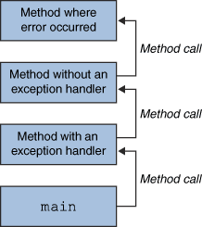
Throwing and catching
At run time, your program has a stack of currently executing methods
Dynamic: reflects runtime order of method calls
No relation to static nesting of classes or packages or such
When an exception is thrown, control transfers to nearest method with a matching catch block
If none found, top-level handler prints a stack trace & terminates
Exceptions allow non-local error handling
A method many levels up the stack can handle a deep error

Slide 13
The finally block
try { code… } catch (type name) { code… to handle the exception } finally { code… to run after the try or catch finishes }
finally is often used for common “clean-up” code
try { // ... read from out; might throw } catch (IOException e) { System.out.println("Caught IOException: “ + e.getMessage()); } finally { out.close(); }

Slide 14
Propagating an exception
// returns: x such that ax^2 + bx + c = 0
// throws: IllegalArgumentException if no real soln exists
double solveQuad(double a, double b, double c) throws IllegalArgumentException
{
// No need to catch exception thrown by sqrt
return (-b + sqrt(b*b - 4*a*c)) / (2*a);
}
How can clients know if a set of arguments to solveQuad is illegal?

Slide 15
Exception translation
// returns: x such that ax^2 + bx + c = 0
// throws: NotRealException if no real solution exists
double solveQuad(double a, double b, double c) throws NotRealException
{
try {
return (-b + sqrt(b*b - 4*a*c)) / (2*a);
} catch (IllegalArgumentException e) {
throw new NotRealException();
}
}
class NotRealException extends Exception {
NotRealException() { super(); }
NotRealException(String message) { super(message); }
NotRealException(Throwable cause) { super(cause); }
NotRealException(String msg, Throwable c) { super(msg, c); }
}
Exception chaining:
throw new NotRealException(e);

Slide 16
Exceptions as non-local control flow
void compile() {
try {
parse();
typecheck();
optimize();
generate():
} catch (RuntimeException e) {
Logger.log(“Failed: ” + e.getMessage());
}
}
Not common – usually bad style to use exceptions for regular control flow. Exceptions are expensive if thrown/caught.
Reserve exceptions for exceptional conditions.
Notes:
Wi12: Is this really a good thing to do?

Slide 17
Informing the client of a problem
Special value
null – Map.get
-1 – indexOf
NaN – sqrt of negative number
Problems with using special value
Hard to distinguish from real results
Error-prone: what if the programmer forgets to check result?
Needs to be a value that cannot be a legal result and best if it will trigger a failure later
Ugly
Less efficient
A better solution: exceptions

Slide 18
Two distinct uses of exceptions
Failures
Unexpected
Should be rare with well-written client and library
Can be the client’s fault or the library’s
Usually unrecoverable
Special results
Expected
Unpredictable or unpreventable by client

Slide 19
Handling exceptions
Failures
Usually can’t recover
If the condition is not checked, the exception propagates up the stack
The top-level handler prints the stack trace
Special results
Take special action and continue computing
Should always check for this condition
Should handle locally

Slide 20
Why catch exceptions locally?
Failure to catch exceptions violates modularity
Call chain: A → IntegerSet.insert → IntegerList.insert
IntegerList.insert throws an exception
Implementer of IntegerSet.insert knows how list is being used
Implementer of A may not even know that IntegerList exists
Procedure on the stack may think that it is handling an exception raised by a different call
Better alternative: catch it and throw it again
“chaining” or “translation”
Do this even if the exception is better handled up a level
Makes it clear to reader of code that it was not an omission

Slide 21
Java exceptions for failures and for special cases
Checked exceptions for special cases
Library: must declare in signature
Client: must either catch or declare
Even if you can prove it will never happen at run time
There is guaranteed to be a dynamically enclosing catch
Unchecked exceptions for failures
Library: no need to declare
Client: no need to catch
RuntimeException and Error
and their subclasses
Throwable
Exception
Error
…
checked exceptions
Runtime- Exception

Slide 22
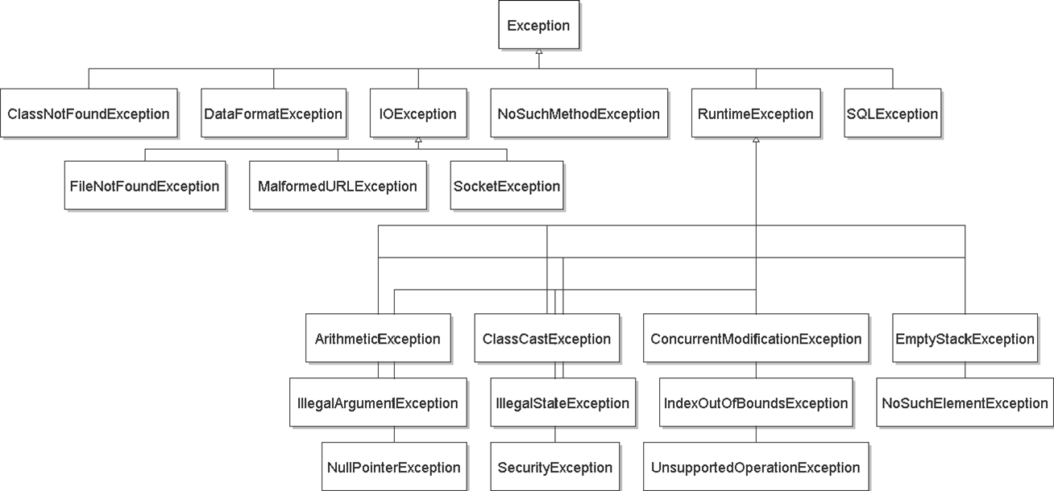
exception hierarchy

Slide 23
Catching with inheritance
try { code… } catch (FileNotFoundException fnfe) { code… to handle the file not found exception } catch (IOException ioe) { code… to handle any other I/O exception } catch (Exception e) { code to handle any other exception }
a SocketException would match the second block
an ArithmeticException would match the third block

Slide 24
Avoid proliferation of checked exceptions
Unchecked exceptions are better if clients will usually write code that ensures the exception will not happen
There is a convenient and inexpensive way to avoid it
The exception reflects unanticipatable failures
Otherwise use a checked exception
Must be caught and handled – prevents program defects
Checked exceptions should be locally caught and handled
Checked exceptions that propagate long distances suggests bad design (failure of modularity)
Java sometimes uses null (or NaN, etc.) as a special value
Acceptable if used judiciously, carefully specified
Easy to forget to check

Slide 25
Don’t ignore exceptions
Effective Java Tip #65: Don't ignore exceptions
An empty catch block is (a common) poor style – often done to get code to compile or hide an error
try { readFile(filename); } catch (IOException e) {} // do nothing on error
At a minimum, print out the exception so you know it happened } catch (IOException e) { e.printStackTrace(); // just in case }

Slide 26
Exceptions in review
Use an exception when
Used in a broad or unpredictable context
Checking the condition is feasible
Use a precondition when
Checking would be prohibitive
E.g., requiring that a list be sorted
Used in a narrow context in which calls can be checked
Avoid preconditions because
Caller may violate precondition
Program can fail in an uninformative or dangerous way
Want program to fail as early as possible
How do preconditions and exceptions differ, for the client?

Slide 27
Exceptions in review, continued
Use checked exceptions most of the time
Handle exceptions sooner rather than later
Not all exceptions are errors
A program structuring mechanism with non-local jumps (expensive, should be rare)
Used for exceptional (unpredictable) circumstances

Slide 28
Exceptions vs assertions
Both can be used to check for errors. No universal consensus on which to use where. But general guidelines:
Exceptions
Use for defensive programming, particularly checks at public API interfaces
Use to signal when client can or could recover, or otherwise handle a situation
Assertions
Use for internal consistency checks – things that should “never happen”
Use to catch things that are bugs and should be fixed
Use for expensive checks during development/debugging
Good reference on all of this: Bloch Effective Java, ch. 9

