Slide 1
CSE 331 Software Design & Implementation
Hal Perkins
Autumn 2012
Module Design and General Style Guidelines
(Based on slides by David Notkin and Mike Ernst)

Slide 2
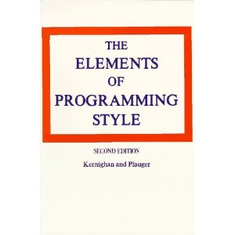
Style: It isn’t just about fashion…
“Use the active voice.”
“Omit needless words.”
“Don't patch bad code - rewrite it.”
“Make sure your code 'does nothing' gracefully.”

Slide 3
Modules
A module is a relatively general term for a class or a type or any kind of design unit in software
A modular design focuses on what modules are defined, what their specifications are, how they relate to each other, but not usually on the implementation of the modules themselves

Slide 4
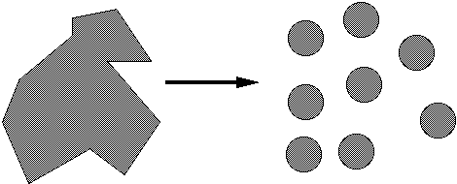
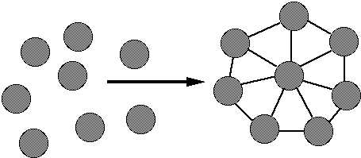
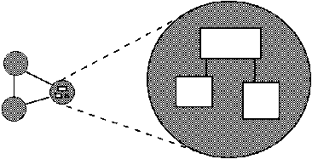
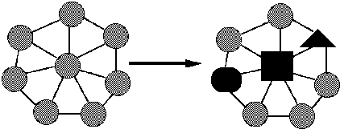
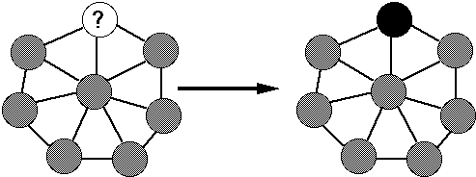
Ideals of modular software
Decomposable – can be broken down into modules to reduce complexity and allow teamwork
Composable – “Having divided to conquer, we must reunite to rule [M. Jackson].”
Understandable – one module can be examined, reasoned about, developed, etc. in isolation
Continuity – a small change in the requirements should affect a small number of modules
Isolation – an error in one module should be as contained as possible

Slide 5
Two general design issues
Cohesion – how well components fit together to form something that is self-contained, independent, and with a single, well-defined purpose
Coupling – how much dependency there is between components
Guideline: reduce coupling, increase cohesion
Applies to modules and individual routines
Each method should do one thing well
Each module should provide a single abstraction

Slide 6
Cohesion
The most common reason to put data and behavior together is to form an ADT
There are, at least historically, other reasons to place elements together – for example, for performance reasons it was sometimes good to place together all code to be run upon initialization of a program
The common design objective of separation of concerns suggests a module should address a single set of concerns

Slide 7
Coupling
How are modules dependent on one another?
Statically (in the code)? Dynamically (at run-time)? More?
Ideally, split design into parts that don't interact much
Roughly, the more coupled modules are, the more they need to be thought of as a single, larger module
MY
FINAL
PROJECT
MY
MY
FINAL
PROJECT
FINECT
PROJAL
An application
A poor decomposition
(parts strongly coupled)
A better decomposition
(parts weakly coupled)

Slide 8
Coupling is the path to the dark side
Coupling leads to complexity
Complexity leads to confusion
Confusion leads to suffering
Once you start down the dark path, forever will it dominate your destiny, consume you it will

Slide 9
Law of Demeter Karl Lieberherr and colleagues
Law of Demeter: An object should know as little as possible about the internal structure of other objects with which it interacts – a question of coupling
Or… “only talk to your immediate friends”
Closely related to representation exposure and (im)mutability
Bad example – too-tight chain of coupling between classes general.getColonel().getMajor(m).getCaptain(cap) .getSergeant(ser).getPrivate(name).digFoxHole();
Better example general.superviseFoxHole(m, cap, ser, name);

Slide 10
An object should only send messages to … (More Demeter)
itself (this)
its instance variables
its methods’ parameters
any object it creates
any object returned by a call to one of this's methods
any objects in a collection of the above
notably absent: objects returned by messages sent to other objects
Guidelines: not strict rules! But thinking about them will generally help you produce better designs

Slide 11
God classes
god class: a class that hoards too much of the data or functionality of a system
Poor cohesion – little thought about why all of the elements are placed together
Only reduces coupling by collapsing multiple modules into one (which reduces dependences between modules to dependences within a module)
A god class is an example of an anti-pattern – it is a known bad way of doing things

Slide 12
Method design
A method should do only one thing, and do it well – for example, observe but not mutate, …
Effective Java (EJ) Tip #40: Design method signatures carefully
Avoid long parameter lists
Perlis: “If you have a procedure with ten parameters, you probably missed some.”
Especially error-prone if parameters are all the same type
Avoid methods that take lots of boolean "flag" parameters
EJ Tip #41: Use overloading judiciously
Can be useful, but don't overload with same number of parameters & think about whether methods really are related.

Slide 13
Cohesion again…
Methods should do one thing well:
Compute a value but let client decide what to do with it
Observe or mutate, don’t do both
Don’t print as a side effect of some other operation
Don’t limit future possible uses of the method by having it do multiple, not-necessarily related things
If you’ve got a method that is doing too much, split it up
Maybe separate, unrelated methods; maybe one method that does a task and another that calls it
“Flag” variables are often a symptom of this problem

Slide 14
Field design
A variable should be made into a field if and only if
It is part of the inherent internal state of the object
It has a value that retains meaning throughout the object's life
Its state must persist past the end of any one public method
All other variables can and should be local to the methods in which they are used
Fields should not be used to avoid parameter passing
Not every constructor parameter needs to be a field

Slide 15
Constructor design
Constructors should take all arguments necessary to initialize the object's state – no more, no less
Don't make the client pass in things they shouldn't have to
Object should be completely initialized after constructor is done
Shouldn't need to call other methods to “finish” initialization
Minimize the work done in a constructor
A constructor should not do any heavy work, such as printing state, or performing expensive computations
If an object's creation is heavyweight, use a static method instead

Slide 16
Naming
Choose good names for classes and interfaces
Class names should be nouns
Watch out for "verb + er" names, e.g. Manager, Scheduler, ShapeDisplayer
Interface names often end in -able or -ible, e.g. Iterable, Comparable
Method names should be verb phrases
Observer methods can be nouns like size or totalQuantity
Many observers should be named with "get" or "is" or "has"
Most mutators should be named with "set" or similar
Choose affirmative, positive names over negative ones
isSafe not isUnsafe
isEmpty not hasNoElements
EJ Tip #56: Adhere to generally accepted naming conventions

Slide 17
Terrible names…
count, flag, status, compute, check, value, pointer, any name starting with my…
These convey no useful information
myWidget is a cliché – sounds like picked by a 3-year-old
What others can you think of?
Describe what is being counted, what the “flag” indicates, etc.
numberOfStudents, courseFull, flightStatus (still not great), calculatePayroll, validateWebForm, …
But short names in local contexts are good:
Good: for (i = 0; i < size; i++) items[i]=0;
Bad: for (theLoopCounter = 0; theLoopCounter < theCollectionSize; theLoopCounter++) theCollectionItems[theLoopCounter]=0;
Notes:
But theSystemIsAboutToDieAHorribleDeath was pretty good in an old OS

Slide 18
Class design ideals
Cohesion and coupling, already discussed
Completeness: Every class should present a complete interface
Clarity: Interface should make sense without confusion
Convenience: Provide simple ways for clients to do common tasks
Consistency: In names, param/returns, ordering, and behavior

Slide 19
Completeness
Leaving out important methods makes a class cumbersome to use
counterexample: A collection with add but no remove
counterexample: A tool object with a setHighlighted method to select it, but no setUnhighlighted method to deselect it
counterexample: Date class has no date-arithmetic features
Related
Objects that have a natural ordering should implement Comparable
Objects that might have duplicates should implement equals
Almost all objects should implement toString

Slide 20
But…
Don’t include everything you can possibly think of
If you include it you’re stuck with it forever (even if almost nobody ever uses it)
Tricky balancing act: include what’s needed/useful, but don’t make things overly complicated
You can always add it later if you really need it
“Everything should be made as simple as possible, but not simpler.”
- Einstein

Slide 21
Consistency
A class or interface should have consistent names, parameters/returns, ordering, and behavior
Use a similar naming scheme; accept parameters in the same order – not like
setFirst(int index, String value) setLast(String value, int index)
Some counterexamples
Date/GregorianCalendar use 0-based months
String equalsIgnoreCase, compareToIgnoreCase; but regionMatches(boolean ignoreCase)
String.length(), array.length, collection.size()

Slide 22
Clarity and Convenience
Clarity: An interface should make sense without creating confusion
Even without fully reading the spec/docs, a client should largely be able to follow his/her natural intuitions about how to use your class – although reading and precision are crucial
Counterexample: Iterator's remove method
Convenience: Provide simple ways for clients to do common tasks
If you have a size / indexOf, include isEmpty / contains, too
Counterexample: System.in is terrible; finally fixed with Scanner

Slide 23
Open-Closed Principle
Software entities should be open for extension, but closed for modification
When features are added to your system, do so by adding new classes or reusing existing ones in new ways
If possible, don't make change by modifying existing ones – existing code works and changing it can introduce bugs and errors.
Related: Code to interfaces, not to classes
Ex: accept a List parameter, not ArrayList or LinkedList
EJ Tip #52: Refer to objects by their interfaces

Slide 24
Cohesion again (“expert pattern”)
The class that contains most of the data needed to perform a task should perform the task
counterexample: A class with lots of getters but not a lot of methods that actually do work – relies on other classes to “get” the data and process it externally
Reduce duplication
Only one class should be responsible for maintaining a set of data, even (especially) if it is used by many other classes

Slide 25
Invariants
Class invariant: An assertion that is true about every object of a class throughout each object’s lifetime
Ex: A BankAccount's balance will never be negative
State them in your documentation, and enforce them in your code
These are often representation invariants

Slide 26
Documenting a class
Keep internal and external documentation separate
external: /** ... */ Javadoc for classes, interfaces, and methods
Describes things that clients need to know about the class
Should be specific enough to exclude unacceptable implementations, but general enough to allow for all correct implementations
Includes all pre/postconditons and abstract class invariants
internal: // comments inside method bodies
Describes details of how the code is implemented
Information that clients wouldn't and shouldn't need, but a fellow developer working on this class would want – invariants and internal pre/post conditions especially

Slide 27
The role of documentation From Kernighan and Plauger
If a program is incorrect, it matters little what the docs say
If documentation does not agree with the code, it is not worth much
Consequently, code must largely document itself. If not, rewrite the code rather than increasing the documentation of the existing complex code. Good code needs fewer comments than bad code.
Comments should provide additional information from the code itself. They should not echo the code.
Mnemonic variable names and labels, and a layout that emphasizes logical structure, help make a program self-documenting

Slide 28
Static vs. non-static design
What members should be static?
members that are related to an entire class
not related to the data inside a particular object of that class’s type
Should I have to construct an object just to call this method?
Examples
Time.fromString
Math.pow
Calendar.getInstance
NumberFormatter.getCurrencyInstance
Arrays.toString? Collections.sort?

Slide 29
Public vs. private design
Strive to minimize the public interface of the classes
Clients like classes that are simple to use and understand
Reasoning is easier with narrower interfaces and specifications
Achieve a minimal public interface by
Removing unnecessary methods – consider each one
Making everything private unless absolutely necessary
Pulling out unrelated behavior into a separate class
public static constants are okay if declared final
But still better to have a public static method to get the value; why?
Or use enums if that’s what you’re trying to do

Slide 30
Choosing types – some hints
Numbers: Favor int and long for most numeric computations
EJ Tip #48: Avoid float and double if exact answers are required
Classic example: Representing money (round-off is bad here)
Favor the use of collections (e.g. lists) over arrays
Strings are often overused since much data comes in as text

Slide 31
Choosing types – more hints
Consider use of enums, even with only two values – which of the following is better?
oven.setTemp(97, true); oven.setTemp(97, Temperature.CELSIUS);
Wrapper types should be used minimally (usually with collections)
EJ Tip #49: Prefer primitive types (int, double) to boxed primitives (that is, Integer, Float, etc.)
Bad: public Tally(Character ch)

Slide 32
Independence of views
Confine user interaction to a core set of “view” classes and isolate these from the classes that maintain the key system data
Do not put println statements in your core classes
This locks your code into a text representation
Makes it less useful if the client wants a GUI, a web app, etc.
Instead, have your core classes return data that can be displayed by the view classes
Which of the following is better?
public void printMyself()
public String toString()

