Slide 1
CSE 331
Software Design & Implementation
Hal Perkins
Autumn 2012
Testing
(Slides by Mike Ernst)

Slide 2
Overview
Testing principles, strategies, and tactics & why this matters
You’ve already seen JUnit use in section and on hw4. Not repeated here, but will revisit later in sections as needed.

Slide 3
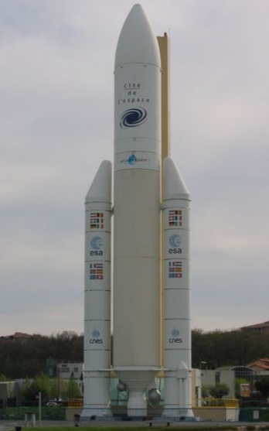
Ariane 5 rocket
The rocket self-destructed 37 seconds after launch
Reason: A control software bug that went undetected
  Conversion from 64-bit floating point to 16-bit signed integer value had caused an exception
    The floating point number was larger than 32767 (max 16-bit signed integer)
  Efficiency considerations led to the disabling of the exception handler.
  Program crashed → rocket crashed
Total Cost: over $1 billion
Notes:
GO QUICKLY through these intro slides; don’t get bogged down in details. Spending too much time on them distracts from the more important content.

Slide 4
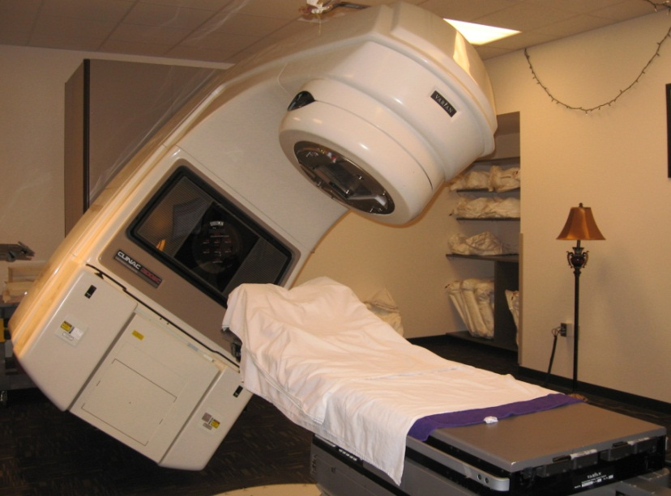
Therac-25 radiation therapy machine
Excessive radiation killed patients (1985-87)
  New design removed hardware interlocks that prevent the electron-beam from operating in its high-energy mode. Now all the safety checks are done in software.
  The equipment control task did not properly synchronize with the operator interface task, so that race conditions occurred if the operator changed the setup too quickly.
  This was missed during testing,
  since it took practice before
  operators were able to work
  quickly enough for the problem
  to occur.
Panama, 2000: At least 8 dead
Many more! (NYT 12/28/2010)

Slide 5
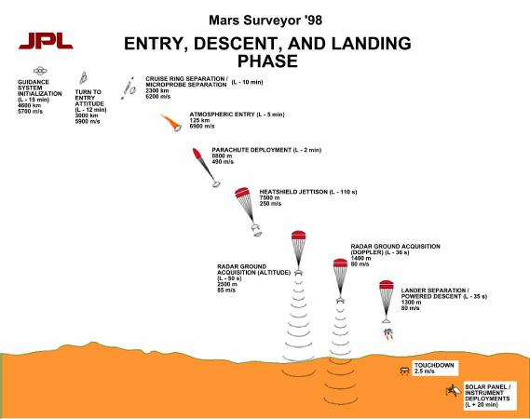
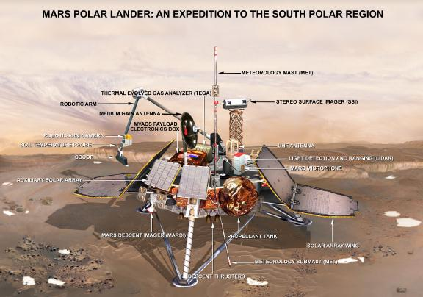
Mars Polar Lander
Legs deployed → Sensor signal falsely indicated that the craft had touched down (130 feet above the surface)
  Then the descent engines shut down prematurely
The error was traced to a single bad line of software code.
  Why didn’t they blame the sensor?
NASA investigation panel blames “difficult parts of the software-engineering process”

Slide 6
More examples
Microsoft Zune's New Year Crash (2008)
iPhone alarm (2011)
Air-Traffic Control System in LA Airport (2004)
Northeast Blackout (2003)
USS Yorktown Incapacitated (1997)
Denver Airport Baggage-handling System (1994)
Mariner I space probe (1962)
AT&T Network Outage (1990)
Intel Pentium floating point divide (1993)
Prius brakes and engine stalling (2005)
Soviet gas pipeline (1982)
Iran centrifuges (2009)

Slide 7
2002 NIST report on costs to society
Inadequate infrastructure for software testing costs the U.S. $22-$60 billion per year
Testing accounts for about half of software development costs.
  Program understanding and debugging account for up to 70% of time to ship a software product
Improvements in software testing infrastructure might save one-third of the cost
(Source: NIST Planning Report 02-3, 2002)

Slide 8
Building Quality Software
What Affects Software Quality?
External
  Correctness Does it do what it supposed to do?
  Reliability Does it do it accurately all the time?
  Efficiency Does it do with minimum use of resources?
  Integrity Is it secure?
Internal
  Portability Can I use it under different conditions?
  Maintainability Can I fix it?
  Flexibility Can I change it or extend it or reuse it?
Quality Assurance
  Process of uncovering problems and improving quality of software.
  Testing is a major part of QA.

Slide 9
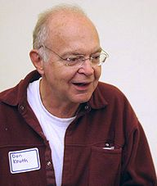
Software Quality Assurance (QA)
Testing plus other activities including:
  Static analysis (assessing code without executing it)
  Proofs of correctness (theorems about program properties)
  Code reviews (people reading each others’ code)
  Software process (methodology for code development)
  …and many other ways to find problems and increase confidence
No single activity or approach can guarantee software quality
  “Beware of bugs in the above code;
  I have only proved it correct, not tried it.”
  -Donald Knuth, 1977

Slide 10
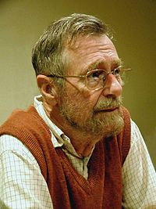
What can you learn from testing?
“Program testing can be used to show the presence of bugs, but never to show their absence!”
Edsgar Dijkstra
Notes on Structured Programming, 1970
Nevertheless testing is essential. Why?

Slide 11
What Is Testing For?
Validation = reasoning + testing
  Make sure module does what it is specified to do
  Uncover problems, increase confidence
Two rules:
1. Do it early and do it often
  Catch bugs quickly, before they have a chance to hide
  Automate the process if you can
2. Be systematic
  If you thrash about randomly, the bugs will hide in the corner until you're gone

Slide 12
Phases of Testing
Unit Testing
  Does each module do what it supposed to do?
Integration Testing
  Do you get the expected results when the parts are put together?
Validation Testing
  Does the program satisfy the requirements?
System Testing
  Does it work within the overall system?

Slide 13
Unit Testing
A unit test focuses on one method, class, interface, or module
Test a single unit in isolation from all others

Slide 14
Do you look at the code?
Black box testing
  Choose test data without looking at implementation
Glass box (white box, clear box) testing
  Choose test data with knowledge of implementation

Slide 15
How is testing done?
Basic steps of a test
  1) Choose input data/configuration
  2) Define the expected outcome
  3) Run program/method against the input and record the results
  4) Examine results against the expected outcome
Testing can't generally prove absence of bugs
  But can increase quality and confidence

Slide 16
sqrt example
// throws: IllegalArgumentException if x<0
// returns: approximation to square root of x
public double sqrt(double x)
What are some values or ranges of x that might be worth probing?
    x < 0 (exception thrown)
    x ≥ 0 (returns normally)
    around x = 0 (boundary condition)
    perfect squares (sqrt(x) an integer), non-perfect squares
    x<sqrt(x) and x>sqrt(x) – that's x<1 and x>1 (and x=1)
    Specific tests: say x = -1, 0, 0.5, 1, 4

Slide 17
What’s So Hard About Testing?
"just try it and see if it works...“
// requires: 1 ≤ x,y,z ≤ 10000
// effects: computes some f(x,y,z)
int proc1(int x, int y, int z)
Exhaustive testing would require 1 trillion runs!
  Sounds totally impractical – and this is a trivially small problem
Key problem: choosing test suite (set of partitions of inputs)
  Small enough to finish quickly
  Large enough to validate the program
Notes:
(But, can think about doing this many tests today)

Slide 18
Approach: Partition the Input Space
Ideal test suite:
  Identify sets with same behavior
  Try one input from each set
Two problems
  1. Notion of the same behavior is subtle
      Naive approach: execution equivalence
      Better approach: revealing subdomains
  2. Discovering the sets requires perfect knowledge
      Use heuristics to approximate cheaply

Slide 19
Naive Approach: Execution Equivalence
// returns: x < 0 => returns –x
// otherwise => returns x
int abs(int x) {
if (x < 0) return -x;
else return x;
}
All x < 0 are execution equivalent:
  program takes same sequence of steps for any x < 0
All x ≥ 0 are execution equivalent
Suggests that {-3, 3}, for example, is a good test suite

Slide 20
Execution Equivalence Doesn't Work
Consider the following buggy code:
// returns: x < 0 => returns –x
// otherwise => returns x
int abs(int x) {
if (x < -2) return -x;
else return x;
}
{-3, 3} does not reveal the error!
Two executions:
  x < -2 x ≥ -2
Three behaviors:
  x < -2 (OK) x = -2 or -1 (bad) x ≥ 0 (OK)

Slide 21
Heuristic: Revealing Subdomains
A subdomain is a subset of possible inputs
A subdomain is revealing for error E if either:
  Every input in that subdomain triggers error E, or
  No input in that subdomain triggers error E
Need test only one input from a given subdomain
  If subdomains cover the entire input space, we are guaranteed to detect the error if it is present
The trick is to guess these revealing subdomains

Slide 22
Example
For buggy abs, what are revealing subdomains?
  int abs(int x) {
  if (x < -2) return -x;
  else return x;
  }
Example subdomains:
Which is best?
{−1} {−2} {−2, −1} {−3, −2, −1}
{−2, −1}

Slide 23
Heuristics for Designing Test Suites
A good heuristic gives:
  few subdomains
  ∀ errors in some class of errors E,
  high probability that some subdomain is revealing for E
Different heuristics target different classes of errors
  In practice, combine multiple heuristics

Slide 24
Black Box Testing
Heuristic: Explore alternate paths through specification
  Procedure is a black box: interface visible, internals hidden
Example
  int max(int a, int b)
  // effects: a > b => returns a
  // a < b => returns b
  // a = b => returns a
  3 paths, so 3 test cases:
  (4, 3) => 4 (i.e. any input in the subdomain a > b)
  (3, 4) => 4 (i.e. any input in the subdomain a < b)
  (3, 3) => 3 (i.e. any input in the subdomain a = b)

Slide 25
Black Box Testing: Advantages
Process is not influenced by component being tested
  Assumptions embodied in code not propagated to test data.
Robust with respect to changes in implementation
  Test data need not be changed when code is changed
Allows for independent testers
  Testers need not be familiar with code
  Tests can be developed before the code

Slide 26
More Complex Example
Write test cases based on paths through the specification
  // returns: the smallest i such
  // that a[i] == value
  // throws: Missing if value is not in a
  int find(int[] a, int value) throws Missing
Two obvious tests:
( [4, 5, 6], 5 ) => 1
( [4, 5, 6], 7 ) => throw Missing
Have we captured all the paths?
Must hunt for multiple cases in effects or requires
( [4, 5, 5], 5 ) => 1

Slide 27
Heuristic: Boundary Testing
Create tests at the edges of subdomains
Why do this?
  off-by-one bugs
  forgot to handle empty container
  overflow errors in arithmetic
  aliasing
Small subdomains at the edges of the “main” subdomains have a high probability of revealing these common errors
Also, you might have misdrawn the boundaries

Slide 28
Boundary Testing
To define the boundary, need a distance metric
  Define adjacent points
One approach:
  Identify basic operations on input points
  Two points are adjacent if one basic operation apart
Point is on a boundary if either:
  There exists an adjacent point in a different subdomain
  Some basic operation cannot be applied to the point
Example: list of integers
  Basic operations: create, append, remove
  Adjacent points: <[2,3],[2,3,3]>, <[2,3],[2]>
  Boundary point: [ ] (can’t apply remove integer)

Slide 29
Other Boundary Cases
Arithmetic
  Smallest/largest values
  Zero
Objects
  Null
  Circular list
  Same object passed to multiple arguments (aliasing)

Slide 30
Boundary Cases: Arithmetic Overflow
// returns: |x|
public int abs(int x)
Tests for abs
  what are some values or ranges of x that might be worth probing?
    x < 0 (flips sign) or x ≥ 0 (returns unchanged)
    around x = 0 (boundary condition)
    Specific tests: say x = -1, 0, 1
How about…
int x = Integer.MIN_VALUE; // this is -2147483648
System.out.println(x<0); // true
System.out.println(Math.abs(x)<0); // also true!
From Javadoc for Math.abs:
  Note that if the argument is equal to the value of Integer.MIN_VALUE, the most negative representable int value, the result is that same value, which is negative

Slide 31
Boundary Cases: Duplicates & Aliases
// modifies: src, dest
// effects: removes all elements of src and
// appends them in reverse order to
// the end of dest
<E> void appendList(List<E> src, List<E> dest) {
while (src.size()>0) {
E elt = src.remove(src.size()-1);
dest.add(elt)
}
}
What happens if src and dest refer to the same thing?
  This is aliasing
  It’s easy to forget!
  Watch out for shared references in inputs

Slide 32
Heuristic: Clear (glass, white)-box testing
Goal:
  Ensure test suite covers (executes) all of the program
  Measure quality of test suite with % coverage
Assumption:
  high coverage → few mistakes in the program
  (Assuming no errors in test suite oracle (expected output).)
Focus: features not described by specification
  Control-flow details
  Performance optimizations
  Alternate algorithms for different cases

Slide 33
Glass-box Motivation
There are some subdomains that black-box testing won't catch:
boolean[] primeTable = new boolean[CACHE_SIZE];
boolean isPrime(int x) {
if (x>CACHE_SIZE) {
for (int i=2; i<x/2; i++) {
if (x%i==0) return false;
}
return true;
} else {
return primeTable[x];
}
}
Important transition around x = CACHE_SIZE

Slide 34
Glass Box Testing: Advantages
Finds an important class of boundaries
  Yields useful test cases
Consider CACHE_SIZE in isPrime example
  Need to check numbers on each side of CACHE_SIZE
    CACHE_SIZE-1, CACHE_SIZE, CACHE_SIZE+1
  If CACHE_SIZE is mutable, we may need to test with different CACHE_SIZEs
Disadvantages?
  Tests may have same bugs as implementation

Slide 35
Code coverage: what is enough?
static int min (int a, int b) {
int r = a;
if (a <= b) {
r = a;
}
return r;
}
Consider any test with a ≤ b (e.g., min(1,2))
  It executes every instruction
  It misses the bug
Statement coverage is not enough

Slide 36
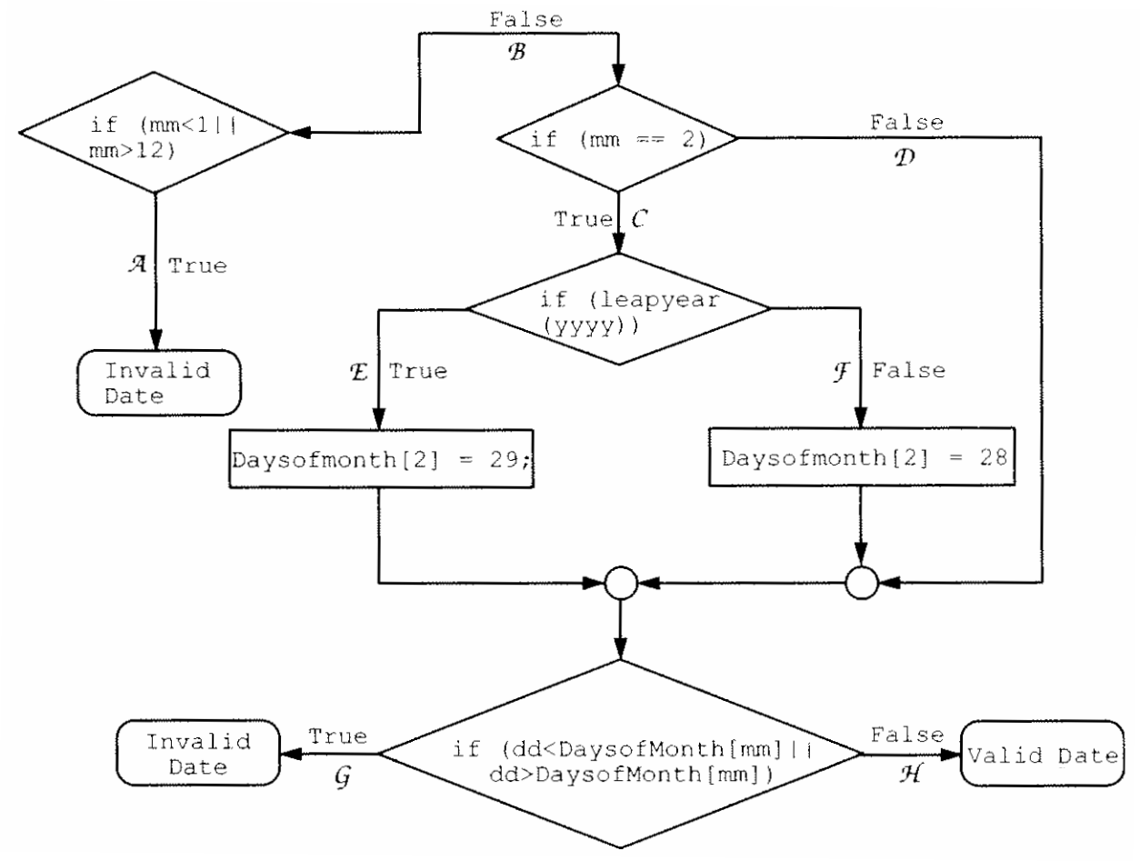
Path coverage example

Slide 37
Varieties of coverage
Covering all of the program
  Statement coverage
  Branch coverage
  Decision coverage
  Loop coverage
  Condition/Decision coverage
  Path coverage
Limitations of coverage:
  100% coverage is not always a reasonable target
  100% may be unattainable (dead code)
  High cost to approach the limit
  Coverage is just a heuristic
  We really want the revealing subdomains
increasing
number of
test cases
(more or
less)

Slide 38
Pragmatics: Regression Testing
Whenever you find a bug
  Store the input that elicited that bug, plus the correct output
  Add these to the test suite
  Verify that the test suite fails
  Fix the bug
  Verify the fix
Ensures that your fix solves the problem
  Don’t add a test that succeeded to begin with!
Helps to populate test suite with good tests
Protects against reversions that reintroduce bug
  It happened at least once, and it might happen again

Slide 39
Rules of Testing
First rule of testing: Do it early and do it often
  Best to catch bugs soon, before they have a chance to hide.
  Automate the process if you can
  Regression testing will save time
Second rule of testing: Be systematic
  If you randomly thrash, bugs will hide in the corner until you're gone
  Writing tests is a good way to understand the spec
    Think about revealing domains and boundary cases
    If the spec is confusing → write more tests
  Spec can be buggy too
    Incorrect, incomplete, ambiguous, and missing corner cases
  When you find a bug → write a test for it first and then fix it

Slide 40
Summary
Testing matters
  You need to convince others that module works
Catch problems earlier
  Bugs become obscure beyond the unit they occur in
Don't confuse volume with quality of test data
  Can lose relevant cases in mass of irrelevant ones
  Look for revealing subdomains
Choose test data to cover
  Specification (black box testing)
  Code (glass box testing)
Testing can't generally prove absence of bugs
  But it can increase quality and confidence

