Slide 1
CSE 312 Section 8
Tail Bounds

Slide 2
Announcements & Reminders
HW6
Due on Wednesday 2/25
Late deadline Saturday 2/28 @ 11:59 pm
HW7
Released
Due Wednesday 3/4 @ 11:59 pm
Late deadline Saturday 3/7 @ 11:59 pm

Slide 3
Review & Questions

Slide 4
Any lingering questions from this last week?
Each week in section, we’ll be reviewing the main concepts from this week and putting them into action by going through some practice problems together. But before we get into that review, we’ll try to start off each section with some time for you to ask questions. Was anything particularly confusing this week? Is there anything we can clarify before we dive into the review? This is your chance to clear things up!

Slide 5

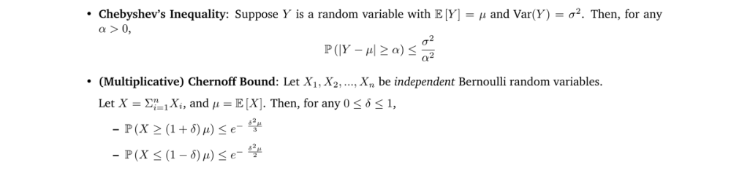
Review of Main Concepts

Slide 6
Problem 2 – Tail Bounds

Slide 7
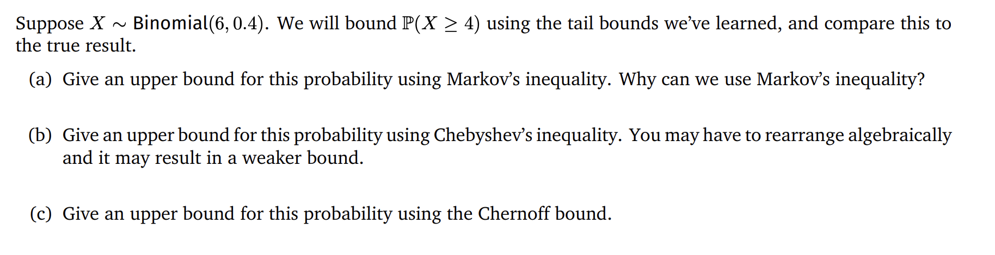
Problem 2 – Tail Bounds
Work on this with the people around you and then we’ll go over it together!

Slide 9
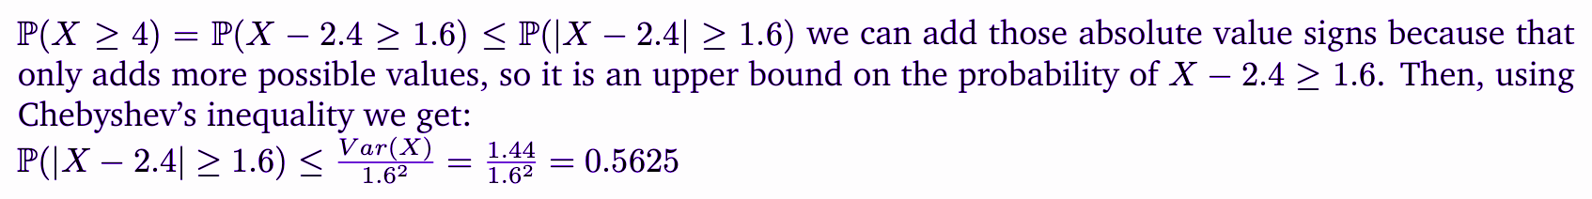

Slide 10
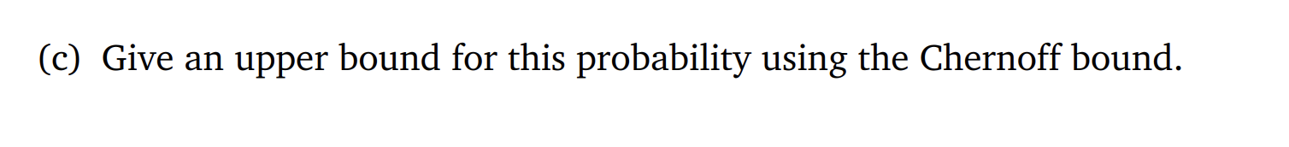
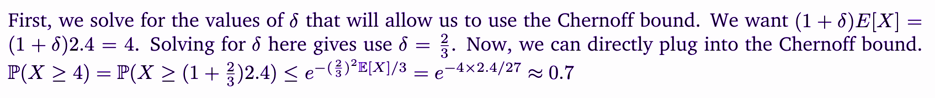

Slide 11
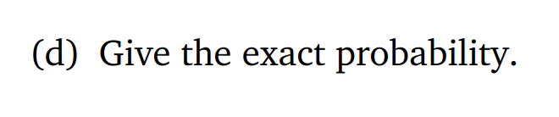

Slide 12
Problem 0 – Central Limit Theorem Practice

Slide 13
Problem 0 - Central Limit Theorem Practice
You're playing ping pong with your friend, and want to keep playing until you've scored 15 points. Unfortunately, your friend is a much more skilled ping pong player than you, so you only win points 25% of the time (with each point being independent of the other points). Approximate the probability that you'll need to play at least 50 points before stopping.
Work on this with the people around you and then we’ll go over it together!

Slide 14
Problem 0 - Central Limit Theorem Practice
You're playing ping pong with your friend, and want to keep playing until you've scored 15 points. Unfortunately, your friend is a much more skilled ping pong player than you, so you only win points 25% of the time (with each point being independent of the other points). Approximate the probability that you'll need to play at least 50 points before stopping.
Let X be the total number of points played before stopping. We want to approximate P(X ≥ 50).
For i in {1, …, 15}, Let X_{i} be the number of points played after the i - 1th point you win, up to and including the i-th point you win. Then, X = ∑X_{i}
Because you win each point independently with probability 0.25, X_{i} ~ Geo(0.25). So,
E[X_{i}] = 4, and Var[X_{i}] = 12
Work on this with the people around you and then we’ll go over it together!

Slide 15
Problem 0 - Central Limit Theorem Practice
You're playing ping pong with your friend, and want to keep playing until you've scored 15 points. Unfortunately, your friend is a much more skilled ping pong player than you, so you only win points 25% of the time (with each point being independent of the other points). Approximate the probability that you'll need to play at least 50 points before stopping.
Because you win each point independently with probability 0.25, X_{i} ~ Geo(0.25). So,
E[X_{i}] = 4, and Var[X_{i}] = 12.
By the central limit theorem, X ≈ N ~ Norm(15 • 4, 15 • 12).
Applying continuity correction, P(X ≥ 50) = P(X ≥ 49.5) ≈ P(N ≥ 49.5)
Work on this with the people around you and then we’ll go over it together!

Slide 16
Problem 0 - Central Limit Theorem Practice
You're playing ping pong with your friend, and want to keep playing until you've scored 15 points. Unfortunately, your friend is a much more skilled ping pong player than you, so you only win points 25% of the time (with each point being independent of the other points). Approximate the probability that you'll need to play at least 50 points before stopping.
Applying continuity correction, P(X ≥ 50) = P(X ≥ 49.5) ≈ P(N ≥ 49.5)
Standardizing N with μ = 60 and σ² = 180, we get
P(N ≥ 49.5) = P((N - 60)/√180 ≥ (49.5 - 60) / √180) ≈ P(Z ≥ -0.783)
Work on this with the people around you and then we’ll go over it together!

Slide 17
Problem 0 - Central Limit Theorem Practice
You're playing ping pong with your friend, and want to keep playing until you've scored 15 points. Unfortunately, your friend is a much more skilled ping pong player than you, so you only win points 25% of the time (with each point being independent of the other points). Approximate the probability that you'll need to play at least 50 points before stopping.
Standardizing N with μ = 60 and σ² = 180, we get
P(N ≥ 49.5) = P((N - 60)/√180 ≥ (49.5 - 60) / √180) ≈ P(Z ≥ -0.783)
Converting this to a Z-table form, we get
P(Z ≥ -0.783) = 1 - P(Z ≤ -0.783) = 1 - Φ(-0.783) = 1 - (1 - Φ(0.783)) = Φ(0.783) ≈ 0.783
So, P(X ≥ 50) ≈ 0.783
Work on this with the people around you and then we’ll go over it together!

Slide 18
Review Questions

Slide 19
Question #1
True or false: the Union Bound always gives a result in [0, 1]
True
False

Slide 20
Question #1
True or false: the Union Bound always gives a result in [0, 1]
True
False

Slide 21
Question #2
b) True or False: Markov’s Inequality always gives a non-negative result.
True
False

Slide 22
Question #2
b) True or False: Markov’s Inequality always gives a non-negative result.
True
False

Slide 23
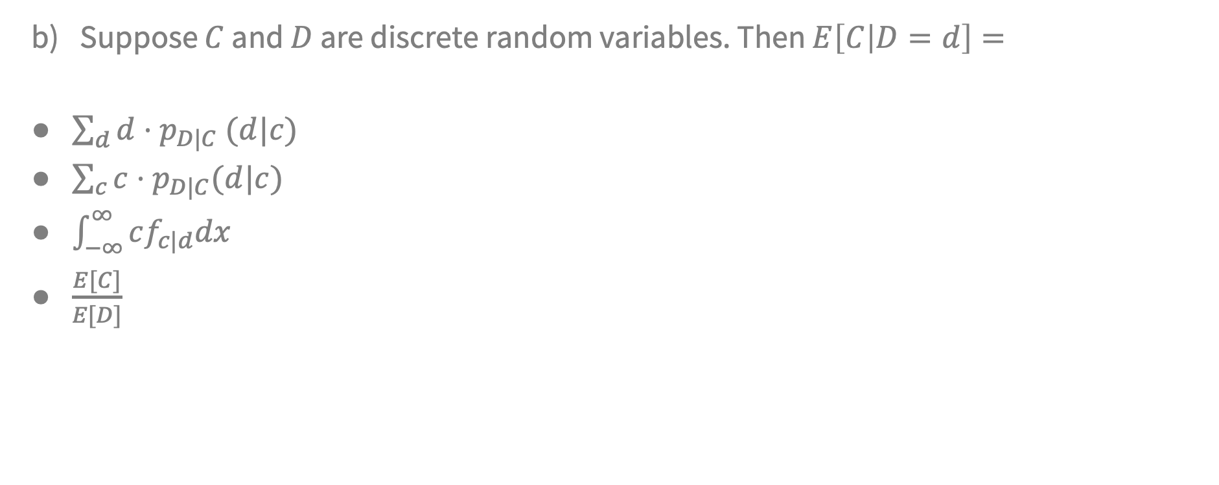
Question #3

Slide 24
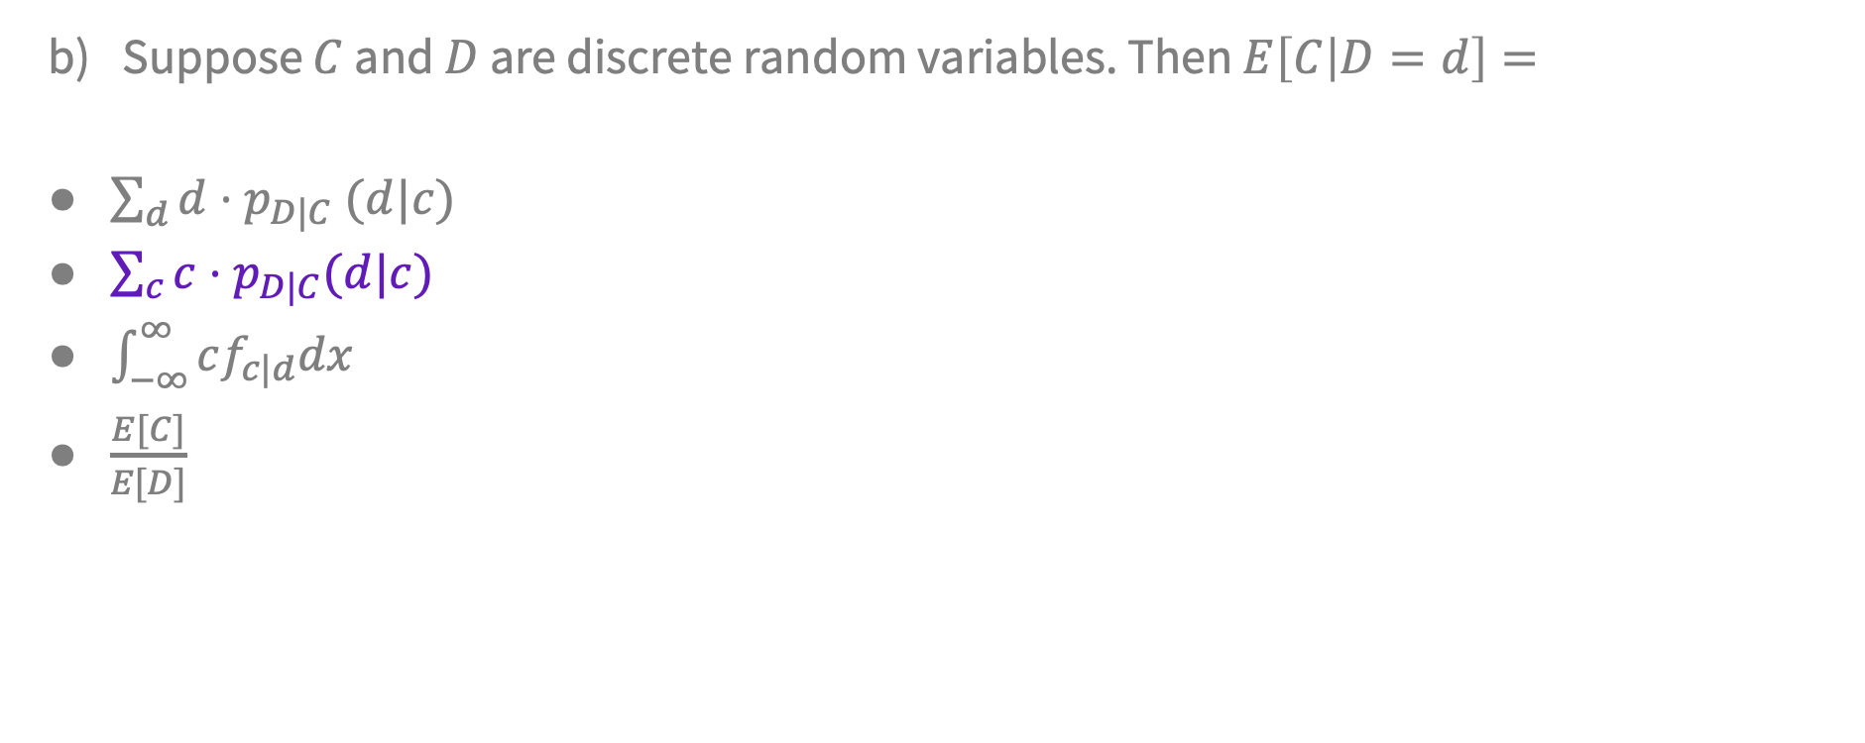
Question #3

Slide 25
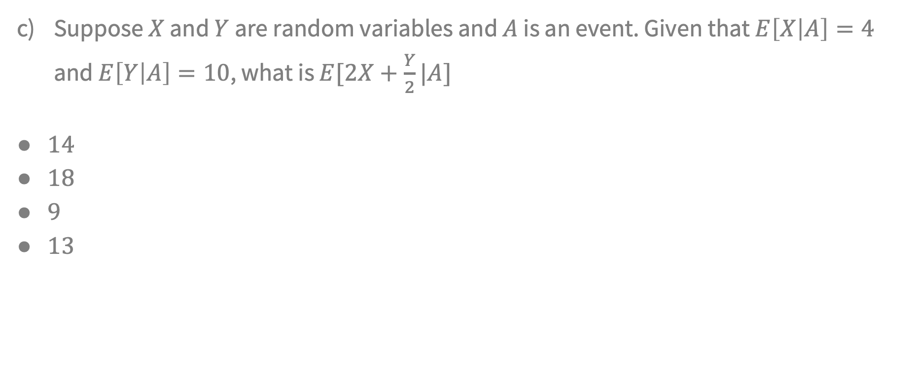
Question #4

Slide 26
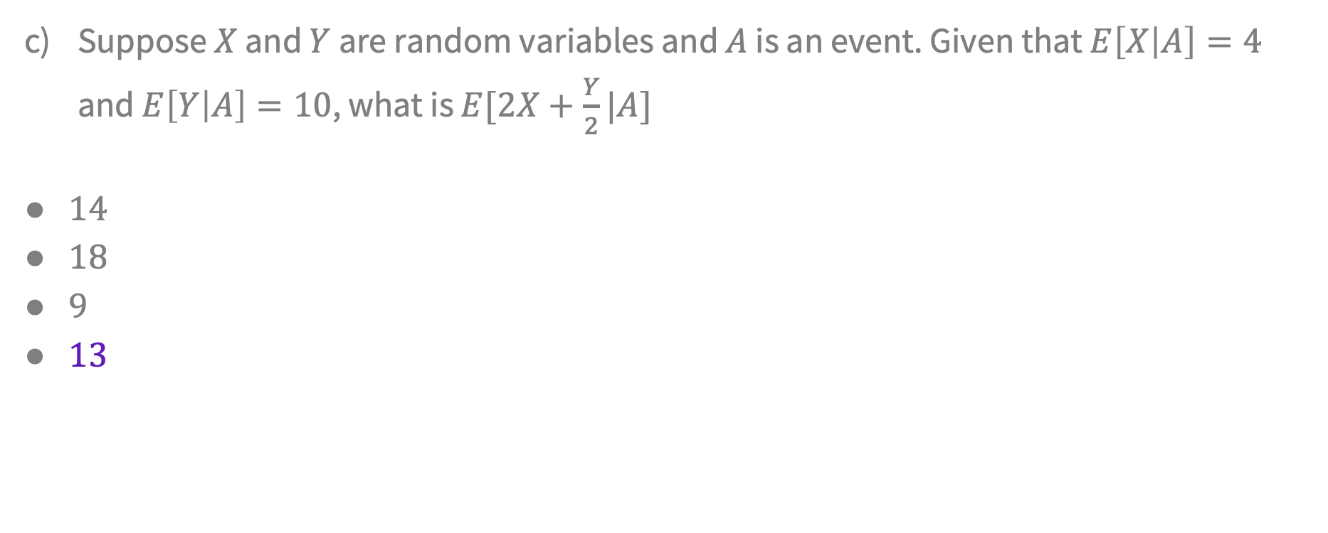
Question #4

Slide 27
Question #5
True or false: Chebyshev’s Inequality can best be described as giving an upper bound on the distribution’s right tail.
True
False

Slide 28
Question #5
True or false: Chebyshev’s Inequality can best be described as giving an upper bound on the distribution’s right tail.
True
False

Slide 29
Problem 3 – Exponential Tail Bounds

Slide 30
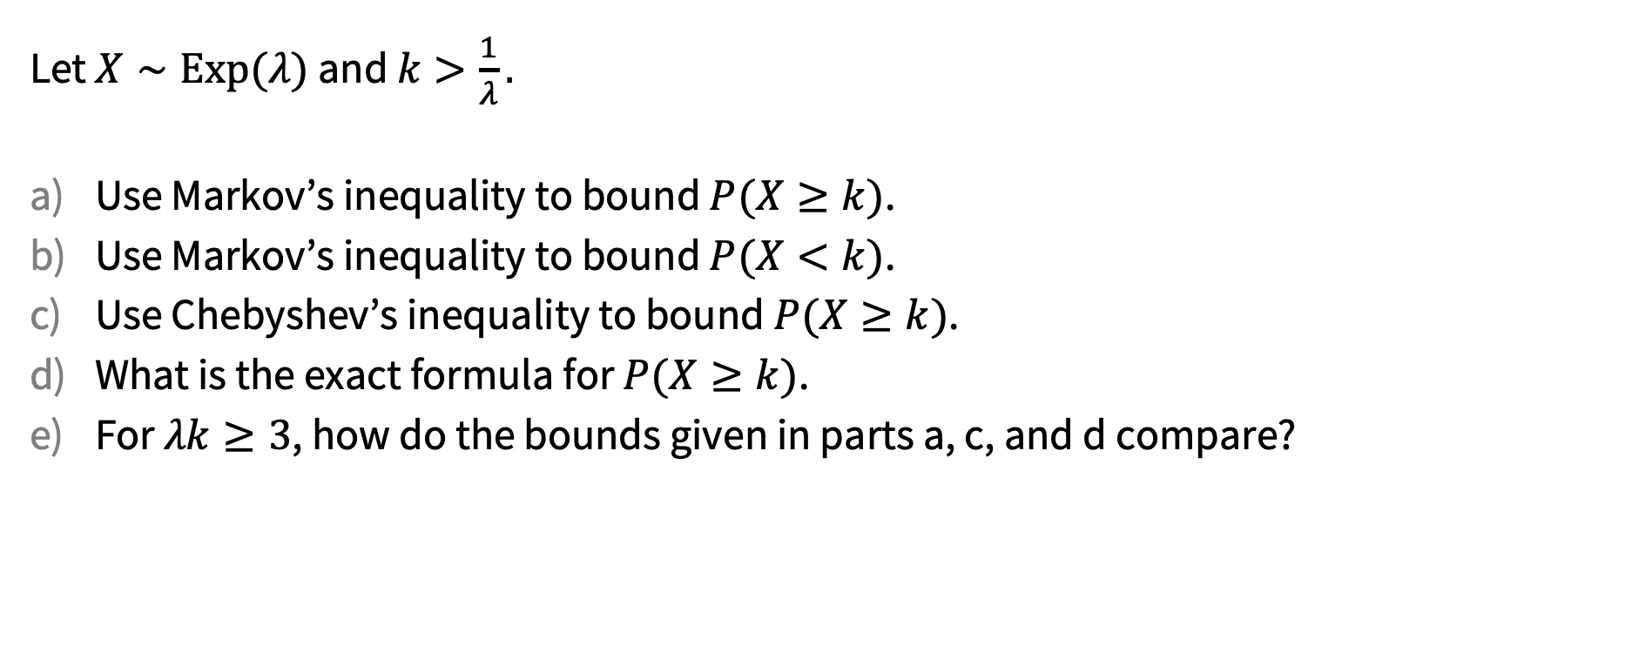
Problem 3 – Exponential Tail Bounds
Work on this with the people around you and then we’ll go over it together!

Slide 31
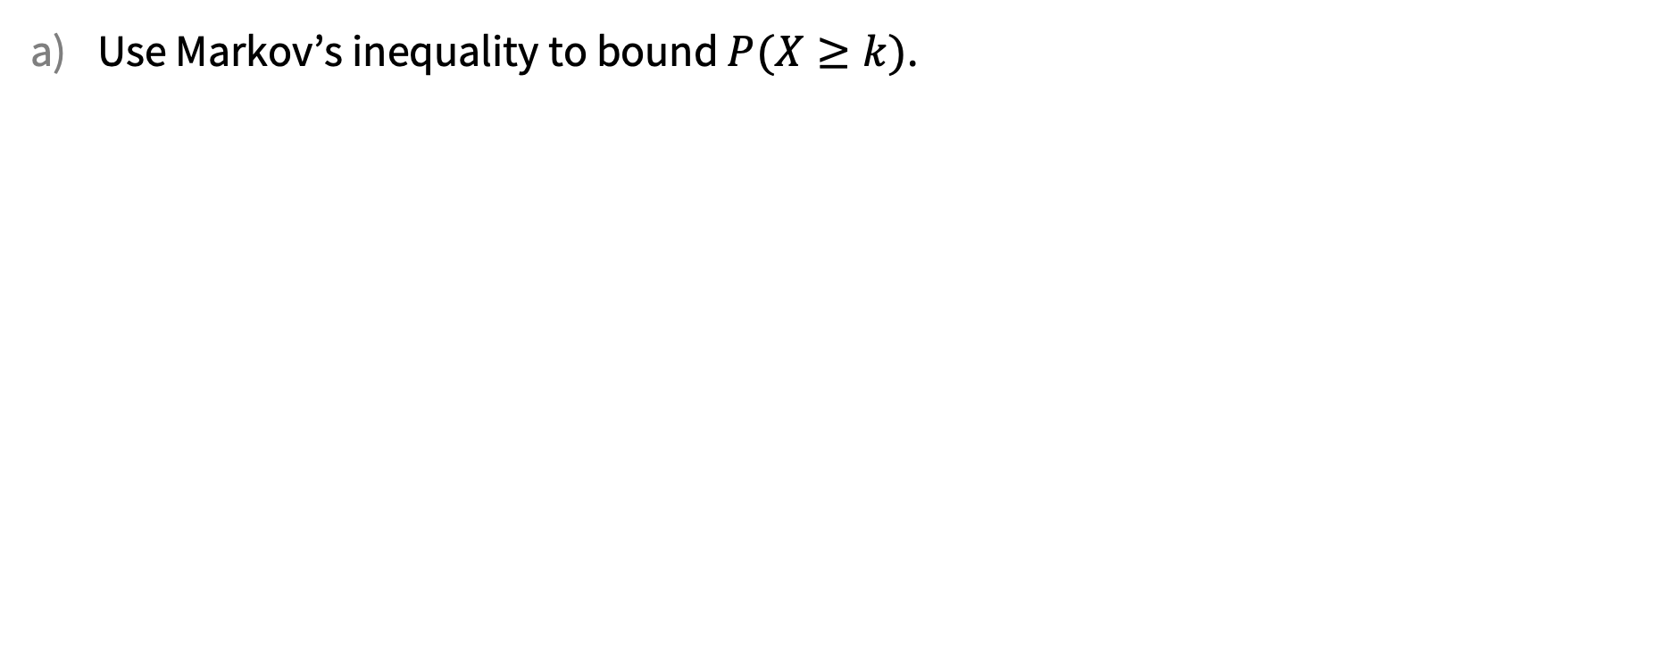
Problem 3 – Exponential Tail Bounds

Slide 32
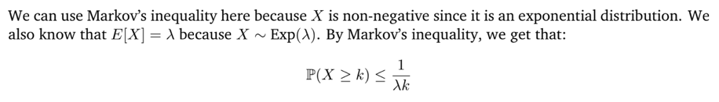
Problem 3 – Exponential Tail Bounds

Slide 33

Problem 3 – Exponential Tail Bounds

Slide 34
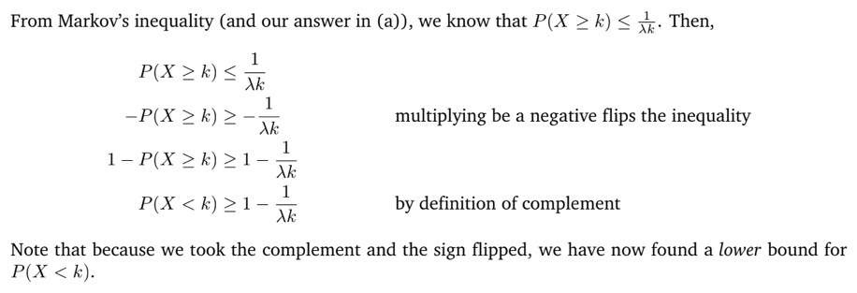
Problem 3 – Exponential Tail Bounds

Slide 35

Problem 3 – Exponential Tail Bounds

Slide 36
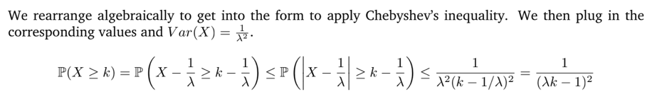
Problem 3 – Exponential Tail Bounds

Slide 37

Problem 3 – Exponential Tail Bounds

Slide 38
Problem 3 – Exponential Tail Bounds

Slide 39

Problem 3 – Exponential Tail Bounds

Slide 40

Problem 3 – Exponential Tail Bounds

Slide 41
That’s All, Folks!
Thanks for coming to section this week!
Any questions?

