Slide 1
CSE 312 Section 6
Continuous RVs

Slide 2
Administrivia

Slide 3
Announcements & Reminders
HW5
last homework before the midterm
Due Friday 2/13 @ 11:59pm
Late deadline Monday 2/16 @ 11:59pm
Note that Monday is a university holiday, so last OH likely Friday

Slide 4
Review & Questions

Slide 5
Any lingering questions from this last week?
Each week in section, we’ll be reviewing the main concepts from this week and putting them into action by going through some practice problems together. But before we get into that review, we’ll try to start off each section with some time for you to ask questions. Was anything particularly confusing this week? Is there anything we can clarify before we dive into the review? This is your chance to clear things up!

Slide 6
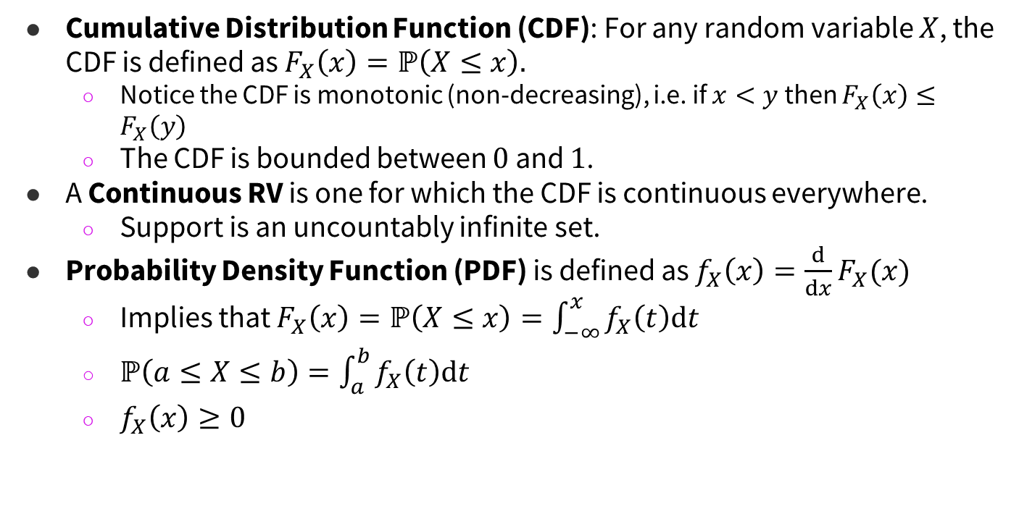
Review of Main Concepts

Slide 7
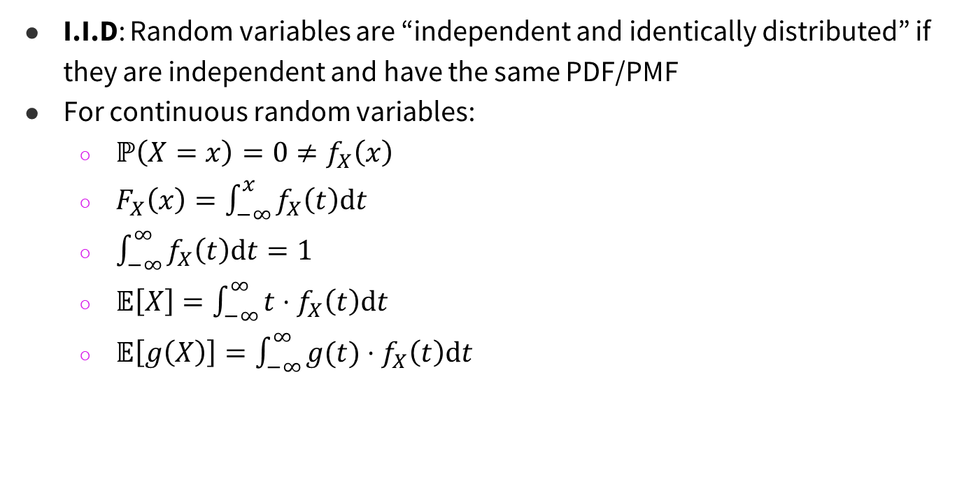
Review of Main Concepts

Slide 8
Problem 1 – Content Review

Slide 9
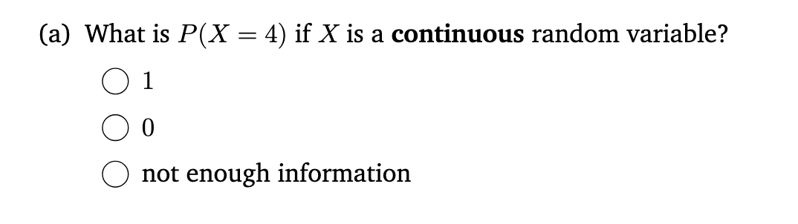
1 – Content Review

Slide 10
1 – Content Review

Slide 11
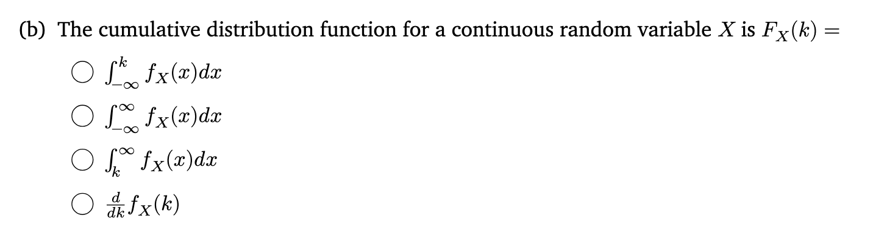
1 – Content Review

Slide 12
1 – Content Review

Slide 13
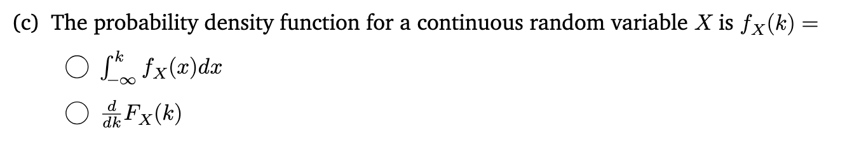
1 – Content Review

Slide 14
1 – Content Review

Slide 15
1 – Content Review

Slide 16

1 – Content Review

Slide 17
1 – Content Review

Slide 18
1 – Content Review

Slide 19
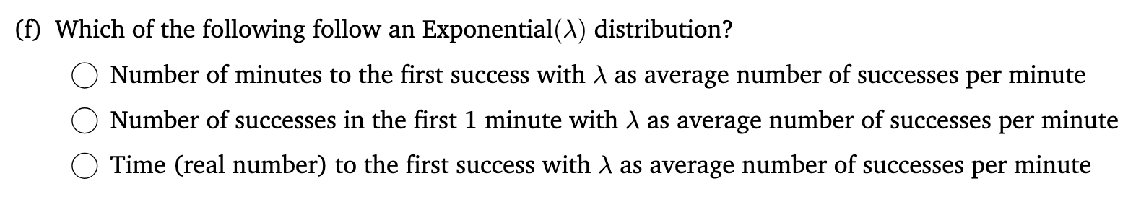
1 – Content Review

Slide 20
1 – Content Review

Slide 21
Problem 2 – Uniform2

Slide 22
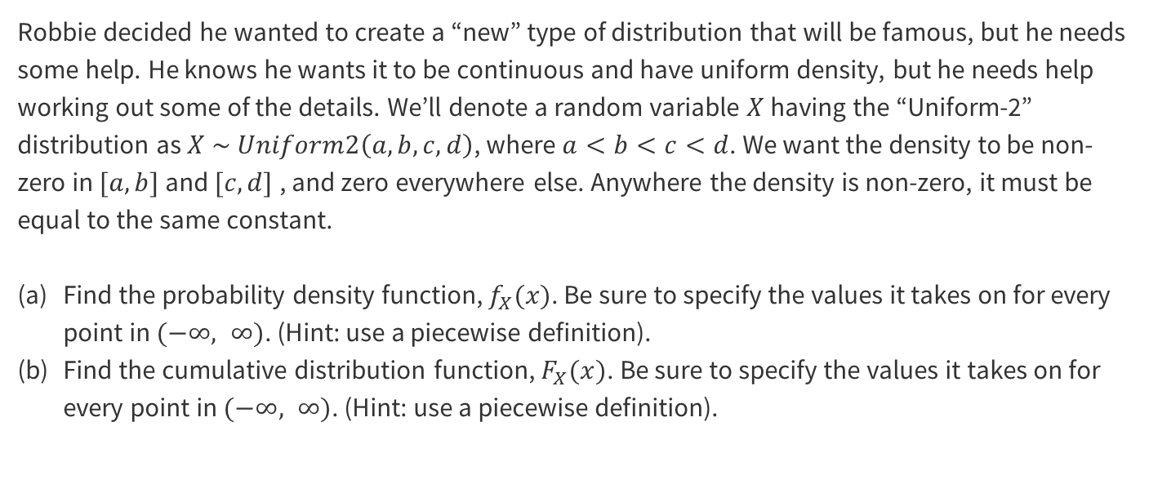
2 – Uniform2
Work on this problem with the people around you, and then we’ll go over it together!

Slide 23
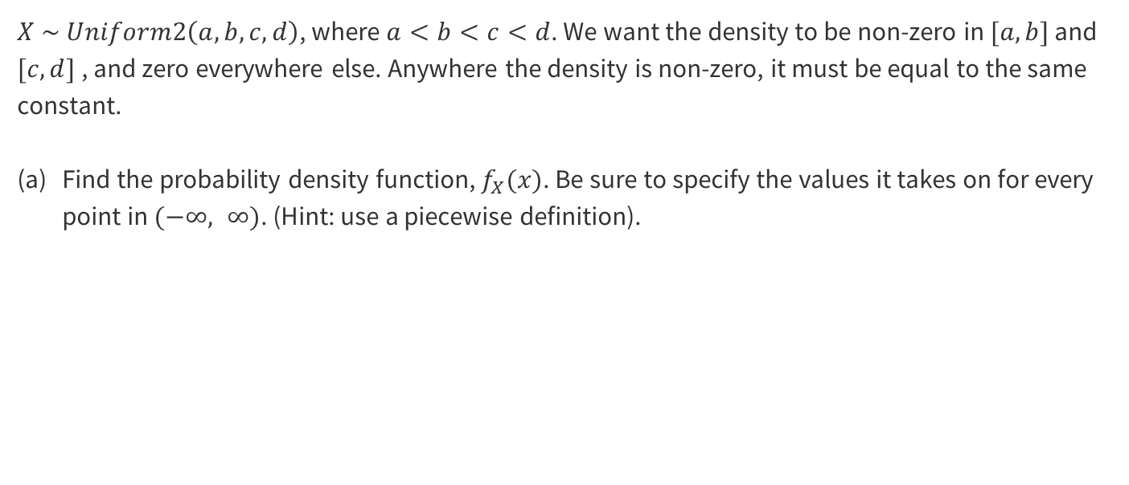
2 – Uniform2

Slide 24
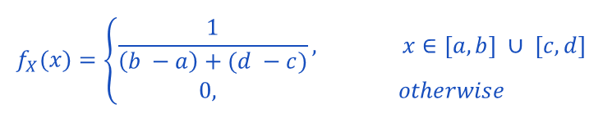
2 – Uniform2

Slide 25
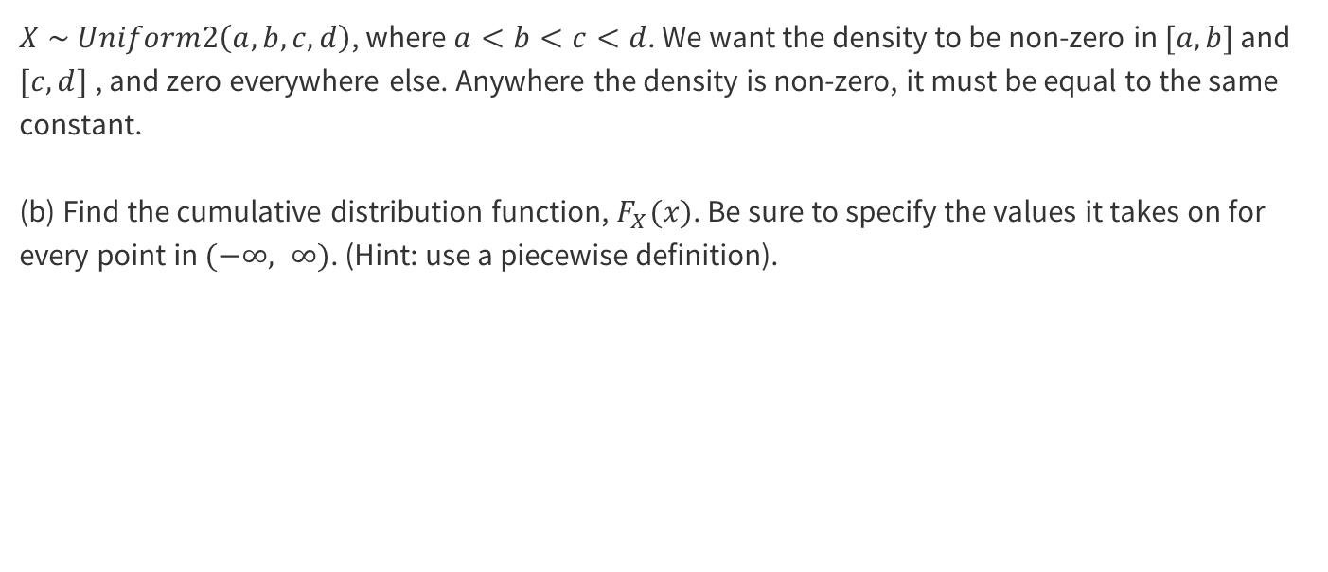
2 – Uniform2

Slide 26
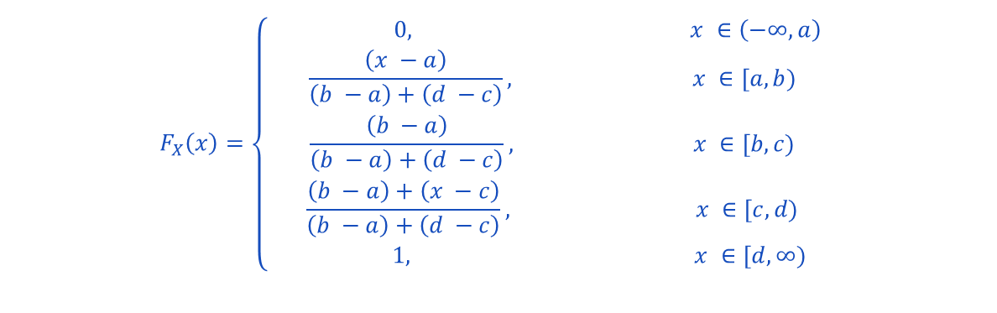
2 – Uniform2

Slide 27
Problem 6 – Throwing a dart

Slide 28
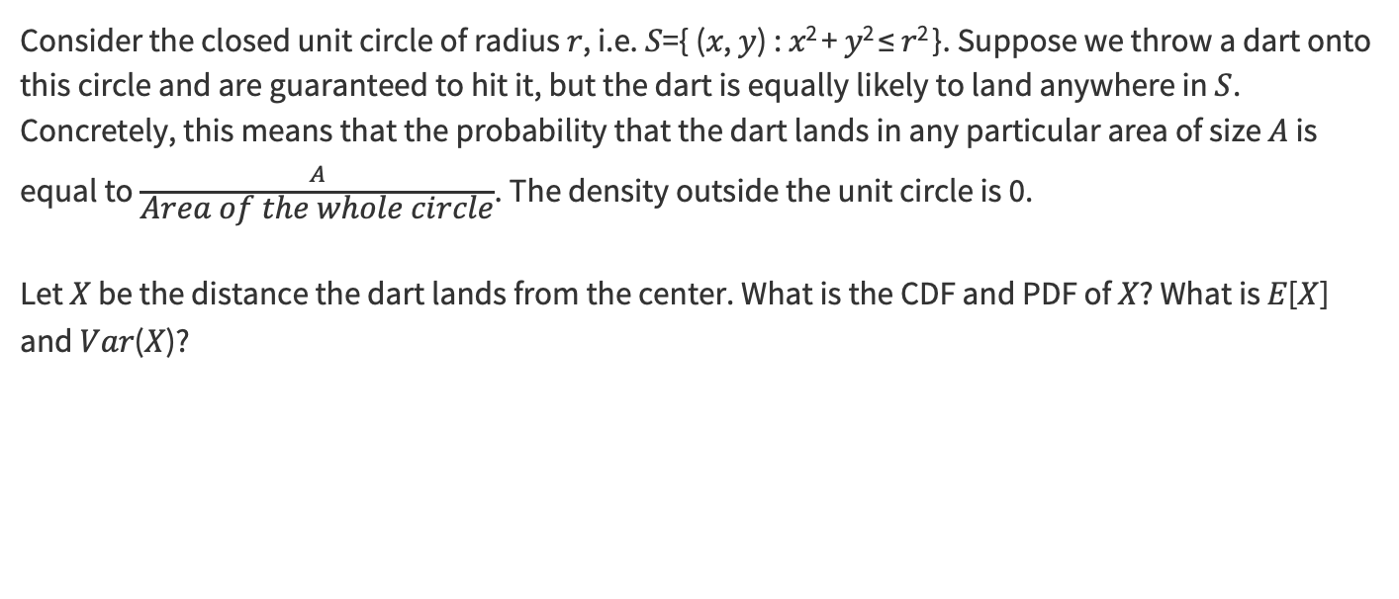
6 – Throwing a dart
Work on this problem with the people around you, and then we’ll go over it together!

Slide 29
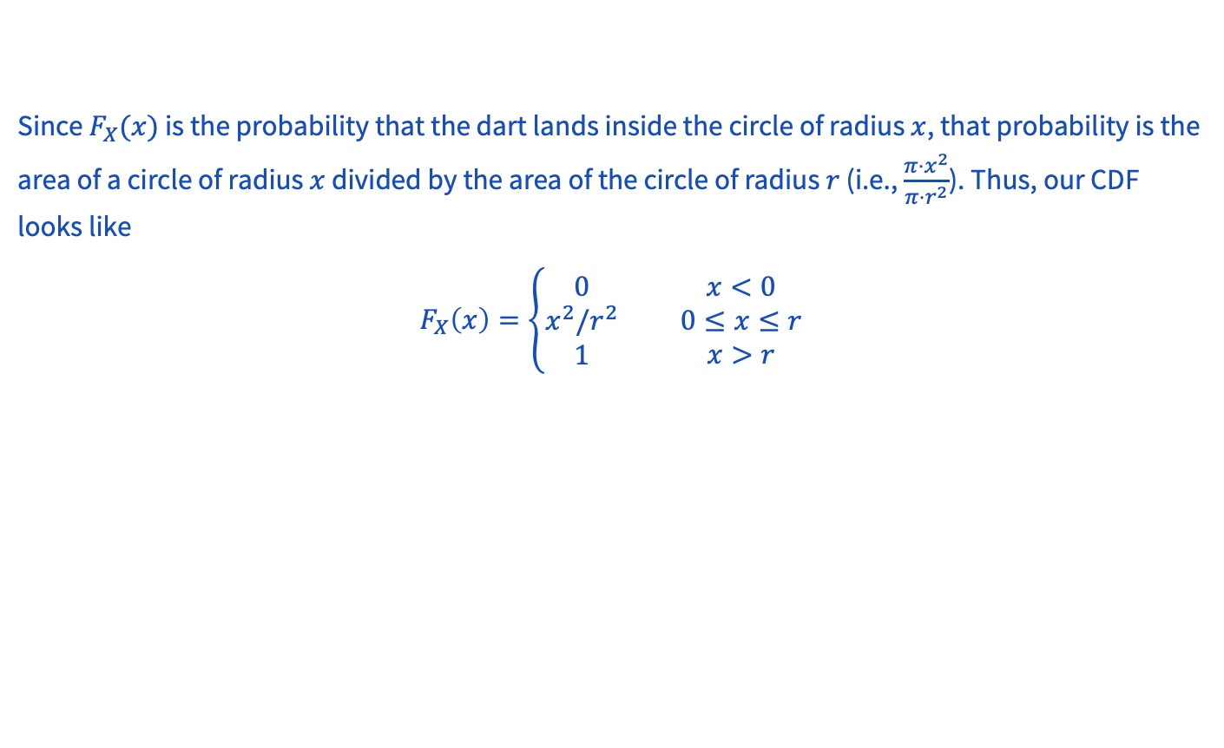
6 – Throwing a dart

Slide 30
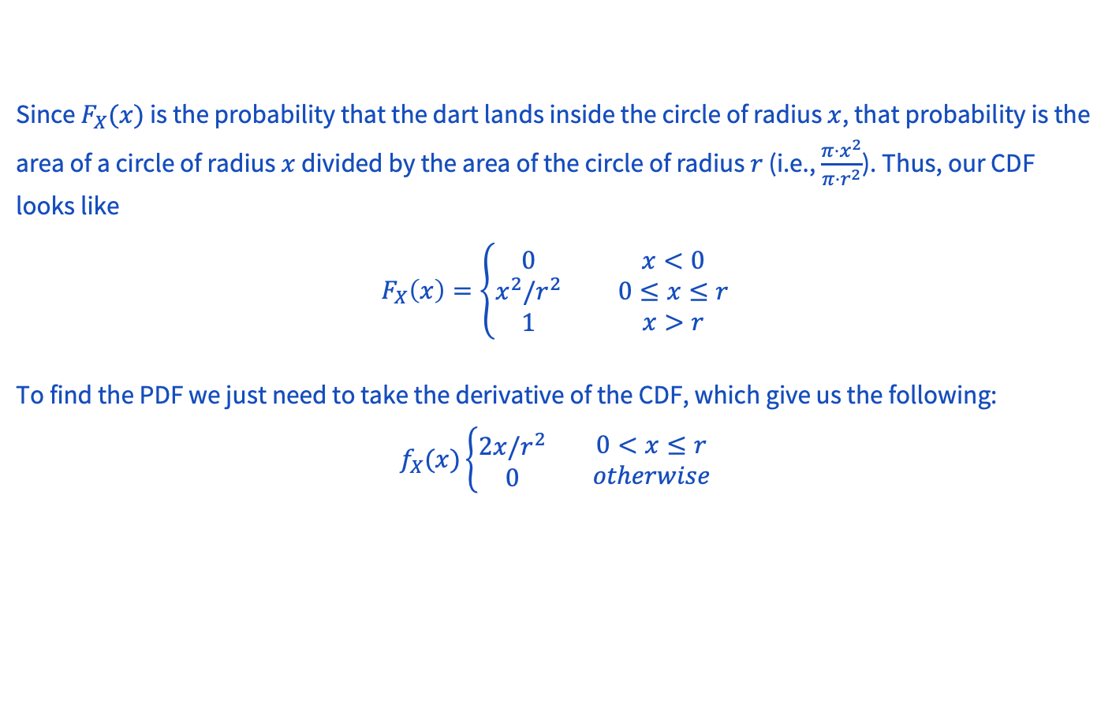
6 – Throwing a dart

Slide 31
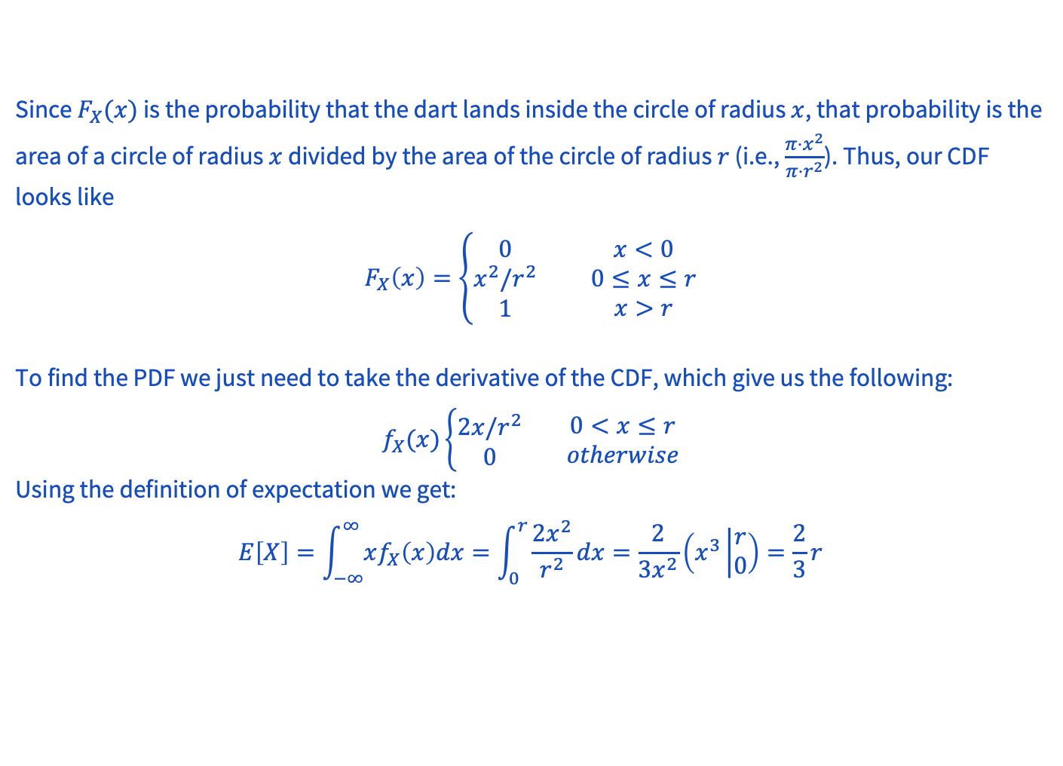
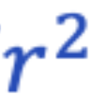
6 – Throwing a dart

Slide 32
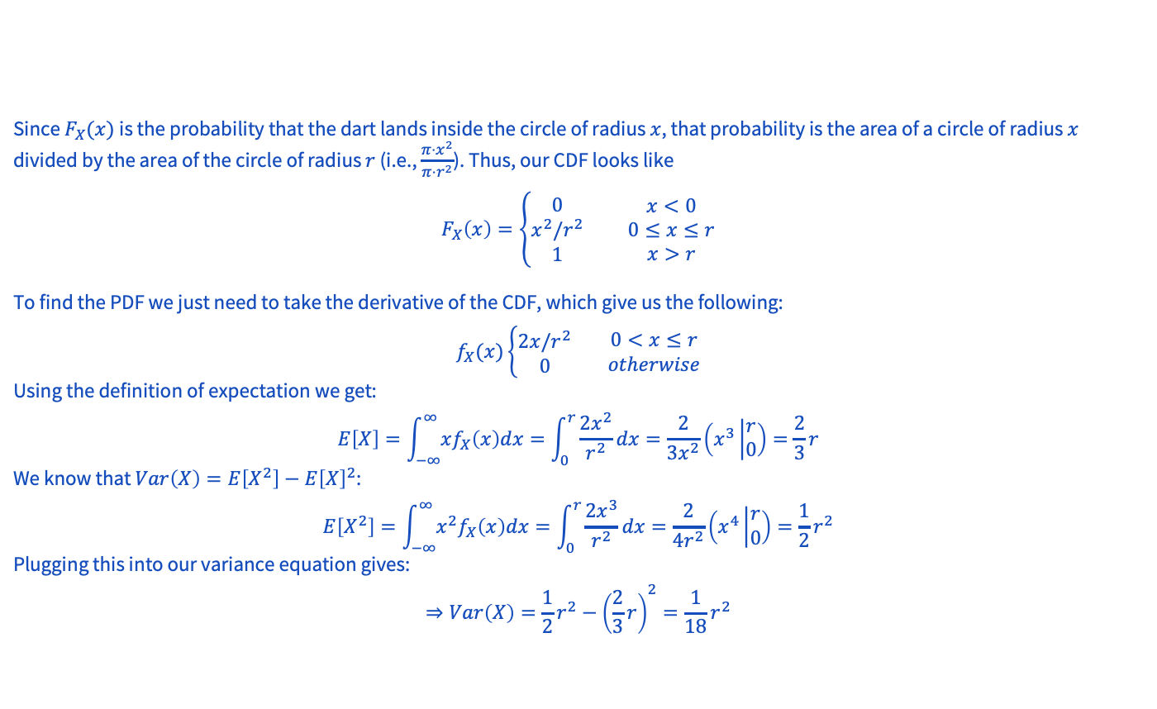
6 – Throwing a dart

Slide 33
Problem 4 – Max of uniforms

Slide 34
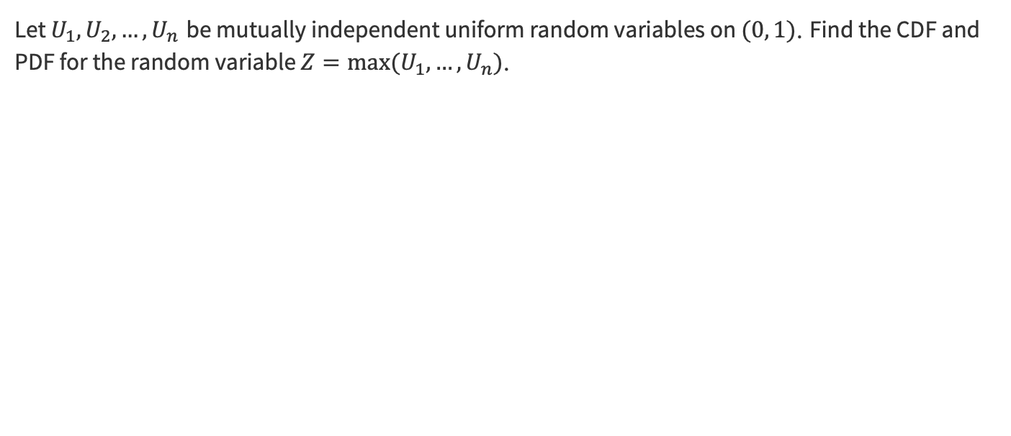
4 – Max of uniforms
Work on this problem with the people around you, and then we’ll go over it together!

Slide 35
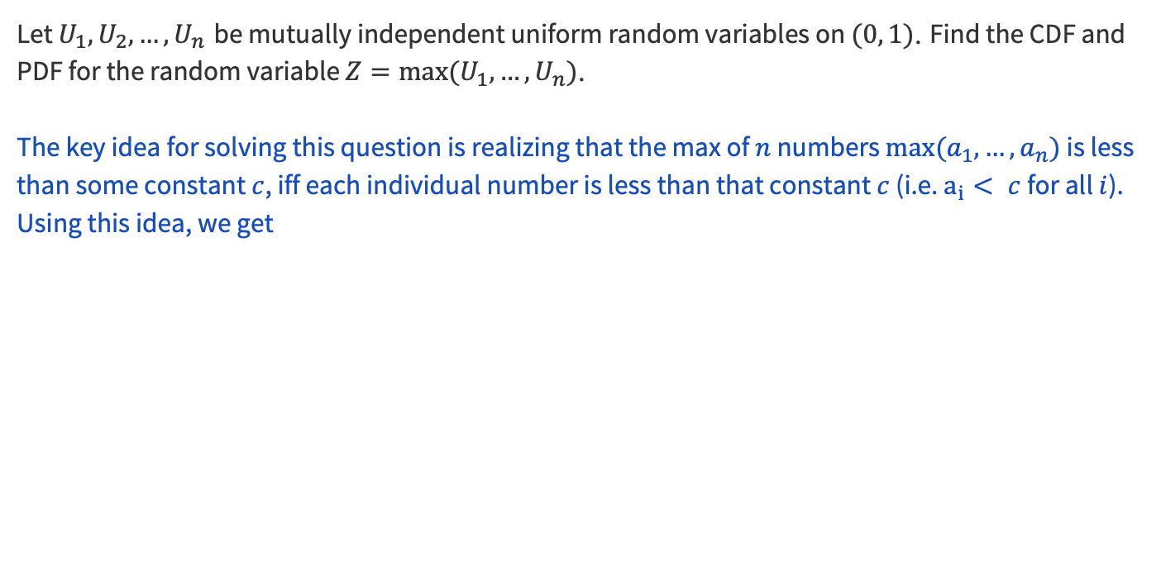
4 – Max of uniforms

Slide 36
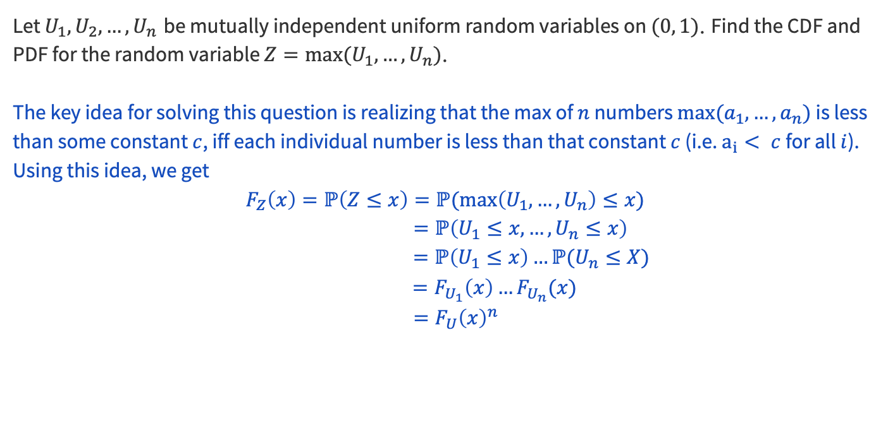

4 – Max of uniforms
by independence

Slide 37
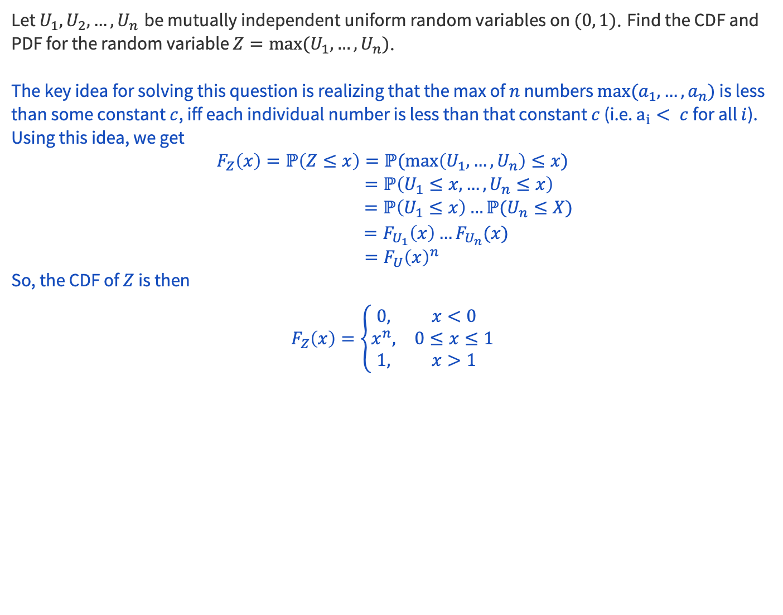

4 – Max of uniforms
by independence

Slide 38
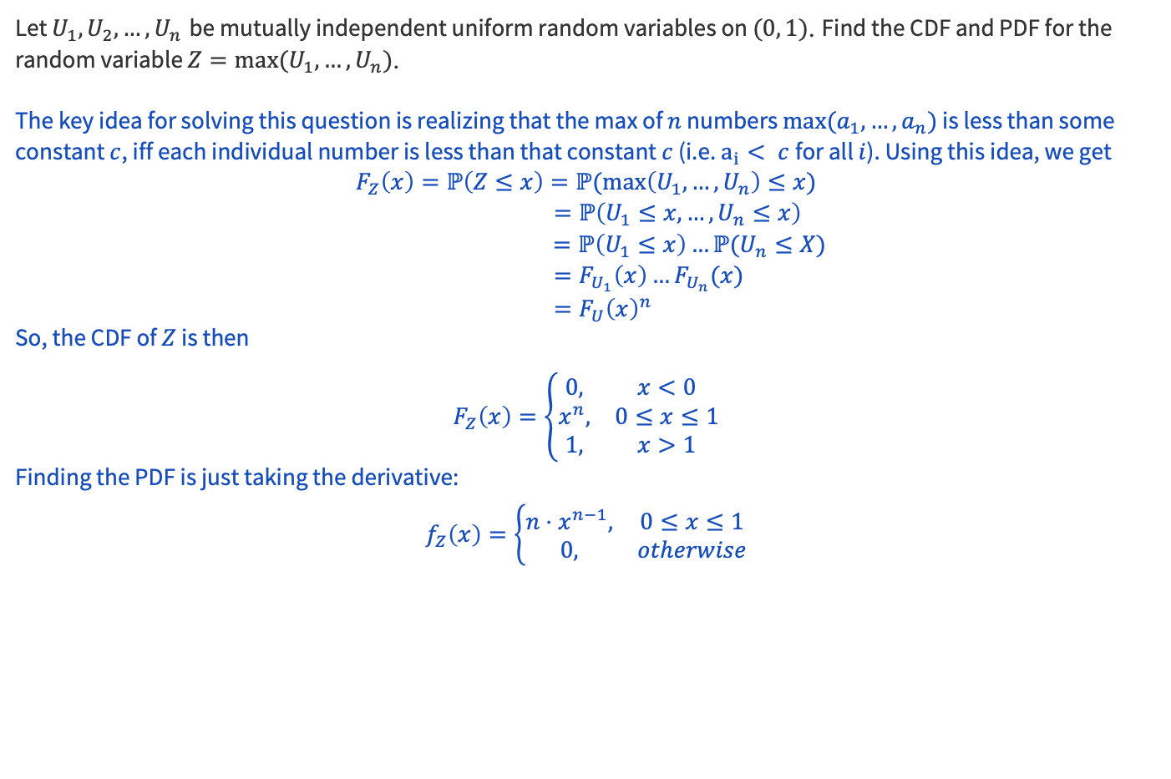

4 – Max of uniforms
by independence

Slide 39
Midterm Review

Slide 40
Topic Coverage
Counting
Pigeonhole principle
Stars and bars
Binomial theorem
Inclusion-exclusion
Probability
Conditional probability and Bayes Rules
Independence
Discrete RV (defining RVs, PMF, CDF, expectation, variance)
Linearity of expectation
Discrete RV Zoo

Slide 41
Problem 5 (Midterm Review)

Slide 42
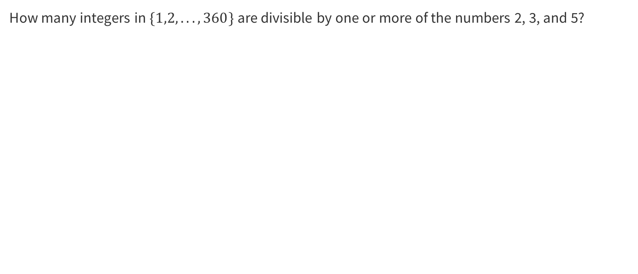
5 (Midterm Review)
Work on this problem with the people around you, and then we’ll go over it together!

Slide 43
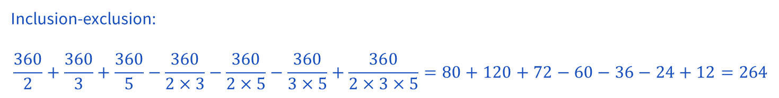
5 (Midterm Review)

Slide 44
Problem 3 (Midterm Review)

Slide 45
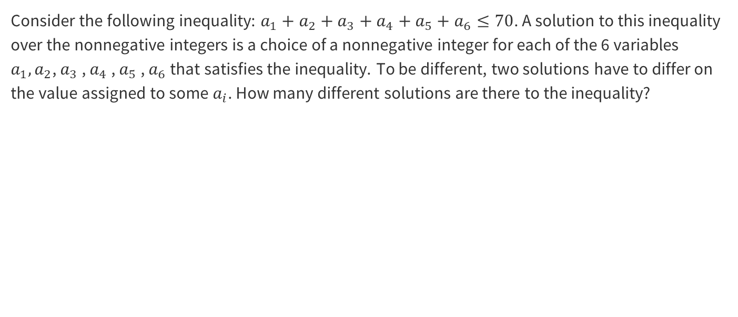
3 (Midterm Review)
Work on this problem with the people around you, and then we’ll go over it together!

Slide 46
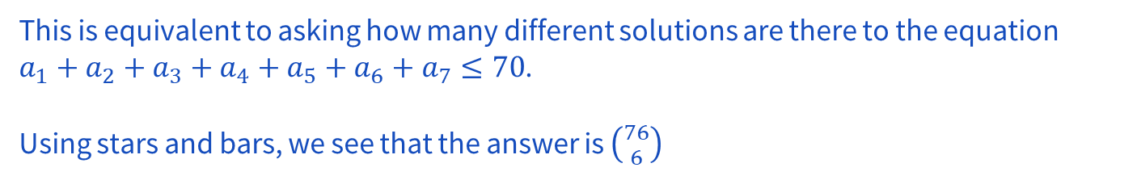


3 (Midterm Review)

Slide 47
Problem 12 (Midterm Review)

Slide 48
12 (Midterm Review)
You are working on a difficult passage from a new piece you are learning on the piano. You wish to play it correctly 4 times before stopping for the day. If your probability of playing it correctly on each attempt is 2/3, and the attempts are independent (unfortunately!), what is the probability that you have to play it at least 8 times?
Work on this problem with the people around you, and then we’ll go over it together!

Slide 49
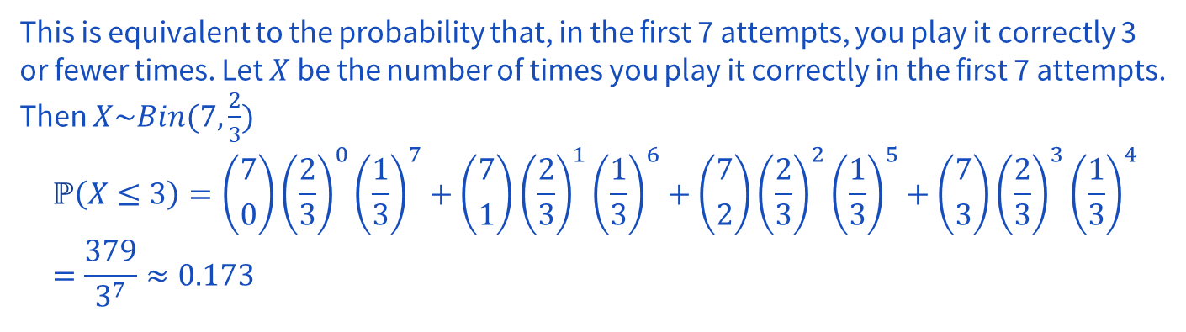
12 (Midterm Review)
You are working on a difficult passage from a new piece you are learning on the piano. You wish to play it correctly 4 times before stopping for the day. If your probability of playing it correctly on each attempt is 2/3, and the attempts are independent (unfortunately!), what is the probability that you have to play it at least 8 times?

Slide 50
Problem 10 (Midterm Review)

Slide 51
10 (Midterm Review)
Suppose you record the birthdays of a large group of people, one at a time, until you have
found a person whose birthday matches your own birthday. What is the probability that it
takes exactly 20 people for this to occur? Assume that there are 365 possible birthdays and
each one is equally probable for a randomly chosen person.
Work on this problem with the people around you, and then we’ll go over it together!

Slide 52

10 (Midterm Review)
Suppose you record the birthdays of a large group of people, one at a time, until you have
found a person whose birthday matches your own birthday. What is the probability that it
takes exactly 20 people for this to occur? Assume that there are 365 possible birthdays and
each one is equally probable for a randomly chosen person.

Slide 53
Problem 9 (Midterm review)

Slide 54
9 (Midterm Review)
The space shuttle has 6 O-rings: these were involved in the Challenger disaster. When the
space shuttle is launched, each O-ring has a probability of failure of 0.0137, independent of
whether other O-rings fail.
(a) What is the probability that, during 23 launches, no O-ring will fail, but that at least
one O-ring will fail during the 24th launch?
Work on this problem with the people around you, and then we’ll go over it together!

Slide 55
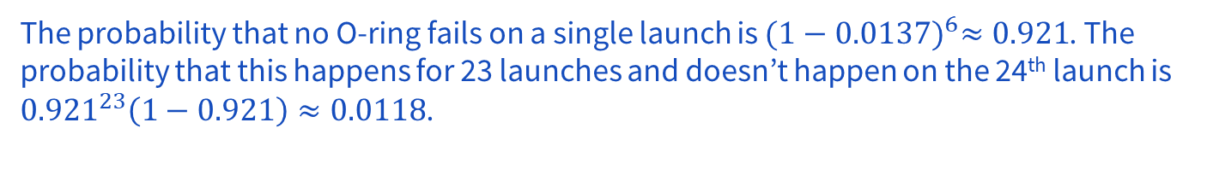
9 (Midterm Review)
The space shuttle has 6 O-rings: these were involved in the Challenger disaster. When the
space shuttle is launched, each O-ring has a probability of failure of 0.0137, independent of
whether other O-rings fail.
(a) What is the probability that, during 23 launches, no O-ring will fail, but that at least
one O-ring will fail during the 24th launch?

Slide 56
9 (Midterm Review)
The space shuttle has 6 O-rings: these were involved in the Challenger disaster. When the
space shuttle is launched, each O-ring has a probability of failure of 0.0137, independent of
whether other O-rings fail.
(b) What is the probability that no O-ring fails during 24 launches?
Work on this problem with the people around you, and then we’ll go over it together!

Slide 57
9 (Midterm Review)
The space shuttle has 6 O-rings: these were involved in the Challenger disaster. When the
space shuttle is launched, each O-ring has a probability of failure of 0.0137, independent of
whether other O-rings fail.
(b) What is the probability that no O-ring fails during 24 launches?

Slide 58
Problem 7 (Midterm review)

Slide 59
7 (Midterm Review)
You are trying to diagnose the probability that a patient with a positive blood sugar test
result has diabetes, even though she is in a low-risk group. The probability of a woman in
this group having diabetes is 0.8%. 90% of women with diabetes will test positive in the blood sugar test. 7% of women without diabetes will test positive in the blood sugar test. Your patient tests positive in the blood sugar test. What is the probability that she has diabetes?
Work on this problem with the people around you, and then we’ll go over it together!

Slide 60
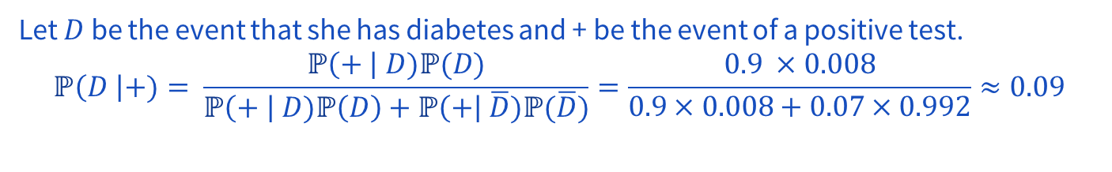
7 (Midterm Review)
You are trying to diagnose the probability that a patient with a positive blood sugar test
result has diabetes, even though she is in a low-risk group. The probability of a woman in
this group having diabetes is 0.8%. 90% of women with diabetes will test positive in the blood sugar test. 7% of women without diabetes will test positive in the blood sugar test. Your patient tests positive in the blood sugar test. What is the probability that she has diabetes?

Slide 61
Problem 1 (Midterm review)

Slide 62
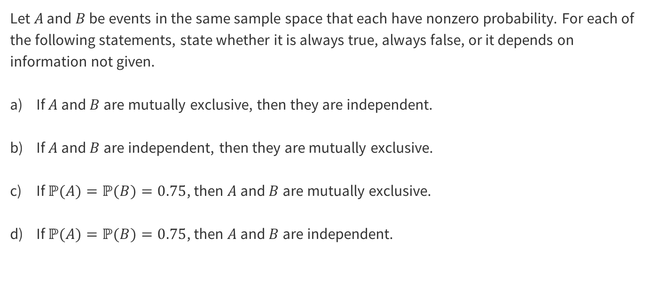
1
Work on this problem with the people around you, and then we’ll go over it together!

Slide 63
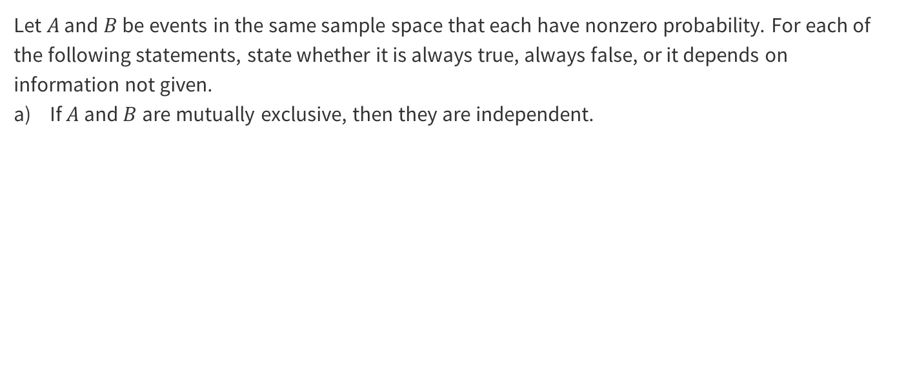
1

Slide 64
1
False

Slide 65
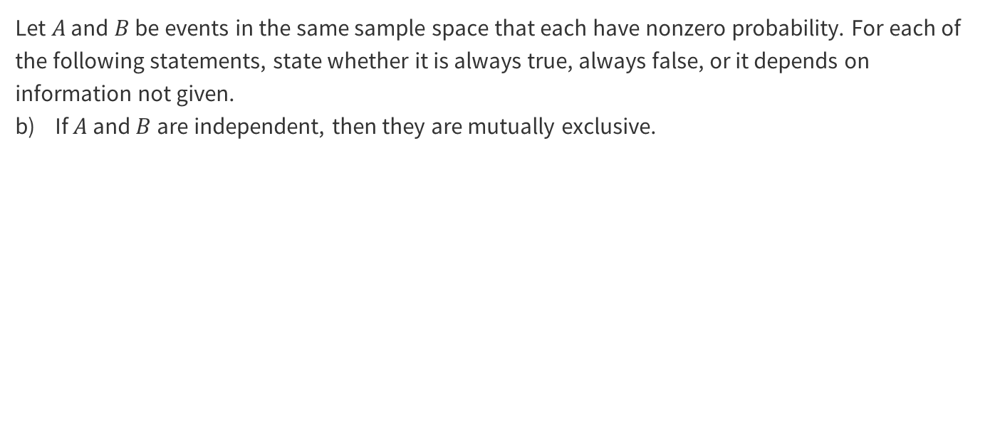
1

Slide 66
1
False

Slide 67
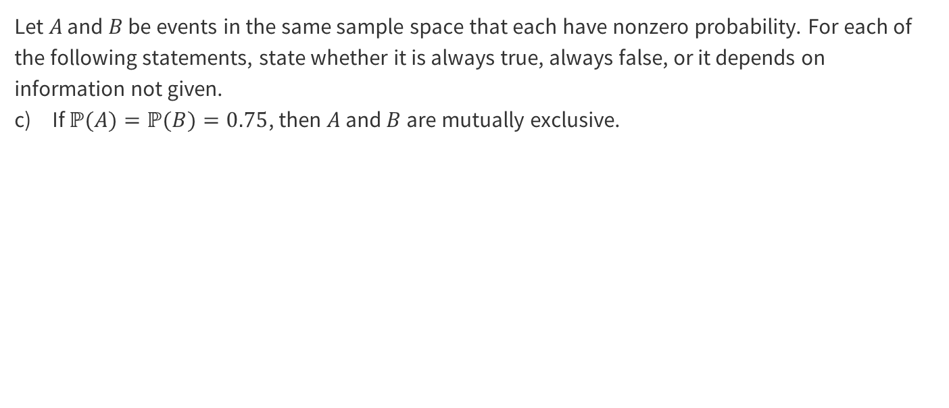
1

Slide 68
1
False

Slide 69
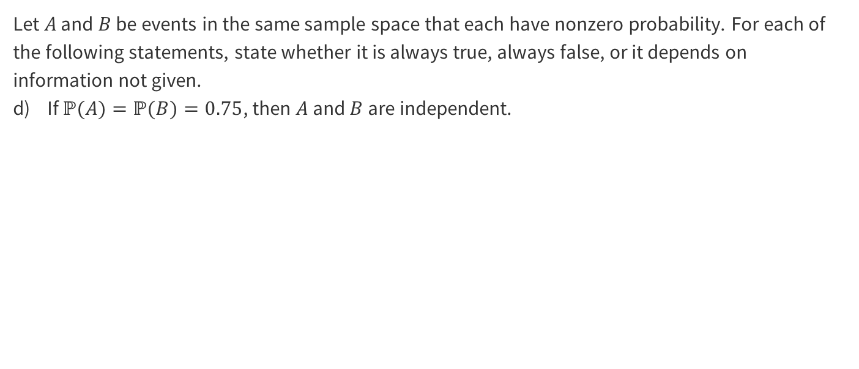
1

Slide 70
1

Slide 71
Problem 2 (Midterm review)

Slide 72
2
Given any set of 18 integers, show that one may always choose two of them so that their difference is divisible by 17.
Work on this problem with the people around you, and then we’ll go over it together!

Slide 73
2
Given any set of 18 integers, show that one may always choose two of them so that their difference is divisible by 17.

Slide 74
Problem 4 (Midterm Review)

Slide 75
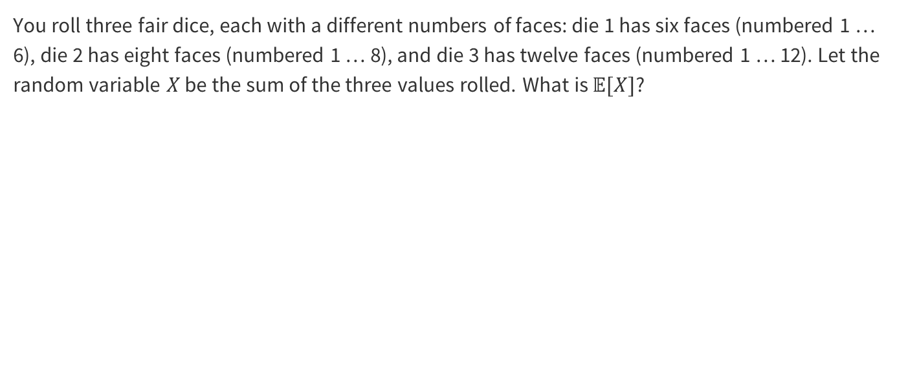
4
Work on this problem with the people around you, and then we’ll go over it together!

Slide 76
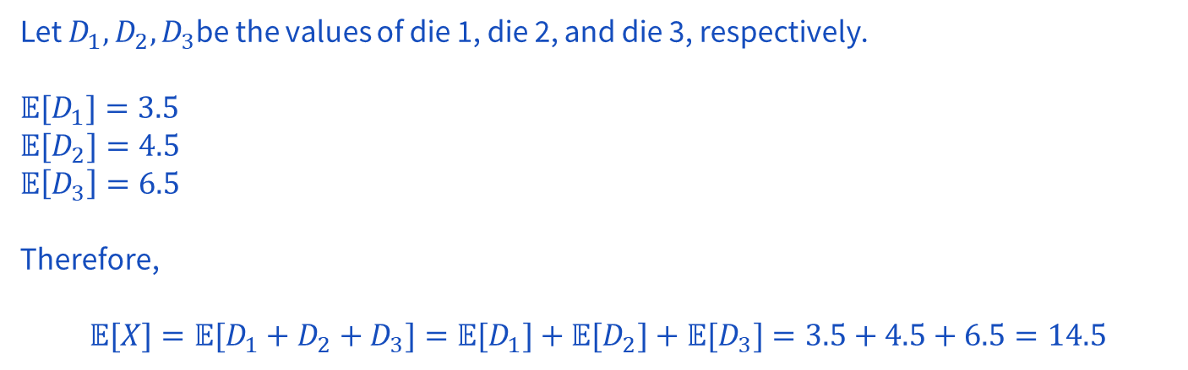
4

Slide 77
Problem 3 – Create the distribution

Slide 78
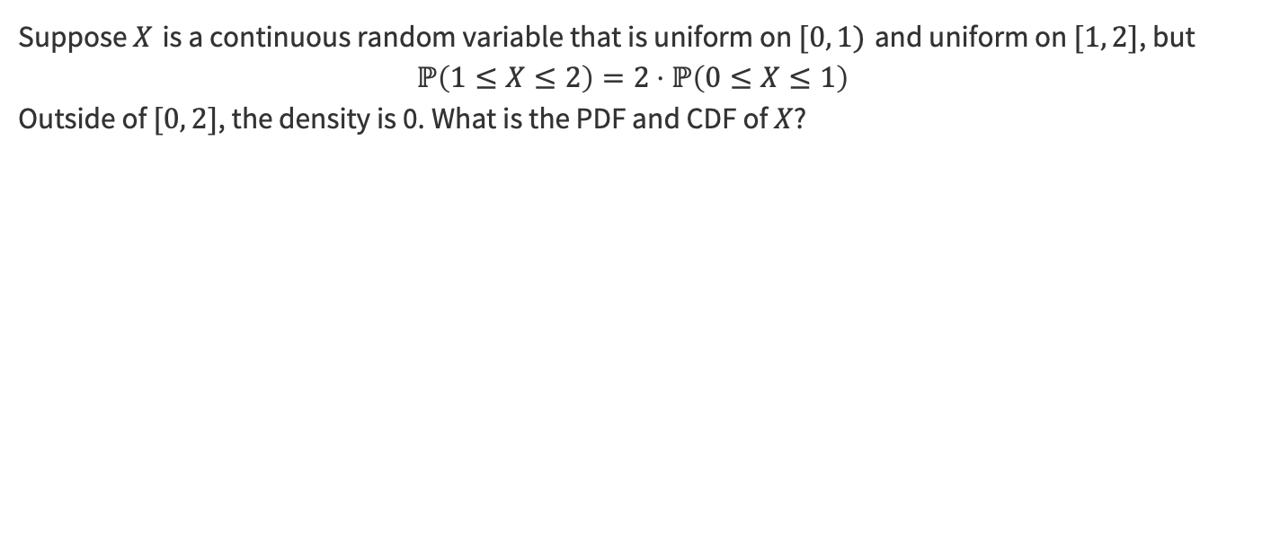
3 – Create the distribution
Work on this problem with the people around you, and then we’ll go over it together!

Slide 79
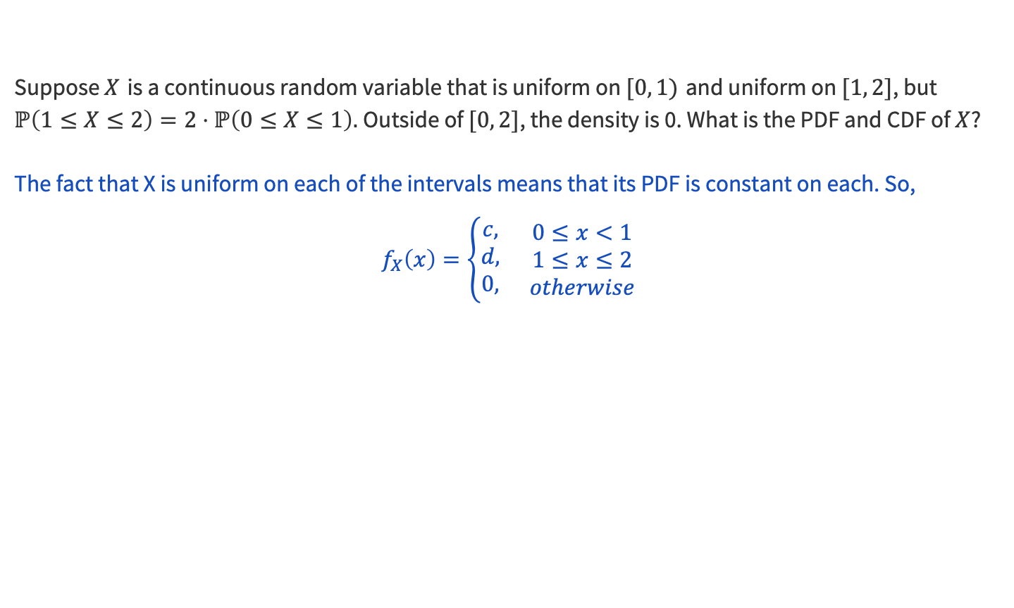
3 – Create the distribution

Slide 80
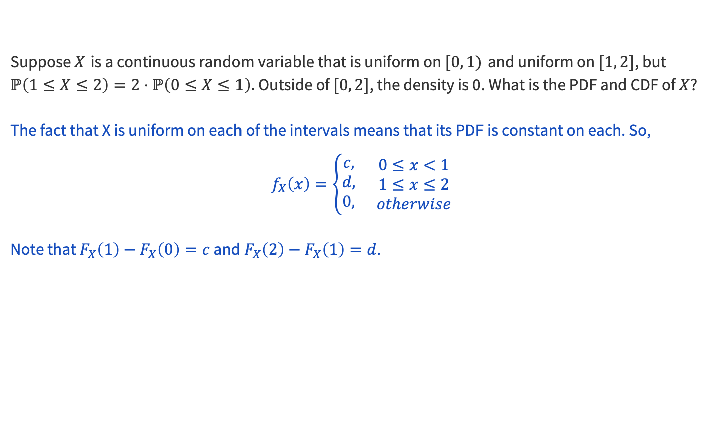
3 – Create the distribution

Slide 81
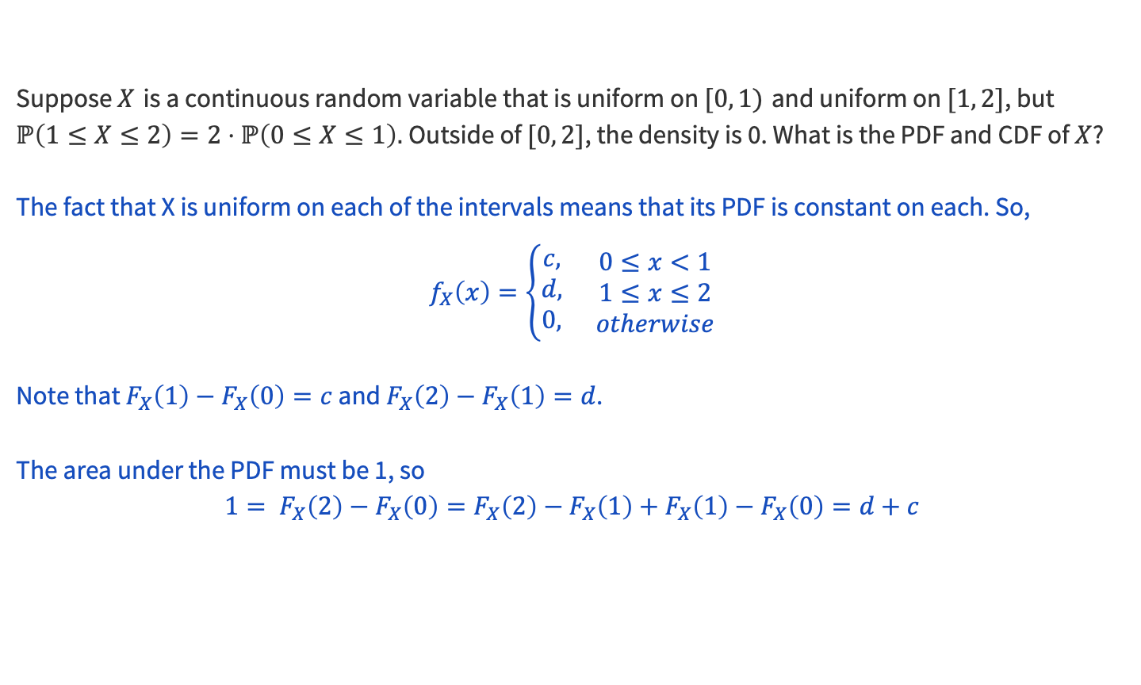
3 – Create the distribution

Slide 82
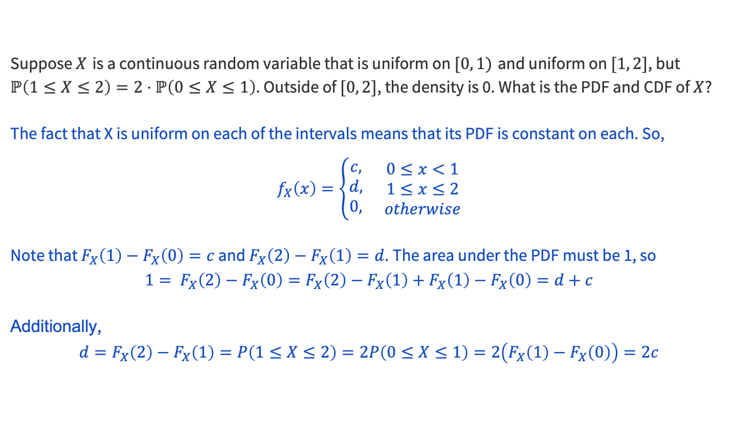
3 – Create the distribution

Slide 83
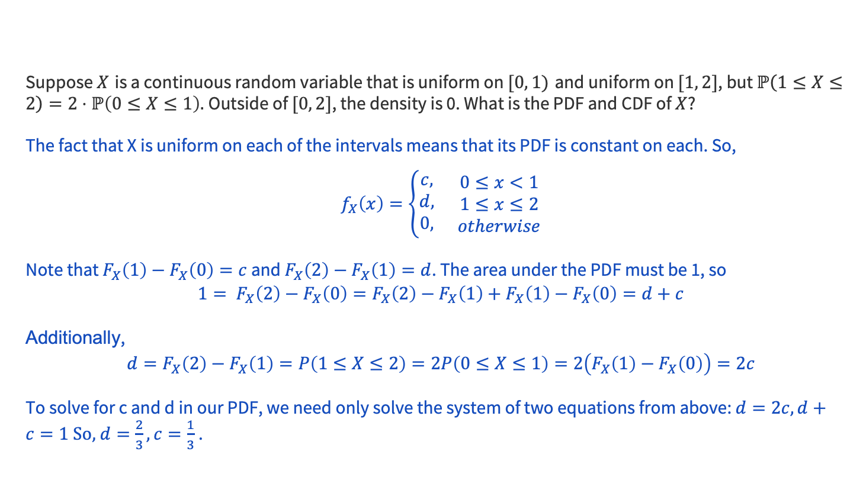
3 – Create the distribution

Slide 84
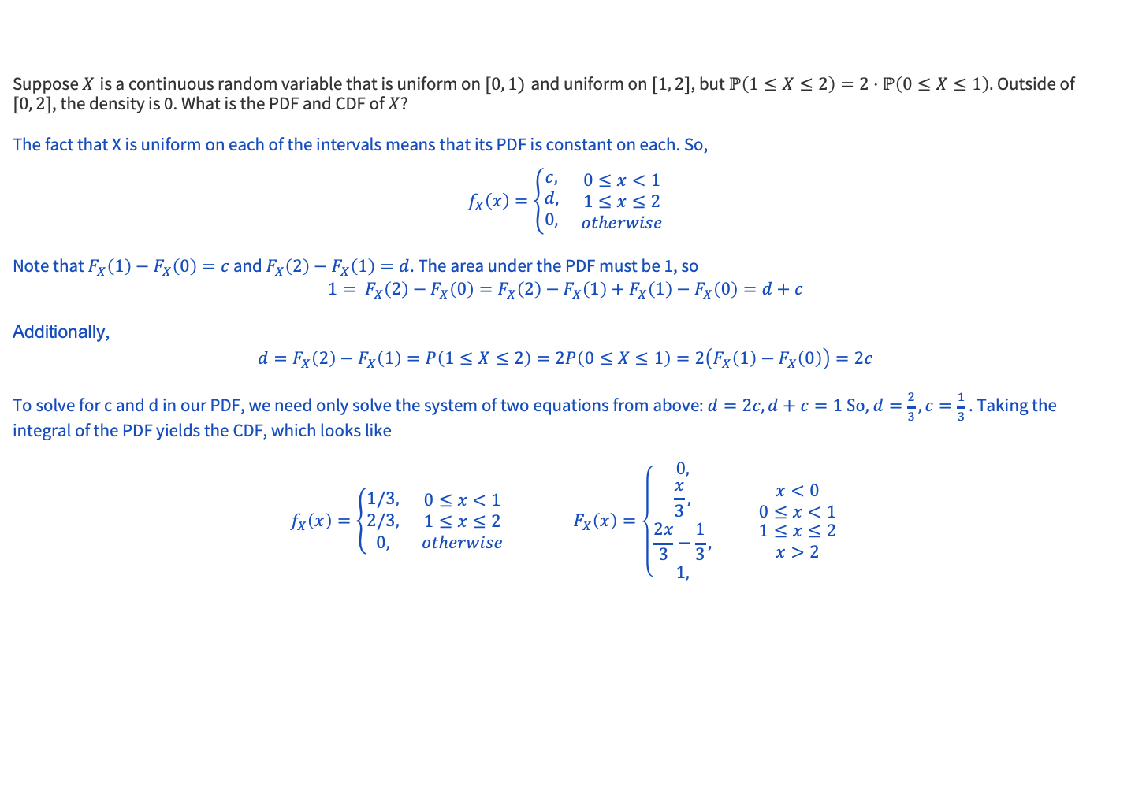
3 – Create the distribution

Slide 85
That’s All, Folks!
Thanks for coming to section this week!
Any questions?

