Slide 1
CSE 312 Section 5
More Random Variable and Discrete Zoo

Slide 2
Quiz!

Slide 3
Administrivia

Slide 4
Announcements & Reminders
HW3
  Grades released on gradescope – check your submission to read comments
  Regrade requests open ~24 hours after grades are released and close after a week
HW4
  Due yesterday, 2/4 @ 11:59pm
  Late deadline Saturday 2/7 @ 11:59pm
HW5
  Released
  Due Wednesday 2/11 @ 11:59pm
  Late deadline Saturday 2/14 @ 11:59pm

Slide 5
Review & Questions

Slide 6
Any lingering questions from this last week?
Each week in section, we’ll be reviewing the main concepts from this week and putting them into action by going through some practice problems together. But before we get into that review, we’ll try to start off each section with some time for you to ask questions. Was anything particularly confusing this week? Is there anything we can clarify before we dive into the review? This is your chance to clear things up!

Slide 7
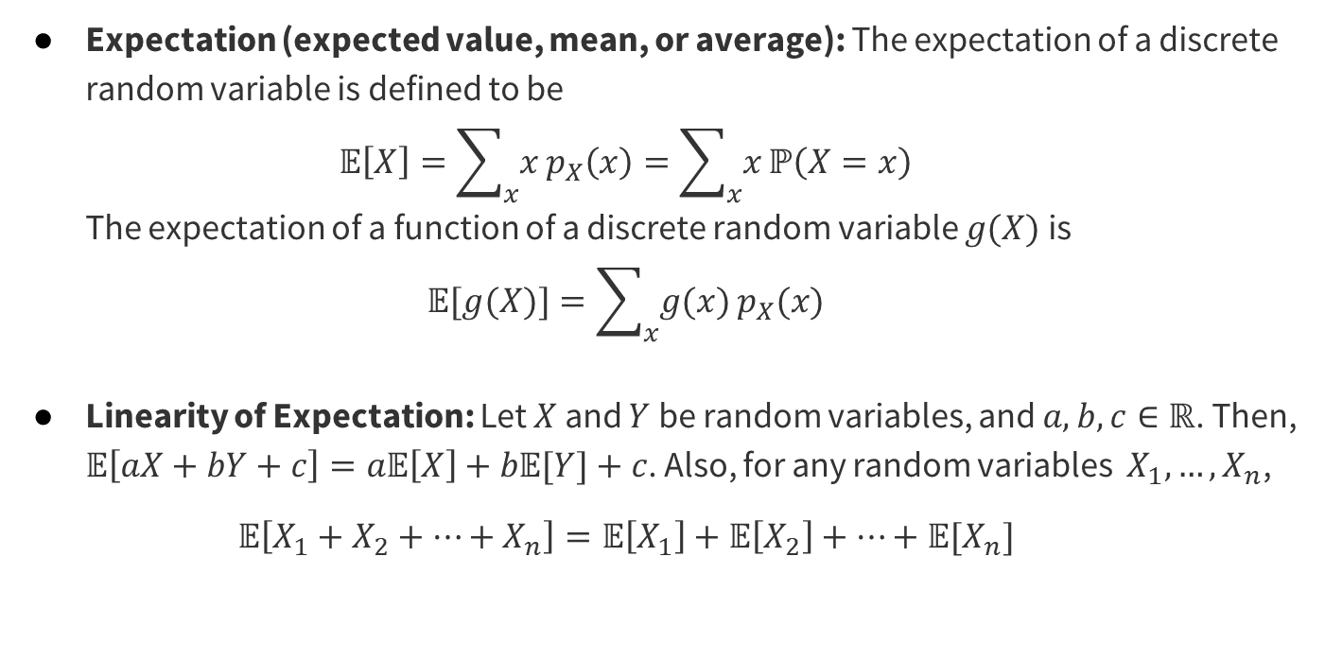
Review of Main Concepts

Slide 8
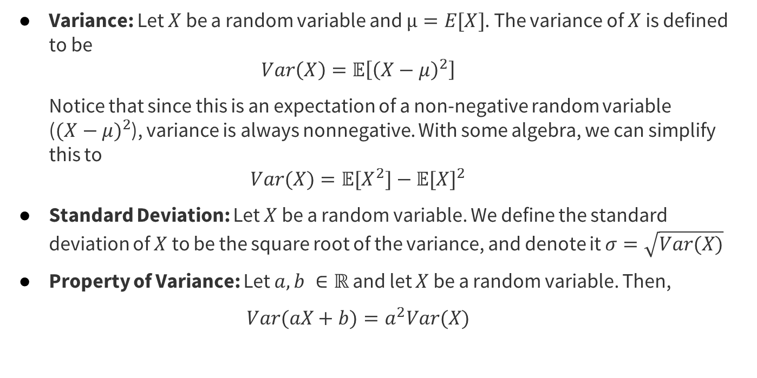
Review of Main Concepts

Slide 9
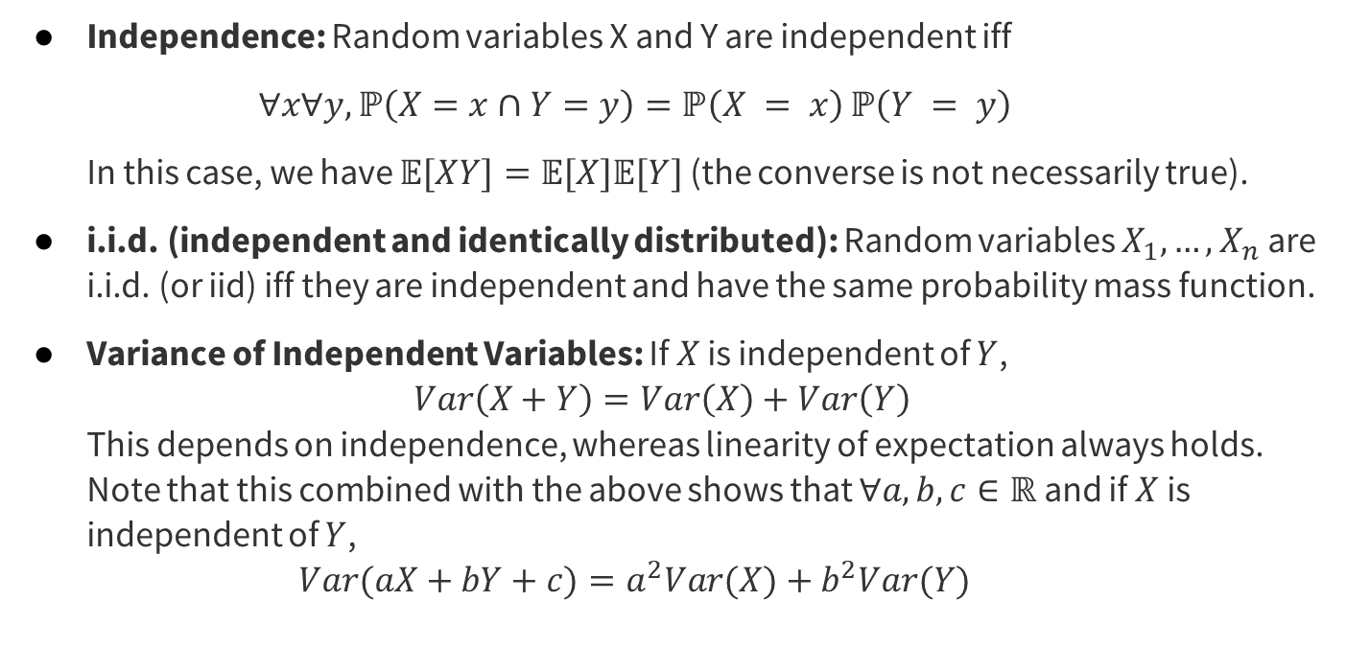
Review of Main Concepts

Slide 10
Review Questions

Slide 11
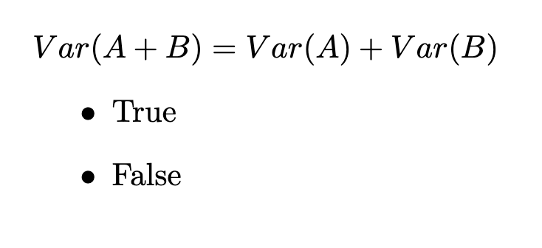
Question #1

Slide 12
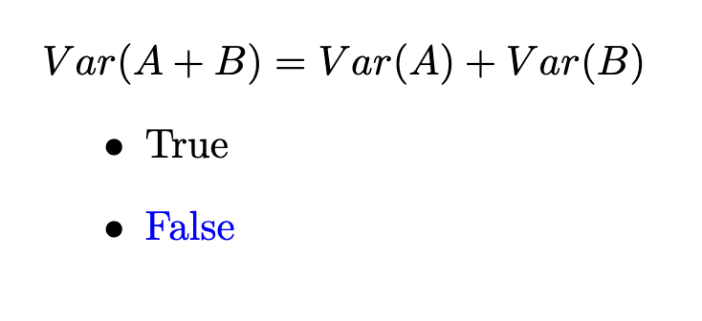
Question #1

Slide 13
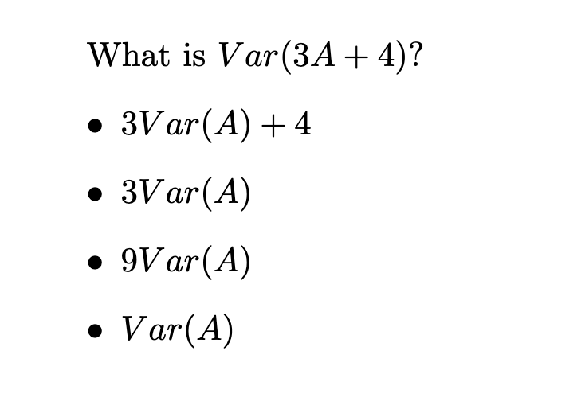
Question #2

Slide 14
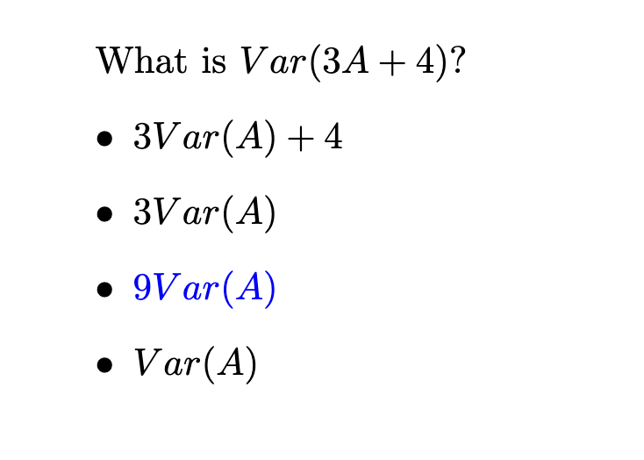
Question #2

Slide 15
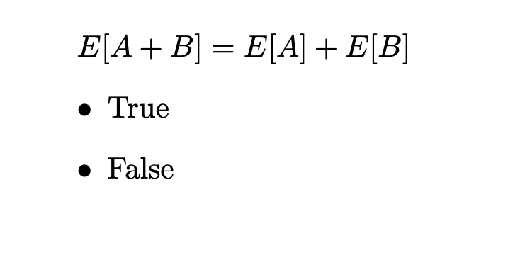
Question #3

Slide 16
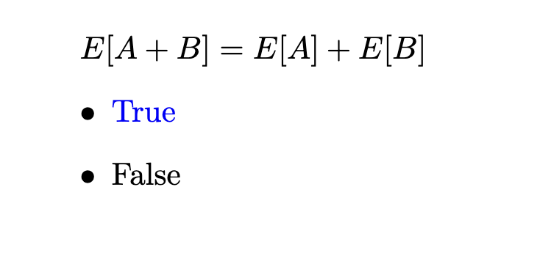
Question #3

Slide 17
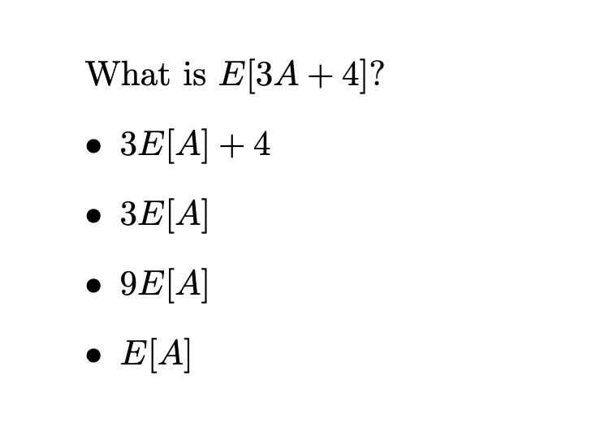
Question #4

Slide 18
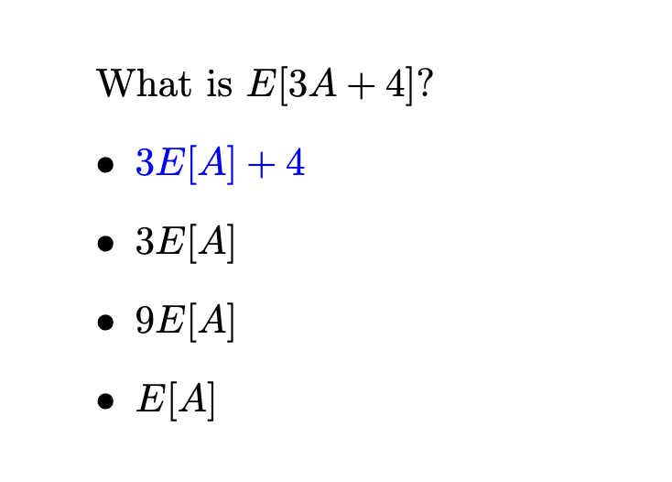
Question #4

Slide 19
Problem 3 - Balls and Bins

Slide 20
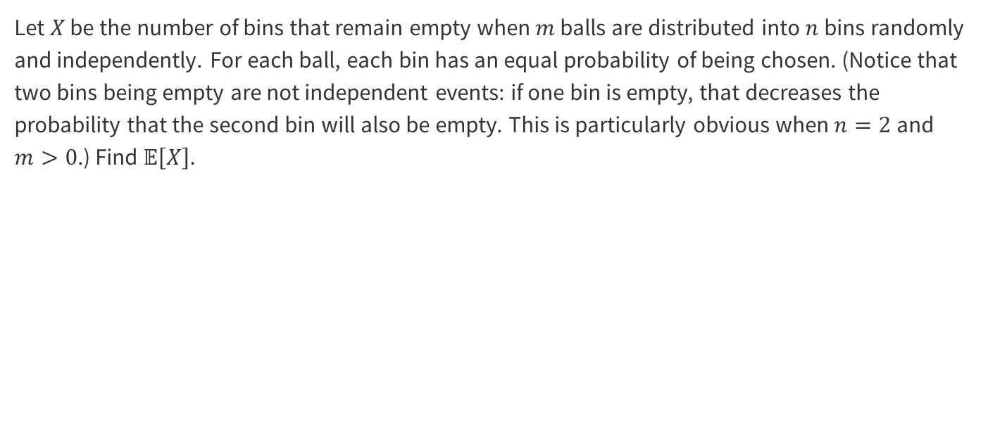
Problem 3 - Balls and Bins
Work on this problem with the people around you, and then we’ll go over it together!

Slide 21

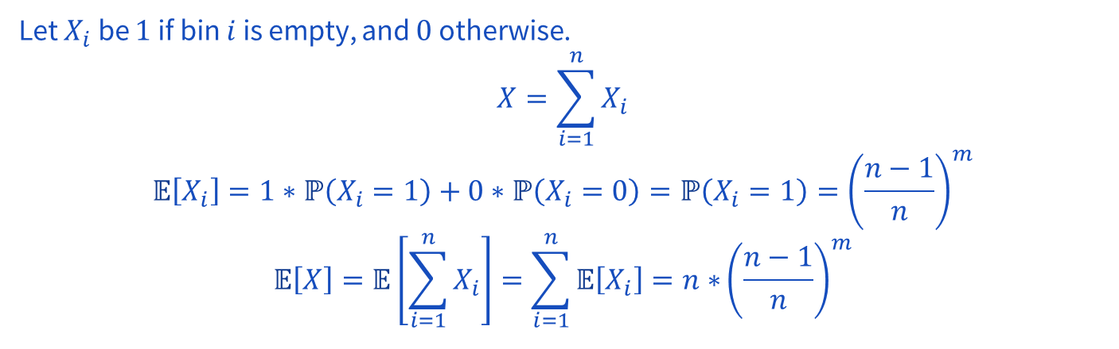
Problem 3 - Balls and Bins

Slide 22
Problem 4 - 3 Sided Die

Slide 23
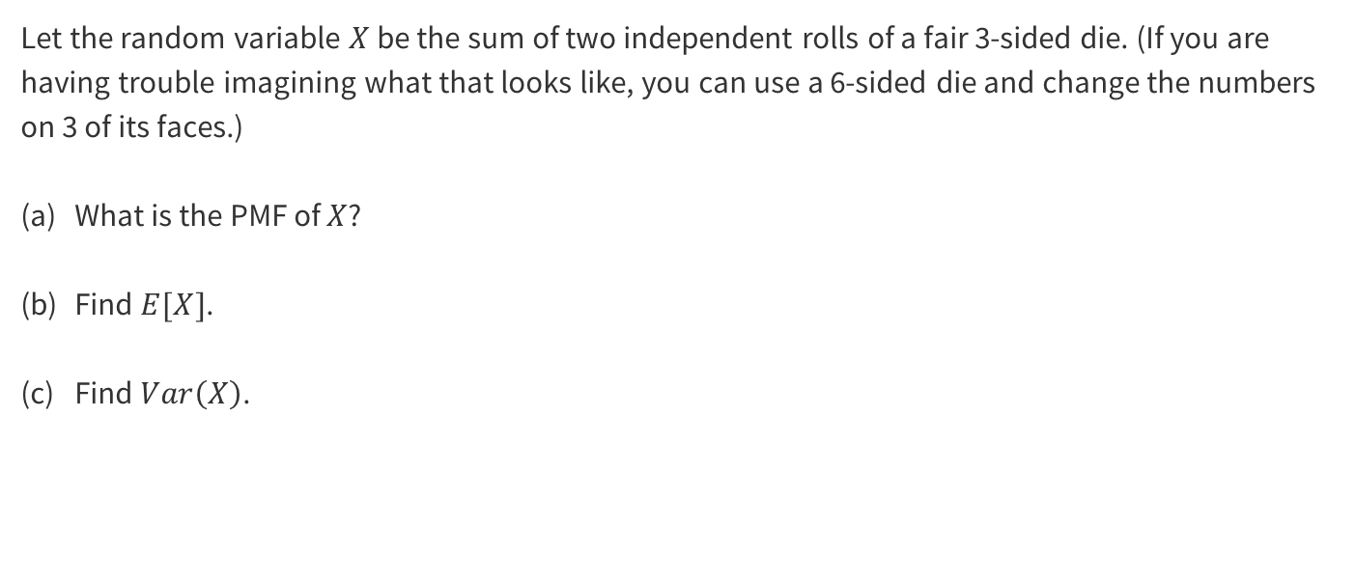
Problem 4 - 3 Sided Die
Work on this problem with the people around you, and then we’ll go over it together!

Slide 24
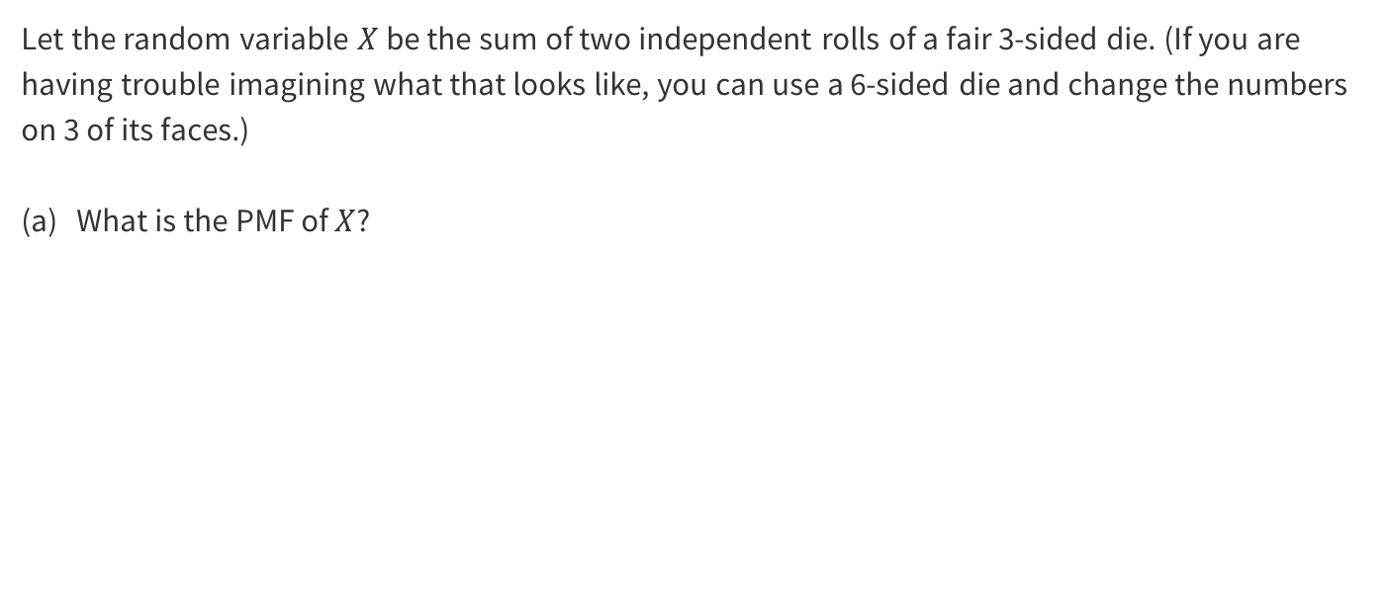
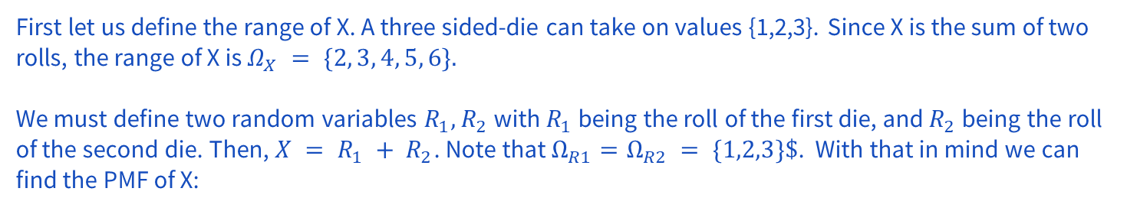
Problem 4 - 3 Sided Die
Work on this problem with the people around you, and then we’ll go over it together!

Slide 25
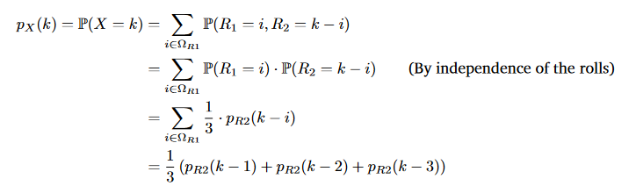
Problem 4 - 3 Sided Die
This gives us the following:

Slide 26
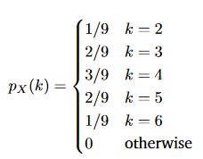
Problem 4 - 3 Sided Die

Slide 27
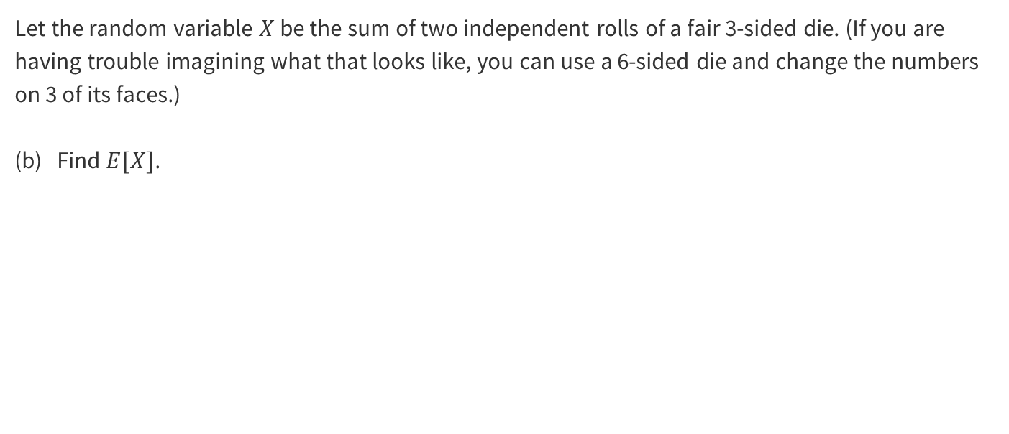
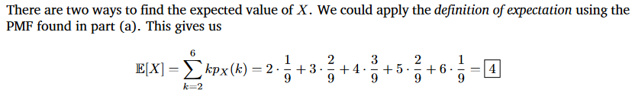
Problem 4 - 3 Sided Die

Slide 28
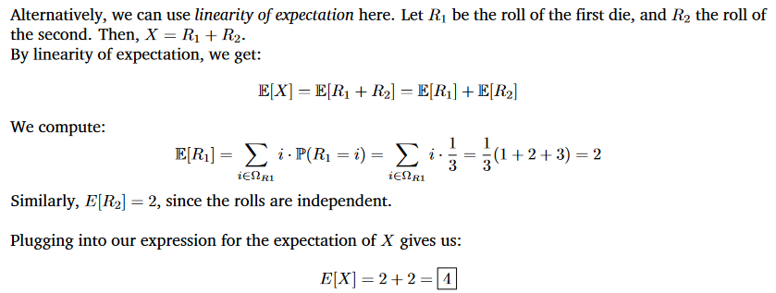
Problem 4 - 3 Sided Die

Slide 29
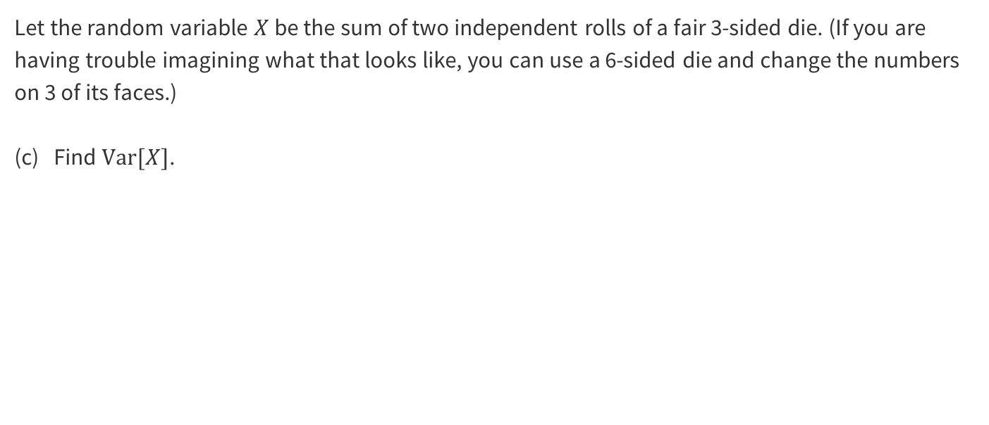
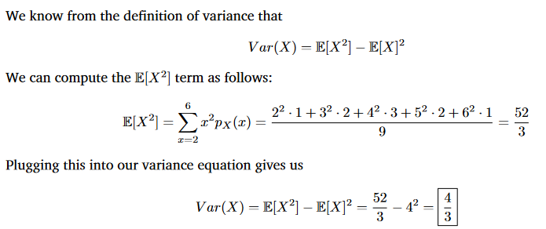
Problem 4 - 3 Sided Die

Slide 30
Problem 10 - Poisson Practice

Slide 31
Problem 10 – Poisson Practice
Seattle averages 3 days with snowfall per year. Suppose the number of days with snowfall follows a Poisson distribution.
What is the probability of getting exactly 5 days of snow in a year?
According to the Poisson model, what is the probability of getting 367 days of snow?
Work on this problem with the people around you, and then we’ll go over it together!

Slide 32
Problem 10 – Poisson Practice
Seattle averages 3 days with snowfall per year. Suppose the number of days with snowfall follows a Poisson distribution.
What is the probability of getting exactly 5 days of snow in a year?

Slide 33
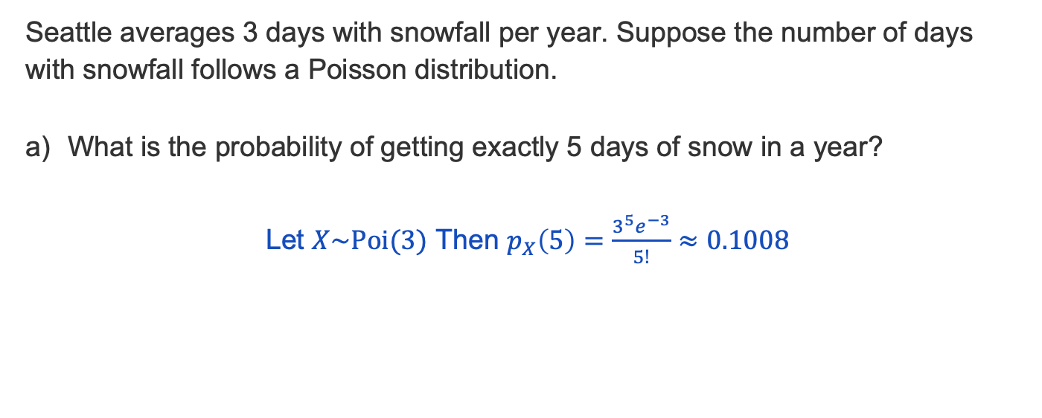
Problem 10 – Poisson Practice
Notes:
lamda = avr value, so lambda = 3,

Slide 34
Problem 10 – Poisson Practice
Seattle averages 3 days with snowfall per year. Suppose the number of days with snowfall follows a Poisson distribution.
According to the Poisson model, what is the probability of getting 367 days of snow?

Slide 35
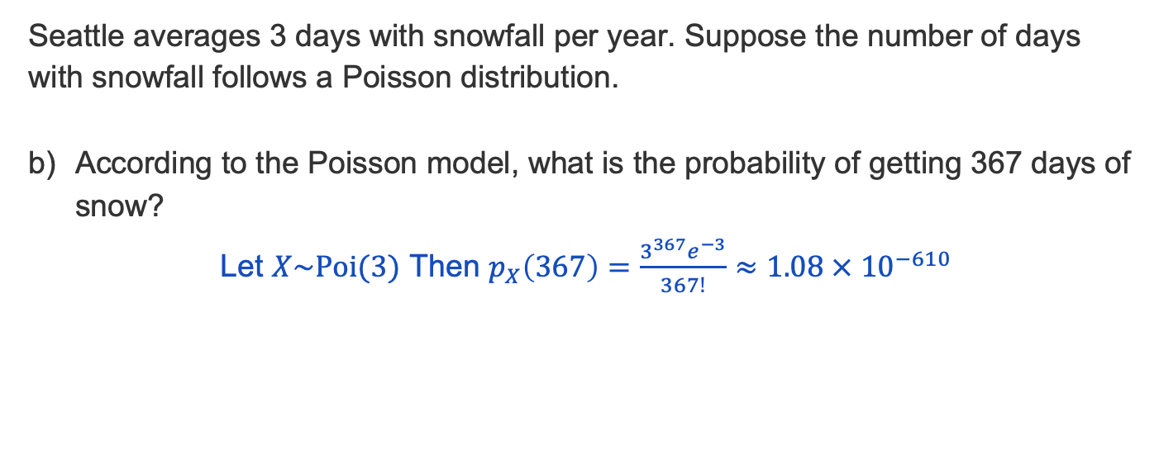
Problem 10 – Poisson Practice

Slide 36
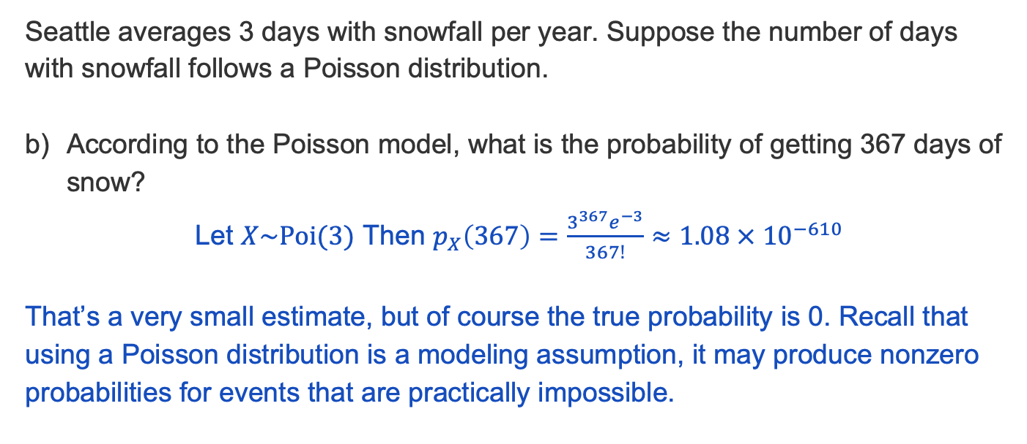
Problem 10 – Poisson Practice

Slide 37
Problem 7 – True or False?

Slide 38
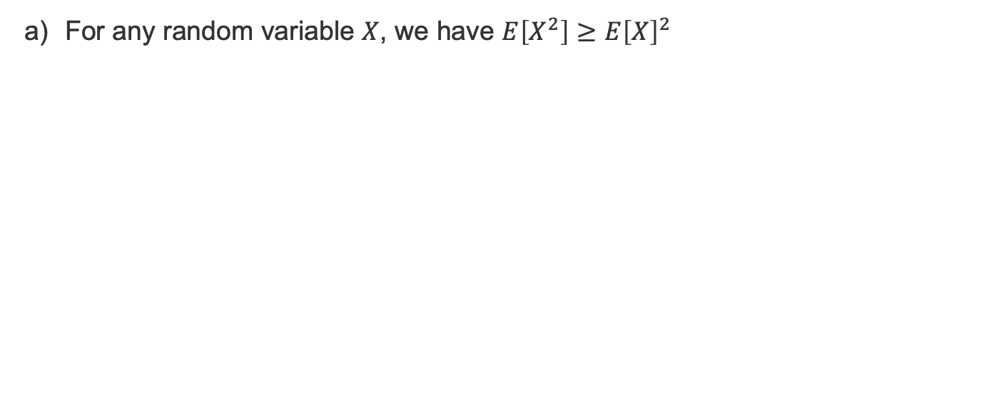
Problem 7 – True or False?

Slide 39
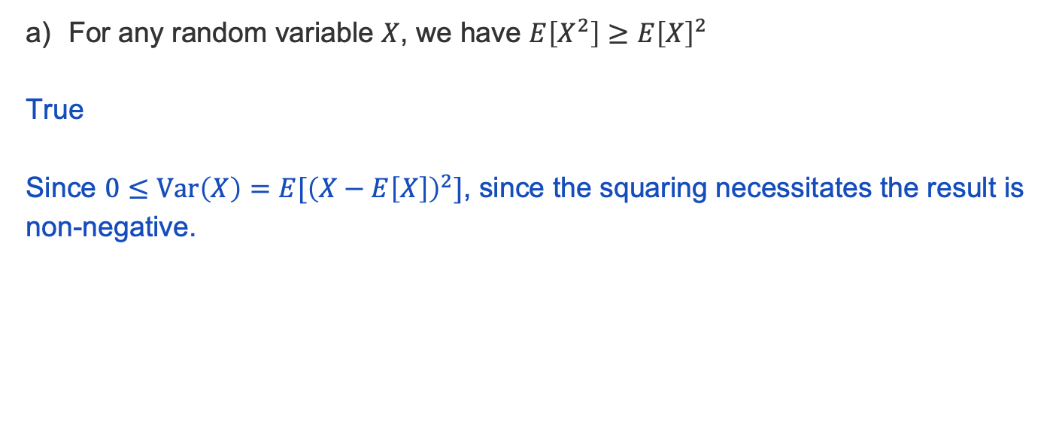
Problem 7 – True or False?

Slide 40
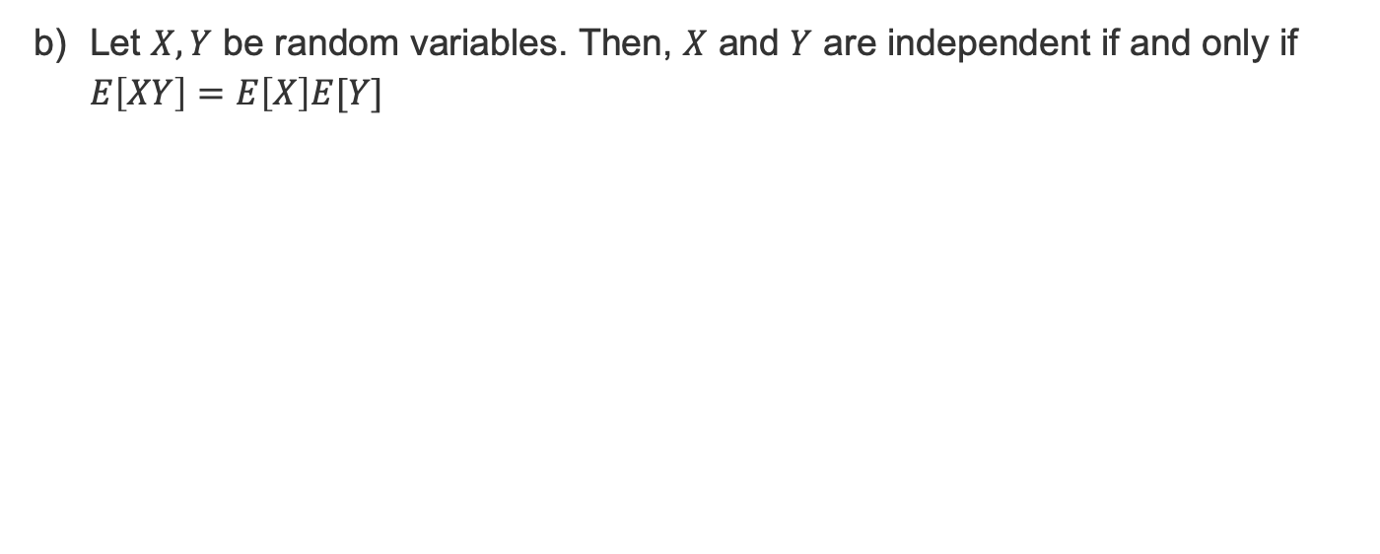
Problem 7 – True or False?

Slide 41
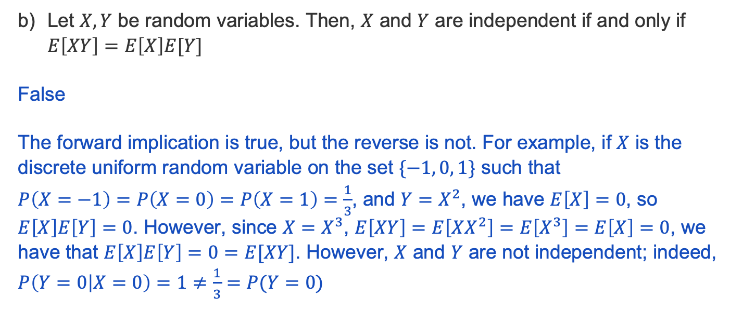
Problem 7 – True or False?

Slide 42
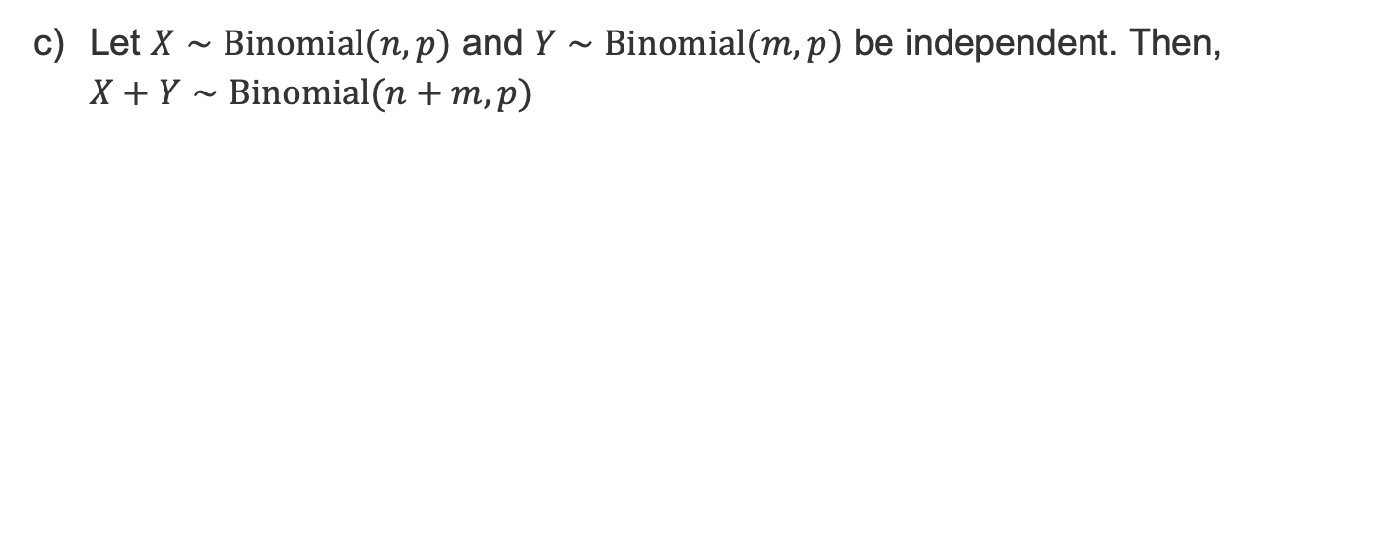
Problem 7 – True or False?

Slide 43
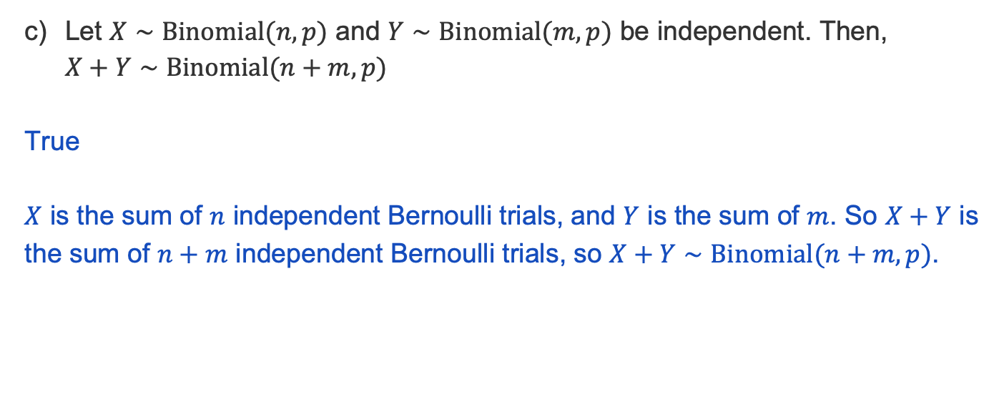
Problem 7 – True or False?

Slide 44
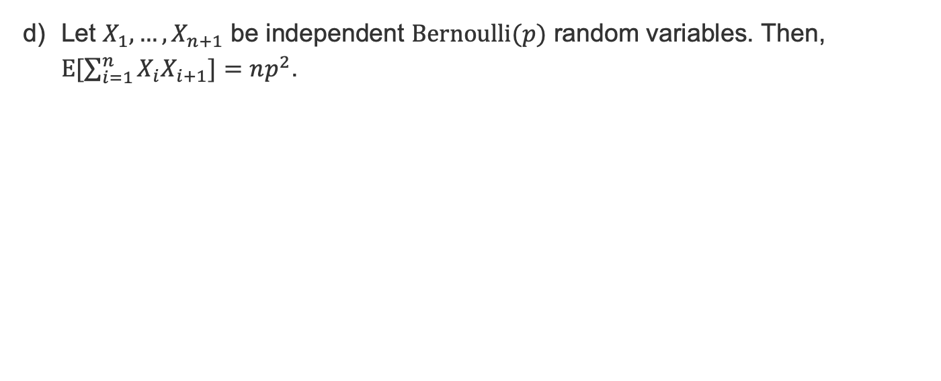
Problem 7 – True or False?

Slide 45
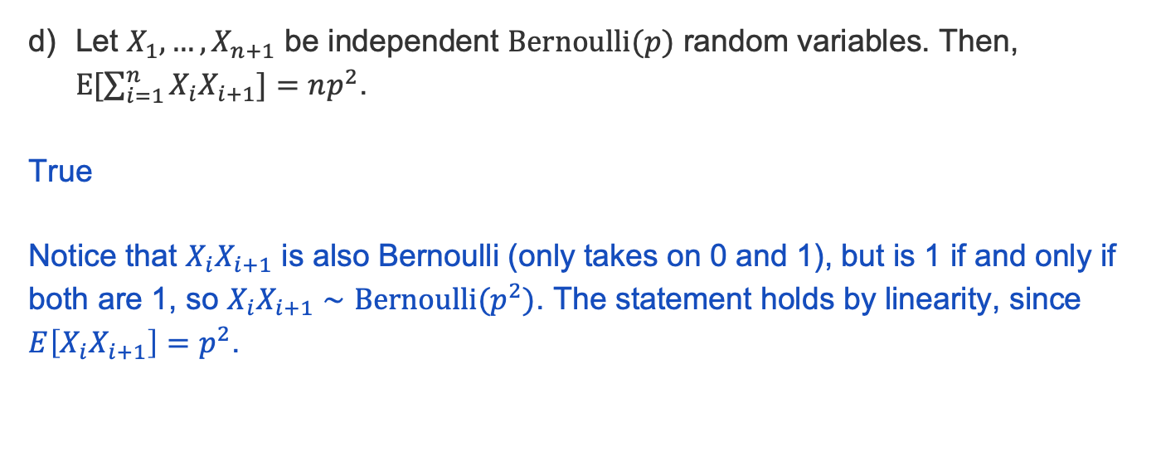
Problem 7 – True or False?

Slide 46
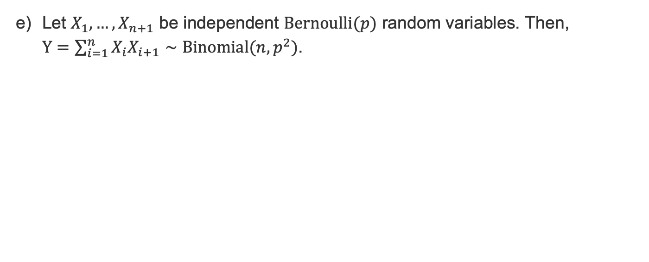
Problem 7 – True or False?

Slide 47
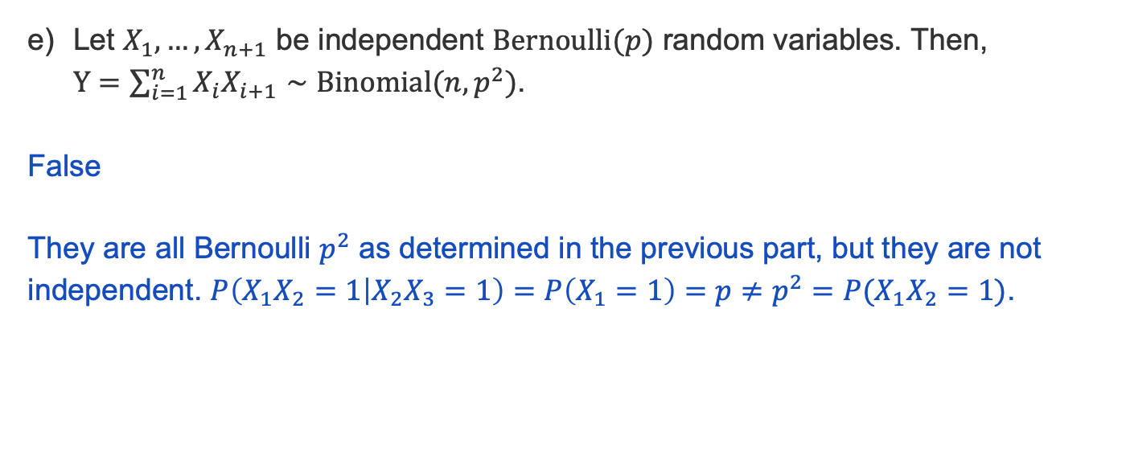
Problem 7 – True or False?

Slide 48
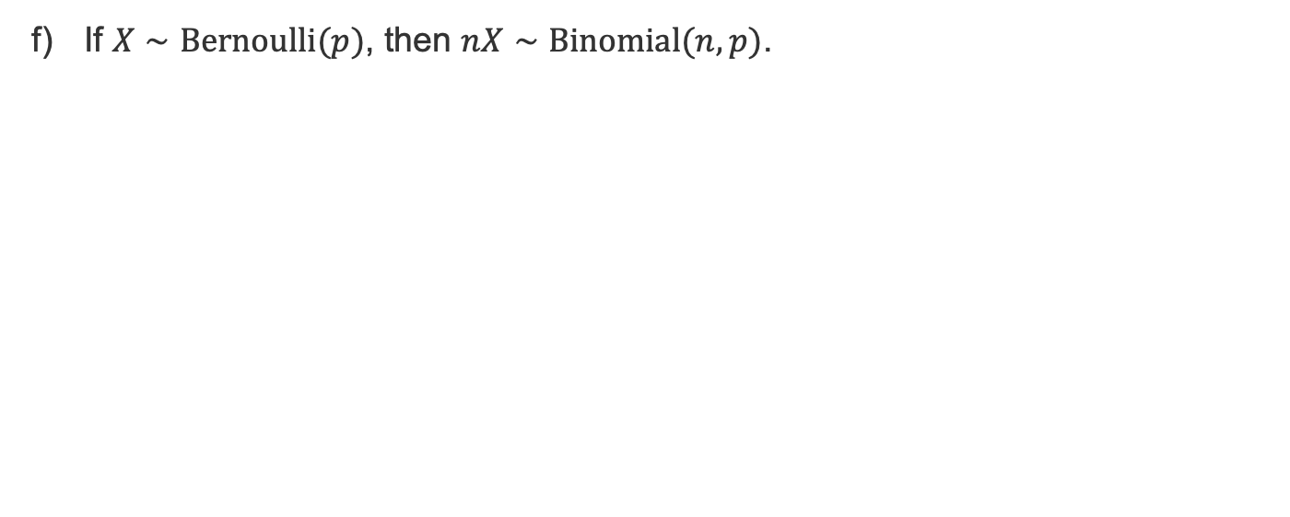
Problem 7 – True or False?

Slide 49
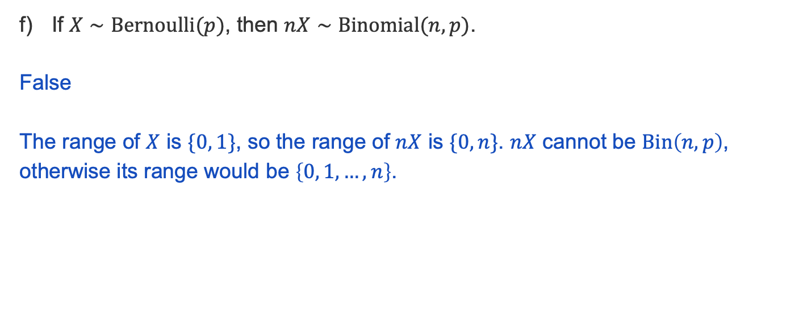
Problem 7 – True or False?

Slide 50
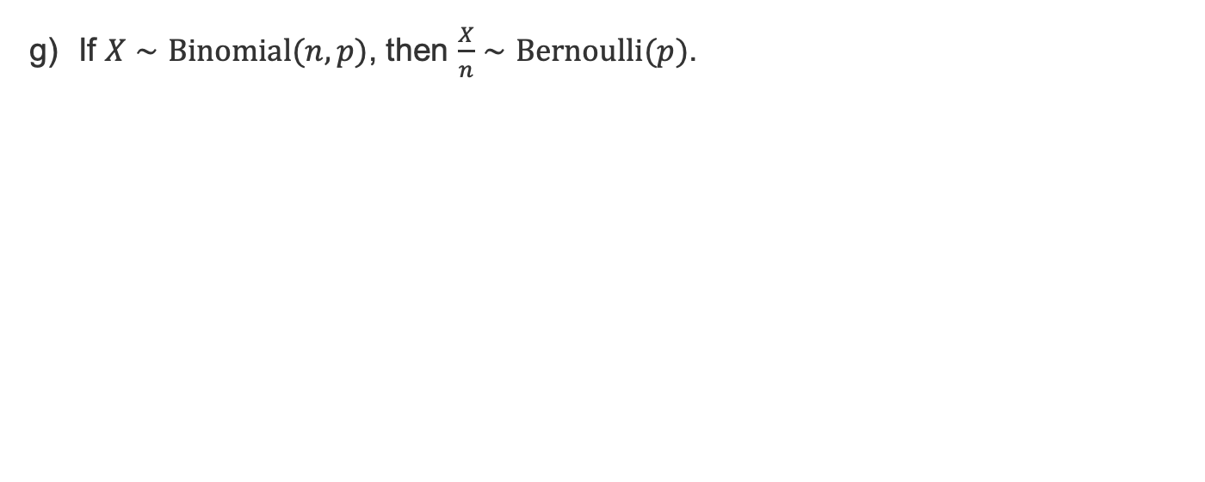
Problem 7 – True or False?

Slide 51
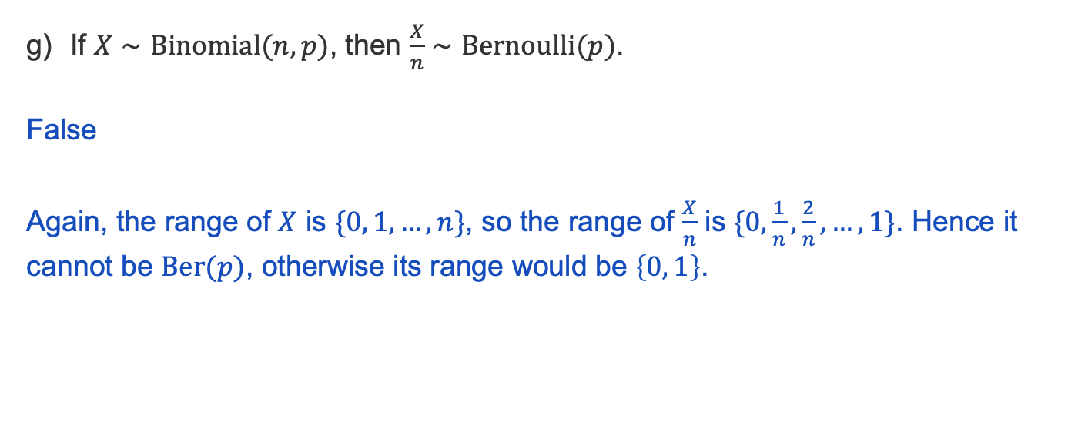
Problem 7 – True or False?

Slide 52
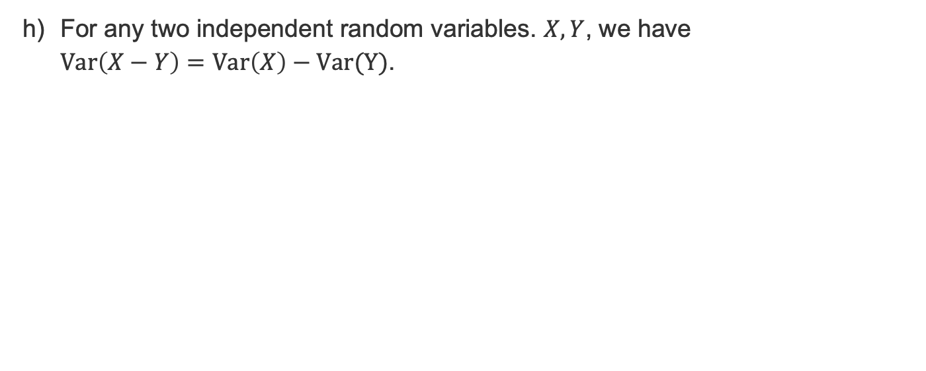
Problem 7 – True or False?

Slide 53
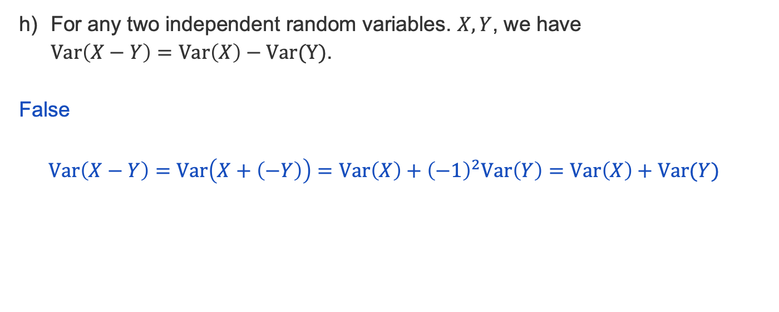
Problem 7 – True or False?

Slide 54
Problem 2 - Pond fishing

Slide 55
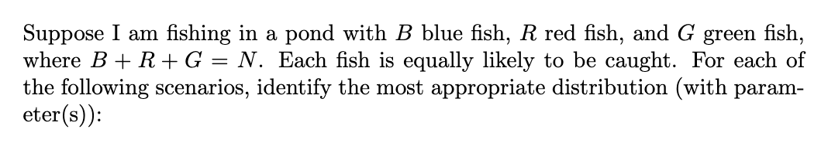
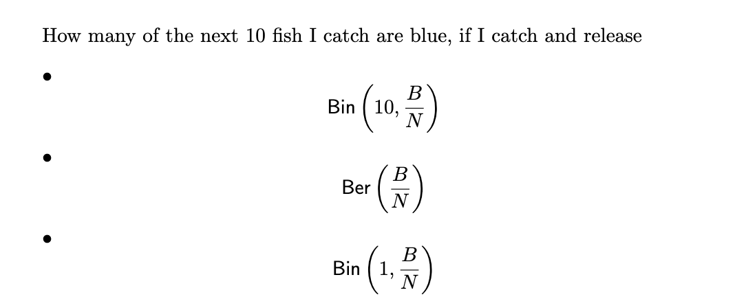
Part a

Slide 56
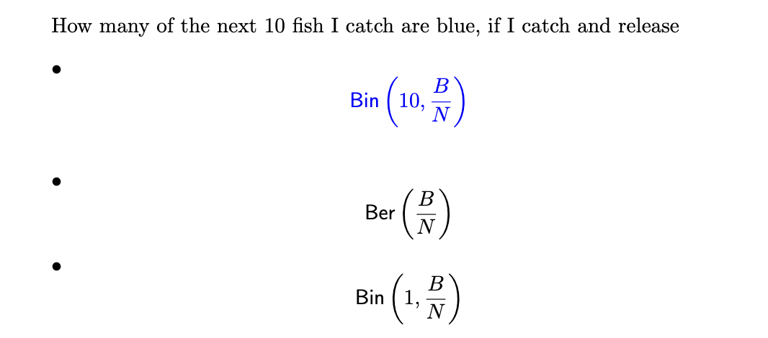
Part a

Slide 57
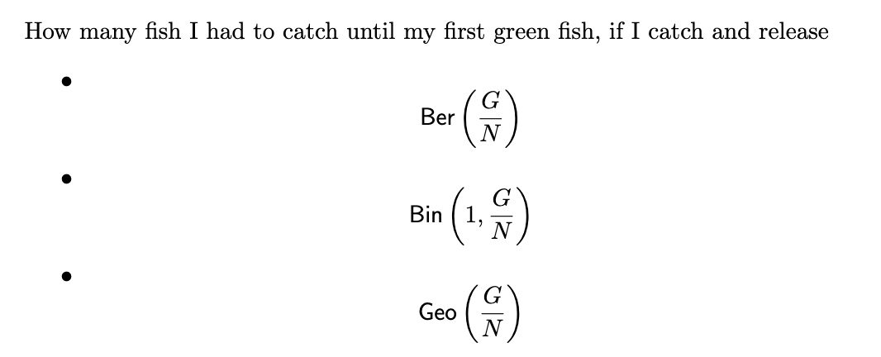
Part b

Slide 58
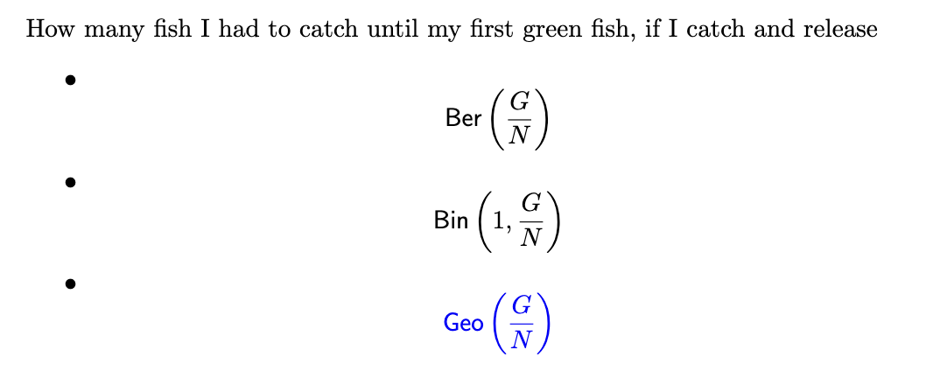
Part b

Slide 59
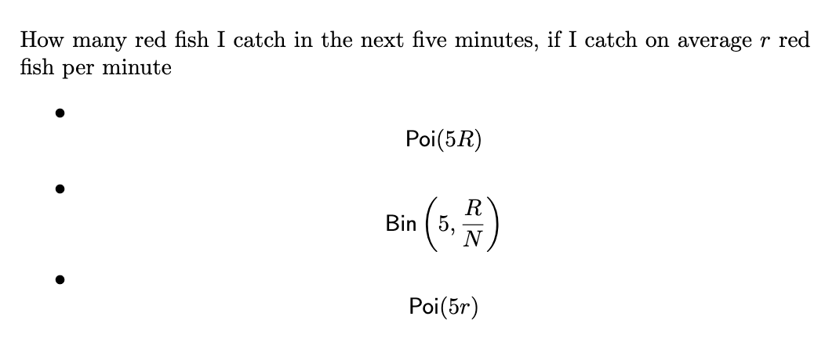
Part c

Slide 60
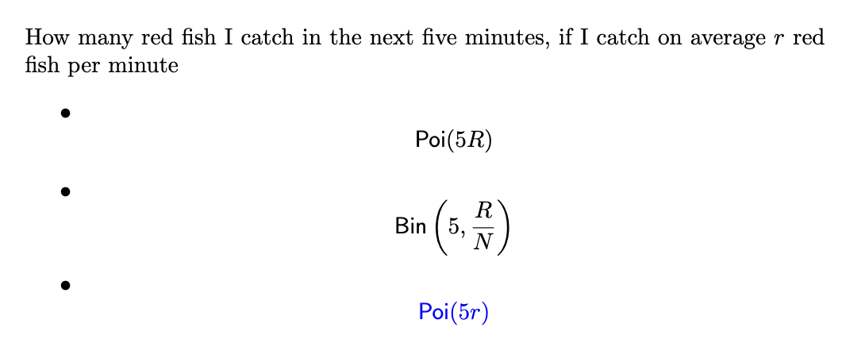
Part c

Slide 61
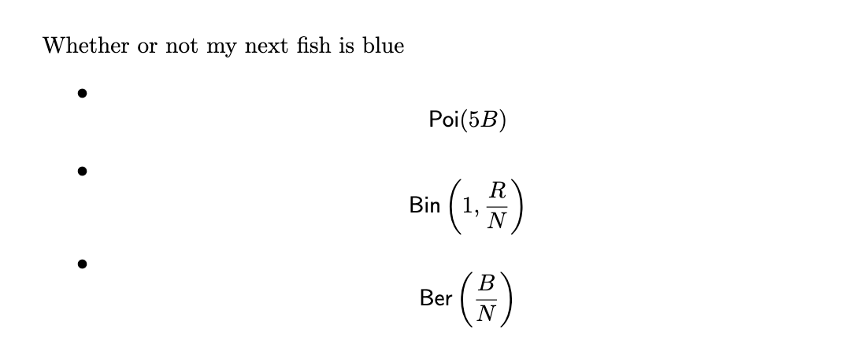
Part d

Slide 62

Part d

Slide 63
Problem 5 (Midterm Review)

Slide 64

5 (Midterm Review)
Work on this problem with the people around you, and then we’ll go over it together!

Slide 65

5 (Midterm Review)

Slide 66
Problem 3 (Midterm Review)

Slide 67

3 (Midterm Review)
Work on this problem with the people around you, and then we’ll go over it together!

Slide 68

3 (Midterm Review)

Slide 69
Problem 12 (Midterm Review)

Slide 70
12 (Midterm Review)
You are working on a difficult passage from a new piece you are learning on the piano. You wish to play it correctly 4 times before stopping for the day. If your probability of playing it correctly on each attempt is 2/3, and the attempts are independent (unfortunately!), what is the probability that you have to play it at least 8 times?
Work on this problem with the people around you, and then we’ll go over it together!

Slide 71

12 (Midterm Review)
You are working on a difficult passage from a new piece you are learning on the piano. You wish to play it correctly 4 times before stopping for the day. If your probability of playing it correctly on each attempt is 2/3, and the attempts are independent (unfortunately!), what is the probability that you have to play it at least 8 times?

Slide 72
Problem 10 (Midterm Review)

Slide 73
10 (Midterm Review)
Suppose you record the birthdays of a large group of people, one at a time, until you have
found a person whose birthday matches your own birthday. What is the probability that it
takes exactly 20 people for this to occur? Assume that there are 365 possible birthdays and
each one is equally probable for a randomly chosen person.
Work on this problem with the people around you, and then we’ll go over it together!

Slide 74

10 (Midterm Review)
Suppose you record the birthdays of a large group of people, one at a time, until you have
found a person whose birthday matches your own birthday. What is the probability that it
takes exactly 20 people for this to occur? Assume that there are 365 possible birthdays and
each one is equally probable for a randomly chosen person.

Slide 75
Problem 9 (Midterm review)

Slide 76
9 (Midterm Review)
The space shuttle has 6 O-rings: these were involved in the Challenger disaster. When the
space shuttle is launched, each O-ring has a probability of failure of 0.0137, independent of
whether other O-rings fail.
(a) What is the probability that, during 23 launches, no O-ring will fail, but that at least
one O-ring will fail during the 24th launch?
Work on this problem with the people around you, and then we’ll go over it together!

Slide 77

9 (Midterm Review)
The space shuttle has 6 O-rings: these were involved in the Challenger disaster. When the
space shuttle is launched, each O-ring has a probability of failure of 0.0137, independent of
whether other O-rings fail.
(a) What is the probability that, during 23 launches, no O-ring will fail, but that at least
one O-ring will fail during the 24th launch?

Slide 78
9 (Midterm Review)
The space shuttle has 6 O-rings: these were involved in the Challenger disaster. When the
space shuttle is launched, each O-ring has a probability of failure of 0.0137, independent of
whether other O-rings fail.
(b) What is the probability that no O-ring fails during 24 launches?
Work on this problem with the people around you, and then we’ll go over it together!

Slide 79
9 (Midterm Review)
The space shuttle has 6 O-rings: these were involved in the Challenger disaster. When the
space shuttle is launched, each O-ring has a probability of failure of 0.0137, independent of
whether other O-rings fail.
(b) What is the probability that no O-ring fails during 24 launches?

Slide 80
Problem 7 (Midterm review)

Slide 81
7 (Midterm Review)
You are trying to diagnose the probability that a patient with a positive blood sugar test
result has diabetes, even though she is in a low-risk group. The probability of a woman in
this group having diabetes is 0.8%. 90% of women with diabetes will test positive in the blood
sugar test. 7% of women without diabetes will test positive in the blood sugar test. Your
patient tests positive in the blood sugar test. What is the probability that she has diabetes?
Work on this problem with the people around you, and then we’ll go over it together!

Slide 82

7 (Midterm Review)
You are trying to diagnose the probability that a patient with a positive blood sugar test
result has diabetes, even though she is in a low-risk group. The probability of a woman in
this group having diabetes is 0.8%. 90% of women with diabetes will test positive in the blood
sugar test. 7% of women without diabetes will test positive in the blood sugar test. Your
patient tests positive in the blood sugar test. What is the probability that she has diabetes?

Slide 83
Problem 1 (Midterm review)

Slide 84

1
Work on this problem with the people around you, and then we’ll go over it together!

Slide 85

1

Slide 86
1
False

Slide 87

1

Slide 88
1
False

Slide 89

1

Slide 90
1
False

Slide 91

1

Slide 92
1

Slide 93
Problem 2 (Midterm review)

Slide 94
2
Given any set of 18 integers, show that one may always choose two of them so that their difference is divisible by 17.
Work on this problem with the people around you, and then we’ll go over it together!

Slide 95
2
Given any set of 18 integers, show that one may always choose two of them so that their difference is divisible by 17.

Slide 96
Problem 4 (Midterm Review)

Slide 97

4
Work on this problem with the people around you, and then we’ll go over it together!

Slide 98

4

Slide 99
That’s All, Folks!
Thanks for coming to section this week!
Any questions?

