Slide 1
CSE 312 Section 4
Random Variables and Expectation

Slide 2
Administrivia

Slide 3
Announcements & Reminders
HW2
Grades released on gradescope – check your submission to read comments
Regrade requests open ~24 hours after grades are released and close after a week
HW3
Due yesterday, 1/28 @11:59pm
Late deadline Saturday 1/31 @ 11:59pm
# late days used for HW3 = Max(late days for written, late days for coding)
If you submit one day late for homework but two days late for coding, it counts for two late days total
HW4
Released on the course website
Due Wednesday 2/4 @ 11:59pm

Slide 4
Problem 1 – Bayes’ Rule Practice

Slide 5
1 - Bayes’ Rule Practice

Slide 6
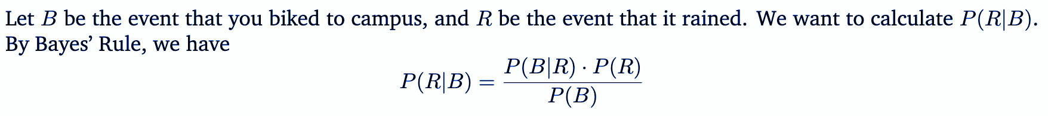
1 - Bayes’ Rule Practice
Work on finding the probability with the people around you!

Slide 7
1 - Bayes’ Rule Practice

Slide 8
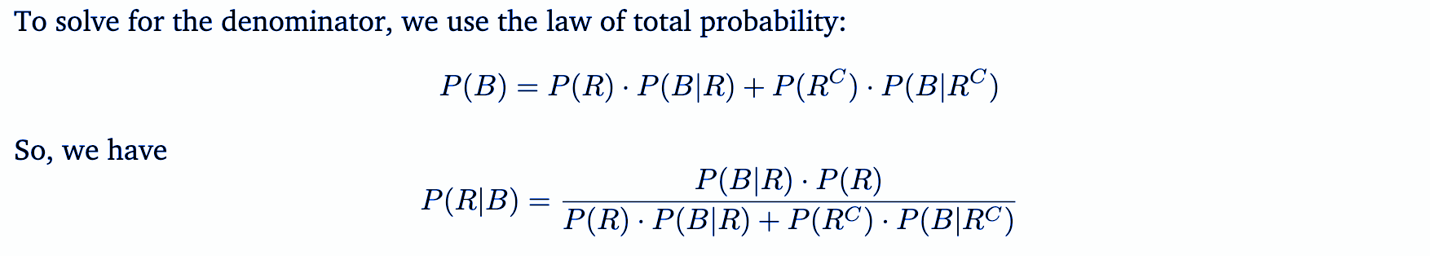
1 - Bayes’ Rule Practice

Slide 9
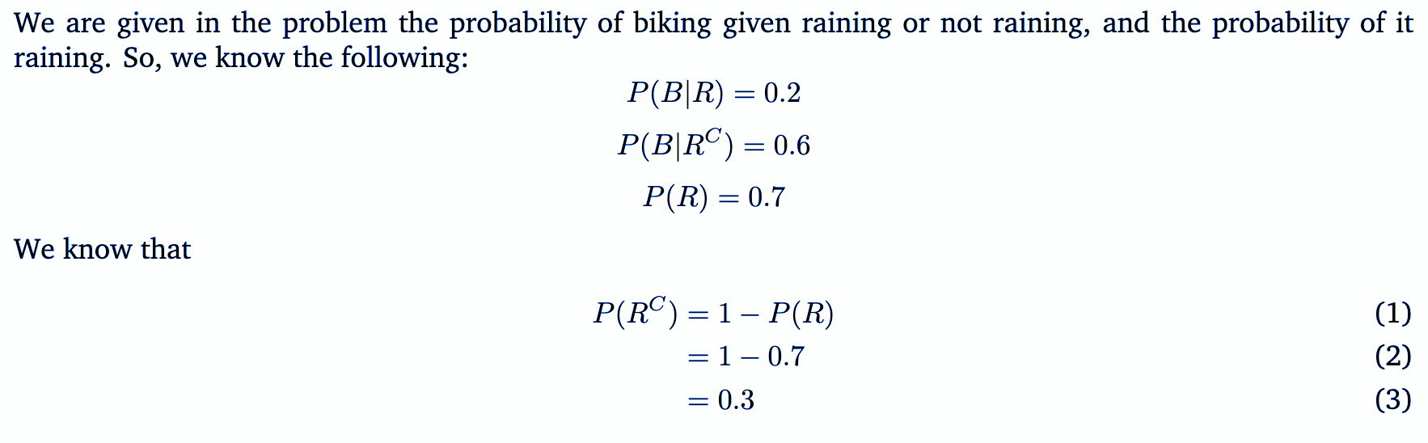
1 - Bayes’ Rule Practice

Slide 10
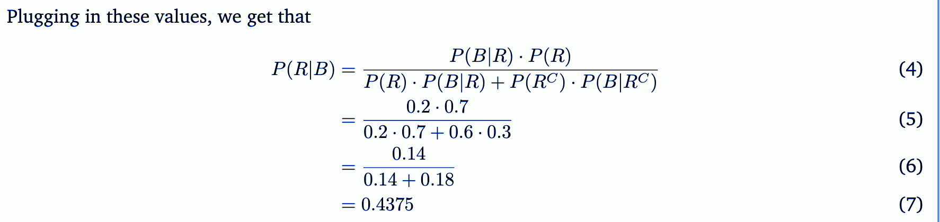
1 - Bayes’ Rule Practice

Slide 11
Review Questions

Slide 12
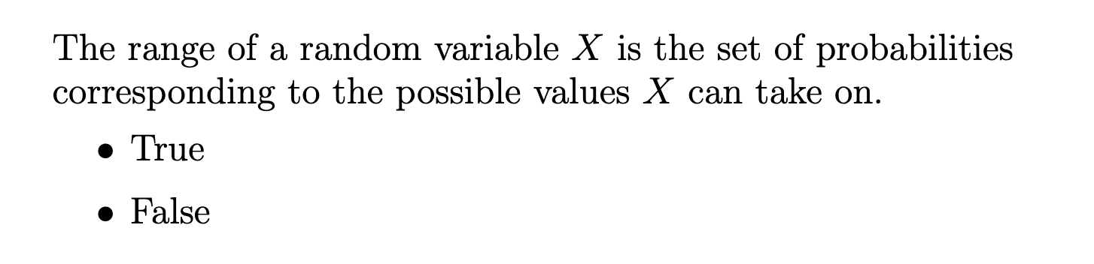
Question #1

Slide 13
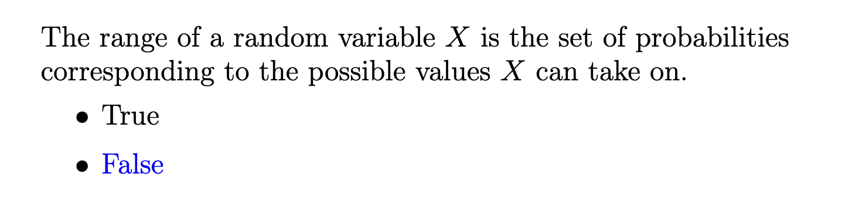
Question #1

Slide 14
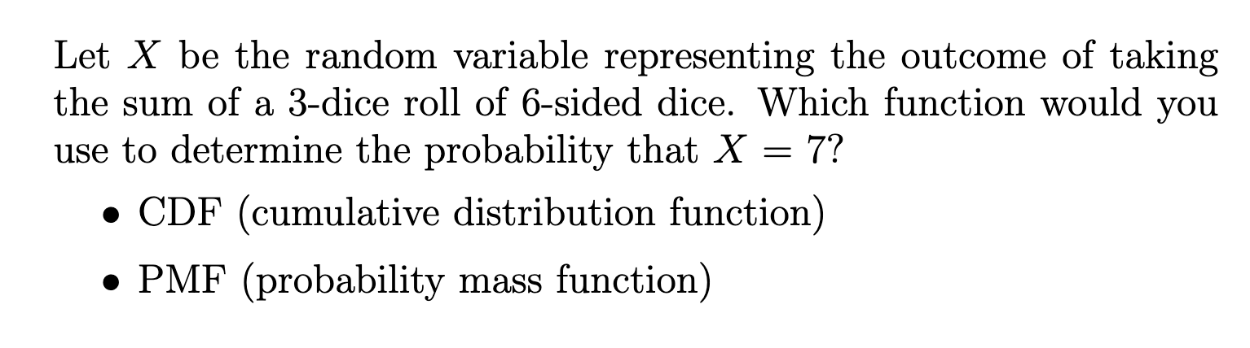
Question #2

Slide 15
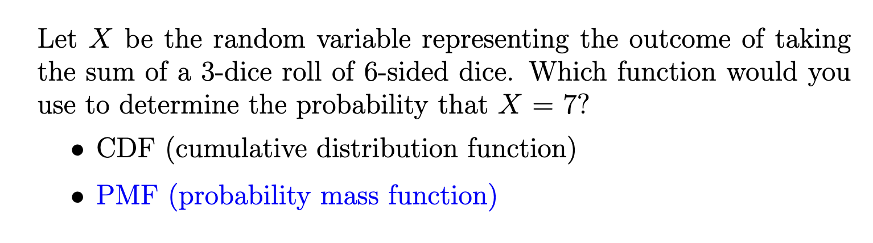
Question #2

Slide 16
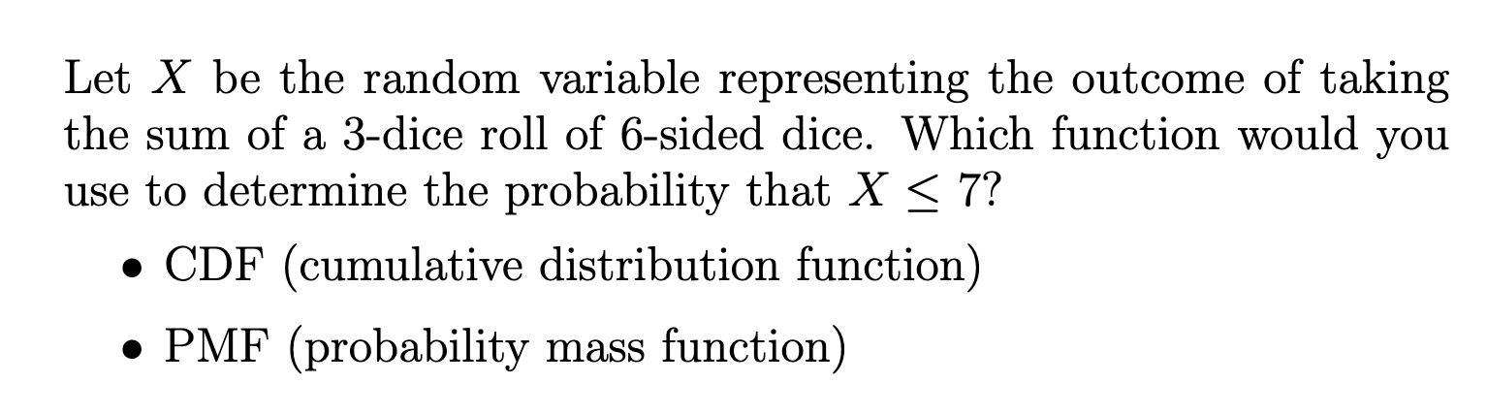
Question #3

Slide 17
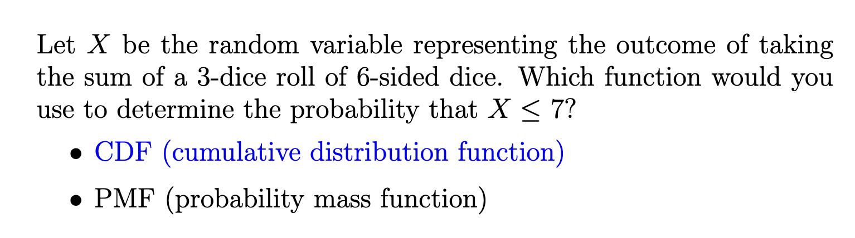
Question #3

Slide 18
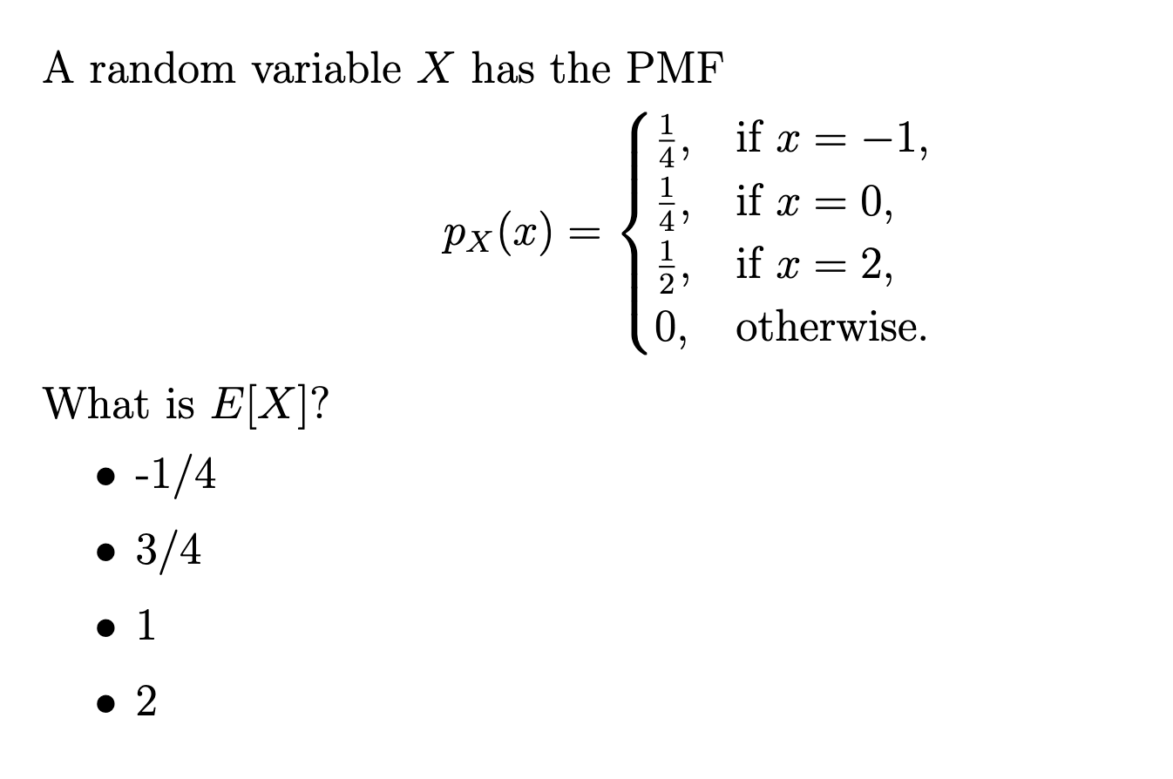
Question #4

Slide 19
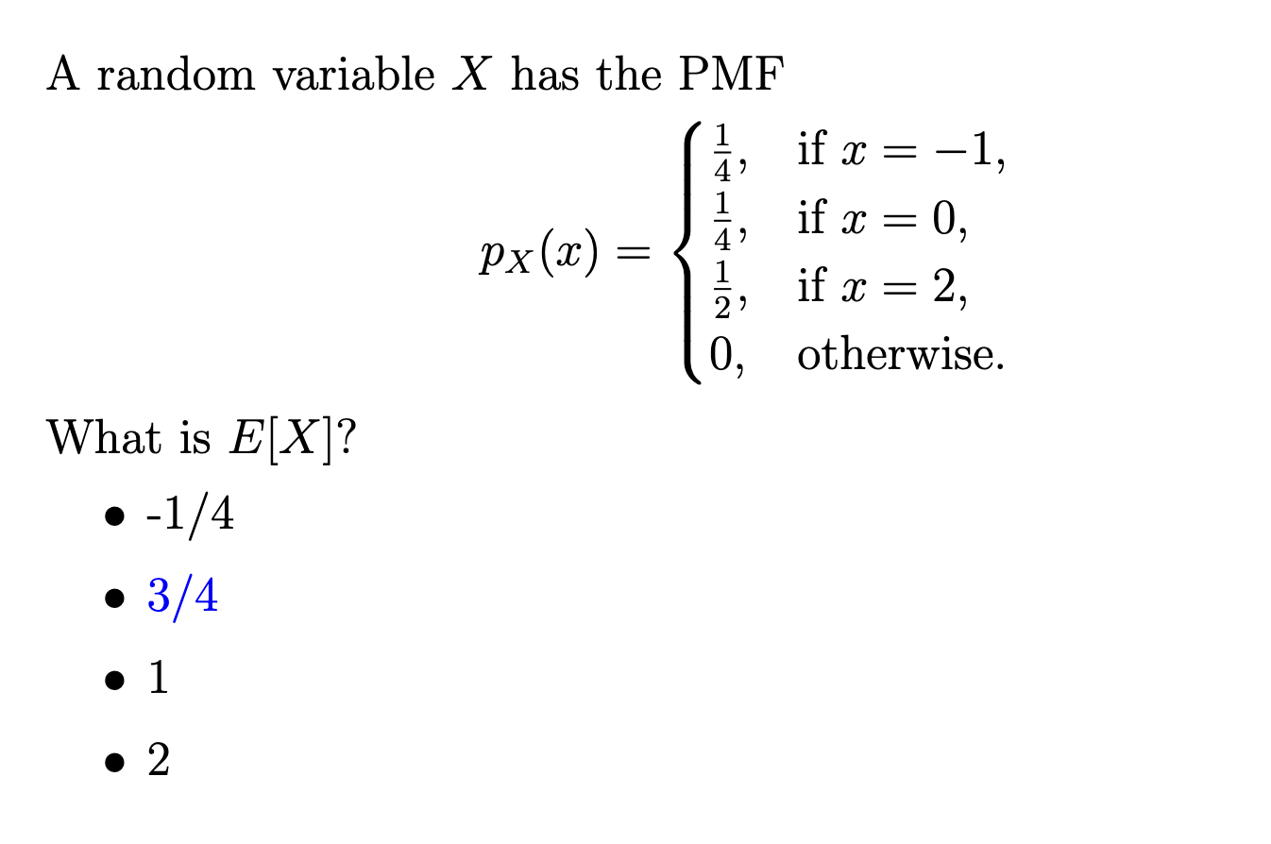
Question #4

Slide 20
Problem 5 – Kit Kats Again

Slide 21
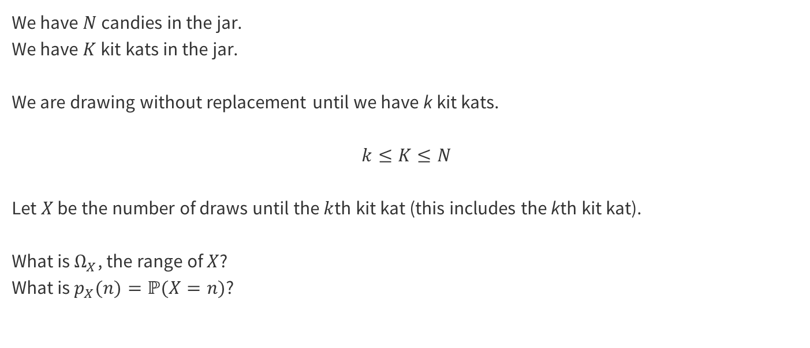
5 – Kit Kats Again
Work on finding the range of X with the people around you!

Slide 22
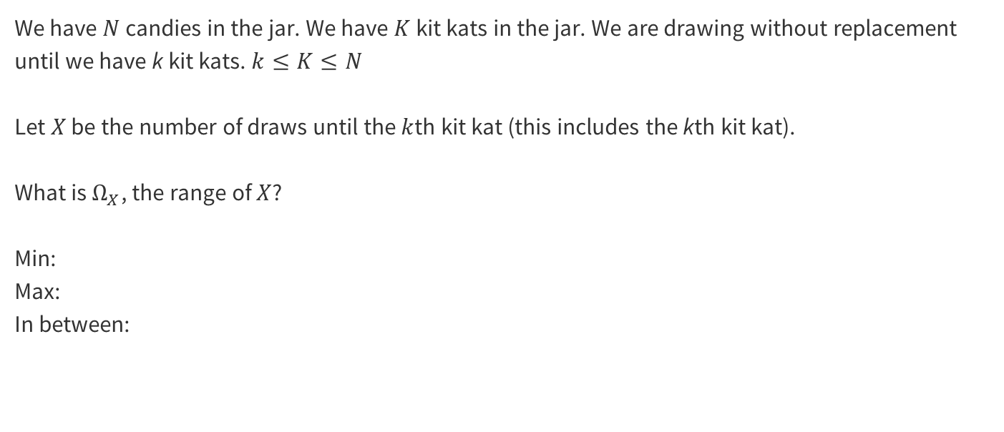
5 – Kit Kats Again

Slide 23
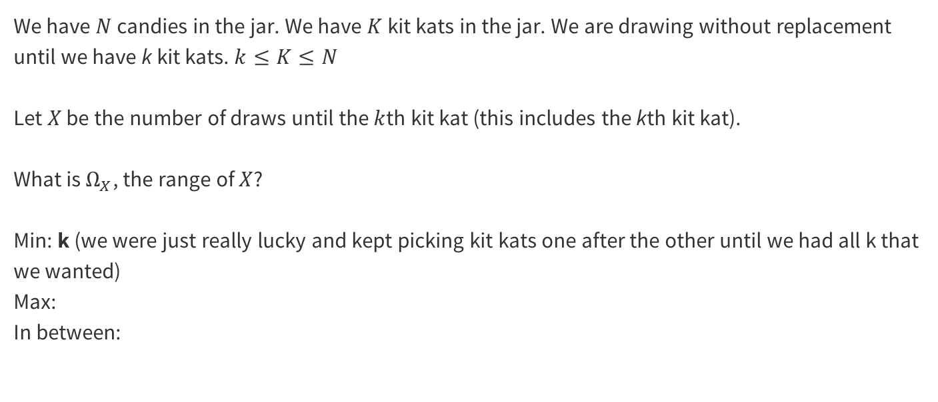
5 – Kit Kats Again

Slide 24
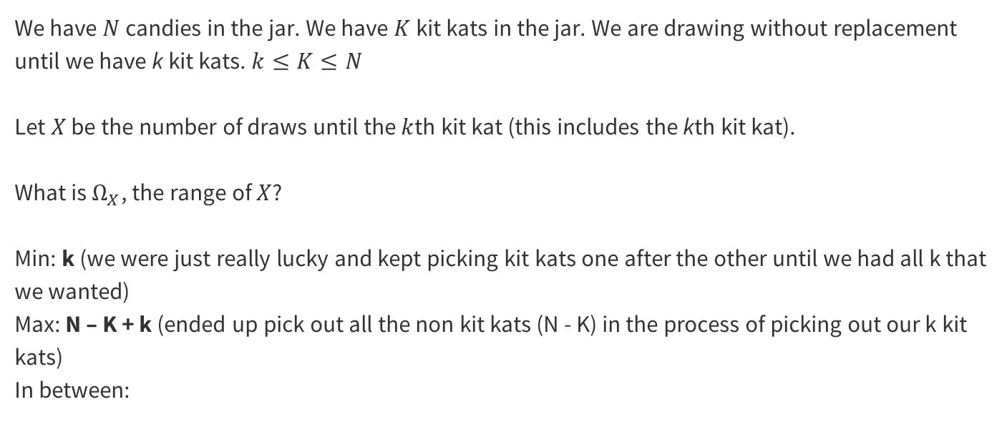
5 – Kit Kats Again

Slide 25
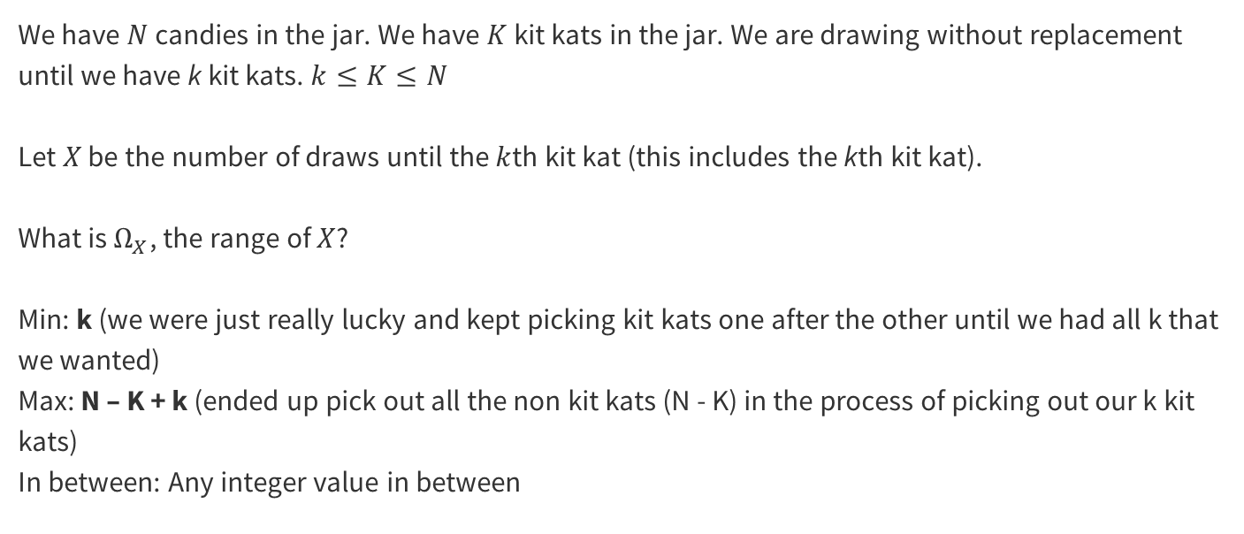
5 – Kit Kats Again

Slide 26
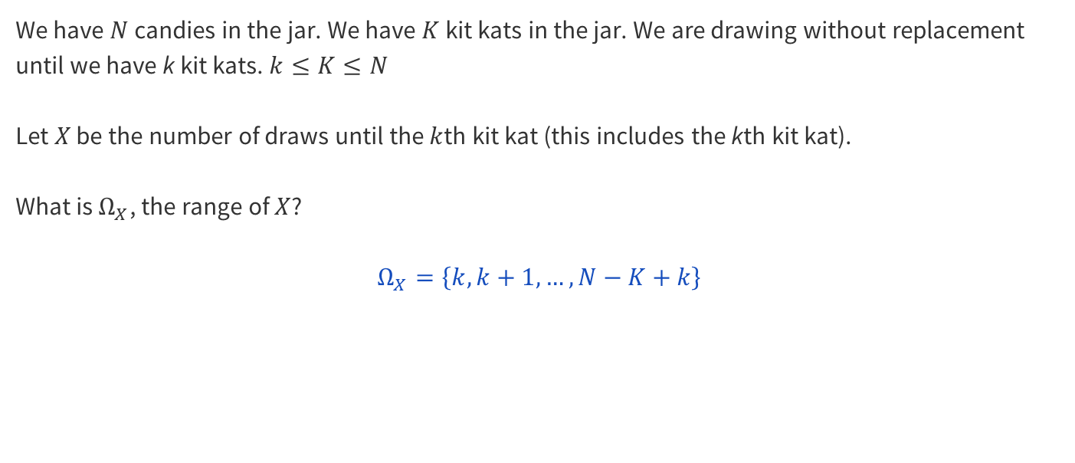
5 – Kit Kats Again

Slide 27
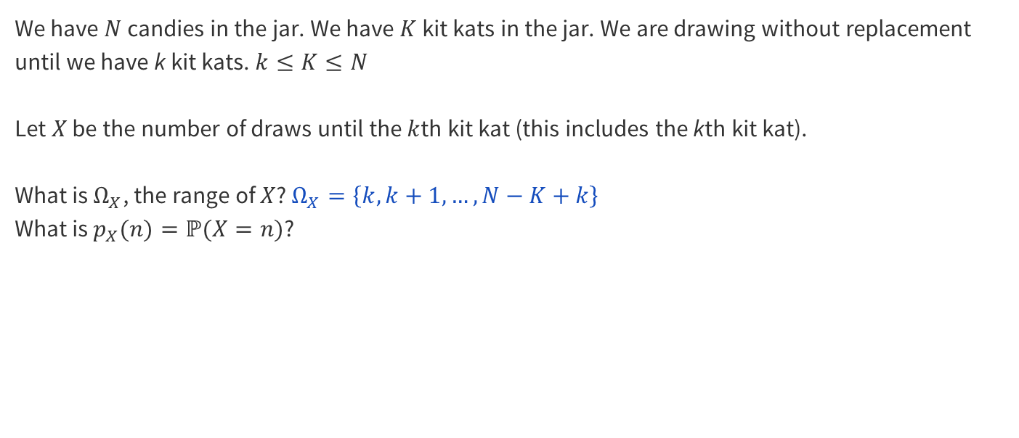
5 – Kit Kats Again
Work on finding the PMF of X with the people around you!
Notes:
Can someone explain in English what P(X = n) means?
This can also be though of what is the probability of us taking n draws until we have drawn k kit kats from our jar.

Slide 28
5 – Kit Kats Again
Notes:
Did anyone have any ideas on how to approach this?

Slide 29
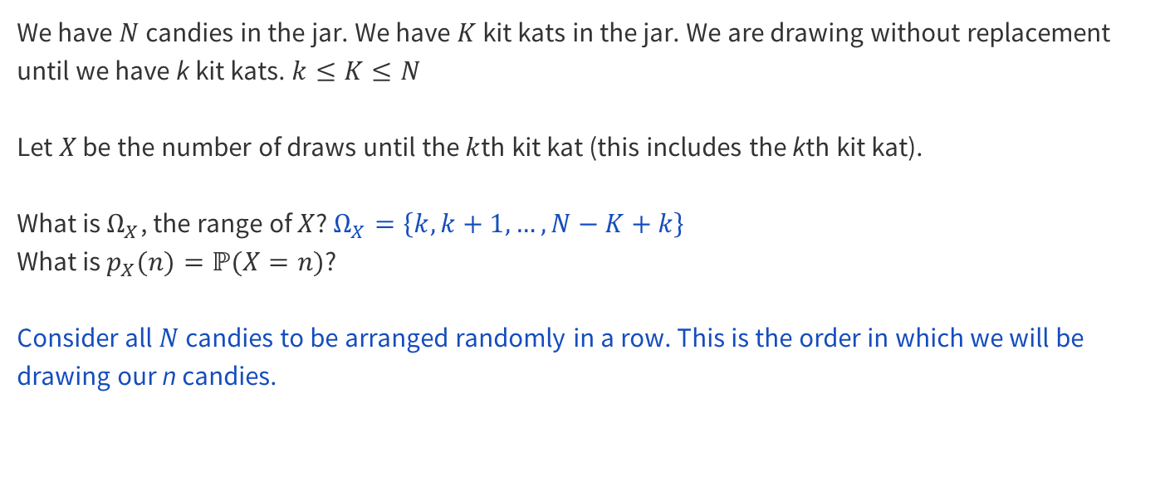
5 – Kit Kats Again
Notes:
What do we know about the nth draw? What candy is that?

Slide 30
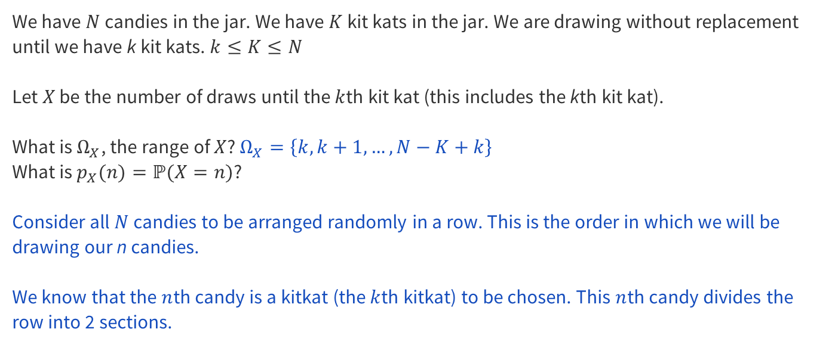
5 – Kit Kats Again

Slide 31
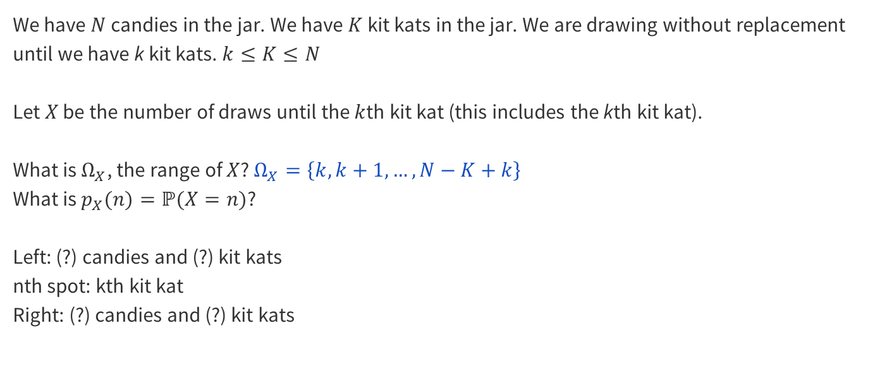
5 – Kit Kats Again
Notes:
Can someone explain what the left side contains?

Slide 32
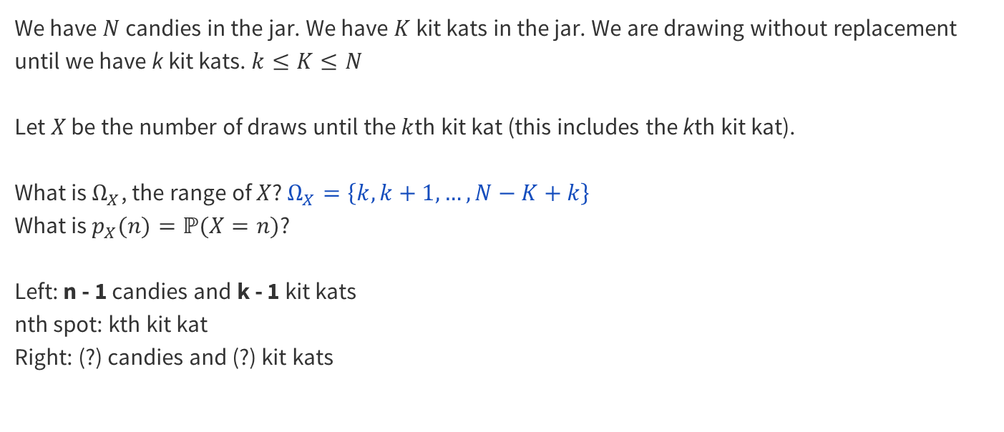
5 – Kit Kats Again
Notes:
Can someone explain what the right side contains?

Slide 33
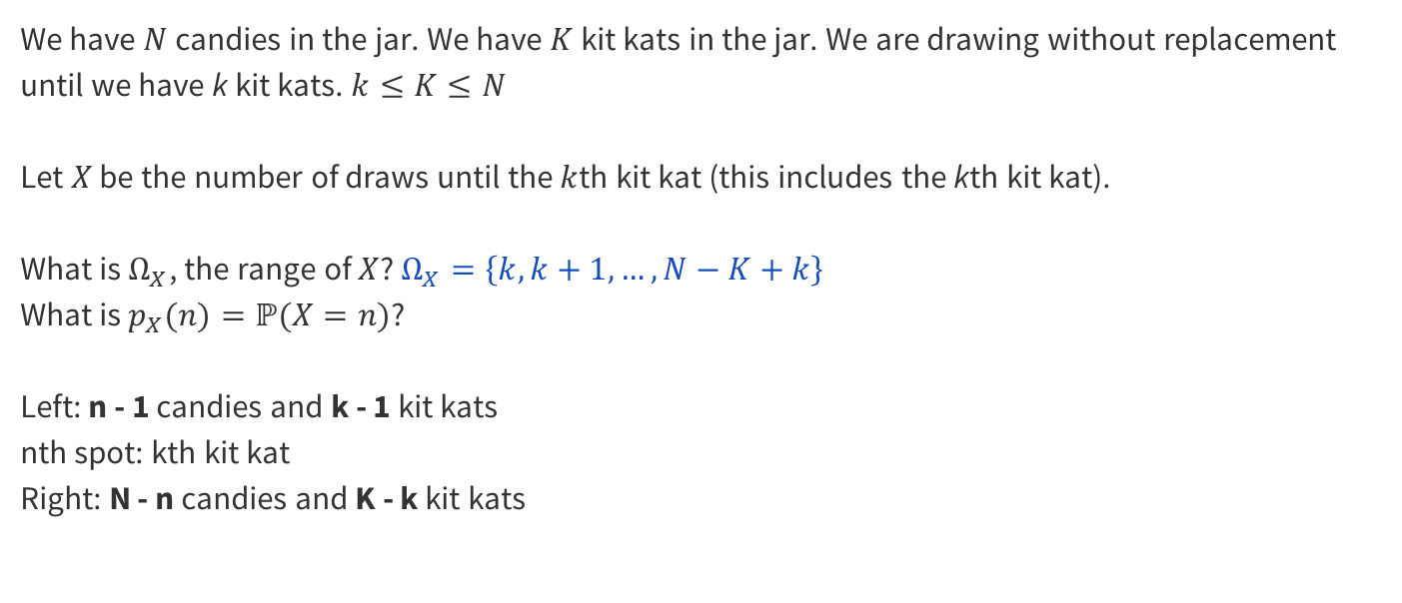
5 – Kit Kats Again
Event:
Sample Space:
Notes:
Now that we know the two sides, how can we use counting to figure out the probability of us taking n draws to pick k kitkats?

Slide 34
5 – Kit Kats Again
Event: number of ways to arrange the candies to have this outcome
Sample Space: number of ways to arrange the candies
Notes:
What will these values be?

Slide 35
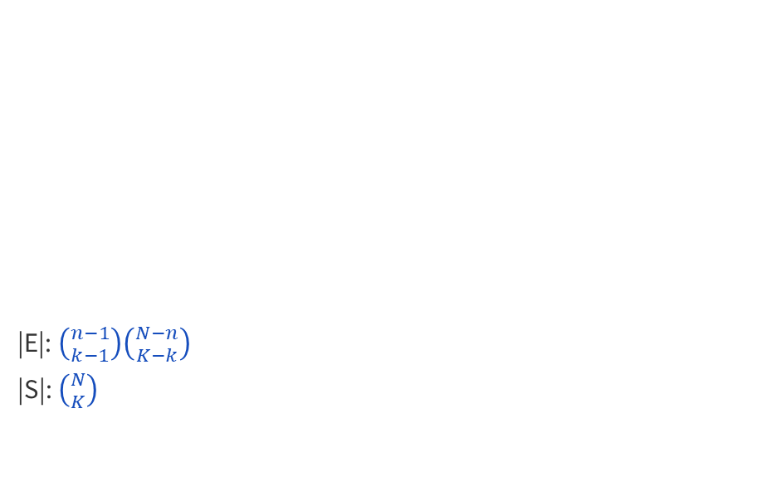
5 – Kit Kats Again
Notes:
What will these values be?

Slide 36
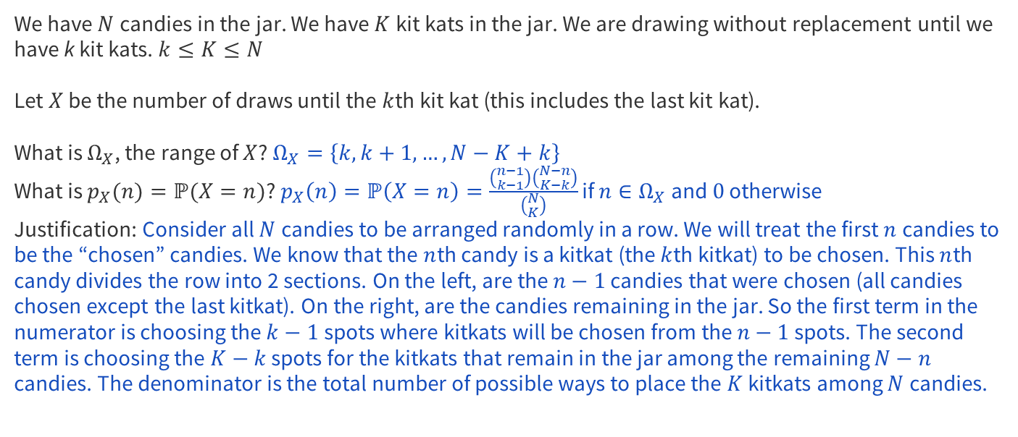
5 – Kit Kats Again
c
Notes:
Did anyone have any ideas on how to approach this?

Slide 37
Problem 6 – Hungry Washing Machine

Slide 38
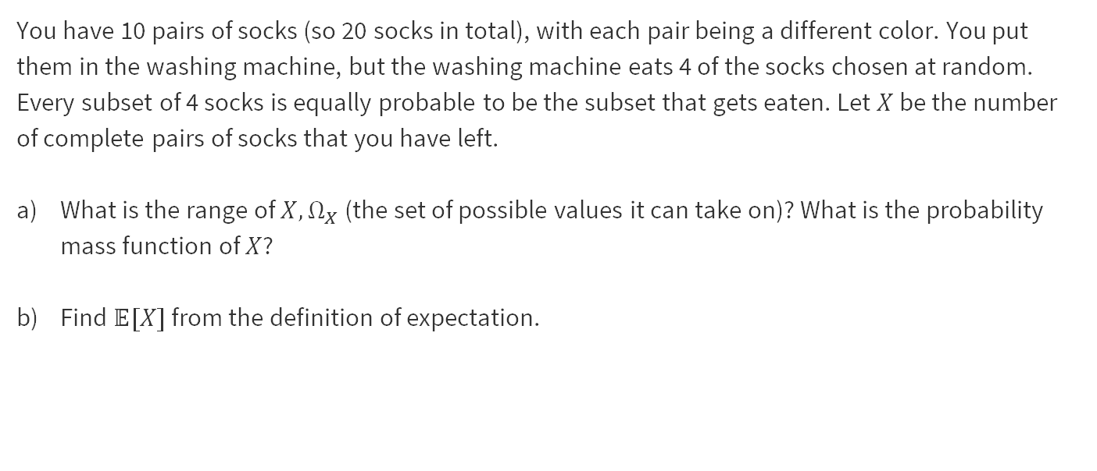
6 – Hungry Washing Machine
Work on this problem with the people around you, and then we’ll go over it together!

Slide 39
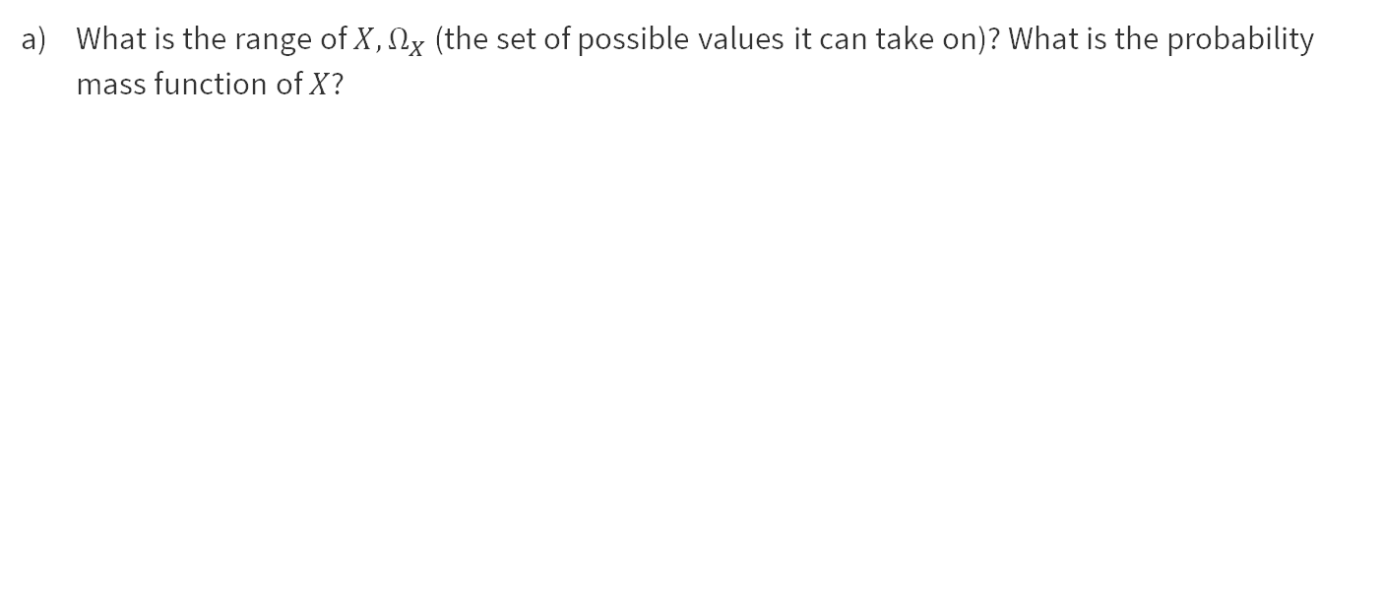
6 – Hungry Washing Machine

Slide 40
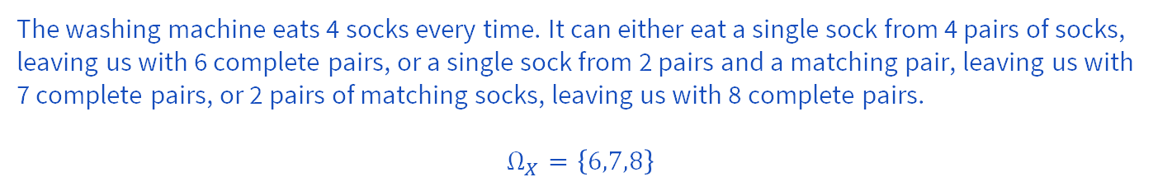
6 – Hungry Washing Machine

Slide 41
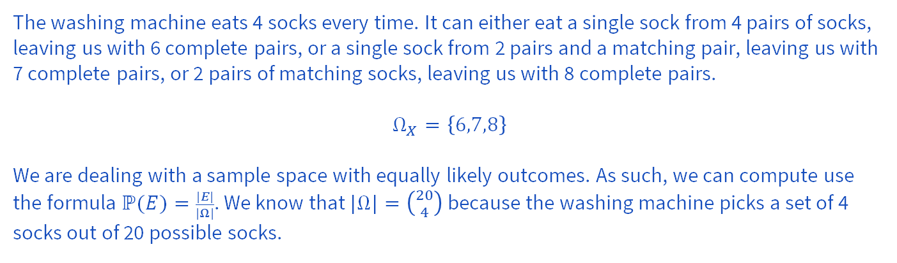
6 – Hungry Washing Machine

Slide 42
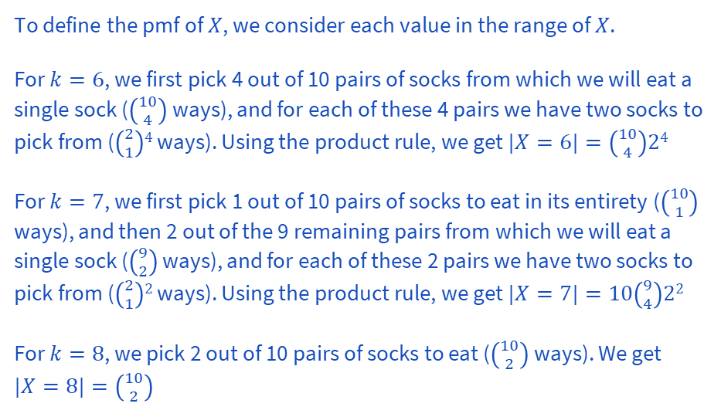

6 – Hungry Washing Machine

Slide 43
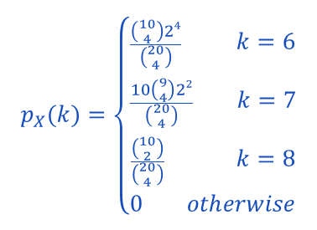
6 – Hungry Washing Machine

Slide 44
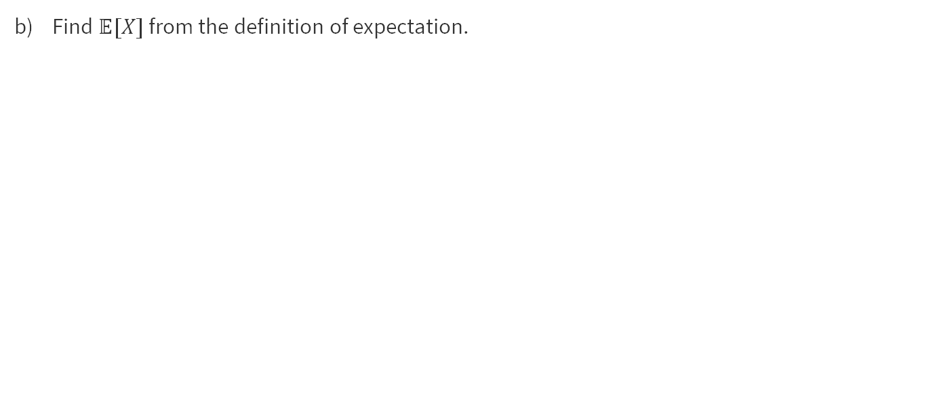
6 – Hungry Washing Machine

Slide 45

6 – Hungry Washing Machine

Slide 46
Problem 2 – Identify that Range!

Slide 47
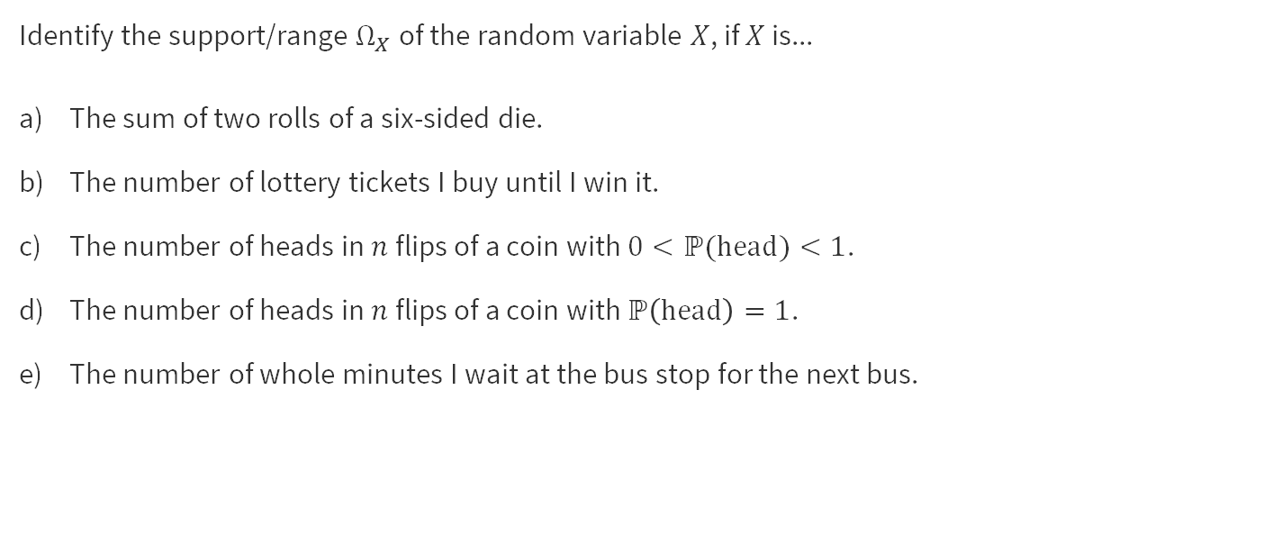
2 – Identify that Range!
Work on this problem with the people around you, and then we’ll go over it together!

Slide 48
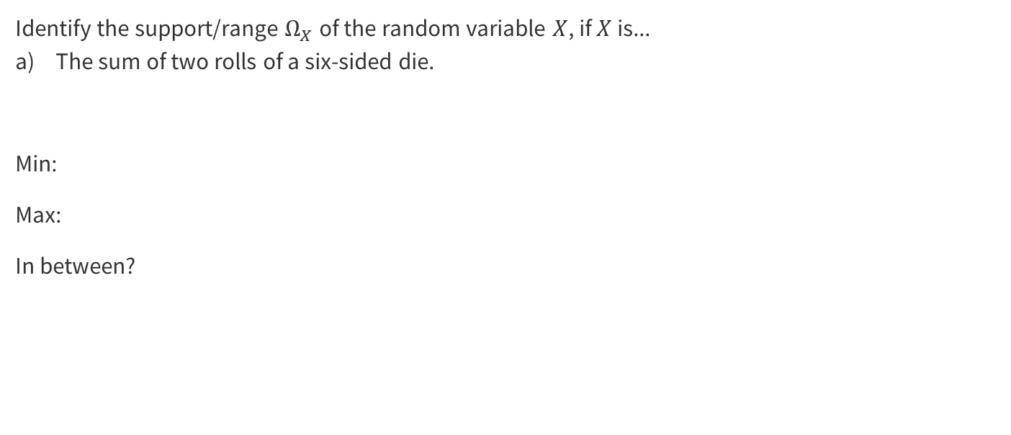
2 – Identify that Range!

Slide 49
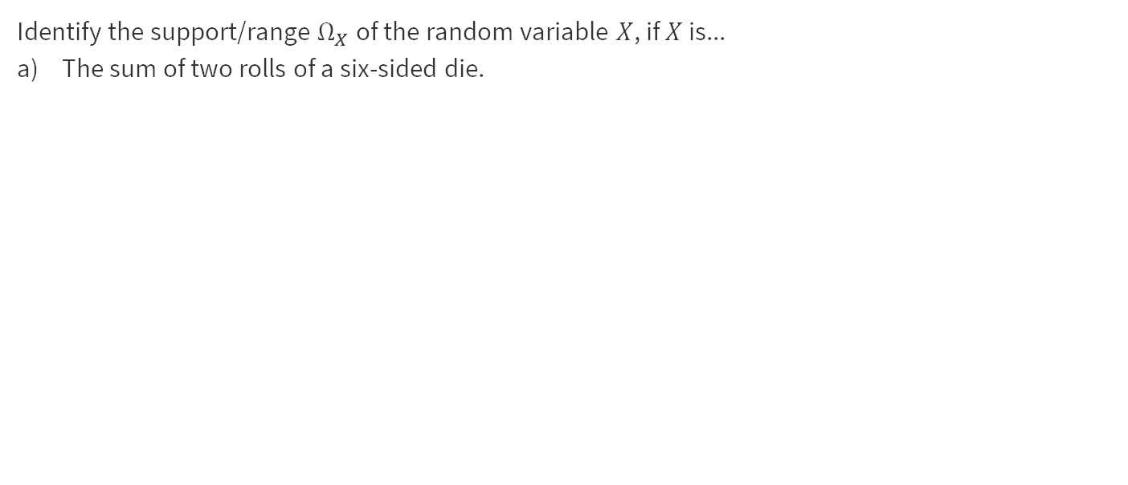
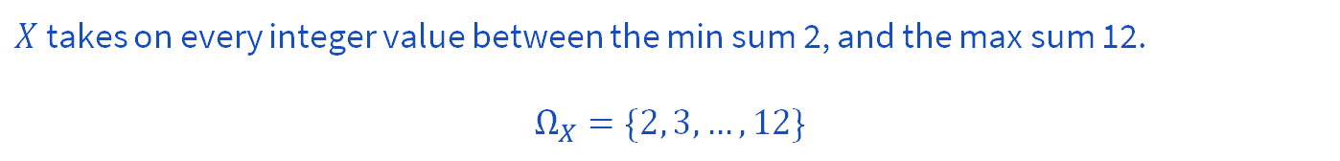
2 – Identify that Range!

Slide 50
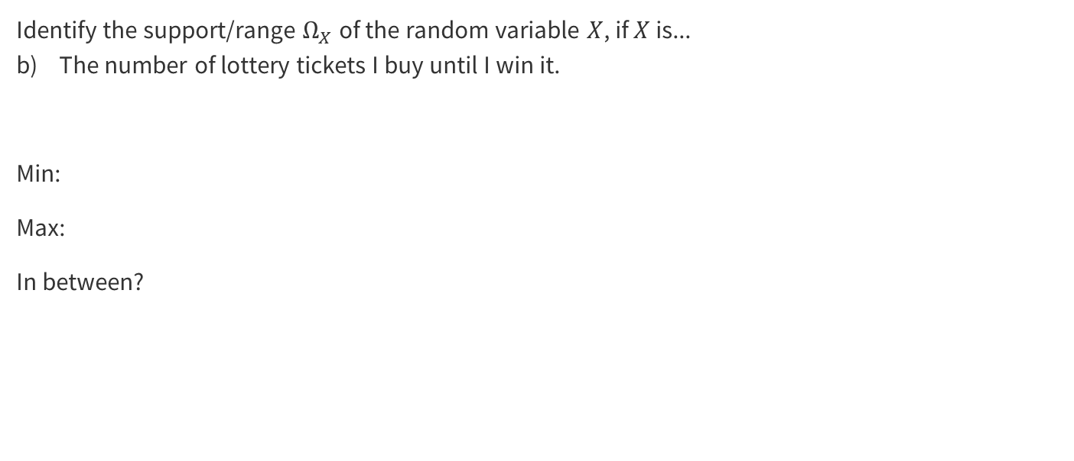
2 – Identify that Range!

Slide 51
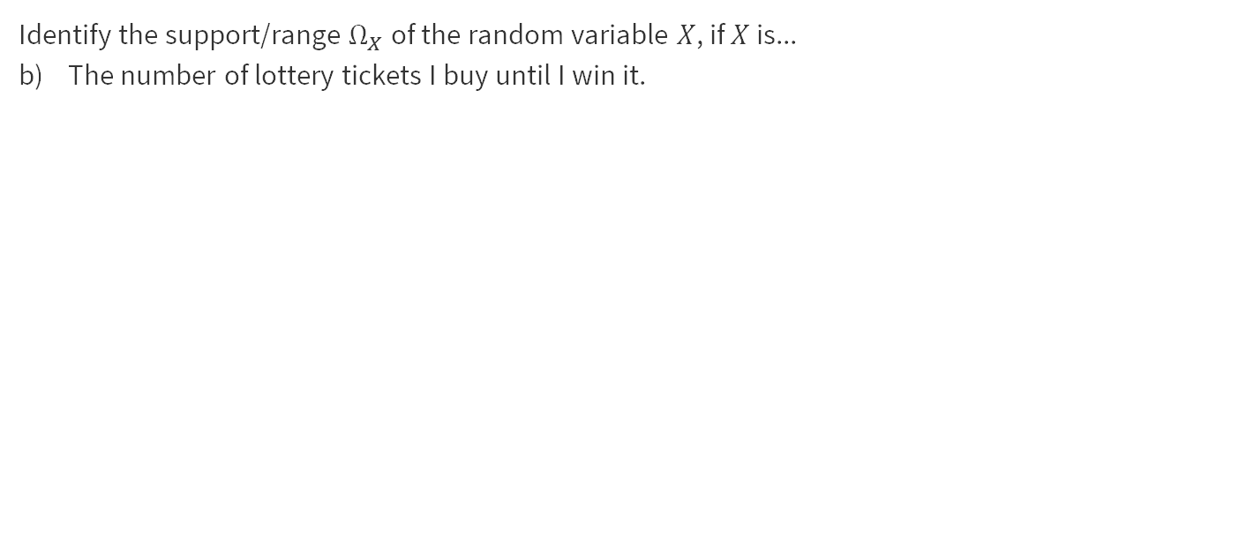
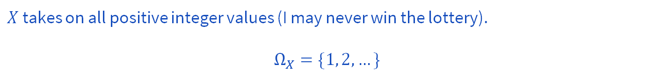
2 – Identify that Range!

Slide 52
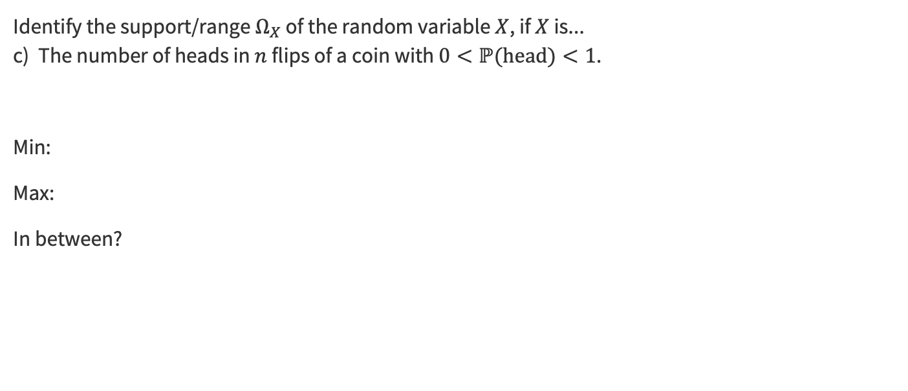
2 – Identify that Range!

Slide 53
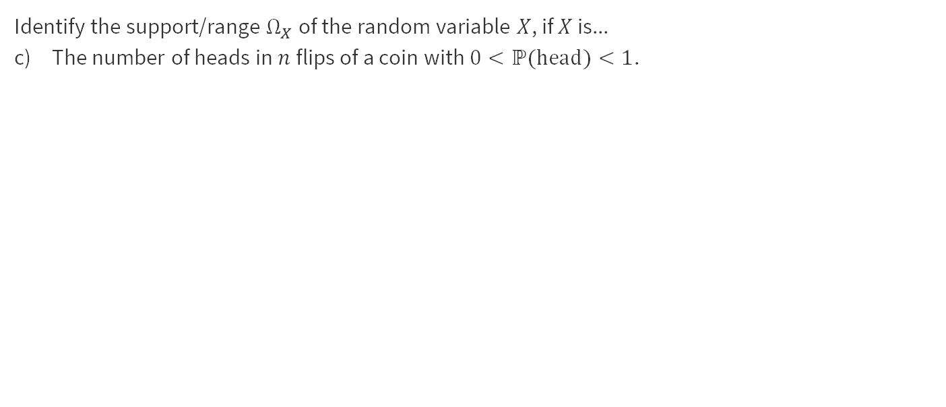
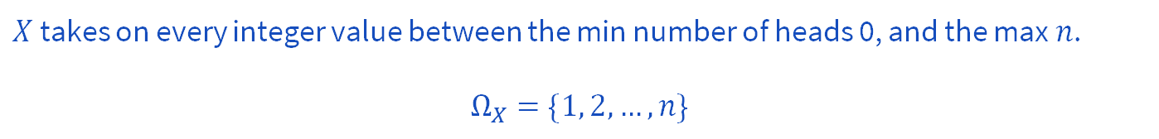
2 – Identify that Range!
0,1,
gg

Slide 54
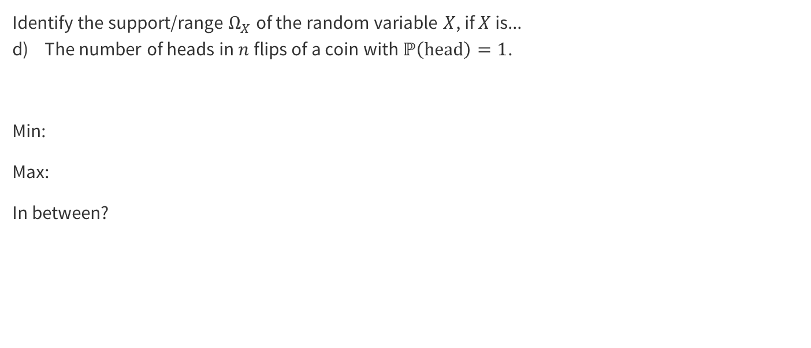
2 – Identify that Range!

Slide 55
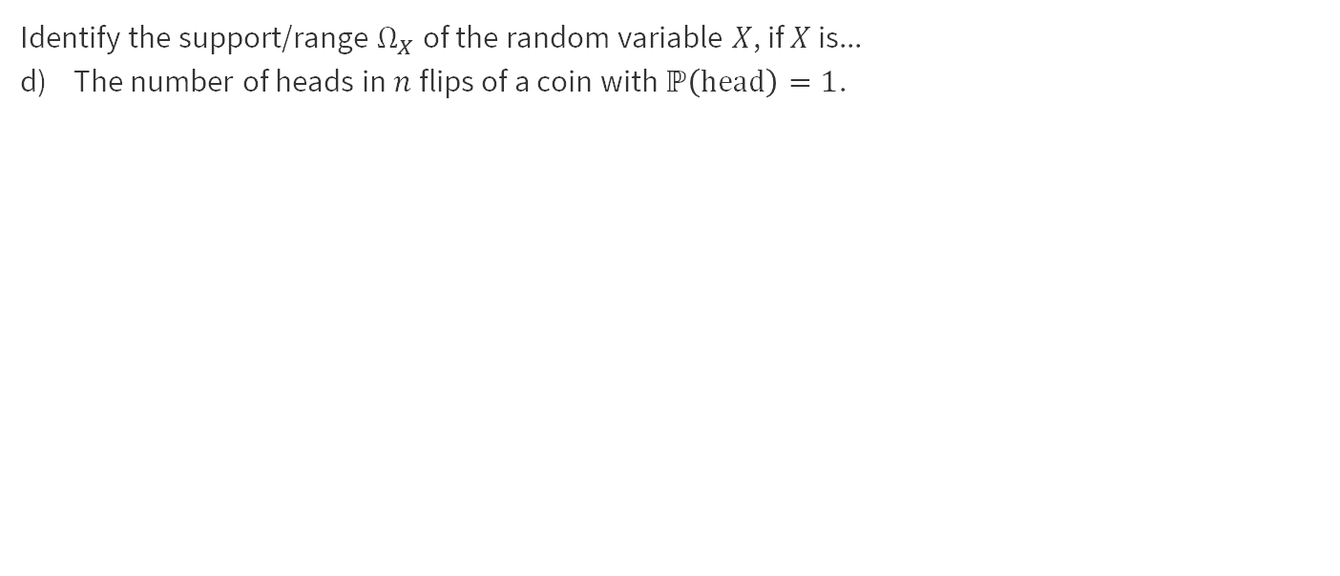
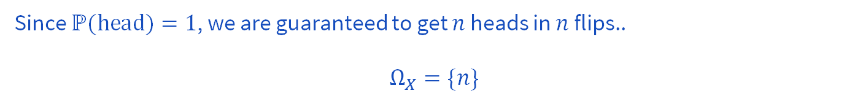
2 – Identify that Range!

Slide 56
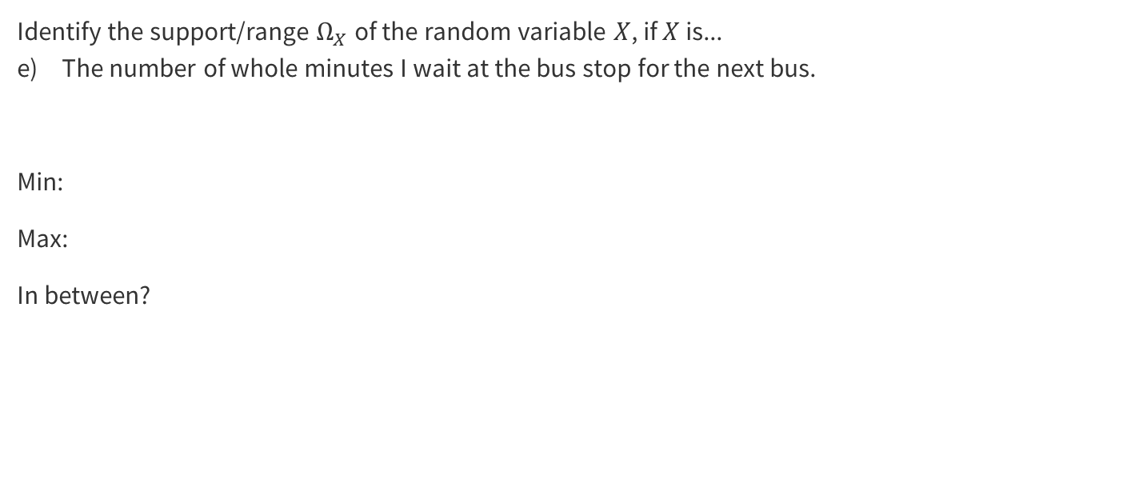
2 – Identify that Range!

Slide 57
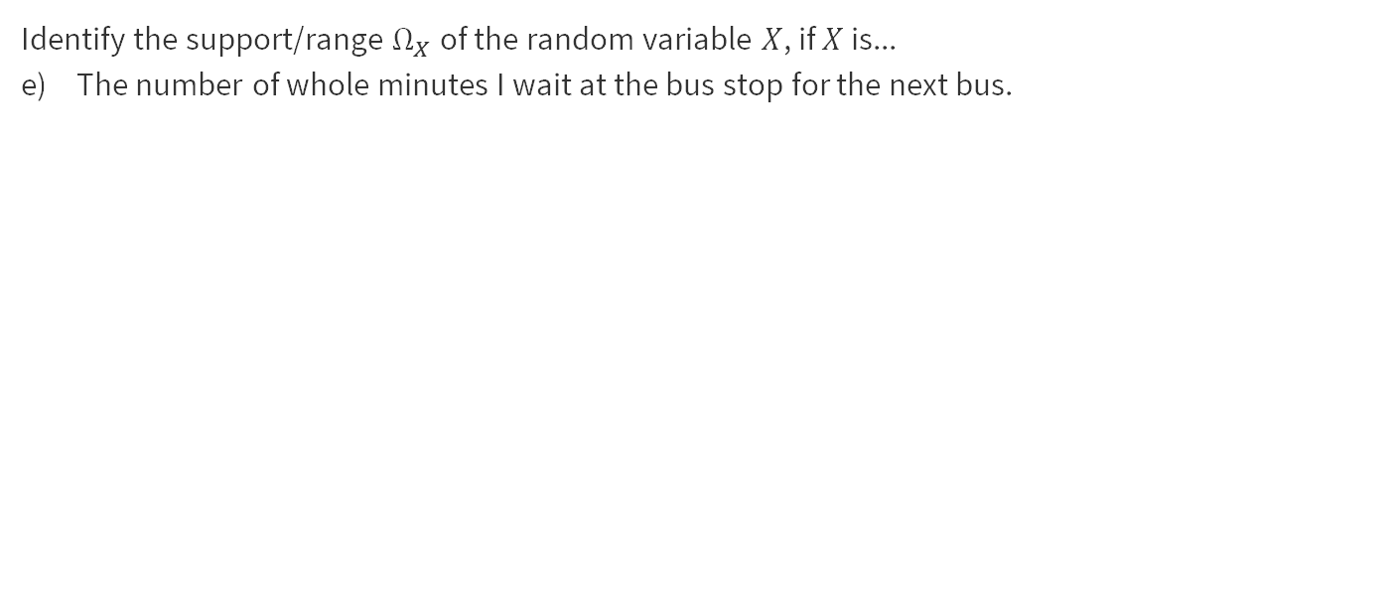
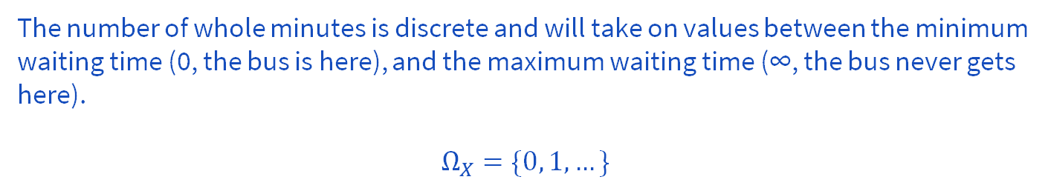
2 – Identify that Range!

Slide 58
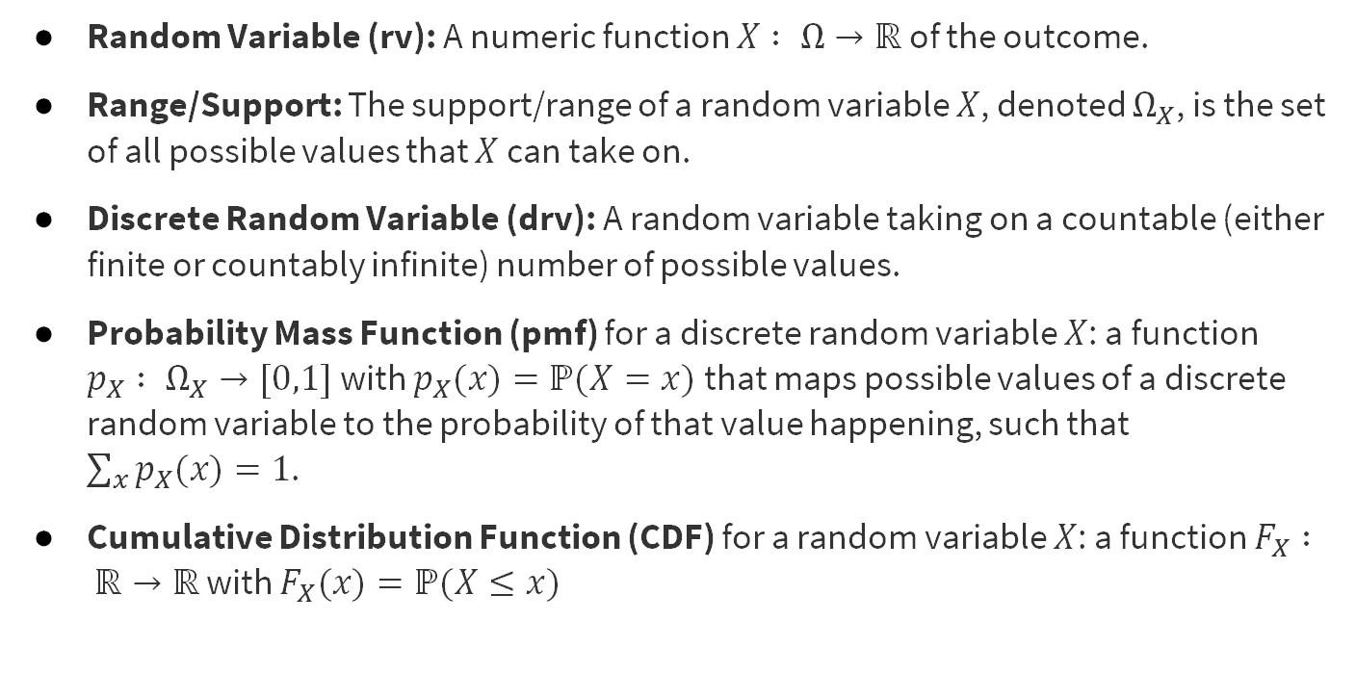
Review of Main Concepts
Notes:
A random variable is a way to summarize the important (numerical) information from your outcome.
PMF -> I think of it as what is the probability that my outcome is exactly x
CDF -> I think of it as what is the probability that my outcome is x or any value less than it, it will be zero after the min of your range and 1 after the max of you range

Slide 59

Review of Main Concepts
Notes:
Expectation is just the fancy way of thinking about what is the most likely outcome for this event. For example, if you had a 6 sided die, 4 -> 90% others 2%. If you had that die, what would you expect it to land on?
Other things will be covered in later lectures.

Slide 60

Review of Main Concepts

Slide 61

Review of Main Concepts

Slide 62

Review of Main Concepts

Slide 63
That’s All, Folks!
Thanks for coming to section this week!
Any questions?

Slide 64
Problem 7 – Frogger

Slide 65

7 – Frogger
Work on this problem with the people around you, and then we’ll go over it together!

Slide 66

7 – Frogger

Slide 67

7 – Frogger

Slide 68

7 – Frogger

Slide 69

7 – Frogger

Slide 70
7 – Frogger

