Slide 1
CSE 312 Section 3
Conditional Probability

Slide 2
Administrivia

Slide 3
Announcements & Reminders
HW1
Grades released on gradescope – check your submission to read comments
Regrade requests open ~24 hours after grades are released and close after a week
HW2
Was due yesterday, Wednesday 01/21 @ 11:59pm
Late deadline Saturday 01/24 @ 11:59pm (max of 3 late days per problem)
HW3
Released on the course website
Due Wednesday 01/28 @ 11:59pm

Slide 4
Review

Slide 5
Any lingering questions from this last week?
Each week in section, we’ll be reviewing the main concepts from this week and putting them into action by going through some practice problems together. But before we get into that review, we’ll try to start off each section with some time for you to ask questions. Was anything particularly confusing this week? Is there anything we can clarify before we dive into the review? This is your chance to clear things up!

Slide 6
Quiz

Slide 7
Review Questions?

Slide 8
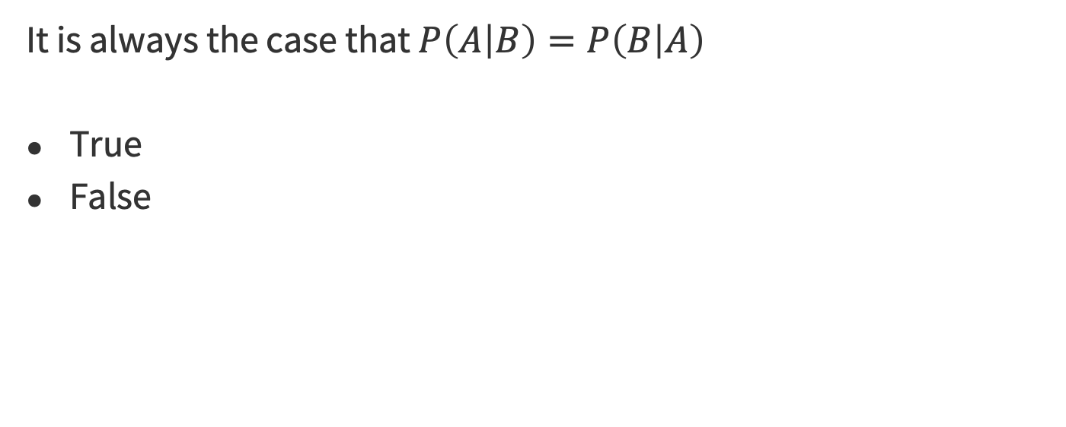
Question #1

Slide 9
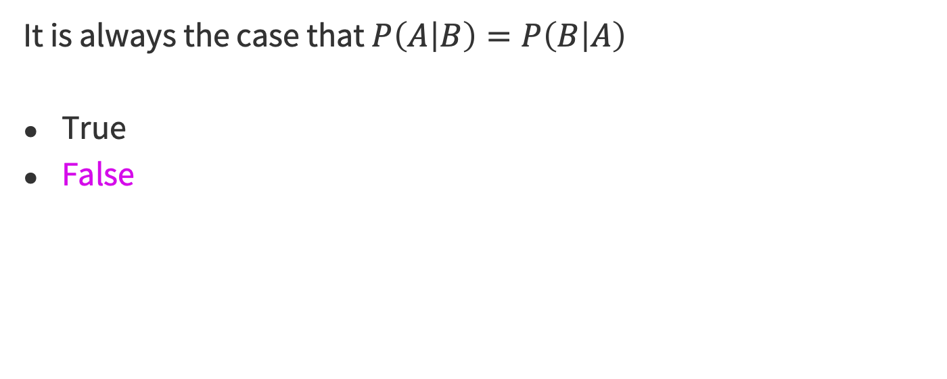
Question #1

Slide 10
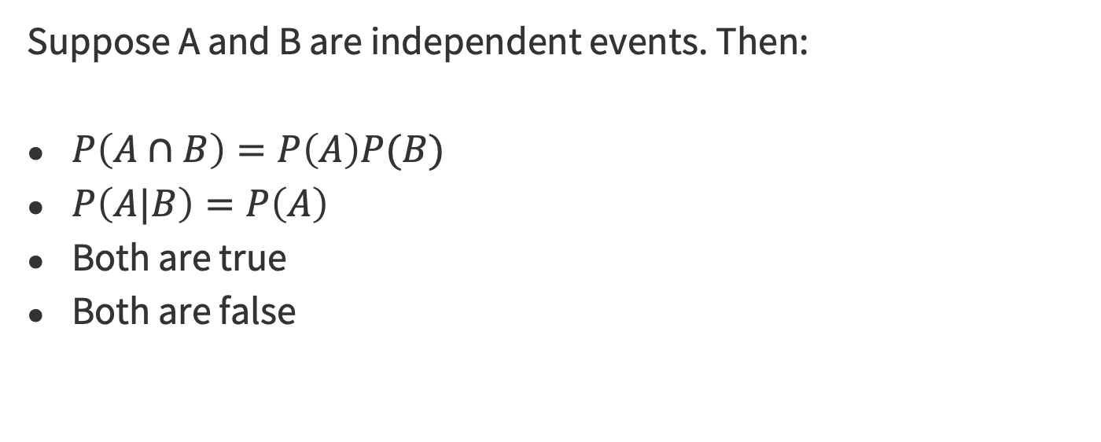
Question #2

Slide 11
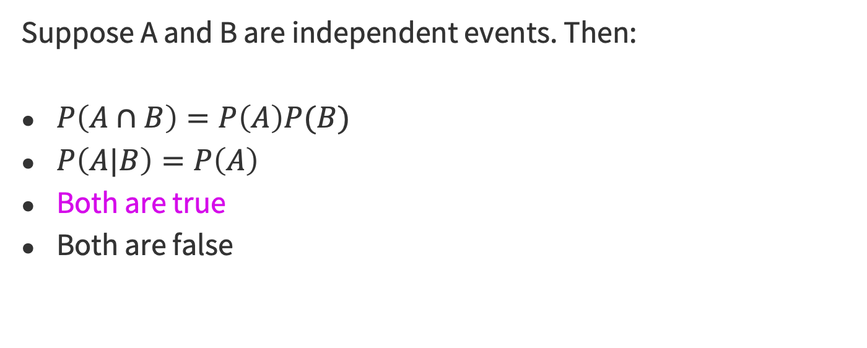
Question #2

Slide 12
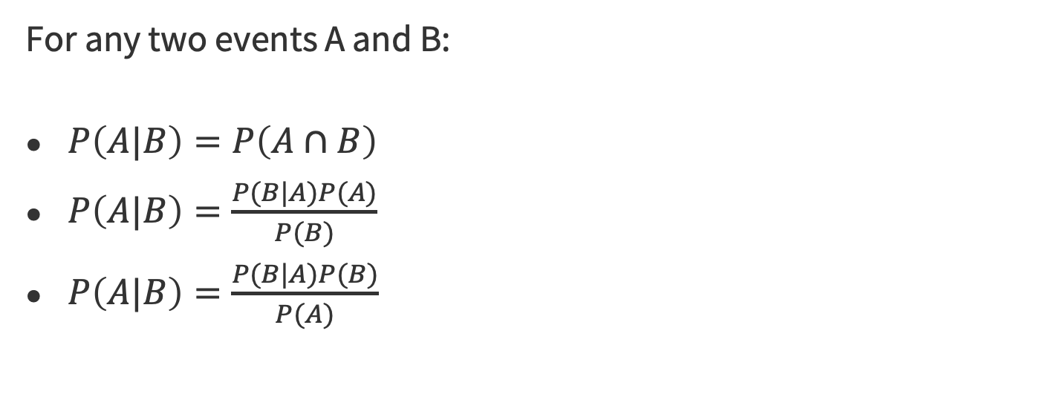
Question #3

Slide 13
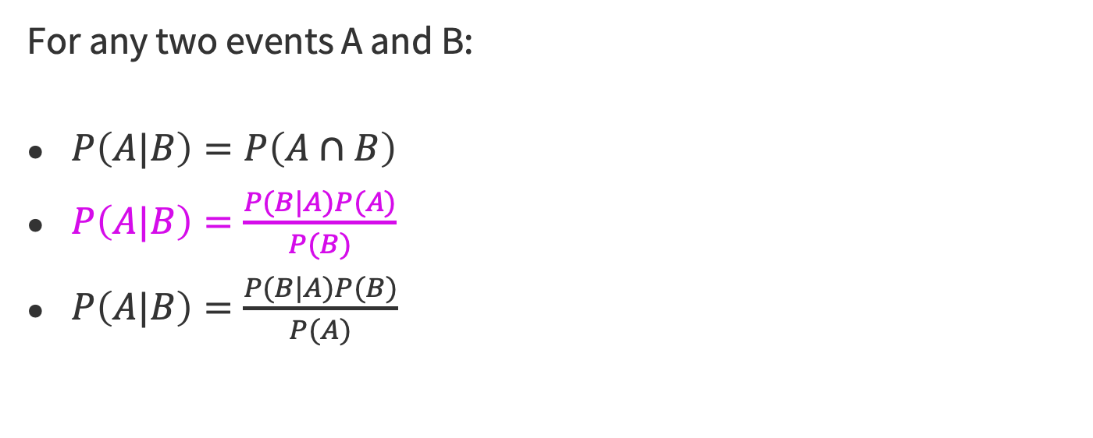
Question #3

Slide 14
Question #4
Let A and B be the event that a six-sided die is at most 3 and at least 4, respectively. Then A and B are a partition.
True
False

Slide 15
Question #4
Let A and B be the event that a six-sided die is at most 3 and at least 4, respectively. Then A and B are a partition.
True
False

Slide 16
Question #5
Let T be the event that Alice tests positive for the cold. Let C be the event that Alice actually has the cold. Suppose the probability that Alice tests positive given that she has a cold is 0.8. Then the probability she tests negative given that she has a cold is:
0.8
0.2
Not enough information

Slide 17
Question #5
Let T be the event that Alice tests positive for the cold. Let C be the event that Alice actually has the cold. Suppose the probability that Alice tests positive given that she has a cold is 0.8. Then the probability she tests negative given that she has a cold is:
0.8
0.2
Not enough information

Slide 18
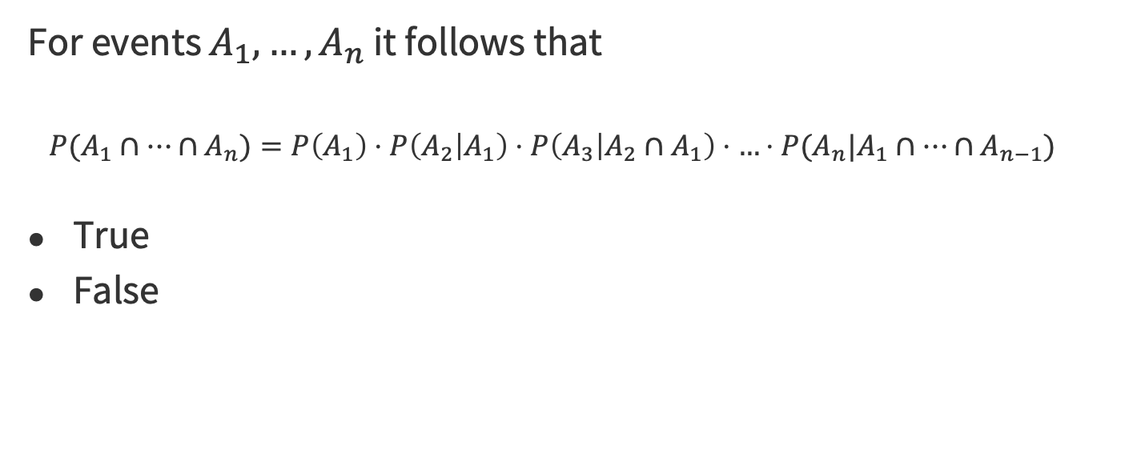
Question #6

Slide 19
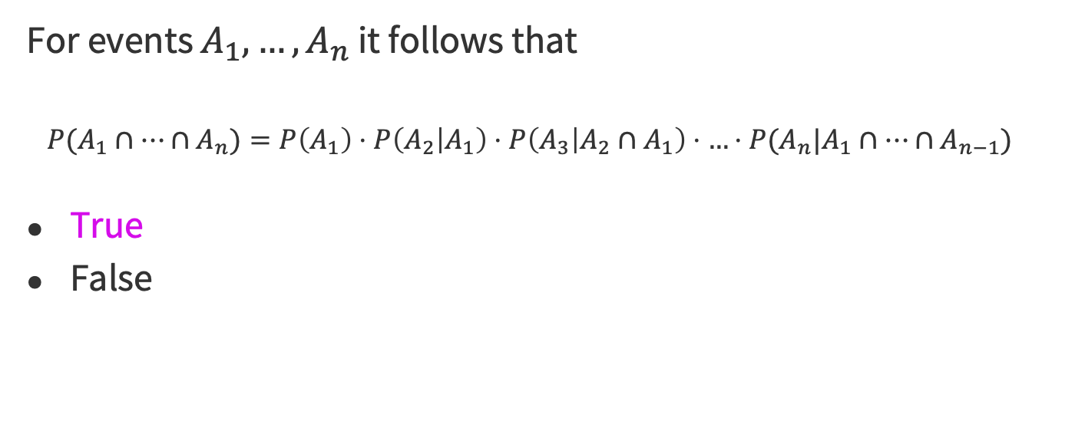
Question #6

Slide 20
Problem 5 – Parallel Systems

Slide 21
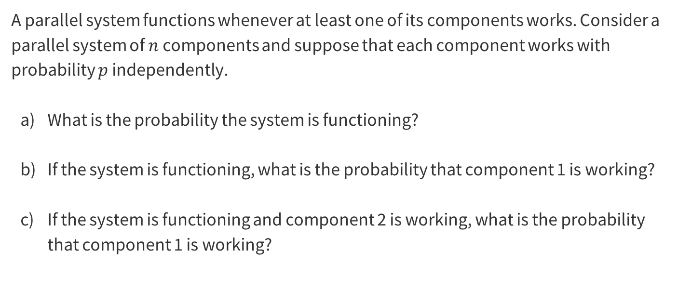
5 – Parallel Systems
Work on this problem with the people around you, and then we’ll go over it together!

Slide 22
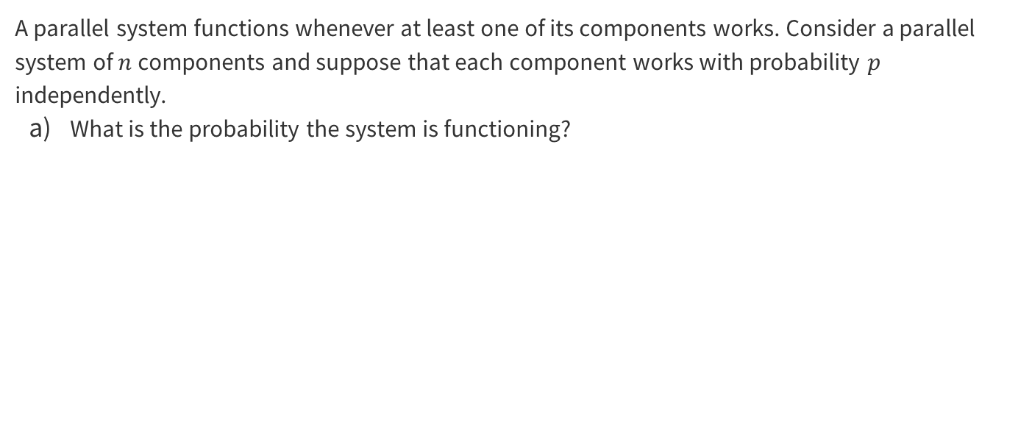
5 – Parallel Systems

Slide 23
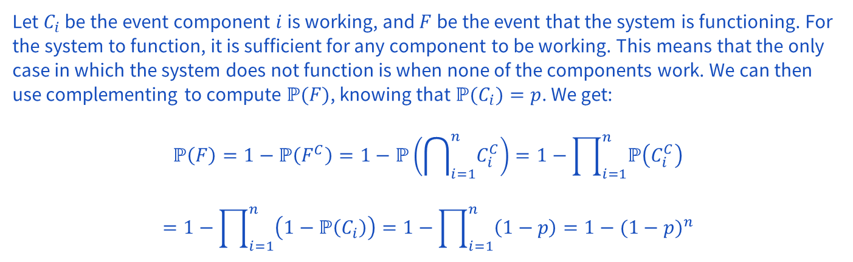
5 – Parallel Systems

Slide 24
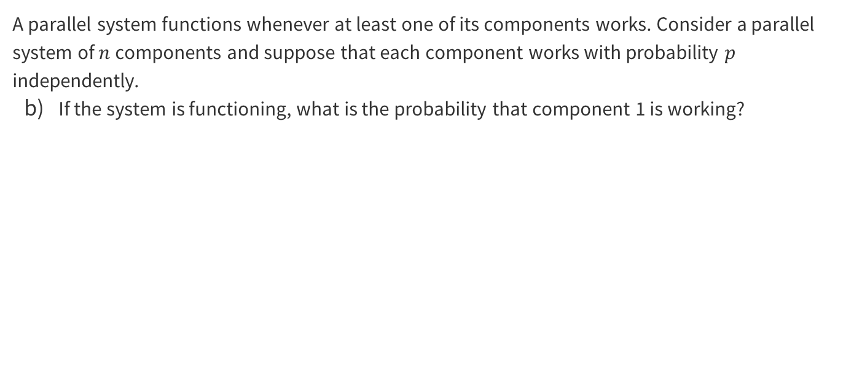
5 – Parallel Systems

Slide 25
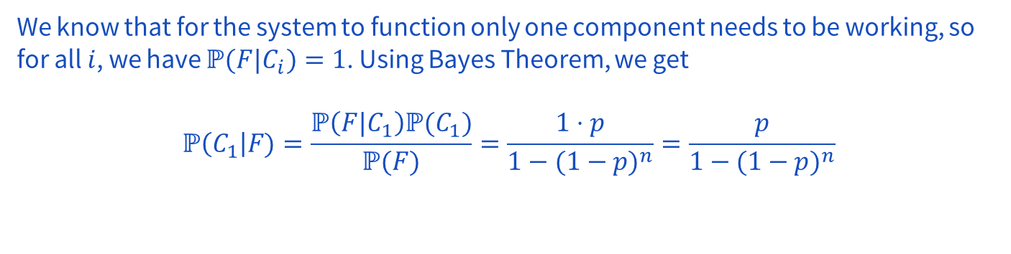
5 – Parallel Systems

Slide 26
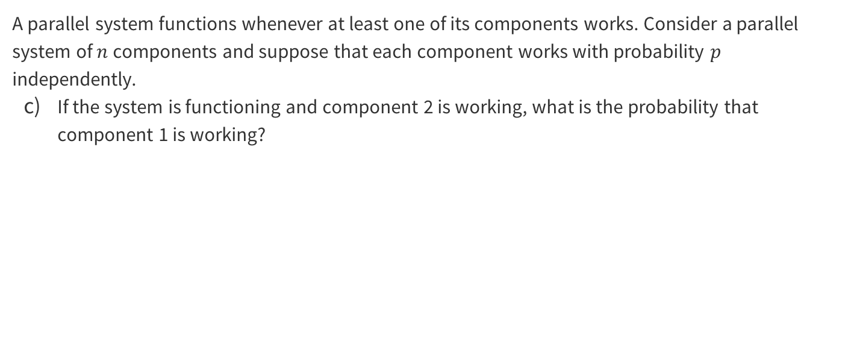
5 – Parallel Systems

Slide 27
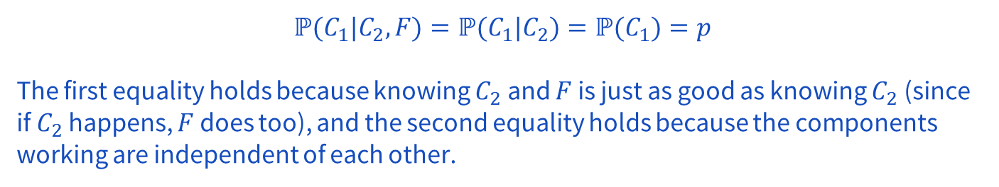
5 – Parallel Systems

Slide 28
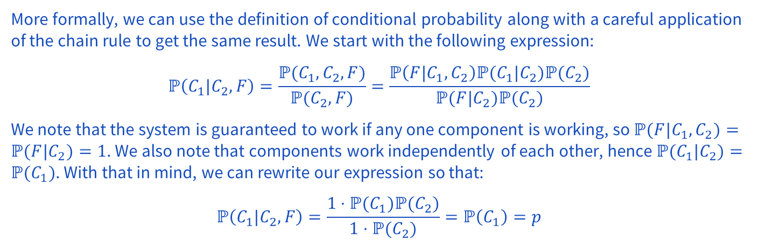
5 – Parallel Systems

Slide 29
Problem 9 – Dependent Dice Duo

Slide 30
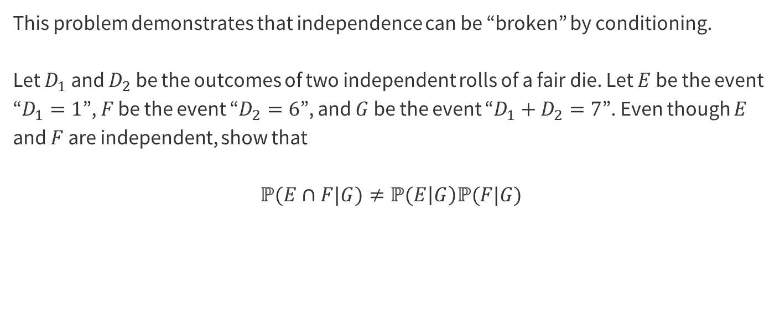
9 – Dependent Dice Duo
Work on this problem with the people around you, and then we’ll go over it together!

Slide 31
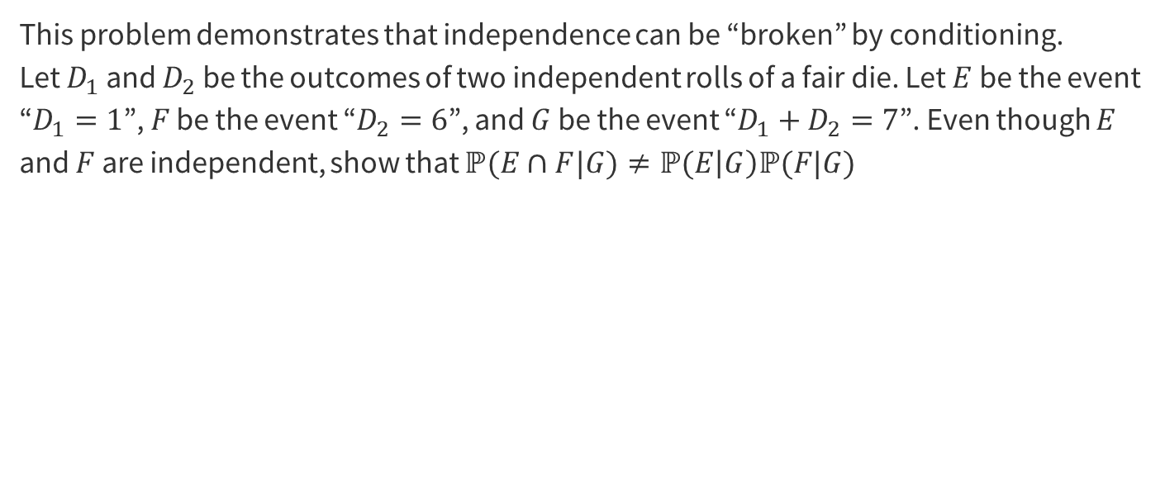
9 – Dependent Dice Duo

Slide 32

9 – Dependent Dice Duo

Slide 33
9 – Dependent Dice Duo
When we condition on G, our sample space Ω becomes {(1,6), (2,5), (3,4), (4,3), (2,5), (6,1)}, where the first number in the pair is the D₁ outcome and the second number is the D₂ outcome.
From here we can see that P(E|G) = P(D₁ = 1 | D₁ + D₂ = 7) = 1/6 as (1,6) is 1 of the 6 possible rolls that sum to 7 and each roll is equally likely.
We also see that P(F|G) = P(D₂ = 6 | D₁ + D₂ = 7) = 1/6 and P(E ∩ F|G) = P(D₁ = 1 ∩ D₂ = 6 | D₁ + D₂ = 7) = 1/6 using similar reasoning. Now we have that P(E|G) * P(F|G) = 1/36. Notice that 1/36 ≠ 1/6 so we have shown that independence can be "broken" by conditioning.

Slide 34
That’s All, Folks!
Thanks for coming to section this week!
Any questions?

Slide 36
Problem 4 – Game Show

Slide 37
4 – Game Show
Corrupted by their power, the judges running the popular game show America’s Next Top Mathematician have been taking bribes from many of the contestants. During each of two episodes, a given contestant is either allowed to stay on the show or is kicked off. If the contestant has been bribing the judges, she will be allowed to stay with probability 1. If the contestant has not been bribing the judges, she will be allowed to stay with probability 1/3, independent of what happens in earlier episodes. Suppose that 1/4 of the contestants have been bribing the judges. The same contestants bribe the judges in both rounds.

Slide 38
4 – Game Show
2 rounds, contestants bribe in both rounds. If contestant has been bribing , allowed to stay with probability 1. If contestant has not been bribing, allowed to stay with probability 1/3, independent of earlier. Suppose that 1/4 of the contestants have been bribing the judges.
If you pick a random contestant, what is the probability that she is allowed to stay during the first episode?
If you pick a random contestant, what is the probability that she is allowed to stay during both episodes?
If you pick a random contestant who was allowed to stay during the first episode, what is the probability that she gets kicked off during the second episode?
If you pick a random contestant who was allowed to stay during the first episode, what is the probability that she was bribing the judges?
Work on this problem with the people around you, and then we’ll go over it together!

Slide 39
4 – Game Show
If you pick a random contestant, what is the probability that she is allowed to stay during the first episode?

Slide 40
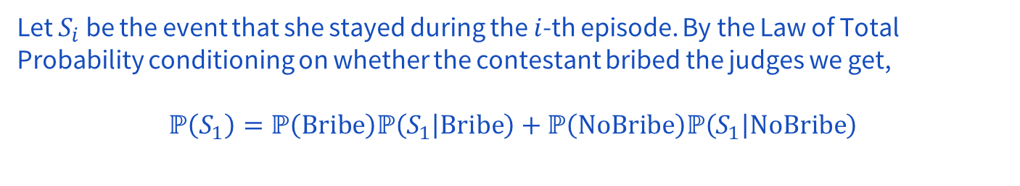
4 – Game Show
If you pick a random contestant, what is the probability that she is allowed to stay during the first episode?

Slide 41
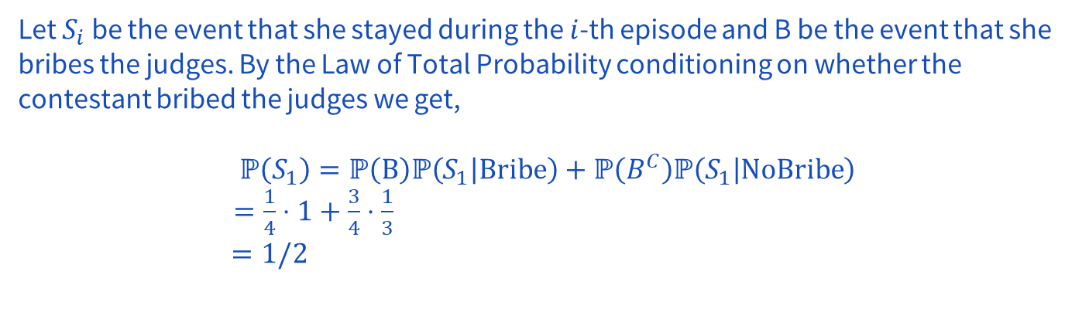
4 – Game Show
If you pick a random contestant, what is the probability that she is allowed to stay during the first episode?

Slide 42
4 – Game Show
If you pick a random contestant, what is the probability that she is allowed to stay during both episodes?

Slide 43
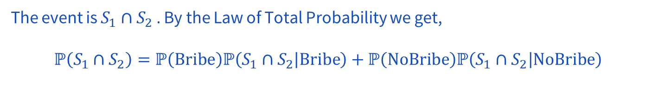
4 – Game Show
If you pick a random contestant, what is the probability that she is allowed to stay during both episodes?

Slide 44
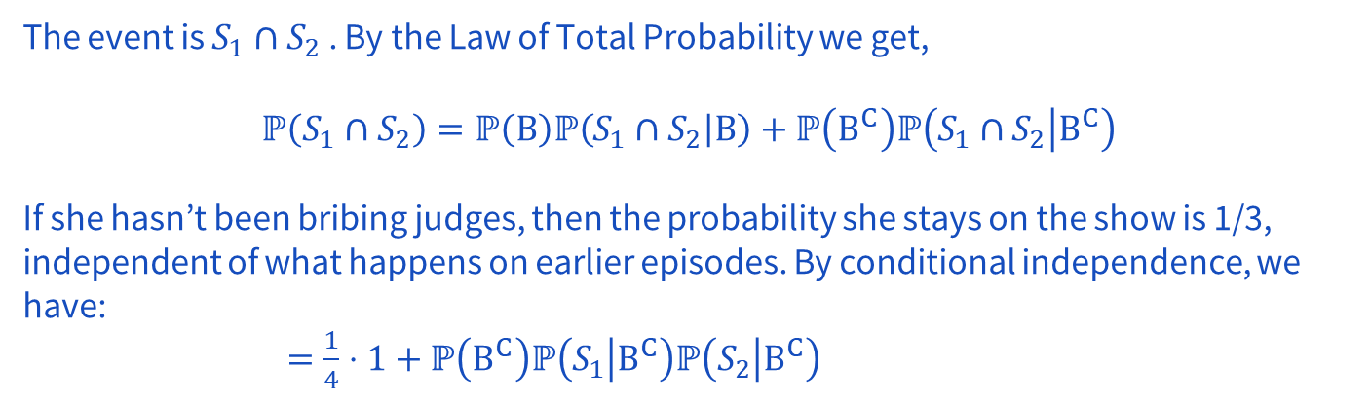
4 – Game Show
If you pick a random contestant, what is the probability that she is allowed to stay during both episodes?

Slide 45
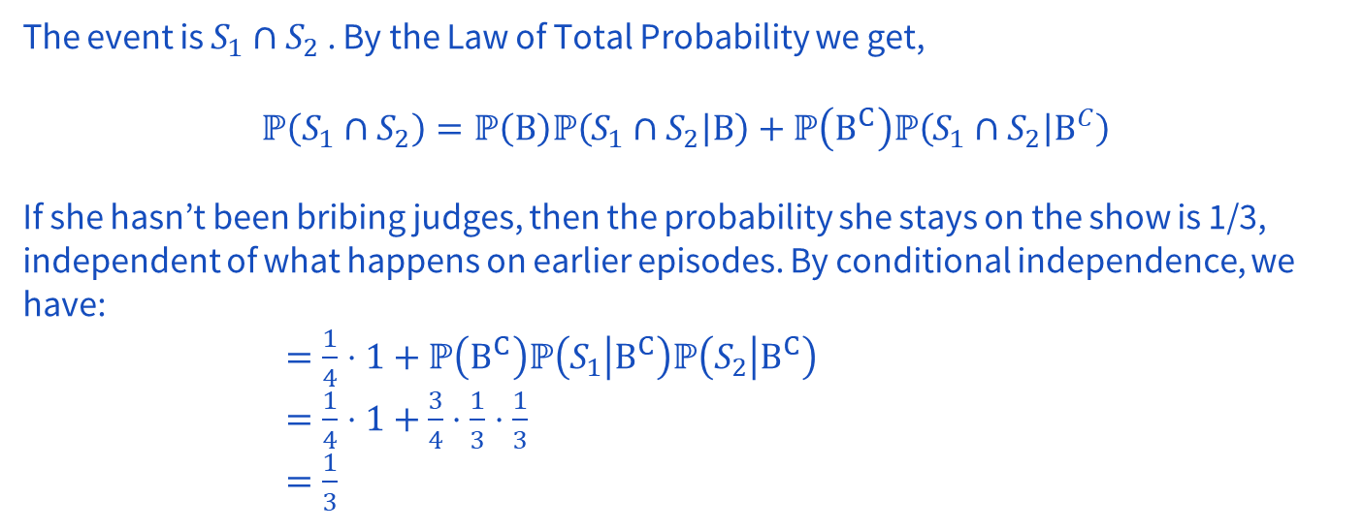
4 – Game Show
If you pick a random contestant, what is the probability that she is allowed to stay during both episodes?

Slide 46
4 – Game Show
If you pick a random contestant who was allowed to stay during the first episode, what is the probability that she gets kicked off during the second episode?

Slide 47
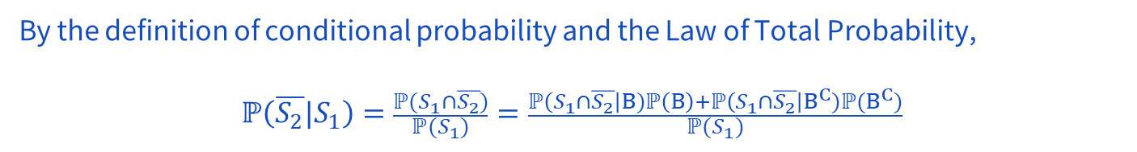
4 – Game Show
If you pick a random contestant who was allowed to stay during the first episode, what is the probability that she gets kicked off during the second episode?

Slide 48
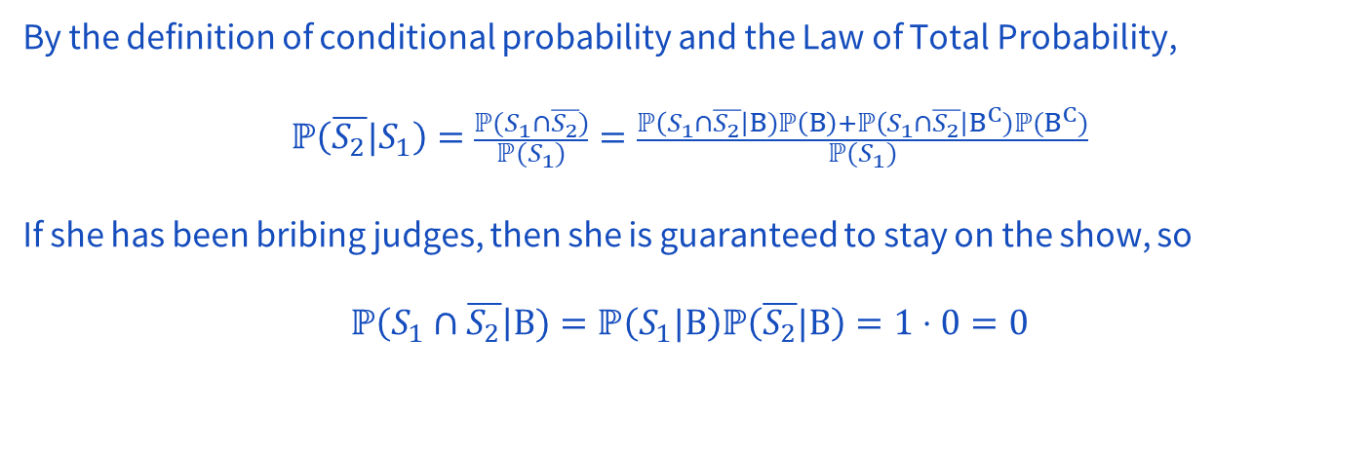
4 – Game Show
If you pick a random contestant who was allowed to stay during the first episode, what is the probability that she gets kicked off during the second episode?

Slide 49
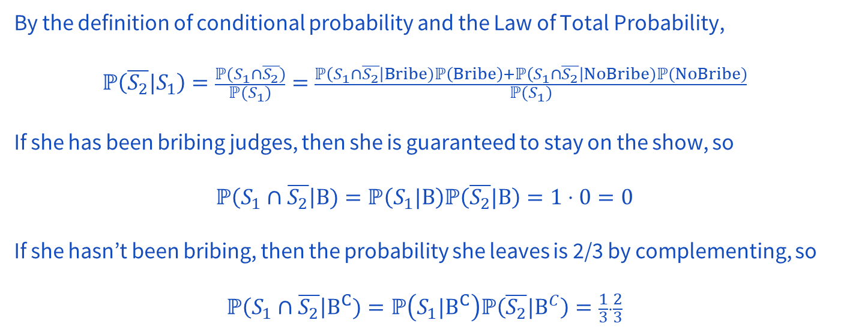
4 – Game Show
If you pick a random contestant who was allowed to stay during the first episode, what is the probability that she gets kicked off during the second episode?

Slide 50
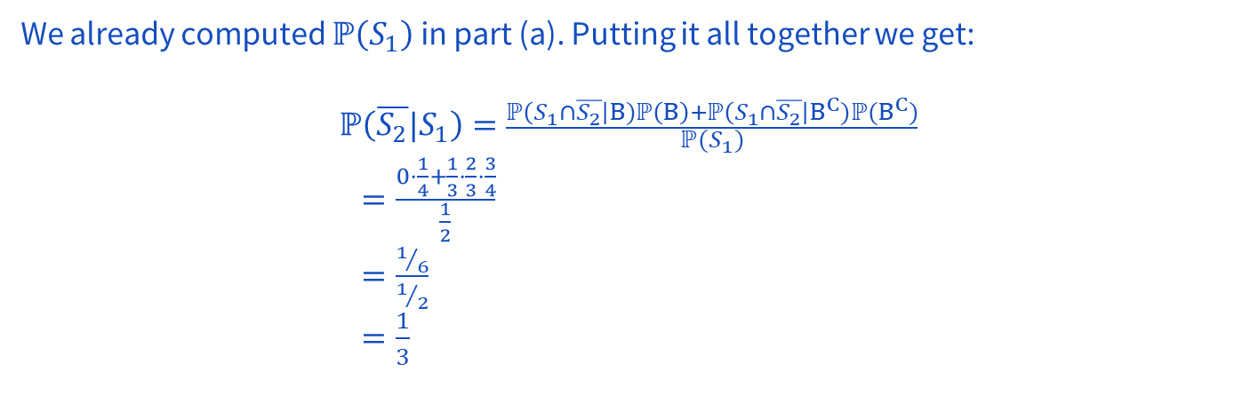
4 – Game Show
If you pick a random contestant who was allowed to stay during the first episode, what is the probability that she gets kicked off during the second episode?

Slide 51
4 – Game Show
If you pick a random contestant who was allowed to stay during the first episode, what is the probability that she was bribing the judges?

Slide 52
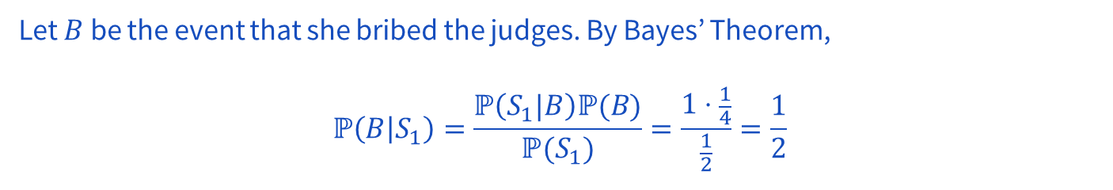
4 – Game Show
If you pick a random contestant who was allowed to stay during the first episode, what is the probability that she was bribing the judges?

Slide 53
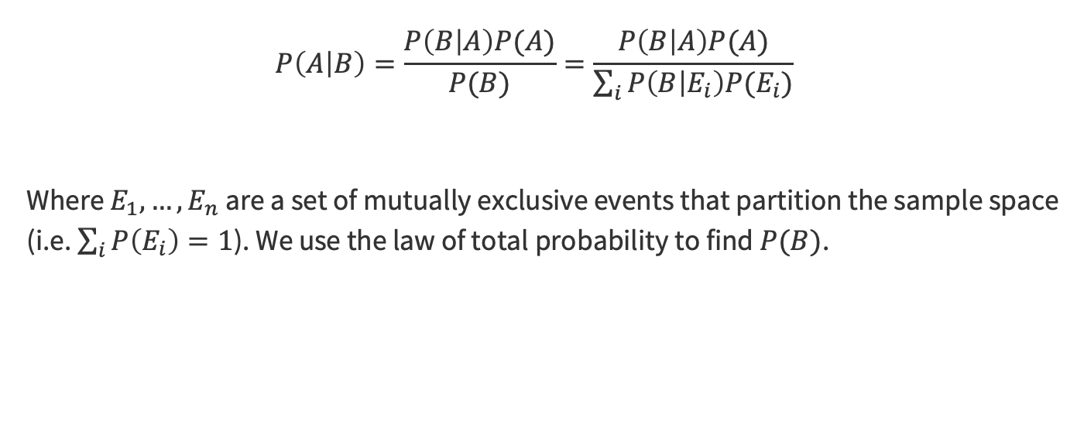
Bayes Theorem with Law of Total Probability

Slide 54
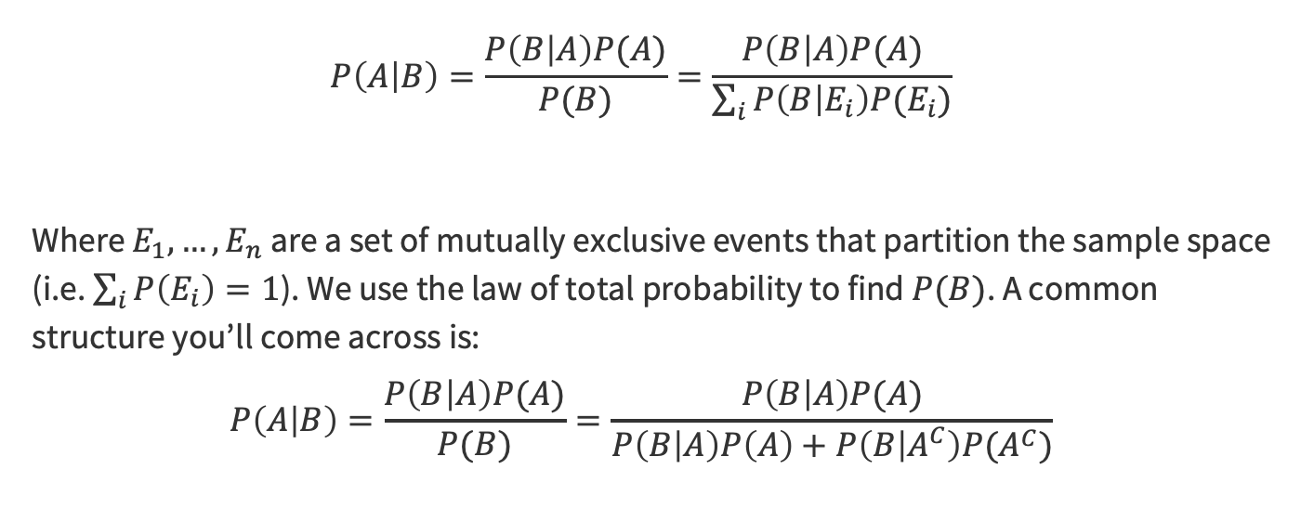
Bayes Theorem with Law of Total Probability

Slide 55
Problem 6 – Allergy Season

Slide 56
6 – Allergy Season
In a certain population, everyone is equally susceptible to colds. The number of colds suffered by each person during each winter season ranges from 0 to 4, with probability 0.2 for each value (see table below). A new cold prevention drug is introduced that, for people for whom the drug is effective, changes the probabilities as shown in the table. Unfortunately, the effects of the drug last only the duration of one winter season, and the drug is only effective in 20% of people, independently.
Number of colds | No drug / ineffective | Drug effective
0 | 0.2 | 0.4
1 | 0.2 | 0.3
2 | 0.2 | 0.2
3 | 0.2 | 0.1
4 | 0.2 | 0.0

Slide 57
6 – Allergy Season
Number of colds | No drug / ineffective | Drug effective
0 | 0.2 | 0.4
1 | 0.2 | 0.3
2 | 0.2 | 0.2
3 | 0.2 | 0.1
4 | 0.2 | 0.0
The drug is only effective in 20%
of people, independently.
Sneezy decides to take the drug. Given that he gets 1 cold that winter, what is the probability that the drug is effective for Sneezy?
The next year he takes the drug again. Given that he gets 2 colds in this winter, what is the updated probability that the drug is effective for Sneezy?
Why is the answer to (b) the same as the answer to (a)?
Work on this problem with the people around you, and then we’ll go over it together!

Slide 58
6 – Allergy Season
Number of colds | No drug / ineffective | Drug effective
0 | 0.2 | 0.4
1 | 0.2 | 0.3
2 | 0.2 | 0.2
3 | 0.2 | 0.1
4 | 0.2 | 0.0
Sneezy decides to take the drug. Given that he gets 1 cold that winter, what is the probability that the drug is effective for Sneezy?

Slide 59
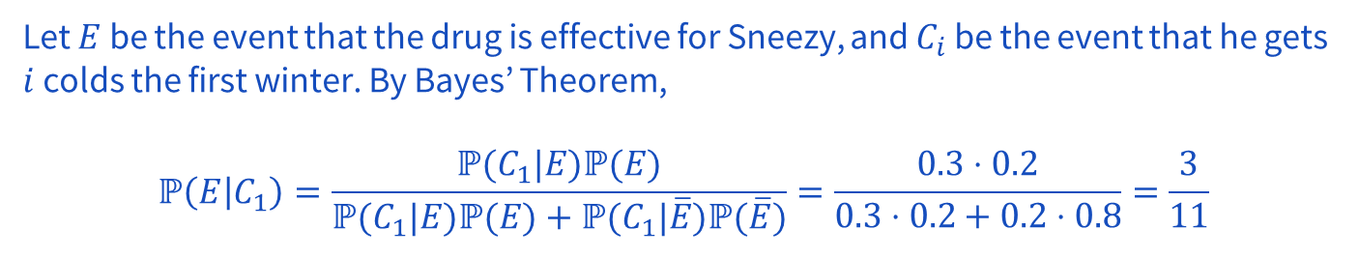
6 – Allergy Season
Number of colds | No drug / ineffective | Drug effective
0 | 0.2 | 0.4
1 | 0.2 | 0.3
2 | 0.2 | 0.2
3 | 0.2 | 0.1
4 | 0.2 | 0.0
Sneezy decides to take the drug. Given that he gets 1 cold that winter, what is the probability that the drug is effective for Sneezy?

Slide 60
6 – Allergy Season
Number of colds | No drug / ineffective | Drug effective
0 | 0.2 | 0.4
1 | 0.2 | 0.3
2 | 0.2 | 0.2
3 | 0.2 | 0.1
4 | 0.2 | 0.0
The next year he takes the drug again. Given that he gets 2 colds in this winter, what is the updated probability that the drug is effective for Sneezy?

Slide 61
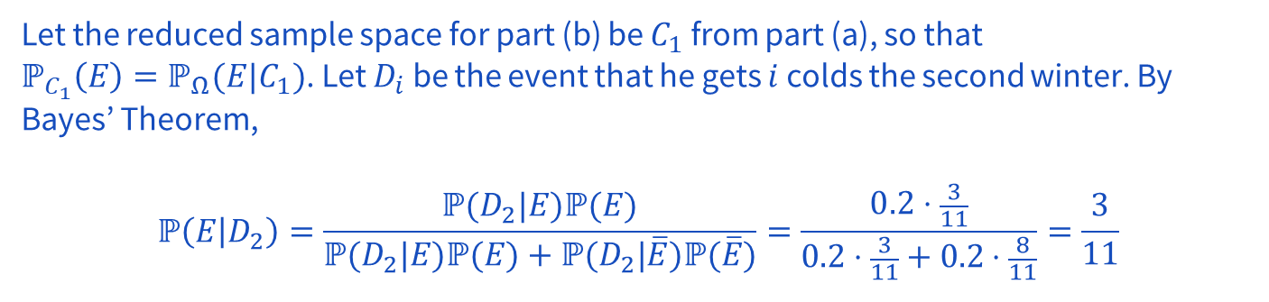
6 – Allergy Season
Number of colds | No drug / ineffective | Drug effective
0 | 0.2 | 0.4
1 | 0.2 | 0.3
2 | 0.2 | 0.2
3 | 0.2 | 0.1
4 | 0.2 | 0.0
The next year he takes the drug again. Given that he gets 2 colds in this winter, what is the updated probability that the drug is effective for Sneezy?

Slide 62
6 – Allergy Season
Number of colds | No drug / ineffective | Drug effective
0 | 0.2 | 0.4
1 | 0.2 | 0.3
2 | 0.2 | 0.2
3 | 0.2 | 0.1
4 | 0.2 | 0.0
Why is the answer to (b) the same as the answer to (a)?

Slide 63
6 – Allergy Season
Number of colds | No drug / ineffective | Drug effective
0 | 0.2 | 0.4
1 | 0.2 | 0.3
2 | 0.2 | 0.2
3 | 0.2 | 0.1
4 | 0.2 | 0.0
Why is the answer to (b) the same as the answer to (a)?
The probability of two colds whether or not the drug was effective is the same. Hence knowing that Sneezy got two colds does not change the probability of the drug’s effectiveness.

Slide 64
Problem 3 – Marbles in Pockets

Slide 65
3 – Marbles in Pockets
Aleks has 5 blue and 3 white marbles in her left pocket, and 4 blue and 4 white marbles in her right pocket. If he transfers a randomly chosen marble from left pocket to right pocket without looking, and then draws a randomly chosen marble from her right pocket, what is the probability that it is blue?
Work on this problem with the people around you, and then we’ll go over it together!

Slide 66
3 – Marbles in Pockets
Aleks has 5 blue and 3 white marbles in her left pocket, and 4 blue and 4 white marbles in her right pocket. If he transfers a randomly chosen marble from left pocket to right pocket without looking, and then draws a randomly chosen marble from her right pocket, what is the probability that it is blue?

Slide 67
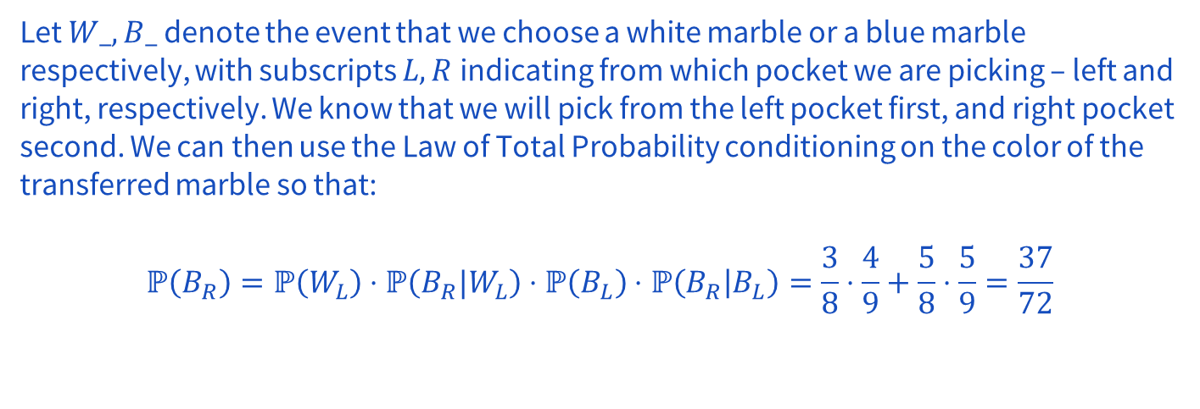
3 – Marbles in Pockets
Aleks has 5 blue and 3 white marbles in her left pocket, and 4 blue and 4 white marbles in her right pocket. If he transfers a randomly chosen marble from left pocket to right pocket without looking, and then draws a randomly chosen marble from her right pocket, what is the probability that it is blue?

Slide 68
Problem 7 – A Game

Slide 69
7 – A Game
Howard and Jerome are playing the following game: A 6-sided die is thrown and each time it’s thrown, regardless of the history, it is equally likely to show any of the six numbers.
If it shows 5, Howard wins.
If it shows 1, 2, or 6, Jerome wins.
Otherwise, they play a second round and so on.
What is the probability that Jerome wins on the 4th round?
Work on this problem with the people around you, and then we’ll go over it together!

Slide 70
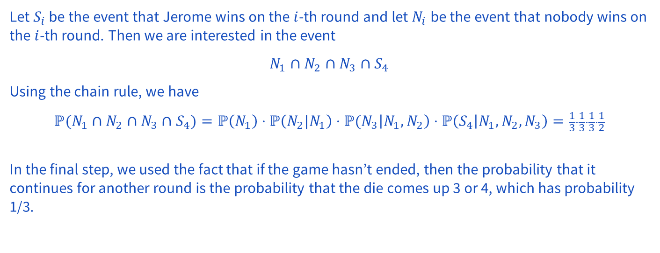
7 – A Game
Howard and Jerome are playing the following game: A 6-sided die is thrown and each time it’s thrown, regardless of the history, it is equally likely to show any of the six numbers.
If it shows 5, Howard wins. If it shows 1, 2, or 6, Jerome wins. Otherwise, they play a second round and so on. What is the probability that Jerome wins on the 4th round?

