Slide 1
CSE 312 Section 2
Intro to Discrete Probability

Slide 2
Administrivia

Slide 3
Announcements & Reminders
Office Hours
  Offered every day! Mostly in-person, a few zoom options
  Times posted on the calendar on the course website
HW1
  Was due yesterday, Wednesday 1/15 @ 11:59pm
  Late deadline Saturday 1/18 @ 11:59pm (max of 3 late days per homework)
HW2
  Released on the course website
  Due Wednesday 1/22 @ 11:59pm

Slide 4
Homework
Submissions
  LaTeX (highly encouraged)
    overleaf.com
    Many TAs are familiar with Overleaf and using LaTeX
  Word Editor that supports mathematical equations
  Handwritten neatly and scanned
Homework will typically be due on Wednesdays at 11:59pm on Gradescope
Each assignment can be submitted a max of 72 hours late
You have 6 late days total to use throughout the quarter
  Anything beyond that will result in a deduction on further late assignments

Slide 5
Feeling Stuck?
Many of the strategies you need to solve homework problems are usually practiced in section
For Homework 2, make sure to review Problems 2, 6, and 7 on the section handout today to practice combinatorics on the Pigeonhole Principle
There are many ways to get help! EdStem, office hours, lecture slides, etc.

Slide 6
Review

Slide 7
Any lingering questions from this last week?

Slide 8
Problem 7 - Dinner Party

Slide 9
7 – Dinner Party
At a dinner party, the n people present are to be seated uniformly spaced around a circular table. Suppose there is a nametag at each place at the table and suppose that nobody sits down at the correct place. Show that it is possible to rotate the table so that at least two people are sitting in the correct place.
Work on this problem with the people around you, and then we’ll go over it together!

Slide 10
7 – Dinner Party
At a dinner party, the n people present are to be seated uniformly spaced around a circular table. Suppose there is a nametag at each place at the table and suppose that nobody sits down at the correct place. Show that it is possible to rotate the table so that at least two people are sitting in the correct place.
For i = 1, ..., n, let r_{i} be the number of rotations clockwise needed for the ith person to be in their spot.

Slide 11
7 – Dinner Party
At a dinner party, the n people present are to be seated uniformly spaced around a circular table. Suppose there is a nametag at each place at the table and suppose that nobody sits down at the correct place. Show that it is possible to rotate the table so that at least two people are sitting in the correct place.
For i = 1, ..., n, let r_{i} be the number of rotations clockwise needed for the ith person to be in their spot.
Each r_{i} can be between 1 and n − 1 (not 0 since no one is at their nametag, and not n since it is equivalent to 0). Since there are n people and only n − 1 possible values for the rotations, at least two must have the same value by the pigeonhole principle.

Slide 12
7 – Dinner Party
At a dinner party, the n people present are to be seated uniformly spaced around a circular table. Suppose there is a nametag at each place at the table and suppose that nobody sits down at the correct place. Show that it is possible to rotate the table so that at least two people are sitting in the correct place.
For i = 1, ..., n, let r_{i} be the number of rotations clockwise needed for the ith person to be in their spot.
Each r_{i} can be between 1 and n − 1 (not 0 since no one is at their nametag, and not n since it is equivalent to 0). Since there are n people and only n − 1 possible values for the rotations, at least two must have the same value by the pigeonhole principle.
Rotate the table clockwise by that much, and at least two people will be in the correct place!

Slide 13
Problem 10 – Balls from an Urn

Slide 14
10 – Balls from an Urn
Say an urn contains one red ball, one blue ball, and one green ball. (Other than for their colors, balls are identical.) Imagine we draw two balls with replacement, i.e., after drawing one ball, with put it back into the urn, before we draw the second one. (In particular, each ball is equally likely to be drawn.)
Give a probability space describing the experiment.
What is the probability that both balls are red? (Describe the event first, before you compute its probability.)
What is the probability that at most one ball is red?
What is the probability that we get at least one green ball?
Repeat a)-d) for the case where the balls are drawn without replacement, i.e., when the first ball is drawn, it is not placed back from the urn.
Work on this problem with the people around you, and then we’ll go over it together!

Slide 15
10 – Balls from an Urn
An urn contains one red ball, one blue ball, and one green ball. Draw two balls with replacement.
Give a probability space describing the experiment.

Slide 16
10 – Balls from an Urn
An urn contains one red ball, one blue ball, and one green ball. Draw two balls with replacement.
Give a probability space describing the experiment.

Slide 17
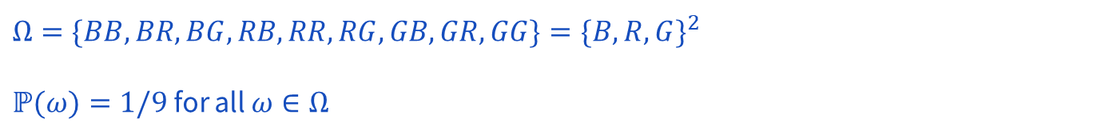
10 – Balls from an Urn
An urn contains one red ball, one blue ball, and one green ball. Draw two balls with replacement.
Give a probability space describing the experiment.

Slide 18
10 – Balls from an Urn
An urn contains one red ball, one blue ball, and one green ball. Draw two balls with replacement.
What is the probability that both balls are red? (Describe the event first, before you compute its probability.)

Slide 19
10 – Balls from an Urn
An urn contains one red ball, one blue ball, and one green ball. Draw two balls with replacement.
What is the probability that both balls are red? (Describe the event first, before you compute its probability.)

Slide 20
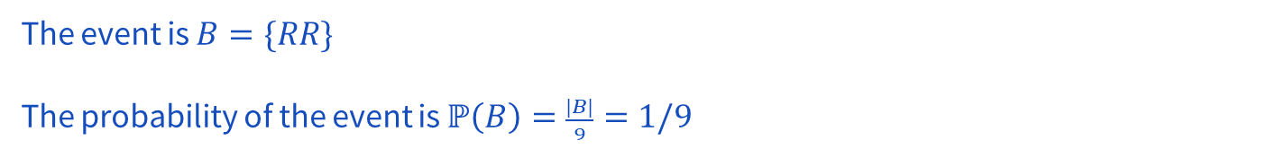
10 – Balls from an Urn
An urn contains one red ball, one blue ball, and one green ball. Draw two balls with replacement.
What is the probability that both balls are red? (Describe the event first, before you compute its probability.)

Slide 21
10 – Balls from an Urn
An urn contains one red ball, one blue ball, and one green ball. Draw two balls with replacement.
What is the probability that at most one ball is red?

Slide 22
10 – Balls from an Urn
An urn contains one red ball, one blue ball, and one green ball. Draw two balls with replacement.
What is the probability that at most one ball is red?

Slide 23
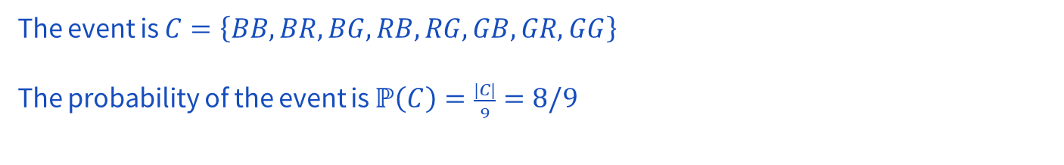
10 – Balls from an Urn
An urn contains one red ball, one blue ball, and one green ball. Draw two balls with replacement.
What is the probability that at most one ball is red?

Slide 24
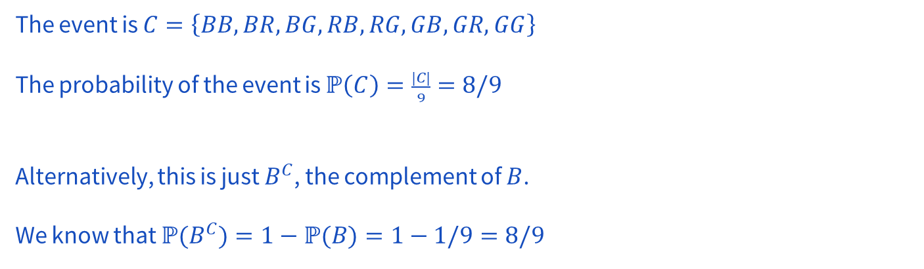
10 – Balls from an Urn
An urn contains one red ball, one blue ball, and one green ball. Draw two balls with replacement.
What is the probability that at most one ball is red?

Slide 25
10 – Balls from an Urn
An urn contains one red ball, one blue ball, and one green ball. Draw two balls with replacement.
What is the probability that we get at least one green ball?

Slide 26
10 – Balls from an Urn
An urn contains one red ball, one blue ball, and one green ball. Draw two balls with replacement.
What is the probability that we get at least one green ball?

Slide 27
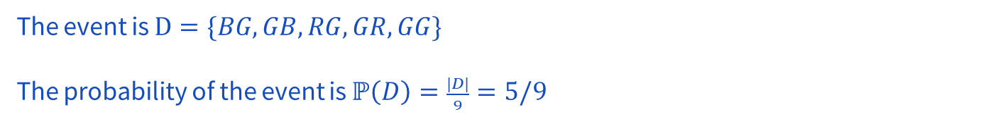
10 – Balls from an Urn
An urn contains one red ball, one blue ball, and one green ball. Draw two balls with replacement.
What is the probability that we get at least one green ball?

Slide 28
10 – Balls from an Urn
An urn contains one red ball, one blue ball, and one green ball.
Repeat b)-d) for the case where the balls are drawn without replacement.
a) Does the probability space change? If so, what is it now?
b) What is the probability that both balls are red?
c) What is the probability that at most one ball is red?
d) What is the probability that we get at least one green ball?

Slide 29
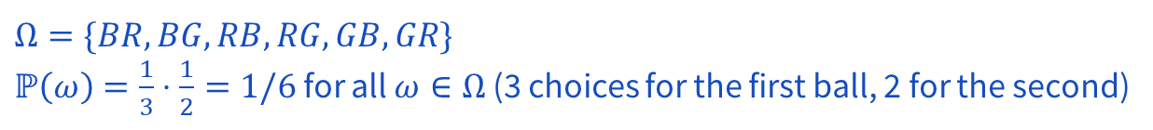
10 – Balls from an Urn
An urn contains one red ball, one blue ball, and one green ball.
Repeat b)-d) for the case where the balls are drawn without replacement.
a) Does the probability space change? If so, what is it now?
b) What is the probability that both balls are red?
c) What is the probability that at most one ball is red?
d) What is the probability that we get at least one green ball?

Slide 30
10 – Balls from an Urn
An urn contains one red ball, one blue ball, and one green ball.
Repeat b)-d) for the case where the balls are drawn without replacement.
a) Does the probability space change? If so, what is it now?
b) What is the probability that both balls are red?
c) What is the probability that at most one ball is red?
d) What is the probability that we get at least one green ball?

Slide 31
10 – Balls from an Urn
An urn contains one red ball, one blue ball, and one green ball.
Repeat b)-d) for the case where the balls are drawn without replacement.
a) Does the probability space change? If so, what is it now?
b) What is the probability that both balls are red?
c) What is the probability that at most one ball is red?
d) What is the probability that we get at least one green ball?

Slide 32
10 – Balls from an Urn
An urn contains one red ball, one blue ball, and one green ball.
Repeat b)-d) for the case where the balls are drawn without replacement.
a) Does the probability space change? If so, what is it now?
b) What is the probability that both balls are red?
c) What is the probability that at most one ball is red?
d) What is the probability that we get at least one green ball?

Slide 33
Problem 12 – Shuffling Cards

Slide 34
12 – Shuffling Cards
We have a deck of cards, with 4 suits, with 13 cards in each. Within each suit, the cards are ordered Ace > King > Queen > Jack > 10 > · · · > 2. Also, suppose we perfectly shuffle the deck (i.e., all possible shuffles are equally likely). What is the probability the first card on the deck is (strictly) larger than the second one?
Work on this problem with the people around you, and then we’ll go over it together!

Slide 35
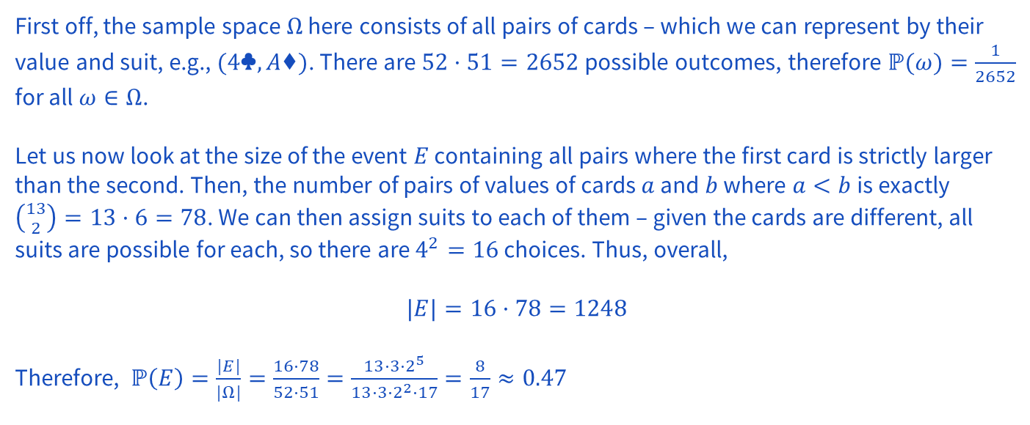
12 – Shuffling Cards
We have a deck of cards, with 4 suits, with 13 cards in each. Within each suit, the cards are ordered Ace > King > Queen > Jack > 10 > · · · > 2. Also, suppose we perfectly shuffle the deck (i.e., all possible shuffles are equally likely). What is the probability the first card on the deck is (strictly) larger than the second one?

Slide 36
Problem 11 – Weighted Die

Slide 37
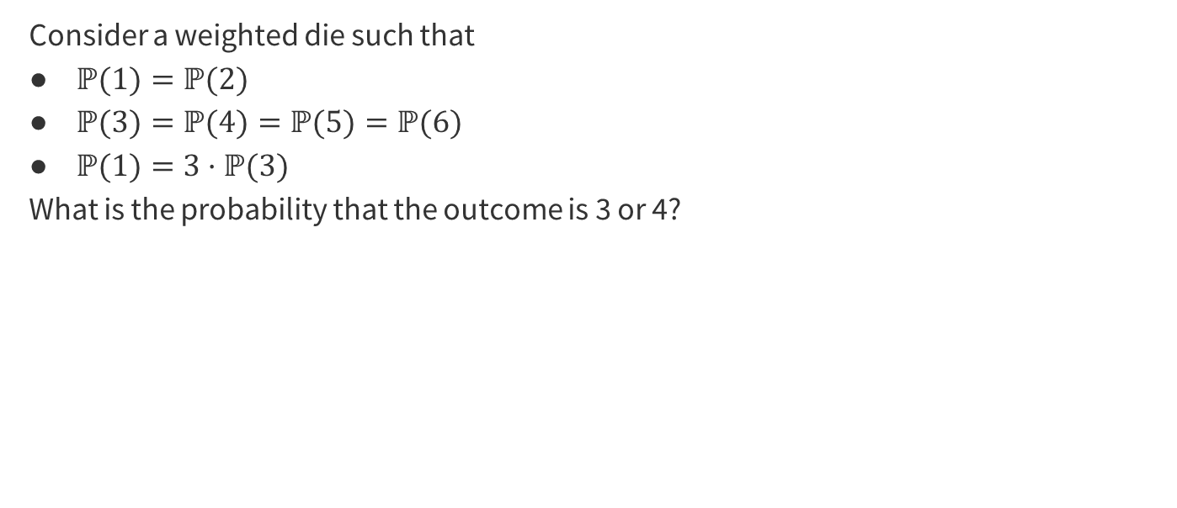
11 – Weighted Die
Work on this problem with the people around you, and then we’ll go over it together!

Slide 38
11 – Weighted Die

Slide 39
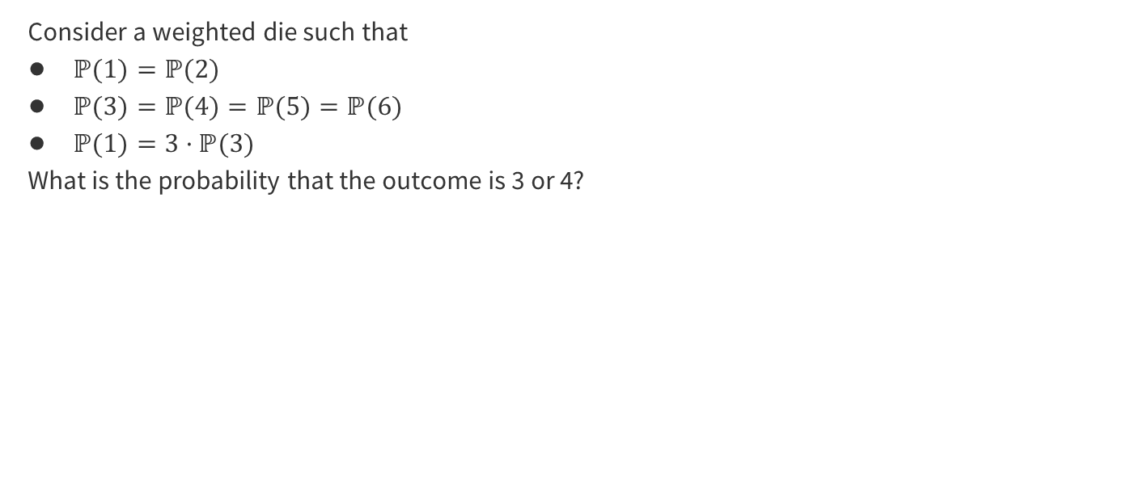
11 – Weighted Die
By the second axiom of probability, the sum of probabilities for the sample space must equal 1.

Slide 40
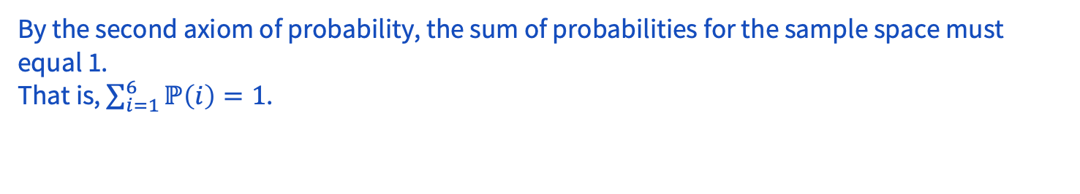
11 – Weighted Die

Slide 41
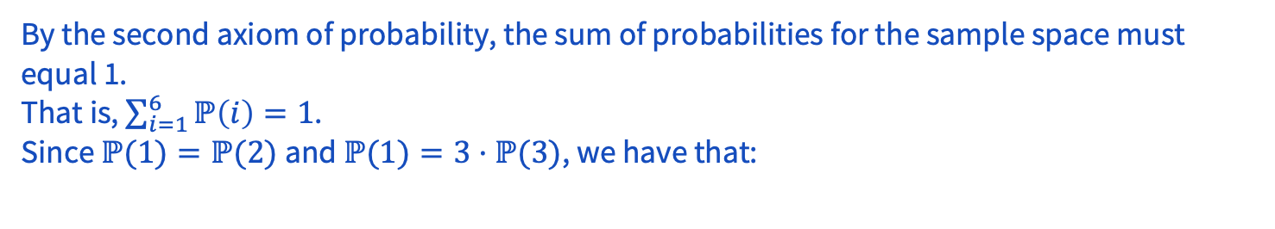
11 – Weighted Die

Slide 42
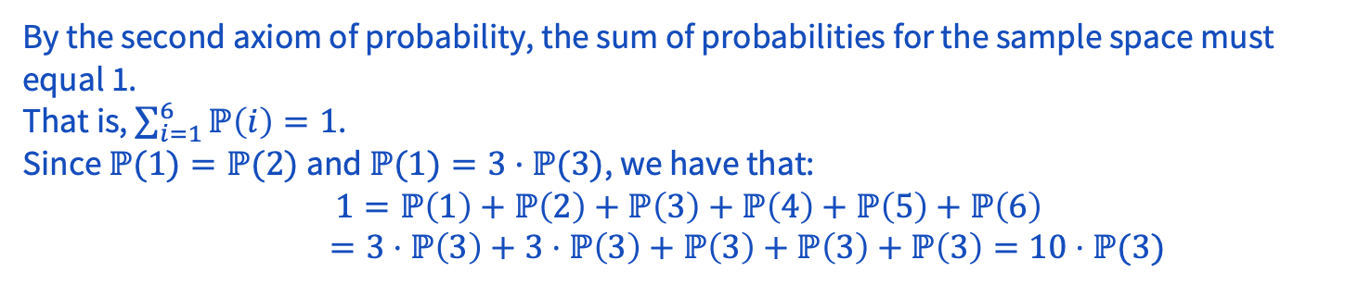
11 – Weighted Die

Slide 43
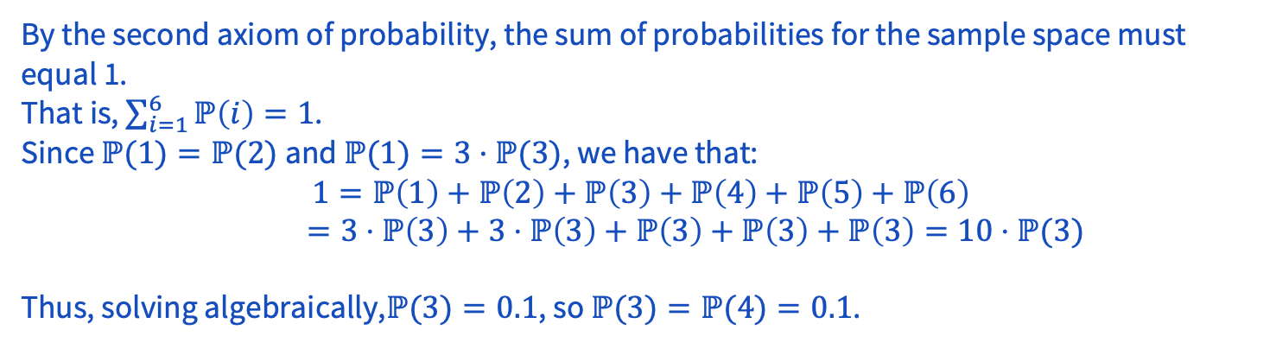
11 – Weighted Die

Slide 44
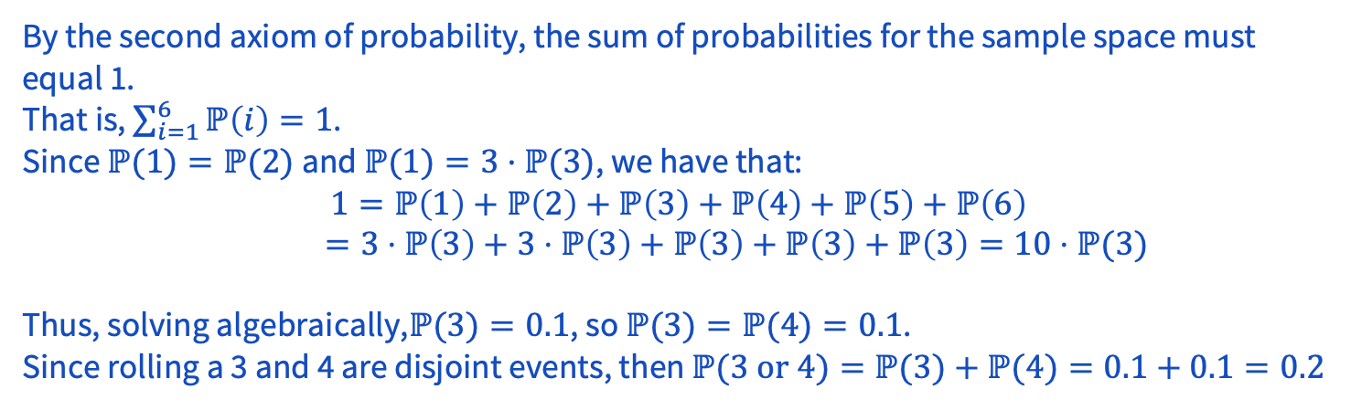
11 – Weighted Die

Slide 45
Problem 2 - Subsubset

Slide 46
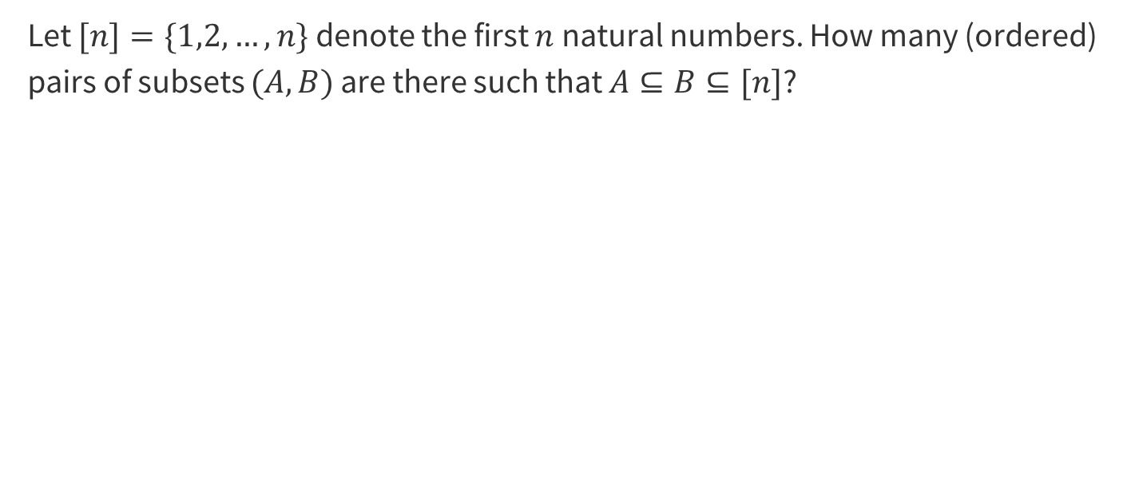
2 – Subsubset
Work on this problem with the people around you, and then we’ll go over it together!

Slide 47
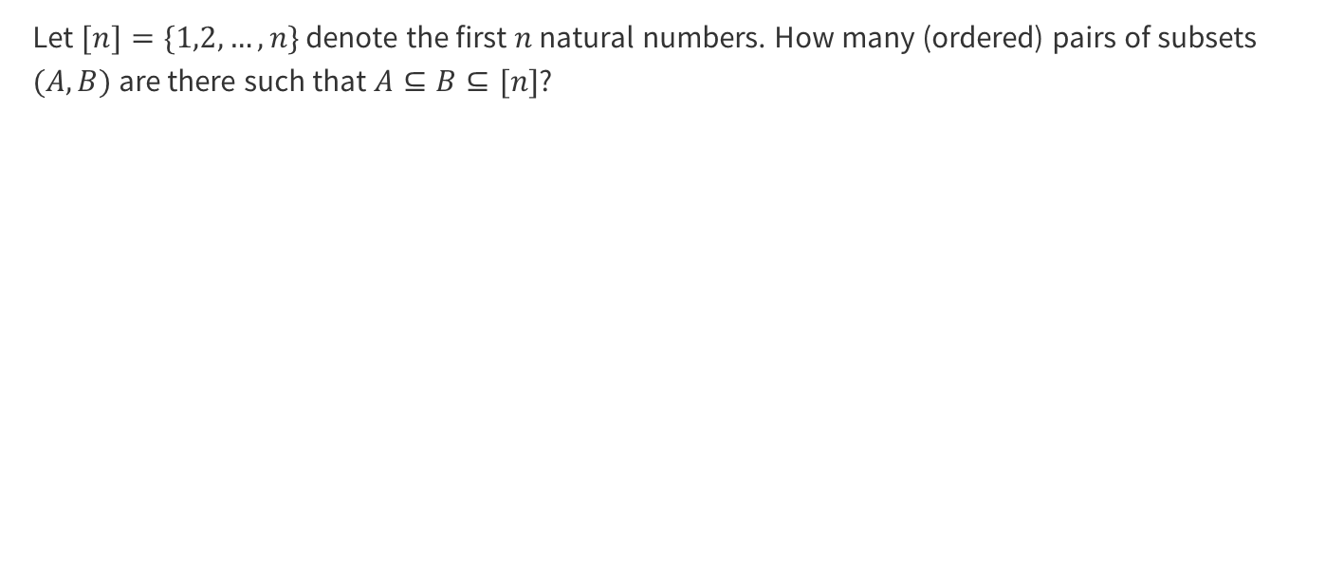
2 – Subsubset

Slide 48
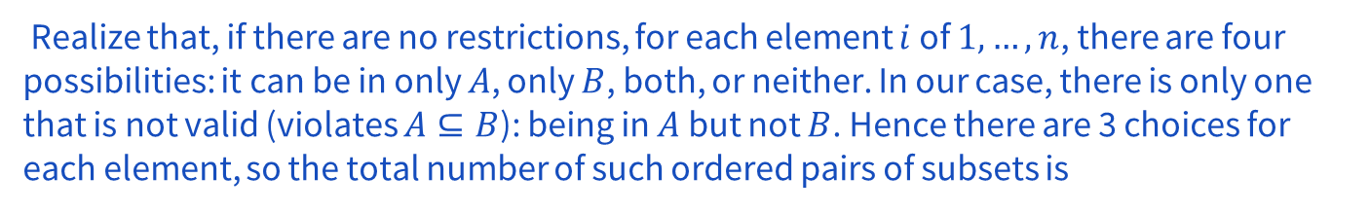
2 – Subsubset

Slide 49
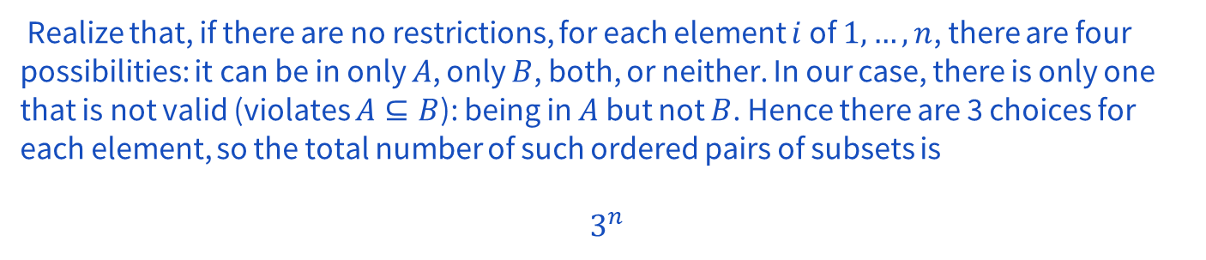
2 – Subsubset

Slide 50
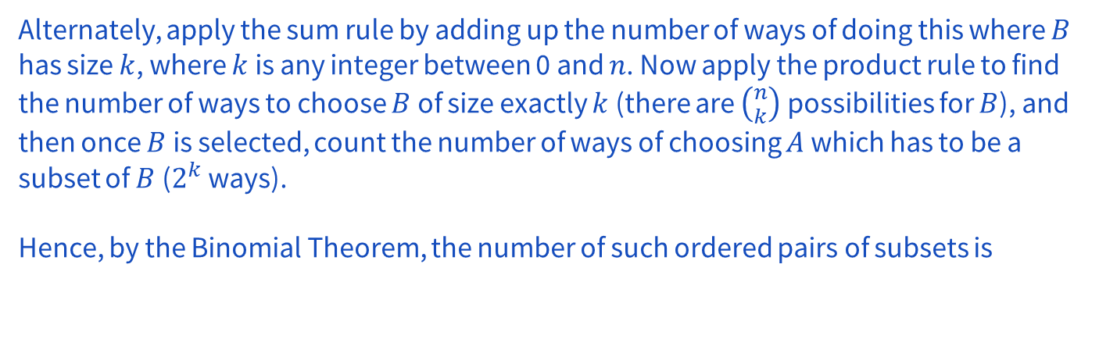
2 – Subsubset

Slide 51
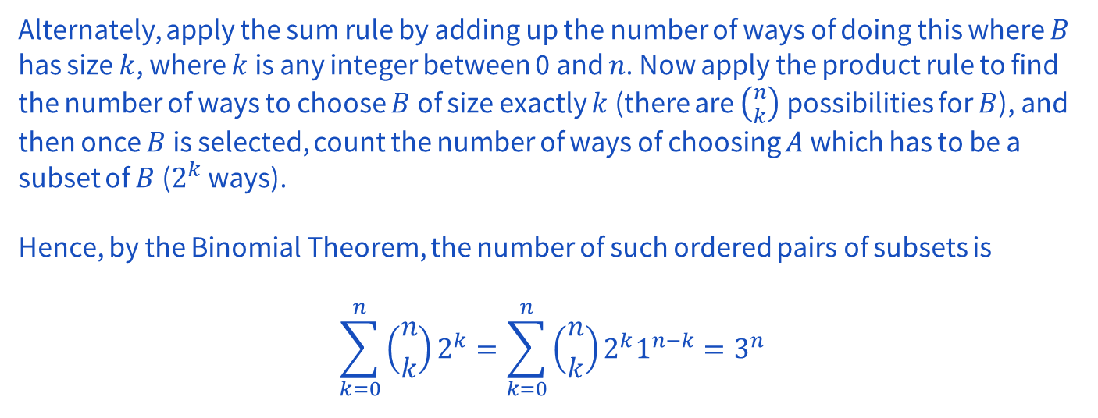
2 – Subsubset

Slide 52
Problem 4 – GREED INNIT

Slide 53
4 – GREED INNIT
Find the number of ways to rearrange the word “INGREDIENT”, such that no two identical letters are adjacent to each other. For example, “INGREEDINT” is invalid because the two E’s are adjacent.
Repeat the question for the letters “AAAAABBB”.
Work on this problem with the people around you, and then we’ll go over it together!

Slide 54
4 – GREED INNIT
Find the number of ways to rearrange the word “INGREDIENT”, such that no two identical letters are adjacent to each other.

Slide 55
4 – GREED INNIT
Find the number of ways to rearrange the word “INGREDIENT”, such that no two identical letters are adjacent to each other.
We use inclusion-exclusion.

Slide 56
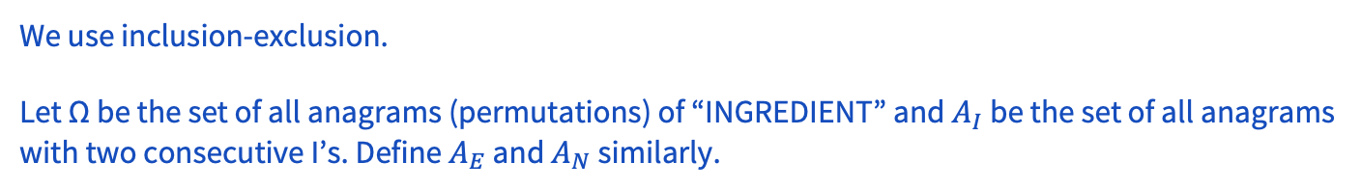
4 – GREED INNIT
Find the number of ways to rearrange the word “INGREDIENT”, such that no two identical letters are adjacent to each other.

Slide 57
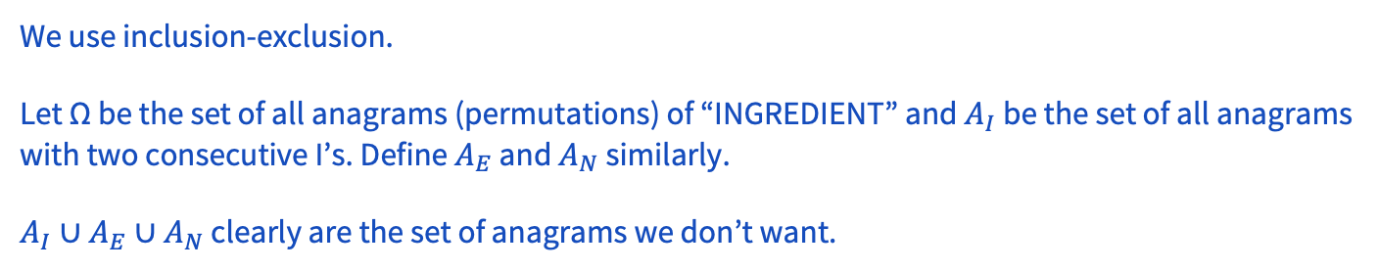
4 – GREED INNIT
Find the number of ways to rearrange the word “INGREDIENT”, such that no two identical letters are adjacent to each other.

Slide 58
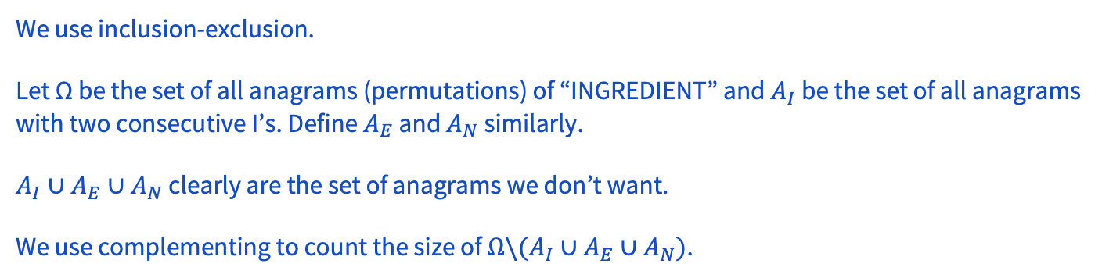
4 – GREED INNIT
Find the number of ways to rearrange the word “INGREDIENT”, such that no two identical letters are adjacent to each other.

Slide 59
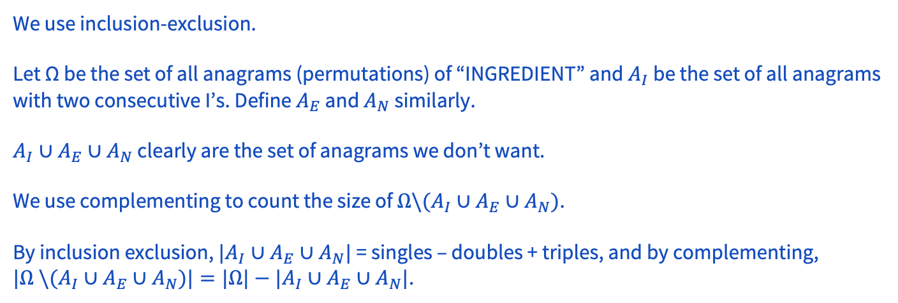
4 – GREED INNIT
Find the number of ways to rearrange the word “INGREDIENT”, such that no two identical letters are adjacent to each other.

Slide 60
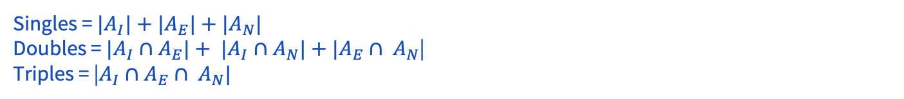
4 – GREED INNIT
Find the number of ways to rearrange the word “INGREDIENT”, such that no two identical letters are adjacent to each other.

Slide 61
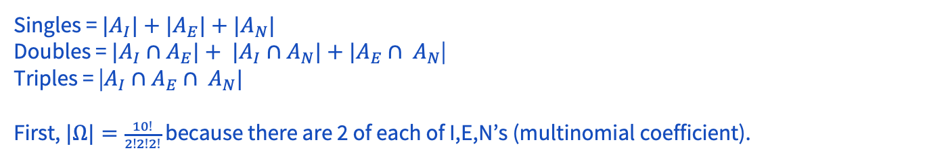
4 – GREED INNIT
Find the number of ways to rearrange the word “INGREDIENT”, such that no two identical letters are adjacent to each other.

Slide 62
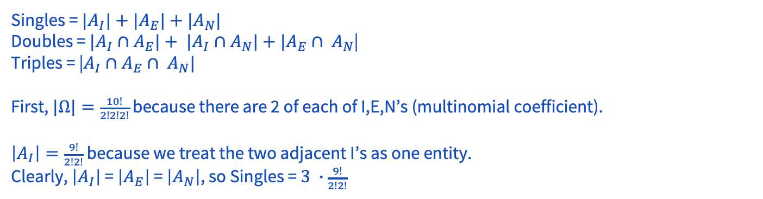
4 – GREED INNIT
Find the number of ways to rearrange the word “INGREDIENT”, such that no two identical letters are adjacent to each other.

Slide 63
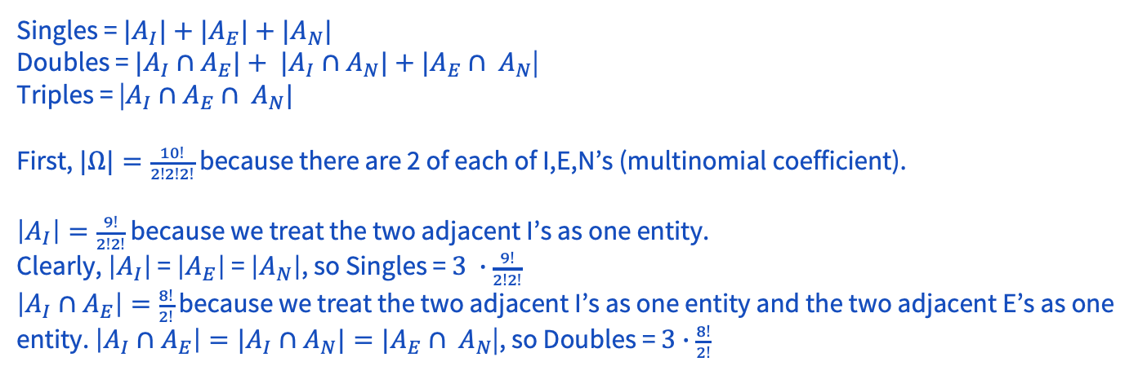
4 – GREED INNIT
Find the number of ways to rearrange the word “INGREDIENT”, such that no two identical letters are adjacent to each other.

Slide 64
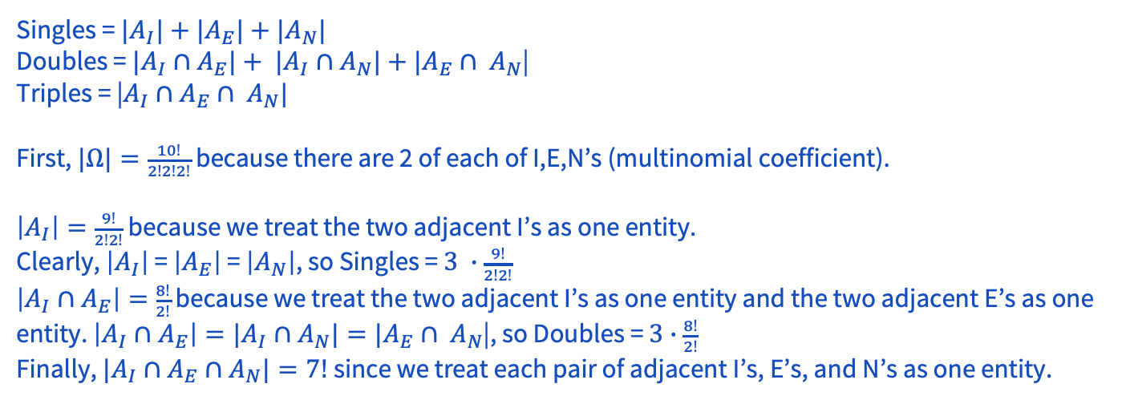
4 – GREED INNIT
Find the number of ways to rearrange the word “INGREDIENT”, such that no two identical letters are adjacent to each other.

Slide 65
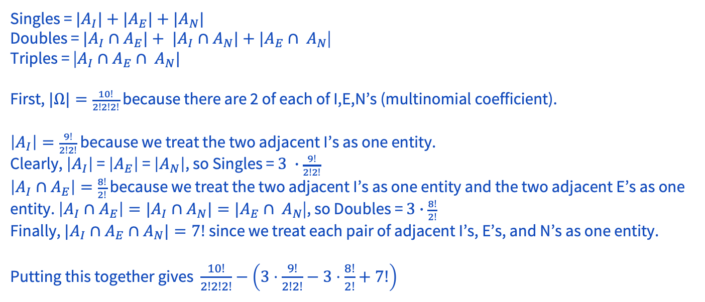
4 – GREED INNIT
Find the number of ways to rearrange the word “INGREDIENT”, such that no two identical letters are adjacent to each other.

Slide 66
4 – GREED INNIT
Repeat the question for the letters “AAAAABBB”.

Slide 67
4 – GREED INNIT
Repeat the question for the letters “AAAAABBB”.
Note that no A’s and no B’s can be adjacent. So let us put the B’s down first:
_B_B_B_
By the pigeonhole principle, two A’s must go in the same slot, but then they would be adjacent, so there are no ways .

Slide 68
Problem 5 - Friendships

Slide 69
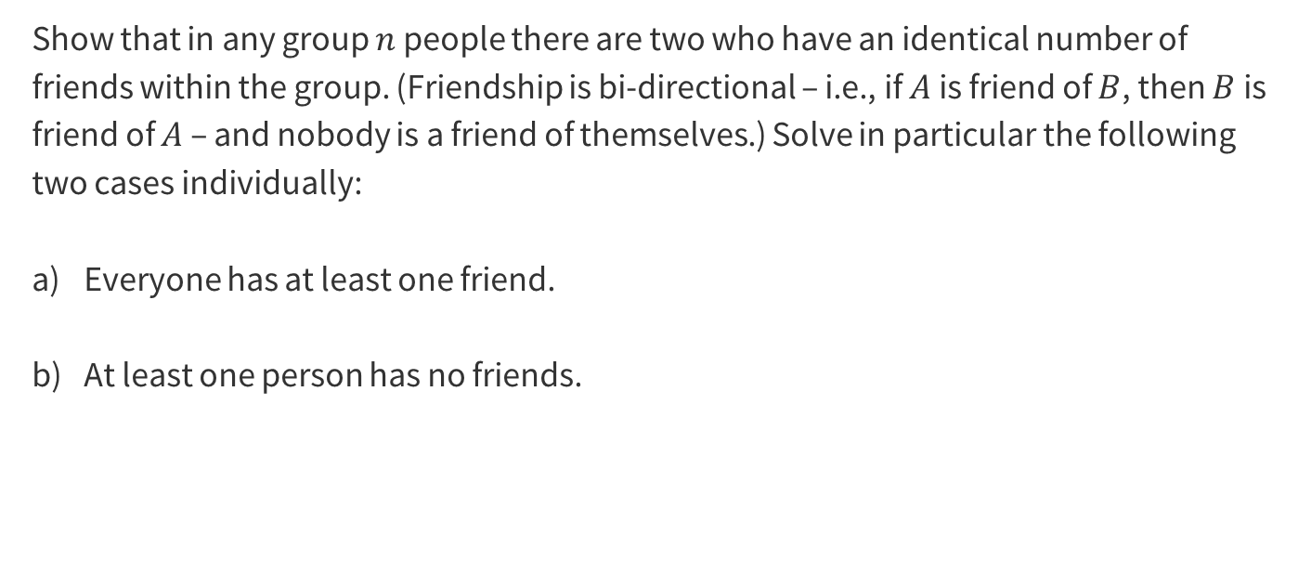
5 – Friendships
Work on this problem with the people around you, and then we’ll go over it together!

Slide 70
5 – Friendships
Everyone has at least one friend.

Slide 71
5 – Friendships
Everyone has at least one friend.

Slide 72
5 – Friendships
At least one person has no friends.

Slide 73
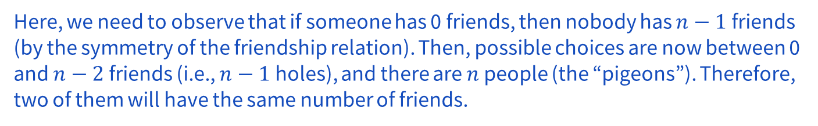
5 – Friendships
At least one person has no friends.

Slide 74
That’s All, Folks!
Thanks for coming to section this week!
Any questions?

Slide 75
Problem 6 – Powers and Divisibility

Slide 76
6 – Powers and Divisibility
Prove that there exist two powers of 7 whose difference is divisible by 2003. (You may want to use the Pigeonhole principle.)
Work on this problem with the people around you, and then we’ll go over it together!

Slide 77
6 – Powers and Divisibility
Prove that there exist two powers of 7 whose difference is divisible by 2003. (You may want to use the Pigeonhole principle.)
HINT: think about what are the pigeons, and what are the pigeonholes?
Work on this problem with the people around you, and then we’ll go over it together!

Slide 78
6 – Powers and Divisibility
Prove that there exist two powers of 7 whose difference is divisible by 2003. (You may want to use the Pigeonhole principle.)

Slide 79
6 – Powers and Divisibility
Prove that there exist two powers of 7 whose difference is divisible by 2003. (You may want to use the Pigeonhole principle.)
There are 2003 possible remainders of division by 2003 (0 through 2002).

Slide 80

6 – Powers and Divisibility
Prove that there exist two powers of 7 whose difference is divisible by 2003. (You may want to use the Pigeonhole principle.)

Slide 81
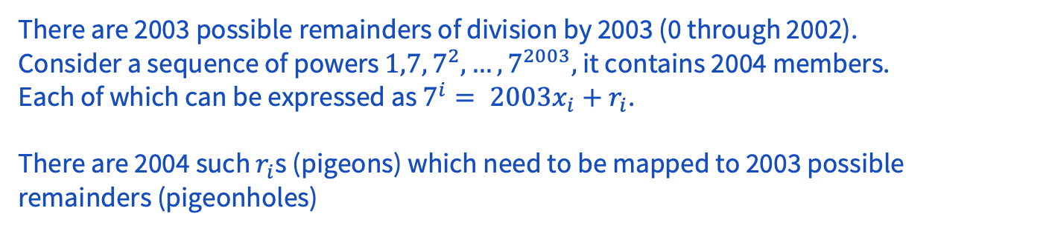
6 – Powers and Divisibility
Prove that there exist two powers of 7 whose difference is divisible by 2003. (You may want to use the Pigeonhole principle.)

Slide 82
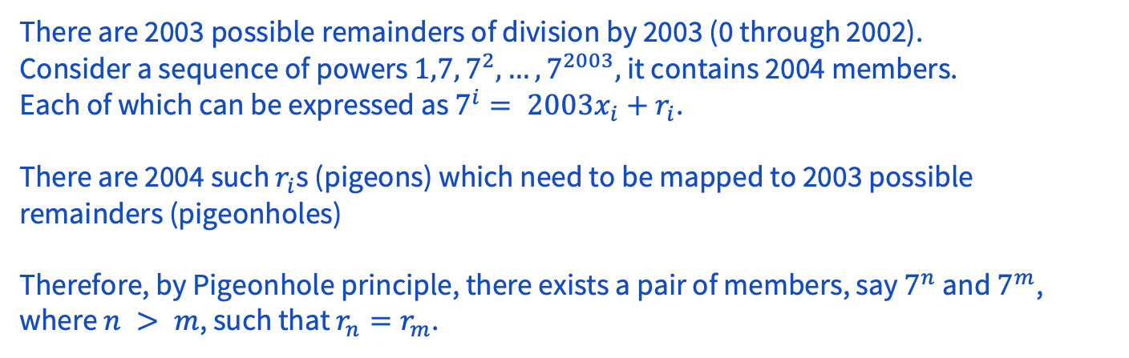
6 – Powers and Divisibility
Prove that there exist two powers of 7 whose difference is divisible by 2003. (You may want to use the Pigeonhole principle.)

Slide 83
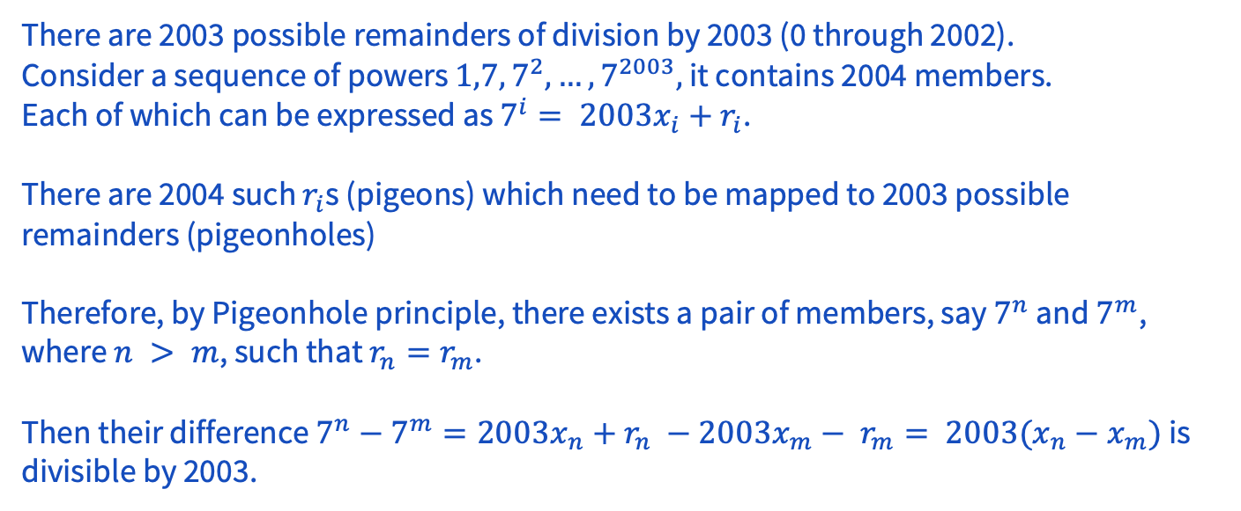
6 – Powers and Divisibility
Prove that there exist two powers of 7 whose difference is divisible by 2003. (You may want to use the Pigeonhole principle.)

