Slide 1
CSE 312 Section 1
Combinatorics

Slide 2
Administrivia & Introductions

Slide 3
Announcements & Reminders
Section Materials
  Handouts will be provided in at each section
  Worksheets and sample solutions will be available on the course calendar later this evening
Office Hours
  We’ll start hosting office hours Friday!
  Exact times and locations will be posted on the calendar on the course website
HW1
  Released yesterday!
  Due Wednesday, Jan 14th @ 11:59pm

Slide 4
Homework
Submissions
  LaTeX (highly encouraged)
    Parchment (easier-to-learn interface for subset of LaTeX)
    overleaf.com (full-power of LaTeX).
      Login through UW’s SSO for free Overleaf Premium!
    template and LaTeX guide posted on course website!
  Word Editor that supports mathematical equations
  Handwritten neatly and scanned
Homework will typically be due on Wednesdays at 11:59pm on Gradescope
Each assignment can be submitted a max of 72 hours late
You have 6 late days total to use throughout the quarter
  Anything beyond that will result in a 15% deduction per day

Slide 5
Your TAs
Ta 1
Ta 2

Slide 6
Our Office Hours
TA 1
  OH
TA 2
  OH

Slide 7
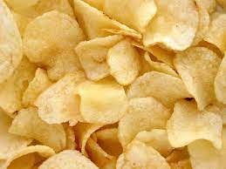
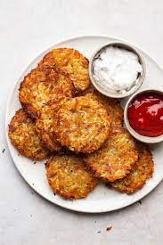
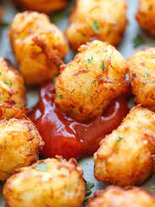
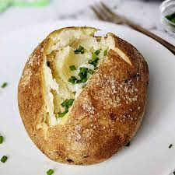
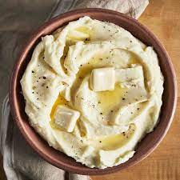

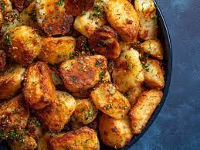
Icebreaker
Small groups of 4-6ish
Please share with your group
  Your name
  Number of years in department/ at UW
  What was something fun you did over Spring break?
  What are you concerned about for 312 / what are you excited about?
Then, share how you like to eat your potatoes (baked, fried, chips, etc)
We’ll go around and see what style of potato is most popular!

Slide 8
Review

Slide 9
Any lingering questions from this last week?
Each week in section, we’ll be reviewing the main concepts from this week by going through some practice problems together. But before that, we’ll try to start off each section with some time for you to ask questions.
Was anything particularly confusing this week? Is there anything we can clarify before we dive into the review? This is your chance to clear things up!

Slide 10
Problem 1 - Seating

Slide 11
1 – Seating
How many ways are there to seat 10 people, consisting of 5 couples, in a row of 10 seats if …
… all couples are to get adjacent seats?
… anyone can sit anywhere, except that one couple insists on not sitting in adjacent seats?
Work on this problem with the people around you, and then we’ll go over it together!

Slide 12
1 – Seating
How many ways are there to seat 10 people, consisting of 5 couples, in a row of 10 seats if all couples are to get adjacent seats?

Slide 13
1 – Seating
How many ways are there to seat 10 people, consisting of 5 couples, in a row of 10 seats if all couples are to get adjacent seats?
Consider each couple as a unit.

Slide 14
1 – Seating
How many ways are there to seat 10 people, consisting of 5 couples, in a row of 10 seats if all couples are to get adjacent seats?
Consider each couple as a unit.
Count the number of ways we can order the 5 couples in the row.

Slide 15
1 – Seating
How many ways are there to seat 10 people, consisting of 5 couples, in a row of 10 seats if all couples are to get adjacent seats?
Consider each couple as a unit.
Count the number of ways we can order the 5 couples in the row.
We can choose any one of the 5 couples for the first pair of seats, then any of the 4 remaining couples for the second pair of seats, then any of the 3 remaining couples for the third pair of seats, then one of the 2 remaining couples for the fourth pair of seats. The last couple must go into the last pair of seats.

Slide 16
1 – Seating
How many ways are there to seat 10 people, consisting of 5 couples, in a row of 10 seats if all couples are to get adjacent seats?
Consider each couple as a unit.
Count the number of ways we can order the 5 couples in the row.
We can choose any one of the 5 couples for the first pair of seats, then any of the 4 remaining couples for the second pair of seats, then any of the 3 remaining couples for the third pair of seats, then one of the 2 remaining couples for the fourth pair of seats. The last couple must go into the last pair of seats.
Applying the product rule, this gives us 5 · 4 · 3 · 2 · 1 options for ordering the couples.
Note that this equals 5 factorial, or 5! . We’ll go over factorials and counting sequences in lecture tomorrow

Slide 17
1 – Seating
How many ways are there to seat 10 people, consisting of 5 couples, in a row of 10 seats if all couples are to get adjacent seats?
Applying the product rule, this gives us 5 · 4 · 3 · 2 · 1 options for ordering the couples.
Now, apply the product rule to count the number of ways the people in each couple can be assigned to their seat pair. Each couple can be assigned to the seat pair in 2 different ways, and we have 5 couples, giving us 2⁵.
Use the product rule to combine the number of ways to order the couples with the number of ways to assign the people in the couple to their seats. Thus, the final answer is
5 · 4 · 3 · 2 · 1 · 2⁵
Or, more concisely,
5! · 2⁵

Slide 18
1 – Seating
How many ways are there to seat 10 people, consisting of 5 couples, in a row of 10 seats if anyone can sit anywhere, except that one couple insists on not sitting in adjacent seats?

Slide 19
1 – Seating
How many ways are there to seat 10 people, consisting of 5 couples, in a row of 10 seats if anyone can sit anywhere, except that one couple insists on not sitting in adjacent seats?
One way we can solve this is to consider by cases.
Name the two people in the couple A and B. There are two cases: A can sit on one of the ends, or not.

Slide 20
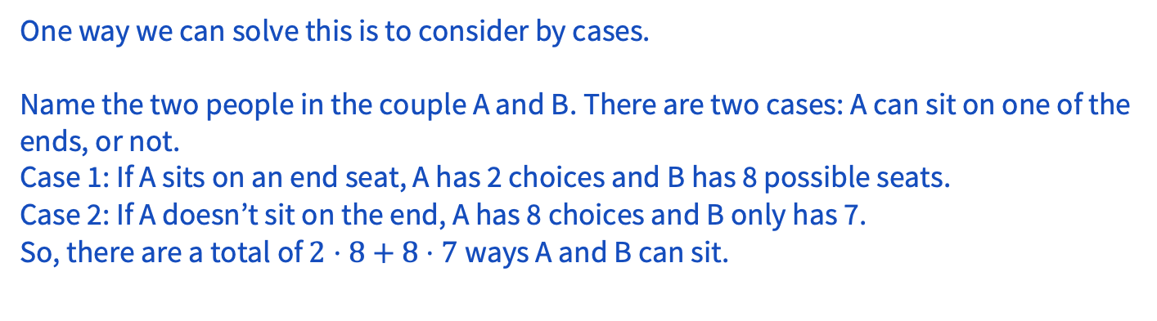
1 – Seating
How many ways are there to seat 10 people, consisting of 5 couples, in a row of 10 seats if anyone can sit anywhere, except that one couple insists on not sitting in adjacent seats?

Slide 21
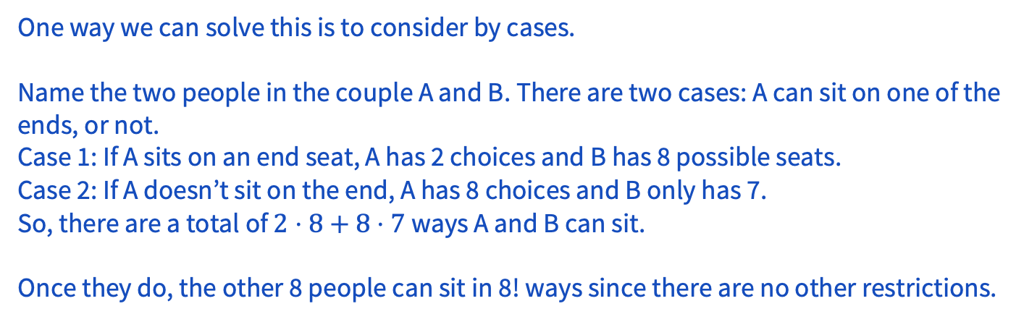
1 – Seating
How many ways are there to seat 10 people, consisting of 5 couples, in a row of 10 seats if anyone can sit anywhere, except that one couple insists on not sitting in adjacent seats?

Slide 22
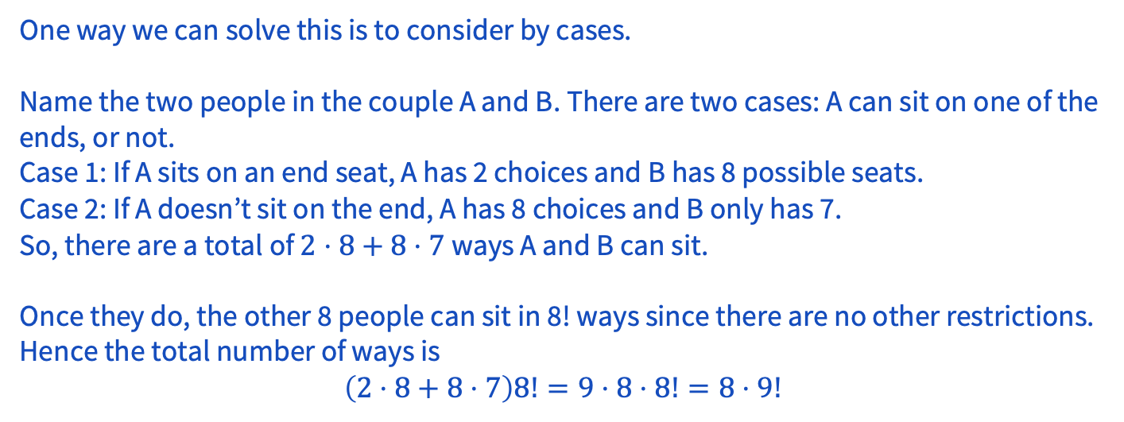
1 – Seating
How many ways are there to seat 10 people, consisting of 5 couples, in a row of 10 seats if anyone can sit anywhere, except that one couple insists on not sitting in adjacent seats?

Slide 23
1 – Seating
How many ways are there to seat 10 people, consisting of 5 couples, in a row of 10 seats if anyone can sit anywhere, except that one couple insists on not sitting in adjacent seats?
Another way to solve this is to apply complementary counting to first compute the total number of arrangements of the 10 people, and then subtract from this the number of arrangements in which that particular couple does get adjacent seats.

Slide 24
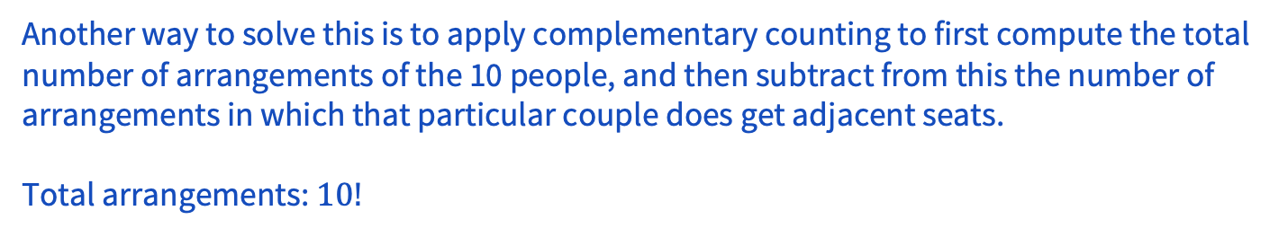
1 – Seating
How many ways are there to seat 10 people, consisting of 5 couples, in a row of 10 seats if anyone can sit anywhere, except that one couple insists on not sitting in adjacent seats?

Slide 25
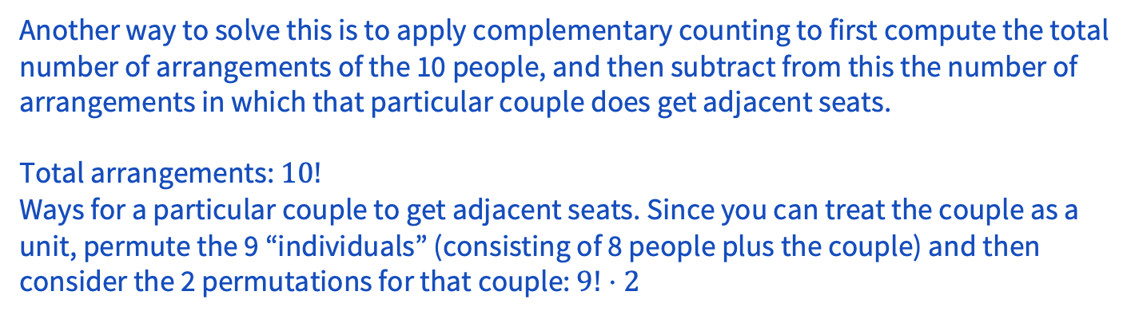
1 – Seating
How many ways are there to seat 10 people, consisting of 5 couples, in a row of 10 seats if anyone can sit anywhere, except that one couple insists on not sitting in adjacent seats?

Slide 26
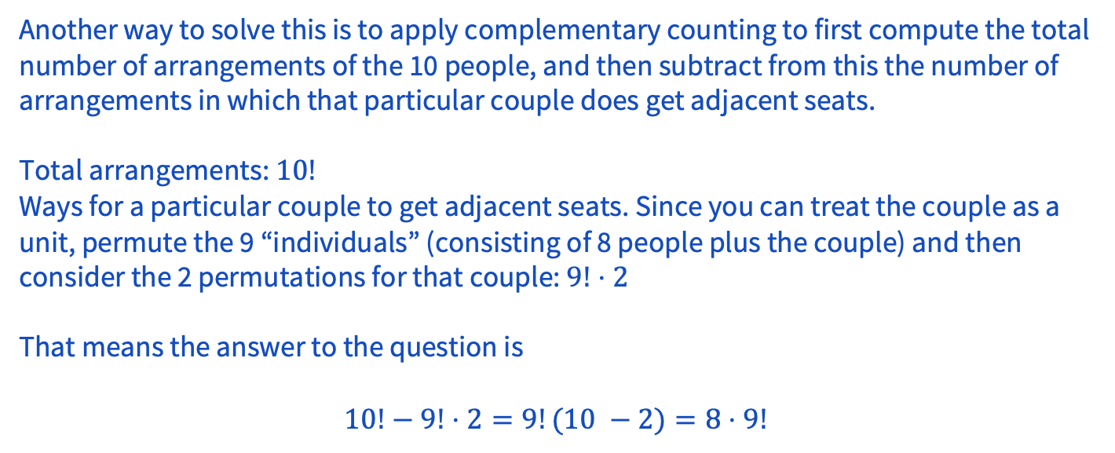
1 – Seating
How many ways are there to seat 10 people, consisting of 5 couples, in a row of 10 seats if anyone can sit anywhere, except that one couple insists on not sitting in adjacent seats?

Slide 27
Problem 5 – Birthday Cake

Slide 28
5 – Birthday Cake
A chef is preparing desserts for the week, starting on a Sunday. On each day, only one of five desserts (apple pie, cherry pie, strawberry pie, pineapple pie, and cake) may be served. On Thursday there is a birthday, so cake must be served that day. On no two consecutive days can the chef serve the same dessert. How many dessert menus are there for the week?
Work on this problem with the people around you, and then we’ll go over it together!

Slide 29
5 – Birthday Cake
A chef is preparing desserts for the week, starting on a Sunday. On each day, only one of five desserts (apple pie, cherry pie, strawberry pie, pineapple pie, and cake) may be served. On Thursday there is a birthday, so cake must be served that day. On no two consecutive days can the chef serve the same dessert. How many dessert menus are there for the week?

Slide 30
5 – Birthday Cake
A chef is preparing desserts for the week, starting on a Sunday. On each day, only one of five desserts (apple pie, cherry pie, strawberry pie, pineapple pie, and cake) may be served. On Thursday there is a birthday, so cake must be served that day. On no two consecutive days can the chef serve the same dessert. How many dessert menus are there for the week?
Apply the product rule. Start from Thursday and work forward and backward in the week:
Notes:
Mentions the wrong approach
Note: You can’t start on Sunday! Starting on Sunday (and getting the answer 5⋅4^5) counts possibilities on Sunday that aren’t actually valid—start from the known quantity of Thursday first.

Slide 31
5 – Birthday Cake
A chef is preparing desserts for the week, starting on a Sunday. On each day, only one of five desserts (apple pie, cherry pie, strawberry pie, pineapple pie, and cake) may be served. On Thursday there is a birthday, so cake must be served that day. On no two consecutive days can the chef serve the same dessert. How many dessert menus are there for the week?
Apply the product rule. Start from Thursday and work forward and backward in the week:
Given the 1 choice on Thursday, for each of Wednesday and Friday, there are 4 choices (the different pie options).
Notes:
Mentions the wrong approach
Note: You can’t start on Sunday! Starting on Sunday (and getting the answer 5⋅4^5) counts possibilities on Sunday that aren’t actually valid—start from the known quantity of Thursday first.

Slide 32
5 – Birthday Cake
A chef is preparing desserts for the week, starting on a Sunday. On each day, only one of five desserts (apple pie, cherry pie, strawberry pie, pineapple pie, and cake) may be served. On Thursday there is a birthday, so cake must be served that day. On no two consecutive days can the chef serve the same dessert. How many dessert menus are there for the week?
Apply the product rule. Start from Thursday and work forward and backward in the week:
Given the 1 choice on Thursday, for each of Wednesday and Friday, there are 4 choices (the different pie options).
Given the choice on Wednesday, there are 4 choices for Tuesday, and given the choice on Tuesday, there are 4 choices for Monday, and given the choice on Monday, there are 4 choices on Sunday. Similarly, given the choice on Friday, there are 4 choices on Saturday.
Notes:
Mentions the wrong approach
Note: You can’t start on Sunday! Starting on Sunday (and getting the answer 5⋅4^5) counts possibilities on Sunday that aren’t actually valid—start from the known quantity of Thursday first.

Slide 33
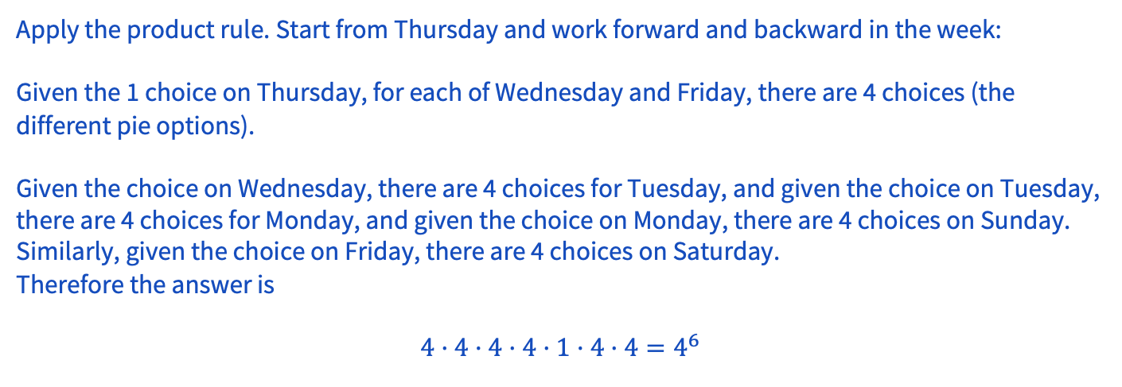
5 – Birthday Cake
A chef is preparing desserts for the week, starting on a Sunday. On each day, only one of five desserts (apple pie, cherry pie, strawberry pie, pineapple pie, and cake) may be served. On Thursday there is a birthday, so cake must be served that day. On no two consecutive days can the chef serve the same dessert. How many dessert menus are there for the week?
Notes:
Mentions the wrong approach
Note: You can’t start on Sunday! Starting on Sunday (and getting the answer 5⋅4^5) counts possibilities on Sunday that aren’t actually valid—start from the known quantity of Thursday first.

Slide 34
Problem 4 – Escape the Professor

Slide 35
4 – Escape the Professor
There are 6 security professors and 7 theory professors taking part in an escape room. If 4 security professors and 4 theory professors are chosen and paired off, how many pairings are possible?
Work on this problem with the people around you, and then we’ll go over it together!

Slide 36
4 – Escape the Professor
There are 6 security professors and 7 theory professors taking part in an escape room. If 4 security professors and 4 theory professors are chosen and paired off, how many pairings are possible?

Slide 37
4 – Escape the Professor
There are 6 security professors and 7 theory professors taking part in an escape room. If 4 security professors and 4 theory professors are chosen and paired off, how many pairings are possible?
Apply the product rule to first choose 4 of the security professors, then 4 of the theory professors. Then assign each theory professor to a security professor (4 choices for the first, 3 for the second and so on).
The answer is

Slide 38
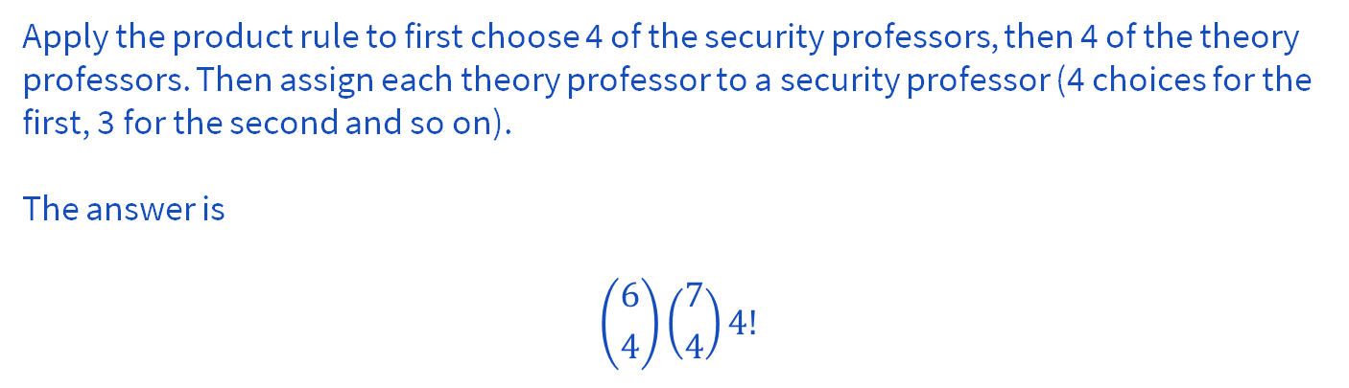
4 – Escape the Professor
There are 6 security professors and 7 theory professors taking part in an escape room. If 4 security professors and 4 theory professors are chosen and paired off, how many pairings are possible?

Slide 39
Problem 10 – Extended Family Portrait

Slide 40
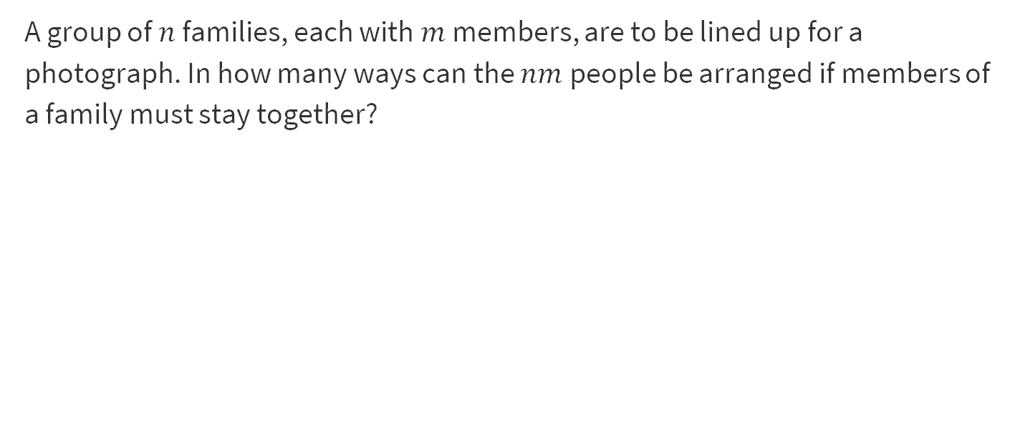
10 – Extended Family Portrait
Work on this problem with the people around you, and then we’ll go over it together!

Slide 41
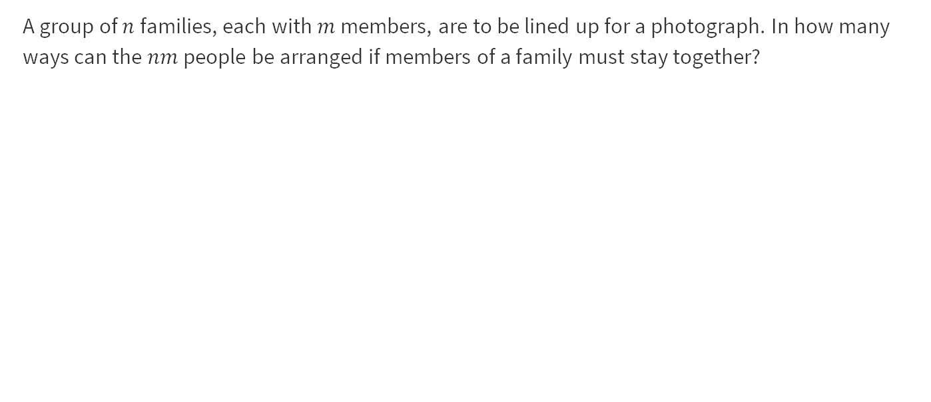
10 – Extended Family Portrait

Slide 42
10 – Extended Family Portrait
Apply the product rule.

Slide 43
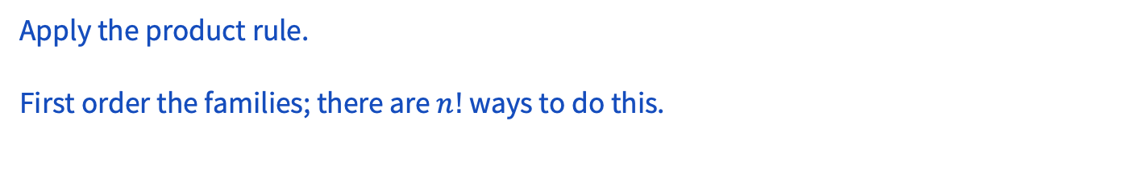
10 – Extended Family Portrait

Slide 44
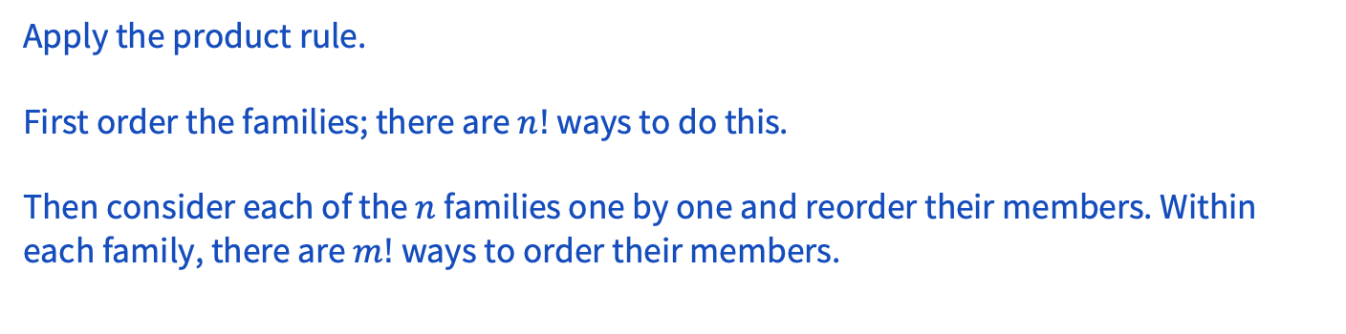
10 – Extended Family Portrait

Slide 45
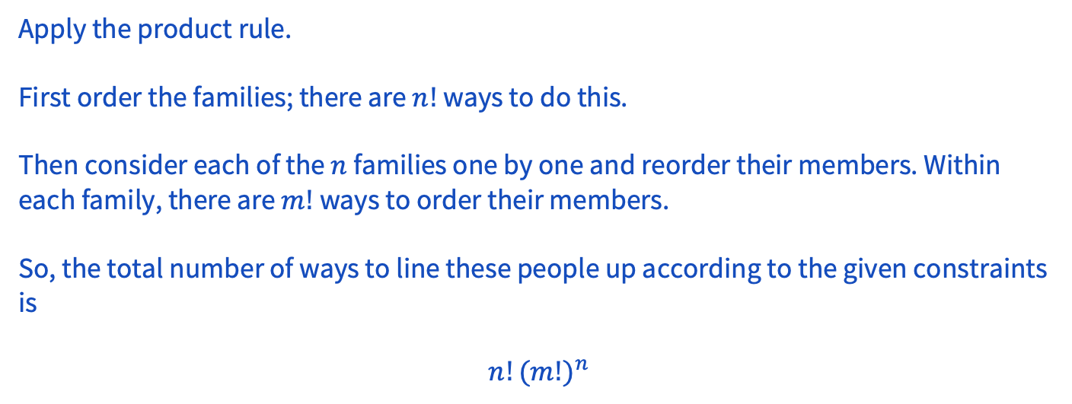
10 – Extended Family Portrait

Slide 46
Problem 9 – Rabbits!

Slide 47
9 – Rabbits!
Rabbits Peter and Pauline have three offspring: Flopsie, Mopsie, and Cotton-tail. These five rabbits are to be distributed to four different pet stores so that no store gets both a parent and a child. It is not required that every store gets a rabbit. In how many different ways can this be done?
Work on this problem with the people around you, and then we’ll go over it together!

Slide 48
9 – Rabbits!
Rabbits Peter and Pauline have three offspring: Flopsie, Mopsie, and Cotton-tail. These 5 rabbits are to be distributed to 4 different pet stores so that no store gets both a parent and a child. It is not required that every store gets a rabbit. In how many different ways can this be done?

Slide 49
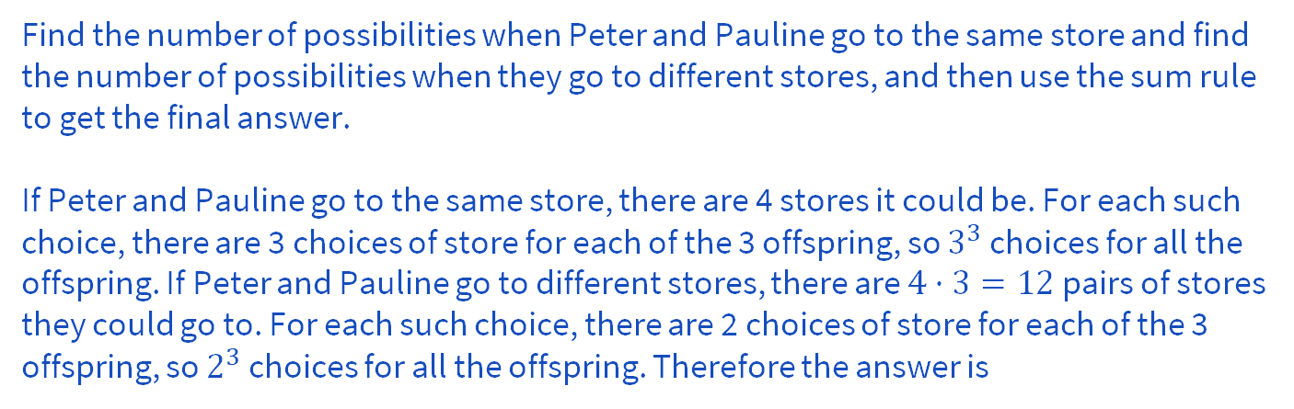
9 – Rabbits!
Rabbits Peter and Pauline have three offspring: Flopsie, Mopsie, and Cotton-tail. These 5 rabbits are to be distributed to 4 different pet stores so that no store gets both a parent and a child. It is not required that every store gets a rabbit. In how many different ways can this be done?

Slide 50
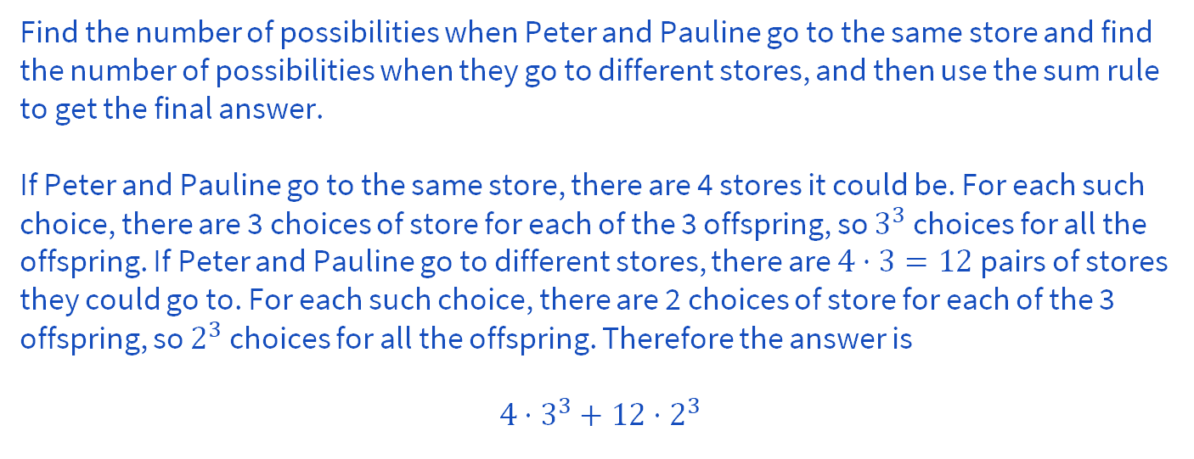
9 – Rabbits!
Rabbits Peter and Pauline have three offspring: Flopsie, Mopsie, and Cotton-tail. These 5 rabbits are to be distributed to 4 different pet stores so that no store gets both a parent and a child. It is not required that every store gets a rabbit. In how many different ways can this be done?

Slide 51
Problem 11 - Subsubset

Slide 52
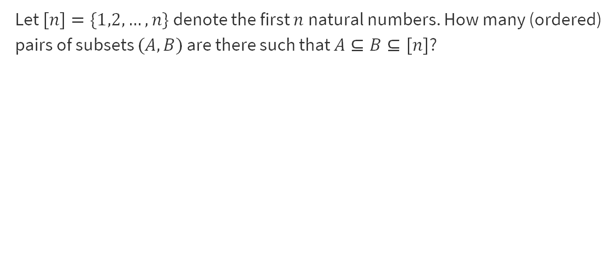
11 – Subsubset
Work on this problem with the people around you, and then we’ll go over it together!

Slide 53
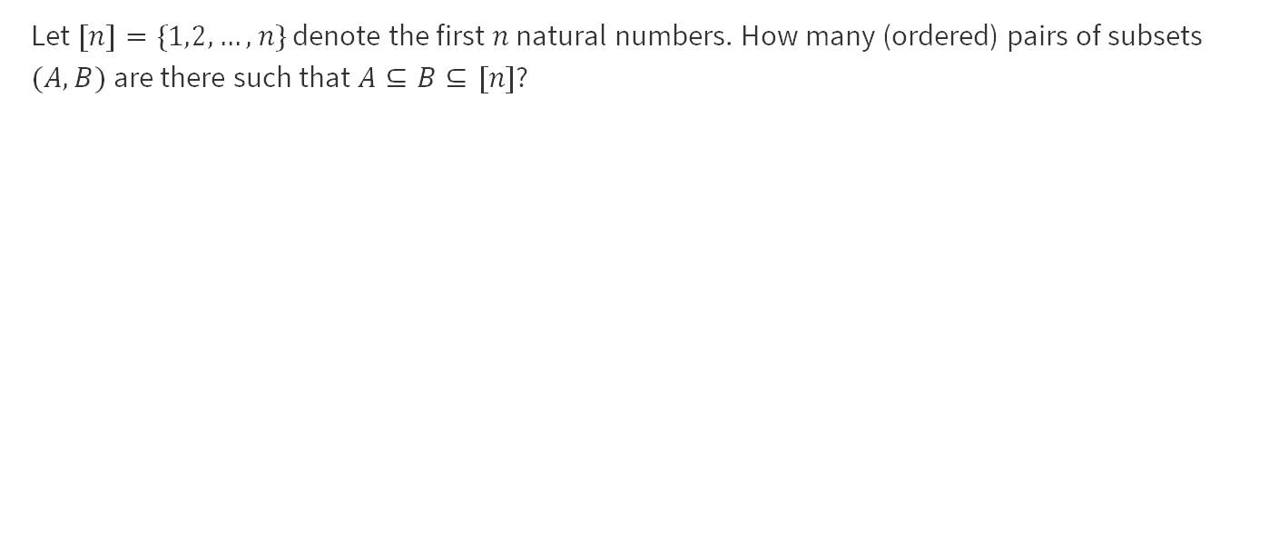
11 – Subsubset

Slide 54
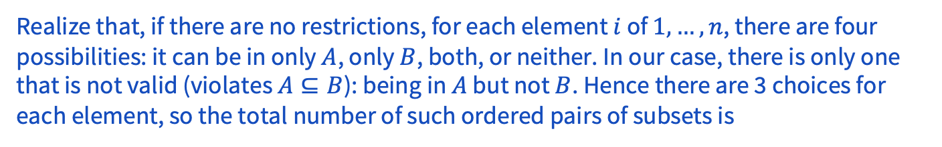
11 – Subsubset

Slide 55
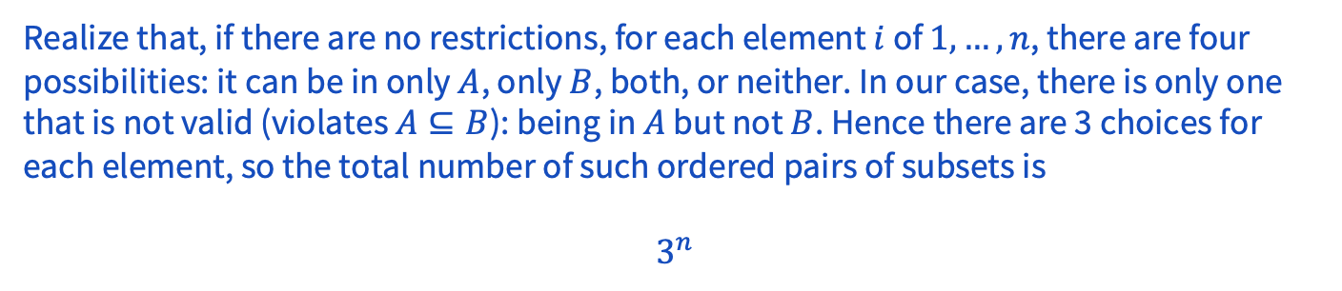
11 – Subsubset

Slide 56
That’s All, Folks!
Thanks for coming to section this week!
Any questions?

