Slide 1
More Tail Bounds
CSE 312 Winter 26
Lecture 20

Slide 2
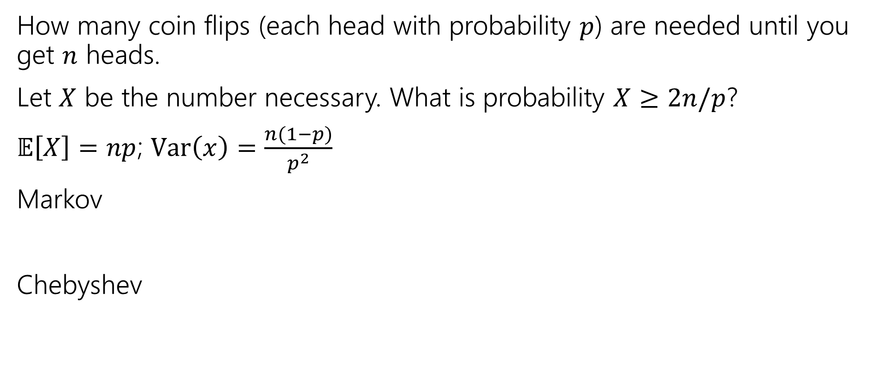
Chebyshev’s – Repeated Experiments
How many coin flips (each head with probability $p$) are needed until you get $n$ heads.
Let $X$ be the number necessary. What is probability $X≥2n/p$?
$𝔼\left[X\right]=np$; $Var\left(x\right)=\frac{n(1−p)}{p^{2}}$
Markov
Chebyshev

Slide 3
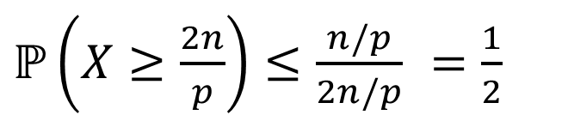


Chebyshev’s – Repeated Experiments (soln)
How many coin flips (each head with probability $p$) are needed until you get $n$ heads.
Let $X$ be the number necessary. What is probability $X≥2n/p$?
Markov
Chebyshev
$ℙ\left(X≥\frac{2n}{p}\right)≤\frac{n/p}{2n/p}$ $=\frac{1}{2}$
$ℙ\left(X≥\frac{2n}{p}\right)≤ℙ\left(\left|X−\frac{n}{p}\right|≥\frac{n}{p}\right)≤\frac{Var(X)}{n^{2}/p^{2}}$ $=\frac{n(1−p)/p^{2}}{n^{2}/p^{2}}$ $=\frac{1−p}{n}$

Slide 4

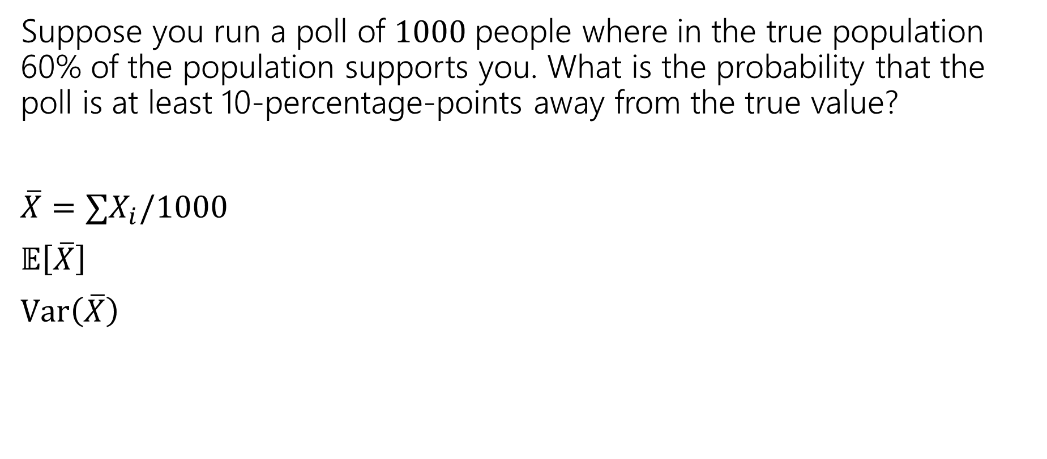
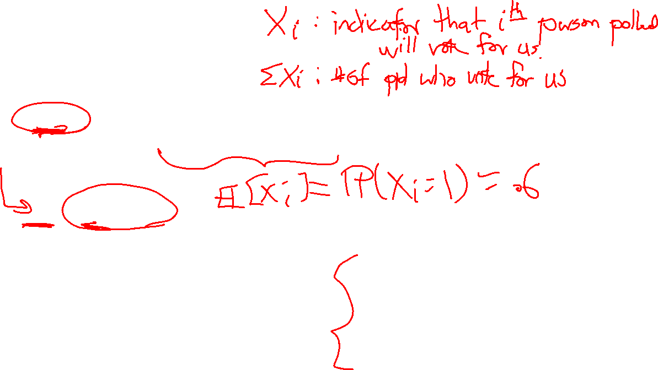
Near the mean
Suppose you run a poll of $1000$people where in the true population 60% of the population supports you. What is the probability that the poll is at least 10-percentage-points away from the true value?
$\overline{X}=∑X_{i}/1000$
$𝔼\left[\overline{X}\right]$
$Var\left(\overline{X}\right)$
Let $X$ be a random variable. For any $t>0$
$$ℙ\left(\left|X−𝔼\left[X\right]\right|≥t\right)≤\frac{Var(X)}{t^{2}}$$
Chebyshev’s Inequality
Chebyshev’s Inequality

Slide 5
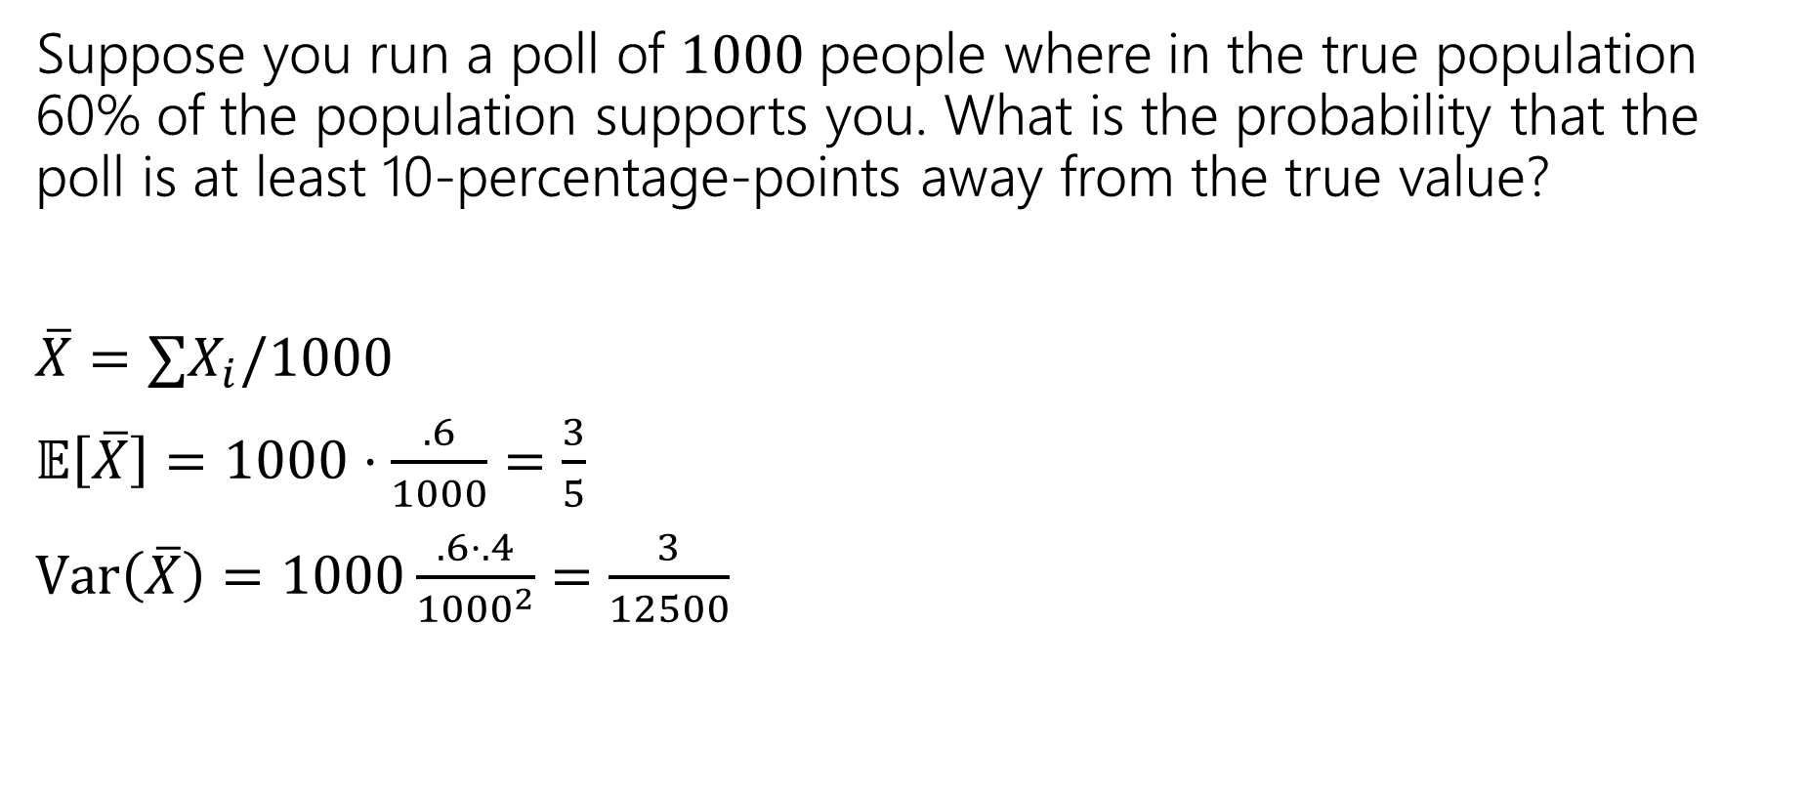
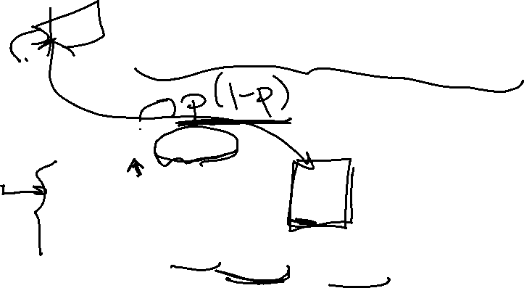
Near the mean (calculation)
Suppose you run a poll of $1000$people where in the true population 60% of the population supports you. What is the probability that the poll is at least 10-percentage-points away from the true value?
$\overline{X}=∑X_{i}/1000$
$𝔼\left[\overline{X}\right]=1000⋅\frac{.6}{1000}=\frac{3}{5}$
$Var\left(\overline{X}\right)=1000\frac{.6⋅.4}{{1000}^{2}}=\frac{3}{12500}$
Let $X$ be a random variable. For any $t>0$
$$ℙ\left(\left|X−𝔼\left[X\right]\right|≥t\right)≤\frac{Var(X)}{t^{2}}$$
Chebyshev’s Inequality
Chebyshev’s Inequality

Slide 6
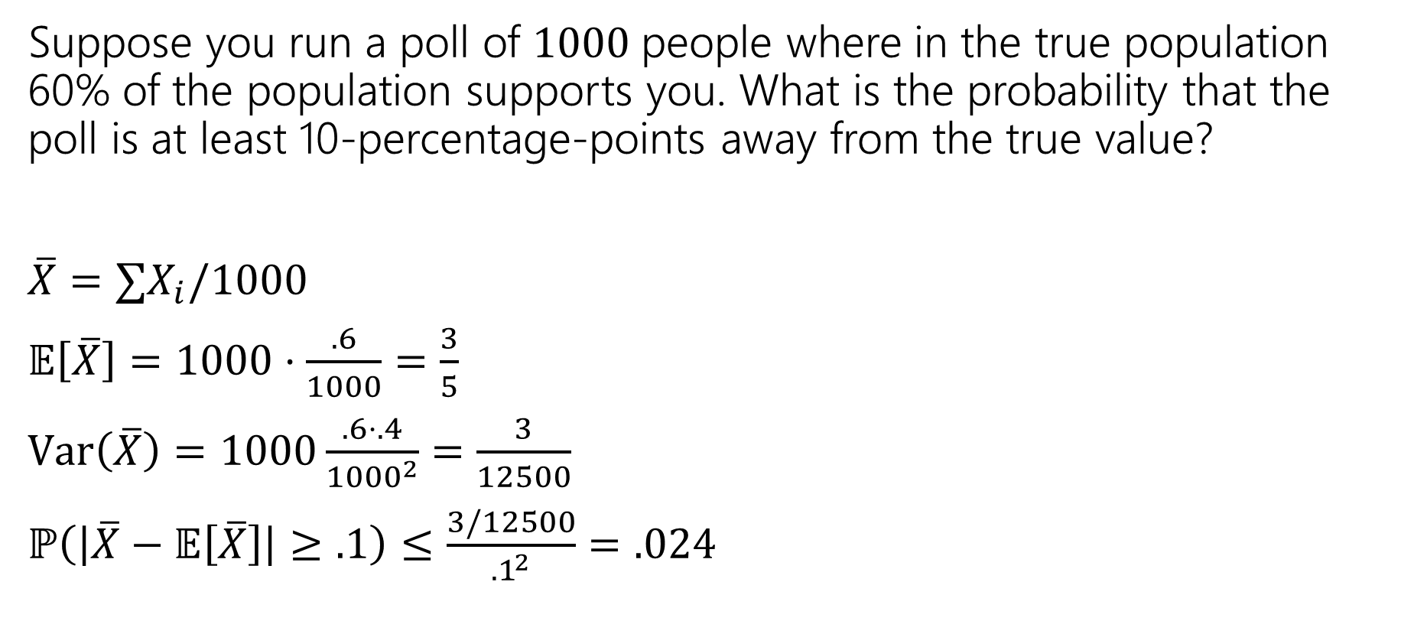
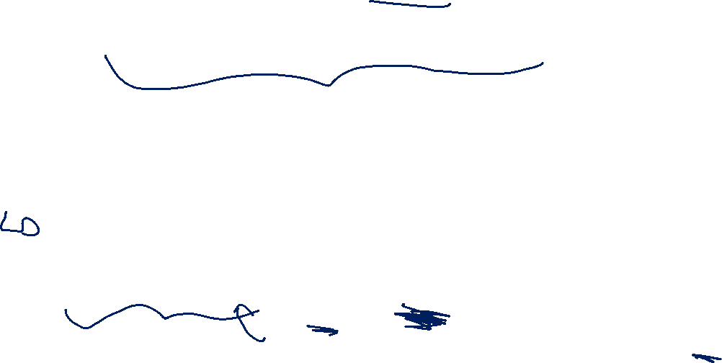
Near the mean (final answer)
Suppose you run a poll of $1000$people where in the true population 60% of the population supports you. What is the probability that the poll is at least 10-percentage-points away from the true value?
$\overline{X}=∑X_{i}/1000$
$𝔼\left[\overline{X}\right]=1000⋅\frac{.6}{1000}=\frac{3}{5}$
$Var\left(\overline{X}\right)=1000\frac{.6⋅.4}{{1000}^{2}}=\frac{3}{12500}$
$ℙ\left(\left|\overline{X}−𝔼\left[\overline{X}\right]\right|≥.1\right)≤\frac{3/12500}{{.1}^{2}}$ $=.024$
Let $X$ be a random variable. For any $t>0$
$$ℙ\left(\left|X−𝔼\left[X\right]\right|≥t\right)≤\frac{Var(X)}{t^{2}}$$
Chebyshev’s Inequality
Chebyshev’s Inequality

Slide 7

Takeaway
Chebyshev gets more powerful as the variance shrinks.
Repeated experiments are a great way to cause that to happen.

Slide 8
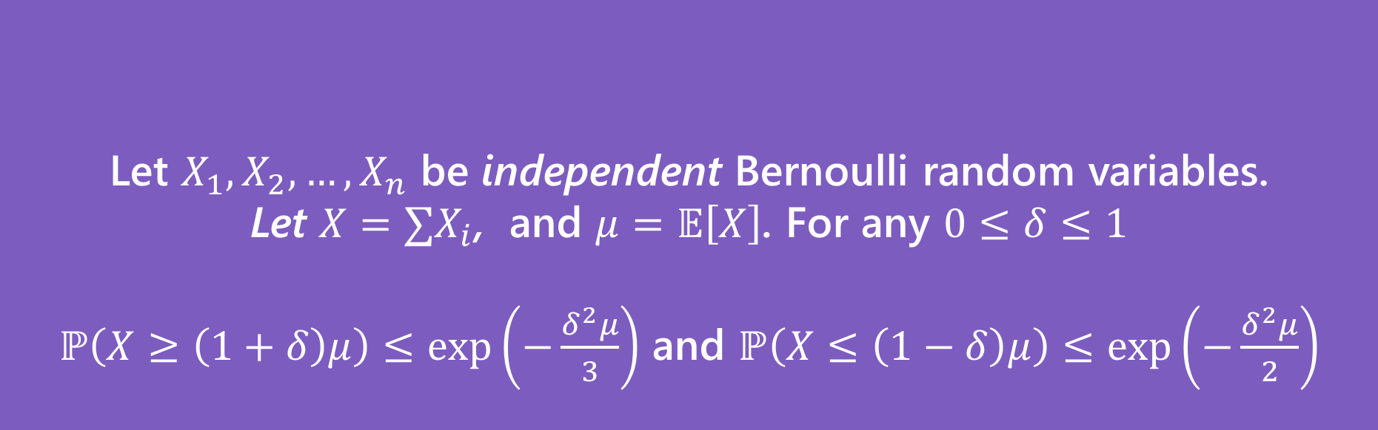
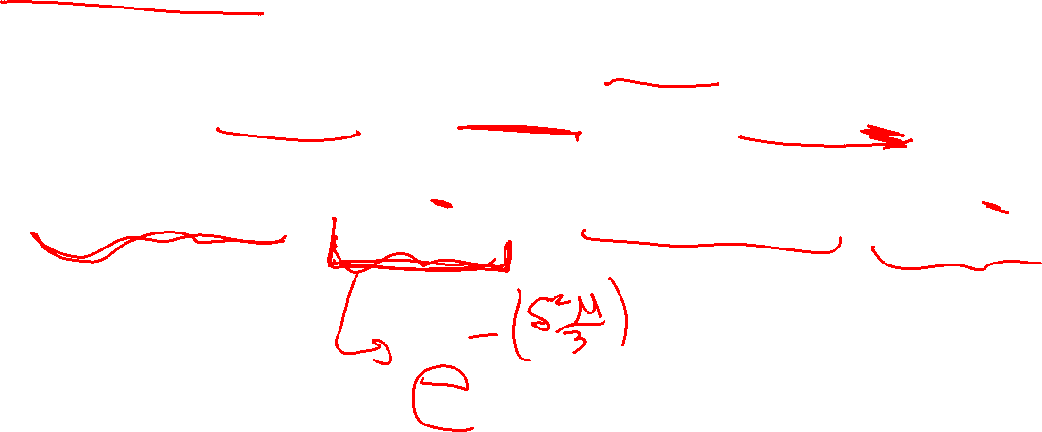
More Assumptions → Better Guarantee
Let $X_{1},X_{2},…,X_{n}$ be independent Bernoulli random variables.
Let $X=∑X_{i}$, and $μ=𝔼\left[X\right]$. For any $0≤δ≤1$
$ℙ\left(X≥\left(1+δ\right)μ\right)≤\exp\left(−\frac{δ^{2}μ}{3}\right)$ and $ℙ\left(X≤\left(1−δ\right)μ\right)≤\exp\left(−\frac{δ^{2}μ}{2}\right)$
(Multiplicative) Chernoff Bound

Slide 9
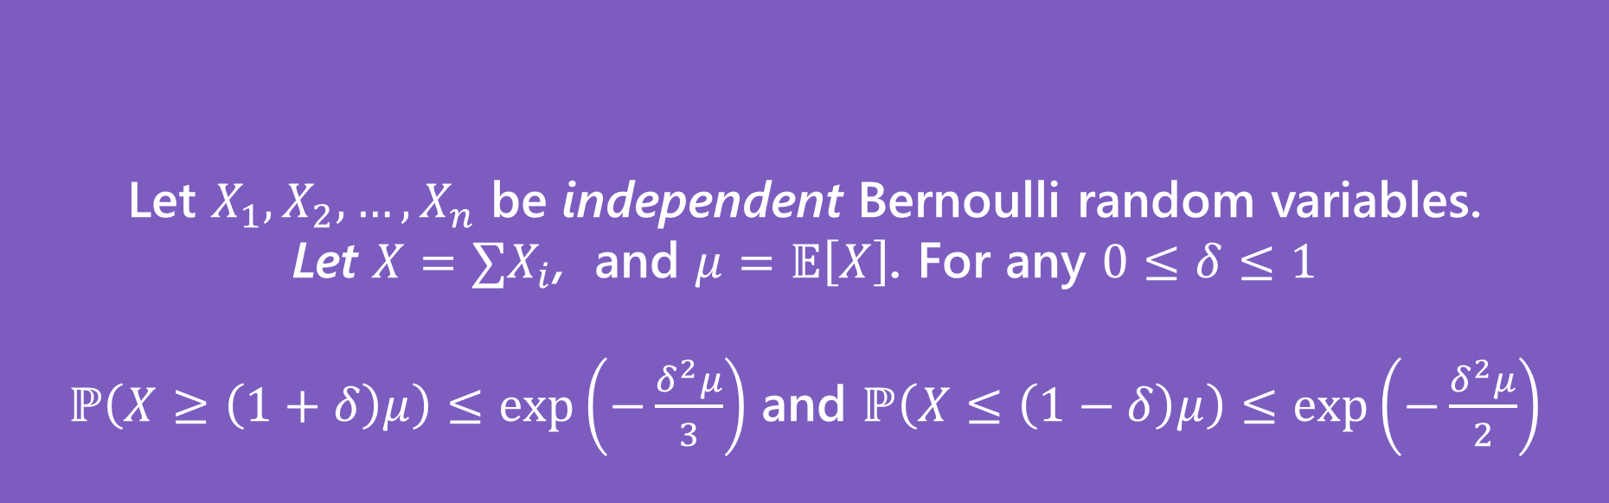

Same Problem, New Solution
Suppose you run a poll of $1000$people where in the true population 60% of the population supports you. What is the probability that the poll is not within 10-percentage-points of the true value?
Let $X_{1},X_{2},…,X_{n}$ be independent Bernoulli random variables.
Let $X=∑X_{i}$, and $μ=𝔼\left[X\right]$. For any $0≤δ≤1$
$ℙ\left(X≥\left(1+δ\right)μ\right)≤\exp\left(−\frac{δ^{2}μ}{3}\right)$ and $ℙ\left(X≤\left(1−δ\right)μ\right)≤\exp\left(−\frac{δ^{2}μ}{2}\right)$
(Multiplicative) Chernoff Bound

Slide 10

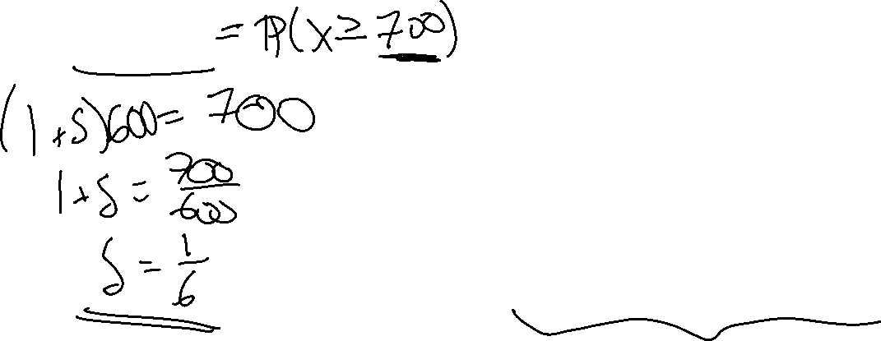

Right Tail
Suppose you run a poll of $1000$people where in the true population 60% of the population supports you. What is the probability that the poll is not within 10-percentage-points of the true value?
Want $ℙ\left(\frac{X}{1000}≥.7\right)$
Let $X_{1},X_{2},…,X_{n}$ be independent Bernoulli random variables.
Let $X=∑X_{i}$, and $μ=𝔼\left[X\right]$. For any $0≤δ≤1$
$ℙ\left(X≥\left(1+δ\right)μ\right)≤\exp\left(−\frac{δ^{2}μ}{3}\right)$
Chernoff Bound (right tail)
Notes:
Need X=sum X_i
So P(X >= 700)
Now, we need to rewrite 700 = (1+delta)mu mu is E[X] (NOT E[X-bar]) E[X] is 600 (1+delta)*600 = 700 (1+delta) = 7/6 delta = 1/6

Slide 11

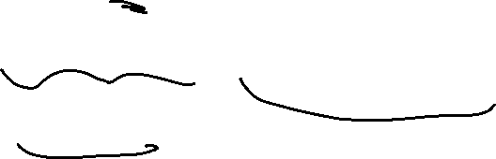
Right Tail (solution)
Suppose you run a poll of $1000$people where in the true population 60% of the population supports you. What is the probability that the poll is not within 10-percentage-points of the true value?
Want $ℙ\left(\frac{X}{1000}≥.7\right)=ℙ(X≥.7⋅1000)$
$=ℙ\left(X≥\left(1+.1/.6\right)⋅(.6⋅1000)\right)$
So $δ=\frac{1}{6}$ and $μ=.6⋅1000$
$ℙ\left(X≥700\right)≤\exp\left(−\frac{\frac{1}{6^{2}}⋅.6⋅1000}{3}\right)$
$≤0.0039$
Let $X_{1},X_{2},…,X_{n}$ be independent Bernoulli random variables.
Let $X=∑X_{i}$, and $μ=𝔼\left[X\right]$. For any $0≤δ≤1$
$ℙ\left(X≥\left(1+δ\right)μ\right)≤\exp\left(−\frac{δ^{2}μ}{3}\right)$
Chernoff Bound (right tail)

Slide 12


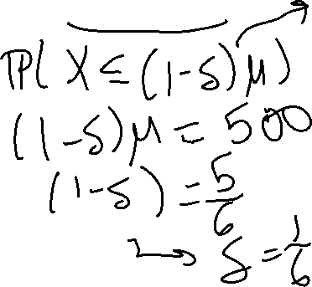
Left Tail
Suppose you run a poll of $1000$people where in the true population 60% of the population supports you. What is the probability that the poll is not within 10-percentage-points of the true value?
Want $ℙ\left(\frac{X}{1000}≤.5\right)=ℙ(X≤.5⋅1000)$
Let $X_{1},X_{2},…,X_{n}$ be independent Bernoulli random variables.
Let $X=∑X_{i}$, and $μ=𝔼\left[X\right]$. For any $0≤δ≤1$
$ℙ\left(X≤\left(1−δ\right)μ\right)≤\exp\left(−\frac{δ^{2}μ}{2}\right)$
Chernoff Bound (left tail)

Slide 13

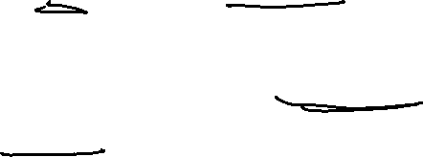
Left Tail (solution)
Suppose you run a poll of $1000$people where in the true population 60% of the population supports you. What is the probability that the poll is not within 10-percentage-points of the true value?
Want $ℙ\left(\frac{X}{1000}≤.5\right)=ℙ(X≤.5⋅1000)$
$=ℙ\left(X≤\left(1−.1/.6\right)⋅(.6⋅1000)\right)$
So $δ=\frac{1}{6}$ and $μ=.6⋅1000$
$ℙ\left(X≤500\right)≤\exp\left(−\frac{\frac{1}{6^{2}}⋅.6⋅1000}{2}\right)$
$≤0.0003$
Let $X_{1},X_{2},…,X_{n}$ be independent Bernoulli random variables.
Let $X=∑X_{i}$, and $μ=𝔼\left[X\right]$. For any $0≤δ≤1$
$ℙ\left(X≤\left(1−δ\right)μ\right)≤\exp\left(−\frac{δ^{2}μ}{2}\right)$
Chernoff Bound (left tail)

Slide 14
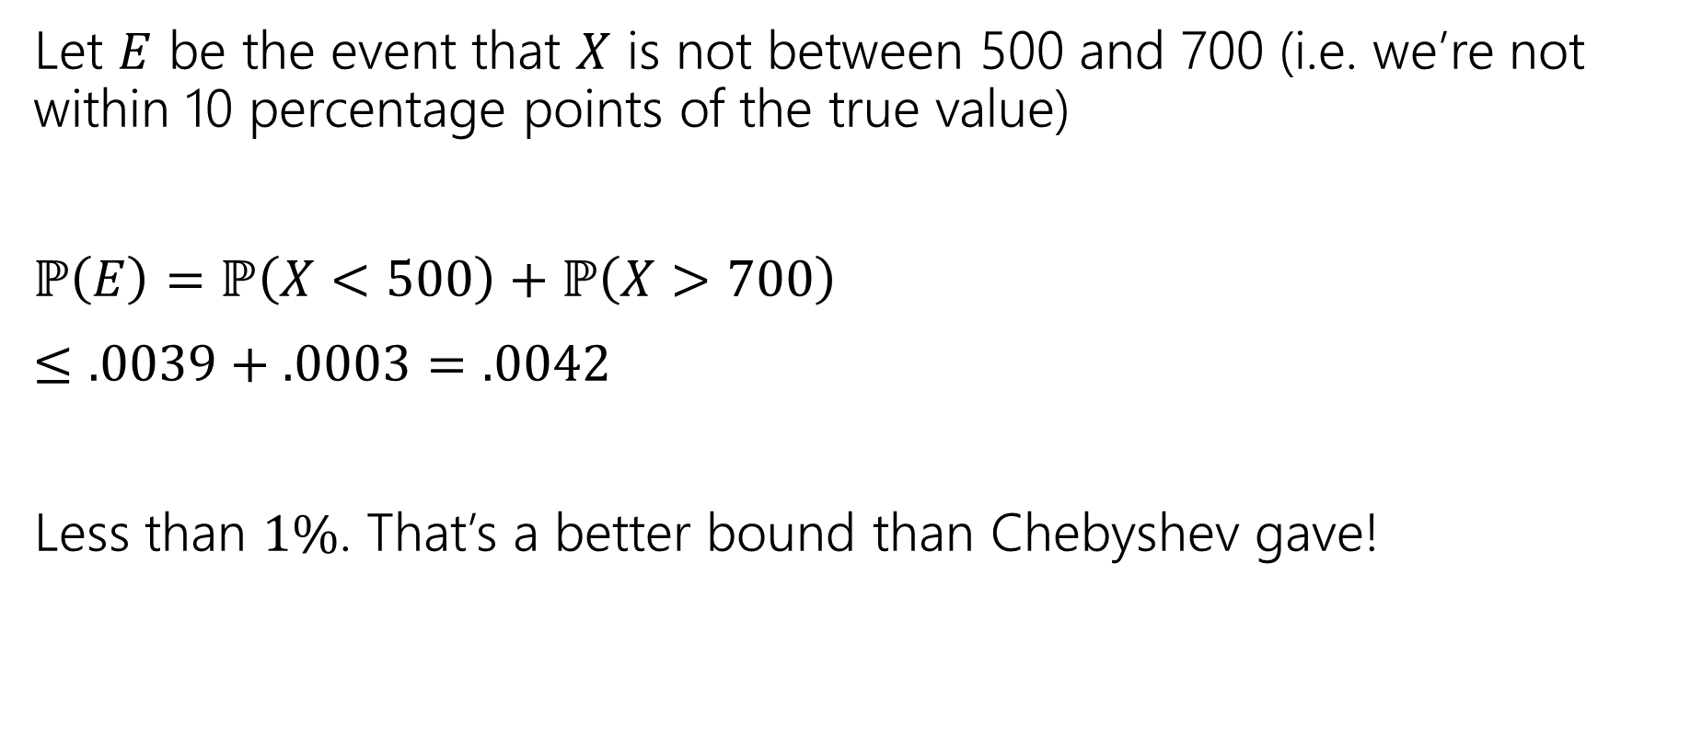
Both Tails
Let $E$ be the event that $X$ is not between 500 and 700 (i.e. we’re not within 10 percentage points of the true value)
$ℙ\left(E\right)=ℙ\left(X<500\right)+ℙ\left(X>700\right)$
$≤.0039+.0003=.0042$
Less than $1\%$. That’s a better bound than Chebyshev gave!

Slide 15
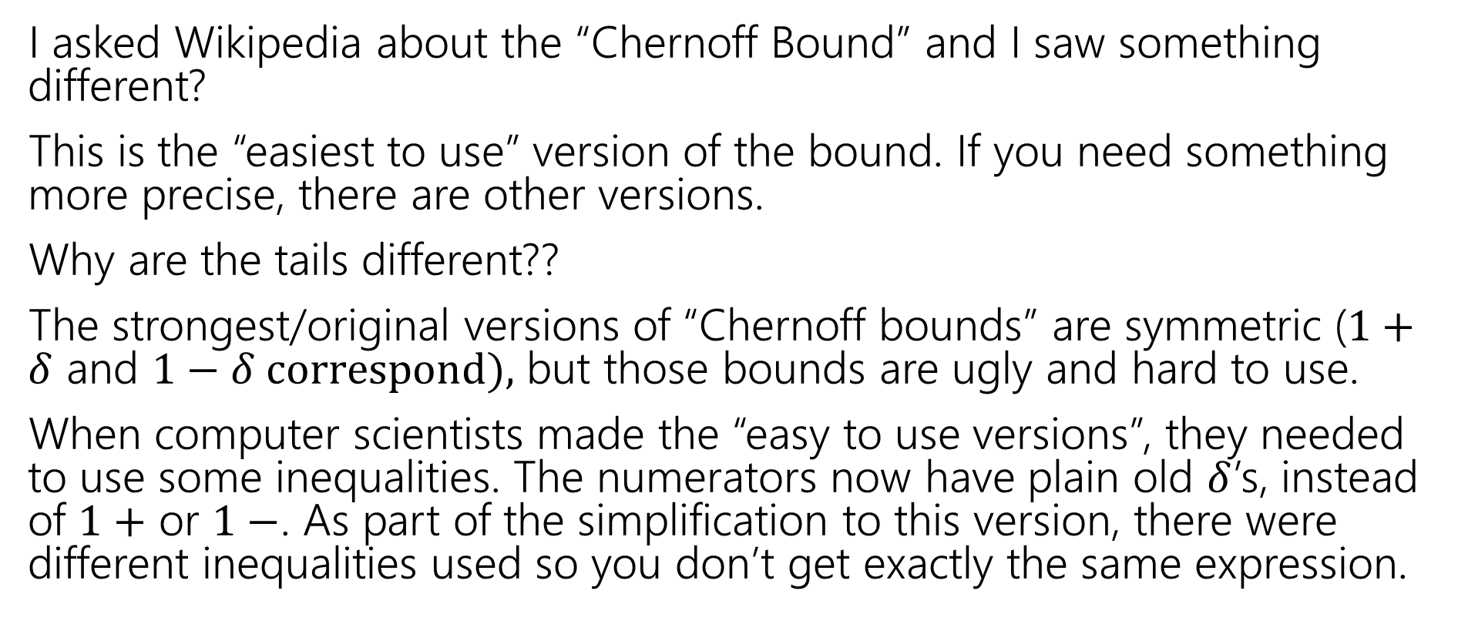
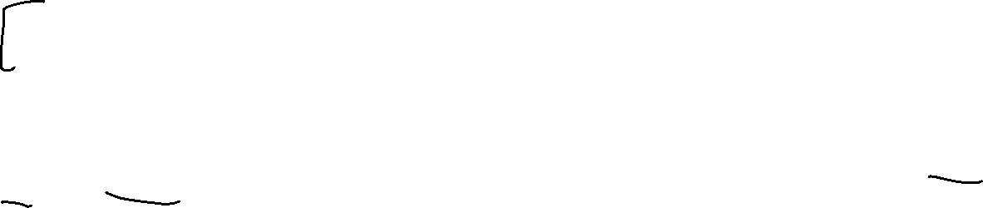
Wait a Minute (use official resources)
I asked Wikipedia about the “Chernoff Bound” and I saw something different?
This is the “easiest to use” version of the bound. If you need something more precise, there are other versions.
Why are the tails different??
The strongest/original versions of “Chernoff bounds” are symmetric ($1+δ$ and $1−δ correspond),$ but those bounds are ugly and hard to use.
When computer scientists made the “easy to use versions”, they needed to use some inequalities. The numerators now have plain old $δ$’s, instead of $1+$ or $1−$. As part of the simplification to this version, there were different inequalities used so you don’t get exactly the same expression.

Slide 16
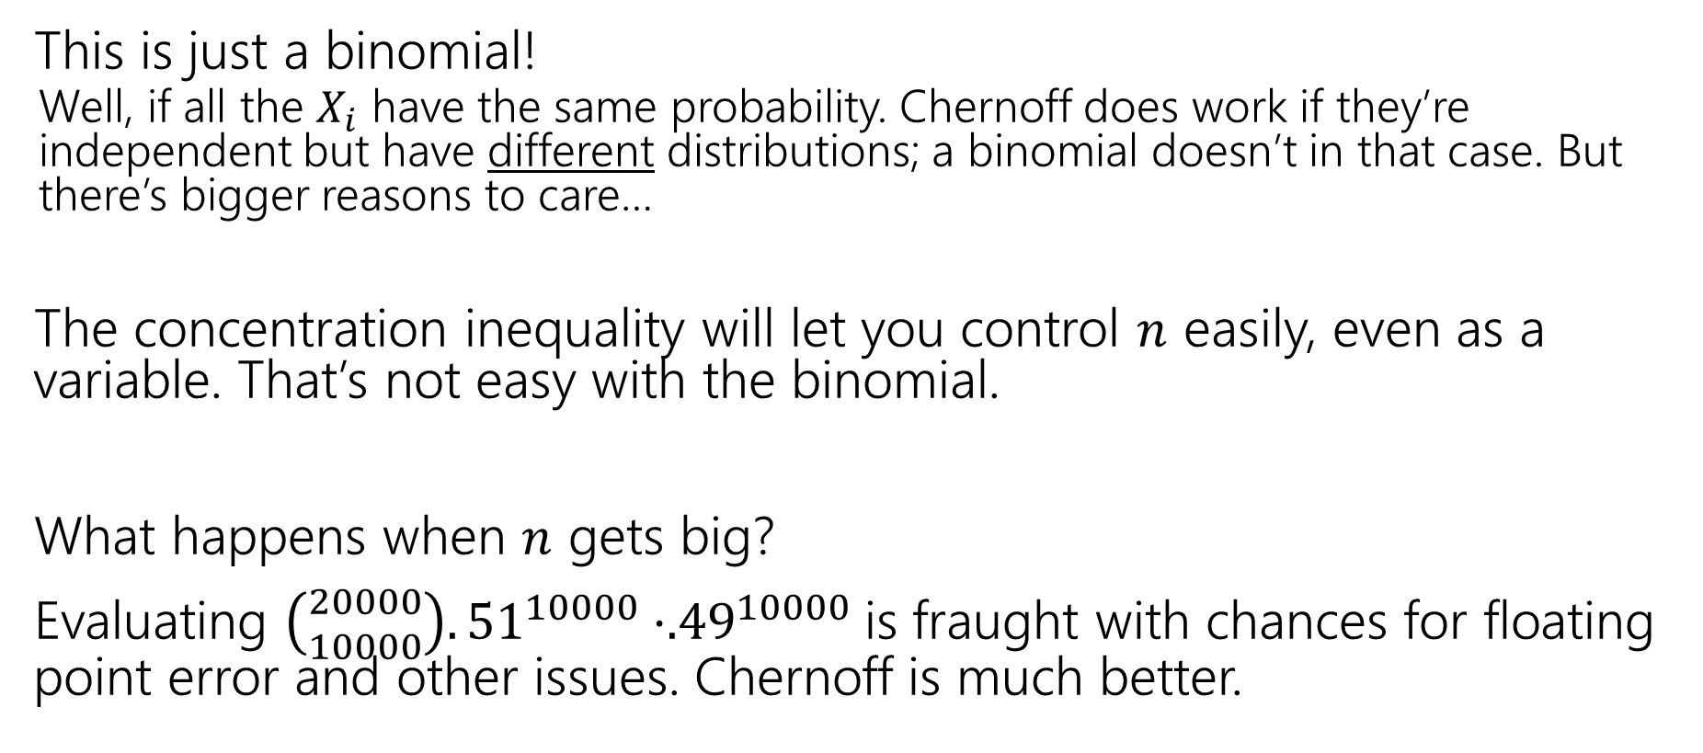

Wait a Minute (is this theorem helpful?)
This is just a binomial!
Well, if all the $X_{i}$ have the same probability. Chernoff does work if they’re independent but have different distributions; a binomial doesn’t in that case. But there’s bigger reasons to care…
The concentration inequality will let you control $n$ easily, even as a variable. That’s not easy with the binomial.
What happens when $n$ gets big?
Evaluating ${\left({20000 \atop 10000}\right).51}^{10000}⋅{.49}^{10000}$is fraught with chances for floating point error and other issues. Chernoff is much better.

Slide 17
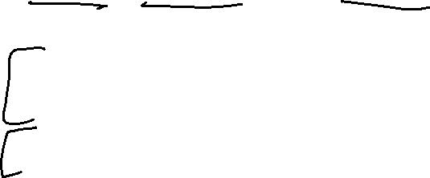
But Wait! There’s More
For this class, please limit yourself to: Markov, Chebyshev, and Chernoff, as stated in these slides…
But for your information. There’s more.
Trying to apply Chebyshev, but only want a “one-sided” bound (and tired of losing that almost-factor-of-two)Try Cantelli’s Inequality
In a position to use Chernoff, but want additive distance to the mean instead of multiplicative? They got one of those.
Have a sum of independent random variables that aren’t indicators, but are bounded, you better believe Wikipedia’s got one
Have a sum of random matrices instead of a sum of random numbers. Not only is that a thing you can do, but the eigenvalue of the matrix concentrates
There’s a whole book of these!

Slide 18
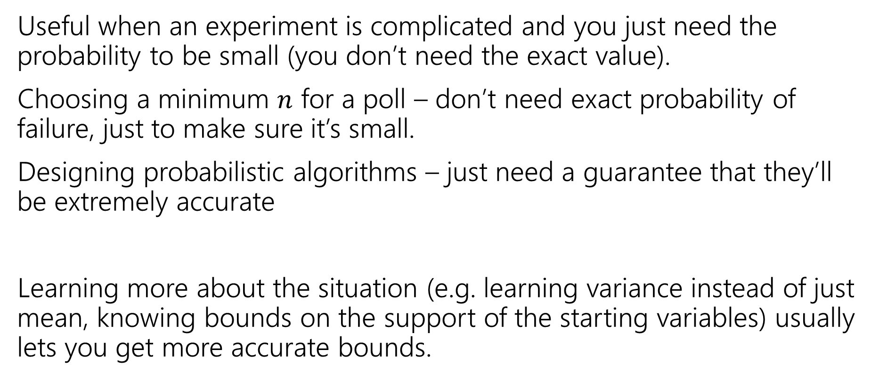
Tail Bounds – Takeaways
Useful when an experiment is complicated and you just need the probability to be small (you don’t need the exact value).
Choosing a minimum $n$ for a poll – don’t need exact probability of failure, just to make sure it’s small.
Designing probabilistic algorithms – just need a guarantee that they’ll be extremely accurate
Learning more about the situation (e.g. learning variance instead of just mean, knowing bounds on the support of the starting variables) usually lets you get more accurate bounds.

Slide 19
One More Bound

Slide 20
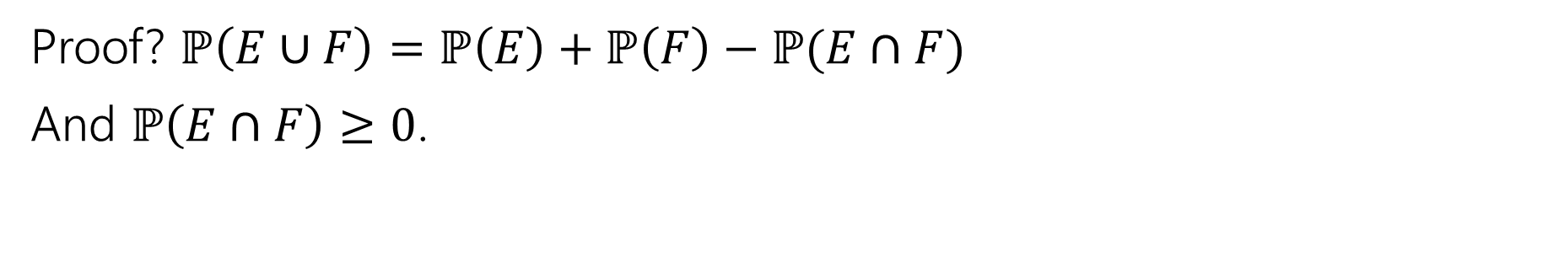

The union bound
The Union bound
For any events $E,F$
$$ℙ\left(E∪F\right)≤ℙ\left(E\right)+ℙ(F)$$
Union Bound
Proof? $ℙ\left(E∪F\right)=ℙ\left(E\right)+ℙ\left(F\right)−ℙ(E∩F)$
And $ℙ\left(E∩F\right)≥0$.

Slide 21
Concentration Applications
A common pattern:
Figure out “what could possibly go wrong” – often these are dependent.
Use a concentration inequality for each of the things that could go wrong.
Union bound over everything that could go wrong.

Slide 22
Frogs
There are 20 frogs on each location in a 5x5 grid. Each frog will independently jump to the left, right, up, down, or stay where it is with equal probability. A frog at an edge of the grid magically warps to the corresponding edge (pac-man-style).
Bound the probability that at least one square ends up with at least 36 frogs.
These events are dependent – adjacent squares affect each other!

Slide 23
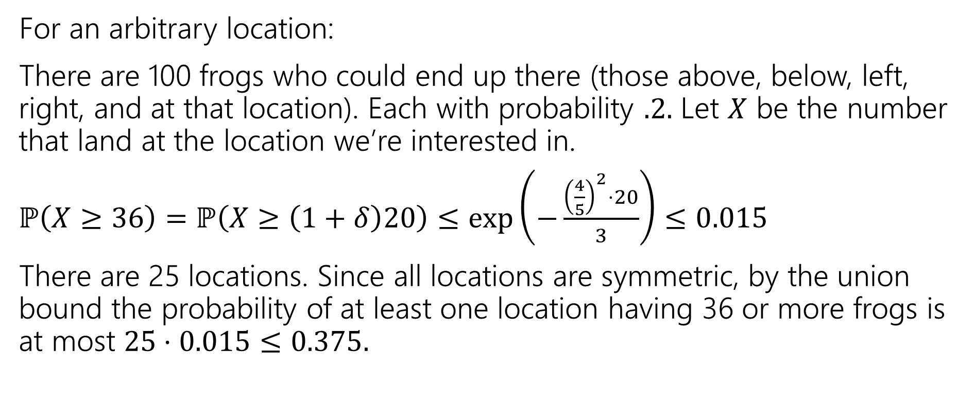
Frogs (answer)
For an arbitrary location:
There are 100 frogs who could end up there (those above, below, left, right, and at that location). Each with probability $.2.$ Let $X$ be the number that land at the location we’re interested in.
$ℙ\left(X≥36\right)=ℙ\left(X≥\left(1+δ\right)20\right)≤\exp\left(−\frac{{\left(\frac{4}{5}\right)}^{2}⋅20}{3}\right)≤0.015$
There are 25 locations. Since all locations are symmetric, by the union bound the probability of at least one location having 36 or more frogs is at most $25⋅0.015≤0.375.$

Slide 24
Applications

Slide 25
Privacy Preservation
A real-world example (adapted from The Ethical Algorithm by Kearns and Roth; based on protocol by Warner [1965]).
And gives a sense of how randomness is actually used to protect privacy.

Slide 26
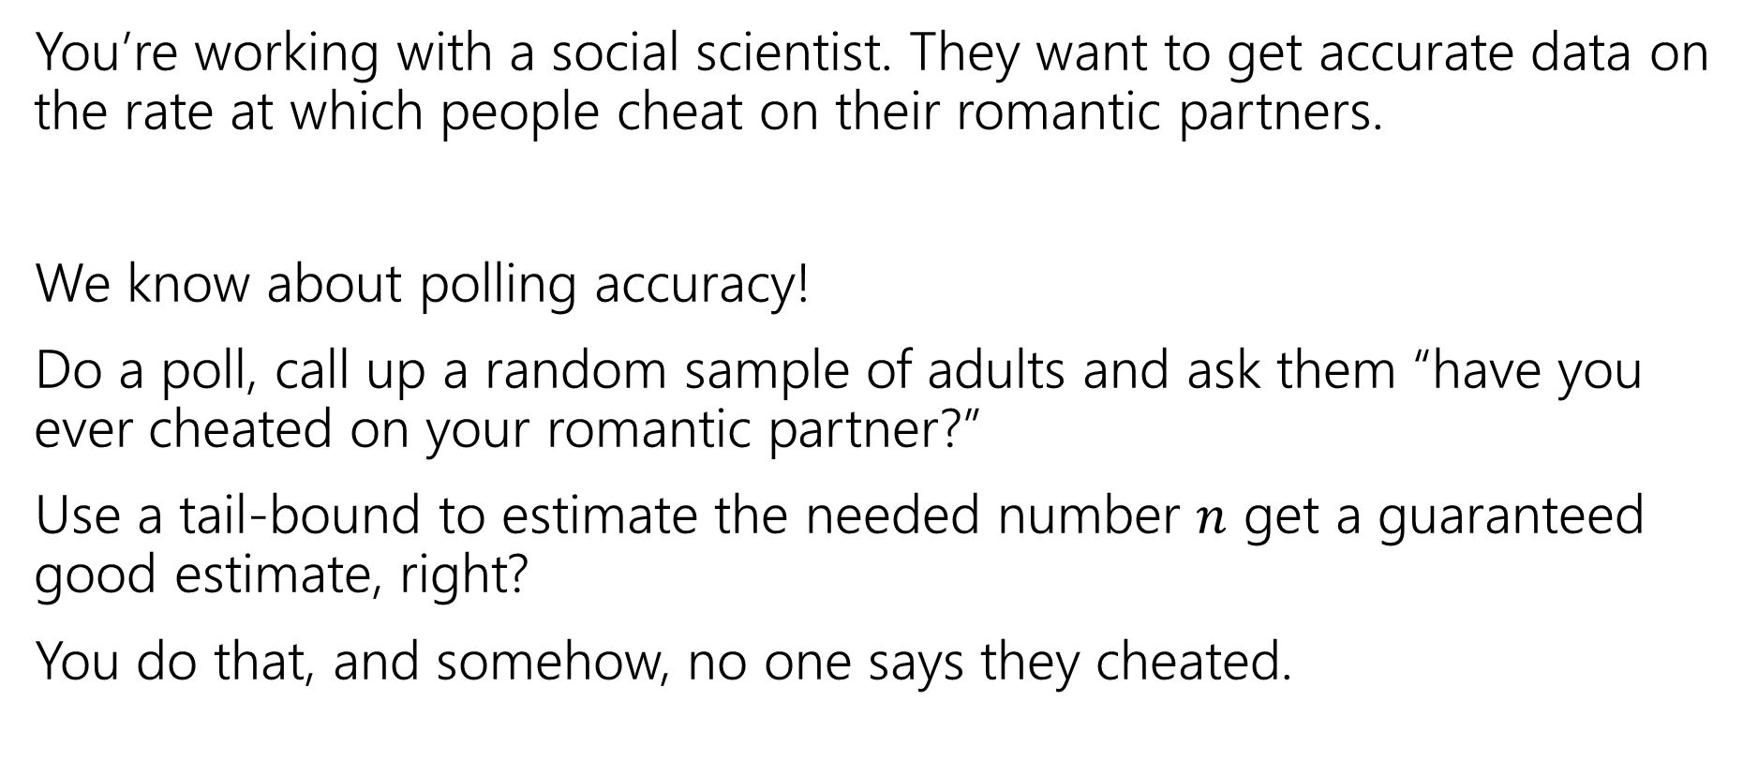
Privacy Preservation with Randomness
You’re working with a social scientist. They want to get accurate data on the rate at which people cheat on their romantic partners.
We know about polling accuracy!
Do a poll, call up a random sample of adults and ask them “have you ever cheated on your romantic partner?”
Use a tail-bound to estimate the needed number $n$ get a guaranteed good estimate, right?
You do that, and somehow, no one says they cheated.

Slide 27
What’s the problem?
People lie.
Or they might be concerned about you keeping this data.
Databases can be leaked (or infiltrated. Or subpoenaed).
You don’t want to hold this data, and the people you’re calling don’t want you to hold this data.

Slide 28
Doing Better With Randomness
You don’t really need to know who was cheating. Just how many people were.
Here’s a protocol:
Please flip a coin.
If the coin is heads, or you have ever cheated, please tell me “heads”
If the coin is tails and you have not ever cheated, please tell me “tails”

Slide 29
Will it be private?
If you are someone who has cheated, and you report heads can that be used against you? Not substantially – just say “no the coin came up heads!”
You discover your partner said heads, what’s the probability that they cheated?

Slide 30
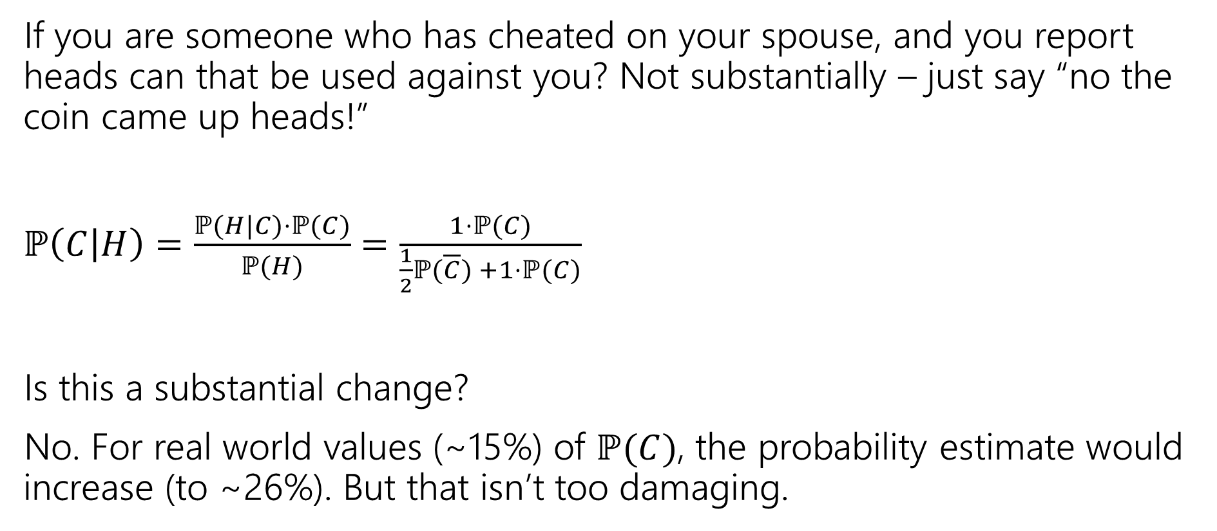
Will it be private? (computation)
If you are someone who has cheated on your spouse, and you report heads can that be used against you? Not substantially – just say “no the coin came up heads!”
$ℙ\left(C | H\right)=\frac{ℙ(H|C)⋅ℙ(C)}{ℙ(H)}$ $=\frac{1⋅ℙ(C)}{\frac{1}{2}ℙ(\overline{C}) +1⋅ℙ(C)}$
Is this a substantial change?
No. For real world values (~15%) of $ℙ(C)$, the probability estimate would increase (to ~26%). But that isn’t too damaging.
Notes:
Largest absolute increase is between .15 and .2, happens at P(C)approx. .4. Plot x-x/(.5(1-x)+.5)

Slide 31

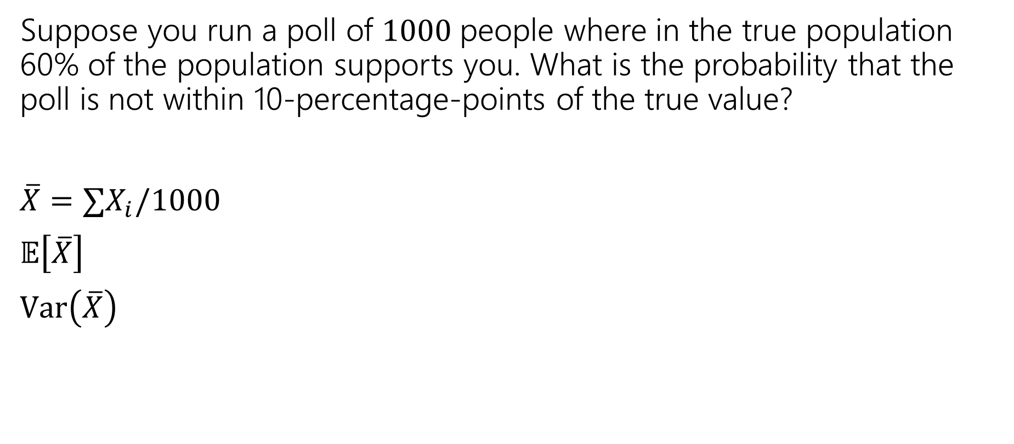
Near the mean (activity)
Suppose you run a poll of $1000$people where in the true population 60% of the population supports you. What is the probability that the poll is not within 10-percentage-points of the true value?
$\overline{X}=∑X_{i}/1000$
$𝔼\left[\overline{X}\right]$
$Var\left(\overline{X}\right)$
Let $X$ be a random variable. For any $t>0$
$$ℙ\left(\left|X−𝔼\left[X\right]\right|≥t\right)≤\frac{Var(X)}{t^{2}}$$
Chebyshev’s Inequality

Slide 32
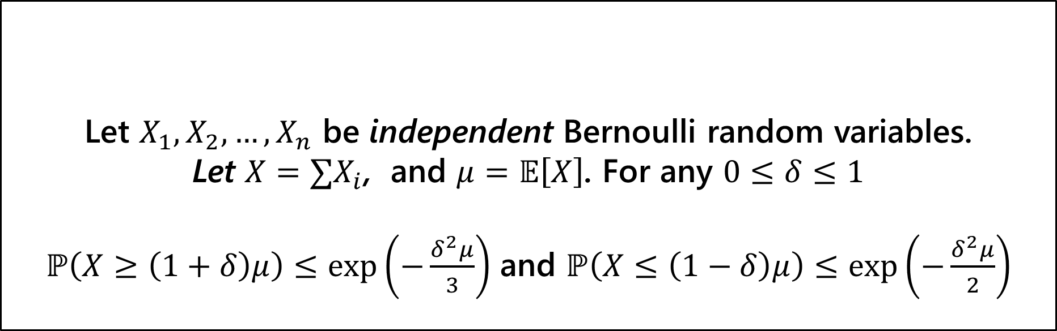
More Assumptions → Better Guarantee
Let $X_{1},X_{2},…,X_{n}$ be independent Bernoulli random variables.
Let $X=∑X_{i}$, and $μ=𝔼\left[X\right]$. For any $0≤δ≤1$
$ℙ\left(X≥\left(1+δ\right)μ\right)≤\exp\left(−\frac{δ^{2}μ}{3}\right)$ and $ℙ\left(X≤\left(1−δ\right)μ\right)≤\exp\left(−\frac{δ^{2}μ}{2}\right)$
(Multiplicative) Chernoff Bound

Slide 33

Left Tail (activity)
Suppose you run a poll of $1000$people where in the true population 60% of the population supports you. What is the probability that the poll is not within 10-percentage-points of the true value?
Want $ℙ\left(\frac{X}{1000}≤.5\right)=ℙ(X≤.5⋅1000)$
Let $X_{1},X_{2},…,X_{n}$ be independent Bernoulli random variables.
Let $X=∑X_{i}$, and $μ=𝔼\left[X\right]$. For any $0≤δ≤1$
$ℙ\left(X≤\left(1−δ\right)μ\right)≤\exp\left(−\frac{δ^{2}μ}{2}\right)$
Chernoff Bound (left tail)

Slide 34

One More Bound
The Union bound
For any events $E,F$
$$ℙ\left(E∪F\right)≤ℙ\left(E\right)+ℙ(F)$$
Union Bound
Proof? $ℙ\left(E∪F\right)=ℙ\left(E\right)+ℙ\left(F\right)−ℙ(E∩F)$
And $ℙ\left(E∩F\right)≥0$.

