Slide 1
Tail Bounds
CSE 312 Winter 26
Lecture 19

Slide 2
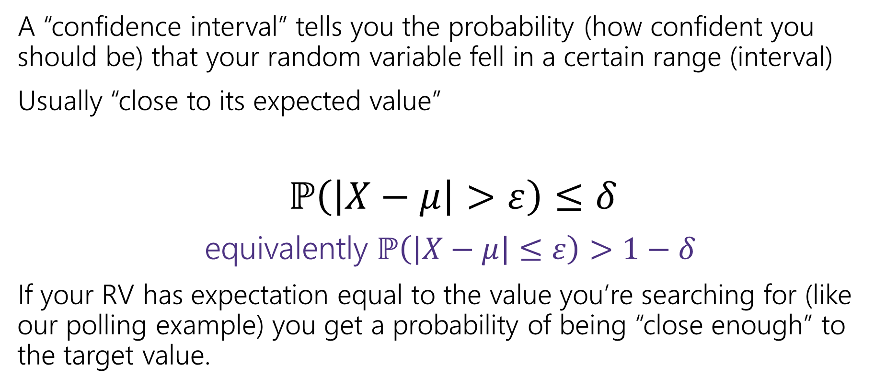
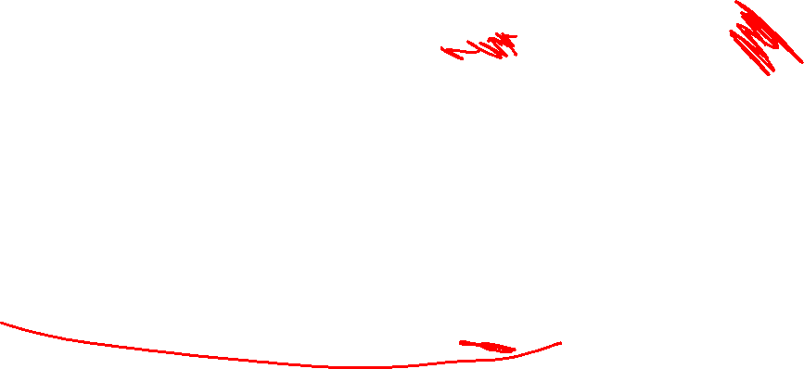
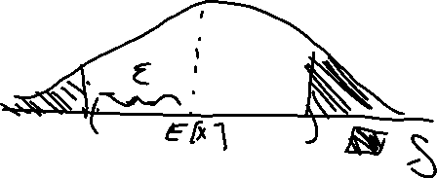
Confidence Intervals
A “confidence interval” tells you the probability (how confident you should be) that your random variable fell in a certain range (interval)
Usually “close to its expected value”
$ℙ\left(\left|X−μ\right|>ε\right)≤δ$
equivalently $ℙ\left(\left|X−μ\right|≤ε\right)>1−δ$
If your RV has expectation equal to the value you’re searching for (like our polling example) you get a probability of being “close enough” to the target value.

Slide 3

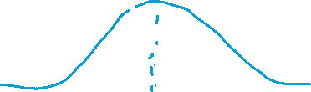
What’s a Tail Bound?
When we were finding our margin of error, we didn’t need an exact calculation of the probability.
We needed an inequality: the probability of being outside the margin of error was at most 5%.
A tail bound (or concentration inequality) is a statement that bounds the probability in the “tails” of the distribution (says there’s very little probability far from the center) or (equivalently) says that the probability is concentrated near the expectation.

Slide 4
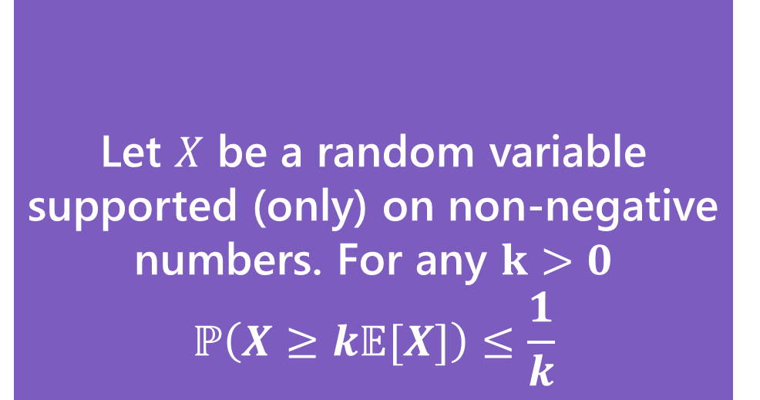
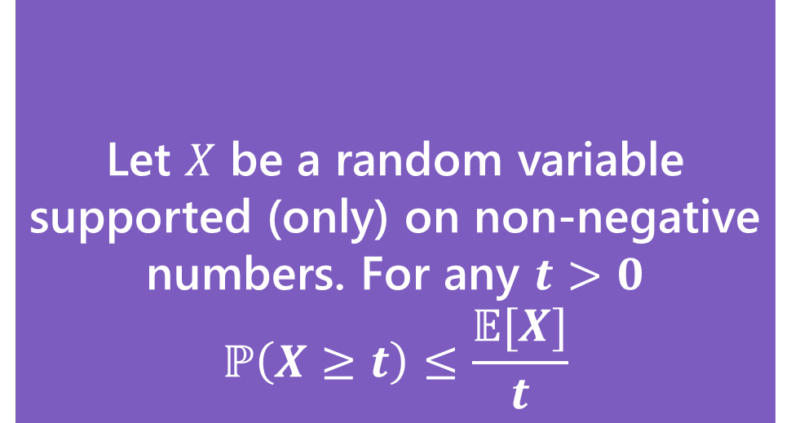
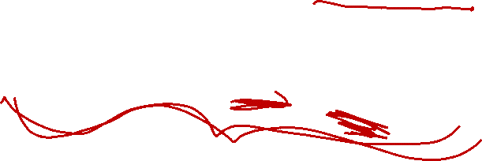
Our First bound
Two statements are equivalent. Left form is often easier to use. Right form is more intuitive.
Let $X$ be a random variable supported (only) on non-negative numbers. For any $t>0$
$$ℙ\left(X≥t\right)≤\frac{𝔼[X]}{t}$$
Let $X$ be a random variable supported (only) on non-negative numbers. For any $k>0$
$$ℙ\left(X≥k𝔼[X]\right)≤\frac{1}{k}$$
Markov’s Inequality
Markov’s Inequality
To apply this bound you only need to know:
1. it’s non-negative
2. Its expectation.

Slide 5

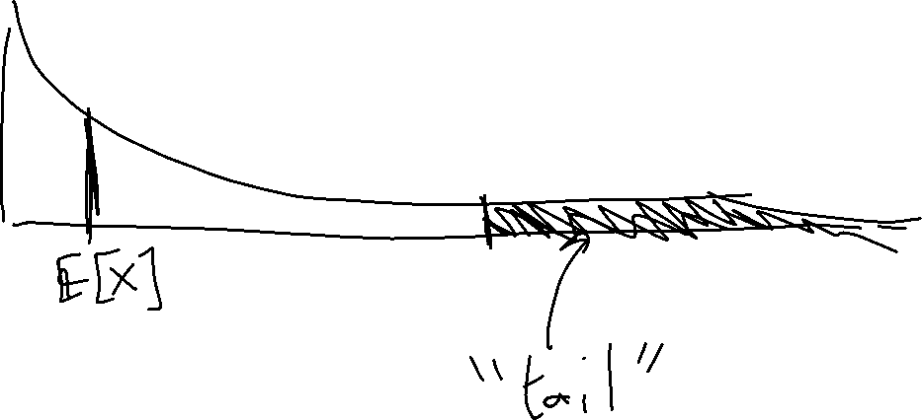
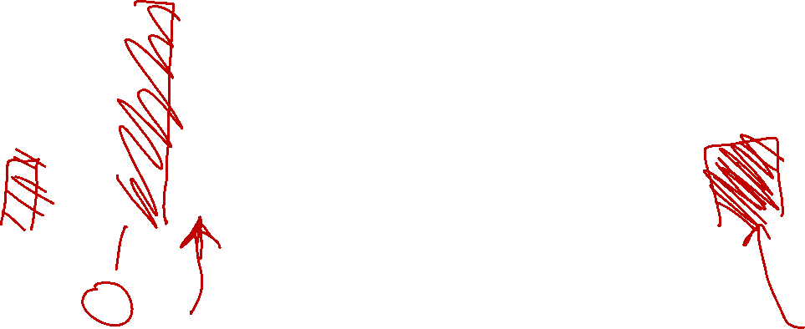
One-sided Tail

Slide 6
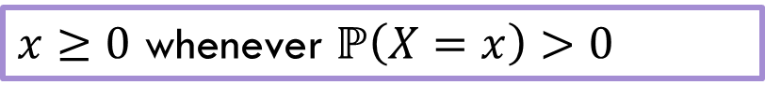
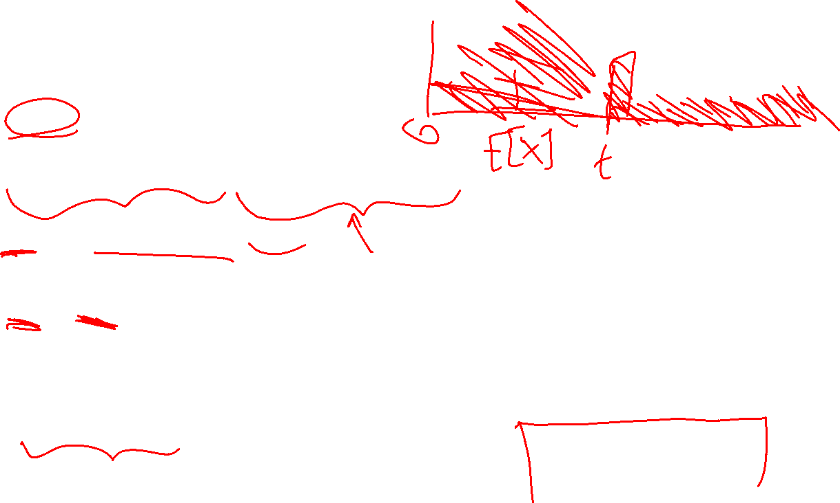
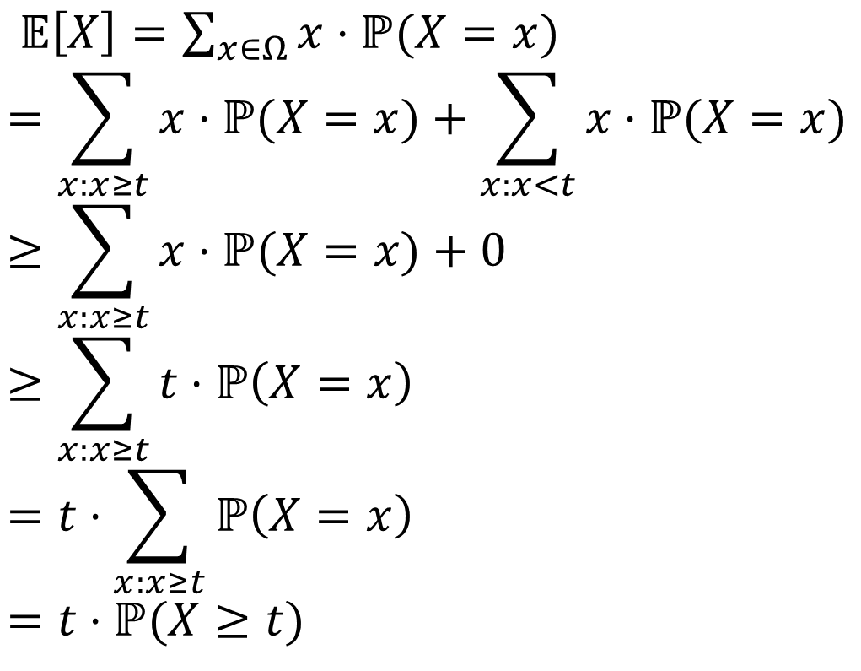
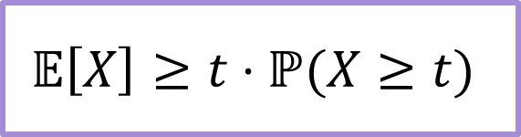
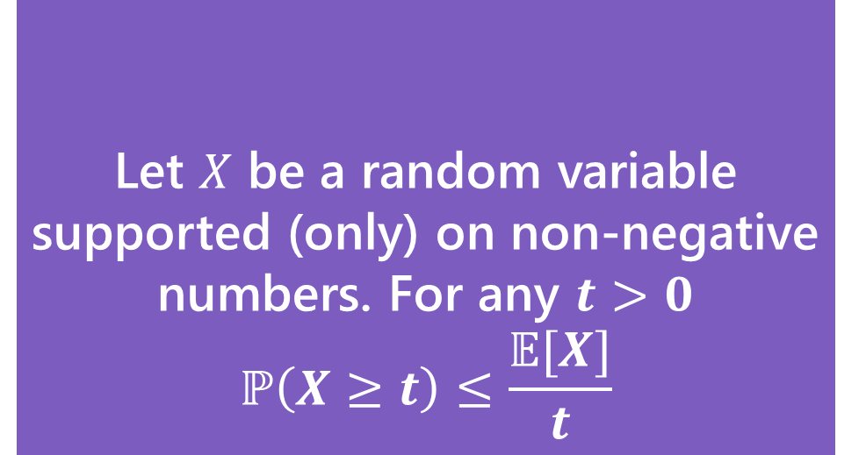
Proof
$𝔼\left[X\right]=\sum_{x∈Ω}{x⋅ℙ(X=x)}$
$$=\sum_{x:x≥t}{x⋅ℙ(X=x)}+\sum_{x:x<t}{x⋅ℙ(X=x)}$$
$$≥\sum_{x:x≥t}{x⋅ℙ(X=x)}+0$$
$$≥\sum_{x:x≥t}{t⋅ℙ\left(X=x\right)}$$
$$=t⋅\sum_{x:x≥t}{ℙ\left(X=x\right)}$$
$$=t⋅ℙ(X≥t)$$
$x≥0$ whenever $ℙ\left(X=x\right)>0$
Let $X$ be a random variable supported (only) on non-negative numbers. For any $t>0$
$$ℙ\left(X≥t\right)≤\frac{𝔼[X]}{t}$$
Markov’s Inequality
$$𝔼\left[X\right]≥t⋅ℙ(X≥t)$$

Slide 7
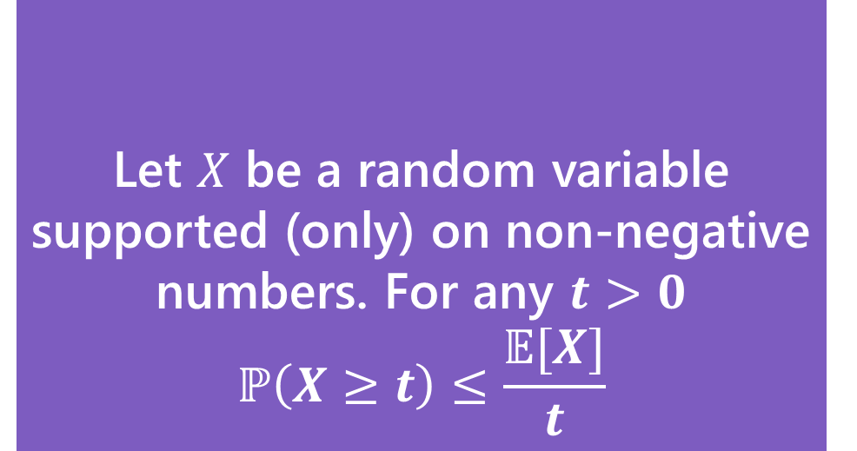
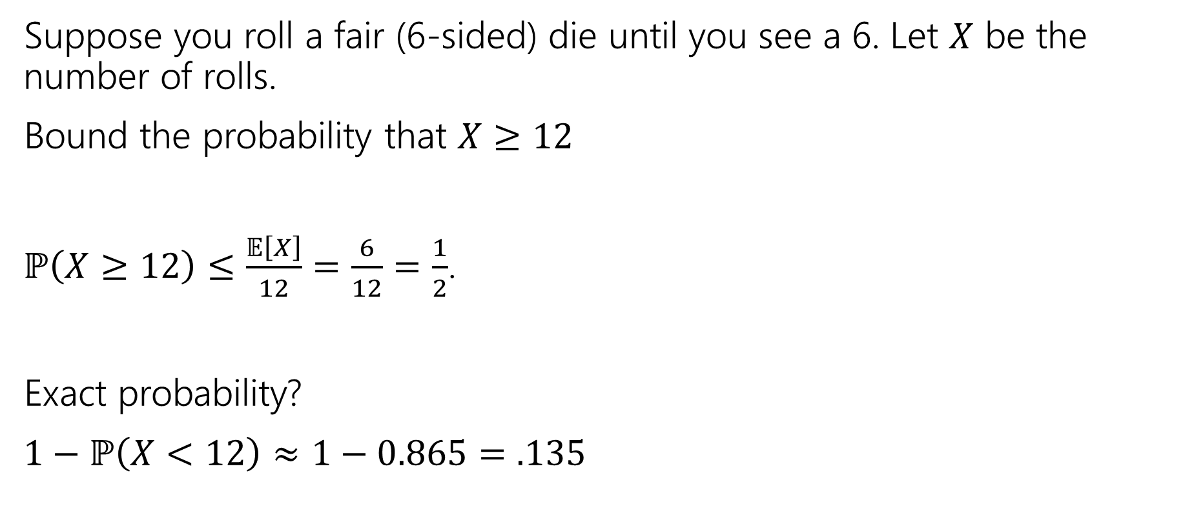
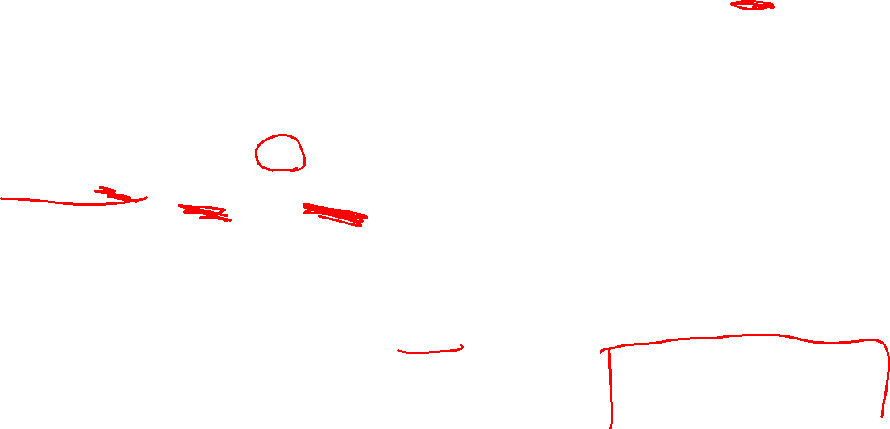
Example with geometric RV
Suppose you roll a fair (6-sided) die until you see a 6. Let $X$ be the number of rolls.
Bound the probability that $X≥12$
$ℙ\left(X≥12\right)≤\frac{𝔼\left[X\right]}{12}=\frac{6}{12}=\frac{1}{2}$.
Exact probability?
$1−ℙ\left(X<12\right)≈1−0.865=.135$
Let $X$ be a random variable supported (only) on non-negative numbers. For any $t>0$
$$ℙ\left(X≥t\right)≤\frac{𝔼[X]}{t}$$
Markov’s Inequality

Slide 8

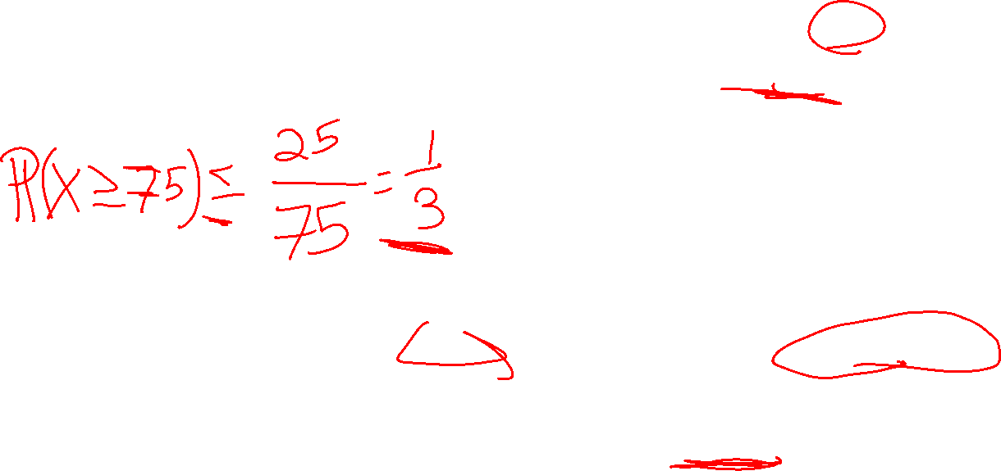
A Second Example
Suppose the average number of ads you see on a website is 25. Give an upper bound on the probability of seeing a website with 75 or more ads.
Let $X$ be a random variable supported (only) on non-negative numbers. For any $t>0$
$$ℙ\left(X≥t\right)≤\frac{𝔼[X]}{t}$$
Markov’s Inequality

Slide 9

A Second Example (answer)
Suppose the average number of ads you see on a website is 25. Give an upper bound on the probability of seeing a website with 75 or more ads.
$ℙ\left(X≥75\right)≤\frac{𝔼\left[X\right]}{75}=\frac{25}{75}=\frac{1}{3}$
Let $X$ be a random variable supported (only) on non-negative numbers. For any $t>0$
$$ℙ\left(X≥t\right)≤\frac{𝔼[X]}{t}$$
Markov’s Inequality

Slide 10

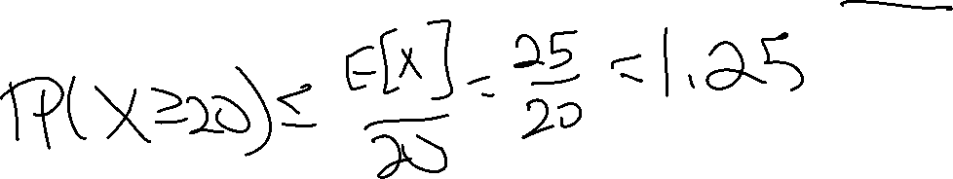
Useless Example
Suppose the average number of ads you see on a website is 25. Give an upper bound on the probability of seeing a website with 20 or more ads.
Let $X$ be a random variable supported (only) on non-negative numbers. For any $t>0$
$$ℙ\left(X≥t\right)≤\frac{𝔼[X]}{t}$$
Markov’s Inequality

Slide 11
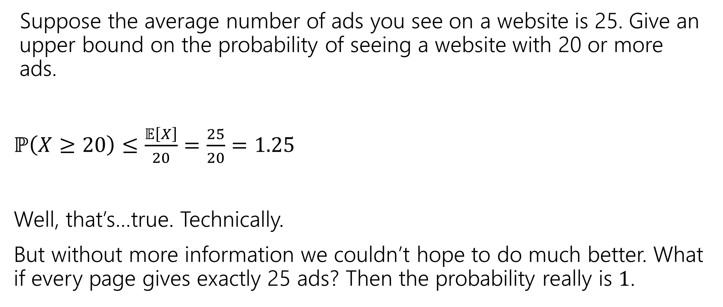
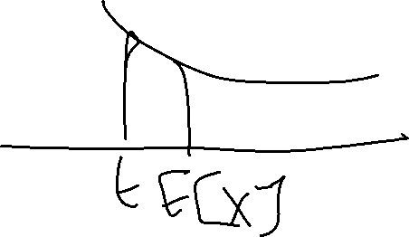
Useless Example (answer)
Suppose the average number of ads you see on a website is 25. Give an upper bound on the probability of seeing a website with 20 or more ads.
$ℙ\left(X≥20\right)≤\frac{𝔼\left[X\right]}{20}=\frac{25}{20}=1.25$
Well, that’s…true. Technically.
But without more information we couldn’t hope to do much better. What if every page gives exactly 25 ads? Then the probability really is $1$.

Slide 12

So…what do we do?
A better inequality!
We’re trying to bound the tails of the distribution.
What parameter of a random variable describes the tails?
The variance!

Slide 13
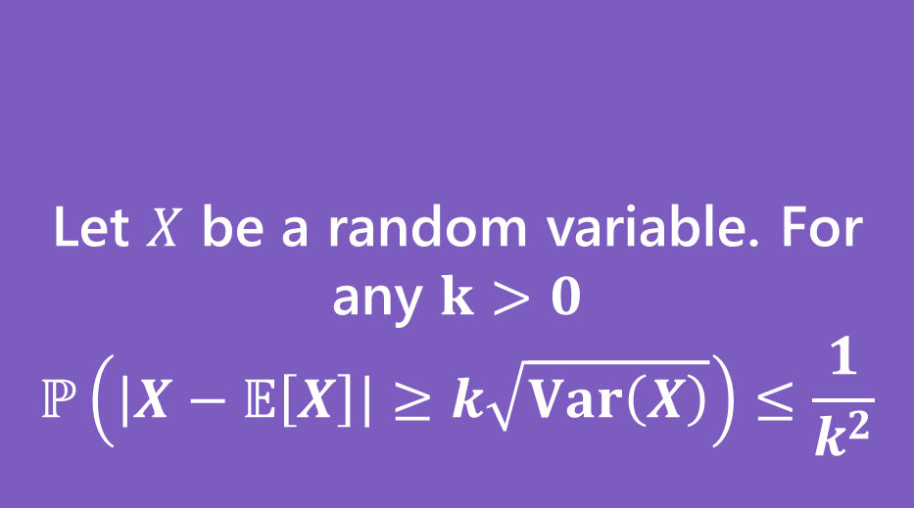
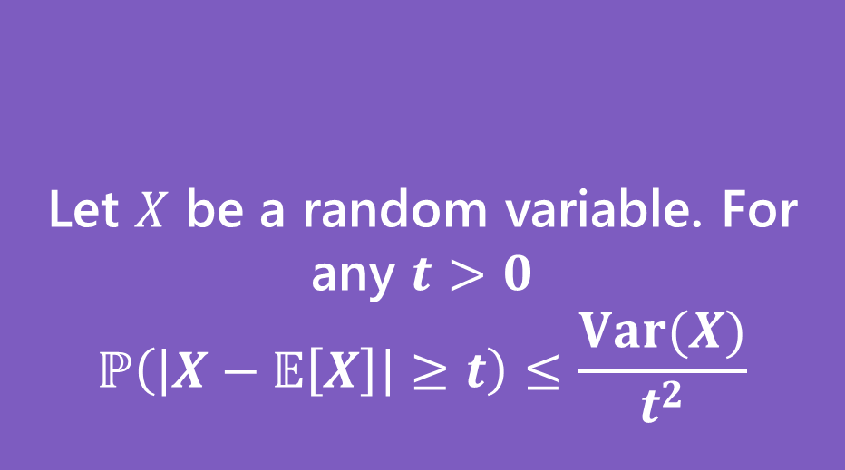

Chebyshev’s Inequality
Two statements are equivalent. Left form is often easier to use. Right form is more intuitive.
Let $X$ be a random variable. For any $t>0$
$$ℙ\left(\left|X−𝔼\left[X\right]\right|≥t\right)≤\frac{Var(X)}{t^{2}}$$
Let $X$ be a random variable. For any $k>0$
$$ℙ\left(\left|X−𝔼\left[X\right]\right|≥k\sqrt{Var\left(X\right)}\right)≤\frac{1}{k^{2}}$$
Chebyshev’s Inequality
Chebyshev’s Inequality

Slide 14


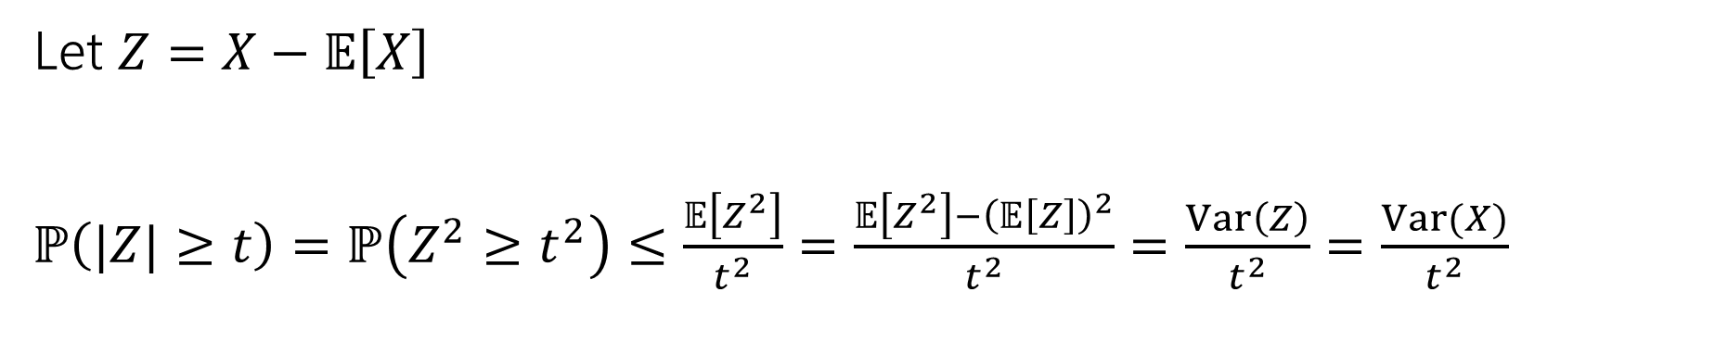

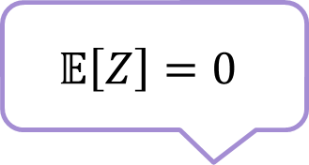
Proof of Chebyshev
Let $X$ be a random variable. For any $t>0$
$$ℙ\left(\left|X−𝔼\left[X\right]\right|≥t\right)≤\frac{Var(X)}{t^{2}}$$
Chebyshev’s Inequality
Let $Z=X−𝔼\left[X\right]$
$ℙ\left(|Z|≥t\right)=ℙ\left(Z^{2}≥t^{2}\right)≤\frac{𝔼\left[Z^{2}\right]}{t^{2}}=\frac{𝔼\left[Z^{2}\right]−{\left(𝔼\left[Z\right]\right)}^{2}}{t^{2}}=\frac{Var\left(Z\right)}{t^{2}}=\frac{Var(X)}{t^{2}}$
Markov’s Inequality
$$𝔼\left[Z\right]=0$$
Inequalities are equivalent (square each side).
$Z$ is just $X$ shifted. Variance is unchanged.

Slide 15

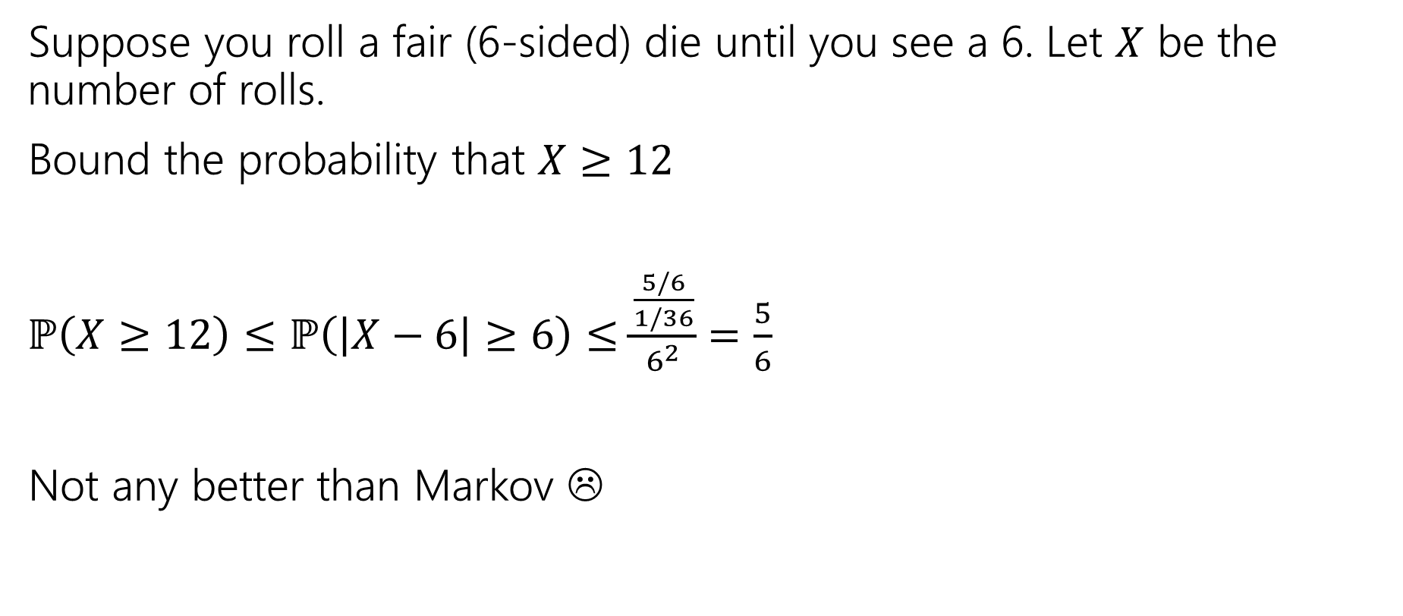

Example with geometric RV (Chebyshev)
Suppose you roll a fair (6-sided) die until you see a 6. Let $X$ be the number of rolls.
Bound the probability that $X≥12$
$ℙ\left(X≥12\right)≤ℙ\left(\left|X−6\right|≥6\right)≤\frac{\frac{5/6}{1/36}}{6^{2}}$ $=\frac{5}{6}$
Not any better than Markov ☹
Let $X$ be a random variable. For any $t>0$
$$ℙ\left(\left|X−𝔼\left[X\right]\right|≥t\right)≤\frac{Var(X)}{t^{2}}$$
Chebyshev’s Inequality

Slide 16
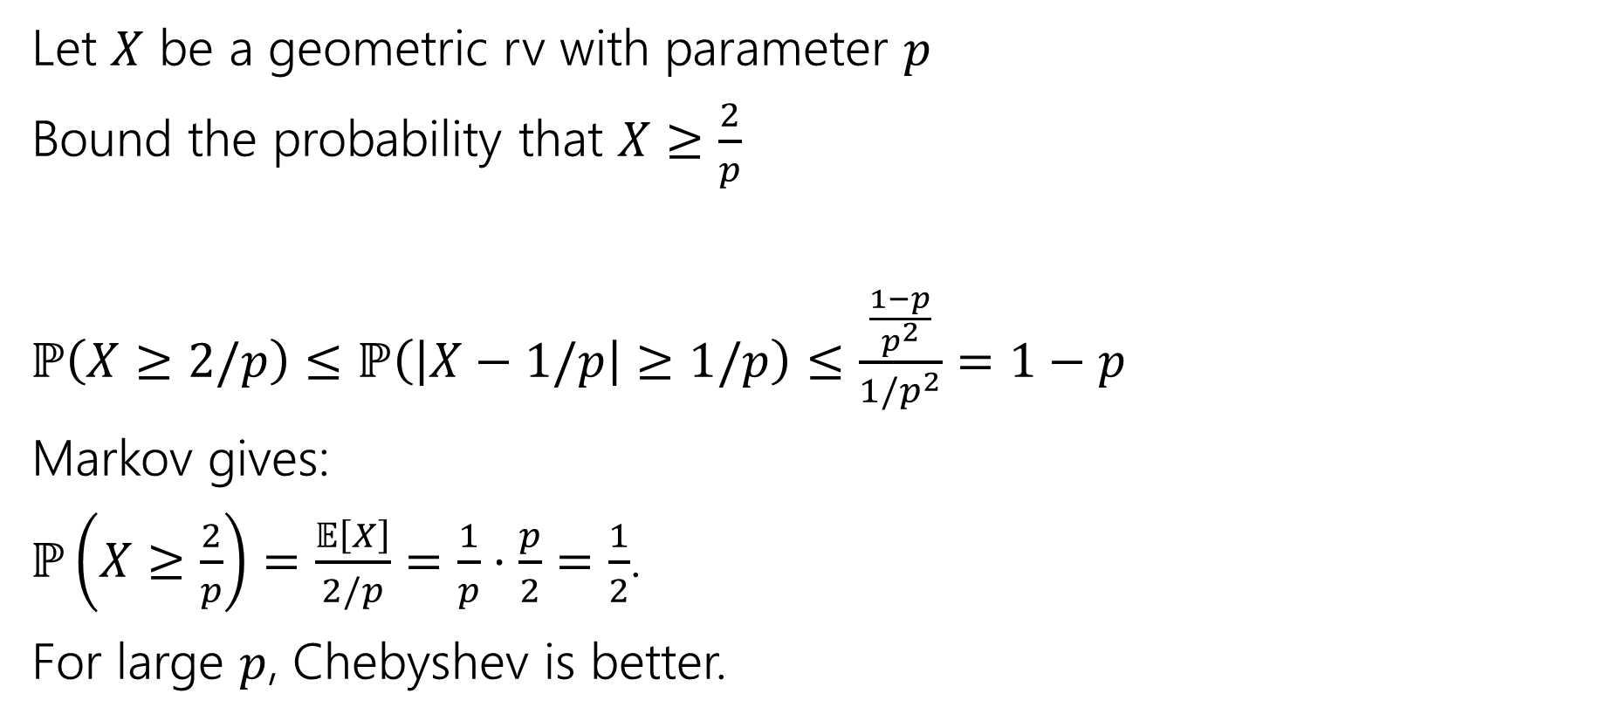
Example with geometric RV (general p)
Let $X$ be a geometric rv with parameter $p$
Bound the probability that $X≥\frac{2}{p}$
$ℙ\left(X≥2/p\right)≤ℙ\left(\left|X−1/p\right|≥1/p\right)≤\frac{\frac{1−p}{p^{2}}}{{1/p}^{2}}$ $=1−p$
Markov gives:
$ℙ\left(X≥\frac{2}{p}\right)=\frac{𝔼\left[X\right]}{2/p}=\frac{1}{p}⋅\frac{p}{2}=\frac{1}{2}$.
For large $p$, Chebyshev is better.
Let $X$ be a random variable. For any $t>0$
$$ℙ\left(\left|X−𝔼\left[X\right]\right|≥t\right)≤\frac{Var(X)}{t^{2}}$$
Chebyshev’s Inequality

Slide 17
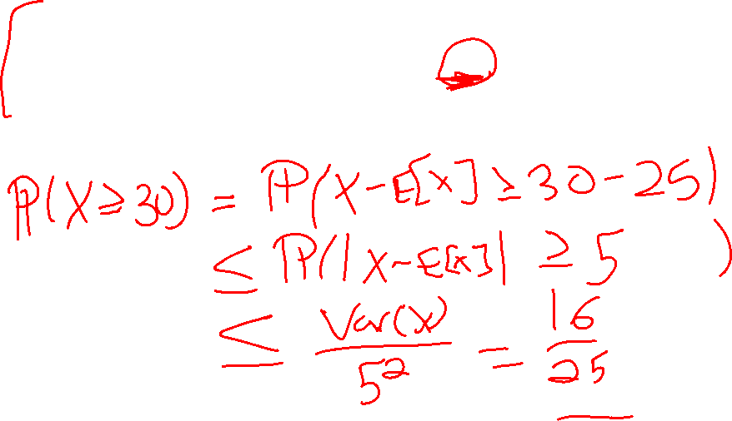
Better Example
Suppose the average number of ads you see on a website is 25. And the variance of the number of ads is 16. Give an upper bound on the probability of seeing a website with 30 or more ads.

Slide 18
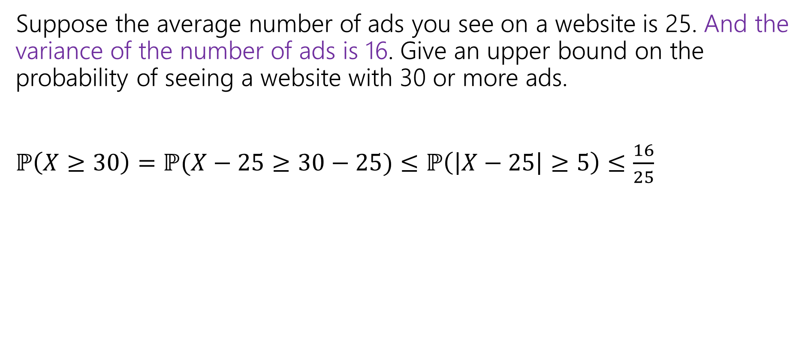
Better Example (answer)
Suppose the average number of ads you see on a website is 25. And the variance of the number of ads is 16. Give an upper bound on the probability of seeing a website with 30 or more ads.
$ℙ\left(X≥30\right)=ℙ(X−25≥30−25)≤ℙ\left(\left|X−25\right|≥5\right)≤\frac{16}{25}$

Slide 19

Chebyshev’s – Repeated Experiments
How many coin flips (each head with probability $p$) are needed until you get $n$ heads.
Let $X$ be the number necessary. What is probability $X≥2n/p$?
Markov
Chebyshev

Slide 20
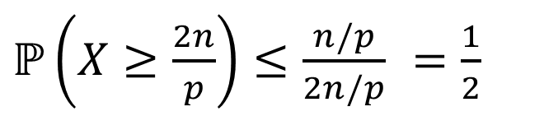
Chebyshev’s – Repeated Experiments answer
How many coin flips (each head with probability $p$) are needed until you get $n$ heads.
Let $X$ be the number necessary. What is probability $X≥2n/p$?
Markov
Chebyshev
$ℙ\left(X≥\frac{2n}{p}\right)≤\frac{n/p}{2n/p}$ $=\frac{1}{2}$
$ℙ\left(X≥\frac{2n}{p}\right)≤ℙ\left(\left|X−\frac{n}{p}\right|≥\frac{n}{p}\right)≤\frac{Var(X)}{n^{2}/p^{2}}$ $=\frac{n(1−p)/p^{2}}{n^{2}/p^{2}}$ $=\frac{1−p}{n}$

Slide 21
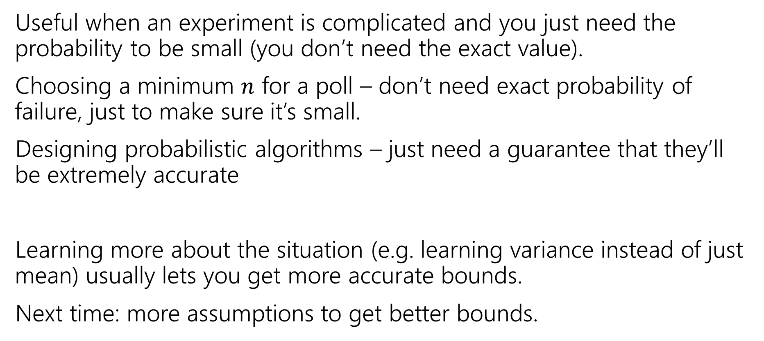
Tail Bounds – Takeaways
Useful when an experiment is complicated and you just need the probability to be small (you don’t need the exact value).
Choosing a minimum $n$ for a poll – don’t need exact probability of failure, just to make sure it’s small.
Designing probabilistic algorithms – just need a guarantee that they’ll be extremely accurate
Learning more about the situation (e.g. learning variance instead of just mean) usually lets you get more accurate bounds.
Next time: more assumptions to get better bounds.

Slide 22
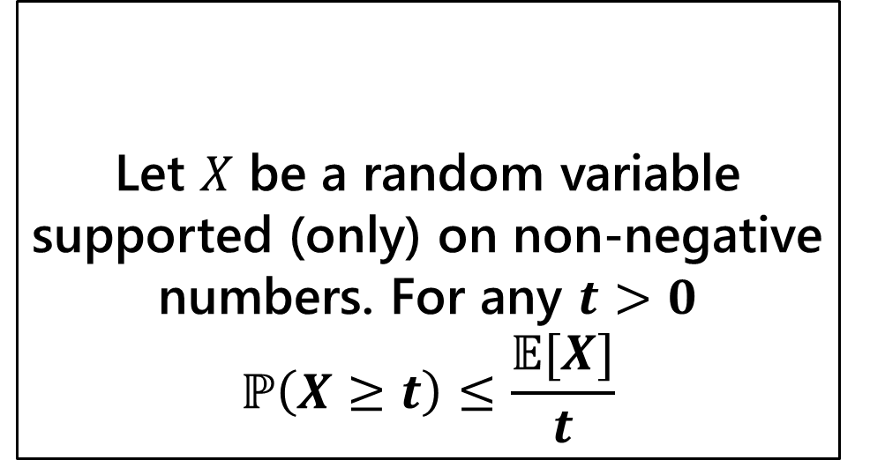
A Second Example
Suppose the average number of ads you see on a website is 25. Give an upper bound on the probability of seeing a website with 75 or more ads.
Let $X$ be a random variable supported (only) on non-negative numbers. For any $t>0$
$$ℙ\left(X≥t\right)≤\frac{𝔼[X]}{t}$$
Markov’s Inequality

Slide 23
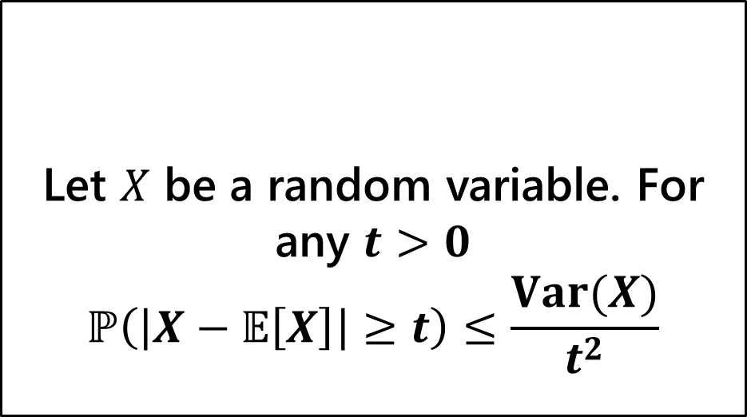
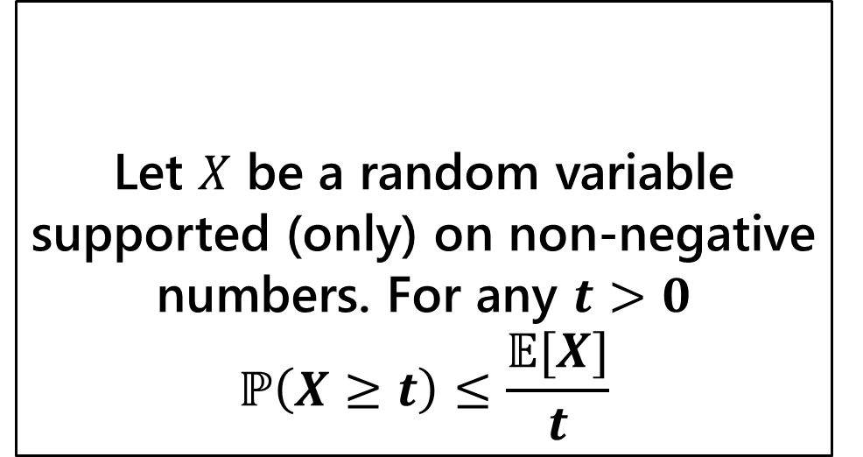
Our First Two Inequalities
Let $X$ be a random variable supported (only) on non-negative numbers. For any $t>0$
$$ℙ\left(X≥t\right)≤\frac{𝔼[X]}{t}$$
Let $X$ be a random variable. For any $t>0$
$$ℙ\left(\left|X−𝔼\left[X\right]\right|≥t\right)≤\frac{Var(X)}{t^{2}}$$
Markov’s Inequality
Chebyshev’s Inequality

