Slide 1




















Wrap CLT
CSE 312 Winter 26
Lecture 18

Slide 2
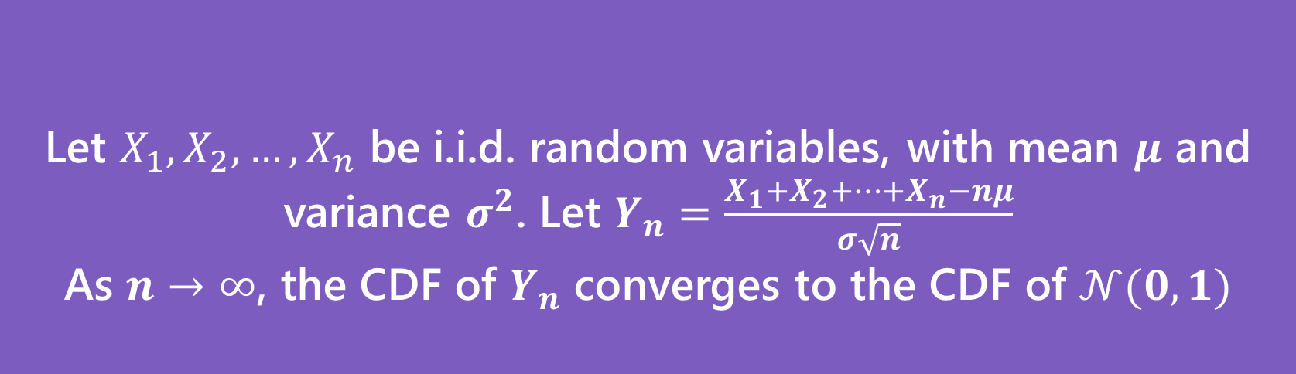

Why Learn Normals?
When we add together independent normal random variables, you get another normal random variable.
The sum of any independent random variables approaches a normal distribution.
Let $X_{1},X_{2},…,X_{n}$ be i.i.d. random variables, with mean $μ$ and variance $σ^{2}$. Let $Y_{n}=\frac{X_{1}+X_{2}+…+X_{n}−nμ}{σ\sqrt{n}}$
As $n→∞$, the CDF of $Y_{n}$ converges to the CDF of $𝒩(0,1)$
Central Limit Theorem

Slide 3
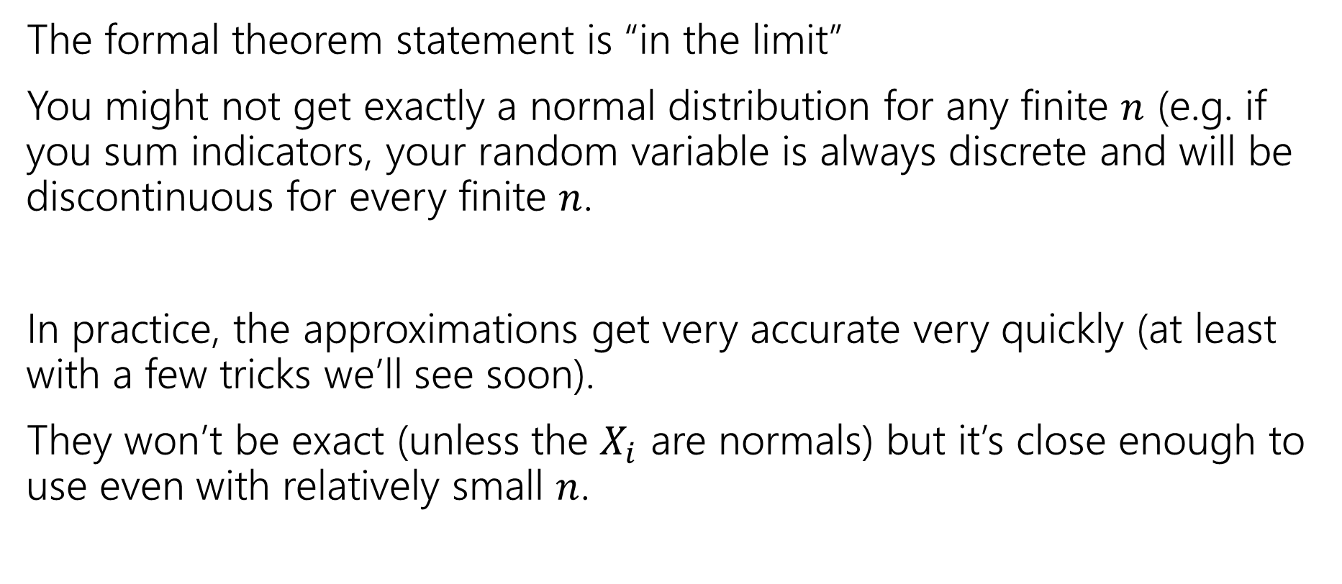

Theory vs. Practice
The formal theorem statement is “in the limit”
You might not get exactly a normal distribution for any finite $n$ (e.g. if you sum indicators, your random variable is always discrete and will be discontinuous for every finite $n$.
In practice, the approximations get very accurate very quickly (at least with a few tricks we’ll see soon).
They won’t be exact (unless the $X_{i}$ are normals) but it’s close enough to use even with relatively small $n$.

Slide 4

Using the Central Limit Theorem
Suppose you are managing a factory, that produces widgets. Each widget produced is defective (independently) with probability 5%.
Your factory will produce 1000 (possibly defective) widgets. You want to know what the chances are of having a “very bad day” where “very bad” means producing at most 940 non-defective widgets.
(In expectation, you produce 950 non-defective widgets)
What is the probability?

Slide 5


True Answer
Let $X\sim Bin(1000,.95)$
What is $ℙ(X≤940)$?
The cdf is ugly…and that’s a big summation.
$\sum_{k=0}^{940}{\left({1000 \atop k}\right)(.{95)}^{k}⋅(.{05)}^{1000−k}≈}.08673$
What does the CLT give?
Notes:
Ugly for a few reasons
- This is actually 941 computations. Sometimes you can make that smaller (59 via complement), but that’s still a lot of computations
C(1000,k) is annoying to compute; it’s a very huge number divided by a huge number. Even if you’re careful.
Then you have a small number raised to a big power
Then you combine the huge number times the tiny number and get a small number.
If you just write the first piece of code you think of to compute this, it probably won’t get you a good answer because of some combination of overflow and underflow.

Slide 6
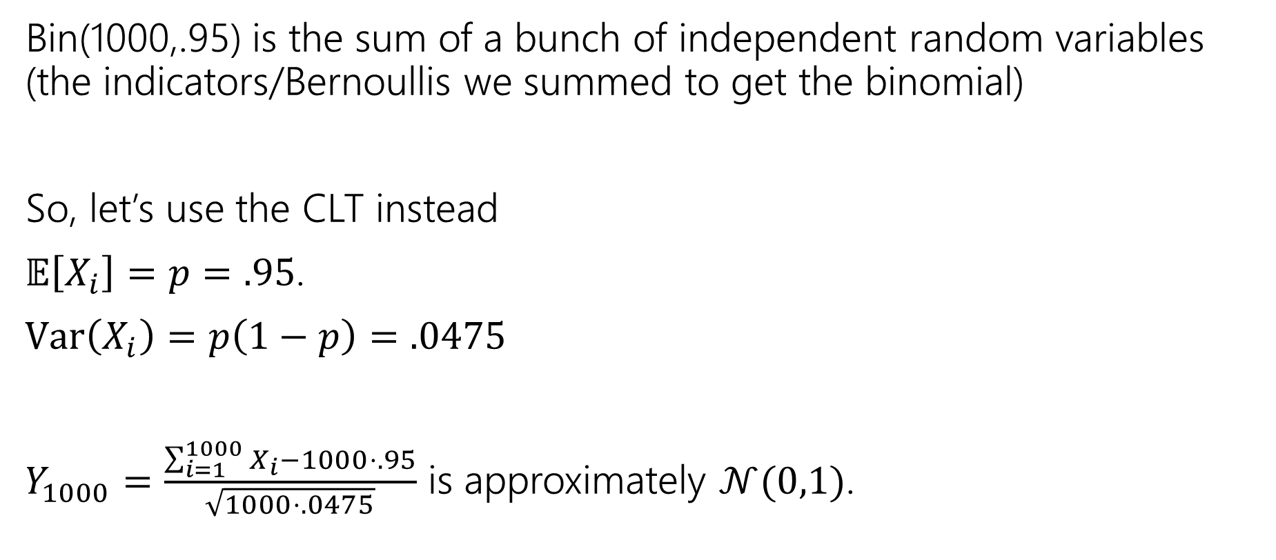
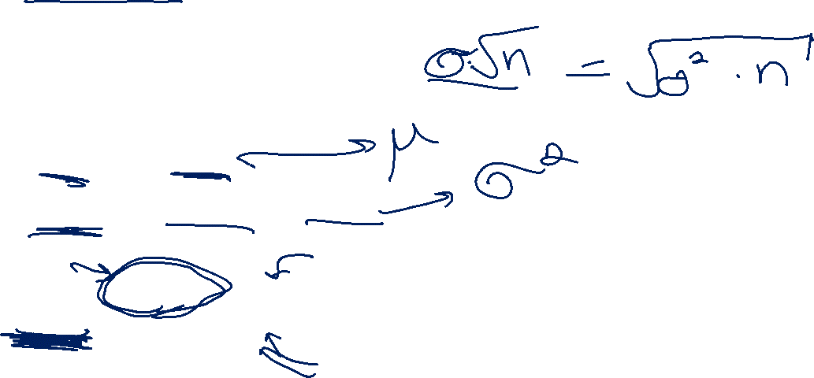
CLT setup
Bin(1000,.95) is the sum of a bunch of independent random variables (the indicators/Bernoullis we summed to get the binomial)
So, let’s use the CLT instead
$𝔼\left[X_{i}\right]=p=.95$.
$Var\left(X_{i}\right)=p\left(1−p\right)=.0475$
$Y_{1000}=\frac{\sum_{i=1}^{1000}{X_{i}}−1000⋅.95}{\sqrt{1000⋅.0475}}$ is approximately $𝒩(0,1)$.

Slide 7
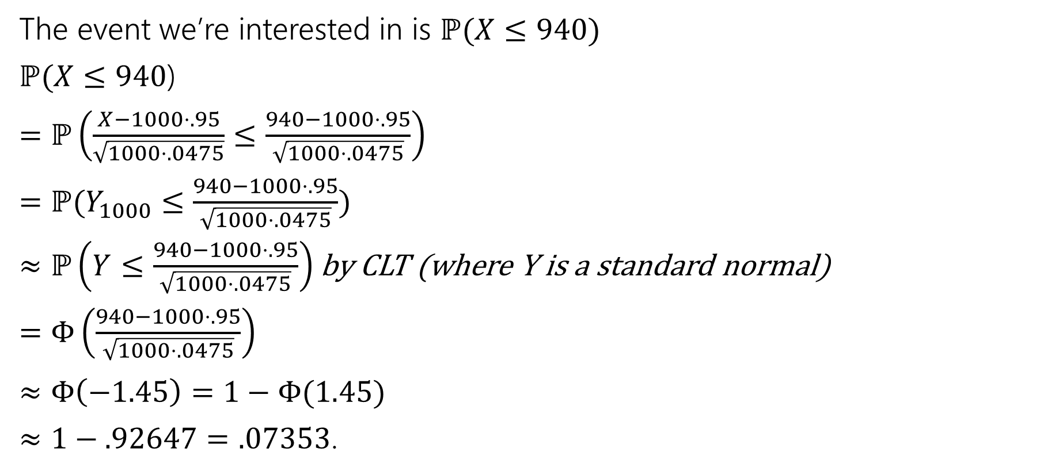
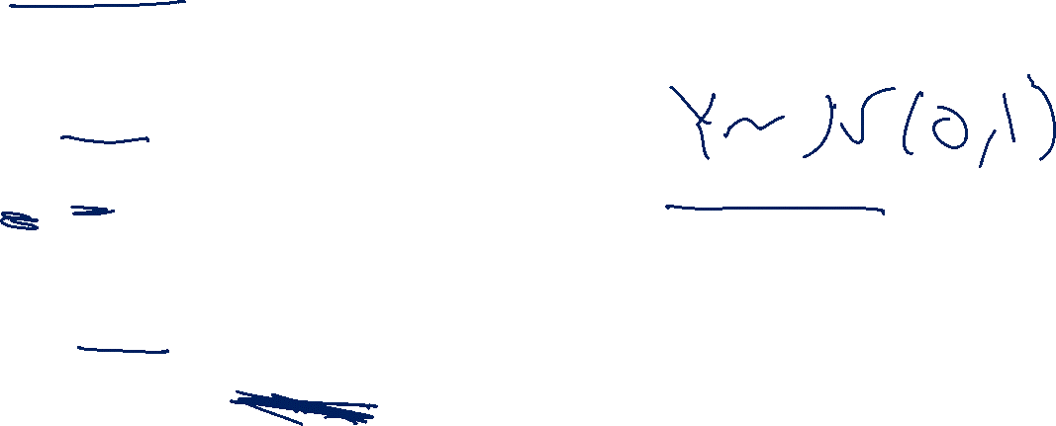
With the CLT.
The event we’re interested in is $ℙ(X≤940)$
$ℙ(X≤940$)
$=ℙ\left(\frac{X−1000⋅.95}{\sqrt{1000⋅.0475}}≤\frac{940−1000⋅.95}{\sqrt{1000⋅.0475}}\right)$
$=ℙ(Y_{1000}≤\frac{940−1000⋅.95}{\sqrt{1000⋅.0475}})$
$≈ℙ\left(Y≤\frac{940−1000⋅.95}{\sqrt{1000⋅.0475}}\right)$ by CLT (where Y is a standard normal)
$=Φ\left(\frac{940−1000⋅.95}{\sqrt{1000⋅.0475}}\right)$
$≈Φ\left(−1.45\right)=1−Φ(1.45)$
$≈1−.92647=.07353$.

Slide 8
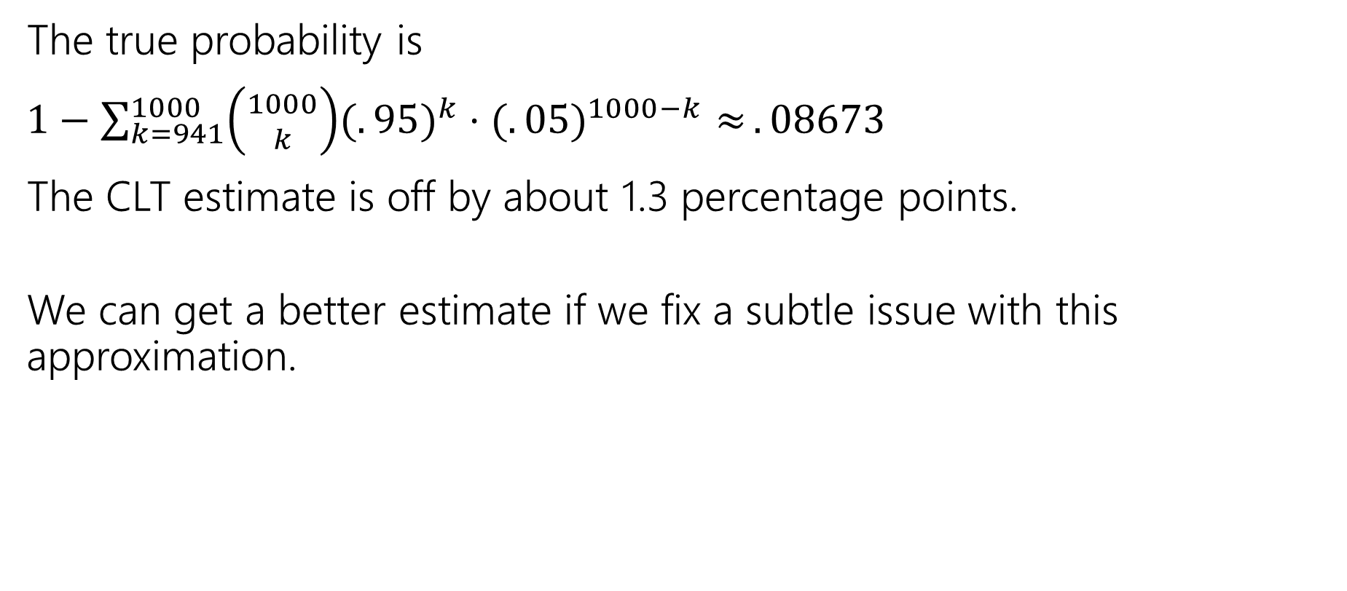
It’s an approximation!
The true probability is
$1−\sum_{k=941}^{1000}{\left({1000 \atop k}\right)(.{95)}^{k}⋅(.{05)}^{1000−k}≈}.08673$
The CLT estimate is off by about 1.3 percentage points.
We can get a better estimate if we fix a subtle issue with this approximation.

Slide 9

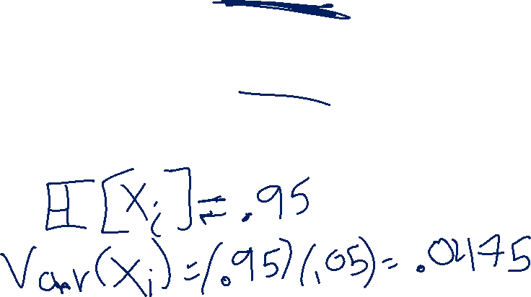
A problem
What’s the probability that $X=950$? (exactly)
True value, we can get with binomial:
$\left({1000 \atop 950}\right)⋅(.{95)}^{950}⋅(.05)^{50}≈.05779$
What does the CLT say?

Slide 10
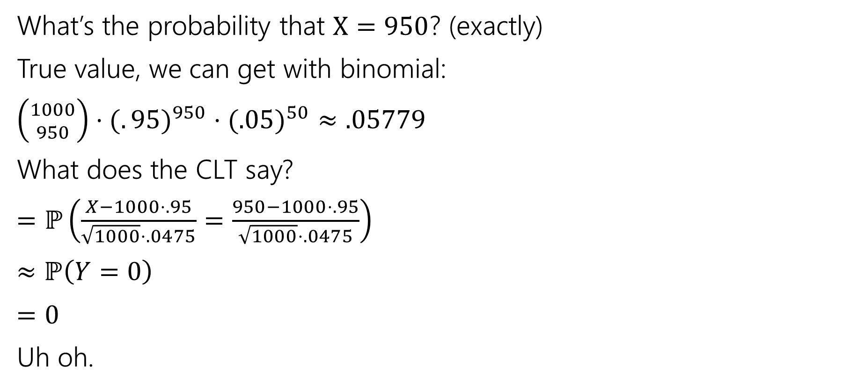
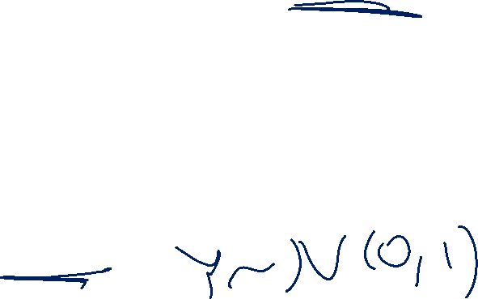
A problem
What’s the probability that $X=950$? (exactly)
True value, we can get with binomial:
$\left({1000 \atop 950}\right)⋅(.{95)}^{950}⋅(.05)^{50}≈.05779$
What does the CLT say?
$=ℙ\left(\frac{X−1000⋅.95}{\sqrt{1000}⋅.0475}=\frac{950−1000⋅.95}{\sqrt{1000}⋅.0475}\right)$
$≈ℙ\left(Y=0\right)$
$=0$
Uh oh.

Slide 11
Continuity Correction
The binomial distribution is discrete, but the normal is continuous.
Let’s correct for that (called a “continuity correction”)
Before we switch from the binomial to the normal, ask “what values of a continuous random variable would round to this event?”

Slide 12
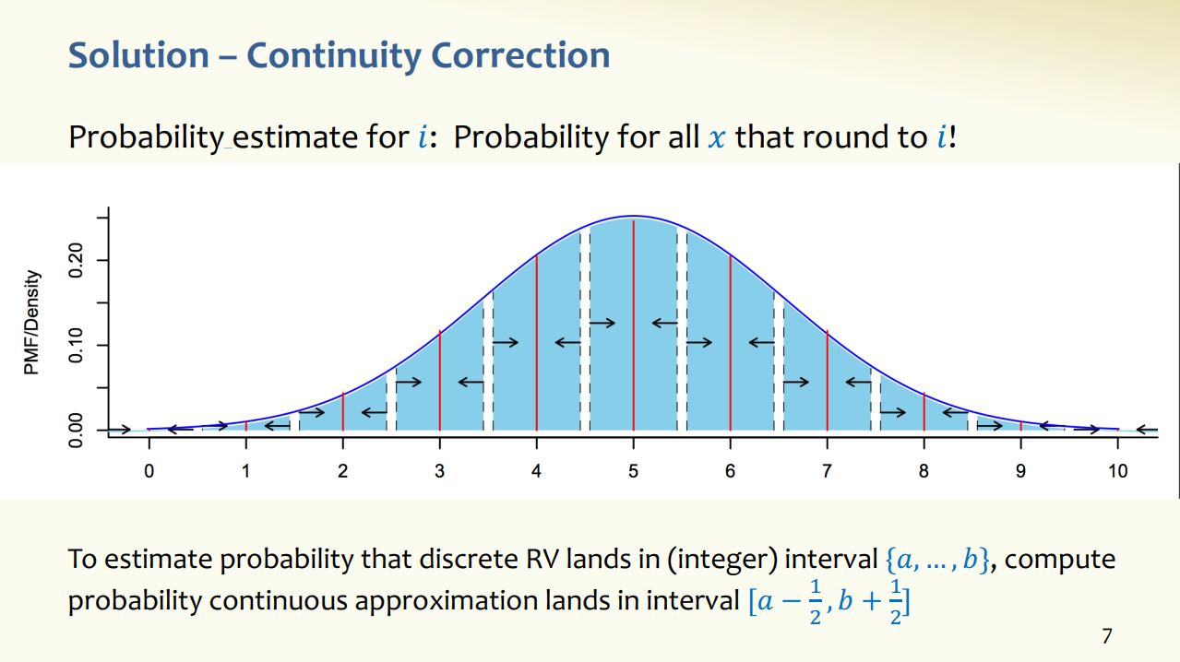

Slide from 24AU 312 (Rao/Tessaro)
Assumes discrete RV takes on integer values; if RV has different support, interval is different, but idea is same.

Slide 13

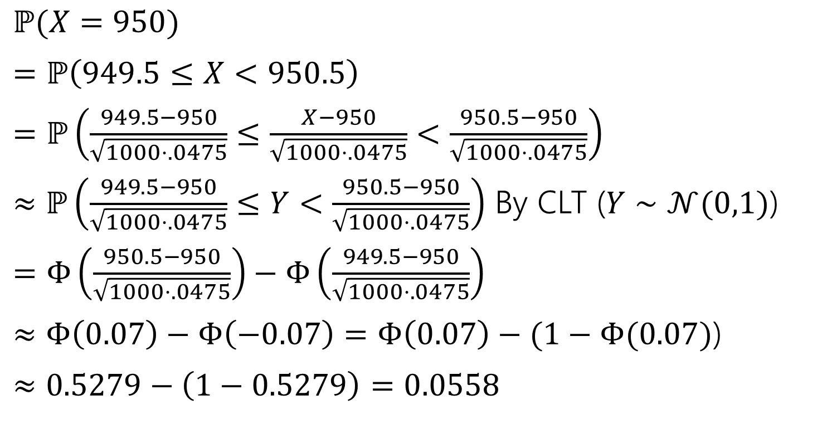

Applying the continuity correction
$ℙ(X=950)$
$=ℙ\left(949.5≤X<950.5\right)$
$=ℙ\left(\frac{949.5−950}{\sqrt{1000⋅.0475}}≤\frac{X−950}{\sqrt{1000⋅.0475}}<\frac{950.5−950}{\sqrt{1000⋅.0475}}\right)$
$≈ℙ\left(\frac{949.5−950}{\sqrt{1000⋅.0475}}≤Y<\frac{950.5−950}{\sqrt{1000⋅.0475}}\right)$ By CLT ($Y∼𝒩(0,1)$)
$=Φ\left(\frac{950.5−950}{\sqrt{1000⋅.0475}}\right)−Φ\left(\frac{949.5−950}{\sqrt{1000⋅.0475}}\right)$
$≈Φ\left(0.07\right)−Φ\left(−0.07\right)=Φ\left(0.07\right)−(1−Φ(0.07)$)
$≈0.5279−\left(1−0.5279\right)=0.0558$
Continuity correction.
This step really is an “exactly equal to”
The discrete rv $X$ can’t equal $950.2.$

Slide 14


Still an Approximation
$\left({1000 \atop 950}\right)⋅(.{95)}^{950}⋅(.05)^{50}≈.05779$ is the true value
The CLT approximates: $0.0558$
Very close! But still not perfect.

Slide 15

Let’s fix that other one
Question was “what’s the probability of seeing at most 940 non-defective widgets?”

Slide 16
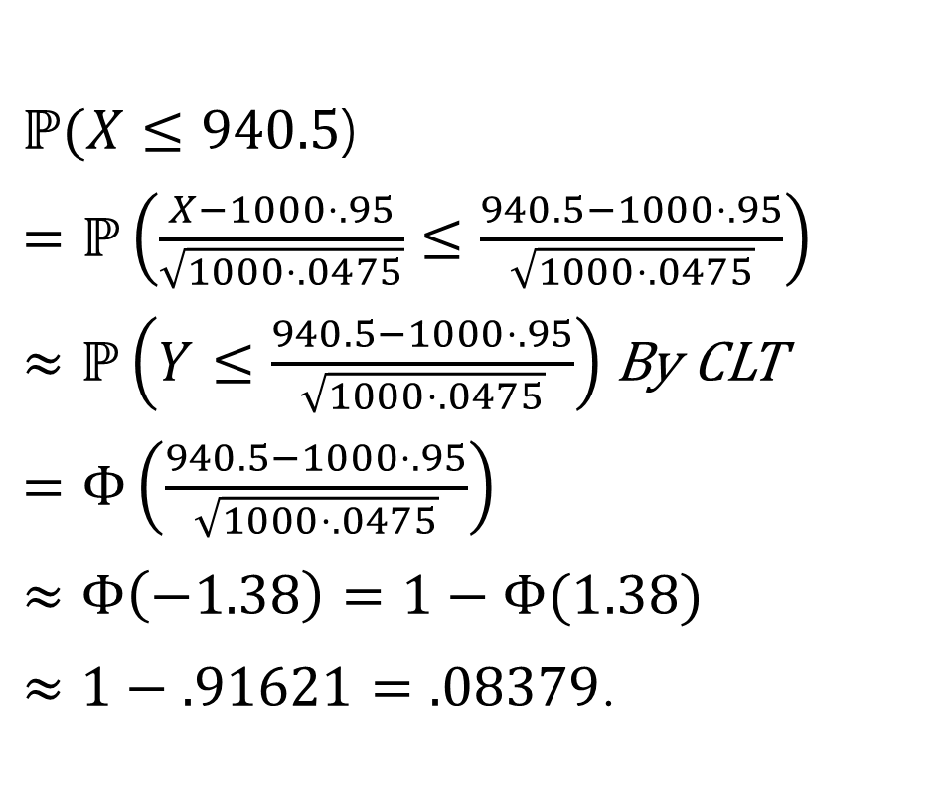
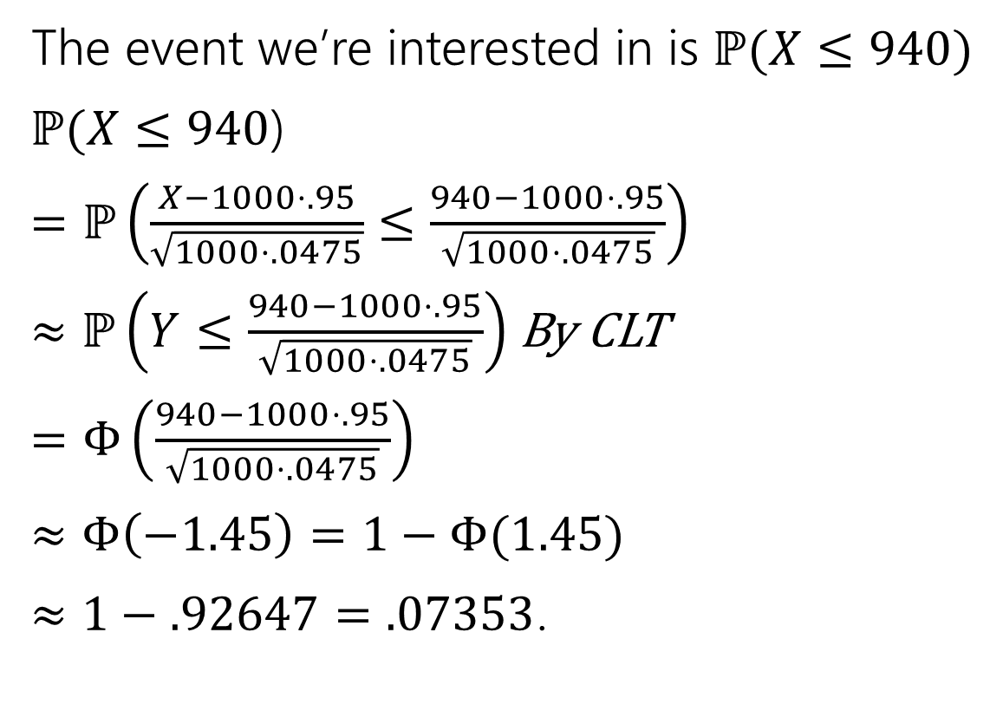

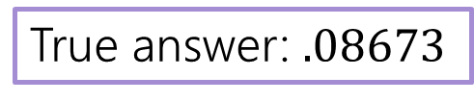
With the CLT.
The event we’re interested in is $ℙ(X≤940)$
$ℙ(X≤940$)
$=ℙ\left(\frac{X−1000⋅.95}{\sqrt{1000⋅.0475}}≤\frac{940−1000⋅.95}{\sqrt{1000⋅.0475}}\right)$
$≈ℙ\left(Y≤\frac{940−1000⋅.95}{\sqrt{1000⋅.0475}}\right)$ By CLT
$=Φ\left(\frac{940−1000⋅.95}{\sqrt{1000⋅.0475}}\right)$
$≈Φ\left(−1.45\right)=1−Φ(1.45)$
$≈1−.92647=.07353$.
$ℙ(X≤940.5$)
$=ℙ\left(\frac{X−1000⋅.95}{\sqrt{1000⋅.0475}}≤\frac{940.5−1000⋅.95}{\sqrt{1000⋅.0475}}\right)$
$≈ℙ\left(Y≤\frac{940.5−1000⋅.95}{\sqrt{1000⋅.0475}}\right)$By CLT
$=Φ\left(\frac{940.5−1000⋅.95}{\sqrt{1000⋅.0475}}\right)$
$≈Φ\left(−1.38\right)=1−Φ(1.38)$
$≈1−.91621=.08379$.
True answer: $.08673$

Slide 17
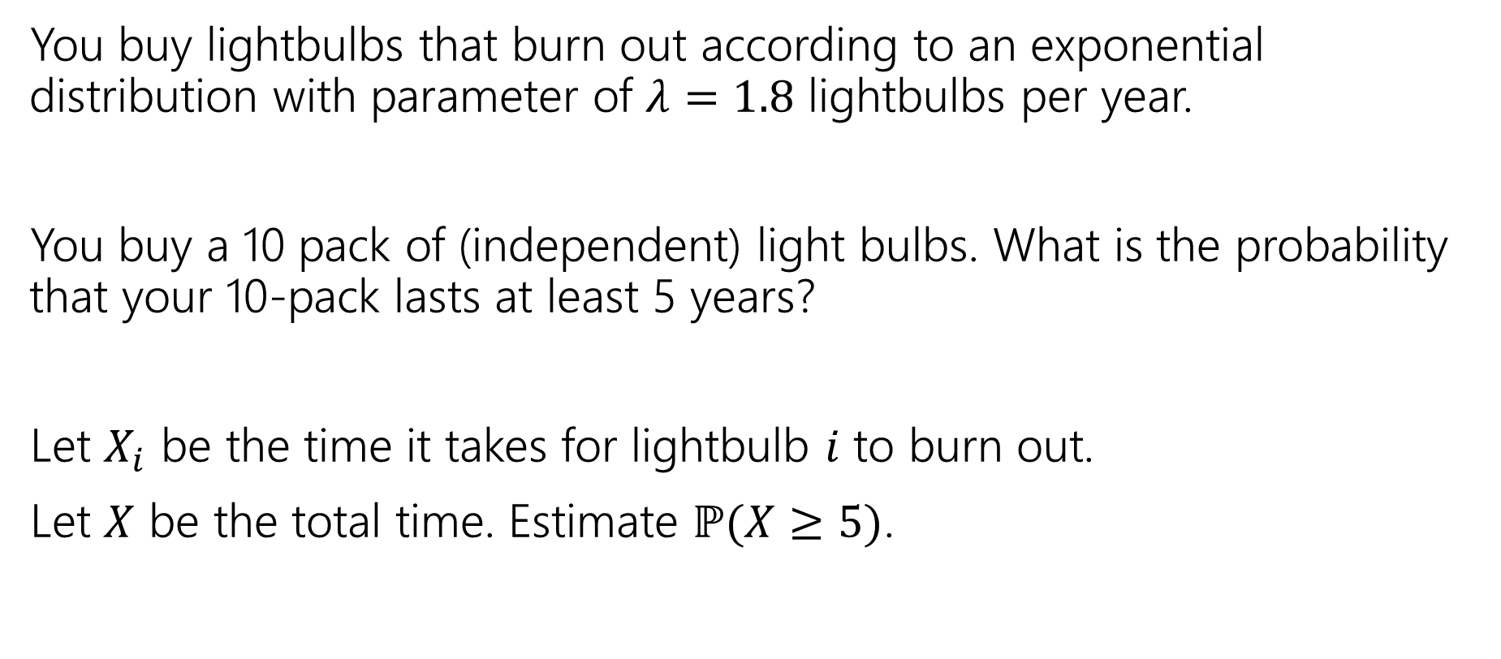
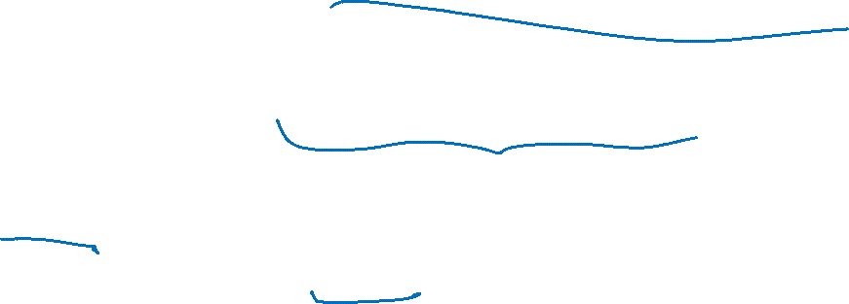
Approximating a continuous distribution
You buy lightbulbs that burn out according to an exponential distribution with parameter of $λ=1.8$ lightbulbs per year.
You buy a 10 pack of (independent) light bulbs. What is the probability that your 10-pack lasts at least 5 years?
Let $X_{i}$ be the time it takes for lightbulb $i$ to burn out.
Let $X$ be the total time. Estimate $ℙ(X≥5)$.

Slide 18
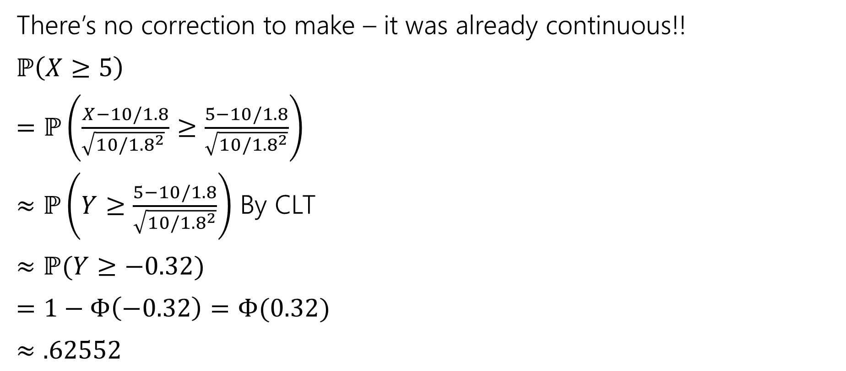
Where’s the continuity correction?
There’s no correction to make – it was already continuous!!
$ℙ\left(X≥5\right)$
$=ℙ\left(\frac{X−10/1.8}{\sqrt{10/{1.8}^{2}} }≥\frac{5−10/1.8}{\sqrt{10/{1.8}^{2}}}\right)$
$≈ℙ\left(Y≥\frac{5−10/1.8}{\sqrt{10/{1.8}^{2}}}\right)$ By CLT
$≈ℙ(Y≥−0.32)$
$=1−Φ\left(−0.32\right)=Φ(0.32)$
$≈.62552$
True value (needs a distribution not in our zoo) is $≈0.58741$
Notes:
Sum of n IID exponentials with parameter lambda is a Gamma distribution with paramaters n, 1/lambda
https://en.wikipedia.org/wiki/Gamma_distribution

Slide 19
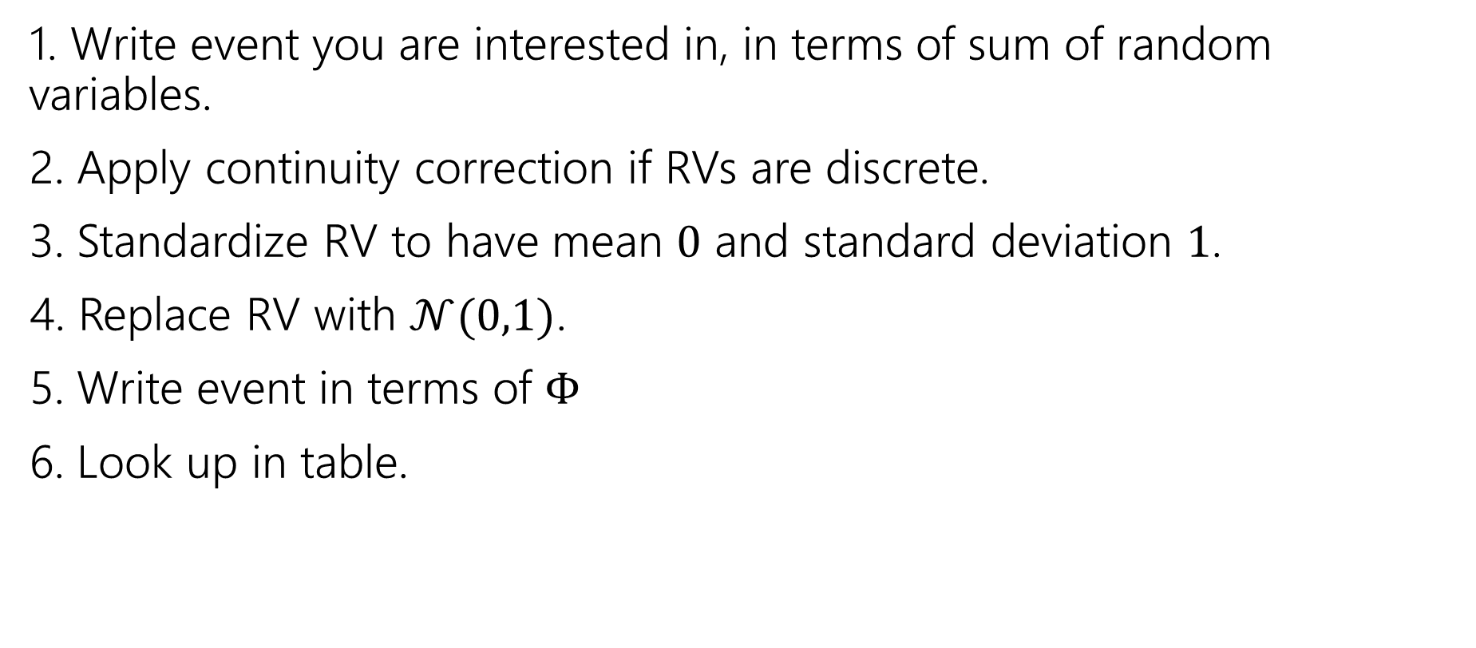

Outline of CLT steps
1. Write event you are interested in, in terms of sum of random variables.
2. Apply continuity correction if RVs are discrete.
3. Standardize RV to have mean $0$ and standard deviation $1$.
4. Replace RV with $𝒩(0,1)$.
5. Write event in terms of $Φ$
6. Look up in table.

Slide 20
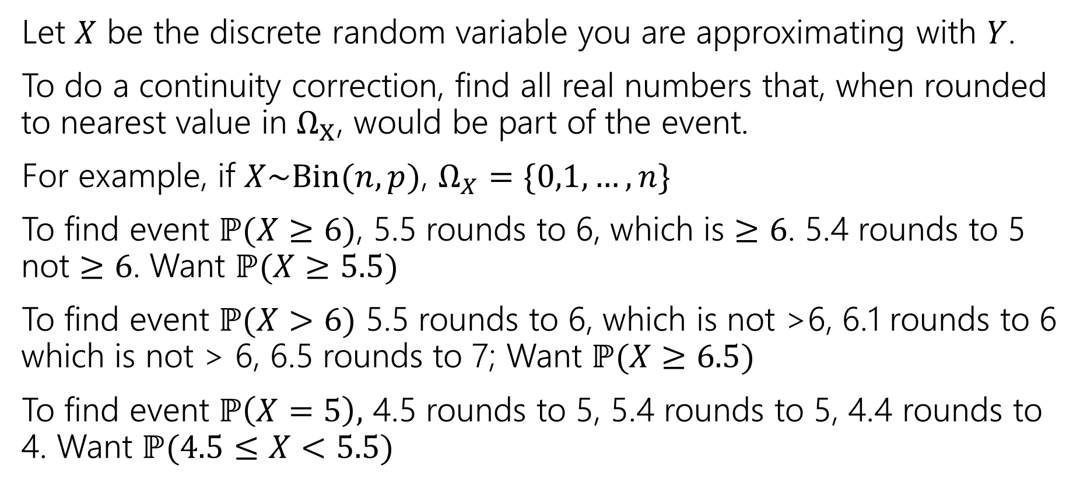
Process For Continuity Correction
Let $X$ be the discrete random variable you are approximating with $Y$.
To do a continuity correction, find all real numbers that, when rounded to nearest value in $Ω_{X}$, would be part of the event.
For example, if $X\sim Bin(n,p)$, $Ω_{X}=\{0,1,…,n\}$
To find event $ℙ(X≥6)$, 5.5 rounds to 6, which is $≥6$. 5.4 rounds to 5 not $≥6$. Want $ℙ(X≥5.5)$
To find event $ℙ(X>6)$ 5.5 rounds to 6, which is not >6, 6.1 rounds to 6 which is not > 6, 6.5 rounds to 7; Want $ℙ(X≥6.5)$
To find event $ℙ\left(X=5\right),$ 4.5 rounds to 5, 5.4 rounds to 5, 4.4 rounds to 4. Want $ℙ(4.5≤X<5.5)$

Slide 21
Confidence Intervals

Slide 22
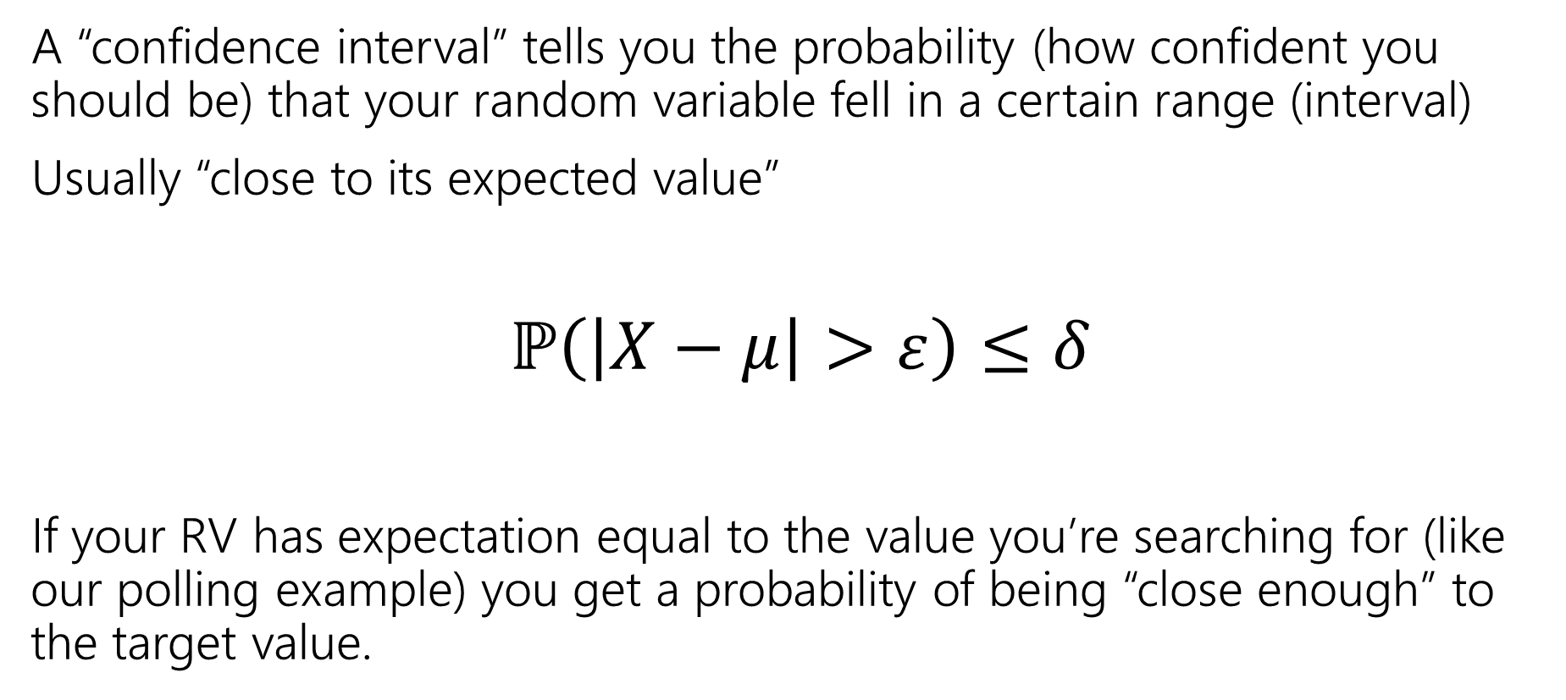

Confidence Intervals
A “confidence interval” tells you the probability (how confident you should be) that your random variable fell in a certain range (interval)
Usually “close to its expected value”
$ℙ\left(\left|X−μ\right|>ε\right)≤δ$
If your RV has expectation equal to the value you’re searching for (like our polling example) you get a probability of being “close enough” to the target value.

Slide 23




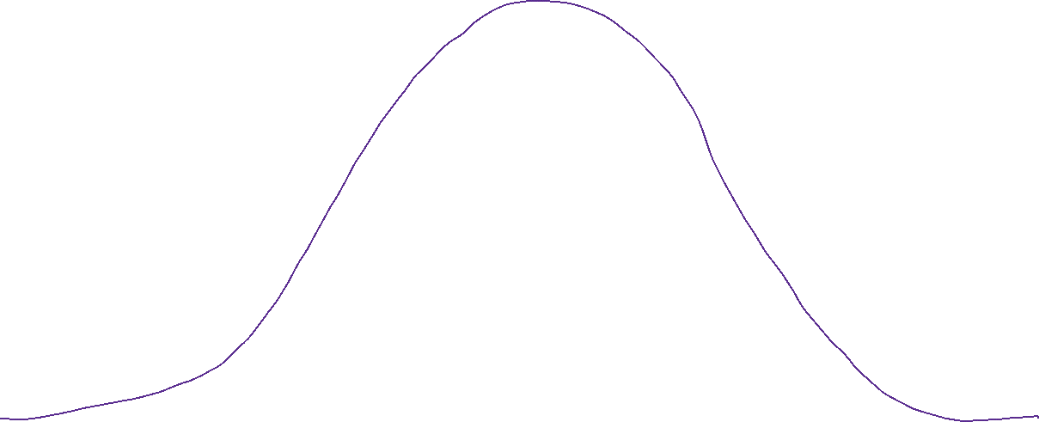


























































Confidence Interval (visualized)

