Slide 1
Central Limit Theorem
CSE 312 Winter 26
Lecture 17

Slide 2
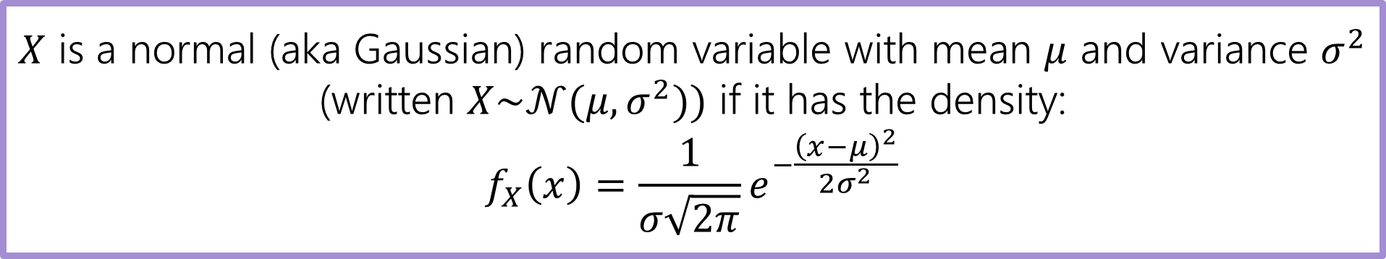
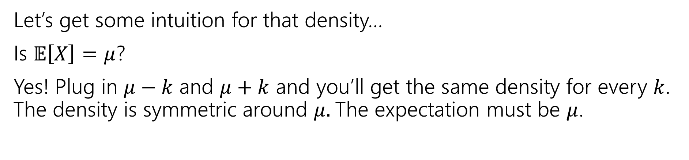
Normal Random Variable
$X$ is a normal (aka Gaussian) random variable with mean $μ$ and variance $σ^{2}$ (written $X\sim 𝒩(μ,σ^{2}))$ if it has the density:
$$f_{X}\left(x\right)=\frac{1}{σ\sqrt{2π}}e^{−\frac{{\left(x−μ\right)}^{2}}{2σ^{2}}}$$
Let’s get some intuition for that density…
Is $𝔼\left[X\right]=μ$?
Yes! Plug in $μ−k$ and $μ+k$ and you’ll get the same density for every $k$. The density is symmetric around $μ.$The expectation must be $μ$.

Slide 3
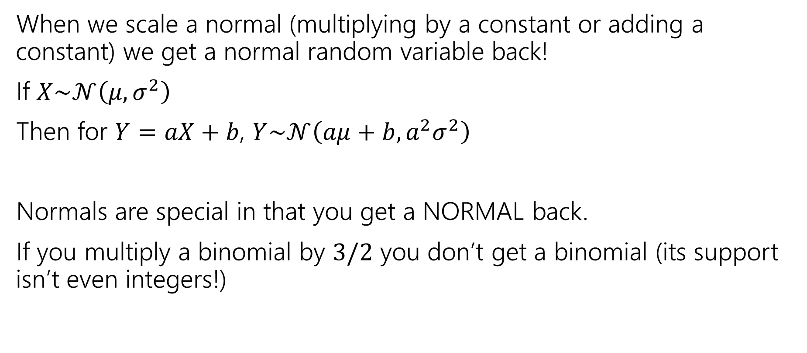
Scaling Normals
When we scale a normal (multiplying by a constant or adding a constant) we get a normal random variable back!
If $X\sim 𝒩\left(μ,σ^{2}\right)$
Then for $Y=aX+b$, $Y\sim 𝒩\left(aμ+b, a^{2}σ^{2}\right)$
Normals are special in that you get a NORMAL back.
If you multiply a binomial by $3/2$ you don’t get a binomial (its support isn’t even integers!)

Slide 4
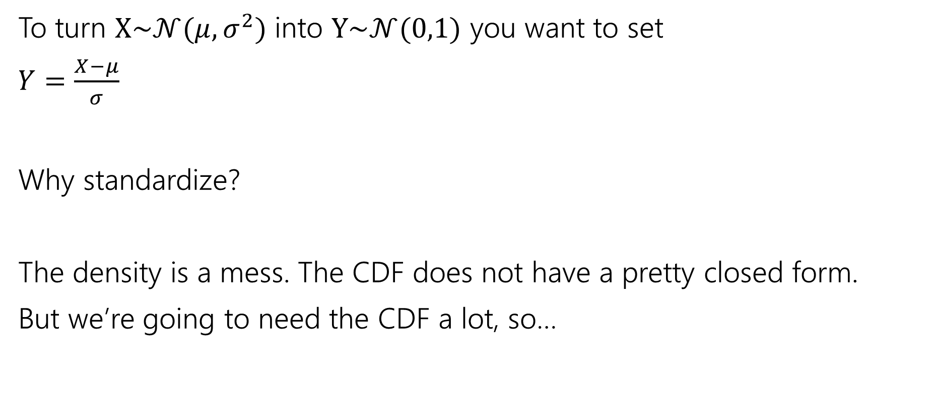
Standardize
To turn $X\sim 𝒩(μ,σ^{2})$ into $Y\sim 𝒩(0,1)$ you want to set
$Y=\frac{X−μ}{σ}$
Why standardize?
The density is a mess. The CDF does not have a pretty closed form.
But we’re going to need the CDF a lot, so…
Notes:
You’ll be tempted to say “normalize” because normal means….normal. But we really want to say “standardize” the “standard” one has mean 0 variance 1.

Slide 5
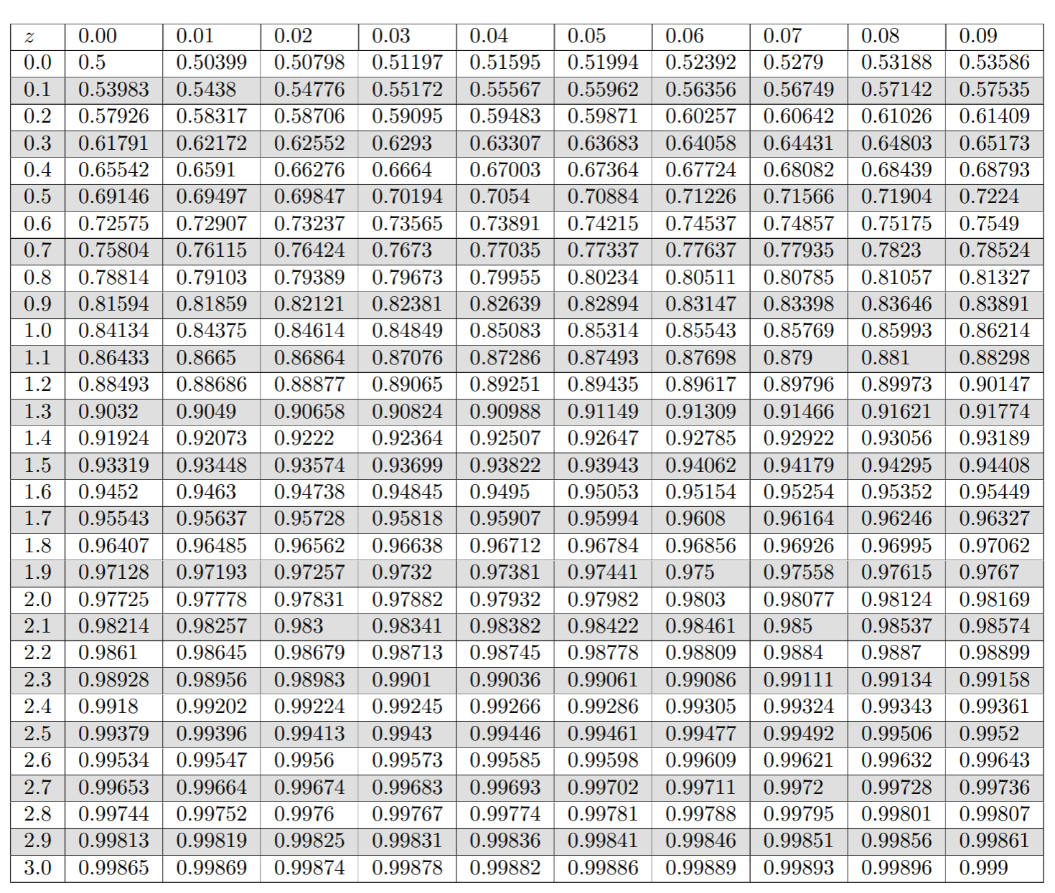
Table of Standard Normal CDF
It’s ok to use an online calculator, but expect slightly different rounding.
The way we’ll evaluate the CDF of a normal is to: 1. convert to a standard normal
2. Round the “z-score” to the hundredths place.
3. Look up the value in the table.
It’s 2026, we’re using a table?
The table makes sure we have consistent rounding rules (makes it easier for us to debug with you).
You can’t evaluate this by hand – the “z-score” can give you intuition right away.

Slide 6
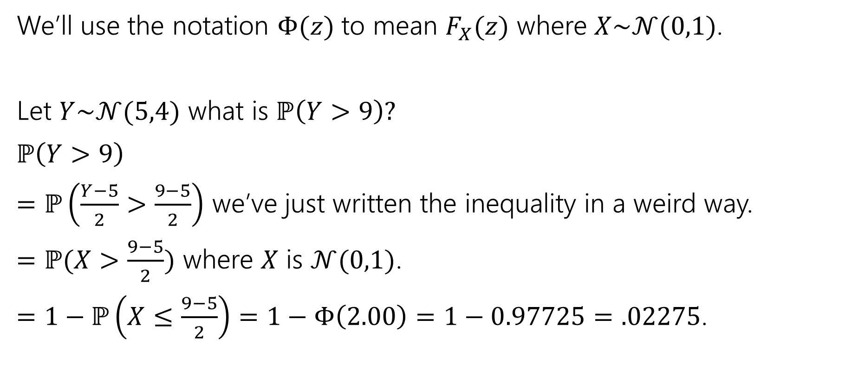
Let’s try the table!
We’ll use the notation $Φ(z)$ to mean $F_{X}(z)$ where $X\sim 𝒩(0,1)$.
Let $Y\sim 𝒩(5,4)$ what is $ℙ\left(Y>9\right)?$
$ℙ\left(Y>9\right)$
$=ℙ\left(\frac{Y−5}{2}>\frac{9−5}{2}\right)$ we’ve just written the inequality in a weird way.
$=ℙ(X>\frac{9−5}{2})$ where $X$ is $𝒩(0,1)$.
$=1−ℙ\left(X≤\frac{9−5}{2}\right)=1−Φ\left(2.00\right)=1−0.97725=.02275$.

Slide 7

Normal (aka Guassian)
$X\sim 𝒩(μ,σ^{2})$
Parameter $μ$ is the expectation; $σ^{2}$ is the variance.
$f_{X}\left(x\right)=\frac{1}{σ\sqrt{2π}}e^{−\frac{{\left(x−μ\right)}^{2}}{2σ^{2}}}$
$F_{X}\left(k\right)$ has no nice closed form. Use the table.
$𝔼\left[X\right]=μ$
$Var\left(X\right)=σ^{2}$

Slide 8

More practice
Let $X\sim 𝒩(3, 2)$.
What is the probability that $1≤X≤4$

Slide 9
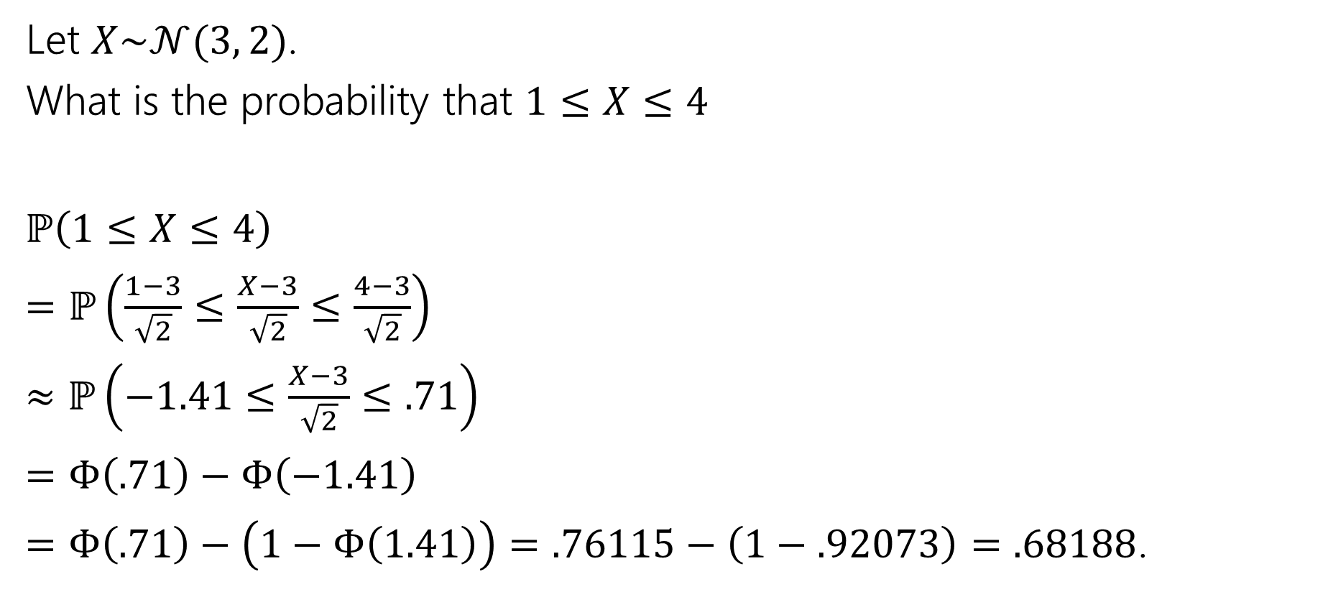
More practice
Let $X\sim 𝒩(3, 2)$.
What is the probability that $1≤X≤4$
$ℙ\left(1≤X≤4\right)$
$=ℙ\left(\frac{1−3}{\sqrt{2}}≤\frac{X−3}{\sqrt{2}}≤\frac{4−3}{\sqrt{2}}\right)$
$≈ℙ\left(−1.41≤\frac{X−3}{\sqrt{2}}≤.71\right)$
$=Φ\left(.71\right)−Φ\left(−1.41\right)$
$=Φ\left(.71\right)−\left(1−Φ\left(1.41\right)\right)=.76115−\left(1−.92073\right)=.68188$.

Slide 10

















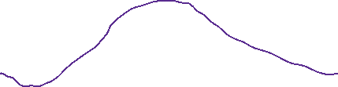
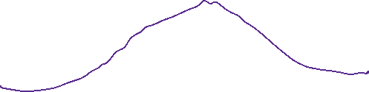



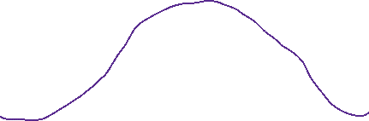








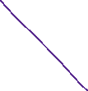























Slide 11







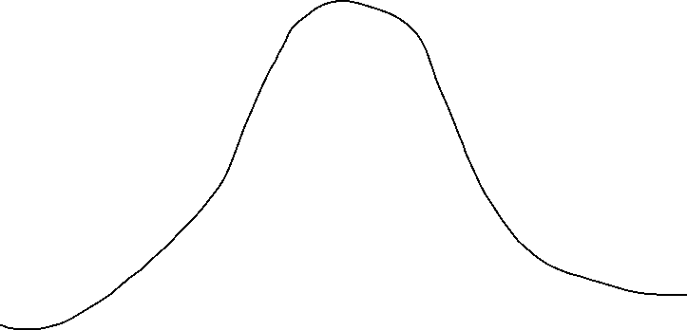




















Slide 12
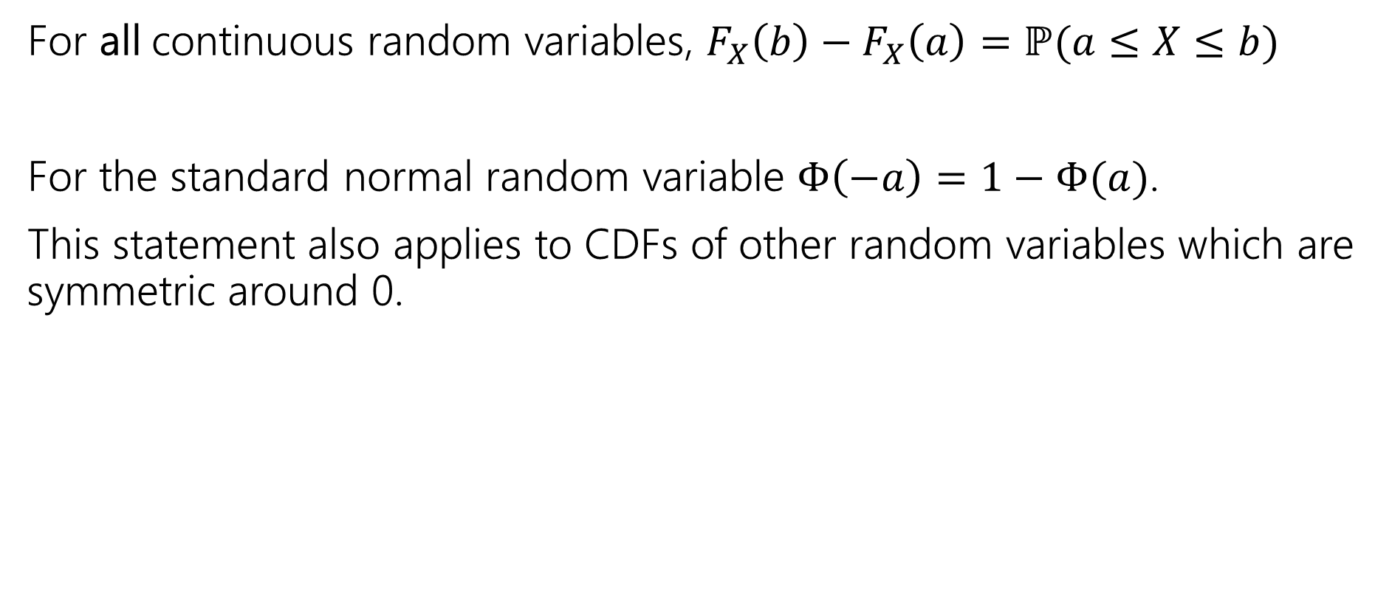
Takeaways
For all continuous random variables, $F_{X}\left(b\right)−F_{X}\left(a\right)=ℙ(a≤X≤b)$
For the standard normal random variable $Φ\left(−a\right)=1−Φ(a)$.
This statement also applies to CDFs of other random variables which are symmetric around 0.

Slide 13
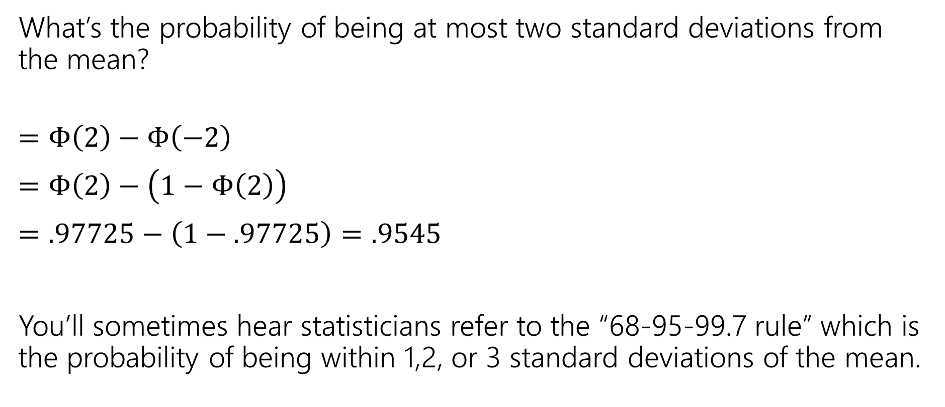
In real life
What’s the probability of being at most two standard deviations from the mean?
$=Φ\left(2\right)−Φ\left(−2\right)$
$=Φ\left(2\right)−\left(1−Φ\left(2\right)\right)$
$=.97725−\left(1−.97725\right)=.9545$
You’ll sometimes hear statisticians refer to the “68-95-99.7 rule” which is the probability of being within 1,2, or 3 standard deviations of the mean.

Slide 14
One last (notation) thing

Slide 15
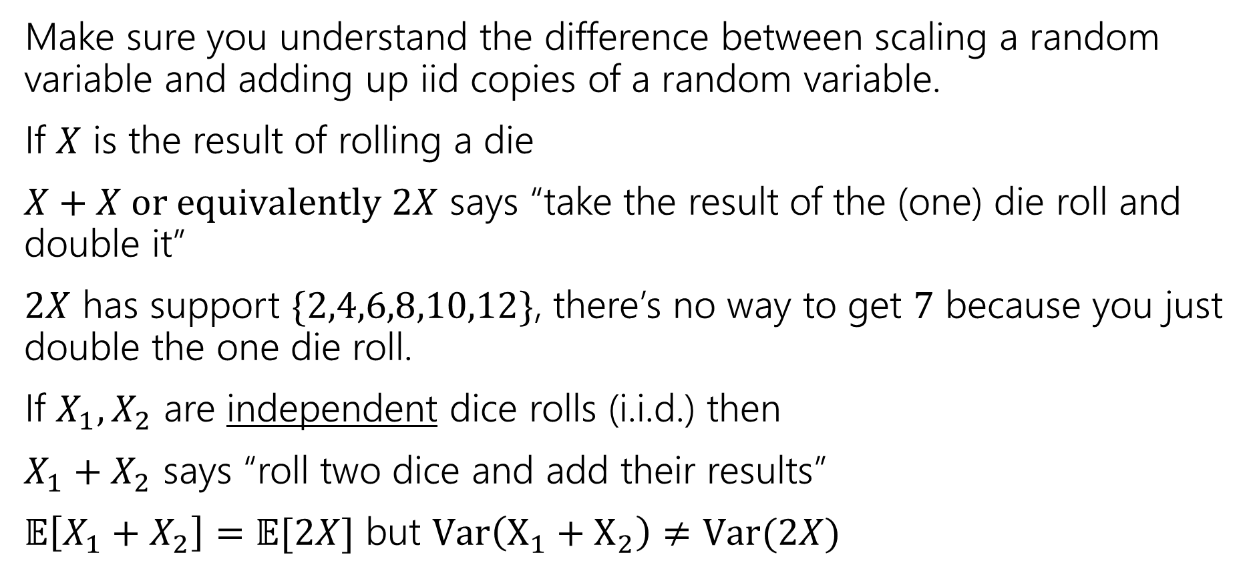
A Side Note
Make sure you understand the difference between scaling a random variable and adding up iid copies of a random variable.
If $X$ is the result of rolling a die
$X+X or equivalently 2X$ says “take the result of the (one) die roll and double it”
$2X$ has support $\{2,4,6,8,10,12\}$, there’s no way to get $7$ because you just double the one die roll.
If $X_{1},X_{2}$ are independent dice rolls (i.i.d.) then
$X_{1}+X_{2}$ says “roll two dice and add their results”
$𝔼\left[X_{1}+X_{2}\right]=𝔼[2X]$ but $Var\left(X_{1}+X_{2}\right)≠Var(2X)$

Slide 16
Why do Gaussians Matter?

Slide 17
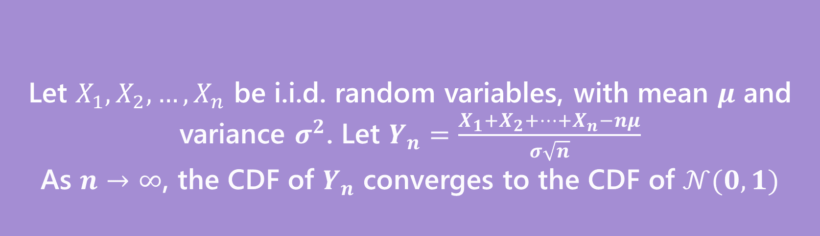
Why Learn Normals?
When we add together independent normal random variables, you get another normal random variable.
The sum of any independent random variables approaches a normal distribution.
Let $X_{1},X_{2},…,X_{n}$ be i.i.d. random variables, with mean $μ$ and variance $σ^{2}$. Let $Y_{n}=\frac{X_{1}+X_{2}+…+X_{n}−nμ}{σ\sqrt{n}}$
As $n→∞$, the CDF of $Y_{n}$ converges to the CDF of $𝒩(0,1)$
Central Limit Theorem

Slide 18
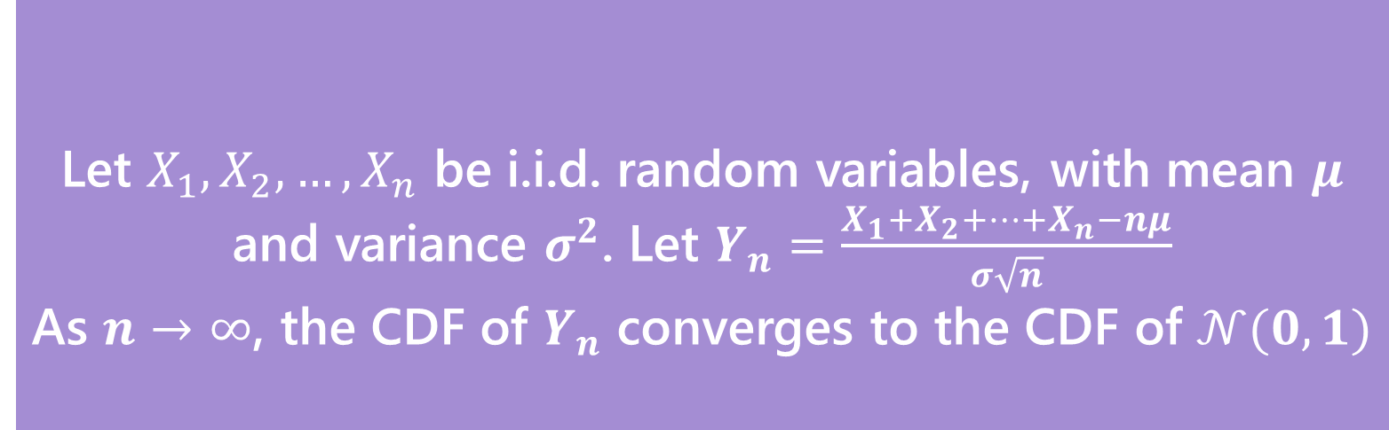
Breaking down the theorem
Let $X_{1},X_{2},…,X_{n}$ be i.i.d. random variables, with mean $μ$ and variance $σ^{2}$. Let $Y_{n}=\frac{X_{1}+X_{2}+…+X_{n}−nμ}{σ\sqrt{n}}$
As $n→∞$, the CDF of $Y_{n}$ converges to the CDF of $𝒩(0,1)$
Central Limit Theorem
Notes:
The X_i are iid. Independence is needed! If X_i are all same RV (i.e. all have the same value, fully dependent) then Y_n is distributed as normalized die roll (i.e. mean 0, variance 1, but still support of size 6)
What is Y_n ? Well, we’re standardizing: subtracting the mean and dividing by the standard deviation.
This is a limit statement as n-> infinity
CDF convergence: your intuition for what it means to a function to converge is good enough here, but take an analysis class if you want to know more Key is Normal! Don’t need a big theorem to say it’s mean 0 variance 1. It’s normality that’s the result of the theorem.

Slide 19

Proof of the CLT?
No.
How is the proof done?
Step 1: Prove that for all positive integers $k, 𝔼\left[{\left(Y_{n}\right)}^{k}\right]→𝔼[Z^{k}]$
Step 2: Prove that if $𝔼\left[{\left(Y_{n}\right)}^{k}\right]=𝔼\left[Z^{k}\right]$ for all $k$ then $F_{Y_{n}}\left(z\right)=F_{Z}(z)$
Notes:
Z is standard normal on this slide
Called the “moments” of the distribution. This is another reason why Variance is a “good” thing, it’s based off moments which are a full description of a RV.

Slide 20
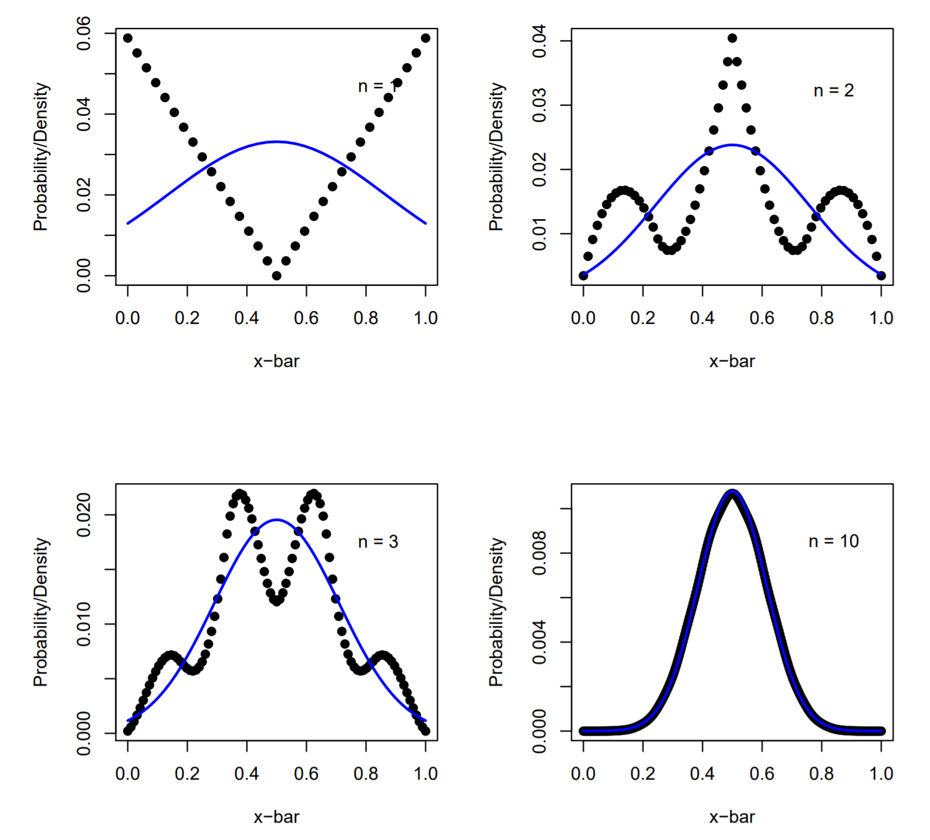
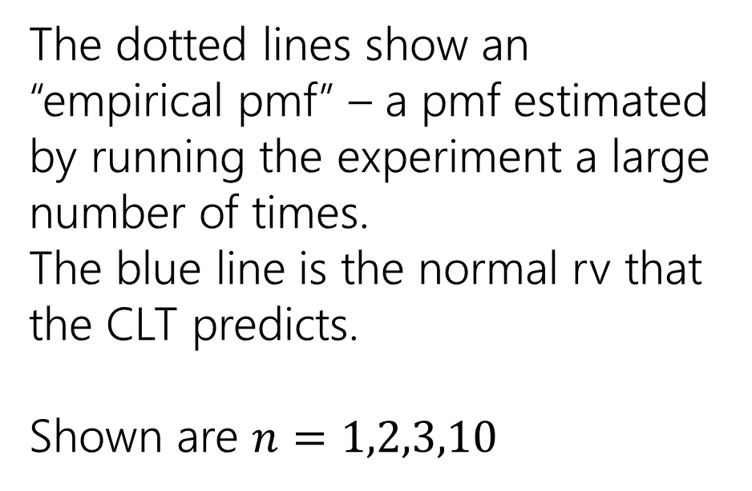
“Proof by example”
The dotted lines show an “empirical pmf” – a pmf estimated by running the experiment a large number of times.
The blue line is the normal rv that the CLT predicts.
Shown are $n=1,2,3,10$

Slide 21
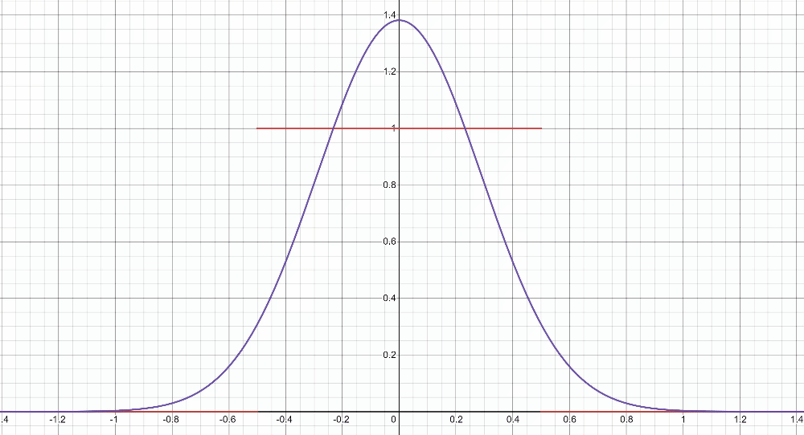
“Proof by example” -- uniform
https://www.desmos.com/calculator/2n2m05a9km

Slide 22
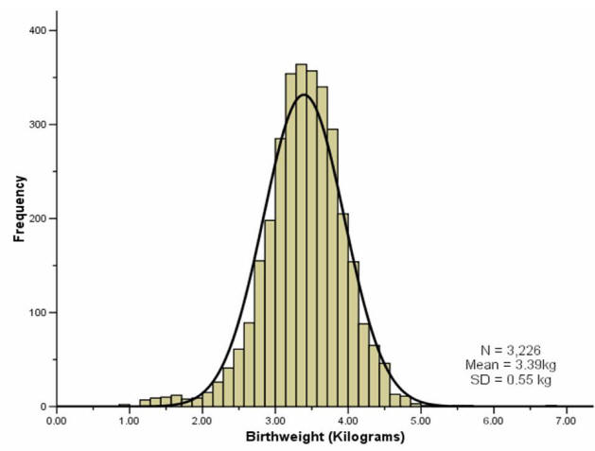
“Proof by real-world”
A lot of real-world bell-curves can be explained as:
1. The random variable comes from a combination of independent factors.
2. The CLT says the distribution will become like a bell curve.
birthweight

Slide 23
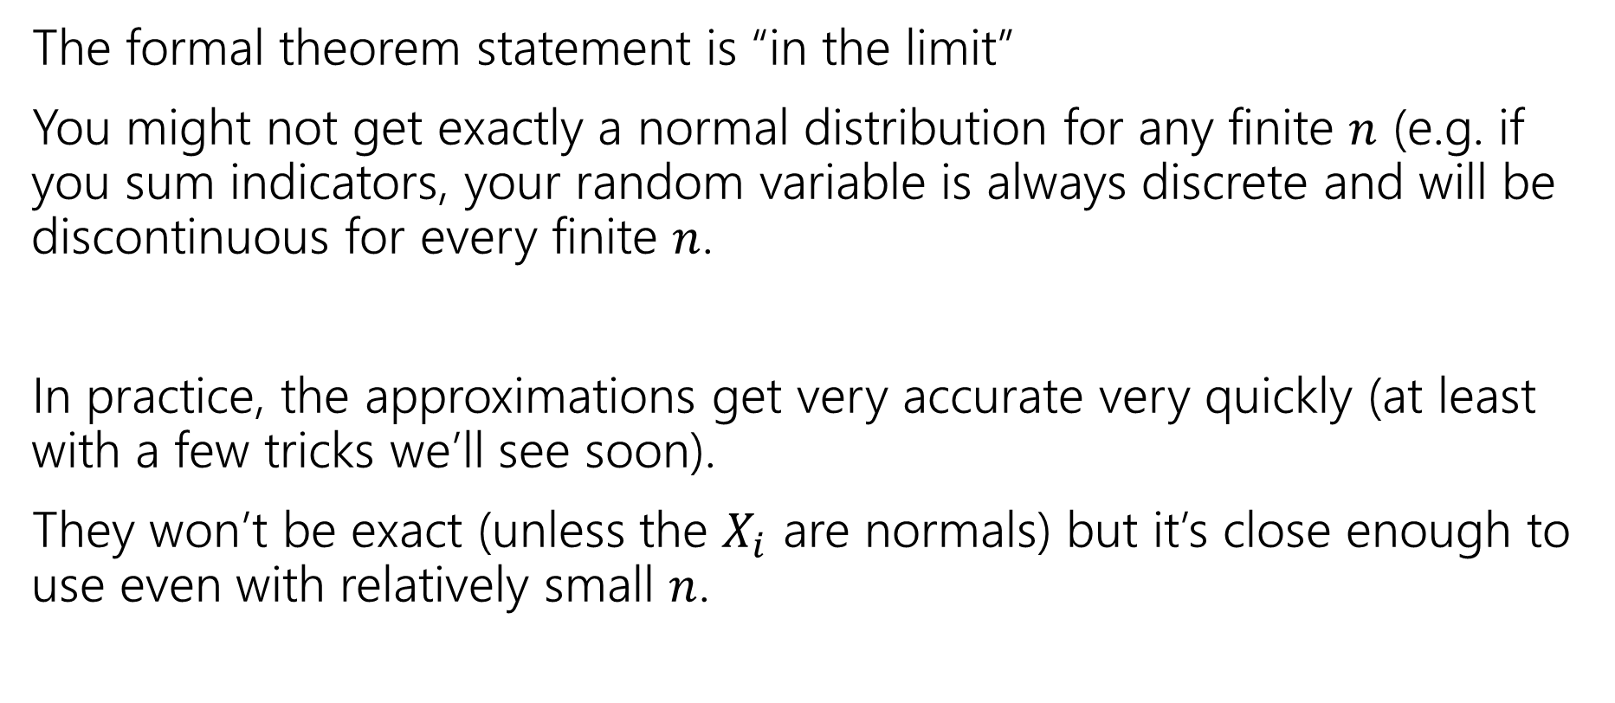
Theory vs. Practice
The formal theorem statement is “in the limit”
You might not get exactly a normal distribution for any finite $n$ (e.g. if you sum indicators, your random variable is always discrete and will be discontinuous for every finite $n$.
In practice, the approximations get very accurate very quickly (at least with a few tricks we’ll see soon).
They won’t be exact (unless the $X_{i}$ are normals) but it’s close enough to use even with relatively small $n$.

Slide 24
Using the Central Limit Theorem
Suppose you are managing a factory, that produces widgets. Each widget produced is defective (independently) with probability 5%.
Your factory will produce 1000 (possibly defective) widgets. You want to know what the chances are of having a “very bad day” where “very bad” means producing at most 940 non-defective widgets. (In expectation, you produce 950 non-defective widgets)
What is the probability?

Slide 25

True Answer
Let $X\sim Bin(1000,.95)$
What is $ℙ(X≤940)$?
The cdf is ugly…and that’s a big summation.
$\sum_{k=0}^{940}{\left({1000 \atop k}\right)(.{95)}^{k}⋅(.{05)}^{1000−k}≈}.08673$
What does the CLT give?

Slide 26
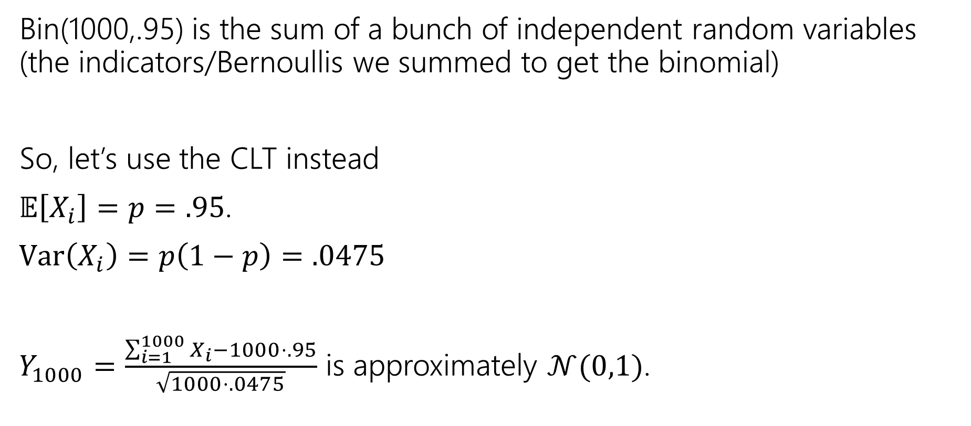
CLT setup
Bin(1000,.95) is the sum of a bunch of independent random variables (the indicators/Bernoullis we summed to get the binomial)
So, let’s use the CLT instead
$𝔼\left[X_{i}\right]=p=.95$.
$Var\left(X_{i}\right)=p\left(1−p\right)=.0475$
$Y_{1000}=\frac{\sum_{i=1}^{1000}{X_{i}}−1000⋅.95}{\sqrt{1000⋅.0475}}$ is approximately $𝒩(0,1)$.

Slide 27
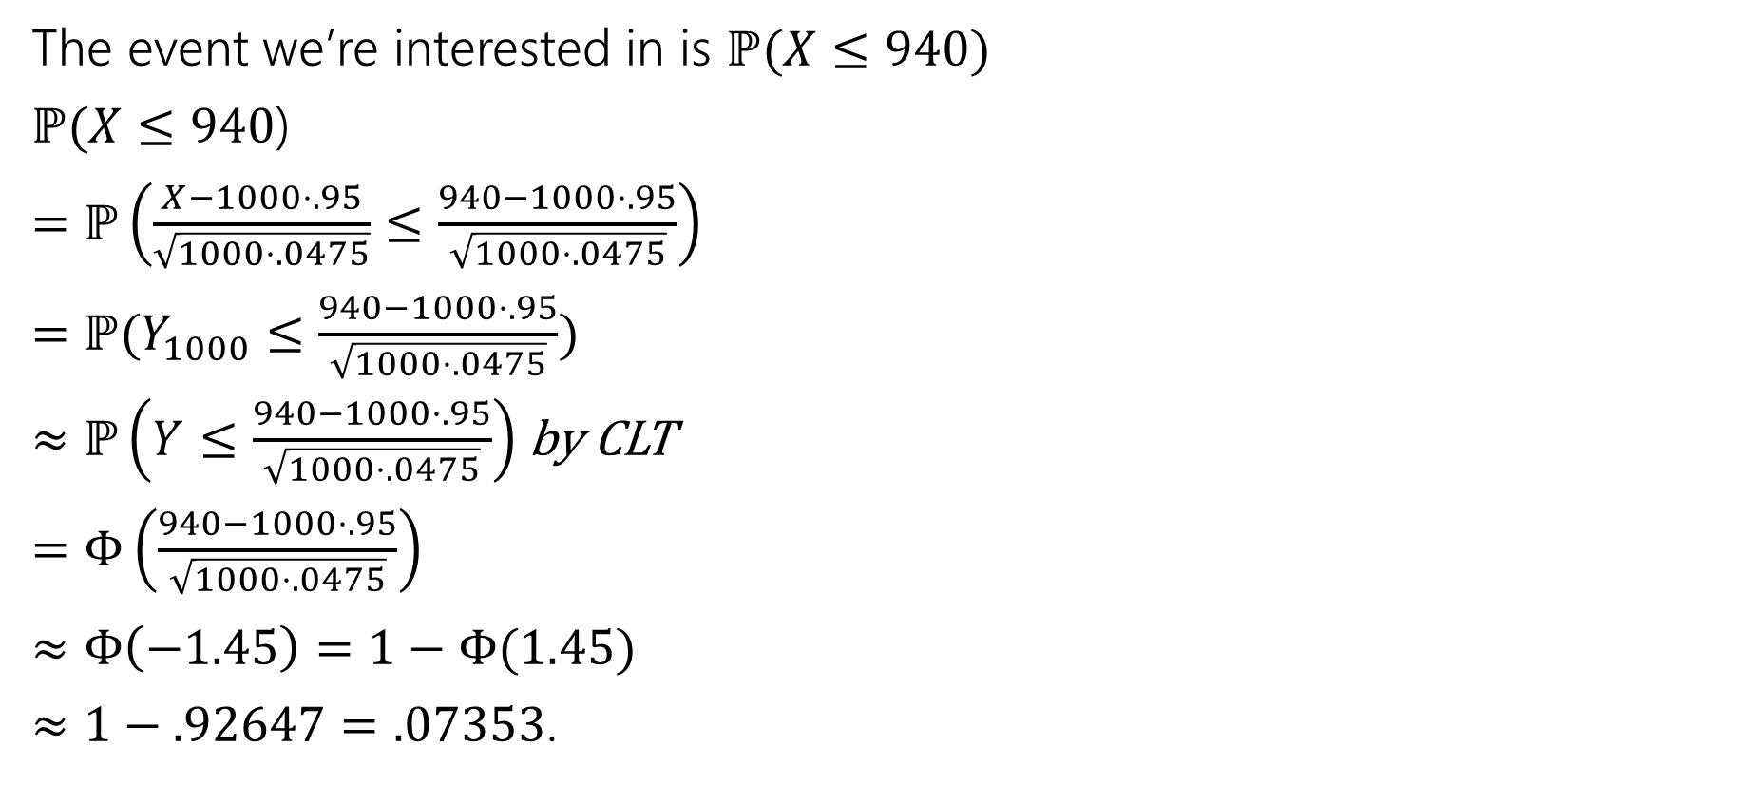
With the CLT.
The event we’re interested in is $ℙ(X≤940)$
$ℙ(X≤940$)
$=ℙ\left(\frac{X−1000⋅.95}{\sqrt{1000⋅.0475}}≤\frac{940−1000⋅.95}{\sqrt{1000⋅.0475}}\right)$
$=ℙ(Y_{1000}≤\frac{940−1000⋅.95}{\sqrt{1000⋅.0475}})$
$≈ℙ\left(Y≤\frac{940−1000⋅.95}{\sqrt{1000⋅.0475}}\right)$ by CLT
$=Φ\left(\frac{940−1000⋅.95}{\sqrt{1000⋅.0475}}\right)$
$≈Φ\left(−1.45\right)=1−Φ(1.45)$
$≈1−.92647=.07353$.

Slide 28
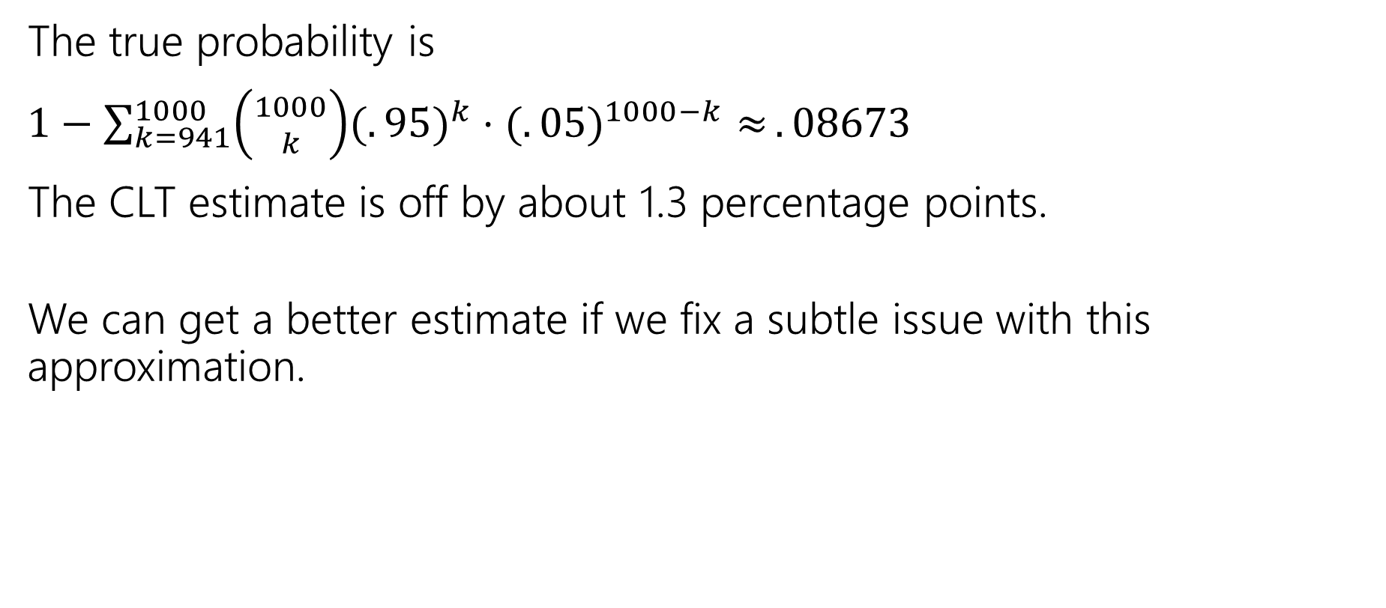
It’s an approximation!
The true probability is
$1−\sum_{k=941}^{1000}{\left({1000 \atop k}\right)(.{95)}^{k}⋅(.{05)}^{1000−k}≈}.08673$
The CLT estimate is off by about 1.3 percentage points.
We can get a better estimate if we fix a subtle issue with this approximation.

Slide 29

A problem
What’s the probability that $X=950$? (exactly)
True value, we can get with binomial:
$\left({1000 \atop 950}\right)⋅(.{95)}^{950}⋅(.05)^{50}≈.05779$
What does the CLT say?

Slide 30
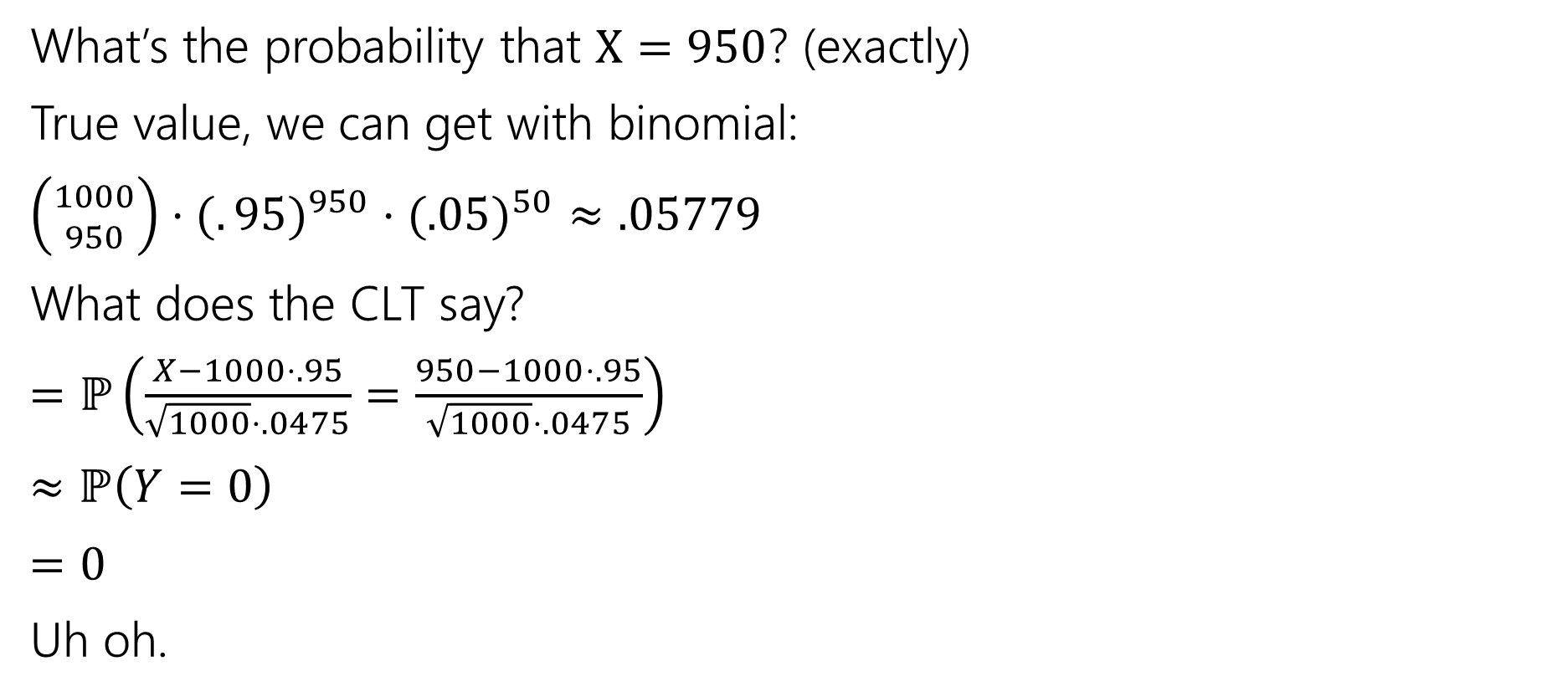
A problem
What’s the probability that $X=950$? (exactly)
True value, we can get with binomial:
$\left({1000 \atop 950}\right)⋅(.{95)}^{950}⋅(.05)^{50}≈.05779$
What does the CLT say?
$=ℙ\left(\frac{X−1000⋅.95}{\sqrt{1000}⋅.0475}=\frac{950−1000⋅.95}{\sqrt{1000}⋅.0475}\right)$
$≈ℙ\left(Y=0\right)$
$=0$
Uh oh.

Slide 31
Continuity Correction
The binomial distribution is discrete, but the normal is continuous.
Let’s correct for that (called a “continuity correction”)
Before we switch from the binomial to the normal, ask “what values of a continuous random variable would round to this event?”

Slide 32
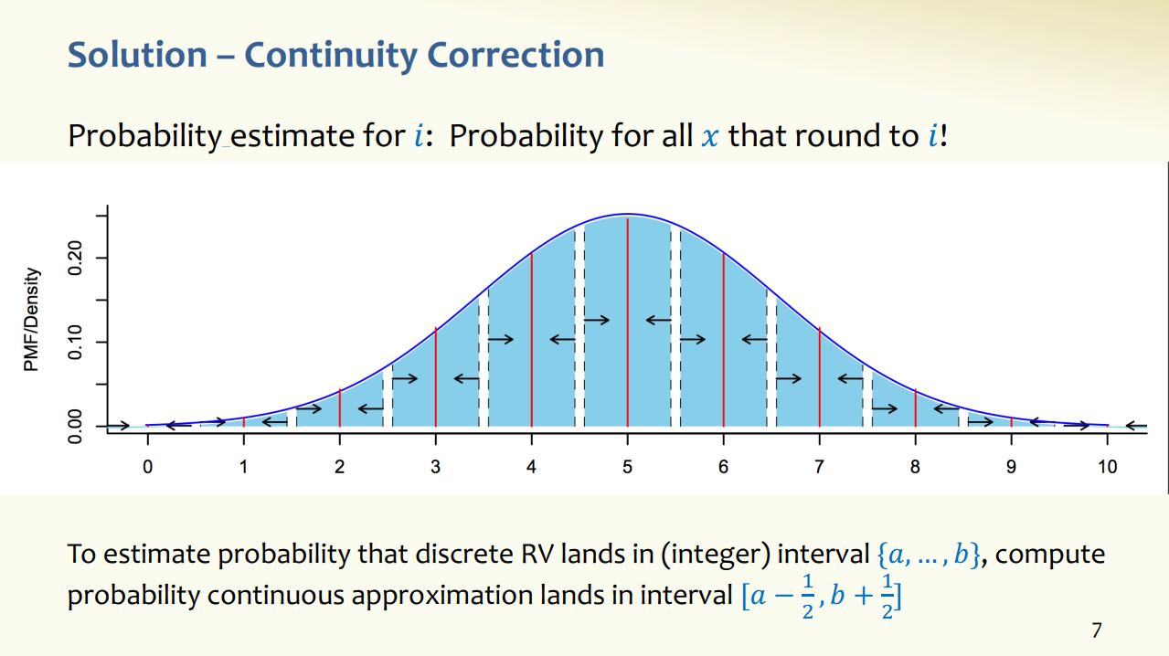
Slide from 24AU 312 (Rao/Tessaro)
Assumes discrete RV takes on integer values; if RV has different support, interval is different, but idea is same.

Slide 33

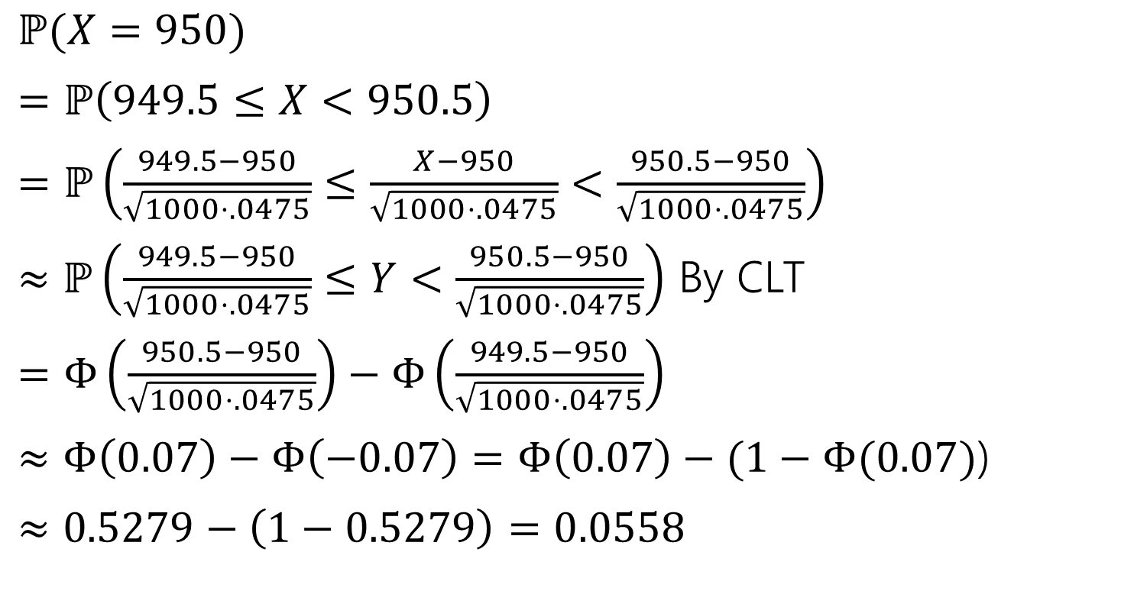
Applying the continuity correction
$ℙ(X=950)$
$=ℙ\left(949.5≤X<950.5\right)$
$=ℙ\left(\frac{949.5−950}{\sqrt{1000⋅.0475}}≤\frac{X−950}{\sqrt{1000⋅.0475}}<\frac{950.5−950}{\sqrt{1000⋅.0475}}\right)$
$≈ℙ\left(\frac{949.5−950}{\sqrt{1000⋅.0475}}≤Y<\frac{950.5−950}{\sqrt{1000⋅.0475}}\right)$ By CLT
$=Φ\left(\frac{950.5−950}{\sqrt{1000⋅.0475}}\right)−Φ\left(\frac{949.5−950}{\sqrt{1000⋅.0475}}\right)$
$≈Φ\left(0.07\right)−Φ\left(−0.07\right)=Φ\left(0.07\right)−(1−Φ(0.07)$)
$≈0.5279−\left(1−0.5279\right)=0.0558$
Continuity correction. This step really is an “exactly equal to” The discrete rv $X$ can’t equal $950.2.$

Slide 34

Still an Approximation
$\left({1000 \atop 950}\right)⋅(.{95)}^{950}⋅(.05)^{50}≈.05779$ is the true value
The CLT approximates: $0.0558$
Very close! But still not perfect.

Slide 35
Let’s fix that other one
Question was “what’s the probability of seeing at most 940 non-defective widgets?”

Slide 36
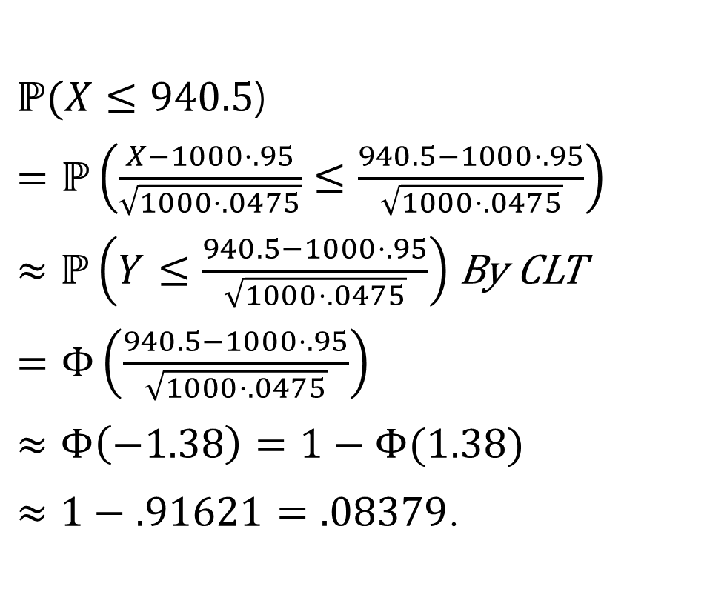
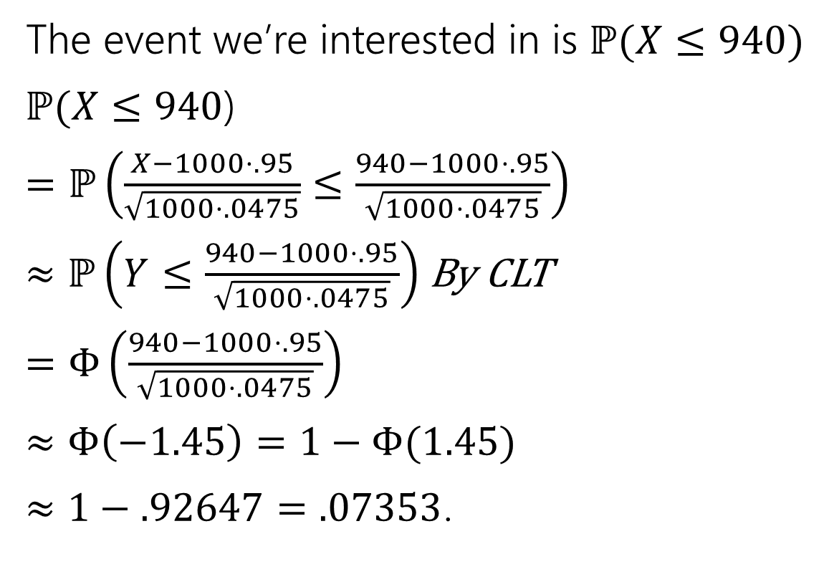
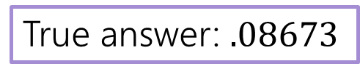
With the CLT.
The event we’re interested in is $ℙ(X≤940)$
$ℙ(X≤940$)
$=ℙ\left(\frac{X−1000⋅.95}{\sqrt{1000⋅.0475}}≤\frac{940−1000⋅.95}{\sqrt{1000⋅.0475}}\right)$
$≈ℙ\left(Y≤\frac{940−1000⋅.95}{\sqrt{1000⋅.0475}}\right)$ By CLT
$=Φ\left(\frac{940−1000⋅.95}{\sqrt{1000⋅.0475}}\right)$
$≈Φ\left(−1.45\right)=1−Φ(1.45)$
$≈1−.92647=.07353$.
$ℙ(X≤940.5$)
$=ℙ\left(\frac{X−1000⋅.95}{\sqrt{1000⋅.0475}}≤\frac{940.5−1000⋅.95}{\sqrt{1000⋅.0475}}\right)$
$≈ℙ\left(Y≤\frac{940.5−1000⋅.95}{\sqrt{1000⋅.0475}}\right)$By CLT
$=Φ\left(\frac{940.5−1000⋅.95}{\sqrt{1000⋅.0475}}\right)$
$≈Φ\left(−1.38\right)=1−Φ(1.38)$
$≈1−.91621=.08379$.
True answer: $.08673$

Slide 37
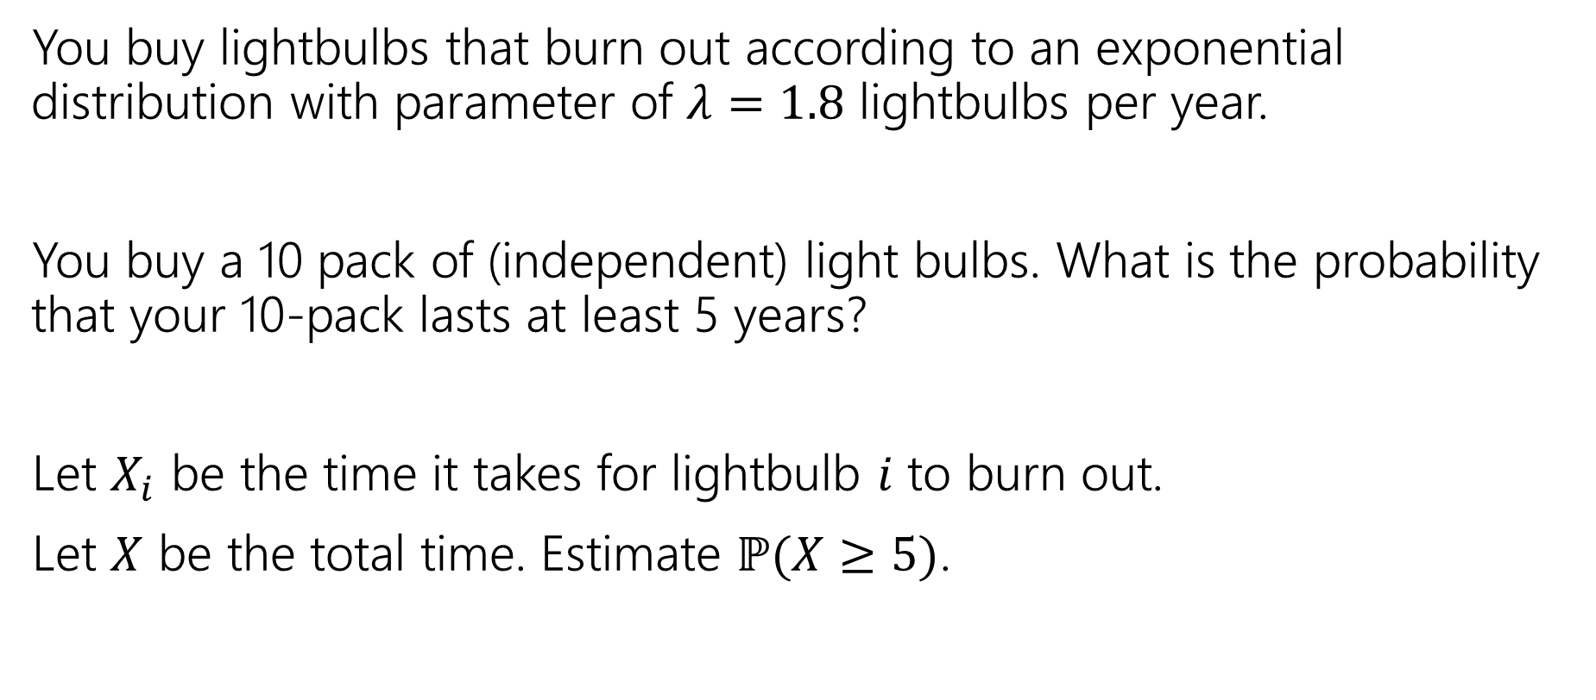
Approximating a continuous distribution
You buy lightbulbs that burn out according to an exponential distribution with parameter of $λ=1.8$ lightbulbs per year.
You buy a 10 pack of (independent) light bulbs. What is the probability that your 10-pack lasts at least 5 years?
Let $X_{i}$ be the time it takes for lightbulb $i$ to burn out.
Let $X$ be the total time. Estimate $ℙ(X≥5)$.

Slide 38
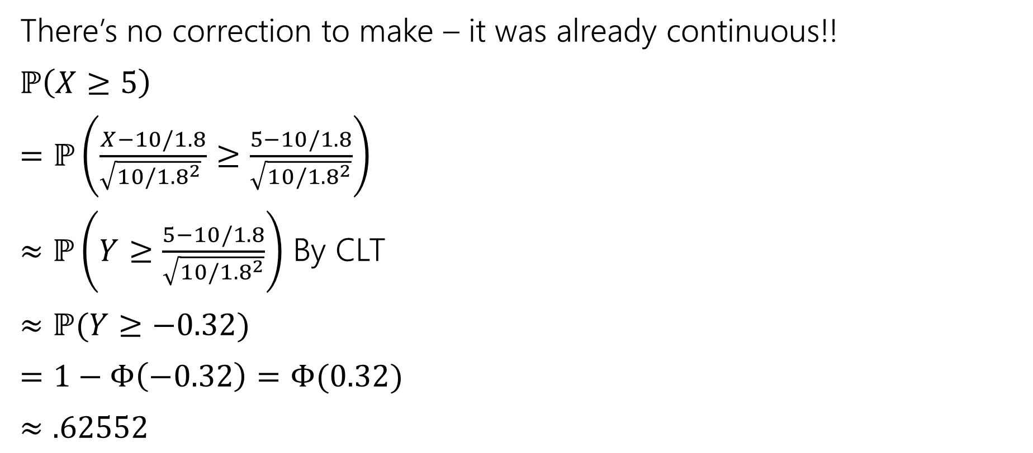
Where’s the continuity correction?
There’s no correction to make – it was already continuous!!
$ℙ\left(X≥5\right)$
$=ℙ\left(\frac{X−10/1.8}{\sqrt{10/{1.8}^{2}} }≥\frac{5−10/1.8}{\sqrt{10/{1.8}^{2}}}\right)$
$≈ℙ\left(Y≥\frac{5−10/1.8}{\sqrt{10/{1.8}^{2}}}\right)$ By CLT
$≈ℙ(Y≥−0.32)$
$=1−Φ\left(−0.32\right)=Φ(0.32)$
$≈.62552$
True value (needs a distribution not in our zoo) is $≈0.58741$
Notes:
Sum of n IID exponentials with parameter lambda is a Gamma distribution with paramaters n, 1/lambda https://en.wikipedia.org/wiki/Gamma_distribution

Slide 39
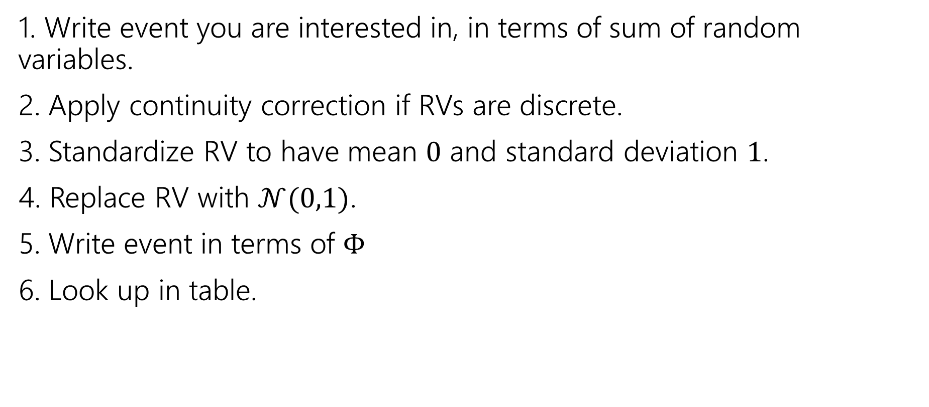
Outline of CLT steps
1. Write event you are interested in, in terms of sum of random variables.
2. Apply continuity correction if RVs are discrete.
3. Standardize RV to have mean $0$ and standard deviation $1$.
4. Replace RV with $𝒩(0,1)$.
5. Write event in terms of $Φ$
6. Look up in table.

Slide 40
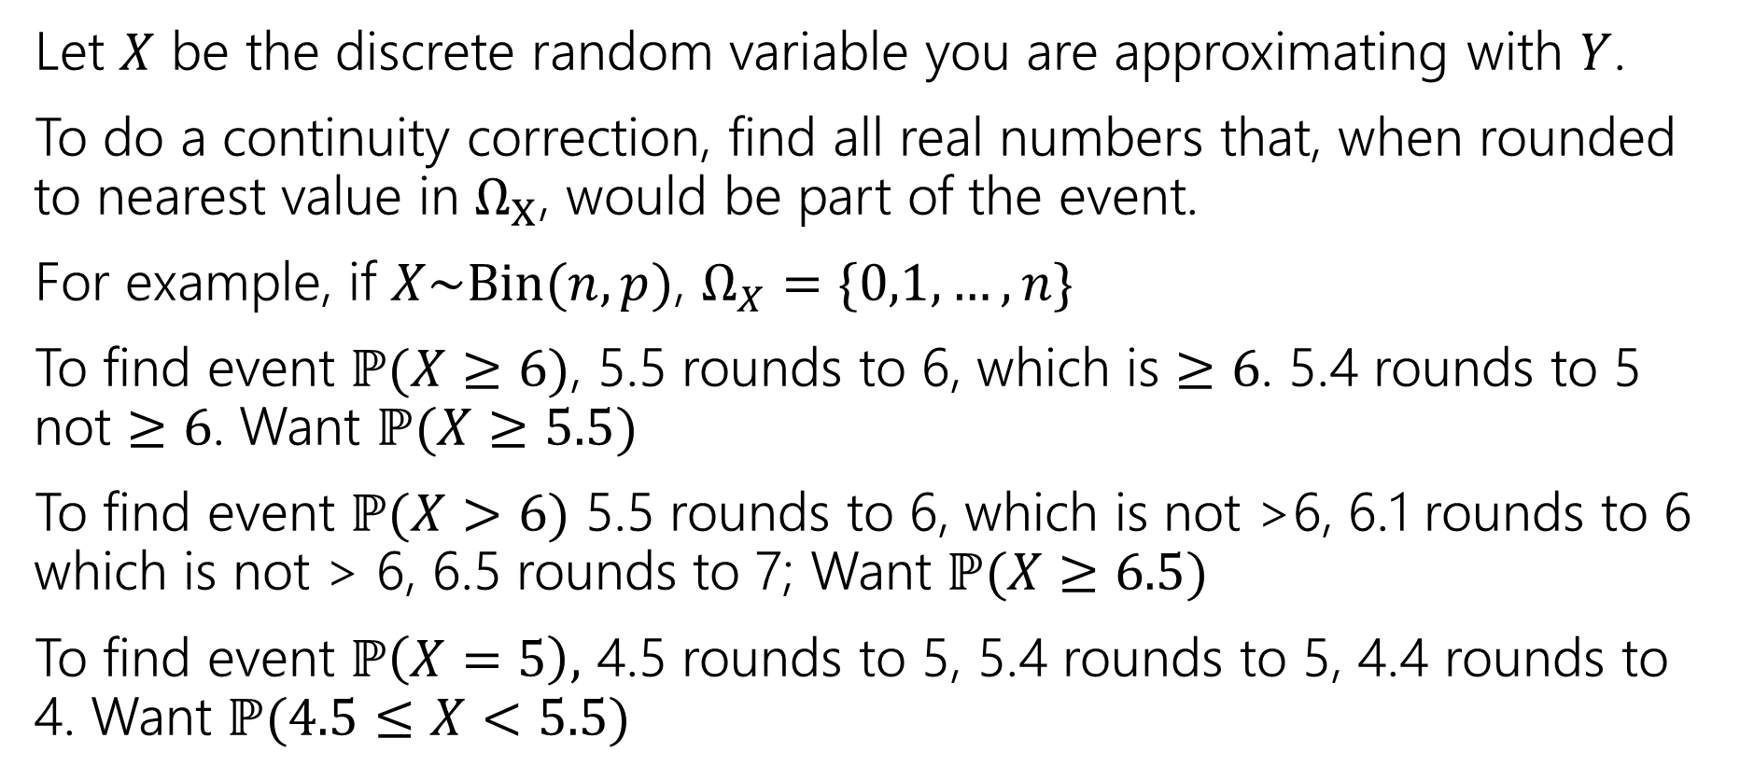
Process For Continuity Correction
Let $X$ be the discrete random variable you are approximating with $Y$.
To do a continuity correction, find all real numbers that, when rounded to nearest value in $Ω_{X}$, would be part of the event.
For example, if $X\sim Bin(n,p)$, $Ω_{X}=\{0,1,…,n\}$
To find event $ℙ(X≥6)$, 5.5 rounds to 6, which is $≥6$. 5.4 rounds to 5 not $≥6$. Want $ℙ(X≥5.5)$
To find event $ℙ(X>6)$ 5.5 rounds to 6, which is not >6, 6.1 rounds to 6 which is not > 6, 6.5 rounds to 7; Want $ℙ(X≥6.5)$
To find event $ℙ\left(X=5\right),$ 4.5 rounds to 5, 5.4 rounds to 5, 4.4 rounds to 4. Want $ℙ(4.5≤X<5.5)$

Slide 41
Confidence Intervals

Slide 42
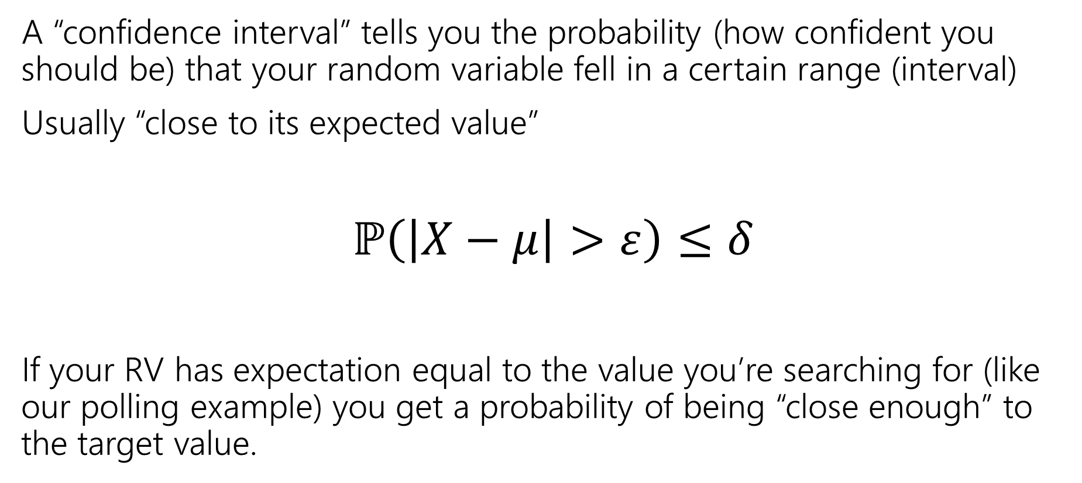
Confidence Intervals
A “confidence interval” tells you the probability (how confident you should be) that your random variable fell in a certain range (interval)
Usually “close to its expected value”
$ℙ\left(\left|X−μ\right|>ε\right)≤δ$
If your RV has expectation equal to the value you’re searching for (like our polling example) you get a probability of being “close enough” to the target value.

Slide 43




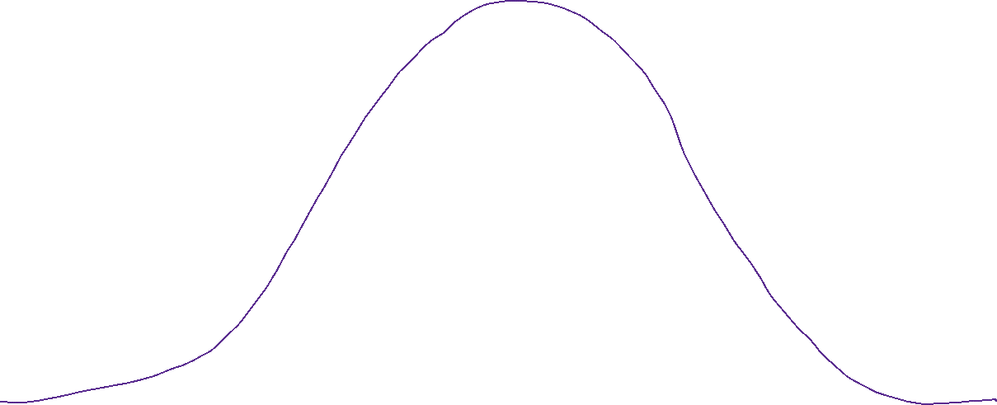







































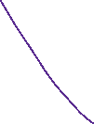












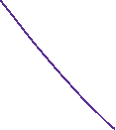






Slide 44
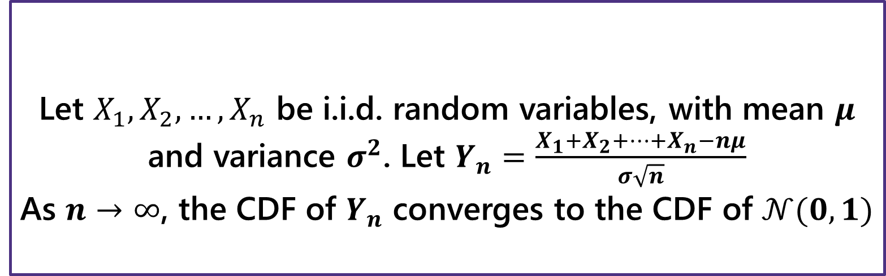
Breaking down the theorem
Let $X_{1},X_{2},…,X_{n}$ be i.i.d. random variables, with mean $μ$ and variance $σ^{2}$. Let $Y_{n}=\frac{X_{1}+X_{2}+…+X_{n}−nμ}{σ\sqrt{n}}$
As $n→∞$, the CDF of $Y_{n}$ converges to the CDF of $𝒩(0,1)$
Central Limit Theorem
Notes:
The X_i are iid. Independence is needed! If X_i are all same RV (i.e. all have the same value, fully dependent) then Y_n is distributed as normalized die roll (i.e. mean 0, variance 1, but still support of size 6)
What is Y_n ? Well, we’re standardizing: subtracting the mean and dividing by the standard deviation.
This is a limit statement as n-> infinity
CDF convergence: your intuition for what it means to a function to converge is good enough here, but take an analysis class if you want to know more Key is Normal! Don’t need a big theorem to say it’s mean 0 variance 1. It’s normality that’s the result of the theorem.

Slide 45
