Slide 1

Exponential and Normal RVs
CSE 312 Winter 26
Lecture 16

Slide 2
Announcements
Midterm logistics posted later today.
We have a form to fill out to:
Tell us about a schedule conflict
Tell us if you prefer a left- or right-handed desk (we’re going to assign seats).
Practice material also posted

Slide 3
Continuous Zoo
$$X\sim Unif(a,b)$$
$$X\sim Exp(λ)$$
$$X\sim 𝒩(μ,σ^{2})$$
$$f_{X}\left(k\right)=\frac{1}{b−a}$$
$$𝔼\left[X\right]=\frac{a+b}{2}$$
$$Var\left(X\right)=\frac{{\left(b−a\right)}^{2}}{12}$$
$f_{X}\left(k\right)=λe^{−λk}$ for $k≥0$
$$𝔼\left[X\right]=\frac{1}{λ}$$
$$Var\left(X\right)=\frac{1}{λ^{2}}$$
$$f_{X}\left(k\right)=\frac{1}{σ\sqrt{2π}}exp\left(−\frac{{\left(x−μ\right)}^{2}}{2σ^{2}}\right)$$
$$𝔼\left[X\right]=μ$$
$$Var\left(X\right)=σ^{2}$$
It’s a smaller zoo, but it’s just as much fun!

Slide 4
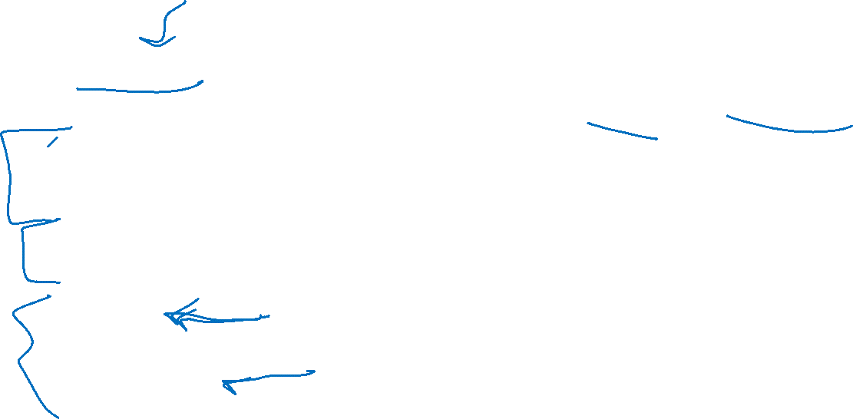
Exponential
$X\sim Exp(λ)$
Parameter $λ≥0$ is the average number of events in a unit of time.
$f_{X}\left(k\right)=\left\{\begin{aligned}λe^{−λk} if k≥0 \\ 0 otherwise\end{aligned}\right.$
$F_{X}\left(k\right)=\left\{\begin{aligned}1−e^{−λk} if k≥0 \\ 0 otherwise\end{aligned}\right.$
$𝔼\left[X\right]=\frac{1}{λ}$
$Var\left(X\right)=\frac{1}{λ^{2}}$

Slide 5
A continuous memoryless RV?
Poisson random variables come from a memoryless-type process.
Number of earthquakes (people in bakery, days with snow) would be memoryless under assumption that events are independent of each other!
Same experiments, but now ask a different question:
Poisson: how many incidents occur in fixed interval?
Exponential: how long do I have to wait to see the next incident?

Slide 6
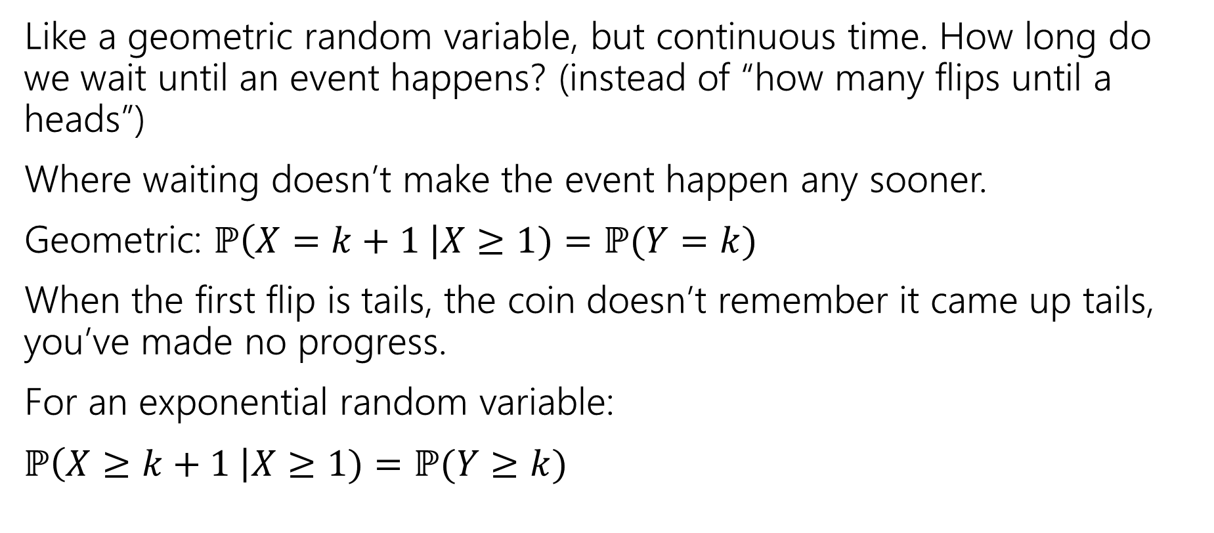

Exponential Random Variable
Like a geometric random variable, but continuous time. How long do we wait until an event happens? (instead of “how many flips until a heads”)
Where waiting doesn’t make the event happen any sooner.
Geometric: $ℙ\left(X=k+1 \right|X≥1)=ℙ(Y=k)$
When the first flip is tails, the coin doesn’t remember it came up tails, you’ve made no progress.
For an exponential random variable:
$ℙ\left(X≥k+1 \right|X≥1)=ℙ(Y≥k)$

Slide 7
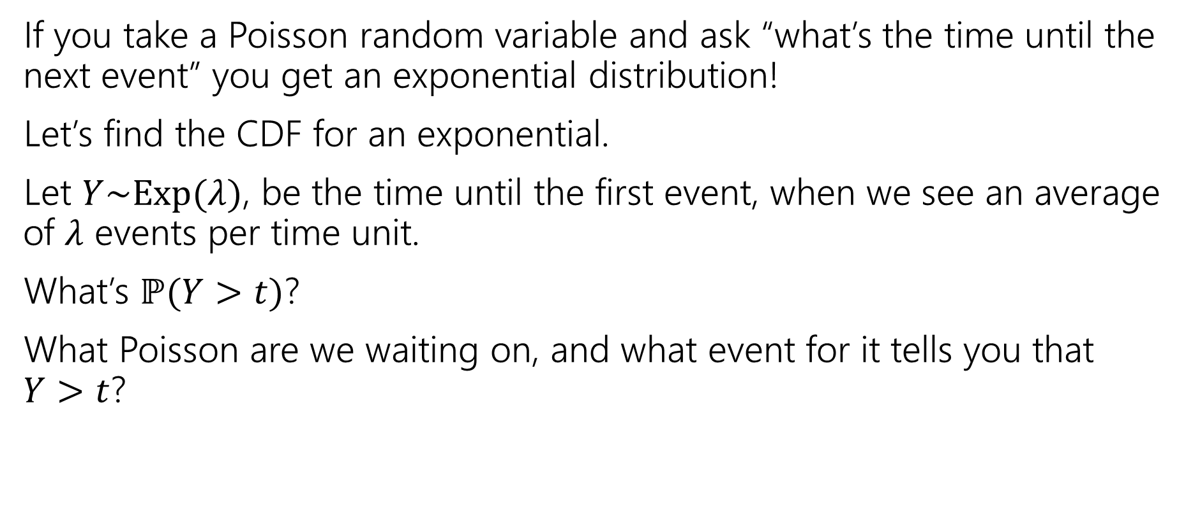
Exponential random variable
If you take a Poisson random variable and ask “what’s the time until the next event” you get an exponential distribution!
Let’s find the CDF for an exponential.
Let $Y\sim Exp(λ)$, be the time until the first event, when we see an average of $λ$ events per time unit.
What’s $ℙ(Y>t)$?
What Poisson are we waiting on, and what event for it tells you that $Y>t$?

Slide 8
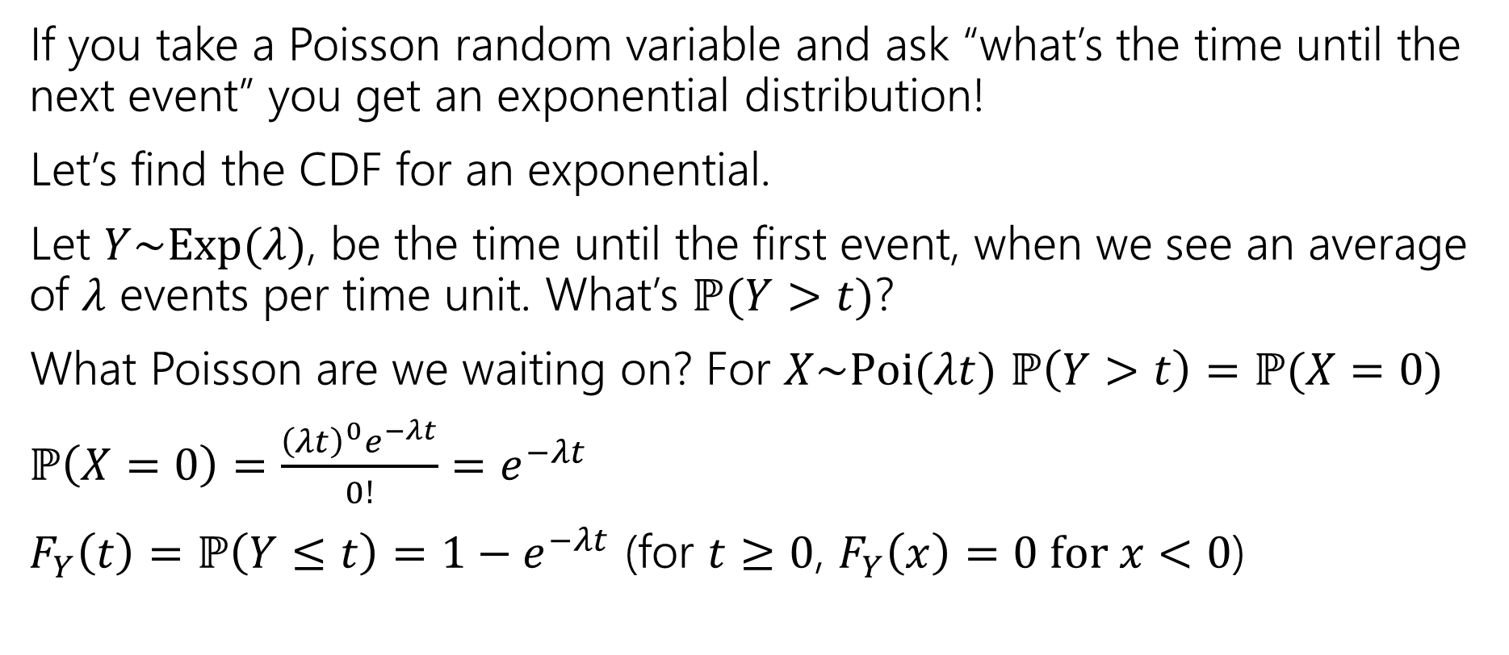
Exponential random variable
If you take a Poisson random variable and ask “what’s the time until the next event” you get an exponential distribution!
Let’s find the CDF for an exponential.
Let $Y\sim Exp(λ)$, be the time until the first event, when we see an average of $λ$ events per time unit. What’s $ℙ(Y>t)$?
What Poisson are we waiting on? For $X\sim Poi(λt)$ $ℙ\left(Y>t\right)=ℙ(X=0)$
$ℙ\left(X=0\right)=\frac{{\left(λt\right)}^{0}e^{−λt}}{0!}=e^{−λt}$
$F_{Y}\left(t\right)=ℙ\left(Y≤t\right)=1−e^{−λt}$ (for $t≥0$, $F_{Y}\left(x\right)=0 for x<0$)

Slide 9
Find the density
We know the CDF, $F_{Y}\left(t\right)=ℙ\left(Y≤t\right)=1−e^{−λt}$
What’s the density?
$f_{Y}\left(t\right)=$

Slide 10

Find the density
We know the CDF, $F_{Y}\left(t\right)=ℙ\left(Y≤t\right)=1−e^{−λt}$
What’s the density?
$f_{Y}\left(t\right)=\frac{d}{dt}\left(1−e^{−λt}\right)=0−\frac{d}{dt}\left(e^{−λt}\right)=λe^{−λt}$.
For $t≥0$ it’s that expression
For $t<0$ it’s just $0.$

Slide 11
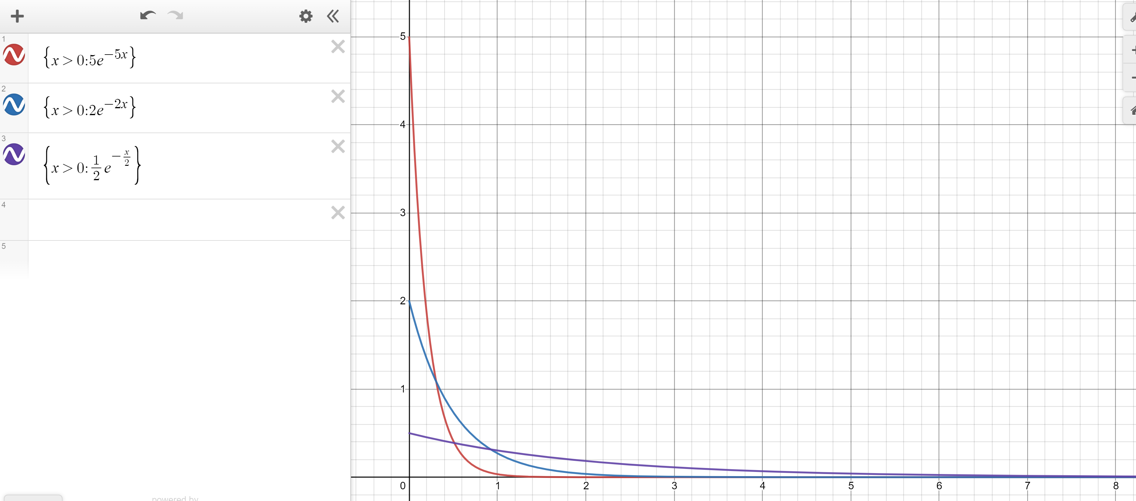
Exponential PDF
Red: $λ=5$
Blue: $λ=2$
Purple: $λ=0.5$

Slide 12
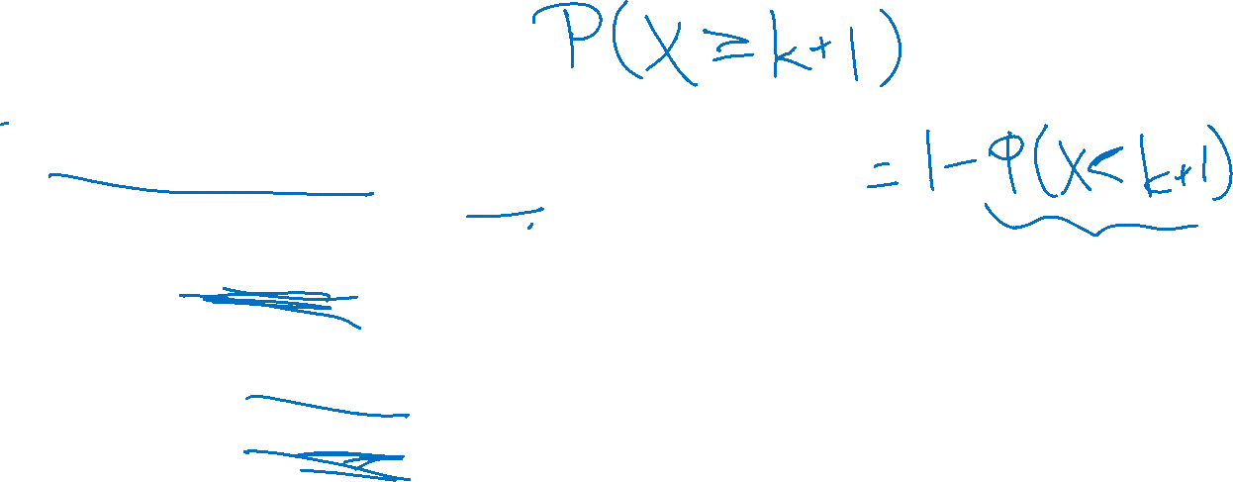
Memorylessness
$ℙ\left(X≥k+1 | X≥1\right)=\frac{ℙ(X≥k+1∩X≥1)}{ℙ(X≥1)}=\frac{ℙ(X≥k+1)}{1−(1−e^{−λ⋅1})}$
$=\frac{e^{−λ(k+1)}}{e^{−λ}}=e^{−λk}$
What about $ℙ(X≥k)$ (without conditioning on the first step)?
${1−(1−e}^{−λk})=e^{−λk}$
It’s the same!!!
More generally, for an exponential rv $X,$ $ℙ\left(X≥s+t | X≥s\right)=ℙ(X≥t)$

Slide 13
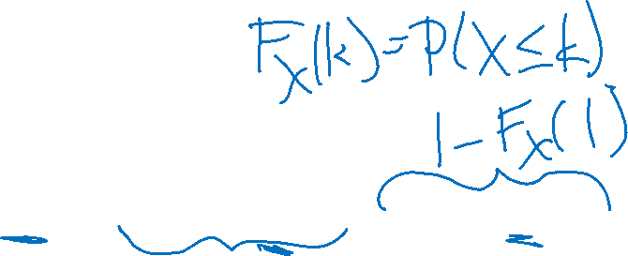
Side note
I hid a trick in that algebra,
$ℙ\left(X≥1\right)=1−ℙ\left(X<1\right)=1−ℙ(X≤1)$
The first step is the complementary law.
The second step is using that $\int_{1}^{1}{f_{X}\left(z\right)dz}=0$
In general, for continuous random variables we can switch out $≤$ and $<$without anything changing.
We can’t make those switches for discrete random variables.

Slide 14

Expectation of an exponential
Don’t worry about the derivation (it’s here if you’re interested; you’re not responsible for the derivation. Just the value.
Let $X\sim Exp(λ)$
$𝔼\left[X\right]=\int_{−∞}^{∞}{{z⋅f}_{X}\left(z\right)dz}$
$=\int_{0}^{∞}{z⋅λe^{−λz}}dz$
Let $u=z; dv=λe^{−λz}dz$ ($v=−e^{−λz}$)
Integrate by parts:$−ze^{−λz}−\int{−e^{−λz}}dz=−ze^{−λz}−\frac{1}{λ}e^{−λz}$
Definite Integral:$−ze^{−λz}−\frac{1}{λ}e^{−λz}{\left.​\right|}_{z=0}^{∞}=(\lim_{z→∞}{−ze^{−λz}−\frac{1}{λ}e^{−λz}) −(0−\frac{1}{λ})}$
By L’Hopital’s Rule $(\lim_{z→∞}{−\frac{z}{e^{λz}}−\frac{1}{λe^{λz}}) −(0−\frac{1}{λ})}=\left(\lim_{z→∞}−\frac{1}{λe^{λz}}\right)+\frac{1}{λ}=\frac{1}{λ}$

Slide 15
Variance of an exponential
If $X\sim Exp\left(λ\right)then Var\left(X\right)=\frac{1}{λ^{2}}$
Similar calculus tricks will get you there.

Slide 16
Exponential
$X\sim Exp(λ)$
Parameter $λ≥0$ is the average number of events in a unit of time.
$f_{X}\left(k\right)=\left\{\begin{aligned}λe^{−λk} if k≥0 \\ 0 otherwise\end{aligned}\right.$
$F_{X}\left(k\right)=\left\{\begin{aligned}1−e^{−λk} if k≥0 \\ 0 otherwise\end{aligned}\right.$
$𝔼\left[X\right]=\frac{1}{λ}$
$Var\left(X\right)=\frac{1}{λ^{2}}$

Slide 17
The Normal (Gaussian) Distribution

Slide 18

The Normal distribution
Our next random variable is weird in a lot of ways:
Complicated PDF
Yet more complicated CDF
It is extremely important
“real world” data under many circumstances looks like a Gaussian distribution (a “bell cure”) is one of these distributions.

Slide 19
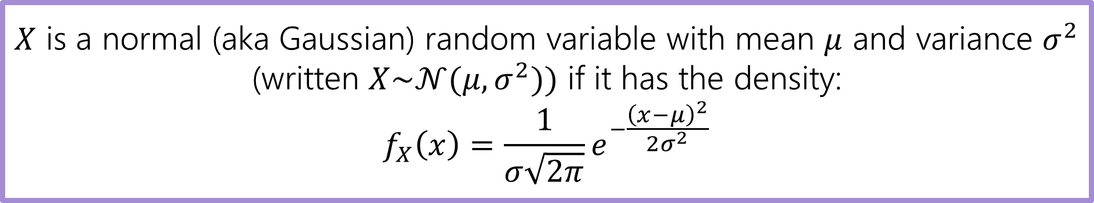
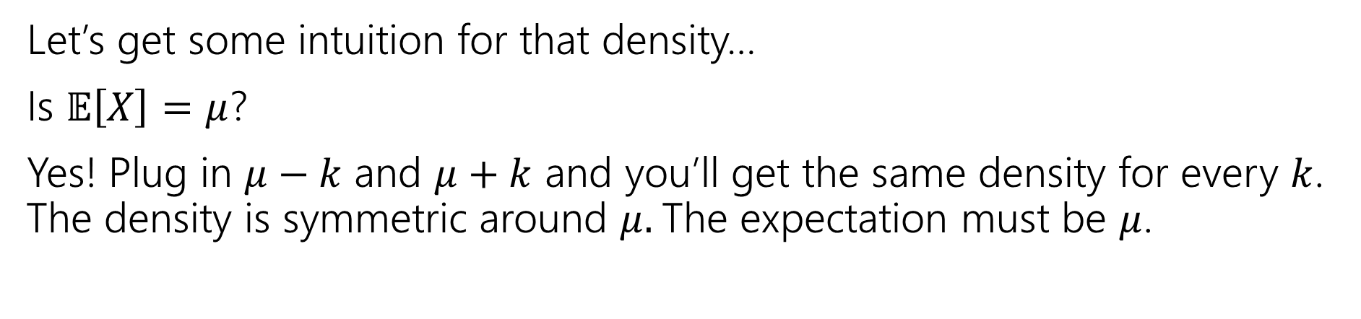

Normal Random Variable
$X$ is a normal (aka Gaussian) random variable with mean $μ$ and variance $σ^{2}$ (written $X\sim 𝒩(μ,σ^{2}))$ if it has the density:
$$f_{X}\left(x\right)=\frac{1}{σ\sqrt{2π}}e^{−\frac{{\left(x−μ\right)}^{2}}{2σ^{2}}}$$
Let’s get some intuition for that density…
Is $𝔼\left[X\right]=μ$?
Yes! Plug in $μ−k$ and $μ+k$ and you’ll get the same density for every $k$. The density is symmetric around $μ.$The expectation must be $μ$.

Slide 20
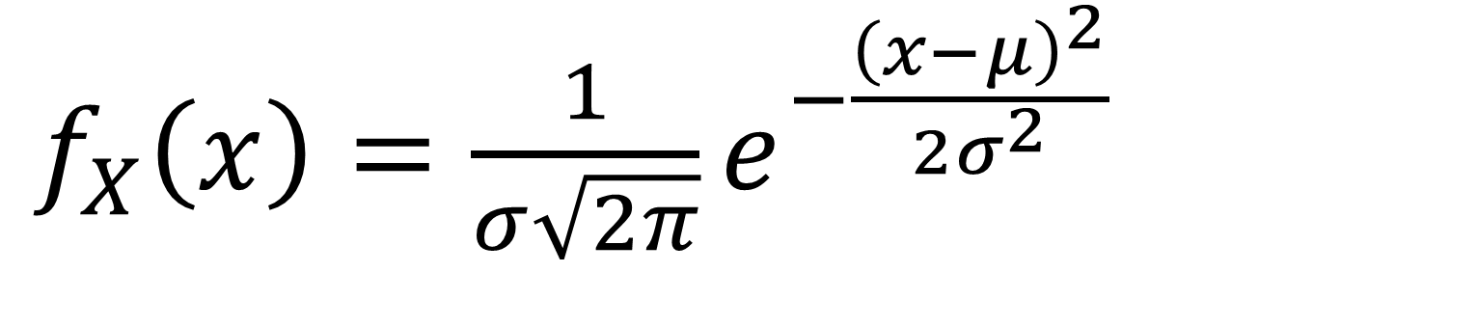
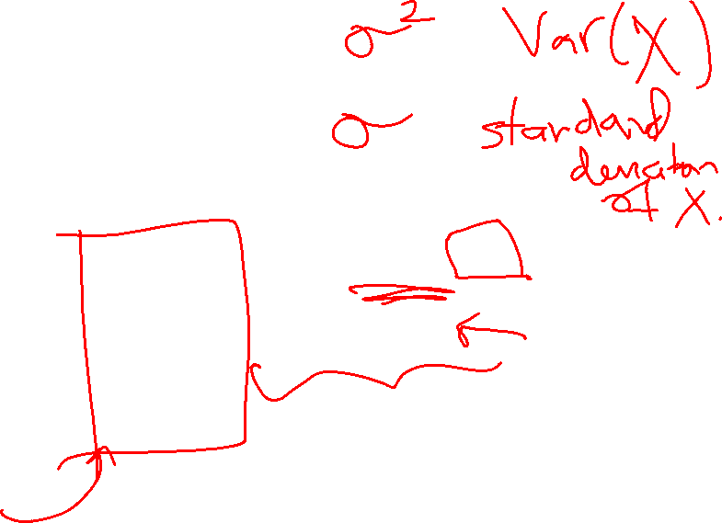
Breaking down the density
$f_{X}\left(x\right)=\frac{1}{σ\sqrt{2π}}e^{−\frac{{\left(x−μ\right)}^{2}}{2σ^{2}}}$
Notes:
Constant 1 / sigma sqrt(2 pi) makes sure when we integrate we get 1
e to the negative power, means we expect exponential decay
x minus mu squared says exponential decay is fast as you move away from the mean, and in either direction /2 sigma squared controls the rate at which decay occurs (if variance is larger, you decay slower)

Slide 21
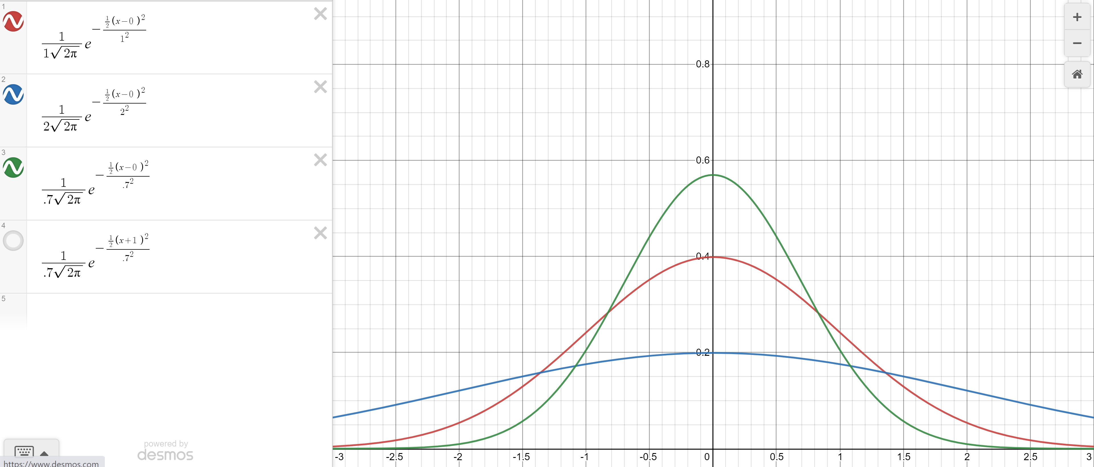


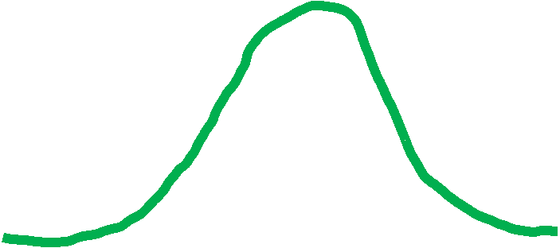
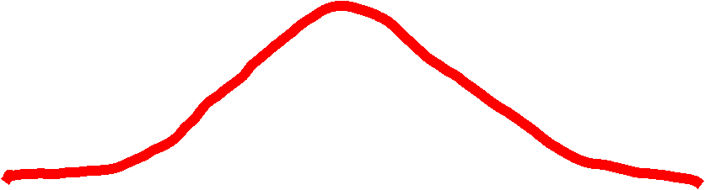
Changing the variance
Green: $σ^{2}=.7$
Red $σ^{2}=1$
Blue: $σ^{2}=2$

Slide 22
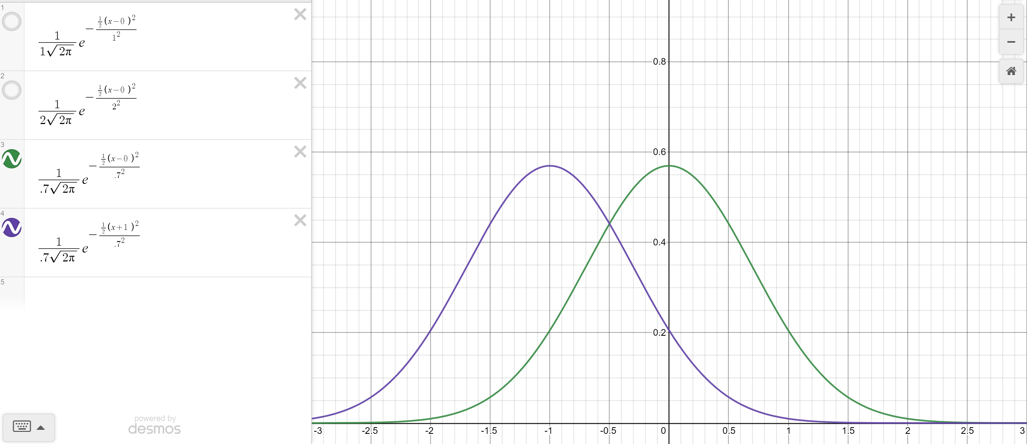


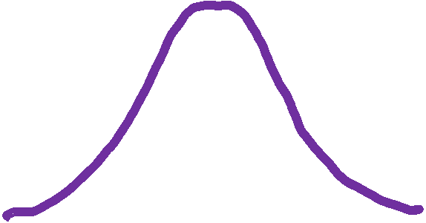


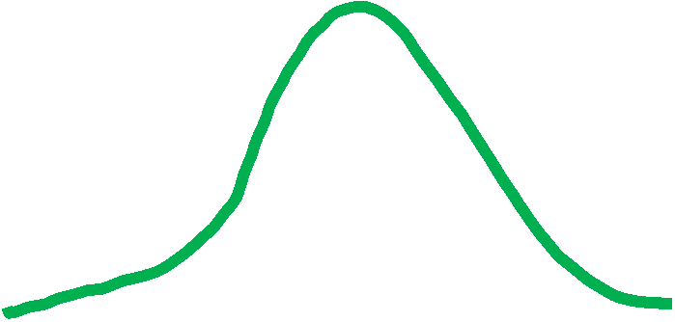


Changing the mean
Green: $σ^{2}=.7, μ=0$
Purple $σ^{2}=.7, μ=−1$

Slide 23
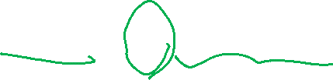
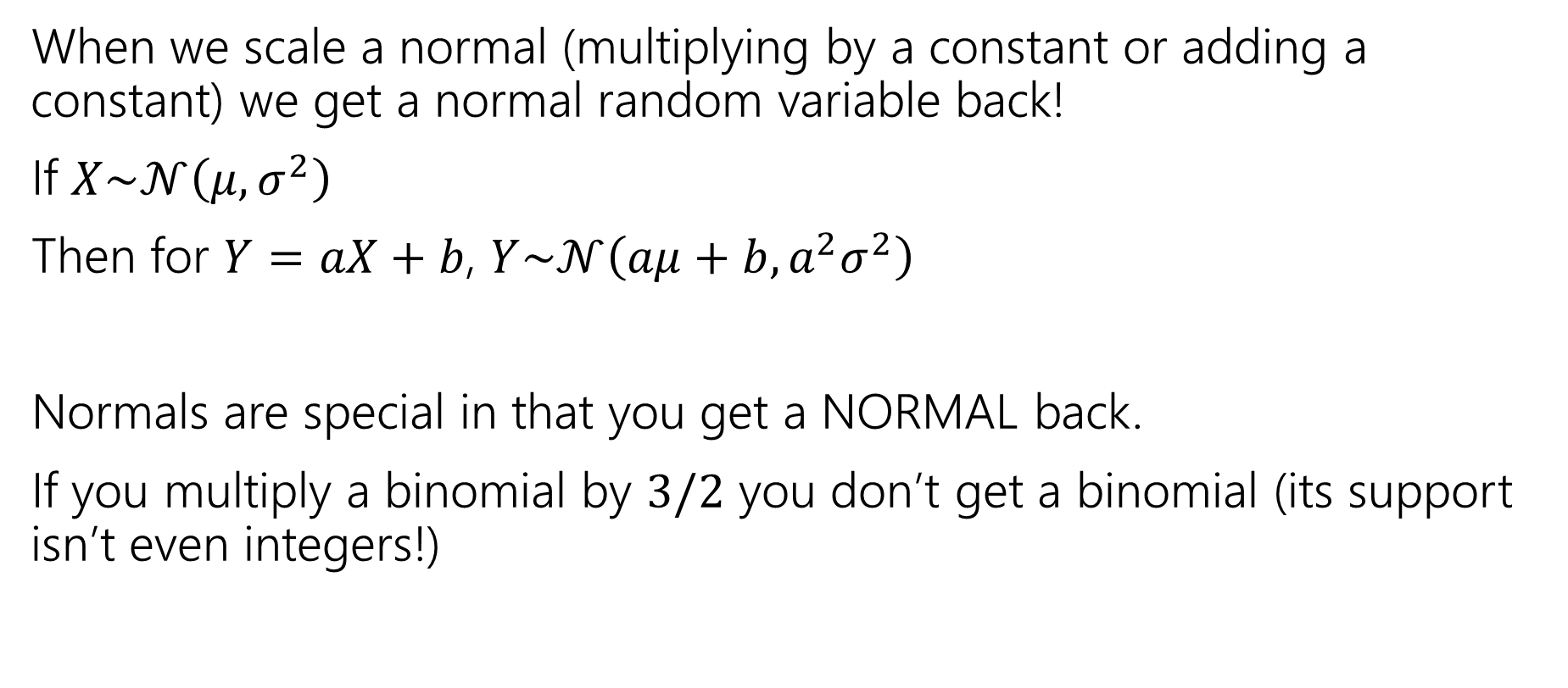
Scaling Normals
When we scale a normal (multiplying by a constant or adding a constant) we get a normal random variable back!
If $X\sim 𝒩\left(μ,σ^{2}\right)$
Then for $Y=aX+b$, $Y\sim 𝒩\left(aμ+b, a^{2}σ^{2}\right)$
Normals are special in that you get a NORMAL back.
If you multiply a binomial by $3/2$ you don’t get a binomial (its support isn’t even integers!)

Slide 24
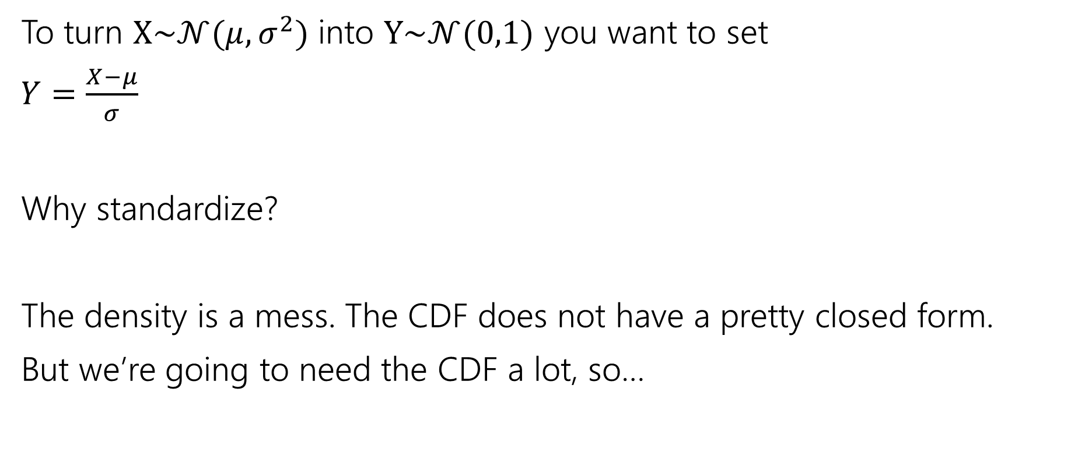
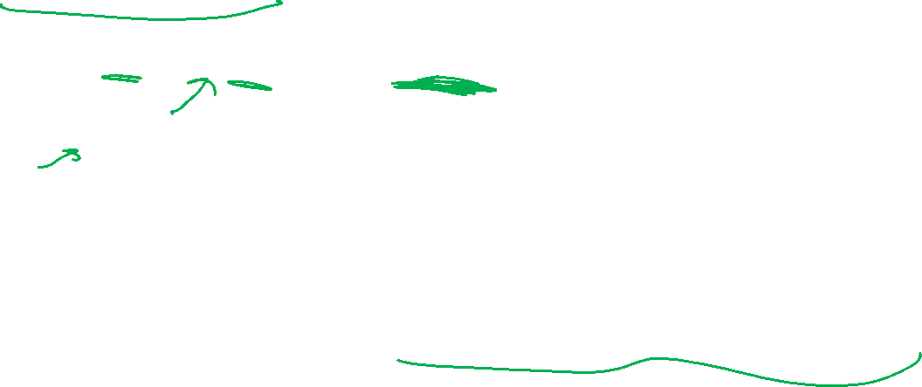
Standardize
To turn $X\sim 𝒩(μ,σ^{2})$ into $Y\sim 𝒩(0,1)$ you want to set
$Y=\frac{X−μ}{σ}$
Why standardize?
The density is a mess. The CDF does not have a pretty closed form.
But we’re going to need the CDF a lot, so…
Notes:
You’ll be tempted to say “normalize” because normal means….normal. But we really want to say “standardize” the “standard” one has mean 0 variance 1.

Slide 25
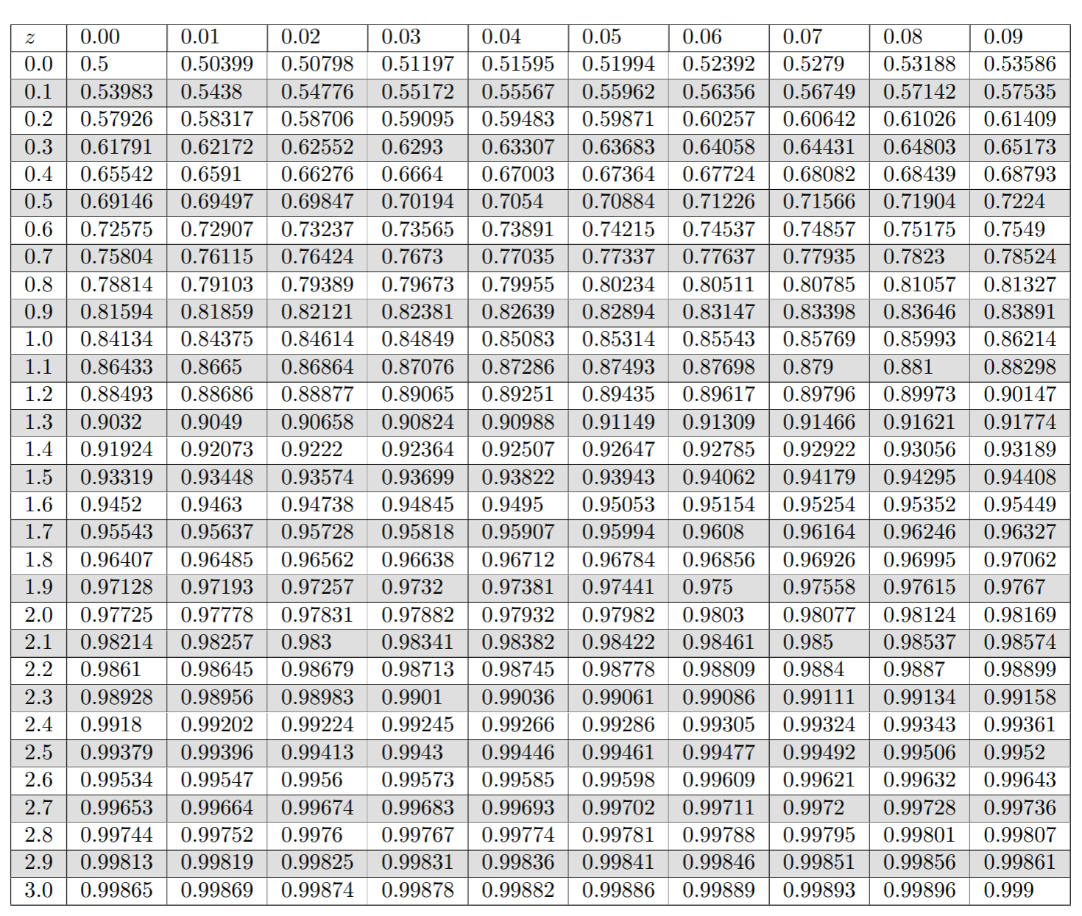
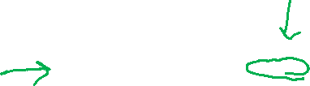
Table of Standard Normal CDF
The way we’ll evaluate the CDF of a normal is to: 1. convert to a standard normal
2. Round the “z-score” to the hundredths place.
3. Look up the value in the table.
It’s 2025, we’re using a table?
The table makes sure we have consistent rounding rules (makes it easier for us to debug with you).
You can’t evaluate this by hand – the “z-score” can give you intuition right away.

Slide 26
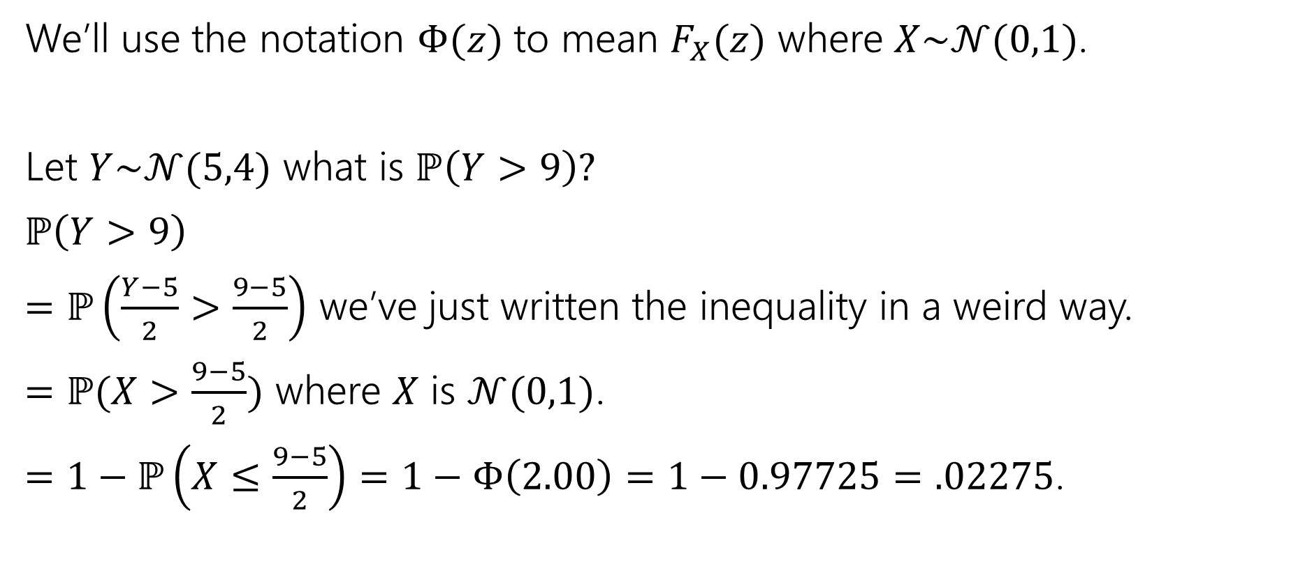
Use the table!
We’ll use the notation $Φ(z)$ to mean $F_{X}(z)$ where $X\sim 𝒩(0,1)$.
Let $Y\sim 𝒩(5,4)$ what is $ℙ\left(Y>9\right)?$
$ℙ\left(Y>9\right)$
$=ℙ\left(\frac{Y−5}{2}>\frac{9−5}{2}\right)$ we’ve just written the inequality in a weird way.
$=ℙ(X>\frac{9−5}{2})$ where $X$ is $𝒩(0,1)$.
$=1−ℙ\left(X≤\frac{9−5}{2}\right)=1−Φ\left(2.00\right)=1−0.97725=.02275$.

Slide 27

Normal (aka Guassian)
$X\sim 𝒩(μ,σ^{2})$
Parameter $μ$ is the expectation; $σ^{2}$ is the variance.
$f_{X}\left(x\right)=\frac{1}{σ\sqrt{2π}}e^{−\frac{{\left(x−μ\right)}^{2}}{2σ^{2}}}$
$F_{X}\left(k\right)$ has no nice closed form. Use the table.
$𝔼\left[X\right]=μ$
$Var\left(X\right)=σ^{2}$

Slide 28

More practice
Let $X\sim 𝒩(3, 2)$.
What is the probability that $1≤X≤4$

Slide 29
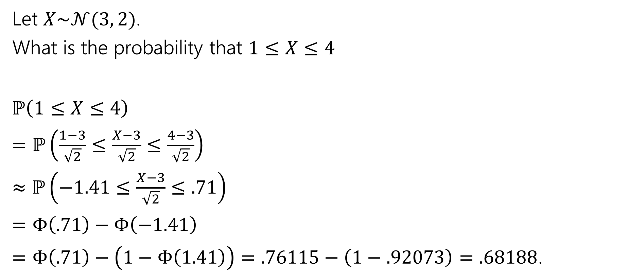
More practice
Let $X\sim 𝒩(3, 2)$.
What is the probability that $1≤X≤4$
$ℙ\left(1≤X≤4\right)$
$=ℙ\left(\frac{1−3}{\sqrt{2}}≤\frac{X−3}{\sqrt{2}}≤\frac{4−3}{\sqrt{2}}\right)$
$≈ℙ\left(−1.41≤\frac{X−3}{\sqrt{2}}≤.71\right)$
$=Φ\left(.71\right)−Φ\left(−1.41\right)$
$=Φ\left(.71\right)−\left(1−Φ\left(1.41\right)\right)=.76115−\left(1−.92073\right)=.68188$.

Slide 30

















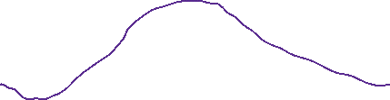
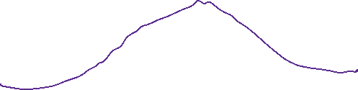



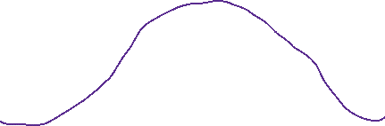








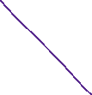























Slide 31
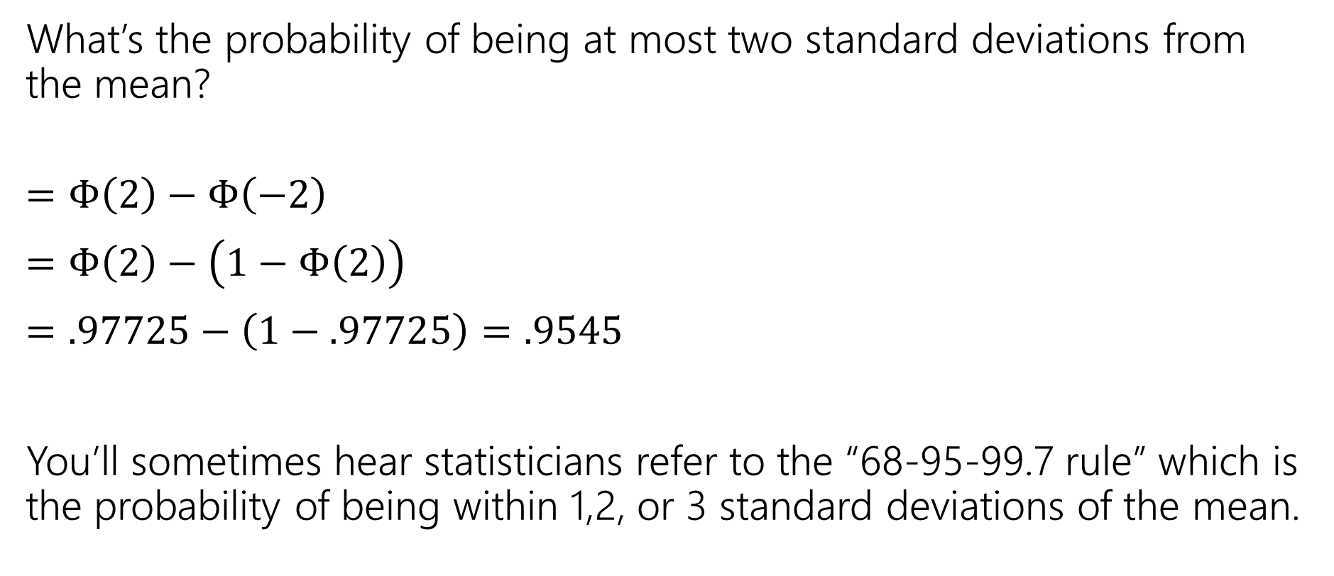
In real life
What’s the probability of being at most two standard deviations from the mean?
$=Φ\left(2\right)−Φ\left(−2\right)$
$=Φ\left(2\right)−\left(1−Φ\left(2\right)\right)$
$=.97725−\left(1−.97725\right)=.9545$
You’ll sometimes hear statisticians refer to the “68-95-99.7 rule” which is the probability of being within 1,2, or 3 standard deviations of the mean.

Slide 32
One last (unrelated) thing

Slide 33
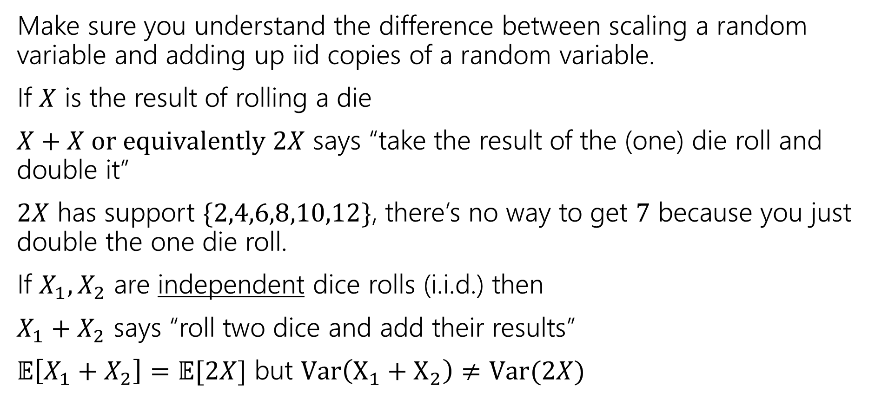
A Side Note
Make sure you understand the difference between scaling a random variable and adding up iid copies of a random variable.
If $X$ is the result of rolling a die
$X+X or equivalently 2X$ says “take the result of the (one) die roll and double it”
$2X$ has support $\{2,4,6,8,10,12\}$, there’s no way to get $7$ because you just double the one die roll.
If $X_{1},X_{2}$ are independent dice rolls (i.i.d.) then
$X_{1}+X_{2}$ says “roll two dice and add their results”
$𝔼\left[X_{1}+X_{2}\right]=𝔼[2X]$ but $Var\left(X_{1}+X_{2}\right)≠Var(2X)$

Slide 34


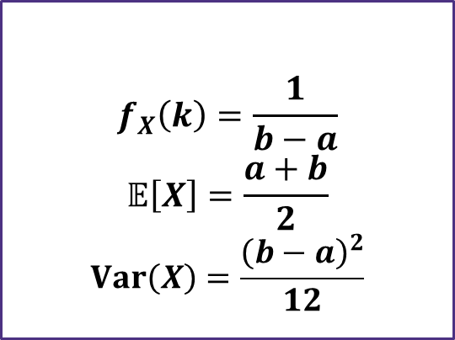
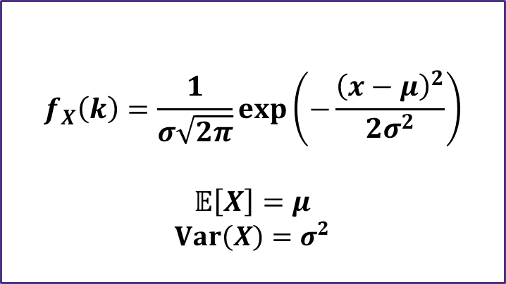

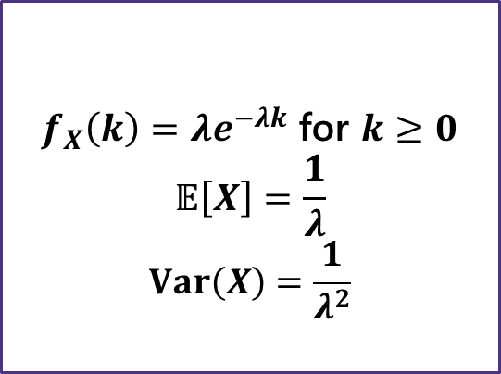
Continuous Zoo
$$X\sim Unif(a,b)$$
$$X\sim Exp(λ)$$
$$X\sim 𝒩(μ,σ^{2})$$
$$f_{X}\left(k\right)=\frac{1}{b−a}$$
$$𝔼\left[X\right]=\frac{a+b}{2}$$
$$Var\left(X\right)=\frac{{\left(b−a\right)}^{2}}{12}$$
$f_{X}\left(k\right)=λe^{−λk}$ for $k≥0$
$$𝔼\left[X\right]=\frac{1}{λ}$$
$$Var\left(X\right)=\frac{1}{λ^{2}}$$
$$f_{X}\left(k\right)=\frac{1}{σ\sqrt{2π}}exp\left(−\frac{{\left(x−μ\right)}^{2}}{2σ^{2}}\right)$$
$$𝔼\left[X\right]=μ$$
$$Var\left(X\right)=σ^{2}$$
It’s a smaller zoo, but it’s just as much fun!

