Slide 1
Continuous Zoo
CSE 312 Winter 26
Lecture 15

Slide 2
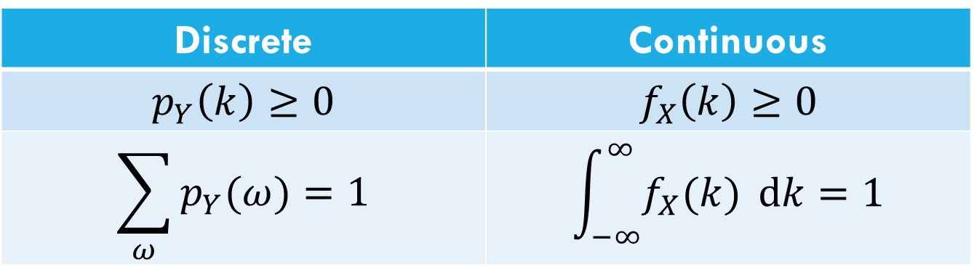
Let’s start with the pmf
For discrete random variables, we defined the pmf: $p_{Y}\left(k\right)=ℙ(Y=k)$.
We can’t have a pmf quite like we did for discrete random variables. Let $X$be a random real number between $0$ and $1$.
$ℙ\left(X=.1\right)=\frac{1}{∞}$??
Let’s try to maintain as many rules as we can…
Discrete | Continuous
$$p_{Y}\left(k\right)≥0$$ | $$f_{X}\left(k\right)≥0$$
$$\sum_{ω}{p_{Y}(ω)}=1$$ | $$\int_{−∞}^{∞}{f_{X}(k)} dk=1$$
Use $f_{X}$ instead of $p_{X}$ to remember it’s different .

Slide 3
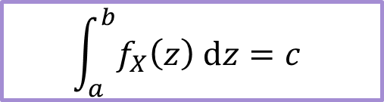
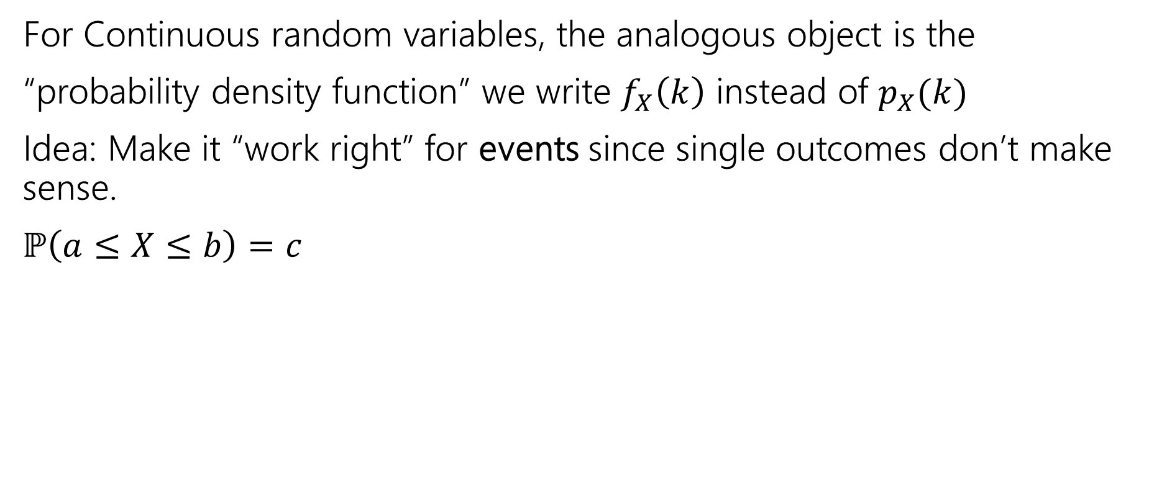
The probability density function
For Continuous random variables, the analogous object is the
“probability density function” we write $f_{X}\left(k\right)$ instead of $p_{X}(k)$
Idea: Make it “work right” for events since single outcomes don’t make sense.
$ℙ\left(a≤X≤b\right)=c$
$$\int_{a}^{b}{f_{X}\left(z\right) dz}=c$$
integrating is analogous to sum.
Let’s derive an example PDF together!
For a uniform random real number in [0,1]

Slide 4
CDFs

Slide 5

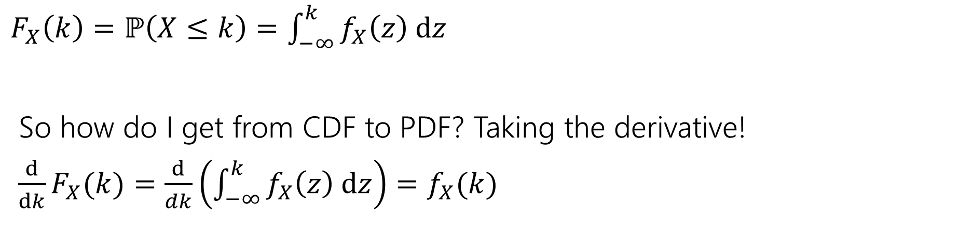
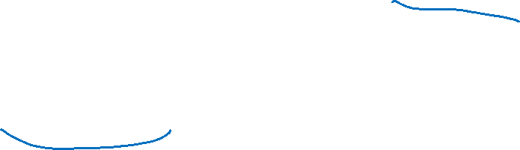
What’s a CDF?
The Cumulative Distribution Function $F_{X}\left(k\right)=ℙ(X≤k)$
analogous to the CDF for discrete variables.
$F_{X}\left(k\right)=ℙ\left(X≤k\right)=\int_{−∞}^{k}{f_{X}\left(z\right) dz}$
So how do I get from CDF to PDF? Taking the derivative!
$\frac{d}{dk}F_{X}(k)=\frac{d}{dk}\left(\int_{−∞}^{k}{f_{X}\left(z\right) dz}\right)=f_{X}(k)$

Slide 6
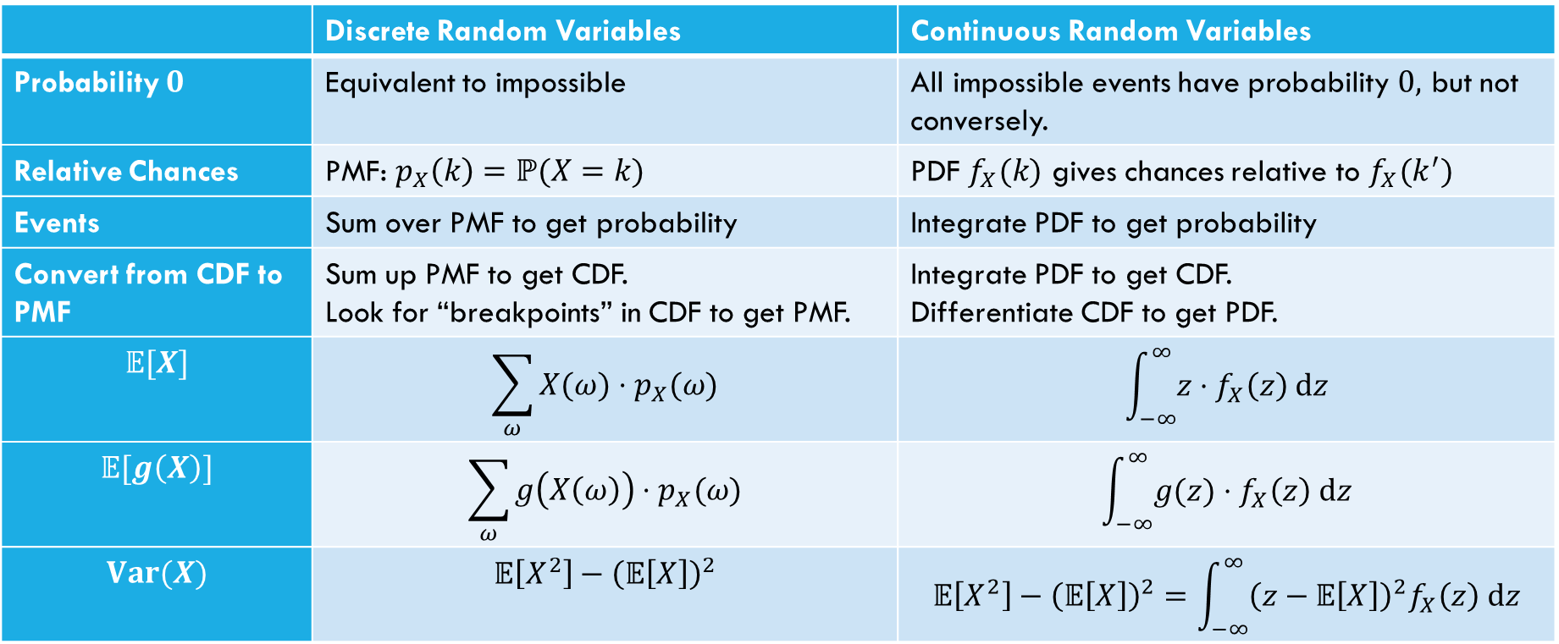
Comparing Discrete and Continuous
 | Discrete Random Variables | Continuous Random Variables
Probability $0$ | Equivalent to impossible | All impossible events have probability $0,$ but not conversely.
Relative Chances | PMF: $p_{X}\left(k\right)=ℙ(X=k)$ | PDF $f_{X}(k)$ gives chances relative to $f_{X}(k^{′})$
Events | Sum over PMF to get probability | Integrate PDF to get probability
Convert from CDF to PMF | Sum up PMF to get CDF. Look for “breakpoints” in CDF to get PMF. | Integrate PDF to get CDF. Differentiate CDF to get PDF.
$$𝔼[X]$$ | $$\sum_{ω}{X(ω)⋅p_{X}(ω)}$$ | $$\int_{−∞}^{∞}{z⋅f_{X}\left(z\right) dz}$$
$$𝔼[g\left(X\right)]$$ | $$\sum_{ω}{g\left(X\left(ω\right)\right)⋅p_{X}(ω)}$$ | $$\int_{−∞}^{∞}{g(z)⋅f_{X}\left(z\right) dz}$$
$$Var(X)$$ | $$𝔼\left[X^{2}\right]−{\left(𝔼\left[X\right]\right)}^{2}$$ | $$𝔼\left[X^{2}\right]−{\left(𝔼\left[X\right]\right)}^{2}=\int_{−∞}^{∞}{{\left(z−𝔼\left[X\right]\right)}^{2}f_{X}\left(z\right) dz}$$

Slide 7


What about expectation?
For a random variable $X$, we define:
$𝔼\left[X\right]=\int_{−∞}^{∞}{{z⋅f}_{X}\left(z\right) dz}$
Just replace summing over the pmf with integrating the pdf.
It still represents the average value of $X$.

Slide 8

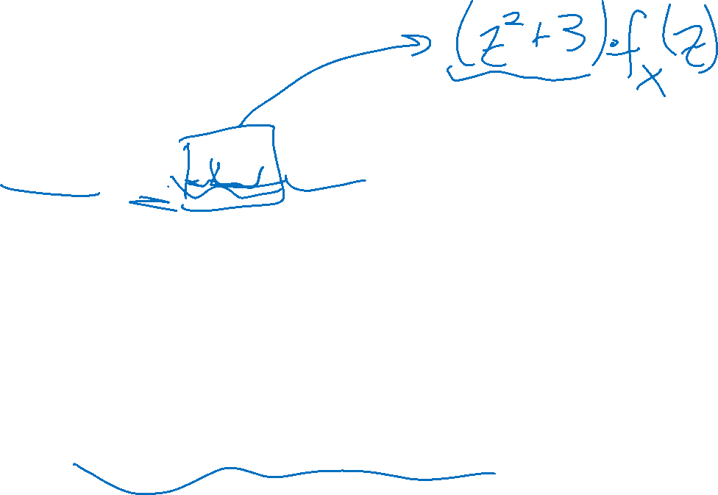
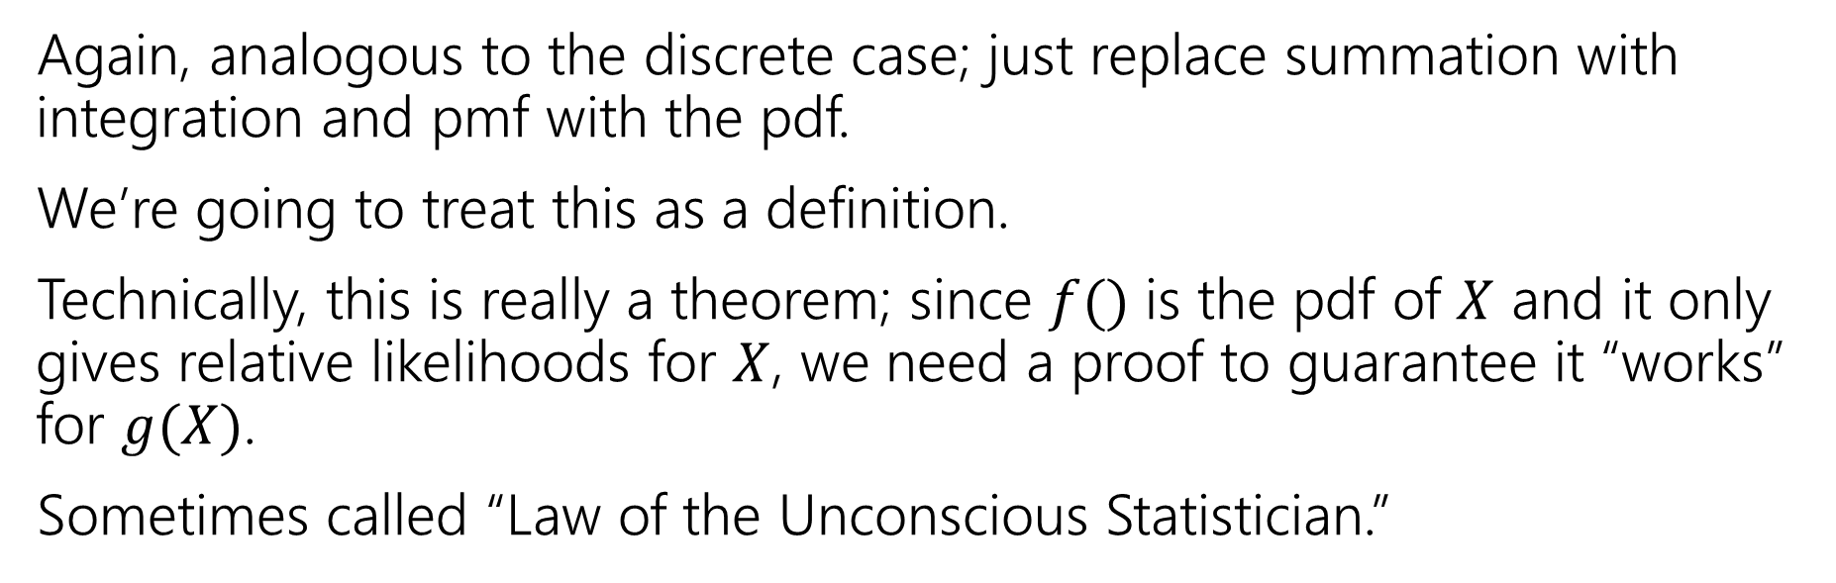
Expectation of a function
For any function $g$ and any continuous random variable, $X:$
$𝔼\left[g\left(X\right)\right]=\int_{−∞}^{∞}{g\left(X(z)\right)⋅f_{X}\left(z\right) dz}$
Again, analogous to the discrete case; just replace summation with integration and pmf with the pdf.
We’re going to treat this as a definition.
Technically, this is really a theorem; since $f()$ is the pdf of $X$ and it only gives relative likelihoods for $X$, we need a proof to guarantee it “works” for $g(X)$.
Sometimes called “Law of the Unconscious Statistician.”

Slide 9
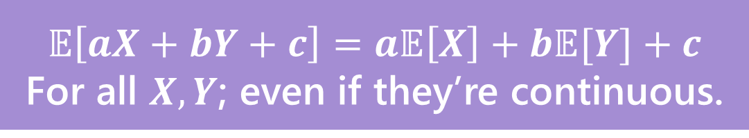
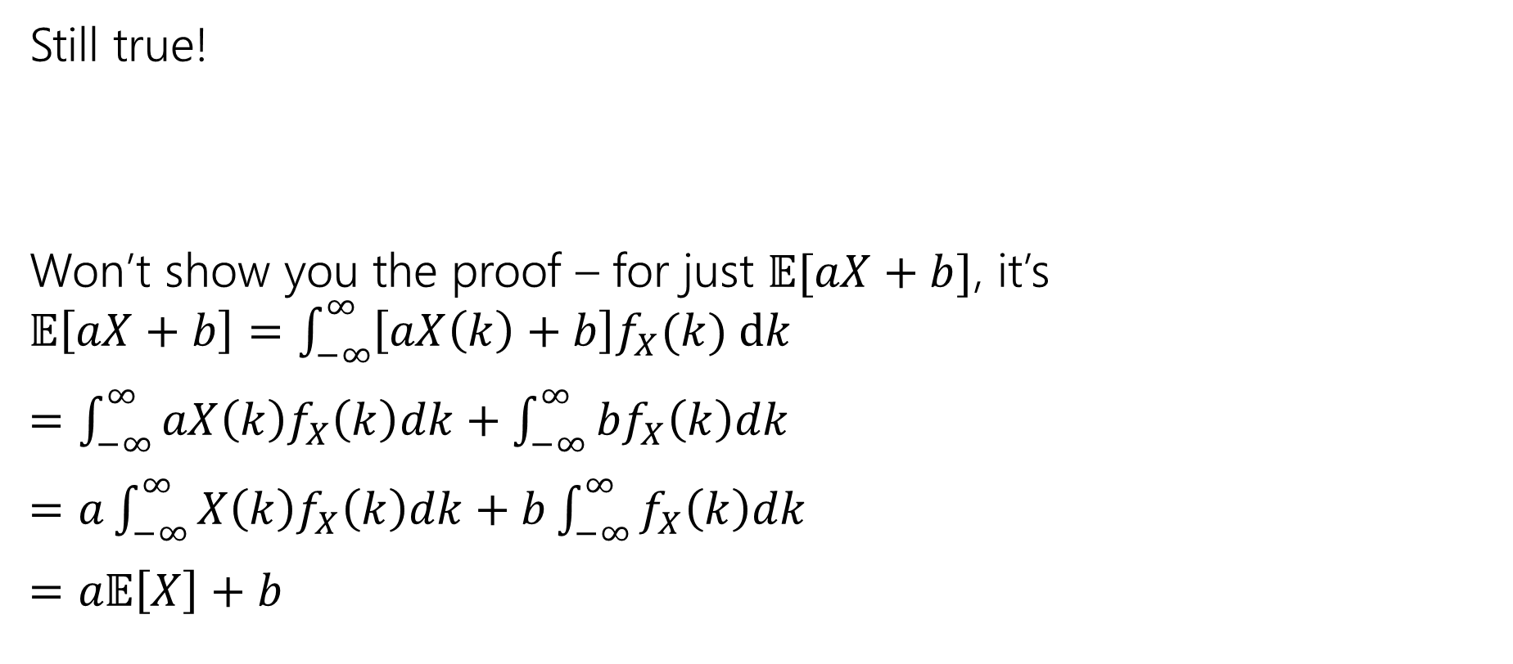
Linearity of Expectation
Still true!
Won’t show you the proof – for just $𝔼[aX+b]$, it’s $𝔼\left[aX+b\right]=\int_{−∞}^{∞}{\left[aX\left(k\right)+b\right]f_{X}(k) dk}$
$=\int_{−∞}^{∞}{aX\left(k\right)f_{X}\left(k\right)dk}+\int_{−∞}^{∞}{bf_{X}\left(k\right)dk}$
$=a\int_{−∞}^{∞}{X\left(k\right)f_{X}\left(k\right)dk}+b\int_{−∞}^{∞}{f_{X}\left(k\right)dk}$
$=a𝔼\left[X\right]+b$
$$𝔼\left[aX+bY+c\right]=a𝔼\left[X\right]+b𝔼[Y]+c$$
For all $X,Y$; even if they’re continuous.

Slide 10
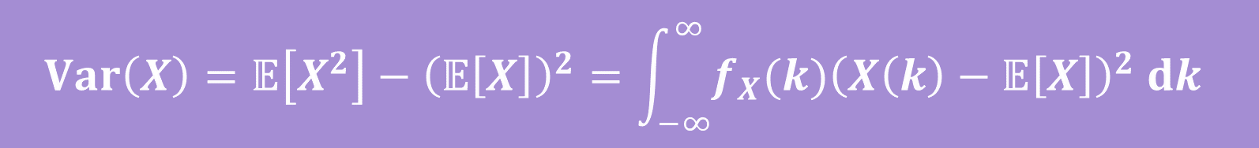
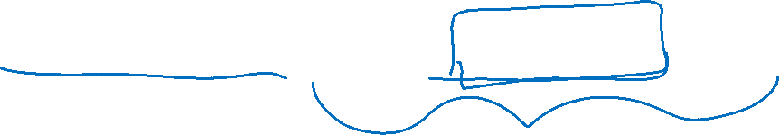
Variance
No surprises here
$$Var\left(X\right)=𝔼\left[X^{2}\right]−{\left(𝔼\left[X\right]\right)}^{2}=\int_{−∞}^{∞}{{f_{X}(k)\left(X\left(k\right)−𝔼\left[X\right]\right)}^{2} dk}$$

Slide 11



Let’s calculate an expectation
Let $X$ be a uniform random number between $a$ and$b$.
$𝔼\left[X\right]=\int_{−∞}^{∞}{z⋅f_{X}\left(z\right) dz}$

Slide 12
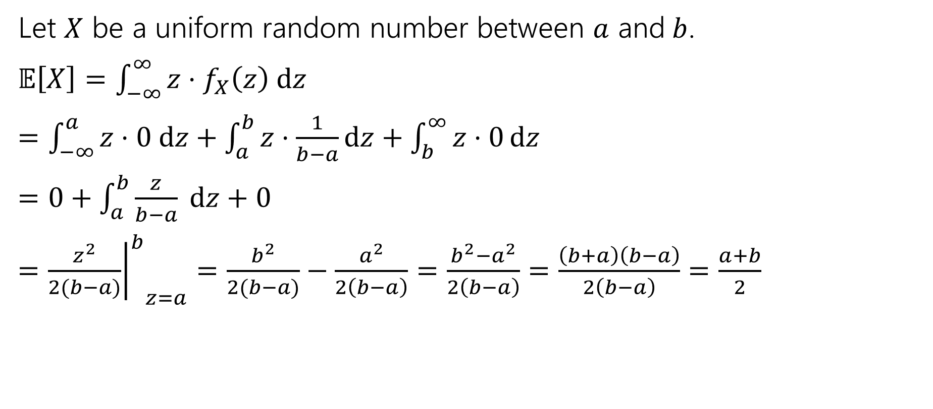
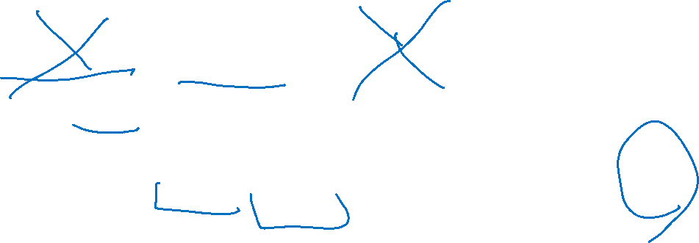
Let’s calculate an expectation
Let $X$ be a uniform random number between $a$ and$b$.
$𝔼\left[X\right]=\int_{−∞}^{∞}{z⋅f_{X}\left(z\right) dz}$
$=\int_{−∞}^{a}{z⋅0 dz}+\int_{a}^{b}{z⋅\frac{1}{b−a}dz}+\int_{b}^{∞}{z⋅0}dz$
$=0+\int_{a}^{b}{\frac{z}{b−a} dz+0}$
$={{\left.\frac{z^{2}}{2(b−a)}\right|}^{b}}_{z=a}=\frac{b^{2}}{2(b−a)}−\frac{a^{2}}{2\left(b−a\right)}=\frac{b^{2}−a^{2}}{2\left(b−a\right)}=\frac{\left(b+a\right)\left(b−a\right)}{2\left(b−a\right)}=\frac{a+b}{2}$

Slide 13
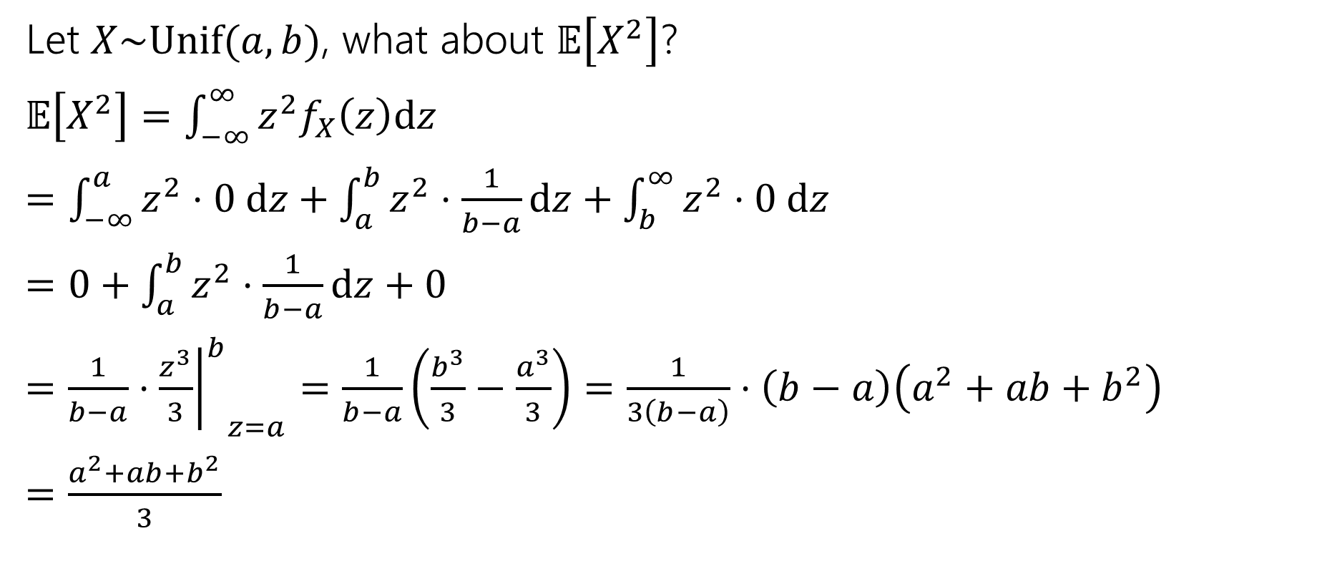


What about $𝔼\left[g\left(X\right)\right]$
Let $X\sim Unif(a,b)$, what about $𝔼\left[X^{2}\right]$?
$𝔼\left[X^{2}\right]=\int_{−∞}^{∞}{z^{2}f_{X}\left(z\right)dz}$
$=\int_{−∞}^{a}{z^{2}⋅0 dz+\int_{a}^{b}{z^{2}⋅\frac{1}{b−a}dz}+\int_{b}^{∞}{z^{2}⋅0 dz}}$
$=0+\int_{a}^{b}{z^{2}⋅\frac{1}{b−a}dz}+0$
$=\frac{1}{b−a}⋅{{\left.\frac{z^{3}}{3}\right|}^{b}}_{z=a}=\frac{1}{b−a}\left(\frac{b^{3}}{3}−\frac{a^{3}}{3}\right)=\frac{1}{3\left(b−a\right)}⋅\left(b−a\right)\left(a^{2}+ab+b^{2}\right)$
$=\frac{a^{2}+ab+b^{2}}{3}$

Slide 14


Let’s assemble the variance
$Var\left(X\right)=𝔼\left[X^{2}\right]−{\left(𝔼\left[X\right]\right)}^{2}$
$=\frac{a^{2}+ab+b^{2}}{3}−{\left(\frac{a+b}{2}\right)}^{2}$
$=\frac{4(a^{2}+ab+b^{2})}{12}−\frac{{3(a}^{2}+2ab+b^{2})}{12}$
$=\frac{a^{2}−2ab+b^{2}}{12}$
$=\frac{{\left(a−b\right)}^{2}}{12}$

Slide 15
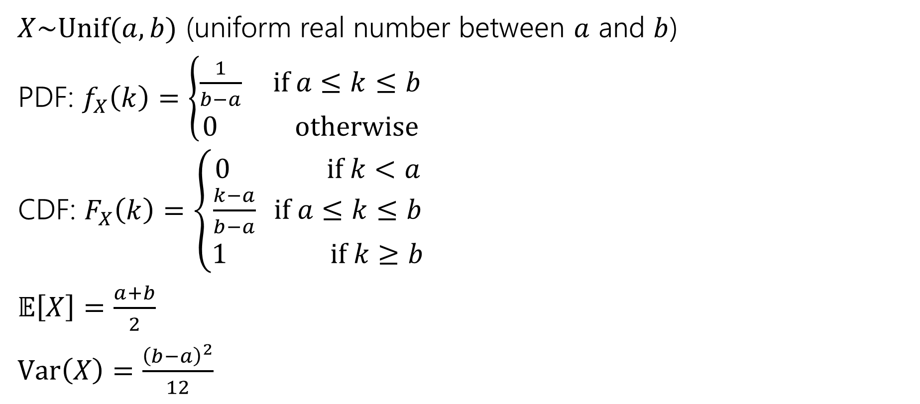

Continuous Uniform Distribution
$X\sim Unif(a,b)$ (uniform real number between $a$ and $b$)
PDF: $f_{X}\left(k\right)=\left\{\begin{aligned}\frac{1}{b−a} if a≤k≤b \\ 0 otherwise\end{aligned}\right.$
CDF: $F_{X}\left(k\right)=\left\{\begin{aligned}0 if k<a \\ \frac{k−a}{b−a} if a≤k≤b \\ 1 if k≥b\end{aligned}\right.$
$𝔼\left[X\right]=\frac{a+b}{2}$
$Var\left(X\right)=\frac{{\left(b−a\right)}^{2}}{12}$

Slide 16

Comparing Discrete and Continuous
 | Discrete Random Variables | Continuous Random Variables
Probability $0$ | Equivalent to impossible | All impossible events have probability $0,$ but not conversely.
Relative Chances | PMF: $p_{X}\left(k\right)=ℙ(X=k)$ | PDF $f_{X}(k)$ gives chances relative to $f_{X}(k^{′})$
Events | Sum over PMF to get probability | Integrate PDF to get probability
Convert from CDF to PMF | Sum up PMF to get CDF. Look for “breakpoints” in CDF to get PMF. | Integrate PDF to get CDF. Differentiate CDF to get PDF.
$$𝔼[X]$$ | $$\sum_{ω}{X(ω)⋅p_{X}(ω)}$$ | $$\int_{−∞}^{∞}{z⋅f_{X}\left(z\right) dz}$$
$$𝔼[g\left(X\right)]$$ | $$\sum_{ω}{g\left(X\left(ω\right)\right)⋅p_{X}(ω)}$$ | $$\int_{−∞}^{∞}{g(z)⋅f_{X}\left(z\right) dz}$$
$$Var(X)$$ | $$𝔼\left[X^{2}\right]−{\left(𝔼\left[X\right]\right)}^{2}$$ | $$𝔼\left[X^{2}\right]−{\left(𝔼\left[X\right]\right)}^{2}=\int_{−∞}^{∞}{{\left(z−𝔼\left[X\right]\right)}^{2}f_{X}\left(z\right) dz}$$

Slide 17

Continuous Zoo
$$X\sim Unif(a,b)$$
$$X\sim Exp(λ)$$
$$X\sim 𝒩(μ,σ^{2})$$
$$f_{X}\left(k\right)=\frac{1}{b−a}$$
$$𝔼\left[X\right]=\frac{a+b}{2}$$
$$Var\left(X\right)=\frac{{\left(b−a\right)}^{2}}{12}$$
$f_{X}\left(k\right)=λe^{−λk}$ for $k≥0$
$$𝔼\left[X\right]=\frac{1}{λ}$$
$$Var\left(X\right)=\frac{1}{λ^{2}}$$
$$f_{X}\left(k\right)=\frac{1}{σ\sqrt{2π}}exp\left(−\frac{{\left(x−μ\right)}^{2}}{2σ^{2}}\right)$$
$$𝔼\left[X\right]=μ$$
$$Var\left(X\right)=σ^{2}$$
It’s a smaller zoo, but it’s just as much fun!

Slide 18
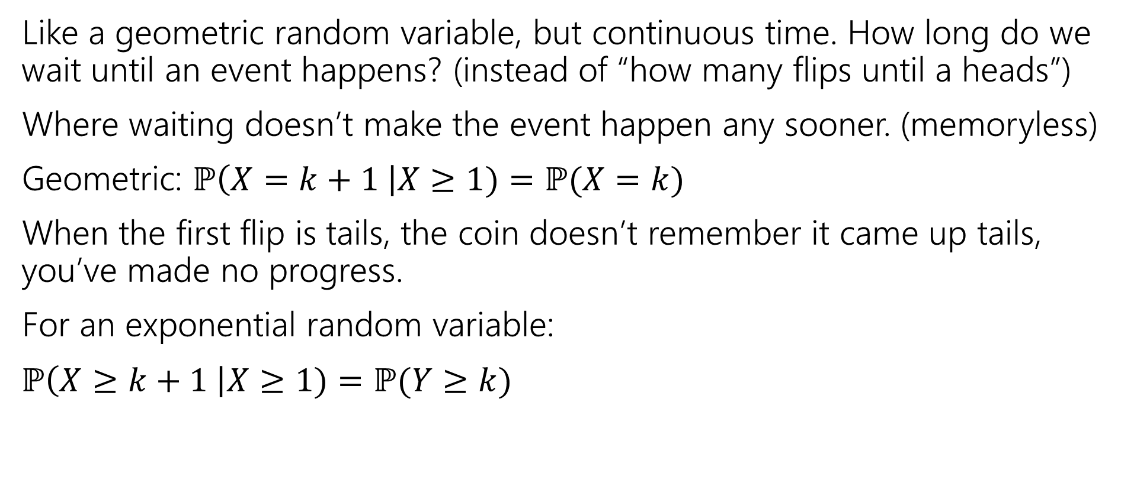
Exponential Random Variable
Like a geometric random variable, but continuous time. How long do we wait until an event happens? (instead of “how many flips until a heads”)
Where waiting doesn’t make the event happen any sooner. (memoryless)
Geometric: $ℙ\left(X=k+1 \right|X≥1)=ℙ(X=k)$
When the first flip is tails, the coin doesn’t remember it came up tails, you’ve made no progress.
For an exponential random variable:
$ℙ\left(X≥k+1 \right|X≥1)=ℙ(Y≥k)$

Slide 19
Are these memoryless?
You arrive to a bus stop at a (uniformly) random time, to a bus that arrives every 10 minutes. How long until the bus arrives? How long conditioned on you’ve already waited 8 minutes?
You put everyone in class into a random order. You’ll iterate through that list. What is the probability of being next? Probability of being next conditioned on not selected yet AND half the class has gone?
You flip a coin (independently) until you see a heads. How many flips do you need? How many additional flips after seeing 4 tails?

Slide 20

Are these memoryless?
You arrive to a bus stop at a (uniformly) random time, to a bus that arrives every 10 minutes. How long until the bus arrives? How long conditioned on you’ve already waited 8 minutes?
Not memoryless! (bus must arrive in 10 minutes total, must be soon!)
You put everyone in class into a random order. You’ll iterate through that list. What is the probability of being next? Probability of being next conditioned on not selected yet AND half the class has gone?
Not memoryless ($1/n$ of being first $1/(n/2)$ after half class gone)
You flip a coin (independently) until you see a heads
Memoryless!

Slide 21
A continuous memoryless RV?
Poisson random variables come from a memoryless-type process.
Number of earthquakes (people in bakery, days with snow) would be memoryless under assumption that events are independent of each other!
Same experiments, but now ask a different question:
Poisson: how many incidents occur in fixed interval?
Exponential: how long do I have to wait to see the next incident?

Slide 22
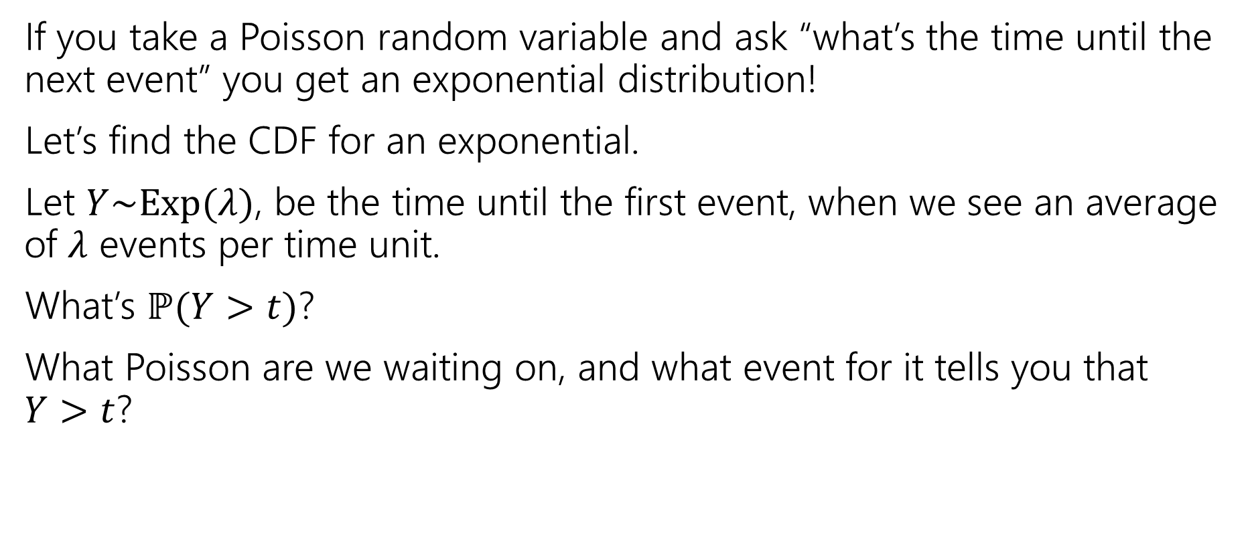
Exponential random variable
If you take a Poisson random variable and ask “what’s the time until the next event” you get an exponential distribution!
Let’s find the CDF for an exponential.
Let $Y\sim Exp(λ)$, be the time until the first event, when we see an average of $λ$ events per time unit.
What’s $ℙ(Y>t)$?
What Poisson are we waiting on, and what event for it tells you that $Y>t$?

Slide 23
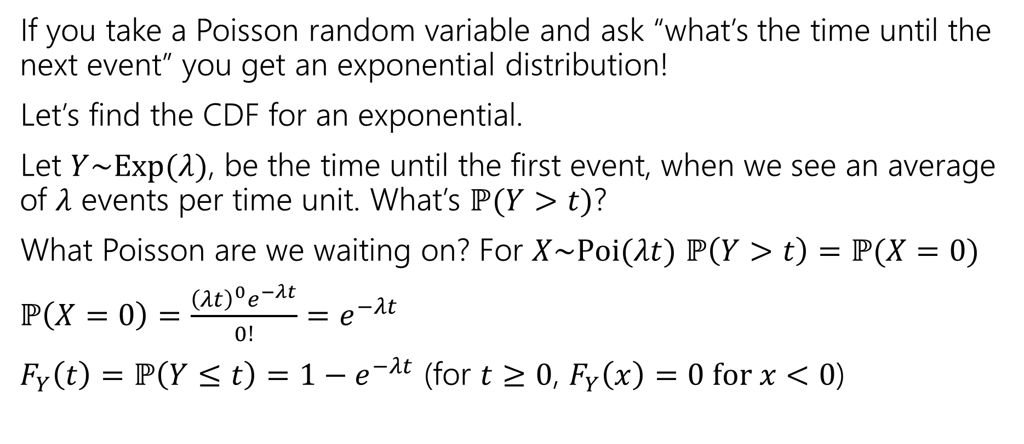
Exponential random variable
If you take a Poisson random variable and ask “what’s the time until the next event” you get an exponential distribution!
Let’s find the CDF for an exponential.
Let $Y\sim Exp(λ)$, be the time until the first event, when we see an average of $λ$ events per time unit. What’s $ℙ(Y>t)$?
What Poisson are we waiting on? For $X\sim Poi(λt)$ $ℙ\left(Y>t\right)=ℙ(X=0)$
$ℙ\left(X=0\right)=\frac{{\left(λt\right)}^{0}e^{−λt}}{0!}=e^{−λt}$
$F_{Y}\left(t\right)=ℙ\left(Y≤t\right)=1−e^{−λt}$ (for $t≥0$, $F_{Y}\left(x\right)=0 for x<0$)

Slide 24
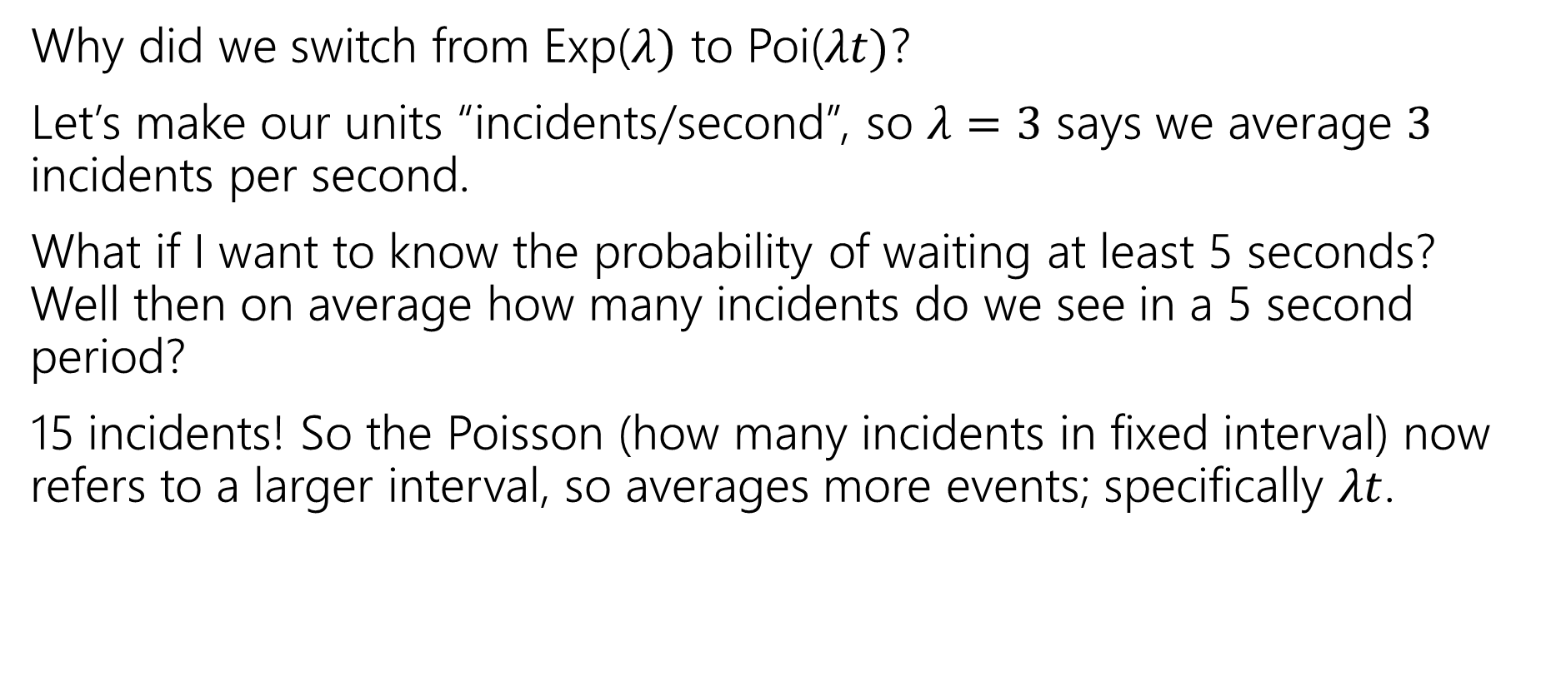

Where did the $t$ come from?
Why did we switch from Exp($λ)$ to Poi($λt)$?
Let’s make our units “incidents/second”, so $λ=3$ says we average $3$ incidents per second.
What if I want to know the probability of waiting at least 5 seconds? Well then on average how many incidents do we see in a 5 second period?
15 incidents! So the Poisson (how many incidents in fixed interval) now refers to a larger interval, so averages more events; specifically $λt$.

Slide 25
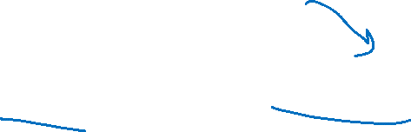
Find the density
We know the CDF, $F_{Y}\left(t\right)=ℙ\left(Y≤t\right)=1−e^{−λt}$
What’s the density?
$f_{Y}\left(t\right)=$

Slide 26
Find the density
We know the CDF, $F_{Y}\left(t\right)=ℙ\left(Y≤t\right)=1−e^{−λt}$
What’s the density?
$f_{Y}\left(t\right)=\frac{d}{dt}\left(1−e^{−λt}\right)=0−\frac{d}{dt}\left(e^{−λt}\right)=λe^{−λt}$.
For $t≥0$ it’s that expression
For $t<0$ it’s just $0.$

Slide 27
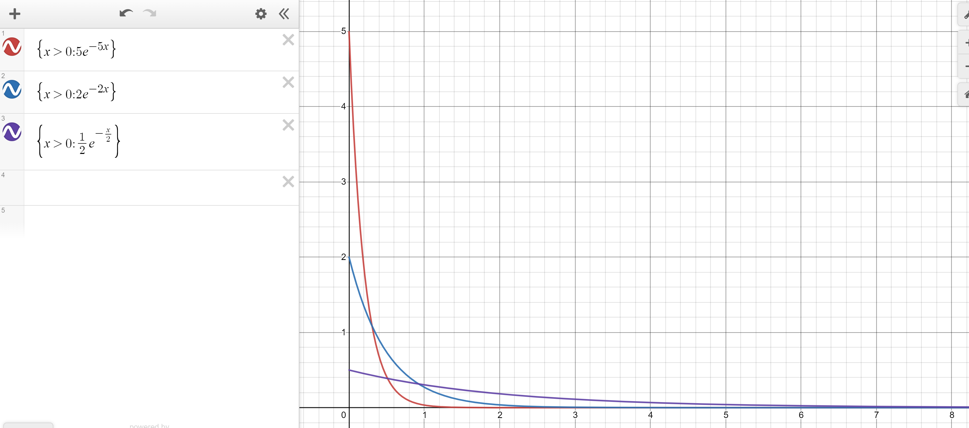
Exponential PDF
Red: $λ=5$
Blue: $λ=2$
Purple: $λ=0.5$

Slide 28
Memorylessness
$ℙ\left(X≥k+1 | X≥1\right)=\frac{ℙ(X≥k+1∩X≥1)}{ℙ(X≥1)}=\frac{ℙ(X≥k+1)}{1−(1−e^{−λ⋅1})}$
$=\frac{e^{−λ(k+1)}}{e^{−λ}}=e^{−λk}$
What about $ℙ(X≥k)$ (without conditioning on the first step)?
${1−(1−e}^{−λk})=e^{−λk}$
It’s the same!!!
More generally, for an exponential rv $X,$ $ℙ\left(X≥s+t | X≥s\right)=ℙ(X≥t)$

Slide 29
Side note
I hid a trick in that algebra,
$ℙ\left(X≥1\right)=1−ℙ\left(X<1\right)=1−ℙ(X≤1)$
The first step is the complementary law.
The second step is using that $\int_{1}^{1}{f_{X}\left(z\right)dz}=0$
In general, for continuous random variables we can switch out $≤$ and $<$without anything changing.
We can’t make those switches for discrete random variables.

Slide 30
Expectation of an exponential
Don’t worry about the derivation (it’s here if you’re interested; you’re not responsible for the derivation. Just the value.
Let $X\sim Exp(λ)$
$𝔼\left[X\right]=\int_{−∞}^{∞}{{z⋅f}_{X}\left(z\right)dz}$
$=\int_{0}^{∞}{z⋅λe^{−λz}}dz$
Let $u=z; dv=λe^{−λz}dz$ ($v=−e^{−λz}$)
Integrate by parts:$−ze^{−λz}−\int{−e^{−λz}}dz=−ze^{−λz}−\frac{1}{λ}e^{−λz}$
Definite Integral:$−ze^{−λz}−\frac{1}{λ}e^{−λz}{\left.​\right|}_{z=0}^{∞}=(\lim_{z→∞}{−ze^{−λz}−\frac{1}{λ}e^{−λz}) −(0−\frac{1}{λ})}$
By L’Hopital’s Rule $(\lim_{z→∞}{−\frac{z}{e^{λz}}−\frac{1}{λe^{λz}}) −(0−\frac{1}{λ})}=\left(\lim_{z→∞}−\frac{1}{λe^{λz}}\right)+\frac{1}{λ}=\frac{1}{λ}$

Slide 31
Variance of an exponential
If $X\sim Exp\left(λ\right)then Var\left(X\right)=\frac{1}{λ^{2}}$
Similar calculus tricks will get you there.

Slide 32
Exponential
$X\sim Exp(λ)$
Parameter $λ≥0$ is the average number of events in a unit of time.
$f_{X}\left(k\right)=\left\{\begin{aligned}λe^{−λk} if k≥0 \\ 0 otherwise\end{aligned}\right.$
$F_{X}\left(k\right)=\left\{\begin{aligned}1−e^{−λk} if k≥0 \\ 0 otherwise\end{aligned}\right.$
$𝔼\left[X\right]=\frac{1}{λ}$
$Var\left(X\right)=\frac{1}{λ^{2}}$

Slide 33

What about $𝔼\left[g\left(X\right)\right]$
Let $X\sim Unif(a,b)$, what about $𝔼\left[X^{2}\right]$?
$𝔼\left[X^{2}\right]=$

Slide 34


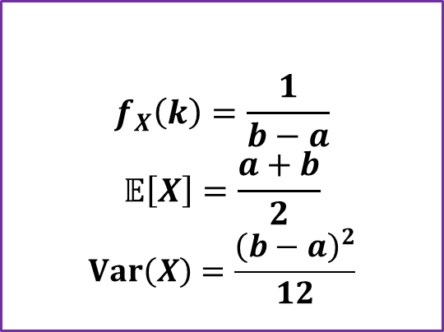
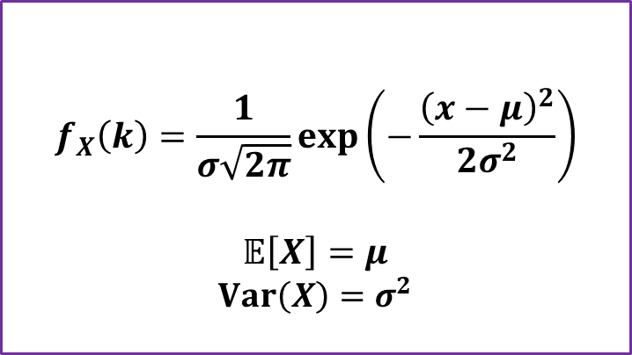

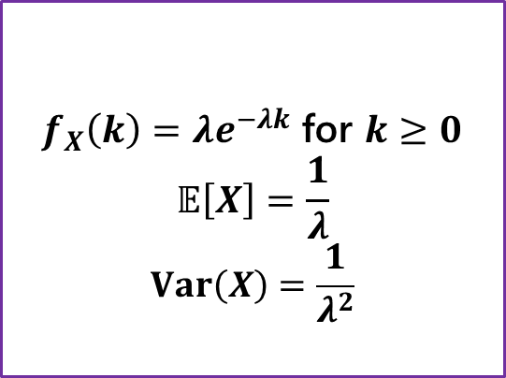
Continuous Zoo
$$X\sim Unif(a,b)$$
$$X\sim Exp(λ)$$
$$X\sim 𝒩(μ,σ^{2})$$
$$f_{X}\left(k\right)=\frac{1}{b−a}$$
$$𝔼\left[X\right]=\frac{a+b}{2}$$
$$Var\left(X\right)=\frac{{\left(b−a\right)}^{2}}{12}$$
$f_{X}\left(k\right)=λe^{−λk}$ for $k≥0$
$$𝔼\left[X\right]=\frac{1}{λ}$$
$$Var\left(X\right)=\frac{1}{λ^{2}}$$
$$f_{X}\left(k\right)=\frac{1}{σ\sqrt{2π}}exp\left(−\frac{{\left(x−μ\right)}^{2}}{2σ^{2}}\right)$$
$$𝔼\left[X\right]=μ$$
$$Var\left(X\right)=σ^{2}$$
It’s a smaller zoo, but it’s just as much fun!

Slide 35
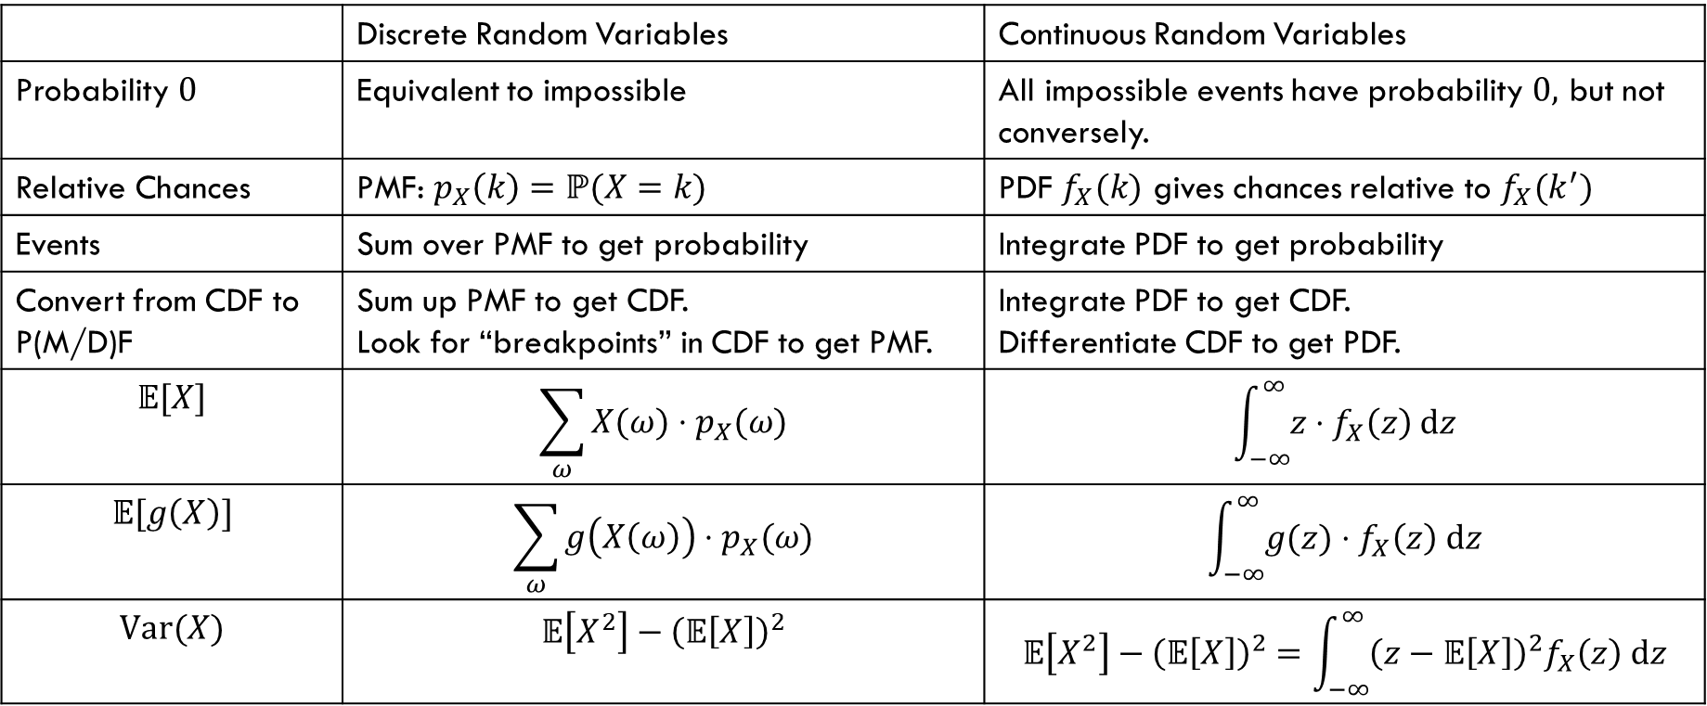
Comparing Discrete and Continuous
 | Discrete Random Variables | Continuous Random Variables
Probability $0$ | Equivalent to impossible | All impossible events have probability $0,$ but not conversely.
Relative Chances | PMF: $p_{X}\left(k\right)=ℙ(X=k)$ | PDF $f_{X}(k)$ gives chances relative to $f_{X}(k^{′})$
Events | Sum over PMF to get probability | Integrate PDF to get probability
Convert from CDF to P(M/D)F | Sum up PMF to get CDF. Look for “breakpoints” in CDF to get PMF. | Integrate PDF to get CDF. Differentiate CDF to get PDF.
$$𝔼[X]$$ | $$\sum_{ω}{X(ω)⋅p_{X}(ω)}$$ | $$\int_{−∞}^{∞}{z⋅f_{X}\left(z\right) dz}$$
$$𝔼[g\left(X\right)]$$ | $$\sum_{ω}{g\left(X\left(ω\right)\right)⋅p_{X}(ω)}$$ | $$\int_{−∞}^{∞}{g(z)⋅f_{X}\left(z\right) dz}$$
$$Var(X)$$ | $$𝔼\left[X^{2}\right]−{\left(𝔼\left[X\right]\right)}^{2}$$ | $$𝔼\left[X^{2}\right]−{\left(𝔼\left[X\right]\right)}^{2}=\int_{−∞}^{∞}{{\left(z−𝔼\left[X\right]\right)}^{2}f_{X}\left(z\right) dz}$$

