Slide 1
Continuous Probability
CSE 312 Winter 26
Lecture 14

Slide 2

Announcements
Midterm coverage ends with lecture 13 (two days ago).
Normally midterm would be next week, but the 332 midterm is next week.
So the 312 midterm is later than usual
Good news: more time to study for the midterm
Bad news: the end of the quarter is packed with 2 more quizzes + quiz retakes in the last three weeks.
HW5 is delayed, it comes out tonight; due Friday Feb 13
We’ll be back to Wed deadlines after midterm.

Slide 3
Where Are We?

Slide 4

What have we done over the past 5 weeks?
Counting
Combinations, permutations, indistinguishable elements, starts and bars, inclusion-exclusion…
Probability foundations
Events, sample space, axioms of probability, expectation, variance
Conditional probability
Conditioning, independence, Bayes’ Rule
Refined our intuition
Especially around Bayes’ Rule

Slide 5

What’s next?
Continuous random variables.
So far our sample spaces have been countable. What happens if we want to choose a random real number?
How do expectation, variance, conditioning, etc. change in this new context?
Mostly analogous to discrete cases, but with integrals instead of sums.
Analysis when it’s inconvenient (or impossible) to exactly calculate probabilities.
Central Limit Theorem (approximating discrete distributions with continuous ones)
Tail Bounds/Concentration (arguing it’s unlikely that a random variable is far from its expectation)
A first taste of making predictions from data (i.e., a bit of ML)

Slide 6

Today
Continuous Probability
Probability Density Function
Cumulative Distribution Function
Goal for today is to get intuition on what’s different in the continuous case. Your goal today is to start building up a gut-feeling of what’s happening.
ASK QUESTIONS, (always, but today especially).

Slide 7
Continuous Random Variables

Slide 8

Continuous Random Variables
We’ll need continuous probability spaces and continuous random variables to describe experiments that have uncountably-infinite sample spaces.
e.g. all real numbers
How long until the next bus shows up?
What location does a dart land?

Slide 9

Continuous Random Variables
Wait, we’re computer scientists. Computers don’t do real numbers, why should we?
Continuous random variables will be a useful model for enormous sample spaces. The math will be easier.
Example: polling a large population. The sample space is actually discrete. But we’re going to round the result anyway. Make it continuous first for easier math, then round.

Slide 10
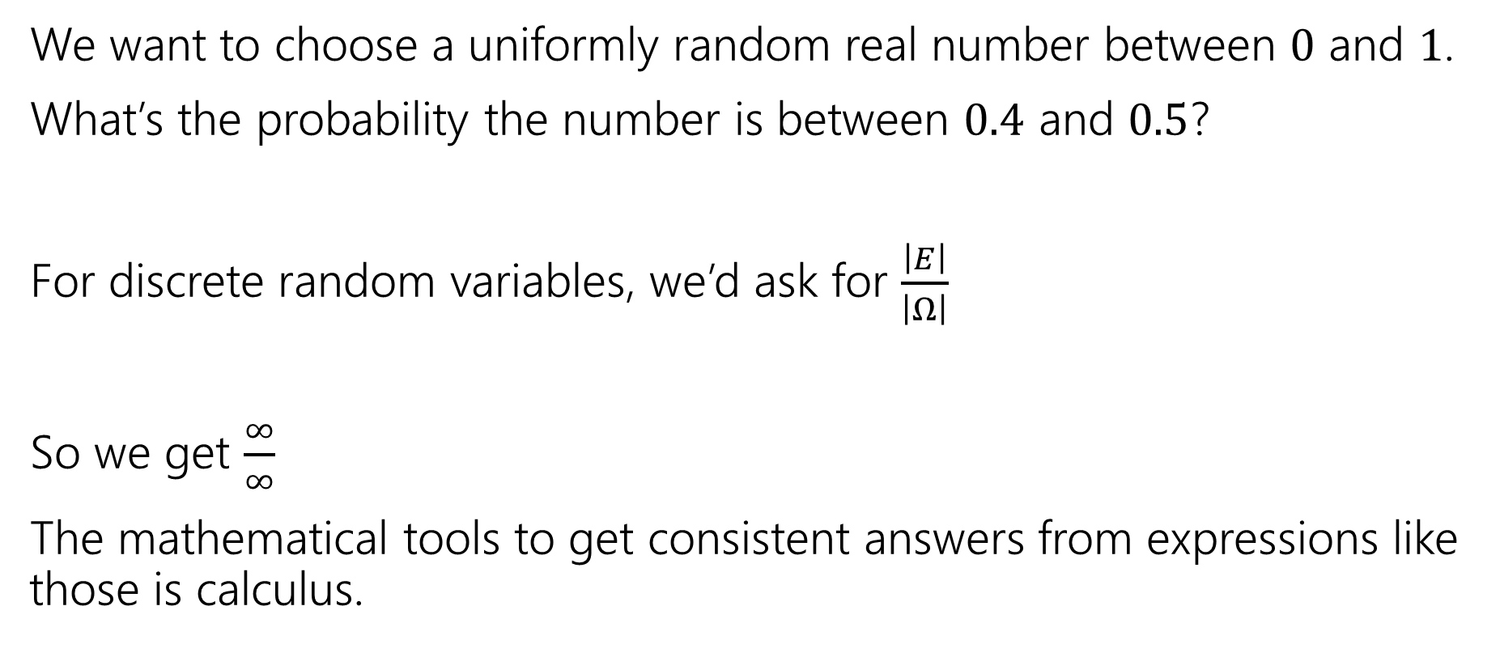
Why Need New Rules?
We want to choose a uniformly random real number between $0$ and $1$.
What’s the probability the number is between $0.4$ and $0.5$?
For discrete random variables, we’d ask for $\frac{\left|E\right|}{\left|Ω\right|}$
So we get $\frac{∞}{∞}$
The mathematical tools to get consistent answers from expressions like those is calculus.

Slide 11
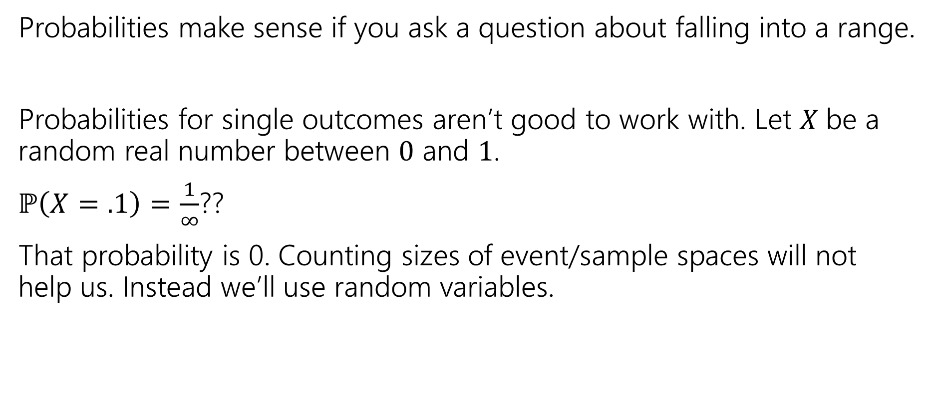

For Continuous Random ariables
Probabilities make sense if you ask a question about falling into a range.
Probabilities for single outcomes aren’t good to work with. Let $X$be a random real number between $0$ and $1$.
$ℙ\left(X=.1\right)=\frac{1}{∞}$??
That probability is 0. Counting sizes of event/sample spaces will not help us. Instead we’ll use random variables.

Slide 12
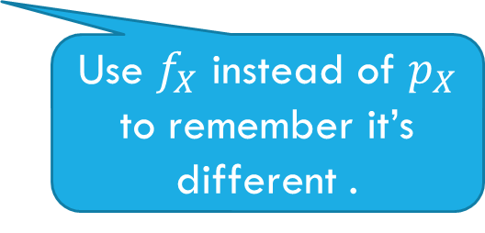


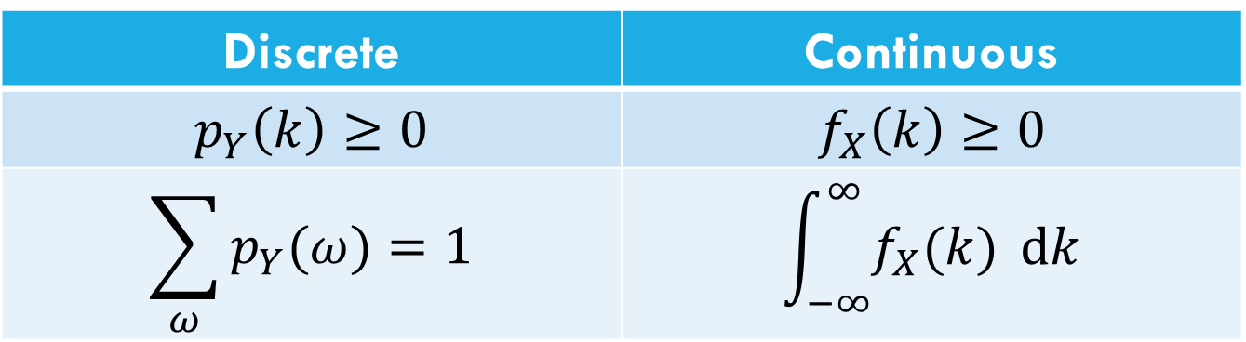
Let’s start with the pmf
For discrete random variables, we defined the pmf: $p_{Y}\left(k\right)=ℙ(Y=k)$.
We can’t have a pmf quite like we did for discrete random variables. Remember $ℙ\left(X=.1\right)=0$. The PMF would be 0 everywhere… Let’s try to maintain as many rules as we can…
Discrete | Continuous
$$p_{Y}\left(k\right)≥0$$ | $$f_{X}\left(k\right)≥0$$
$$\sum_{ω}{p_{Y}(ω)}=1$$ | $$\int_{−∞}^{∞}{f_{X}(k)} dk$$
Use $f_{X}$ instead of $p_{X}$ to remember it’s different .

Slide 13

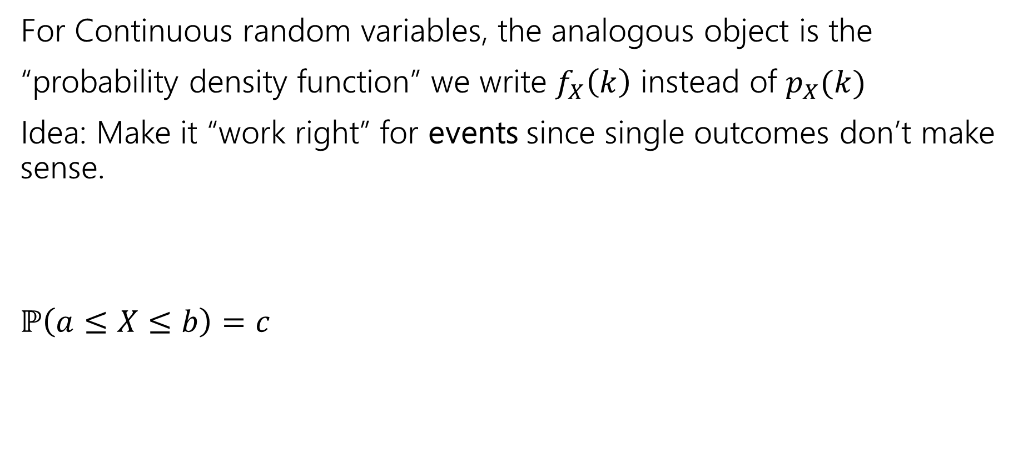

The probability density function
For Continuous random variables, the analogous object is the
“probability density function” we write $f_{X}\left(k\right)$ instead of $p_{X}(k)$
Idea: Make it “work right” for events since single outcomes don’t make sense.
$ℙ\left(a≤X≤b\right)=c$
$$\int_{a}^{b}{f_{X}\left(z\right) dz}=c$$
integrating is analogous to sum.

Slide 14

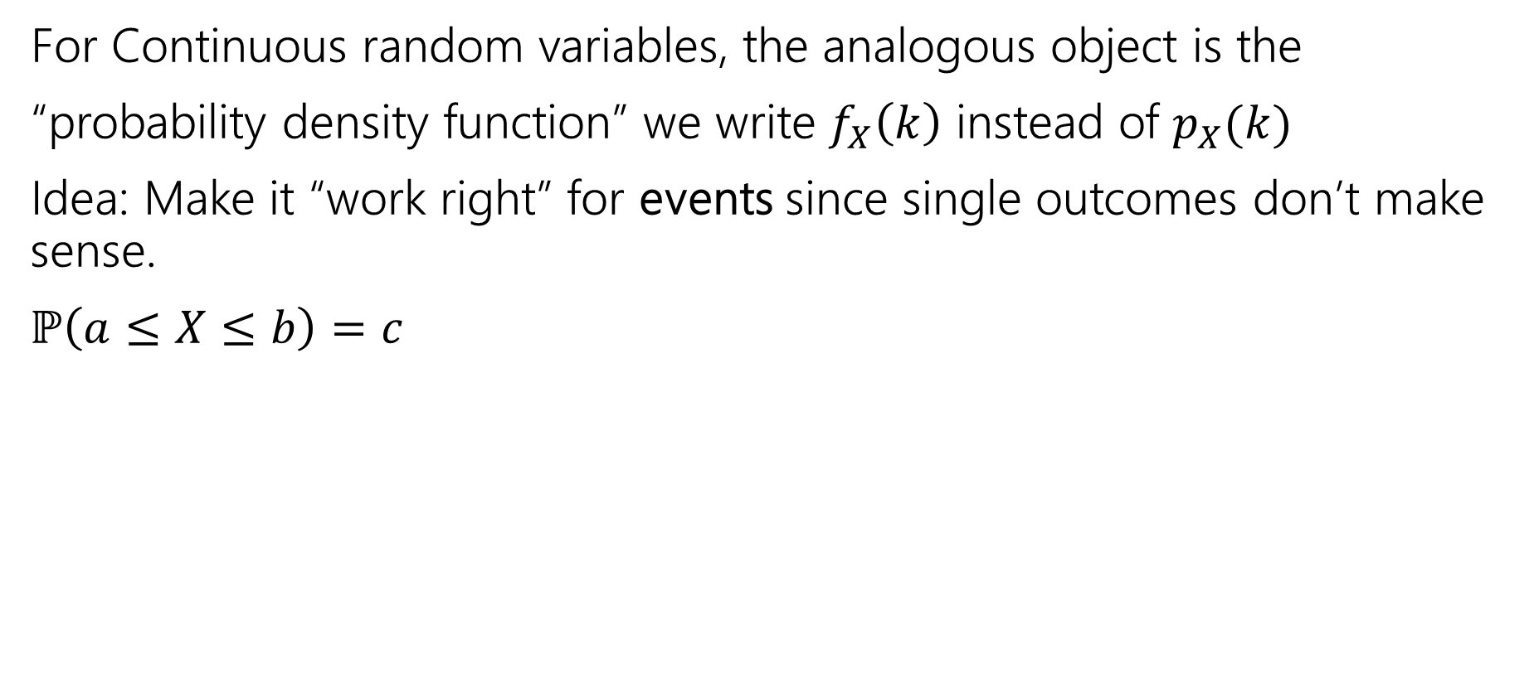
The probability density function
For Continuous random variables, the analogous object is the
“probability density function” we write $f_{X}\left(k\right)$ instead of $p_{X}(k)$
Idea: Make it “work right” for events since single outcomes don’t make sense.
$ℙ\left(a≤X≤b\right)=c$
$$\int_{a}^{b}{f_{X}\left(z\right) dz}=c$$
integrating is analogous to sum.
Let’s derive an example PDF together!
For a uniform random real number in [0,1]

Slide 15
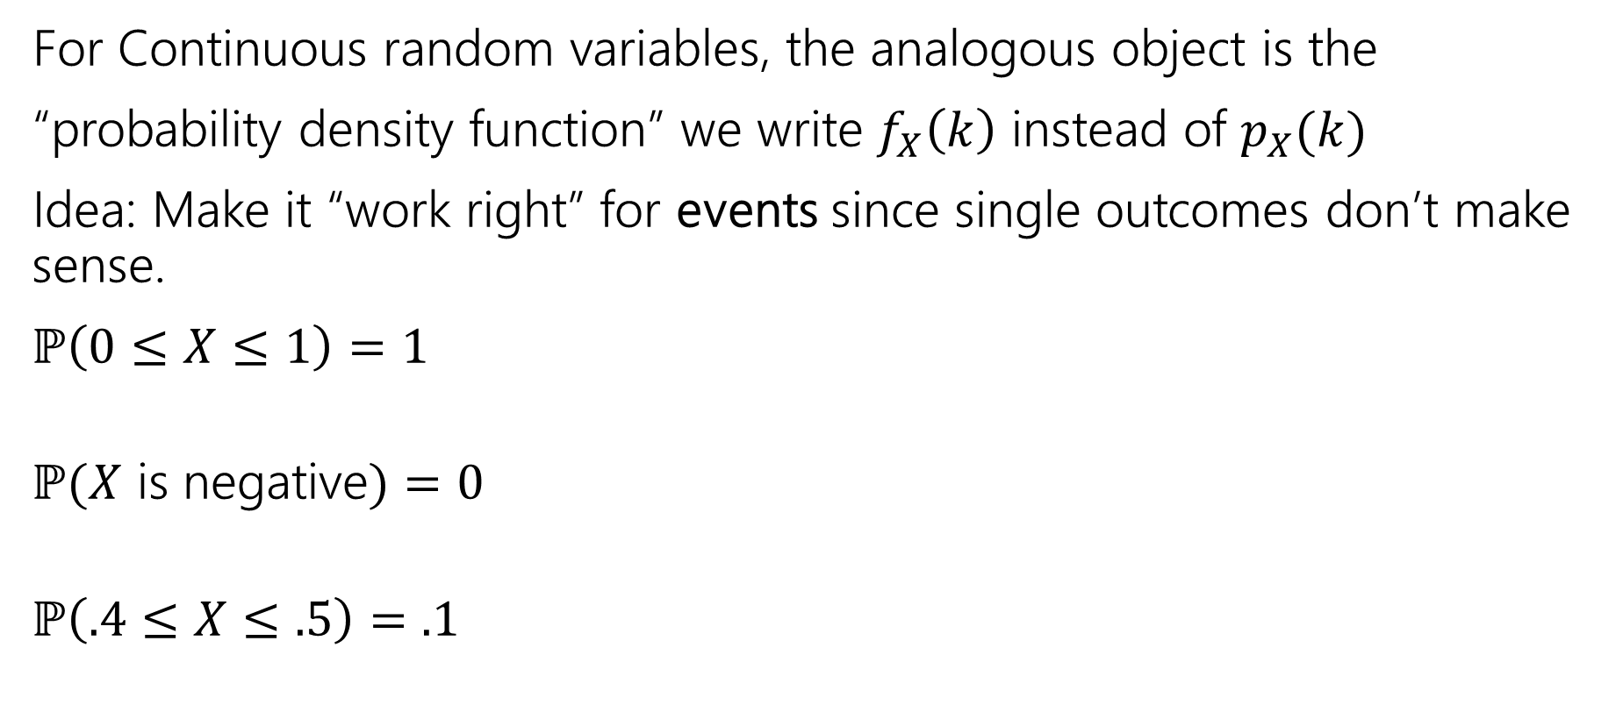

The probability density function
For Continuous random variables, the analogous object is the
“probability density function” we write $f_{X}\left(k\right)$ instead of $p_{X}(k)$
Idea: Make it “work right” for events since single outcomes don’t make sense.
$ℙ\left(0≤X≤1\right)=1$
$ℙ(X$ is negative$)=0$
$ℙ\left(.4≤X≤.5\right)=.1$
integrating is analogous to sum.

Slide 16
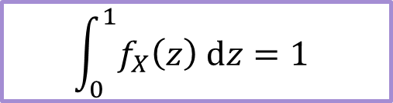

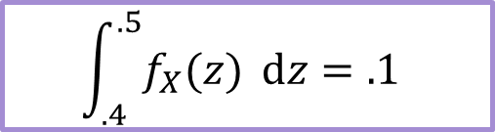
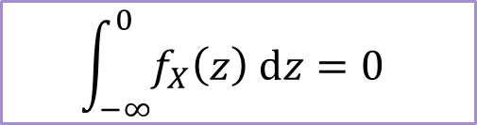
The probability density function
For Continuous random variables, the analogous object is the
“probability density function” we write $f_{X}\left(k\right)$ instead of $p_{X}(k)$
Idea: Make it “work right” for events since single outcomes don’t make sense.
$ℙ\left(0≤X≤1\right)=1$
$ℙ(X$ is negative$)=0$
$ℙ\left(.4≤X≤.5\right)=.1$
$$\int_{0}^{1}{f_{X}\left(z\right) dz}=1$$
integrating is analogous to sum.
$$\int_{−∞}^{0}{f_{X}\left(z\right) dz=0}$$
$$\int_{.4}^{.5}{f_{X}(z)} dz=.1$$

Slide 17

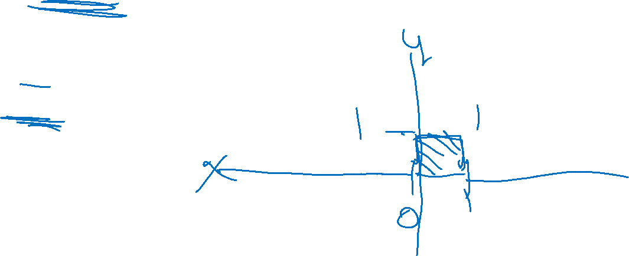
PDF for uniform
Let $X$ be a uniform real number between $0$ and $1$.
What should $f_{X}(k)$ be to make all those events integrate to the right values?
$f_{X}\left(k\right)=\left\{\begin{aligned}0 if k<0 or k>1 \\ 1 if 0≤k≤1\end{aligned}\right.$

Slide 18


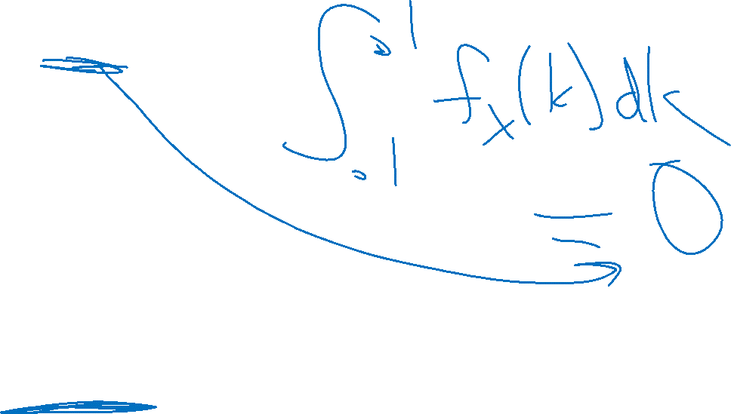
Probability Density Function
So $ℙ\left(X=.1\right)=??$
$f_{X}\left(.1\right)=1$
The number that best represents $ℙ(X=.1)$ is $0$.
This is different from $f_{X}(x)$
So…what is $f_{X}(x)$???
For continuous probability spaces:
Impossible events have probability $0$, but some probability $0$ events might be possible.

Slide 19
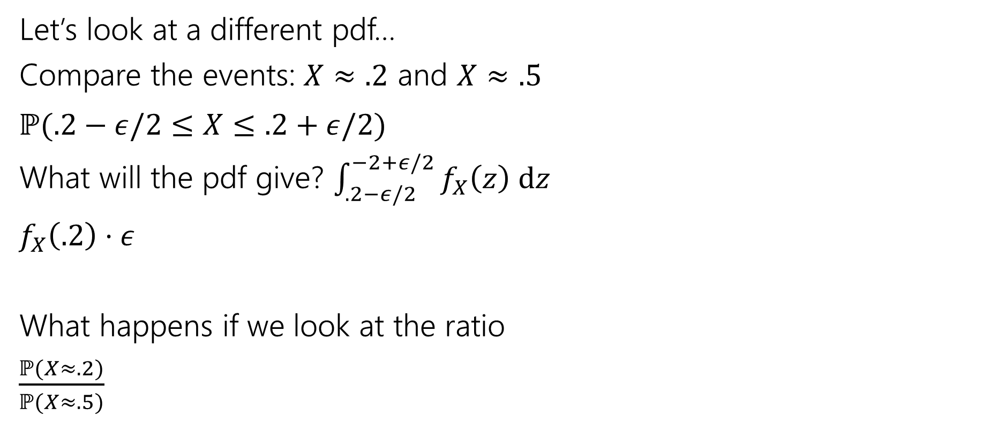

Using the PDF
Let’s look at a different pdf…
Compare the events: $X≈.2$ and $X≈.5$
$ℙ(.2−ε/2≤X≤.2+ε/2)$
What will the pdf give? $\int_{.2−ε/2}^{−2+ε/2}{f_{X}\left(z\right) dz}$
$f_{X}\left(.2\right)⋅ε$
What happens if we look at the ratio
$\frac{ℙ(X≈.2)}{ℙ(X≈.5)}$
.2
.5

Slide 20
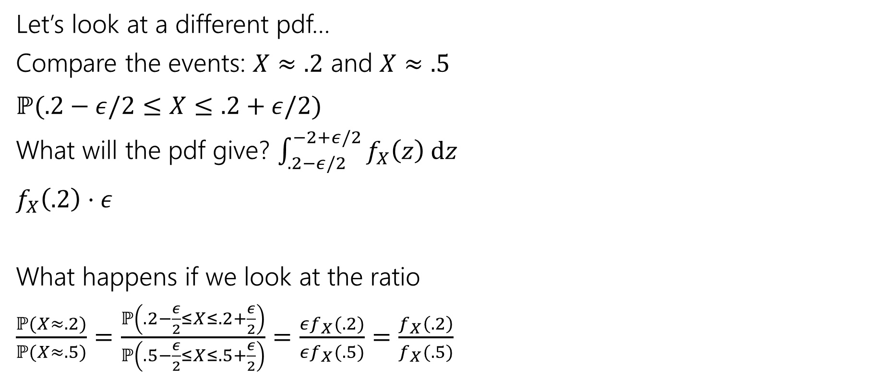

Using the PDF
Let’s look at a different pdf…
Compare the events: $X≈.2$ and $X≈.5$
$ℙ(.2−ε/2≤X≤.2+ε/2)$
What will the pdf give? $\int_{.2−ε/2}^{−2+ε/2}{f_{X}\left(z\right) dz}$
$f_{X}\left(.2\right)⋅ε$
What happens if we look at the ratio
$\frac{ℙ(X≈.2)}{ℙ(X≈.5)}=\frac{ℙ\left(.2−\frac{ε}{2}≤X≤.2+\frac{ε}{2}\right)}{ℙ\left(.5−\frac{ε}{2}≤X≤.5+\frac{ε}{2}\right)}=\frac{εf_{X}(.2)}{εf_{X}(.5)}=\frac{f_{X}\left(.2\right)}{f_{X}(.5)}$
.2
.5

Slide 21
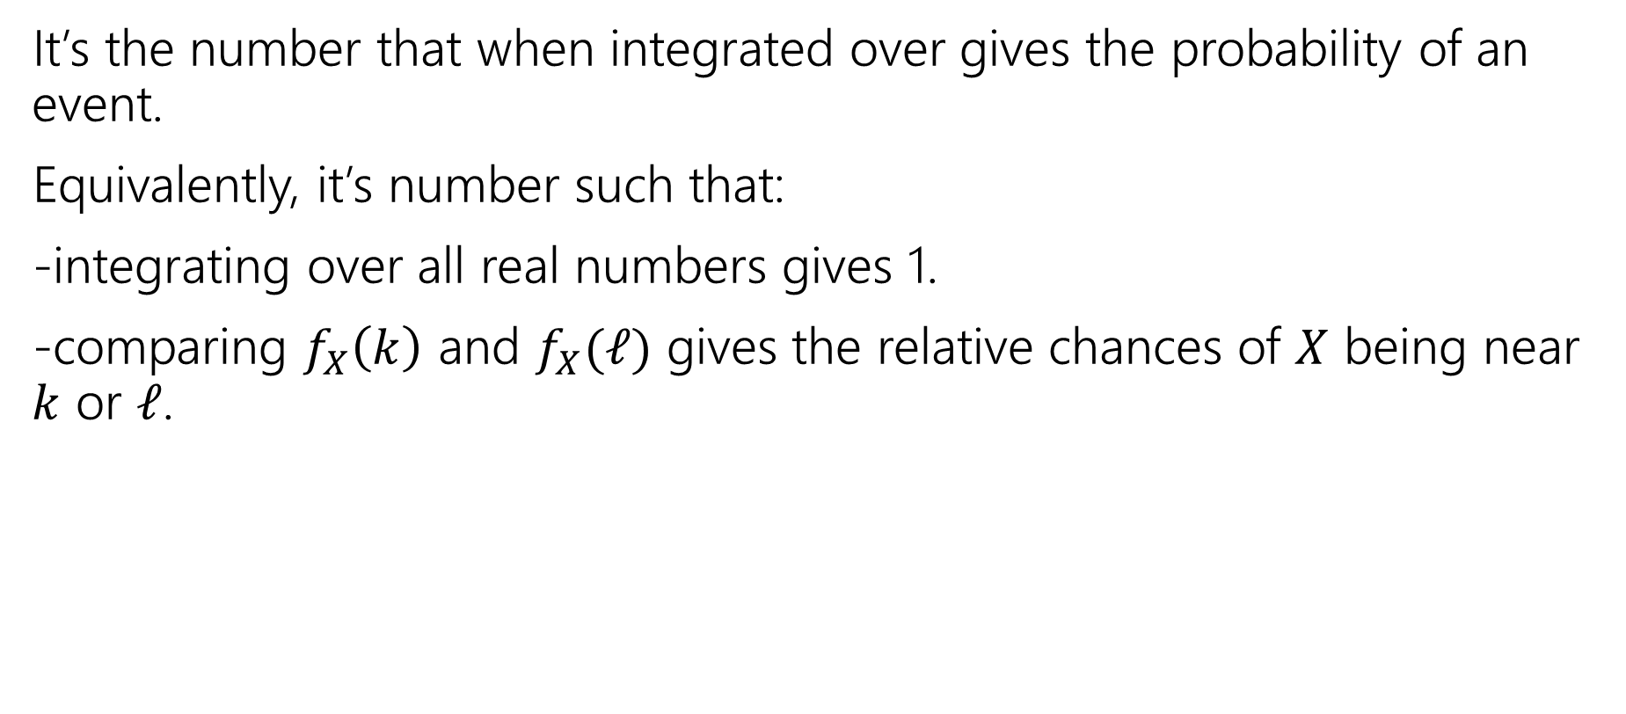

So what’s the pdf?
It’s the number that when integrated over gives the probability of an event.
Equivalently, it’s number such that:
-integrating over all real numbers gives 1.
-comparing $f_{X}\left(k\right)$ and $f_{X}(ℓ)$ gives the relative chances of $X$ being near $k$ or $ℓ$.

Slide 22
CDFs

Slide 23

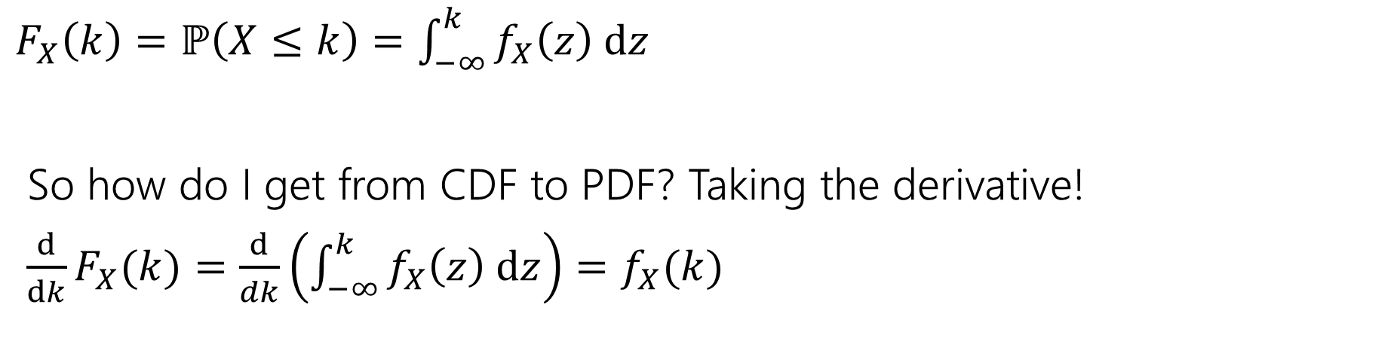

What’s a CDF?
The Cumulative Distribution Function $F_{X}\left(k\right)=ℙ(X≤k)$
analogous to the CDF for discrete variables.
$F_{X}\left(k\right)=ℙ\left(X≤k\right)=\int_{−∞}^{k}{f_{X}\left(z\right) dz}$
So how do I get from CDF to PDF? Taking the derivative!
$\frac{d}{dk}F_{X}(k)=\frac{d}{dk}\left(\int_{−∞}^{k}{f_{X}\left(z\right) dz}\right)=f_{X}(k)$

Slide 24
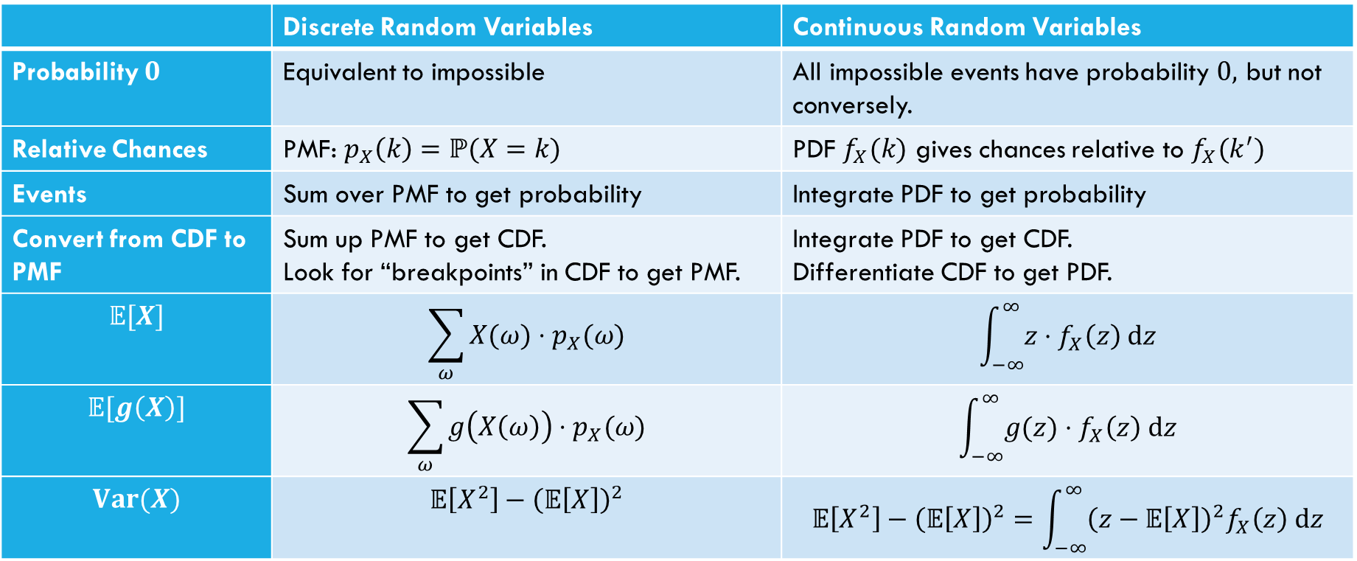

Comparing Discrete and Continuous
 | Discrete Random Variables | Continuous Random Variables
Probability $0$ | Equivalent to impossible | All impossible events have probability $0,$ but not conversely.
Relative Chances | PMF: $p_{X}\left(k\right)=ℙ(X=k)$ | PDF $f_{X}(k)$ gives chances relative to $f_{X}(k^{′})$
Events | Sum over PMF to get probability | Integrate PDF to get probability
Convert from CDF to PMF | Sum up PMF to get CDF. Look for “breakpoints” in CDF to get PMF. | Integrate PDF to get CDF. Differentiate CDF to get PDF.
$$𝔼[X]$$ | $$\sum_{ω}{X(ω)⋅p_{X}(ω)}$$ | $$\int_{−∞}^{∞}{z⋅f_{X}\left(z\right) dz}$$
$$𝔼[g\left(X\right)]$$ | $$\sum_{ω}{g\left(X\left(ω\right)\right)⋅p_{X}(ω)}$$ | $$\int_{−∞}^{∞}{g(z)⋅f_{X}\left(z\right) dz}$$
$$Var(X)$$ | $$𝔼\left[X^{2}\right]−{\left(𝔼\left[X\right]\right)}^{2}$$ | $$𝔼\left[X^{2}\right]−{\left(𝔼\left[X\right]\right)}^{2}=\int_{−∞}^{∞}{{\left(z−𝔼\left[X\right]\right)}^{2}f_{X}\left(z\right) dz}$$

Slide 25

What about expectation?
For a random variable $X$, we define:
$𝔼\left[X\right]=\int_{−∞}^{∞}{{X(z)⋅f}_{X}\left(z\right) dz}$
Just replace summing over the pmf with integrating the pdf.
It still represents the average value of $X$.

Slide 26

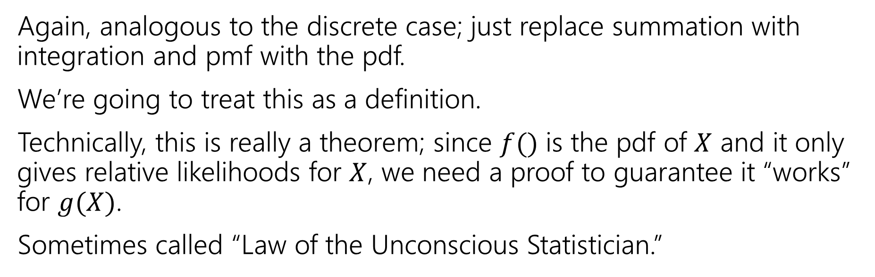
Expectation of a function
For any function $g$ and any continuous random variable, $X:$
$𝔼\left[g\left(X\right)\right]=\int_{−∞}^{∞}{g\left(X(z)\right)⋅f_{X}\left(z\right) dz}$
Again, analogous to the discrete case; just replace summation with integration and pmf with the pdf.
We’re going to treat this as a definition.
Technically, this is really a theorem; since $f()$ is the pdf of $X$ and it only gives relative likelihoods for $X$, we need a proof to guarantee it “works” for $g(X)$.
Sometimes called “Law of the Unconscious Statistician.”

Slide 27
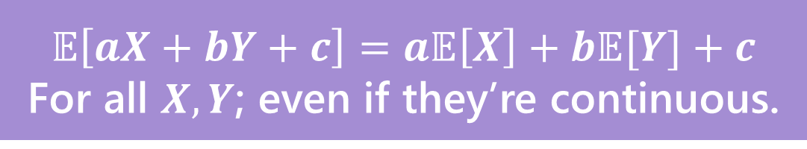
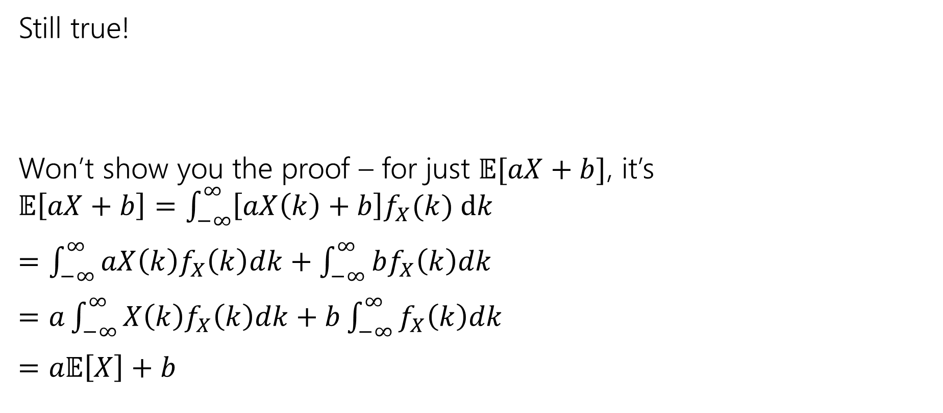
Linearity of Expectation
Still true!
Won’t show you the proof – for just $𝔼[aX+b]$, it’s $𝔼\left[aX+b\right]=\int_{−∞}^{∞}{\left[aX\left(k\right)+b\right]f_{X}(k) dk}$
$=\int_{−∞}^{∞}{aX\left(k\right)f_{X}\left(k\right)dk}+\int_{−∞}^{∞}{bf_{X}\left(k\right)dk}$
$=a\int_{−∞}^{∞}{X\left(k\right)f_{X}\left(k\right)dk}+b\int_{−∞}^{∞}{f_{X}\left(k\right)dk}$
$=a𝔼\left[X\right]+b$
$$𝔼\left[aX+bY+c\right]=a𝔼\left[X\right]+b𝔼[Y]+c$$
For all $X,Y$; even if they’re continuous.

Slide 28
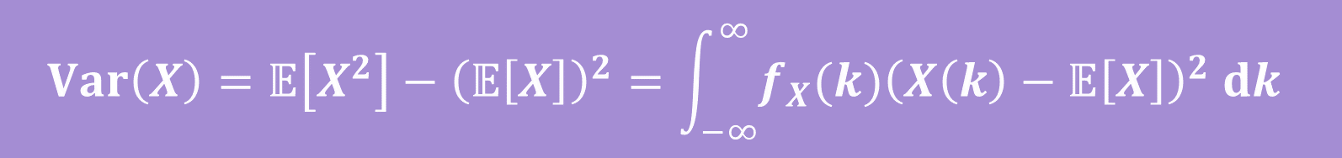
Variance
No surprises here
$$Var\left(X\right)=𝔼\left[X^{2}\right]−{\left(𝔼\left[X\right]\right)}^{2}=\int_{−∞}^{∞}{{f_{X}(k)\left(X\left(k\right)−𝔼\left[X\right]\right)}^{2} dk}$$

Slide 29

Let’s calculate an expectation
Let $X$ be a uniform random number between $a$ and$b$.
$𝔼\left[X\right]=\int_{−∞}^{∞}{z⋅f_{X}\left(z\right) dz}$

Slide 30
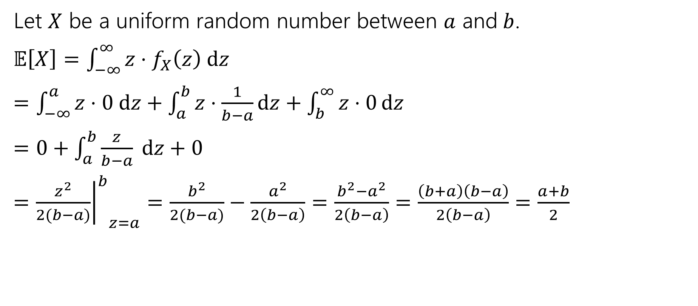
Let’s calculate an expectation
Let $X$ be a uniform random number between $a$ and$b$.
$𝔼\left[X\right]=\int_{−∞}^{∞}{z⋅f_{X}\left(z\right) dz}$
$=\int_{−∞}^{a}{z⋅0 dz}+\int_{a}^{b}{z⋅\frac{1}{b−a}dz}+\int_{b}^{∞}{z⋅0}dz$
$=0+\int_{a}^{b}{\frac{z}{b−a} dz+0}$
$={{\left.\frac{z^{2}}{2(b−a)}\right|}^{b}}_{z=a}=\frac{b^{2}}{2(b−a)}−\frac{a^{2}}{2\left(b−a\right)}=\frac{b^{2}−a^{2}}{2\left(b−a\right)}=\frac{\left(b+a\right)\left(b−a\right)}{2\left(b−a\right)}=\frac{a+b}{2}$

Slide 31
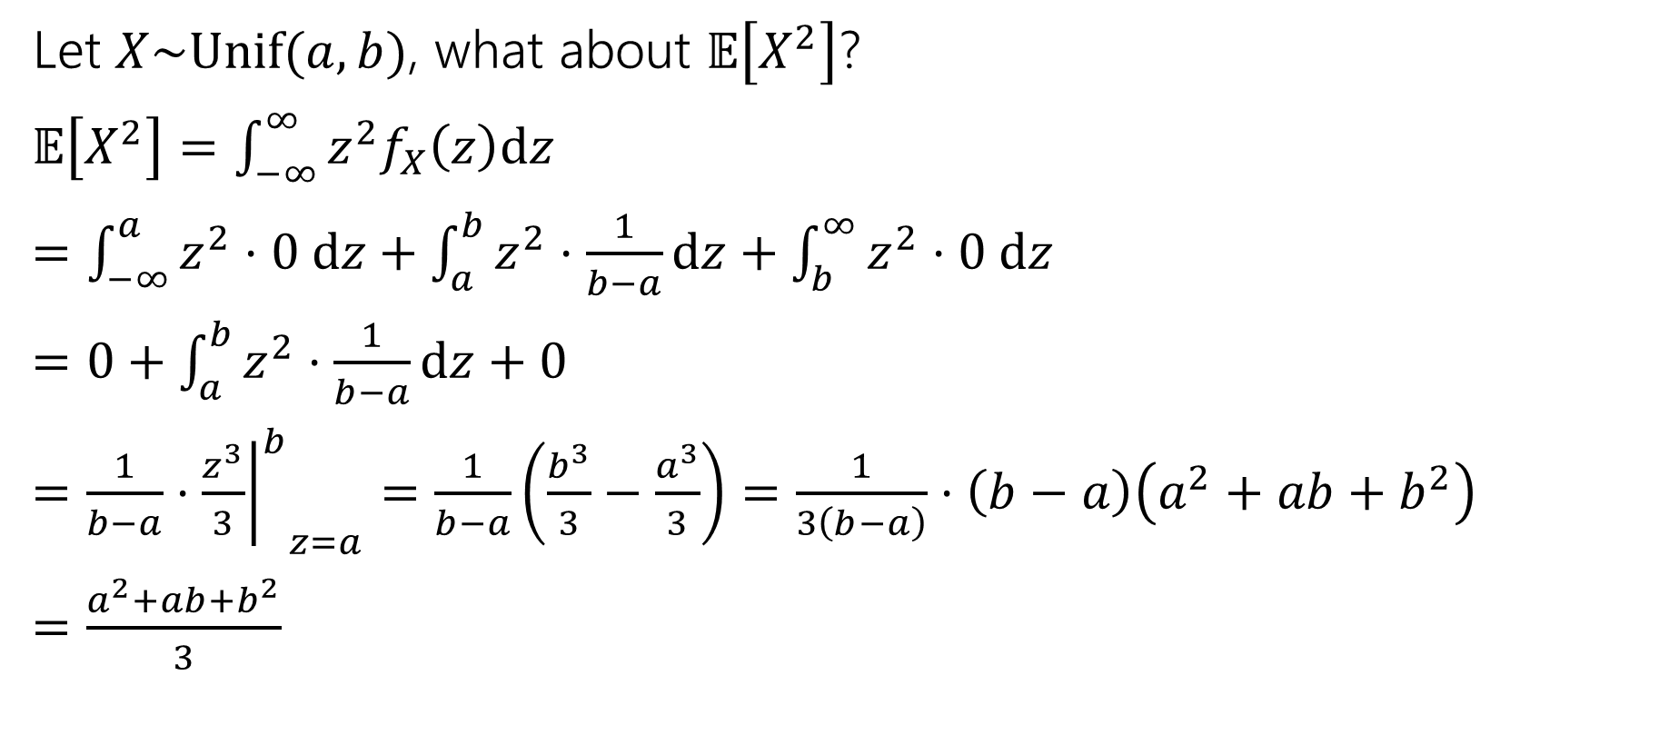

What about $𝔼\left[g\left(X\right)\right]$
Let $X\sim Unif(a,b)$, what about $𝔼\left[X^{2}\right]$?
$𝔼\left[X^{2}\right]=\int_{−∞}^{∞}{z^{2}f_{X}\left(z\right)dz}$
$=\int_{−∞}^{a}{z^{2}⋅0 dz+\int_{a}^{b}{z^{2}⋅\frac{1}{b−a}dz}+\int_{b}^{∞}{z^{2}⋅0 dz}}$
$=0+\int_{a}^{b}{z^{2}⋅\frac{1}{b−a}dz}+0$
$=\frac{1}{b−a}⋅{{\left.\frac{z^{3}}{3}\right|}^{b}}_{z=a}=\frac{1}{b−a}\left(\frac{b^{3}}{3}−\frac{a^{3}}{3}\right)=\frac{1}{3\left(b−a\right)}⋅\left(b−a\right)\left(a^{2}+ab+b^{2}\right)$
$=\frac{a^{2}+ab+b^{2}}{3}$

Slide 32

Let’s assemble the variance
$Var\left(X\right)=𝔼\left[X^{2}\right]−{\left(𝔼\left[X\right]\right)}^{2}$
$=\frac{a^{2}+ab+b^{2}}{3}−{\left(\frac{a+b}{2}\right)}^{2}$
$=\frac{4(a^{2}+ab+b^{2})}{12}−\frac{{3(a}^{2}+2ab+b^{2})}{12}$
$=\frac{a^{2}−2ab+b^{2}}{12}$
$=\frac{{\left(a−b\right)}^{2}}{12}$

Slide 33
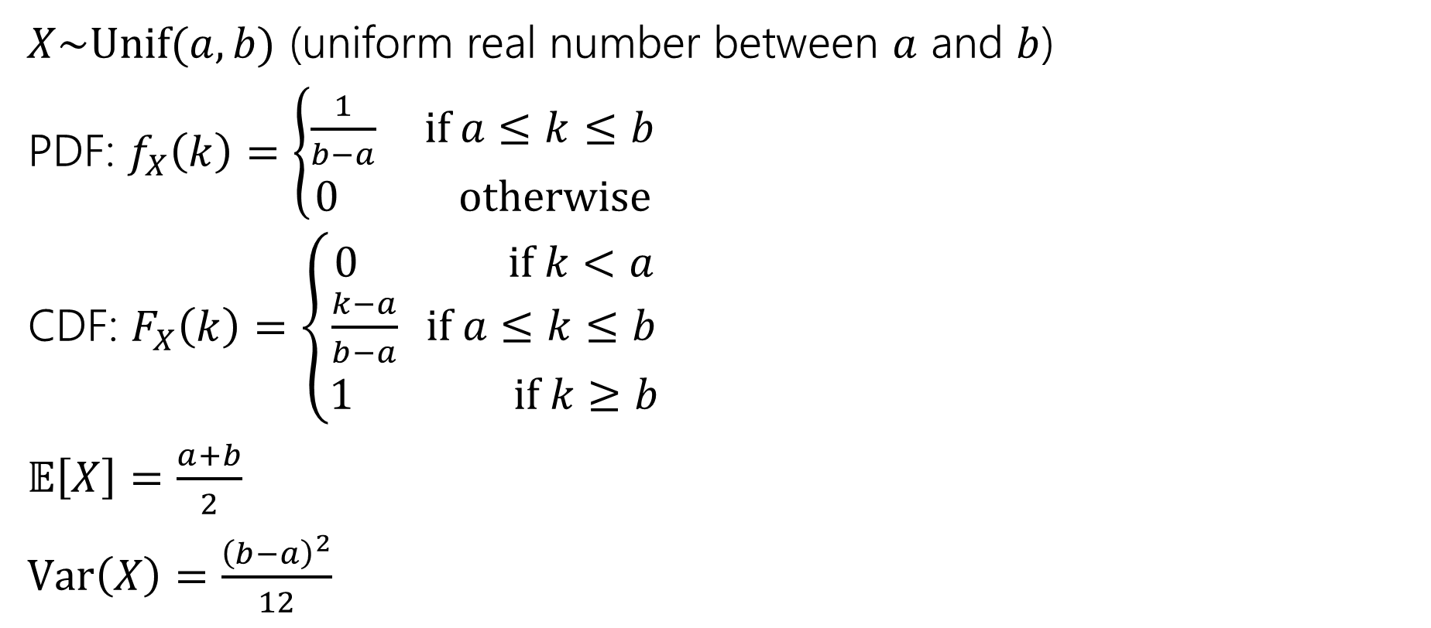
Continuous Uniform Distribution
$X\sim Unif(a,b)$ (uniform real number between $a$ and $b$)
PDF: $f_{X}\left(k\right)=\left\{\begin{aligned}\frac{1}{b−a} if a≤k≤b \\ 0 otherwise\end{aligned}\right.$
CDF: $F_{X}\left(k\right)=\left\{\begin{aligned}0 if k<a \\ \frac{k−a}{b−a} if a≤k≤b \\ 1 if k≥b\end{aligned}\right.$
$𝔼\left[X\right]=\frac{a+b}{2}$
$Var\left(X\right)=\frac{{\left(b−a\right)}^{2}}{12}$

Slide 34
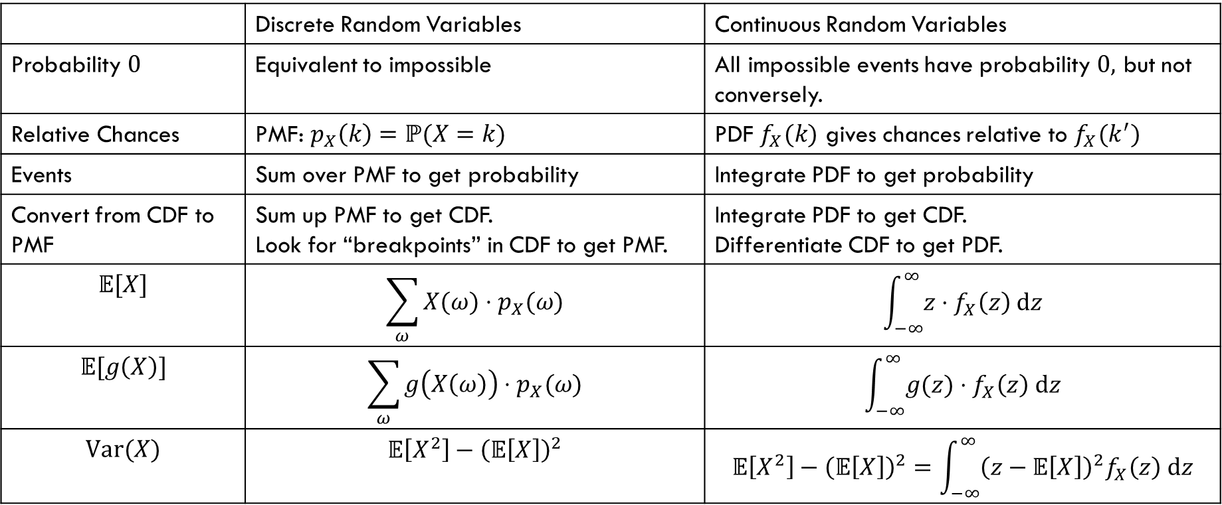
Comparing Discrete and Continuous
 | Discrete Random Variables | Continuous Random Variables
Probability $0$ | Equivalent to impossible | All impossible events have probability $0,$ but not conversely.
Relative Chances | PMF: $p_{X}\left(k\right)=ℙ(X=k)$ | PDF $f_{X}(k)$ gives chances relative to $f_{X}(k^{′})$
Events | Sum over PMF to get probability | Integrate PDF to get probability
Convert from CDF to PMF | Sum up PMF to get CDF. Look for “breakpoints” in CDF to get PMF. | Integrate PDF to get CDF. Differentiate CDF to get PDF.
$$𝔼[X]$$ | $$\sum_{ω}{X(ω)⋅p_{X}(ω)}$$ | $$\int_{−∞}^{∞}{z⋅f_{X}\left(z\right) dz}$$
$$𝔼[g\left(X\right)]$$ | $$\sum_{ω}{g\left(X\left(ω\right)\right)⋅p_{X}(ω)}$$ | $$\int_{−∞}^{∞}{g(z)⋅f_{X}\left(z\right) dz}$$
$$Var(X)$$ | $$𝔼\left[X^{2}\right]−{\left(𝔼\left[X\right]\right)}^{2}$$ | $$𝔼\left[X^{2}\right]−{\left(𝔼\left[X\right]\right)}^{2}=\int_{−∞}^{∞}{{\left(z−𝔼\left[X\right]\right)}^{2}f_{X}\left(z\right) dz}$$

