Slide 1
Discrete RV Zoo
CSE 312 Winter 26
Lecture 12

Slide 2
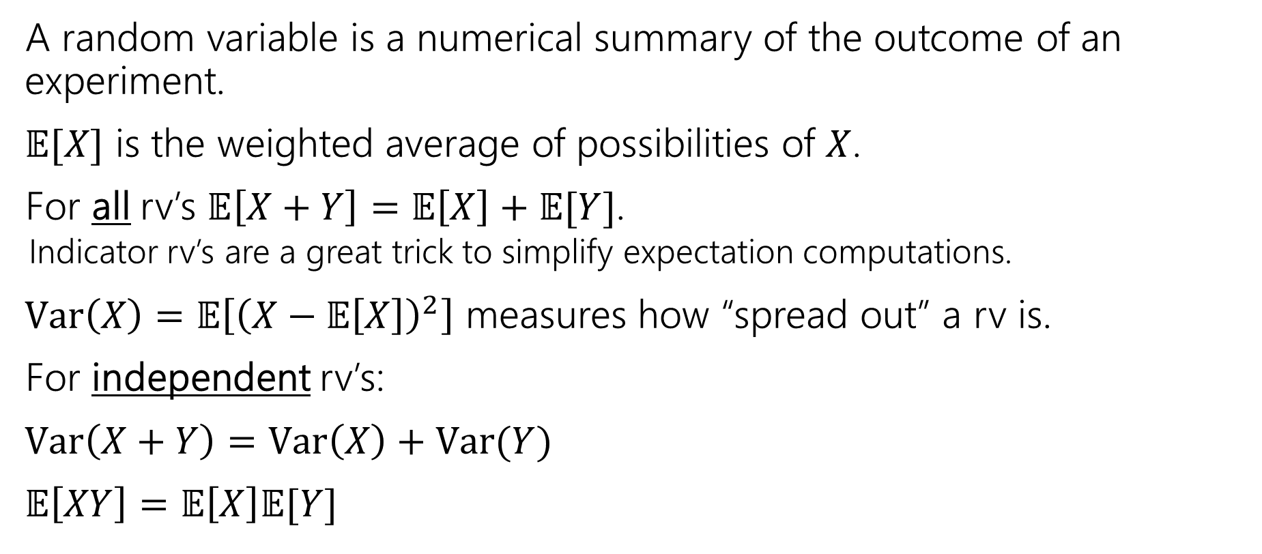
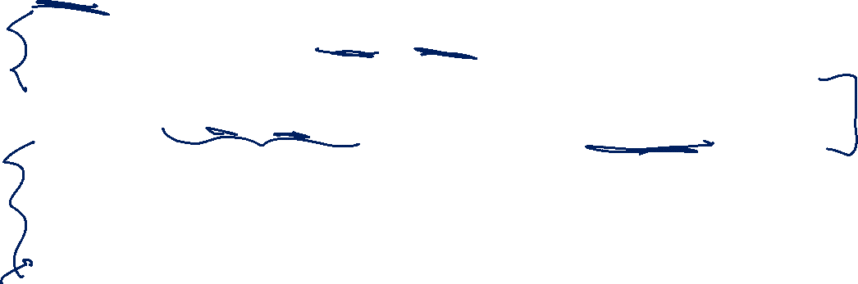
Where are we?
A random variable is a numerical summary of the outcome of an experiment.
$𝔼[X]$ is the weighted average of possibilities of $X$.
For all rv’s $𝔼\left[X+Y\right]=𝔼\left[X\right]+𝔼[Y]$.
  Indicator rv’s are a great trick to simplify expectation computations.
$Var\left(X\right)=𝔼\left[{\left(X−𝔼\left[X\right]\right)}^{2}\right]$ measures how “spread out” a rv is.
For independent rv’s:
$Var\left(X+Y\right)=Var\left(X\right)+Var(Y)$
$𝔼\left[XY\right]=𝔼\left[X\right]𝔼[Y]$

Slide 3
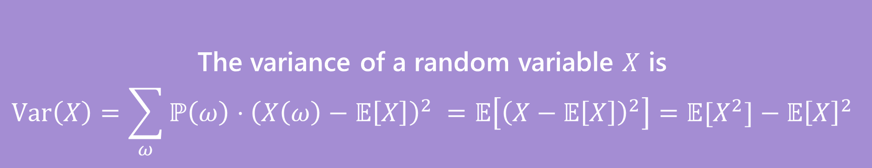

Variance
The first two forms are the definition. The last one is an algebra trick.
The variance of a random variable $X$ is
$$Var\left(X\right)=\sum_{ω}{ℙ\left(ω\right)⋅{\left(X\left(ω\right)−𝔼\left[X\right]\right)}^{2} }=𝔼\left[{\left(X−𝔼\left[X\right]\right)}^{2}\right]=𝔼[X^{2}]−𝔼{\left[X\right]}^{2}$$
Variance

Slide 4
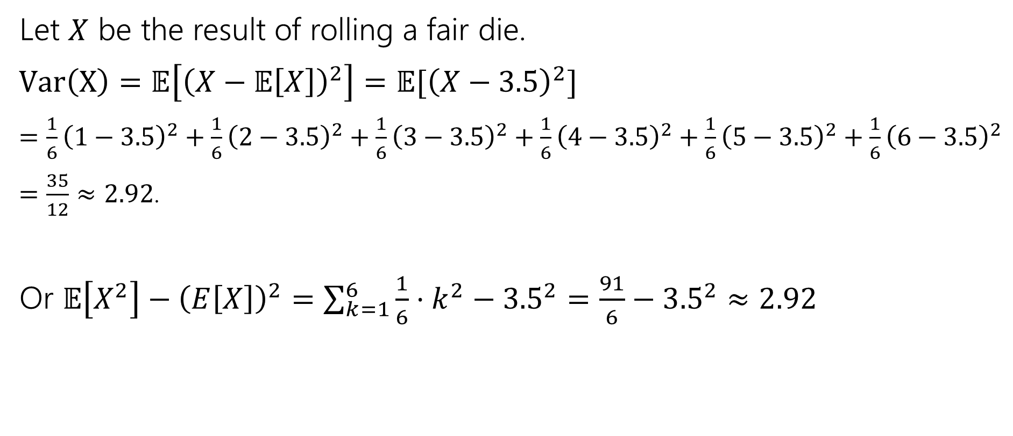

Variance of a die
Let $X$ be the result of rolling a fair die.
$Var\left(X\right)=𝔼\left[{\left(X−𝔼\left[X\right]\right)}^{2}\right]=𝔼[{\left(X−3.5\right)}^{2}]$
$=\frac{1}{6}{\left(1−3.5\right)}^{2}+\frac{1}{6}{\left(2−3.5\right)}^{2}+\frac{1}{6}{\left(3−3.5\right)}^{2}+\frac{1}{6}{\left(4−3.5\right)}^{2}+\frac{1}{6}{\left(5−3.5\right)}^{2}+\frac{1}{6}{\left(6−3.5\right)}^{2}$
$=\frac{35}{12}≈2.92$.
Or $𝔼\left[X^{2}\right]−{\left(E\left[X\right]\right)}^{2}=\sum_{k=1}^{6}{\frac{1}{6}⋅k^{2}−{3.5}^{2}}=\frac{91}{6}−{3.5}^{2}≈2.92$

Slide 5
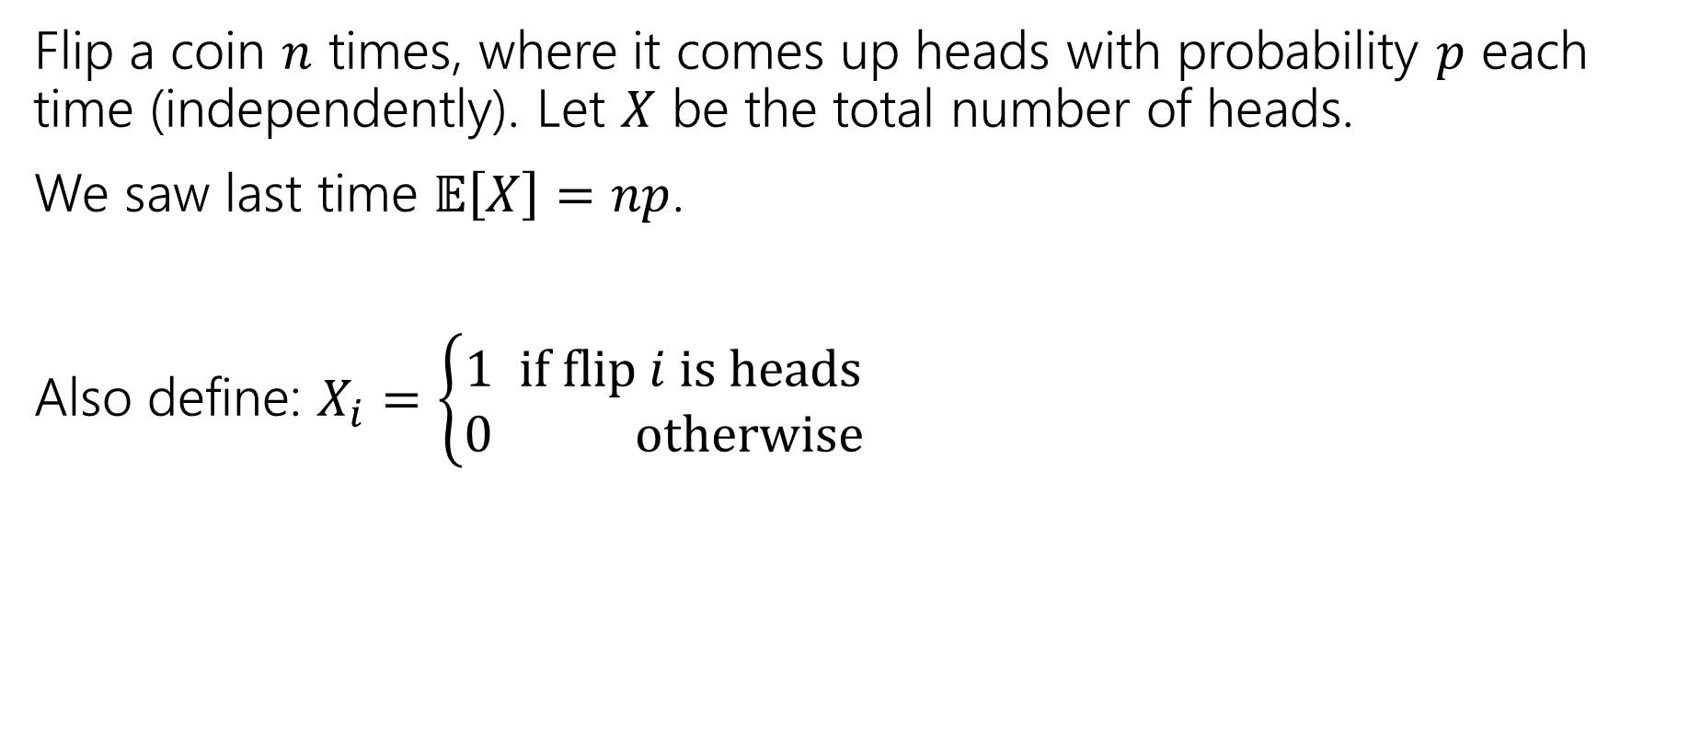

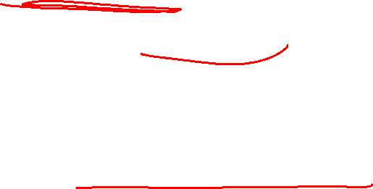
Variance of $n$ Coin Flips
Flip a coin $n$ times, where it comes up heads with probability $p$ each time (independently). Let $X$ be the total number of heads.
We saw last time $𝔼\left[X\right]=np$.
Also define: $X_{i}=\left\{\begin{aligned}1 if flip i is heads \\ 0 otherwise\end{aligned}\right.$

Slide 6
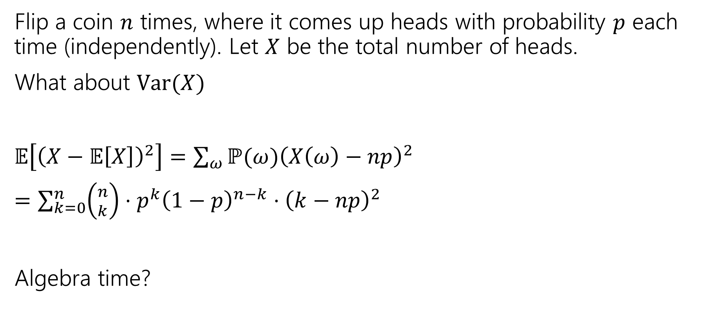
Variance of $n$ Coin Flips
Flip a coin $n$ times, where it comes up heads with probability $p$ each time (independently). Let $X$ be the total number of heads.
What about $Var(X)$
$𝔼\left[{\left(X−𝔼\left[X\right]\right)}^{2}\right]=\sum_{ω}{ℙ(ω){\left(X\left(ω\right)−np\right)}^{2}}$
$=\sum_{k=0}^{n}{\left({n \atop k}\right)⋅p^{k}{\left(1−p\right)}^{n−k}⋅{\left(k−np\right)}^{2}}$
Algebra time?

Slide 7

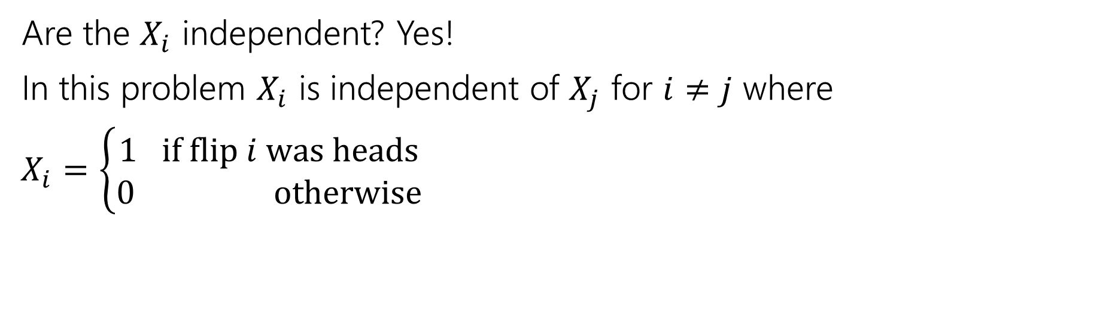
Variance
If $X$ and $Y$ are independent then
$$Var\left(X+Y\right)=Var\left(X\right)+Var(Y)$$
Are the $X_{i}$ independent? Yes!
In this problem $X_{i}$ is independent of $X_{j}$ for $i≠j$ where
$X_{i}=\left\{\begin{aligned}1 if flip i was heads \\ 0 otherwise\end{aligned}\right.$

Slide 8
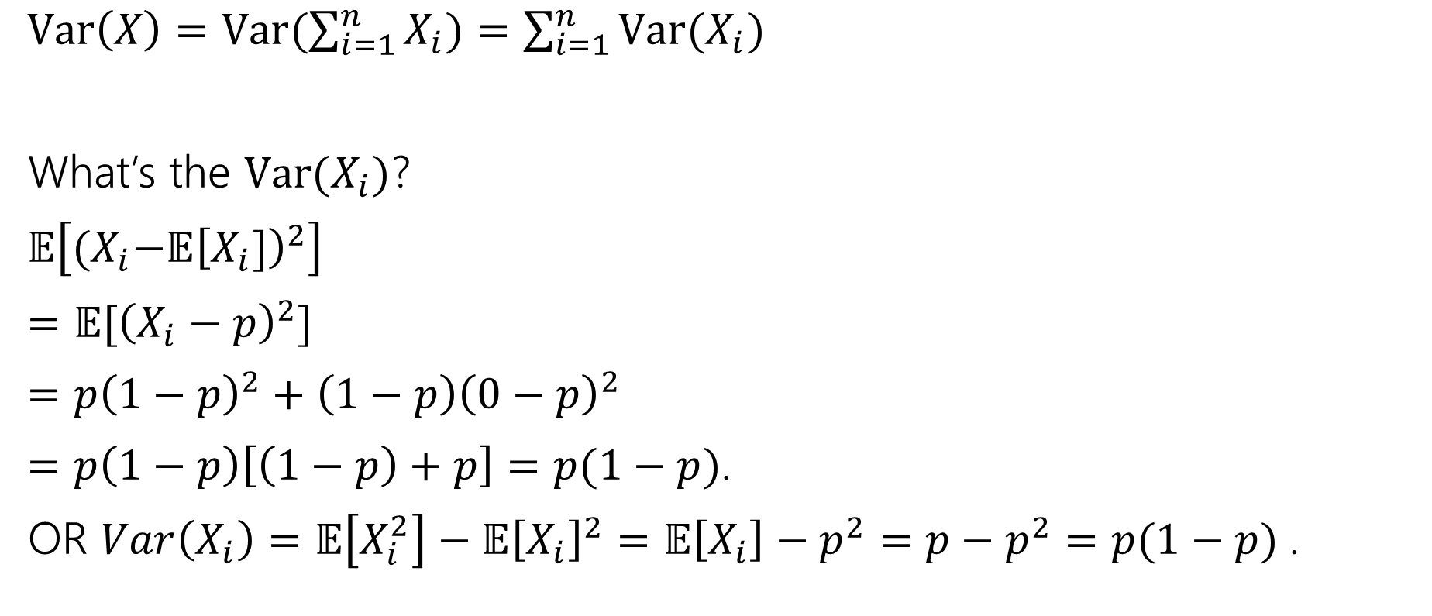

Variance
$Var\left(X\right)=Var(\sum_{i=1}^{n}{X_{i})=\sum_{i=1}^{n}{Var(X_{i})}}$
What’s the $Var(X_{i})$?
$𝔼\left[{(X}_{i}−𝔼{\left[X_{i}]\right)}^{2}\right]$
$=𝔼[{\left(X_{i}−p\right)}^{2}]$
$=p{\left(1−p\right)}^{2}+\left(1−p\right){\left(0−p\right)}^{2}$
$=p\left(1−p\right)\left[\left(1−p\right)+p\right]=p(1−p)$.
OR $Var\left(X_{i}\right)=𝔼\left[X_{i}^{2}\right]−𝔼{\left[X_{i}\right]}^{2}=𝔼\left[X_{i}\right]−p^{2}=p−p^{2}=p(1−p)$.

Slide 9

Plugging In
$Var\left(X\right)=Var(\sum_{i=1}^{n}{X_{i})=\sum_{i=1}^{n}{Var(X_{i})}}$
What’s the $Var(X_{i})$?
$p(1−p)$.
$Var\left(X\right)=\sum_{i=1}^{n}{p\left(1−p\right)=}np(1−p)$.

Slide 10
Expectation and Variance aren’t everything
Alright, so expectation and variance is everything right?
No!
A PMF or CDF *does* fully describe a random variable.
Flip a fair coin 3 times indep. Count heads.
Flip a biased coin (prob heads=2/3) until heads. Count flips.
…

Slide 11
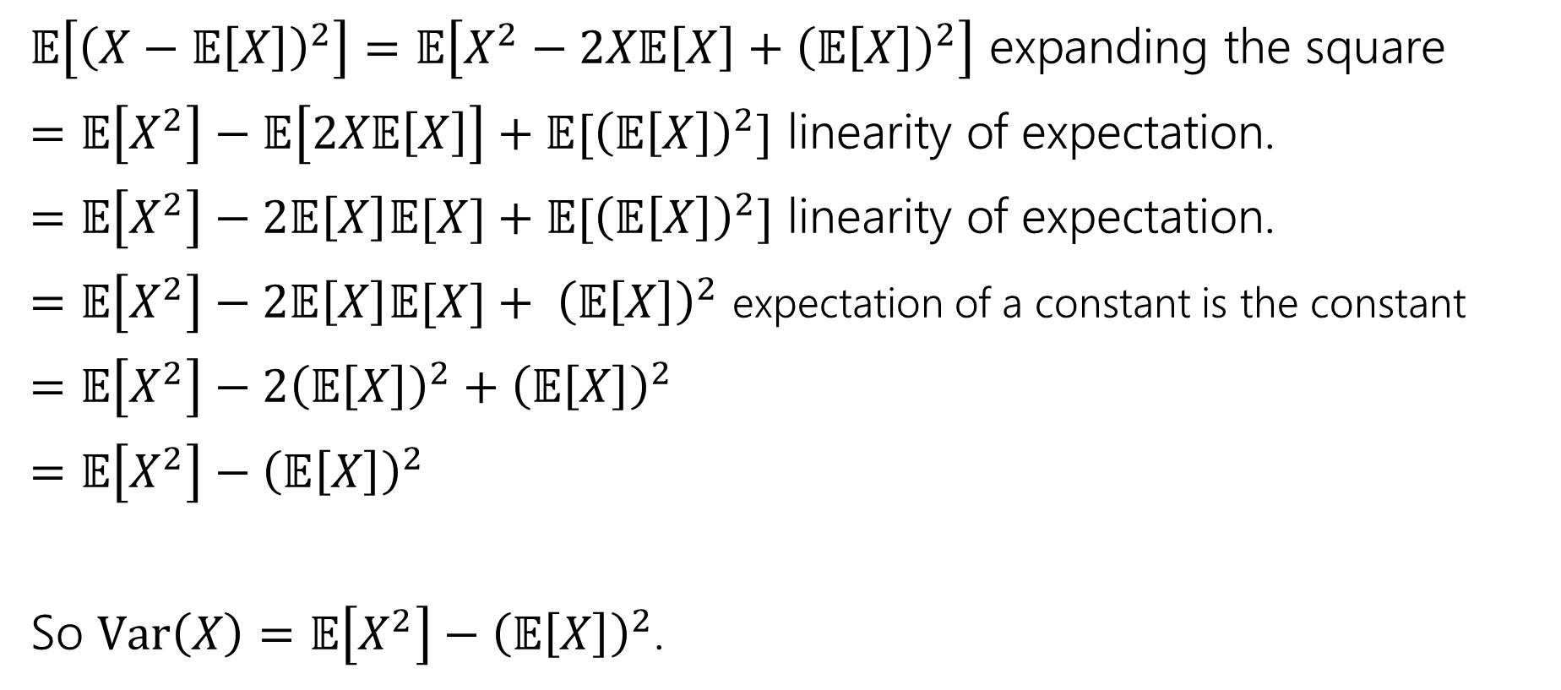
Proof of Calculation Trick
$𝔼\left[{\left(X−𝔼\left[X\right]\right)}^{2}\right]=𝔼\left[X^{2}−2X𝔼\left[X\right]+{\left(𝔼\left[X\right]\right)}^{2}\right]$ expanding the square
$=𝔼\left[X^{2}\right]−𝔼\left[2X𝔼\left[X\right]\right]+𝔼[{\left(𝔼\left[X\right]\right)}^{2}]$ linearity of expectation.
$=𝔼\left[X^{2}\right]−2𝔼\left[X\right]𝔼[X]+𝔼[{\left(𝔼\left[X\right]\right)}^{2}]$ linearity of expectation.
$=𝔼\left[X^{2}\right]−2𝔼\left[X\right]𝔼[X]+ {\left(𝔼\left[X\right]\right)}^{2}$ expectation of a constant is the constant
$=𝔼\left[X^{2}\right]−2{\left(𝔼\left[X\right]\right)}^{2}+{\left(𝔼\left[X\right]\right)}^{2}$
$=𝔼\left[X^{2}\right]−{\left(𝔼\left[X\right]\right)}^{2}$
So $Var\left(X\right)=𝔼\left[X^{2}\right]−{\left(𝔼\left[X\right]\right)}^{2}$.

Slide 12


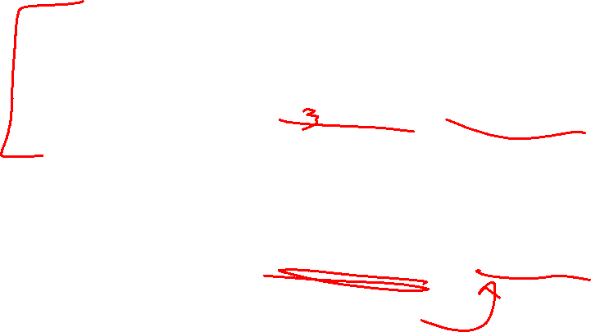
Shifting a random variable
For any random variable $X,$ and any constants $a,b$:
$$𝔼\left[aX+b\right]=a𝔼\left[X\right]+b$$
For any random variable $X,$ and any constants $a,b$:
$$Var\left(aX+b\right)=a^{2}Var(X)$$

Slide 13
Random Variable Zoo

Slide 14
Discrete Random Variable Zoo
There are common patterns of experiments:
Flip a [fair/unfair] coin [blah] times and count the number of heads.
Flip a [fair/unfair] coin until the first time that you see a heads
Draw a uniformly random element from [set]
Define an indicator random variable for [event]
…
Instead of calculating the pmf, cdf, support, expectation, variance,… every time, why not calculate it once and look it up every time?

Slide 15
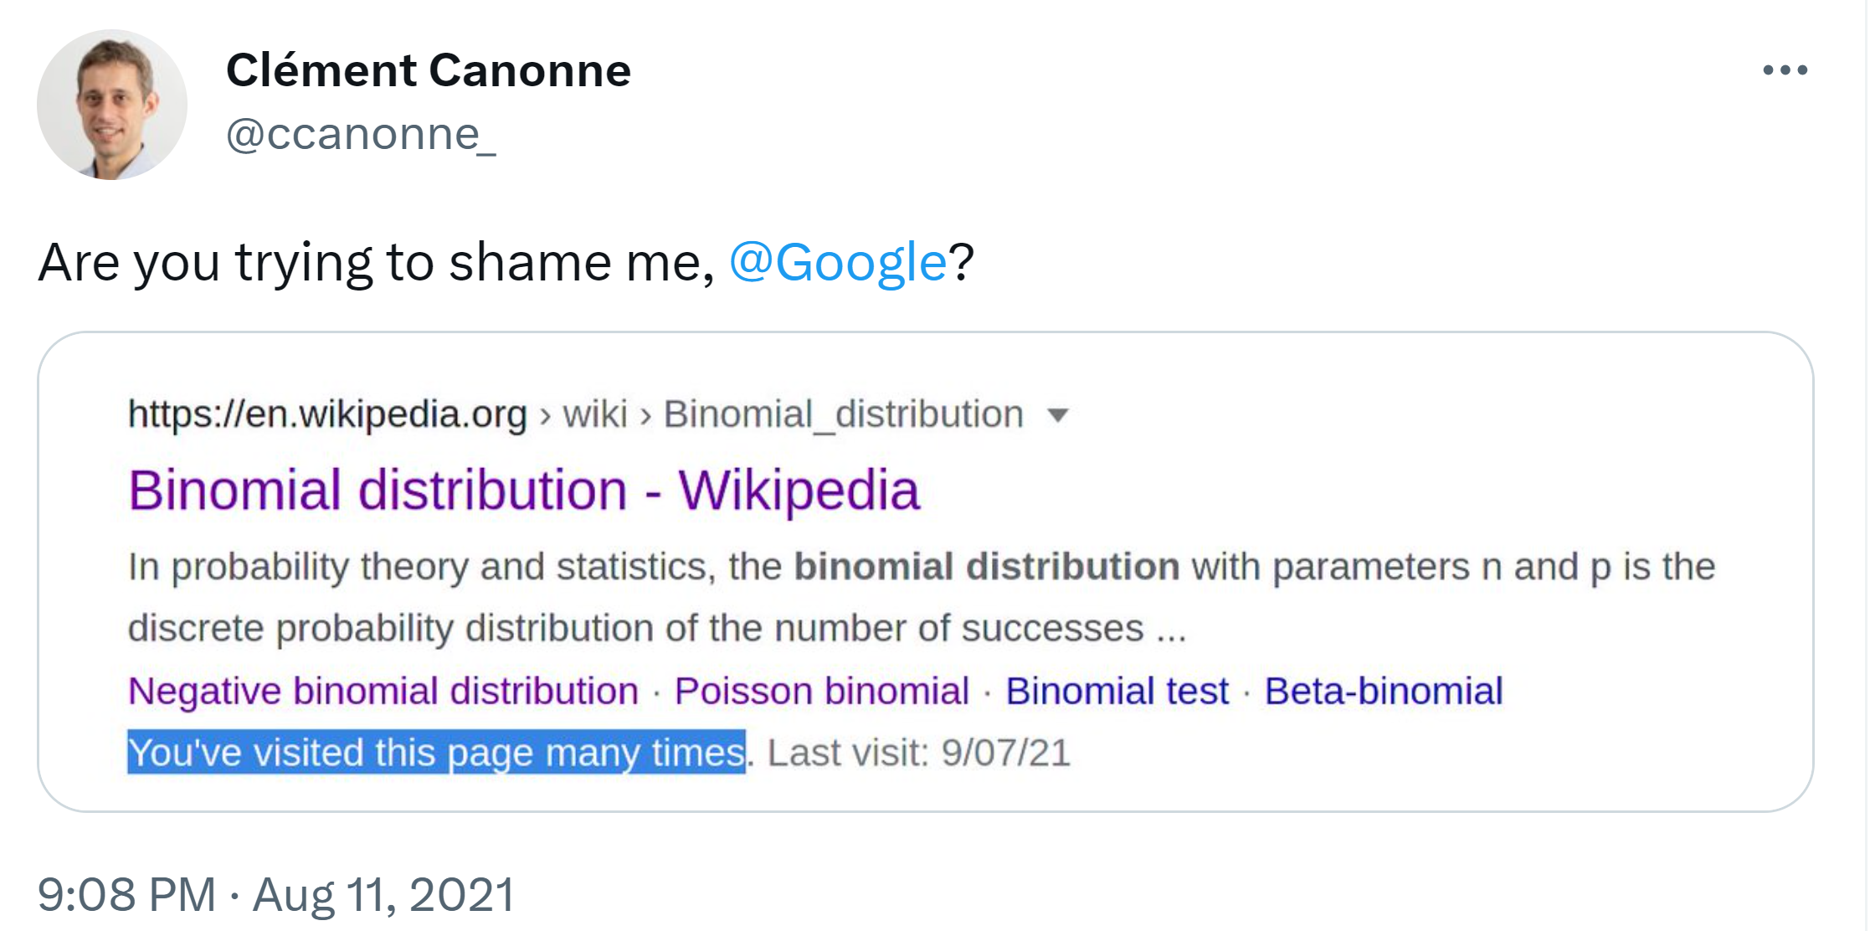

What’s our goal?
Your goal is NOT to memorize these facts (it’ll be convenient to memorize some of them, but don’t waste time making flash cards).
  Everything is on Wikipedia anyway. Everyone checks Wikipedia when they forget these.

Slide 16
What’s our goal?
Your goal is NOT to memorize these facts (it’ll be convenient to memorize some of them, but don’t waste time making flash cards).
  Everything is on Wikipedia anyway. Everyone checks Wikipedia when they forget these.
Our goals are:
0. Introduce one new distribution we haven’t seen at all (next time).
1. Practice expectation, variance, etc. for ones we have gotten hints of.
2. Review the first half of the course with some probability calculations.

Slide 17










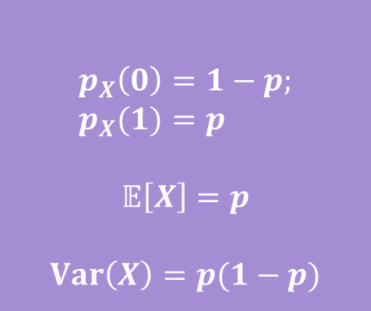
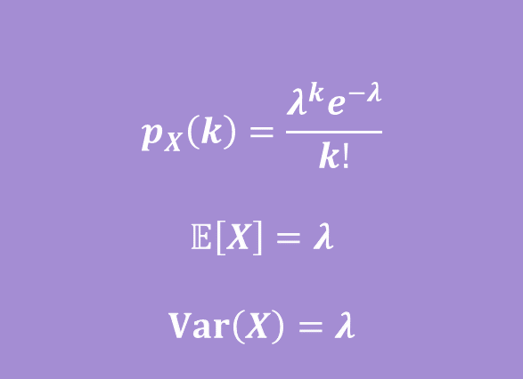



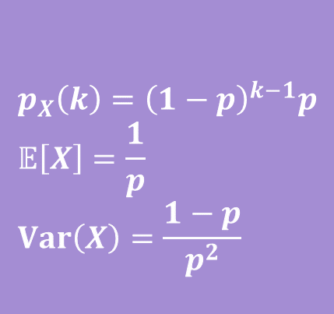
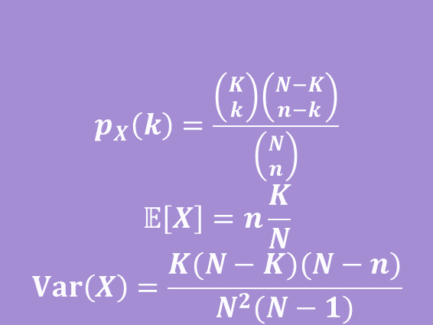

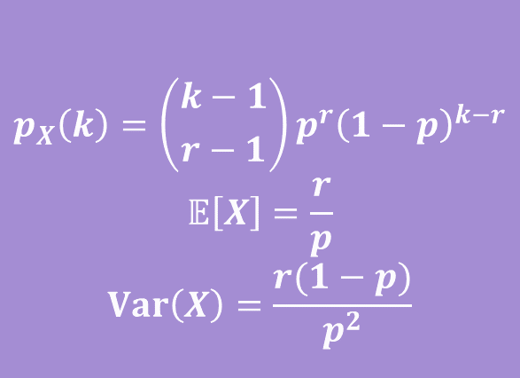

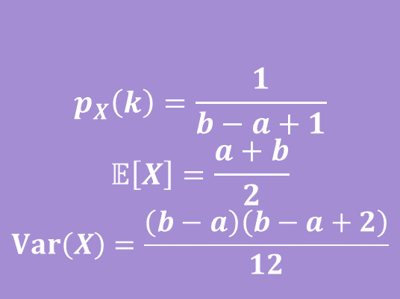

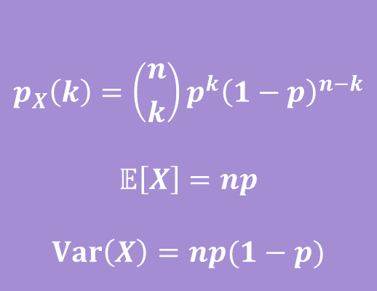

Zoo!
$$X\sim Geo(p)$$
$$X\sim Unif(a,b)$$
$$p_{X}\left(k\right)={\left(1−p\right)}^{k−1}p \\ 𝔼\left[X\right]=\frac{1}{p} \\ Var\left(X\right)=\frac{1−p}{p^{2}}$$
$$p_{X}\left(k\right)=\frac{1}{b−a+1}$$
$$𝔼\left[X\right]=\frac{a+b}{2}$$
$$Var\left(X\right)=\frac{\left(b−a\right)\left(b−a+2\right)}{12}$$
$$X\sim Ber(p)$$
$$X\sim Bin(n,p)$$
$$p_{X}\left(0\right)=1−p; \\ p_{X}(1)=p$$
$$𝔼\left[X\right]=p$$
$$Var\left(X\right)=p(1−p)$$
$$p_{X}\left(k\right)=\left({n \atop k}\right)p^{k}{\left(1−p\right)}^{n−k}$$
$$𝔼\left[X\right]=np$$
$$Var\left(X\right)=np(1−p)$$
$$X\sim Poi(λ)$$
$$X\sim NegBin(r,p)$$
$$p_{X}\left(k\right)=\frac{λ^{k}e^{−λ}}{k!}$$
$$𝔼\left[X\right]=λ$$
$$Var\left(X\right)=λ$$
$$p_{X}\left(k\right)=\left({k−1 \atop r−1}\right)p^{r}{\left(1−p\right)}^{k−r}$$
$$𝔼\left[X\right]=\frac{r}{p}$$
$$Var\left(X\right)=\frac{r(1−p)}{p^{2}}$$
$$X\sim HypGeo(N,K,n)$$
$$p_{X}\left(k\right)=\frac{\left({K \atop k}\right)\left({N−K \atop n−k}\right)}{\left({N \atop n}\right)}$$
$$𝔼\left[X\right]=n\frac{K}{N}$$
$$Var\left(X\right)=\frac{K(N−K)(N−n)}{N^{2}(N−1)}$$

Slide 18
Some More Familiar Variables

Slide 19
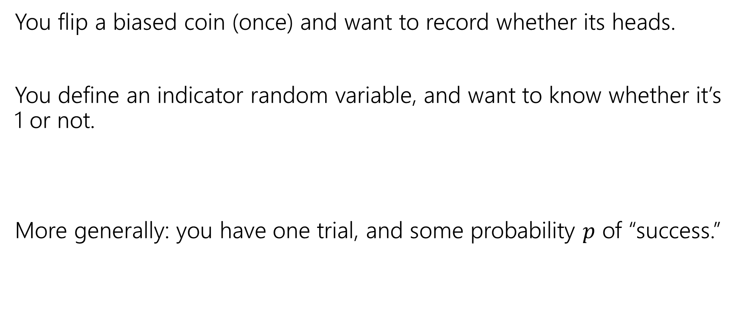

Situation: Bernoulli
You flip a biased coin (once) and want to record whether its heads.
You define an indicator random variable, and want to know whether it’s 1 or not.
More generally: you have one trial, and some probability $p$ of “success.”

Slide 20
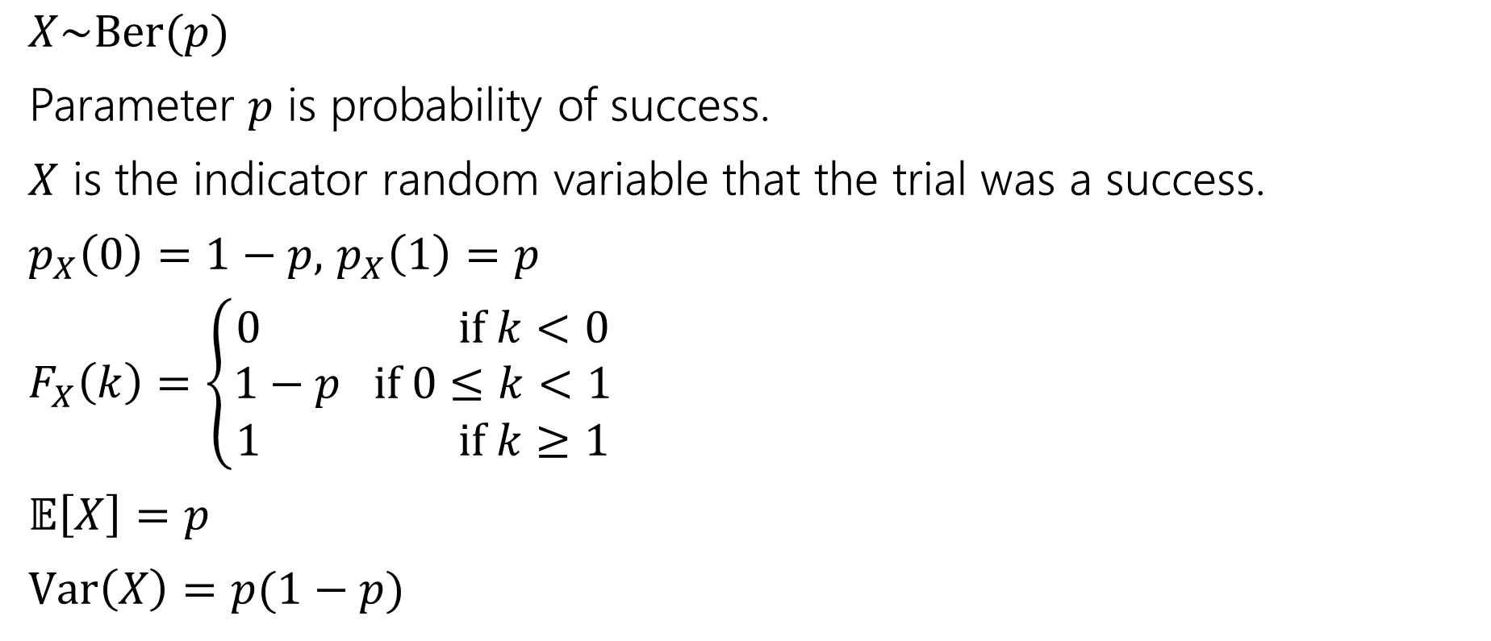
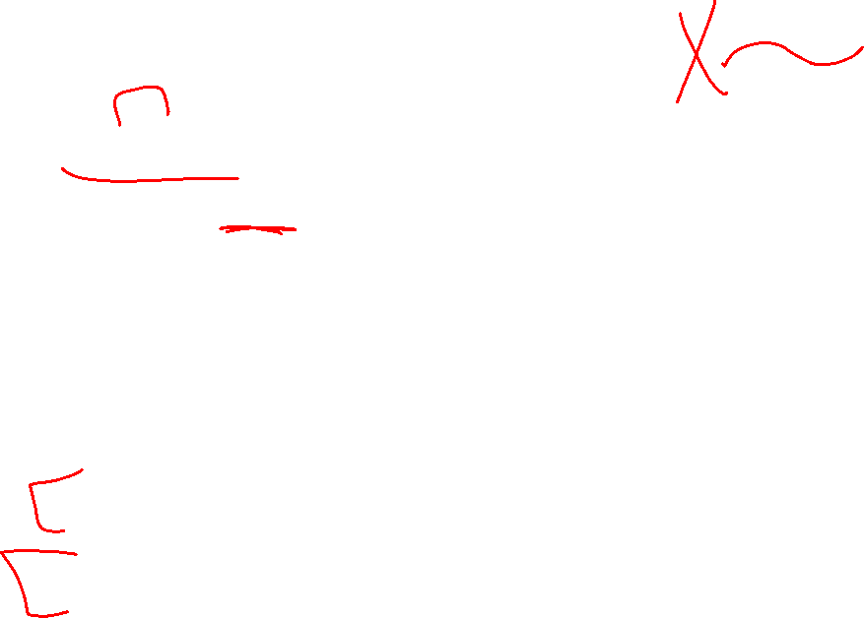
Bernoulli Distribution
$X\sim Ber(p)$
Parameter $p$ is probability of success.
$X$ is the indicator random variable that the trial was a success.
$p_{X}\left(0\right)=1−p,$ $p_{X}\left(1\right)=p$
$F_{X}\left(k\right)=\left\{\begin{aligned}0 if k<0 \\ 1−p if 0≤k<1 \\ 1 if k≥1\end{aligned}\right.$
$𝔼\left[X\right]=p$
$Var\left(X\right)=p(1−p)$
Some other uses:
Did a particular bit get written correctly on the device?
Did you guess right on a multiple choice test?
Did a server in a cluster fail?

Slide 21
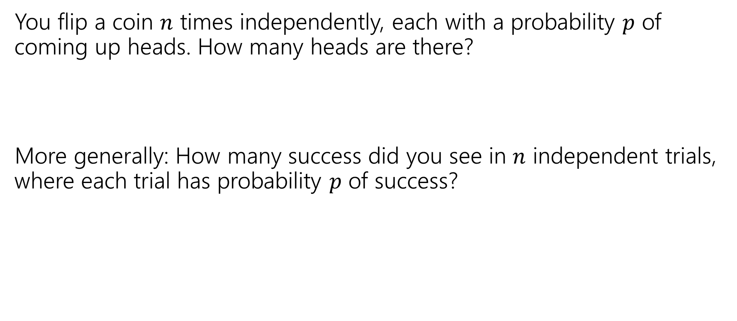

Situation: Binomial
You flip a coin $n$ times independently, each with a probability $p$ of coming up heads. How many heads are there?
More generally: How many success did you see in $n$ independent trials, where each trial has probability $p$ of success?

Slide 22
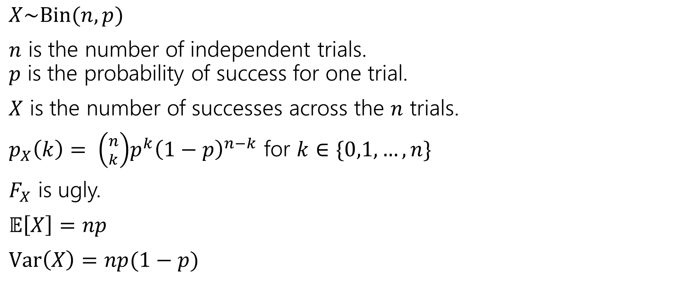

Binomial Distribution
$X\sim Bin(n,p)$
$n$ is the number of independent trials.
$p$ is the probability of success for one trial.
$X$ is the number of successes across the $n$ trials.
$p_{X}\left(k\right)= \left({n \atop k}\right)p^{k}{\left(1−p\right)}^{n−k}$ for $k∈\{0,1,…,n\}$
$F_{X}$ is ugly.
$𝔼\left[X\right]=np$
$Var\left(X\right)=np(1−p)$
Some other uses:
How many bits were written correctly on the device?
How many questions did you guess right on a multiple choice test?
How many servers in a cluster failed?
How many keys went to one bucket in a hash table?

Slide 23

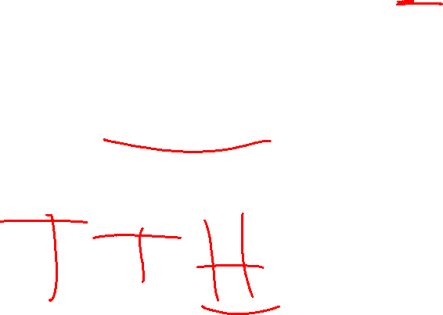
Situation: Geometric
You flip a coin (which comes up heads with probability $p$) until you get a heads. How many flips did you need?
More generally: how many independent trials are needed until the first success?

Slide 24
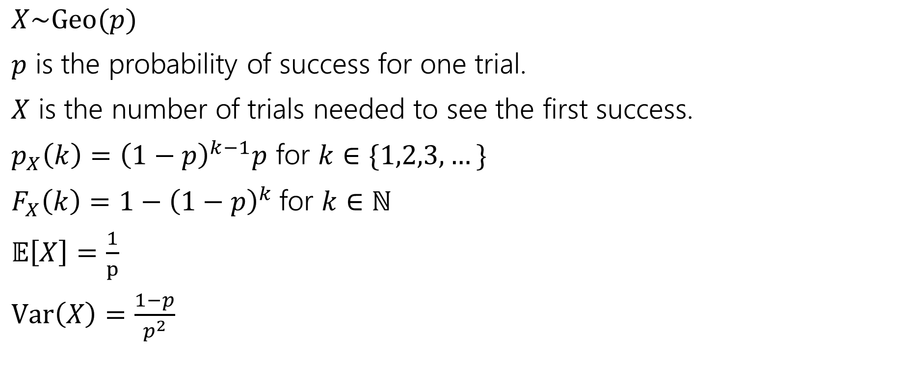
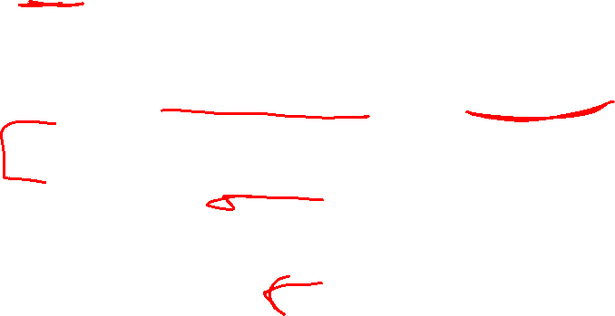
Geometric Distribution
$X\sim Geo(p)$
$p$ is the probability of success for one trial.
$X$ is the number of trials needed to see the first success.
$p_{X}\left(k\right)={\left(1−p\right)}^{k−1}p$ for $k∈\{1,2,3,…\}$
$F_{X}\left(k\right)=1−{\left(1−p\right)}^{k}$for $k∈ℕ$
$𝔼\left[X\right]=\frac{1}{p}$
$Var\left(X\right)=\frac{1−p}{p^{2}}$
Some other uses:
How many bits can we write before one is incorrect?
How many questions do you have to answer until you get one right?
How many times can you run an experiment until it fails for the first time?

Slide 25
Geometric: Analysis
Both the expectation and variance are new to us.
The derivations of both are uninformative
  Every derivation I’ve ever seen has wild algebra tricks.

Slide 26
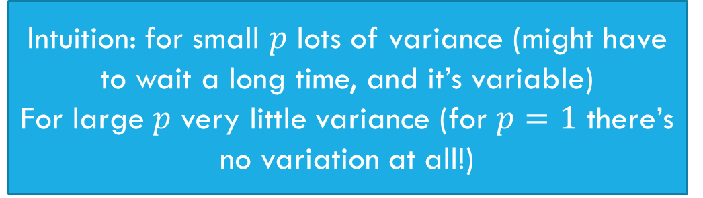



Geometric: Expectation
$𝔼\left[X\right]=\sum_{k=1}^{∞}{k{\left(1−p\right)}^{k−1}p}$
$=p\sum_{k=1}^{∞}{k{\left(1−p\right)}^{k−1}}=p⋅\frac{1}{p^{2}}=\frac{1}{p}$.
$Var\left(X\right)=𝔼\left[X^{2}\right]−{\left(𝔼\left[X\right]\right)}^{2}$
$=\frac{2−p}{p^{2}}−\frac{1}{p^{2}}=\frac{1−p}{p^{2}}$
Intuition: Smaller $p$ means longer wait
Intuition: for small $p$ lots of variance (might have to wait a long time, and it’s variable)
For large $p$ very little variance (for $p=1$ there’s no variation at all!)

Slide 27

Geometric Property
Geometric random variables are called “memoryless”
Suppose you’re flipping coins (independently) until you see a heads.
The first two came up tails.
How many flips are left until you see the first heads?
It’s another independent copy of the original!
The coin “forgot” it already came up tails 2 times.

Slide 28


Formally…
Let $X$ be the total number of flips needed, $Y$ be the flips after the second.
$ℙ\left(Y=k\right|X≥3)=?$
…
Which is $p_{X}(k)$.

Slide 29
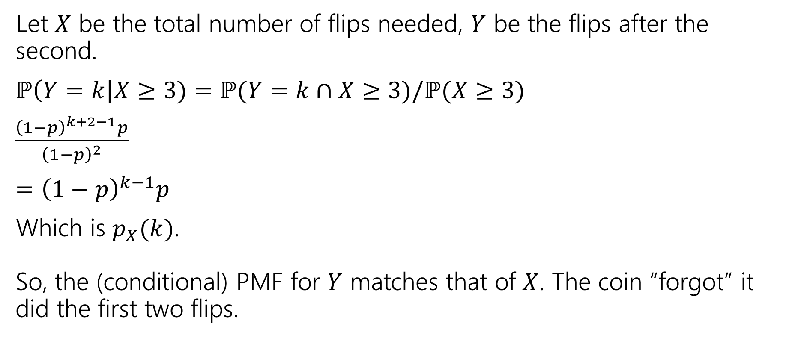
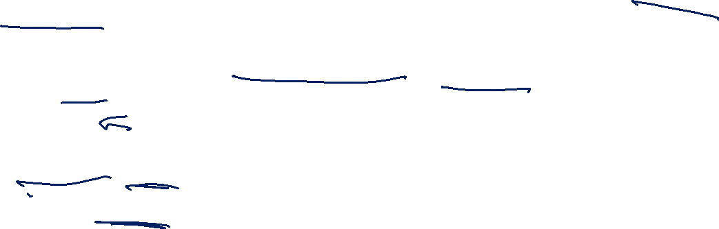
Formally…
Let $X$ be the total number of flips needed, $Y$ be the flips after the second.
$ℙ\left(Y=k\right|X≥3)=ℙ(Y=k∩X≥3)/ℙ(X≥3)$
$\frac{{\left(1−p\right)}^{k+2−1}p}{{\left(1−p\right)}^{2}}$
$={\left(1−p\right)}^{k−1}p$
Which is $p_{X}(k)$.
So, the (conditional) PMF for $Y$ matches that of $X$. The coin “forgot” it did the first two flips.

Slide 30
Scenario: Uniform
You Roll a Fair Die (or draw a random integer from 1,…,n).
More generally: you want an integer in some range, with each equally likely.

Slide 31
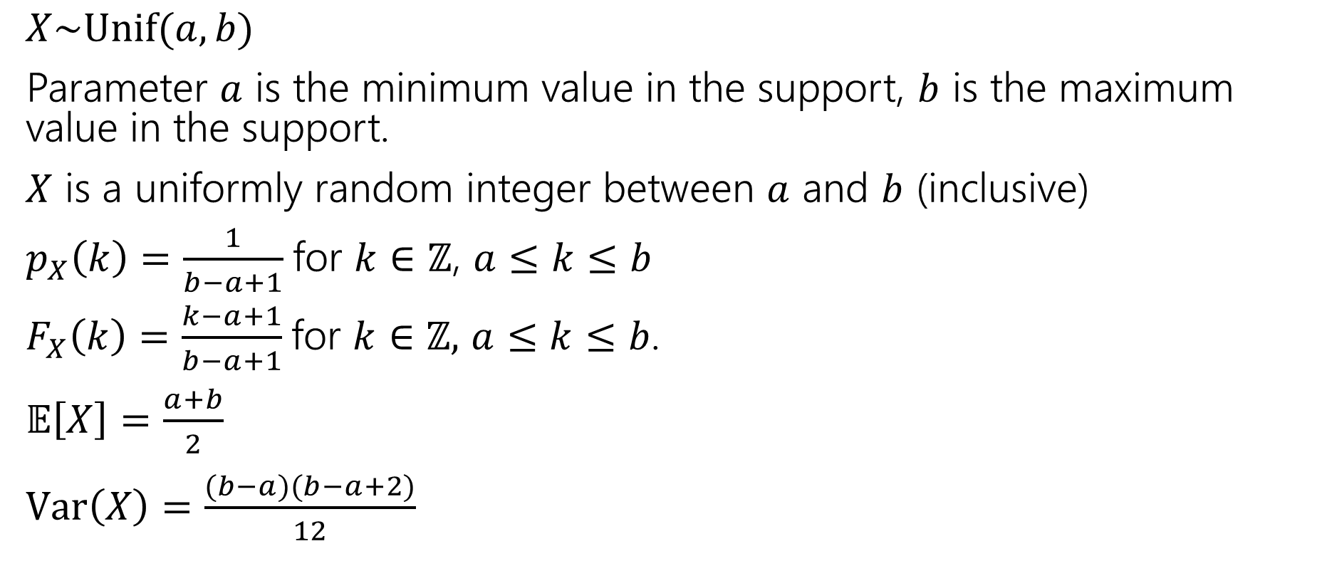
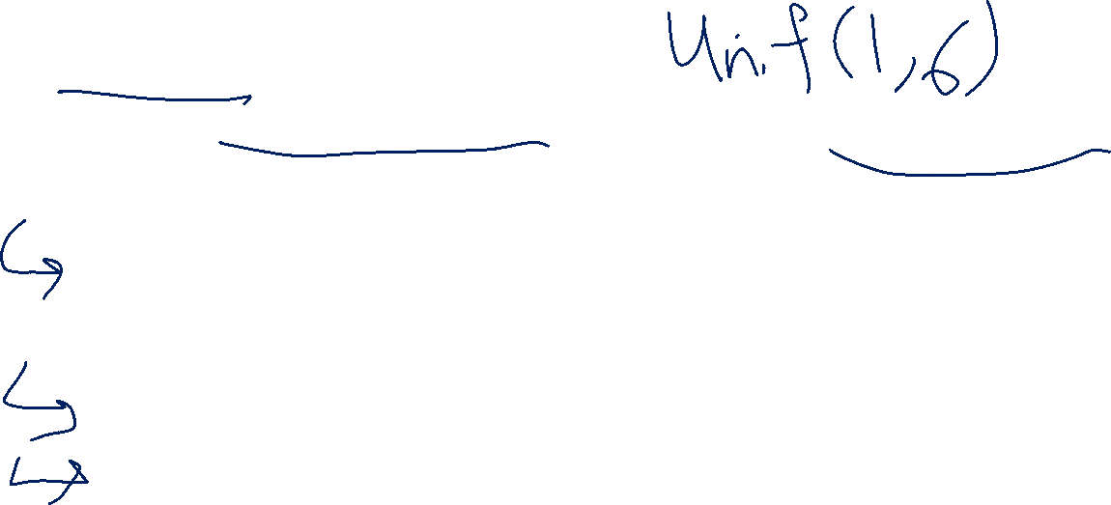
Discrete Uniform Distribution
$X\sim Unif(a,b)$
Parameter $a$ is the minimum value in the support, $b$ is the maximum value in the support.
$X$ is a uniformly random integer between $a$ and $b$ (inclusive)
$p_{X}\left(k\right)=\frac{1}{b−a+1}$for $k∈ℤ$, $a≤k≤b$
$F_{X}\left(k\right)=\frac{k−a+1}{b−a+1}$for $k∈ℤ,$ $a≤k≤b$.
$𝔼\left[X\right]=\frac{a+b}{2}$
$Var\left(X\right)=\frac{(b−a)(b−a+2)}{12}$

Slide 32
Some Less Familiar Distributions

Slide 33

The Poisson Distribution
A new kind of random variable.
We use a Poisson distribution when:
We’re trying to count the number of times something happens in some interval of time.
We know the average number that happen (i.e. the expectation)
Each occurrence is independent of the others.
There are a VERY large number of “potential sources” for those events, few of which happen.
Notes:
Simeon Davis Poisson was a French mathematician

Slide 34
The Poisson Distribution
Classic applications:
  How many traffic accidents occur in Seattle in a day
  How many major earthquakes occur in a year (not including aftershocks)
  How many customers visit a bakery in an hour.
Why not just use counting coin flips?
What are the flips…the number of cars? Every person who might visit the bakery? There are way too many of these to count exactly or think about dependency between. But a Poisson might accurately model what’s happening.

Slide 35
It’s a model
By modeling choice, we mean that we’re choosing math that we think represents the real world as best as possible
Is every traffic accident really independent?
Not really, one causes congestion, which causes angrier drivers. Or both might be caused by bad weather/more cars on the road.
But we assume they are (because the dependence is so weak that the model is useful).

Slide 36
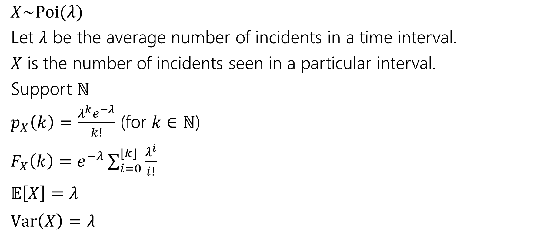

Poisson Distribution
$X\sim Poi(λ)$
Let $λ$ be the average number of incidents in a time interval.
$X$ is the number of incidents seen in a particular interval.
Support $ℕ$
$p_{X}\left(k\right)=\frac{λ^{k}e^{−λ}}{k!}$ (for $k∈ℕ$)
$F_{X}\left(k\right)=e^{−λ}\sum_{i=0}^{⌊k⌋}{\frac{λ^{i}}{i!}}$
$𝔼\left[X\right]=λ$
$Var\left(X\right)=λ$

Slide 37

Some Sample PMFs
…
…
0
5
10
0
5
10

Slide 38
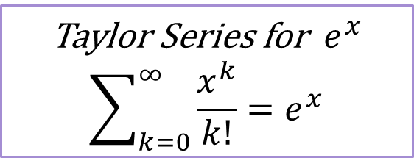



Let’s take a closer look at that pmf
$p_{X}\left(k\right)=\frac{λ^{k}e^{−λ}}{k!}$ (for $k∈ℕ$)
If this is a real PMF, it should sum to $1$.
Let’s check that to understand the PMF a little better.
$\sum_{k=0}^{∞}{\frac{λ^{k}e^{−λ}}{k!}}$
$=e^{−λ}\sum_{k=0}^{∞}{\frac{λ^{k}}{k!}}$
Taylor Series for $e^{x}$
$$\sum_{k=0}^{∞}{\frac{x^{k}}{k!}}=e^{x}$$
$$=e^{−λ}e^{λ}=e^{0}=1$$

Slide 39
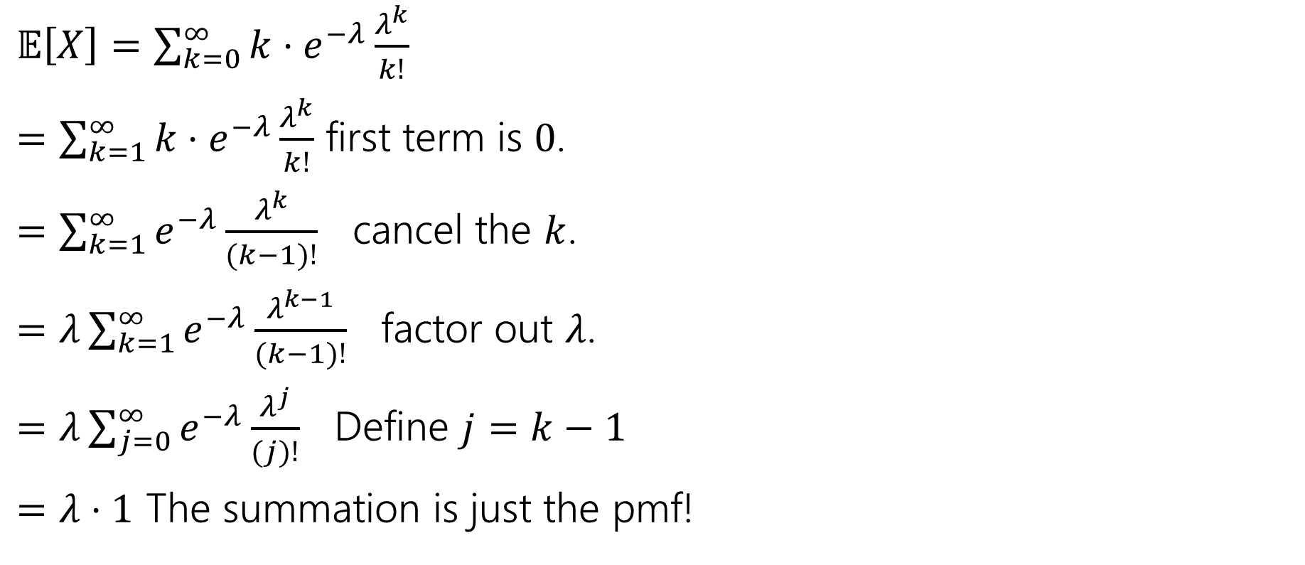
Let’s check something…the expectation
$𝔼\left[X\right]=\sum_{k=0}^{∞}{k⋅e^{−λ}\frac{λ^{k}}{k!}}$
$=\sum_{k=1}^{∞}{k⋅e^{−λ}\frac{λ^{k}}{k!}}$ first term is $0$.
$=\sum_{k=1}^{∞}{e^{−λ}\frac{λ^{k}}{(k−1)!}}$ cancel the $k$.
$=λ\sum_{k=1}^{∞}{e^{−λ}\frac{λ^{k−1}}{(k−1)!}}$ factor out $λ$.
$=λ\sum_{j=0}^{∞}{e^{−λ}\frac{λ^{j}}{(j)!}}$ Define $j=k−1$
$=λ⋅1$ The summation is just the pmf!

Slide 40
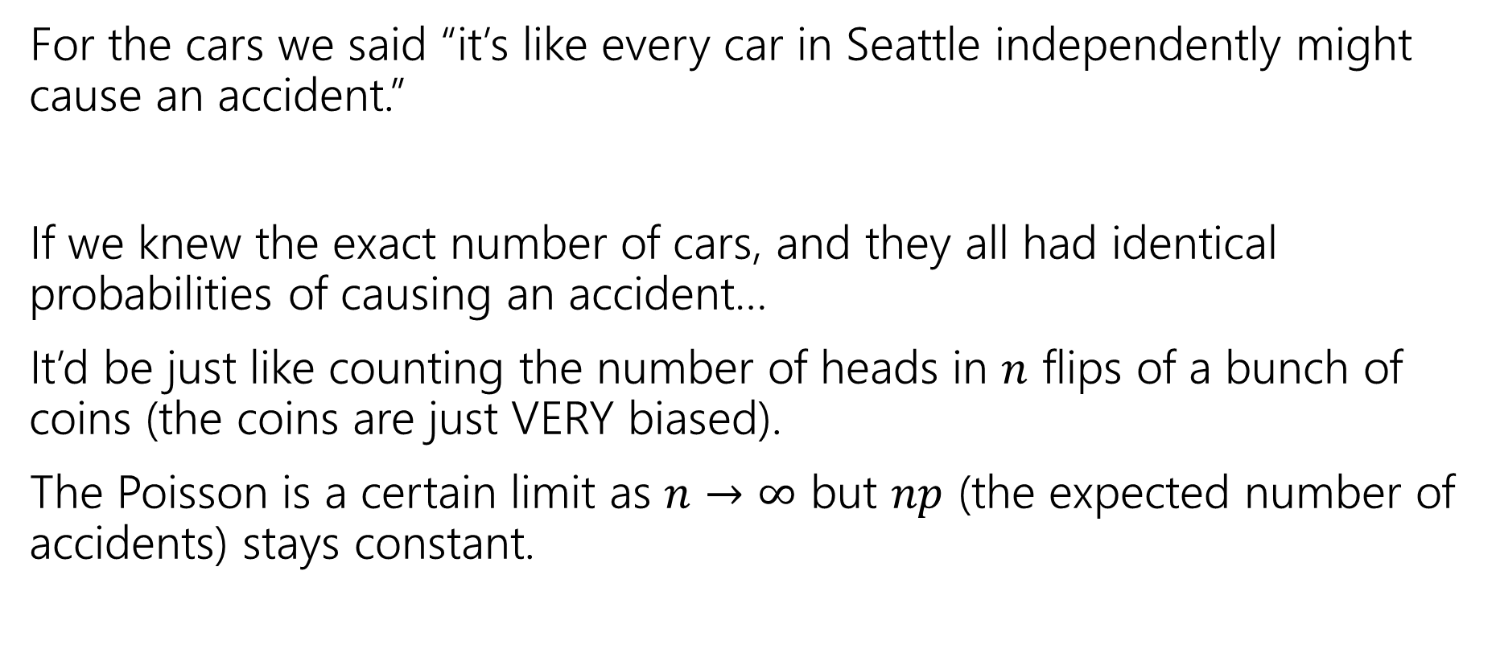

Where did this expression come from?
For the cars we said “it’s like every car in Seattle independently might cause an accident.”
If we knew the exact number of cars, and they all had identical probabilities of causing an accident…
It’d be just like counting the number of heads in $n$ flips of a bunch of coins (the coins are just VERY biased).
The Poisson is a certain limit as $n→∞$ but $np$ (the expected number of accidents) stays constant.

Slide 41

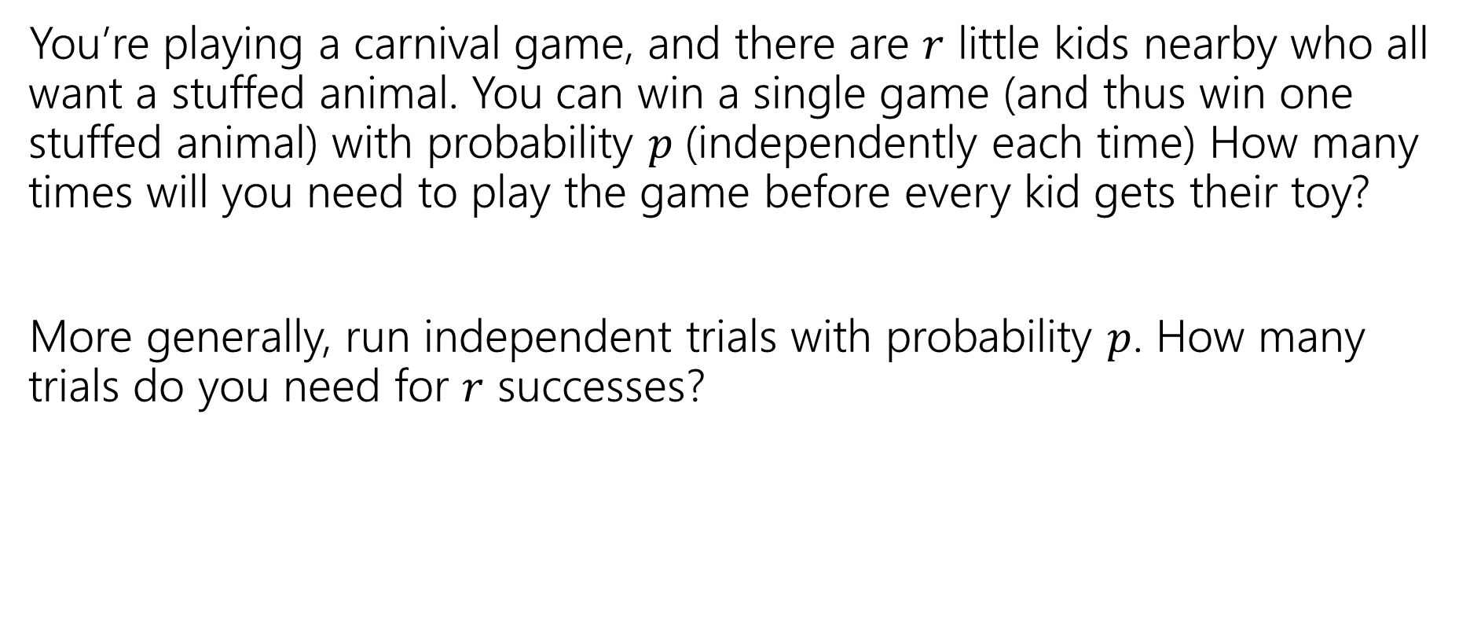
Scenario: Negative Binomial
You’re playing a carnival game, and there are $r$ little kids nearby who all want a stuffed animal. You can win a single game (and thus win one stuffed animal) with probability $p$(independently each time) How many times will you need to play the game before every kid gets their toy?
More generally, run independent trials with probability $p$. How many trials do you need for $r$ successes?

Slide 42
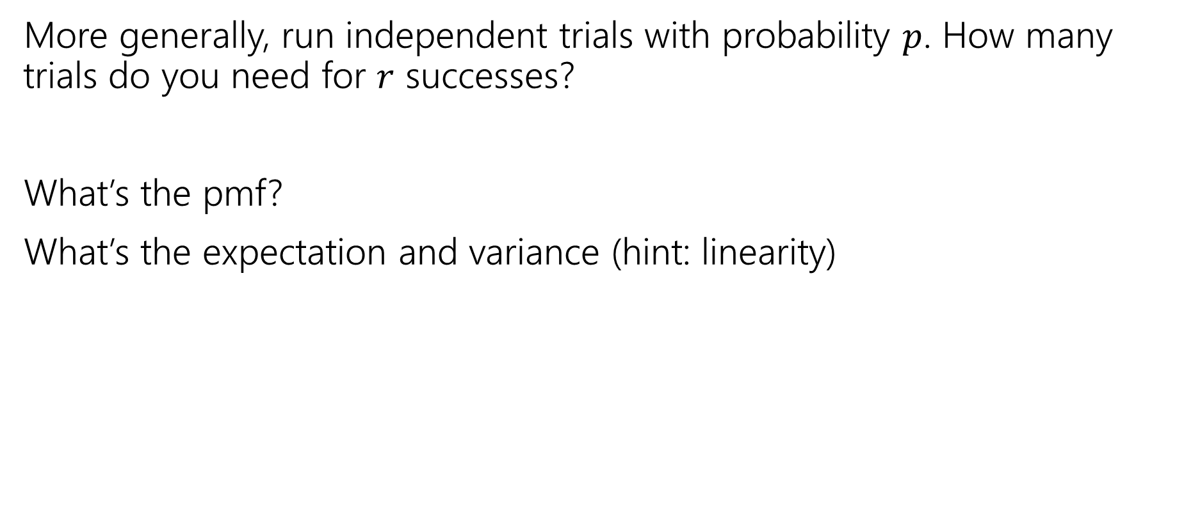
Try it
More generally, run independent trials with probability $p$. How many trials do you need for $r$ successes?
What’s the pmf?
What’s the expectation and variance (hint: linearity)

Slide 43
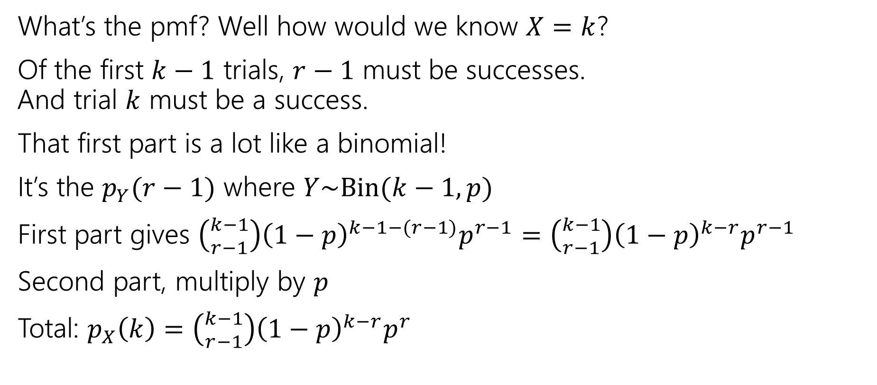
Negative Binomial Analysis
What’s the pmf? Well how would we know $X=k$?
Of the first $k−1$ trials, $r−1$ must be successes.
And trial $k$ must be a success.
That first part is a lot like a binomial!
It’s the $p_{Y}(r−1)$ where $Y\sim Bin(k−1, p)$
First part gives $\left({k−1 \atop r−1}\right){\left(1−p\right)}^{k−1−(r−1)}p^{r−1}=\left({k−1 \atop r−1}\right){\left(1−p\right)}^{k−r}p^{r−1}$
Second part, multiply by $p$
Total: $p_{X}\left(k\right)=\left({k−1 \atop r−1}\right){\left(1−p\right)}^{k−r}p^{r}$

Slide 44
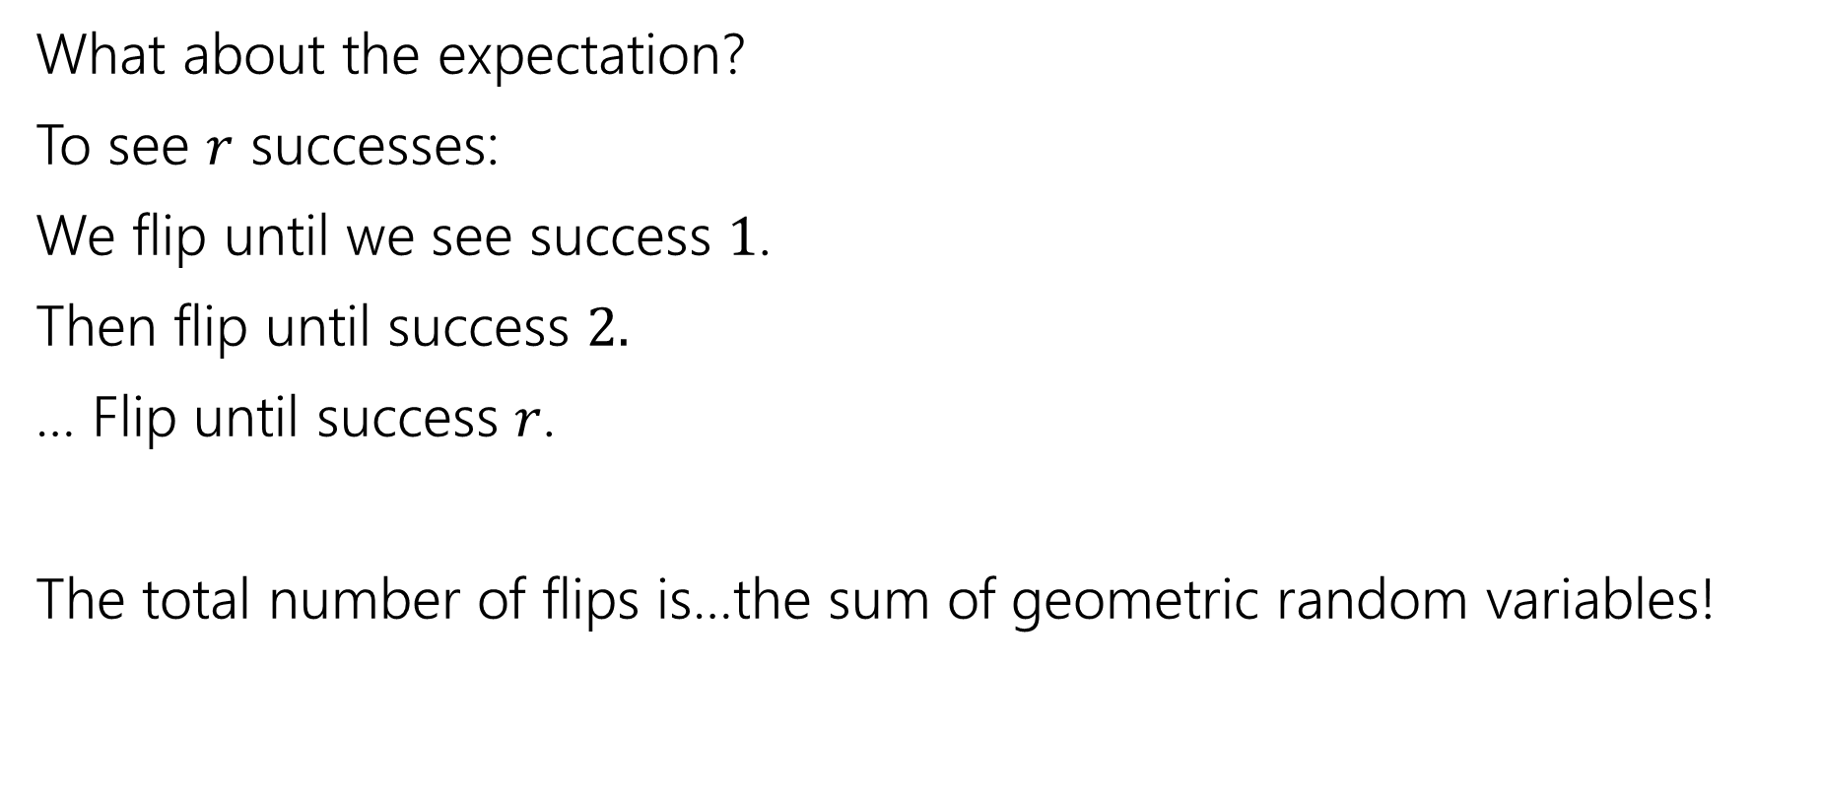
Negative Binomial Analysis
What about the expectation?
To see $r$ successes:
We flip until we see success $1$.
Then flip until success $2.$
… Flip until success $r$.
The total number of flips is…the sum of geometric random variables!

Slide 45
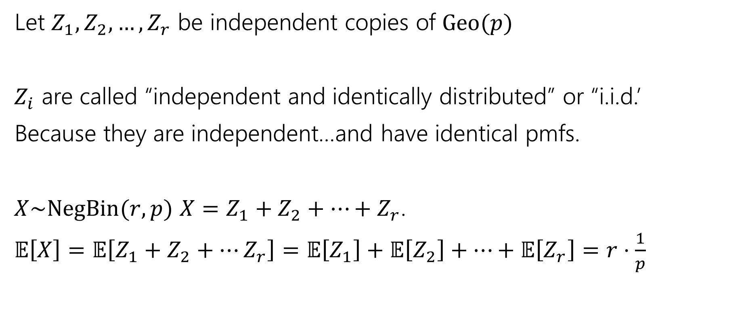
Negative Binomial Analysis
Let $Z_{1},Z_{2},…,Z_{r}$ be independent copies of $Geo(p)$
$Z_{i}$ are called “independent and identically distributed” or “i.i.d.’
Because they are independent…and have identical pmfs.
$X\sim NegBin(r,p)$ $X=Z_{1}+Z_{2}+…+Z_{r}$.
$𝔼\left[X\right]=𝔼\left[Z_{1}+Z_{2}+…Z_{r}\right]=𝔼\left[Z_{1}\right]+𝔼\left[Z_{2}\right]+…+𝔼\left[Z_{r}\right]=r⋅\frac{1}{p}$

Slide 46
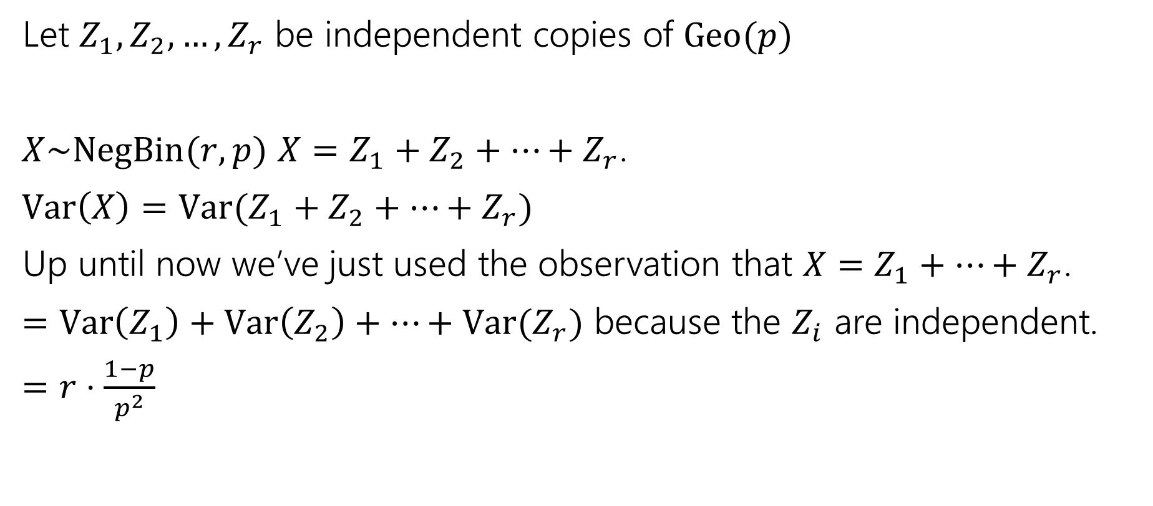
Negative Binomial Analysis
Let $Z_{1},Z_{2},…,Z_{r}$ be independent copies of $Geo(p)$
$X\sim NegBin(r,p)$ $X=Z_{1}+Z_{2}+…+Z_{r}$.
$Var\left(X\right)=Var(Z_{1}+Z_{2}+…+Z_{r})$
Up until now we’ve just used the observation that $X=Z_{1}+…+Z_{r}$.
$=Var\left(Z_{1}\right)+Var\left(Z_{2}\right)+…+Var(Z_{r})$ because the $Z_{i}$ are independent.
$=r⋅\frac{1−p}{p^{2}}$

Slide 47
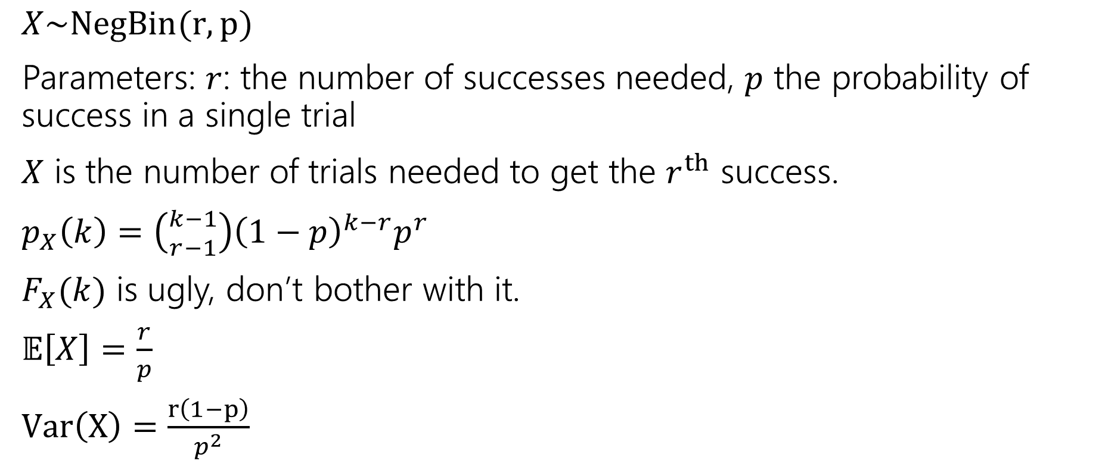
Negative Binomial
$X\sim NegBin(r,p)$
Parameters: $r$: the number of successes needed, $p$ the probability of success in a single trial
$X$ is the number of trials needed to get the $r^{th}$ success.
$p_{X}\left(k\right)=\left({k−1 \atop r−1}\right){\left(1−p\right)}^{k−r}p^{r}$
$F_{X}(k)$ is ugly, don’t bother with it.
$𝔼\left[X\right]=\frac{r}{p}$
$Var\left(X\right)=\frac{r\left(1−p\right)}{p^{2}}$

Slide 48


Scenario: Hypergeometric
You have an urn with $N$ balls, of which $K$ are purple. You are going to draw balls out of the urn without replacement.
If you draw out $n$ balls, what is the probability you see $k$ purple ones?

Slide 49
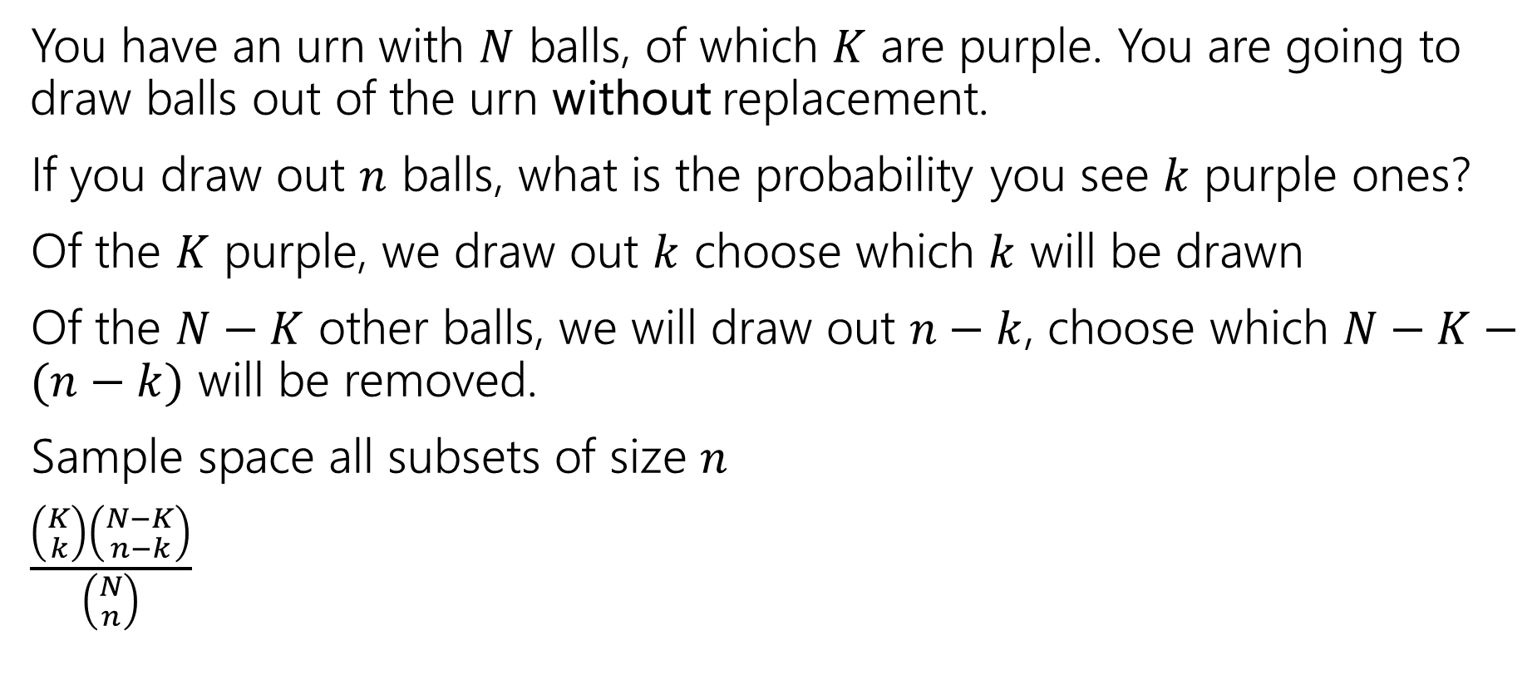
Hypergeometric: Analysis
You have an urn with $N$ balls, of which $K$ are purple. You are going to draw balls out of the urn without replacement.
If you draw out $n$ balls, what is the probability you see $k$ purple ones?
Of the $K$ purple, we draw out $k$ choose which $k$ will be drawn
Of the $N−K$ other balls, we will draw out $n−k$, choose which $N−K−(n−k)$ will be removed.
Sample space all subsets of size $n$
$\frac{\left({K \atop k}\right)\left({N−K \atop n−k}\right)}{\left({N \atop n}\right)}$

Slide 50

Hypergeometric: Analysis
$X=D_{1}+D_{2}+…+D_{n}$
Where $D_{i}$ is the indicator that draw $i$ is purple.
$D_{1}$ is $1$with probability $K/N$.
What about $D_{2}$?
$ℙ\left(D_{2}=1\right)=\frac{K−1}{N−1}⋅\frac{K}{N}+\frac{K}{N−1}⋅\frac{K−N}{N}=\frac{K\left(K−N+K−1\right)}{N\left(N−1\right)}=\frac{K}{N}$
In general $ℙ\left(D_{i}=1\right)=\frac{K}{N}$
It might feel counterintuitive, but it’s true!

Slide 51

Hypergeometric: Analysis
$𝔼[X]$
$=𝔼\left[D_{1}+…D_{n}\right]=𝔼\left[D_{1}\right]+…+𝔼\left[D_{n}\right]=n⋅\frac{K}{N}$
Can we do the same for variance?
No! The $D_{i}$ are dependent. Even if they have the same probability.

Slide 52

Hypergeometric Random Variable
$X\sim HypGeo(N,K,n)$
Parameters: A total of $N$ balls in an urn, of which $K$ are successes.
Draw $n$ balls without replacement.
$X$ is the number of success balls drawn.
$p_{X}\left(k\right)=\frac{\left({K \atop k}\right)\left({N−K \atop n−k}\right)}{\left({N \atop n}\right)}$
$𝔼\left[X\right]=\frac{nK}{N}$
$Var\left(X\right)=n⋅\frac{K}{N}⋅\frac{N−K}{N}⋅\frac{N−n}{N−1}$

Slide 53
Zoo!
$$X\sim Geo(p)$$
$$X\sim Unif(a,b)$$
$$p_{X}\left(k\right)={\left(1−p\right)}^{k−1}p \\ 𝔼\left[X\right]=\frac{1}{p} \\ Var\left(X\right)=\frac{1−p}{p^{2}}$$
$$p_{X}\left(k\right)=\frac{1}{b−a+1}$$
$$𝔼\left[X\right]=\frac{a+b}{2}$$
$$Var\left(X\right)=\frac{\left(b−a\right)\left(b−a+2\right)}{12}$$
$$X\sim Ber(p)$$
$$X\sim Bin(n,p)$$
$$p_{X}\left(0\right)=1−p; \\ p_{X}(1)=p$$
$$𝔼\left[X\right]=p$$
$$Var\left(X\right)=p(1−p)$$
$$p_{X}\left(k\right)=\left({n \atop k}\right)p^{k}{\left(1−p\right)}^{n−k}$$
$$𝔼\left[X\right]=np$$
$$Var\left(X\right)=np(1−p)$$
$$X\sim Poi(λ)$$
$$X\sim NegBin(r,p)$$
$$p_{X}\left(k\right)=\frac{λ^{k}e^{−λ}}{k!}$$
$$𝔼\left[X\right]=λ$$
$$Var\left(X\right)=λ$$
$$p_{X}\left(k\right)=\left({k−1 \atop r−1}\right)p^{r}{\left(1−p\right)}^{k−r}$$
$$𝔼\left[X\right]=\frac{r}{p}$$
$$Var\left(X\right)=\frac{r(1−p)}{p^{2}}$$
$$X\sim HypGeo(N,K,n)$$
$$p_{X}\left(k\right)=\frac{\left({K \atop k}\right)\left({N−K \atop n−k}\right)}{\left({N \atop n}\right)}$$
$$𝔼\left[X\right]=n\frac{K}{N}$$
$$Var\left(X\right)=\frac{K(N−K)(N−n)}{N^{2}(N−1)}$$

Slide 54
Zoo Takeaways
You can do relatively complicated counting/probability calculations much more quickly than you could week 1!
You can now explain why your problem is a zoo variable and save explanation on homework (and save yourself calculations in the future).
Don’t spend extra effort memorizing…but be careful when looking up Wikipedia articles.
  The exact definitions of the parameters can differ (is a geometric random variable the number of failures before the first success, or the total number of trials including the success?)

Slide 55
First Half Review

Slide 56
What have we done over the past 5 weeks?
Counting
  Combinations, permutations, indistinguishable elements, starts and bars, inclusion-exclusion…
  Probability foundations
  Events, sample space, axioms of probability, expectation, variance
  Conditional probability
  Conditioning, independence, Bayes’ Rule
  Refined our intuition
  Especially around Bayes’ Rule

Slide 57
What’s next?
Continuous random variables.
  So far our sample spaces have been countable. What happens if we want to choose a random real number?
  How do expectation, variance, conditioning, etc. change in this new context?
  Mostly analogous to discrete cases, but with integrals instead of sums.
  Analysis when it’s inconvenient (or impossible) to exactly calculate probabilities.
  Central Limit Theorem (approximating discrete distributions with continuous ones)
  Tail Bounds/Concentration (arguing it’s unlikely that a random variable is far from its expectation)
  A first taste of making predictions from data (i.e., a bit of ML)

Slide 58
Practice Problem: Coin Flips
There are two coins, heads up, on a table in front of you. One is a trick coin – both sides are heads. The other is a fair coin.
You are allowed 2 coin flips (total between the two coins) to figure out which coin is which. What is your strategy? What is the probability of success?

Slide 59

Flip each once
With probability $1$ when we flip the trick coin it shows heads.
With probability $½$ the fair coin shows tails, and we know it’s the fair one.
With probability 1/2, both the coins were heads and we have learned nothing. So we have a ½ chance of guessing which is which.
$\frac{1}{2}⋅1+\frac{1}{2}⋅\frac{1}{2}=\frac{3}{4}$ chance of success

Slide 60

Flip one twice.
Now flip the same coin twice.
We’ll see a tails with probability $\frac{1}{2}⋅\frac{3}{4}=\frac{3}{8}$
If we don’t see a tails, just guess the other one? What’s our probability of guessing right? Let $T$ be the event “we’re flipping the trick coin” $N$ be the event we saw no tails
$ℙ\left(T | N\right)=\frac{ℙ(N|T)ℙ\left(T\right)}{ℙ(N)}=\frac{1⋅\frac{1}{2}}{1⋅\frac{1}{2}+\frac{1}{4}⋅\frac{1}{2}}=\frac{4}{5}$
Guess right: $1⋅\frac{3}{8}+\frac{4}{5}⋅\frac{5}{8}=\frac{7}{8}$ Better to flip the same coin twice!

Slide 61
Practice Problem: Donuts
You are buying at most 7 donuts (could be 0, could be 1,…, could be 7).
There are chocolate, strawberry, and vanilla donuts.
How many different orders could you make – give a simple formula!

Slide 62

Donuts: Approach 1
Use the sum rule over the possible numbers of donuts.
For $n$ donuts, by the stars and bars formula there are $\left({n+3−1 \atop 3−1}\right)$
So we have $\sum_{n=0}^{7}{\left({n+3−1 \atop 3−1}\right)}$ correct. But not simple yet…
Use pascal’s rule. Rewrite $\left({2 \atop 2}\right)$ as $\left({3 \atop 3}\right)$
We’ll get $\left({j \atop 2}\right)+\left({j \atop 3}\right)=\left({j+1 \atop 3}\right)$, that can combine with $\left({j+1 \atop 2}\right)$ until you get
$\left({7+3−1+1 \atop 3}\right)=\left({10 \atop 3}\right)$

Slide 63

Donuts: Approach 2
Clever way: a fourth type of donut: the don’t-buy-one donut.
Then we’re buying exactly seven donuts of the four types (chocolate, strawberry, vanilla, don’t-buy-one)
By stars and bars $\left({7+4−1 \atop 4−1}\right)=\left({10 \atop 3}\right)$.

Slide 64
Practice Problem: Poisson
Seattle averages 3 days with snowfall per year.
Suppose that the number of days with snow follows a Poisson distribution. What is the probability of getting exactly 5 days of snow?
According to the Poisson model, what is the probability of getting 367 days of snow?

Slide 65

Practice: Poisson
Let $X\sim Poi(3)$.
$f_{X}\left(5\right)=\frac{3^{5}e^{−3}}{5!}≈.1008$
Or about once a decade.
Probability of 367 snowy days, err…
The distribution says
$f_{X}\left(367\right)≈1.8x{10}^{−610}$.
Definition of a “year” says probability should be $0.$

Slide 66


Shifting a random variable
For any random variable $X,$ and any constants $a,b$:
$$𝔼\left[aX+b\right]=a𝔼\left[X\right]+b$$
For any random variable $X,$ and any constants $a,b$:
$$Var\left(aX+b\right)=a^{2}Var(X)$$

Slide 67














Zoo!
$$X\sim Geo(p)$$
$$X\sim Unif(a,b)$$
$$p_{X}\left(k\right)={\left(1−p\right)}^{k−1}p \\ 𝔼\left[X\right]=\frac{1}{p} \\ Var\left(X\right)=\frac{1−p}{p^{2}}$$
$$p_{X}\left(k\right)=\frac{1}{b−a+1}$$
$$𝔼\left[X\right]=\frac{a+b}{2}$$
$$Var\left(X\right)=\frac{\left(b−a\right)\left(b−a+2\right)}{12}$$
$$X\sim Ber(p)$$
$$X\sim Bin(n,p)$$
$$p_{X}\left(0\right)=1−p; \\ p_{X}(1)=p$$
$$𝔼\left[X\right]=p$$
$$Var\left(X\right)=p(1−p)$$
$$p_{X}\left(k\right)=\left({n \atop k}\right)p^{k}{\left(1−p\right)}^{n−k}$$
$$𝔼\left[X\right]=np$$
$$Var\left(X\right)=np(1−p)$$
$$X\sim Poi(λ)$$
$$X\sim NegBin(r,p)$$
$$p_{X}\left(k\right)=\frac{λ^{k}e^{−λ}}{k!}$$
$$𝔼\left[X\right]=λ$$
$$Var\left(X\right)=λ$$
$$p_{X}\left(k\right)=\left({k−1 \atop r−1}\right)p^{r}{\left(1−p\right)}^{k−r}$$
$$𝔼\left[X\right]=\frac{r}{p}$$
$$Var\left(X\right)=\frac{r(1−p)}{p^{2}}$$
$$X\sim HypGeo(N,K,n)$$
$$p_{X}\left(k\right)=\frac{\left({K \atop k}\right)\left({N−K \atop n−k}\right)}{\left({N \atop n}\right)}$$
$$𝔼\left[X\right]=n\frac{K}{N}$$
$$Var\left(X\right)=\frac{K(N−K)(N−n)}{N^{2}(N−1)}$$

