Slide 1
Linearity of Expectation
CSE 312 Winter 26
Lecture 11

Slide 2
Outline
Linearity of expectation
  Statement
  Proof
  A whole bunch of examples

Slide 3
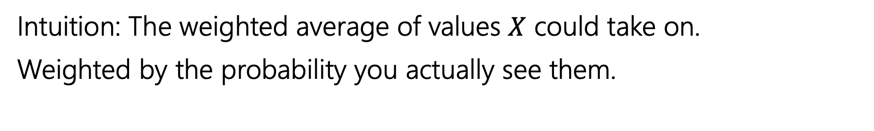

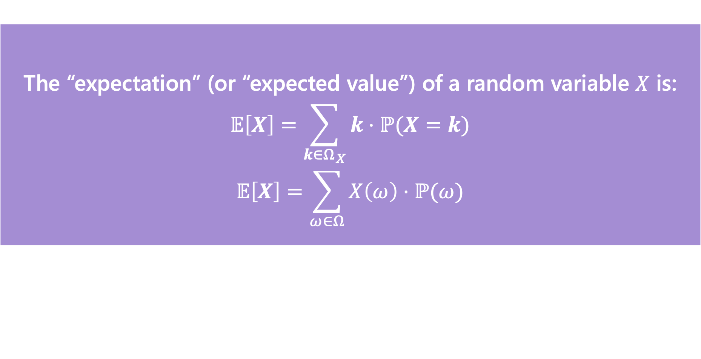
Expectation
The “expectation” (or “expected value”) of a random variable $X$ is:
$$𝔼\left[X\right]=\sum_{k∈Ω_{X}}{k⋅ℙ(X=k)}$$
$$𝔼\left[X\right]=\sum_{ω∈Ω}{X\left(ω\right)⋅ℙ(ω)}$$
Expectation
Intuition: The weighted average of values $X$ could take on.
Weighted by the probability you actually see them.

Slide 4

Linearity of Expectation
For any two random variables $X$ and $Y$:
$$𝔼\left[X+Y\right]=𝔼\left[X\right]+𝔼[Y]$$
Note: $X$ and $Y$ do not have to be independent
Linearity of Expectation

Slide 5
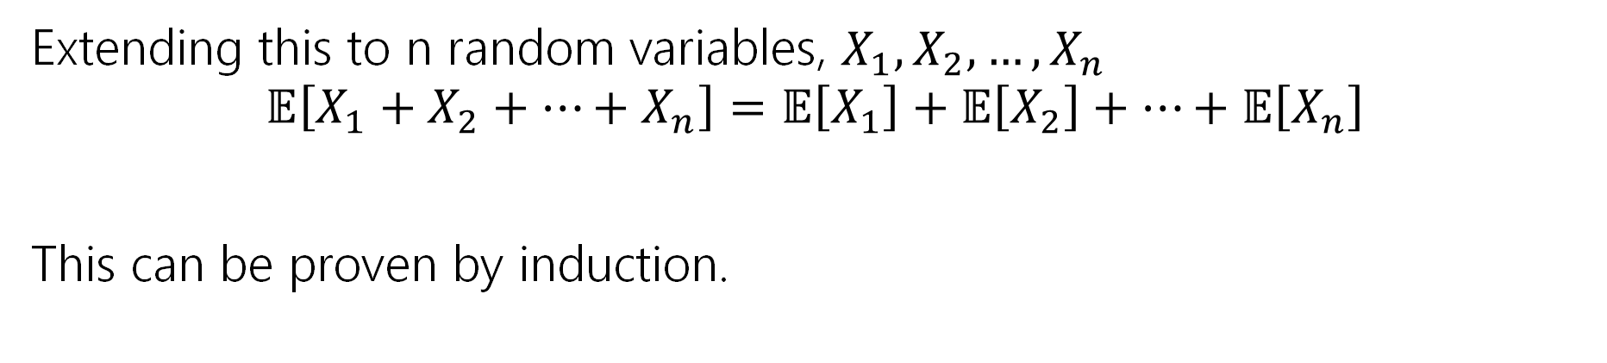
Linearity of Expectation
For any two random variables $X$ and $Y$:
$$𝔼\left[X+Y\right]=𝔼\left[X\right]+𝔼[Y]$$
Note: $X$ and $Y$ do not have to be independent
Linearity of Expectation
Extending this to n random variables, $X_{1},X_{2},…,X_{n}$
$$𝔼\left[X_{1}+X_{2}+…+X_{n}\right]=𝔼\left[X_{1}\right]+𝔼\left[X_{2}\right]+…+𝔼\left[X_{n}\right]$$
This can be proven by induction.

Slide 6
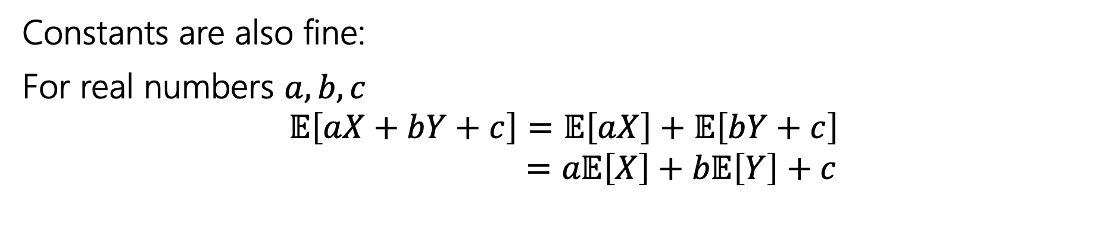


Linearity of Expectation
For any two random variables $X$ and $Y$:
$$𝔼\left[X+Y\right]=𝔼\left[X\right]+𝔼[Y]$$
Note: $X$ and $Y$ do not have to be independent
Linearity of Expectation
Constants are also fine:
For real numbers $a,b,c$
$$𝔼\left[aX+bY+c\right]=𝔼\left[aX\right]+𝔼\left[bY+c\right]$$
$$=a𝔼\left[X\right]+b𝔼\left[Y\right]+c$$

Slide 7
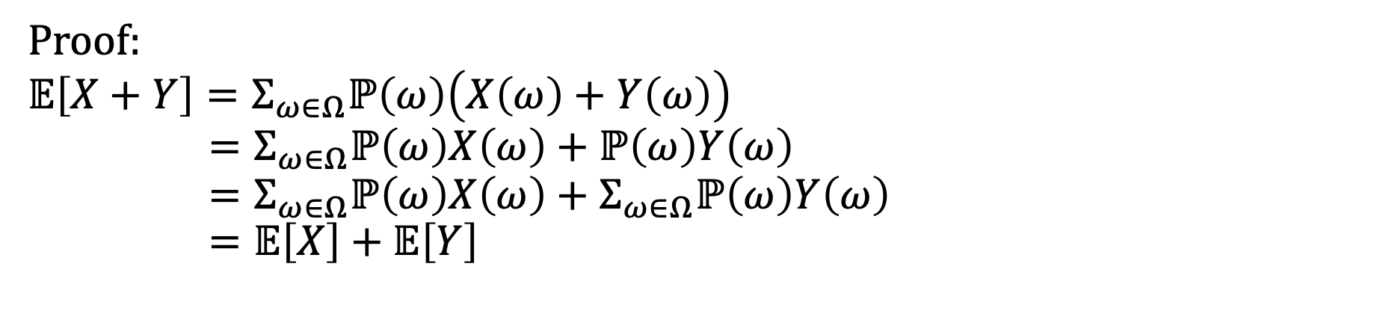
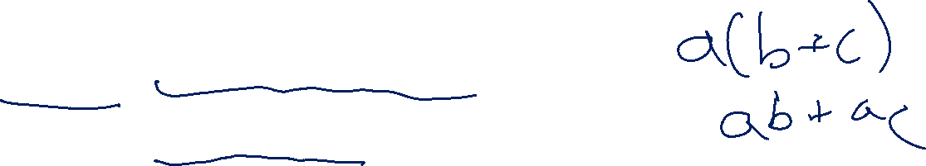
Linearity of Expectation - Proof
For any two random variables $X$ and $Y$:
$$𝔼\left[X+Y\right]=𝔼\left[X\right]+𝔼[Y]$$
Note: $X$ and $Y$ do not have to be independent
Linearity of Expectation
Proof:
$$𝔼\left[X+Y\right]=Σ_{ω∈Ω}ℙ\left(ω\right)\left(X\left(ω\right)+Y\left(ω\right)\right)$$
$$=Σ_{ω∈Ω}ℙ\left(ω\right)X\left(ω\right)+ℙ\left(ω\right)Y\left(ω\right) \\ =Σ_{ω∈Ω}ℙ\left(ω\right)X\left(ω\right)+Σ_{ω∈Ω}ℙ\left(ω\right)Y\left(ω\right)=𝔼\left[X\right]+𝔼\left[Y\right]$$

Slide 8
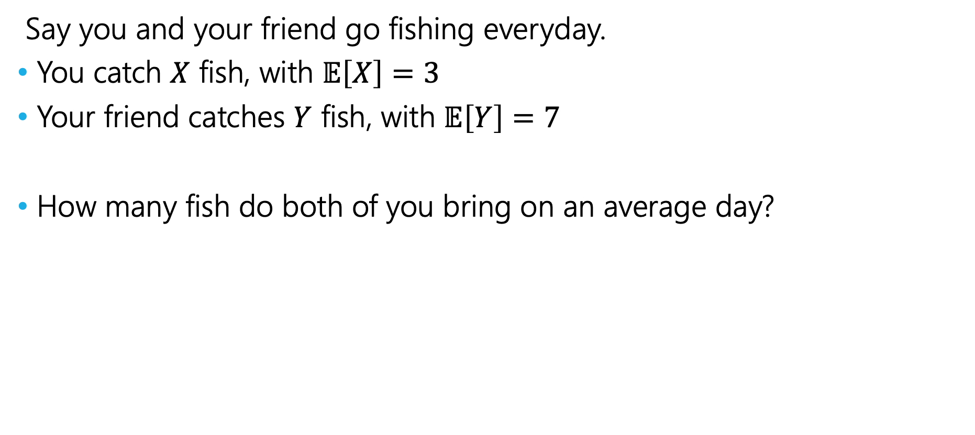

Fishy Business
Say you and your friend go fishing everyday.
You catch $X$ fish, with $𝔼\left[X\right]=3$
Your friend catches $Y$ fish, with $𝔼\left[Y\right]=7$
How many fish do both of you bring on an average day?

Slide 9
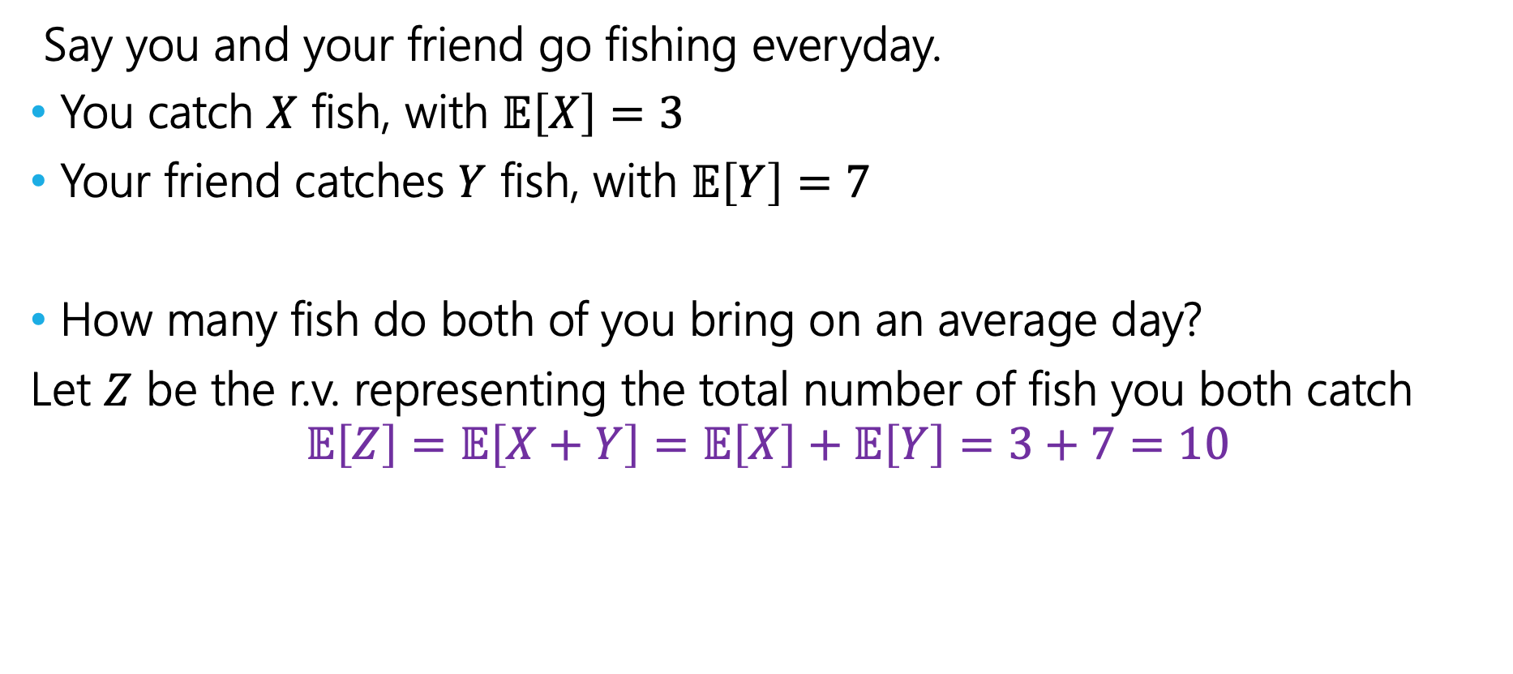

Fishy Business
Say you and your friend go fishing everyday.
You catch $X$ fish, with $𝔼\left[X\right]=3$
Your friend catches $Y$ fish, with $𝔼\left[Y\right]=7$
How many fish do both of you bring on an average day?
Let $Z$ be the r.v. representing the total number of fish you both catch
$$𝔼\left[Z\right]=𝔼\left[X+Y\right]=𝔼\left[X\right]+𝔼\left[Y\right]=3+7=10$$

Slide 10
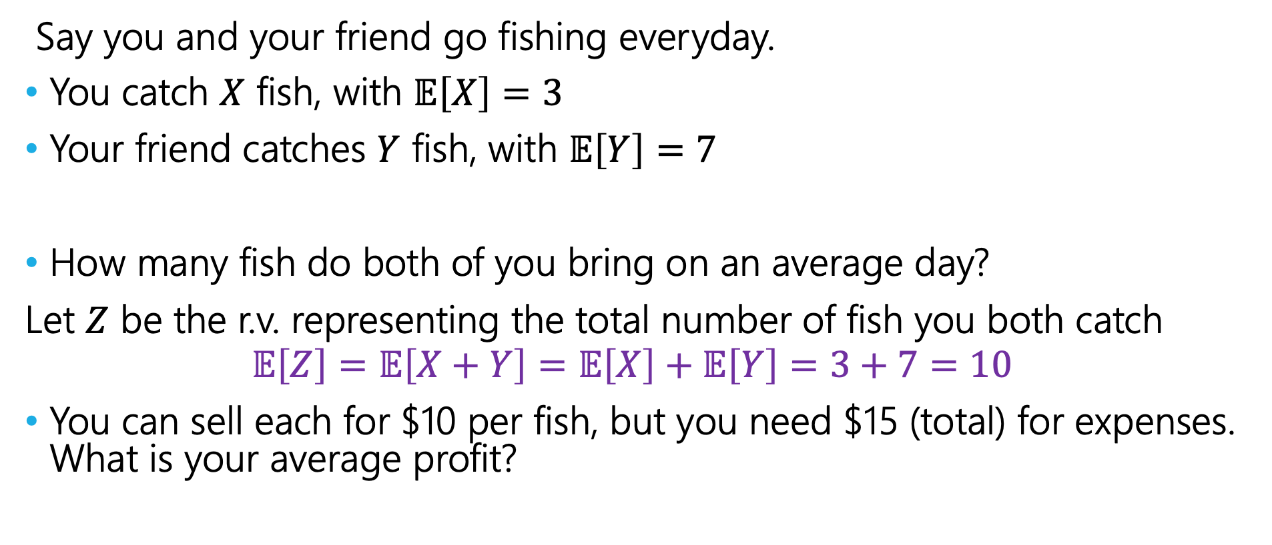
Fishy Business
Say you and your friend go fishing everyday.
You catch $X$ fish, with $𝔼\left[X\right]=3$
Your friend catches $Y$ fish, with $𝔼\left[Y\right]=7$
How many fish do both of you bring on an average day?
Let $Z$ be the r.v. representing the total number of fish you both catch
$$𝔼\left[Z\right]=𝔼\left[X+Y\right]=𝔼\left[X\right]+𝔼\left[Y\right]=3+7=10$$
You can sell each for $10 per fish, but you need $15 (total) for expenses. What is your average profit?

Slide 11
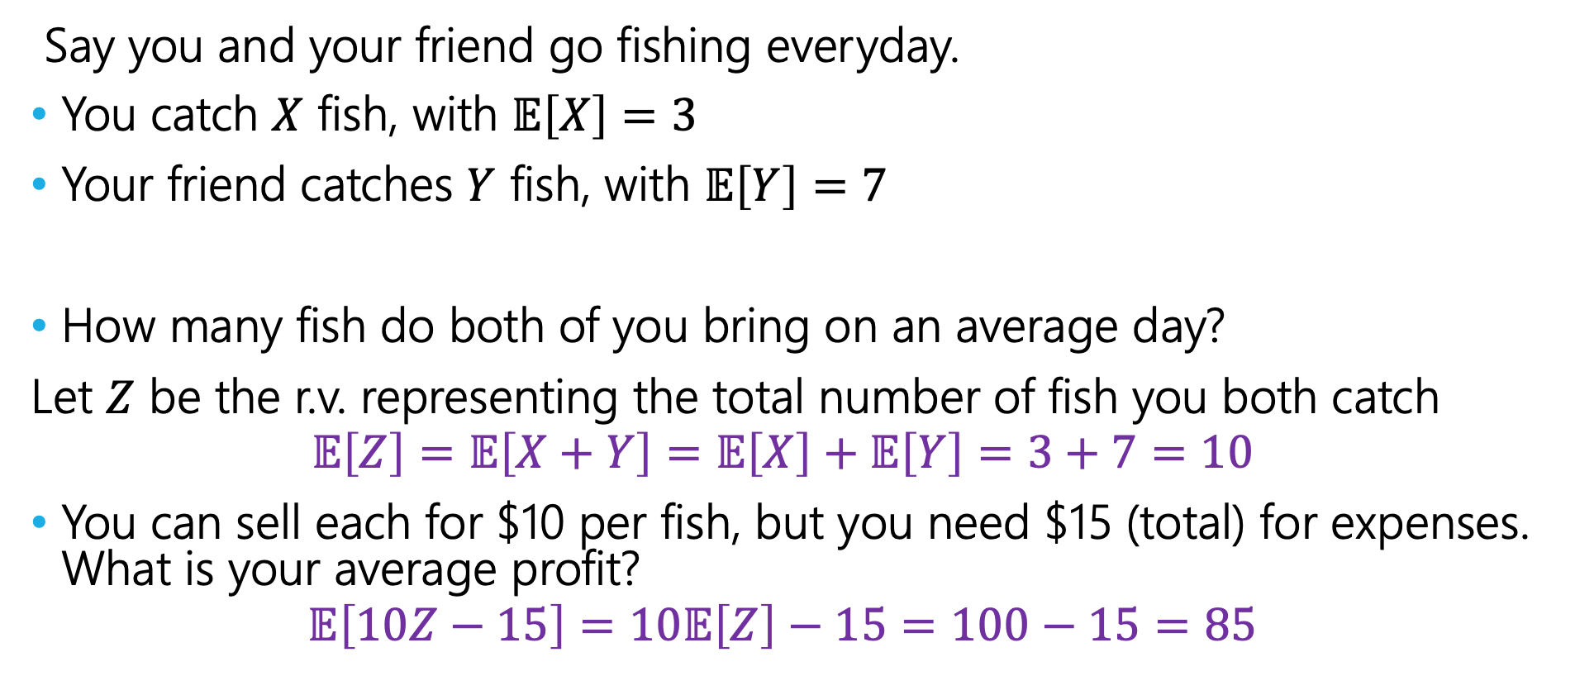

Fishy Business
Say you and your friend go fishing everyday.
You catch $X$ fish, with $𝔼\left[X\right]=3$
Your friend catches $Y$ fish, with $𝔼\left[Y\right]=7$
How many fish do both of you bring on an average day?
Let $Z$ be the r.v. representing the total number of fish you both catch
$$𝔼\left[Z\right]=𝔼\left[X+Y\right]=𝔼\left[X\right]+𝔼\left[Y\right]=3+7=10$$
You can sell each for $10 per fish, but you need $15 (total) for expenses. What is your average profit?
$$𝔼\left[10Z−15\right]=10𝔼\left[Z\right]−15=100−15=85$$

Slide 12
Coin Tosses
If we flip a coin twice, what is the expected number of heads that come up?

Slide 13
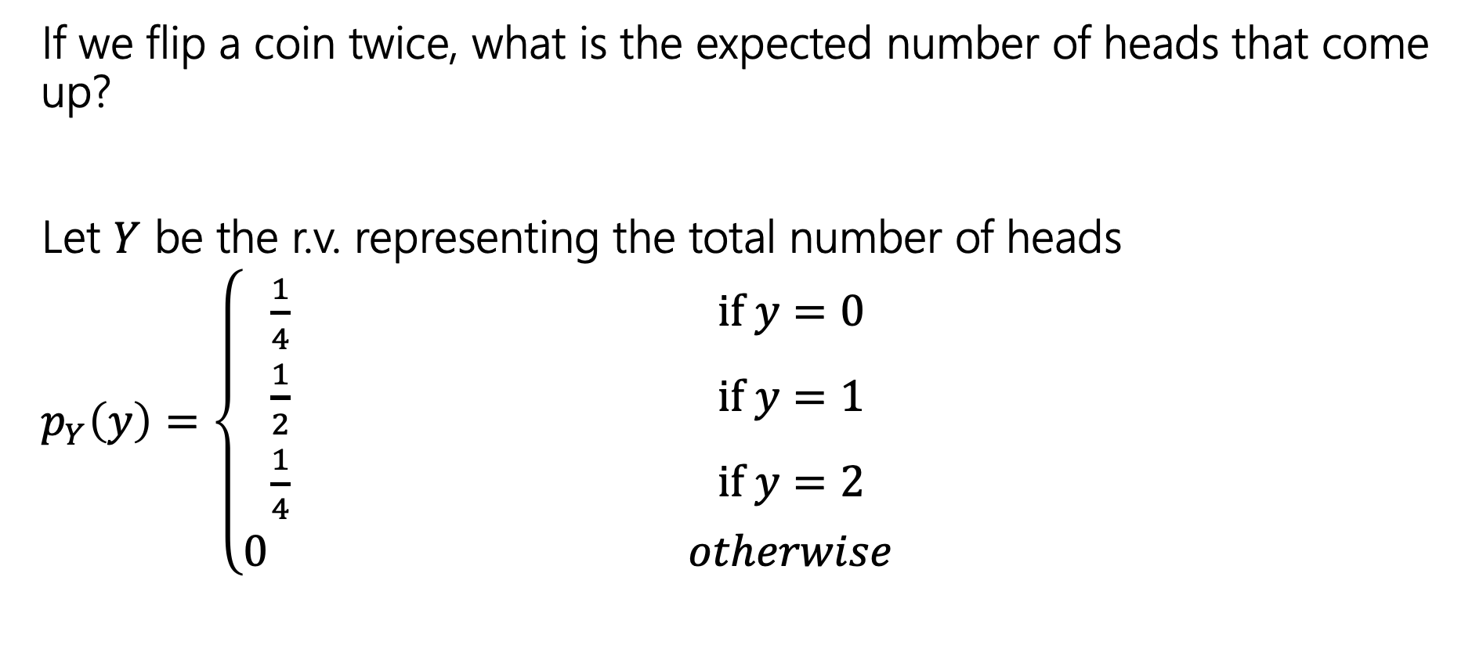
Coin Tosses
If we flip a coin twice, what is the expected number of heads that come up?
Let $Y$ be the r.v. representing the total number of heads
$p_{Y}\left(y\right)=\left\{\begin{aligned}\frac{1}{4} if y=0 \\ \frac{1}{2} if y=1 \\ \frac{1}{4} if y=2 \\ 0 otherwise\end{aligned}\right.$

Slide 14
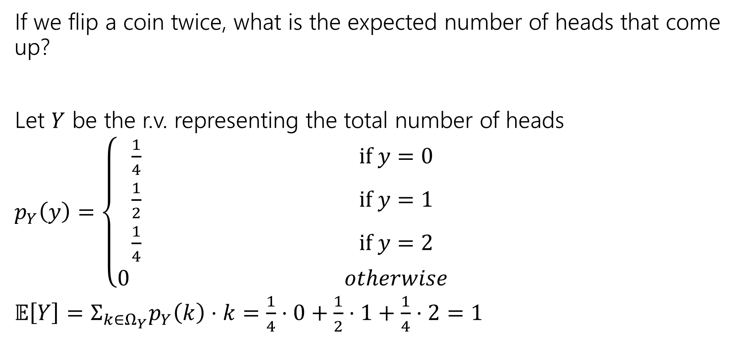
Coin Tosses
If we flip a coin twice, what is the expected number of heads that come up?
Let $Y$ be the r.v. representing the total number of heads
$p_{Y}\left(y\right)=\left\{\begin{aligned}\frac{1}{4} if y=0 \\ \frac{1}{2} if y=1 \\ \frac{1}{4} if y=2 \\ 0 otherwise\end{aligned}\right.$
$𝔼\left[Y\right]=Σ_{k∈Ω_{Y}}p_{Y}\left(k\right)⋅k=\frac{1}{4}⋅0+\frac{1}{2}⋅1+\frac{1}{4}⋅2=1$

Slide 15



Repeated Coin Tosses
Now what if the probability of flipping a head was $p$ and that we wanted to find the total number of heads flipped when we flip the coin $n$ times?
Let $X$ be the r.v. representing the total number of heads.
Make a prediction --- what should $𝔼[X]$ be?

Slide 16
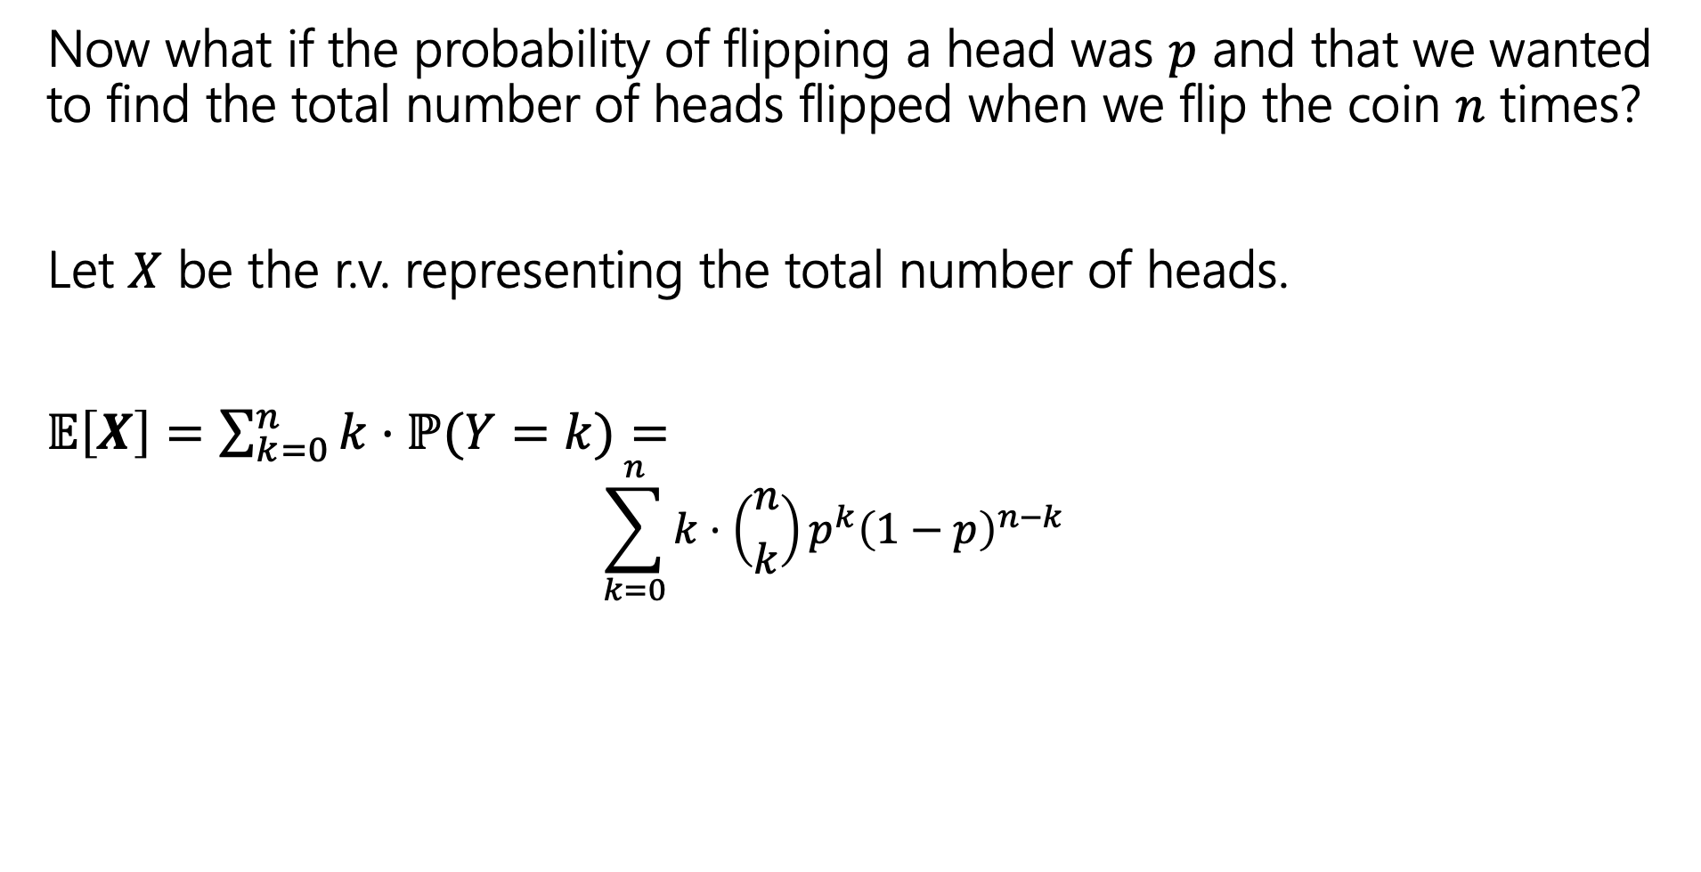
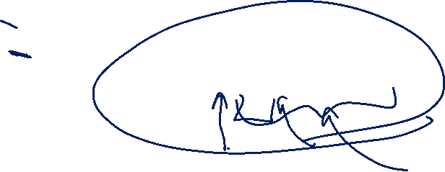
Repeated Coin Tosses
Now what if the probability of flipping a head was $p$ and that we wanted to find the total number of heads flipped when we flip the coin $n$ times?
Let $X$ be the r.v. representing the total number of heads.
$𝔼\left[X\right]=\sum_{k=0}^{n}{k⋅ℙ(Y=k)}=$
  $$\sum_{k=0}^{n}{k⋅\left({n \atop k}\right)p^{k}{\left(1−p\right)}^{n−k}}$$
Ok, but what actually is it?
I don’t have intuition for this formula.

Slide 17
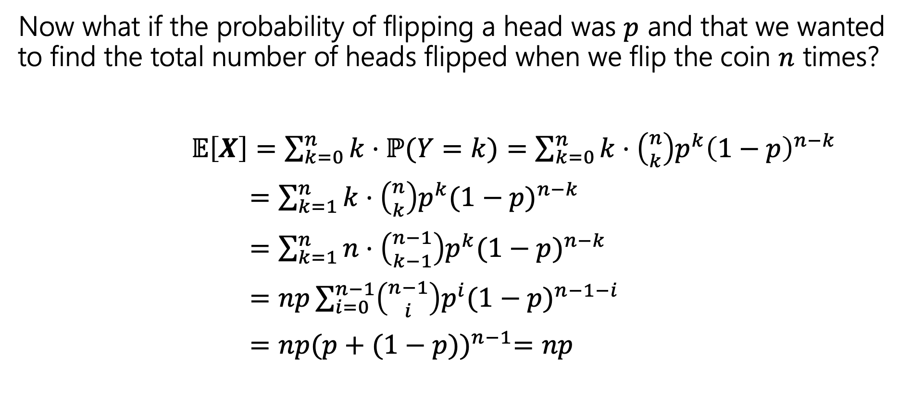
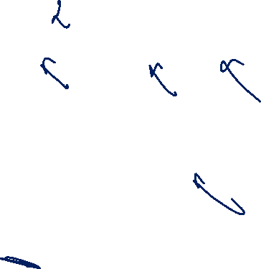
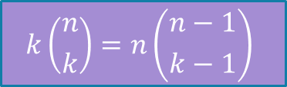
Repeated Coin Tosses
Now what if the probability of flipping a head was $p$ and that we wanted to find the total number of heads flipped when we flip the coin $n$ times?
$𝔼\left[X\right]=\sum_{k=0}^{n}{k⋅ℙ(Y=k)}=\sum_{k=0}^{n}{k⋅\left({n \atop k}\right)p^{k}{\left(1−p\right)}^{n−k}}$
$=\sum_{k=1}^{n}{k⋅\left({n \atop k}\right)p^{k}{(1−p)}^{n−k}}$
$=\sum_{k=1}^{n}{n⋅\left({n−1 \atop k−1}\right)p^{k}{(1−p)}^{n−k}}$
$=np\sum_{i=0}^{n−1}{\left({n−1 \atop i}\right)p^{i}{(1−p)}^{n−1−i}}$
$=np{(p+(1−p))}^{n−1}=np$
$$k\left({n \atop k}\right)=n\left({n−1 \atop k−1}\right)$$
Binomial Theorem!
We did it! And all it took was a clever application of the binomial theorem,
setup by a very non-obvious application of an obscure combinatorial identity. Ezpz.

Slide 18
Repeated Coin Tosses
Now what if the probability of flipping a head was $p$ and that we wanted to find the total number of heads flipped when we flip the coin $n$ times?
$𝔼\left[X\right]=\sum_{k=0}^{n}{k⋅ℙ(Y=k)}=\sum_{k=0}^{n}{k⋅\left({n \atop k}\right)p^{k}{\left(1−p\right)}^{n−k}}$
$=\sum_{k=1}^{n}{k⋅\left({n \atop k}\right)p^{k}{(1−p)}^{n−k}}$
$=\sum_{k=1}^{n}{n⋅\left({n−1 \atop k−1}\right)p^{k}{(1−p)}^{n−k}}$
$=np\sum_{i=0}^{n−1}{\left({n−1 \atop i}\right)p^{i}{(1−p)}^{n−1−i}}$
$=np{(p+(1−p))}^{n−1}=np$
No one wants to do proofs like this every time!
$$k\left({n \atop k}\right)=n\left({n−1 \atop k−1}\right)$$
Binomial Theorem!
We did it! And all it took was a clever application of the binomial theorem,
setup by a very non-obvious application of an obscure combinatorial identity. Ezpz.

Slide 19
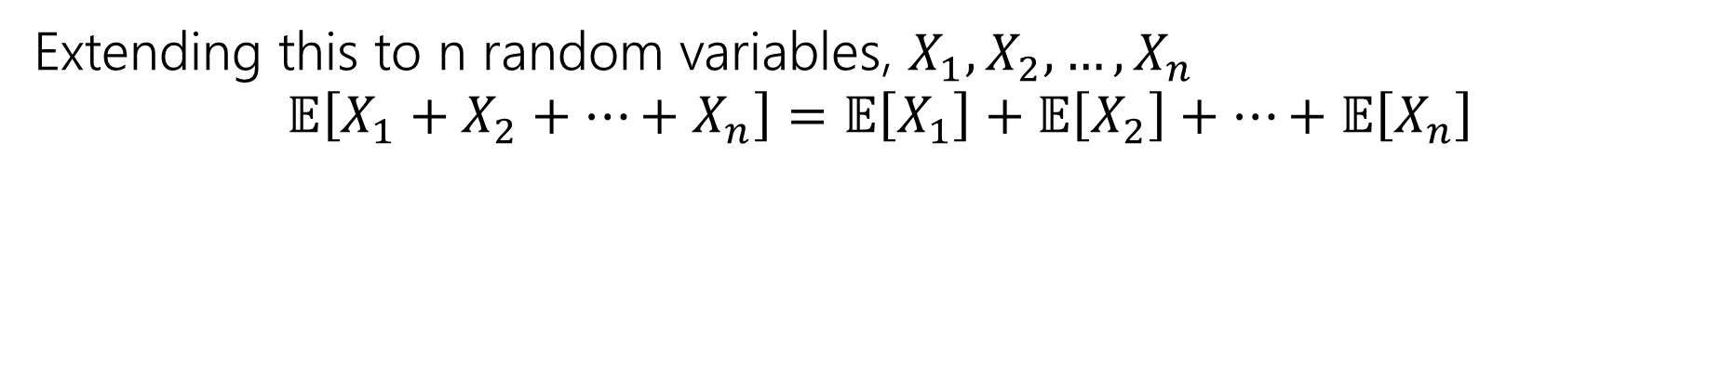
Linearity of Expectation
For any two random variables $X$ and $Y$:
$$𝔼\left[X+Y\right]=𝔼\left[X\right]+𝔼[Y]$$
Note: $X$ and $Y$ do not have to be independent
Linearity of Expectation
Extending this to n random variables, $X_{1},X_{2},…,X_{n}$
$$𝔼\left[X_{1}+X_{2}+…+X_{n}\right]=𝔼\left[X_{1}\right]+𝔼\left[X_{2}\right]+…+𝔼\left[X_{n}\right]$$

Slide 20









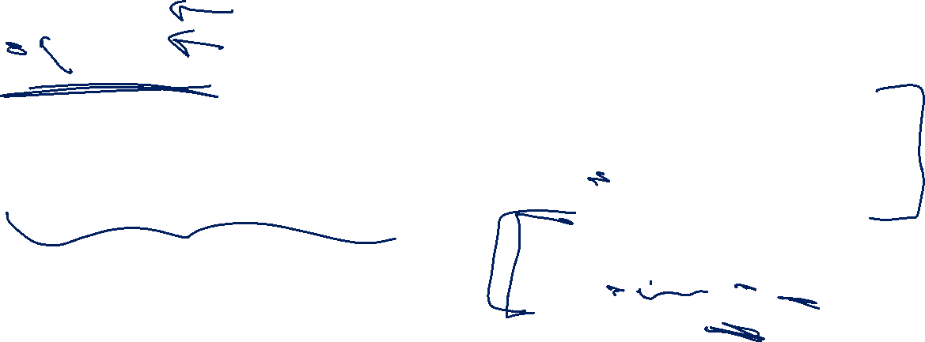
Indicator Random Variables
For any event $A$, we can define the indicator random variable $1[A]$ for $A$
$1[A]=\left\{\begin{aligned} 1 if event A occurs \\ 0 otherwise\end{aligned}\right.$
You’ll also see notation like:
$$ℙ\left(X=1\right)=ℙ\left(A\right)$$
$$ℙ\left(X=0\right)=1−ℙ(A)$$
$$p_{X}\left(x\right)=\left\{\begin{aligned}ℙ\left(A\right) if x=1 \\ 1−ℙ\left(A\right) if x=0 \\ 0 otherwise\end{aligned}\right.$$
$$𝔼 \left[X\right]=1⋅p_{X}\left(1\right)+0⋅p_{X}(0)=p_{X}\left(1\right)=ℙ(A)$$
Notes:
Intuition: cast Boolean to an int

Slide 21

Repeated Coin Tosses (Again)
The probability of flipping a head is $p$ and we want to find the total number of heads flipped when we flip the coin $n$ times?
Let $X$ be the total number of heads
What indicators can we define? What ‘Booleans’ have enough information to combine (add) and solve the problem?

Slide 22
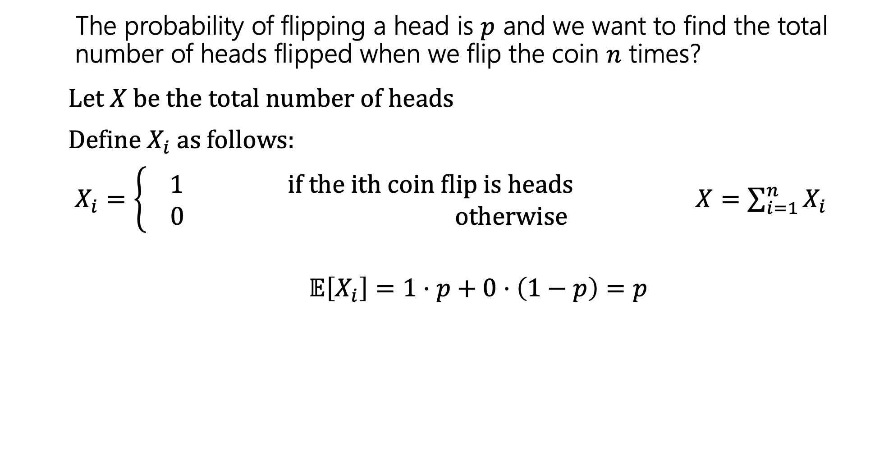

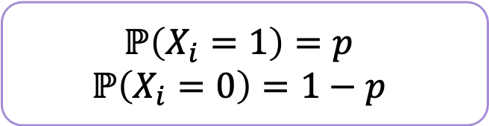
Repeated Coin Tosses (Again)
The probability of flipping a head is $p$ and we want to find the total number of heads flipped when we flip the coin $n$ times?
Let $X$ be the total number of heads
Define $X_{i}$as follows:
$X_{i}=\left\{\begin{aligned} 1 if the ith coin flip is heads \\ 0 otherwise\end{aligned}\right.$ $X=\sum_{i=1}^{n}{X_{i}}$
$$𝔼\left[X_{i}\right]=1⋅p+0⋅\left(1−p\right)=p$$
$$ℙ\left(X_{i}=1\right)=p$$
$$ℙ\left(X_{i}=0\right)=1−p$$

Slide 23
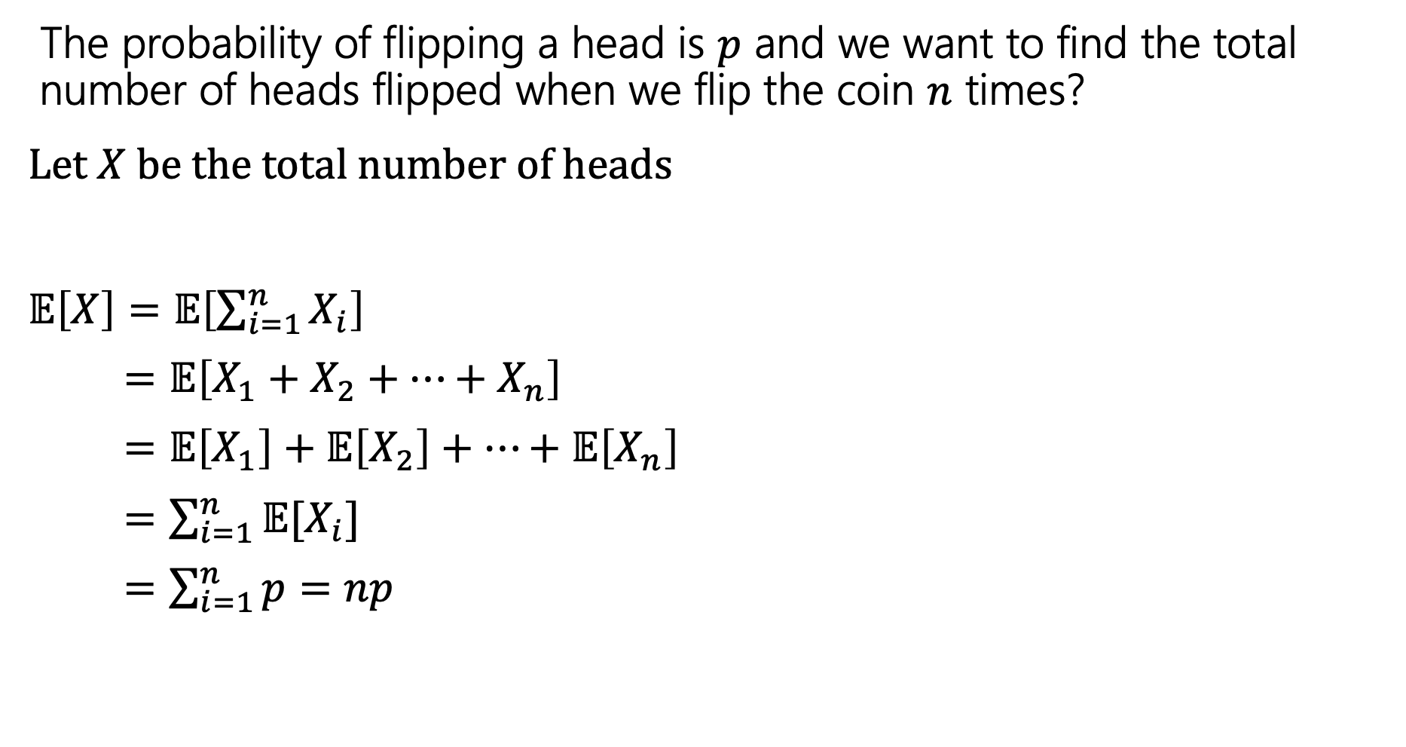
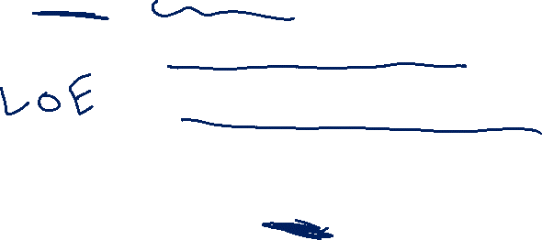
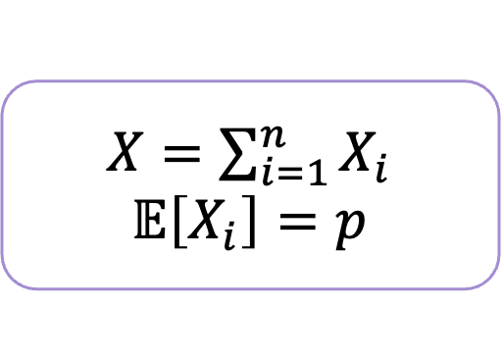
Repeated Coin Tosses (Again)
The probability of flipping a head is $p$ and we want to find the total number of heads flipped when we flip the coin $n$ times?
Let $X$ be the total number of heads
$𝔼\left[X\right]=𝔼\left[\sum_{i=1}^{n}{X_{i}}\right]$
$=𝔼\left[X_{1}+X_{2}+…+X_{n}\right]$
= $𝔼\left[X_{1}\right]+𝔼\left[X_{2}\right]+…+𝔼\left[X_{n}\right]$
$=\sum_{i=1}^{n}{𝔼[X_{i}]}$
$=\sum_{i=1}^{n}{p}=np$
$X=\sum_{i=1}^{n}{X_{i}}$
$$𝔼\left[X_{i}\right]=p$$

Slide 24
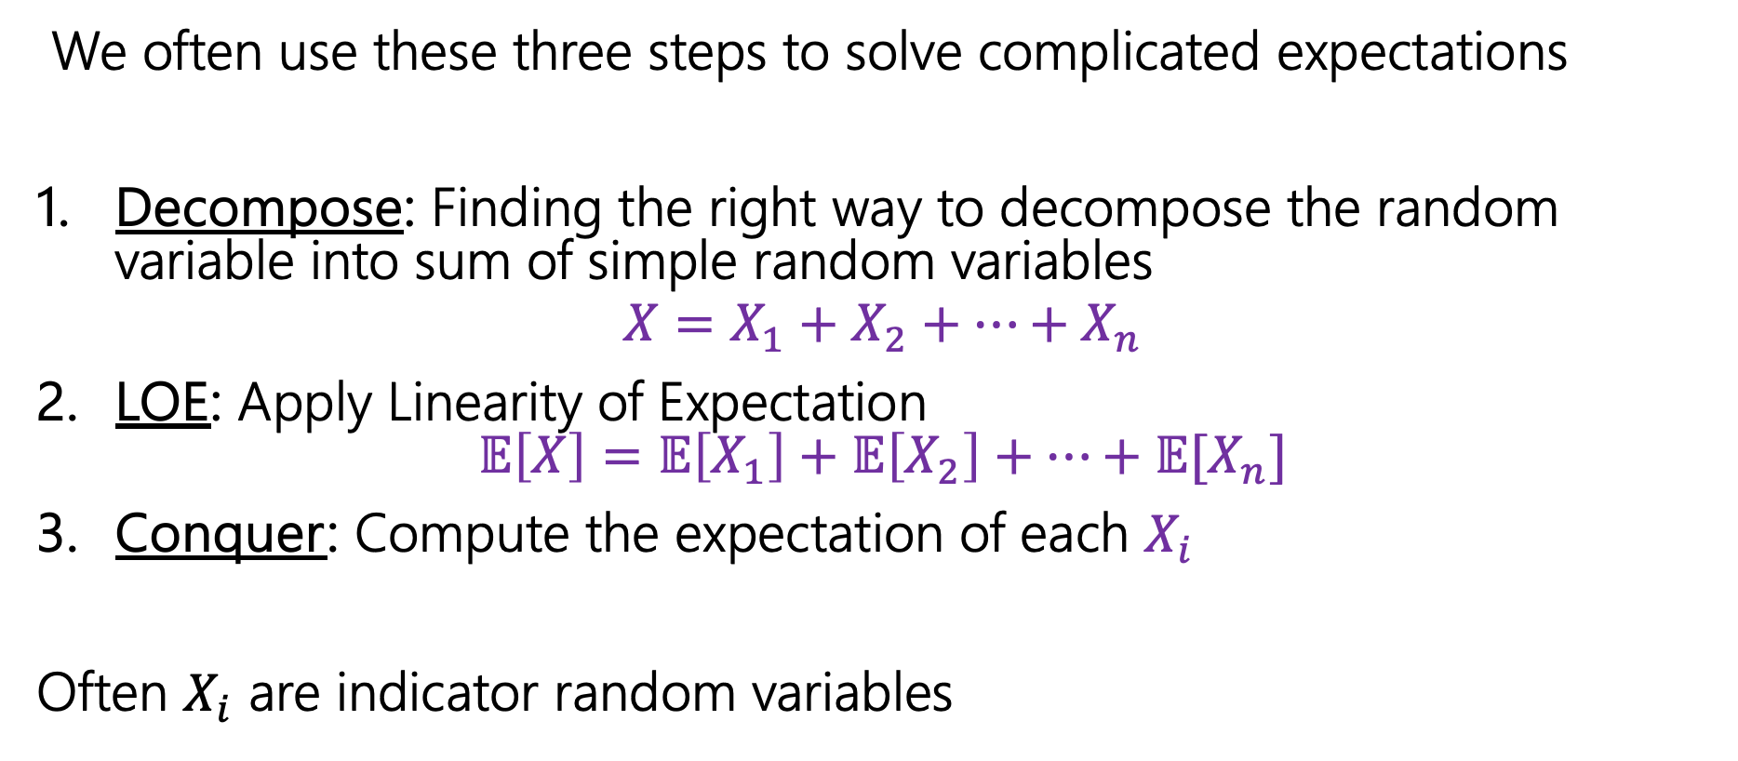

Computing complicated expectations
We often use these three steps to solve complicated expectations
Decompose: Finding the right way to decompose the random variable into sum of simple random variables
$$X=X_{1}+X_{2}+…+X_{n}$$
LOE: Apply Linearity of Expectation
$𝔼\left[X\right]=𝔼\left[X_{1}\right]+𝔼\left[X_{2}\right]+…+𝔼[X_{n}]$
Conquer: Compute the expectation of each $X_{i}$
Often $X_{i}$ are indicator random variables

Slide 25

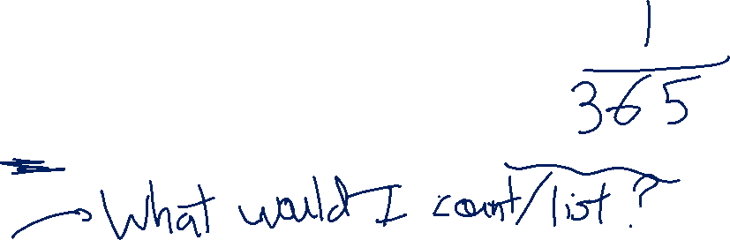
Pairs with the same birthday
In a class of $m$ students, on average how many pairs of people have the same birthday?
Decompose:
LOE:
Conquer:

Slide 26
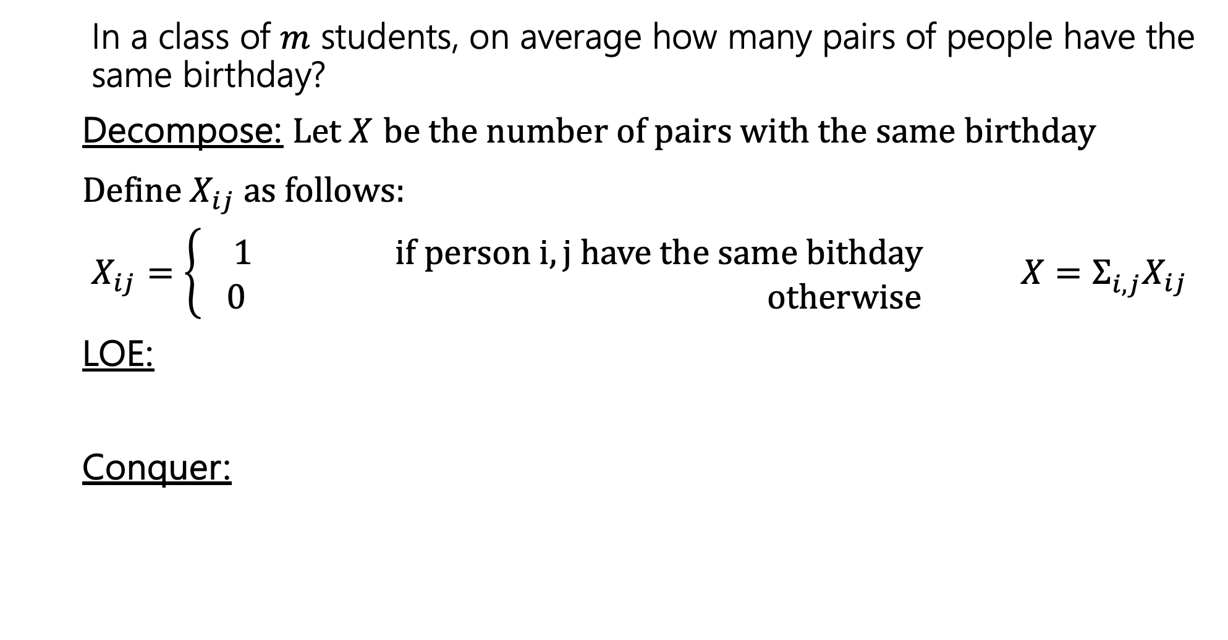

Pairs with the same birthday
In a class of $m$ students, on average how many pairs of people have the same birthday?
Decompose: Let $X$ be the number of pairs with the same birthday
Define $X_{ij}$as follows:
$X_{ij}=\left\{\begin{aligned} 1 if person i,j have the same bithday \\ 0 otherwise\end{aligned}\right.$ ${X=Σ_{i,j}^{}X}_{ij}$
LOE:
Conquer:

Slide 27
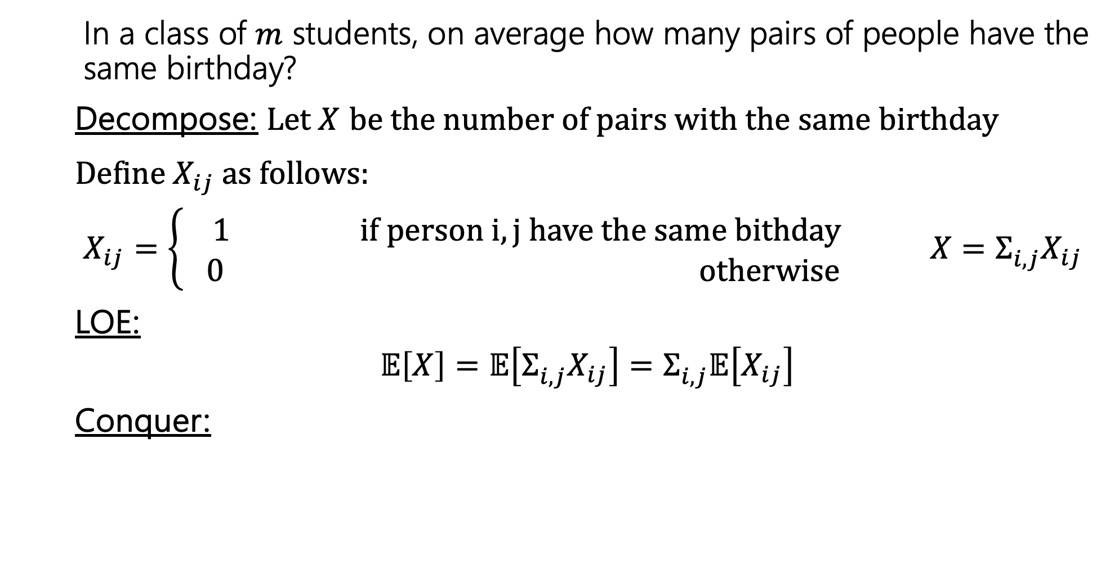
Pairs with the same birthday
In a class of $m$ students, on average how many pairs of people have the same birthday?
Decompose: Let $X$ be the number of pairs with the same birthday
Define $X_{ij}$as follows:
$X_{ij}=\left\{\begin{aligned} 1 if person i,j have the same bithday \\ 0 otherwise\end{aligned}\right.$ ${X=Σ_{i,j}^{}X}_{ij}$
LOE:
$$𝔼\left[X\right]=𝔼\left[Σ_{i,j}^{}X_{ij}\right]=Σ_{i,j}^{}𝔼\left[X_{ij}\right]$$
Conquer:

Slide 28
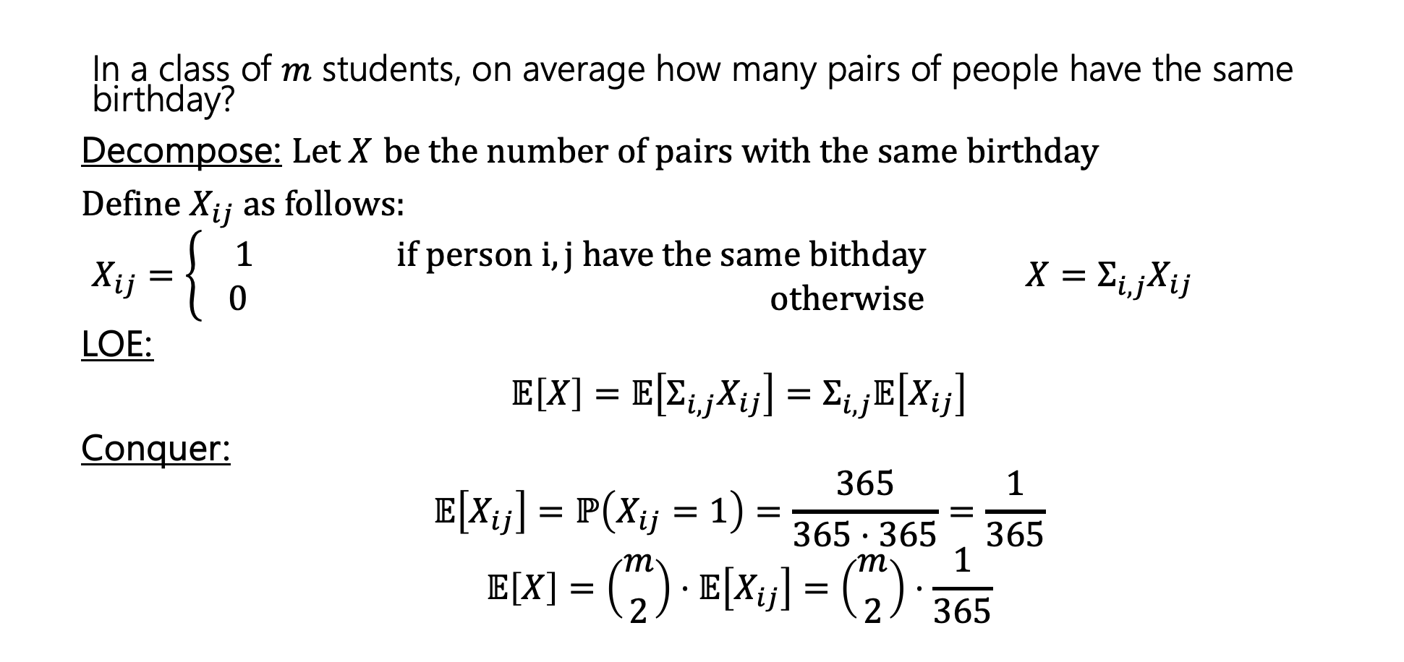

Pairs with the same birthday
In a class of $m$ students, on average how many pairs of people have the same birthday?
Decompose: Let $X$ be the number of pairs with the same birthday
Define $X_{ij}$as follows:
$X_{ij}=\left\{\begin{aligned} 1 if person i,j have the same bithday \\ 0 otherwise\end{aligned}\right.$ ${X=Σ_{i,j}^{}X}_{ij}$
LOE:
$$𝔼\left[X\right]=𝔼\left[Σ_{i,j}^{}X_{ij}\right]=Σ_{i,j}^{}𝔼\left[X_{ij}\right]$$
Conquer:
$$𝔼\left[X_{ij}\right]=ℙ\left(X_{ij}=1\right)=\frac{365}{365⋅365}=\frac{1}{365}$$
$$𝔼\left[X\right]=\left({m \atop 2}\right)⋅𝔼\left[X_{ij}\right]=\left({m \atop 2}\right)⋅\frac{1}{365}$$

Slide 29
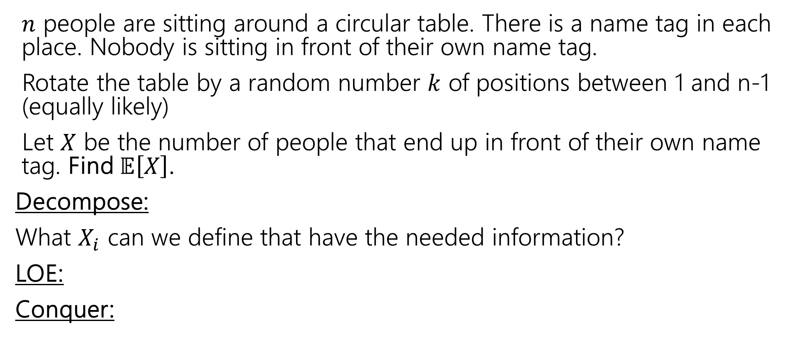
Rotating the table
$n$ people are sitting around a circular table. There is a name tag in each place. Nobody is sitting in front of their own name tag.
Rotate the table by a random number $k$ of positions between 1 and n-1 (equally likely)
Let $X$ be the number of people that end up in front of their own name tag. Find $𝔼\left[X\right]$.
Decompose:
What $X_{i}$ can we define that have the needed information?
LOE:
Conquer:

Slide 30

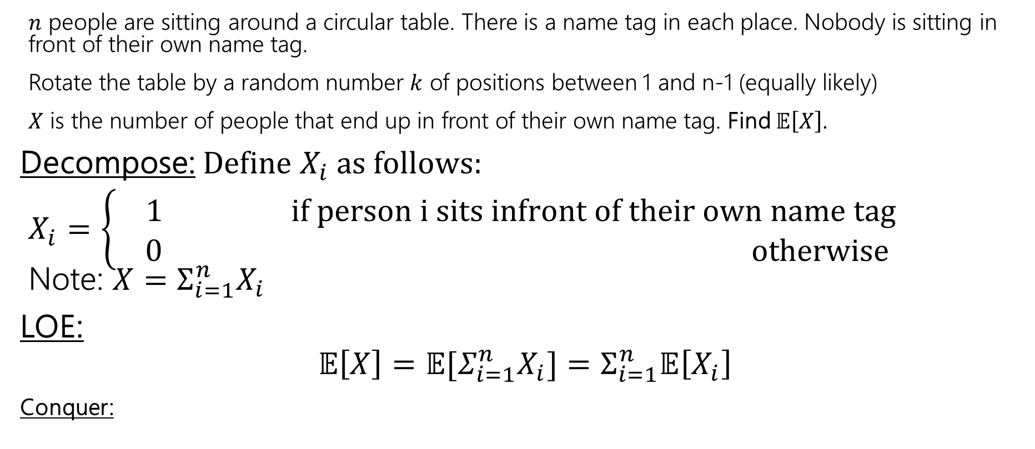
Rotating the table
$n$ people are sitting around a circular table. There is a name tag in each place. Nobody is sitting in front of their own name tag.
Rotate the table by a random number $k$ of positions between 1 and n-1 (equally likely)
$X$ is the number of people that end up in front of their own name tag. Find $𝔼\left[X\right]$.
Decompose: Define $X_{i}$as follows:
$X_{i}=\left\{\begin{aligned} 1 if person i sits infront of their own name tag \\ 0 otherwise\end{aligned}\right.$ Note: ${X=Σ_{i=1}^{n}X}_{i}$
LOE:
$$𝔼\left[X\right]=𝔼[Σ_{i=1}^{n}X_{i}]=Σ_{i=1}^{n}𝔼\left[X_{i}\right]$$
Conquer:
These $X_{i}$ are not independent!
That’s ok!!

Slide 31
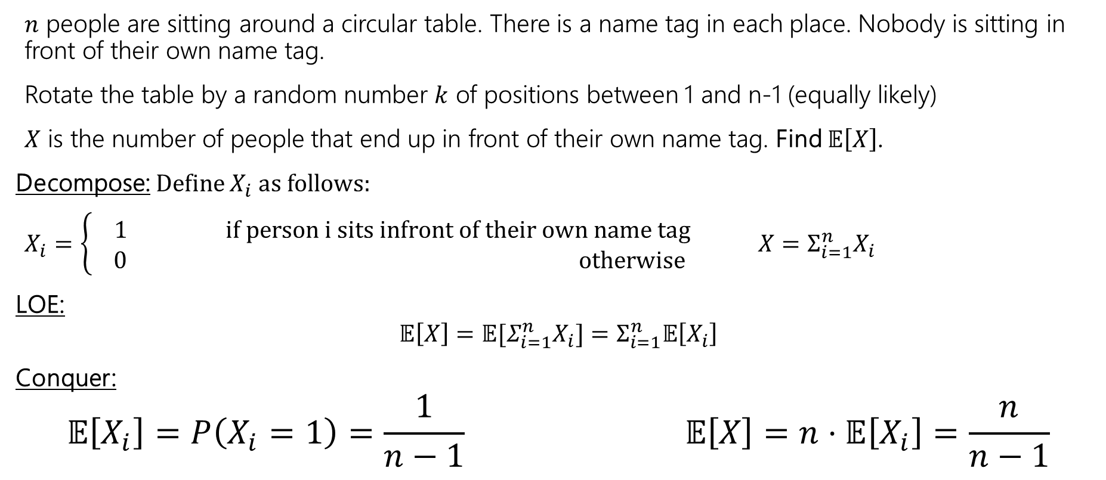
Rotating the table
$n$ people are sitting around a circular table. There is a name tag in each place. Nobody is sitting in front of their own name tag.
Rotate the table by a random number $k$ of positions between 1 and n-1 (equally likely)
$X$ is the number of people that end up in front of their own name tag. Find $𝔼\left[X\right]$.
Decompose: Define $X_{i}$as follows:
$X_{i}=\left\{\begin{aligned} 1 if person i sits infront of their own name tag \\ 0 otherwise\end{aligned}\right.$ ${X=Σ_{i=1}^{n}X}_{i}$
LOE:
$$𝔼\left[X\right]=𝔼[Σ_{i=1}^{n}X_{i}]=Σ_{i=1}^{n}𝔼\left[X_{i}\right]$$
Conquer:
$$𝔼\left[X_{i}\right]=P\left(X_{i}=1\right)=\frac{1}{n−1} 𝔼\left[X\right]=n⋅𝔼\left[X_{i}\right]=\frac{n}{n−1}$$

Slide 32
Extra Practice

Slide 33


Frogger
A frog starts on a 1-dimensional number line at 0.
Each second, independently, the frog takes a unit step right with probability $p_{1}$, to the left with probability $p_{2}$, and doesn't move with probability $p_{3}$, where ${p_{1}+p}_{2}+p_{3}=1$.
After 2 seconds, let $X$ be the location of the frog. Find $𝔼\left[X\right]$.

Slide 34
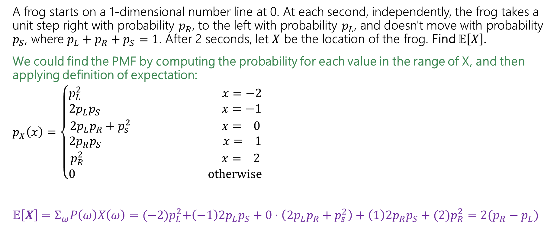
Frogger – Brute Force
A frog starts on a 1-dimensional number line at 0. At each second, independently, the frog takes a unit step right with probability $p_{R}$, to the left with probability $p_{L}$, and doesn't move with probability $p_{S}$, where ${p_{L}+p}_{R}+p_{S}=1$. After 2 seconds, let $X$ be the location of the frog. Find $𝔼\left[X\right]$.
We could find the PMF by computing the probability for each value in the range of X, and then applying definition of expectation:
$p_{X}\left(x\right)=\left\{\begin{aligned}p_{L}^{2} x=−2 \\ {2p}_{L}p_{S} x=−1 \\ {2p}_{L}p_{R}+p_{s}^{2} x= 0 \\ {2p}_{R}p_{S} x= 1 \\ p_{R}^{2} x= 2 \\ 0 otherwise\end{aligned}\right.$
$𝔼\left[X\right]=Σ_{ω}P\left(ω\right)X\left(ω\right)={(−2)p}_{L}^{2}+\left(−1\right){2p}_{L}p_{S}+0⋅\left({2p}_{L}p_{R}+p_{s}^{2}\right)+\left(1\right){2p}_{R}p_{S}+(2)p_{R}^{2}=2(p_{R}−p_{L})$
We think about the outcomes that correspond to each value of X and compute the probability of that. For example, X=0 happens when the frog is at the same position after 2 sec – this means it either moved left and then right, or right and then left, or did not move both seconds.

Slide 35
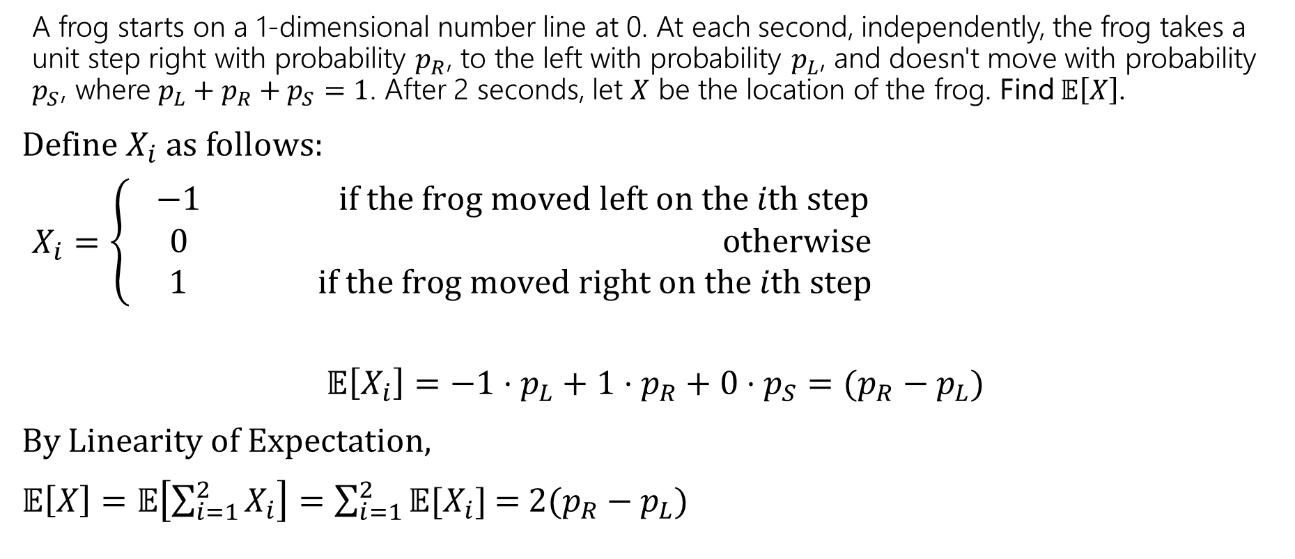
Frogger – LOE
Or we can apply LoE!
A frog starts on a 1-dimensional number line at 0. At each second, independently, the frog takes a unit step right with probability $p_{R}$, to the left with probability $p_{L}$, and doesn't move with probability $p_{S}$, where ${p_{L}+p}_{R}+p_{S}=1$. After 2 seconds, let $X$ be the location of the frog. Find $𝔼\left[X\right]$.
Define $X_{i}$as follows:
$X_{i}=\left\{\begin{aligned} −1 if the frog moved left on the ith step \\ 0 otherwise \\ 1 if the frog moved right on the ith step\end{aligned}\right.$
$$𝔼\left[X_{i}\right]={−1⋅p_{L}+1⋅p}_{R}+0⋅p_{S}=(p_{R}−p_{L})$$
By Linearity of Expectation,
$𝔼\left[X\right]=𝔼\left[\sum_{i=1}^{2}{X_{i}}\right]=\sum_{i=1}^{2}{𝔼[X_{i}]}$ =$2(p_{R}−p_{L})$

Slide 36
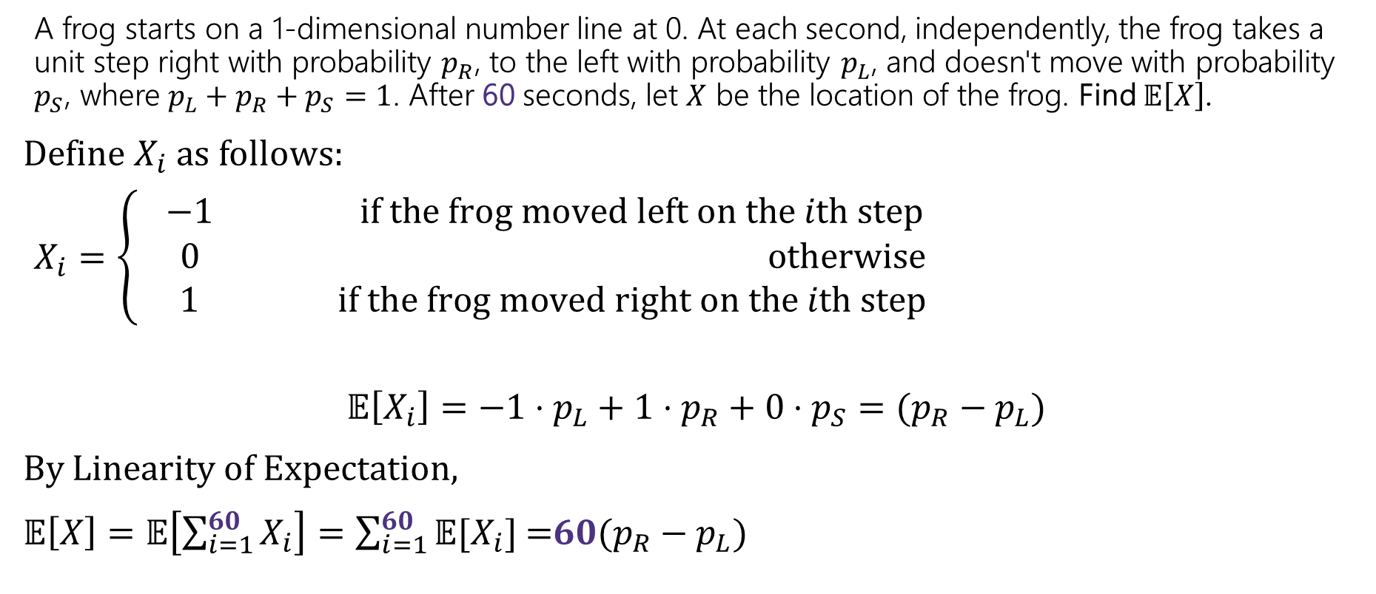
Frogger – LOE
If we interested in a whole minute (60 sec), the first approach would be awful because we would need to compute many probabilities or deal with a gnarly summation! Instead, we can use LoE!
A frog starts on a 1-dimensional number line at 0. At each second, independently, the frog takes a unit step right with probability $p_{R}$, to the left with probability $p_{L}$, and doesn't move with probability $p_{S}$, where ${p_{L}+p}_{R}+p_{S}=1$. After 60 seconds, let $X$ be the location of the frog. Find $𝔼\left[X\right]$.
Define $X_{i}$as follows:
$X_{i}=\left\{\begin{aligned} −1 if the frog moved left on the ith step \\ 0 otherwise \\ 1 if the frog moved right on the ith step\end{aligned}\right.$
$$𝔼\left[X_{i}\right]={−1⋅p_{L}+1⋅p}_{R}+0⋅p_{S}=(p_{R}−p_{L})$$
By Linearity of Expectation,
$𝔼\left[X\right]=𝔼\left[\sum_{i=1}^{60}{X_{i}}\right]=\sum_{i=1}^{60}{𝔼[X_{i}]}$ =$60(p_{R}−p_{L})$

Slide 37
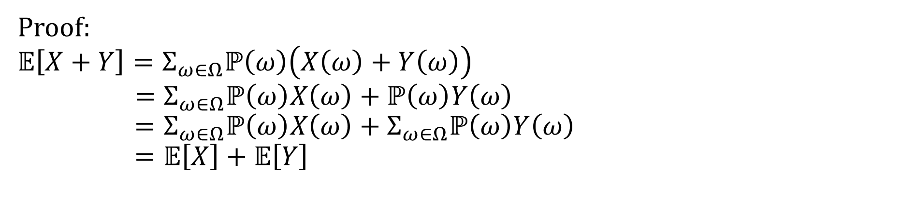

Linearity of Expectation - Proof
For any two random variables $X$ and $Y$:
$$𝔼\left[X+Y\right]=𝔼\left[X\right]+𝔼[Y]$$
Note: $X$ and $Y$ do not have to be independent
Linearity of Expectation
Proof:
$$𝔼\left[X+Y\right]=Σ_{ω∈Ω}ℙ\left(ω\right)\left(X\left(ω\right)+Y\left(ω\right)\right)$$
$$=Σ_{ω∈Ω}ℙ\left(ω\right)X\left(ω\right)+ℙ\left(ω\right)Y\left(ω\right) \\ =Σ_{ω∈Ω}ℙ\left(ω\right)X\left(ω\right)+Σ_{ω∈Ω}ℙ\left(ω\right)Y\left(ω\right)=𝔼\left[X\right]+𝔼\left[Y\right]$$

