Slide 1
More Random Variables
Expectation, Independence
CSE 312 Winter 26
Lecture 10

Slide 2
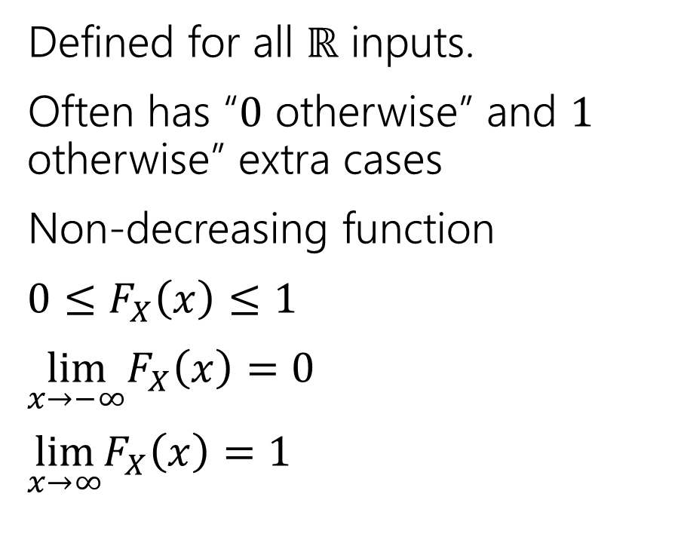
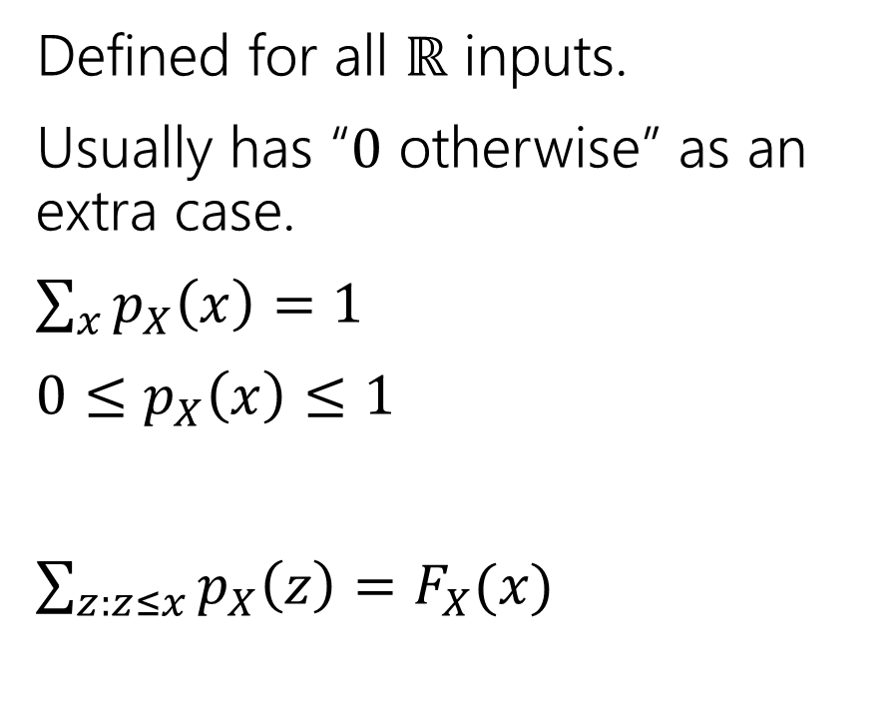
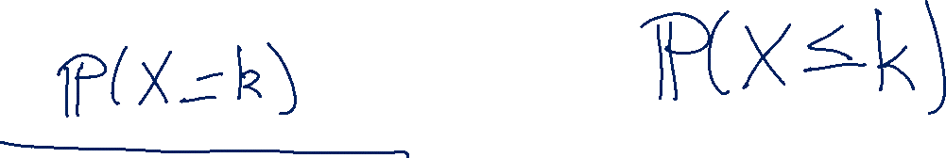
Two descriptions
Probability mass function
Cumulative Distribution function
Defined for all $ℝ$ inputs.
Usually has “$0$ otherwise” as an extra case.
$\sum_{x}{p_{X}\left(x\right)=1}$
$0≤p_{X}\left(x\right)≤1$
$\sum_{z:z≤x}{p_{X}\left(z\right)=F_{X}(x)}$
Defined for all $ℝ$ inputs.
Often has “$0$ otherwise” and $1$ otherwise” extra cases
Non-decreasing function
$0≤F_{X}\left(x\right)≤1$
$\lim_{x→−∞}F_{X}\left(x\right)=0$
$\lim_{x→∞}F_{X}\left(x\right)=1⁡$

Slide 3


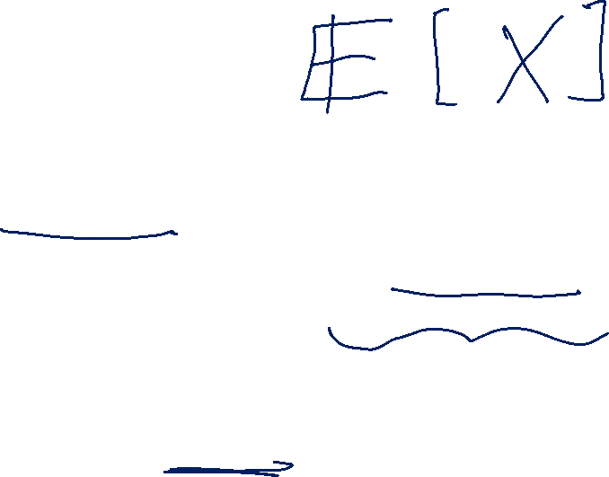
Expectation
The “expectation” (or “expected value”) of a random variable $X$ is:
$$𝔼\left[X\right]=\sum_{k}{k⋅ℙ(X=k)}$$
Expectation
Intuition: The weighted average of values $X$ could take on.
Weighted by the probability you actually see them.

Slide 4


Example 1
Flip a fair coin twice (independently)
Let $X$be the number of heads.
$Ω=\{TT,TH,HT,HH\}$, $ℙ()$ is uniform measure.
$𝔼\left[X\right]=\frac{1}{4}⋅0+\frac{1}{2}⋅1+\frac{1}{4}⋅2=0+\frac{1}{2}+\frac{1}{2}=1$.

Slide 5
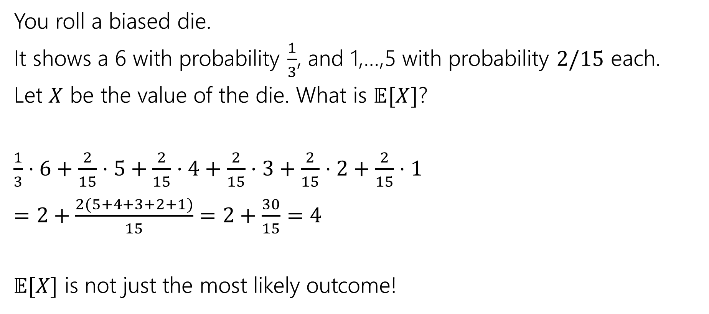

Example 2
You roll a biased die.
It shows a 6 with probability $\frac{1}{3}$, and 1,…,5 with probability $2/15$ each.
Let $X$ be the value of the die. What is $𝔼[X]$?
$\frac{1}{3}⋅6+\frac{2}{15}⋅5+\frac{2}{15}⋅4+\frac{2}{15}⋅3+\frac{2}{15}⋅2+\frac{2}{15}⋅1$
$=2+\frac{2(5+4+3+2+1)}{15}=2+\frac{30}{15}=4$
$𝔼[X]$ is not just the most likely outcome!

Slide 6


Try it yourself
Let $X$ be the result shown on a fair die. What is $𝔼[X]$?
Let $Y$ be the sum of two (independent) fair die rolls. What is $𝔼[Y]$?

Slide 7


Try it yourself
Let $X$ be the result shown on a fair die. What is $𝔼[X]$
$6⋅\frac{1}{6}+5⋅\frac{1}{6}+4⋅\frac{1}{6}+3⋅\frac{1}{6}+2⋅\frac{1}{6}+1⋅\frac{1}{6}$
$=\frac{21}{6}=3.5$
$𝔼[X]$ is not necessarily a possible outcome!
That’s ok, it’s an average!

Slide 8

Try it yourself
$𝔼\left[Y\right]=$
$\frac{1}{36}⋅2+\frac{2}{36}⋅3+\frac{3}{36}⋅4+\frac{4}{36}⋅5+\frac{5}{36}⋅6+\frac{6}{36}⋅7+\frac{5}{36}⋅8+\frac{4}{36}⋅9+\frac{3}{36}⋅10+\frac{2}{36}⋅11+\frac{1}{36}⋅12$
$=7$
$𝔼\left[Y\right]=2𝔼[X]$. That’s not a coincidence…we’ll talk about why on Friday.

Slide 9

Subtle but Important
$X$ is random. You don’t know what it is (at least until you run the experiment).
$𝔼[X]$ is not random. It’s a number.
You don’t need to run the experiment to know what it is.

Slide 10
More Independence

Slide 11

Independence of Random Variables
That’s for events…what about random variables?
$X$ and $Y$ are independent if for all $k,ℓ$
$$ℙ\left(X=k, Y=ℓ\right)=ℙ\left(X=k\right)ℙ(Y=ℓ)$$
Independence (of random variables)
We’ll often use commas instead of $∩$ symbol.

Slide 12


Independence of Random Variables
The “for all values” is important.
We say that the event “the sum is 7” is independent of “the red die is 5”
What about $S=$“the sum of two dice” and $R=$“the value of the red die”

Slide 13
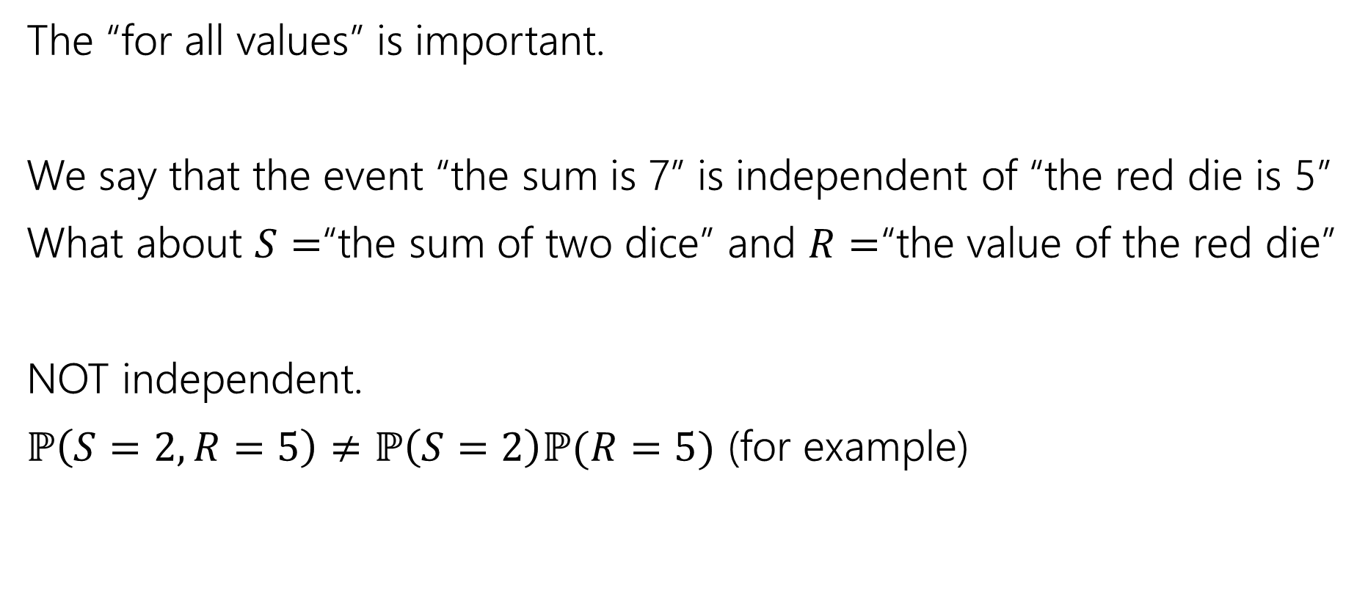
Independence of Random Variables
The “for all values” is important.
We say that the event “the sum is 7” is independent of “the red die is 5”
What about $S=$“the sum of two dice” and $R=$“the value of the red die”
NOT independent.
$ℙ\left(S=2, R=5\right)≠ℙ\left(S=2\right)ℙ(R=5)$ (for example)

Slide 14

Independence of Random Variables
Flip a coin independently $2n$ times.
Let $X$ be “the number of heads in the first $n$ flips.”
Let $Y$ be “the number of heads in the last $n$ flips.”
$X$ and $Y$ are independent.

Slide 15
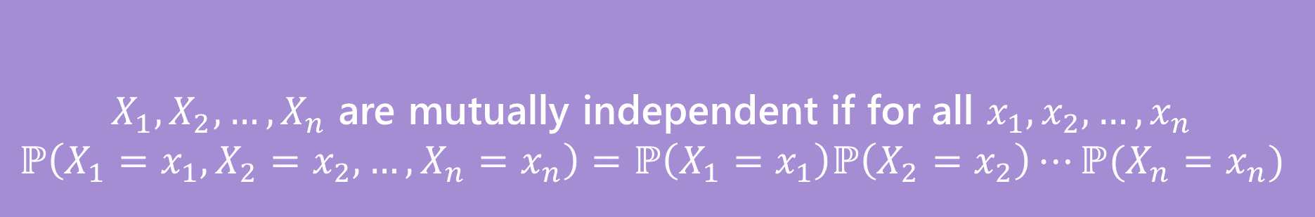


Mutual Independence for RVs
A little simpler to write down than for events
DON’T need to check all subsets for random variables…
But you do need to check all values (all possible $x_{i}$) still.
$X_{1},X_{2},…,X_{n}$ are mutually independent if for all $x_{1},x_{2},…,x_{n}$
$$ℙ\left(X_{1}=x_{1}, X_{2}=x_{2},…,X_{n}=x_{n}\right)=ℙ\left(X_{1}=x_{1}\right)ℙ\left(X_{2}=x_{2}\right)⋯ℙ(X_{n}=x_{n})$$
Mutual Independence (of random variables)

Slide 16
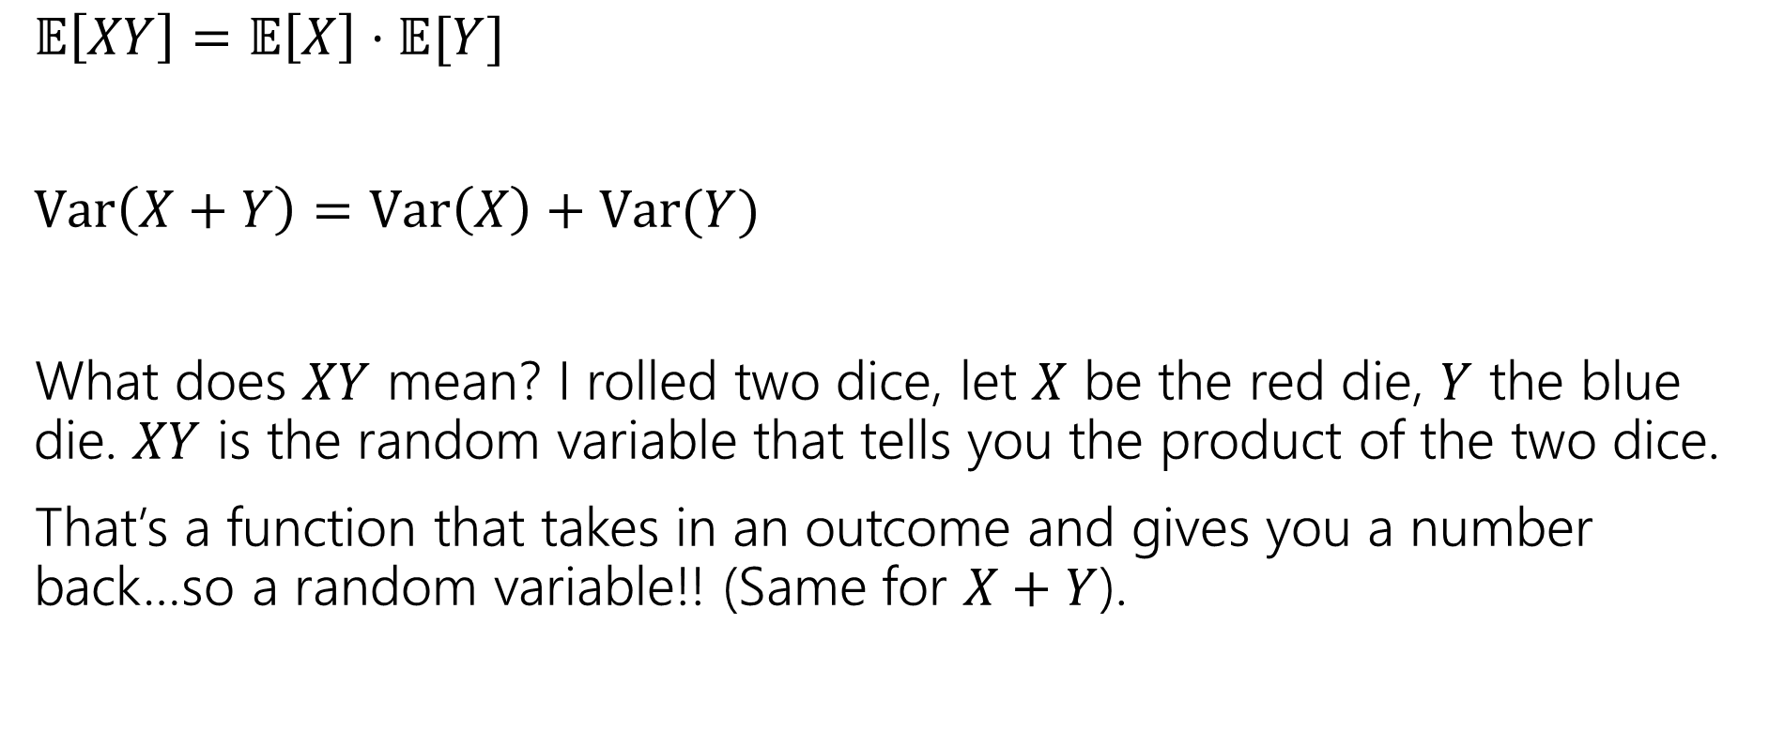

What does Independence give you?
$𝔼\left[XY\right]=𝔼\left[X\right]⋅𝔼[Y]$
$Var\left(X+Y\right)=Var\left(X\right)+Var(Y)$
What does $XY$ mean? I rolled two dice, let $X$ be the red die, $Y$ the blue die. $XY$ is the random variable that tells you the product of the two dice.
That’s a function that takes in an outcome and gives you a number back…so a random variable!! (Same for $X+Y$).

Slide 17
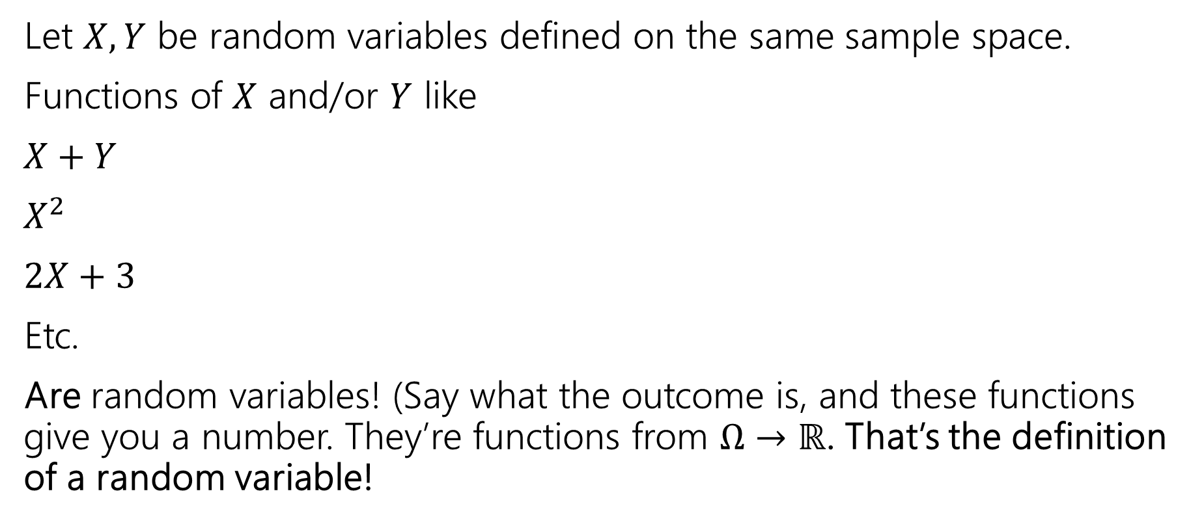

Functions of a random variable
Let $X,Y$ be random variables defined on the same sample space.
Functions of $X$ and/or $Y$ like
$X+Y$
$X^{2}$
$2X+3$
Etc.
Are random variables! (Say what the outcome is, and these functions give you a number. They’re functions from $Ω→ℝ$. That’s the definition of a random variable!

Slide 18
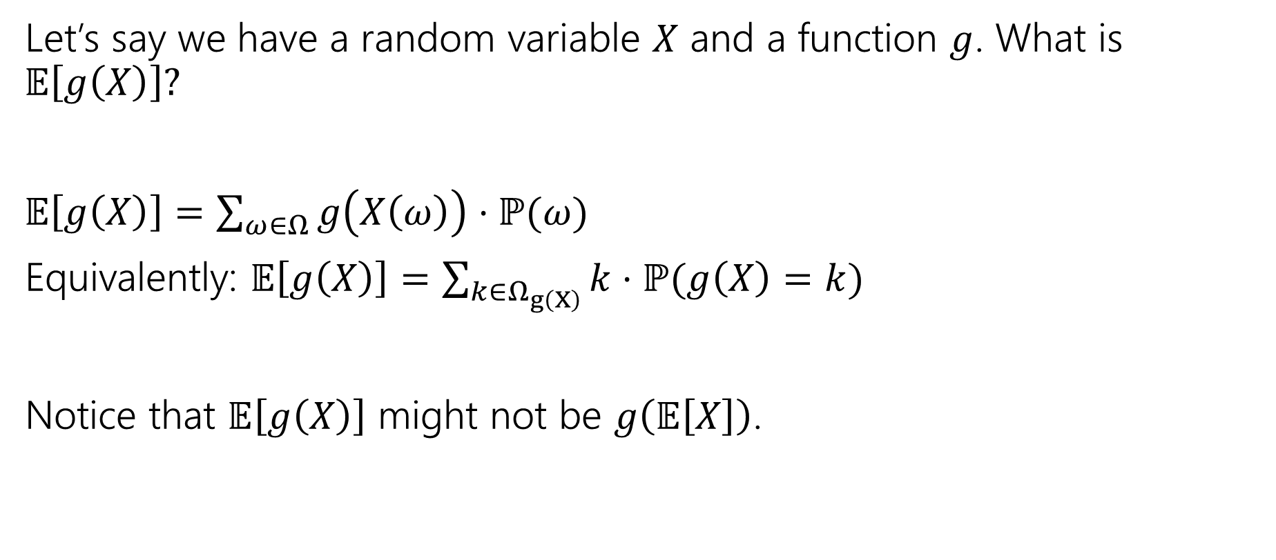

Expectations of functions of random variables
Let’s say we have a random variable $X$ and a function $g$. What is $𝔼\left[g\left(X\right)\right]?$
$𝔼\left[g\left(X\right)\right]=\sum_{ω∈Ω}{g\left(X\left(ω\right)\right)⋅ℙ(ω)}$
Equivalently: $𝔼\left[g\left(X\right)\right]=\sum_{k∈Ω_{g\left(X\right)}}{k⋅ℙ(g\left(X\right)=k)}$
Notice that $𝔼\left[g\left(X\right)\right]$ might not be $g\left(𝔼\left[X\right]\right)$.

Slide 19
Variance

Slide 20

Where are we?
A random variable is a way to summarize what outcome you saw.
The Expectation of a random variable is its average value.
A way to summarize a random variable

Slide 21
Variance
Another one number summary of a random variable.
But wait, we already have expectation, what’s this for?

Slide 22
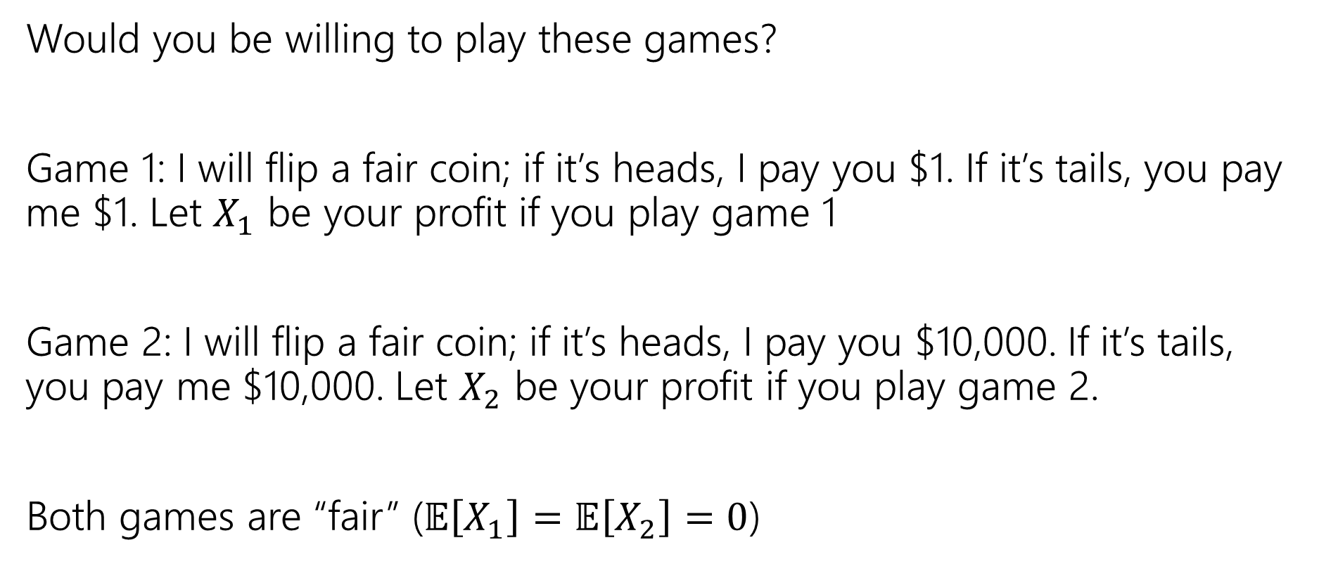

Consider these two games
Would you be willing to play these games?
Game 1: I will flip a fair coin; if it’s heads, I pay you $1. If it’s tails, you pay me $1. Let $X_{1}$ be your profit if you play game 1
Game 2: I will flip a fair coin; if it’s heads, I pay you $10,000. If it’s tails, you pay me $10,000. Let $X_{2}$ be your profit if you play game 2.
Both games are “fair” ($𝔼\left[X_{1}\right]=𝔼\left[X_{2}\right]=0$)

Slide 23
What’s the difference
Expectation tells you what the average will be…
But it doesn’t tell you how “extreme” your results could be.
Nor how likely those extreme results are.
Game 2 has many (well, only) very extreme results.
In expectation they “cancel out” but if you can only play once…
…it would be nice to measure that.

Slide 24
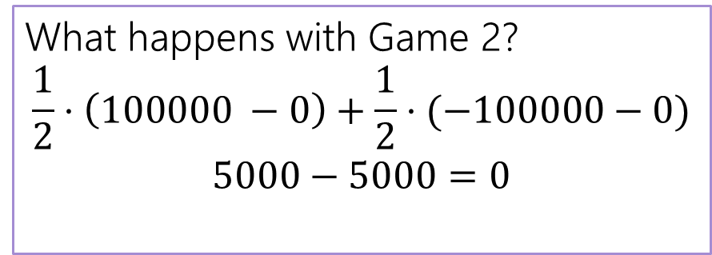
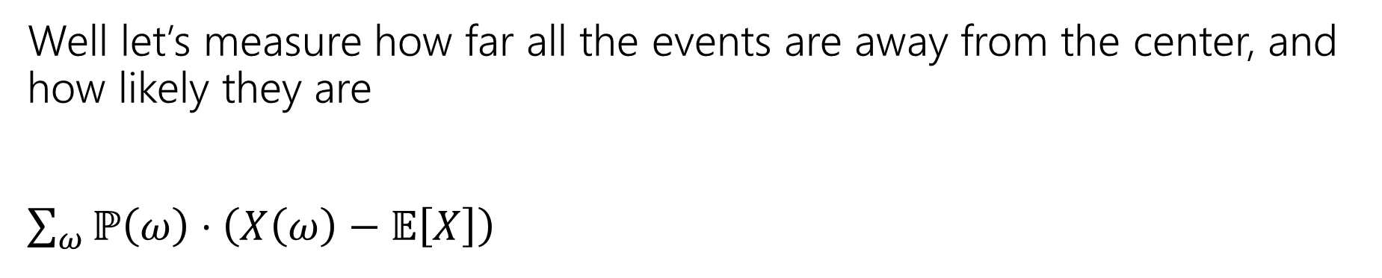
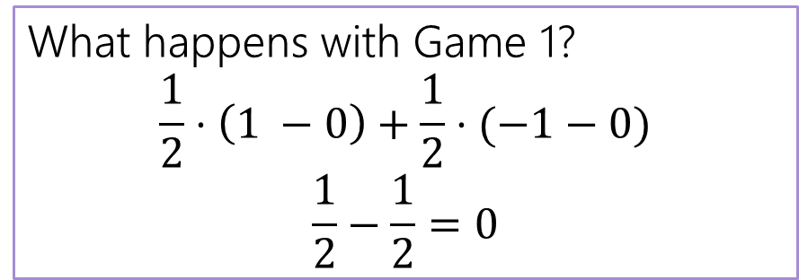
Designing a Measure – Try 1
Well let’s measure how far all the events are away from the center, and how likely they are
$\sum_{ω}{ℙ\left(ω\right)⋅\left(X\left(ω\right)−𝔼\left[X\right]\right) }$
What happens with Game 1?
$$\frac{1}{2}⋅\left(1 −0\right)+\frac{1}{2}⋅(−1−0)$$
$$\frac{1}{2}−\frac{1}{2}=0$$
What happens with Game 2?
$$\frac{1}{2}⋅\left(100000 −0\right)+\frac{1}{2}⋅(−100000−0)$$
$$5000−5000=0$$

Slide 25
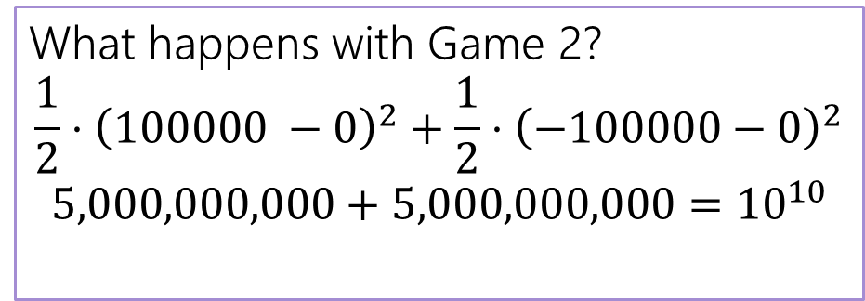
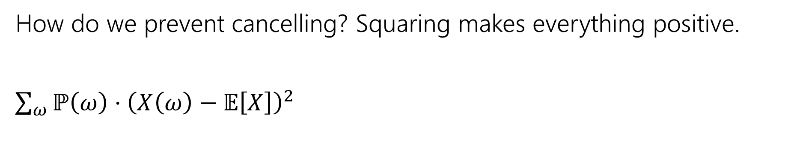


Designing a Measure – Try 2
How do we prevent cancelling? Squaring makes everything positive.
$\sum_{ω}{ℙ\left(ω\right)⋅{\left(X\left(ω\right)−𝔼\left[X\right]\right)}^{2} }$
What happens with Game 1?
$$\frac{1}{2}⋅{\left(1 −0\right)}^{2}+\frac{1}{2}⋅{\left(−1−0\right)}^{2}$$
$$\frac{1}{2}+\frac{1}{2}=1$$
What happens with Game 2?
$$\frac{1}{2}⋅{\left(100000 −0\right)}^{2}+\frac{1}{2}⋅{\left(−100000−0\right)}^{2}$$
$$5,000,000,000+5,000,000,000={10}^{10}$$

Slide 26
Why Squaring
Why not absolute value? Or Fourth power?
Squaring is nicer algebraically.
Our goal with variance was to talk about the spread of results. Squaring makes extreme results even more extreme.
Fourth power over-emphasizes the extreme results (for our purposes).

Slide 27
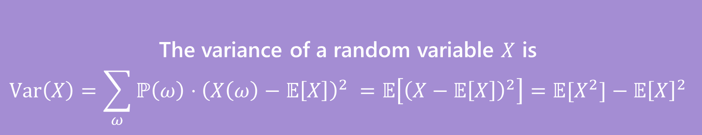
Variance
The first two forms are the definition. The last one is an algebra trick.
The variance of a random variable $X$ is
$$Var\left(X\right)=\sum_{ω}{ℙ\left(ω\right)⋅{\left(X\left(ω\right)−𝔼\left[X\right]\right)}^{2} }=𝔼\left[{\left(X−𝔼\left[X\right]\right)}^{2}\right]=𝔼[X^{2}]−𝔼{\left[X\right]}^{2}$$
Variance

Slide 28
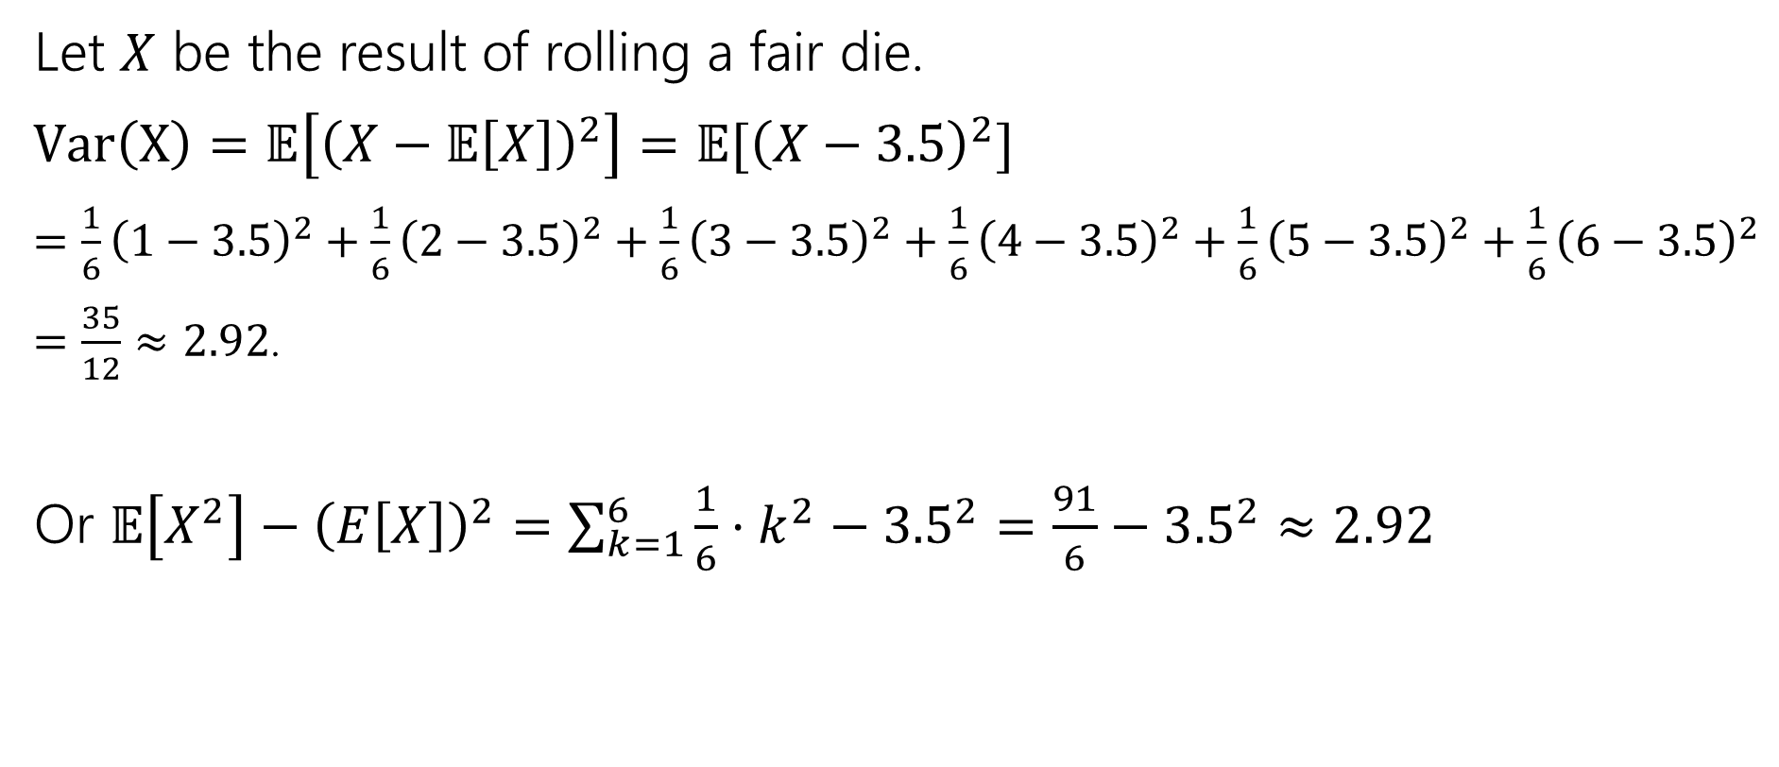
Variance of a die
Let $X$ be the result of rolling a fair die.
$Var\left(X\right)=𝔼\left[{\left(X−𝔼\left[X\right]\right)}^{2}\right]=𝔼[{\left(X−3.5\right)}^{2}]$
$=\frac{1}{6}{\left(1−3.5\right)}^{2}+\frac{1}{6}{\left(2−3.5\right)}^{2}+\frac{1}{6}{\left(3−3.5\right)}^{2}+\frac{1}{6}{\left(4−3.5\right)}^{2}+\frac{1}{6}{\left(5−3.5\right)}^{2}+\frac{1}{6}{\left(6−3.5\right)}^{2}$
$=\frac{35}{12}≈2.92$.
Or $𝔼\left[X^{2}\right]−{\left(E\left[X\right]\right)}^{2}=\sum_{k=1}^{6}{\frac{1}{6}⋅k^{2}−{3.5}^{2}}=\frac{91}{6}−{3.5}^{2}≈2.92$

Slide 29
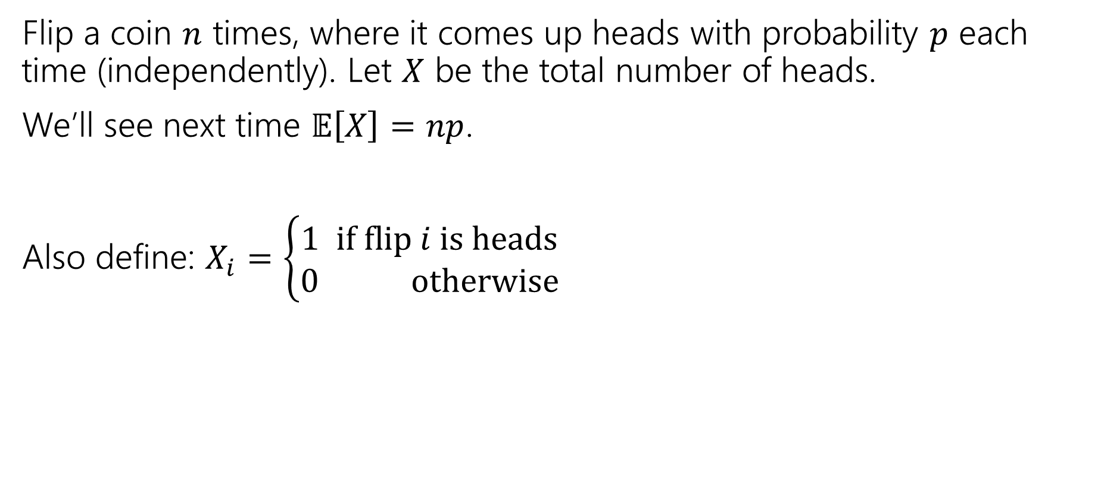

Variance of $n$ Coin Flips
Flip a coin $n$ times, where it comes up heads with probability $p$ each time (independently). Let $X$ be the total number of heads.
We’ll see next time $𝔼\left[X\right]=np$.
Also define: $X_{i}=\left\{\begin{aligned}1 if flip i is heads \\ 0 otherwise\end{aligned}\right.$

Slide 30
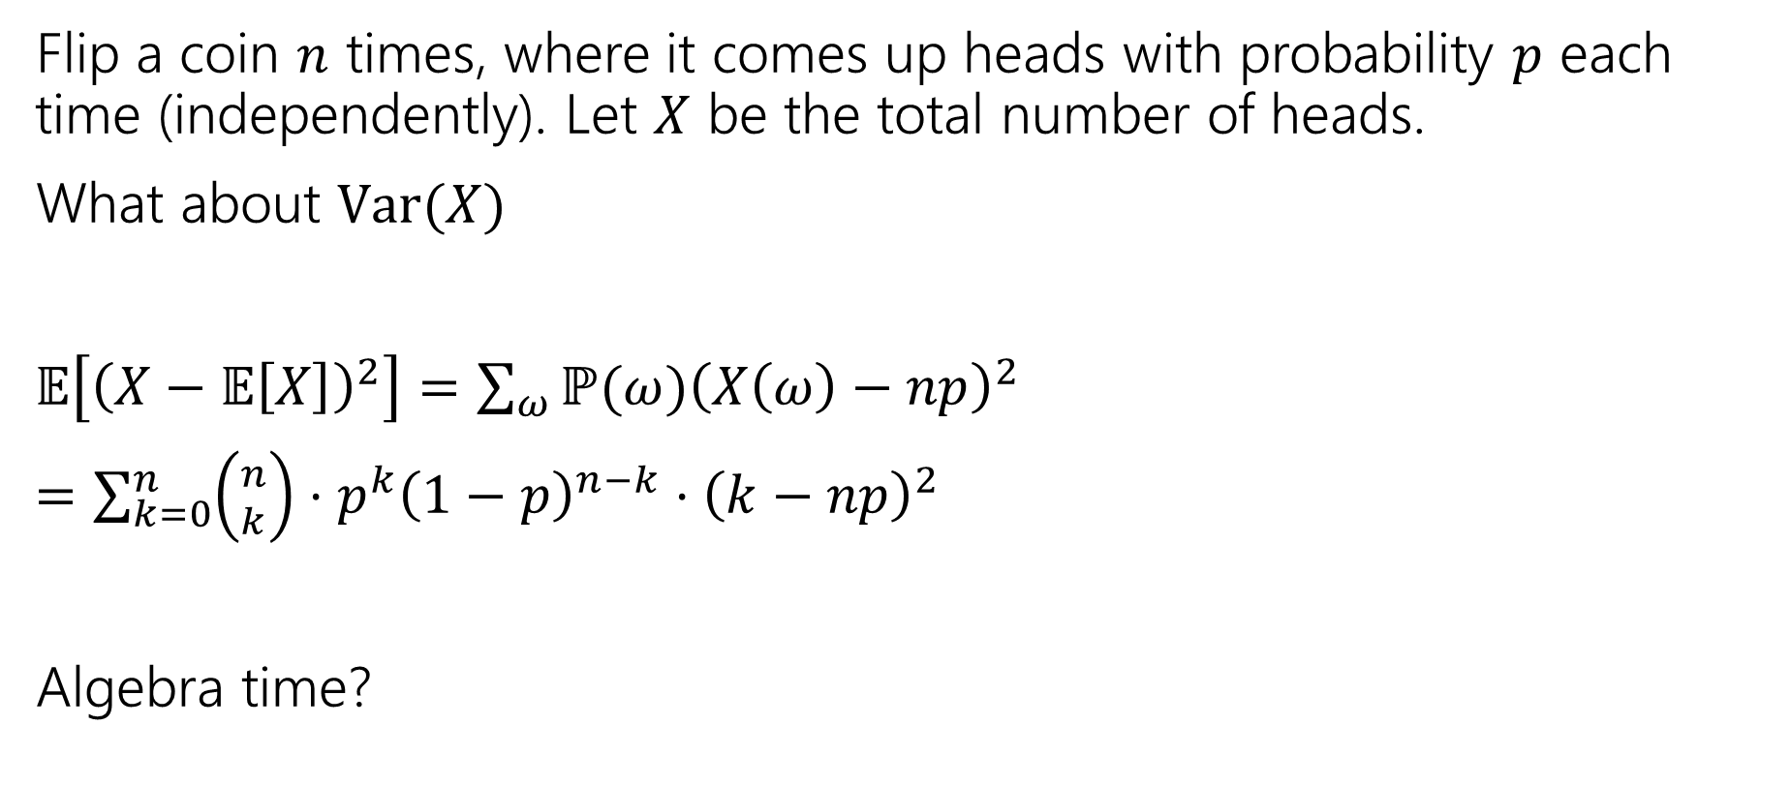
Variance of $n$ Coin Flips
Flip a coin $n$ times, where it comes up heads with probability $p$ each time (independently). Let $X$ be the total number of heads.
What about $Var(X)$
$𝔼\left[{\left(X−𝔼\left[X\right]\right)}^{2}\right]=\sum_{ω}{ℙ(ω){\left(X\left(ω\right)−np\right)}^{2}}$
$=\sum_{k=0}^{n}{\left({n \atop k}\right)⋅p^{k}{\left(1−p\right)}^{n−k}⋅{\left(k−np\right)}^{2}}$
Algebra time?

Slide 31

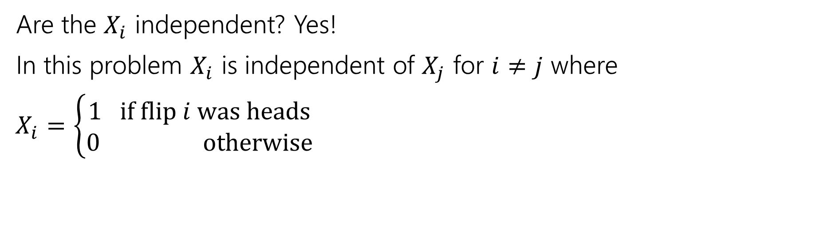
Variance
If $X$ and $Y$ are independent then
$$Var\left(X+Y\right)=Var\left(X\right)+Var(Y)$$
Are the $X_{i}$ independent? Yes!
In this problem $X_{i}$ is independent of $X_{j}$ for $i≠j$ where
$X_{i}=\left\{\begin{aligned}1 if flip i was heads \\ 0 otherwise\end{aligned}\right.$

Slide 32
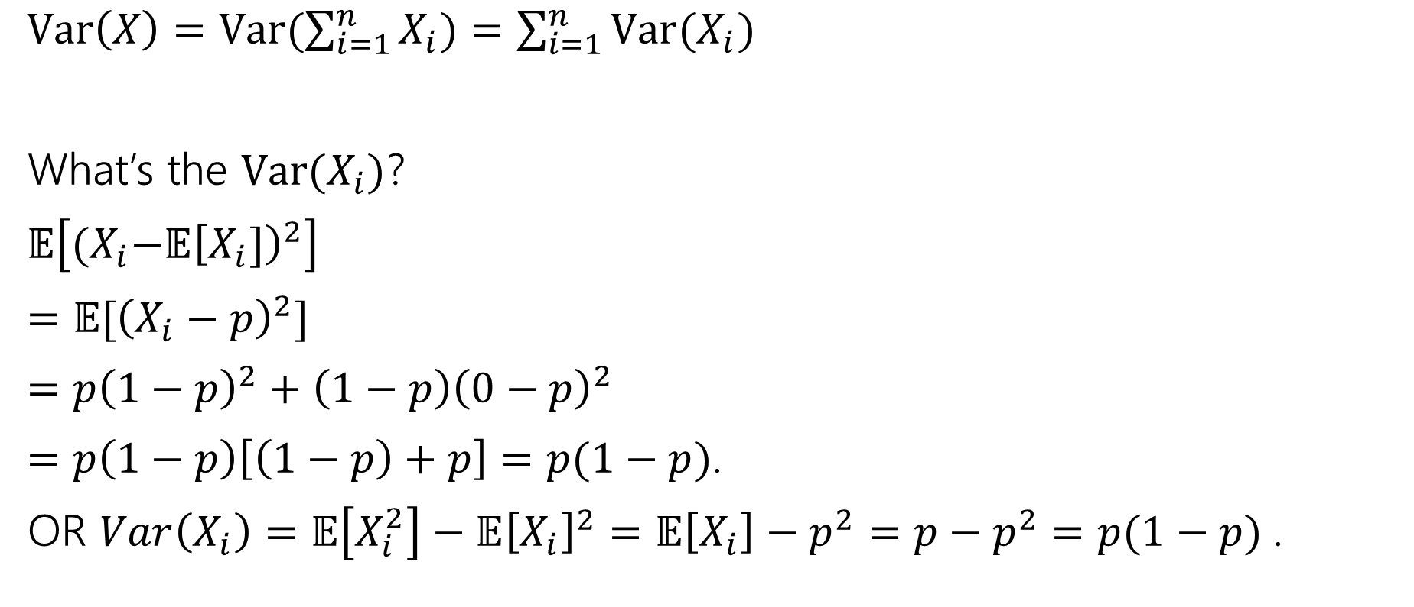
Variance
$Var\left(X\right)=Var(\sum_{i=1}^{n}{X_{i})=\sum_{i=1}^{n}{Var(X_{i})}}$
What’s the $Var(X_{i})$?
$𝔼\left[{(X}_{i}−𝔼{\left[X_{i}]\right)}^{2}\right]$
$=𝔼[{\left(X_{i}−p\right)}^{2}]$
$=p{\left(1−p\right)}^{2}+\left(1−p\right){\left(0−p\right)}^{2}$
$=p\left(1−p\right)\left[\left(1−p\right)+p\right]=p(1−p)$.
OR $Var\left(X_{i}\right)=𝔼\left[X_{i}^{2}\right]−𝔼{\left[X_{i}\right]}^{2}=𝔼\left[X_{i}\right]−p^{2}=p−p^{2}=p(1−p)$.

Slide 33

Plugging In
$Var\left(X\right)=Var(\sum_{i=1}^{n}{X_{i})=\sum_{i=1}^{n}{Var(X_{i})}}$
What’s the $Var(X_{i})$?
$p(1−p)$.
$Var\left(X\right)=\sum_{i=1}^{n}{p\left(1−p\right)=}np(1−p)$.

Slide 34
Expectation and Variance aren’t everything
Alright, so expectation and variance is everything right?
No!
A PMF or CDF *does* fully describe a random variable.
Flip a fair coin 3 times indep. Count heads.
Flip a biased coin (prob heads=2/3) until heads. Count flips.
…

Slide 35
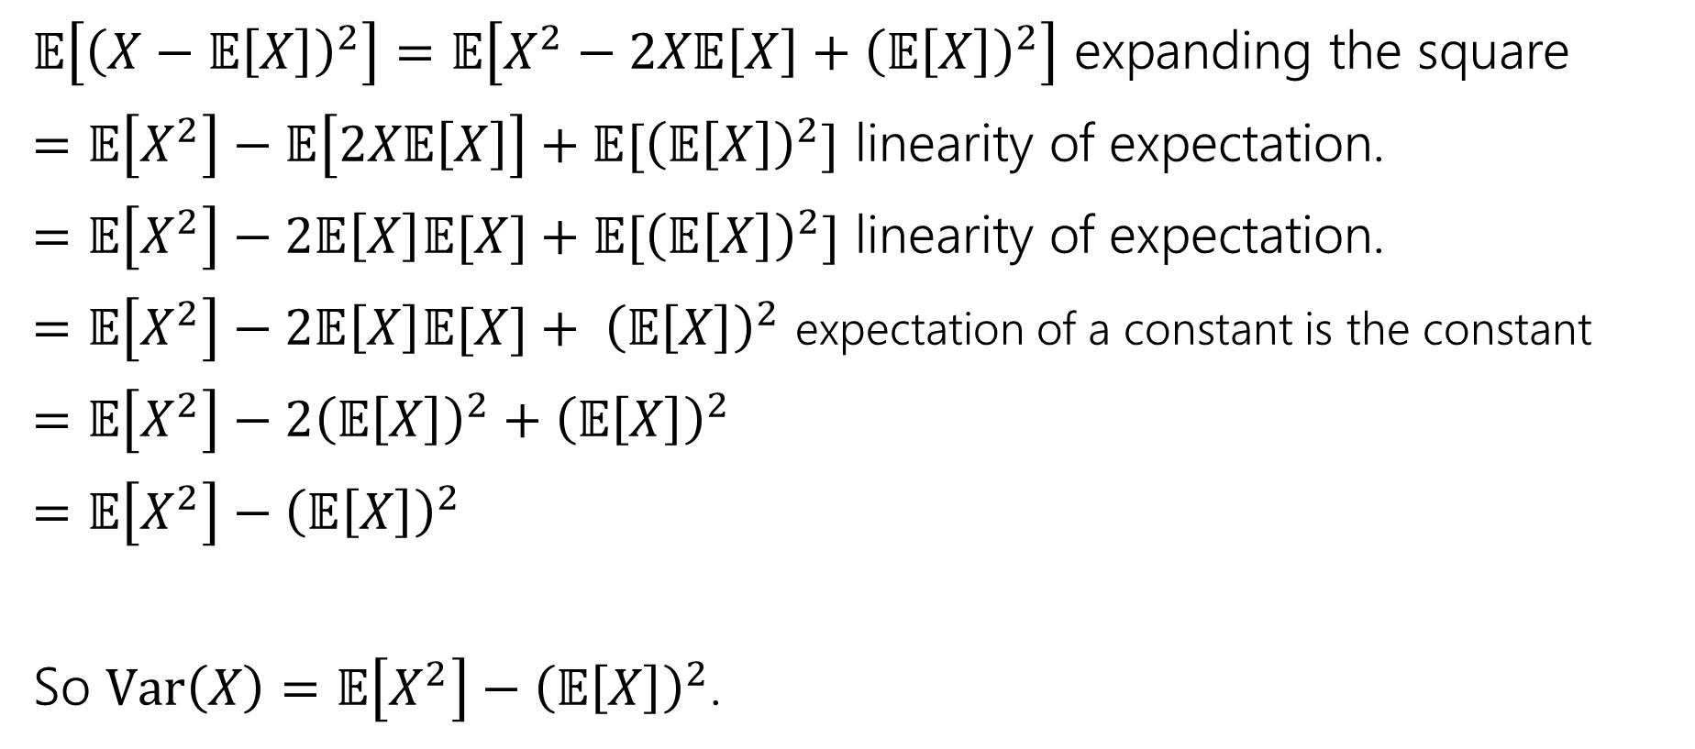
Proof of Calculation Trick
$𝔼\left[{\left(X−𝔼\left[X\right]\right)}^{2}\right]=𝔼\left[X^{2}−2X𝔼\left[X\right]+{\left(𝔼\left[X\right]\right)}^{2}\right]$ expanding the square
$=𝔼\left[X^{2}\right]−𝔼\left[2X𝔼\left[X\right]\right]+𝔼[{\left(𝔼\left[X\right]\right)}^{2}]$ linearity of expectation.
$=𝔼\left[X^{2}\right]−2𝔼\left[X\right]𝔼[X]+𝔼[{\left(𝔼\left[X\right]\right)}^{2}]$ linearity of expectation.
$=𝔼\left[X^{2}\right]−2𝔼\left[X\right]𝔼[X]+ {\left(𝔼\left[X\right]\right)}^{2}$ expectation of a constant is the constant
$=𝔼\left[X^{2}\right]−2{\left(𝔼\left[X\right]\right)}^{2}+{\left(𝔼\left[X\right]\right)}^{2}$
$=𝔼\left[X^{2}\right]−{\left(𝔼\left[X\right]\right)}^{2}$
So $Var\left(X\right)=𝔼\left[X^{2}\right]−{\left(𝔼\left[X\right]\right)}^{2}$.

Slide 36
Extra Practice

Slide 37

More Practice
Suppose you flip a coin until you see a heads for the first time.
Let $X$ be the number of trials (including the heads)
What is the pmf of $X$?
The cdf of $X$?
$𝔼[X]$?

Slide 38
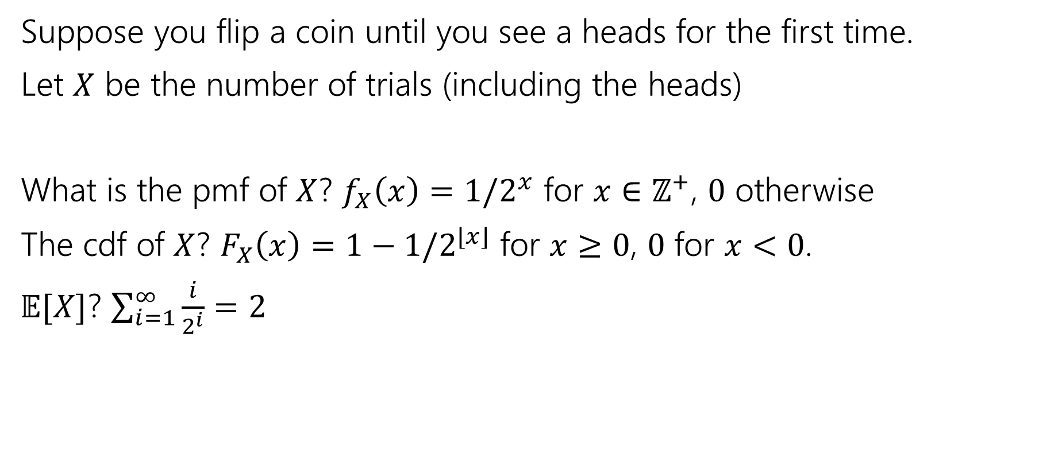
More Practice
Suppose you flip a coin until you see a heads for the first time.
Let $X$ be the number of trials (including the heads)
What is the pmf of $X$? $f_{X}\left(x\right)=1/2^{x}$ for $x∈ℤ^{+}$, $0$ otherwise
The cdf of $X$? $F_{X}\left(x\right)=1−1/2^{⌊x⌋}$ for $x≥0$, $0$ for $x<0$.
$𝔼[X]$? $\sum_{i=1}^{∞}{\frac{i}{2^{i}}}=2$

Slide 39
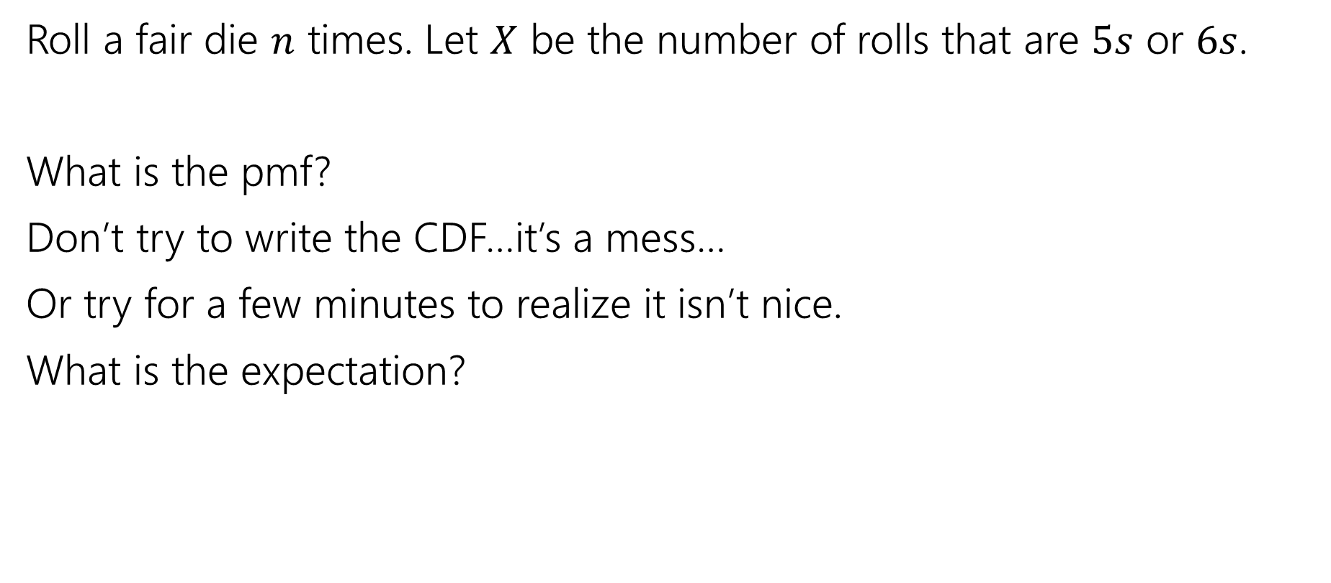
More Random Variable Practice
Roll a fair die $n$ times. Let $X$ be the number of rolls that are $5s$ or $6s$.
What is the pmf?
Don’t try to write the CDF…it’s a mess…
Or try for a few minutes to realize it isn’t nice.
What is the expectation?

Slide 40
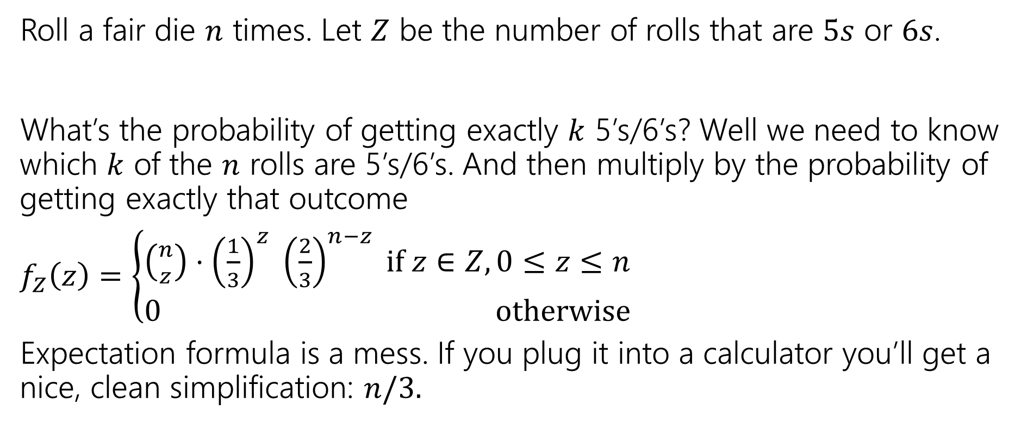
More Random Variable Practice
Roll a fair die $n$ times. Let $Z$ be the number of rolls that are $5s$ or $6s$.
What’s the probability of getting exactly $k$ 5’s/6’s? Well we need to know which $k$ of the $n$ rolls are 5’s/6’s. And then multiply by the probability of getting exactly that outcome
$f_{Z}\left(z\right)=\left\{\begin{aligned}\left({n \atop z}\right)⋅{\left(\frac{1}{3}\right)}^{z} {\left(\frac{2}{3}\right)}^{n−z} if z∈Z,0≤z≤n \\ 0 otherwise\end{aligned}\right.$
Expectation formula is a mess. If you plug it into a calculator you’ll get a nice, clean simplification: $n/3.$

Slide 41
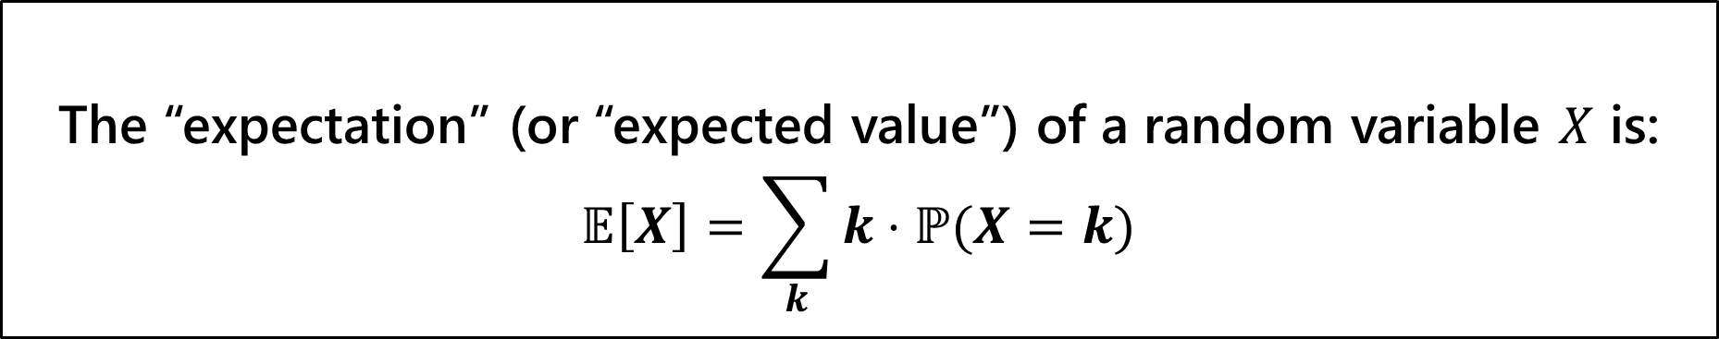
Try it yourself
Let $X$ be the result shown on a fair die. What is $𝔼[X]$?
Let $Y$ be the sum of two (independent) fair die rolls. What is $𝔼[Y]$?
The “expectation” (or “expected value”) of a random variable $X$ is:
$$𝔼\left[X\right]=\sum_{k}{k⋅ℙ(X=k)}$$
Expectation

Slide 42
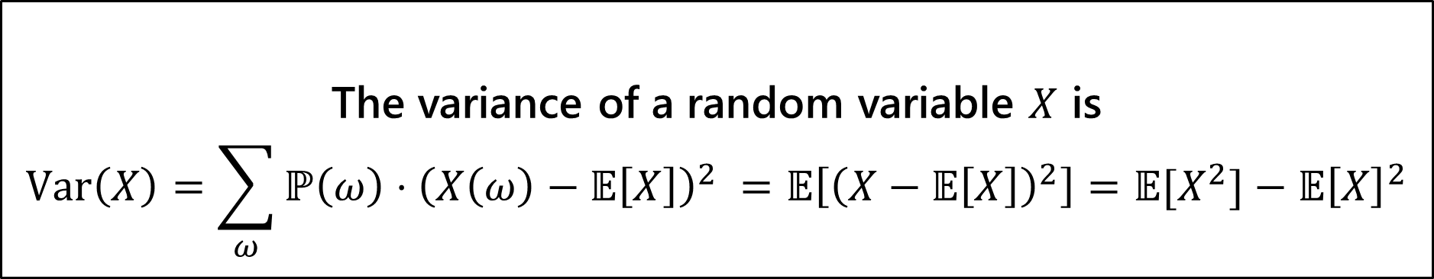

Variance
The first two forms are the definition. The last one is an algebra trick.
The variance of a random variable $X$ is
$$Var\left(X\right)=\sum_{ω}{ℙ\left(ω\right)⋅{\left(X\left(ω\right)−𝔼\left[X\right]\right)}^{2} }=𝔼\left[{\left(X−𝔼\left[X\right]\right)}^{2}\right]=𝔼[X^{2}]−𝔼{\left[X\right]}^{2}$$
Variance
If $X$ and $Y$ are independent, then
$$Var\left(X+Y\right)=Var\left(X\right)+Var(Y)$$

Slide 43
What does Independence give you?
$𝔼\left[XY\right]=𝔼\left[X\right]⋅𝔼[Y]$
$Var\left(X+Y\right)=Var\left(X\right)+Var(Y)$
What does $XY$ mean? I rolled two dice, let $X$ be the red die, $Y$ the blue die. $XY$ is the random variable that tells you the product of the two dice.
That’s a function that takes in an outcome and gives you a number back…so a random variable!! (Same for $X+Y$).

Slide 44

Independence of Random Variables
That’s for events…what about random variables?
$X$ and $Y$ are independent if for all $k,ℓ$
$$ℙ\left(X=k, Y=ℓ\right)=ℙ\left(X=k\right)ℙ(Y=ℓ)$$
Independence (of random variables)
We’ll often use commas instead of $∩$ symbol.

