Slide 1

Random Variables
CSE 312 Winter 26
Lecture 9

Slide 2
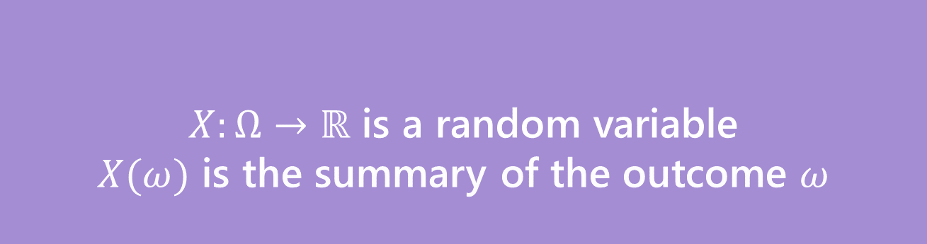
Random Variable
What’s a random variable?
Formally
Informally: A random variable is a way to summarize the important (numerical) information from your outcome.
$X:Ω→ℝ$ is a random variable
$X(ω)$ is the summary of the outcome $ω$
Random Variable

Slide 3

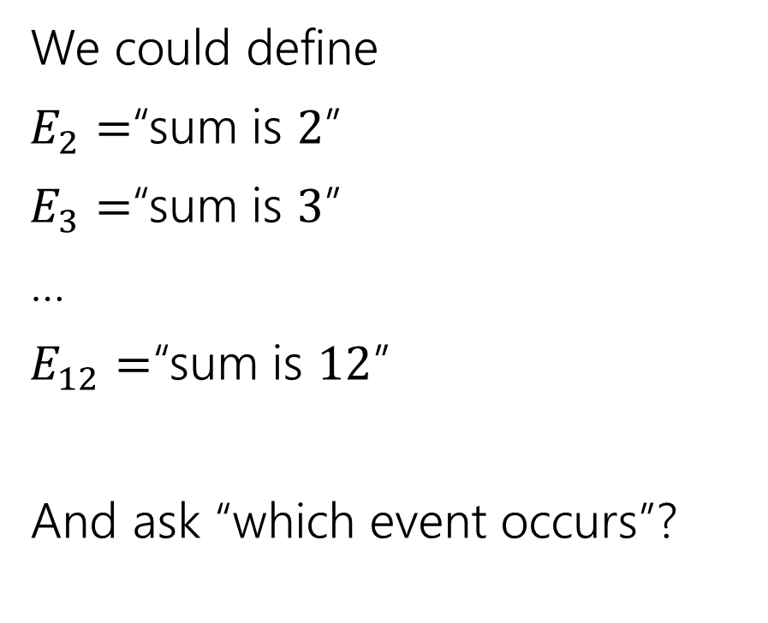
The sum of two dice
Events
Random variable
We could define
$E_{2}=$“sum is $2$”
$E_{3}=$“sum is $3$”
…
$E_{12}=$“sum is $12$”
And ask “which event occurs”?
$X:Ω→ℝ$
$X$is the sum of the two dice.

Slide 4
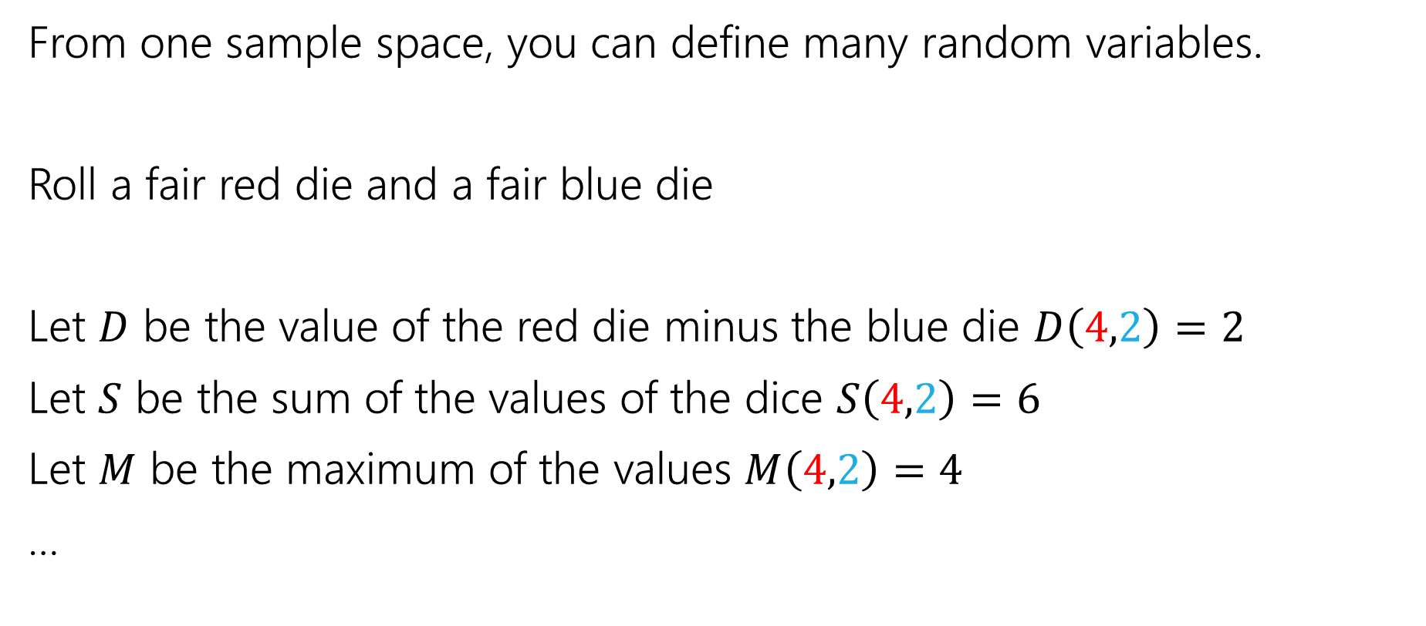

More random variables
From one sample space, you can define many random variables.
Roll a fair red die and a fair blue die
Let $D$ be the value of the red die minus the blue die $D\left(4,2\right)=2$
Let $S$ be the sum of the values of the dice $S\left(4,2\right)=6$
Let $M$ be the maximum of the values $M\left(4,2\right)=4$
…

Slide 5
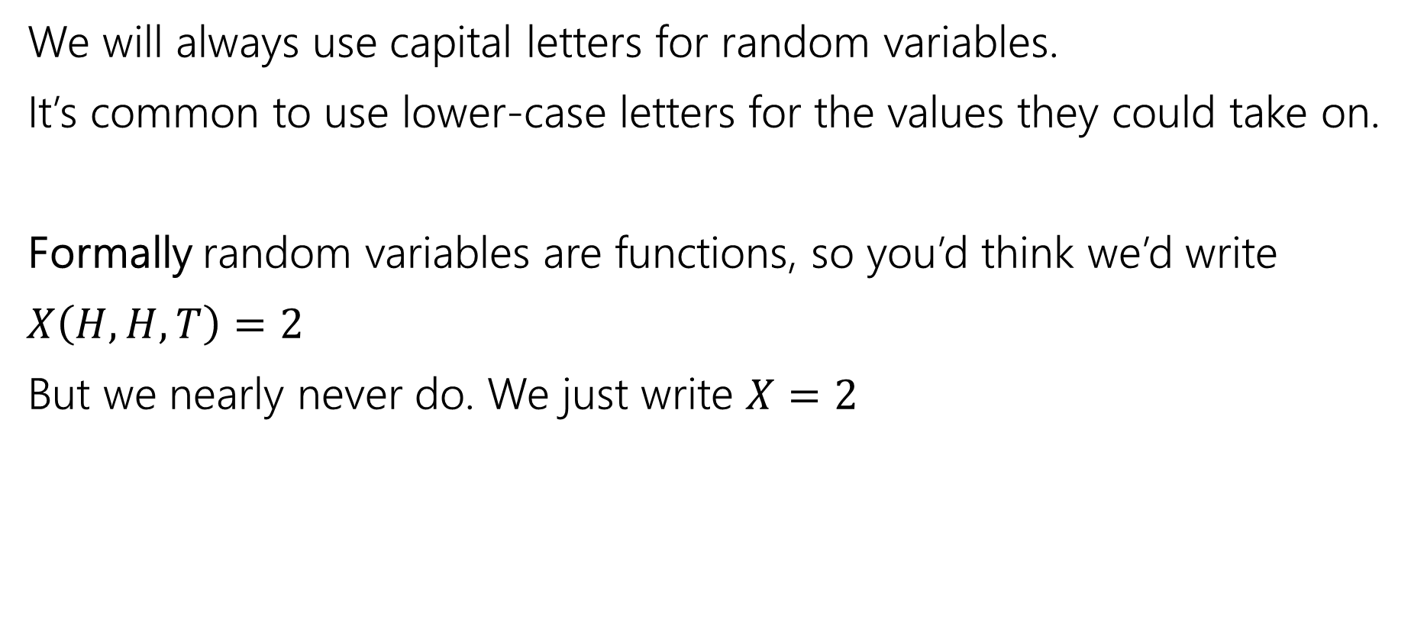

Notational Notes
We will always use capital letters for random variables.
It’s common to use lower-case letters for the values they could take on.
Formally random variables are functions, so you’d think we’d write
$X\left(H,H,T\right)=2$
But we nearly never do. We just write $X=2$

Slide 6
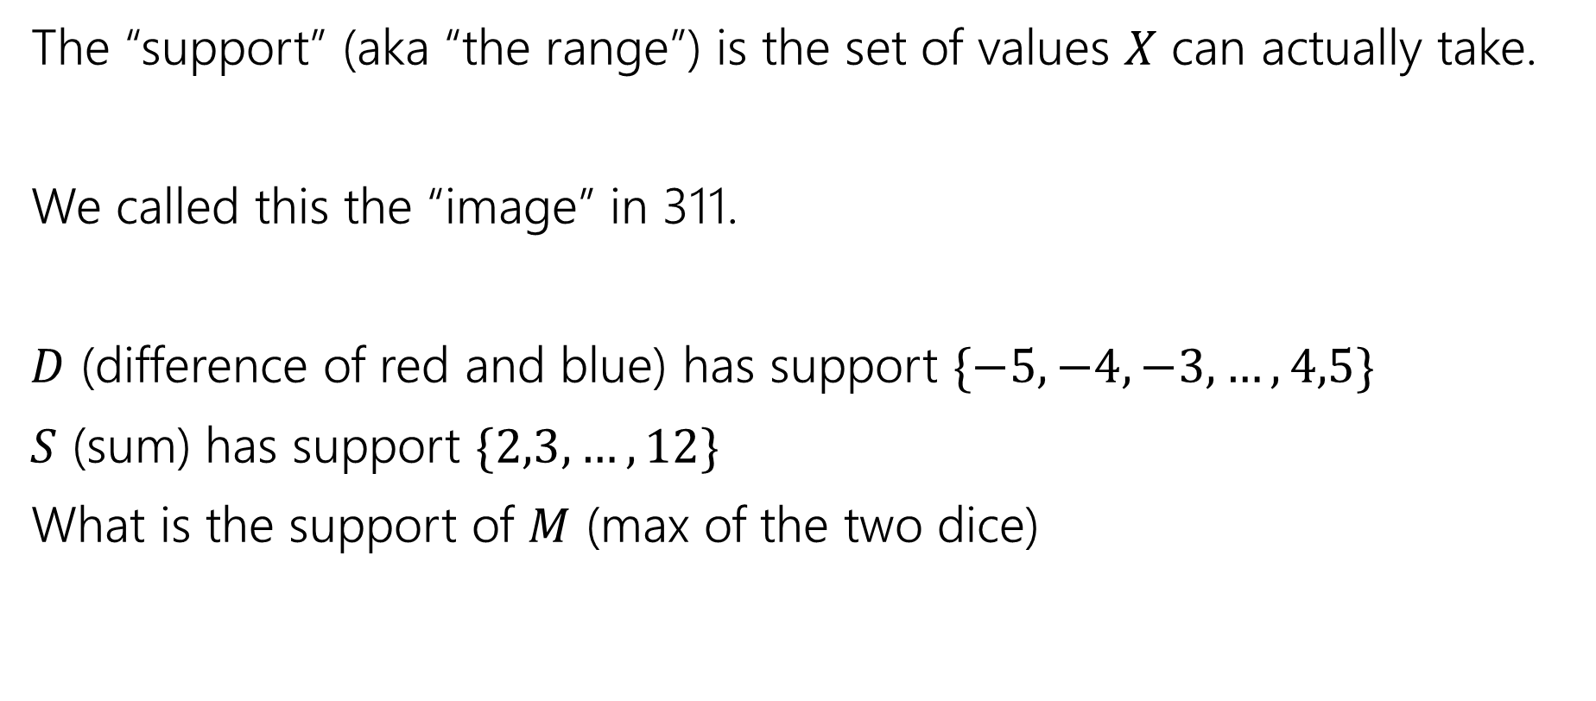


Support ($Ω_{X})$
The “support” (aka “the range”) is the set of values $X$ can actually take.
We called this the “image” in 311.
$D$ (difference of red and blue) has support $\{−5,−4,−3,…,4,5\}$
$S$ (sum) has support $\{2,3,…,12\}$
What is the support of $M$ (max of the two dice)

Slide 7
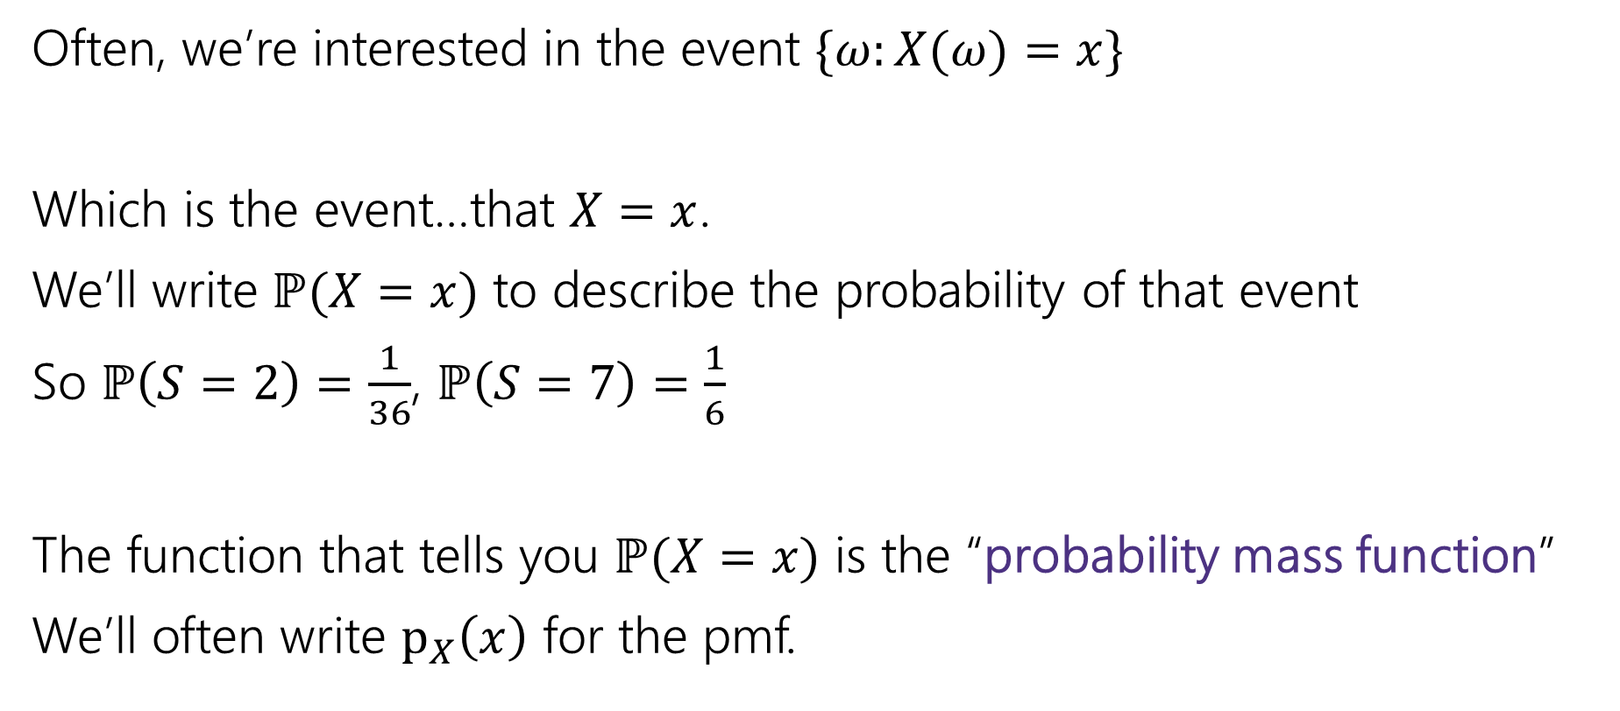
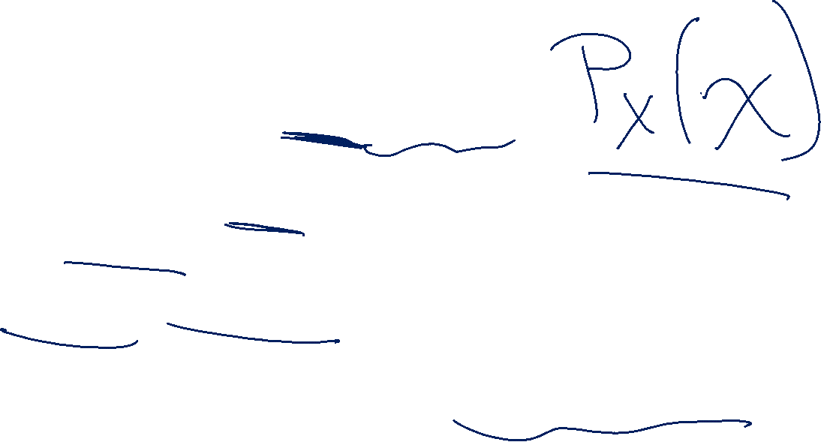
Probability Mass Function
Often, we’re interested in the event $\{ω:X(ω)=x\}$
Which is the event…that $X=x$.
We’ll write $ℙ(X=x)$ to describe the probability of that event
So $ℙ\left(S=2\right)=\frac{1}{36}$, $ℙ\left(S=7\right)=\frac{1}{6}$
The function that tells you $ℙ(X=x)$ is the “probability mass function”
We’ll often write $p_{X}\left(x\right)$ for the pmf.
Notes:
It is pretty standard to use lower-case x to describe the possible value of random variable upper-case-x.
This can be confusing if your handwriting doesn’t differentiate, it can also be confusing out loud (“what’s the probability X = x”) but it’s so standard we’ll do it most of the time. It’s just a convention though, so you can use a different letter if you prefer.

Slide 8
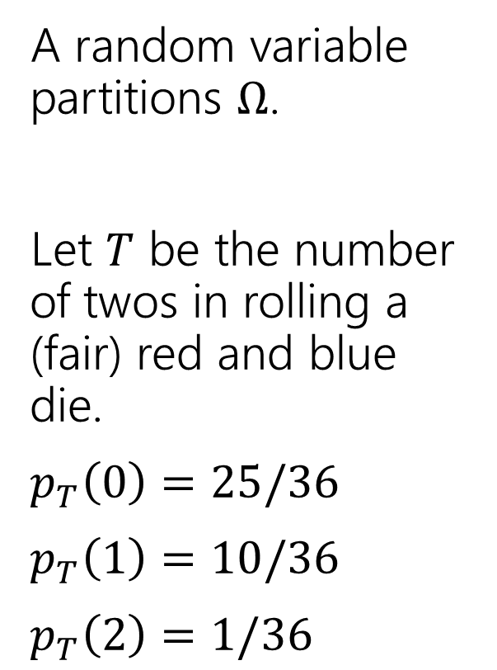
Partition
A random variable partitions $Ω$.
Let $T$ be the number of twos in rolling a (fair) red and blue die.
$p_{T}\left(0\right)=25/36$
$p_{T}\left(1\right)=10/36$
$p_{T}\left(2\right)=1/36$
 | D2=1 | D2=2 | D2=3 | D2=4 | D2=5 | D2=6
D1=1 | (1,1) | (1,2) | (1,3) | (1,4) | (1,5) | (1.6)
D1=2 | (2,1) | (2,2) | (2,3) | (2,4) | (2,5) | (2,6)
D1=3 | (3,1) | (3,2) | (3,3) | (3,4) | (3,5) | (3,6)
D1=4 | (4,1) | (4,2) | (4,3) | (4,4) | (4,5) | (4,6)
D1=5 | (5,1) | (5,2) | (5,3) | (5,4) | (5,5) | (5,6)
D1=6 | (6,1) | (6,2) | (6,3) | (6,4) | (6,5) | (6,6)

Slide 9
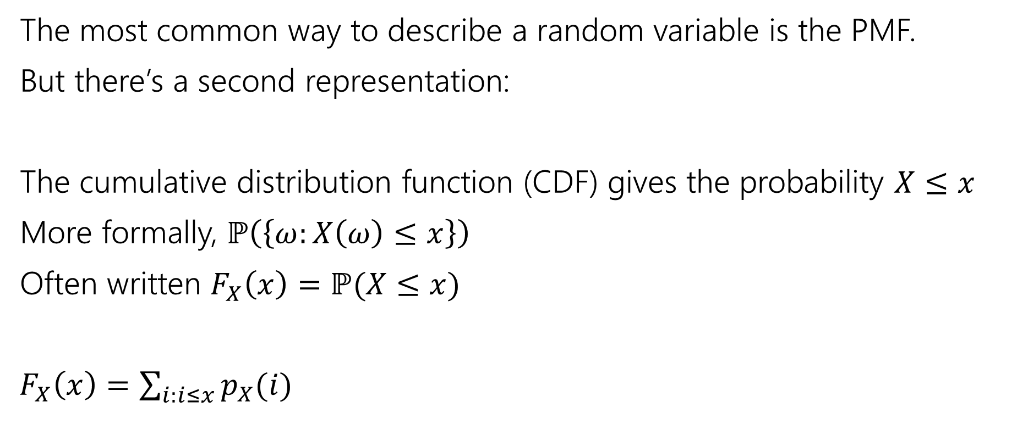

Describing a Random Variable (differently)
The most common way to describe a random variable is the PMF.
But there’s a second representation:
The cumulative distribution function (CDF) gives the probability $X≤x$
More formally, $ℙ\left(\left\{ω:X\left(ω\right)≤x\right\}\right)$
Often written $F_{X}\left(x\right)=ℙ(X≤x)$
$F_{X}\left(x\right)=\sum_{i:i≤x}{p_{X}(i)}$

Slide 10
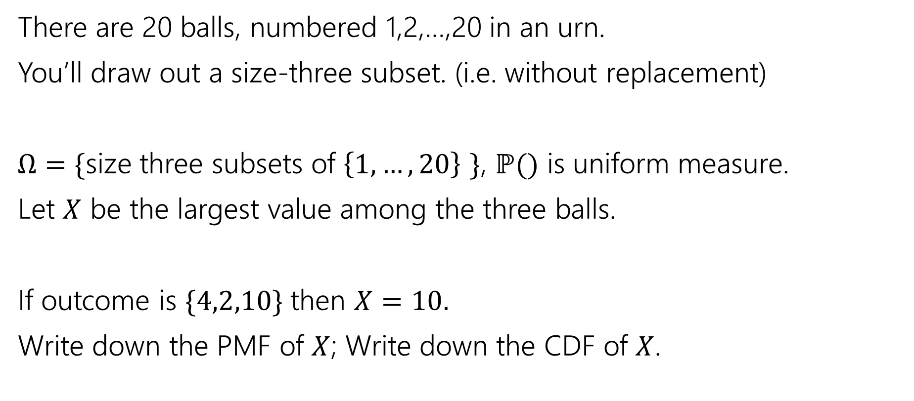
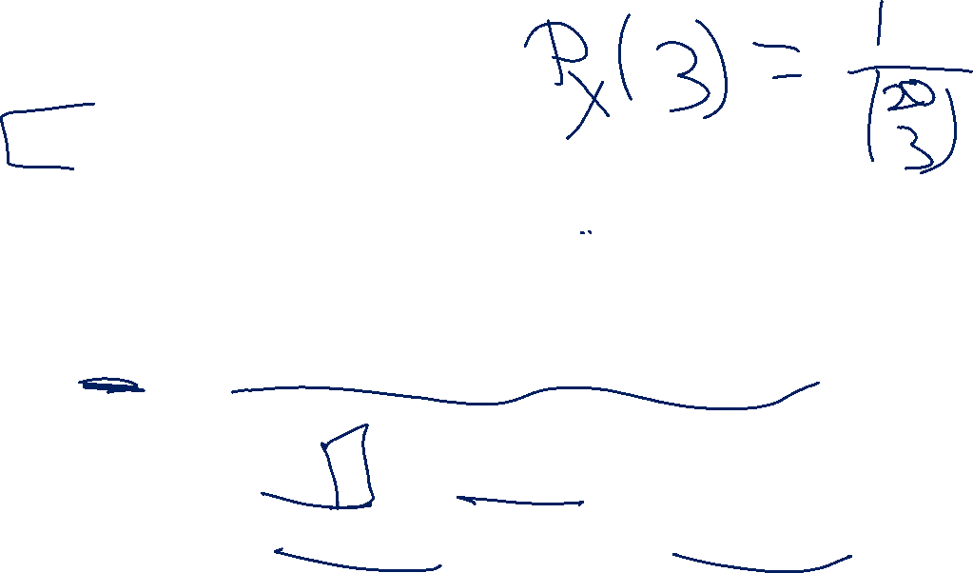
Try It Yourself
There are 20 balls, numbered 1,2,…,20 in an urn.
You’ll draw out a size-three subset. (i.e. without replacement)
$Ω=\{$size three subsets of $\left\{1,…,20\right\}$ $\}$, $ℙ()$ is uniform measure.
Let $X$ be the largest value among the three balls.
If outcome is $\{4,2,10\}$ then $X=10.$
Write down the PMF of $X$; Write down the CDF of $X$.

Slide 11
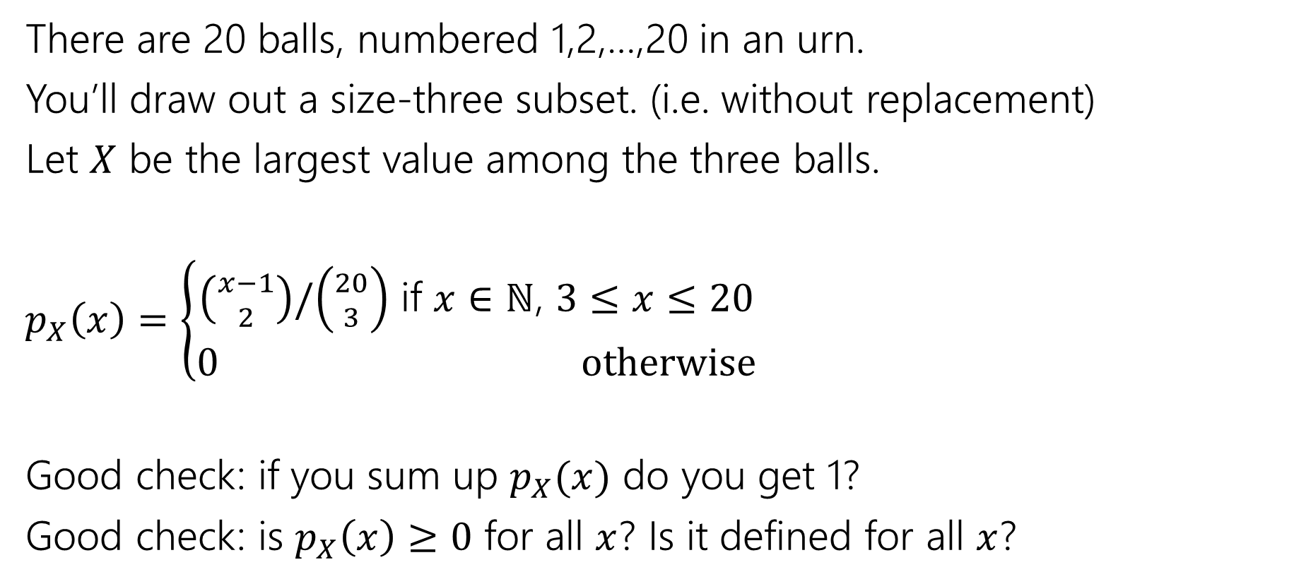

Try It Yourself
There are 20 balls, numbered 1,2,…,20 in an urn.
You’ll draw out a size-three subset. (i.e. without replacement)
Let $X$ be the largest value among the three balls.
$p_{X}\left(x\right)=\left\{\begin{aligned}\left({x−1 \atop 2}\right)/\left({20 \atop 3}\right) \text{if} x∈ℕ\text{, }3≤x≤20 \\ 0 otherwise\end{aligned}\right.$
Good check: if you sum up $p_{X}(x)$ do you get 1?
Good check: is $p_{X}\left(x\right)≥0$ for all $x$? Is it defined for all $x$?

Slide 12
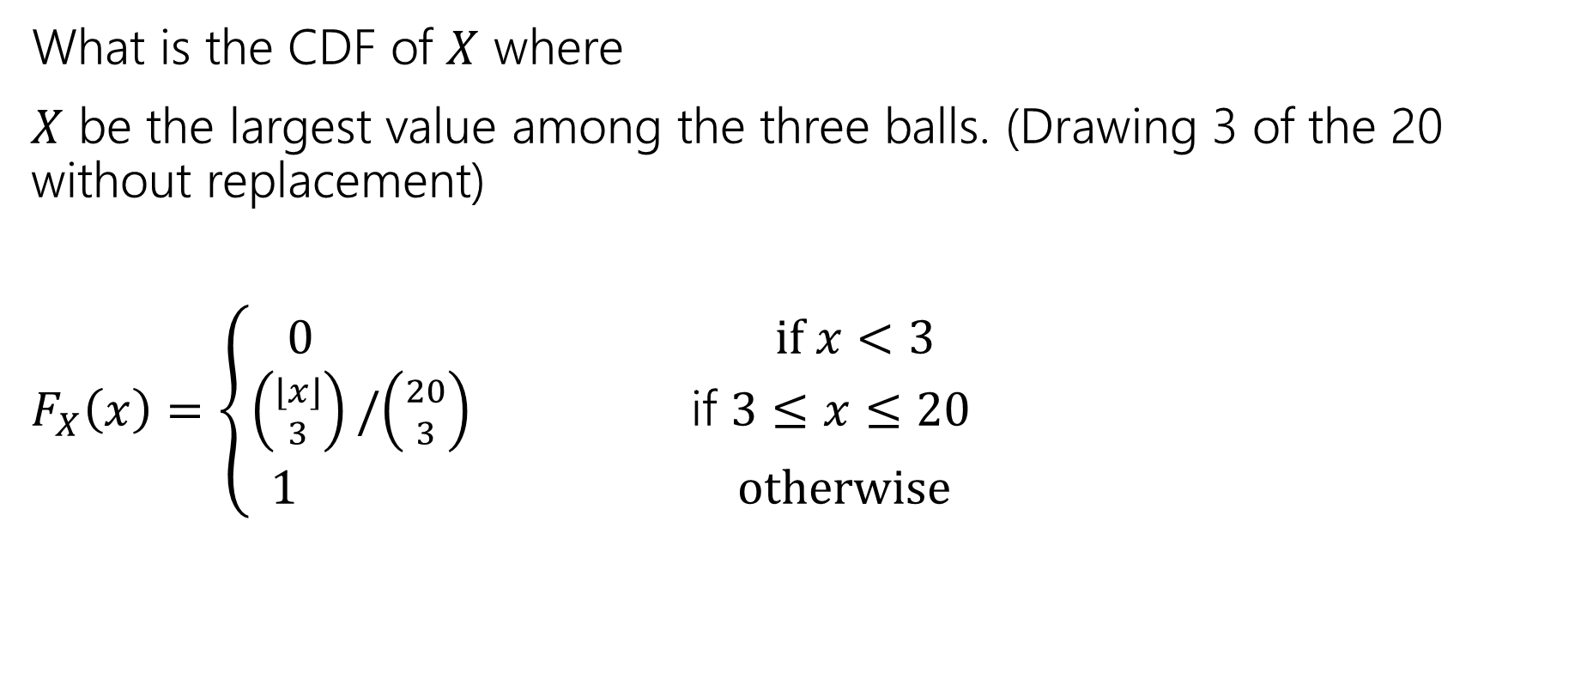
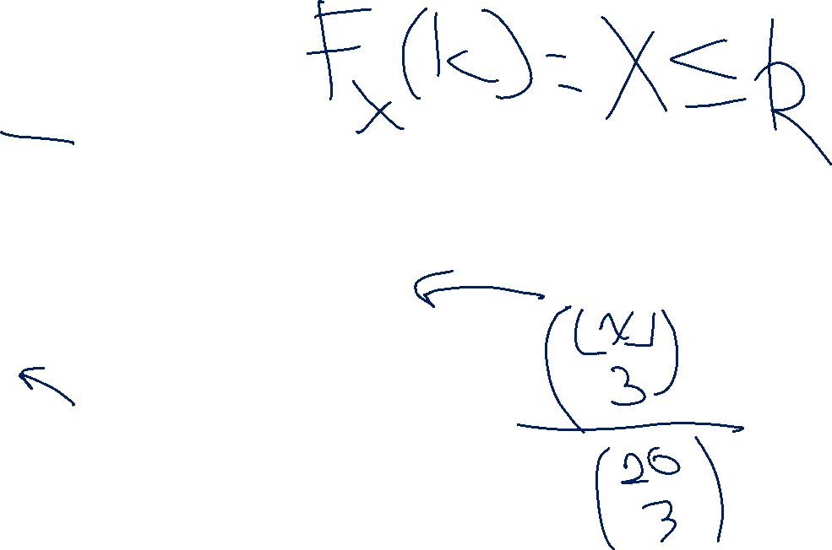
Try it yourself
What is the CDF of $X$ where
$X$ be the largest value among the three balls. (Drawing 3 of the 20 without replacement)
$F_{X}\left(x\right)=\left\{\begin{aligned}\begin{aligned}0 if x<3 \\ \left({⌊x⌋ \atop 3}\right)/\left({20 \atop 3}\right) \text{if} 3≤x≤20\end{aligned} \\ 1 otherwise\end{aligned}\right.$

Slide 13
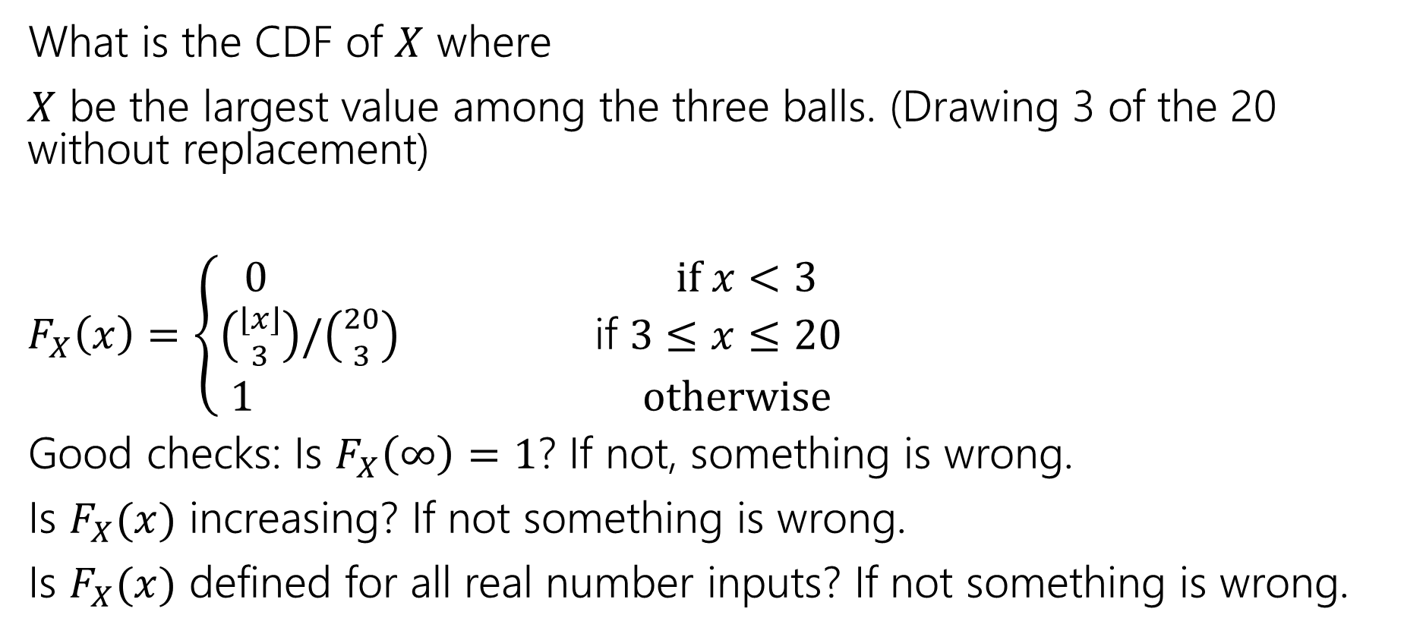
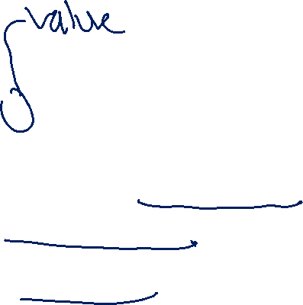
Try it yourself
What is the CDF of $X$ where
$X$ be the largest value among the three balls. (Drawing 3 of the 20 without replacement)
$F_{X}\left(x\right)=\left\{\begin{aligned}\begin{aligned}0 if x<3 \\ \left({⌊x⌋ \atop 3}\right)/\left({20 \atop 3}\right) \text{if} 3≤x≤20\end{aligned} \\ 1 otherwise\end{aligned}\right.$
Good checks: Is $F_{X}\left(∞\right)=1$? If not, something is wrong.
Is $F_{X}(x)$ increasing? If not something is wrong.
Is $F_{X}(x)$ defined for all real number inputs? If not something is wrong.

Slide 14
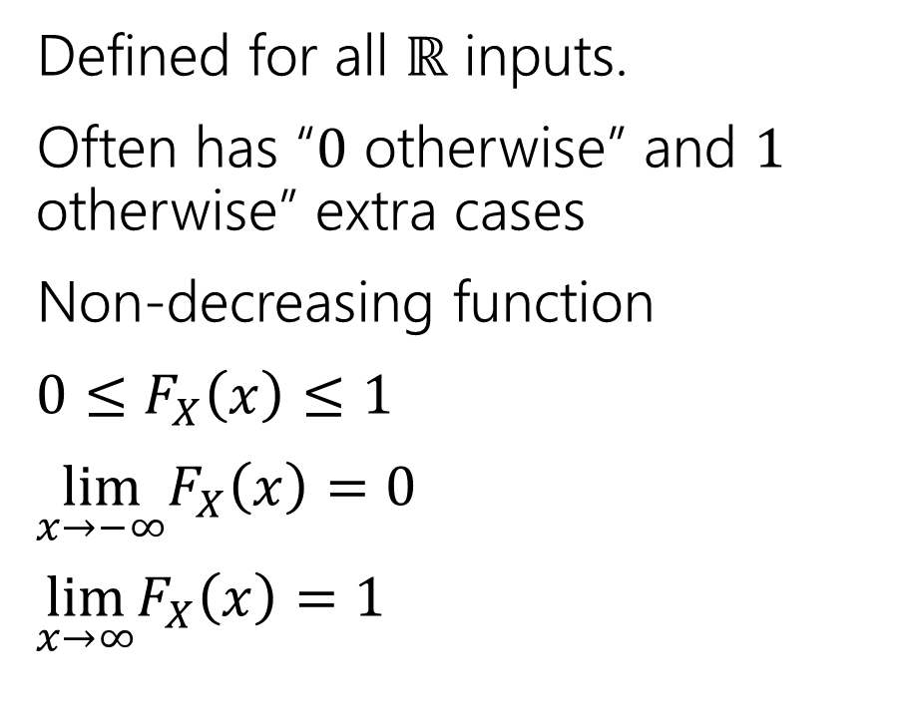
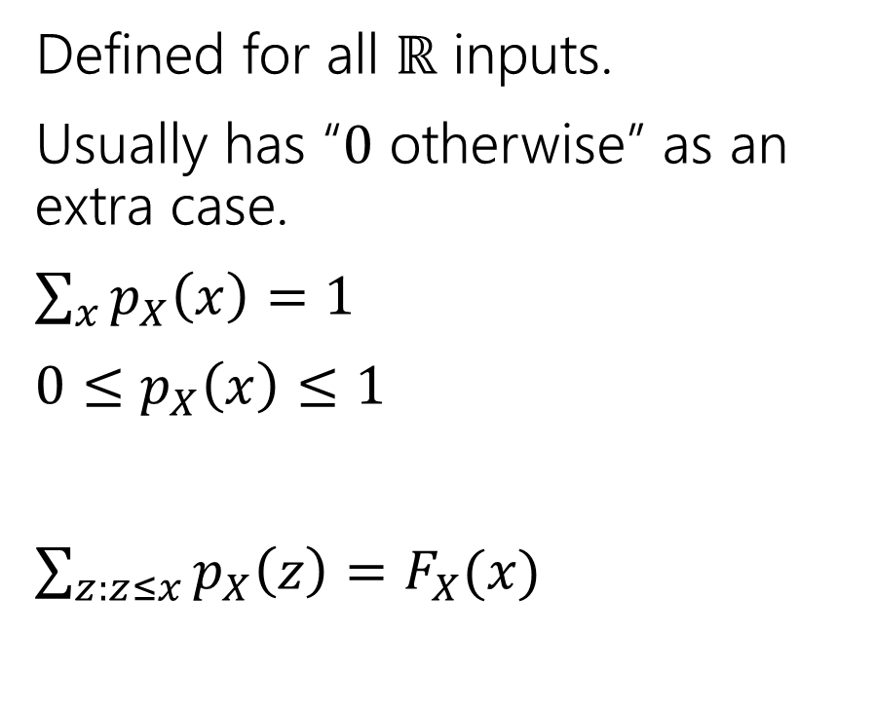

Two descriptions
Probability mass function
Cumulative Distribution function
Defined for all $ℝ$ inputs.
Usually has “$0$ otherwise” as an extra case.
$\sum_{x}{p_{X}\left(x\right)=1}$
$0≤p_{X}\left(x\right)≤1$
$\sum_{z:z≤x}{p_{X}\left(z\right)=F_{X}(x)}$
Defined for all $ℝ$ inputs.
Often has “$0$ otherwise” and $1$ otherwise” extra cases
Non-decreasing function
$0≤F_{X}\left(x\right)≤1$
$\lim_{x→−∞}F_{X}\left(x\right)=0$
$\lim_{x→∞}F_{X}\left(x\right)=1⁡$

Slide 15

More Random Variable Practice
Roll a fair die $n$ times. Let $Z$ be the number of rolls that are $5s$ or $6s$.
What is the pmf?
Don’t try to write the CDF…it’s a mess…
Or try for a few minutes to realize it isn’t nice.

Slide 16
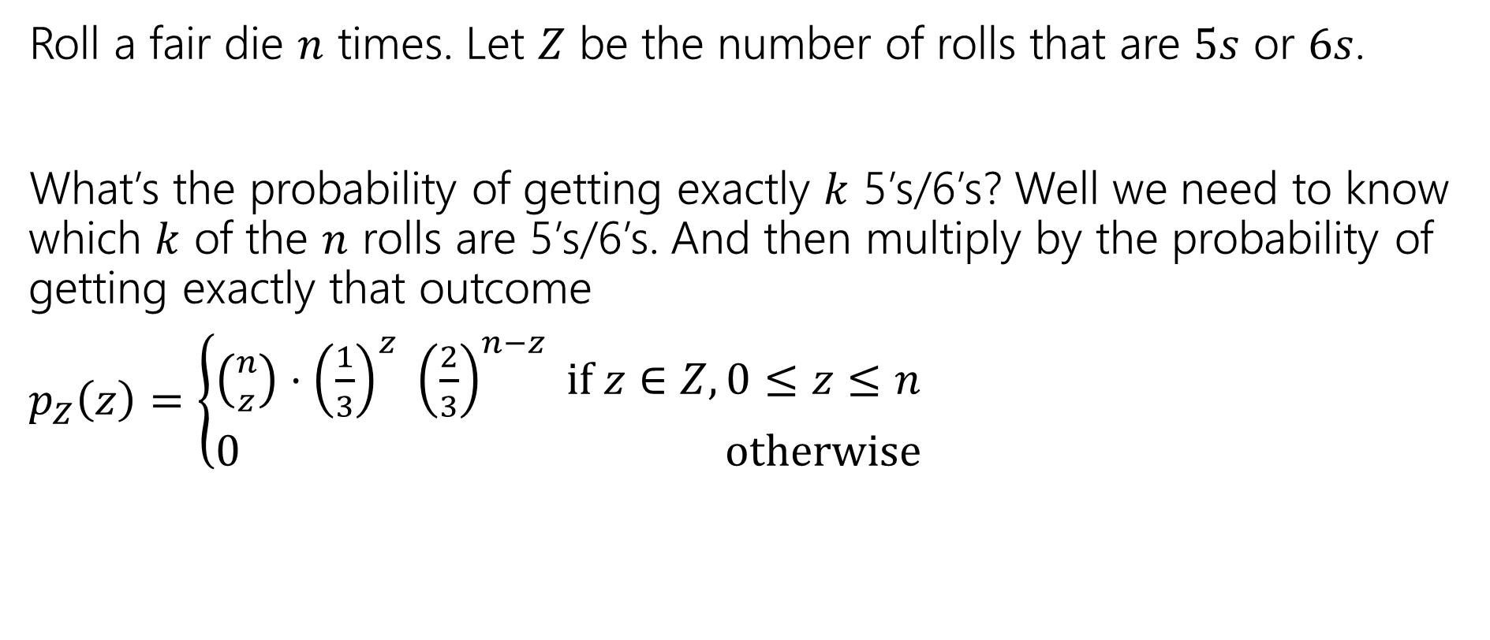
More Random Variable Practice
Roll a fair die $n$ times. Let $Z$ be the number of rolls that are $5s$ or $6s$.
What’s the probability of getting exactly $k$ 5’s/6’s? Well we need to know which $k$ of the $n$ rolls are 5’s/6’s. And then multiply by the probability of getting exactly that outcome
$p_{Z}\left(z\right)=\left\{\begin{aligned}\left({n \atop z}\right)⋅{\left(\frac{1}{3}\right)}^{z} {\left(\frac{2}{3}\right)}^{n−z} if z∈Z,0≤z≤n \\ 0 otherwise\end{aligned}\right.$

Slide 17
Expectation

Slide 18


Expectation
The “expectation” (or “expected value”) of a random variable $X$ is:
$$𝔼\left[X\right]=\sum_{k}{k⋅ℙ(X=k)}$$
Expectation
Intuition: The weighted average of values $X$ could take on.
Weighted by the probability you actually see them.

Slide 19

Example 1
Flip a fair coin twice (independently)
Let $X$be the number of heads.
$Ω=\{TT,TH,HT,HH\}$, $ℙ()$ is uniform measure.
$𝔼\left[X\right]=\frac{1}{4}⋅0+\frac{1}{2}⋅1+\frac{1}{4}⋅2=0+\frac{1}{2}+\frac{1}{2}=1$.

Slide 20
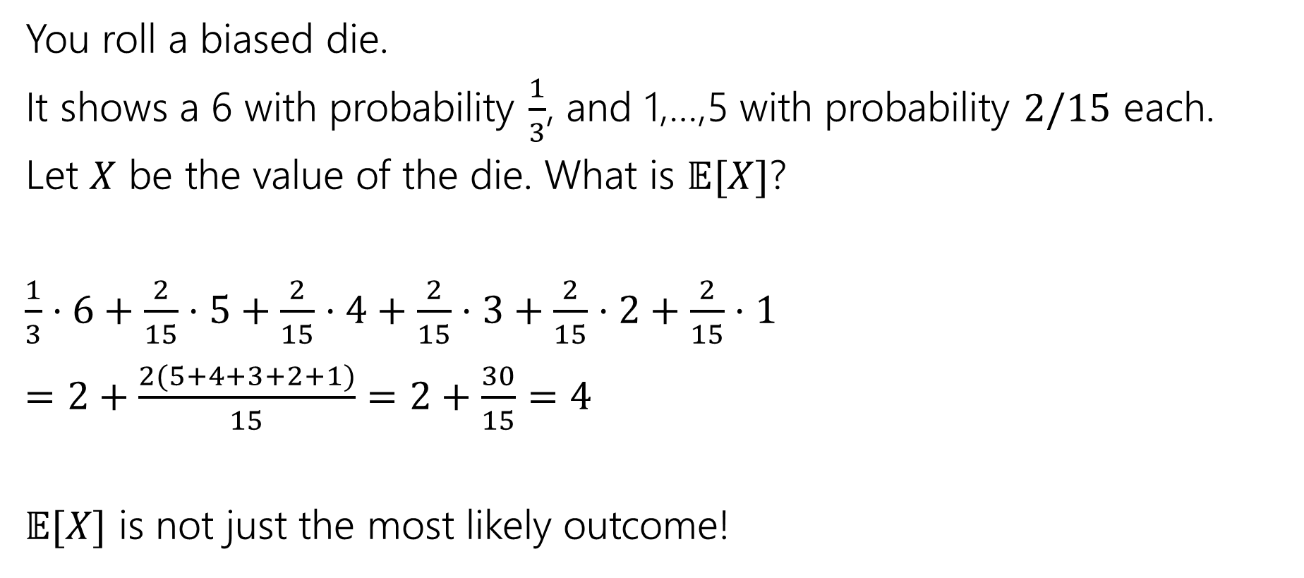
Example 2
You roll a biased die.
It shows a 6 with probability $\frac{1}{3}$, and 1,…,5 with probability $2/15$ each.
Let $X$ be the value of the die. What is $𝔼[X]$?
$\frac{1}{3}⋅6+\frac{2}{15}⋅5+\frac{2}{15}⋅4+\frac{2}{15}⋅3+\frac{2}{15}⋅2+\frac{2}{15}⋅1$
$=2+\frac{2(5+4+3+2+1)}{15}=2+\frac{30}{15}=4$
$𝔼[X]$ is not just the most likely outcome!

Slide 21

Try it yourself
Let $X$ be the result shown on a fair die. What is $𝔼[X]$?
Let $Y$ be the sum of two (independent) fair die rolls. What is $𝔼[Y]$?

Slide 22

Try it yourself
Let $X$ be the result shown on a fair die. What is $𝔼[X]$
$6⋅\frac{1}{6}+5⋅\frac{1}{6}+4⋅\frac{1}{6}+3⋅\frac{1}{6}+2⋅\frac{1}{6}+1⋅\frac{1}{6}$
$=\frac{21}{6}=3.5$
$𝔼[X]$ is not necessarily a possible outcome!
That’s ok, it’s an average!

Slide 23

Try it yourself
$𝔼\left[Y\right]=$
$\frac{1}{36}⋅2+\frac{2}{36}⋅3+\frac{3}{36}⋅4+\frac{4}{36}⋅5+\frac{5}{36}⋅6+\frac{6}{36}⋅7+\frac{5}{36}⋅8+\frac{4}{36}⋅9+\frac{3}{36}⋅10+\frac{2}{36}⋅11+\frac{1}{36}⋅12$
$=7$
$𝔼\left[Y\right]=2𝔼[X]$. That’s not a coincidence…we’ll talk about why on Friday.

Slide 24

Subtle but Important
$X$ is random. You don’t know what it is (at least until you run the experiment).
$𝔼[X]$ is not random. It’s a number.
You don’t need to run the experiment to know what it is.

Slide 25
More Independence

Slide 26
Independence of Random Variables
That’s for events…what about random variables?
$X$ and $Y$ are independent if for all $k,ℓ$
$$ℙ\left(X=k, Y=ℓ\right)=ℙ\left(X=k\right)ℙ(Y=ℓ)$$
Independence (of random variables)
We’ll often use commas instead of $∩$ symbol.

Slide 27

Independence of Random Variables
The “for all values” is important.
We say that the event “the sum is 7” is independent of “the red die is 5”
What about $S=$“the sum of two dice” and $R=$“the value of the red die”

Slide 28
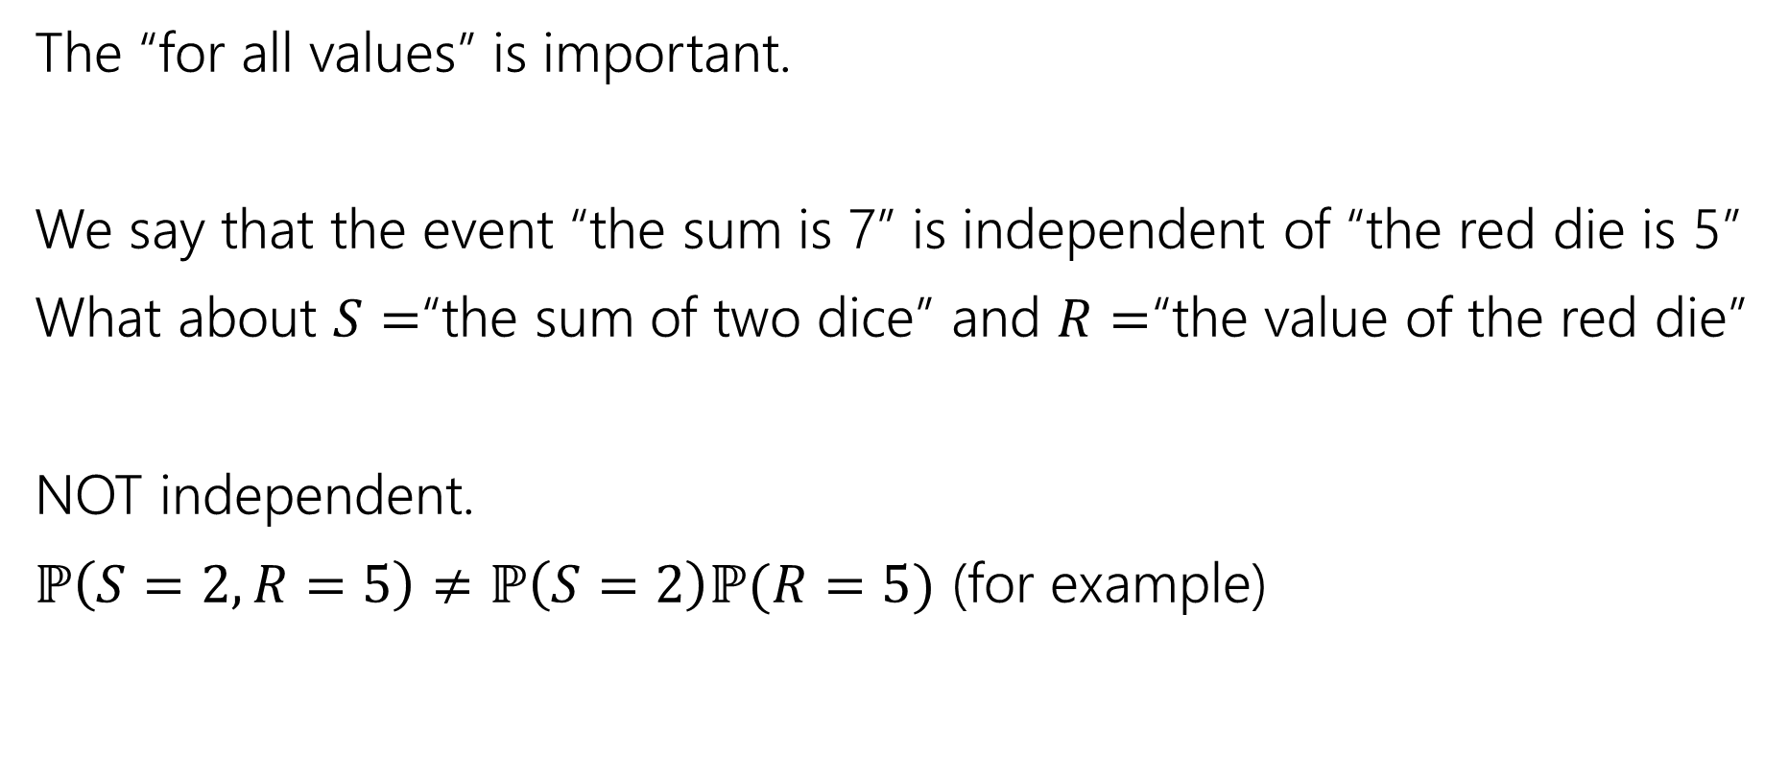
Independence of Random Variables
The “for all values” is important.
We say that the event “the sum is 7” is independent of “the red die is 5”
What about $S=$“the sum of two dice” and $R=$“the value of the red die”
NOT independent.
$ℙ\left(S=2, R=5\right)≠ℙ\left(S=2\right)ℙ(R=5)$ (for example)

Slide 29

Independence of Random Variables
Flip a coin independently $2n$ times.
Let $X$ be “the number of heads in the first $n$ flips.”
Let $Y$ be “the number of heads in the last $n$ flips.”
$X$ and $Y$ are independent.

Slide 30
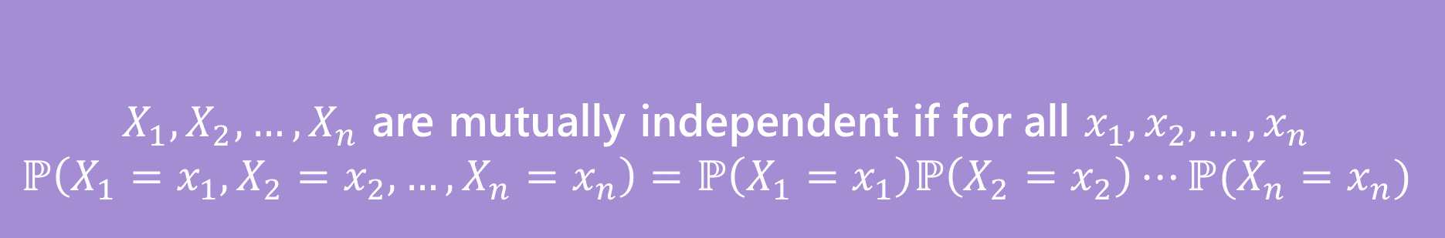

Mutual Independence for RVs
A little simpler to write down than for events
DON’T need to check all subsets for random variables…
But you do need to check all values (all possible $x_{i}$) still.
$X_{1},X_{2},…,X_{n}$ are mutually independent if for all $x_{1},x_{2},…,x_{n}$
$$ℙ\left(X_{1}=x_{1}, X_{2}=x_{2},…,X_{n}=x_{n}\right)=ℙ\left(X_{1}=x_{1}\right)ℙ\left(X_{2}=x_{2}\right)⋯ℙ(X_{n}=x_{n})$$
Mutual Independence (of random variables)

Slide 31
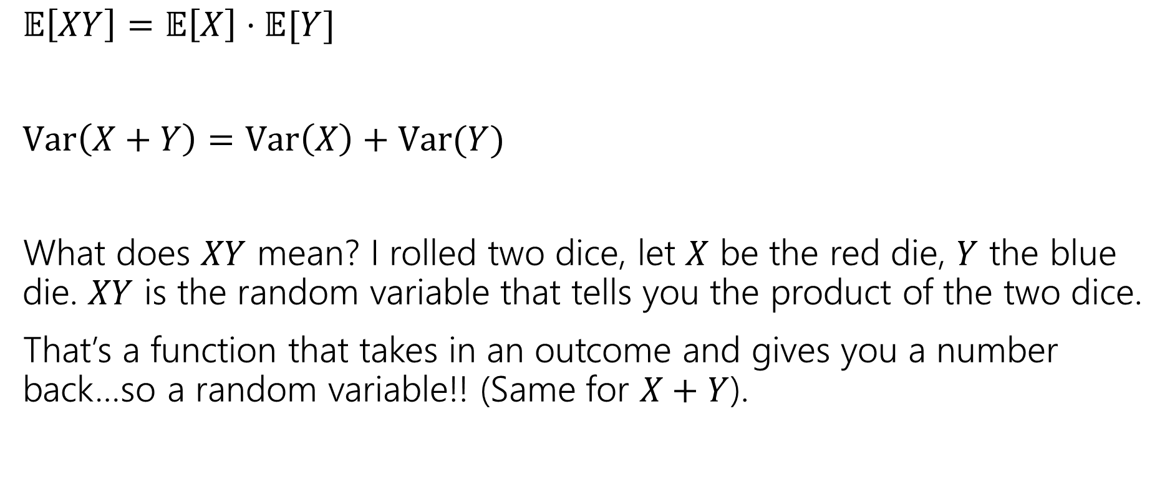
What does Independence give you?
$𝔼\left[XY\right]=𝔼\left[X\right]⋅𝔼[Y]$
$Var\left(X+Y\right)=Var\left(X\right)+Var(Y)$
What does $XY$ mean? I rolled two dice, let $X$ be the red die, $Y$ the blue die. $XY$ is the random variable that tells you the product of the two dice.
That’s a function that takes in an outcome and gives you a number back…so a random variable!! (Same for $X+Y$).

Slide 32
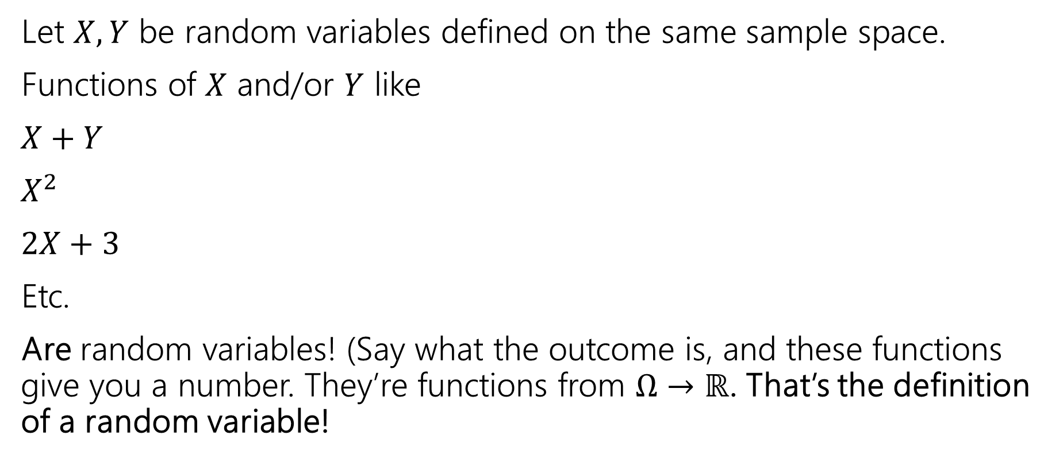
Functions of a random variable
Let $X,Y$ be random variables defined on the same sample space.
Functions of $X$ and/or $Y$ like
$X+Y$
$X^{2}$
$2X+3$
Etc.
Are random variables! (Say what the outcome is, and these functions give you a number. They’re functions from $Ω→ℝ$. That’s the definition of a random variable!

Slide 33
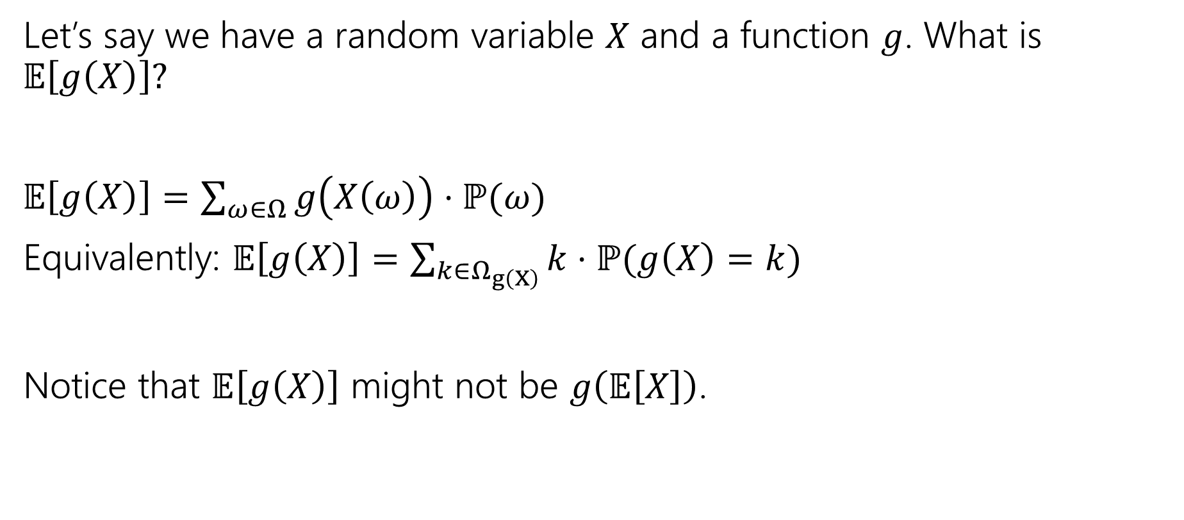
Expectations of functions of random variables
Let’s say we have a random variable $X$ and a function $g$. What is $𝔼\left[g\left(X\right)\right]?$
$𝔼\left[g\left(X\right)\right]=\sum_{ω∈Ω}{g\left(X\left(ω\right)\right)⋅ℙ(ω)}$
Equivalently: $𝔼\left[g\left(X\right)\right]=\sum_{k∈Ω_{g\left(X\right)}}{k⋅ℙ(g\left(X\right)=k)}$
Notice that $𝔼\left[g\left(X\right)\right]$ might not be $g\left(𝔼\left[X\right]\right)$.

Slide 34
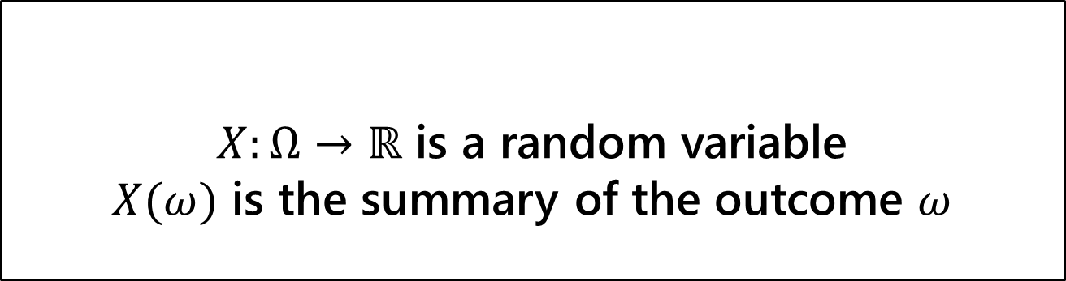
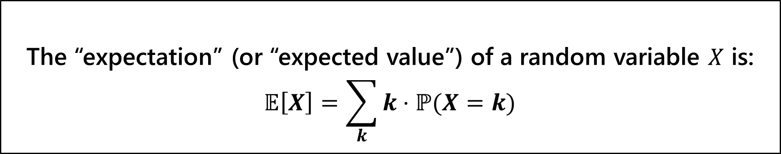
$X:Ω→ℝ$ is a random variable
$X(ω)$ is the summary of the outcome $ω$
Random Variable
The “expectation” (or “expected value”) of a random variable $X$ is:
$$𝔼\left[X\right]=\sum_{k}{k⋅ℙ(X=k)}$$
Expectation

