Slide 1
More Practice Independence, Conditioning, Bayes
CSE 312 Winter 26
Lecture 8

Slide 2

Today
Practice (independence and conditioning)
Bayes’ Rule in the real world!
Announcements
Please don’t discuss the quiz yet (makeups early next week)
HW3 updated (by noon today):
Extra info in Problem 1
We released the coding question (will be due with HW4, but we’d recommend you start now).

Slide 3
Conditional Independence

Slide 4

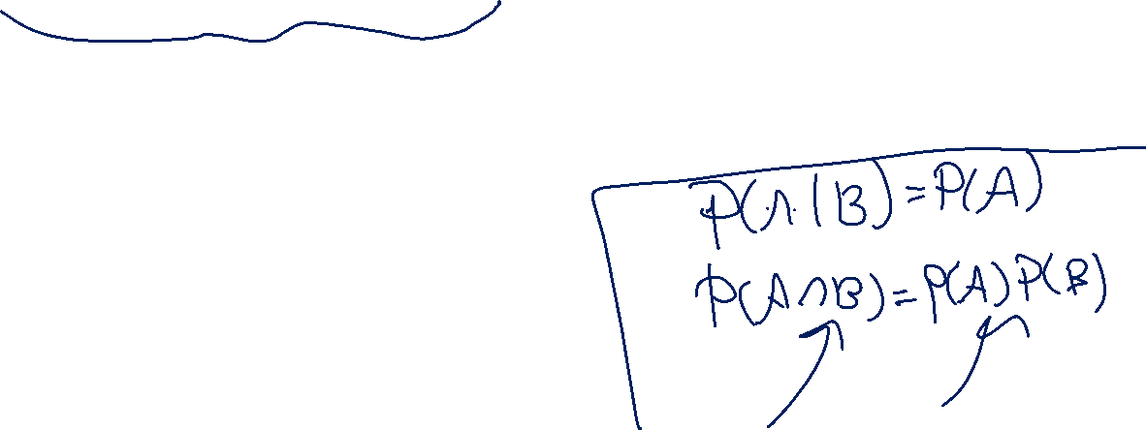
Conditional Independence (definition)
We say $A$ and $B$ are conditionally independent on $C$ if
$ℙ\left(A∩B | C\right)=ℙ\left(A | C\right)⋅ℙ(B|C)$
i.e. if you condition on $C$, they are independent.

Slide 5
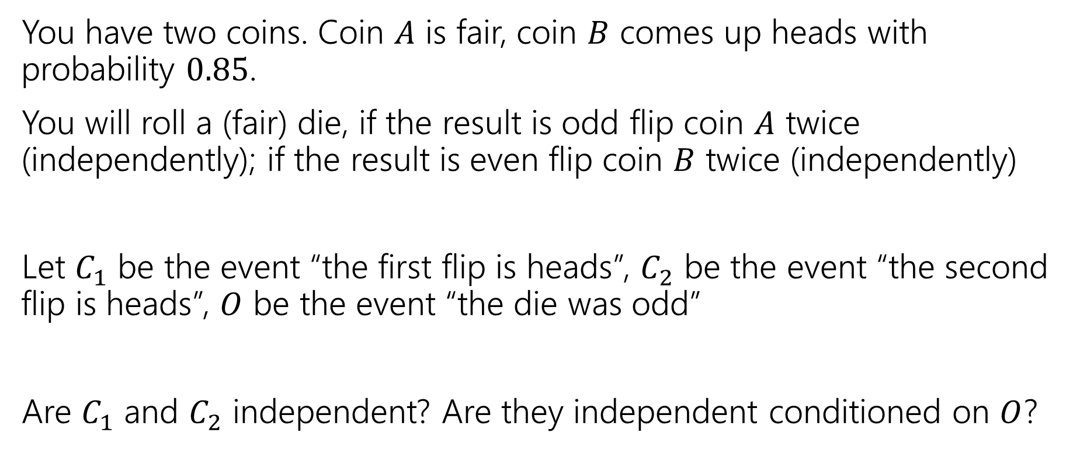
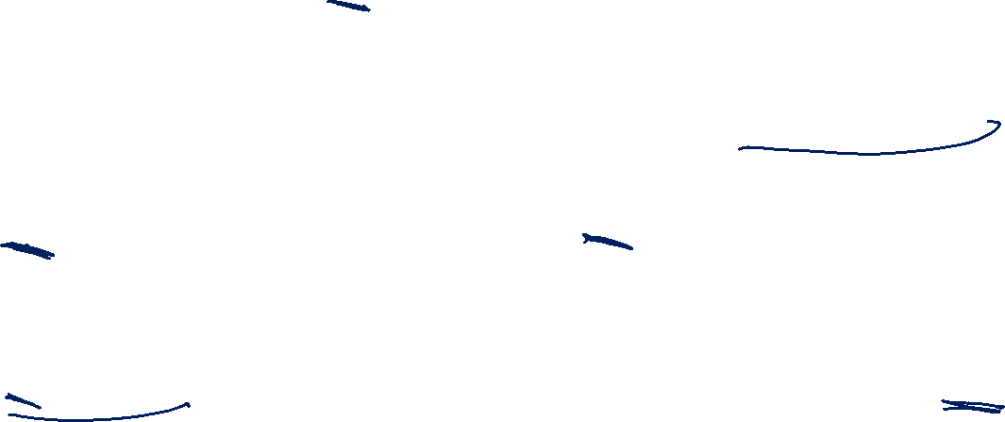
Conditional Independence Example
You have two coins. Coin $A$ is fair, coin $B$ comes up heads with probability $0.85$.
You will roll a (fair) die, if the result is odd flip coin $A$ twice (independently); if the result is even flip coin $B$ twice (independently)
Let $C_{1}$ be the event “the first flip is heads”, $C_{2}$ be the event “the second flip is heads”, $O$ be the event “the die was odd”
Are $C_{1}$ and $C_{2}$ independent? Are they independent conditioned on $O$?

Slide 6
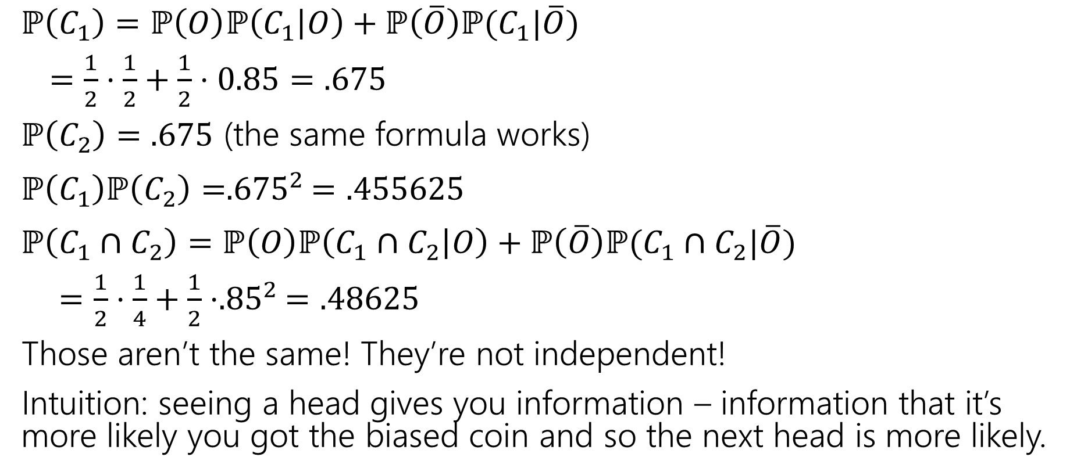

(Unconditioned) Independence
$ℙ\left(C_{1}\right)=ℙ\left(O\right)ℙ\left(C_{1} | O\right)+ℙ\left(\overline{O}\right)ℙ(C_{1}|\overline{O})$
$=\frac{1}{2}⋅\frac{1}{2}+\frac{1}{2}⋅0.85=.675$
$ℙ\left(C_{2}\right)=.675$ (the same formula works)
$ℙ\left(C_{1}\right)ℙ\left(C_{2}\right)={.675}^{2}=.455625$
$ℙ\left(C_{1}∩C_{2}\right)=ℙ\left(O\right)ℙ\left(C_{1}∩C_{2} | O\right)+ℙ\left(\overline{O}\right)ℙ(C_{1}∩C_{2}|\overline{O})$
$=\frac{1}{2}⋅\frac{1}{4}+\frac{1}{2}⋅{.85}^{2}=.48625$
Those aren’t the same! They’re not independent!
Intuition: seeing a head gives you information – information that it’s more likely you got the biased coin and so the next head is more likely.

Slide 7

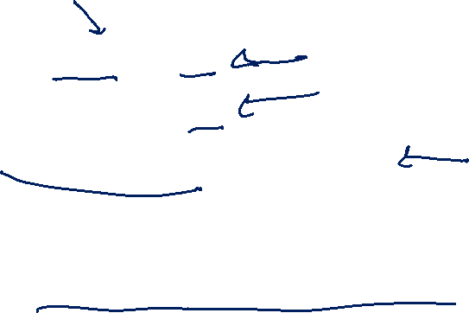
Conditional Independence (computation)
$ℙ\left(C_{1} | O\right)=1/2$
$ℙ\left(C_{2} | O\right)=1/2$
$ℙ\left(C_{1}∩C_{2} | O\right)=\frac{1}{2}⋅\frac{1}{2}=1/4$
$ℙ\left(C_{1} | O\right)ℙ\left(C_{2} | O\right)=ℙ(C_{1}∩C_{2}|O)$
Yes! $C_{1}$ and $C_{2}$ are conditionally independent, conditioned on $O$.

Slide 8
Takeaway
Read a problem carefully – when we say “these steps are independent of each other” about some part of a sequential process, it’s usually “conditioned on all prior steps, these steps are conditionally independent of each other.”
Those conditional steps are usually dependent (without conditioning) because they might give you information about which branch you took.

Slide 9
More Bayes Practice

Slide 10
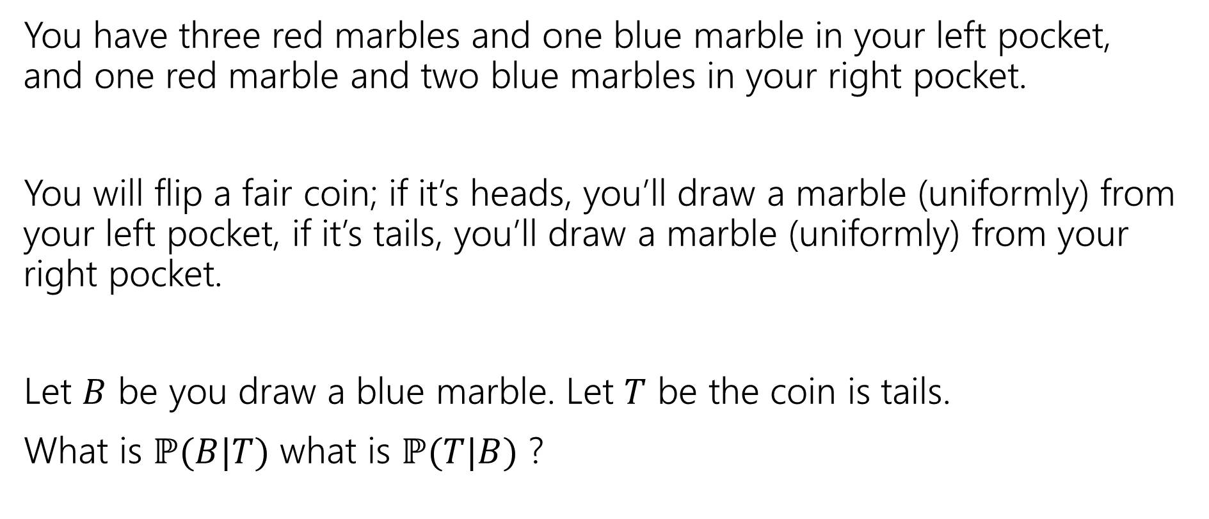
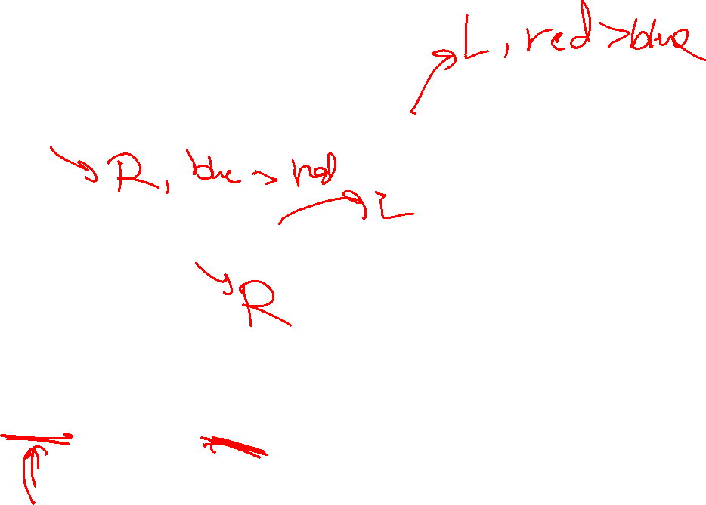
A contrived example
You have three red marbles and one blue marble in your left pocket, and one red marble and two blue marbles in your right pocket.
You will flip a fair coin; if it’s heads, you’ll draw a marble (uniformly) from your left pocket, if it’s tails, you’ll draw a marble (uniformly) from your right pocket.
Let $B$ be you draw a blue marble. Let $T$ be the coin is tails.
What is $ℙ(B|T)$ what is $ℙ(T|B)$ ?

Slide 11

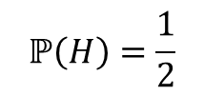







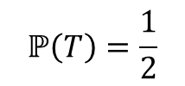

Updated Sequential Processes
You have three red marbles and one blue marble in your left pocket, and one red marble and two blue marbles in your right pocket.
if it’s heads, you’ll draw a marble (uniformly) from your left pocket,
if it’s tails, you’ll draw a marble (uniformly) from your right pocket.
$$ℙ\left(H\right)=\frac{1}{2}$$
$$ℙ\left(T\right)=\frac{1}{2}$$
H
T
For sequential processes with probability, at each step multiply by $ℙ\left(next step \right|all∩prior∩steps)$
$$ℙ\left(R|H\right)=\frac{3}{4}$$
$$ℙ\left(R|T\right)=\frac{1}{3}$$
$$ℙ\left(B|T\right)=\frac{2}{3}$$
$$ℙ\left(B|H\right)=\frac{1}{4}$$
$$ℙ\left(R∩H\right)=3/8$$
$$ℙ\left(R∩T\right)=1/6$$
$$ℙ\left(B∩H\right)=1/8$$
$$ℙ\left(B∩T\right)=1/3$$

Slide 12
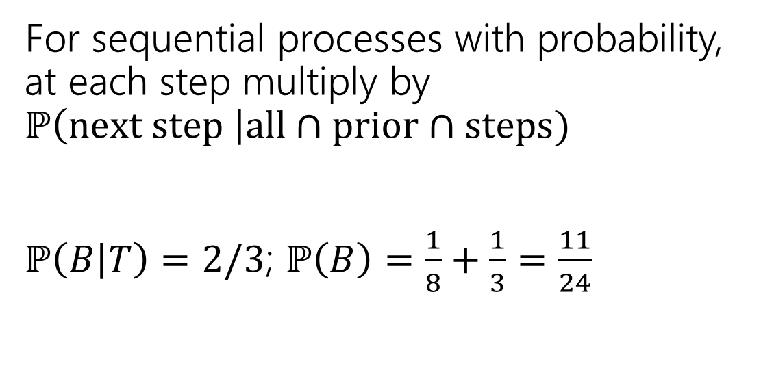
Updated Sequential Processes (answer)
You have three red marbles and one blue marble in your left pocket, and one red marble and two blue marbles in your right pocket.
if it’s heads, you’ll draw a marble (uniformly) from your left pocket,
if it’s tails, you’ll draw a marble (uniformly) from your right pocket.
$$ℙ\left(H\right)=\frac{1}{2}$$
$$ℙ\left(T\right)=\frac{1}{2}$$
H
T
For sequential processes with probability, at each step multiply by $ℙ\left(next step \right|all∩prior∩steps)$
$ℙ\left(B | T\right)=2/3$; $ℙ\left(B\right)=\frac{1}{8}+\frac{1}{3}=\frac{11}{24}$
$$ℙ\left(R|H\right)=\frac{3}{4}$$
$$ℙ\left(R|T\right)=\frac{1}{3}$$
$$ℙ\left(B|T\right)=\frac{2}{3}$$
$$ℙ\left(B|H\right)=\frac{1}{4}$$
$$ℙ\left(R∩H\right)=3/8$$
$$ℙ\left(R∩T\right)=1/6$$
$$ℙ\left(B∩H\right)=1/8$$
$$ℙ\left(B∩T\right)=1/3$$

Slide 13


Flipping the conditioning
You have three red marbles and one blue marble in your left pocket, and one red marble and two blue marbles in your right pocket.
if it’s heads, you’ll draw a marble (uniformly) from your left pocket,
if it’s tails, you’ll draw a marble (uniformly) from your right pocket.
What about $ℙ(T|B)$?
Pause, what’s your intuition?
Is this probability
A. less than $½$
B. equal to $½$
C. greater than $½$

Slide 14
Flipping the conditioning (marbles)
You have three red marbles and one blue marble in your left pocket, and one red marble and two blue marbles in your right pocket.
if it’s heads, you’ll draw a marble (uniformly) from your left pocket,
if it’s tails, you’ll draw a marble (uniformly) from your right pocket.
What about $ℙ(T|B)$?
Pause, what’s your intuition?
Is this probability
A. less than $½$
B. equal to $½$
C. greater than $½$
The right (tails) pocket is far more likely to produce a blue marble if picked than the left (heads) pocket is. Seems like $ℙ(T|B)$ should be greater than ½.

Slide 15


Flipping the conditioning (marbles, answer)
You have three red marbles and one blue marble in your left pocket, and one red marble and two blue marbles in your right pocket.
if it’s heads, you’ll draw a marble (uniformly) from your left pocket,
if it’s tails, you’ll draw a marble (uniformly) from your right pocket.
What about $ℙ(T|B)$?
Bayes’ Rule says:
$ℙ\left(T | B\right)=\frac{ℙ(B|T)ℙ\left(T\right)}{ℙ\left(B\right)}$
$=\frac{\frac{2}{3}⋅\frac{1}{2}}{11/24}=8/11$

Slide 16
The Technical Stuff

Slide 17
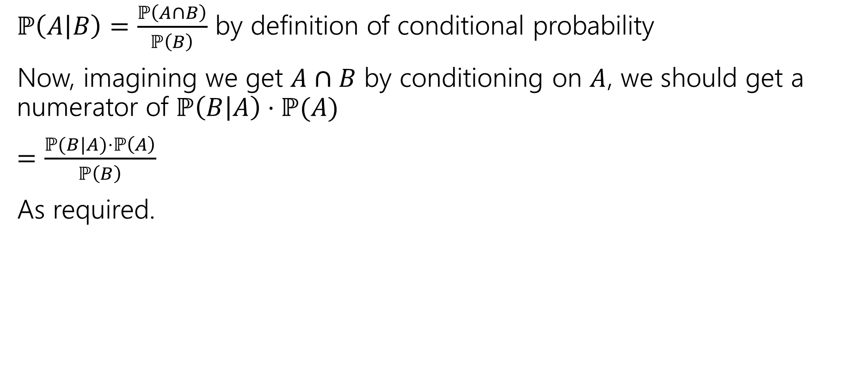

Proof of Bayes’ Rule
$ℙ\left(A | B\right)=\frac{ℙ\left(A∩B\right)}{ℙ\left(B\right)}$ by definition of conditional probability
Now, imagining we get $A∩B$ by conditioning on $A$, we should get a numerator of $ℙ\left(B | A\right)⋅ℙ(A)$
$=\frac{ℙ(B|A)⋅ℙ\left(A\right)}{ℙ\left(B\right)}$
As required.

Slide 18
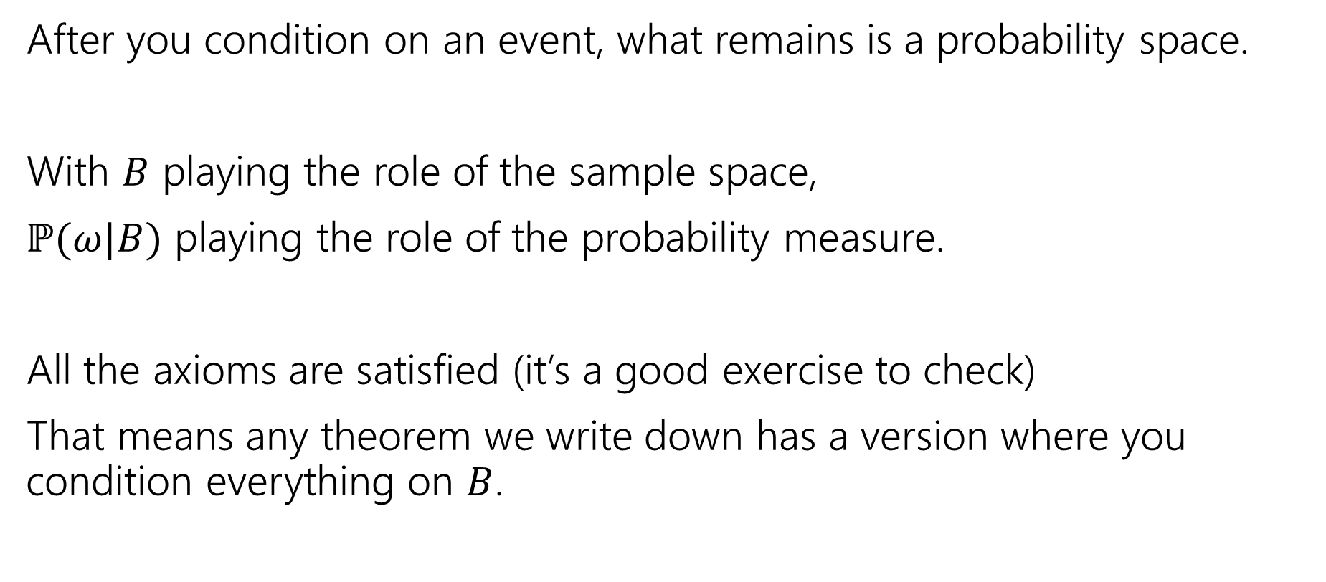

A Technical Note
After you condition on an event, what remains is a probability space.
With $B$ playing the role of the sample space,
$ℙ(ω|B)$ playing the role of the probability measure.
All the axioms are satisfied (it’s a good exercise to check)
That means any theorem we write down has a version where you condition everything on $B$.

Slide 19
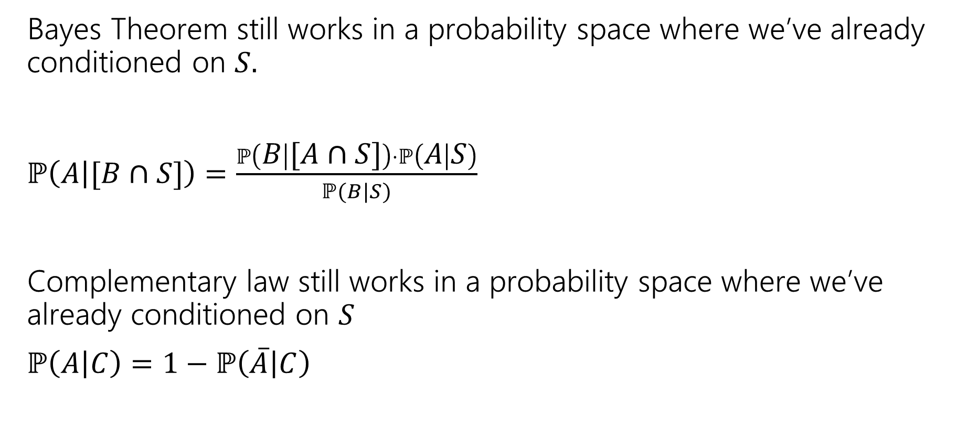
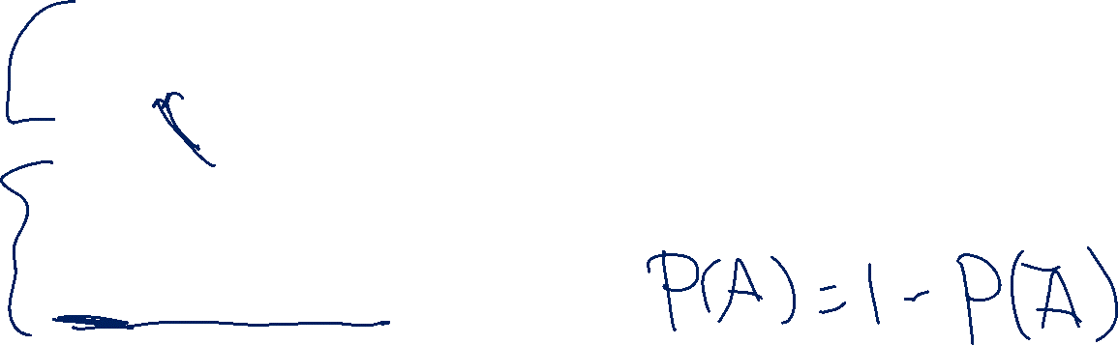
An Example
Bayes Theorem still works in a probability space where we’ve already conditioned on $S.$
$ℙ\left(A | [B∩S]\right)=\frac{ℙ\left(B | [A∩S]\right)⋅ℙ\left(A | S\right)}{ℙ(B|S)}$
Complementary law still works in a probability space where we’ve already conditioned on $S$
$ℙ\left(A | C\right)=1−ℙ\left(\overline{A} | C\right)$
Notes:
These are just examples. EVERY theorem we have that mentions events works this way.

Slide 20
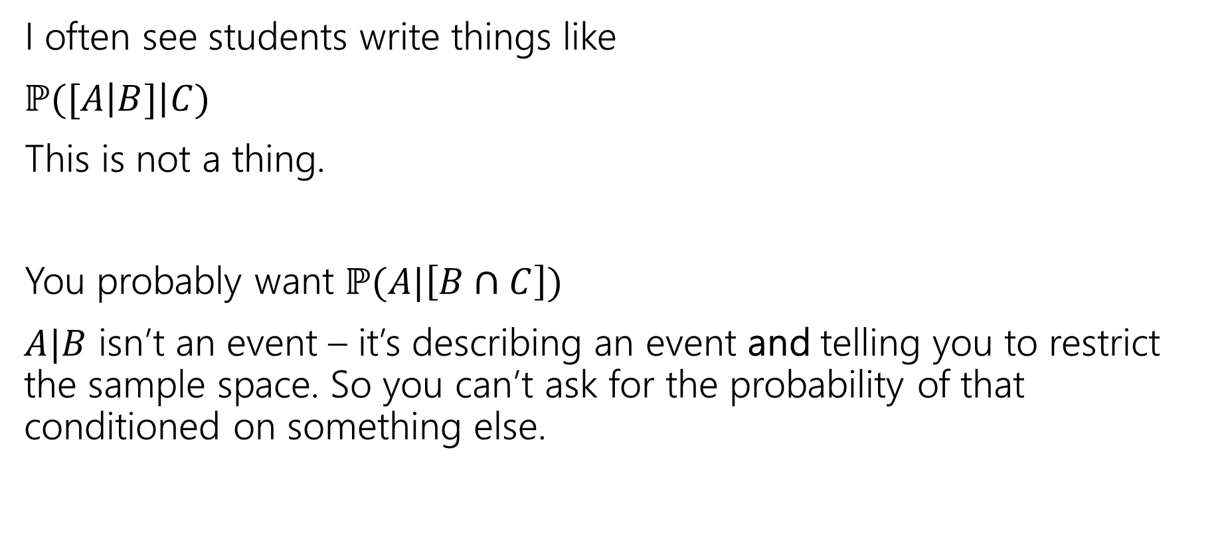
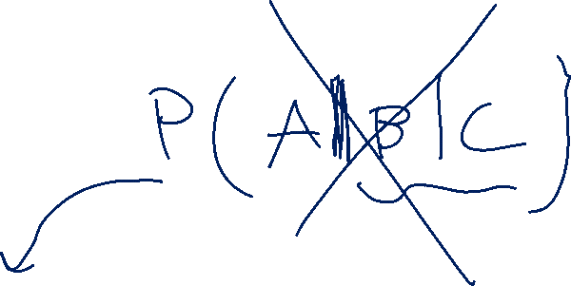
A Quick Technical Remark
I often see students write things like
$ℙ([A\left|B]\right|C)$
This is not a thing.
You probably want $ℙ(A|\left[B∩C\right])$
$A|B$ isn’t an event – it’s describing an event and telling you to restrict the sample space. So you can’t ask for the probability of that conditioned on something else.

Slide 21
Chain Rule

Slide 22

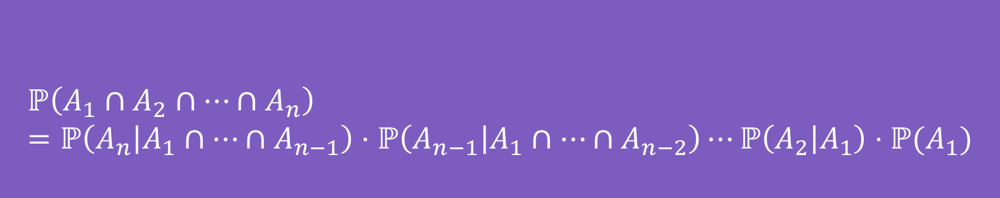
Chain Rule (definition)
We defined conditional probability as: $ℙ\left(A | B\right)=\frac{ℙ\left(A∩B\right)}{ℙ\left(B\right)}$
Which means $ℙ\left(A∩B\right)=ℙ(A|B)ℙ(B)$
$$ℙ\left(A_{1}∩A_{2}∩…∩A_{n}\right)=ℙ\left(A_{n} | A_{1}∩…∩A_{n−1}\right)⋅ℙ\left(A_{n−1} | A_{1}∩…∩A_{n−2}\right)⋯ℙ\left(A_{2} | A_{1}\right)⋅ℙ(A_{1})$$
Chain Rule
Notes:
We see this most frequently when we have an n-step sequential process.

Slide 23
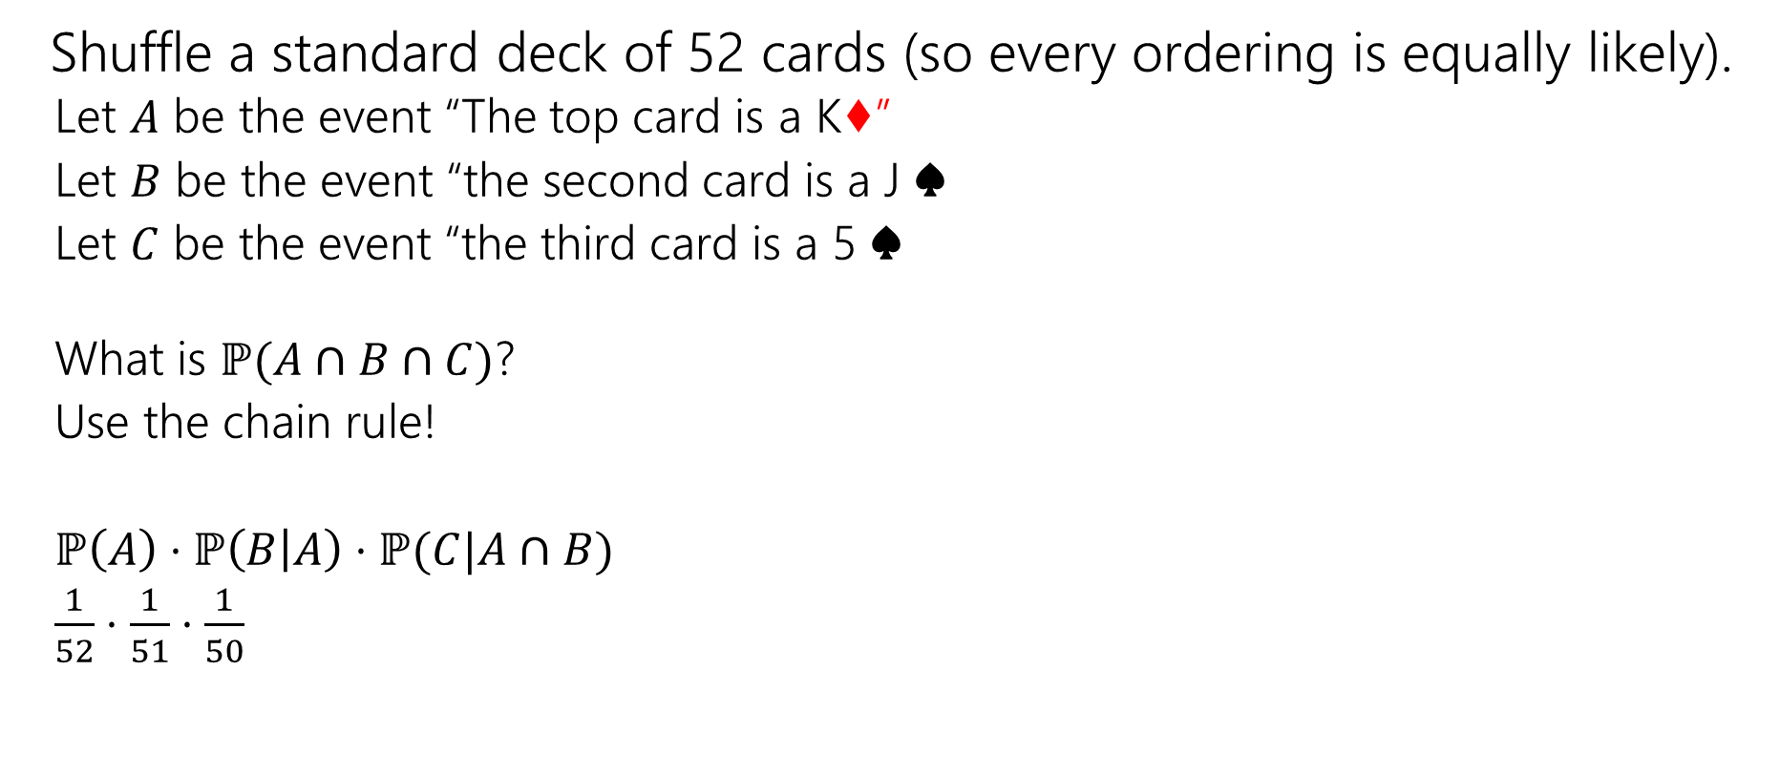
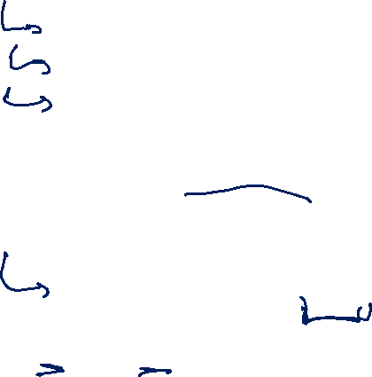
Chain Rule Example
Shuffle a standard deck of 52 cards (so every ordering is equally likely).
Let $A$ be the event “The top card is a K♦”
Let $B$ be the event “the second card is a J ♠️
Let $C$ be the event “the third card is a 5 ♠️
What is $ℙ(A∩B∩C)$?
Use the chain rule!
$ℙ\left(A\right)⋅ℙ\left(B | A\right)⋅ℙ(C|A∩B)$
$\frac{1}{52}⋅\frac{1}{51}⋅\frac{1}{50}$

Slide 24
More Independence

Slide 25
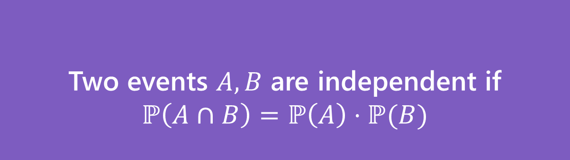
Independence of events
Recall the definition of independence of events:
Two events $A,B$ are independent if
$$ℙ\left(A∩B\right)=ℙ\left(A\right)⋅ℙ(B)$$
Independence

Slide 26

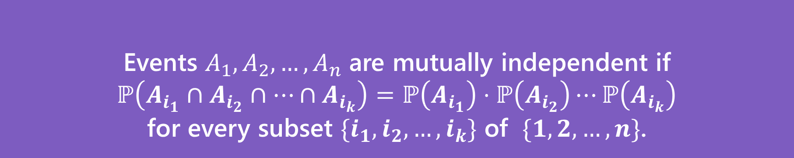
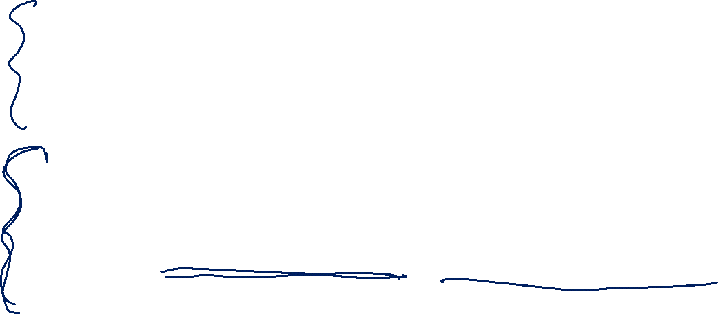
Independence for 3 or more events
For three or more events, we need two kinds of independence
Events $A_{1},A_{2},…,A_{n}$ are pairwise independent if
$ℙ\left(A_{i}∩A_{j}\right)=ℙ\left(A_{i}\right)⋅ℙ\left(A_{j}\right)$ for all $i,j$
Pairwise Independence
Events $A_{1},A_{2},…,A_{n}$ are mutually independent if
$ℙ\left(A_{i_{1}}∩A_{i_{2}}∩…∩A_{i_{k}}\right)=ℙ\left(A_{i_{1}}\right)⋅ℙ\left(A_{i_{2}}\right)⋯ℙ\left(A_{i_{k}}\right)$
for every subset $\{i_{1},i_{2},…,i_{k}\}$ of $\{1,2,…,n\}$.
Mutual Independence

Slide 27


Pairwise Independence vs. Mutual Independence
Roll two fair dice (one red one blue) independently
$R=$“red die is $3$”
$B=$“blue die is 5”
$S=$“sum is $7$”
How should we describe these events?

Slide 28
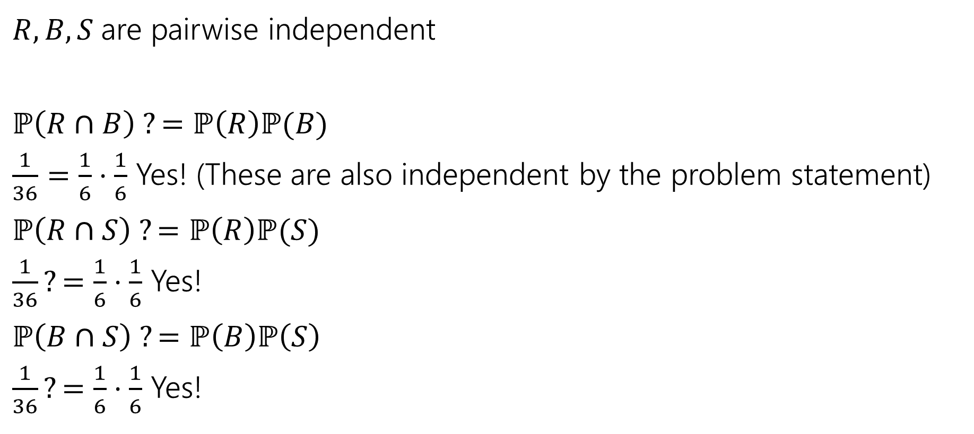
Pairwise Independence
$R,B,S$are pairwise independent
$ℙ\left(R∩B\right) ?=ℙ\left(R\right)ℙ(B)$
$\frac{1}{36}=\frac{1}{6}⋅\frac{1}{6}$ Yes! (These are also independent by the problem statement)
$ℙ\left(R∩S\right) ?=ℙ\left(R\right)ℙ(S)$
$\frac{1}{36}?=\frac{1}{6}⋅\frac{1}{6}$ Yes!
$ℙ\left(B∩S\right) ?=ℙ\left(B\right)ℙ\left(S\right)$
$\frac{1}{36}?=\frac{1}{6}⋅\frac{1}{6}$ Yes!
Since all three pairs are independent, we say the random variables are pairwise independent.

Slide 29

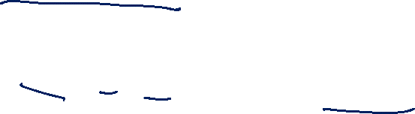
Mutual Independence
$R,B,S$ are not mutually independent.
$ℙ\left(R∩B∩S\right)=0;$if the red die is 3, and blue die is 5 then the sum is 8 (so it can’t be 7)
$ℙ\left(R\right)ℙ\left(B\right)ℙ\left(S\right)={\left(\frac{1}{6}\right)}^{3}=\frac{1}{216}≠0$

Slide 30
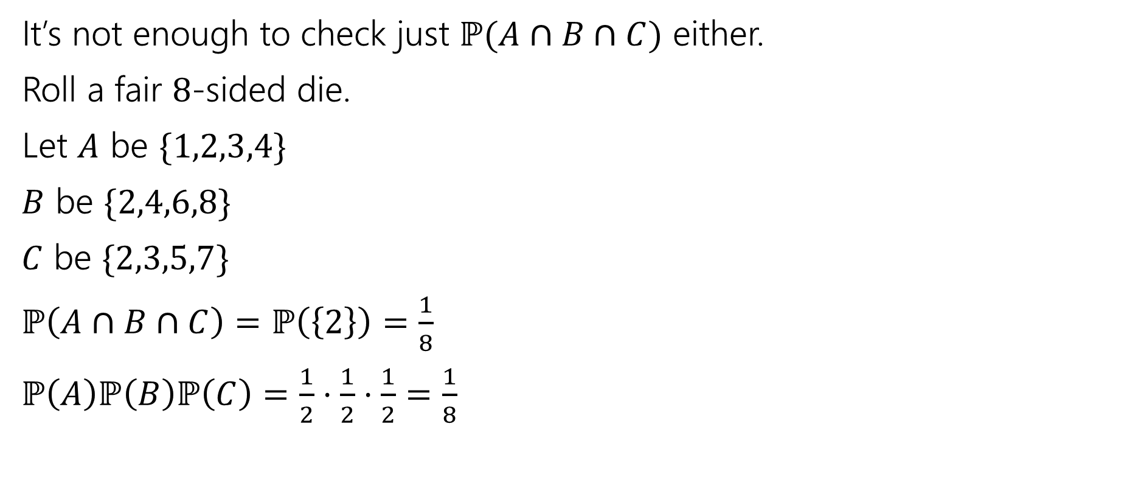
Checking Mutual Independence (1)
It’s not enough to check just $ℙ(A∩B∩C)$ either.
Roll a fair $8$-sided die.
Let $A$ be $\{1,2,3,4\}$
$B$ be $\{2,4,6,8\}$
$C$ be $\{2,3,5,7\}$
$ℙ\left(A∩B∩C\right)=ℙ\left(\left\{2\right\}\right)=\frac{1}{8}$
$ℙ\left(A\right)ℙ\left(B\right)ℙ\left(C\right)=\frac{1}{2}⋅\frac{1}{2}⋅\frac{1}{2}=\frac{1}{8}$

Slide 31
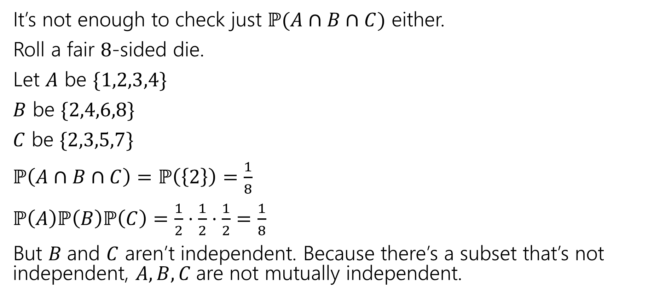
Checking Mutual Independence (2)
It’s not enough to check just $ℙ(A∩B∩C)$ either.
Roll a fair $8$-sided die.
Let $A$ be $\{1,2,3,4\}$
$B$ be $\{2,4,6,8\}$
$C$ be $\{2,3,5,7\}$
$ℙ\left(A∩B∩C\right)=ℙ\left(\left\{2\right\}\right)=\frac{1}{8}$
$ℙ\left(A\right)ℙ\left(B\right)ℙ\left(C\right)=\frac{1}{2}⋅\frac{1}{2}⋅\frac{1}{2}=\frac{1}{8}$
But $B$and $C$ aren’t independent. Because there’s a subset that’s not independent, $A,B,C$are not mutually independent.

Slide 32
Checking Mutual Independence (process)
To check mutual independence of events:
Check every subset.
To check pairwise independence of events:
Check every subset of size two.

Slide 33
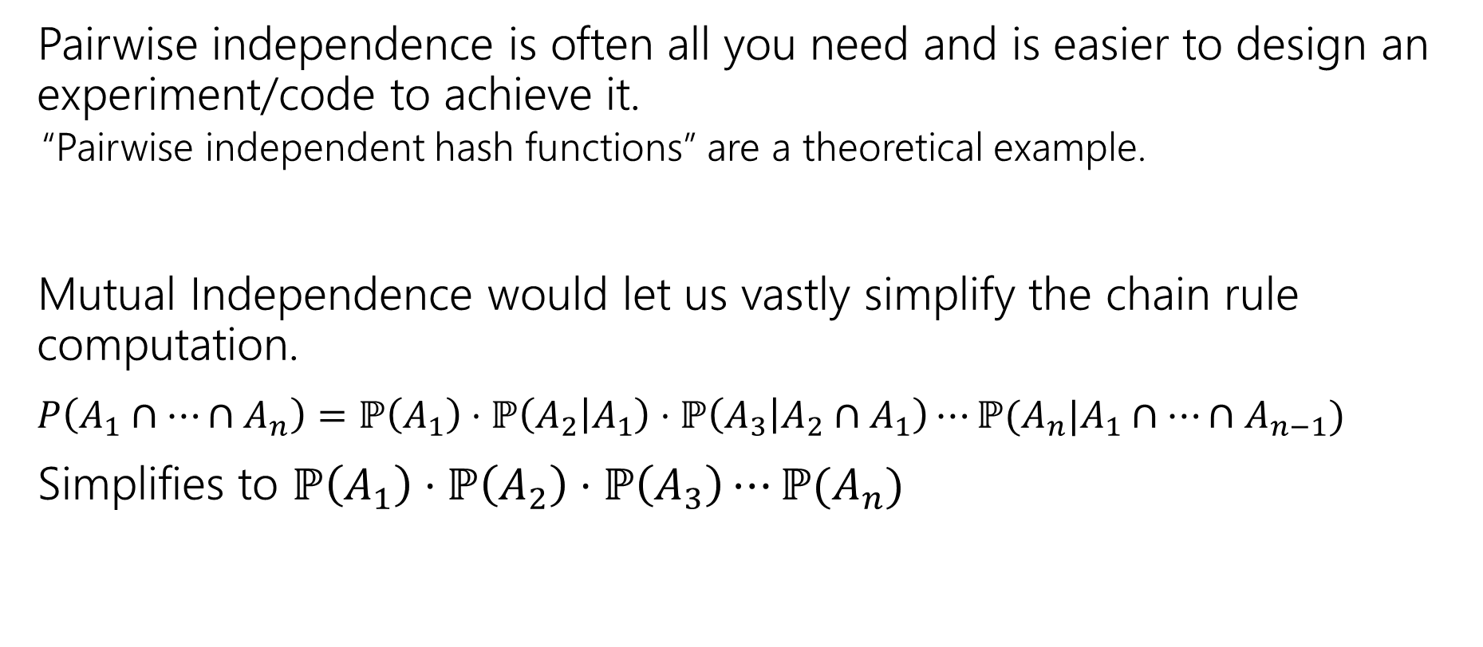

Why Two Versions?
Pairwise independence is often all you need and is easier to design an experiment/code to achieve it.
“Pairwise independent hash functions” are a theoretical example.
Mutual Independence would let us vastly simplify the chain rule computation.
$P\left(A_{1}∩…∩A_{n}\right)=ℙ\left(A_{1}\right)⋅ℙ\left(A_{2} | A_{1}\right)⋅ℙ\left(A_{3} | A_{2}∩A_{1}\right)⋯ℙ(A_{n}|A_{1}∩⋯∩A_{n−1})$
Simplifies to $ℙ\left(A_{1}\right)⋅ℙ\left(A_{2}\right)⋅ℙ\left(A_{3}\right)⋯ℙ(A_{n})$

Slide 34
Bayes in the real world

Slide 35
Application 1: Medical Tests
Helping Doctors and Patients Make Sense of Health Statistics
A researcher posed the following scenario to a group of 160 doctors:
Assume you conduct a disease screening using a standard test in a certain region. You know the following information about the people in this region:
The probability that a person has the disease is 1% (prevalence)
If a person has the disease, the probability that she tests positive is 90% (sensitivity)
If a person does not have the disease, the probability that she nevertheless tests positive is 9% (false-positive rate)
A person tests positive. She wants to know from you whether that means that she has the disease for sure, or what the chances are. What is the best answer?
A. The probability that she has the disease is about 81%.
B. Out of 10 people with a positive test, about 9 have the disease.
C. Out of 10 people with a positive test, about 1 have the disease.
D. The probability that she has the disease is about 1%

Slide 36
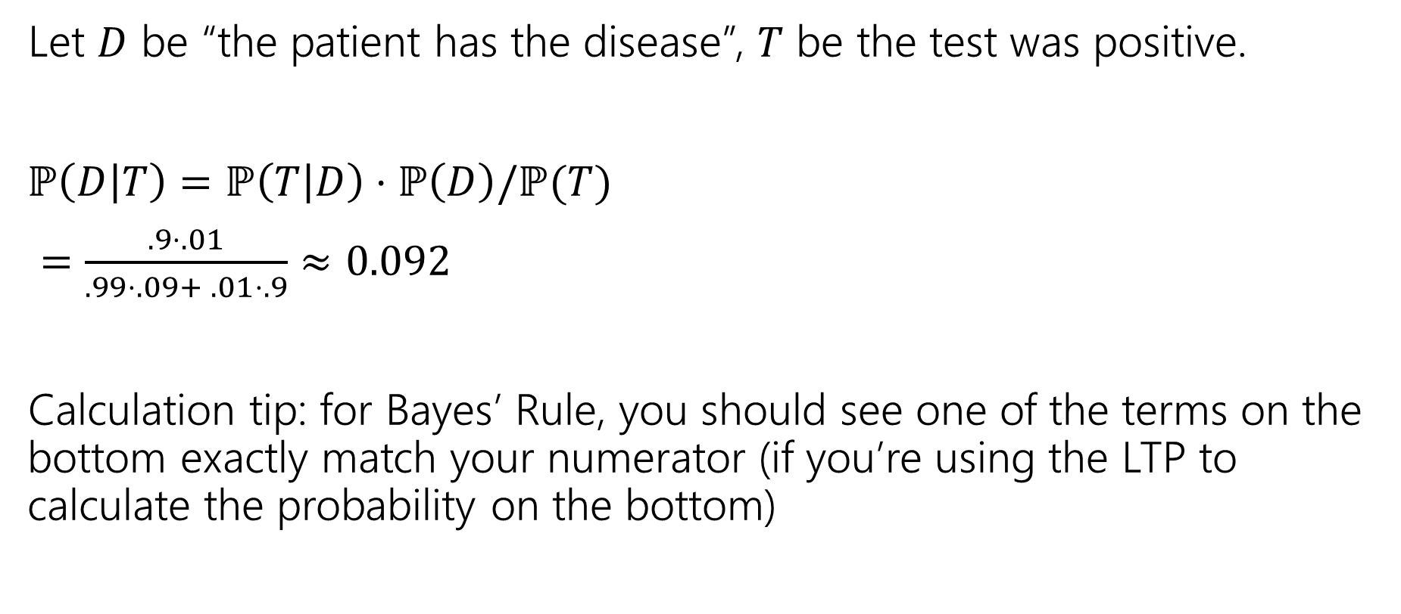
Let’s do the calculation!
Let $D$ be “the patient has the disease”, $T$ be the test was positive.
$ℙ\left(D | T\right)=ℙ\left(T | D\right)⋅ℙ\left(D\right)/ℙ(T)$
$=\frac{.9⋅.01}{.99⋅.09+ .01⋅.9}≈0.092$
Calculation tip: for Bayes’ Rule, you should see one of the terms on the bottom exactly match your numerator (if you’re using the LTP to calculate the probability on the bottom)

Slide 37
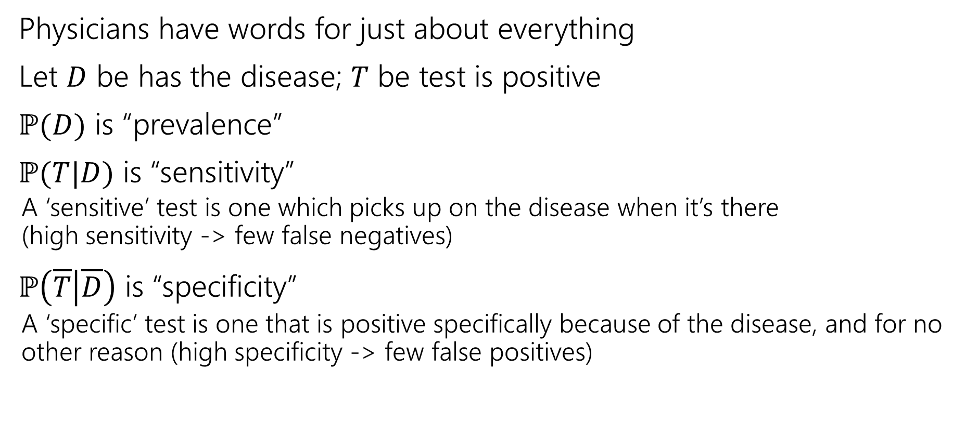
Pause for vocabulary
Physicians have words for just about everything
Let $D$ be has the disease; $T$ be test is positive
$ℙ(D)$ is “prevalence”
$ℙ(T|D)$ is “sensitivity”
A ‘sensitive’ test is one which picks up on the disease when it’s there (high sensitivity -> few false negatives)
$ℙ\left(\overline{T} | \overline{D}\right)$ is “specificity”
A ‘specific’ test is one that is positive specifically because of the disease, and for no other reason (high specificity -> few false positives)

Slide 38
How did the doctors do
C (about 1 in 10) was the correct answer.
Of the doctors surveyed, less than ¼ got it right (so worse than random guessing).
After the researcher taught them his calculation trick, more than 80% got it right.

Slide 39
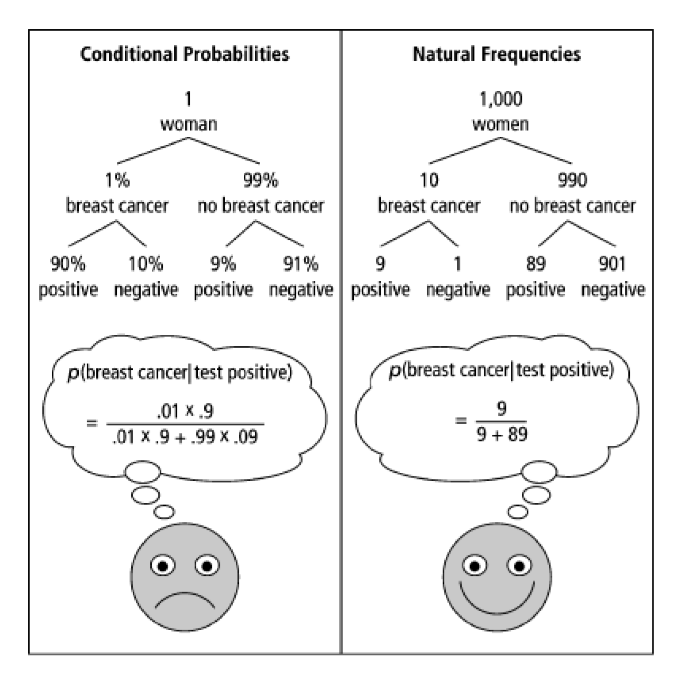
One Weird Trick!
Calculation Trick: imagine you have a large population (not one person) and ask how many there are of false/true positives/negatives.

Slide 40
What about the real world?
When you’re older and have to do more routine medical tests, don’t get concerned (yet) when they ask to run another test.*
It’s usually fine.*
*This is not medical advice, Robbie is not a physician.

Slide 41
Optional: Careful Surveys
Another Real-World Bayes example

Slide 42
Application 2: An Imbalanced Survey
In 2014, a paper was published
“Do non-citizens vote in U.S. elections?”
This is a real paper (peer-reviewed). It claims that
1. In a survey, about 4% (of a few hundred) of non-U.S.-citizens surveyed said they voted in the 2008 federal election (which isn’t allowed).
2. Those non-citizen voters voted heavily (estimate 80+%) for democrats.
3. “It is likely though by no means certain that John McCain would have won North Carolina were it not for the votes for Obama cast by non-citizens”

Slide 43
Application 2: What is this survey?
The “Cooperative Congressional Election Study” was run in 2008 and 2010.
It interviews about 20,000 people about how/whether they voted in federal elections.
Two strange observations:
1. The noncitizens are a very small portion of those surveyed. Feels a little strange.
2. Those people…maybe accidentally admitted to a crime?

Slide 44
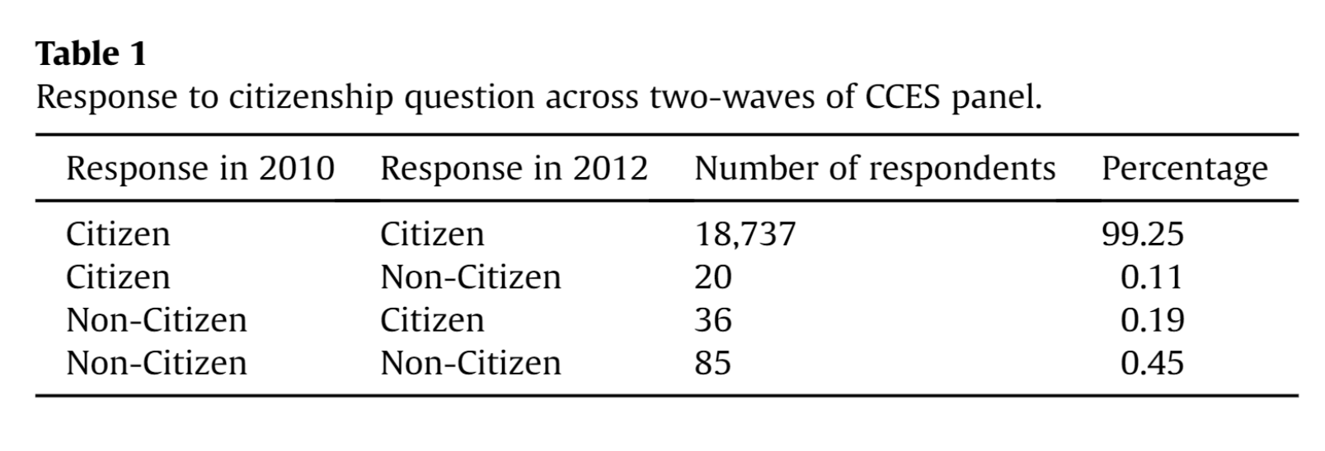
Application 2: Another Red Flag
A response paper (by different authors)
“The perils of cherry picking low frequency events in large sample surveys”
Notes:
A few thousand people per year renounce US citizenship (usually for tax reasons); number varies substantially over time (news source, but lacking exact data: https://www.forbes.com/sites/kathleenpeddicord/2022/07/28/does-renouncing-us-citizenship-make-sense-for-the-average-american-abroad/?sh=105ab80823ca) , but we’d generally expect closer to 1-2 people not 20 that lose citizenship.

Slide 45
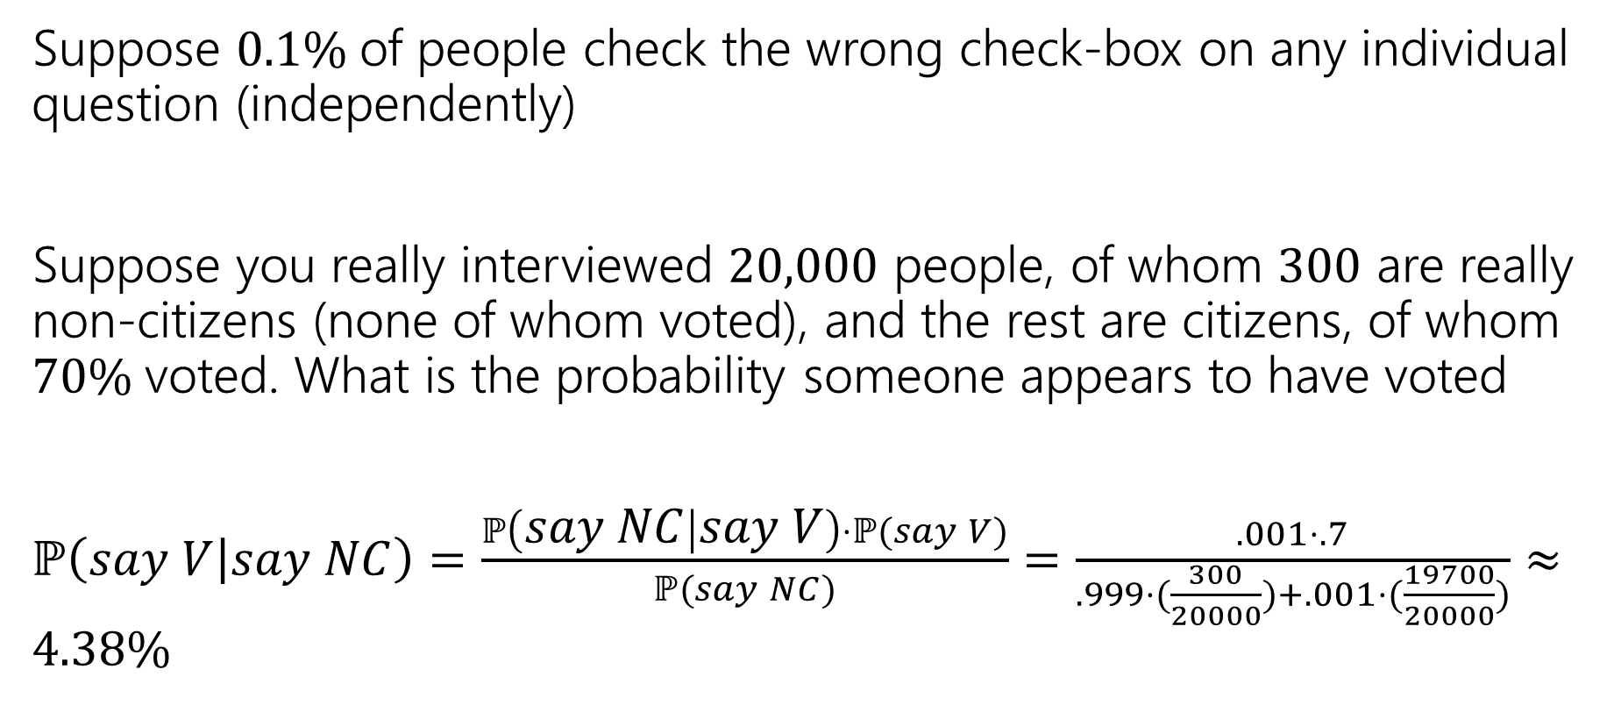
An Explanation
Suppose $0.1\%$of people check the wrong check-box on any individual question (independently)
Suppose you really interviewed $20,000$ people, of whom $300$ are really non-citizens (none of whom voted), and the rest are citizens, of whom $70\%$voted. What is the probability someone appears to have voted
$ℙ\left(say V | say NC\right)=\frac{ℙ\left(say NC | say V\right)⋅ℙ(say V)}{ℙ(say NC)}=\frac{.001⋅.7}{.999⋅(\frac{300}{20000})+.001⋅(\frac{19700}{20000})}≈4.38\%$

Slide 46
Conclusion
The authors of the original paper did know about response error…
…and they have an appendix that argues the population of “non-citizen” voters isn’t distributed exactly like you’d expect.
But with it being such a small number of people, this isn’t surprising.
And even they admit response bias played more of a role than they initially thought.
Though they still think they found some evidence of non-citizens voting (but not enough to flip North Carolina anymore).
Notes:
A possibility (Robbie’s hot take): it might be that question was misinterpreted as “would you vote if allowed/who would you vote for” by some number of people, along with more traditional response error.

Slide 47
Takeaways
When talking about rare events (rare diseases, rare prize-winning-golden-tickets), think carefully about whether a test is really as informative as you think.
Do the explicit calculation
Intuition is easier if thinking about a large population of repeated tests, not just one.
Be careful of small subparts of large datasets
People from a large majority group (accidentally) clicking the wrong demographic information can “drown out” signal of a very small group.

Slide 48
Optional: Bayes Factor
A way to estimate Bayes calculations quickly

Slide 49
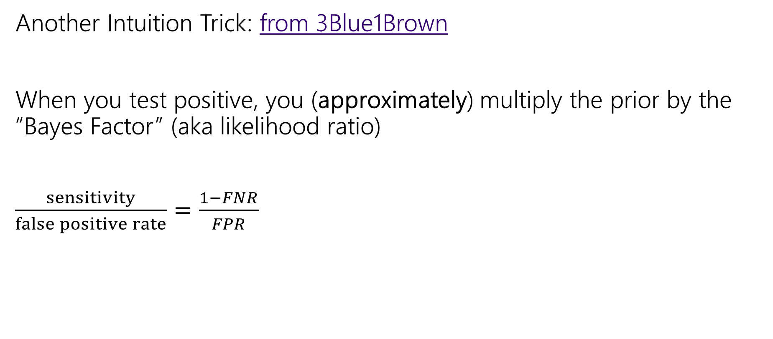
Bayes Factor
Another Intuition Trick: from 3Blue1Brown
When you test positive, you (approximately) multiply the prior by the “Bayes Factor” (aka likelihood ratio)
$\frac{sensitivity}{false positive rate}=\frac{1−FNR}{FPR}$

Slide 50

Bayes Factor (example)
Does it work?
Let’s try it…
Find
$prior⋅\frac{Sensitivity}{FPR}$

Slide 51
Wonka Bars
Willy Wonka has placed golden tickets on 0.1% of his Wonka Bars.
You want to get a golden ticket. You could buy a 1000-or-so of the bars until you find one, but that’s expensive…you’ve got a better idea!
You have a test – a very precise scale you’ve bought.
If the bar you weigh does have a golden ticket, the scale will alert you 99.9% of the time.
If the bar you weigh does not have a golden ticket, the scale will (falsely) alert you only 1% of the time.
If you pick up a bar and it alerts, what is the probability you have a golden ticket?

Slide 52

Wonka Bars (Bayes Factor)
Bayes Factor
$\frac{99.9}{1}$
Prior: $.1\%$
Product: $9.99$, so about $10\%$
About what Bayes Rule gets!

Slide 53
Application 1: Medical Tests (Bayes Factor)
Helping Doctors and Patients Make Sense of Health Statistics
A researcher posed the following scenario to a group of 160 doctors:
Assume you conduct a disease screening using a standard test in a certain region. You know the following information about the people in this region:
The probability that a person has the disease is 1% (prevalence)
If a person has the disease, the probability that she tests positive is 90% (sensitivity)
If a person does not have the disease, the probability that she nevertheless tests positive is 9% (false-positive rate)
A person tests positive. She wants to know from you whether that means that she has the disease for sure, or what the chances are. What is the best answer?
A. The probability that she has the disease is about 81%.
B. Out of 10 people with a positive test, about 9 have the disease.
C. Out of 10 people with a positive test, about 1 have the disease.
D. The probability that she has the disease is about 1%

Slide 54

Bayes Factor (Doctors)
What about with the doctors?
$1\%⋅\frac{90\%}{9\%}=10\%$
Again about right!

Slide 55
Caution
Multiplying by the Bayes Factor is an approximation
It gives you the exact numerator for Bayes, but the denominator is “the number of false positives if the prevalence (/prior) were 0”
When the prior is close to 0, this is a fine approximation!
But plug in a prior of 15% on the last slide, and we get 150% chance.

Slide 56

What about negative tests?
For negative tests, the Bayes Factor is
$\frac{FNR}{specificity }$
Specificity is $(1−false negative rate)$

Slide 57

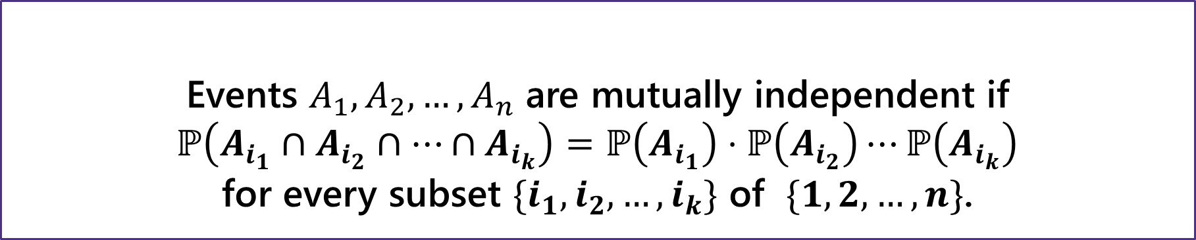
Independence for 3 or more events
For three or more events, we need two kinds of independence
Events $A_{1},A_{2},…,A_{n}$ are pairwise independent if
$ℙ\left(A_{i}∩A_{j}\right)=ℙ\left(A_{i}\right)⋅ℙ\left(A_{j}\right)$ for all $i,j$
Pairwise Independence
Events $A_{1},A_{2},…,A_{n}$ are mutually independent if
$ℙ\left(A_{i_{1}}∩A_{i_{2}}∩…∩A_{i_{k}}\right)=ℙ\left(A_{i_{1}}\right)⋅ℙ\left(A_{i_{2}}\right)⋯ℙ\left(A_{i_{k}}\right)$
for every subset $\{i_{1},i_{2},…,i_{k}\}$ of $\{1,2,…,n\}$.
Mutual Independence

