Slide 1

















Conditional Probability and Bayes Rule
CSE 312 Winter 26 Lecture 6

Slide 2



Last Time
A sample space $Ω$ is the set of all possible outcomes of an experiment.
Sample Space
An event $E⊆Ω$ is a subset of possible outcomes (i.e. a subset of $Ω$)
Event
A probability is a number between 0 and 1 describing how likely a particular outcome is.
Probability

Slide 3
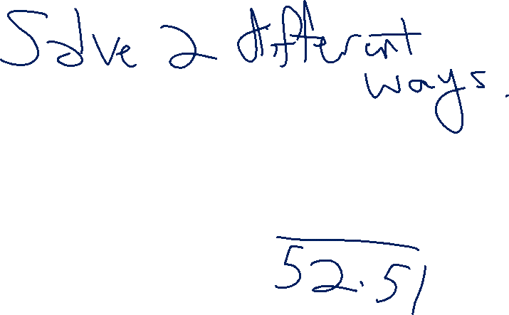
Cards Example
Suppose you shuffle a deck of cards so any arrangement is equally likely. What is the probability that the top two cards have the same value?
Sample Space
Probability Measure
Event
Probability

Slide 4
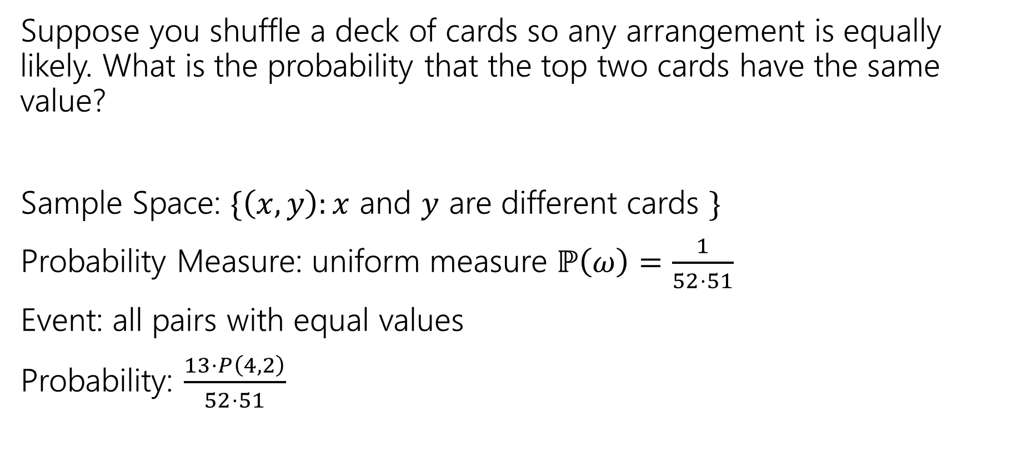
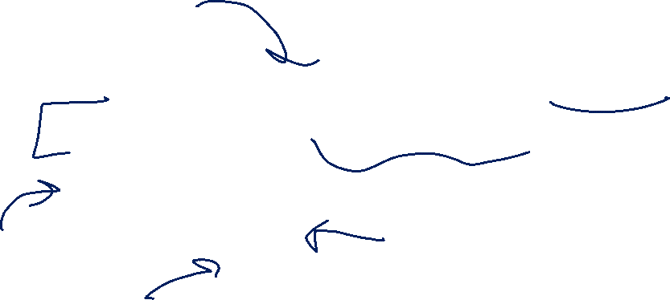
Cards Example (Solution 1)
Suppose you shuffle a deck of cards so any arrangement is equally likely. What is the probability that the top two cards have the same value?
Sample Space: $\{\left(x,y\right):x$ and $y$ are different cards $\}$
Probability Measure: uniform measure $ℙ\left(ω\right)=\frac{1}{52⋅51}$
Event: all pairs with equal values
Probability: $\frac{13⋅P\left(4,2\right)}{52⋅51}$

Slide 5
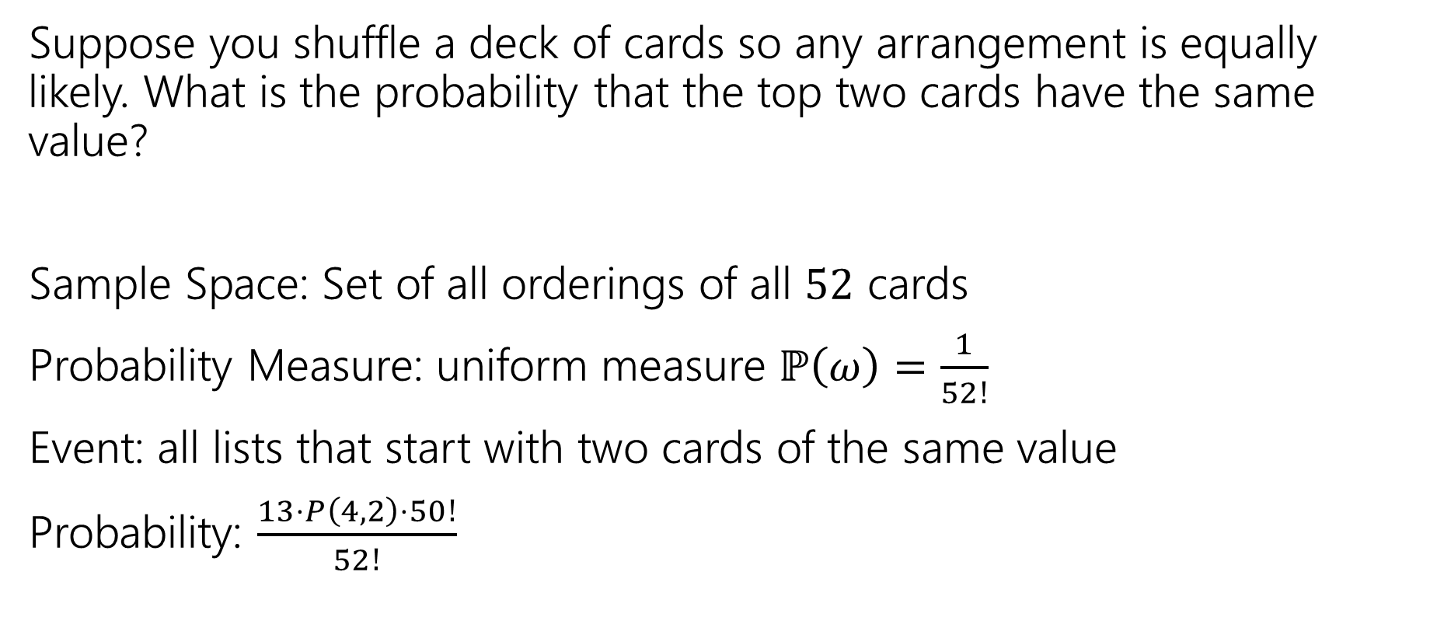

Cards Example (Solution 2)
Suppose you shuffle a deck of cards so any arrangement is equally likely. What is the probability that the top two cards have the same value?
Sample Space: Set of all orderings of all $52$ cards
Probability Measure: uniform measure $ℙ\left(ω\right)=\frac{1}{52!}$
Event: all lists that start with two cards of the same value
Probability: $\frac{13⋅P\left(4,2\right)⋅50!}{52!}$
A lot of cancellation here!

Slide 6
Takeaway
There’s often information you “don’t need” in your sample space.
It won’t give you the wrong answer.
But it sometimes makes for extra work/a harder counting problem,
Good indication: you cancelled A LOT of stuff that was common in the numerator and denominator.

Slide 7
A few notes about events and samples spaces
If you’re dealing with a situation where you may be able to use a uniform probability space, make sure to set up the sample space in a way that every outcome is equally likely.
Try not overcomplicate the sample space – only include the information that you need in it.
Be consistent in your event and sample space:
If order doesn’t matter in one, it doesn’t matter in the other.
If you only think about the first two cards in one, you only think about the first two cards in the other.
Formally, this means when you define an event, you make sure it is a subset of the sample space! (The “types” have to match for that assertion to be true).

Slide 8

Some Quick Observations
For discrete probability spaces (the kind we’ve seen so far)
$ℙ\left(E\right)=0$ if and only if ?
$ℙ\left(E\right)=1$ if and only if ?

Slide 9

Some Quick Observations (answers)
For discrete probability spaces (the kind we’ve seen so far)
$ℙ\left(E\right)=0$ if and only if an event can’t happen.
$ℙ\left(E\right)=1$ if and only if an event is guaranteed (every outcome outside $E$has probability $0$).

Slide 10
Conditioning

Slide 11
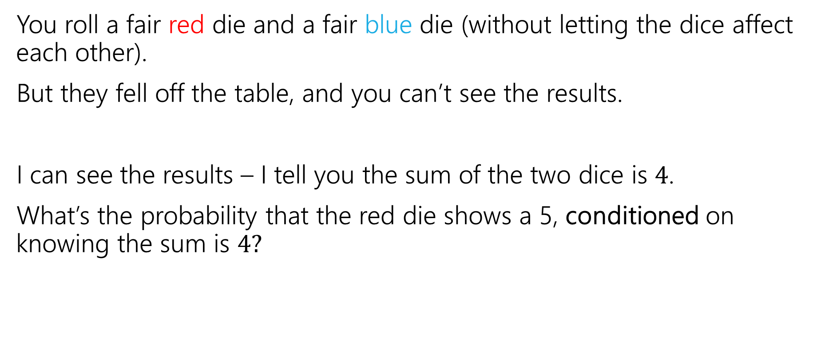
Conditioning Intuition
You roll a fair red die and a fair blue die (without letting the dice affect each other).
But they fell off the table, and you can’t see the results.
I can see the results – I tell you the sum of the two dice is $4$.
What’s the probability that the red die shows a 5, conditioned on knowing the sum is $4?$

Slide 12
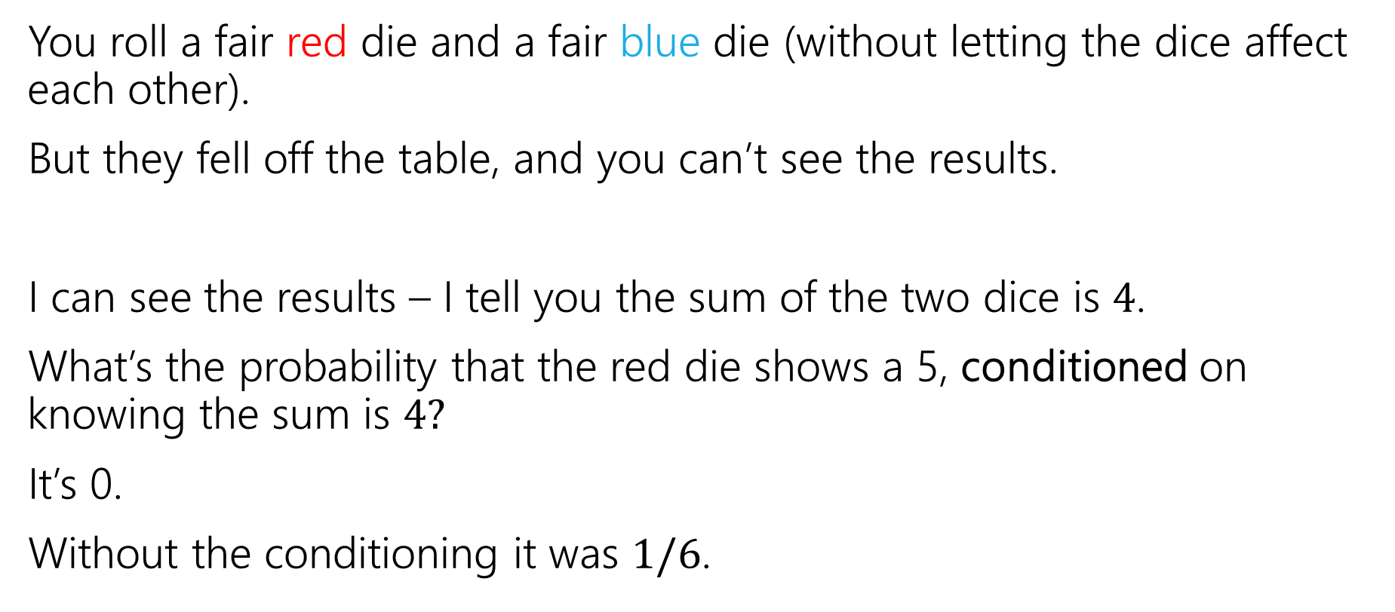
Conditioning Intuition (2)
You roll a fair red die and a fair blue die (without letting the dice affect each other).
But they fell off the table, and you can’t see the results.
I can see the results – I tell you the sum of the two dice is $4$.
What’s the probability that the red die shows a 5, conditioned on knowing the sum is $4?$
It’s 0.
Without the conditioning it was $1/6$.

Slide 13
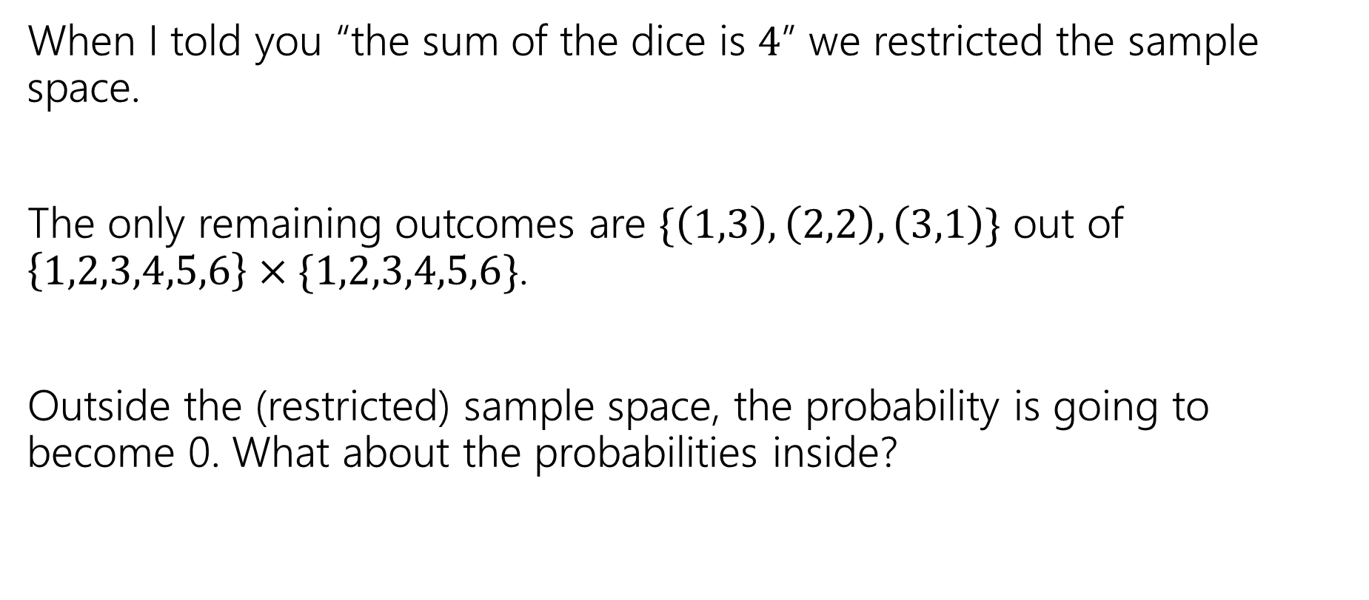
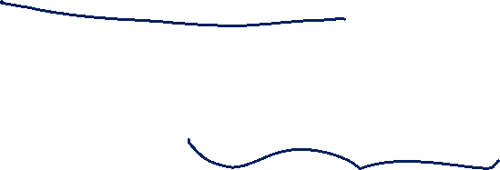
Restrict the Sample Space
When I told you “the sum of the dice is $4$” we restricted the sample space.
The only remaining outcomes are $\{\left(1,3\right), \left(2,2\right), \left(3,1\right)\}$ out of $\left\{1,2,3,4,5,6\right\}×\{1,2,3,4,5,6\}$.
Outside the (restricted) sample space, the probability is going to become 0. What about the probabilities inside?

Slide 14

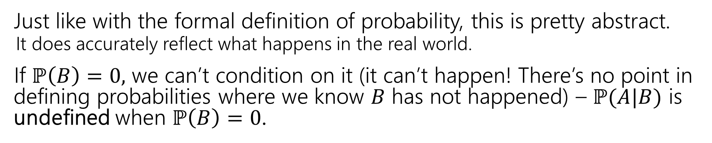
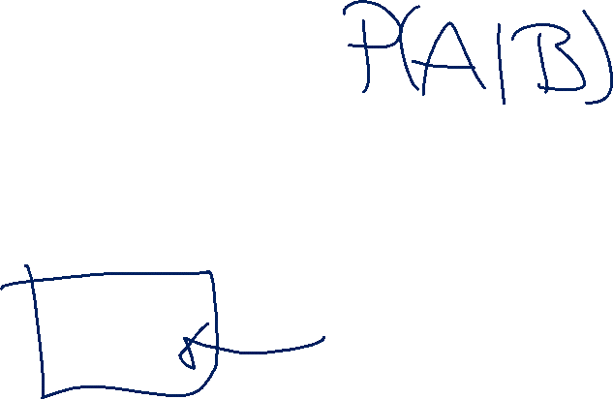
Conditional Probability (formally)
For an event $B$, with $ℙ\left(B\right)>0,$
$t$he “Probability of $A$ conditioned on $B$” is
$$ℙ\left(A | B\right)=\frac{ℙ\left(A∩B\right)}{ℙ\left(B\right)}$$
Conditional Probability
Just like with the formal definition of probability, this is pretty abstract.
It does accurately reflect what happens in the real world.
If $ℙ\left(B\right)=0,$ we can’t condition on it (it can’t happen! There’s no point in defining probabilities where we know $B$ has not happened) – $ℙ(A|B)$ is undefined when $ℙ\left(B\right)=0$.

Slide 15
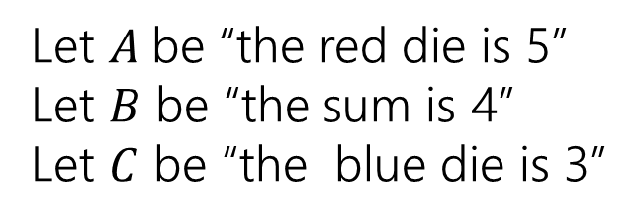
Conditioning…
 | D2=1 | D2=2 | D2=3 | D2=4 | D2=5 | D2=6
D1=1 | (1,1) | (1,2) | (1,3) | (1,4) | (1,5) | (1.6)
D1=2 | (2,1) | (2,2) | (2,3) | (2,4) | (2,5) | (2,6)
D1=3 | (3,1) | (3,2) | (3,3) | (3,4) | (3,5) | (3,6)
D1=4 | (4,1) | (4,2) | (4,3) | (4,4) | (4,5) | (4,6)
D1=5 | (5,1) | (5,2) | (5,3) | (5,4) | (5,5) | (5,6)
D1=6 | (6,1) | (6,2) | (6,3) | (6,4) | (6,5) | (6,6)
Let $A$be “the red die is 5”
Let $B$ be “the sum is 4”
Let $C$ be “the blue die is 3”

Slide 16
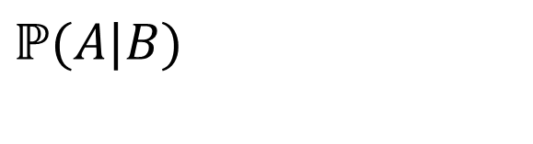
Conditioning…A|B
 | D2=1 | D2=2 | D2=3 | D2=4 | D2=5 | D2=6
D1=1 | (1,1) | (1,2) | (1,3) | (1,4) | (1,5) | (1.6)
D1=2 | (2,1) | (2,2) | (2,3) | (2,4) | (2,5) | (2,6)
D1=3 | (3,1) | (3,2) | (3,3) | (3,4) | (3,5) | (3,6)
D1=4 | (4,1) | (4,2) | (4,3) | (4,4) | (4,5) | (4,6)
D1=5 | (5,1) | (5,2) | (5,3) | (5,4) | (5,5) | (5,6)
D1=6 | (6,1) | (6,2) | (6,3) | (6,4) | (6,5) | (6,6)
Let $A$be “the red die is 5”
Let $B$ be “the sum is 4”
Let $C$ be “the blue die is 3”
$$ℙ(A|B)$$

Slide 17
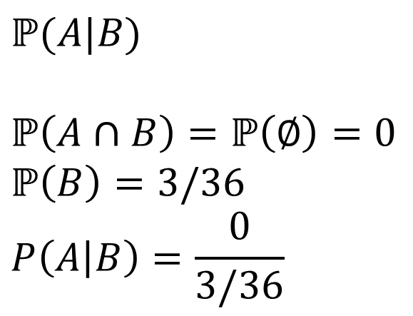

Conditioning…A|B, Solution
 | D2=1 | D2=2 | D2=3 | D2=4 | D2=5 | D2=6
D1=1 | (1,1) | (1,2) | (1,3) | (1,4) | (1,5) | (1.6)
D1=2 | (2,1) | (2,2) | (2,3) | (2,4) | (2,5) | (2,6)
D1=3 | (3,1) | (3,2) | (3,3) | (3,4) | (3,5) | (3,6)
D1=4 | (4,1) | (4,2) | (4,3) | (4,4) | (4,5) | (4,6)
D1=5 | (5,1) | (5,2) | (5,3) | (5,4) | (5,5) | (5,6)
D1=6 | (6,1) | (6,2) | (6,3) | (6,4) | (6,5) | (6,6)
Let $A$be “the red die is 5”
Let $B$ be “the sum is 4”
Let $C$ be “the blue die is 3”
$$ℙ(A|B)$$
$$ℙ\left(A∩B\right)=ℙ\left(∅\right)=0$$
$$ℙ\left(B\right)=3/36$$
$$P\left(A | B\right)=\frac{0}{3/36}$$

Slide 18
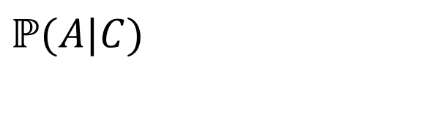
Conditioning…A|C
 | D2=1 | D2=2 | D2=3 | D2=4 | D2=5 | D2=6
D1=1 | (1,1) | (1,2) | (1,3) | (1,4) | (1,5) | (1.6)
D1=2 | (2,1) | (2,2) | (2,3) | (2,4) | (2,5) | (2,6)
D1=3 | (3,1) | (3,2) | (3,3) | (3,4) | (3,5) | (3,6)
D1=4 | (4,1) | (4,2) | (4,3) | (4,4) | (4,5) | (4,6)
D1=5 | (5,1) | (5,2) | (5,3) | (5,4) | (5,5) | (5,6)
D1=6 | (6,1) | (6,2) | (6,3) | (6,4) | (6,5) | (6,6)
Let $A$be “the red die is 5”
Let $B$ be “the sum is 4”
Let $C$ be “the blue die is 3”
$$ℙ(A|C)$$

Slide 19
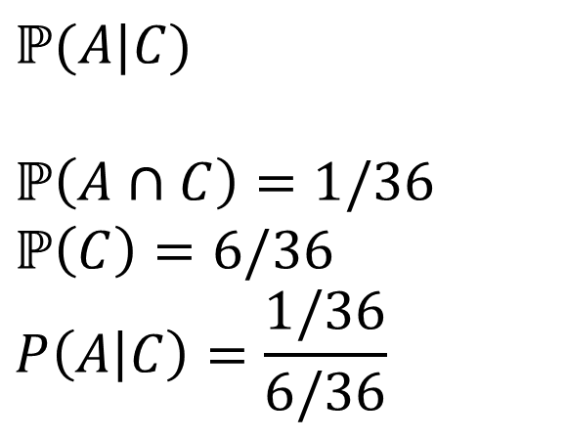

Conditioning…A|C Solution
 | D2=1 | D2=2 | D2=3 | D2=4 | D2=5 | D2=6
D1=1 | (1,1) | (1,2) | (1,3) | (1,4) | (1,5) | (1.6)
D1=2 | (2,1) | (2,2) | (2,3) | (2,4) | (2,5) | (2,6)
D1=3 | (3,1) | (3,2) | (3,3) | (3,4) | (3,5) | (3,6)
D1=4 | (4,1) | (4,2) | (4,3) | (4,4) | (4,5) | (4,6)
D1=5 | (5,1) | (5,2) | (5,3) | (5,4) | (5,5) | (5,6)
D1=6 | (6,1) | (6,2) | (6,3) | (6,4) | (6,5) | (6,6)
Let $A$be “the red die is 5”
Let $B$ be “the sum is 4”
Let $C$ be “the blue die is 3”
$$ℙ(A|C)$$
$$ℙ\left(A∩C\right)=1/36$$
$$ℙ\left(C\right)=6/36$$
$$P\left(A | C\right)=\frac{1/36}{6/36}$$

Slide 20
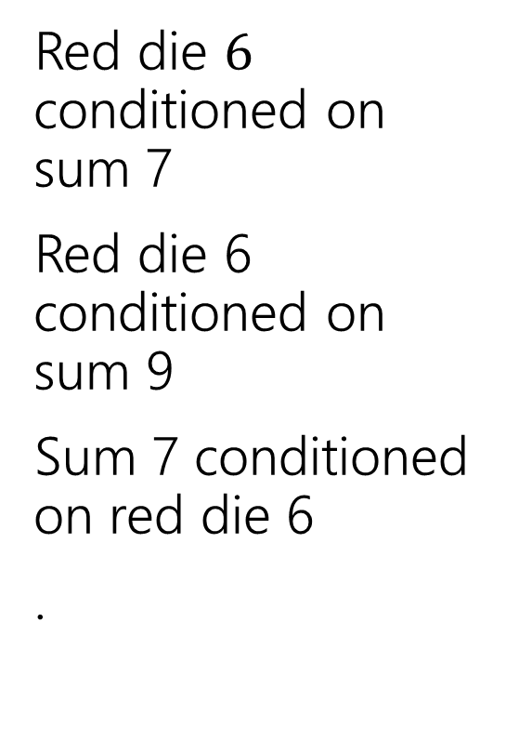
Conditioning Practice
Red die $6$ conditioned on sum 7
Red die 6 conditioned on sum 9
Sum 7 conditioned on red die 6
.
 | D2=1 | D2=2 | D2=3 | D2=4 | D2=5 | D2=6
D1=1 | (1,1) | (1,2) | (1,3) | (1,4) | (1,5) | (1.6)
D1=2 | (2,1) | (2,2) | (2,3) | (2,4) | (2,5) | (2,6)
D1=3 | (3,1) | (3,2) | (3,3) | (3,4) | (3,5) | (3,6)
D1=4 | (4,1) | (4,2) | (4,3) | (4,4) | (4,5) | (4,6)
D1=5 | (5,1) | (5,2) | (5,3) | (5,4) | (5,5) | (5,6)
D1=6 | (6,1) | (6,2) | (6,3) | (6,4) | (6,5) | (6,6)
Take a few minutes to work on this with the people around you! (also on your handout)

Slide 21
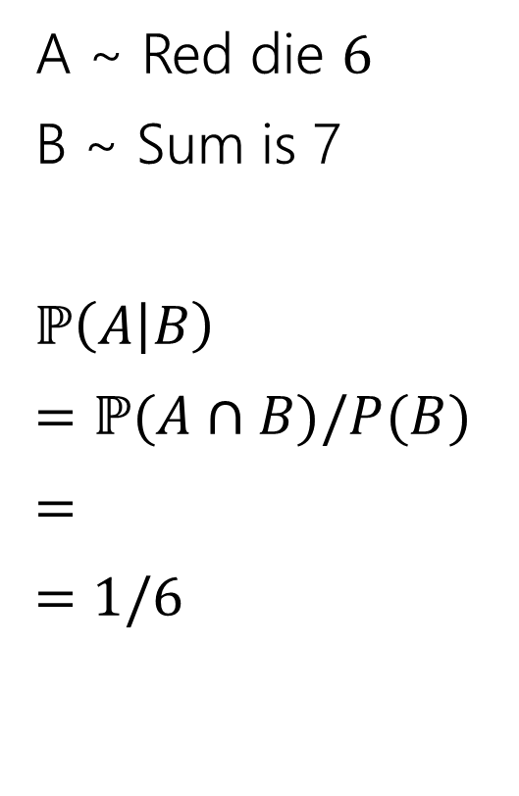

Conditioning Practice A|B
A ~ Red die $6$
B ~ Sum is 7
$ℙ\left(A | B\right)$
$=ℙ(A∩B)/P(B)$
$=$
$=$ $1/6$
 | D2=1 | D2=2 | D2=3 | D2=4 | D2=5 | D2=6
D1=1 | (1,1) | (1,2) | (1,3) | (1,4) | (1,5) | (1.6)
D1=2 | (2,1) | (2,2) | (2,3) | (2,4) | (2,5) | (2,6)
D1=3 | (3,1) | (3,2) | (3,3) | (3,4) | (3,5) | (3,6)
D1=4 | (4,1) | (4,2) | (4,3) | (4,4) | (4,5) | (4,6)
D1=5 | (5,1) | (5,2) | (5,3) | (5,4) | (5,5) | (5,6)
D1=6 | (6,1) | (6,2) | (6,3) | (6,4) | (6,5) | (6,6)

Slide 22
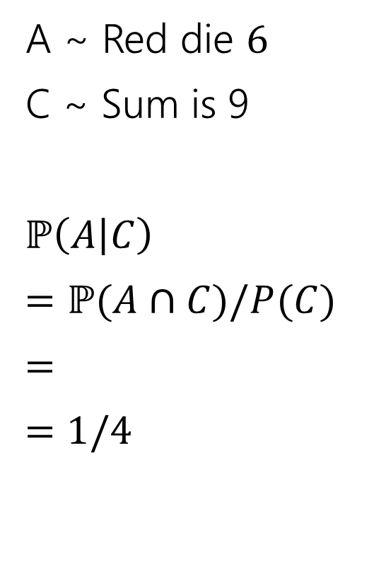

Conditioning Practice A|C
A ~ Red die $6$
C ~ Sum is 9
$ℙ\left(A | C\right)$
$=ℙ(A∩C)/P(C)$
$=$
$=$ $1/4$
 | D2=1 | D2=2 | D2=3 | D2=4 | D2=5 | D2=6
D1=1 | (1,1) | (1,2) | (1,3) | (1,4) | (1,5) | (1.6)
D1=2 | (2,1) | (2,2) | (2,3) | (2,4) | (2,5) | (2,6)
D1=3 | (3,1) | (3,2) | (3,3) | (3,4) | (3,5) | (3,6)
D1=4 | (4,1) | (4,2) | (4,3) | (4,4) | (4,5) | (4,6)
D1=5 | (5,1) | (5,2) | (5,3) | (5,4) | (5,5) | (5,6)
D1=6 | (6,1) | (6,2) | (6,3) | (6,4) | (6,5) | (6,6)

Slide 23
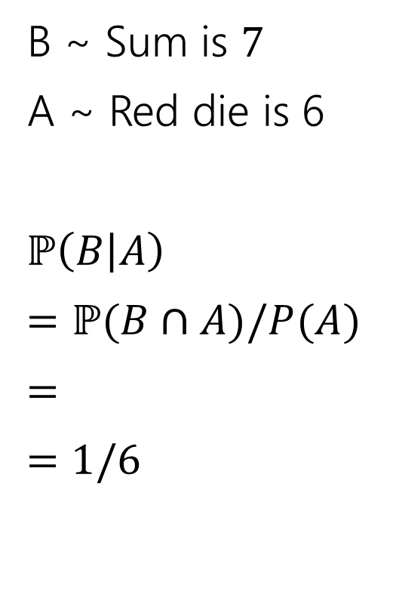

Conditioning Practice B|A
B ~ Sum is $7$
A ~ Red die is 6
$ℙ\left(B | A\right)$
$=ℙ(B∩A)/P(A)$
$=$
$=$ $1/6$
 | D2=1 | D2=2 | D2=3 | D2=4 | D2=5 | D2=6
D1=1 | (1,1) | (1,2) | (1,3) | (1,4) | (1,5) | (1.6)
D1=2 | (2,1) | (2,2) | (2,3) | (2,4) | (2,5) | (2,6)
D1=3 | (3,1) | (3,2) | (3,3) | (3,4) | (3,5) | (3,6)
D1=4 | (4,1) | (4,2) | (4,3) | (4,4) | (4,5) | (4,6)
D1=5 | (5,1) | (5,2) | (5,3) | (5,4) | (5,5) | (5,6)
D1=6 | (6,1) | (6,2) | (6,3) | (6,4) | (6,5) | (6,6)

Slide 24
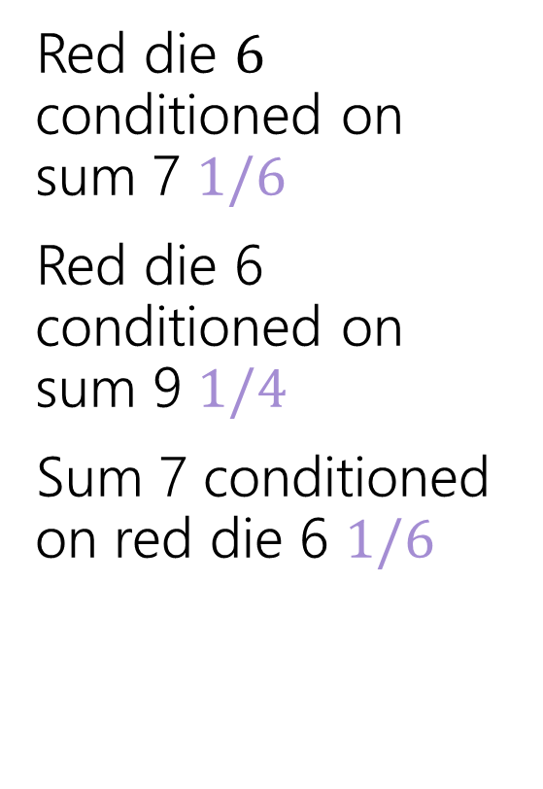
Conditioning Practice (answers)
Red die $6$ conditioned on sum 7 $1/6$
Red die 6 conditioned on sum 9 $1/4$
Sum 7 conditioned on red die 6 $1/6$
 | D2=1 | D2=2 | D2=3 | D2=4 | D2=5 | D2=6
D1=1 | (1,1) | (1,2) | (1,3) | (1,4) | (1,5) | (1.6)
D1=2 | (2,1) | (2,2) | (2,3) | (2,4) | (2,5) | (2,6)
D1=3 | (3,1) | (3,2) | (3,3) | (3,4) | (3,5) | (3,6)
D1=4 | (4,1) | (4,2) | (4,3) | (4,4) | (4,5) | (4,6)
D1=5 | (5,1) | (5,2) | (5,3) | (5,4) | (5,5) | (5,6)
D1=6 | (6,1) | (6,2) | (6,3) | (6,4) | (6,5) | (6,6)

Slide 25

Does Order Matter?
Are $ℙ(A|B)$ and $ℙ(B|A)$ the same?

Slide 26
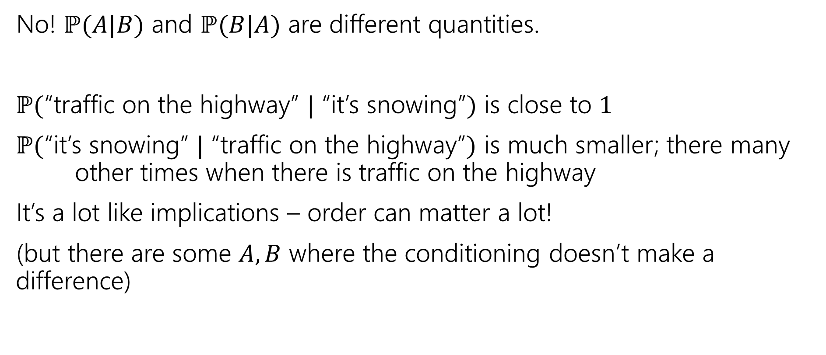
Order Does Matter!
No! $ℙ(A|B)$ and $ℙ(B|A)$ are different quantities.
$ℙ($“traffic on the highway” $|$ “it’s snowing”$)$ is close to $1$
$ℙ($“it’s snowing” $|$ “traffic on the highway”$)$ is much smaller; there many other times when there is traffic on the highway
It’s a lot like implications – order can matter a lot!
(but there are some $A,B$ where the conditioning doesn’t make a difference)

Slide 27
Conditioning Tool: Bayes’ Rule

Slide 28
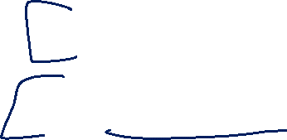
Wonka Bars
Willy Wonka has placed golden tickets on 0.1% of his Wonka Bars.
You want to get a golden ticket. You could buy a 1000-or-so of the bars until you find one, but that’s expensive…you’ve got a better idea!
You have a test – a very precise scale you’ve bought.
If the bar you weigh does have a golden ticket, the scale will alert you 99.9% of the time.
If the bar you weigh does not have a golden ticket, the scale will (falsely) alert you only 1% of the time.
If you pick up a bar and it alerts, what is the probability you have a golden ticket?

Slide 29

Willy Wonka
Fill out the poll everywhere so Robbie knows how long to explain
Go to pollev.com/robbie
Willy Wonka has placed golden tickets on 0.1% of his Wonka Bars.
If the bar you weigh does have a golden ticket, the scale will alert you 99.9% of the time.
If the bar you weigh does not have a golden ticket, the scale will (falsely) alert you only 1% of the time.
You pick up a bar and it alerts, what is the probability you have a golden ticket?
Which of these is closest to the right answer?
0.1%
10%
50%
90%
99%
99.9%

Slide 30
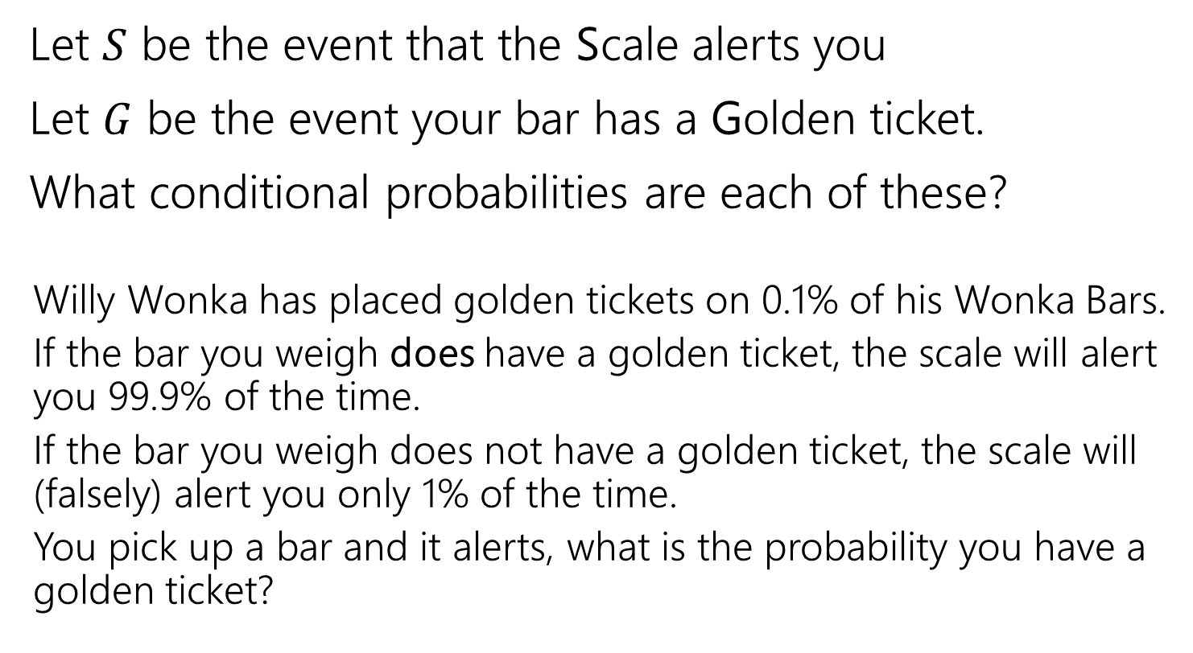
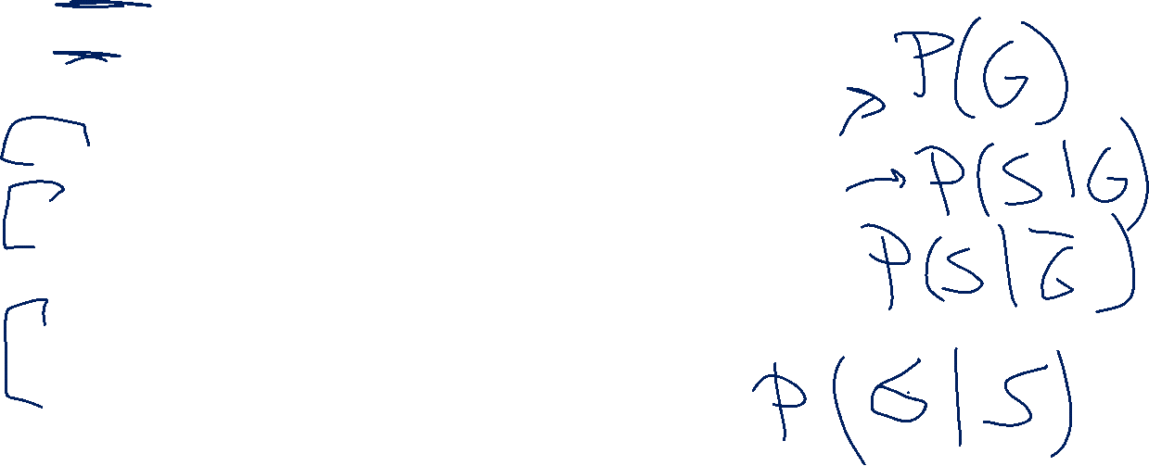
Conditioning (Wonka Bars)
Let $S$ be the event that the Scale alerts you
Let $G$ be the event your bar has a Golden ticket.
What conditional probabilities are each of these?
Willy Wonka has placed golden tickets on 0.1% of his Wonka Bars.
If the bar you weigh does have a golden ticket, the scale will alert you 99.9% of the time.
If the bar you weigh does not have a golden ticket, the scale will (falsely) alert you only 1% of the time.
You pick up a bar and it alerts, what is the probability you have a golden ticket?

Slide 31





Conditioning (labels)
Let $S$ be the event that the Scale alerts you
Let $G$ be the event your bar has a Golden ticket.
What conditional probabilities are each of these?
Willy Wonka has placed golden tickets on 0.1% of his Wonka Bars.
If the bar you weigh does have a golden ticket, the scale will alert you 99.9% of the time.
If the bar you weigh does not have a golden ticket, the scale will (falsely) alert you only 1% of the time.
You pick up a bar and it alerts, what is the probability you have a golden ticket?
$$ℙ(G)$$
$$ℙ(S|G)$$
$$ℙ\left(S | \overline{G}\right)$$
$$ℙ(G|S)$$

Slide 32
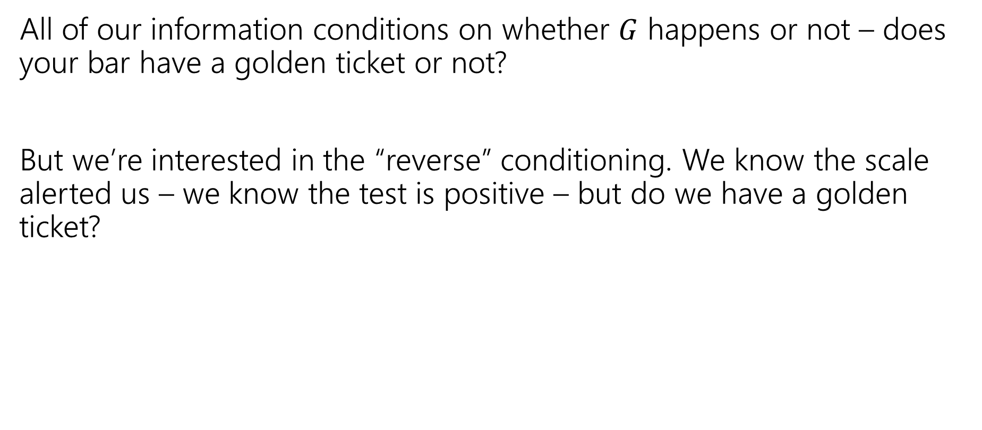
Reversing the Conditioning
All of our information conditions on whether $G$ happens or not – does your bar have a golden ticket or not?
But we’re interested in the “reverse” conditioning. We know the scale alerted us – we know the test is positive – but do we have a golden ticket?

Slide 33

Bayes’ Rule
$$ℙ\left(A | B\right)=\frac{ℙ(B|A)ℙ\left(A\right)}{ℙ\left(B\right)}$$
Bayes’ Rule

Slide 34

Bayes’ Rule (2)
$$ℙ\left(A | B\right)=\frac{ℙ(B|A)ℙ\left(A\right)}{ℙ\left(B\right)}$$
Bayes’ Rule
What do we know about Wonka Bars?
$$ℙ(G|S)=\frac{ℙ\left(S | G\right)⋅ℙ(G)}{ℙ(S)}$$

Slide 35

Bayes’ Rule (3)
$$ℙ\left(A | B\right)=\frac{ℙ(B|A)ℙ\left(A\right)}{ℙ\left(B\right)}$$
Bayes’ Rule
What do we know about Wonka Bars?
$$ℙ(G|S)=\frac{.999⋅.001}{ℙ(S)}$$

Slide 36

Filling In
What’s $ℙ(S)$?
We’ll use a trick called “the law of total probability”:
$ℙ\left(S\right)=ℙ\left(S | G\right)⋅ℙ\left(G\right)+ℙ\left(S | \overline{G}\right)⋅ℙ\left(\overline{G}\right)$
$=0.999⋅.001+.01⋅.999$
$=.010989$

Slide 37
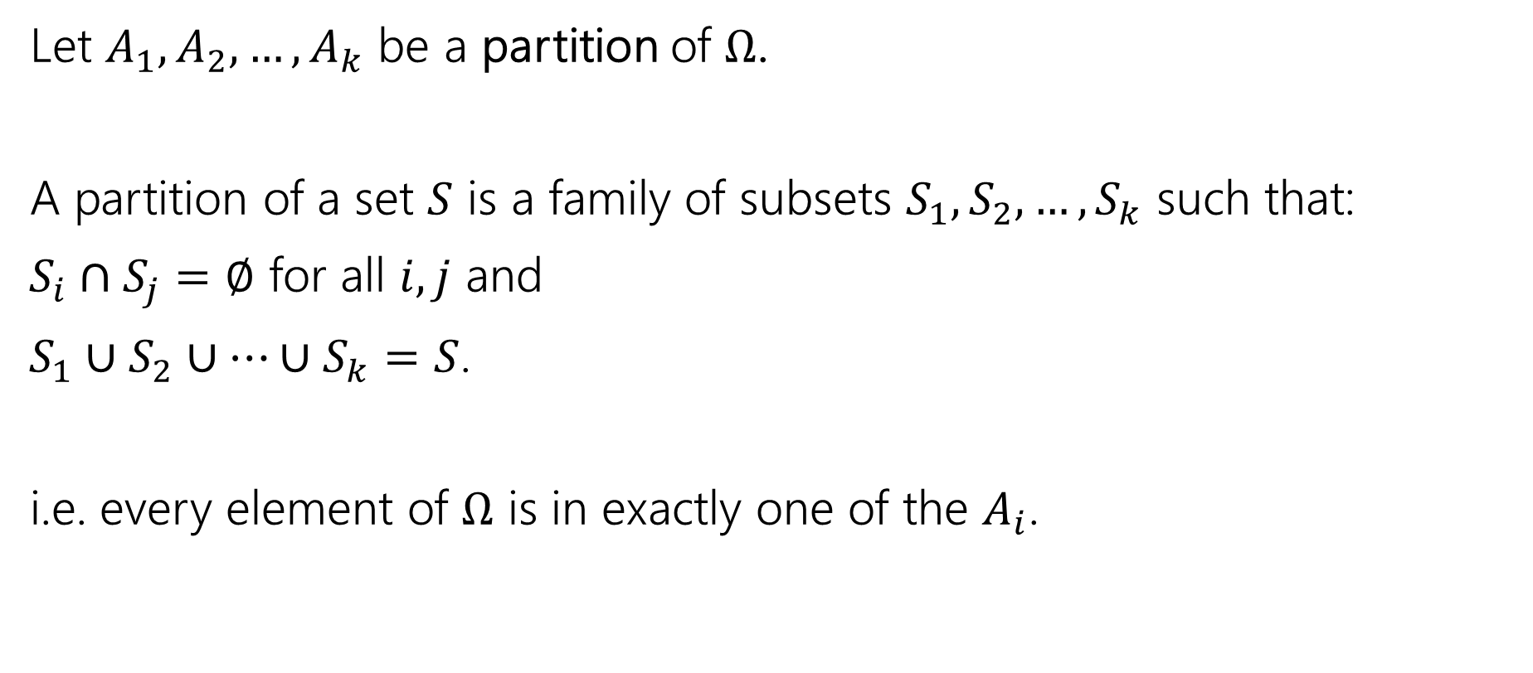
Partition
Let $A_{1},A_{2},…,A_{k}$ be a partition of $Ω$.
A partition of a set $S$ is a family of subsets $S_{1},S_{2},…,S_{k}$ such that:
$S_{i}∩S_{j}=∅$ for all $i,j$ and
$S_{1}∪S_{2}∪…∪S_{k}=S$.
i.e. every element of $Ω$ is in exactly one of the $A_{i}$.

Slide 38

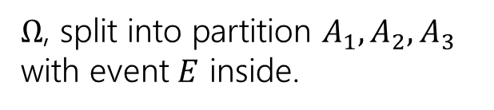




Law of Total Probability
Let $A_{1},A_{2},…,A_{k}$ be a partition of $Ω$.
For any event $E$,
$$ℙ\left(E\right)= \sum_{all i}{ℙ\left(E|A_{i}\right)ℙ(A_{i})}$$
Law of Total Probability
$Ω$, split into partition $A_{1},A_{2},A_{3}$ with event $E$ inside.
$$E$$
$$A_{1}$$
$$A_{2}$$
$$A_{3}$$

Slide 39

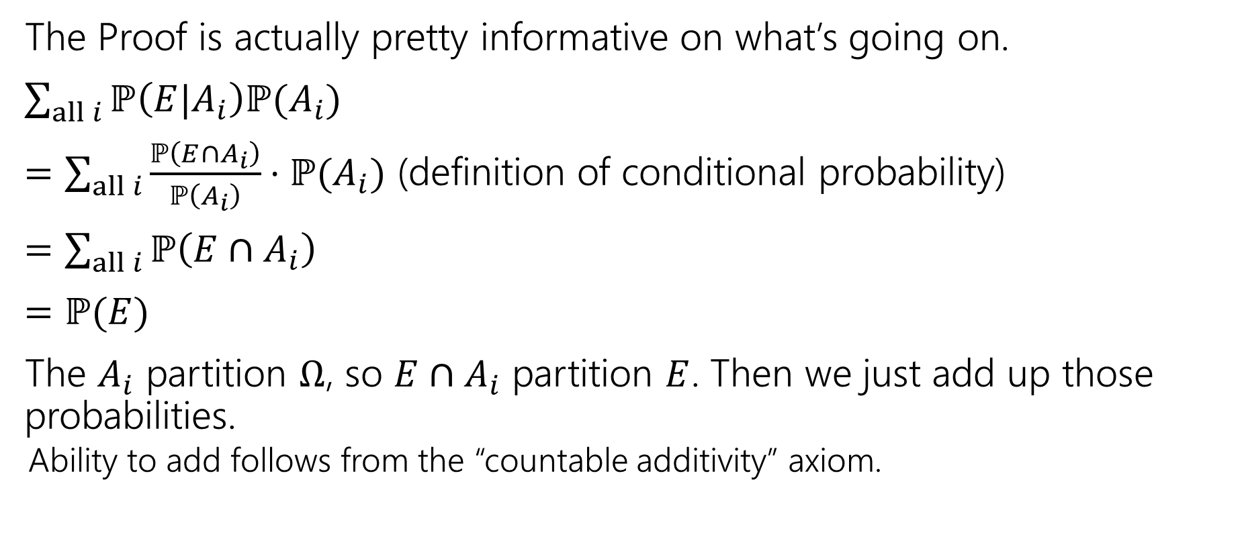



Why?
$$E$$
$$A_{1}$$
$$A_{2}$$
$$A_{3}$$
The Proof is actually pretty informative on what’s going on.
$\sum_{all i}{ℙ\left(E|A_{i}\right)ℙ(A_{i})}$
$=\sum_{all i}{\frac{ℙ\left(E∩A_{i}\right)}{ℙ\left(A_{i}\right)}⋅ℙ(A_{i})}$ (definition of conditional probability)
$=\sum_{all i}{ℙ\left(E∩A_{i}\right)}$
$=ℙ(E)$
The $A_{i}$ partition $Ω$, so $E∩A_{i}$ partition $E$. Then we just add up those probabilities.
Ability to add follows from the “countable additivity” axiom.

Slide 40
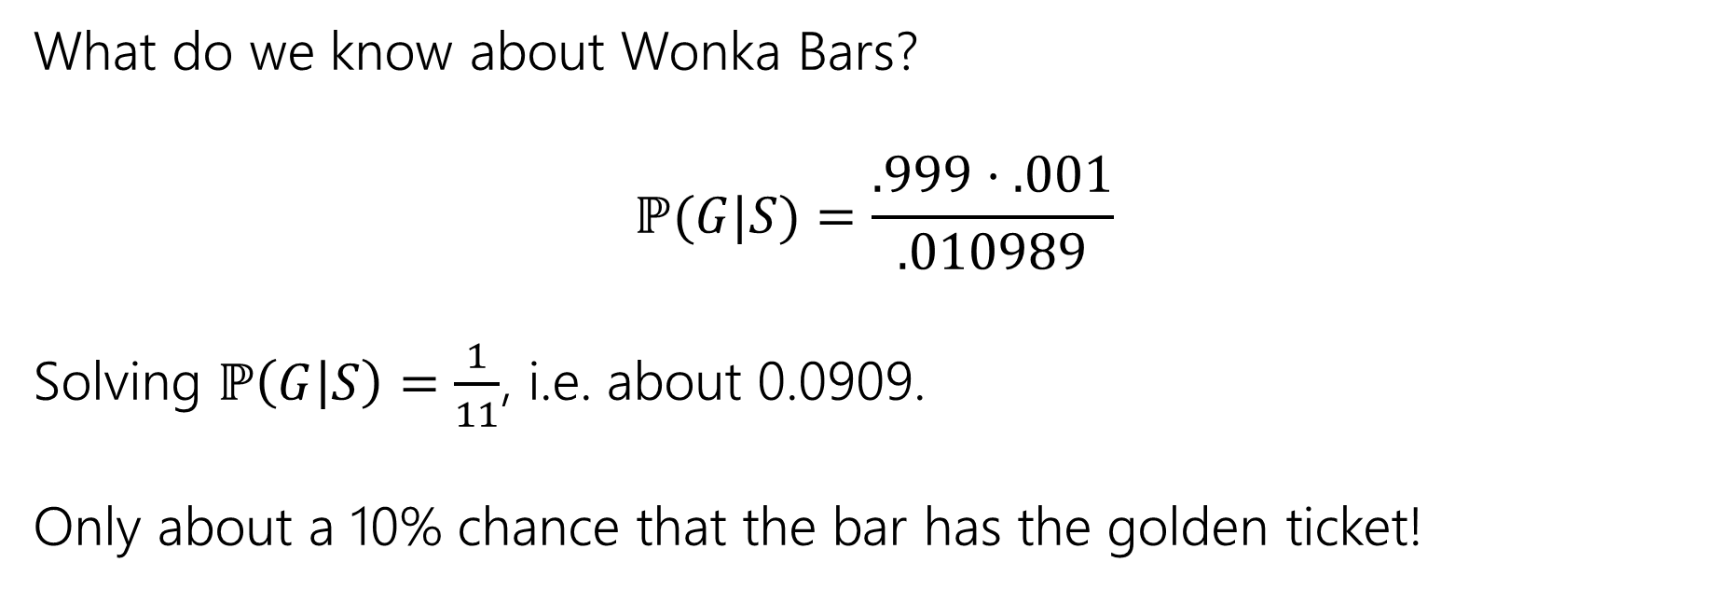
Wonka Bars Answer
What do we know about Wonka Bars?
$$ℙ(G|S)=\frac{.999⋅.001}{.010989}$$
Solving $ℙ\left(G | S\right)=\frac{1}{11}$, i.e. about 0.0909.
Only about a 10% chance that the bar has the golden ticket!

Slide 41
Wait a minute…
Willy Wonka has placed golden tickets on 0.1% of his Wonka Bars.
If the bar you weigh does have a golden ticket, the scale will alert you 99.9% of the time.
If the bar you weigh does not have a golden ticket, the scale will (falsely) alert you only 1% of the time.
That doesn’t fit with many of our guesses. What’s going on?
Instead of saying “we tested one and got a positive” imagine we tested 1000. ABOUT how many bars of each type are there?
(about) 1 with a golden ticket 999 without. Let’s say those are exactly right.
Let’s just say that one golden is truly found.
(about) 1% of the 999 without would be a positive. Let’s say it’s exactly 10.

Slide 42
Visually
Gold bar is the one (true) golden ticket bar.
Purple bars don’t have a ticket and tested negative.
Red bars don’t have a ticket, but tested positive.
The test is, in a sense, doing really well.
It’s almost always right.
The problem is it’s also the case that the correct answer is almost always “no.”

Slide 43

Updating Your Intuition (Take 1)
Take 1: The test is actually good and has VASTLY increased our belief that there IS a golden ticket when you get a positive result.
If we told you “your job is to find a Wonka Bar with a golden ticket” without the test, you have 1/1000 chance, with the test, you have (about) a 1/11 chance. That’s (almost) 100 times better!
This is actually a huge improvement!

Slide 44
Updating Your Intuition (Take 2)
Take 2: Humans are really bad at intuitively understanding very large or very small numbers.
When I hear “99% chance”, “99.9% chance”, “99.99% chance” they all go into my brain as “well that’s basically guaranteed” And then I forget how many 9’s there actually were.
But the number of 9s matters because they end up “cancelling” with the “number of 9’s” in the population that’s truly negative. We’ll talk about this a little more on Friday in the applications.

Slide 45
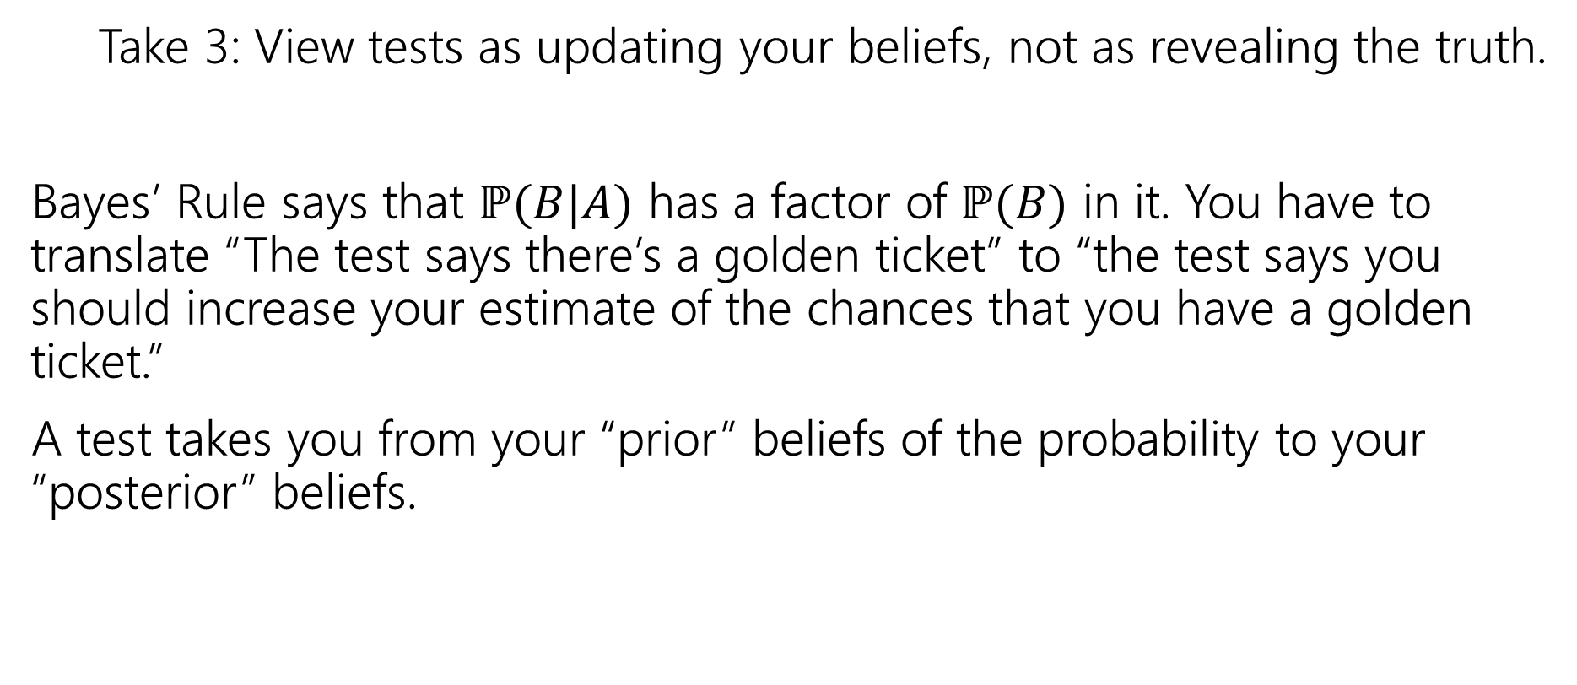
Updating Your Intuition (Take 3)
Take 3: View tests as updating your beliefs, not as revealing the truth.
Bayes’ Rule says that $ℙ(B|A)$ has a factor of $ℙ(B)$ in it. You have to translate “The test says there’s a golden ticket” to “the test says you should increase your estimate of the chances that you have a golden ticket.”
A test takes you from your “prior” beliefs of the probability to your “posterior” beliefs.

Slide 46
More Bayes Practice

Slide 47
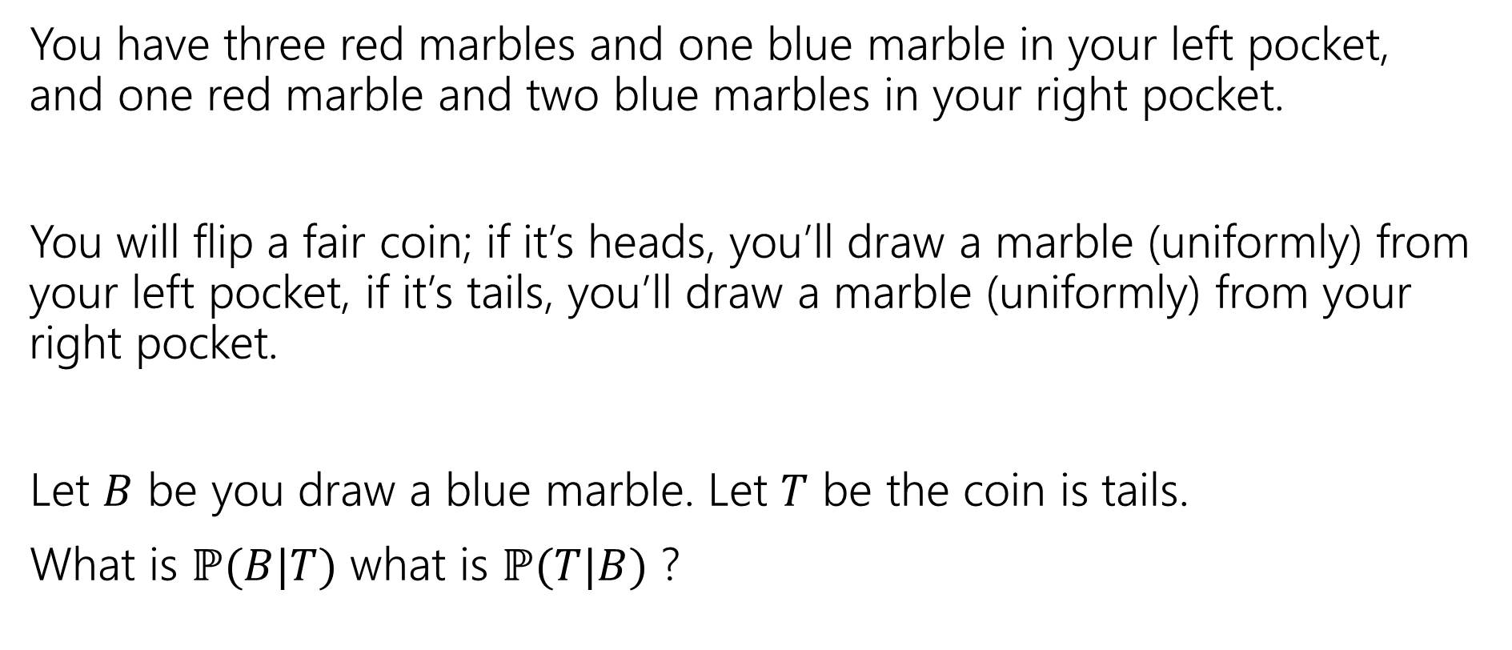
A contrived example
You have three red marbles and one blue marble in your left pocket, and one red marble and two blue marbles in your right pocket.
You will flip a fair coin; if it’s heads, you’ll draw a marble (uniformly) from your left pocket, if it’s tails, you’ll draw a marble (uniformly) from your right pocket.
Let $B$ be you draw a blue marble. Let $T$ be the coin is tails.
What is $ℙ(B|T)$ what is $ℙ(T|B)$ ?

Slide 48

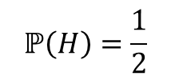







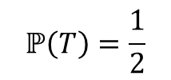

Updated Sequential Processes
You have three red marbles and one blue marble in your left pocket, and one red marble and two blue marbles in your right pocket.
if it’s heads, you’ll draw a marble (uniformly) from your left pocket,
if it’s tails, you’ll draw a marble (uniformly) from your right pocket.
$$ℙ\left(H\right)=\frac{1}{2}$$
$$ℙ\left(T\right)=\frac{1}{2}$$
H
T
For sequential processes with probability, at each step multiply by $ℙ\left(next step \right|all∩prior∩steps)$
$$ℙ\left(R|H\right)=\frac{3}{4}$$
$$ℙ\left(R|T\right)=\frac{1}{3}$$
$$ℙ\left(B|T\right)=\frac{2}{3}$$
$$ℙ\left(B|H\right)=\frac{1}{4}$$
$$ℙ\left(R∩H\right)=3/8$$
$$ℙ\left(R∩T\right)=1/6$$
$$ℙ\left(B∩H\right)=1/8$$
$$ℙ\left(B∩T\right)=1/3$$

Slide 49
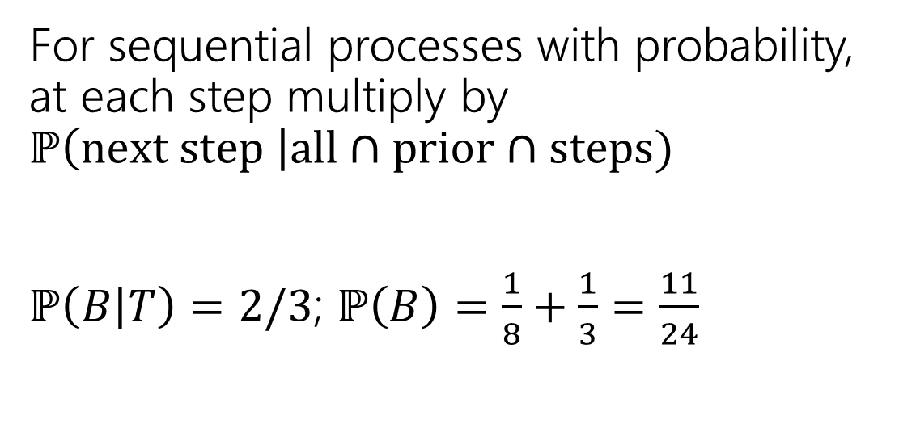
Updated Sequential Processes (answer)
You have three red marbles and one blue marble in your left pocket, and one red marble and two blue marbles in your right pocket.
if it’s heads, you’ll draw a marble (uniformly) from your left pocket,
if it’s tails, you’ll draw a marble (uniformly) from your right pocket.
$$ℙ\left(H\right)=\frac{1}{2}$$
$$ℙ\left(T\right)=\frac{1}{2}$$
H
T
For sequential processes with probability, at each step multiply by $ℙ\left(next step \right|all∩prior∩steps)$
$ℙ\left(B | T\right)=2/3$; $ℙ\left(B\right)=\frac{1}{8}+\frac{1}{3}=\frac{11}{24}$
$$ℙ\left(R|H\right)=\frac{3}{4}$$
$$ℙ\left(R|T\right)=\frac{1}{3}$$
$$ℙ\left(B|T\right)=\frac{2}{3}$$
$$ℙ\left(B|H\right)=\frac{1}{4}$$
$$ℙ\left(R∩H\right)=3/8$$
$$ℙ\left(R∩T\right)=1/6$$
$$ℙ\left(B∩H\right)=1/8$$
$$ℙ\left(B∩T\right)=1/3$$

Slide 50

Flipping the conditioning
You have three red marbles and one blue marble in your left pocket, and one red marble and two blue marbles in your right pocket.
if it’s heads, you’ll draw a marble (uniformly) from your left pocket,
if it’s tails, you’ll draw a marble (uniformly) from your right pocket.
What about $ℙ(T|B)$?
Pause, what’s your intuition?
Is this probability
A. less than $½$
B. equal to $½$
C. greater than $½$

Slide 51
Flipping the conditioning (marbles)
You have three red marbles and one blue marble in your left pocket, and one red marble and two blue marbles in your right pocket.
if it’s heads, you’ll draw a marble (uniformly) from your left pocket,
if it’s tails, you’ll draw a marble (uniformly) from your right pocket.
What about $ℙ(T|B)$?
Pause, what’s your intuition?
Is this probability
A. less than $½$
B. equal to $½$
C. greater than $½$
The right (tails) pocket is far more likely to produce a blue marble if picked than the left (heads) pocket is. Seems like $ℙ(T|B)$ should be greater than ½.

Slide 52

Flipping the conditioning (marbles, answer)
You have three red marbles and one blue marble in your left pocket, and one red marble and two blue marbles in your right pocket.
if it’s heads, you’ll draw a marble (uniformly) from your left pocket,
if it’s tails, you’ll draw a marble (uniformly) from your right pocket.
What about $ℙ(T|B)$?
Bayes’ Rule says:
$ℙ\left(T | B\right)=\frac{ℙ(B|T)ℙ\left(T\right)}{ℙ\left(B\right)}$
$=\frac{\frac{2}{3}⋅\frac{1}{2}}{11/24}=8/11$

Slide 53
The Technical Stuff

Slide 54
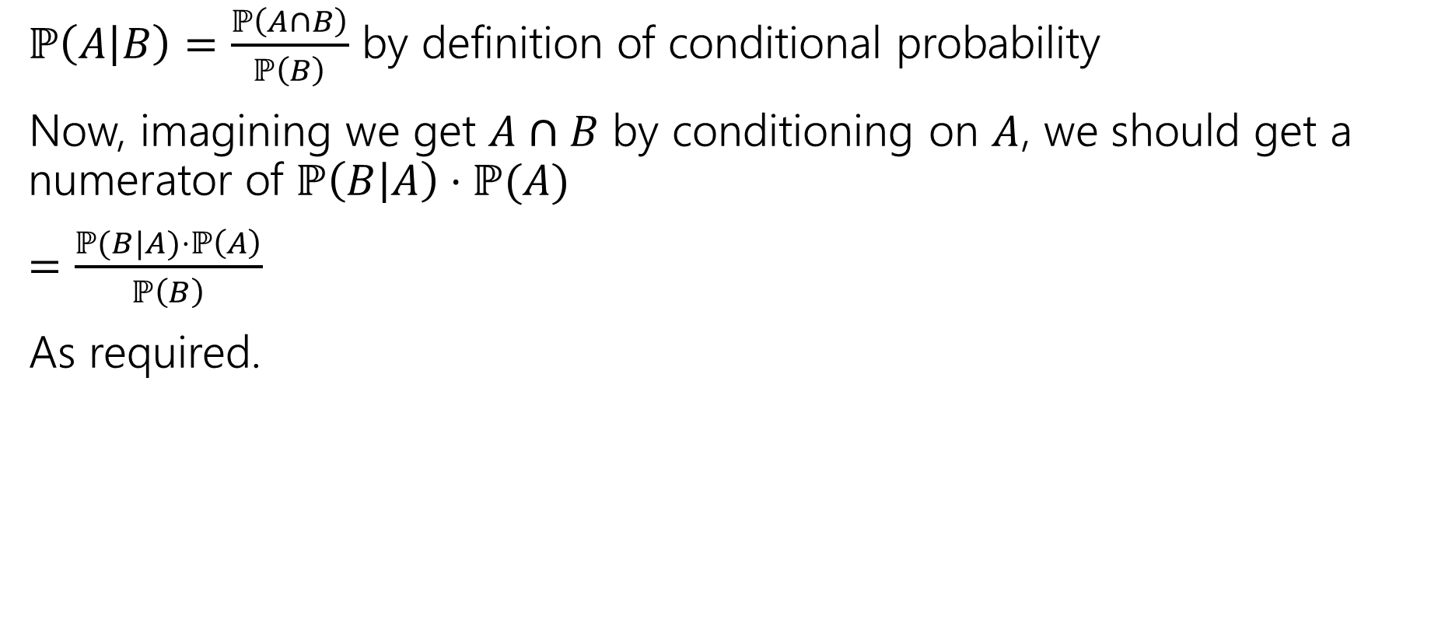
Proof of Bayes’ Rule
$ℙ\left(A | B\right)=\frac{ℙ\left(A∩B\right)}{ℙ\left(B\right)}$ by definition of conditional probability
Now, imagining we get $A∩B$ by conditioning on $A$, we should get a numerator of $ℙ\left(B | A\right)⋅ℙ(A)$
$=\frac{ℙ(B|A)⋅ℙ\left(A\right)}{ℙ\left(B\right)}$
As required.

Slide 55
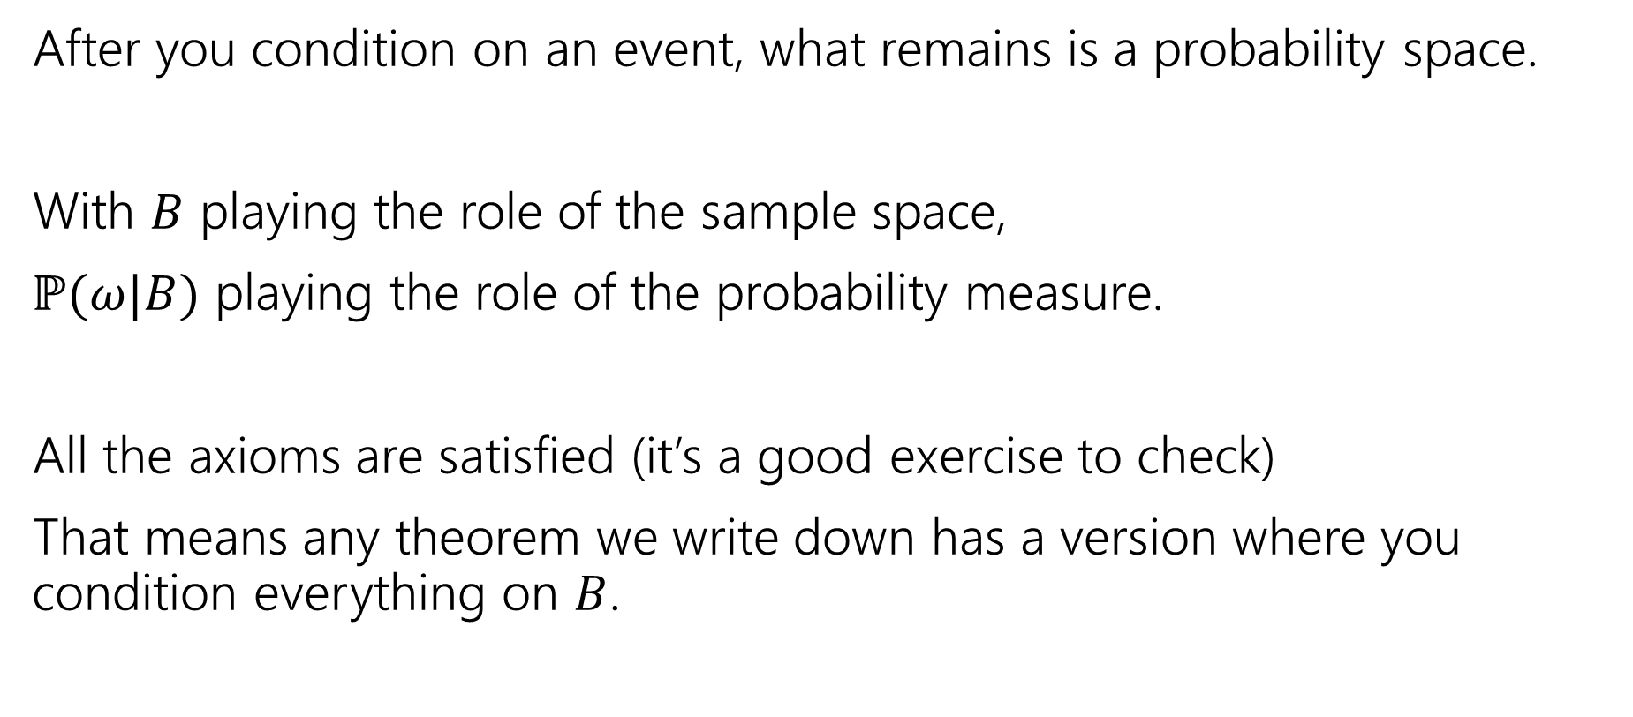
A Technical Note
After you condition on an event, what remains is a probability space.
With $B$ playing the role of the sample space,
$ℙ(ω|B)$ playing the role of the probability measure.
All the axioms are satisfied (it’s a good exercise to check)
That means any theorem we write down has a version where you condition everything on $B$.

Slide 56

An Example
Bayes Theorem still works in a probability space where we’ve already conditioned on $S.$
$ℙ\left(A | [B∩S]\right)=\frac{ℙ\left(B | [A∩S]\right)⋅ℙ\left(A | S\right)}{ℙ(B|S)}$

Slide 57
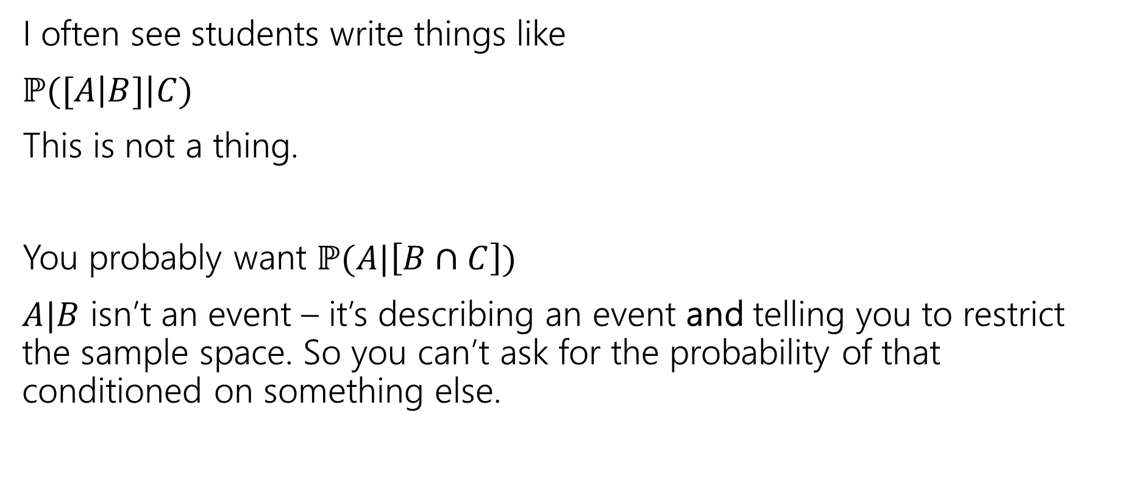
A Quick Technical Remark
I often see students write things like
$ℙ([A\left|B]\right|C)$
This is not a thing.
You probably want $ℙ(A|\left[B∩C\right])$
$A|B$ isn’t an event – it’s describing an event and telling you to restrict the sample space. So you can’t ask for the probability of that conditioned on something else.

Slide 58
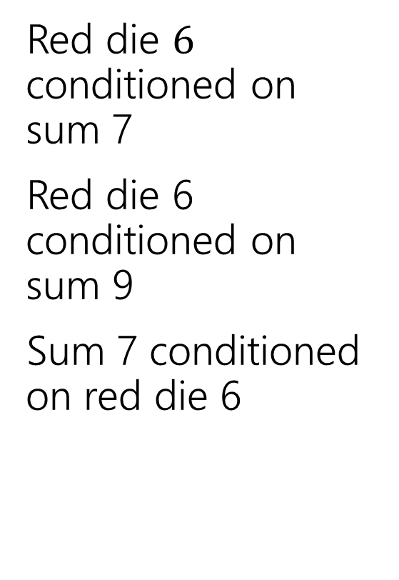
Conditioning Practice
Red die $6$ conditioned on sum 7
Red die 6 conditioned on sum 9
Sum 7 conditioned on red die 6
 | D2=1 | D2=2 | D2=3 | D2=4 | D2=5 | D2=6
D1=1 | (1,1) | (1,2) | (1,3) | (1,4) | (1,5) | (1.6)
D1=2 | (2,1) | (2,2) | (2,3) | (2,4) | (2,5) | (2,6)
D1=3 | (3,1) | (3,2) | (3,3) | (3,4) | (3,5) | (3,6)
D1=4 | (4,1) | (4,2) | (4,3) | (4,4) | (4,5) | (4,6)
D1=5 | (5,1) | (5,2) | (5,3) | (5,4) | (5,5) | (5,6)
D1=6 | (6,1) | (6,2) | (6,3) | (6,4) | (6,5) | (6,6)

Slide 59

Conditional Probability
For an event $B$, with $ℙ\left(B\right)>0,$
$t$he “Probability of $A$ conditioned on $B$” is
$$ℙ\left(A | B\right)=\frac{ℙ\left(A∩B\right)}{ℙ\left(B\right)}$$
Conditional Probability
Just like with the formal definition of probability, this is pretty abstract.
It does accurately reflect what happens in the real world.
If $ℙ\left(B\right)=0,$ we can’t condition on it (it can’t happen! There’s no point in defining probabilities where we know $B$ has not happened) – $ℙ(A|B)$ is undefined when $ℙ\left(B\right)=0$.

Slide 60
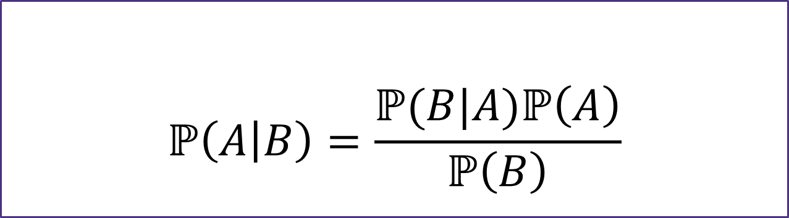

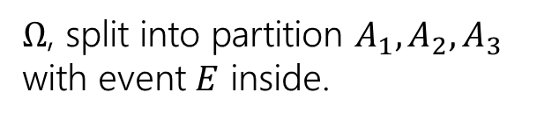
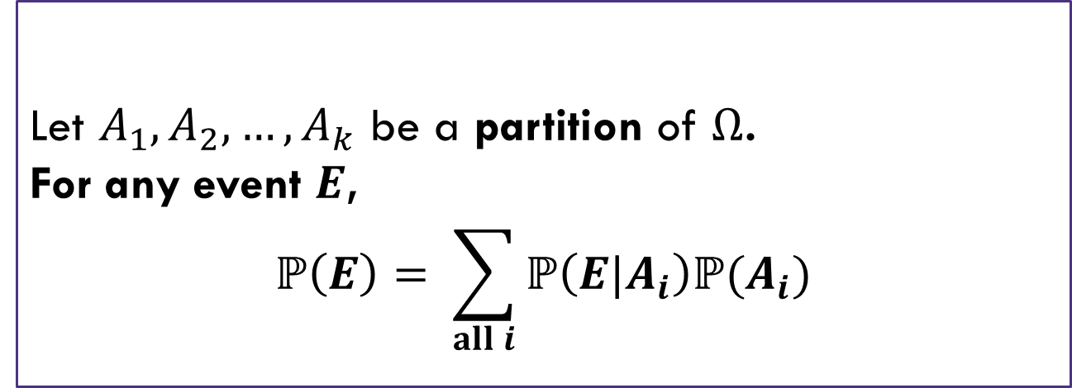



LTP and Bayes
Let $A_{1},A_{2},…,A_{k}$ be a partition of $Ω$.
For any event $E$,
$$ℙ\left(E\right)= \sum_{all i}{ℙ\left(E|A_{i}\right)ℙ(A_{i})}$$
$Ω$, split into partition $A_{1},A_{2},A_{3}$ with event $E$ inside.
Law of Total Probability
$$E$$
$$A_{1}$$
$$A_{2}$$
$$A_{3}$$
Bayes’ Rule
$$ℙ\left(A | B\right)=\frac{ℙ(B|A)ℙ\left(A\right)}{ℙ\left(B\right)}$$

