Slide 1
Probability Definitions
CSE 312 Winter 26
Lecture 5

Slide 2
Extra Practice

Slide 3
Practice
How do we know which rule to apply?
With practice you can pick out patterns for which ones might be plausible.
But if as you’re working you realize things are getting out of control, put it aside and try something different.

Slide 4
Cards
A “standard” deck of cards has 52 cards. Each card has a suit
  diamonds ️♦,
  hearts ♥️,
  clubs ♧,
  spades ♠️
and a value (Ace,2,3,4,5,6,7,8,9,10,Jack,Queen, King).
A “5-card-hand” is a set of 5 cards
How many five-card “flushes” are there? – a flush is a hand of cards all of the same suit.

Slide 5

Cards
How many five-card “flushes” are there? – a flush is a hand of cards all of the same suit.
Way 1: How can I describe a flush? Which suit it is, and which values:
$\left({4 \atop 1}\right)⋅\left({13 \atop 5}\right)$

Slide 6
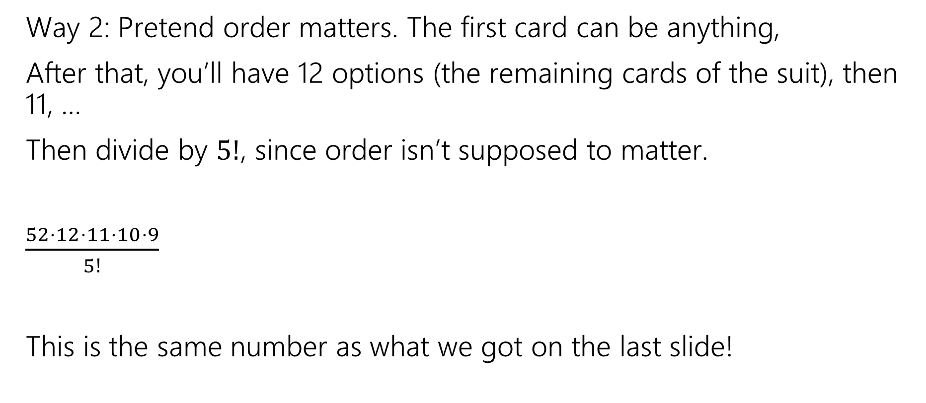
Cards
Way 2: Pretend order matters. The first card can be anything,
After that, you’ll have 12 options (the remaining cards of the suit), then 11, …
Then divide by $5!$, since order isn’t supposed to matter.
$\frac{52⋅12⋅11⋅10⋅9}{5!}$
This is the same number as what we got on the last slide!

Slide 7
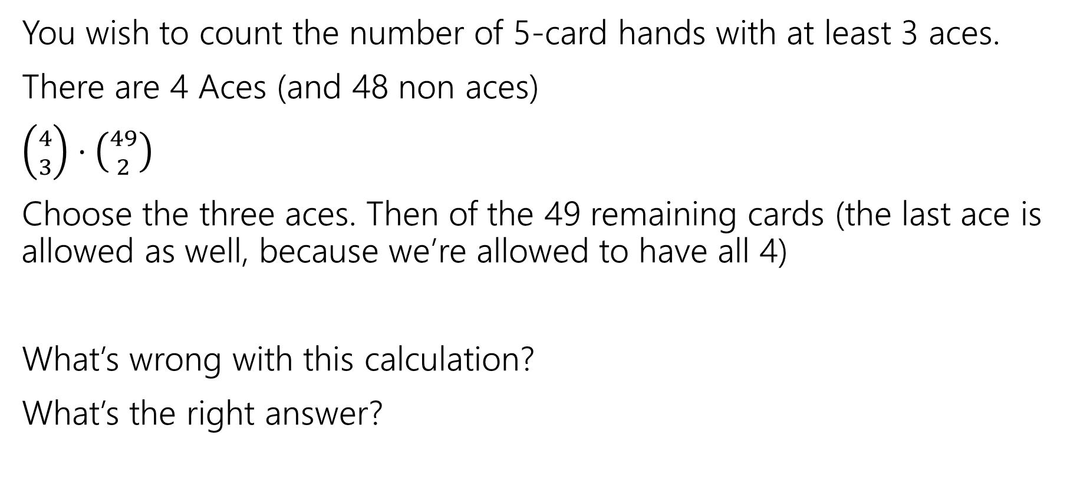

A Solution with a Problem
You wish to count the number of 5-card hands with at least 3 aces.
There are 4 Aces (and 48 non aces)
$\left({4 \atop 3}\right)⋅\left({49 \atop 2}\right)$
Choose the three aces. Then of the 49 remaining cards (the last ace is allowed as well, because we’re allowed to have all 4)
What’s wrong with this calculation?
What’s the right answer?

Slide 8

A Solution with a Problem
For a hand, there should be exactly one set of choices in the sequential process that gets us there.
{A♧, A♠️, A♦️} {A♥️, K ♠️}
And
{A♧, A♠️, A♥️}, {A♦️, K ♠️}
Are two different choices of the process, but they lead to the same hand!

Slide 9
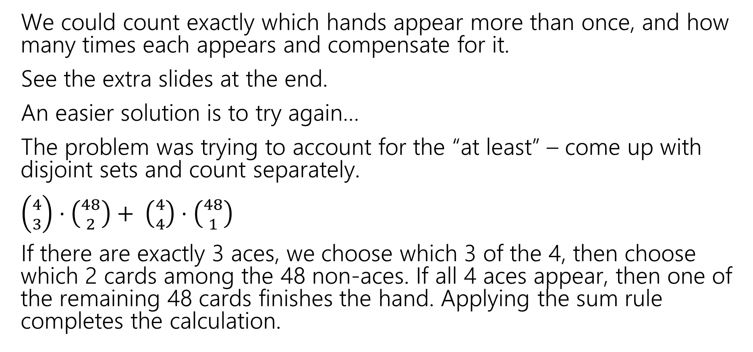
A Solution with a Problem
We could count exactly which hands appear more than once, and how many times each appears and compensate for it.
See the extra slides at the end.
An easier solution is to try again…
The problem was trying to account for the “at least” – come up with disjoint sets and count separately.
$\left({4 \atop 3}\right)⋅\left({48 \atop 2}\right)+ \left({4 \atop 4}\right)⋅\left({48 \atop 1}\right)$
If there are exactly 3 aces, we choose which 3 of the 4, then choose which 2 cards among the 48 non-aces. If all 4 aces appear, then one of the remaining 48 cards finishes the hand. Applying the sum rule completes the calculation.

Slide 10
Takeaway
It’s hard to count sets where one of the conditions is “at least X”
You usually need to break those conditions up into disjoint sets and use the sum rule.

Slide 11
Probability

Slide 12

Probability
Probability is a way of quantifying under uncertainty.
When more than one outcome is possible,
To have “real-world” examples, we’ll need to start with some foundational processes that we’re going to assert exist
  We can flip a coin, and each face is equally likely to come up
  We can roll a die, and every number is equally likely to come up
  We can shuffle a deck of cards so that every ordering is equally likely.

Slide 13

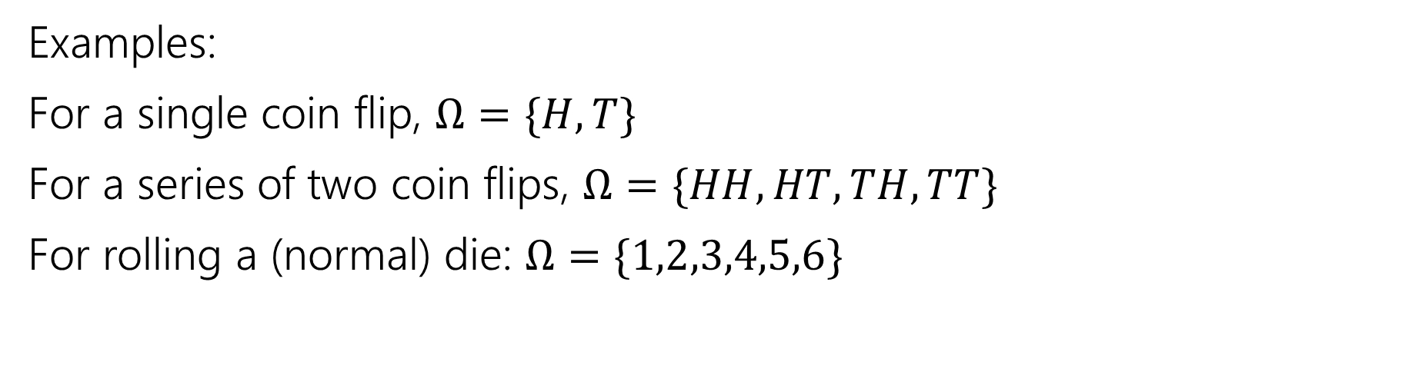


Sample Space
A sample space $Ω$ is the set of all possible outcomes of an experiment.
Sample Space
“outcome” is our word for a single element of $Ω$.
Examples:
For a single coin flip, $Ω=\{H,T\}$
For a series of two coin flips, $Ω=\{HH,HT,TH,TT\}$
For rolling a (normal) die: $Ω=\{1,2,3,4,5,6\}$

Slide 14

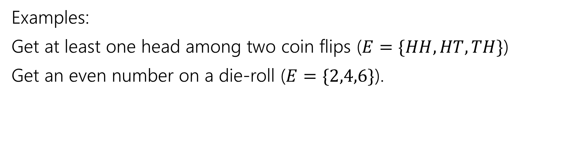

Events
An event $E⊆Ω$ is a subset of possible outcomes (i.e. a subset of $Ω$)
Event
Examples:
Get at least one head among two coin flips ($E=\{HH,HT,TH\}$)
Get an even number on a die-roll ($E=\{2,4,6\}$).

Slide 15

Examples
 | D2=1 | D2=2 | D2=3 | D2=4
D1=1 | (1,1) | (1,2) | (1,3) | (1,4)
D1=2 | (2,1) | (2,2) | (2,3) | (2,4)
D1=3 | (3,1) | (3,2) | (3,3) | (3,4)
D1=4 | (4,1) | (4,2) | (4,3) | (4,4)
I roll a blue 4-sided die and a red 4-sided die.
The table contains the sample space.
The event “the sum of the dice is even” is in gold
The event “the blue die is 1” is in green

Slide 16
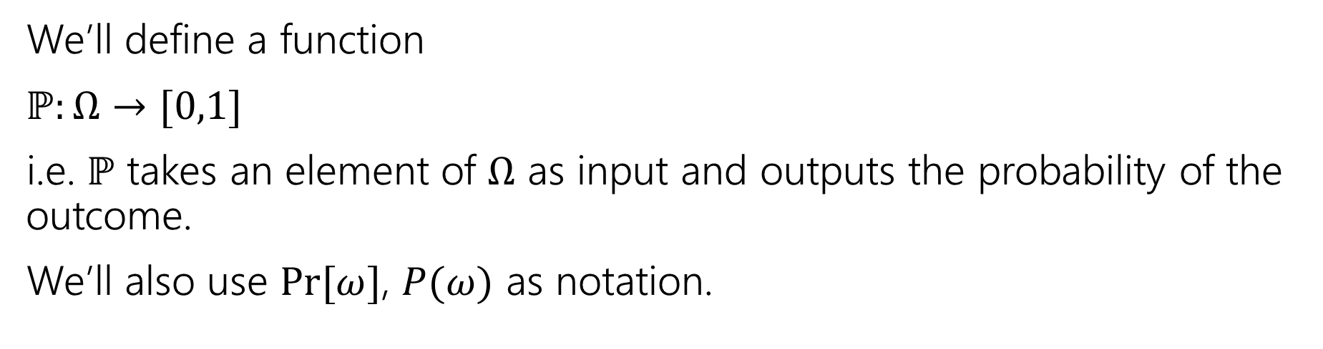
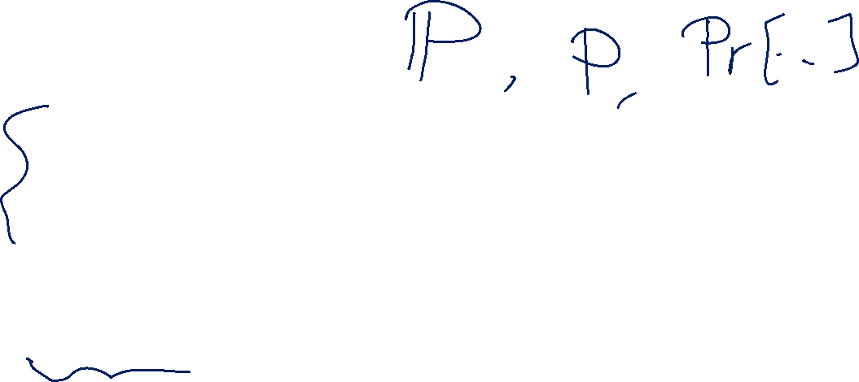
Probability
A probability is a number between 0 and 1 describing how likely a particular outcome is.
Probability
We’ll define a function
$ℙ:Ω→[0,1]$
i.e. $ℙ$ takes an element of $Ω$ as input and outputs the probability of the outcome.
We’ll also use $Pr⁡[ω]$, $P(ω)$ as notation.

Slide 17

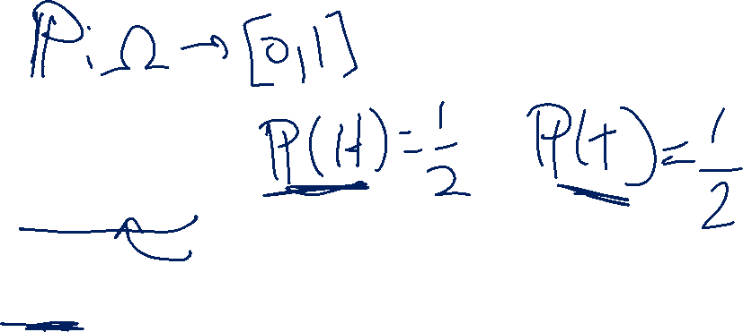
Example
Imagine we toss one coin.
Our sample space $Ω=\{H,T\}$
What do you want $ℙ$ to be?

Slide 18
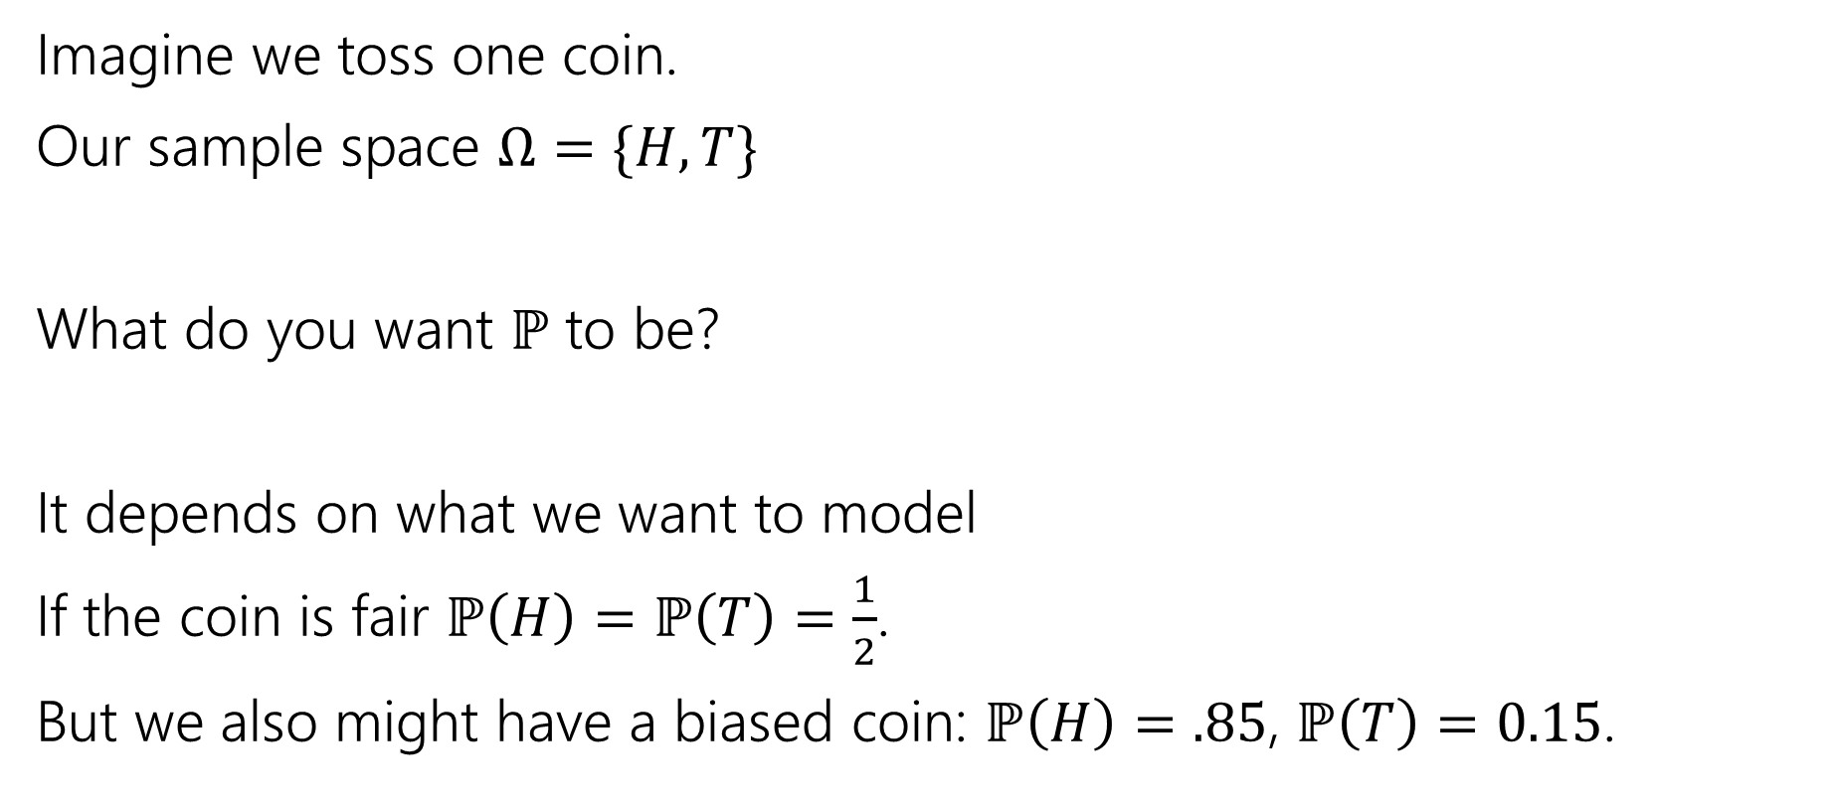
Example
Imagine we toss one coin.
Our sample space $Ω=\{H,T\}$
What do you want $ℙ$ to be?
It depends on what we want to model
If the coin is fair $ℙ\left(H\right)=ℙ\left(T\right)=\frac{1}{2}$.
But we also might have a biased coin: $ℙ\left(H\right)=.85$, $ℙ\left(T\right)=0.15$.

Slide 19


Probability Space
Probability Space
A (discrete) probability space is a pair $(Ω,ℙ)$ where:
$Ω$ is the sample space
$ℙ:Ω→[0,1]$ is the probability measure.
$ℙ$ satisfies:
$ℙ\left(x\right)≥0$ for all $x$
$\sum_{x∈Ω}{ℙ(x)} =1$
If $E,F⊆Ω$ and $E∩F=∅$then $ℙ\left(E∪F\right)=ℙ\left(E\right)+ℙ(F)$

Slide 20
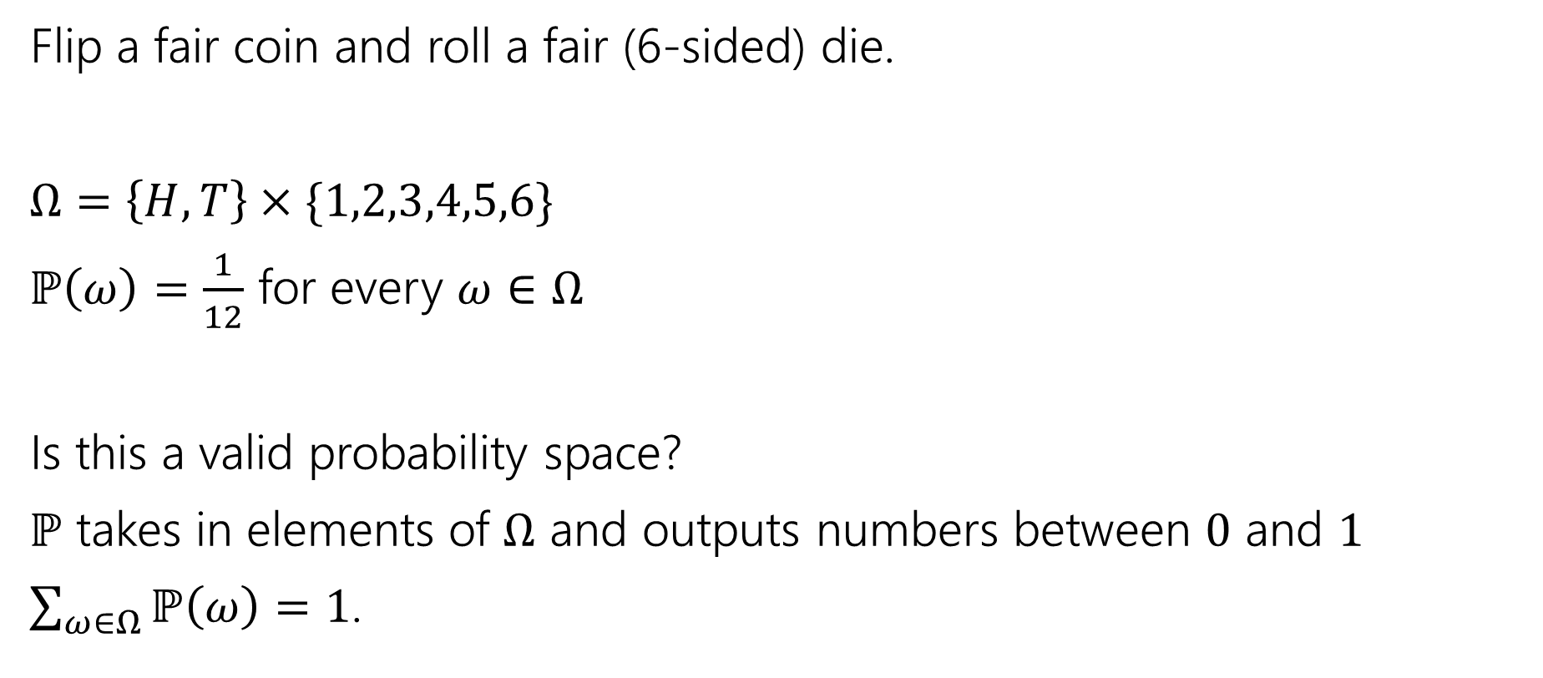
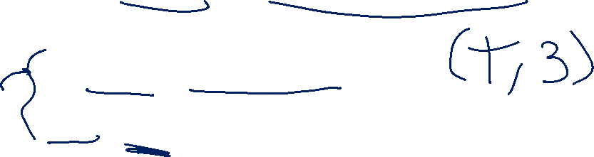
Probability Space
Flip a fair coin and roll a fair (6-sided) die.
$Ω=\left\{H,T\right\}×\{1,2,3,4,5,6\}$
$ℙ\left(ω\right)=\frac{1}{12}$ for every $ω∈Ω$
Is this a valid probability space?
$ℙ$ takes in elements of $Ω$ and outputs numbers between $0$ and $1$
$\sum_{ω∈Ω}{ℙ\left(ω\right)}=1$.

Slide 21
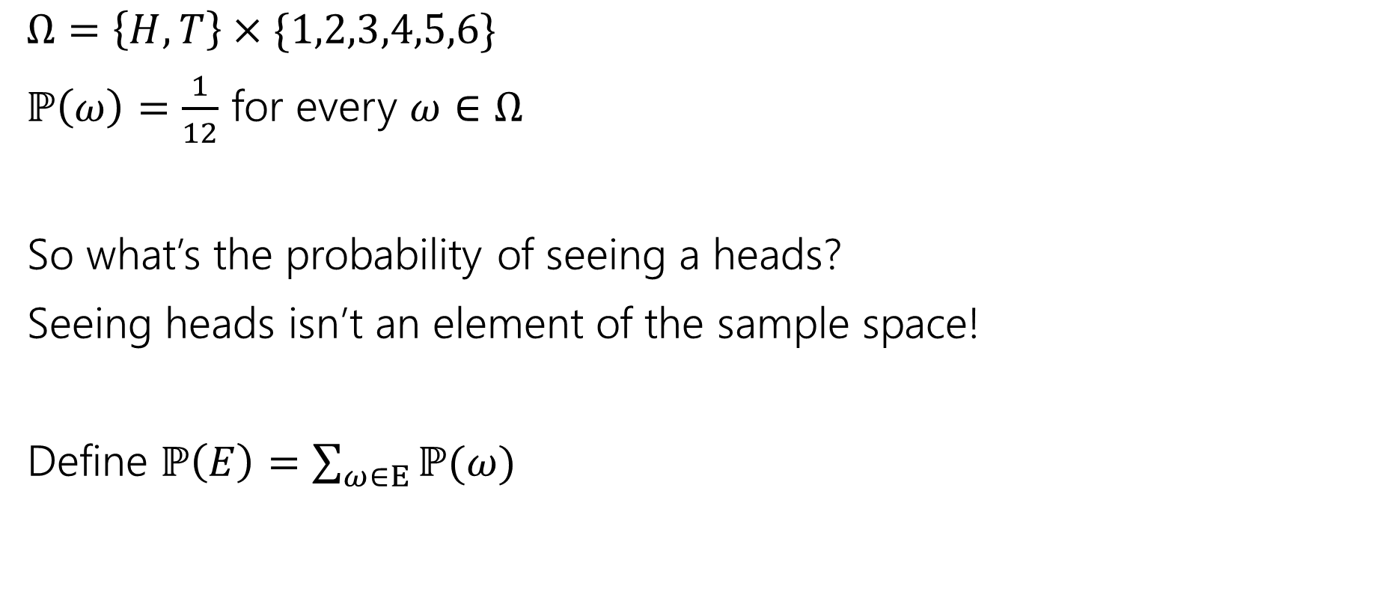

Measure
$Ω=\left\{H,T\right\}×\{1,2,3,4,5,6\}$
$ℙ\left(ω\right)=\frac{1}{12}$ for every $ω∈Ω$
So what’s the probability of seeing a heads?
Seeing heads isn’t an element of the sample space!
Define $ℙ\left(E\right)=\sum_{ω∈E}{ℙ(ω)}$

Slide 22
Probability Space
Probability Space
A (discrete) probability space is a pair $(Ω,ℙ)$ where:
$Ω$ is the sample space
$ℙ:Ω→[0,1]$ is the probability measure.
$ℙ$ satisfies:
$ℙ\left(x\right)≥0$ for all $x$
$\sum_{x∈Ω}{ℙ(x)} =1$
If $E,F⊆Ω$ and $E∩F=∅$then $ℙ\left(E∪F\right)=ℙ\left(E\right)+ℙ(F)$

Slide 23
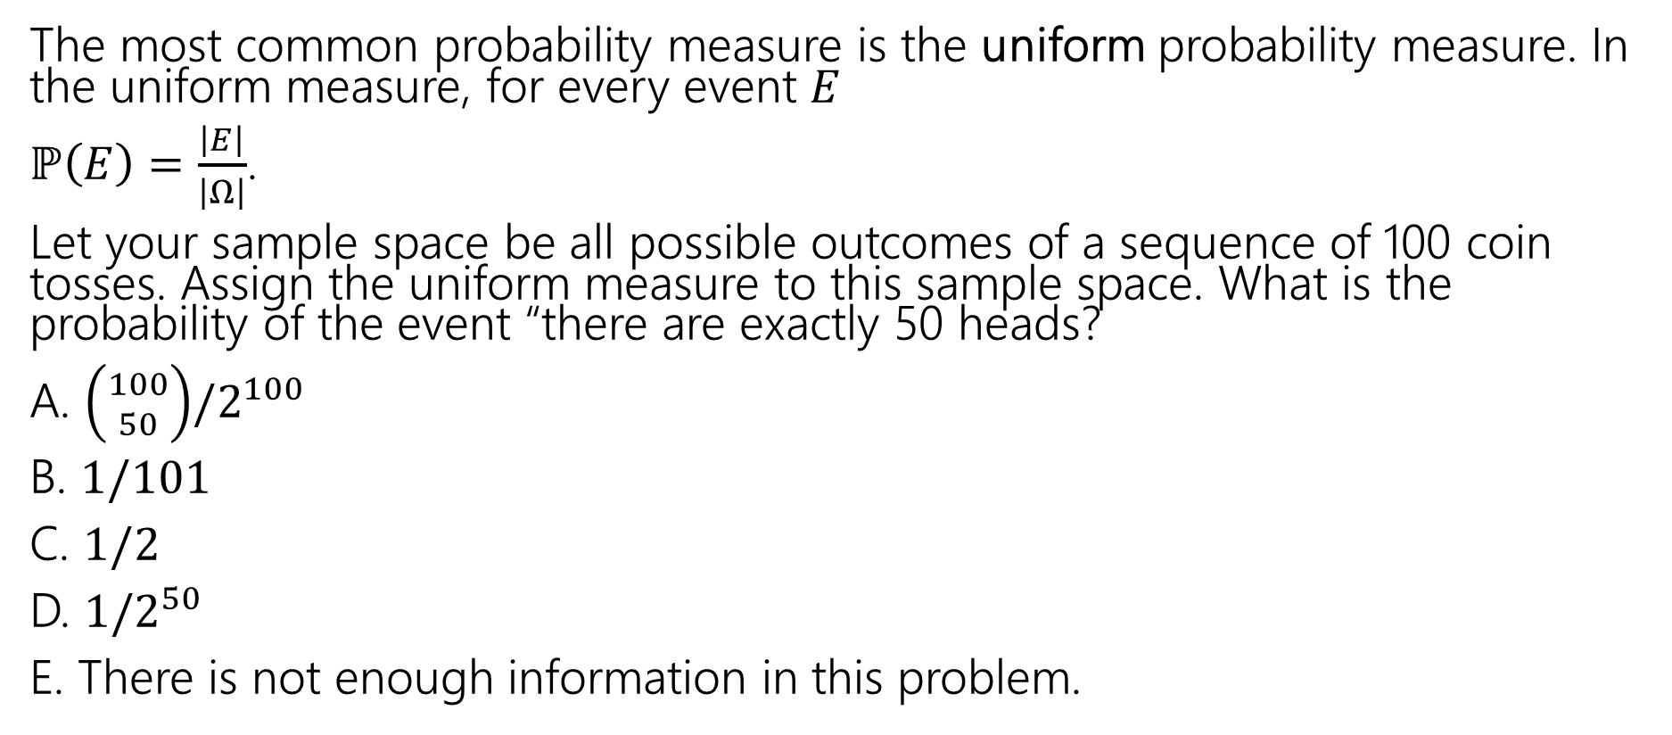
Uniform Probability Space
The most common probability measure is the uniform probability measure. In the uniform measure, for every event $E$
$ℙ\left(E\right)=\frac{\left|E\right|}{\left|Ω\right|}$.
Let your sample space be all possible outcomes of a sequence of 100 coin tosses. Assign the uniform measure to this sample space. What is the probability of the event “there are exactly 50 heads?
A. $\left({100 \atop 50}\right)/2^{100}$
B. $1/101$
C. $1/2$
D. $1/2^{50}$
E. There is not enough information in this problem.

Slide 24

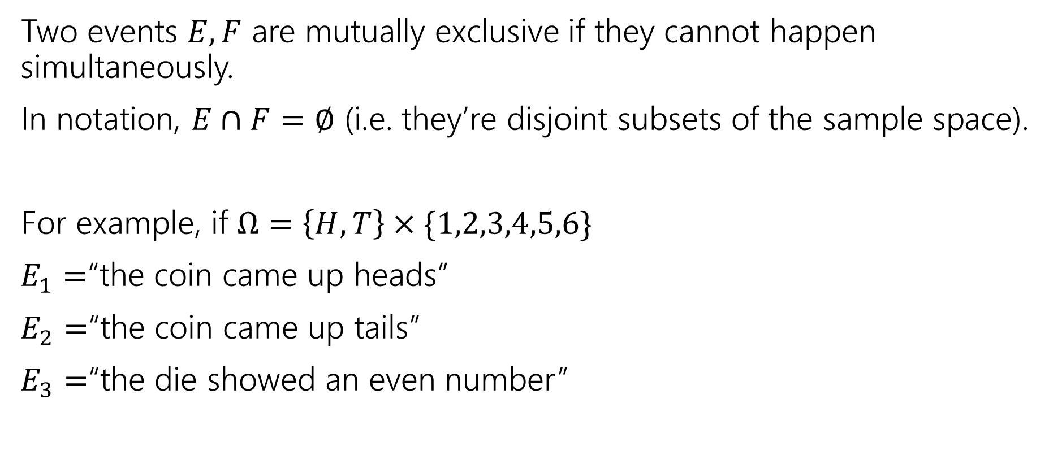
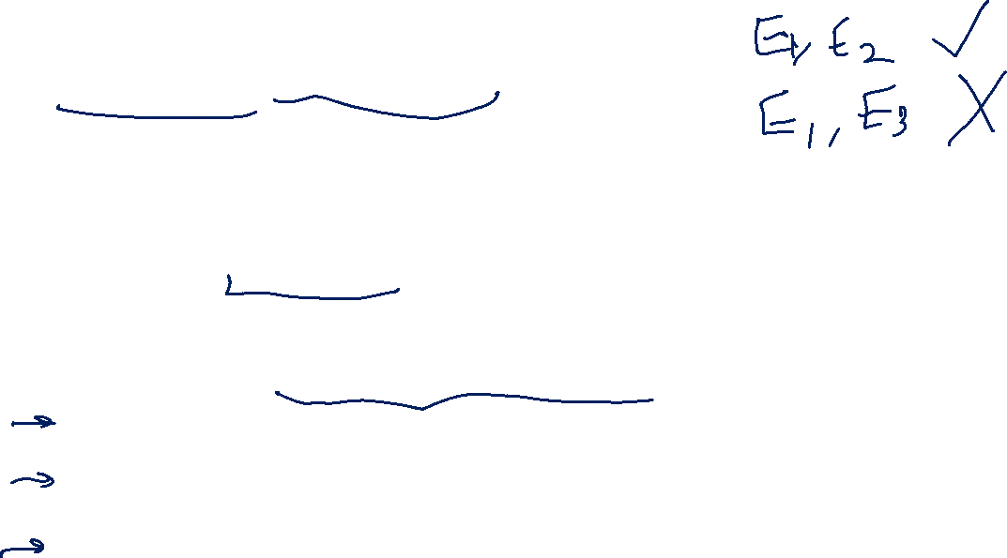
Mutually Exclusive Events
Two events $E,F$ are mutually exclusive if they cannot happen simultaneously.
In notation, $E∩F=∅$ (i.e. they’re disjoint subsets of the sample space).
For example, if $Ω=\left\{H,T\right\}×\{1,2,3,4,5,6\}$
$E_{1}=$“the coin came up heads”
$E_{2}=$“the coin came up tails”
$E_{3}=$“the die showed an even number”
$E_{1}$ and $E_{2}$ are mutually exclusive.
$E_{1}$ and $E_{3}$ are not mutually exclusive.

Slide 25
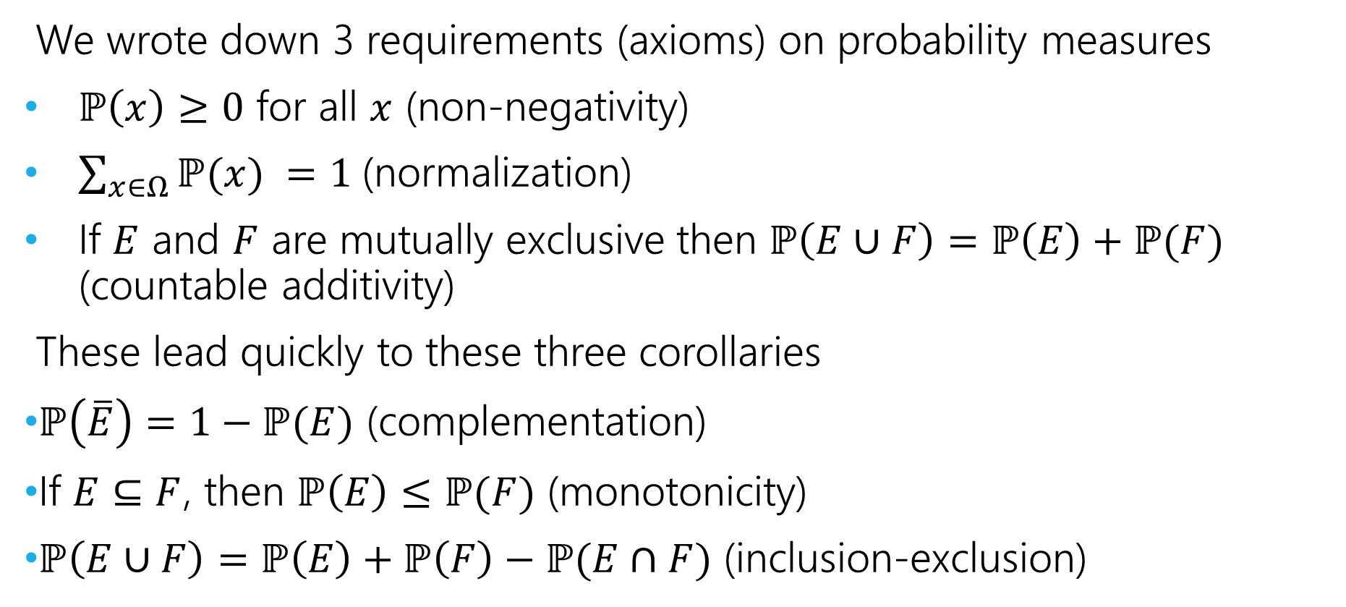

Axioms and Consequences
We wrote down 3 requirements (axioms) on probability measures
$ℙ\left(x\right)≥0$ for all $x$ (non-negativity)
$\sum_{x∈Ω}{ℙ(x)} =1$(normalization)
If $E$ and $F$ are mutually exclusive then $ℙ\left(E∪F\right)=ℙ\left(E\right)+ℙ(F)$ (countable additivity)
These lead quickly to these three corollaries
$ℙ\left(\overline{E}\right)=1−ℙ(E)$ (complementation)
If $E⊆F$, then $ℙ\left(E\right)≤ℙ(F)$ (monotonicity)
$ℙ\left(E∪F\right)=ℙ\left(E\right)+ℙ\left(F\right)−ℙ(E∩F)$ (inclusion-exclusion)

Slide 26
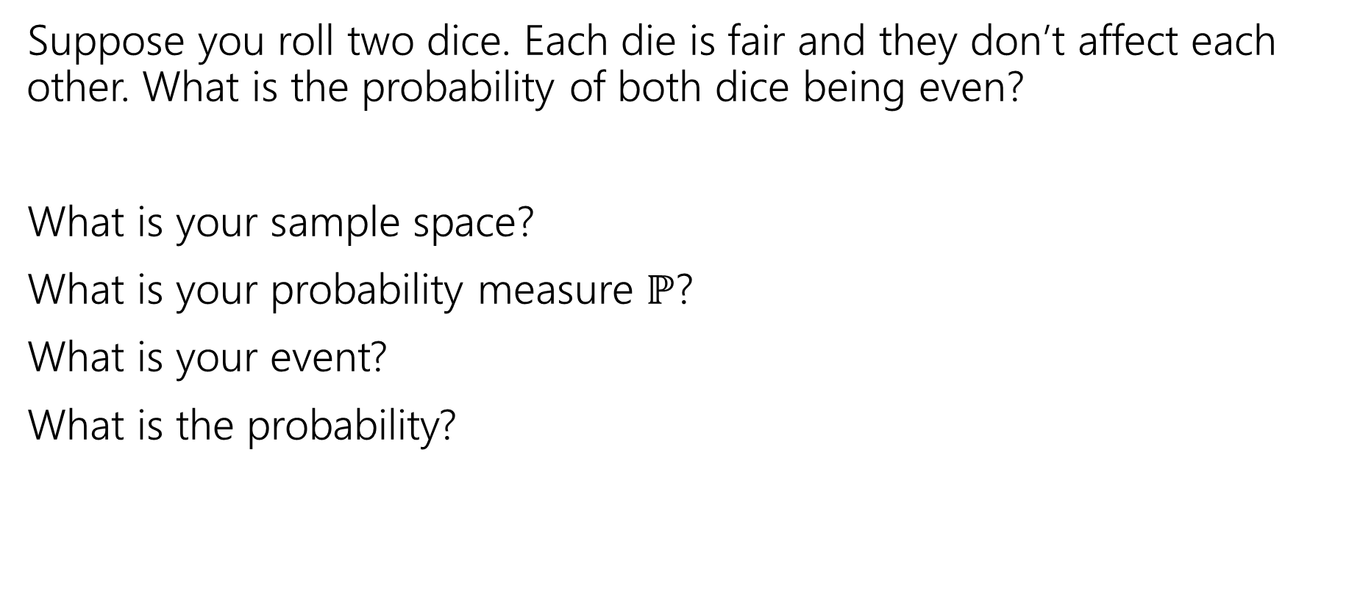
More Examples!
Suppose you roll two dice. Each die is fair and they don’t affect each other. What is the probability of both dice being even?
What is your sample space?
What is your probability measure $ℙ$?
What is your event?
What is the probability?

Slide 27
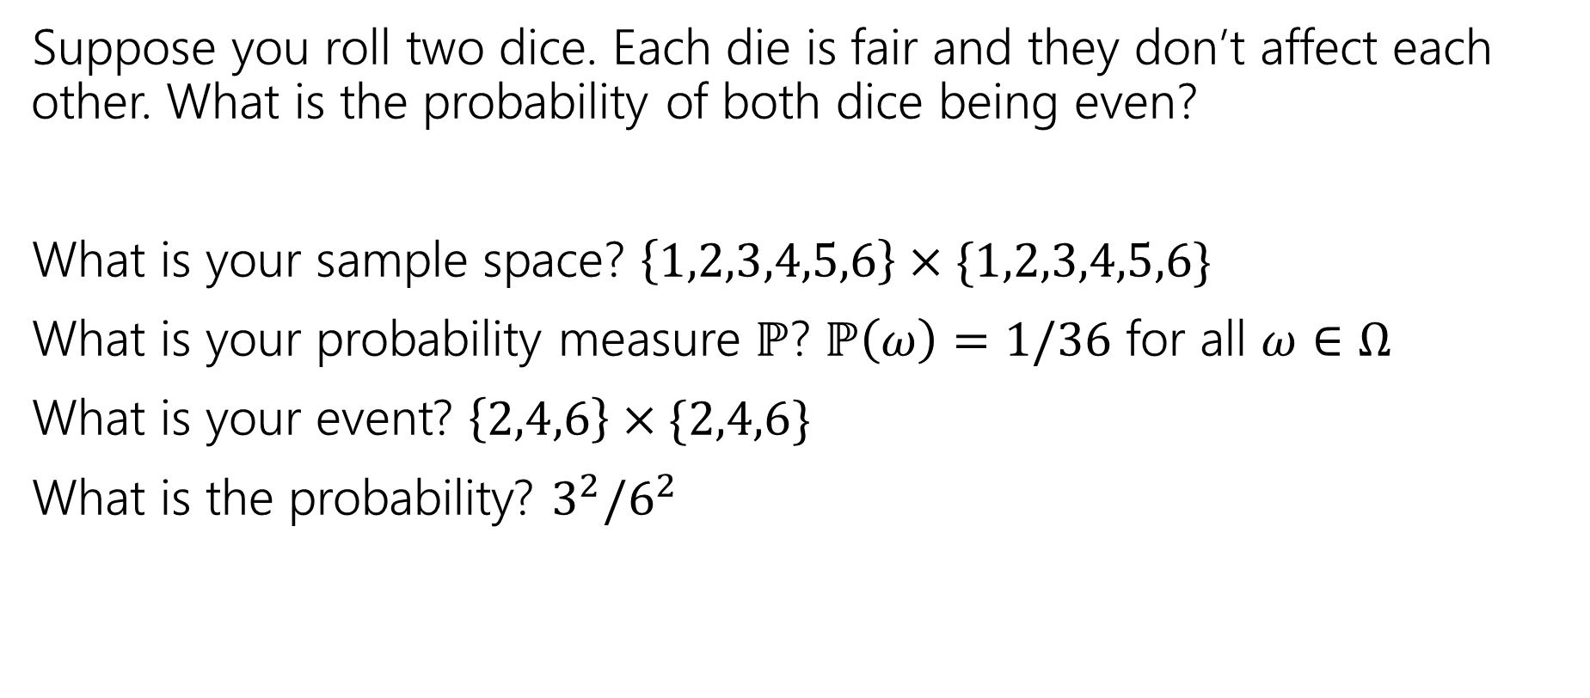
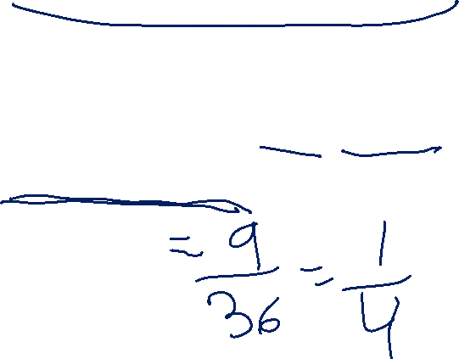
More Examples!
Suppose you roll two dice. Each die is fair and they don’t affect each other. What is the probability of both dice being even?
What is your sample space? $\left\{1,2,3,4,5,6\right\}×\{1,2,3,4,5,6\}$
What is your probability measure $ℙ$? $ℙ\left(ω\right)=1/36$ for all $ω∈Ω$
What is your event? $\left\{2,4,6\right\}×\{2,4,6\}$
What is the probability? $3^{2}/6^{2}$

Slide 28
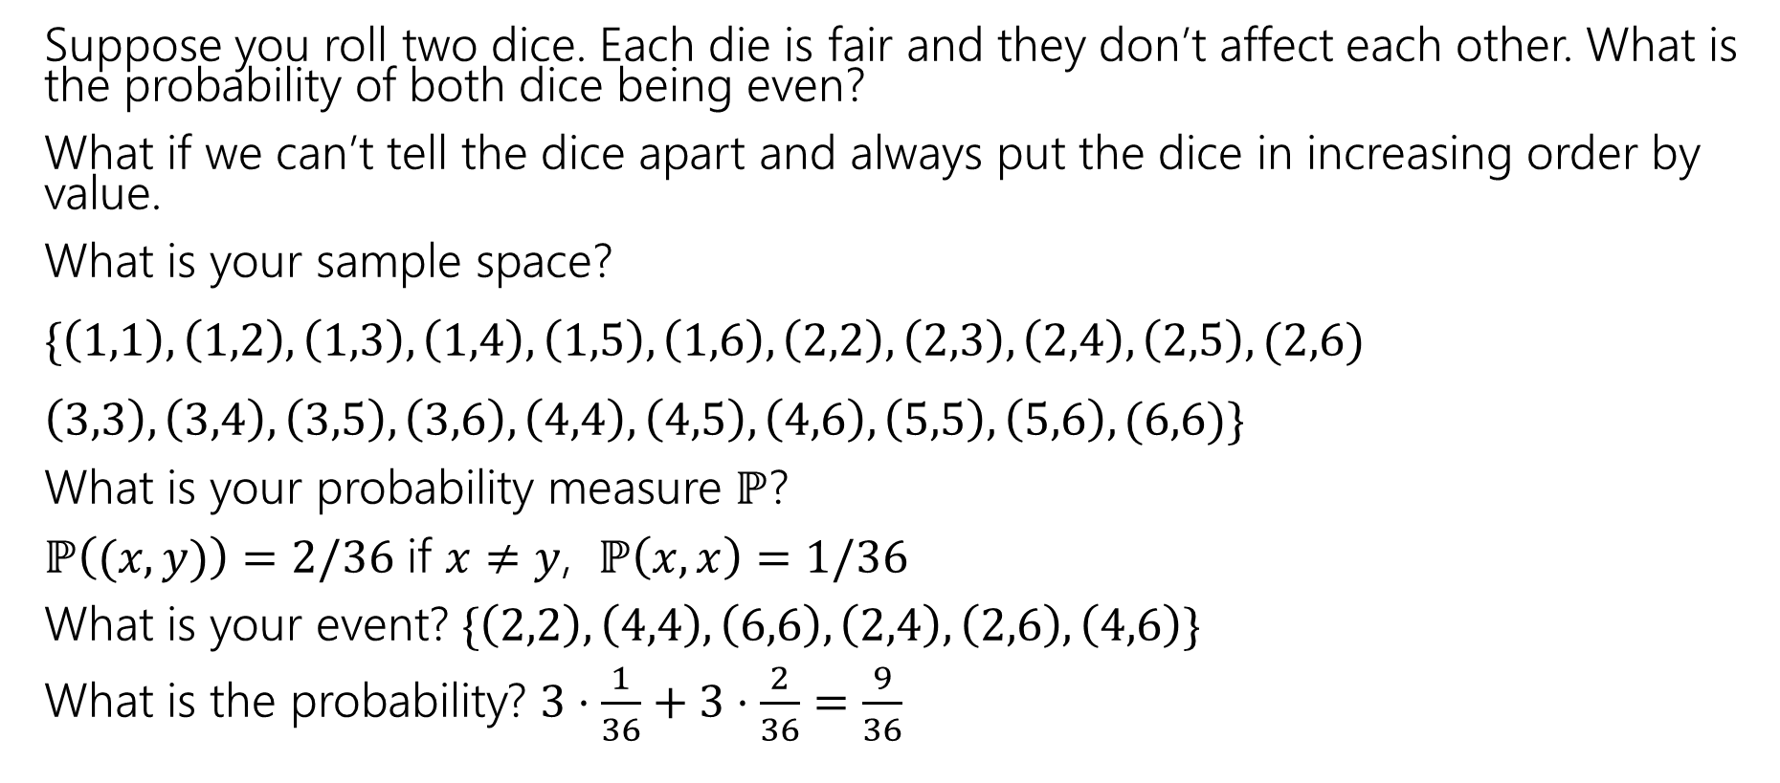
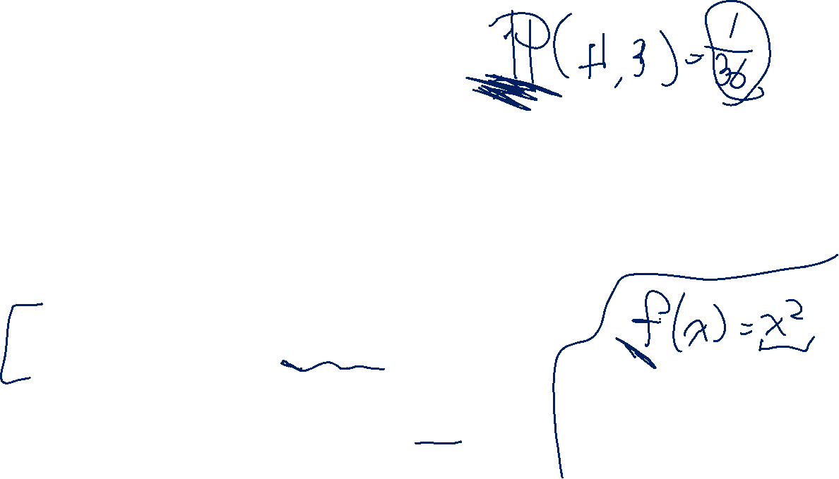
More Examples!
Suppose you roll two dice. Each die is fair and they don’t affect each other. What is the probability of both dice being even?
What if we can’t tell the dice apart and always put the dice in increasing order by value.
What is your sample space?
$\{\left(1,1\right),\left(1,2\right),\left(1,3\right),\left(1,4\right),\left(1,5\right),\left(1,6\right), \left(2,2\right),\left(2,3\right), \left(2,4\right),\left(2,5\right), (2,6)$
$\left(3,3\right),\left(3,4\right),\left(3,5\right),\left(3,6\right),\left(4,4\right),\left(4,5\right),\left(4,6\right),\left(5,5\right),\left(5,6\right), (6,6)\}$
What is your probability measure $ℙ$?
$ℙ\left((x,y)\right)=2/36$ if $x≠y$, $ℙ\left(x,x\right)=1/36$
What is your event? $\{\left(2,2\right),\left(4,4\right),\left(6,6\right), \left(2,4\right),\left(2,6\right),\left(4,6\right)\}$
What is the probability? $3⋅\frac{1}{36}+3⋅\frac{2}{36}=\frac{9}{36}$

Slide 29
Takeaways
There is often more than one sample space possible! But one is probably easier than the others.
Finding a sample space that will make the uniform measure correct will usually make finding the probabilities easier to calculate.

Slide 30
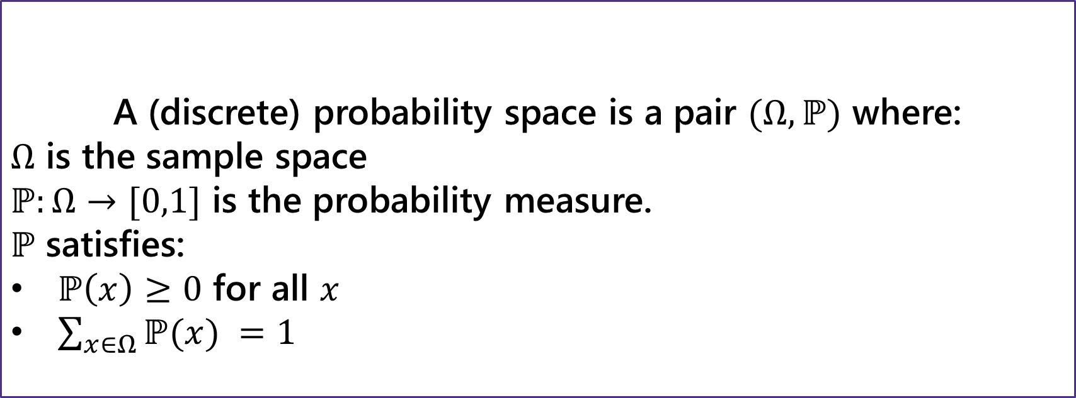
Probability Space
Probability Space
A (discrete) probability space is a pair $(Ω,ℙ)$ where:
$Ω$ is the sample space
$ℙ:Ω→[0,1]$ is the probability measure.
$ℙ$ satisfies:
$ℙ\left(x\right)≥0$ for all $x$
$\sum_{x∈Ω}{ℙ(x)} =1$
If $E,F⊆Ω$ and $E∩F=∅$then $ℙ\left(E∪F\right)=ℙ\left(E\right)+ℙ(F)$

Slide 31
Non-uniform measures

Slide 32
Last Time
A sample space $Ω$ is the set of all possible outcomes of an experiment.
Sample Space
An event $E⊆Ω$ is a subset of possible outcomes (i.e. a subset of $Ω$)
Event
A probability is a number between 0 and 1 describing how likely a particular outcome is.
Probability

Slide 33
Probability Space
Probability Space
A (discrete) probability space is a pair $(Ω,ℙ)$ where:
$Ω$ is the sample space
$ℙ:Ω→[0,1]$ is the probability measure.
$ℙ$ satisfies:
$ℙ\left(x\right)≥0$ for all $x$
$\sum_{x∈Ω}{ℙ(x)} =1$
If $E,F⊆Ω$ and $E∩F=∅$then $ℙ\left(E∪F\right)=ℙ\left(E\right)+ℙ(F)$

Slide 34
Probability Space
Flip a fair coin and roll a fair (6-sided) die.
$Ω=\left\{H,T\right\}×\{1,2,3,4,5,6\}$
$ℙ\left(ω\right)=\frac{1}{12}$ for every $ω∈Ω$
Is this a valid probability space?
$ℙ$ takes in elements of $Ω$ and outputs numbers between $0$ and $1$
$\sum_{ω∈Ω}{ℙ\left(ω\right)}=1$.

Slide 35
Mutually Exclusive Events
Two events $E,F$ are mutually exclusive if they cannot happen simultaneously.
In notation, $E∩F=∅$ (i.e. they’re disjoint subsets of the sample space).
For example, if $Ω=\left\{H,T\right\}×\{1,2,3,4,5,6\}$
$E_{1}=$“the coin came up heads”
$E_{2}=$“the coin came up tails”
$E_{3}=$“the die showed an even number”
$E_{1}$ and $E_{2}$ are mutually exclusive.
$E_{1}$ and $E_{3}$ are not mutually exclusive.

Slide 36
Axioms and Consequences
We wrote down 3 requirements (axioms) on probability measures
$ℙ\left(x\right)≥0$ for all $x$ (non-negativity)
$\sum_{x∈Ω}{ℙ(x)} =1$(normalization)
If $E$ and $F$ are mutually exclusive then $ℙ\left(E∪F\right)=ℙ\left(E\right)+ℙ(F)$ (countable additivity)
These lead quickly to these three corollaries
$ℙ\left(\overline{E}\right)=1−ℙ(E)$ (complementation)
If $E⊆F$, then $ℙ\left(E\right)≤ℙ(F)$ (monotonicity)
$ℙ\left(E∪F\right)=ℙ\left(E\right)+ℙ\left(F\right)−ℙ(E∩F)$ (inclusion-exclusion)

Slide 37
Examples

Slide 38
More Examples!
Suppose you roll two dice. Each die is fair and they don’t affect each other. What is the probability of both dice being even?
What is your sample space?
What is your probability measure $ℙ$?
What is your event?
What is the probability?

Slide 39
More Examples!
Suppose you roll two dice. Each die is fair and they don’t affect each other. What is the probability of both dice being even?
What is your sample space? $\left\{1,2,3,4,5,6\right\}×\{1,2,3,4,5,6\}$
What is your probability measure $ℙ$? $ℙ\left(ω\right)=1/36$ for all $ω∈Ω$
What is your event? $\left\{2,4,6\right\}×\{2,4,6\}$
What is the probability? $3^{2}/6^{2}$

Slide 40
More Examples!
Suppose you roll two dice. Each die is fair and they don’t affect each other. What is the probability of both dice being even?
What if we can’t tell the dice apart and always put the dice in increasing order by value.
What is your sample space?
$\{\left(1,1\right),\left(1,2\right),\left(1,3\right),\left(1,4\right),\left(1,5\right),\left(1,6\right), \left(2,2\right),\left(2,3\right), \left(2,4\right),\left(2,5\right), (2,6)$
$\left(3,3\right),\left(3,4\right),\left(3,5\right),\left(3,6\right),\left(4,4\right),\left(4,5\right),\left(4,6\right),\left(5,5\right),\left(5,6\right), (6,6)\}$
What is your probability measure $ℙ$?
$ℙ\left((x,y)\right)=2/36$ if $x≠y$, $ℙ\left(x,x\right)=1/36$
What is your event? $\{\left(2,2\right),\left(4,4\right),\left(6,6\right), \left(2,4\right),\left(2,6\right),\left(4,6\right)\}$
What is the probability? $3⋅\frac{1}{36}+3⋅\frac{2}{36}=\frac{9}{36}$

Slide 41
Takeaways
There is often more than one sample space possible! But one is probably easier than the others.
Finding a sample space that will make the uniform measure correct will usually make finding the probabilities easier to calculate.

Slide 42
Another Example
Suppose you shuffle a deck of cards so any arrangement is equally likely. What is the probability that the top two cards have the same value?
Sample Space
Probability Measure
Event
Probability

Slide 43
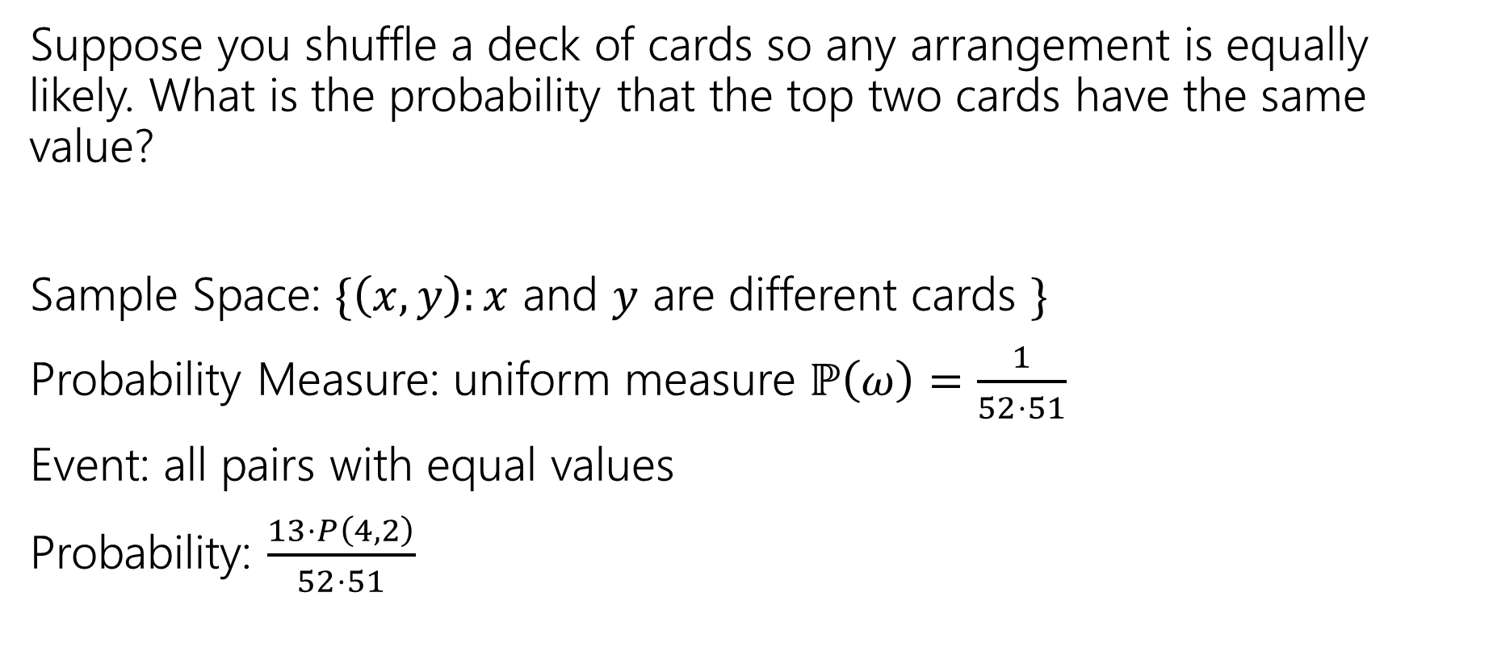
Another Example
Suppose you shuffle a deck of cards so any arrangement is equally likely. What is the probability that the top two cards have the same value?
Sample Space: $\{\left(x,y\right):x$ and $y$ are different cards $\}$
Probability Measure: uniform measure $ℙ\left(ω\right)=\frac{1}{52⋅51}$
Event: all pairs with equal values
Probability: $\frac{13⋅P\left(4,2\right)}{52⋅51}$

Slide 44
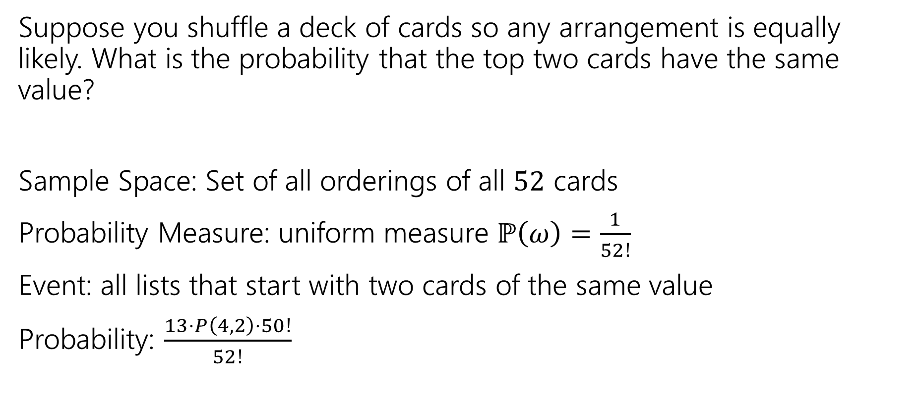
Another Example
Suppose you shuffle a deck of cards so any arrangement is equally likely. What is the probability that the top two cards have the same value?
Sample Space: Set of all orderings of all $52$ cards
Probability Measure: uniform measure $ℙ\left(ω\right)=\frac{1}{52!}$
Event: all lists that start with two cards of the same value
Probability: $\frac{13⋅P\left(4,2\right)⋅50!}{52!}$

Slide 45
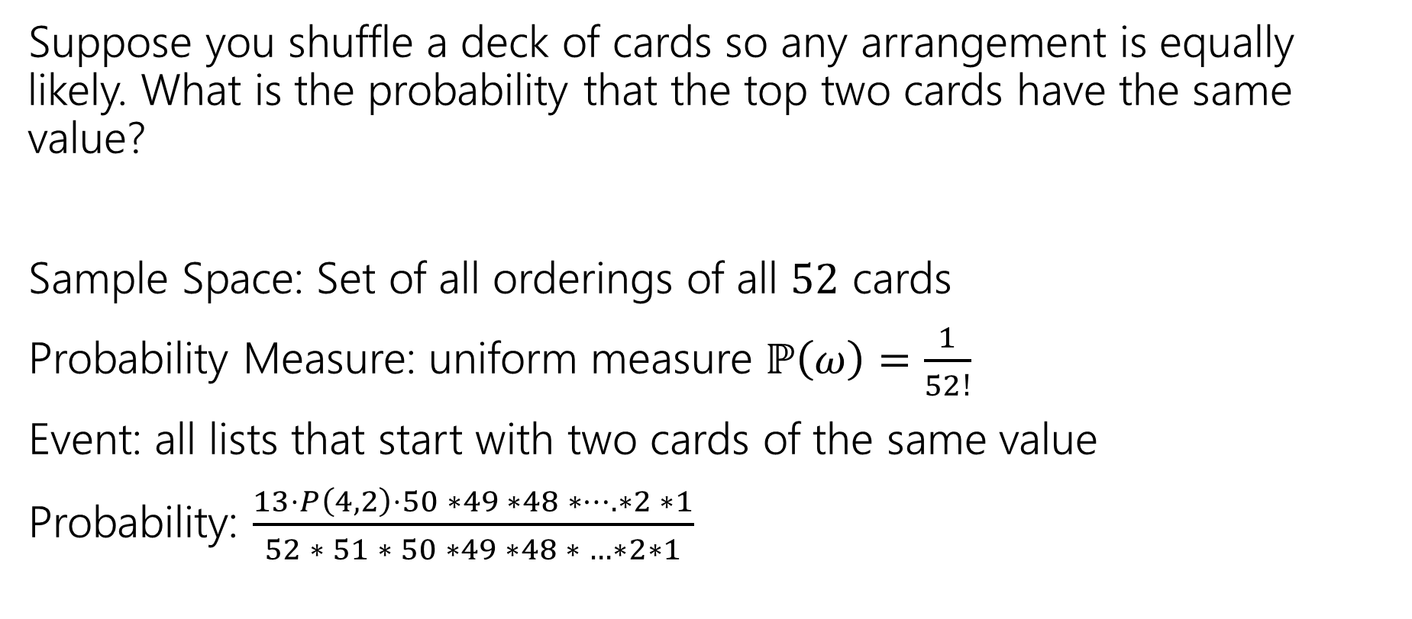
Another Example
Suppose you shuffle a deck of cards so any arrangement is equally likely. What is the probability that the top two cards have the same value?
Sample Space: Set of all orderings of all $52$ cards
Probability Measure: uniform measure $ℙ\left(ω\right)=\frac{1}{52!}$
Event: all lists that start with two cards of the same value
Probability: $\frac{13⋅P\left(4,2\right)⋅50 ∗49 ∗48 ∗…. ∗2 ∗1}{52 ∗ 51 ∗ 50 ∗49 ∗48 ∗ …∗2∗1}$

Slide 46
Last Time
A sample space $Ω$ is the set of all possible outcomes of an experiment.
Sample Space
An event $E⊆Ω$ is a subset of possible outcomes (i.e. a subset of $Ω$)
Event
A probability is a number between 0 and 1 describing how likely a particular outcome is.
Probability

Slide 47
Takeaway
There’s often information you “don’t need” in your sample space.
It won’t give you the wrong answer.
But it sometimes makes for extra work/a harder counting problem,
Good indication: you cancelled A LOT of stuff that was common in the numerator and denominator.

Slide 48
Uniform Probability Space
The most common probability measure is the uniform probability measure. In the uniform measure, for every event $E$
$ℙ\left(E\right)=\frac{\left|E\right|}{\left|Ω\right|}$.
Let your sample space be all possible outcomes of a sequence of 100 coin tosses. Assign the uniform measure to this sample space. What is the probability of the event “there are exactly 50 heads?
A. $\left({100 \atop 50}\right)/2^{100}$
B. $1/101$
C. $1/2$
D. $1/2^{50}$
E. There is not enough information in this problem.

Slide 49
Few notes about events and samples spaces
If you’re dealing with a situation where you may be able to use a uniform probability space, make sure to set up the sample space in a way that every outcome is equally likely.
Try not overcomplicate the sample space – only include the information that you need in it.
When you define an event, make sure it is a subset of the sample space!

Slide 50

Some Quick Observations
For discrete probability spaces (the kind we’ve seen so far)
$ℙ\left(E\right)=0$ if and only if ?
$ℙ\left(E\right)=1$ if and only if ?

Slide 51

Some Quick Observations
For discrete probability spaces (the kind we’ve seen so far)
$ℙ\left(E\right)=0$ if and only if an event can’t happen.
$ℙ\left(E\right)=1$ if and only if an event is guaranteed (every outcome outside $E$has probability $0$).

Slide 52
More Practice

Slide 53
Probable Fruit
The fruit store sells apples, bananas, and oranges.
Robbie will buy a bag of 10 fruits (order doesn’t matter) to bring to lecture, uniformly at random among all possible bags that contain at least one of each fruit type.
You and your friend are first in line to take fruit, and will take an apple each if it’s available---what is the probability you both get an apple?

Slide 54
Probable Fruit (Sample Space)
Defining the sample space (other than in English sentences) would be annoying--we’ll skip it.
But we need its size…two options

Slide 55
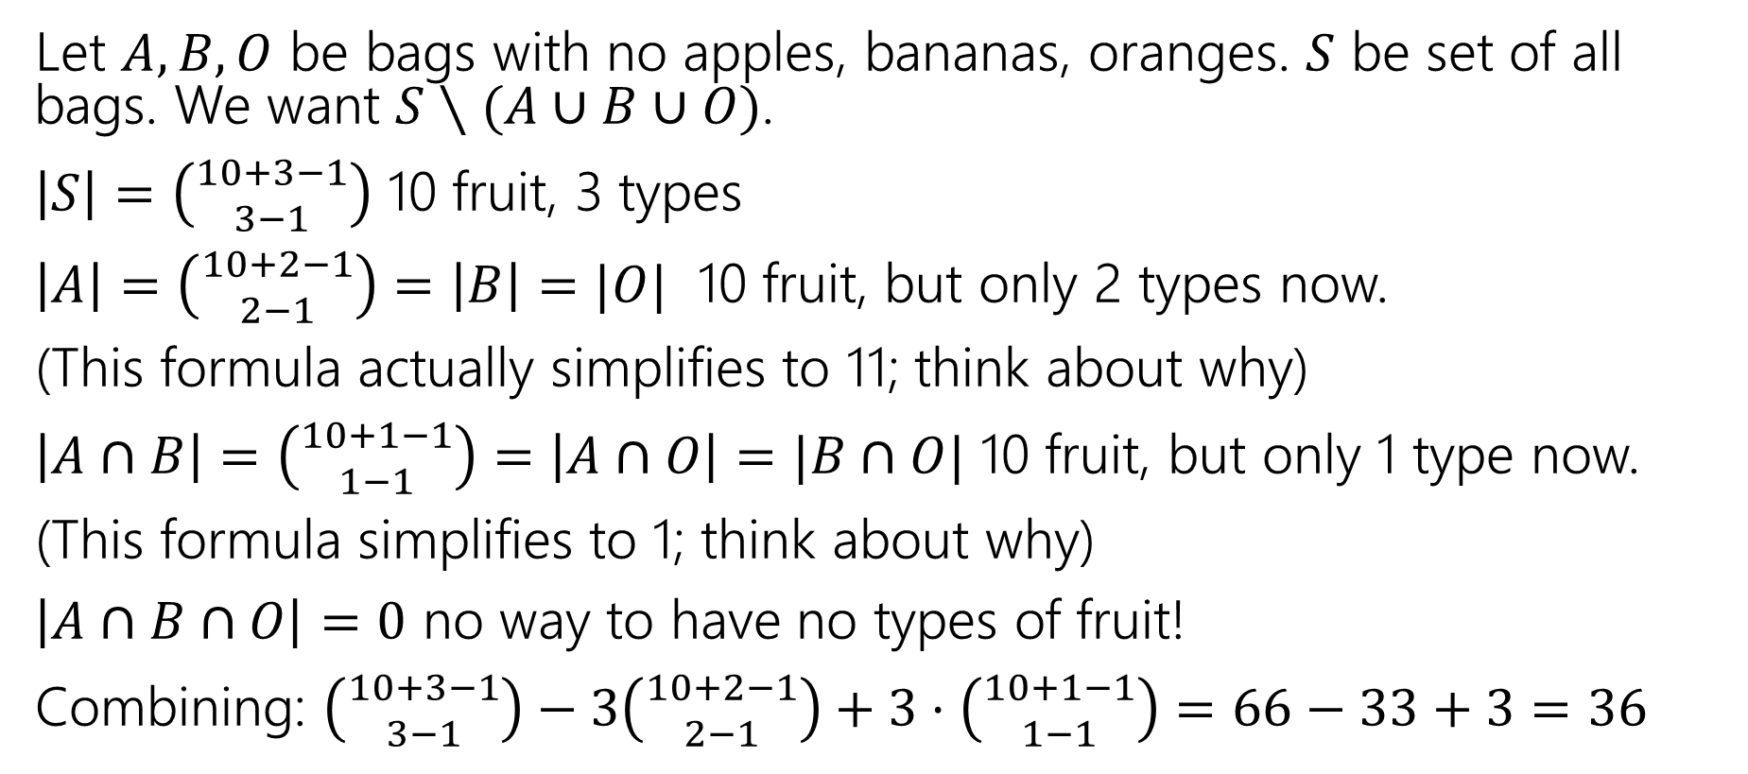
Complementary counting and Inclusion-Exclusion
Let $A,B,O$ be bags with no apples, bananas, oranges. $S$ be set of all bags. We want $S∖(A∪B∪O)$.
$\left|S\right|=\left({10+3−1 \atop 3−1}\right)$ 10 fruit, 3 types
$\left|A\right|=\left({10+2−1 \atop 2−1}\right)=\left|B\right|=|O|$ 10 fruit, but only 2 types now.
(This formula actually simplifies to 11; think about why)
$\left|A∩B\right|=\left({10+1−1 \atop 1−1}\right)=\left|A∩O\right|=|B∩O|$ 10 fruit, but only 1 type now.
(This formula simplifies to 1; think about why)
$\left|A∩B∩O\right|=0$ no way to have no types of fruit!
Combining: $\left({10+3−1 \atop 3−1}\right)−3\left({10+2−1 \atop 2−1}\right)+3⋅\left({10+1−1 \atop 1−1}\right)=66−33+3=36$

Slide 56

Clever Solution
Put the one fruit of each type in the bag first. We now need 7 more fruits (with no restrictions).
$\left({7+3−1 \atop 3−1}\right)=36$.

Slide 57
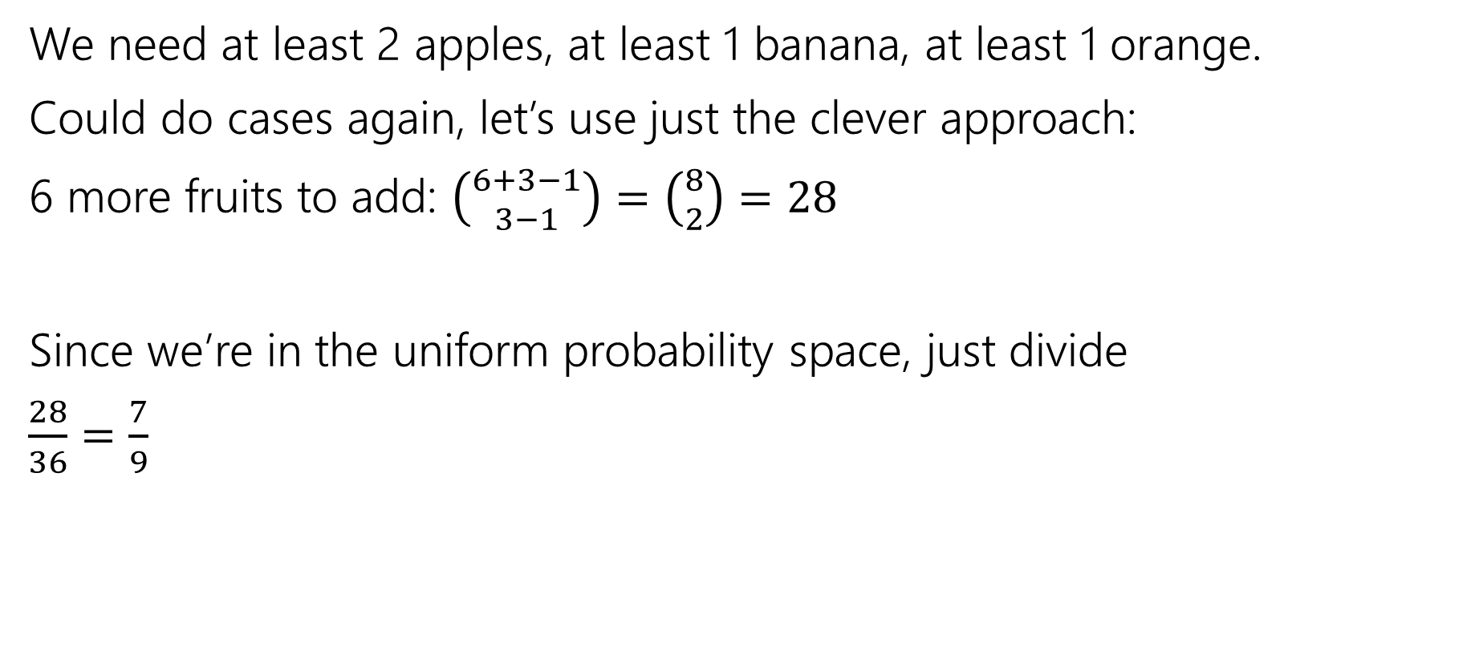
What about the event?
We need at least 2 apples, at least 1 banana, at least 1 orange.
Could do cases again, let’s use just the clever approach:
6 more fruits to add: $\left({6+3−1 \atop 3−1}\right)=\left({8 \atop 2}\right)=28$
Since we’re in the uniform probability space, just divide
$\frac{28}{36}=\frac{7}{9}$

