Slide 1
Wrap Counting Rules
CSE 312 Winter 26
Lecture 4

Slide 2

Outline
Today
Wrap Inclusion-Exclusion
Two Niche Rules
Binomial Theorem
Pigeonhole Principle
Our last big Rule
Counting Practice

Slide 3
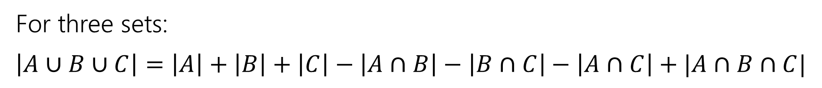
Principle of Inclusion-Exclusion
For three sets:
$\left|A∪B∪C\right|=\left|A\right|+\left|B\right|+\left|C\right|−\left|A∩B\right|−\left|B∩C\right|−\left|A∩C\right|+|A∩B∩C|$

Slide 4

Example
How many length 5 strings over the alphabet $\{a,b,c,…,z\}$ contain:
Exactly 2 ‘a’s OR
Exactly 1 ‘b’ OR
No ‘x’s
For what $A,B,C$ do we want $|A∪B∪C|$?

Slide 5
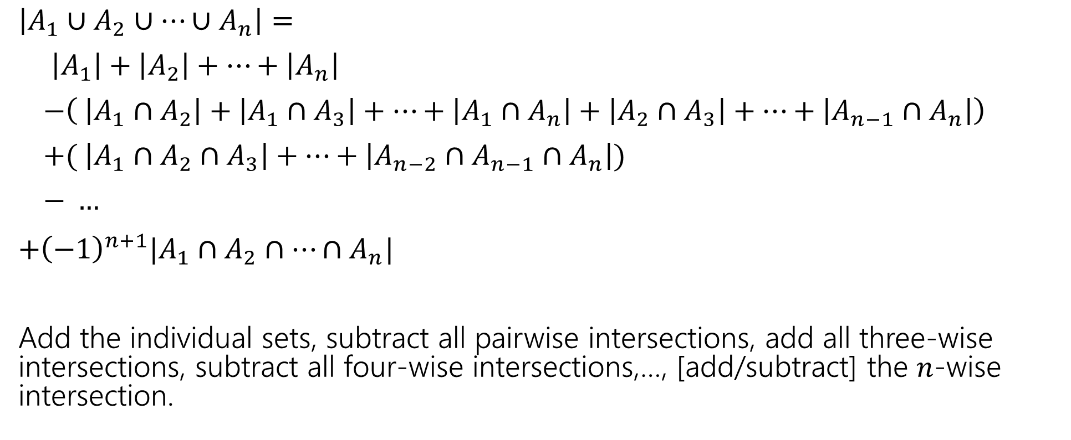
In general:
$\left|A_{1}∪A_{2}∪⋯∪A_{n}\right|=$
$\left|A_{1}\right|+\left|A_{2}\right|+⋯+\left|A_{n}\right|$
$−\left( \left|A_{1}∩A_{2}\right|+\left|A_{1}∩A_{3}\right|+…+\left|A_{1}∩A_{n}\right|+\left|A_{2}∩A_{3}\right|+…+\left|A_{n−1}∩A_{n}\right|\right)$
$+( \left|A_{1}∩A_{2}∩A_{3}\right|+…+\left|A_{n−2}∩A_{n−1}∩A_{n}\right|)$
$− …$
$+{\left(−1\right)}^{n+1}|A_{1}∩A_{2}∩…∩A_{n}|$
Add the individual sets, subtract all pairwise intersections, add all three-wise intersections, subtract all four-wise intersections,…, [add/subtract] the $n$-wise intersection.

Slide 6
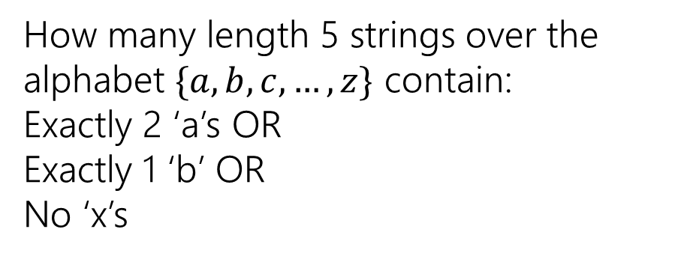
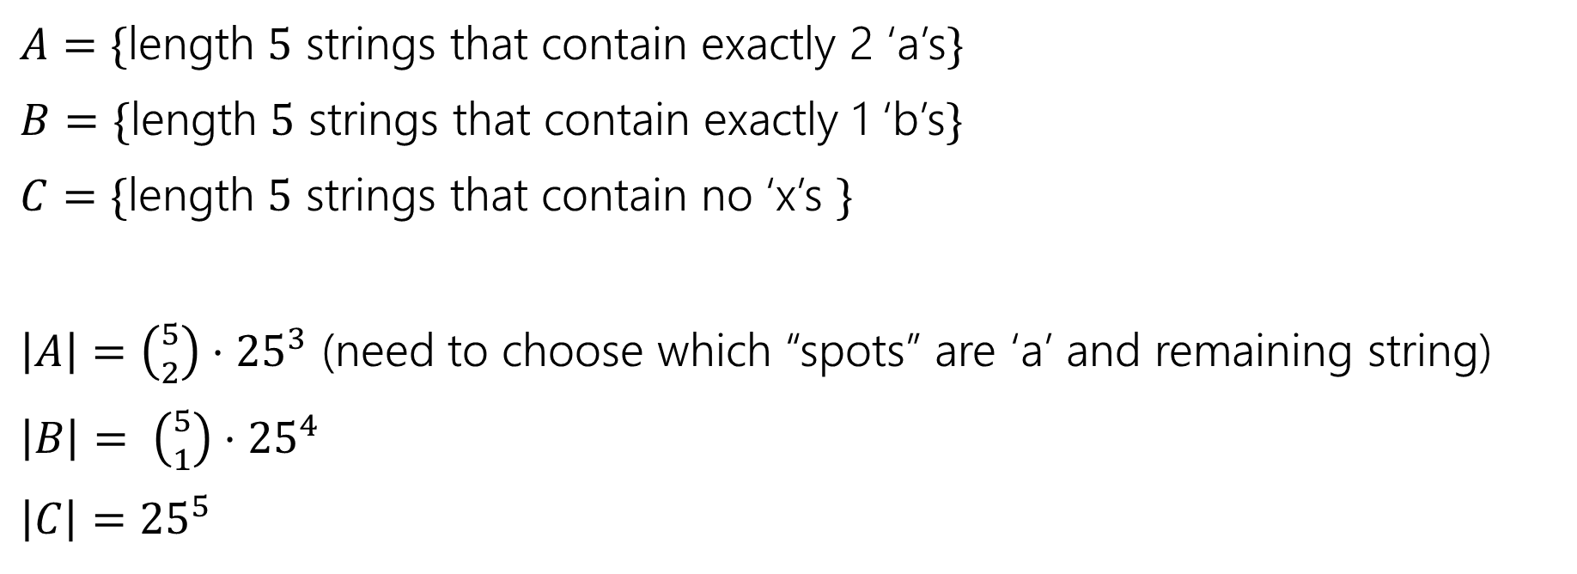
Example
How many length 5 strings over the alphabet $\{a,b,c,…,z\}$ contain:
Exactly 2 ‘a’s OR
Exactly 1 ‘b’ OR
No ‘x’s
$A=\{$length $5$ strings that contain exactly 2 ‘a’s$\}$
$B=\{$length $5$ strings that contain exactly 1 ‘b’s$\}$
$C=\{$length $5$ strings that contain no ‘x’s $\}$
$\left|A\right|=\left({5 \atop 2}\right)⋅{25}^{3}$ (need to choose which “spots” are ‘a’ and remaining string)
$\left|B\right|= \left({5 \atop 1}\right)⋅{25}^{4}$
$\left|C\right|={25}^{5}$

Slide 7

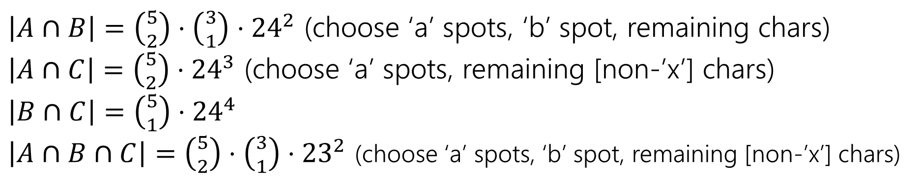

Example
How many length 5 strings over the alphabet $\{a,b,c,…,z\}$ contain:
Exactly 2 ‘a’s OR
Exactly 1 ‘b’ OR
No ‘x’s
$\left|A\right|=\left({5 \atop 2}\right)⋅{25}^{3}$
$\left|B\right|= \left({5 \atop 1}\right)⋅{25}^{3}$
$\left|C\right|={25}^{5}$
$A=\{$length $5$ strings that contain exactly 2 ‘a’s$\}$
$B=\{$length $5$ strings that contain exactly 1 ‘b’s$\}$
$C=\{$length $5$ strings that contain no ‘x’s $\}$
$\left|A∩B\right|=\left({5 \atop 2}\right)⋅\left({3 \atop 1}\right)⋅{24}^{2}$ (choose ‘a’ spots, ‘b’ spot, remaining chars)
$\left|A∩C\right|=\left({5 \atop 2}\right)⋅{24}^{3}$ (choose ‘a’ spots, remaining [non-’x’] chars)
$\left|B∩C\right|=\left({5 \atop 1}\right)⋅{24}^{4}$
$\left|A∩B∩C\right|=\left({5 \atop 2}\right)⋅\left({3 \atop 1}\right)⋅{23}^{2}$ (choose ‘a’ spots, ‘b’ spot, remaining [non-’x’] chars)

Slide 8
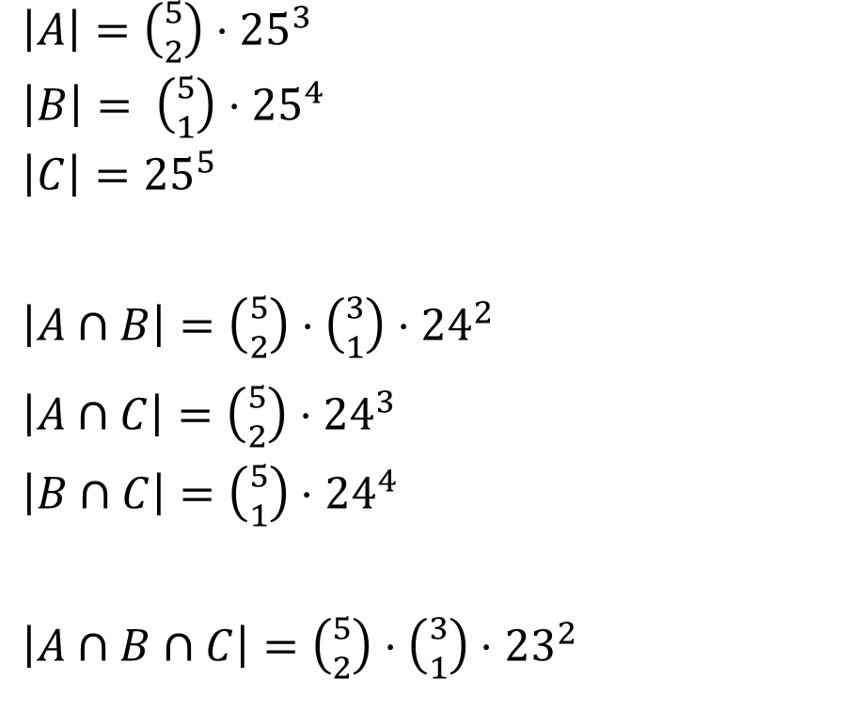
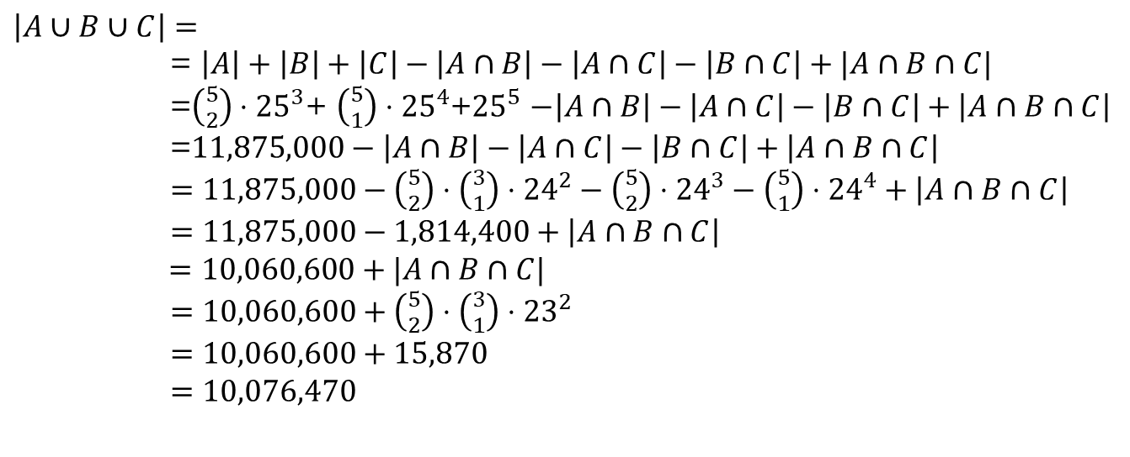
Example
How many length 5 strings over the alphabet $\{a,b,c,…,z\}$ contain:
Exactly 2 ‘a’s OR
Exactly 1 ‘b’ OR
No ‘x’s
$\left|A\right|=\left({5 \atop 2}\right)⋅{25}^{3}$
$\left|B\right|= \left({5 \atop 1}\right)⋅{25}^{4}$
$\left|C\right|={25}^{5}$
$\left|A∩B\right|=\left({5 \atop 2}\right)⋅\left({3 \atop 1}\right)⋅{24}^{2}$
$\left|A∩C\right|=\left({5 \atop 2}\right)⋅{24}^{3}$
$\left|B∩C\right|=\left({5 \atop 1}\right)⋅{24}^{4}$
$\left|A∩B∩C\right|=\left({5 \atop 2}\right)⋅\left({3 \atop 1}\right)⋅{23}^{2}$
$\left|A∪B∪C\right|=$
= $\left|A\right|+\left|B\right|+\left|C\right|−\left|A∩B\right|−\left|A∩C\right|−\left|B∩C\right|+|A∩B∩C|$
=$\left({5 \atop 2}\right)⋅{25}^{3}$+ $\left({5 \atop 1}\right)⋅{25}^{4}$+${25}^{5}$ $−\left|A∩B\right|−\left|A∩C\right|−\left|B∩C\right|+\left|A∩B∩C\right|$
=$11,875,000−\left|A∩B\right|−\left|A∩C\right|−\left|B∩C\right|+\left|A∩B∩C\right|$
$=11,875,000−\left({5 \atop 2}\right)⋅\left({3 \atop 1}\right)⋅{24}^{2}−\left({5 \atop 2}\right)⋅{24}^{3}−\left({5 \atop 1}\right)⋅{24}^{4}+\left|A∩B∩C\right|$
$=11,875,000−1,814,400+\left|A∩B∩C\right|$
$=10,060,600+|A∩B∩C|$
$=10,060,600+\left({5 \atop 2}\right)⋅\left({3 \atop 1}\right)⋅{23}^{2}$
$=10,060,600+15,870$
$=10,076,470$

Slide 9
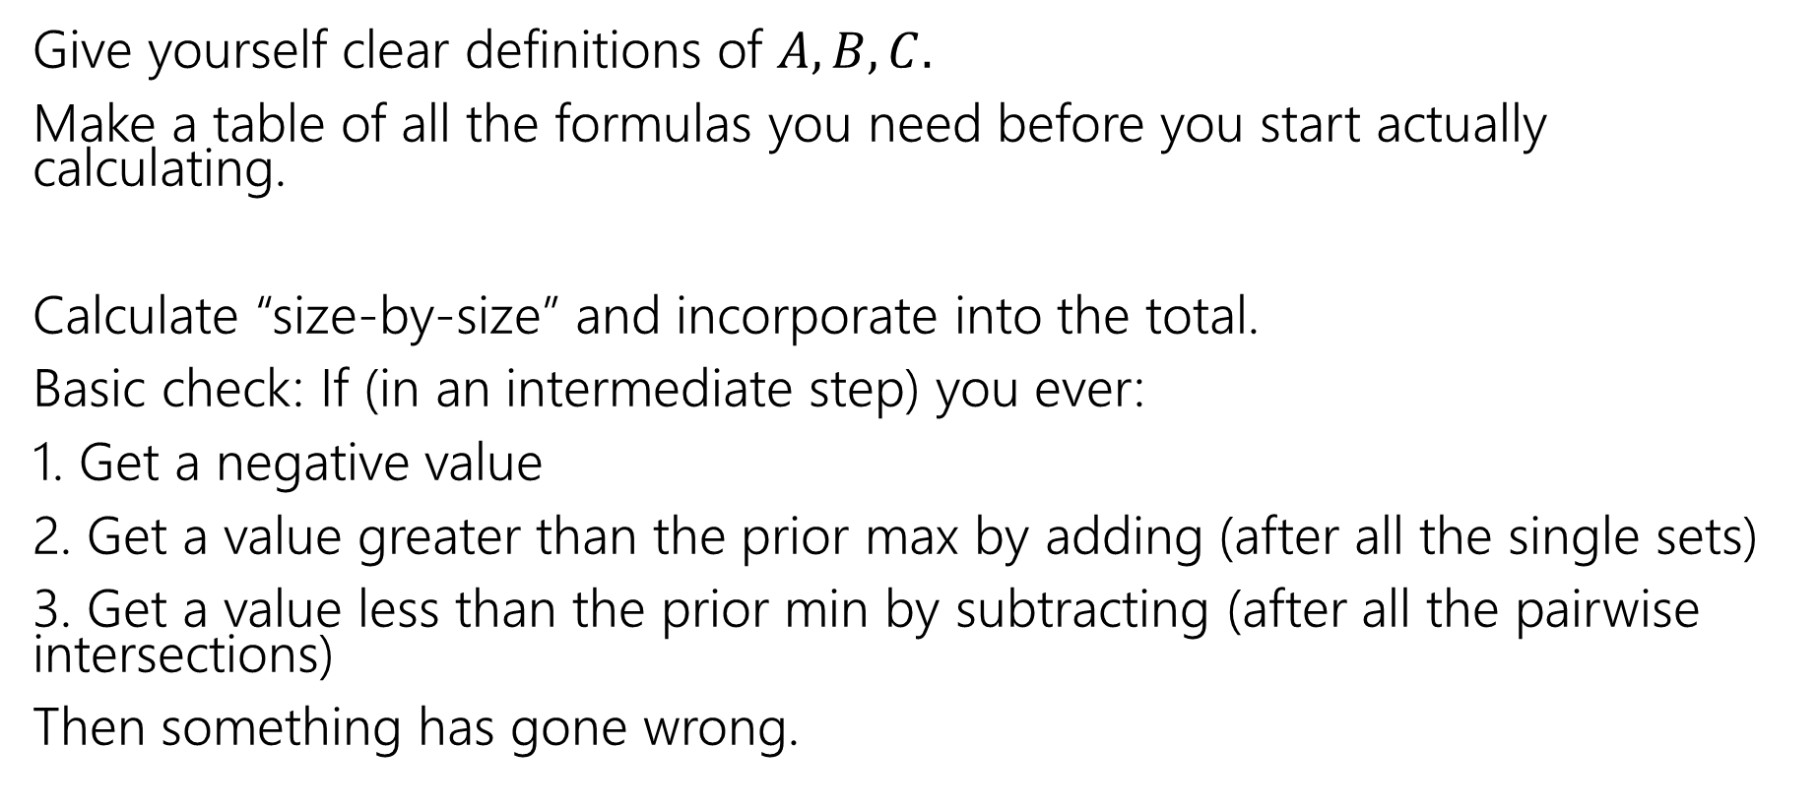
Practical tips
Give yourself clear definitions of $A,B,C.$
Make a table of all the formulas you need before you start actually calculating.
Calculate “size-by-size” and incorporate into the total.
Basic check: If (in an intermediate step) you ever:
1. Get a negative value
2. Get a value greater than the prior max by adding (after all the single sets)
3. Get a value less than the prior min by subtracting (after all the pairwise intersections)
Then something has gone wrong.

Slide 10
The Binomial Theorem

Slide 11
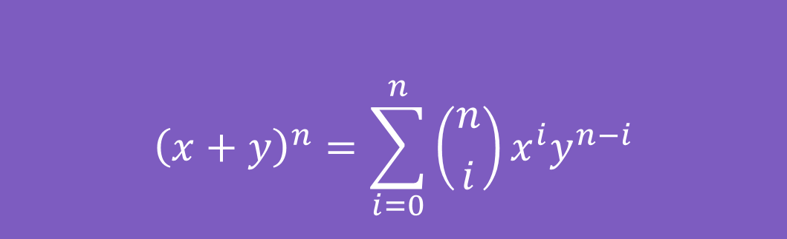

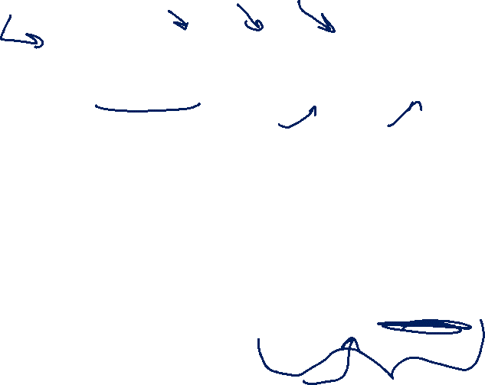
Binomial Theorem
In high school you probably memorized
${\left(x+y\right)}^{2}=x^{2}+2xy+y^{2}$
And ${\left(x+y\right)}^{3}=x^{3}+3x^{2}y+3xy^{2}+y^{3}$
The Binomial Theorem tells us what happens for every $n$:
$${\left(x+y\right)}^{n}=\sum_{i=0}^{n}{\left({n \atop i}\right)x^{i}y^{n−i}}$$
The Binomial Theorem

Slide 12
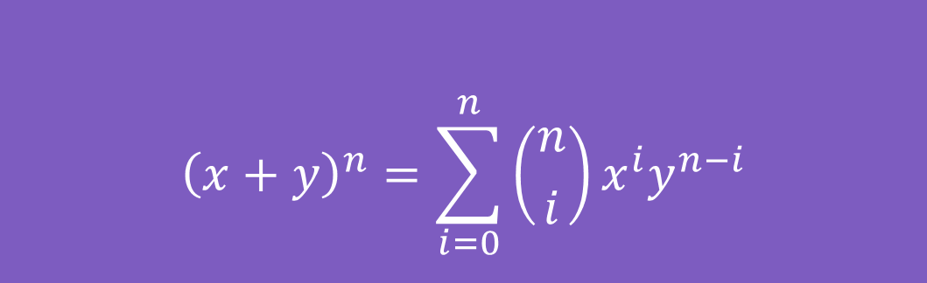
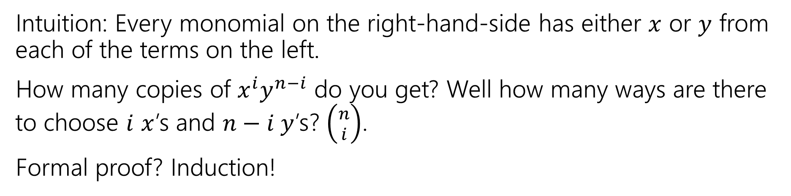
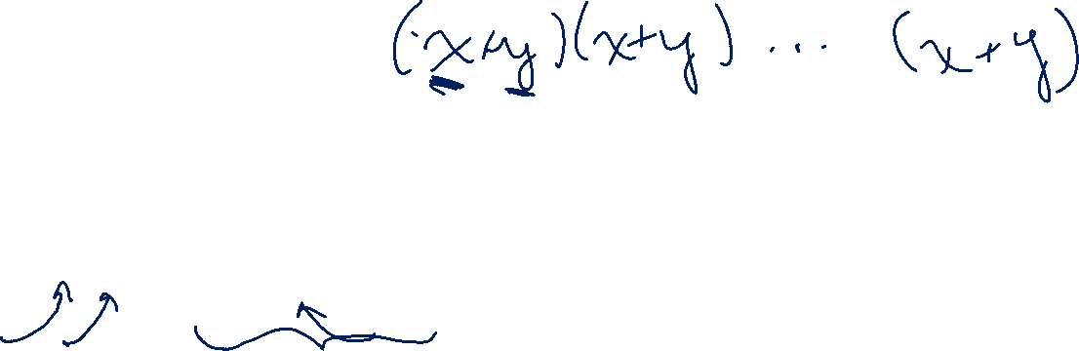
Some intuition
$${\left(x+y\right)}^{n}=\sum_{i=0}^{n}{\left({n \atop i}\right)x^{i}y^{n−i}}$$
The Binomial Theorem
Intuition: Every monomial on the right-hand-side has either $x$ or $y$ from each of the terms on the left.
How many copies of $x^{i}y^{n−i}$ do you get? Well how many ways are there to choose $i$ $x$’s and $n−i y$’s? $\left({n \atop i}\right)$.
Formal proof? Induction!

Slide 13
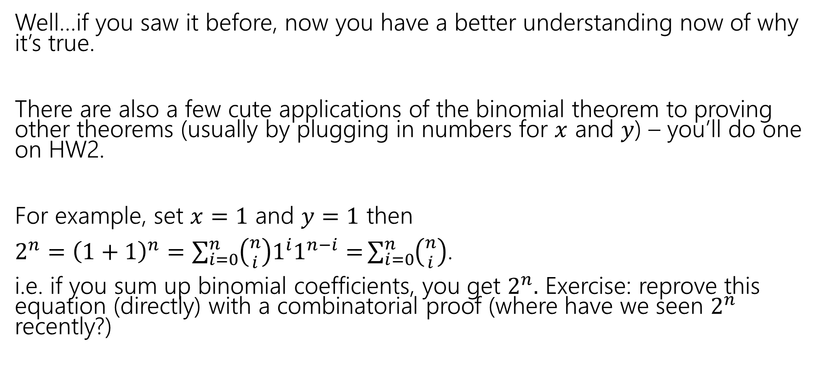

So What?
Well…if you saw it before, now you have a better understanding now of why it’s true.
There are also a few cute applications of the binomial theorem to proving other theorems (usually by plugging in numbers for $x$ and $y$) – you’ll do one on HW2.
For example, set $x=1$ and $y=1$ then
$2^{n}={\left(1+1\right)}^{n}=\sum_{i=0}^{n}{\left({n \atop i}\right)1^{i}1^{n−i}=}\sum_{i=0}^{n}{\left({n \atop i}\right)}$.
i.e. if you sum up binomial coefficients, you get $2^{n}.$ Exercise: reprove this equation (directly) with a combinatorial proof (where have we seen $2^{n}$ recently?)

Slide 14
The Pigeonhole Principle

Slide 15


Pigeonhole Principle
If you have $5$ pigeons, and place them into $4$ holes, then…
At least two pigeons are in the same hole.
Notes:
Animation shows 5 pigeons going into 4 pigeonholes; two end up in hole 4, while one ends up in the other holes.

Slide 16


Pigeonhole Principle (2)
If you have $5$ pigeons, and place them into $4$ holes, then…
At least two pigeons are in the same hole.
It might be more than two.
Notes:
Animation shows 5 pigeons flying into 4 holes. Three go into hole 4, one each into holes 2 and 3; none into hole 1.

Slide 17

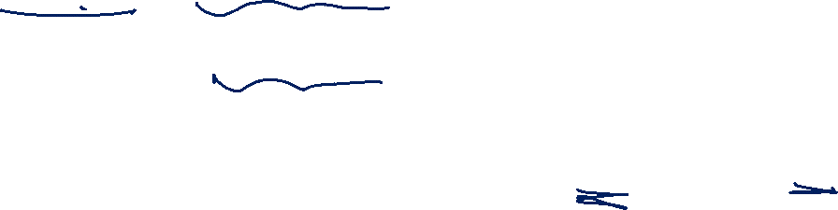
Strong Pigeonhole Principle
If you have $n$ pigeons and $k$ pigeonholes, then there is at least one pigeonhole that has at least $\left\lceil \frac{n}{k}\right\rceil$ pigeons.
$\left\lceil a\right\rceil$ is the “ceiling” of $a$ (it means always round up, $\left\lceil 1.1\right\rceil =2$, $\left\lceil 1\right\rceil =1$).

Slide 18
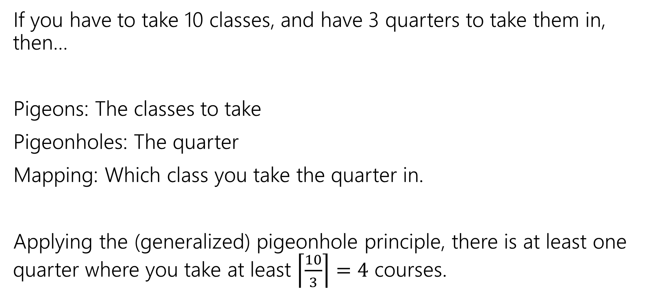
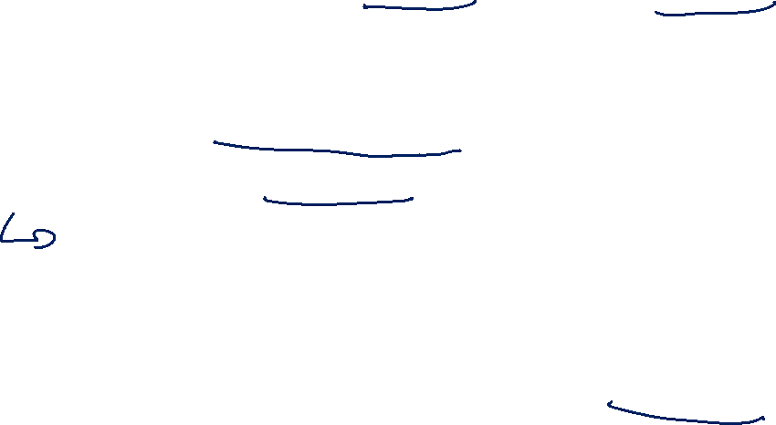
An example
If you have to take 10 classes, and have 3 quarters to take them in, then…
Pigeons: The classes to take
Pigeonholes: The quarter
Mapping: Which class you take the quarter in.
Applying the (generalized) pigeonhole principle, there is at least one quarter where you take at least $\left\lceil \frac{10}{3}\right\rceil =4$ courses.

Slide 19
Practical Tips (PHP)
When the pigeonhole principle is the right tool, it’s usually the first thing you’d think of or the absolute last thing you’d think of.
For really tricky ones, we’ll warn you in advance that it’s the right method (you’ll see one in the section handout).
When applying the principle, say:
What are the pigeons
What are the pigeonholes
How do you map from pigeons to pigeonholes
Look for – a set you’re trying to divide into groups, where collisions would help you somehow.

Slide 20
Our last counting rule

Slide 21
Counting Donuts
You’re going to buy one-dozen donuts (i.e., 12 donuts)
There are chocolate, strawberry, coconut, blueberry, and lemon (i.e. five types)
How many different donut boxes can you buy?
Consider two boxes the same if they contain the same number of every kind of donut (order doesn’t matter)

Slide 22
Donuts, Divided
You’re going to buy one-dozen donuts (i.e., 12 donuts)
There are chocolate, strawberry, coconut, blueberry, and lemon (i.e. five types)
Put donuts in order by type, then put dividers between the types.
Counting the number of ways to place dividers instead.

Slide 23


Explanation 1
Think of it as a string.
There are $12+(5−1)$ characters.
But $12$ are the “donut” character (identical) and $4$ are the “divider” character (identical).
So?
$\frac{16!}{12!4!}$
i.e., $\left({16 \atop 4}\right)$

Slide 24
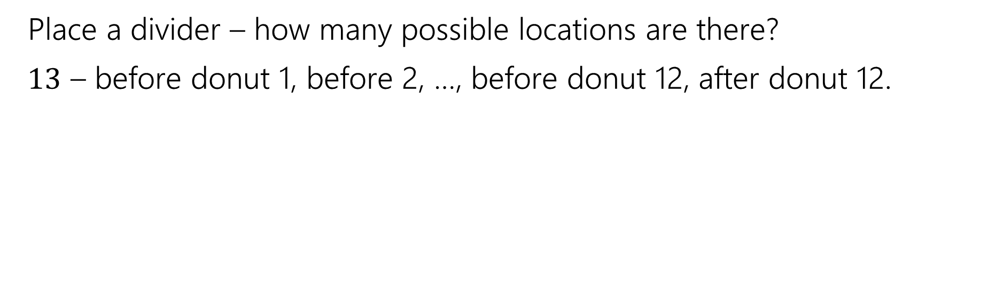
Placing Dividers
Place a divider – how many possible locations are there?
$13$ – before donut 1, before 2, …, before donut 12, after donut 12.

Slide 25
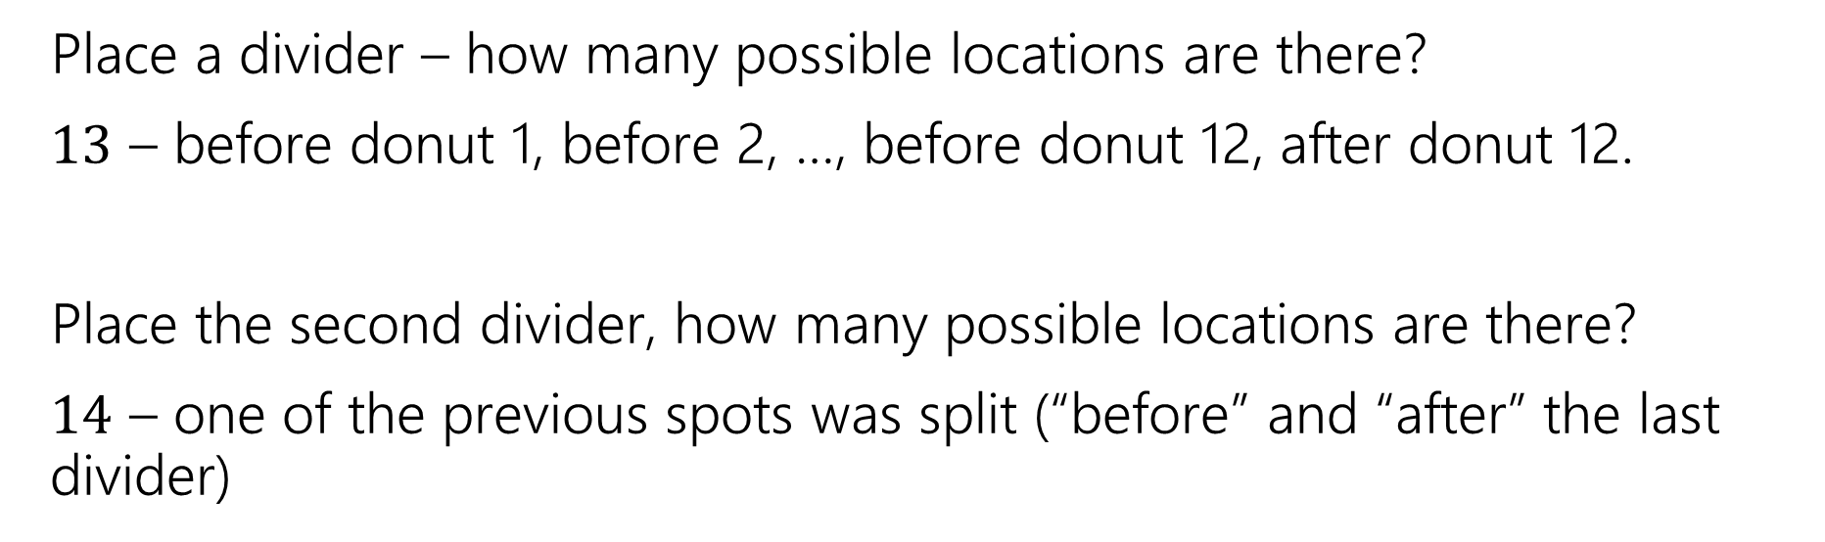

Placing Dividers (1)
Place a divider – how many possible locations are there?
$13$ – before donut 1, before 2, …, before donut 12, after donut 12.
Place the second divider, how many possible locations are there?
$14$ – one of the previous spots was split (“before” and “after” the last divider)

Slide 26
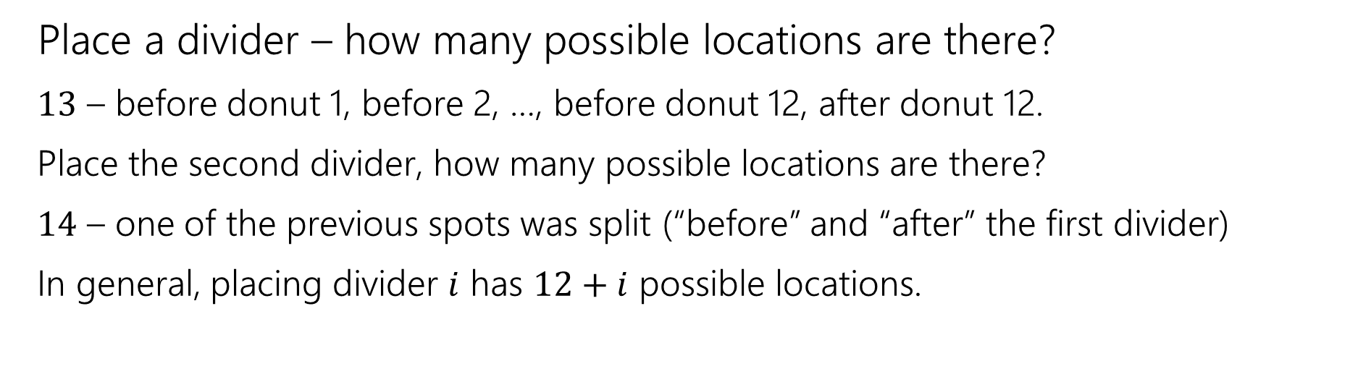
Placing Dividers (2)
Place a divider – how many possible locations are there?
$13$ – before donut 1, before 2, …, before donut 12, after donut 12.
Place the second divider, how many possible locations are there?
$14$ – one of the previous spots was split (“before” and “after” the first divider)
In general, placing divider $i$ has $12+i$ possible locations.

Slide 27
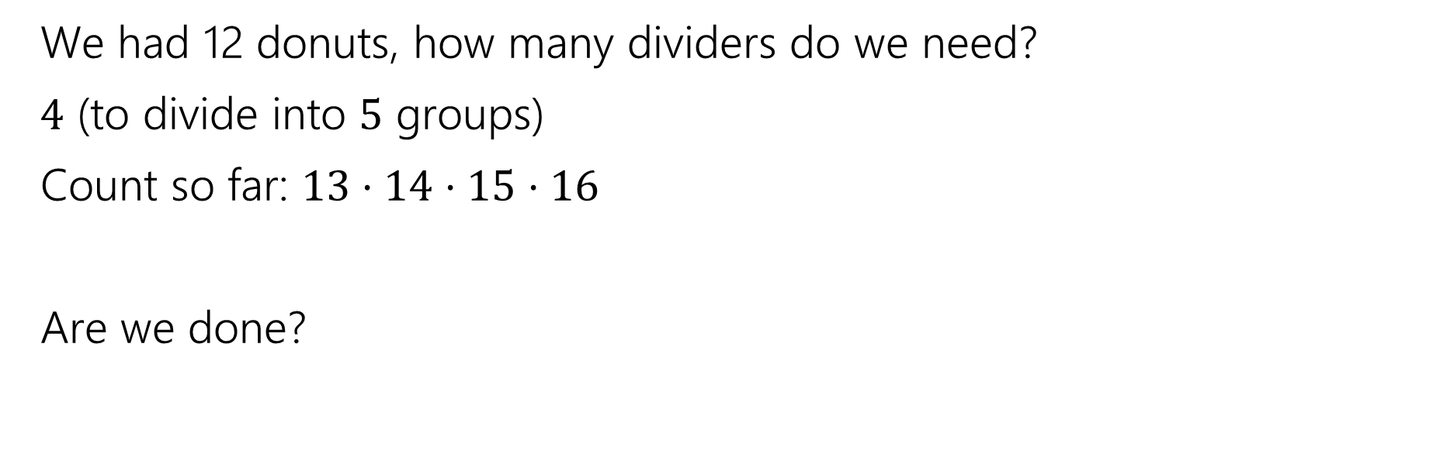
Placing Dividers (3)
We had 12 donuts, how many dividers do we need?
$4$ (to divide into $5$ groups)
Count so far: $13⋅14⋅15⋅16$
Are we done?

Slide 28
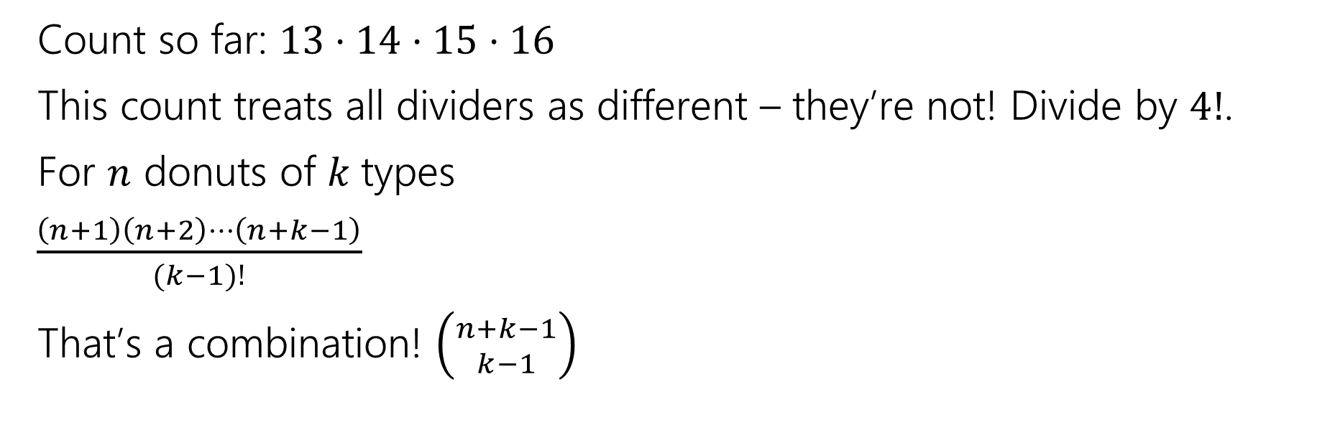
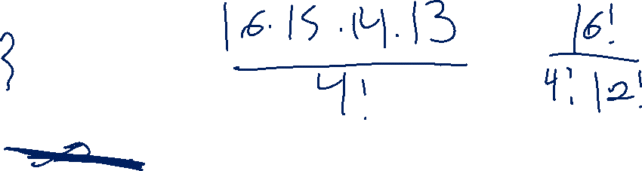
Placing Dividers (4)
Count so far: $13⋅14⋅15⋅16$
This count treats all dividers as different – they’re not! Divide by $4!$.
For $n$ donuts of $k$types
$\frac{\left(n+1\right)\left(n+2\right)⋯\left(n+k−1\right)}{(k−1)!}$
That’s a combination! $\left({n+k−1 \atop k−1}\right)$

Slide 29
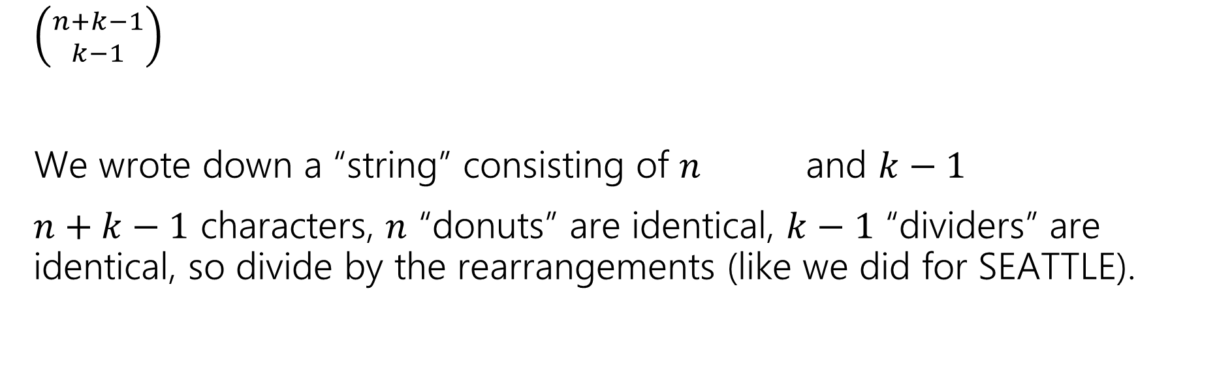
Wrapping Up
$\left({n+k−1 \atop k−1}\right)$
We wrote down a “string” consisting of $n$ and $k−1$
$n+k−1$ characters, $n$ “donuts” are identical, $k−1$ “dividers” are identical, so divide by the rearrangements (like we did for SEATTLE).

Slide 30
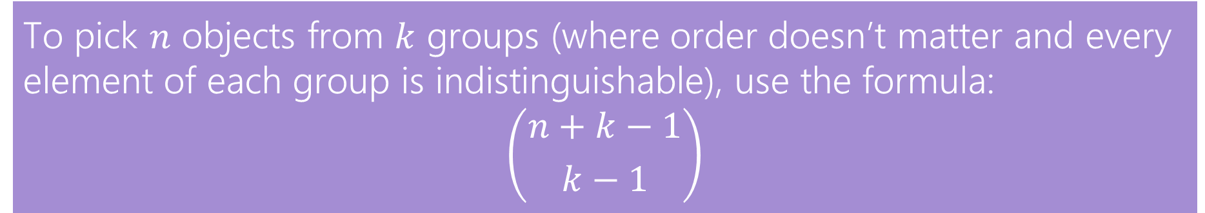
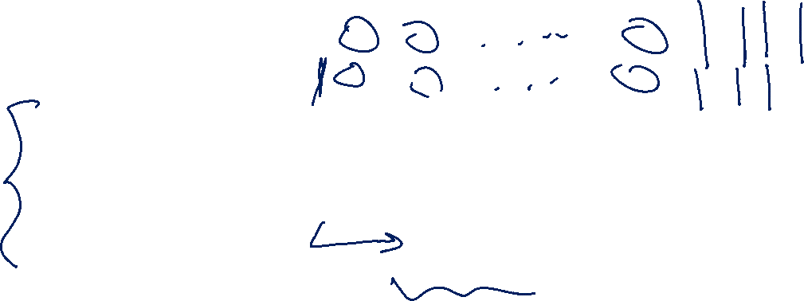
In General
The counting technique we did is often called “stars and bars”
using a “star” instead of a donut shape, and calling the dividers “bars”
To pick $n$ objects from $k$ groups (where order doesn’t matter and every element of each group is indistinguishable), use the formula:
$$\left({n+k−1 \atop k−1}\right)$$

Slide 31
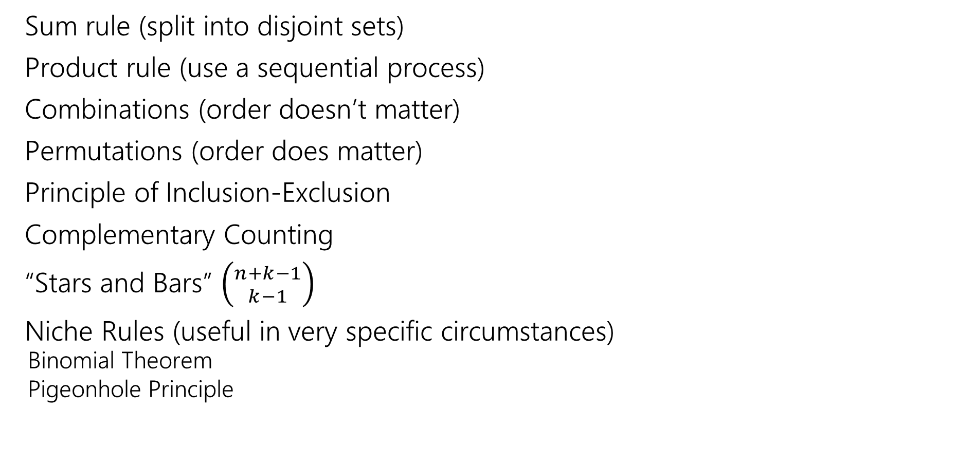
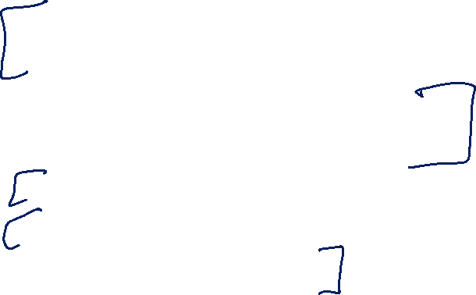
We’ve seen lots of ways to count
Sum rule (split into disjoint sets)
Product rule (use a sequential process)
Combinations (order doesn’t matter)
Permutations (order does matter)
Principle of Inclusion-Exclusion
Complementary Counting
“Stars and Bars” $\left({n+k−1 \atop k−1}\right)$
Niche Rules (useful in very specific circumstances)
Binomial Theorem
Pigeonhole Principle

Slide 32
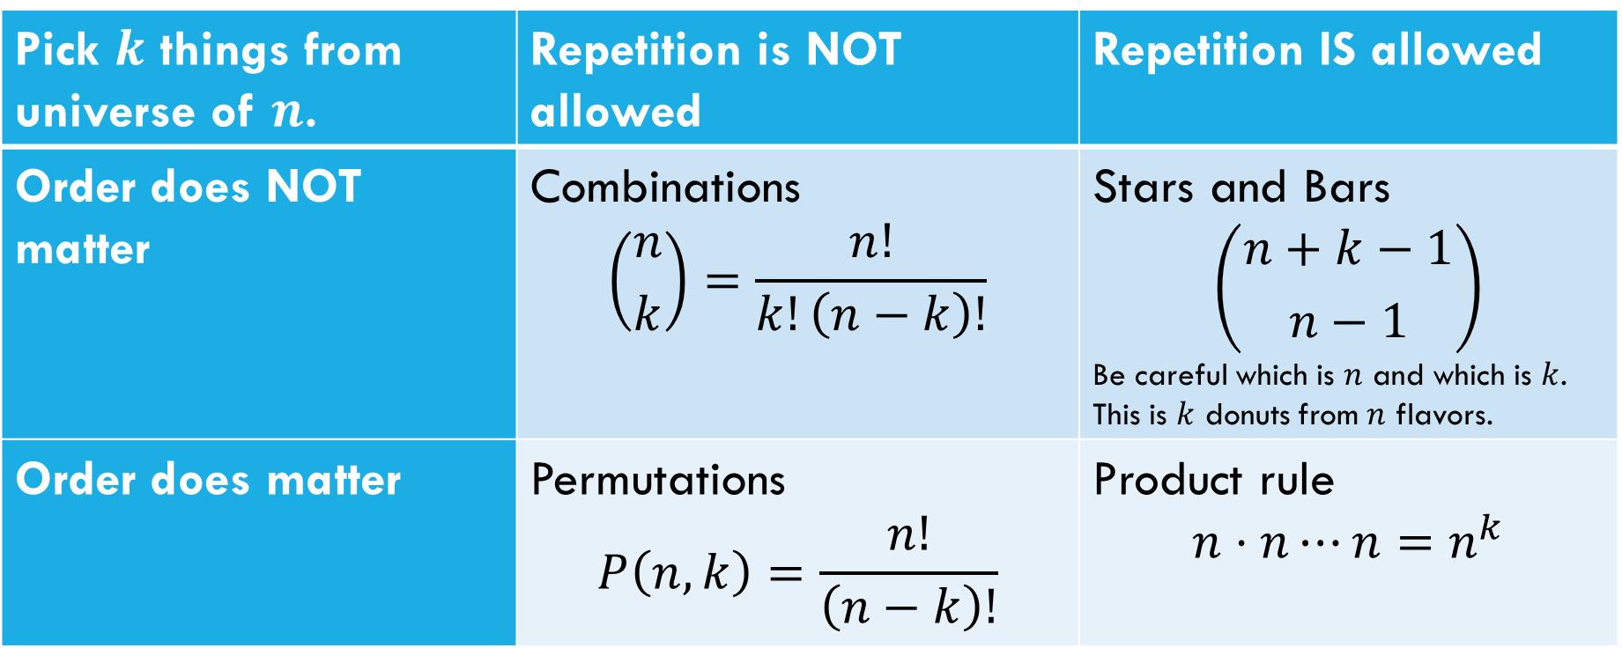
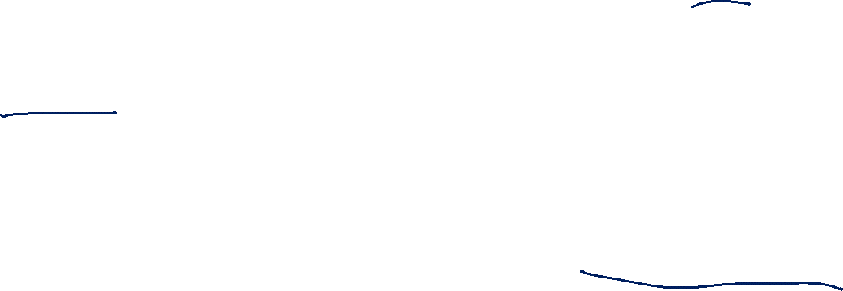
Which Tool Do I Use?
Pick $k$ things from universe of $n$. | Repetition is NOT allowed | Repetition IS allowed
Order does NOT matter | Combinations $$\left({n \atop k}\right)=\frac{n!}{k!\left(n−k\right)!}$$ | Stars and Bars $$\left({n+k−1 \atop n−1}\right)$$ Be careful which is $n$ and which is $k$. This is $k$ donuts from $n$ flavors.
Order does matter | Permutations $$P\left(n,k\right)=\frac{n!}{\left(n−k\right)!}$$ | Product rule $$n⋅n⋯n=n^{k}$$
This is NOT foolproof! Sometimes you need a twist on the formula; sometimes it’s a completely different tool. But a sign where to start.

Slide 33
Extra Practice

Slide 34
Practice
How do we know which rule to apply?
With practice you can pick out patterns for which ones might be plausible.
But if as you’re working you realize things are getting out of control, put it aside and try something different.

Slide 35

Cards
A “standard” deck of cards has 52 cards. Each card has a suit
diamonds ️♦,
hearts ♥️,
clubs ♧,
spades ♠️
and a value (Ace,2,3,4,5,6,7,8,9,10,Jack,Queen, King).
A “5-card-hand” is a set of 5 cards
How many five-card “flushes” are there? – a flush is a hand of cards all of the same suit.

Slide 36

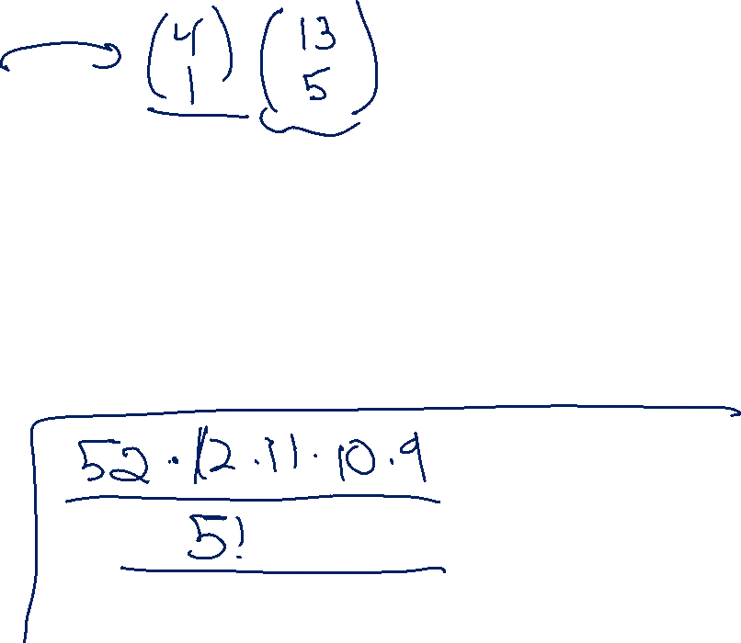
Cards
How many five-card “flushes” are there? – a flush is a hand of cards all of the same suit.
Way 1: How can I describe a flush? Which suit it is, and which values:
$\left({4 \atop 1}\right)⋅\left({13 \atop 5}\right)$

Slide 37
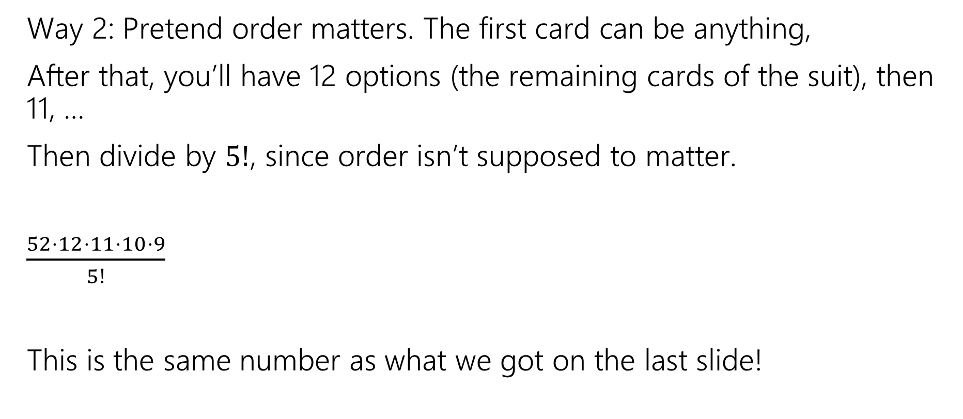
Cards
Way 2: Pretend order matters. The first card can be anything,
After that, you’ll have 12 options (the remaining cards of the suit), then 11, …
Then divide by $5!$, since order isn’t supposed to matter.
$\frac{52⋅12⋅11⋅10⋅9}{5!}$
This is the same number as what we got on the last slide!

Slide 38
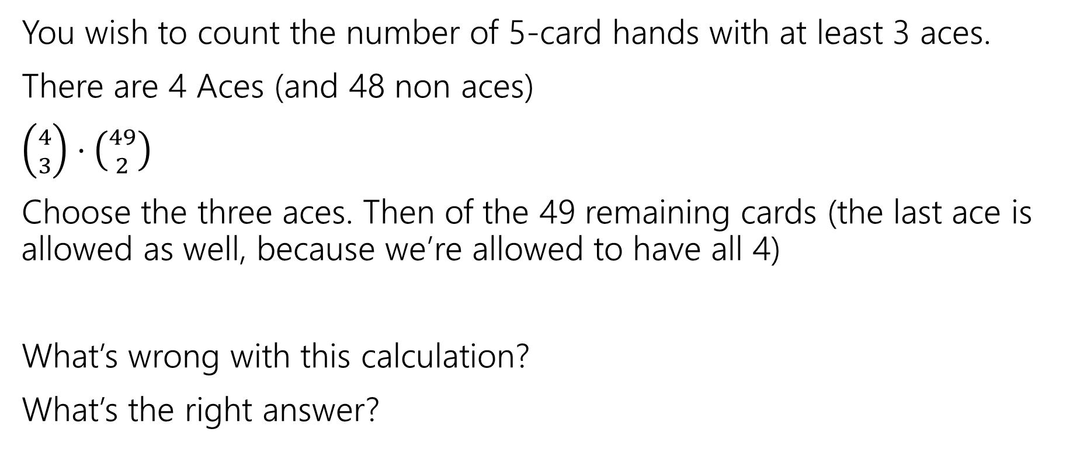

A Solution with a Problem
You wish to count the number of 5-card hands with at least 3 aces.
There are 4 Aces (and 48 non aces)
$\left({4 \atop 3}\right)⋅\left({49 \atop 2}\right)$
Choose the three aces. Then of the 49 remaining cards (the last ace is allowed as well, because we’re allowed to have all 4)
What’s wrong with this calculation?
What’s the right answer?

Slide 39
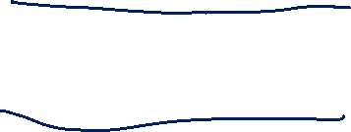
A Solution with a Problem
For a hand, there should be exactly one set of choices in the sequential process that gets us there.
{A♧, A♠️, A♦️} {A♥️, K ♠️}
And
{A♧, A♠️, A♥️}, {A♦️, K ♠️}
Are two different choices of the process, but they lead to the same hand!

Slide 40
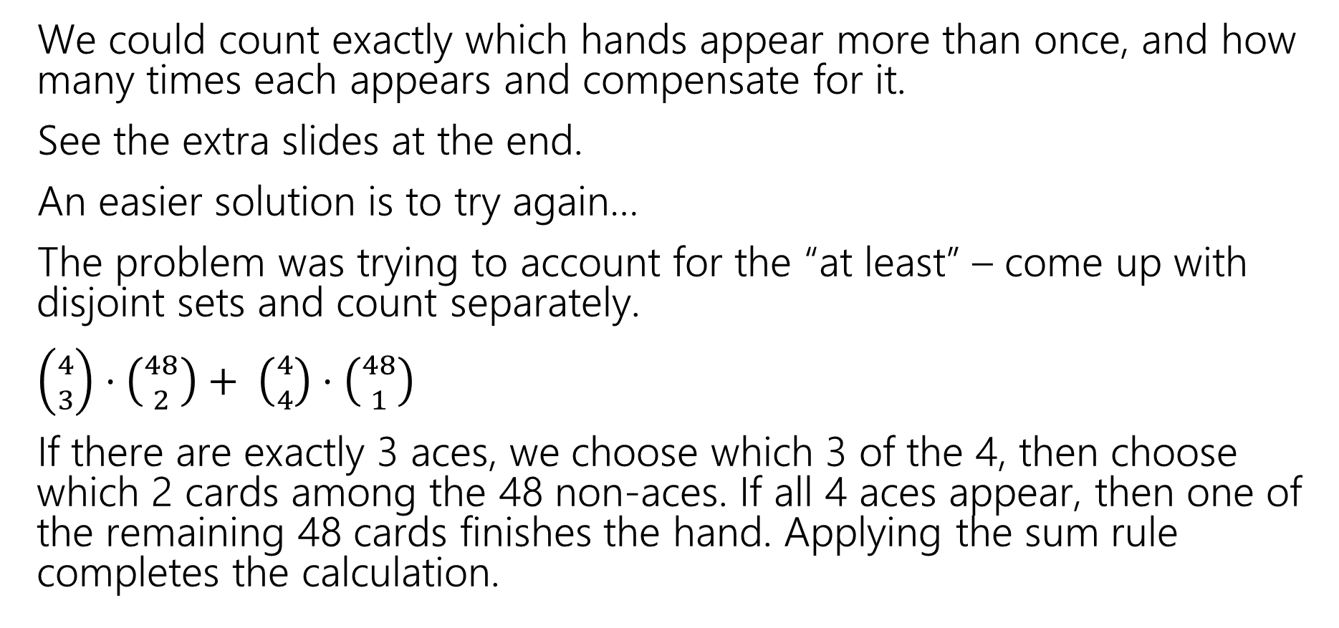

A Solution with a Problem
We could count exactly which hands appear more than once, and how many times each appears and compensate for it.
See the extra slides at the end.
An easier solution is to try again…
The problem was trying to account for the “at least” – come up with disjoint sets and count separately.
$\left({4 \atop 3}\right)⋅\left({48 \atop 2}\right)+ \left({4 \atop 4}\right)⋅\left({48 \atop 1}\right)$
If there are exactly 3 aces, we choose which 3 of the 4, then choose which 2 cards among the 48 non-aces. If all 4 aces appear, then one of the remaining 48 cards finishes the hand. Applying the sum rule completes the calculation.

Slide 41
Takeaway
It’s hard to count sets where one of the conditions is “at least X”
You usually need to break those conditions up into disjoint sets and use the sum rule.

Slide 42
Another Problem
You have to choose 8 pieces of fruit. There are apples, oranges, and bananas.
You need to pick at most 2 apples and at least 1 banana. How many sets of fruit can you choose?

Slide 43
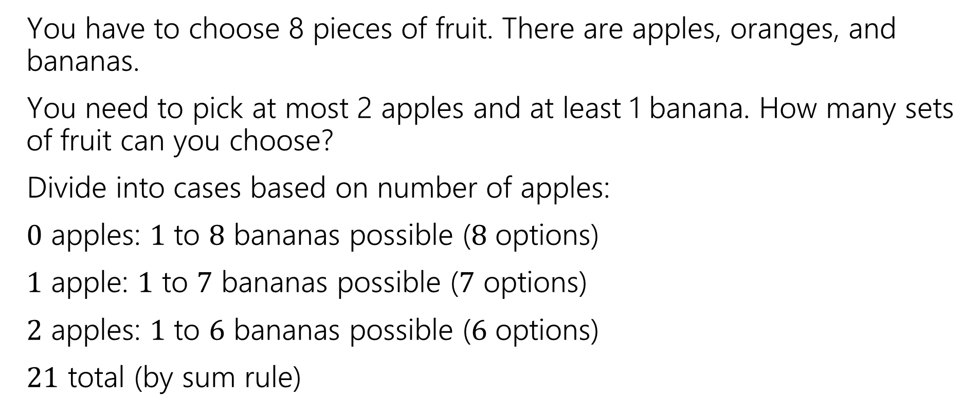
Another Problem
You have to choose 8 pieces of fruit. There are apples, oranges, and bananas.
You need to pick at most 2 apples and at least 1 banana. How many sets of fruit can you choose?
Divide into cases based on number of apples:
$0$ apples: $1$ to $8$ bananas possible ($8$ options)
$1$ apple: $1$ to $7$ bananas possible ($7$ options)
$2$ apples: $1$ to $6$ bananas possible ($6$ options)
$21$ total (by sum rule)

Slide 44
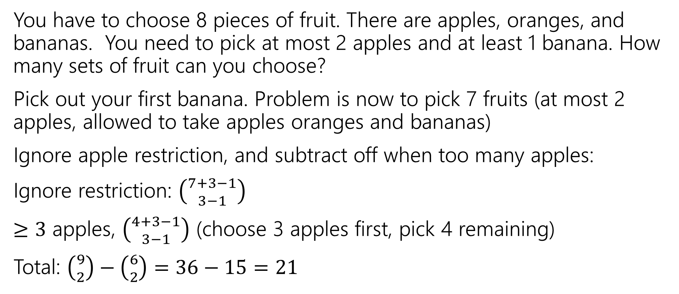
Another Problem
You have to choose 8 pieces of fruit. There are apples, oranges, and bananas. You need to pick at most 2 apples and at least 1 banana. How many sets of fruit can you choose?
Pick out your first banana. Problem is now to pick 7 fruits (at most 2 apples, allowed to take apples oranges and bananas)
Ignore apple restriction, and subtract off when too many apples:
Ignore restriction: $\left({7+3−1 \atop 3−1}\right)$
$≥3$ apples, $\left({4+3−1 \atop 3−1}\right)$ (choose 3 apples first, pick 4 remaining)
Total: $\left({9 \atop 2}\right)−\left({6 \atop 2}\right)=36−15=21$

Slide 45
Takeaways
For donut-counting style problems with “twists”, it sometimes helps to “just throw the first few in the box” to get a problem that is exactly in the donut-counting framework.
When you can do a problem two very different ways and get the same answer, you get much more confident in the answer.

Slide 46

Which Tool Do I Use?
Pick $k$ things from universe of $n.$ | Repetition is NOT allowed | Repetition IS allowed
Order does NOT matter | Combinations $$\left({n \atop k}\right)=\frac{n!}{k!\left(n−k\right)!}$$ | Stars and Bars $$\left({n+k−1 \atop n−1}\right)$$ Be careful which is $n$ and which is $k$. This is $k$ donuts from $n$ flavors.
Order does matter | Permutations $$P\left(n,k\right)=\frac{n!}{\left(n−k\right)!}$$ | Product rule $$n⋅n⋯n=n^{k}$$
This is NOT foolproof! Sometimes you need a twist on the formula; sometimes it’s a completely different tool. But a sign where to start.

Slide 47
Fixing The Overcounting

Slide 48
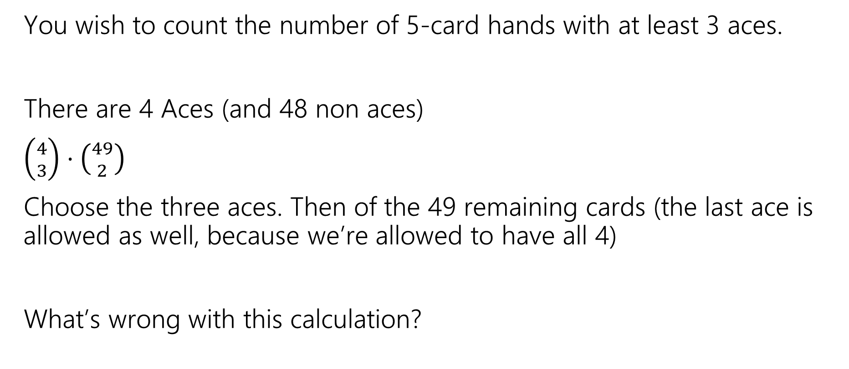
A Solution with a Problem
You wish to count the number of 5-card hands with at least 3 aces.
There are 4 Aces (and 48 non aces)
$\left({4 \atop 3}\right)⋅\left({49 \atop 2}\right)$
Choose the three aces. Then of the 49 remaining cards (the last ace is allowed as well, because we’re allowed to have all 4)
What’s wrong with this calculation?

Slide 49
When do we overcount?
If there are exactly 4 Aces in the hand, then we count the hand 4 different times (once for each ace as an “extra” one:
{A♧, A♠️, A♦️}, {A♥️, ?}
{A♧, A♠️, A♥️}, {A♦️, ?}
{A♧, A♥️, A♦️}, {A♠️, ?}
{A♥️, A♠️, A♦️}, {A♧, ?}

Slide 50
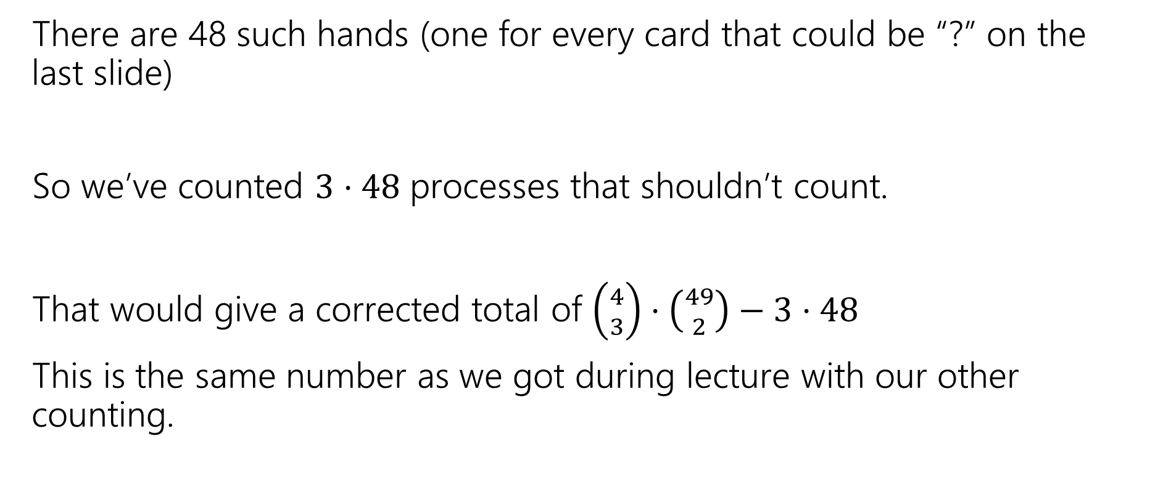
How much do we overcount?
There are 48 such hands (one for every card that could be “?” on the last slide)
So we’ve counted $3⋅48$ processes that shouldn’t count.
That would give a corrected total of $\left({4 \atop 3}\right)⋅\left({49 \atop 2}\right)−3⋅48$
This is the same number as we got during lecture with our other counting.

