Slide 1
Even More Counting
CSE 312 Winter 26
Lecture 3

Slide 2







Announcements
Office hours start today! Visit now before others start on the homework.
Also, please start on the homework early.

Slide 3
Outline
So Far
Sum and Product Rules
Combinations (order doesn’t matter) and Permutations (order does matter)
Introduce ordering or distinction and remove it to make calculations easier
This Time
Some Proofs by counting two ways
Principle of Inclusion-Exclusion

Slide 4
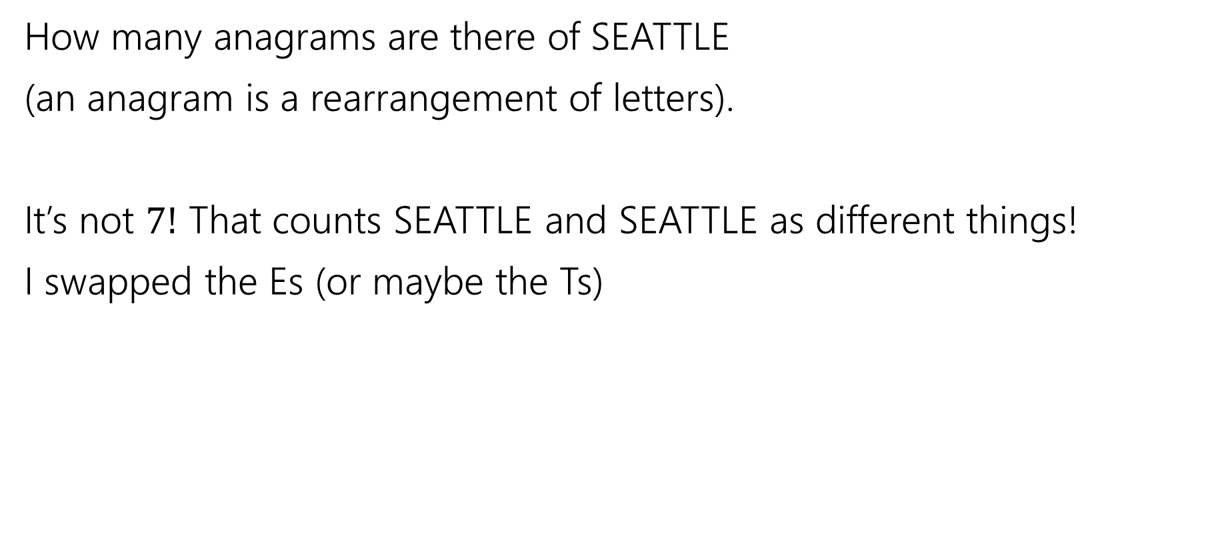

Overcounting
How many anagrams are there of SEATTLE
(an anagram is a rearrangement of letters).
It’s not $7!$ That counts SEATTLE and SEATTLE as different things!
I swapped the Es (or maybe the Ts)

Slide 5
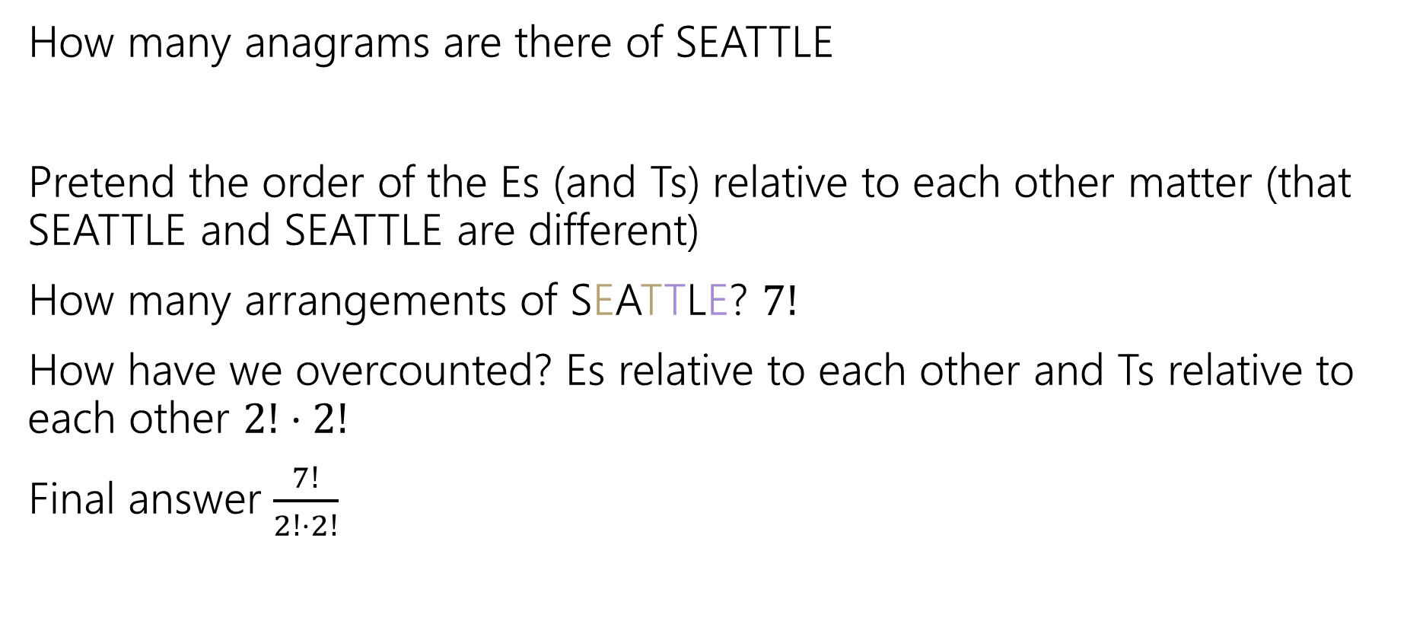
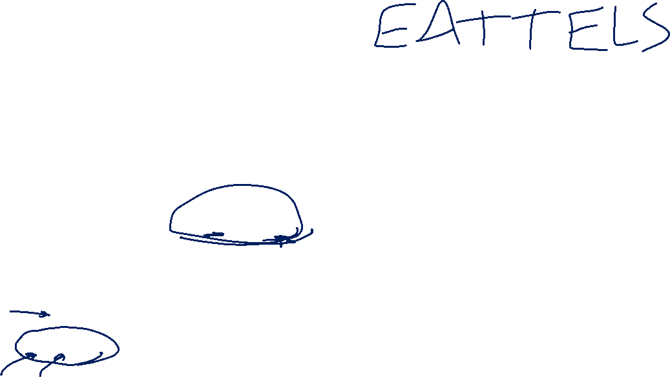
Overcounting (answer)
How many anagrams are there of SEATTLE
Pretend the order of the Es (and Ts) relative to each other matter (that SEATTLE and SEATTLE are different)
How many arrangements of SEATTLE? $7!$
How have we overcounted? Es relative to each other and Ts relative to each other $2!⋅2!$
Final answer $\frac{7!}{2!⋅2!}$

Slide 6
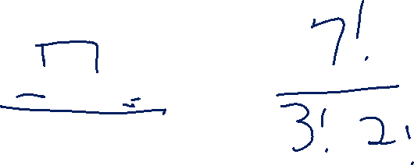
Overcounting (example 2)
How many anagrams are there of GODOGGY?

Slide 7
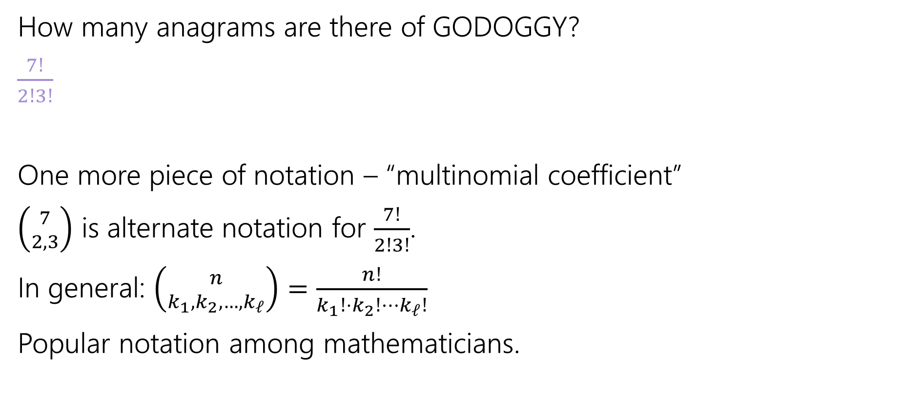
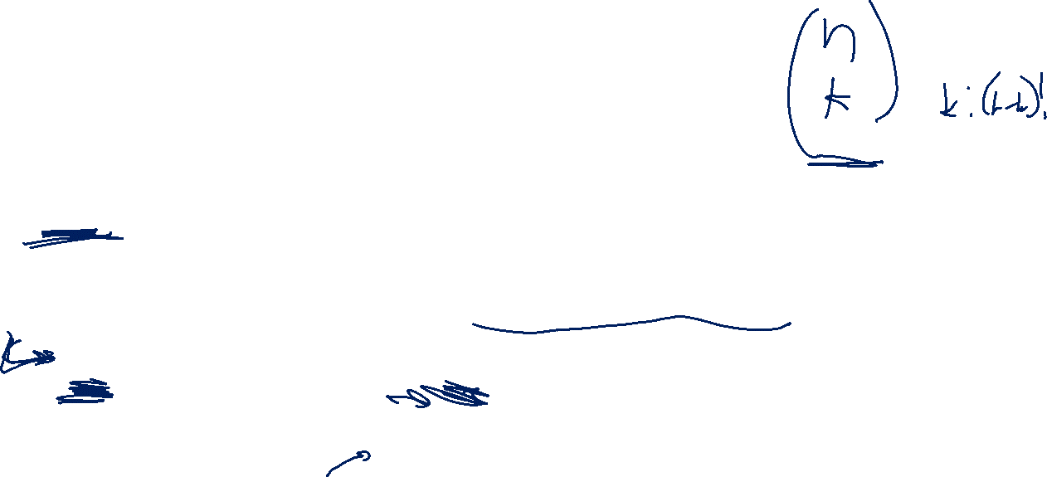
Overcounting (answer 2)
How many anagrams are there of GODOGGY?
$\frac{7!}{2!3!}$
One more piece of notation – “multinomial coefficient”
$\left({7 \atop 2,3}\right)$ is alternate notation for $\frac{7!}{2!3!}$.
In general: $\left({n \atop k_{1},k_{2},…,k_{ℓ}}\right)=\frac{n!}{k_{1}!{⋅k}_{2}!⋯k_{ℓ}!}$
Popular notation among mathematicians.

Slide 8
Combination Facts

Slide 9


Some Facts about combinations
Symmetry of combinations: $\left({n \atop k}\right)=\left({n \atop n−k}\right)$
Pascal’s Rule: $\left({n \atop k}\right)=\left({n−1 \atop k−1}\right)+\left({n−1 \atop k}\right)$

Slide 10

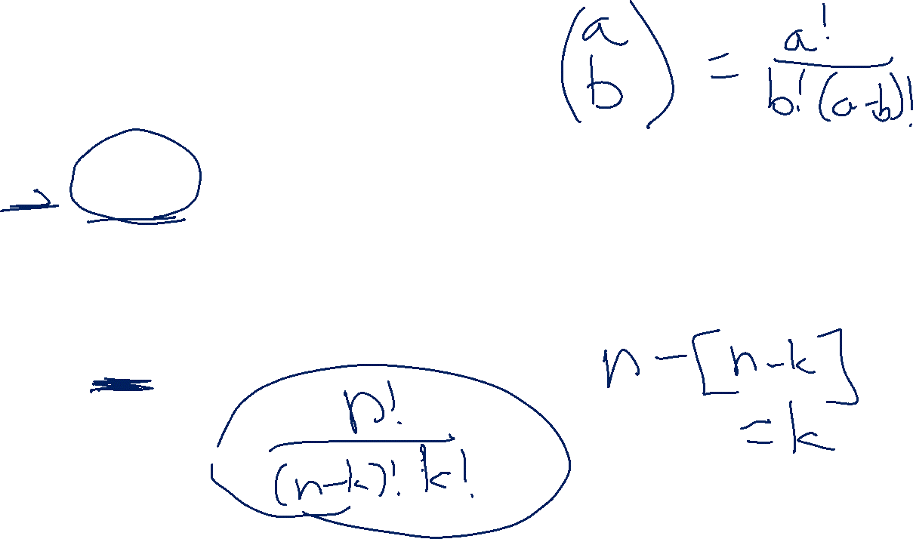
Two Proofs of Symmetry
Proof 1: By algebra
$\left({n \atop k}\right)=\frac{n!}{k!\left(n−k\right)!}$
$=\frac{n!}{\left(n−k\right)!k!}$
$=\left({n \atop n−k}\right)$
Definition of Combination
Algebra (commutativity of multiplication)
Definition of Combination

Slide 11
Two Proofs of Symmetry (analysis)
Wasn’t that a great proof.
Airtight. No disputing it.
Got to say “commutativity of multiplication.”
But…do you know why? Can you feel why it’s true?

Slide 12
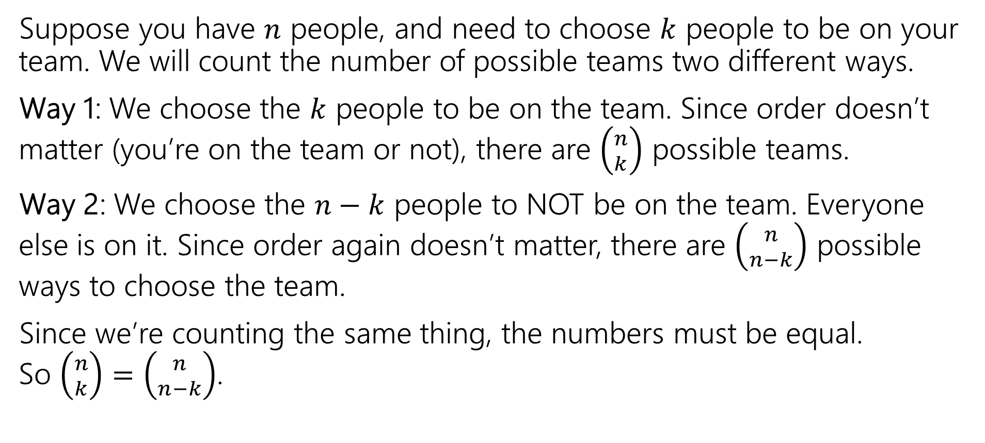
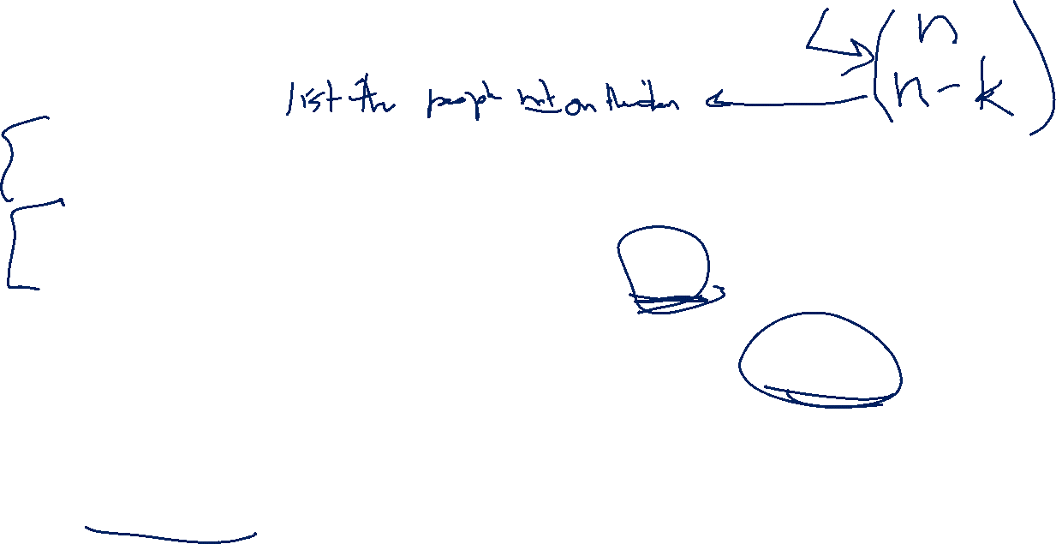
Combinatorial Proof of Symmetry
Suppose you have $n$ people, and need to choose $k$ people to be on your team. We will count the number of possible teams two different ways.
Way 1: We choose the $k$ people to be on the team. Since order doesn’t matter (you’re on the team or not), there are $\left({n \atop k}\right)$ possible teams.
Way 2: We choose the $n−k$ people to NOT be on the team. Everyone else is on it. Since order again doesn’t matter, there are $\left({n \atop n−k}\right)$ possible ways to choose the team.
Since we’re counting the same thing, the numbers must be equal. So $\left({n \atop k}\right)=\left({n \atop n−k}\right)$.

Slide 13
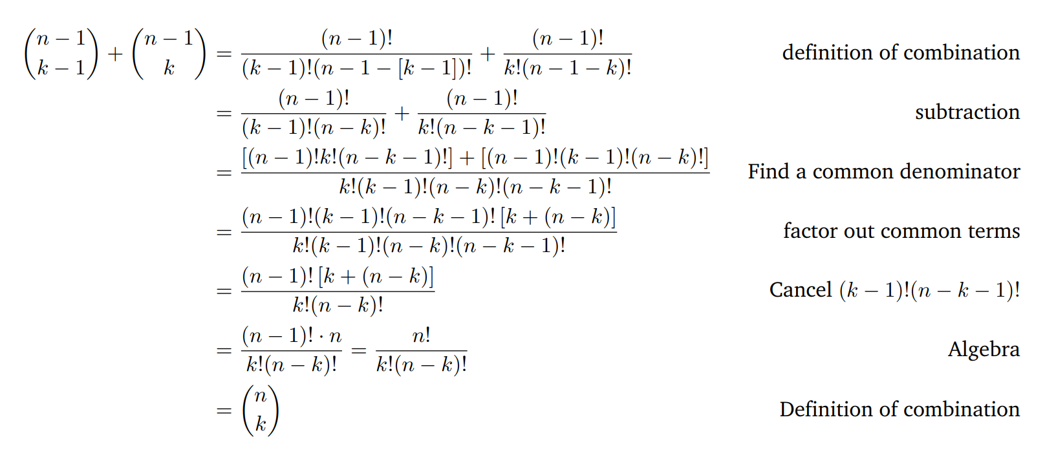

Pascal’s Rule: $\left({n \atop k}\right)=\left({n−1 \atop k−1}\right)+\left({n−1 \atop k}\right)$ algebraic proof

Slide 14
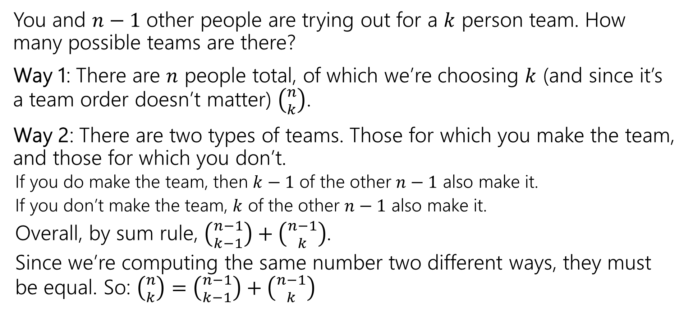


Pascal’s Rule: $\left({n \atop k}\right)=\left({n−1 \atop k−1}\right)+\left({n−1 \atop k}\right)$ combinatorial proof
You and $n−1$ other people are trying out for a $k$ person team. How many possible teams are there?
Way 1: There are $n$ people total, of which we’re choosing $k$ (and since it’s a team order doesn’t matter) $\left({n \atop k}\right)$.
Way 2: There are two types of teams. Those for which you make the team, and those for which you don’t.
If you do make the team, then $k−1$ of the other $n−1$ also make it.
If you don’t make the team, $k$ of the other $n−1$ also make it.
Overall, by sum rule, $\left({n−1 \atop k−1}\right)+\left({n−1 \atop k}\right)$.
Since we’re computing the same number two different ways, they must be equal. So: $\left({n \atop k}\right)=\left({n−1 \atop k−1}\right)+\left({n−1 \atop k}\right)$

Slide 15
Takeaways
Formulas for factorial, permutations, combinations.
A useful trick for counting is to pretend order matters, then account for the overcounting at the end (by dividing out repetitions)
When trying to prove facts about counting, try to have each side of the equation count the same thing.
Much more fun and much more informative than just churning through algebra.

Slide 16
Principle of Inclusion-Exclusion

Slide 17

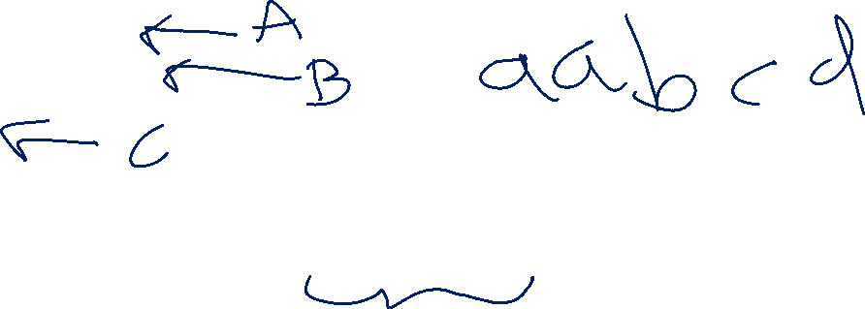
Example
How many length 5 strings over the alphabet $\{a,b,c,…,z\}$ contain:
Exactly 2 ‘a’s OR
Exactly 1 ‘b’ OR
No ‘x’s
For what $A,B,C$ do we want $|A∪B∪C|$?

Slide 18





Principle of Inclusion-Exclusion (2 sets)
The sum rule says when $A$and $B$ are disjoint (no intersection), then $\left|A∪B\right|=\left|A\right|+|B|$.
What about when $A$ and $B$ aren’t disjoint?
For two sets:
$\left|A∪B\right|=\left|A\right|+\left|B\right|−|A∩B|$
$$A$$
$$A∩B$$
$$B$$
Notes:
A Venn diagram showing 2 overlapping sets: A and B. When we add the sets; A turns red, B turns blue, but the overlap turns purple. When we subtract A \cap B, the intersection turns blue, so the entire diagram is colored in a primary color (counted once).

Slide 19

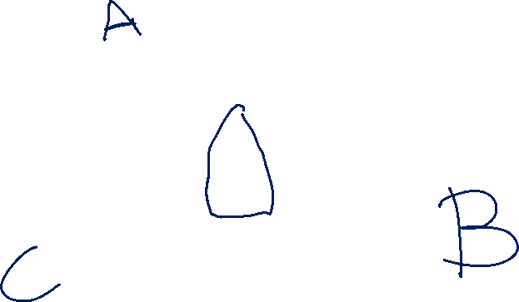
Principle of Inclusion-Exclusion (3 sets)
For three sets:
$\left|A∪B∪C\right|=\left|A\right|+\left|B\right|+\left|C\right|−\left|A∩B\right|−\left|B∩C\right|−\left|A∩C\right|+|A∩B∩C|$
Notes:
A Venn diagram with three overlapping sets: A,B,C. When we add the sets A,B,C they turn blue, red, yellow; but the overlaps turn purple, orange, green, and black. When we subtract the pairwise intersections (A intersect B, A intersect C, B intersect C), the overlaps turn primary colors, except the very center which turns white. When we add the triple intersection (A intersect B intersect C), it turns red, and the entire diagram is colored in a primary color (and so counted once in the formula).

Slide 20
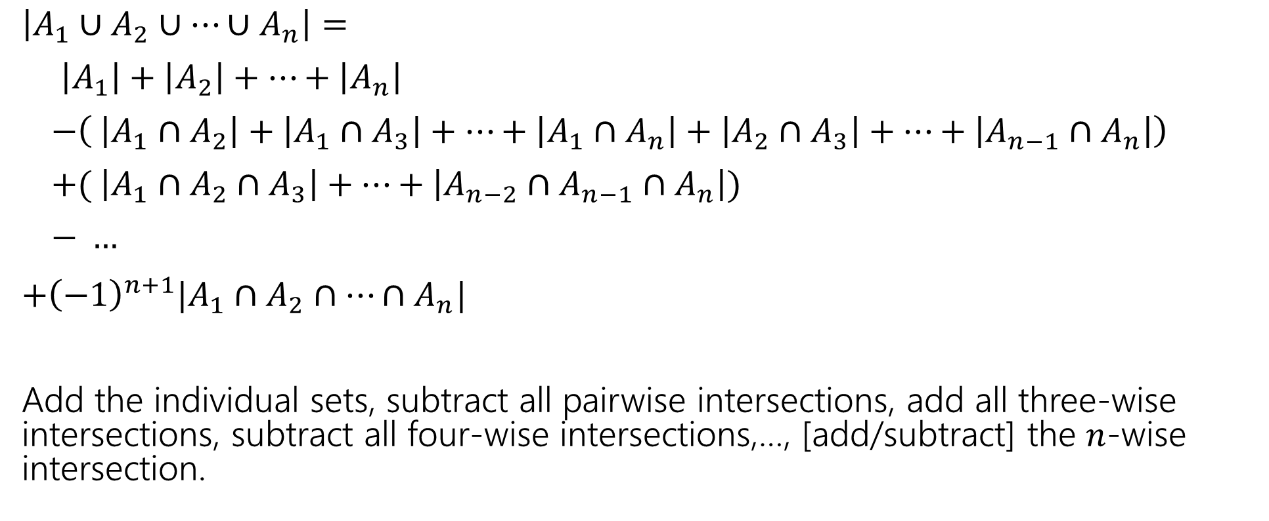
In general:
$\left|A_{1}∪A_{2}∪⋯∪A_{n}\right|=$
$\left|A_{1}\right|+\left|A_{2}\right|+⋯+\left|A_{n}\right|$
$−\left( \left|A_{1}∩A_{2}\right|+\left|A_{1}∩A_{3}\right|+…+\left|A_{1}∩A_{n}\right|+\left|A_{2}∩A_{3}\right|+…+\left|A_{n−1}∩A_{n}\right|\right)$
$+( \left|A_{1}∩A_{2}∩A_{3}\right|+…+\left|A_{n−2}∩A_{n−1}∩A_{n}\right|)$
$− …$
$+{\left(−1\right)}^{n+1}|A_{1}∩A_{2}∩…∩A_{n}|$
Add the individual sets, subtract all pairwise intersections, add all three-wise intersections, subtract all four-wise intersections,…, [add/subtract] the $n$-wise intersection.

Slide 21
PIE Example
How many length 5 strings over the alphabet $\{a,b,c,…,z\}$ contain:
Exactly 2 ‘a’s OR
Exactly 1 ‘b’ OR
No ‘x’s
For what $A,B,C$ do we want $|A∪B∪C|$?

Slide 22
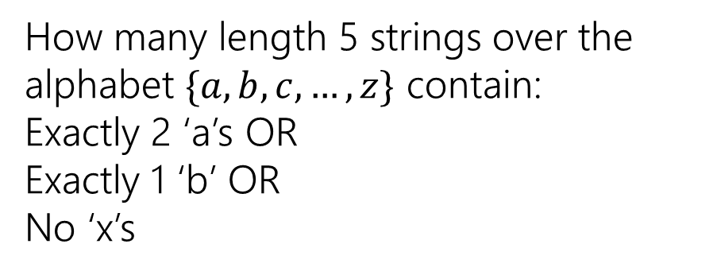
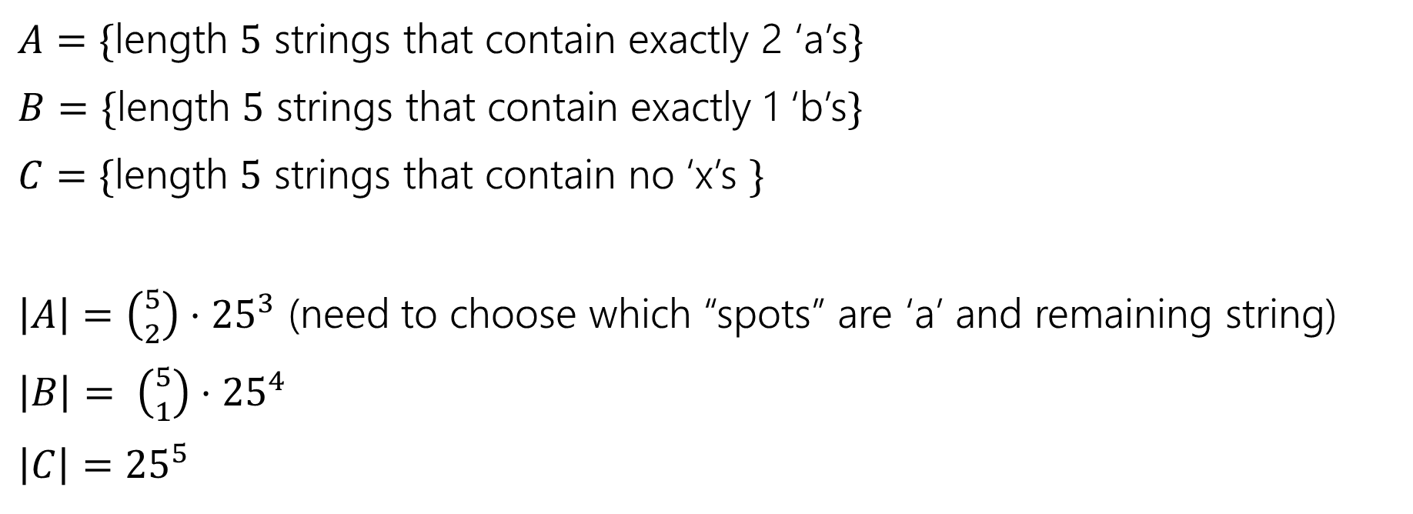
PIE Example (sets)
How many length 5 strings over the alphabet $\{a,b,c,…,z\}$ contain:
Exactly 2 ‘a’s OR
Exactly 1 ‘b’ OR
No ‘x’s
$A=\{$length $5$ strings that contain exactly 2 ‘a’s$\}$
$B=\{$length $5$ strings that contain exactly 1 ‘b’s$\}$
$C=\{$length $5$ strings that contain no ‘x’s $\}$
$\left|A\right|=\left({5 \atop 2}\right)⋅{25}^{3}$ (need to choose which “spots” are ‘a’ and remaining string)
$\left|B\right|= \left({5 \atop 1}\right)⋅{25}^{4}$
$\left|C\right|={25}^{5}$

Slide 23


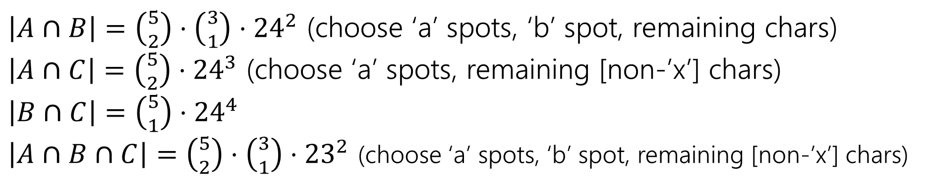

Intersections
How many length 5 strings over the alphabet $\{a,b,c,…,z\}$ contain:
Exactly 2 ‘a’s OR
Exactly 1 ‘b’ OR
No ‘x’s
$\left|A\right|=\left({5 \atop 2}\right)⋅{25}^{3}$
$\left|B\right|= \left({5 \atop 1}\right)⋅{25}^{3}$
$\left|C\right|={25}^{5}$
$A=\{$length $5$ strings that contain exactly 2 ‘a’s$\}$
$B=\{$length $5$ strings that contain exactly 1 ‘b’s$\}$
$C=\{$length $5$ strings that contain no ‘x’s $\}$
$\left|A∩B\right|=\left({5 \atop 2}\right)⋅\left({3 \atop 1}\right)⋅{24}^{2}$ (choose ‘a’ spots, ‘b’ spot, remaining chars)
$\left|A∩C\right|=\left({5 \atop 2}\right)⋅{24}^{3}$ (choose ‘a’ spots, remaining [non-’x’] chars)
$\left|B∩C\right|=\left({5 \atop 1}\right)⋅{24}^{4}$
$\left|A∩B∩C\right|=\left({5 \atop 2}\right)⋅\left({3 \atop 1}\right)⋅{23}^{2}$ (choose ‘a’ spots, ‘b’ spot, remaining [non-’x’] chars)

Slide 24
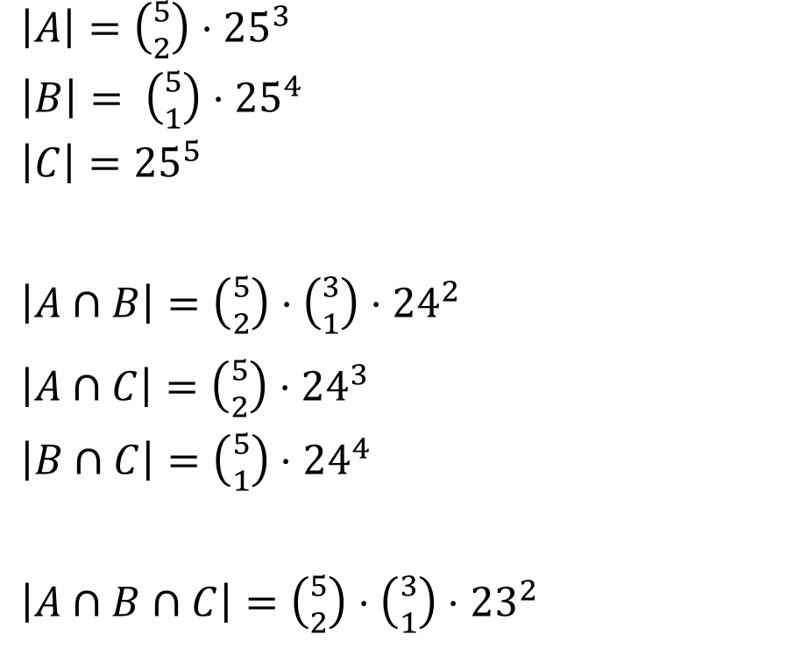
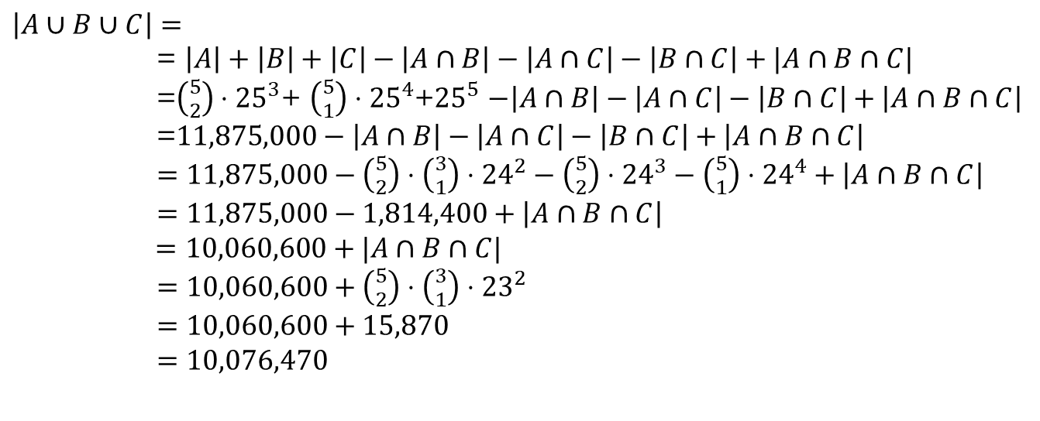
Putting it together
How many length 5 strings over the alphabet $\{a,b,c,…,z\}$ contain:
Exactly 2 ‘a’s OR
Exactly 1 ‘b’ OR
No ‘x’s
$\left|A\right|=\left({5 \atop 2}\right)⋅{25}^{3}$
$\left|B\right|= \left({5 \atop 1}\right)⋅{25}^{4}$
$\left|C\right|={25}^{5}$
$\left|A∩B\right|=\left({5 \atop 2}\right)⋅\left({3 \atop 1}\right)⋅{24}^{2}$
$\left|A∩C\right|=\left({5 \atop 2}\right)⋅{24}^{3}$
$\left|B∩C\right|=\left({5 \atop 1}\right)⋅{24}^{4}$
$\left|A∩B∩C\right|=\left({5 \atop 2}\right)⋅\left({3 \atop 1}\right)⋅{23}^{2}$
$\left|A∪B∪C\right|=$
= $\left|A\right|+\left|B\right|+\left|C\right|−\left|A∩B\right|−\left|A∩C\right|−\left|B∩C\right|+|A∩B∩C|$
=$\left({5 \atop 2}\right)⋅{25}^{3}$+ $\left({5 \atop 1}\right)⋅{25}^{4}$+${25}^{5}$ $−\left|A∩B\right|−\left|A∩C\right|−\left|B∩C\right|+\left|A∩B∩C\right|$
=$11,875,000−\left|A∩B\right|−\left|A∩C\right|−\left|B∩C\right|+\left|A∩B∩C\right|$
$=11,875,000−\left({5 \atop 2}\right)⋅\left({3 \atop 1}\right)⋅{24}^{2}−\left({5 \atop 2}\right)⋅{24}^{3}−\left({5 \atop 1}\right)⋅{24}^{4}+\left|A∩B∩C\right|$
$=11,875,000−1,814,400+\left|A∩B∩C\right|$
$=10,060,600+|A∩B∩C|$
$=10,060,600+\left({5 \atop 2}\right)⋅\left({3 \atop 1}\right)⋅{23}^{2}$
$=10,060,600+15,870$
$=10,076,470$

Slide 25
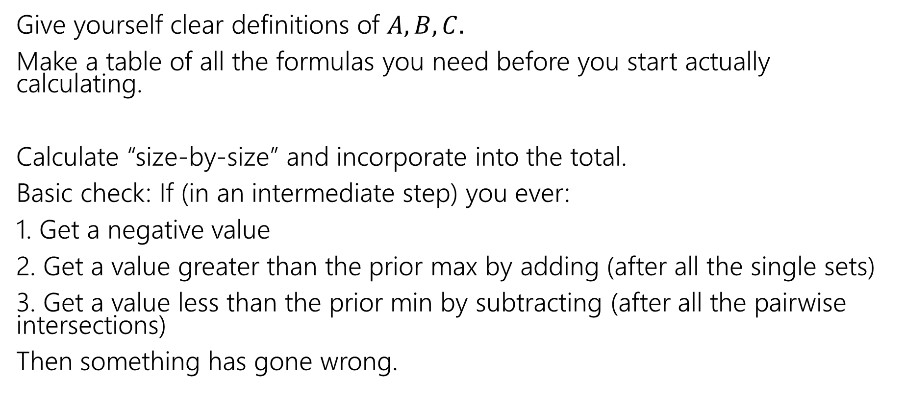
Practical tips (PIE)
Give yourself clear definitions of $A,B,C.$
Make a table of all the formulas you need before you start actually calculating.
Calculate “size-by-size” and incorporate into the total.
Basic check: If (in an intermediate step) you ever:
1. Get a negative value
2. Get a value greater than the prior max by adding (after all the single sets)
3. Get a value less than the prior min by subtracting (after all the pairwise intersections)
Then something has gone wrong.

Slide 26
The Binomial Theorem

Slide 27
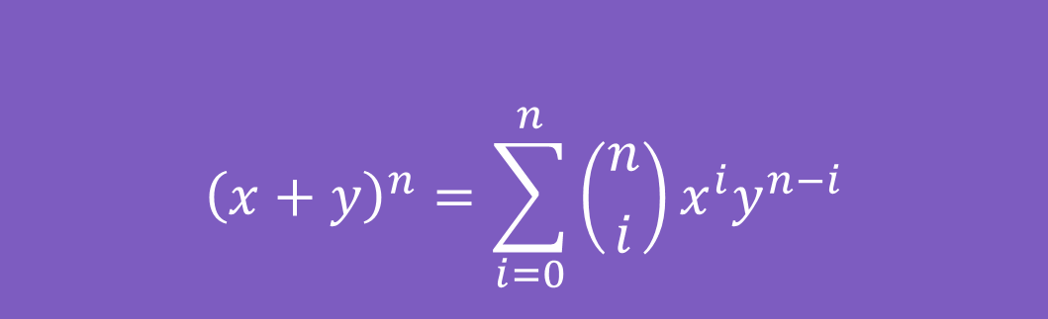

Binomial Theorem
In high school you probably memorized
${\left(x+y\right)}^{2}=x^{2}+2xy+y^{2}$
And ${\left(x+y\right)}^{3}=x^{3}+3x^{2}y+3xy^{2}+y^{3}$
The Binomial Theorem tells us what happens for every $n$:
$${\left(x+y\right)}^{n}=\sum_{i=0}^{n}{\left({n \atop i}\right)x^{i}y^{n−i}}$$
The Binomial Theorem

Slide 28
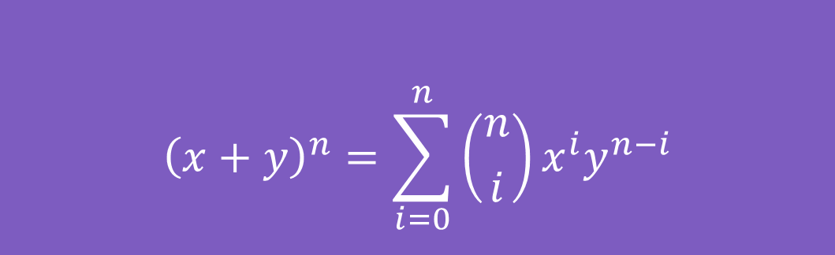
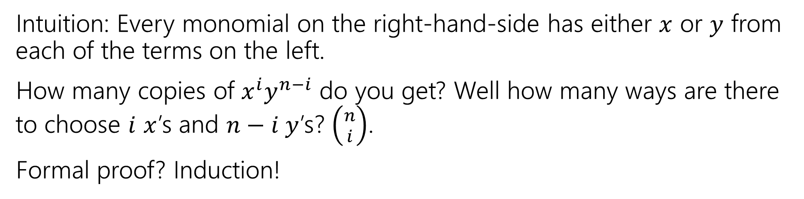
Some intuition
$${\left(x+y\right)}^{n}=\sum_{i=0}^{n}{\left({n \atop i}\right)x^{i}y^{n−i}}$$
The Binomial Theorem
Intuition: Every monomial on the right-hand-side has either $x$ or $y$ from each of the terms on the left.
How many copies of $x^{i}y^{n−i}$ do you get? Well how many ways are there to choose $i$ $x$’s and $n−i y$’s? $\left({n \atop i}\right)$.
Formal proof? Induction!

Slide 29
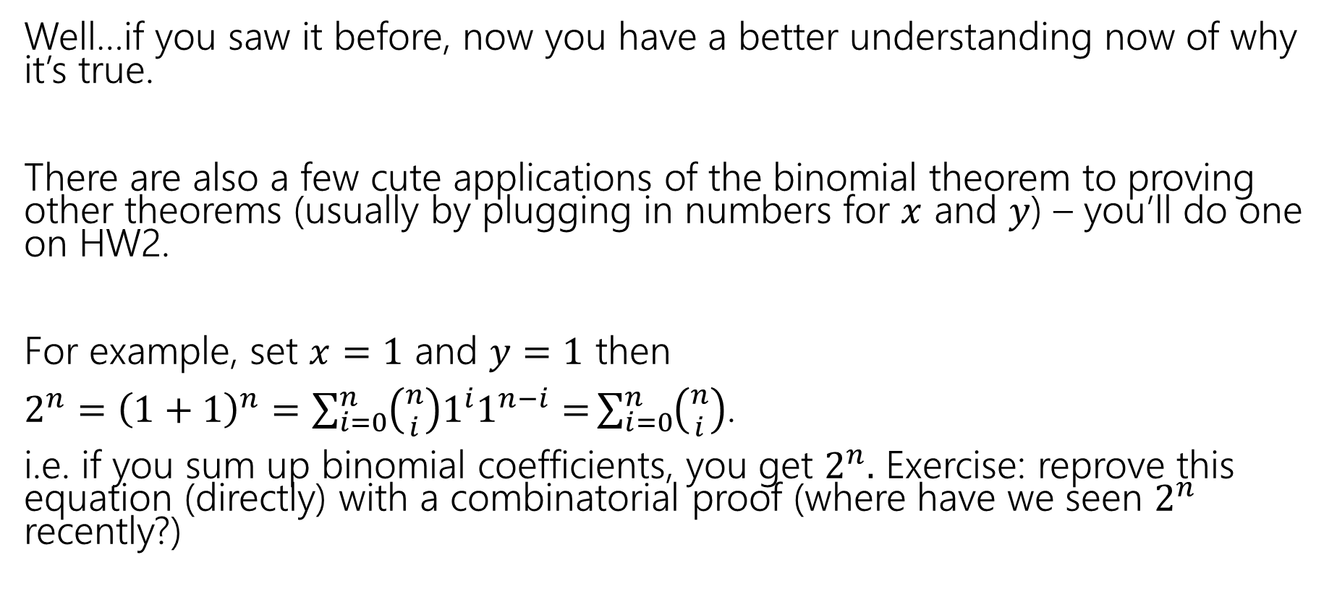
So What?
Well…if you saw it before, now you have a better understanding now of why it’s true.
There are also a few cute applications of the binomial theorem to proving other theorems (usually by plugging in numbers for $x$ and $y$) – you’ll do one on HW2.
For example, set $x=1$ and $y=1$ then
$2^{n}={\left(1+1\right)}^{n}=\sum_{i=0}^{n}{\left({n \atop i}\right)1^{i}1^{n−i}=}\sum_{i=0}^{n}{\left({n \atop i}\right)}$.
i.e. if you sum up binomial coefficients, you get $2^{n}.$ Exercise: reprove this equation (directly) with a combinatorial proof (where have we seen $2^{n}$ recently?)

Slide 30
The Pigeonhole Principle

Slide 31


Pigeonhole Principle
If you have $5$ pigeons, and place them into $4$ holes, then…
At least two pigeons are in the same hole.
Notes:
Animation shows 5 pigeons going into 4 pigeonholes; two end up in hole 4, while one ends up in the other holes.

Slide 32

Pigeonhole Principle (2)
If you have $5$ pigeons, and place them into $4$ holes, then…
At least two pigeons are in the same hole.
It might be more than two.
Notes:
Animation shows 5 pigeons flying into 4 holes. Three go into hole 4, one each into holes 2 and 3; none into hole 1.

Slide 33

Strong Pigeonhole Principle
If you have $n$ pigeons and $k$ pigeonholes, then there is at least one pigeonhole that has at least $\left\lceil \frac{n}{k}\right\rceil$ pigeons.
$\left\lceil a\right\rceil$ is the “ceiling” of $a$ (it means always round up, $\left\lceil 1.1\right\rceil =2$, $\left\lceil 1\right\rceil =1$).

Slide 34
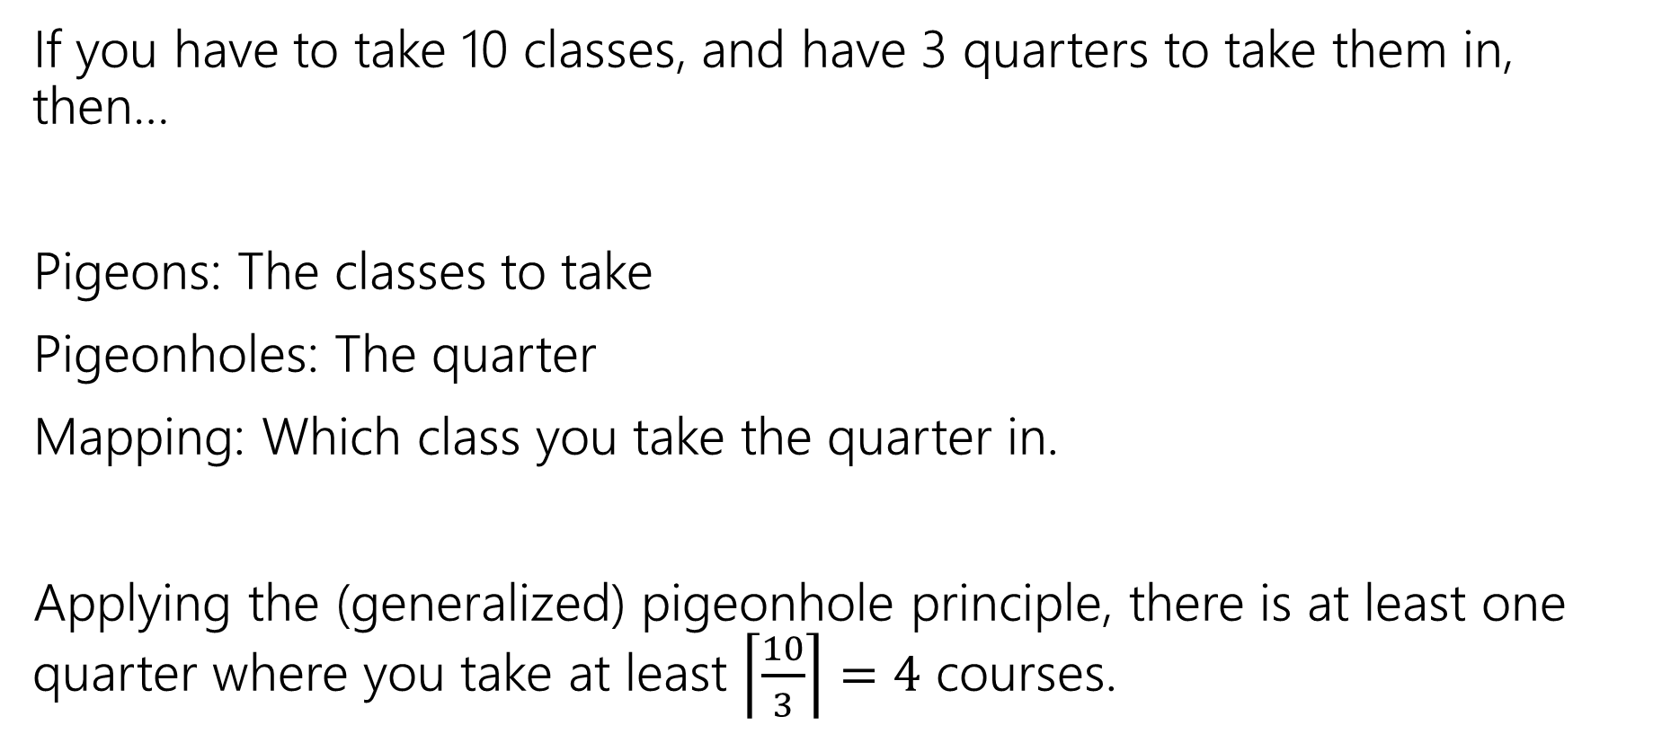
An example
If you have to take 10 classes, and have 3 quarters to take them in, then…
Pigeons: The classes to take
Pigeonholes: The quarter
Mapping: Which class you take the quarter in.
Applying the (generalized) pigeonhole principle, there is at least one quarter where you take at least $\left\lceil \frac{10}{3}\right\rceil =4$ courses.

Slide 35
Practical Tips (PHP)
When the pigeonhole principle is the right tool, it’s usually the first thing you’d think of or the absolute last thing you’d think of.
For really tricky ones, we’ll warn you in advance that it’s the right method (you’ll see one in the section handout).
When applying the principle, say:
What are the pigeons
What are the pigeonholes
How do you map from pigeons to pigeonholes
Look for – a set you’re trying to divide into groups, where collisions would help you somehow.

